Slide 1
Scope of the Beam Vacuum and Diagnostic chambers
S. Pietri

Slide 2
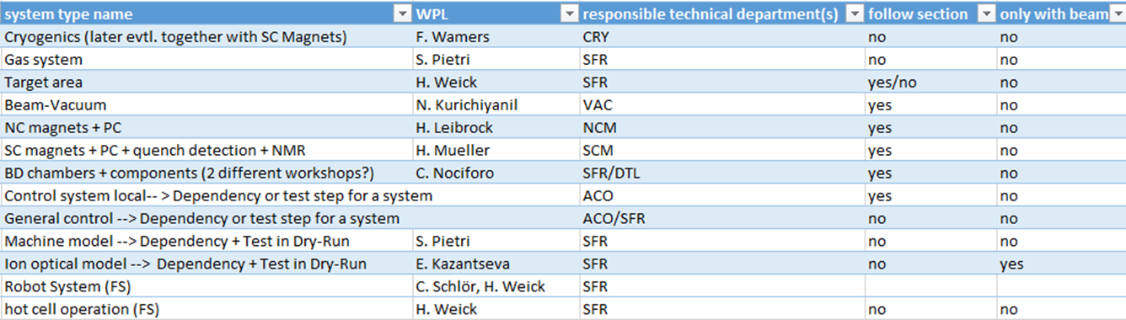
Scope
Goal is to come with an integrated plan for the commissioning of Beam Vacuum
and of the beam diagnostic chambers
BD chambers: 11 of them, between 8 inserts to 1 insert

Slide 3
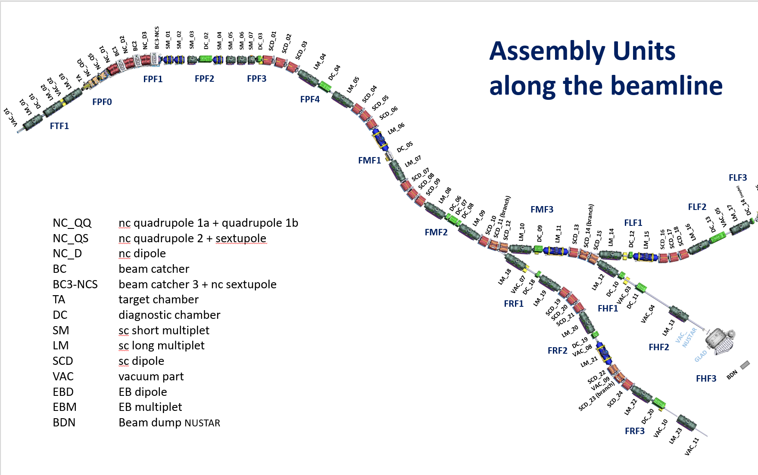
Super-FRS assembly units

Slide 4
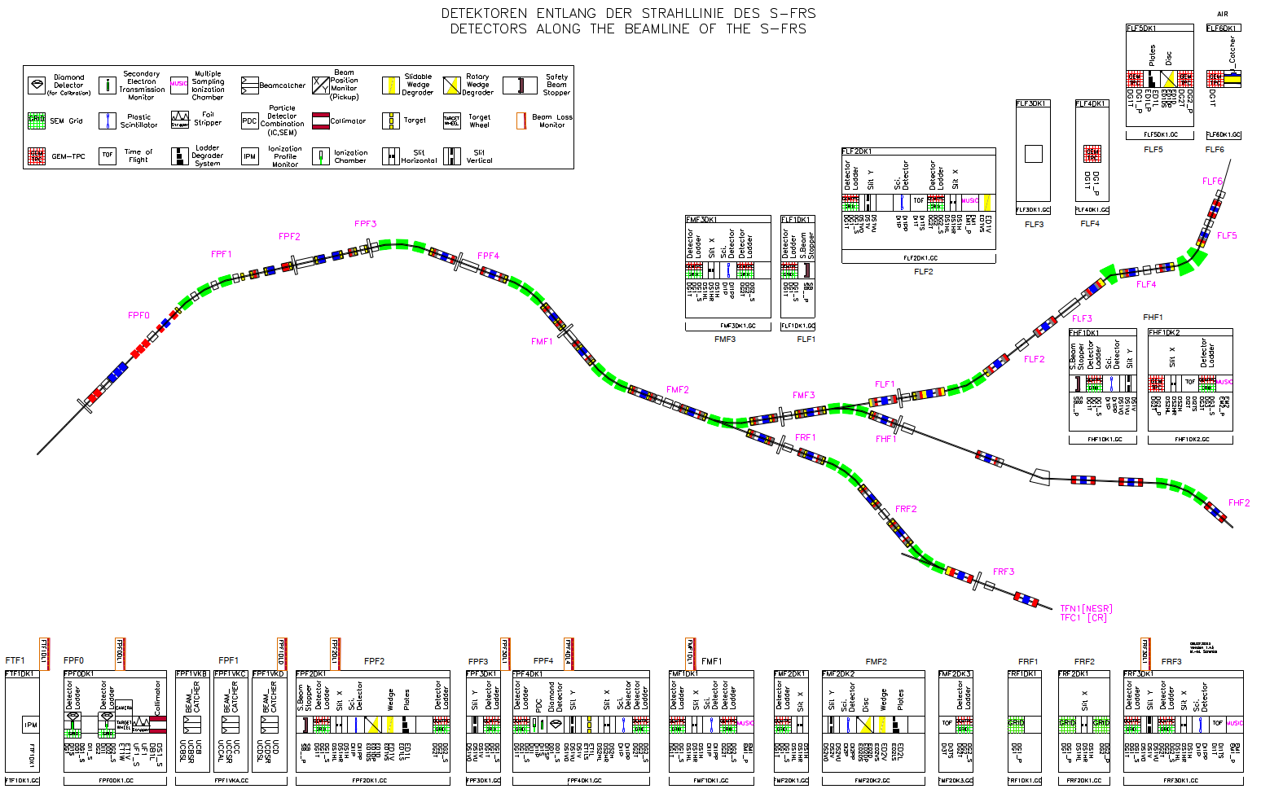
Elements

Slide 5
Input on mechanical completion
Neeraj, Siva, Christian: vacuum and chambers
Mark (Stephane): racks
for the phase 1 commissioning we consider 2 types of inserts:
passive inserts (slits, degradors)
active inserts (detectors), a refinement could be BEA vs DL detectors

