Slide 1
FAIR TGA Status
S. Pietri

Slide 2
Definition of the request
For commissioning we have dependencies of the following system fucntioning:
  power is present
  dry nitrogen
  air pressure
  water cooling
  ….
those dependencies are FSB timeline (not SMG)
we asked colleagues from SMG (sorry) they could not get the information
I tried to get the information, did not work
I found an presentation Haik sent me in september 2024

Slide 3
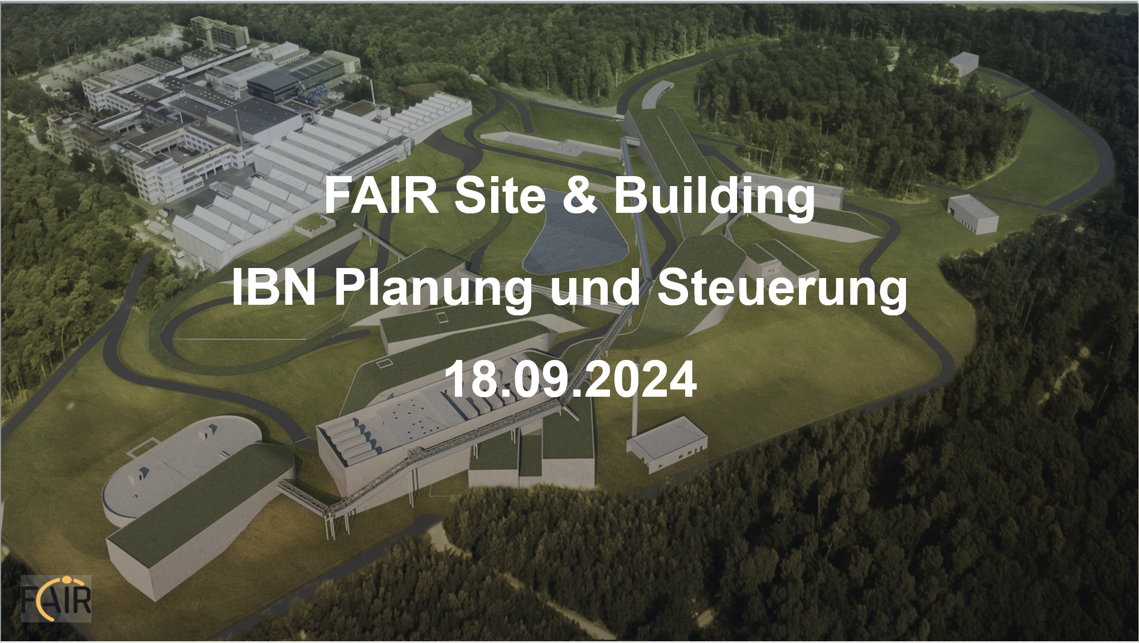

Slide 4
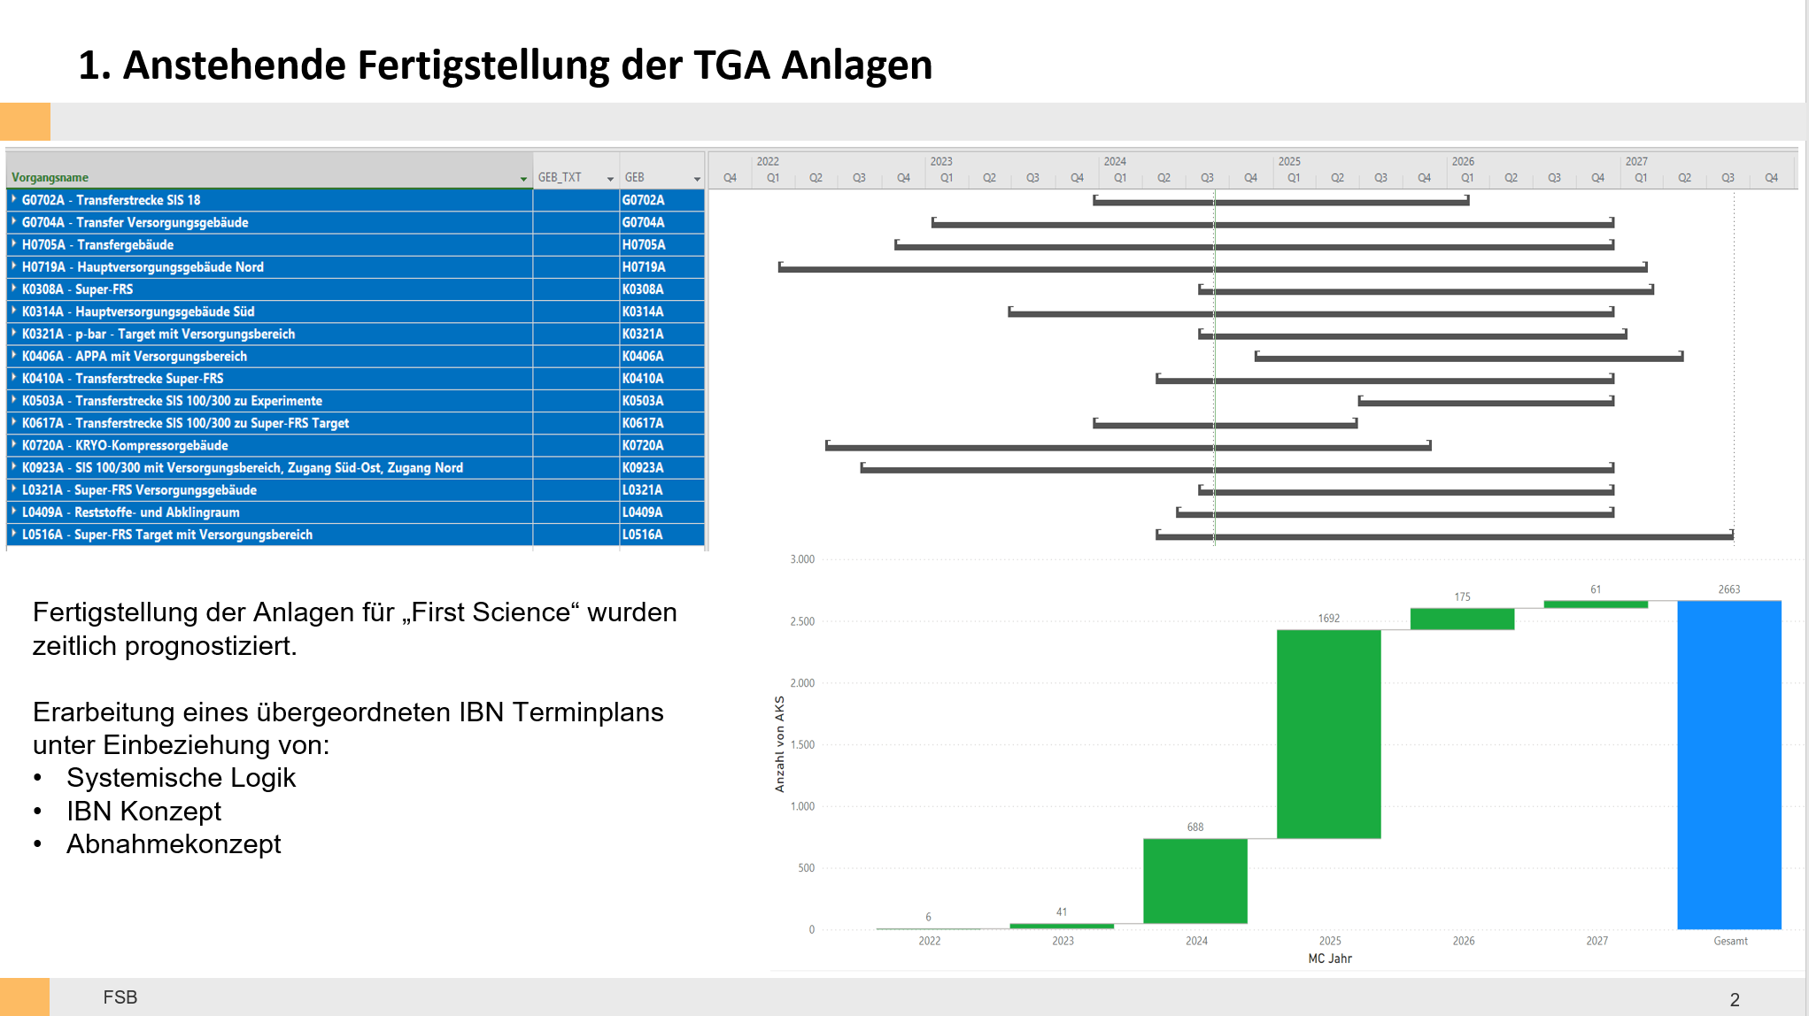

Slide 5

Time plan
L0516A: Q2-2024 to Q3-2027 ➔ target area
K0410A: Q2-2024 to Q4-2026 ➔ main tunnel
L0321A: Q3-2024 to Q4-2026 ➔ service building
K0308A: Q3-2024 to Q2-2027 ➔ HEB (one SFRS multiplet)
Nothing in Planisware, no way to get more detail.

