Slide 1
Commissioning Support Team: Activities and Roles
V. Kamerdzhiev

Slide 2
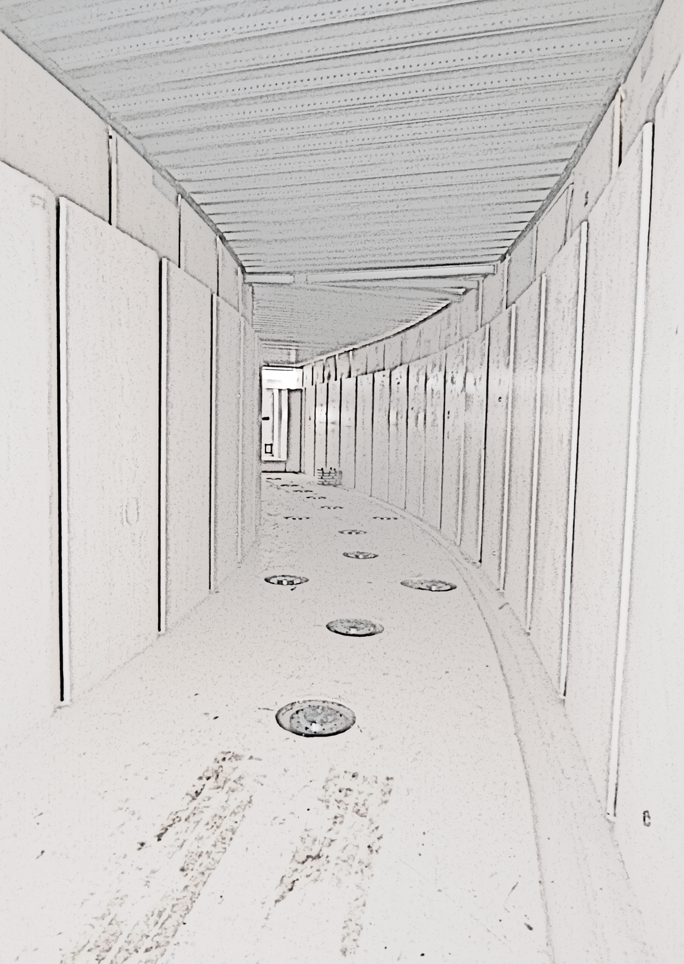
Outline
The FAIR Commissioning and Operation (FCO) team
The role of FCO in the commissioning process
Strengthening the collaboration with SRRS
Activities and responsibilities so far
Upcoming activities

Slide 3
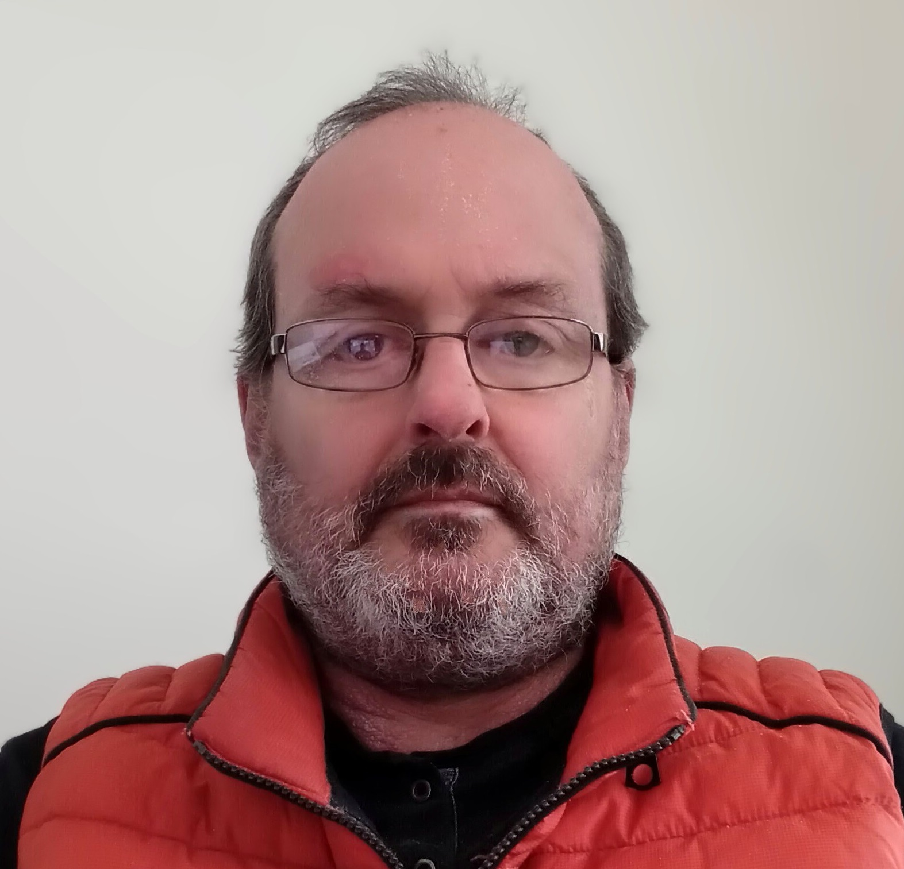
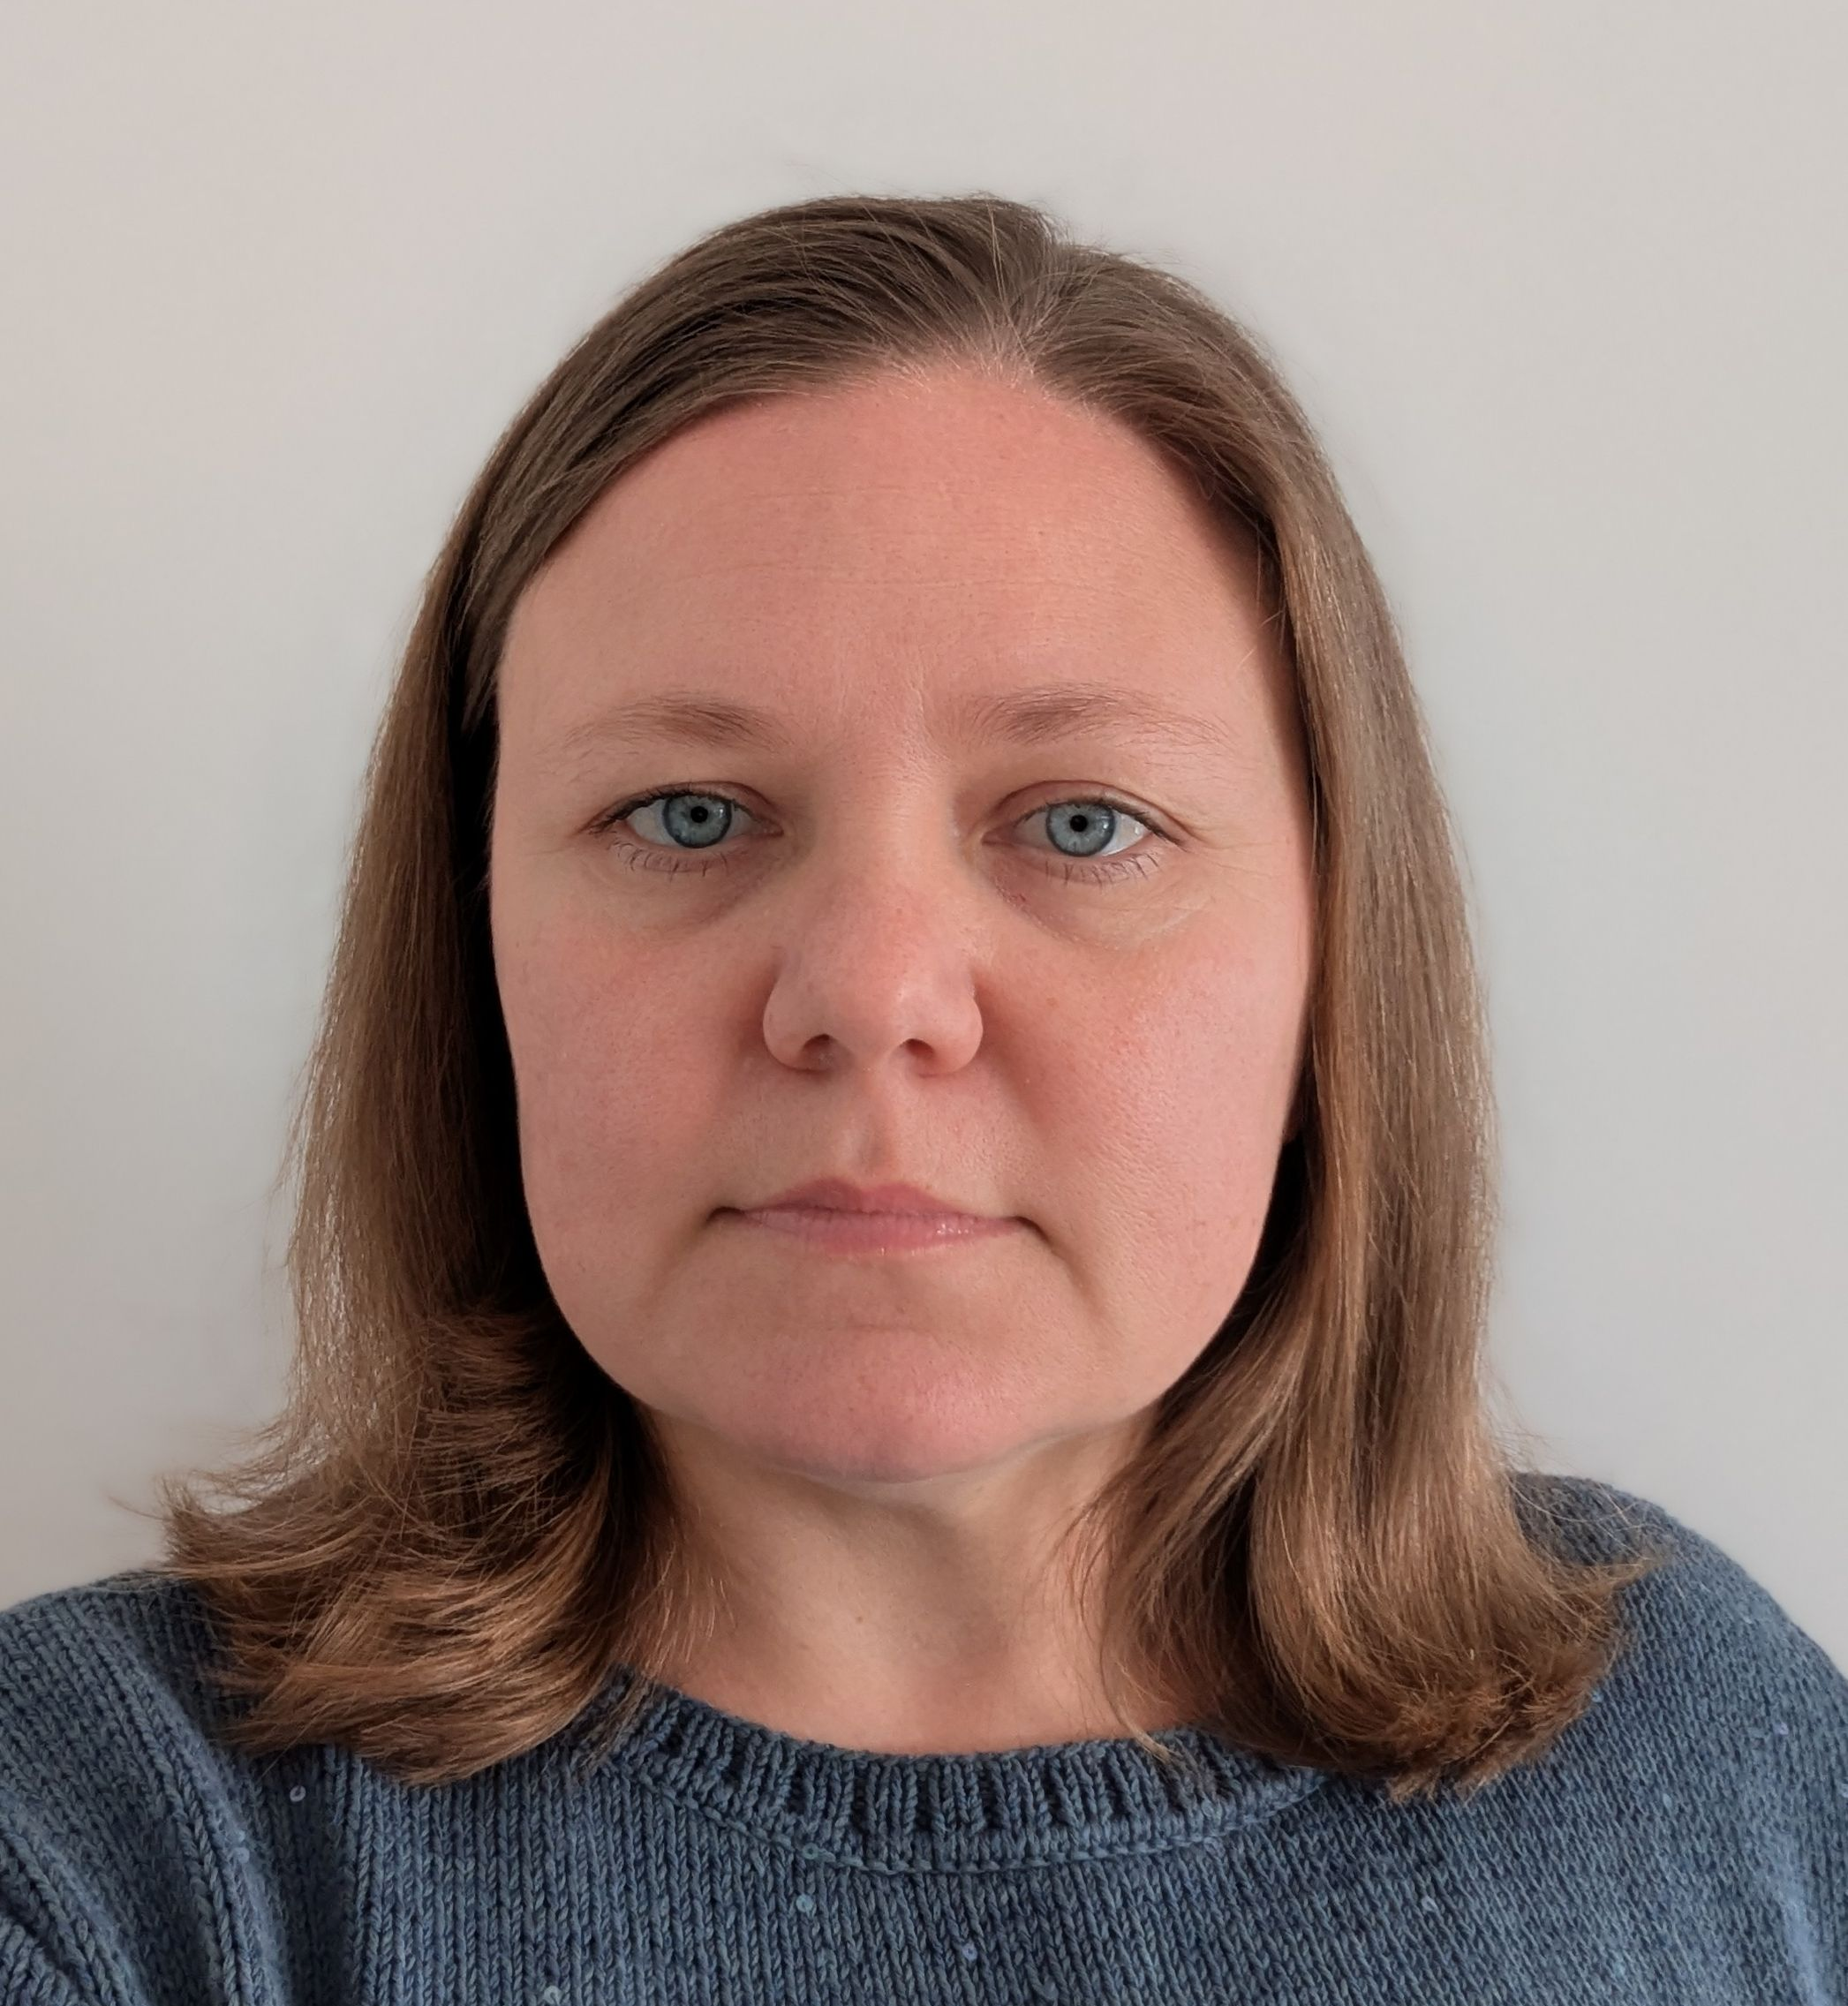
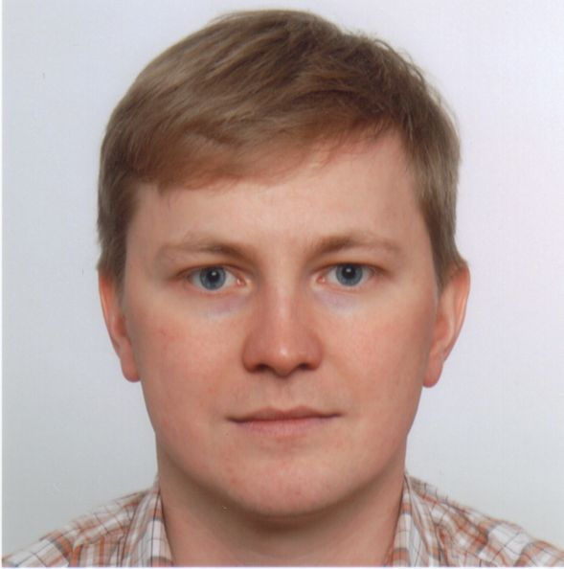
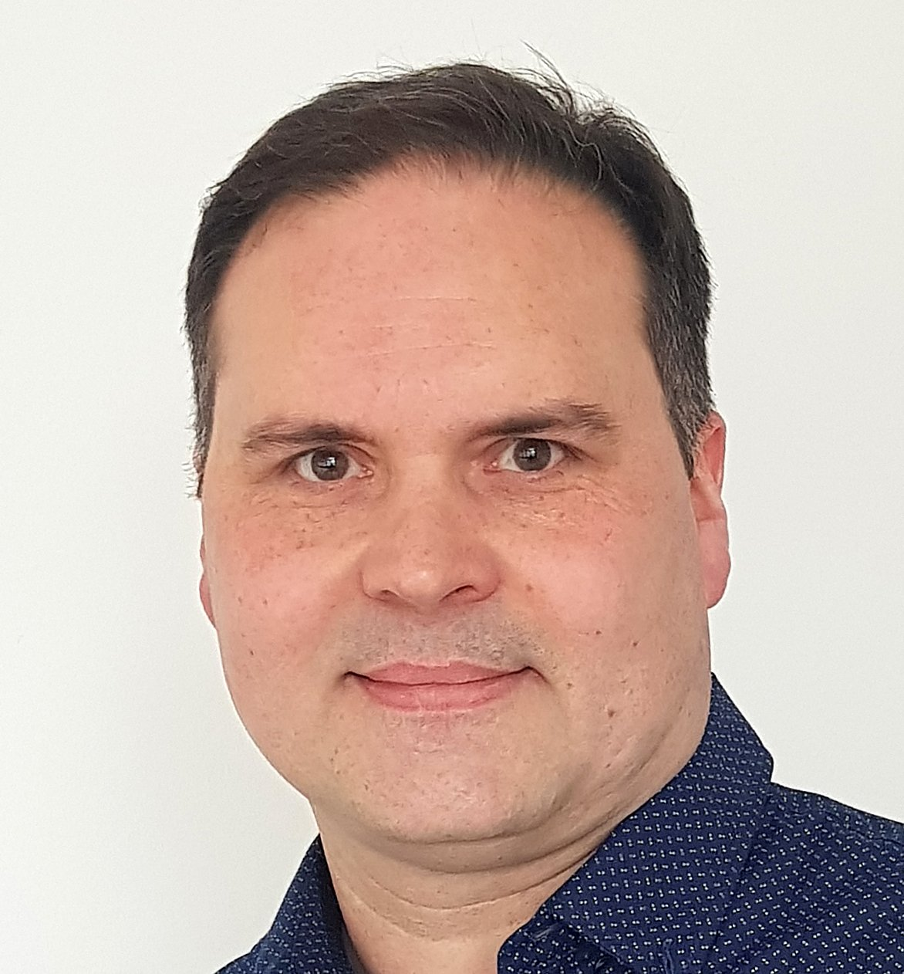
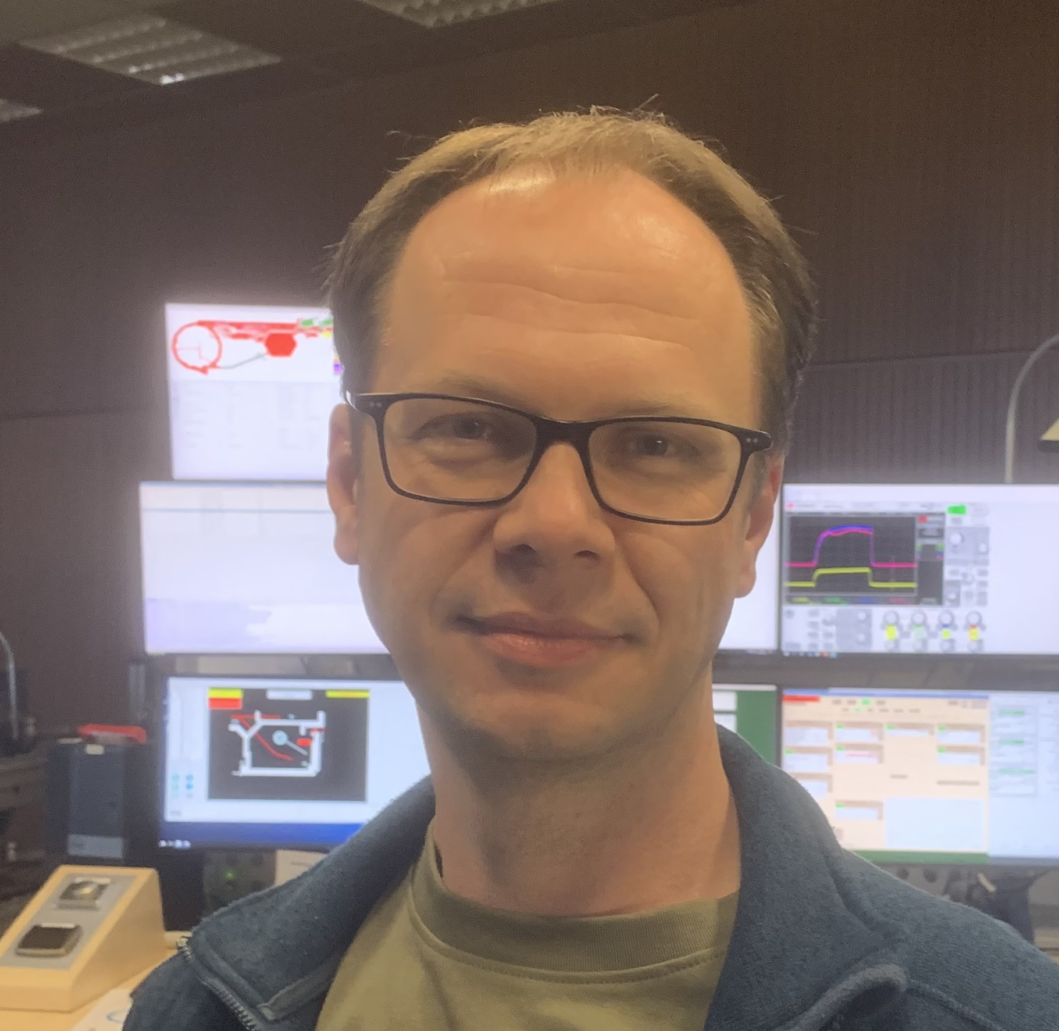
FAIR Commissioning and Operation - FCO
Harald Weiss
Dr. Olga Bertini
Dr. Yury Valdau
Dr. Vsevolod (Seva)
Kamerdzhiev
Dr. Kirill Grigoryev

Slide 4
Roles & Activities, FCO-centric view
FCO
Cryo2 commissioning
FCC commissioning
First Beam Event
Operations, OPE
FAIR Commissioning
Sub-project
LCM commissioning workshops
HEBT
Super-FRS
SIS100
Shifts in MCR
Inter-department projects
Operator training
Coordination of machine experiments
Gate Reviews

Slide 5
Commissioning Team, Roles
Work together with GF, PMO, Safety, QA to establish a useful and practical general framework for commissioning
  Experts don’t need to work out all the details on there own
  We try our best to limit the amount of work to the absolutely necessary …
  ensure a safe and orderly transition from installation to commissioning while minimizing the additional effort for the WPLs
Provide support to SPLs, WPLs and others
  Assist and guide through the process
Interface function, collect, structure, distribute information (all sub-projects)
  typically through the commissioning coordinator (S. Pietri for SFRS)
  requires easy and fast access to information

Slide 6
Commissioning phases for accelerators and detectors
inst.
# | commissioning phase | accelerators & transfer lines | detectors
1 D1 M103 | local HW- commissioning | local system tests in tunnel and supply areas Control system not needed (only in limited aspects) TBI not needed, site power is sufficient | single detector tests tests of individual components install. service & controls
2 D2 M104 | remote & system commissioning | single system test (vertical system integration test) remote testing from MCR (sequences, checklists) TBI (phase 5 and 6), control system integration and timing is needed, access control & STVs needed (3.1) multi system tests | system tests (with HV, gas, ...) pre-test of DAQ system local control
3 D3 M105M11 | integration | control system and accelerator models for pilot beam scenarios fully available, PAS commissioning done | full detector test and DAQ using cosmics
4 E M12 | pilot beam commissioning | (3.2) full Dry-Runs pilot beam commissioning (completion parameters) operation permit | commissioning with pilot beam
Commissioning without Beam
Beam Commissioning
 | beam commission & operation | operation with PCP-beam respectively status quo beam commissioning of advanced systems and complex operation modes / intensity ramp-up accelerator development towards FAIR design parameters
handover to operations
color-codes aligned with responsibility matrices

Slide 7
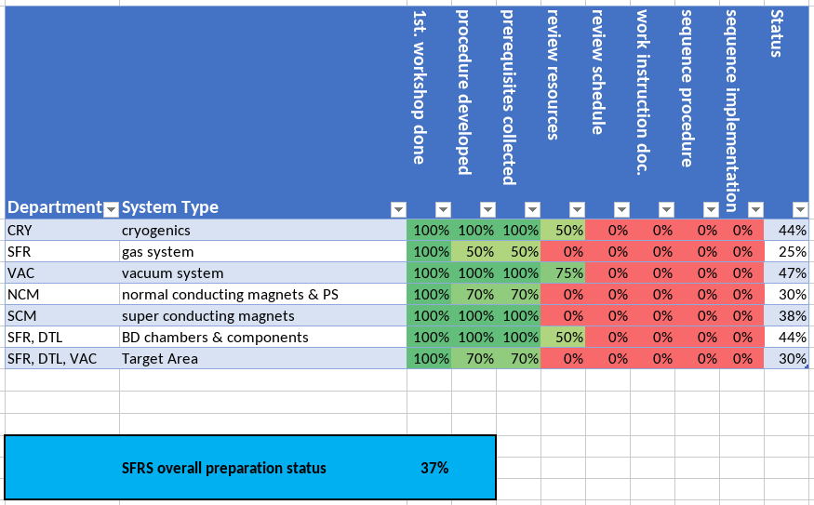
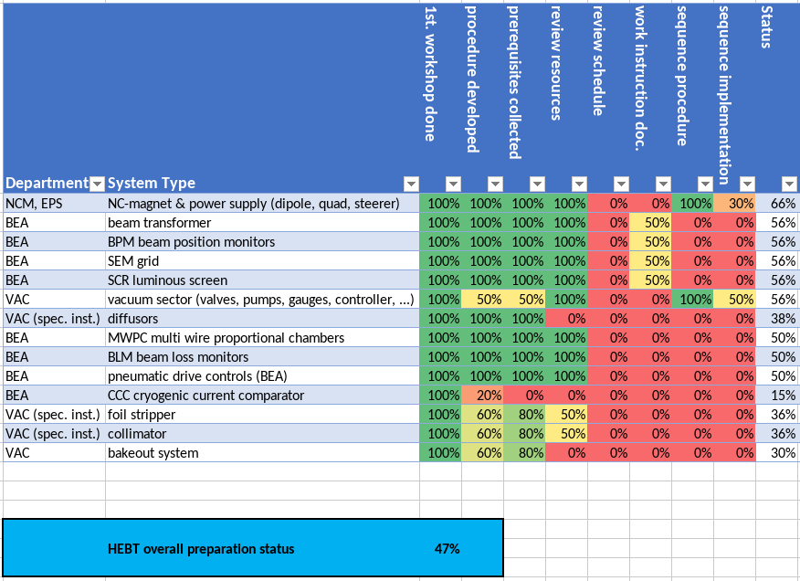
Commissioning LCM Status - HEBT & Super-FRS
higher overall complexity technical & organisational
complex dependencies
many steps are done for the first time
changing priorities and time schedules

Slide 8
Commissioning LCM workshops - outcome
HEBT
Super-FRS

Slide 9
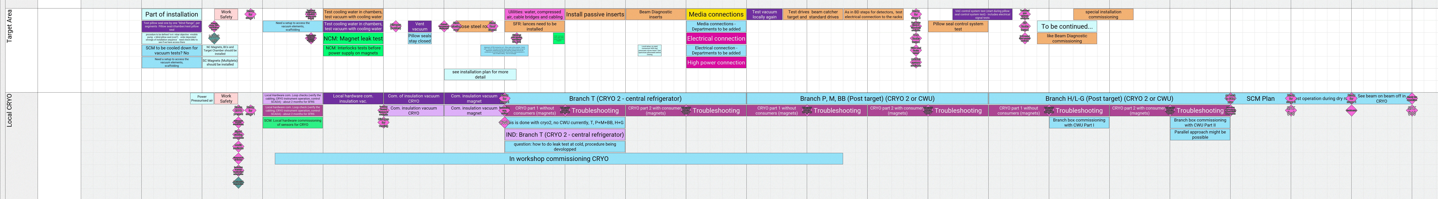
Commissioning LCM workshops - outcome

Slide 10
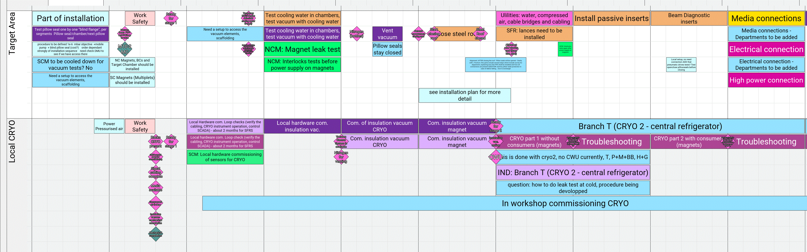
Commissioning LCM workshops - outcome

Slide 11
Commissioning LCM workshops - outcome
Commissioning
work instructions
Template in preparation

Slide 12
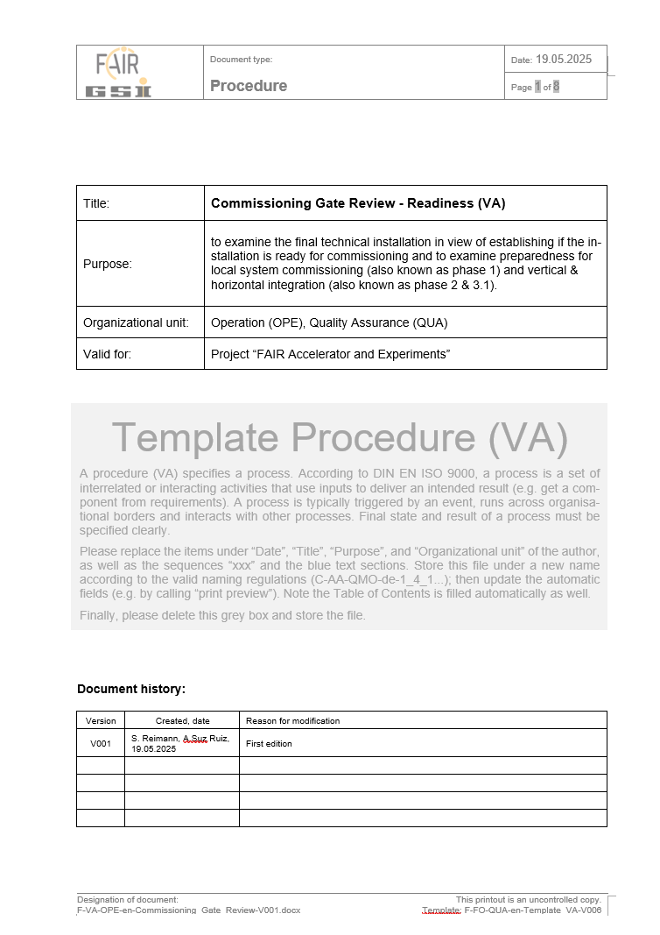
Upcoming – Organization of Gate Reviews
goal is to ensure a safe and orderly transition from installation to commissioning while minimizing the additional effort for the WPLs
key Points:
  declaration of Mechanical Completion (incl. NCRs)
  confirmation of proper commissioning of TBI / media
  commissioning procedures
  all GBU(s) for commissioning
  checklist of test steps (well chosen level of detail)
  appointment of all necessary responsible persons
  ...
procedure & checklist presently in development
first tests:
Cryo and HEBT (T1S1)

Slide 13
Goals for the workshop – FCO view
Improve understanding of Super-FRS systems, current status and issues
Synchronize - achieve similar state of knowledge in team (SFRS+Comm. team)
Develop actionable insights that pave the way to detailed commissioning schedule
Grow together and adopt commissioning thinking into the everyday work

