Slide 1
Current status of Super-FRS Commissioning planning, LCM and open points
S. Pietri

Slide 2
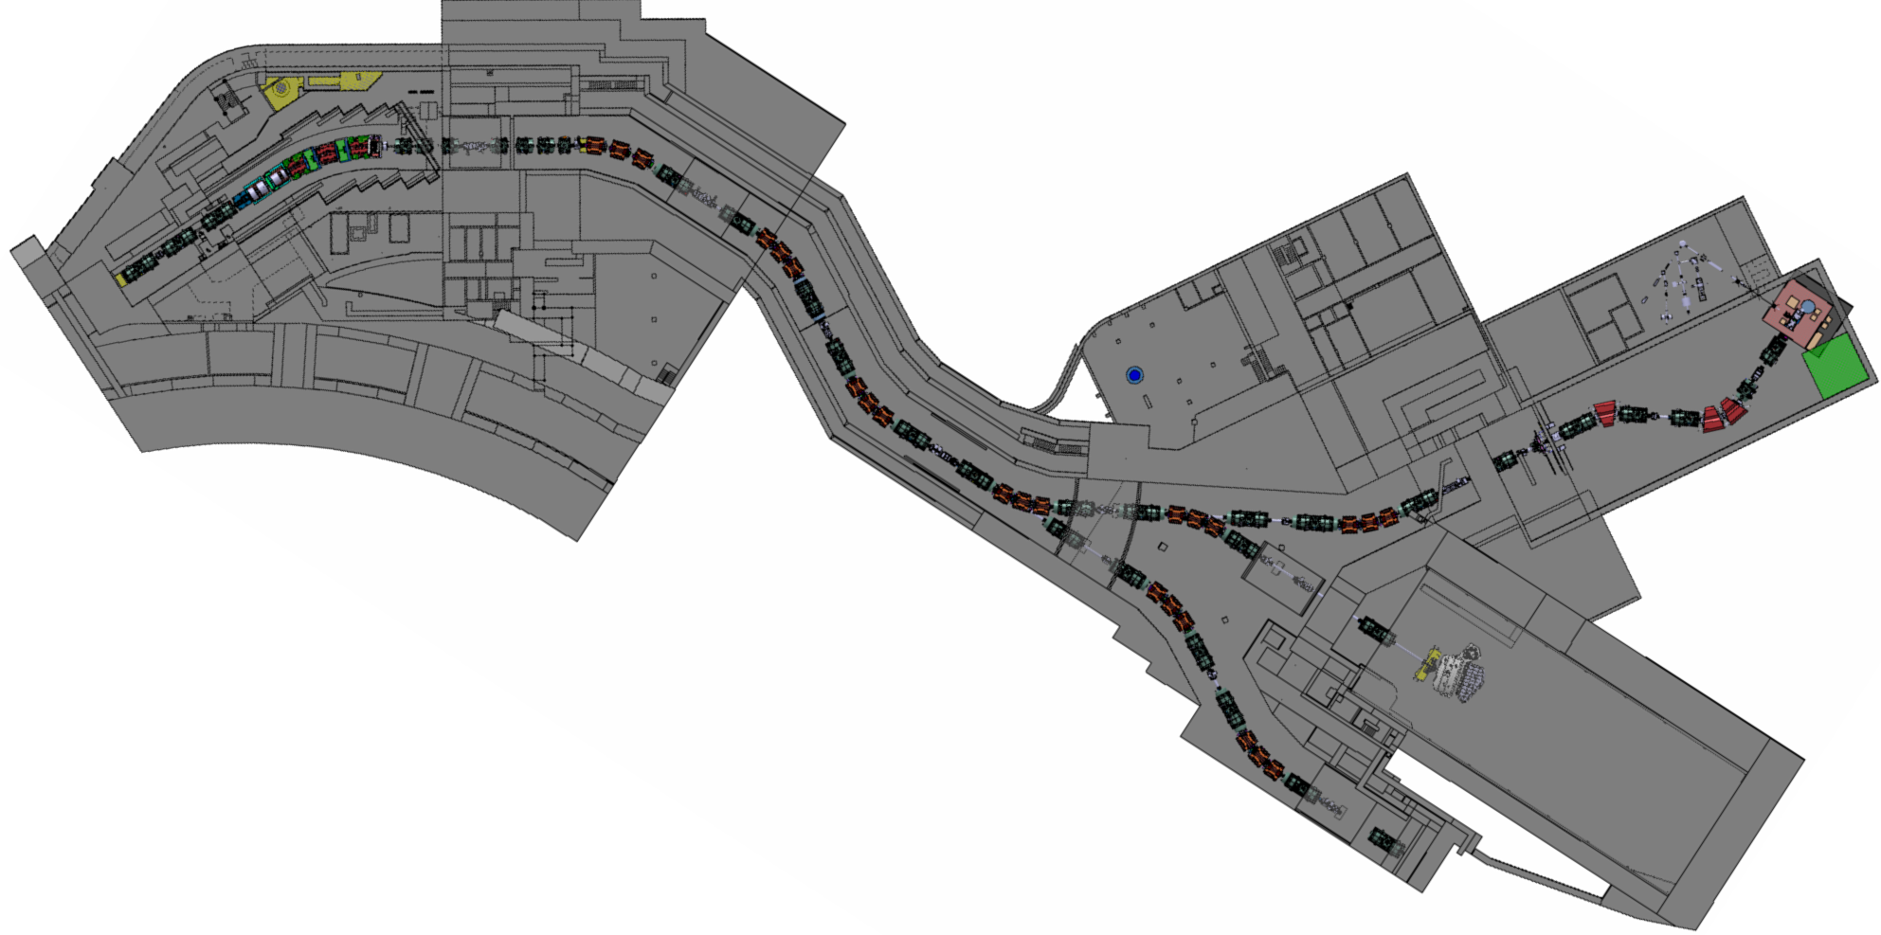
Super-FRS – general overview
Pre-separator
Supply building,
lab, control room
Low Energy Branch
not ES
Target area
Pre-target
Focusing system
FHF2, HEB cave,
R3B NUSTAR
Super-FRS stands for
Super FRagment Separator
Super for super conducting
Main separator
Ring branch, not ES

Slide 3
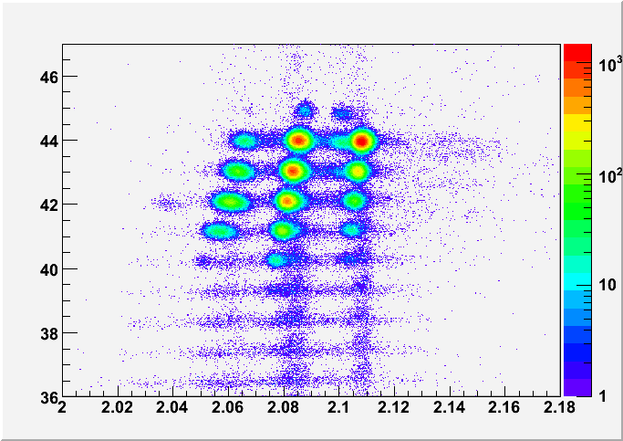
Objective of Super-FRS commissioning
Main goal of Super-FRS: select and identify ions produced in nuclear reactions at the target to deliver to NUSTAR experiments.
Final goal of the Super-FRS commissioning: assure Super-FRS can select and identify ions.
Confirm something like
this ➔
Z of particle
Data from
FRS
AoQ of particle

Slide 4
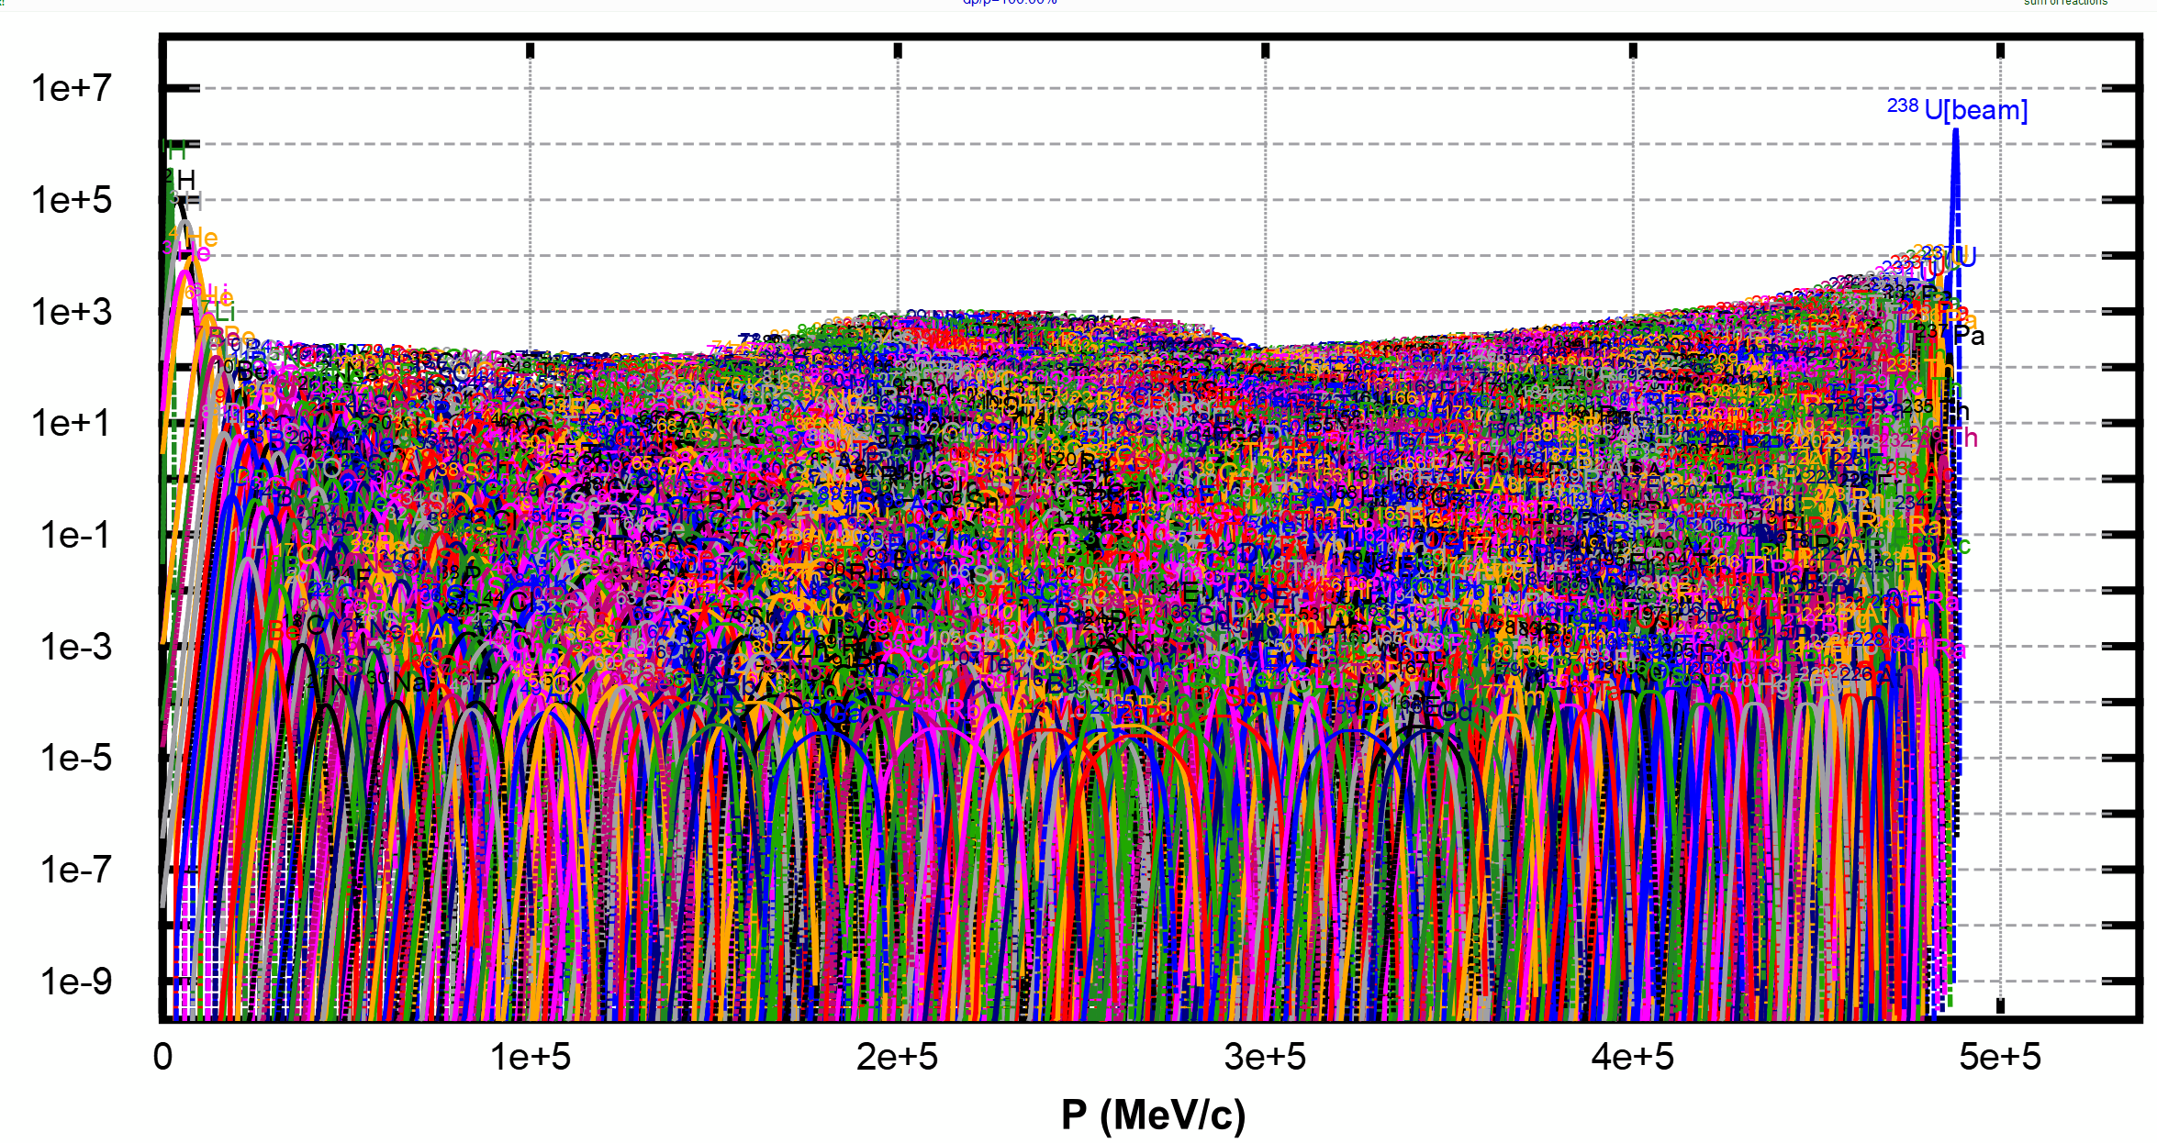
Super-FRS: Super FRagment Separator
²³⁸U from SIS18 on target to produce ²¹²Pb, ²³⁸U+¹²C@1 GeV.A ➔ ²¹²Pb
This is what is produced
at the target (yield)
3000+ isotopes
we need to select
the one we want

Slide 5
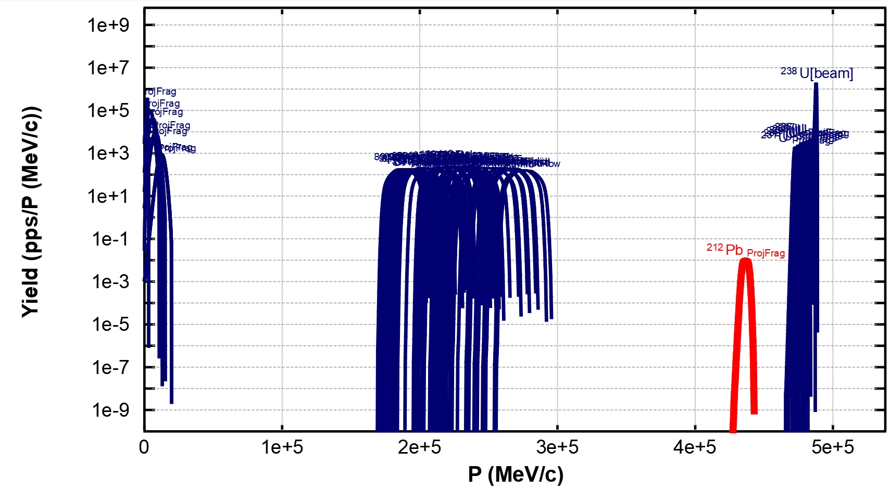
Super-FRS: Super FRagment Separator
²³⁸U from SIS18 on target to produce ²¹²Pb, ²³⁸U+¹²C@1 GeV.A ➔ ²¹²Pb
50 most produced ones
➔ red is ²¹²Pb

Slide 6
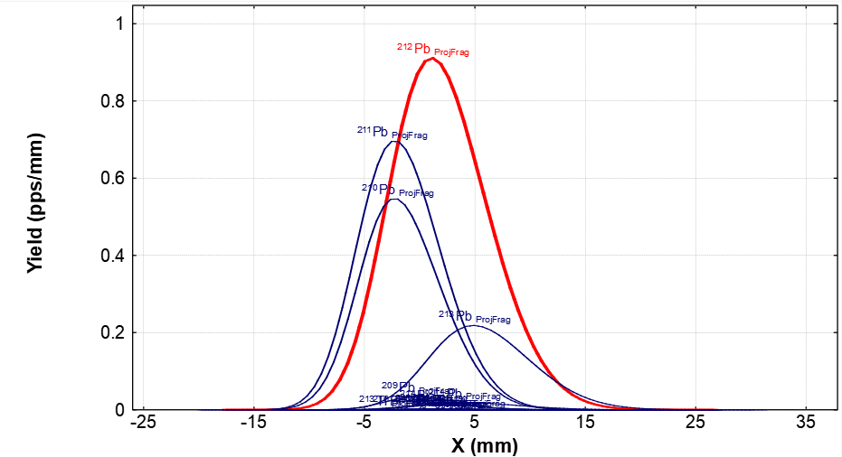
Super-FRS: Super FRagment Separator
²³⁸U from SIS18 on target to produce ²¹²Pb, ²³⁸U+¹²C@1 GeV.A ➔ ²¹²Pb
At FHF2 after selection

Slide 7
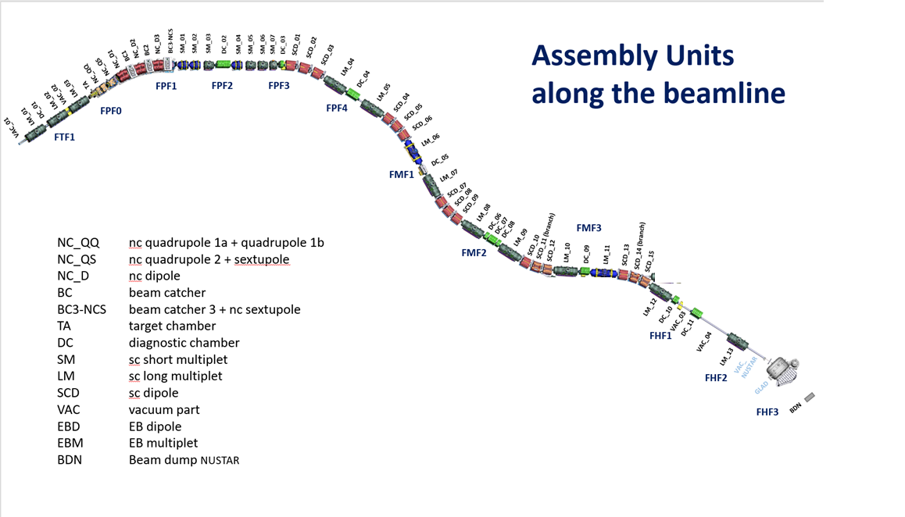
Super-FRS – assembly unit view, ES scope
Installation already started ➔ see Klaus Knie presentation

Slide 8
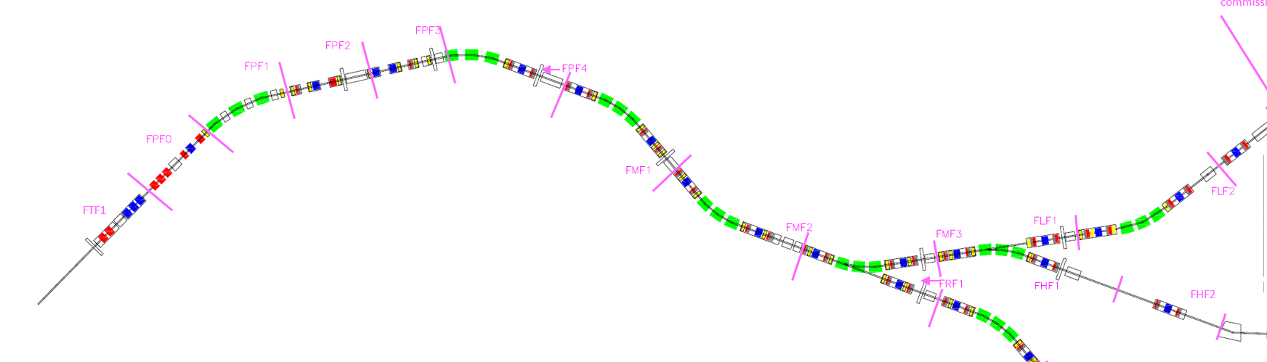
Scope (elements) of commissioning
Goal commissioning: reach FHF2 (commission the full HEB line)

Slide 9
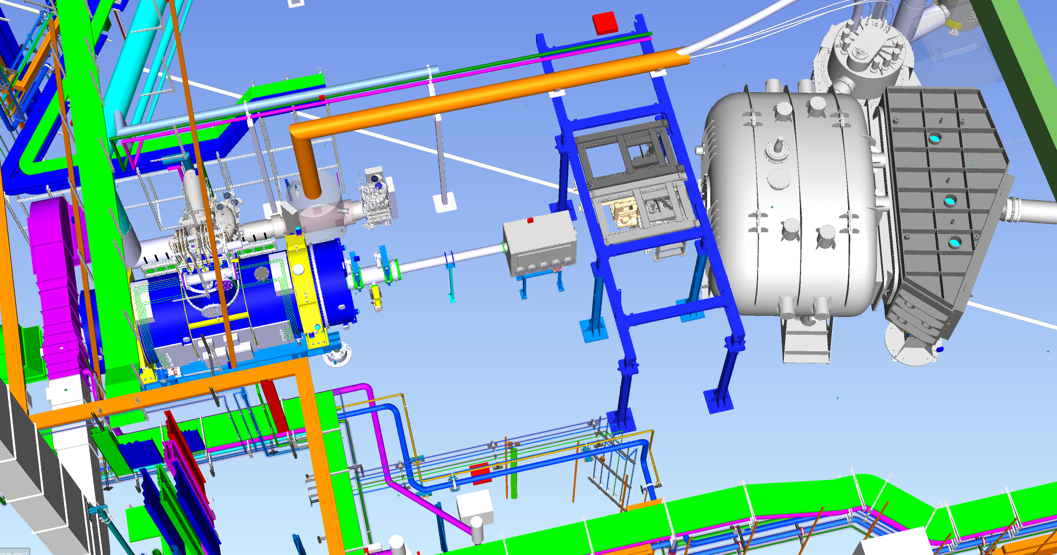
Commissioning include last multiplet at FHF2
FHF2 is in HEB, in front of the R3B experiments
SFRS multiplet
beam reach here during SFRS beam commissioning

Slide 10
Commissioning phases, sections goal
Need sectioning to breakdown the work
Allows to plan parallel installation work and/or commissioning work
First idea: functional sections, Magnets then diagnostics
Goal commissioning: reach FHF2 (commission the full HEB line)

Slide 11
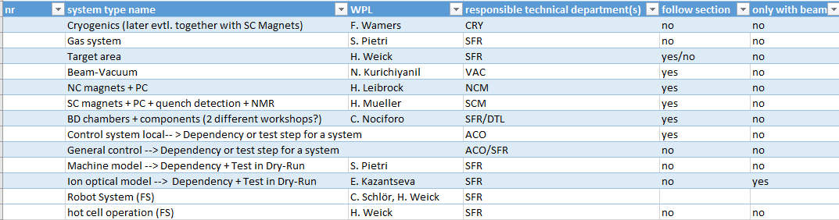
System list
SCM: Super Conducting Magnets
NCM: Normal Conducting Magnets (target area)

Slide 12
Phase of commissioning
Mechanical Completion (end of Installation) M102
Phase 1: hardware commissioning (after mechanical completion) (end M103)
Phase 2: remote commissioning (end M104)
Phase 3.1: integration test (end M105)
Phase 3.2: dry run (SAT Ba/M11)
Phase 4: beam commissioning (SAT Bb/M12)
          (note, beam can be reasonably high intensity at the end)

Slide 13
Milestones commissioning
M102 Mechanical Completion/ ready for hardware commissioning
  STV named, temp. safety present, local power and media supply ready, component inst.
M103: hardware commissioning done, ready for remote commissioning
  TGA installed, commissioned, working, media supply assured, safety implement,
  control system and expert tools present
M104: remote commissioning done, ready for integration test
  TGA, power, cryo, and media supply fully commissioning available
  higher tier control system deployed, sequencer test done
M105 integration test done, ready for dry run
  PAS and Safety installation commissioned
M11/SAT Ba, dry run done ready for beam
M12 beam commissioning done, SAT Bb done, ready for physics
          (note, beam can be reasonably high intensity at the end)

Slide 14
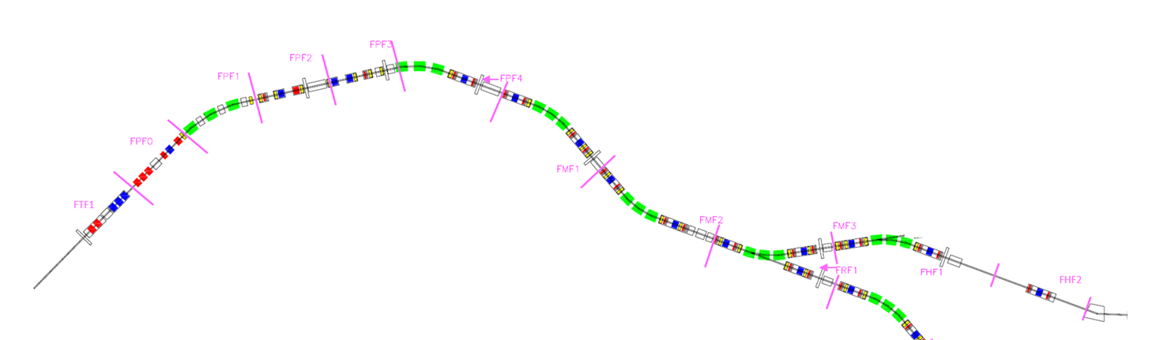
Commissioning phases, sections
for phase 1 (local) and 2 (remote):
  component in sections following assembly unit, commissioning starts as soon as possible
  vacuum and cryo own sections
  special treatment for target area (more on this later)
for phase 3.1 (integration), 3.2 (dry run) and 4 (beam)
  sections are based on functional sectioning (or focal planes)

Slide 15
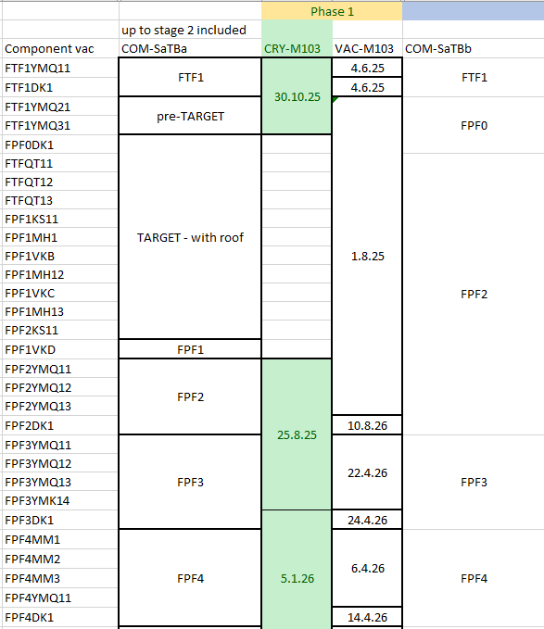
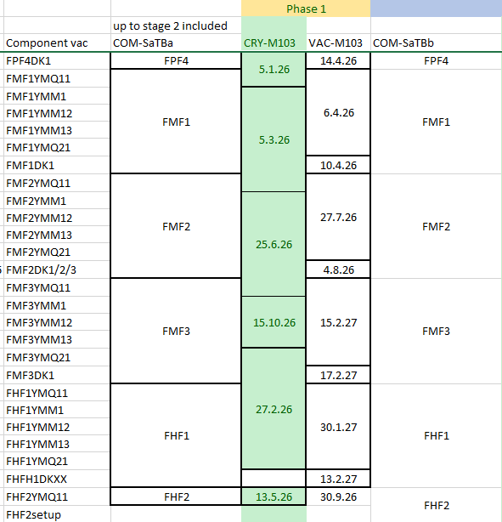
Commissioning phases, sections for phases 1/2 and 3/4
Phase 1 sections different

Slide 16
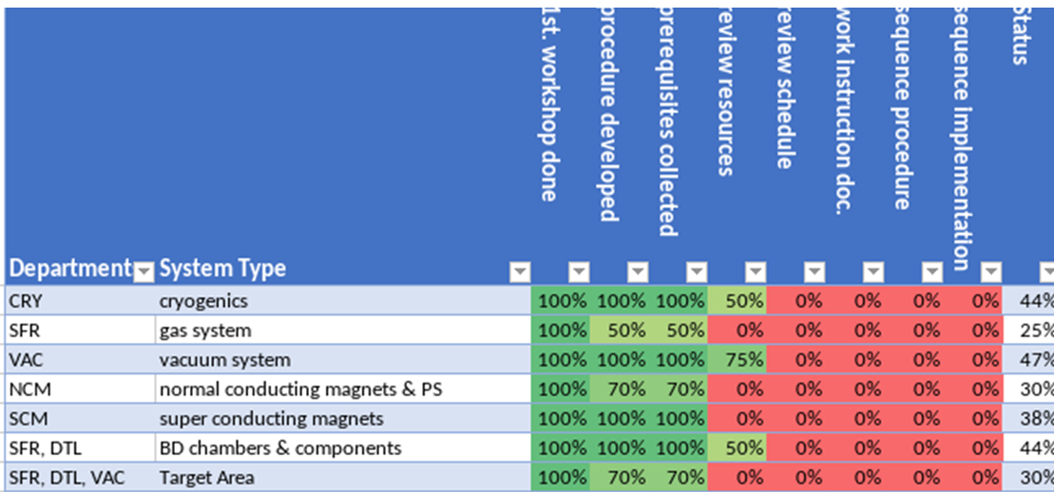

Status of planning - LCM
LCM approach for phase 1 and 2 status (co-organized with V. Kamerdzhiev)
link : FAIR - Commissio... – lcmd https://share.lcmdigital.com

Slide 17
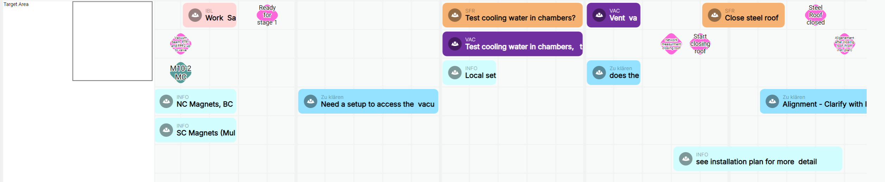
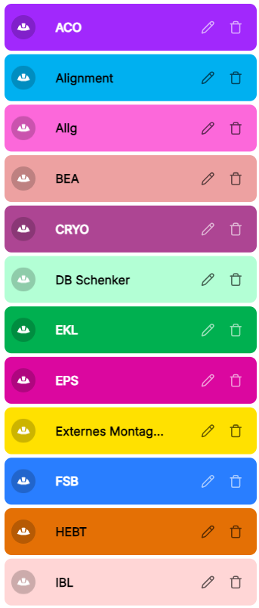
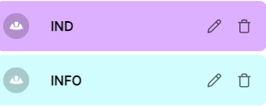
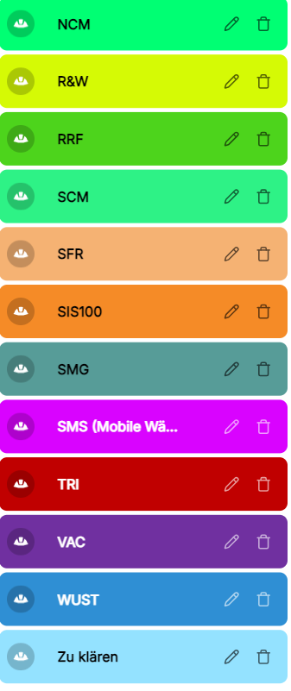
Status of planning,Target area
Example target area

Slide 18
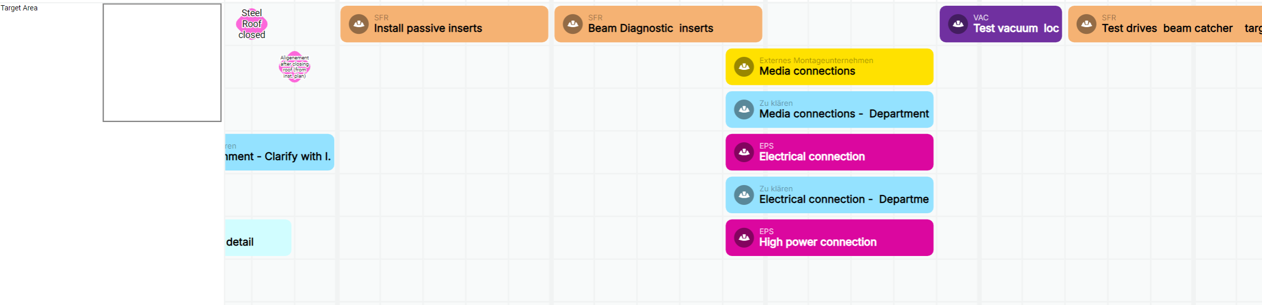
Status of planning, Target area
Example target area

Slide 19
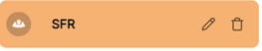
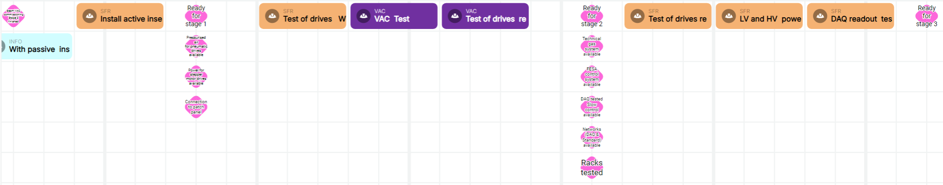
Status of planning, Beam diagnostic chambers
suppose VAC phase 2 done
pressured air, power for motor drive
and patch panel connection
pressured air, power for motor drive
and patch panel connection

Slide 20
Planning - schedule
54 elements, 8 cryo branches, 18 vacuum sections
6 to 8 steps for phase 1 and phase 2
➔ 500 steps for phase 1 and phase 2 in planning
Some elements are only once: Target area, so uncertainties are constrained
SCM 30+, BD chamber 10+, so here uncertainties shall be controlled

Slide 21
System list – more details
Interlinked dependencies in phase 1 and 2:
  Target, Normal conducting magnets, vacuum (pillow seals)
  Super conducting magnets, cryogenics
  Beam vacuum and beam diagnostic chambers
Start of phase 1 per component strongly linked to installation

Slide 22
System status and thought
Gas system : still no planning for it (risk for detector commissioning)
Cryogenics: detailed plan sent by Felix, many open options
Target area: sequence action ready, strongly linked to installation for phase1
NCM: linked to target area (roof closing)
SCM: phase 2 dependent on cryogenics, question on man power for COM.
Beam vacuum: sequences and resources plan available
Beam diagnostic: after beam vacuum, plan and resource needed available
General control, machine model, ion optical model commissioning in phase 3
Beam commissioning: IO commissioning with detector commissioning, then ID

Slide 23
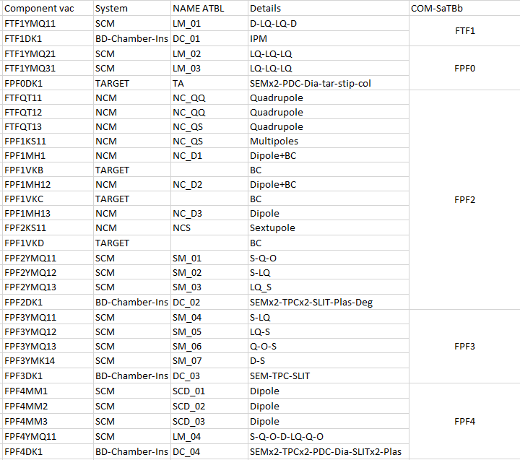
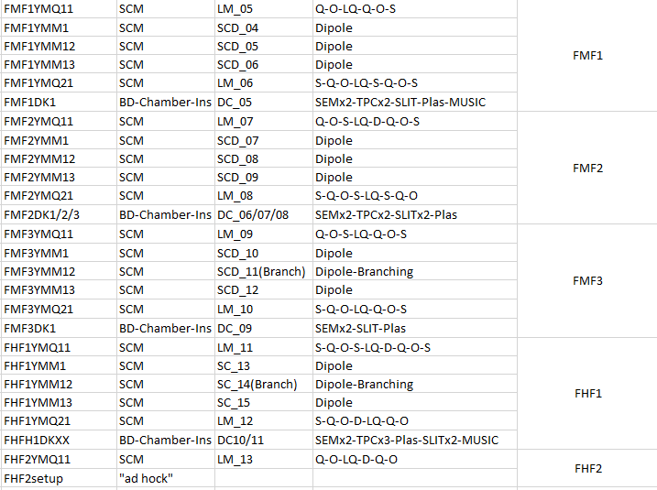
Section, element, heterogeneity of elements

Slide 24
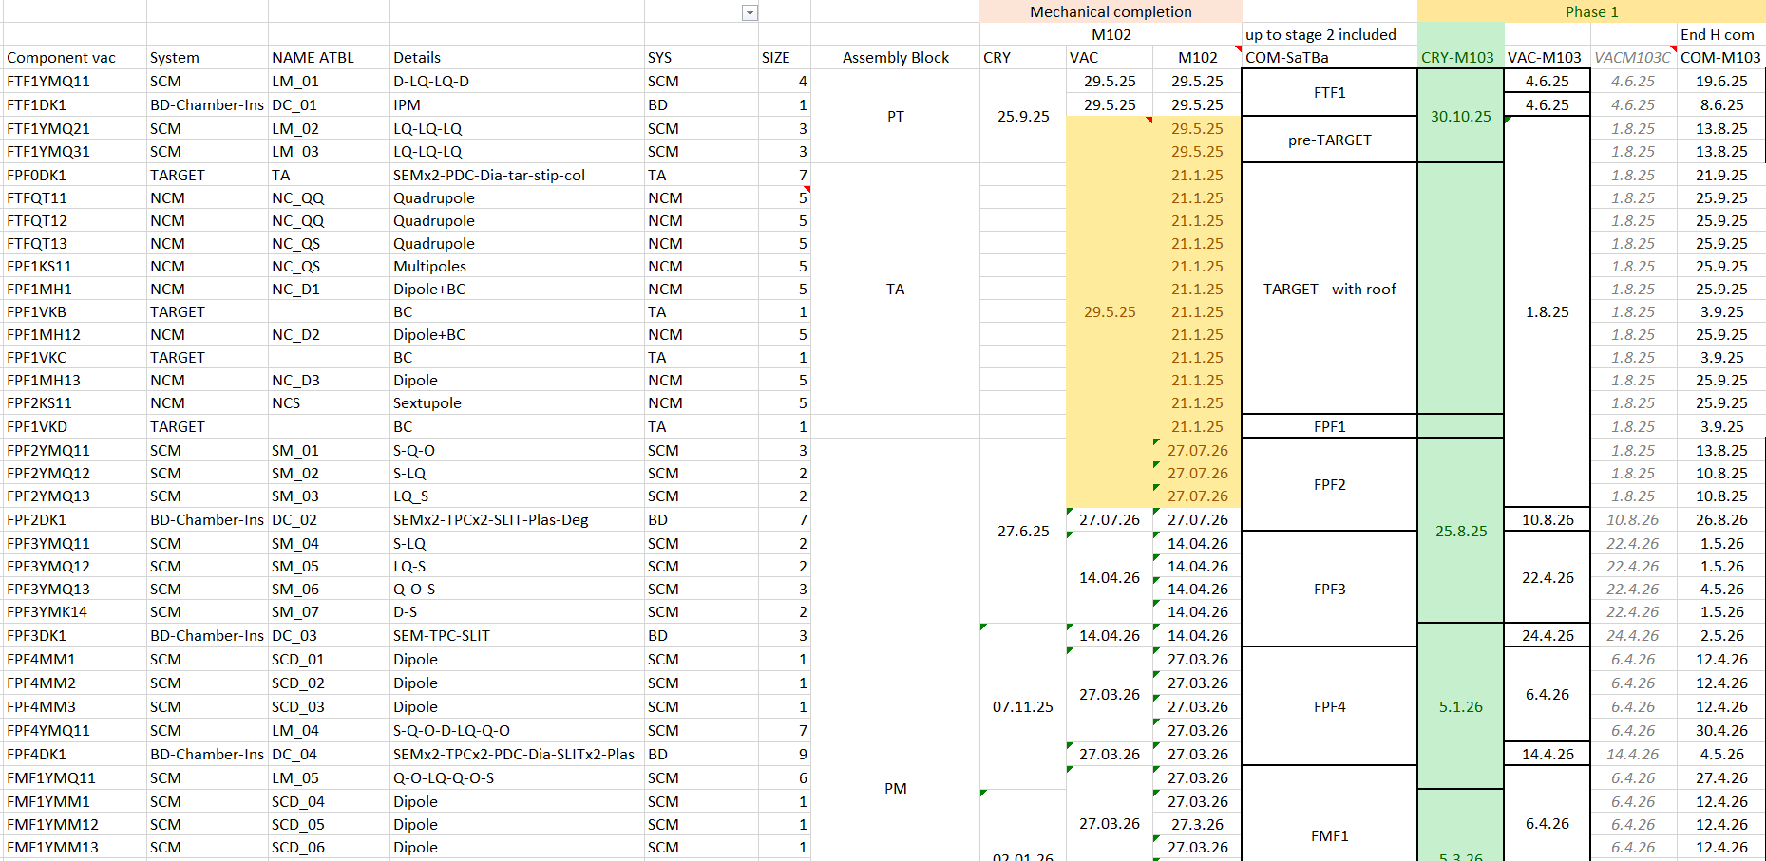
First simulations – toy model
Current planning resource estimate (not fully LCM but taking results into account)

Slide 25
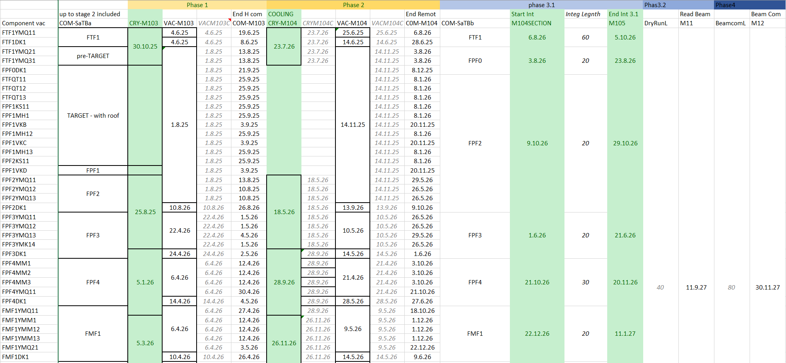
First simulations – toy model

Slide 26
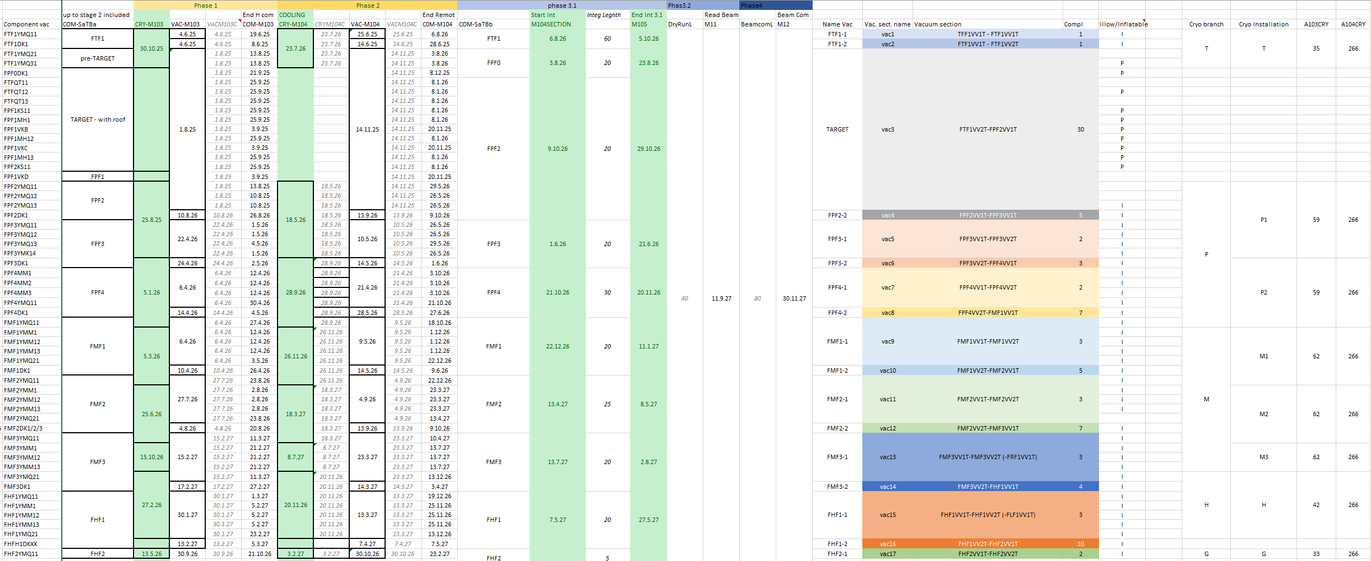
Full .xls document

Slide 27
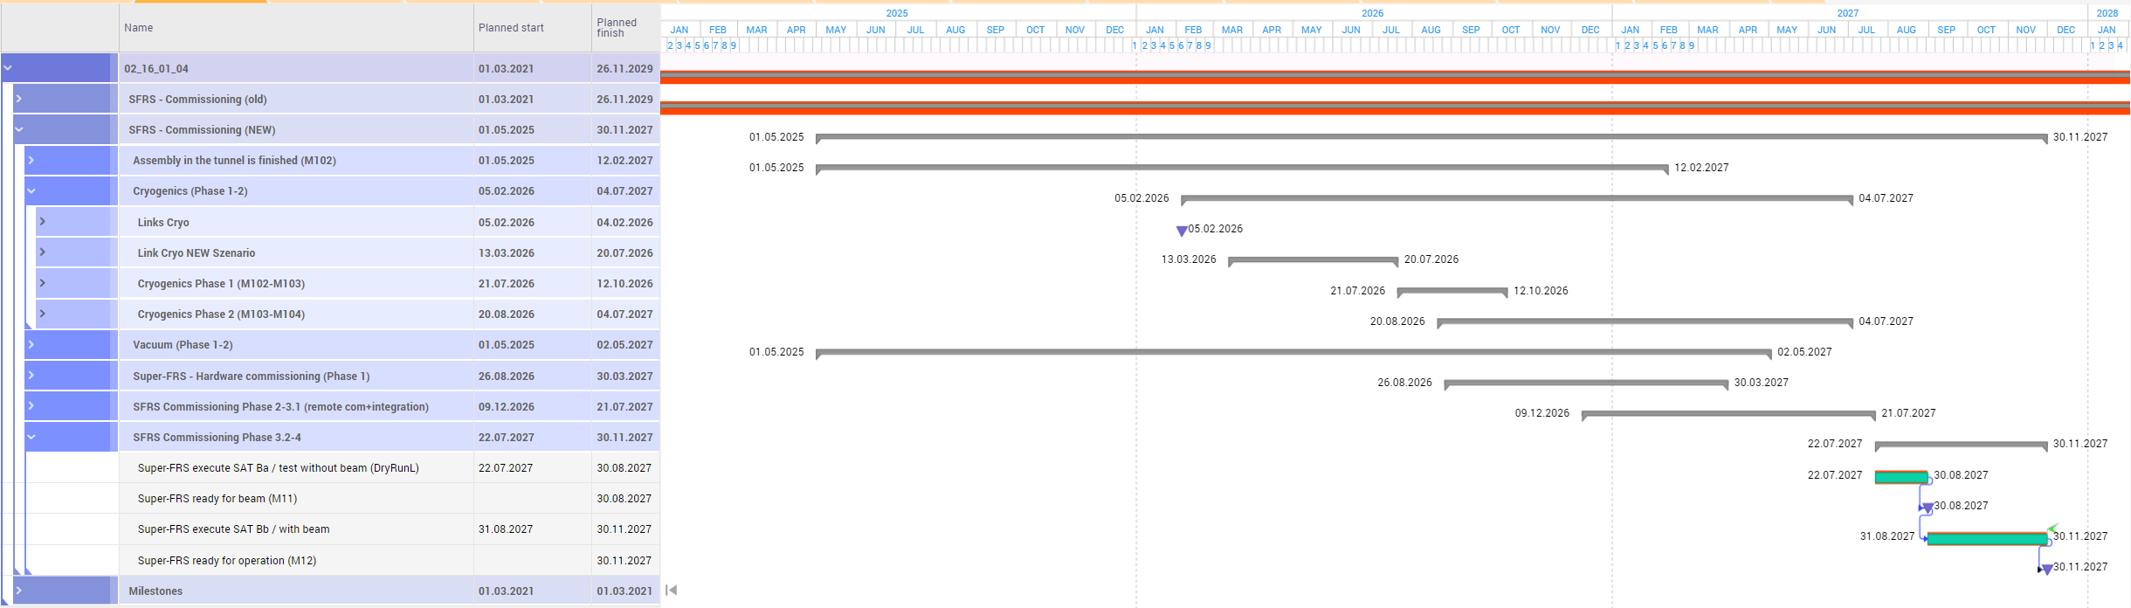
Results in Planisware
Consolidate Planisware, cooling? hypothesis Mar 27?

Slide 28
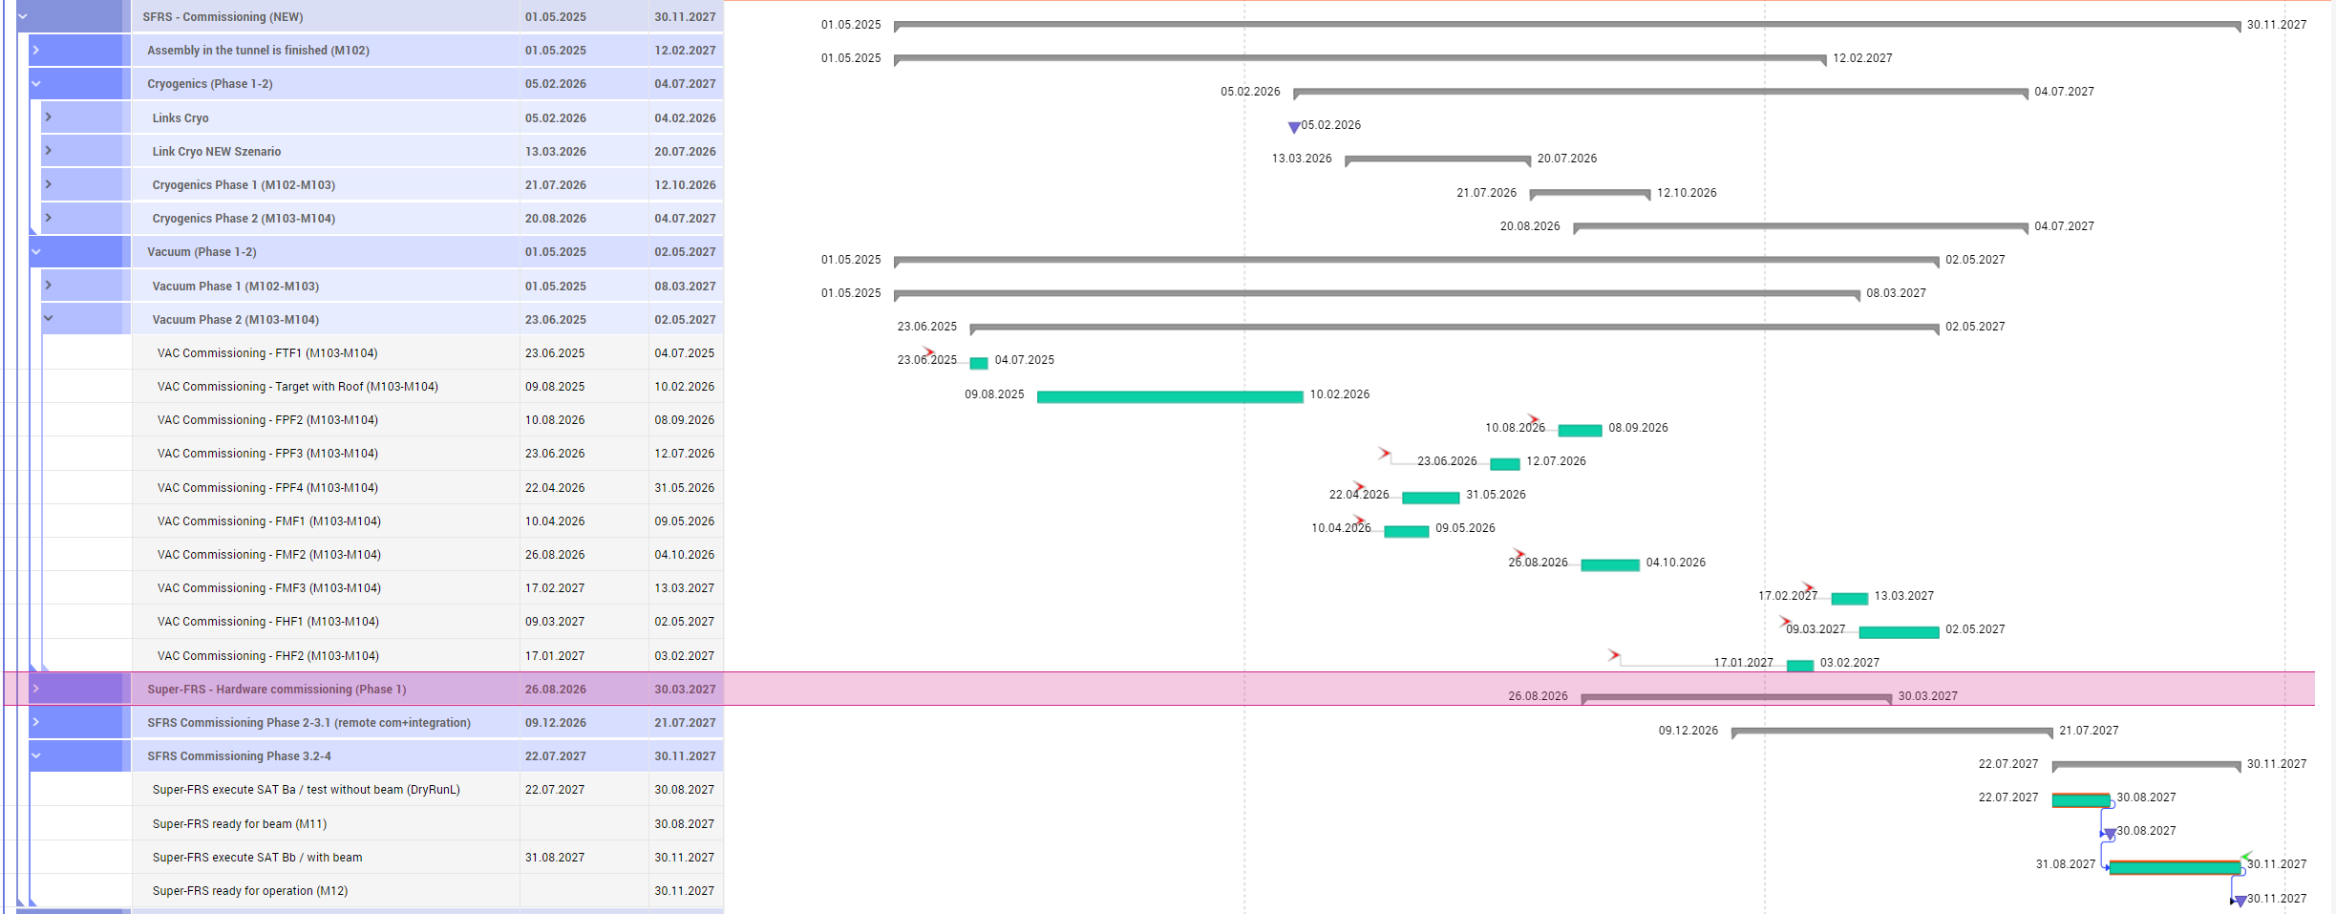
Example of detail

Slide 29
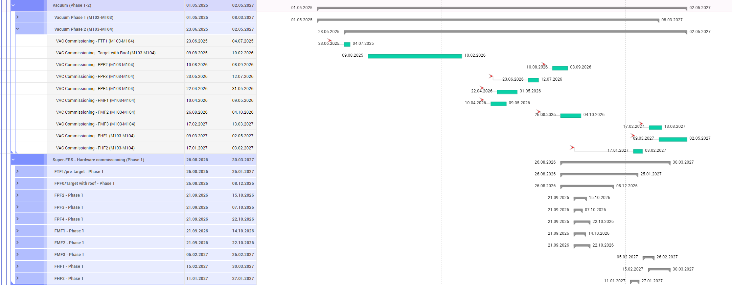
Example of details – vacuum installation
Thanks to Marina Gorda for implementing all the complexity!

Slide 30
plans
plan your work and work you plan!
say what you do, do what you say!
open information exchange
clear dependencies and risk
in planning suggest reasonable estimate and buffer to deal with delays

Slide 31
Goal for this workshop
Come with clear agreement on steps
Identify all dependencies
Start/estimate time for commissioning steps
Check what is missing in installation planning (ex: rack)

Slide 32
My thanks to:
Seva Kamerdzhiev, Marie Cabioch, Marina Gorda, Stephan Reimann,
Heike Marcocelli, Valentina Ricciardi.

Slide 33
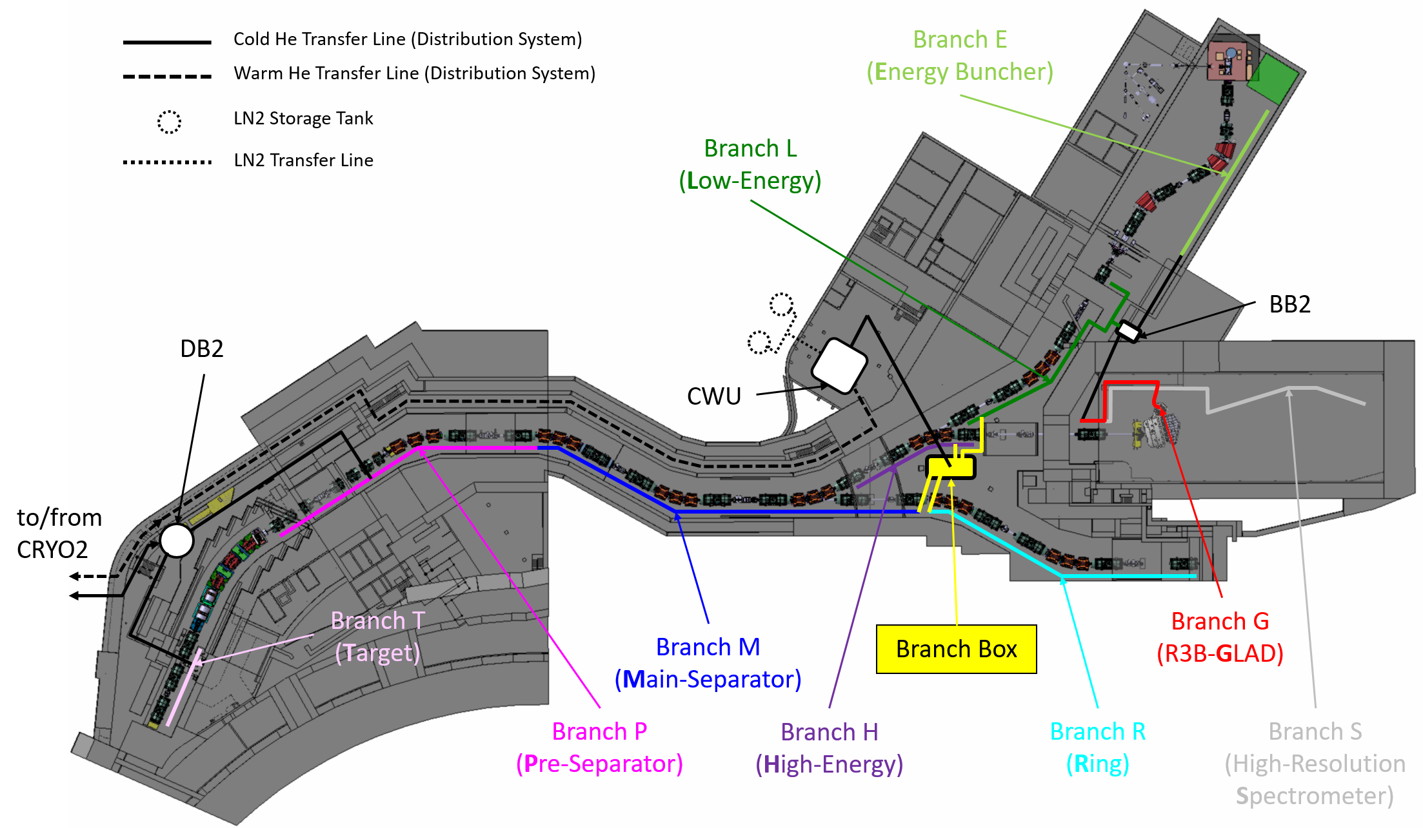
Local Cryogenics Branches

Slide 34
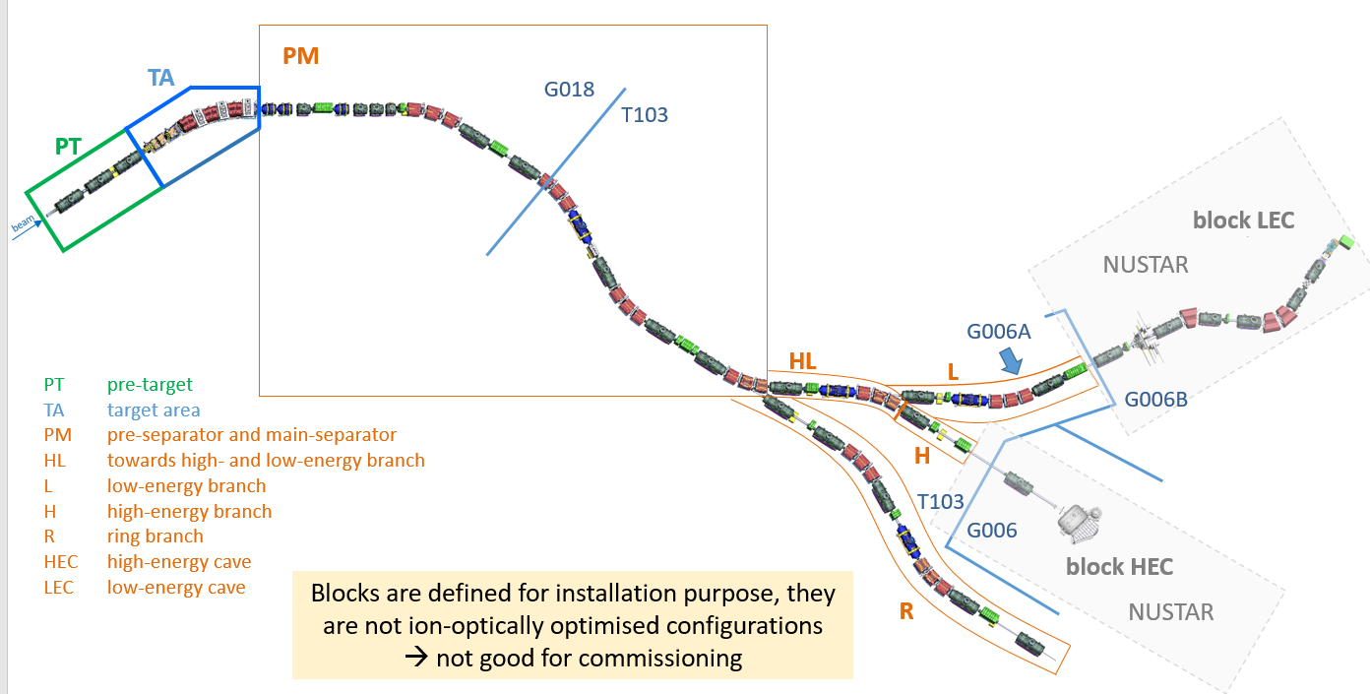
Commissioning need to be done in parallel to installation (as much as possible)
Integration test could be done “per installation block” ➔ main question: Cryo commissioning (no info possible)!

Slide 35
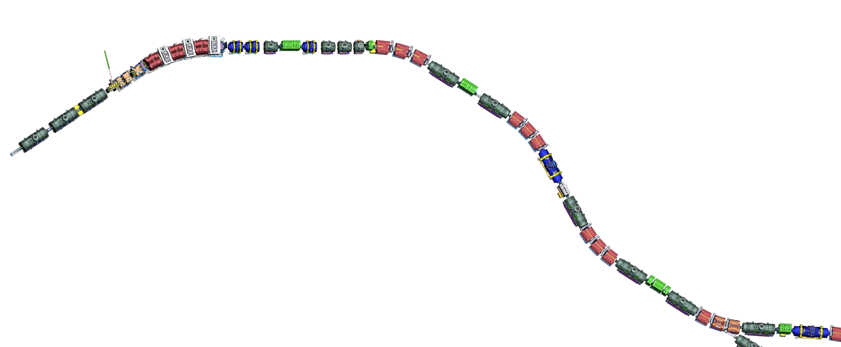
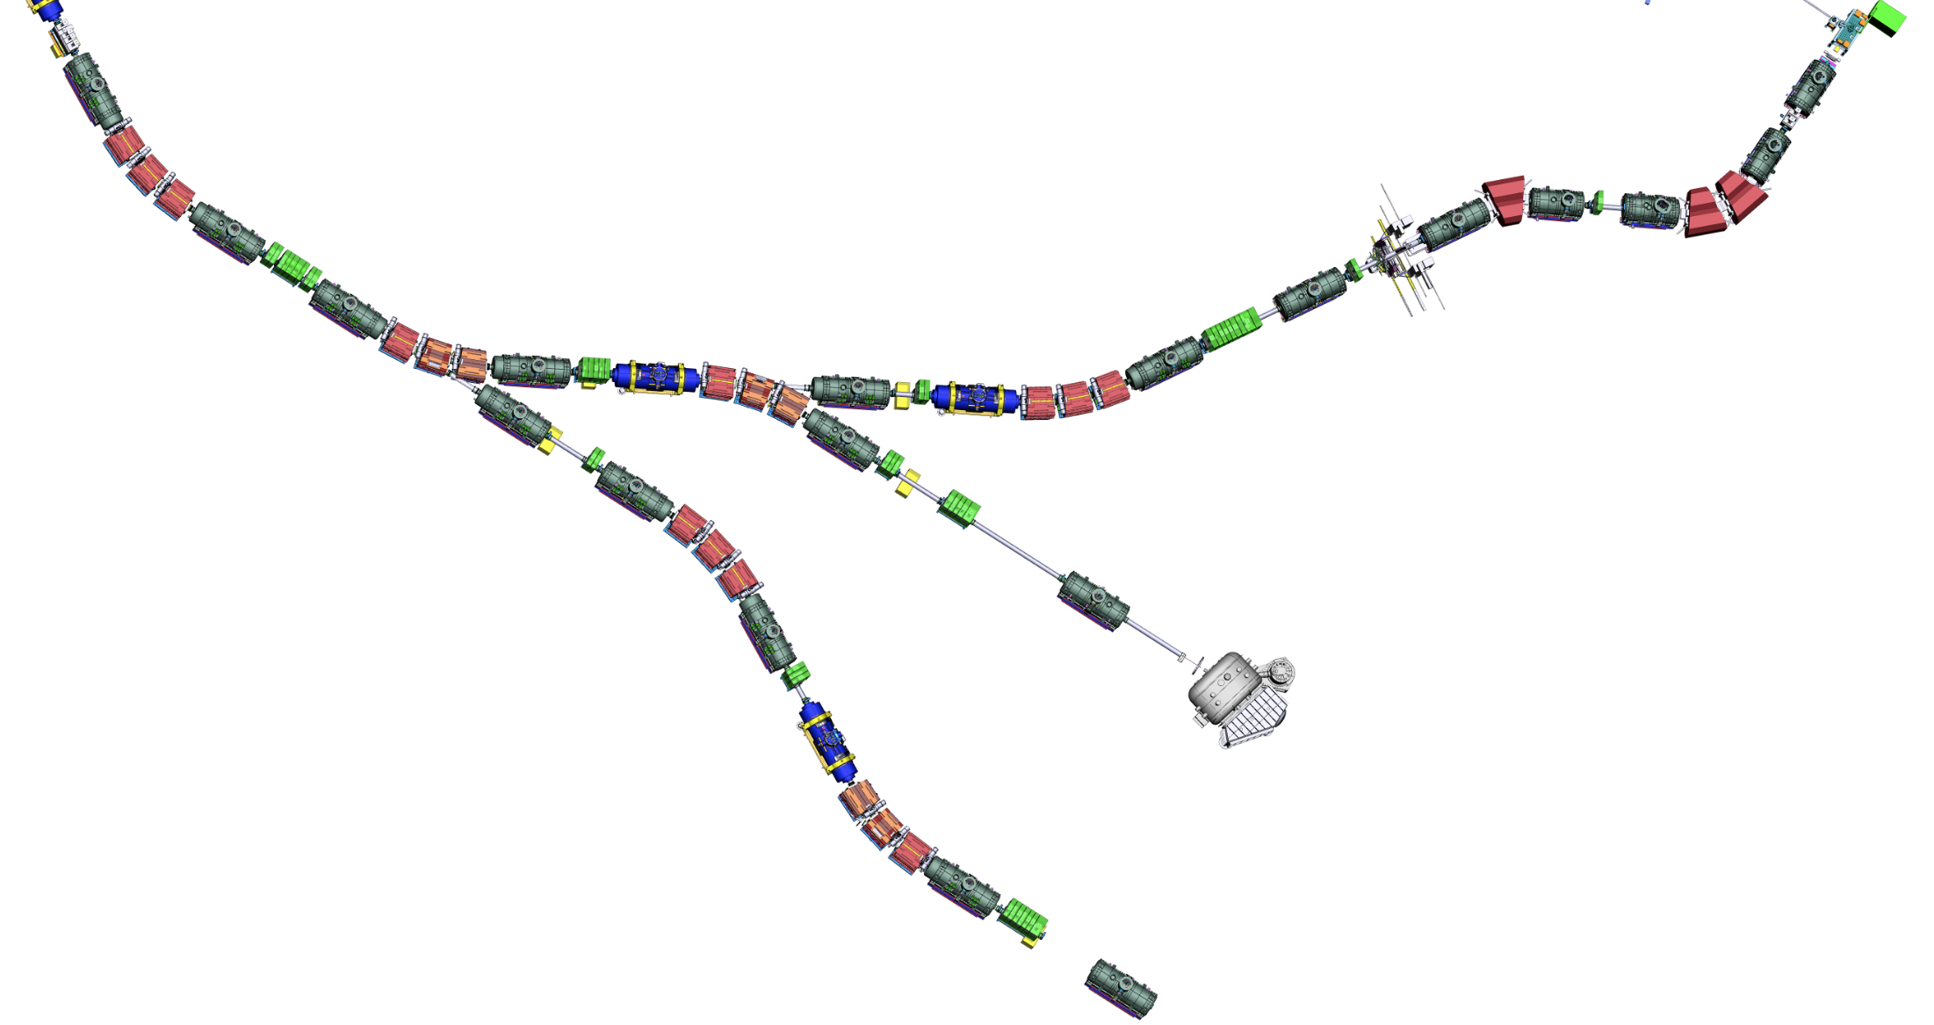
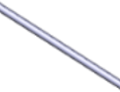
Assembly Units
Assembly Units along the beamline
SM_01
SM sc short multiplet
LM sc long multiplet
SCD sc dipole
DC diagnostic chamber
VAC beam-line vacuum
EBD EB dipole
EBM EB multiplet
TA target
NC_QQ nc quadr. 1a + quadr. 1b
NC_QS nc quadr. 2 + sextupole
NC_D nc dipole
BC beam catcher
NC_S nc sextupole
SM_02
SM_03
SM_04
SM_07
SCD_01
SM_05
BC3
DC_02
SM_06
DC_03
BC2
NC_S
NC_D2
NC_D3
SCD_02
BC1
SCD_03
NC_D1
LM_04
NC_QS
NC_QQ
DC_04
TA
LM_03
FPF1
FPF2
FPF3
LM_05
VAC_02
SCD_04
LM_02
DC_01
FPF0
FPF4
SCD_05
LM_01
SCD_06
VAC_01
FTF1
LM_06
beam
DC_05
Power converter Racks (total) 77
Control Racks (total) 336
not ATB
FLF6
Number of pieces for Early Science
(Target Area excluded)
FMF1
LM_07
DC_17
SCD_07
FLF5
SCD_08
FLF4
EBM_05
SCD_09
LM_08
FLF3
DC_16
DC_06
EBM_04
DC_07
FLF2
7 sc short multiplets
13 sc long multiplets
15 sc dipoles
10 diagnostic chambers (DC_01 not includable)
4 long/special beam pipes
DC_08
SCD_11 (branch)
FMF3
EBD_03
LM_09
SCD_14 (branch)
EBD_01
DC_15
SCD_10
FLF1
DC_13
EBM_02
EBD_02
SCD_12
LM_16
EBM_03
LM_10
SCD_13
EBM_01
FMF2
DC_09
LM_11
LM_14
SCD_18
SCD_17
SCD_15
SCD_16
VAC_06
LM_15
DC_12
LM_17
VAC_05
DC_14 (maybe)
LM_18
LM_12
VAC_07
Additional number of pieces for LEB (up to FLF3)
DC_18
DC_10
LM_19
VAC_03
4 sc long multiplets
3 sc dipoles
2-3 diagnostic chambers
1 long/special beam pipes
FRF1
SCD_19
DC_11
early science locations
SCD_20
FHF1
VAC_04
SCD_21
LM_13
LM_20
VAC_ NUSTAR
DC_19
FHF2
FRF2
VAC_08
GLAD
Additional number of pieces for completion
LM_21
BDN
SCD_22
FHF3
6 sc long multiplets
6 sc dipoles
6 diagnostic chambers
6 long/special beam pipes
5 sc Energy Buncher multiplets
3 sc Energy Buncher dipoles
VAC_09
Installation: Super-FRS
SCD_23 (branch)
SCD_24
Installation: Super-FRS
LM_22
Installation: NUSTAR
DC_20
Installation: NUSTAR
FRF3
VAC_10
LM_23
Fxxx notation defines “focal planes”
VAC_11
Last modified: Super-FRS Workshop, 15-17 Nov. 2021

Slide 36
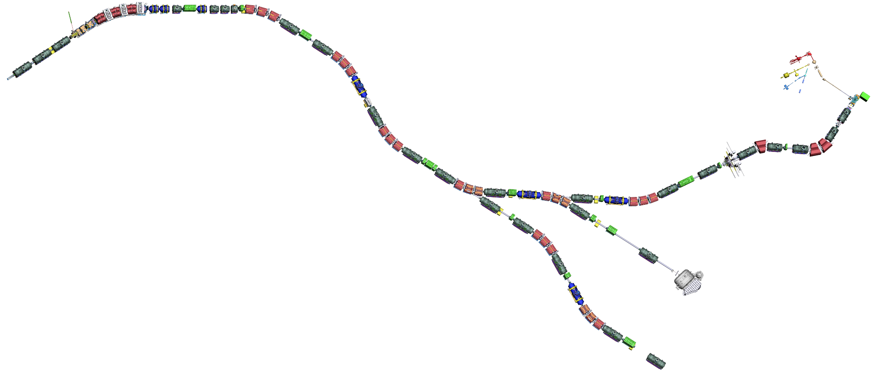
Commissioning sections along the beamline v1
FPF1
FPF2
FPF3
FPF0
FPF4
G018
T103
FTF1
All this is LEB
commissioned together
beam
FMF1
FLF6
FLF5
FMF2
FLF3
FMF3
FLF4
FLF1
FLF2
G006B
G006A
FRF1
FHF1
FRF2
FHF2
T103
blocks for machine installation
G006
sections for commissioning
FRF3

Slide 37
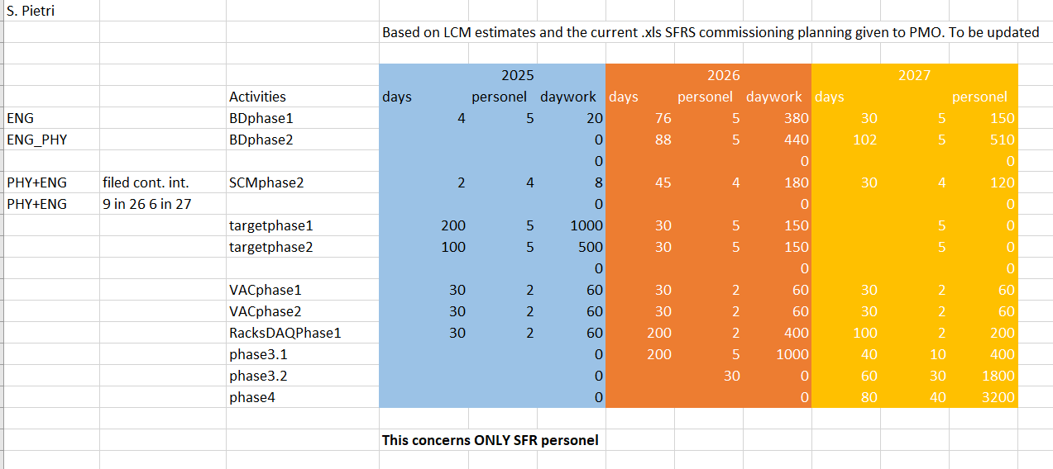

Slide 38
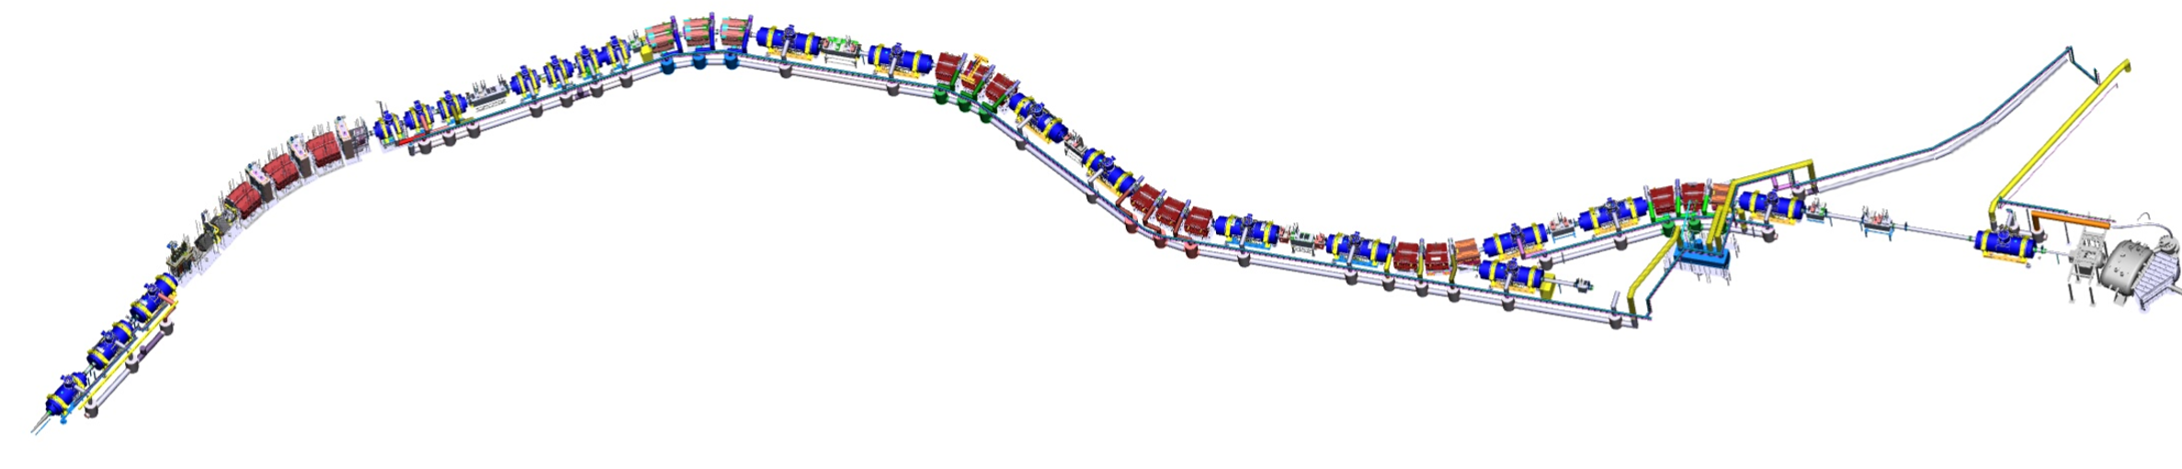

Local Cryogenics branches
M, H, G (B optional)
Procurement and installation branch M
Procurement and installation branches H, G
Planned FAIR contracts: December 2024
Planned delivery to FAIR: October 2025 – July 2026
Planned installation: October 2025 – August 2026
Tender running
Deadline for offers: 23/10/2024
Offers from 4 bidders (3 companies + 1 consortium)
All qualified and well-known companies
Requested schedule confirmed
Negotiations starting
Risk of FAIR internal competition with cryo tenders
CE
Still to be tendered: jumpers of branches M, H, G
Overview tenders LC branches
Delivery dates of local cryogenics boxes
Local cryogenics sectors: installation completed
shielded target area
P2
P1
11.25
M1
08.25
11.25
H
M2
M3
04.26
G
T
04.26
05.26
03.25
09.26
last batch W0 Dec-24
batch W1 06.25
batch W2 09.25
batch M1 10.25
batch M2 02.26
batch M3 07.26
batch H 02.26
batch G 05.26

Slide 39
