Slide 1
Subproject - FAIR Commissioning
S. Reimann

Slide 2
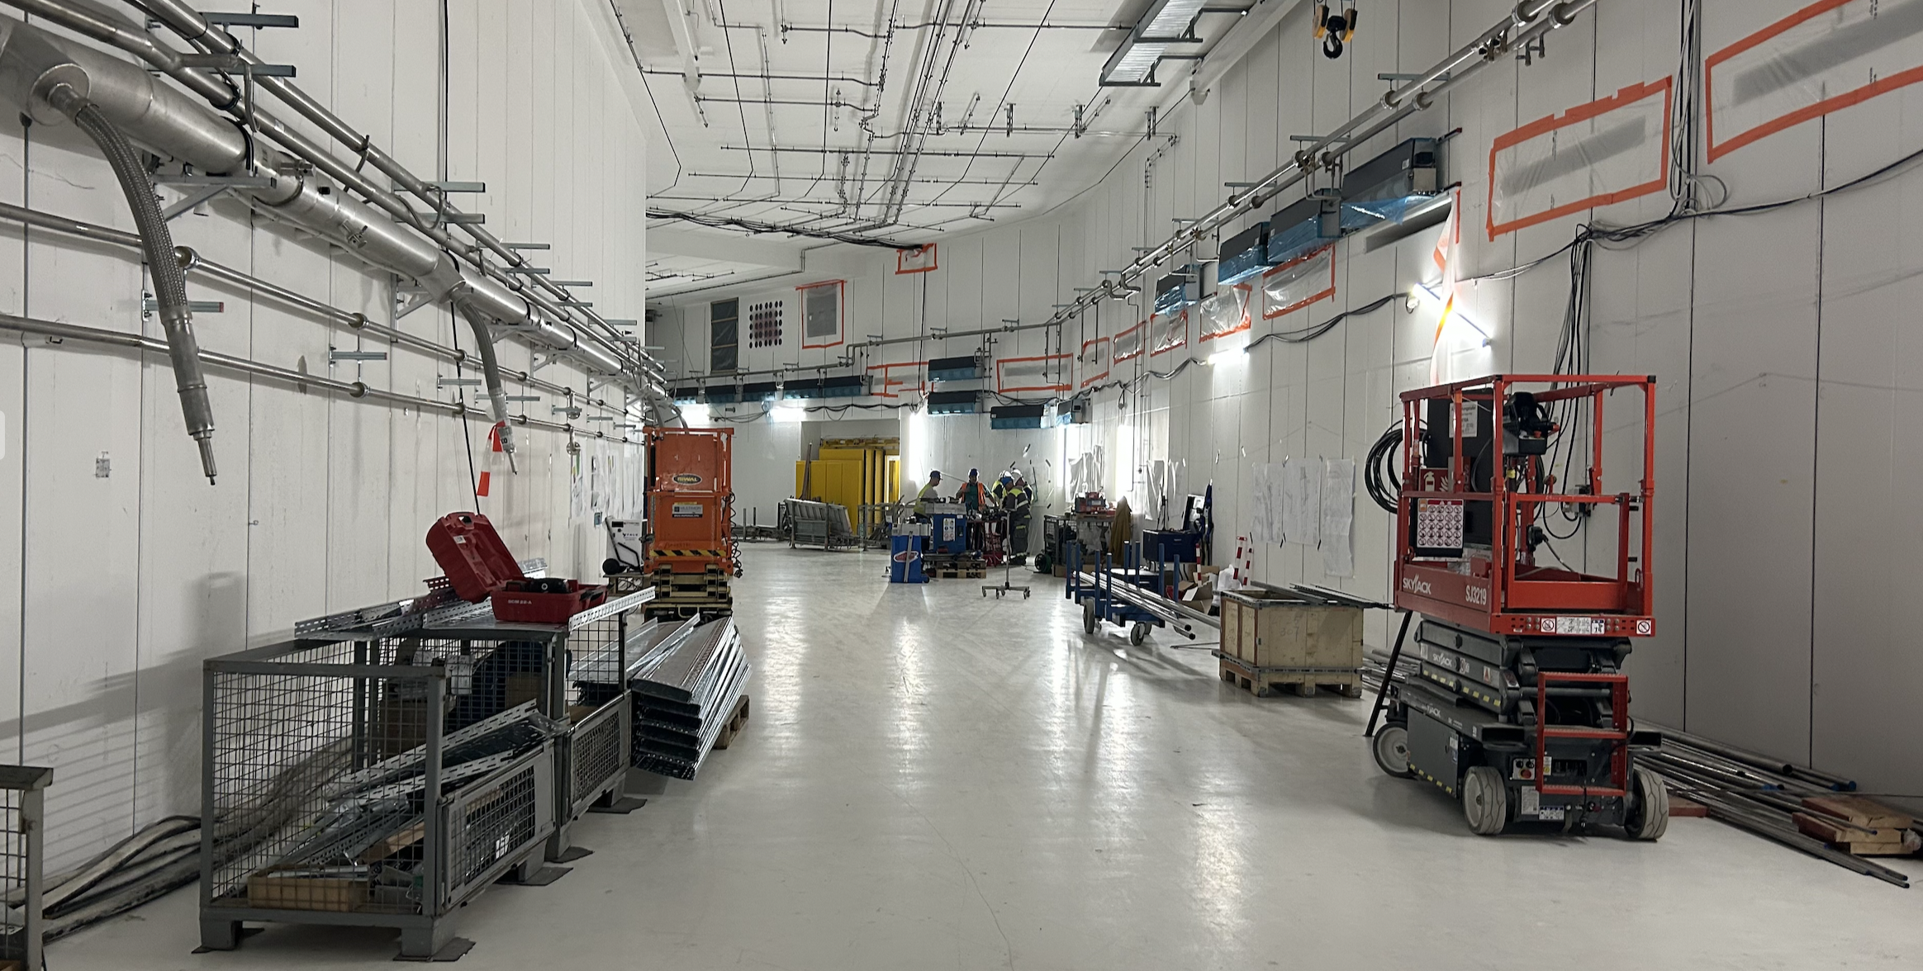
Outline
Top-Level Commissioning Schedule
Organisation of the Subproject FAIR Commissioning
Transition from Installation to Commissioning
Goals of this Workshop

Slide 3
GSI & FAIR – Integrated Campus Schedule
2024 2025 2026 2027 2028
First beam in T1S1
Beam Time
Beam Time
Beam Time
Beam Time
FCC Construction & Procurement of Interior equipment
Equipment
Installation
Commissioning
ACC operation
from new FCC
Injector Controls Upgrade: 1st version of new production system
Injector Controls Upgrade: finalization
Controls & BI Digitization UNILAC, SIS18, ESR, Cryring, HEBT
Civil Construction
FAIR Tech. Buildings Infrastructure
FAIR Buildings Testing & Commissioning
HBO
Regular Operation of Tech. Buildings Infrastructure
FAIR Accelerator / Experiments Procurement & Manufacturing
SFRS-ES
SIS100-FS
FAIR Accelerator / Experiments Installation
HEBT/SFRS-ES
SIS100-FS
Cryo 2
Commissioning
HEBT-ES Hardware-Commissioning
Dry-Runs
Start of ES
science program
SFRS Hardware-Commissioning
ES Beam Commissioning
start of first
science program
& first science+ program
Dry-Runs
SFRS Cooldown
HEBT & SIS100 -FS Hardware-Commissioning
FS Beam Commissioning
Dry-Runs
today
SIS100 Cooldown

Slide 4
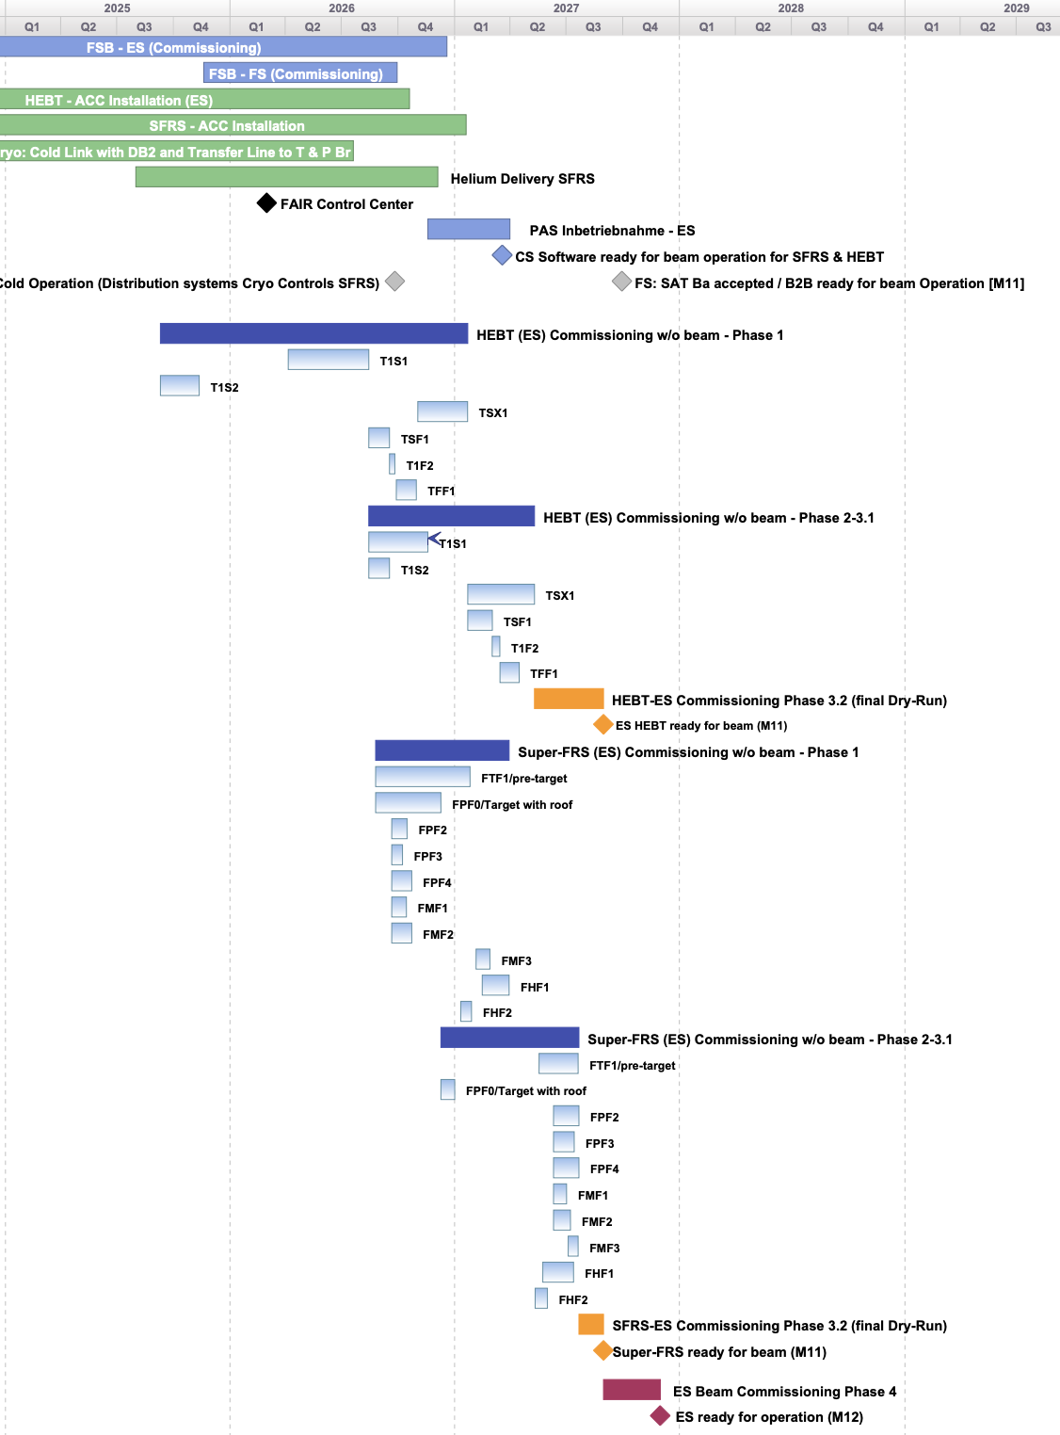
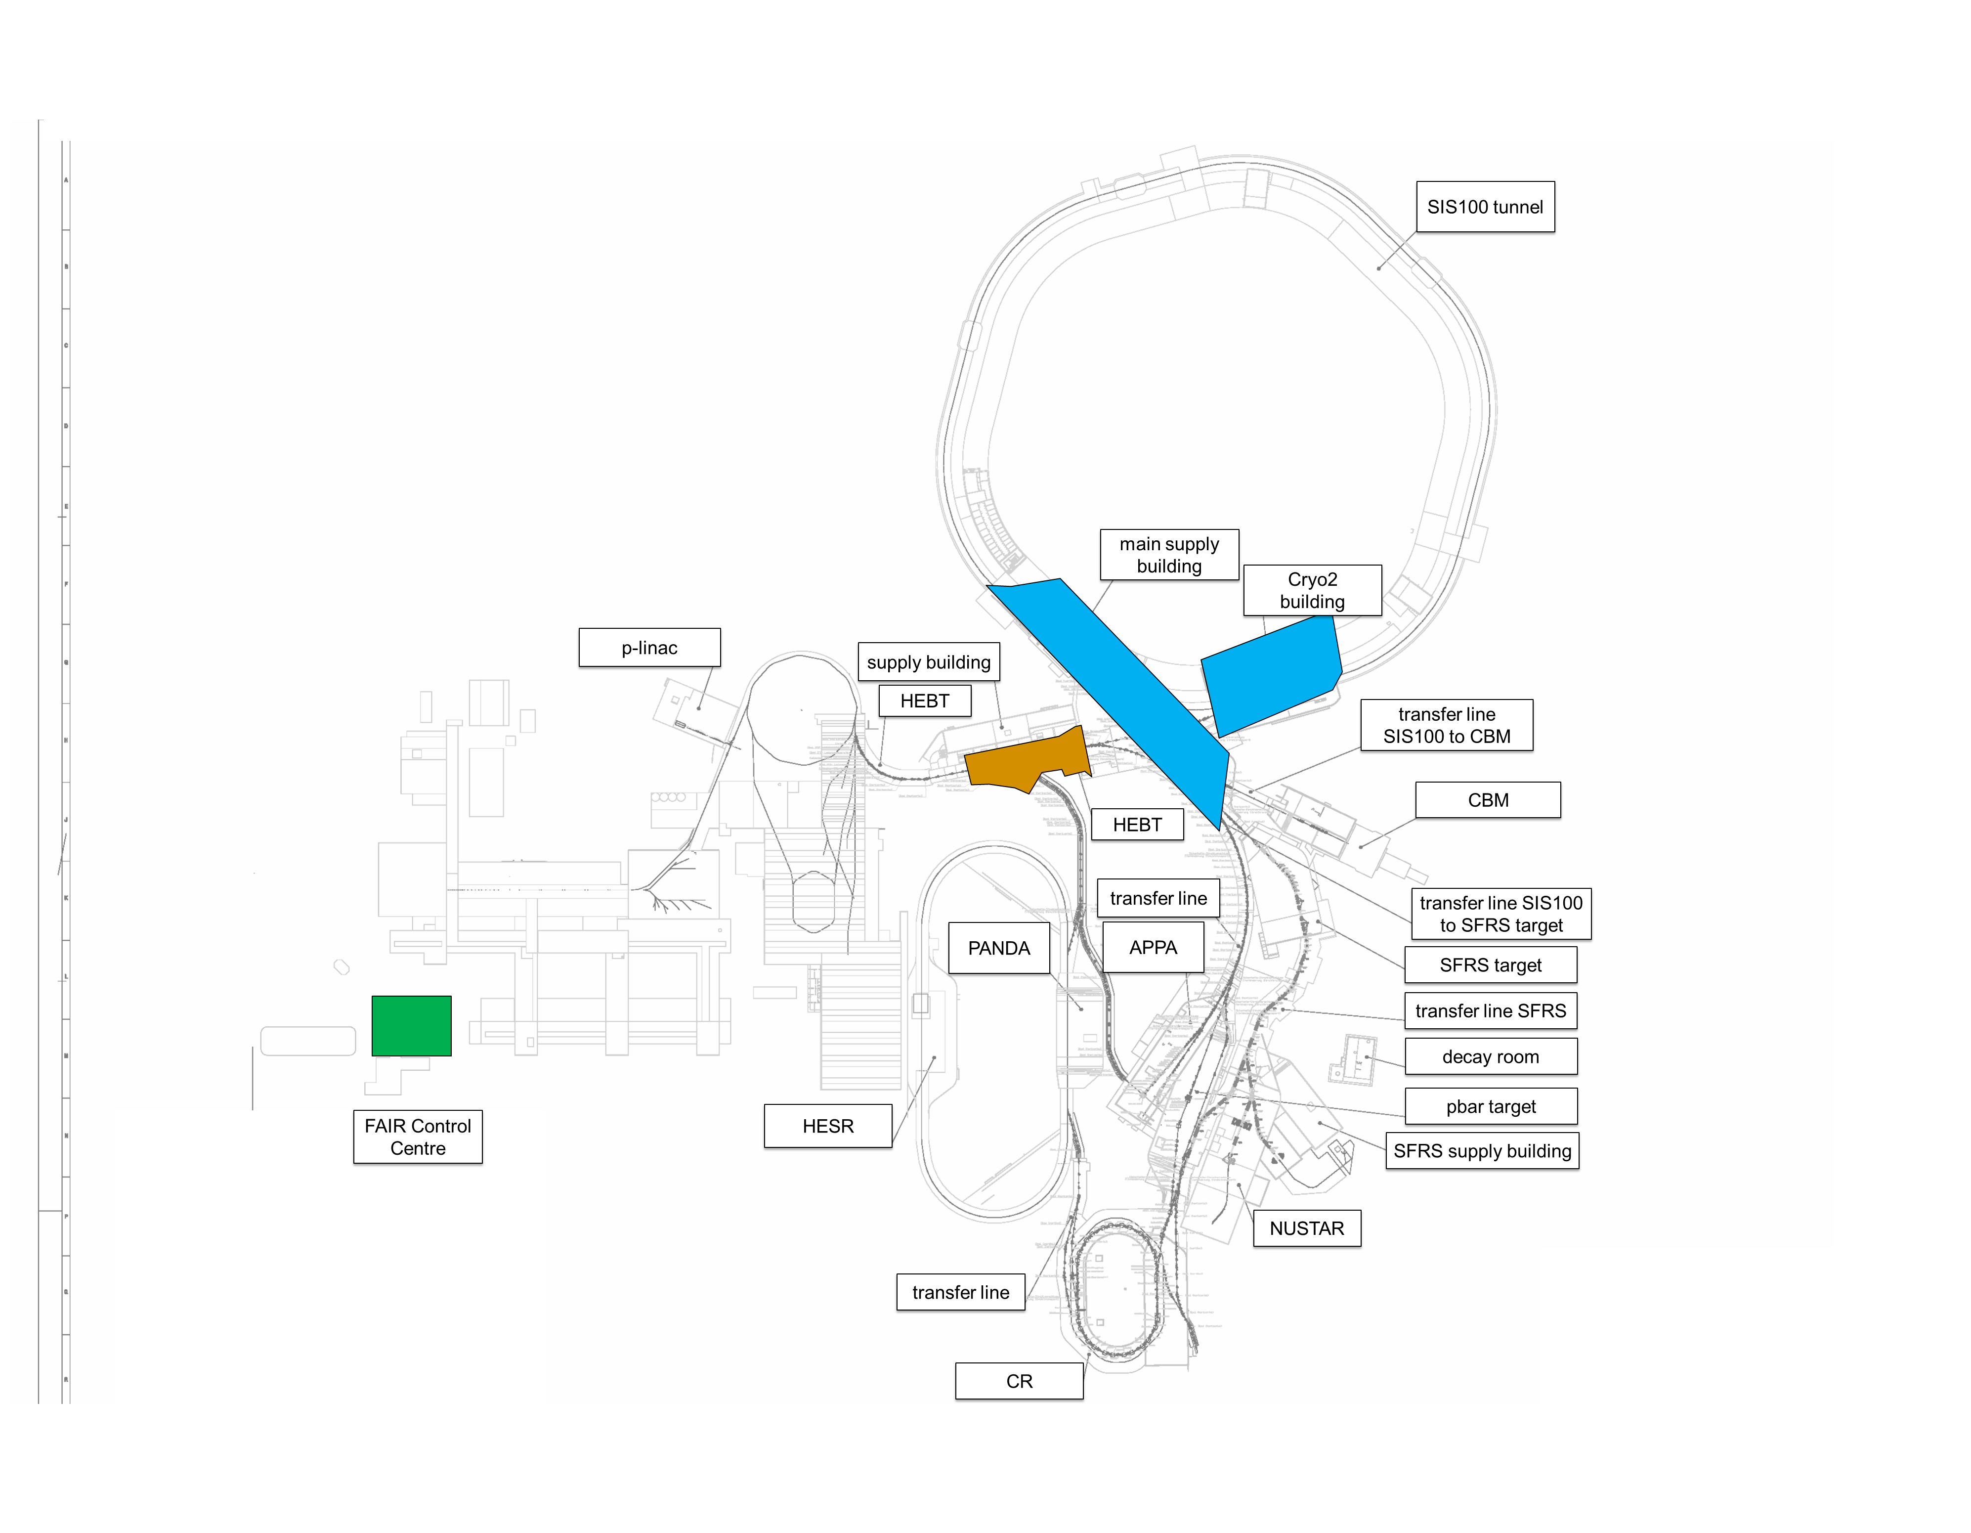
First 3 major Commissioning Milestones
FSB – ES Commissioning
← Early Science commissioning schedule on section level
Cryo2 Commissioning
Q2/2025 → Q4/2025: cryogenic plant “Cryo2” (building K0720A & parts of main supply building H0719A)
Q4/2025: start of first commissioning activities in Transfer Lines T1S1/2
(T1S1 ready for beam in Q4/2026)
Q1/2026 start commissioning of FAIR Control Centre and new Main Control Room
SFRS not yet in focus, but is going to be in 2026

Slide 5
Organisation of Commissioning
Commissioning is organized as a subproject within FAIR project
fully integrated in FAIR management lead team with other sub project leaders and in GSI accelerator organisation (ACC)
fully integrated into FAIR reporting structures (planning, risk management, controlling) and committees
Subproject Commissioning is divided in 12 work packages with dedicated work package leaders (commissioning responsible)
Full integration of experiment groups and facility management (technical building infrastructure) in the commissioning process
Sub structure is developed as project progresses
line management
project organisation (matrix)
Technical Director
J. Blaurock
Note: handover to operation organisation after delivering beam with project completion parameters (PCP) on target:
Early Science: 238U73+, 1 GeV/u, 2E9 ions/second
First Science: 238U28+, 1.4 GeV/u (60Tm), 2.5E10 ions/cycle
First Science+: 197Au79+, 11 GeV/u, 1E7 ions/second
Head Accelerator Operation & Development
R. Assmann
FAIR Project Lead
J. Blaurock
associated GSI-group
(FAIR Commissioning and Operation) in ACC-OPE
Lead: V. Kamerdzhiev
FAIR Commissioning Subproject Leader
& GSI Operation Manager
S. Reimann
HEBT
commissioning responsible
Cryogenic
commissioning responsible
FAIR Control Center
commissioning
responsible
Safety
commissioning responsible
technical building infrastructure
responsible
NUSTAR
commissioning responsible
Radiation Safety
commissioning responsible
SFRS
Stephane Pietri
Controls
commissioning
responsible
Line management
S. Reimann to operations department OPE
first science
and beyond
Notes:
SFRS Commissioning Leader S. Pietri

Slide 6
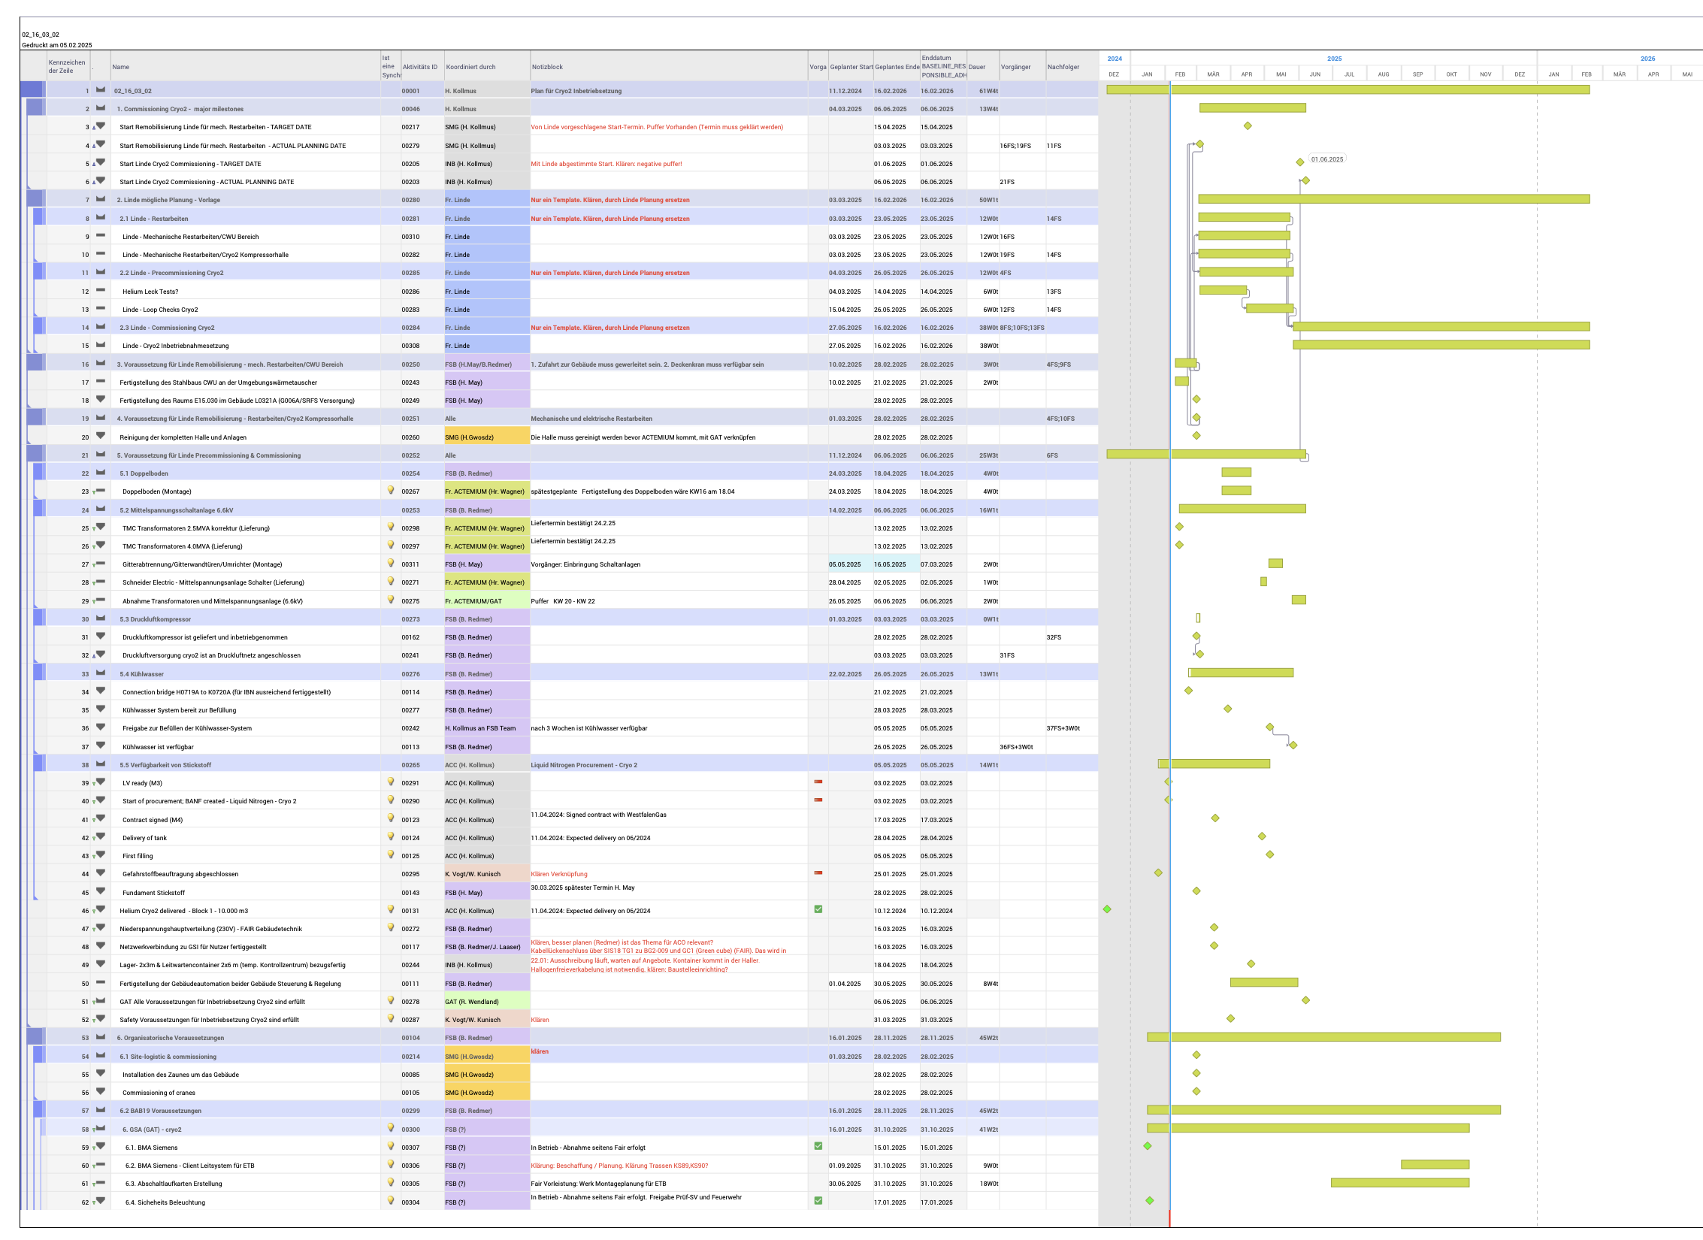
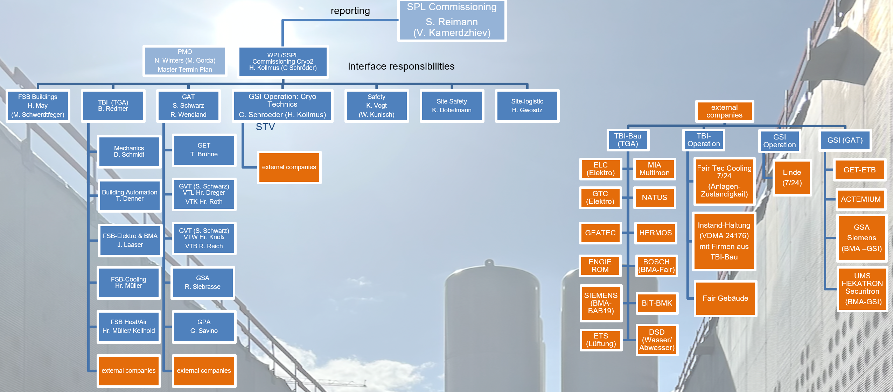
Substructure Example: Cryogenic Systems
Cryo2 Commissioning - work package organization with external companies
Cryo2 work package organization has been developed (as pilot for all further commissioning activities e.g. HEBT & SFRS commissioning)
Strong support by Commissioning Subproject Lead
Organisation, processes and responsibilities including safety are clarified and documented
Detailed commissioning schedule of cryo system

Slide 7
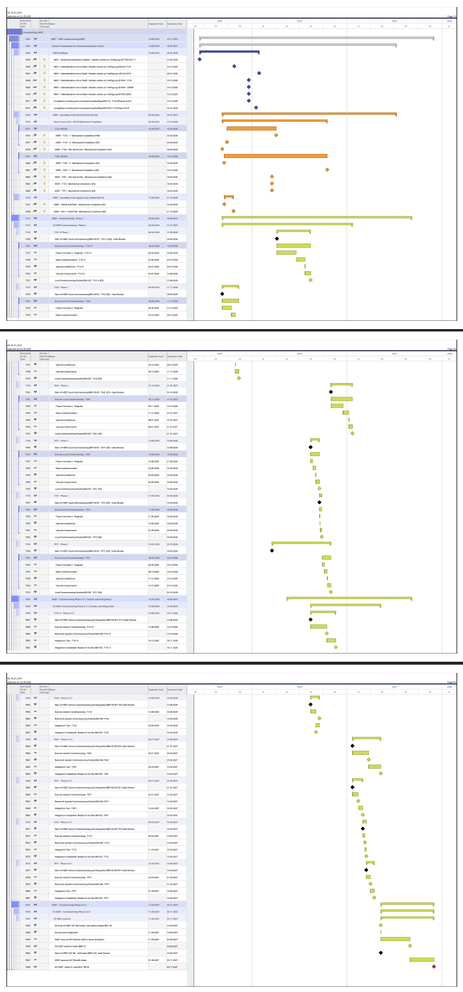
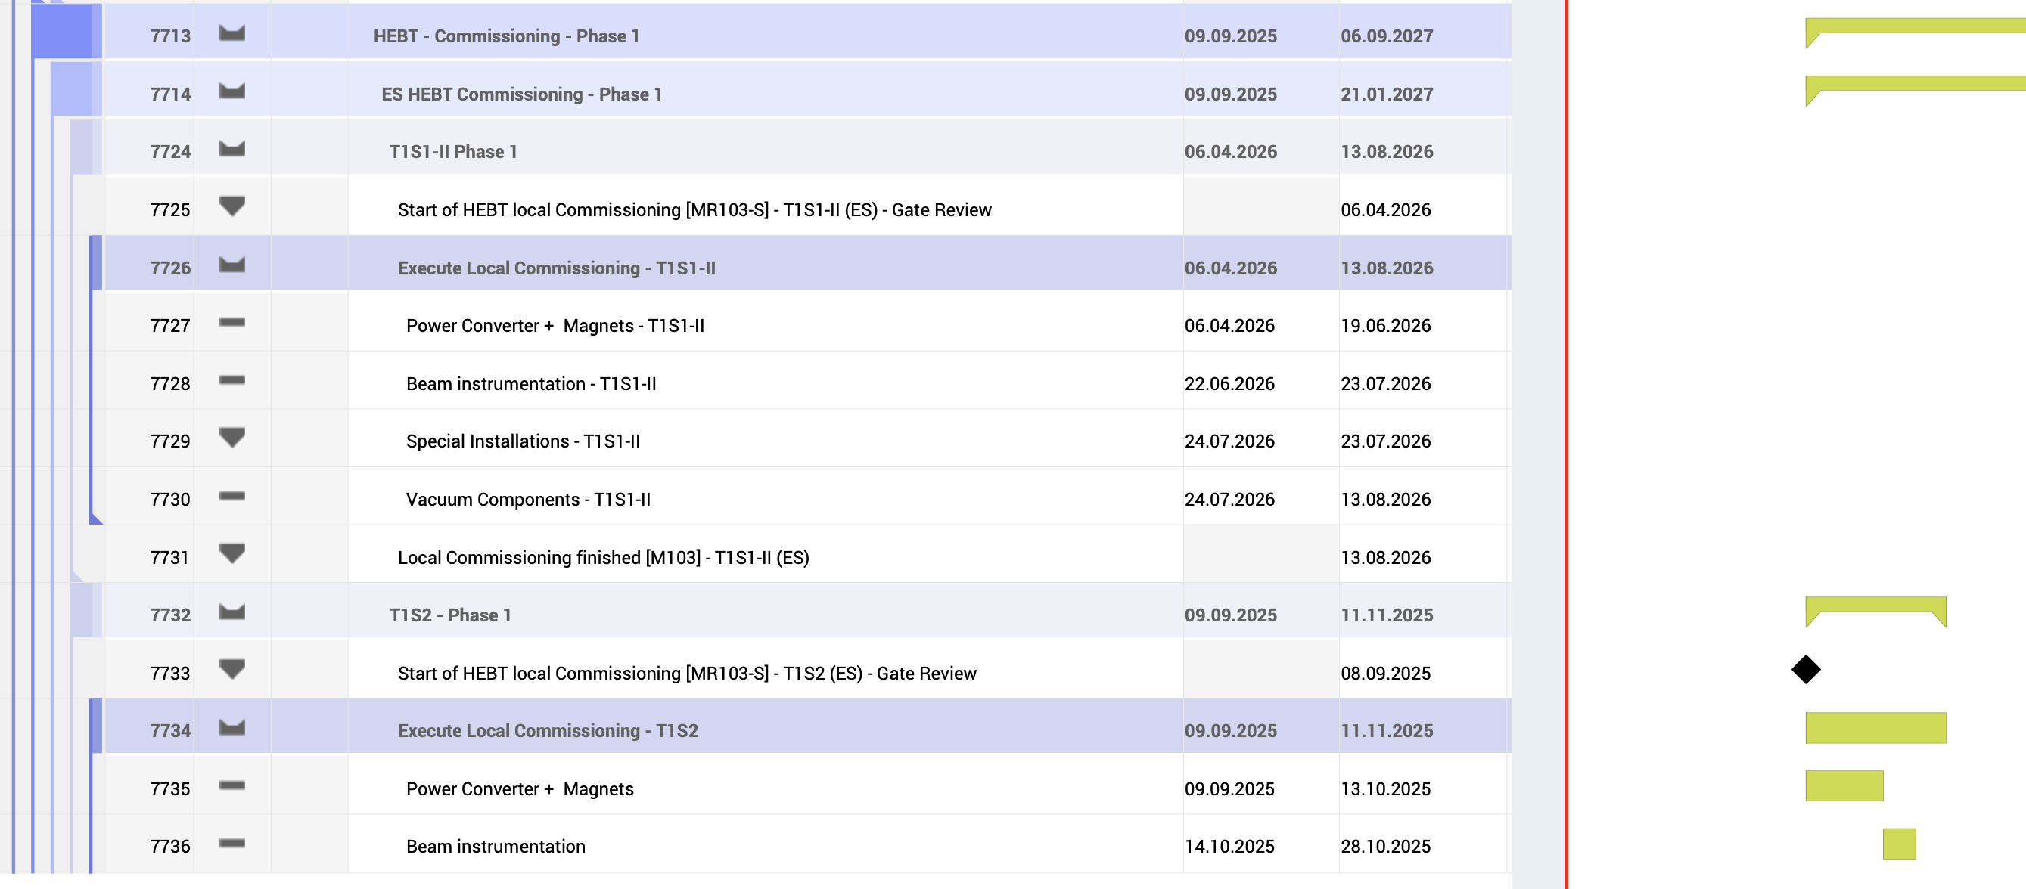
Detailed Commissioning Plan – example ES-HEBT
full file - see attachment: “HEBT_Commissioning_Plan_22.05.2025_ES without FBE.pdf”

Slide 8
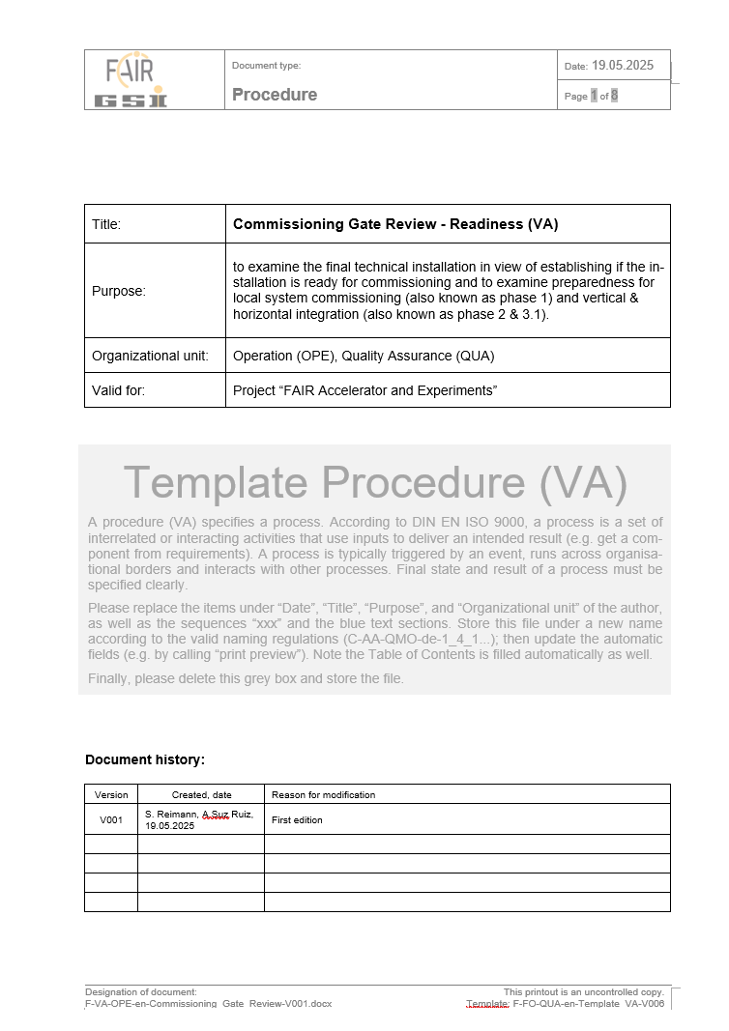
Preparation of Gate Reviews for phase transitions concept under development
goal is to ensure a safe and orderly transition from installation to commissioning while minimizing the additional effort for the WPLs
key Points:
  declaration of Mechanical Completion (incl. NCRs)
  confirmation of proper commissioning of TBI / media
  commissioning procedures
  all GBU(s) for commissioning
  checklist of test steps (well chosen level of detail)
  appointment of all necessary responsible persons
  ...
procedure & checklist presently in development
first tests:
Cryo and HEBT (T1S1)

Slide 9
Preparation of Gate Reviews for phase transitions concept under development
Mechanical Completion
gate review marks the final release before the start of commissioning
different readiness needs, depending on commissioning phase / concept
includes documents, acceptance checklists and inspection walk-through
FSB: TBI & Media Ready
Safety / radiation safety
Commissioning: previous phase are completed
Readiness Review (Gate): release for the next phase
1. Pre-comm. & Local HW
3. Integration
M103-s
M103
M104-s
2. remote & single system
M104
3.1 Integration (multi system)
M11
M12
M12-s
3.2 Integration (Dry Runs)
M105
4. Pilot beam comm.
M12-A

Slide 10
Goals of this Workshop
create an understanding of the commissioning organization and processes
shift the focus of SFRS-team slowly but surely towards commissioning phase
MAC R27.9 Establish a more detailed SFRS commissioning plan.
MAC R27.2 Develop a plan that allows the first beam transfer to the target/dump area of SFRS as a milestone before full completion of the downstream installation.

Slide 11
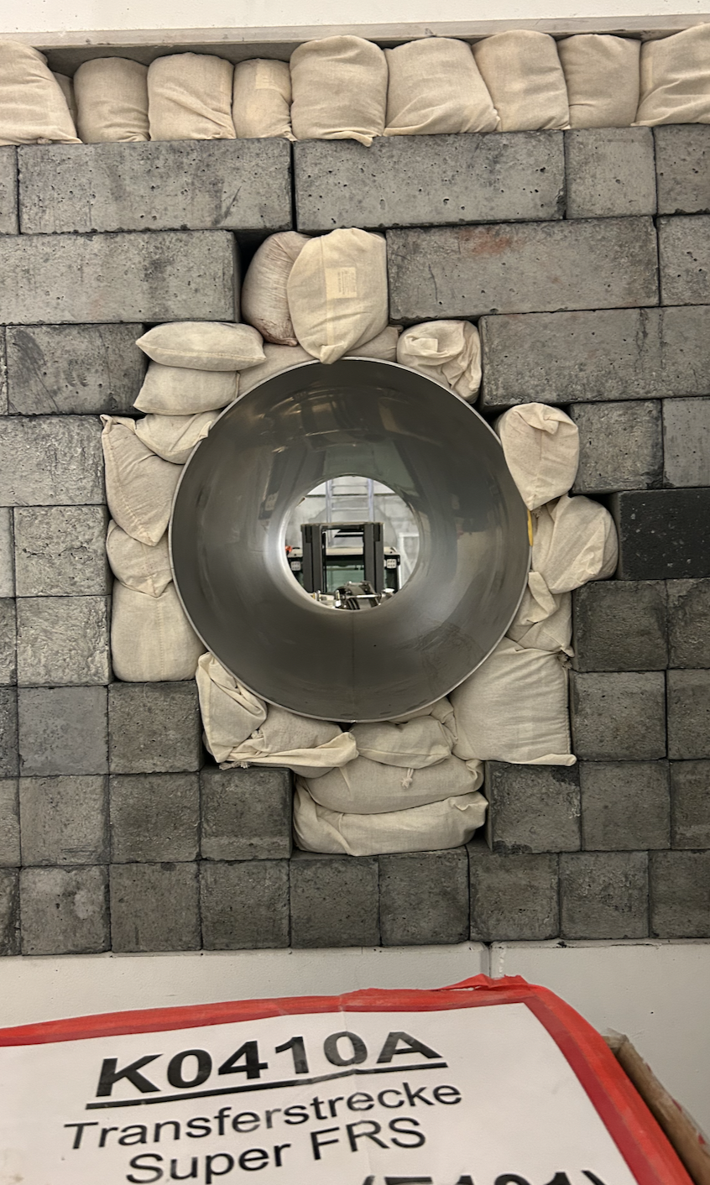
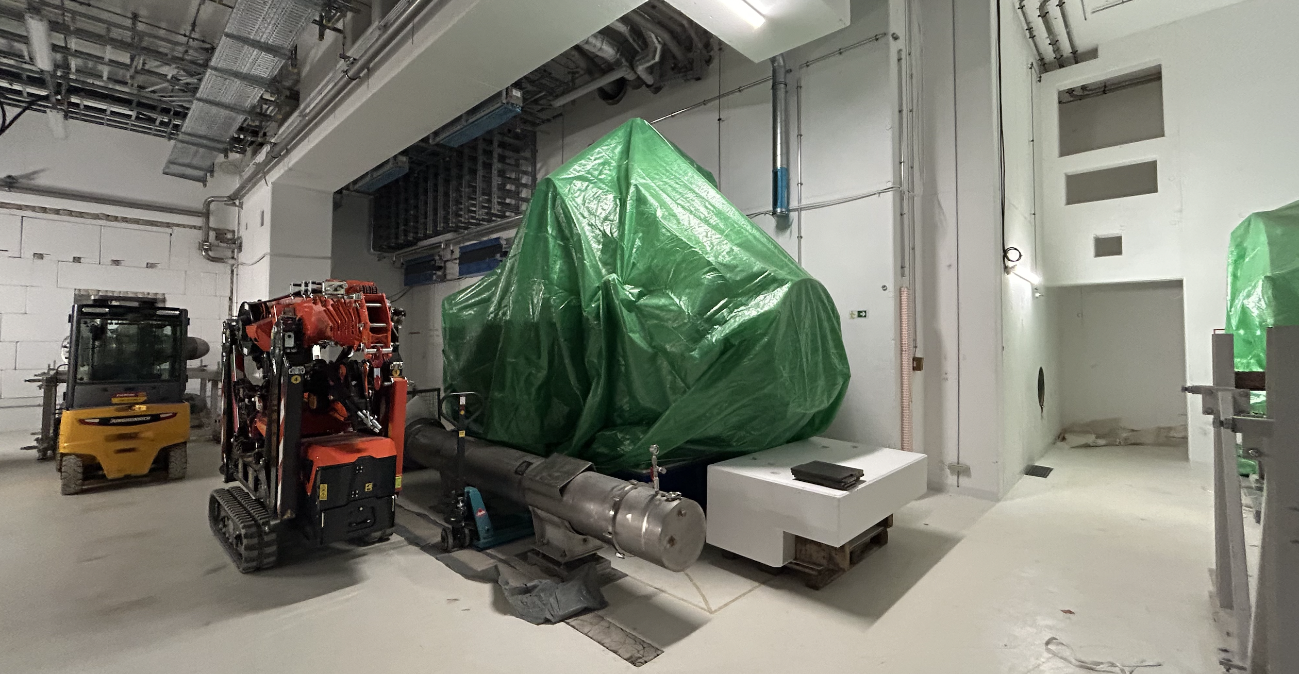
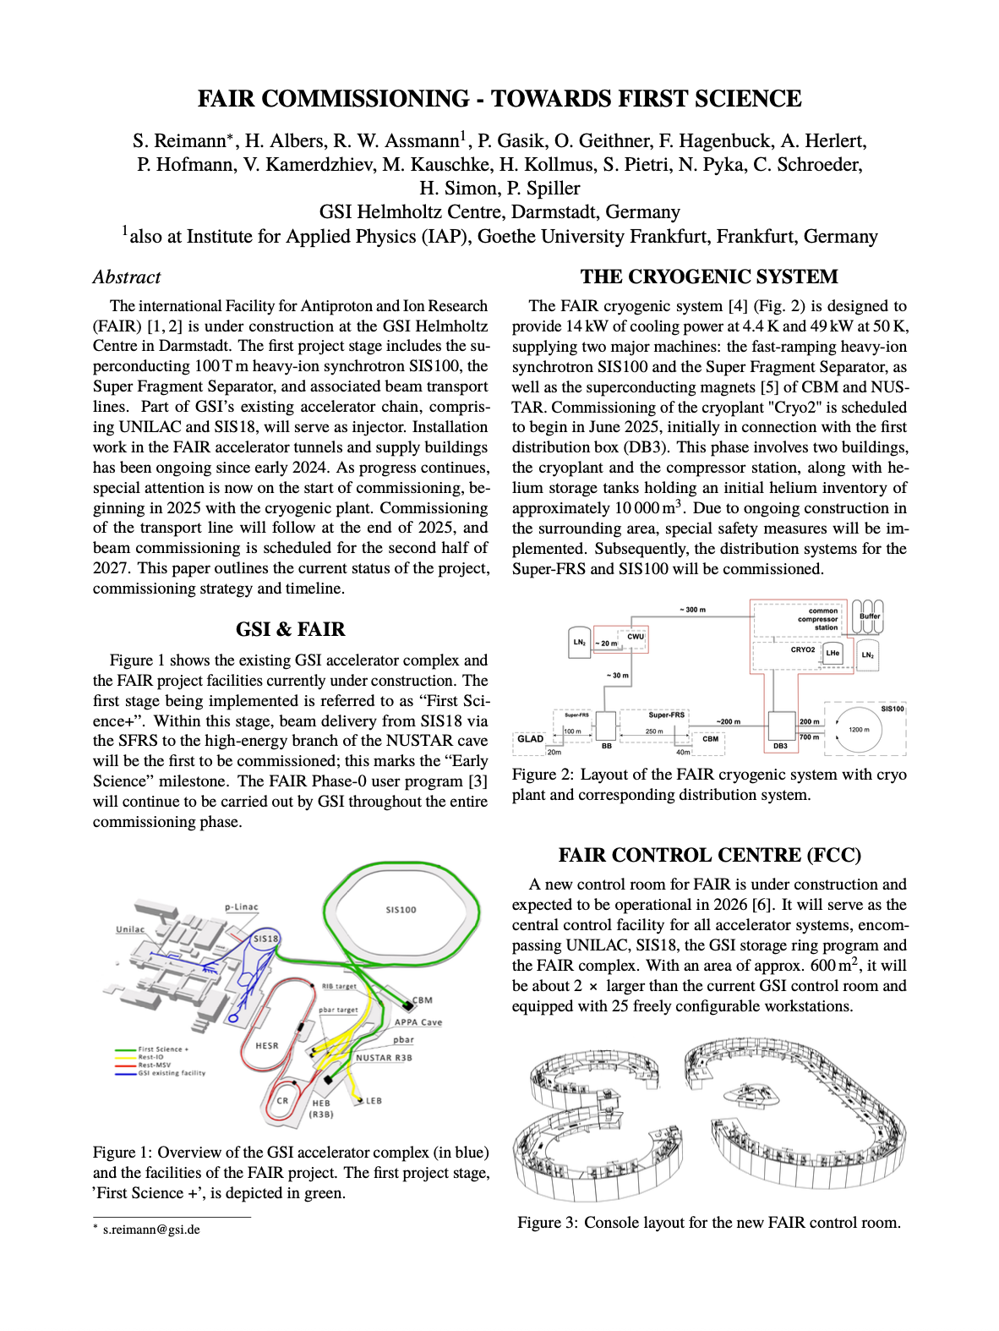
Thank you

