Slide 1




Evaluating Transport Models under Controlled Conditions
(lessons and future directions of TMEP)
Hermann Wolter
University of Munich, ORIGINS Excellence Cluster
(on behalf of TMEP collaboration)
EMMI workshop: Collective phenomena and the EOS of dense bayonic matter, GSI Garmstadt, Nov. 10-13, 2025

Slide 2
Outline:
Motivation: Increase impact of HIC studies on determination of the EOS,
in particular at suprasaturation densities
TMEP: Comparison of transport codes under controlled conditions
box calculations:
test individual ingredients, comparison to exact results,
discuss lessons learned: fluctuations
HIC: open systems, much less agreement,
explanations, but difficult to quantify model dependence
future direction of TMEP
addional box calculations: fluctuations, mom.dep. potentials, clusterization, SRC
Heavy-ion collisions (HICs) Uncertainty quantification:
Bayesian inference with many codes, BMA (Bayesian model averaging)
summary and outlook

Slide 3
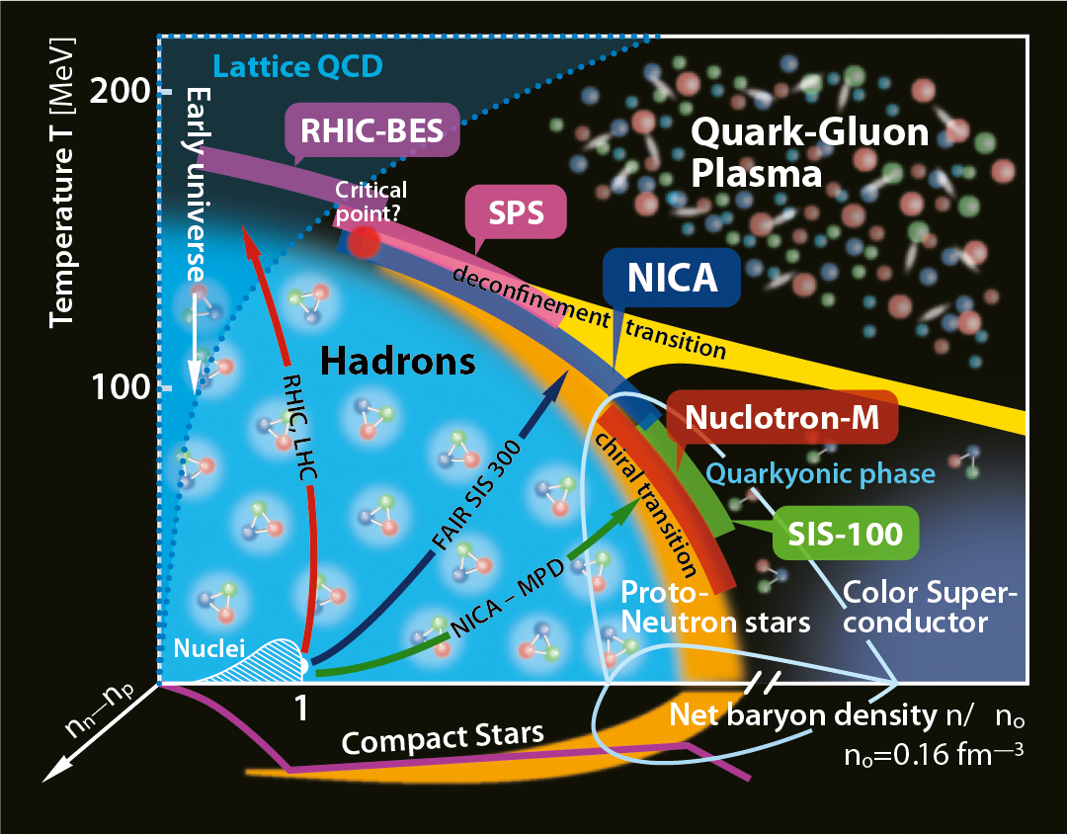
Motivation:
Importance of intermediate-energy heavy-ion collisions (HICs) for the exploration of equation-of-state (EOS)
as a fct. of density ρ, temp T, asymmetry β
→ filling the gap between information from nuclear structure (ρ≤ρ₀) and neutron star observations (ρ≥2.5 ρ₀)
SIS18,NSCL,RIKEN
-> HICs can make a contribution to constrain EOS
-> only astrophysics
-> xEFT, Astro and HICs (Huth, et al., Nature 602 (22)
-> structure, HICs and Astro (C.Y.Tsang, et al.,Nat.Astro 8 (24)
Core collapse
SN
Exotic nuclei
HICs are non-equilibrium
processes, theoretical
description complex,
but based on one code.
robustness of predictions is
an issue.
Tsang et al.

Slide 4
Model dependence of transport model results
non-equilibrium system-> non-equilibrium description, i.e. transport theory
Quantum transport theory (Kadanoff-Baym) complex -> semiclassical approx. (Boltzmann theory; molecular dynamics)
Example: Results of different codes on values and correlations between nuclear matter parameters
K₀, m*/m, F (reduction of in-medium cross section) using the same (FOPI) data (G.J. Wei, et al, arxiv 2509.03406)
K₀↔m*
K₀↔F
m*↔F
250 MeV/A
same data (FOPI, Au+Au),
regions of confidence
do not overlap
400 MeV/A
Increase robustness of conclusions: a) comparisons of transport codes in controlled conditions (TMEP)
b) not only compare but quantify uncertainty (Bayesian inference)

Slide 5
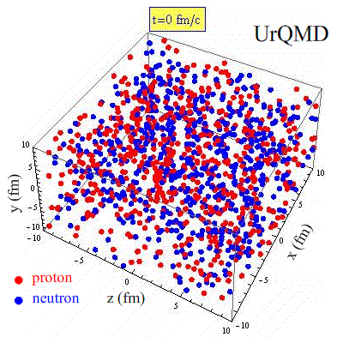
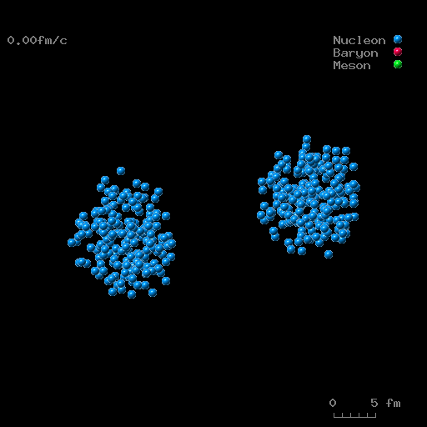
TMEP: compare different transport models und controlled conditions,
i.e. same physical model and similar calculational parameters .
but simplified physical model, no comp. to experiment
two modes of comparisons:
box calculations, periodic boundary conditions,
- simulates infinite nuclear matter,
- study individually different ingredients of physical model, compare to exact limits
- understand important aspects of transport
- always goes to equilibrium, may not say everything for dynamic HICs
2. Full heavy-ion collisions (HICs), compare codes between each other ,
- substantial differences , explanations, but not sufficient convergence
- systematic differences BUU-QMD
- open system, small differences may cause large change in evolution
BUU
QMD

Slide 6
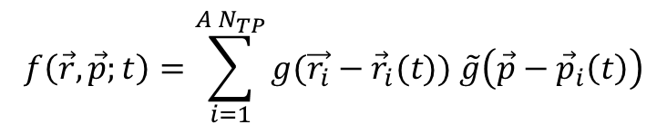


Box: Importance of Fluctuations:
transport equation (BUU)
$$\frac{Df(\vec{r}, \vec{p};t)}{dt}= I_{coll}\left(σ_{12→34}^{in−med};{1−f}_{i}\right)+ δI_{fluc}$$
(Vlasov) (dissipation) (fluctuation)
treatment of fluctuations:
BUU approach: Testparticles ; g TP shape, zero or finite size
N_{TP}→∞, deterministic, include flutuation term δ I_{fluc,} , ->Boltzmann-Langevin approach
N_{TP} finite, numerical fluctuations, can be gauged to physical effects, e.g. damping of collective phenomena
2. QMD approach: molecular dynamics for nucleons with finite-size wave packets:
width parameter L regulates fluctuations
event fluctuations
$$f\left(\vec{r},\vec{p};t\right)=\sum_{i=1}^{{A N}_{TP}}{g(\vec{r_{i}}}−{\vec{r}}_{i}(t)) \tilde{g}\left(\vec{p}−{\vec{p}}_{i}\left(t\right)\right)$$
$$f\left(\vec{r},\vec{p} ;t\right)={\left(\frac{ℏ}{\sqrt{L}}\right)}^{3}\sum_{i}{exp\left[−\frac{{(\vec{r}−{\vec{R}}_{i}\left(t\right))}^{2}}{2L}\right] δ(\vec{p}}−{\vec{P}}_{i}(t))$$
QMD event
different approximate approaches, influence results significantly
not clear, what is more realistic
in the end BUU and QMD should give the similar results for EOS from same data

Slide 7
Box: Importance of Fluctuations: effect on blocking
Test of collision intergral w/o mean field (only nucleons, with Pauli blocking, at T=5 MeV
( YX. Zhang, et al., PRC 97 (2018))
Fluctuations in occupation of final state occupation
exact: red
average: blue
effective ( enforce f≤1): black
Collision rates, compared to exact result:
disregard
Code simulations
exact result
BUU-type
QMD-type
Reason: Fluctuations in Pauli blocking factor (1-f)
generally underblocking (black ↔ red)
systematic diffrence in BUU and QMD
larger fluctuations in QMD, smaller effective occupation

Slide 8
Box: importance of fluctuations: example of blocking term in QMD
Study of dependence of fluctuations in QMD
X. Chen,...,YX. Zhang, A novel Pauli blocking method in quantum molecular dynamics type models,
Phys.Rev.C 109, L021604 (2024) and NuSYM2025
new: av. over all
momentum states
standard
Increase of in-med Xsec
to fit vartl with new PB
-> up to factors of about 2!

Slide 9
Box: importance of fluctuations: influence on mean field propagation
Test of mean field evolution w/o collisions (M. Colonna, et al., PRC104 (2021))
evolution of a standing wave
Force averaged in cells at initial time
strength function, power spectrum:
SMF
ImQMD
BUU-type
BUU type; horizontal lines exact results from Landau theory
disregard red curves
(black) approx. eval. of ρ^{γ} term
(red) better eval. of ρ^{γ} term
lattice Hamiltonian appraoch
QMD codes: broadening (larger fluctuations)

Slide 10
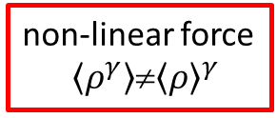
Box: evaluation of mf terms: non-linear forces
Non-linear mean field evolution (M. Colonna, et al., PRC104 (2021))
evolution of a standing wave
Force averaged in cells at initial time
non-linear force
$\left\langle ρ^{γ}\right\rangle$≠${\left\langle ρ\right\rangle }^{γ}$
strength function, power spectrum:
horizontal lines:exact results from Landau theory
SMF
ImQMD
(black) approx. eval. of ρ^{γ} term
(red) better eval. of ρ^{γ} term
lattice Hamiltonian appraoch
QMD codes: shift (from approximation to ρ^{γ} term)
broadening (larger fluctuations)

Slide 11
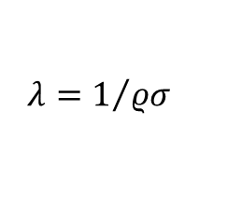

Box: Collision Probability and Memory Effects
collision term (elastic)
collision probablilty
Pauli blocking (see above)
more general: I_{coll}→𝐼_{𝑒𝑙} (𝑁𝑁↔𝑁𝑁)+𝐼_{𝑖𝑛𝑒𝑙} (𝑁𝑁↔𝑁Δ)+𝐼_{𝑑𝑒𝑐𝑎𝑦} (Δ↔𝑁𝜋)
In kinetic theory collision term Markovian, i.e. collisions are not correlated.
In simulations the collision probability is treated by two methods
1. geometric criterion: two particles can collide if the distance is within the range given by the total cross section
in a timestep.
2. statistical criterion: assure that mean free path satisfies
particles are chosen randomly in a cell and their collision proapility is
$$λ=1/{ρσ}$$
$$P_{ij}\left(Δt\right)≈ρσv_{ij}Δt$$
N_{i}
N_{i}
N_{i}
method 1 has to be supplemented to avoid repeated collisions by the same particles
in subsequent steps. However, higher order correlations may occur,
e.g. in an inelastic collisions with an intermediate interaction with a third particle.
other effects may be due to the order in which elastic, inelastic and decay processes
are treated. This was found to influence π and Δ multiplicities
N_{j}
N_{j}
N_{j}

Slide 12
Box 2: collision probability and memory effects
test of pion production in a box w/o Pauli blocking, cascade (A. Ono, et al., PRC 100 (2019) )
extrapolation to time step zero
multiplicities and multiplicity ratios (relative difference to exact result)
determines
π−/π+ ratio
in a HIC
Understanding differences:
- correlations between collisions (non-Markovian behavior)
- geometric criterion induces correlations
- strategies in handling sequence of elastic and inelastic collisions
- Cancel rather well in ratios in a box
- statistical prescription (e.g. pBUU) works very well in box
disregard
Code simulations
exact result

Slide 13
Box calculations: lessons
fluctuations affect evolution of HIC substantially:
less effective blocking, force calculation in mf propagation
memory effects
Simulations using geometrical criteria for the collision probility induce correlations,
cannot be completely eliminated, and are very dependent on strategies in the collision term
Have an effect on multiplicities of secondary particles
but perhaps strict Markovian behavior is an idealization?
other effects (not yet studied in box calculation):
fluctuations are seeds for cluster correlations and light cluster production
(also for fragment formation)
-> important insights into transport smulations from box calculations
concern major open problem in treatment of HICs

Slide 14
Comparison of HICs: open system
Sn+Sn@270 MeV/A (J. Xu, et al., PRC 109, 044609 (2024))
controlled input: common initializ., simple mom.-indep. EOS, σ_{el}=const, NN↔NΔ, Δ↔ Nπ
pion multiplicities
side-ward flow
inelastic reaction rates NN→NΔ
density evolution
correspondingly different stoppîng and flow
BUU codes have stronger flow
inelastic reaction rates are correspondingly weaker in BUU
nucleon evolution not identical,
BUU codes have lower density
fluctuations, approx. in non-linear term in QMD, weaker repulsion
pion multiplicities
(w and w/o Pauli and Coulomb)
generally lower for BUU
Conclusion: differences in the evolution of the system, leads to difference in pion observables
HIC are open systems: small differences can propagate and lead to larger final results, ingrediens interact (unlike in box)
But differences can be understood

Slide 15
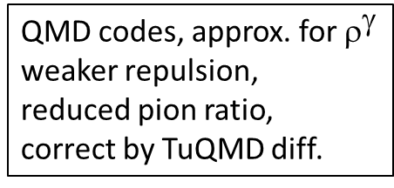
Look closer at charged pion ratio, assumed to be a good probe for the symmetry energy
Qualitative !!
correct approximately for this effect
(stars)
π, Δ feel
symmetry
energy
not comparble
agreement w/o Pauli-blocking very good
with Pauli-blocking differences <≈ 10%
(remaining differences due to Pauli blocking surface correction)
QMD codes, approx. for $^{}$
weaker repulsion,
reduced pion ratio,
correct by TuQMD diff.
Thus, can explain differences, but how to quantify uncertainties

Slide 16
Intermediate conclusion for code comparisons:
box calculation:
we learn a lot about simulations of transport codes
in particular we discussed the importance of fluctuations and of memory effects
we can compare to exact limits, and in most cases satisfy these or understand deviations
box calculations test equilibrium conditions, but not dynamic properties
HICs:
we find considerable differences, which we can mostly explain. residual differences are < 10%
but we cannot eliminate them, and it is not clear, what is best.
open systems, surface effects
uncertainty estimates between code are difficult
one probably should go beyond mere comparisons of codes
ideas of future projects for TMEP:
further box calculations to test some more critical ingredients of transport
HIC: uncertainty quantification

Slide 17
Further box comparisons:
momentum dependence of the potentials, pre-requisite for a realistic description of HICs
on-going study (Dan Cozma) including pion degrees-of-freedom
compare to thermal model (equilibrium)
results: mom.-dependence changes results substantially, threshold effects
non-resonant pion production important at low pion energies
mom.dep. of Δ pot.
threshold effects
2. fluctuations in a box.
exact limits from Laundau theory in the small amplitude limit
insights on the different approaches of BUU and QMD on fluctuations
3. clusterization
compare perturbative (coalescence) and dynamic (light cluster as explicit degrees of freedom) approaches
medium effects on clusters (Mott effect)
τ=p,n
ν≡d,t,h,α

Slide 18
Heavy-ion collisions: Uncertainty quantification of transport results
go beyond mere comparisons
try to quantify uncertainty of results not only from a single code, but from several codes,
- no exact results, use experiment as a reference
comparative Bayesian inference
sketch possible steps and requirements

Slide 19
Bayesian inference with realistic models: steps
1. Collect codes, that have all the physical ingredients for a realistic description of intermediate energy HIC,
mom.-dependence, symmetry energy, effective masses and n/p mass differences, medium modifications of Xsecs
physical models not necessarily identical parametrization,but should allow to vary the physical properties
BUU and QMD codes (if possible also BL and AMD),
not necessarily very many, but willing to make modifications
2. codes should satisfy benchmark calculations in box simulations
3. Select observables sensitive to the EOS and dynamical properties
sufficiently complete data should exist, which include stopping and flow as functions of (y,p_{T})
for a suffiently large range of energies to allow to asses a range of densities and several systems (asymmetry effects)
one could start with a subset of data and with a smaller set of parameters and expand subsequently,
4. Each code makes a Bayesian inference on the given set of data.
obtains probability density distributions (PDFs) for the chosen EOS properties.
sensitivity of the chosen EOS properties to data given by width of marginalized PDFs
could be published individually for each code

Slide 20
Bayesian Inference: posterior Probability Distributions Functions (PDFs)
Example: Extensive Bayesian inference by Dan Cozma with the code dcQMD using FOPI, FOPI-LAND, ASY-EOS, and SpiRIT data on flow (v₁, v₂, varxz, y and p_{T}-spectra, and stopping: D . Cozma, arXiv 2407.16411, PRC 110 (2024)
PDFs for EOS parameters using different data sets
The PDFs are strongy influenced by the choice of the data.
The width of the PDF give the intra-model uncertainty of the parameters by the given data.
Narrow PDFs signify a strongly constraining observable for the respective parameter, thus the sensitivity of an observable.
This is important information, but is derived from only one code, i.e. is model dependent.

Slide 21
Comparative Baysian inference (Bayesian Model Averaging, BMA):
PDFs of different codes are compared
they are combined in a Bayesian model averaging (BMA) with weights,
which depend on the goodness of the optimal fit
the averaged PDFs give the result of transport anlyses on the EOS as a whole and its uncertainty
Example from nuclear structure (M. Qiu,..,Z.Zhang, PLB849, 183435 (24))
BMA for the inference from data of
proton-neutron chemical potential differences Δμ_{pn}* on the symmetry energy at density E_{sym}(2/3 ρ₀) for two models Skyrme and RMF
width of BMA gives
uncertainty of E_{sym}(2/3ρ₀)
taking into account two
structure models

Slide 22
Comparative Baysian analysis: Observables
primary observables, that determine the bulk properties of matter: nucleonic (n,p,LC)
complete: flow, stopping (y, p_{T}; asymetry δ, density ρ)
understand and control first
secondary observables: pionic (π,Δ), strange (K,Λ) depend strongly on bulk description,
reasonably complete similar as nucleonic data,
avoid ratios or double ratios, reduce sensitivity
issues:
π,Δ potentials, momentum dependent
resonant, non-resonant π production mechanism (Cozma)
anti-strange mesons are good messenger of the dense phase

Slide 23
Summary and outlook
TMEP project to evaluate codes by comparison of results with unified input
1. box calculations, comparison to exact equilibrium results
- learn much about critical aspects of transport simulations
- particular important: role of fluctuations
- future box studies: fluctuations, momentum dependence, clusterization, short-range correlations
2. HICs, comparison between codes
- differences in open systems
- possible to explain difference, residual difference estimated <10%
- not possible to quantify model dependence
3. one possible way to go: Comparative Bayesian inference
- realistic models, „complete“ as possible set of data, Bayesian inference for each code
- Baysian model averaging with weight, depending on quality of universal fit
→ uncertainty due to model dependence
other possible way: develop common modular code in a community effort (EMMI?)
Establish HICs as an indispensible way to constrain the EOS
Thank you for your attention

