Slide 1



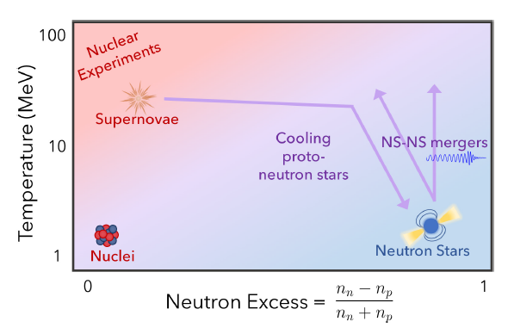
Neutron Star Radii from Laboratory Experiments
W. Trautmann
GSI Helmholtzzentrum Darmstadt
EMMI Workshop:
Collective phenomena and the equation-of-state of dense baryonic matter
GSI Darmstadt, November 10-13, 2025

Slide 2
Neutron Star Radii from Laboratory Experiments
Fig. 1 in Cozma/Trautmann, IJMPE 34, 2530001 (2025)
figure taken from Raithel, Özel and Psaltis, ApJ 875:12 (2019)
“Finite-temperature Extension for Cold Neutron Star Equations of State”
2

Slide 3
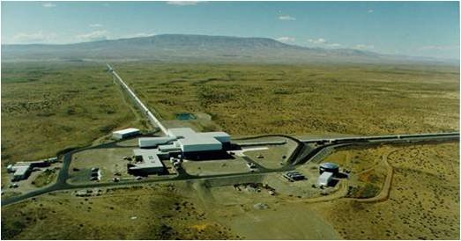
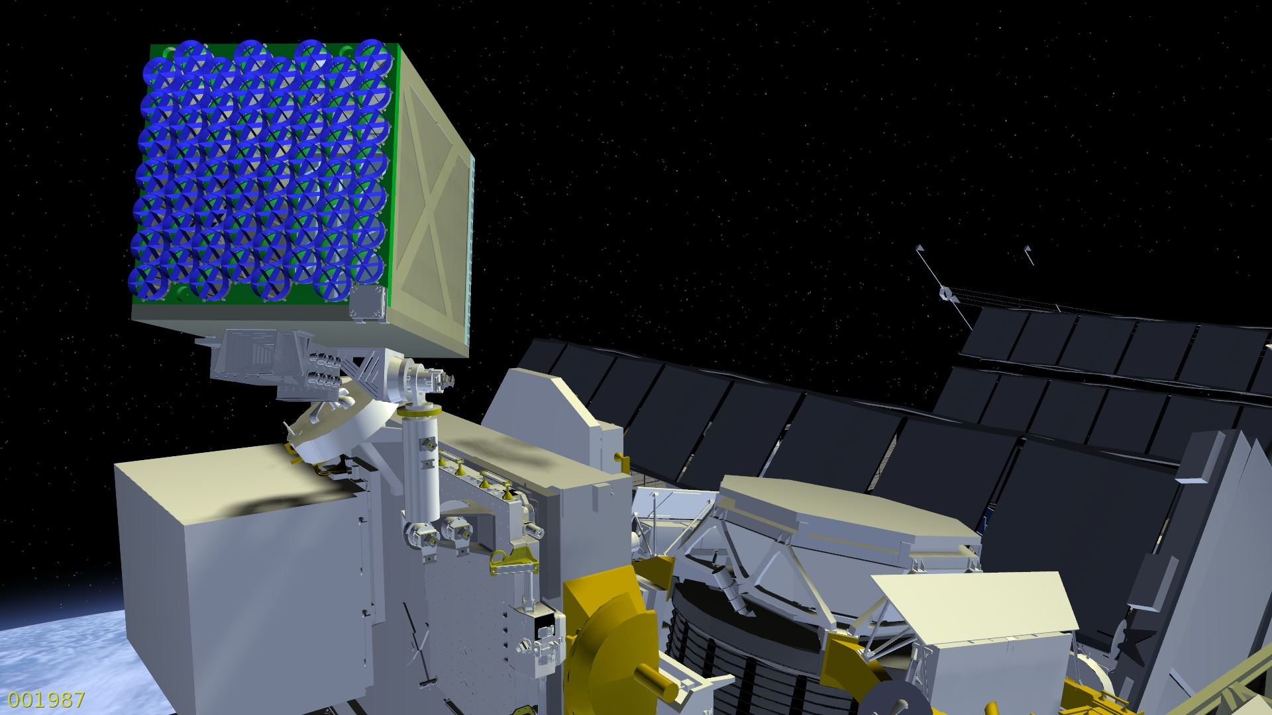
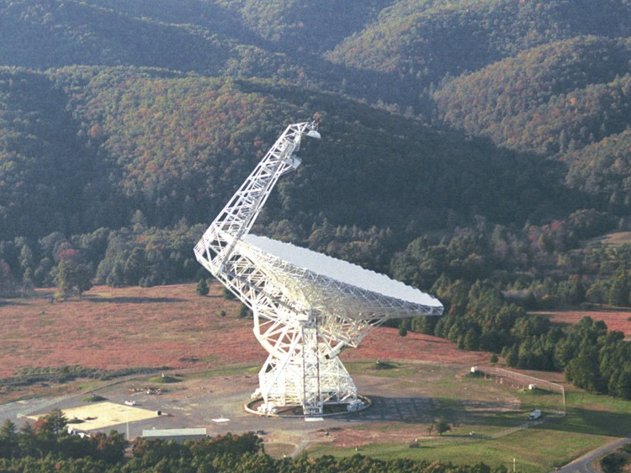
LIGO Hanford observatory
LIGO Hanford observatory
NICER
on the ISS
in 2017
https://www.researchgate.net/
publication/224254006
Neutron Star Interior Composition Explorer
https://heasarc.gsfc.nasa.gov/docs/nicer/
GW170817
Green Bank Telescope
820-1400 MHz
tidal deformation modulates
inspiral frequencies
500 Hz
B.P. Abbott et al., LIGO and Virgo Collab.
The Astrophys. J. Letters, 848:L12 (2017)
Alleghenny mountains, Virginia
source: NRAO/AUI, CC BY 3.0
Notes:
GW170817 at distamce 40Mpc 1pc=3.3 Ly

Slide 4
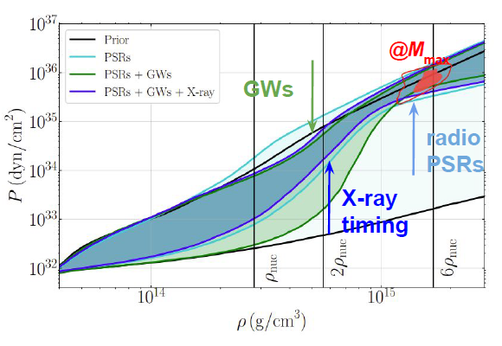
Reed Essick at NuSym22 in Catania
Legred+, PRD 104,
063003 (2021)
50%/90% contours
90% shadings
model-agnostic prior
10²⁸ bar
red contours give pressure and density
in the center of a maximum-mass neutron star
4
Notes:
50% and 90% level contours; PSR (Pulsating Source of Radio): most important: we know the mass to 3%

Slide 5
Nuclear Equation of State well known at high density
Fig. 2 in IJMPE 34
Legred+, PRD 104,
063003 (2021)
50%/90% contours
90% shadings
model-agnostic prior
R_{1.4} = 12.6 ± 1.1 km (90%)
10²⁹ bar
magenta contours give the 50% and 90% level of the central pressure-density
posterior for PSR J0740 + 6620 inferred from all available data
(PSR J0740 + 6620: 2.08 ± 0.08 M_{O}, R = 12.8 ^{+1.5} _{-1.0} km (Dittmann+ 2024), 1.14 kpc)
5
Notes:
use NICER data of Miller and Riley published on September 10, 2021; Dittmann is from the Maryland group

Slide 6
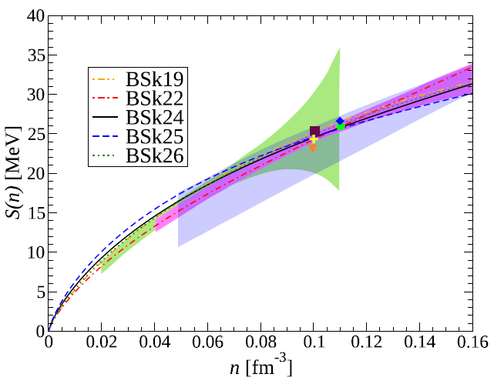
Nuclear Equation of State well known below saturation density
Fig. 3 in IJMPE 34
Perot+, PRC 100,
035801 (2019)
Brussels-Montreal functionals
shadings:
isospin diffusion
Tsang+ PRL (2009)
isobaric analog states
and neutron skin
Danielewicz and Lee
NPA (2014)
electric dipole polarizability
in ²⁰⁸Pb
Zhang and Chen PRC (2014)
data symbols:
giant resonances
binding energies,
separation energies,
radii
five data point at known density:
χ²-analysis: E_{sym}(0.10 ρ₀)=24.8±0.5 MeV
6
Notes:
calculated in the framework of the nuclear energy-density functional theory, fitted to essentially all experimental atomic mass data
BSk19 BSk21 fitted to realistic neutron-matter EoSs, BSk22, BSk24, and BSk25 mainly differ in their predictions for the symmetry energy

Slide 7
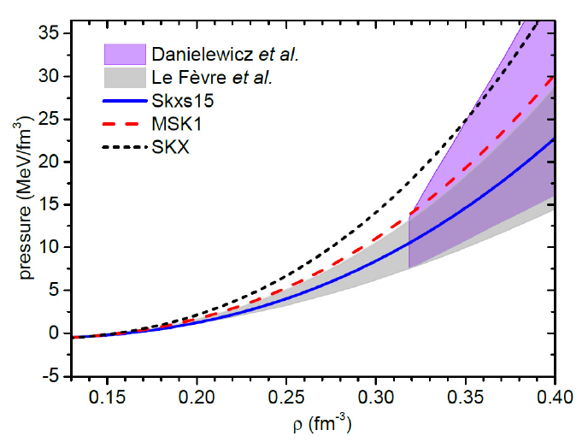
Symmetric matter EoS from collective flows
Fig. 4 in IJMPE 34
figure from
Yongjia Wang+, PLB 778,
207 (2018)
Danielewicz+
Science (2002)
Le Fèvre+
NPA 945 (2016)
K₀ = 190 ± 30 MeV
(FOPI data)
Yongjia Wang+
K₀ = 220 ± 40 MeV
(FOPI data)
M.N. Harakeh at EuNPC 2025: K₀ = 230 MeV
“Isoscalar electric giant resonances: Compression modes and nuclear incompressibility”
7
Notes:
IQMD: Skyrme +Yukawa +V_{mdi} +V_{sym} +V_{Coul} (4 options S, SM, H, HM) K₀ = 190±30 MeV
UrQMD: 3 Skyrme forces Skxs15, MSK1, and SKX (similar S₀, L, different K₀) K₀ = 220±40 MeV

Slide 8
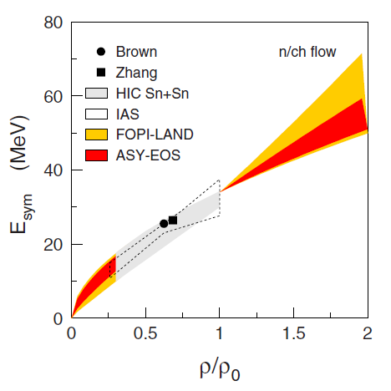
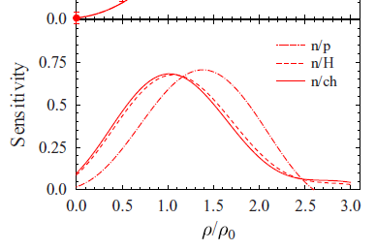
ASY-EOS: neutron vs charged-particle elliptic-flow ratios
Fig. 8 in IJMPE 34
studied reaction
¹⁹⁷Au + ¹⁹⁷Au @ 400 A MeV
P. Russotto+ PRC 94, 034608 (2016)
sensitivity to density (TüQMD)
n/ch n/p
UrQMD: L=72±13 MeV
density probed extends to 2.5 ρ₀
maximum near saturation density
E_{sym}(ρ₀) = 34 MeV => L= 72±13 MeV
E_{sym}(ρ₀) = 31 MeV => L= 63±11 MeV
8

Slide 9
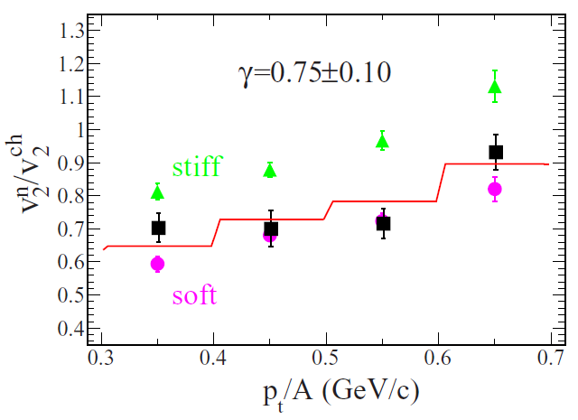
ASY-EOS: data and transport-model analysis
Fig. 7 in IJMPE 34
stiff γ = 1.5
soft γ = 0.5
dependence on transport model ?
dependence on S₀ ?
parametrization used in UrQMD analysis:
E_{sym} (ρ₀)-12 MeV
9

Slide 10
Huth et al., Nature 606 (2022): χEFT prior + HIC + astro
Fig. 1
neutron star
matter
contours at
68% and 95%
credibility
68%, 95%
prior:
χEFT up to 1.5 ρ₀
c_{s} extension
M_{max} ≥1.9 M_{sun}
astro:
GW170817
+kilonova
GW190425
NICER 2 stars
XMM-Newton
M_{max} ≤2.17 M_{sun}
HIC:
PNM: ASY-EOS
SNM: FOPI, AGS
10
Notes:
upper limit of neutron star mass: Rezzolla+ 2.16 and Margalit&Metzger 2.17 Msun

Slide 11
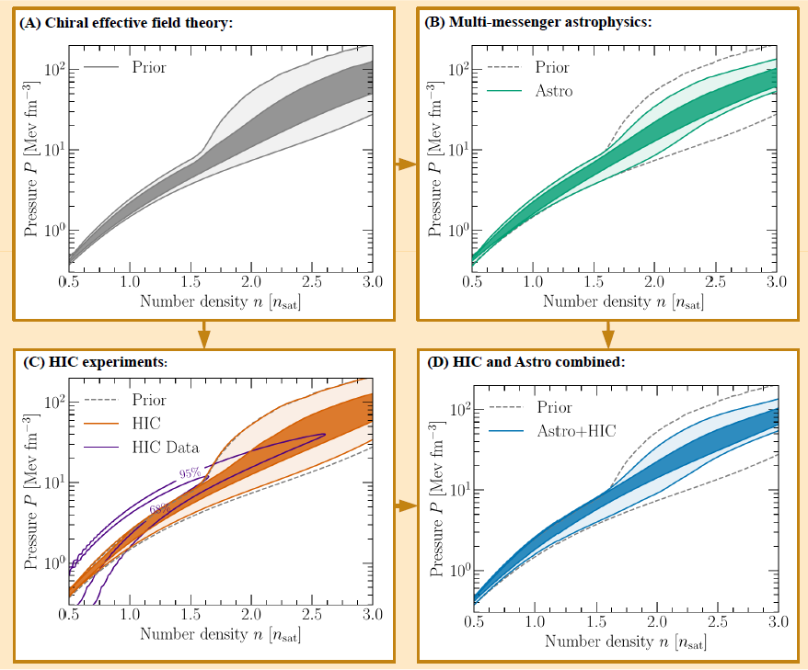
Prior in Huth et al.
Fig. 1
neutron star
matter
contours at
68% and 95%
credibility
χEFT -> 1.5 ρ₀
stability c_{s} > 0
causality c_{s} < c
segments
with c_{s} = 0
M_{max} ≥1.9 M_{sun}
11

Slide 12
Prior + HIC
Fig. 1
neutron star
matter
contours at
68% and 95%
credibility
12

Slide 13
Prior + HIC + astro
Fig. 11 in IJMPE 34
Fig. 1
neutron star
matter
contours at
68% and 95%
credibility
Physics Today June 2022:
Measurements of heavy-ion collisions predict properties of neutron stars
that are consistent with those informed by astrophysical observations.
13

Slide 14
Nuclear Equation of State: inconsistencies near saturation
Fig. 10 in IJMPE 34 M.D. Cozma, PRC 110, 064911 (2024)
Huth+
Legred+ (2021)
C.Y. Tsang+, Nature Astronomy 8, 328 (2024).
14
Notes:
finds that dependence of in-medium elastic cross-sections on isospin asymmetry has a nonnegligible impact

Slide 15
INT Workshop, Seattle, December 2022
review paper:
Sorensen et al., PPNP 134 (2024) 104080
Huth, Pang et al., Nature 606
prior from χEFT up to 1.5 ρ₀
posterior (95%) from HIC and astro
R_{1.4} = 12.0 ± 0.8 km (95%)
Legred+, PRD 104 (2021)
agnostic prior with astro
R_{1.4} = 12.6 ± 1.1 km (90%)
Drischler+, PRC 103 (2021)
χEFT with correlated truncation errors
Fig. 23
χEFT
15
Notes:
Drischler: correlated effective field theory truncation errors

Slide 16
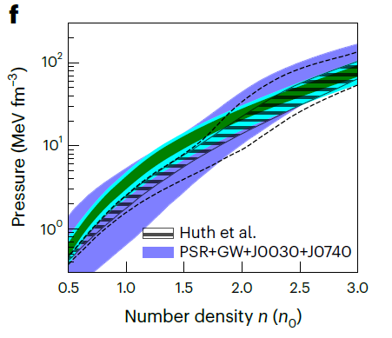
Tsang+, Nature Astronomy 8, 328 (2024)
Tsang, Tsang, Lynch et al.,
Nat Astron. (2024)
posterior (68%, 95%) from
(mainly) HIC and astro
R_{1.4} = 12.9 ± 0.5 km (68%)
Legred+, PRD 104 (2021)
agnostic prior with astro
R_{1.4} = 12.6 ± 1.1 km (68%)
Huth, Pang et al., Nature 606
prior from χEFT up to 1.5 ρ₀
posterior (95%) from HIC and astro
R_{1.4} = 12.0 ± 0.8 km (95%)
the prior makes the difference
16
Notes:
Drischler: correlated effective field theory truncation errors

Slide 17
Conclusion at this point
precise value for E_{sym}(ρ) at 2/3 ρ₀ from nuclear structure
EoS of neutron-star matter at high density well constrained by astro
inconsistencies at 1 – 2 ρ₀ depending on the chosen prior
need improvements of
knowledge of E_{sym}(ρ₀) and consistency of transport-model predictions
17

Slide 18
Sebastien Guillot at NuSym24
Choudhury+, Astrophys. J. Lett. 971, L20 (2024)
18

Slide 19

Sebastien Guillot at NuSym24
Choudhury+, Astrophys. J. Lett. 971, L20 (2024)
19

Slide 20
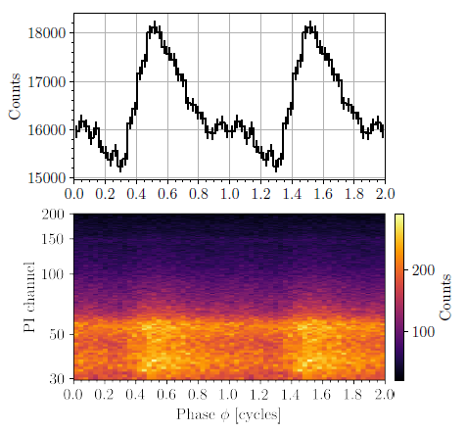
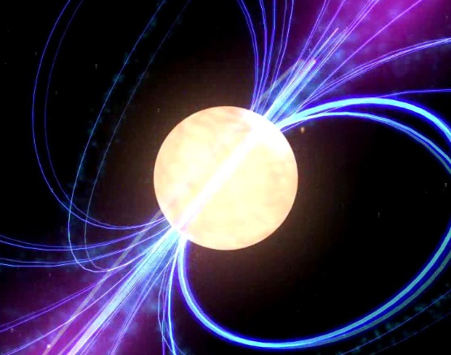
after submission
Mauviard+, arXiv:2506.14883 [astro-ph.HE] (2025)
equatorial hotspot
polar hotspot
PSR J0614-3329
distance 540 – 630 pc
mass 1.44 ± 0.07 M_{O}
radius 10.29 ^{+1.01} _{-0.86} km (68%)
emissions NOT as shown here
Reduced and phase-folded NICER event data
for PSR J0614−3329 duplicated over two
rotational cycles for visualization purpose
(PI channel gives X-ray energy 0.3 – 2.0 keV).
20
Notes:
The top panel displays the 0.3−2.0 keV bolometric pulse profile with its associated Poisson uncertainty.
The bottom panel shows the energy resolved pulse profile.

Slide 21
after submission: from NICER
Mauviard+, arXiv:2506.14883 [astro-ph.HE] (2025)
equatorial hotspot
polar hotspot
PSR J0614-3329
distance 540 – 630 pc
mass 1.44 ± 0.07 M_{O}
the models:
ST-U: 9.1 ± 0.7 km
ST+PDT 10.2 ^{+1.0} _{-0.9} km
PDT-U 10.9 ^{+1.1} _{-1.0} km
best model
ST+PDT 10.29 ^{+1.01} _{-0.86} km
ST Single Temperature
U Unshared
PDT Protruding Double Temperature
radius 10.29 ^{+1.01} _{-0.86} km (68%)
Reduced and phase-folded NICER event data
for PSR J0614−3329 duplicated over two
rotational cycles for visualization purpose
(PI channel gives X-ray energy 0.3 – 2.0 keV).
21
Notes:
The top panel displays the 0.3−2.0 keV bolometric pulse profile with its associated Poisson uncertainty.
The bottom panel shows the energy resolved pulse profile. „well known mass and seen edge on“

Slide 22
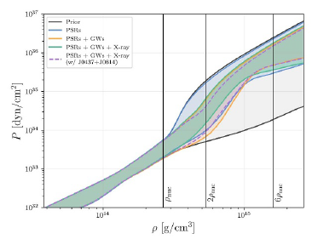
published October 17 2025:
Sunny Ng, Isaac Legred, Lami Suleiman, Philippe Landry, Lyla Traylor, Jocelyn Read
“Inferring the neutron star equation of state with nuclear-physics informed semiparametric models“ Class. Quantum Grav. 42 (2025) 205008
w/o two new stars
R_{1.4} =12.34 km
with two new stars
R_{1.4} =11.44 km
22

Slide 23
additional slides

Slide 24
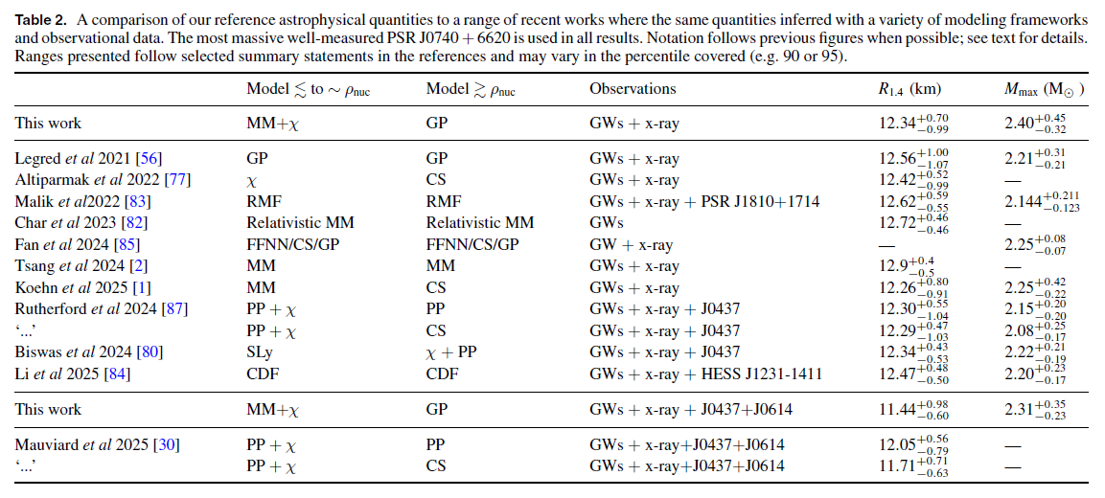
published October 17 2025:
Sunny Ng, Isaac Legred, Lami Suleiman, Philippe Landry, Lyla Traylor, Jocelyn Read
“Inferring the neutron star equation of state with nuclear-physics informed semiparametric models“ Class. Quantum Grav. 42 (2025) 205008
mean value of R1.4: ~12.45 km
mean upper limit of neutron star mass: ~2.2 M_{O}
Margalit&Metzger (2017) 2.17 M_{O} ; Rezzolla+ (2018) 2.16 M_{O}
24

Slide 25
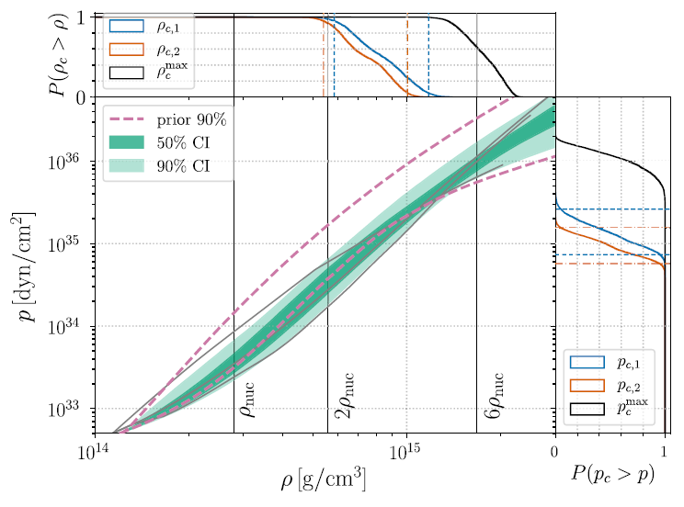
LIGO-Virgo: pressure vs density
GW170817
Abbott et al., PRL (2018)
LIGO & Virgo
tidal effects
of the coalescing bodies
10²⁹ bar
neutron star matter
25
Notes:
lines are EOS, middle line APR4 (1998) 10^36 is equal to 10^30 bar
sum of the two neutron star masses is 2.7 solar masses
„coherent Bayesian analysis“
Drischler: p(rho_0) = 2.8 MeV fm-3, p0 = 3.1 MeV fm-3, L = 58 MeV

Slide 26
SϖRIT at RIKEN: Estee+, PRL 126 (2021)
42 ≤ L ≤ 117
26

