Slide 1
Optimization of stimulated outgassing for particle accelerator vacuum components
Annual Workshop on Ion and Particle Beams 2025
Leon Kirsch, Markus Bender, Verena Velthaus
Notes:
Thank you for the introduction.
Good morning ladies and gentlemen
I‘m happy to present this talk about the:
Optimization of stimulated outgassing for particle accelerator vacuum components
I’m giving this talk on behalf of Markus Bender who cannot take part on this workshop.
I’ll talk about:
Dynamic vacuum in accelerators
A setup for the investigation of different stimuli
Thermal Desorption Spectroscopy (TDS)
Electron-induced desorption (ESD)
Ion-induced desorption (ISD) including theoretic
Conclusion: bulk mechanism understood
Outlook: surface optimization

Slide 2
Outline
Dynamic vacuum in accelerators
A setup for the investigation of different stimuli
Thermal Desorption Spectroscopy (TDS)
Electron-induced desorption (ESD)
Ion-induced desorption (ISD) including theoretic
Conclusion: bulk mechanism understood
Outlook: surface optimization
Notes:
Only a few phenomenologic observations

Slide 3
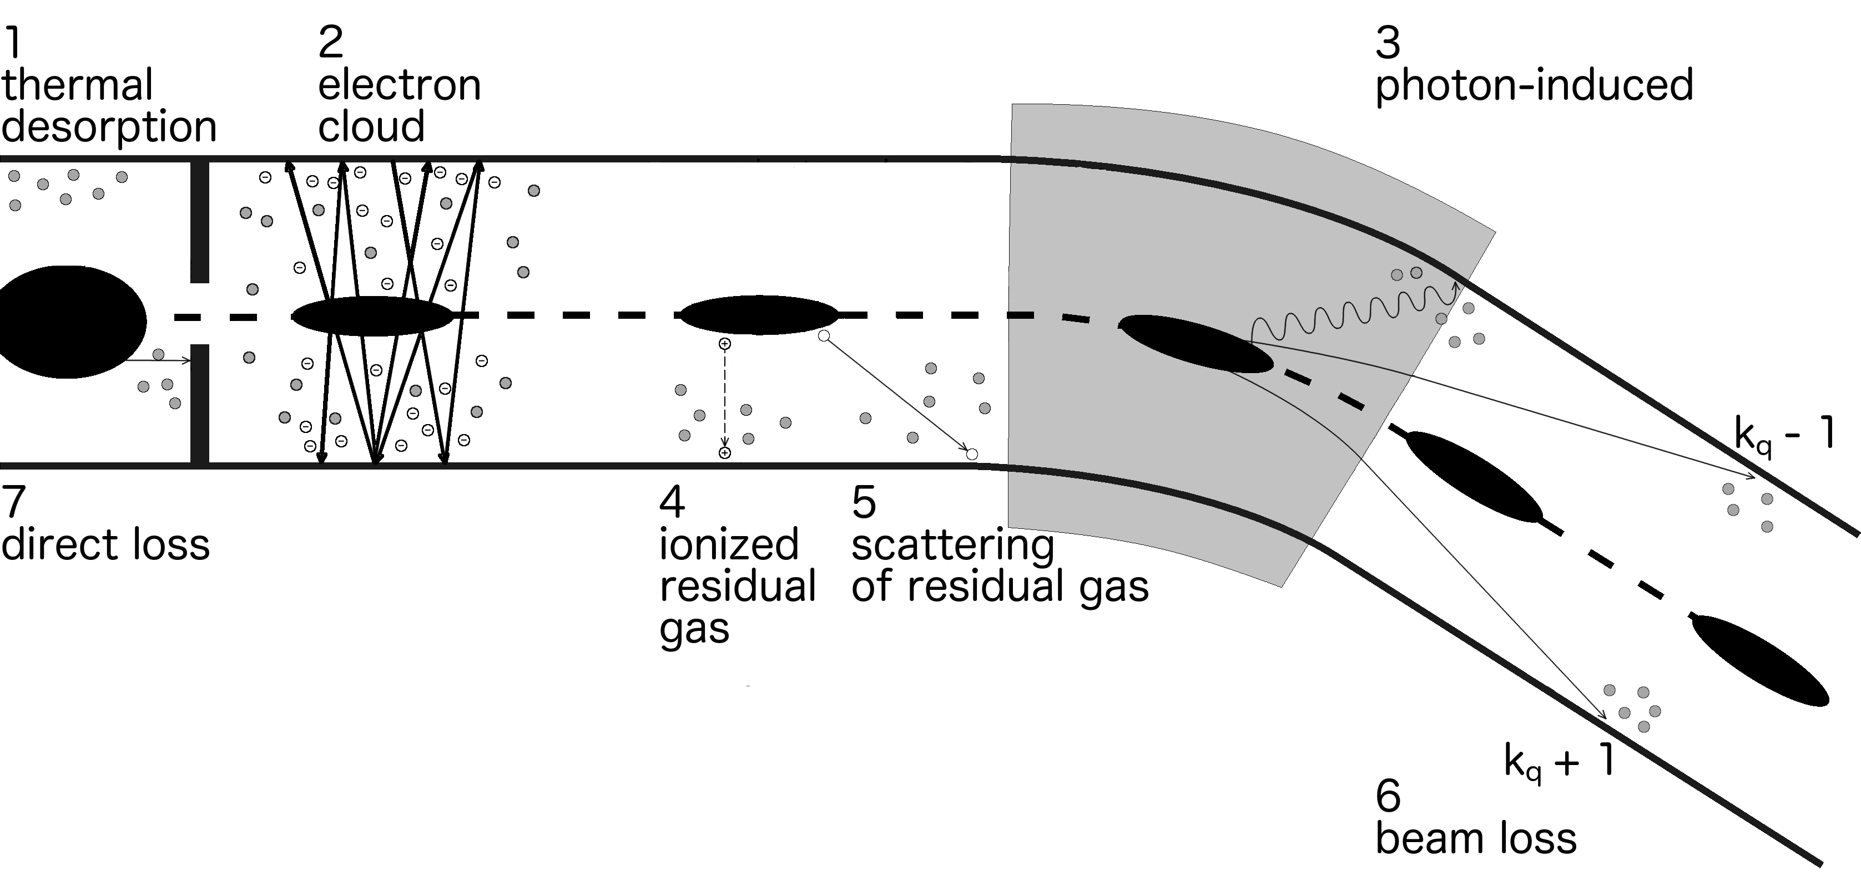
Dynamic vacuum in particle accelerators
M. Bender in O. B. Malyshev (ed.) „Vacuum in particle accelerators“
Notes:
Dynamic vacuum describes the different sources of gas introduction into a vacuum system under beam conditions
(self amplifying effect)
1 thermal desorption from beamline walls
2 electron cloud: Electrons from ionized residual gas, are accelerated towards the ion beam and collide with the vacuum tube. Result more electrons
3 photon induced desorption less prevalent in heavy ion synchrotorns due to low synchroton radiation
4 ionized residual gas is repelled towards the beamline
5 residual gas scattering
6 over or under charged particles are diverted into the beamline
All these effects are self enhancing

Slide 4
Impact & consequences
Any particle accelerator might suffer from beam-induced pressure instabilities:
  (1997): PSD studies V.V. Anashin et al., Vacuum 48 785 (1997)
  (1997): LEAR J. Bosser et al., Part. Accel. 63, 171 (1999)
  (1998): AGS-Booster S.Y. Zhang et al., EPAC 1998, 2149
  (2001): SIS18 A. Krämer et al., EPAC 2002, 2547
  (2002): RHIC → e⁻ - cloud W. Fischer et al., EPAC 2002, 1485
Upcoming accelerators require higher beam intensity:
  FAIR: some 10¹¹ U²⁸⁺ / s
  HIAF: 5 x 10¹¹ U and 4 x 10¹³ p / s
  Spiral2: 5 x 10¹⁴ intermediate heavy / s
Some have cryogenic surfaces
Reduce amount of desorbed gas
Reduce amount of available gas
Block outgassing channels
Notes:
These problems have been known for a long time in various accelerator facilities.
Important for future accelerators with high beam intensities!
Cryogenic structures in new accelerators present new challenges.
Goal: Reduce the amount of desorbed gas by lowering the amount of available gas and blocking outgassing channels

Slide 5
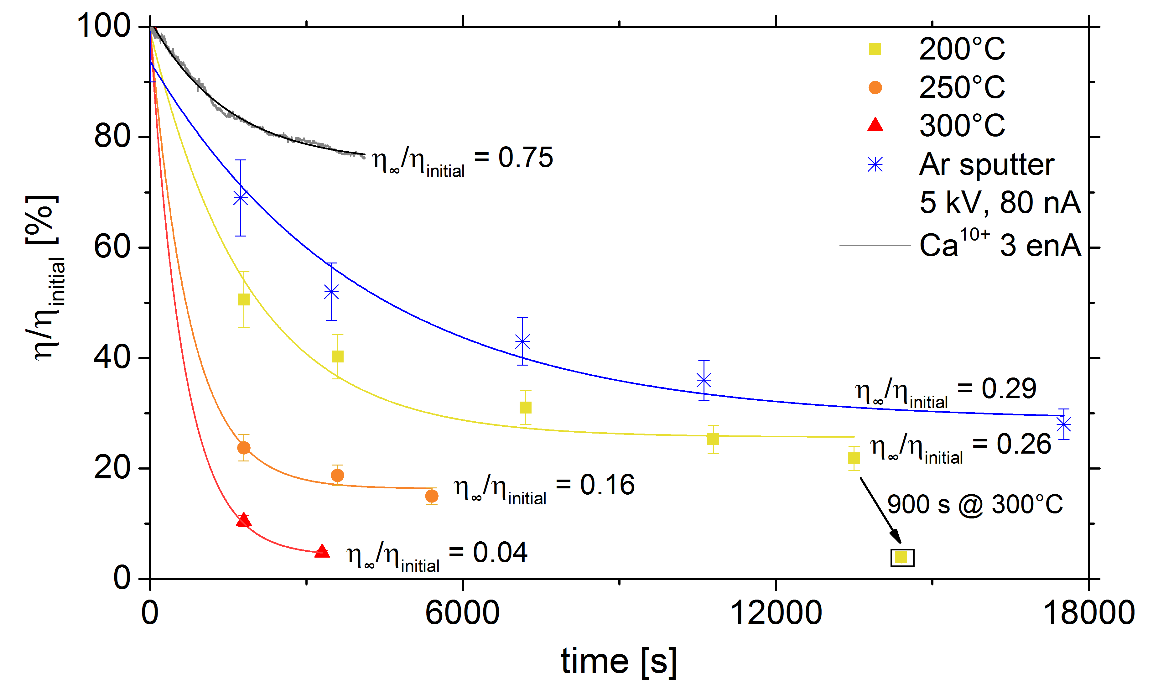
Conditioning to reduce desorption yields
Notes:
Therfore we tested and compared different conditioning procedureds.
Desorption yield: Desorbed ions per incident ion
Beam scrubbing.
keV sputtering
Thermal annealing
Higher temperatures can‘t be replaced by longer thermal annealing.
Consider cryogenic structures (can‘t always be annealed)

Slide 6
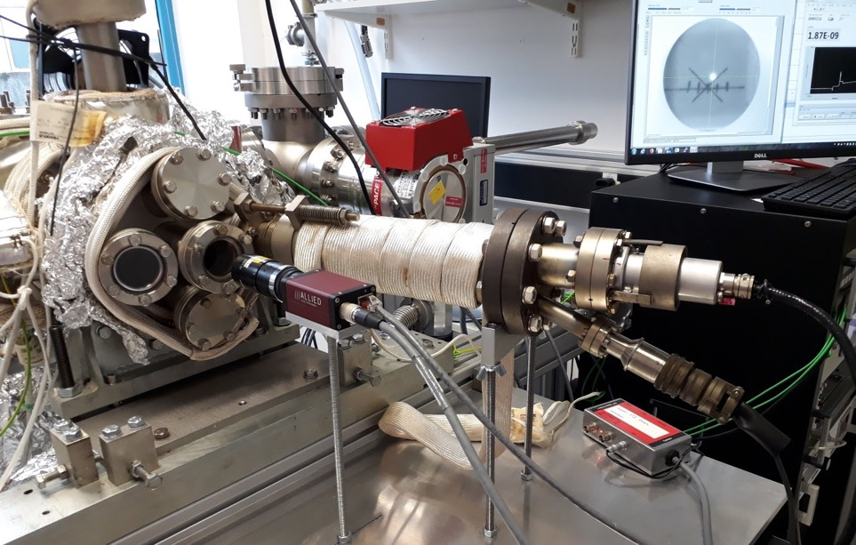
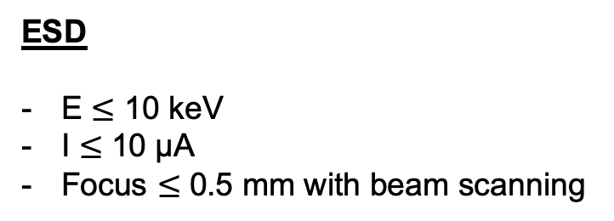
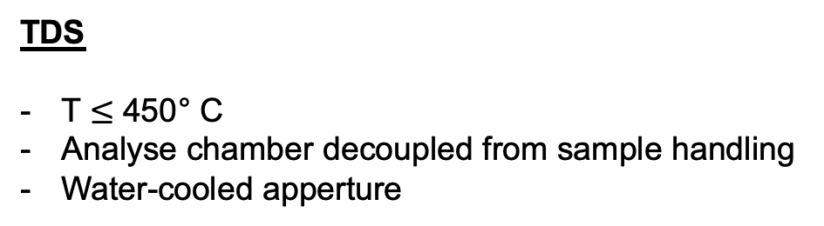
Understand processes → different stimuli
Vaccum diagnostic
Cooled apperture
Electron-gun
Flange or window
Sample →
← Accelerator
Cooling /Heating
keV-sputter-gun
Bypass-
valve
UHV-Pump
IZ, TSP
Turbo pump
TDS
T $≤$ 450° C
Analyse chamber decoupled from sample handling
Water-cooled apperture
ESD
E $≤$ 10 keV
I $≤$ 10 µA
Focus $≤$ 0.5 mm with beam scanning
Notes:
Thermal desorption setup: build to understand different stimuli
1E-11 mbar
heating up to 450C (almost half the melting temperature of copper)
Cooled aperture: isolating the outgassing to the sample
Various devices: Electron gun, keV sputter gun, accelerator
400 Samples
Different materials
varying surface treatments and coatings
Thermal desorption spectroscopy was conducted up to 450C
Electron induced desorption spectroscopy up to 10 keV and 10 uA

Slide 7
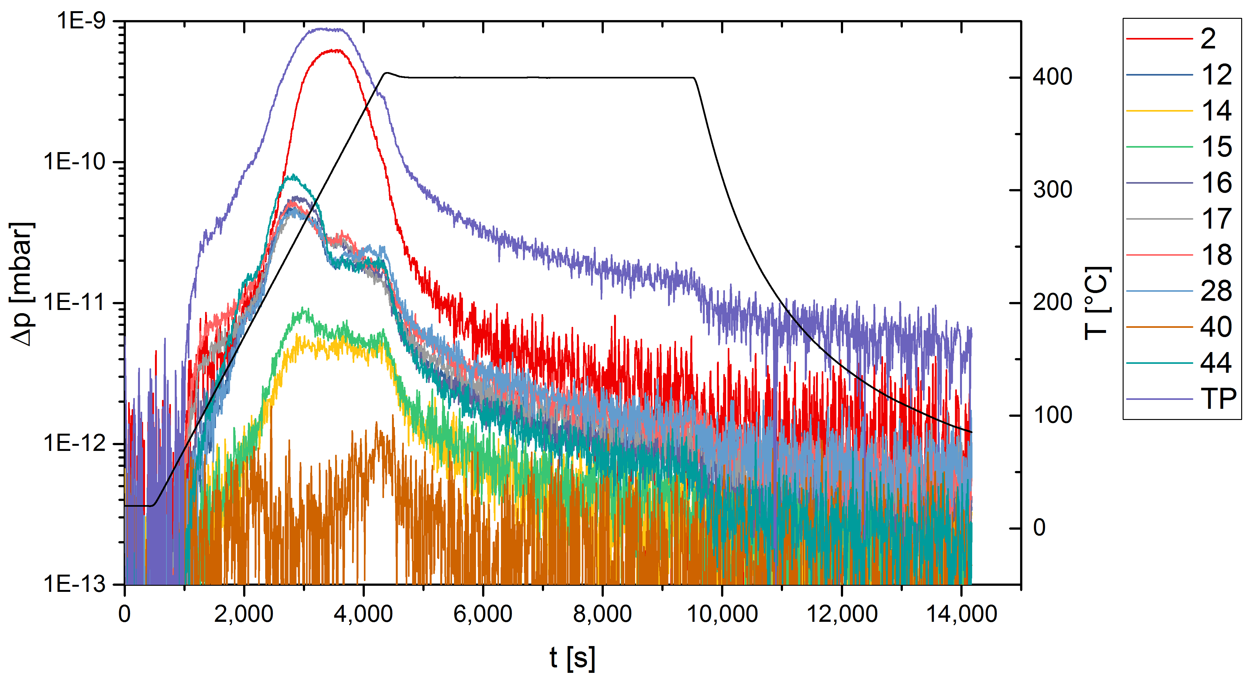
TDS: forced outgassing and annealing
H₂
C
N
CH₃
O
OH
H₂O
CO/N₂
Ar
CO₂
total
pressure
OF-Cu sample
Notes:
Let’s have a look at a TDS spectrum
Heating up to 400 C
Temperature is held for two hours
Total pressure sinks under 1E-11 mbar even at high temperature

Slide 8
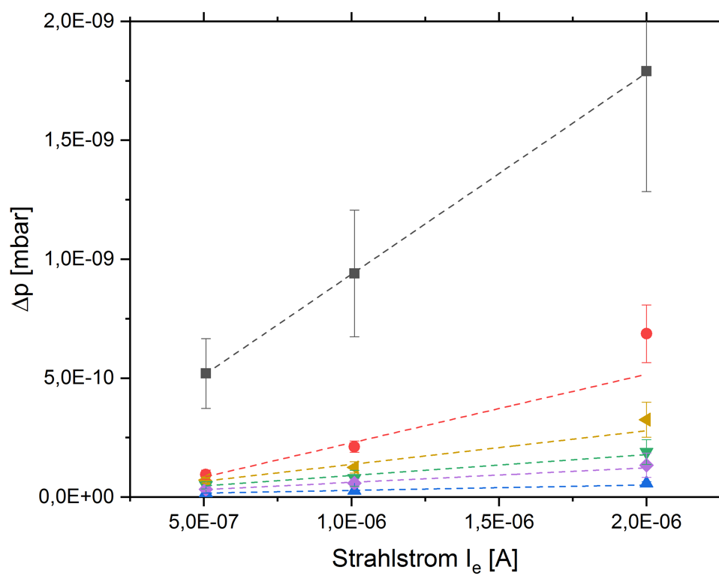
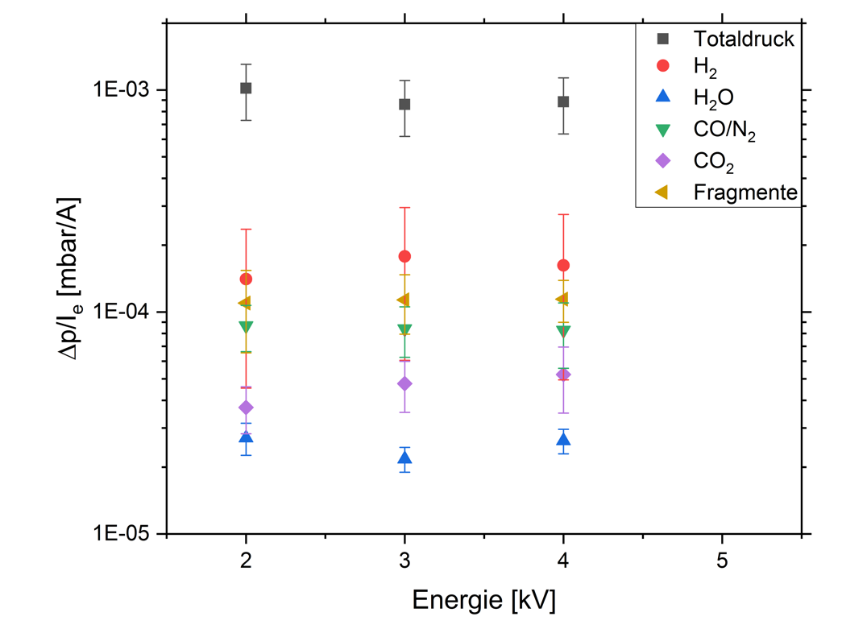
Electron stimulated desorption ESD
Total
Fragments
Current
Energy
Notes:
Electron desorption spectrometry
strong correlation with urrent
no energy dependency

Slide 9
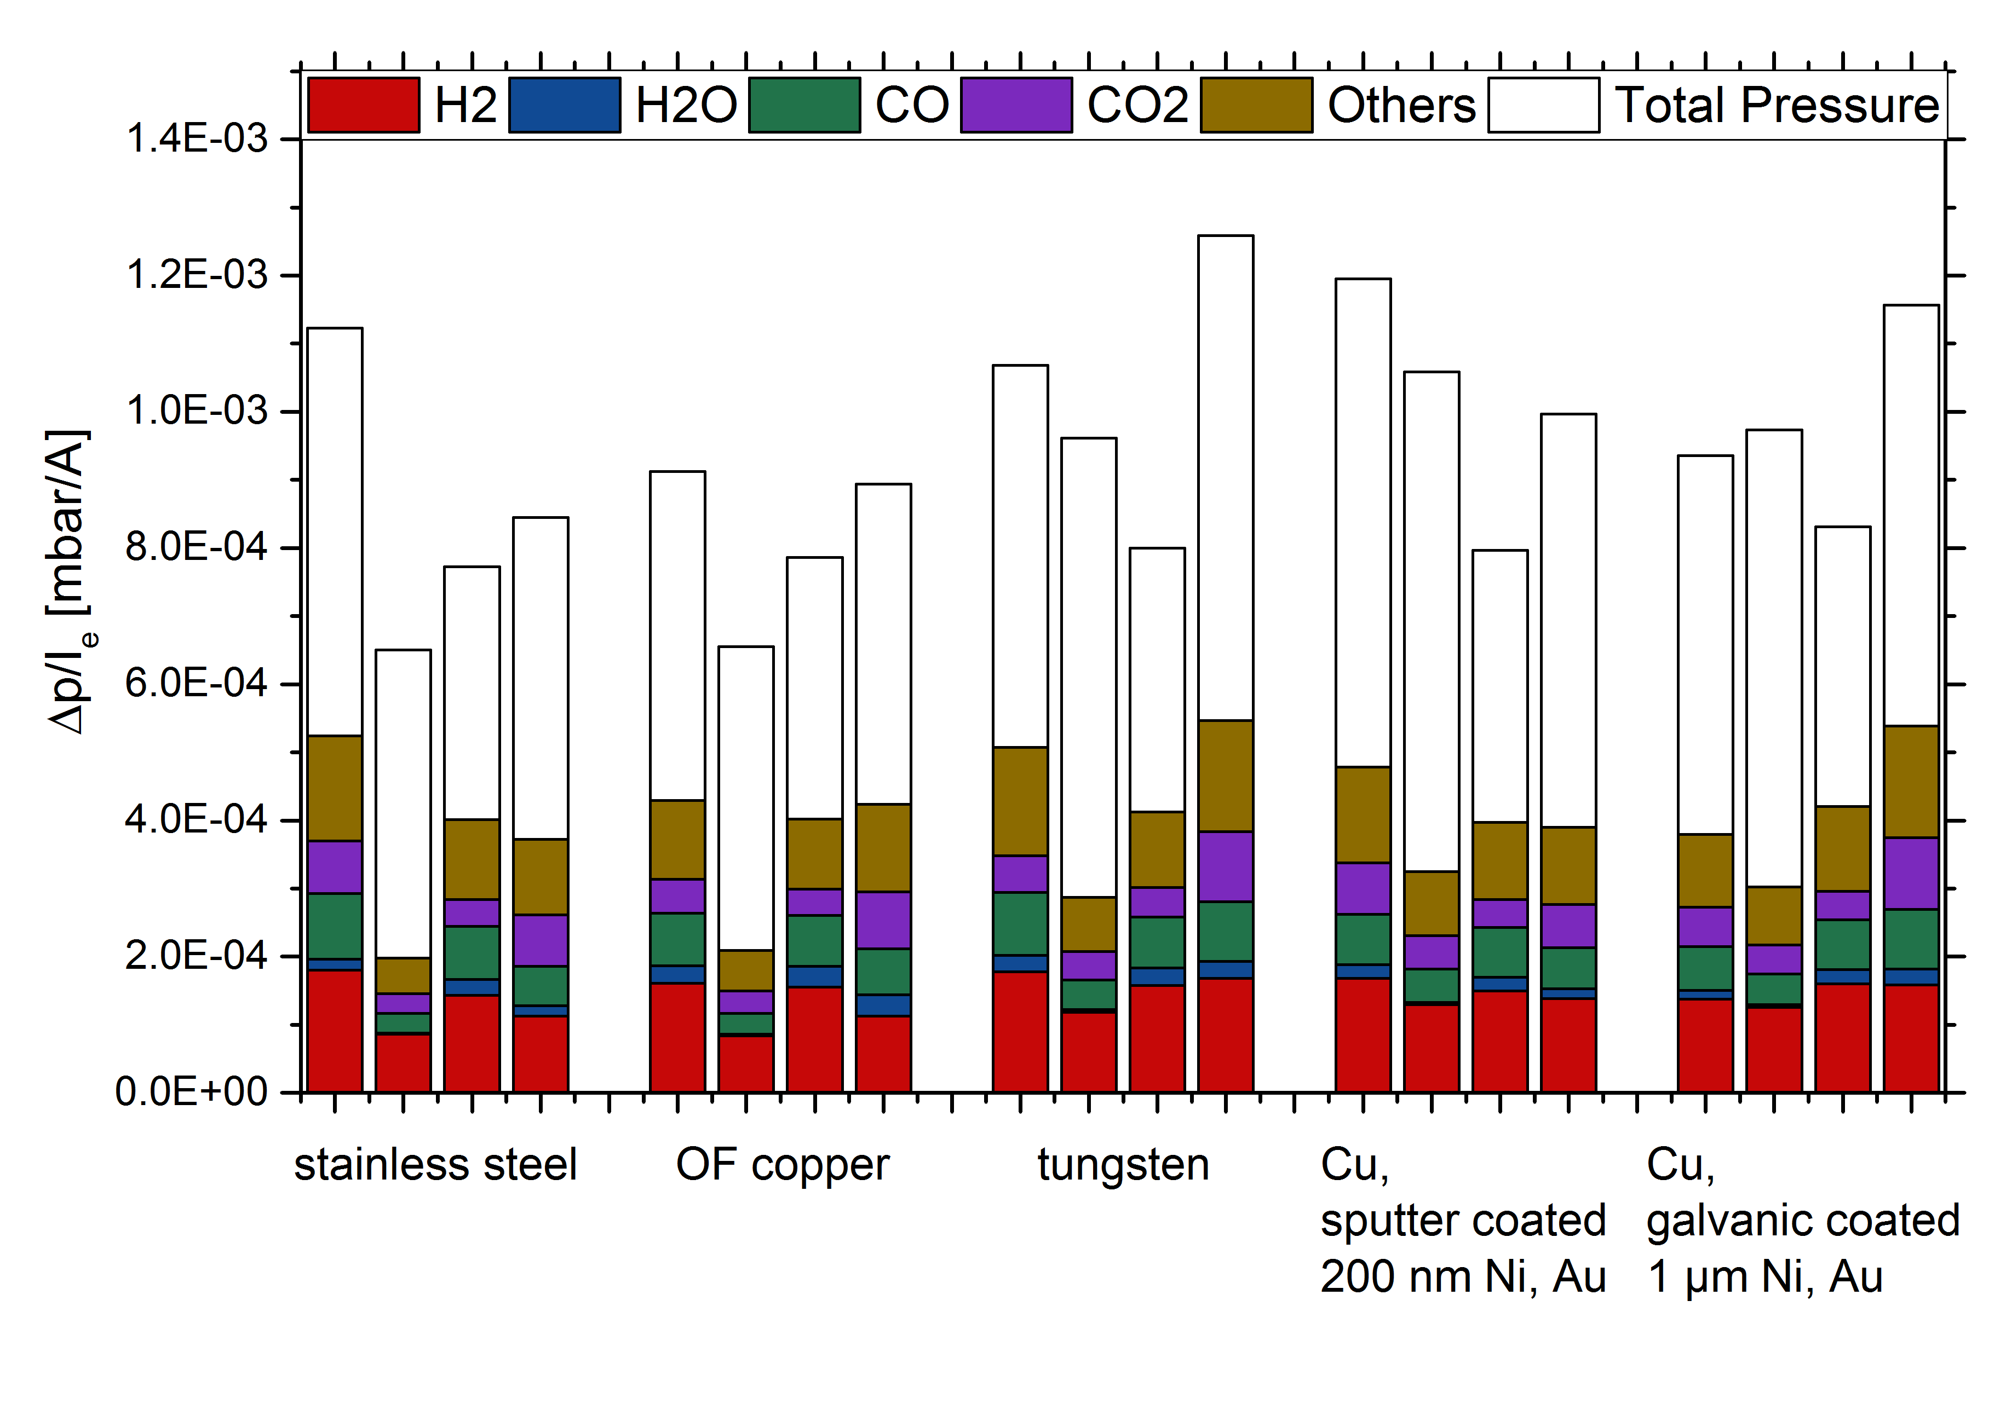
ESD results
4 days atmosphere
1 year atmosphere
as received
annealed
V. Velthaus, PhD Thesis, TU Darmstadt (2023)
Notes:
We don’t go deep into results:
Several materials were tested with different treatments.
Insitu is obviously the best.

Slide 10
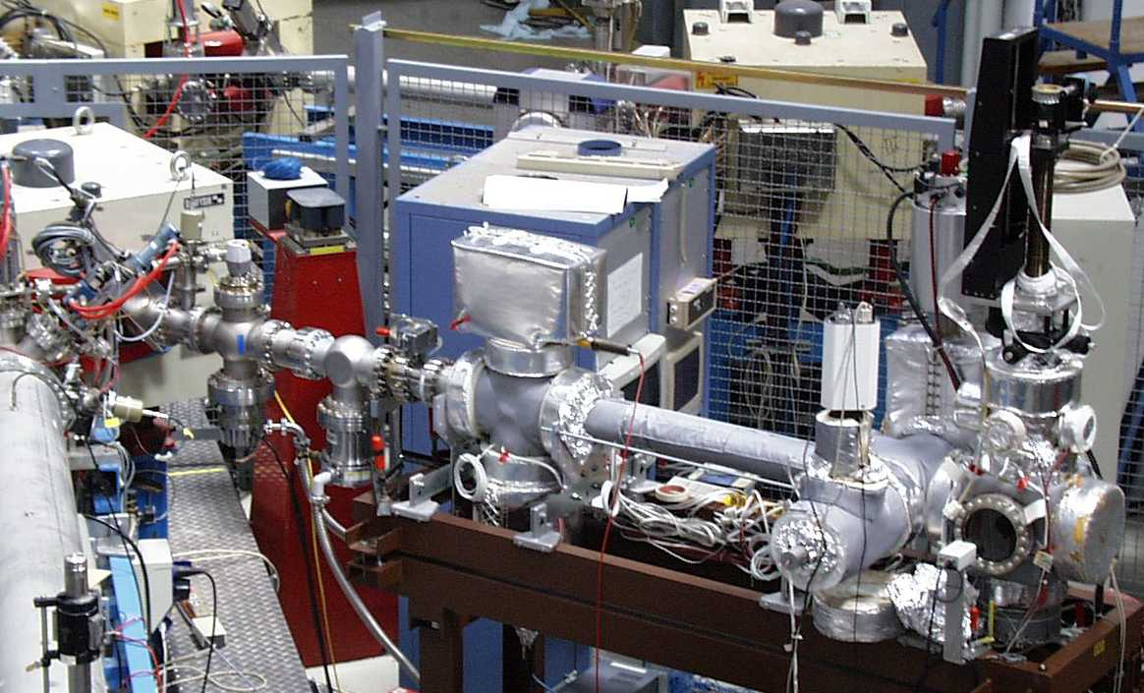
Ion stimulated desorption ISD
beam scrubbing
Continuous bombardment
1Hz, 9⋅10¹⁰ ions/pulse
total pressure increase [mbar]
Experiments by: M. Bender, A. Krämer,
H. Kollmus (GSI), E. Mahner (CERN)
Single shot
9⋅10¹⁰ ions/pulse
E. Mahner, Phys. Rev. ST Accel. Beams 11 (2008), 104801
time [min]
Notes:
Ion induced desorption.
First dedicated experiments.
One can see a pressure increase over more than one order of magnitude for single pulses
Two order orders of magnitude with continuous bombardment.
Slight decrease at the end.

Slide 11
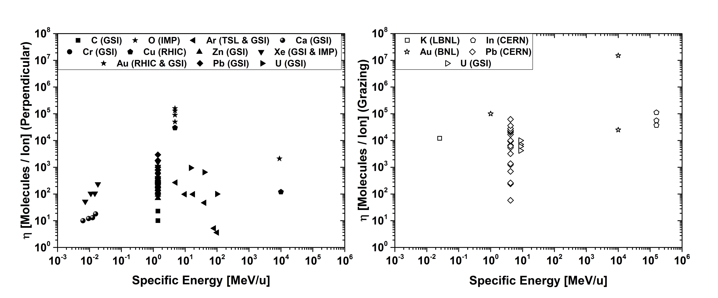
ISD – after 25 years of investigation
Perpendicular Incident
Grazing Incident
Notes:
over 25 years many experiments were conducted at different institutes
with various ions at different energies
under perpendicular and grazing incident
But it doesn’t seem like we learned anything.

Slide 12
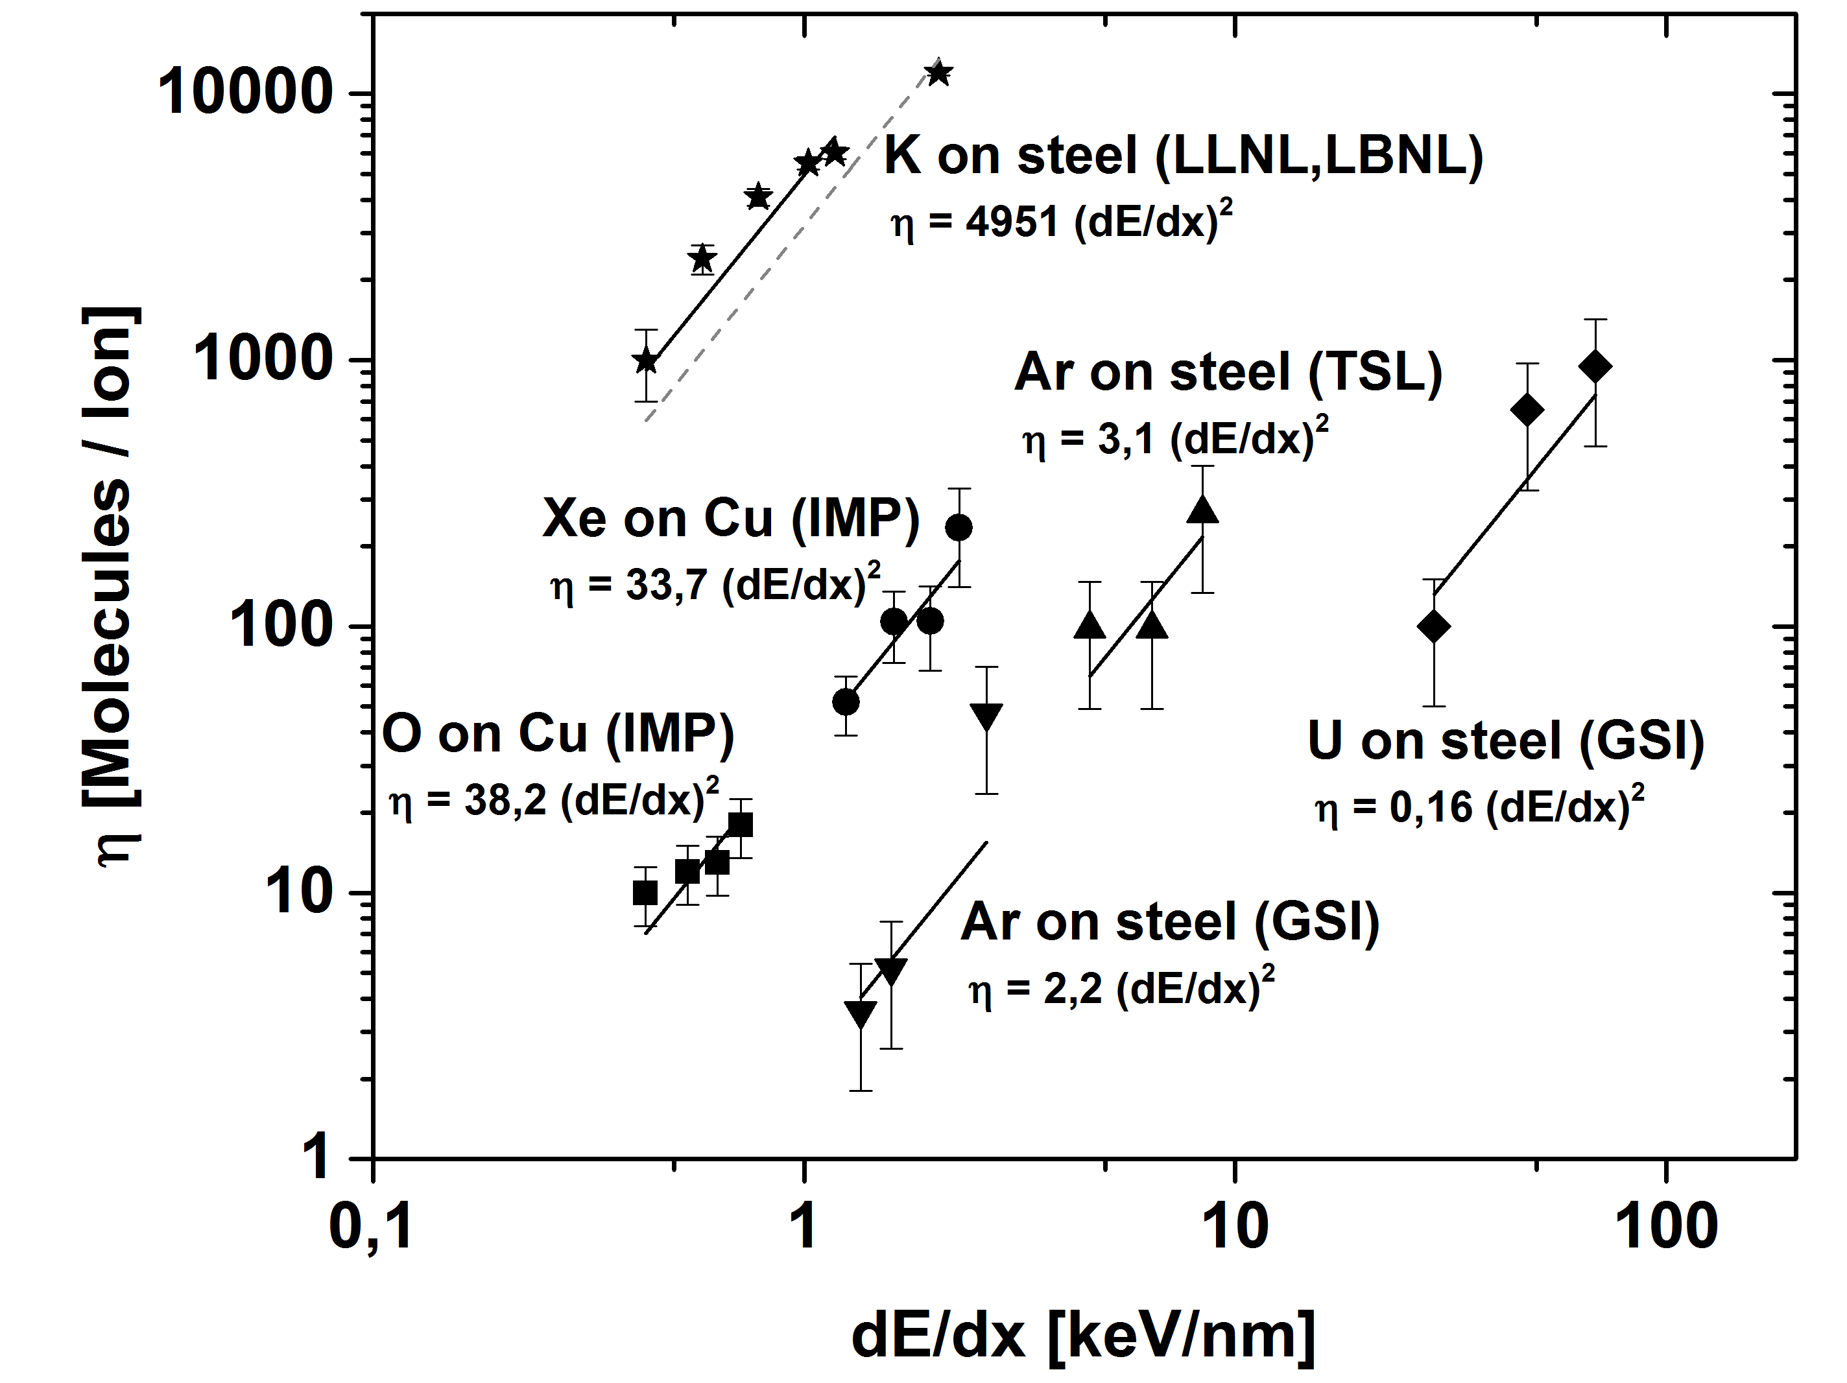

ISD – after 25 years of investigation
With $n≈2$
Notes:
Or did we?
If we plot the desoption yield over energy loss,
we see it scales with an exponent of about 2
with different a material dependent factor k.
Also reproducable

Slide 13
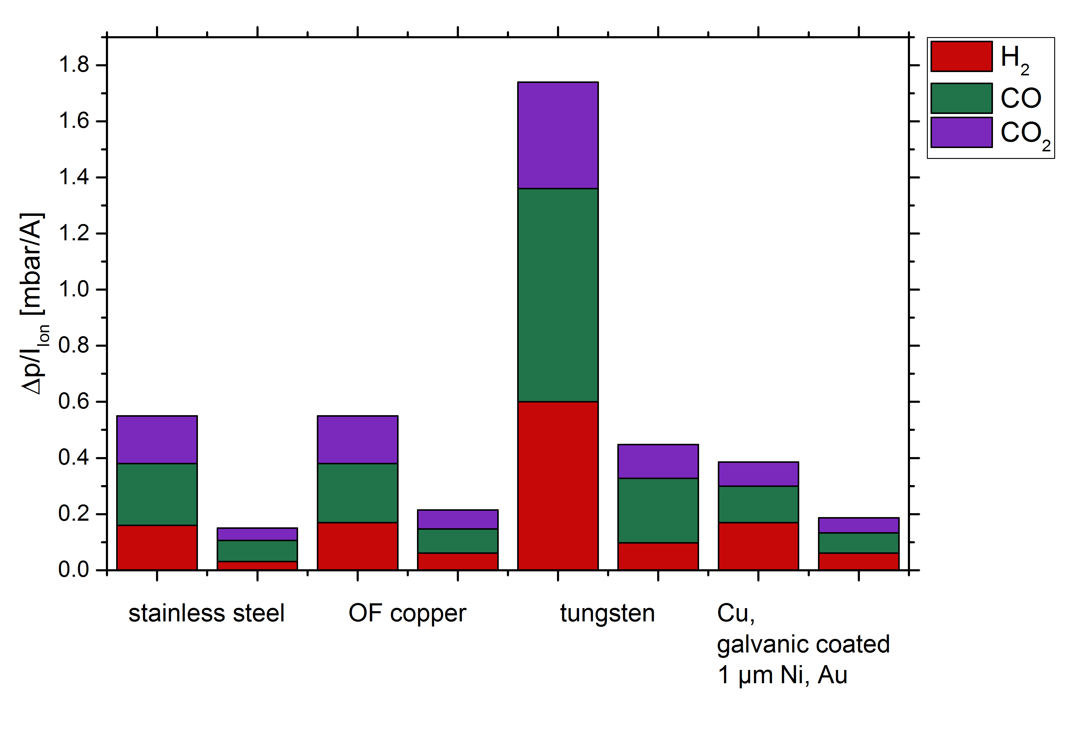
ISD results
as received
annealed
V. Velthaus et al., Vacuum 194 (2021), 110608
Notes:
Significant improvements with thermal annealing.

Slide 14

Desorption channels
desorption
surface diffusion
bulk diffusion
as received
annealed
h$ν$
Ion
e-
Notes:
Understanding the desorption channels:
Gas is stored in the bulk material at the grain bounderies.
From there it diffuses to the surface.
Surface diffusion brings atoms together, molecules like CO form.
From there it desorbes
Annealing increases grains and reduces grain boundary volume.
This is stimulated by different sources

Slide 15
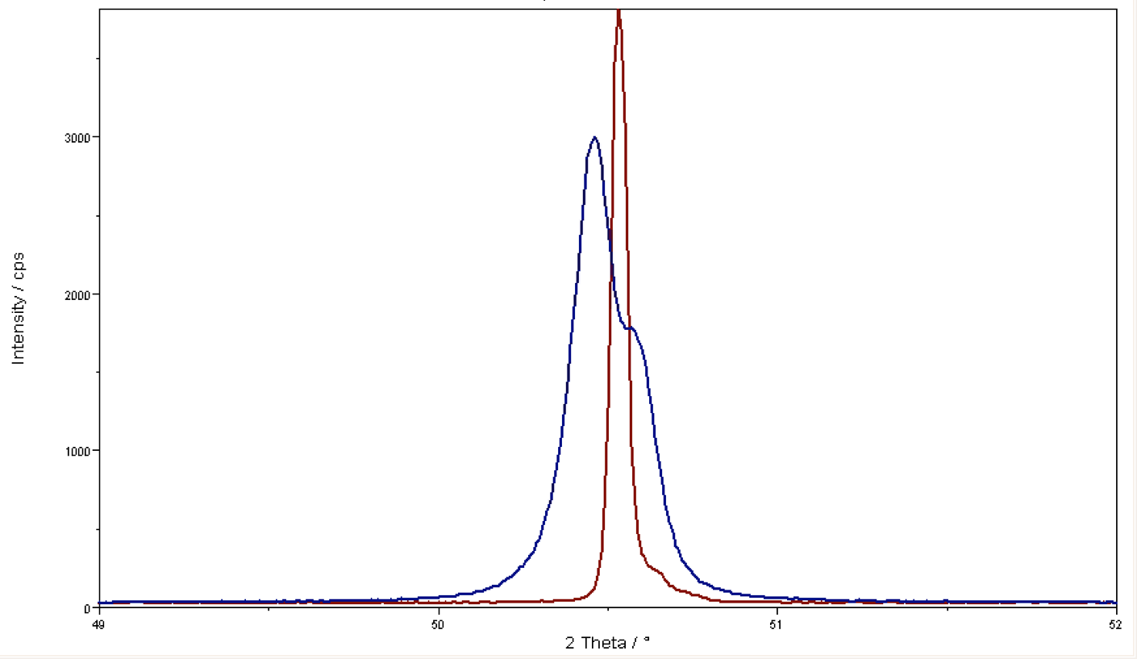
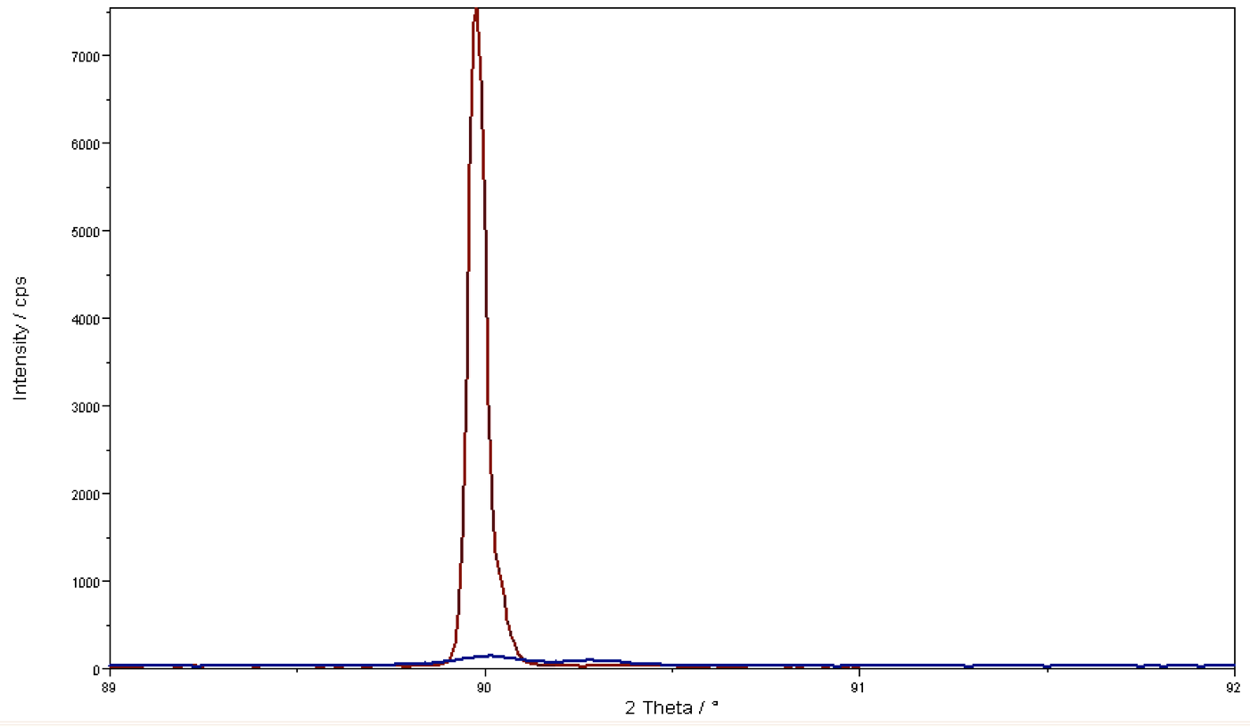
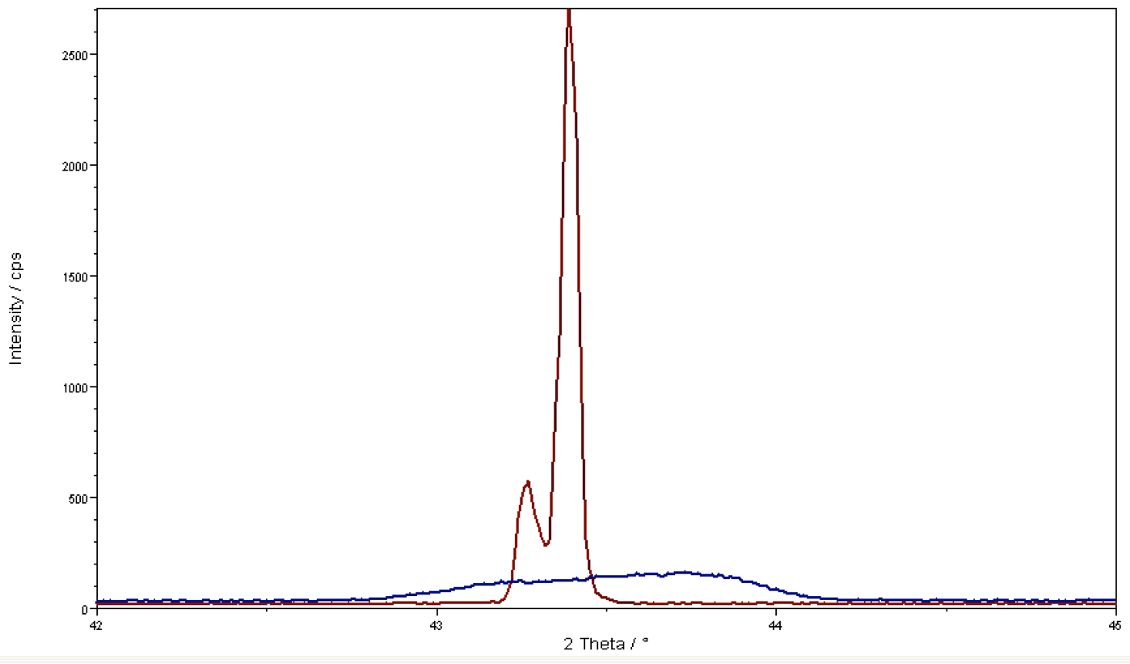
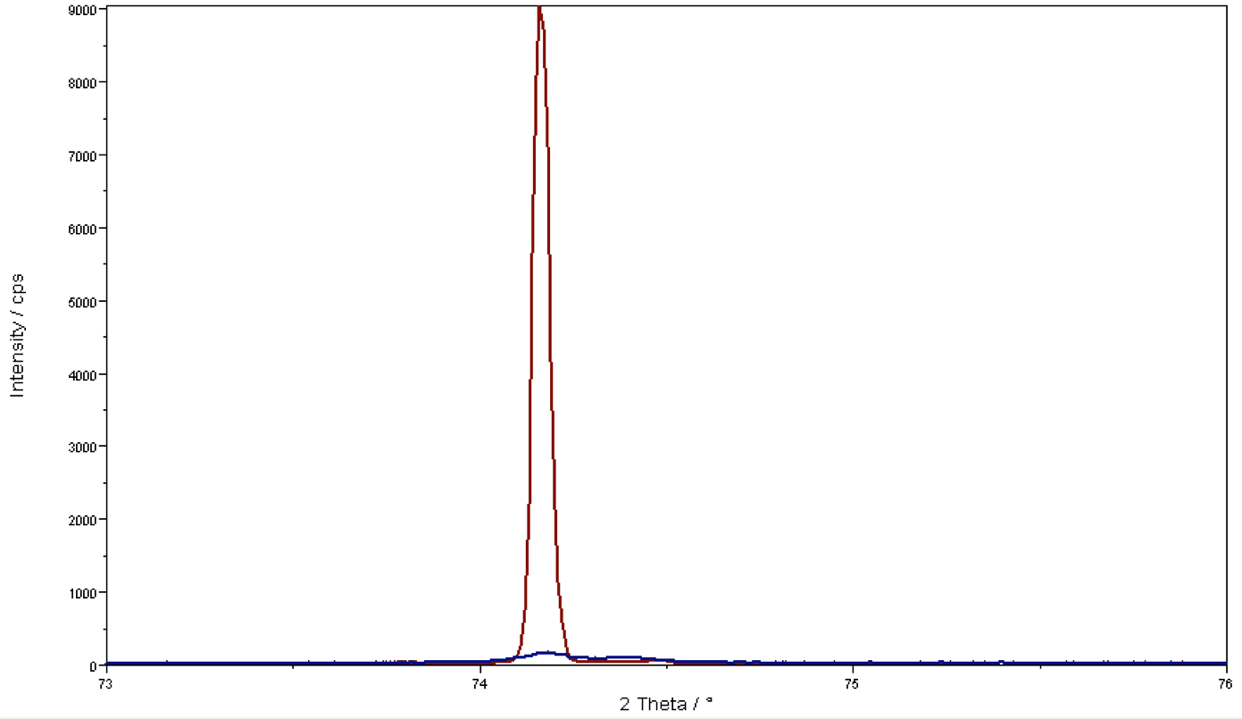
Desorption channels
Cu <111>
Cu <200>
Cu <220>
Cu <113>
as received
annealed
400°C
as received
annealed
as received
annealed
as received
annealed
Structural changes
250°C
UHV - Bakeout
100°C
20°C
RT
Notes:
XRD scans support the theory
Cu at different crystal orientations show a sharpening of the peak,
indicating larger crystal
Looking at a temperature scale:
UHV bakeouts take place at around 200 C
Structural changes start at 400 C

Slide 16
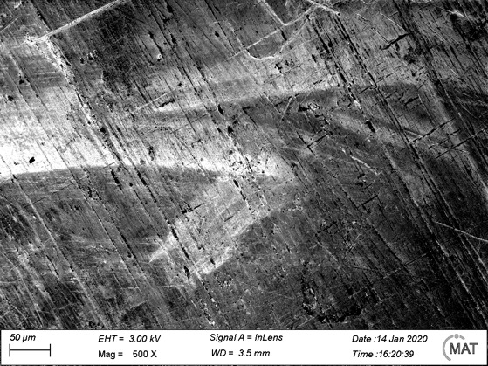
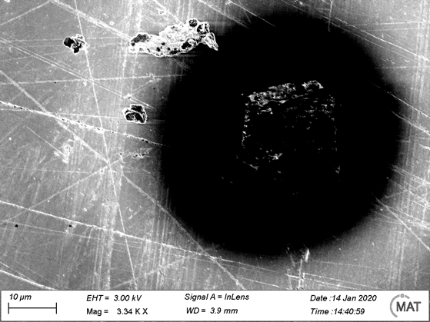
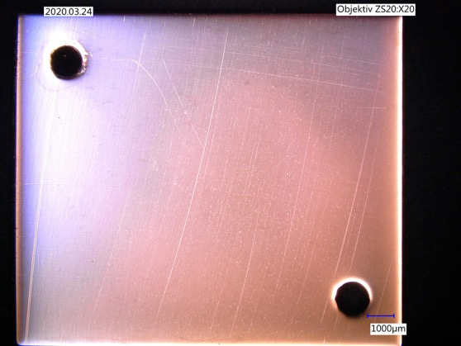
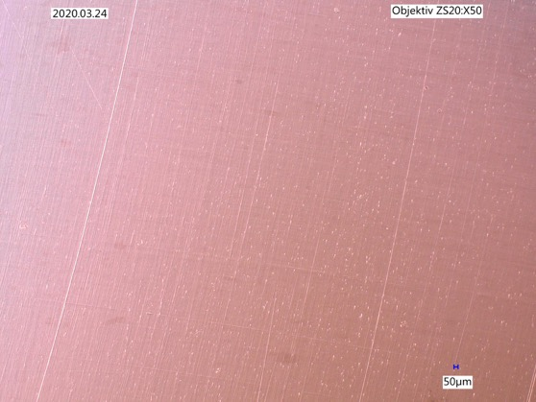
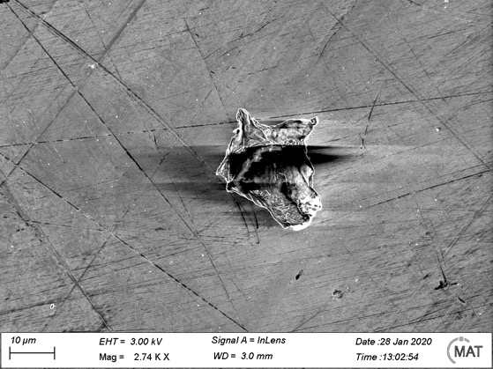
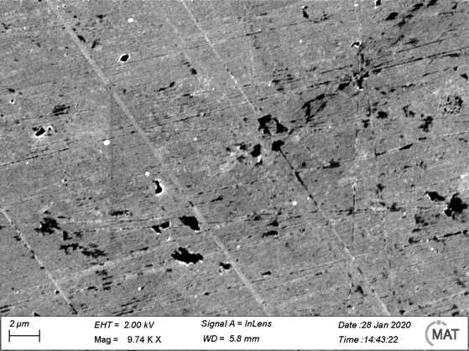
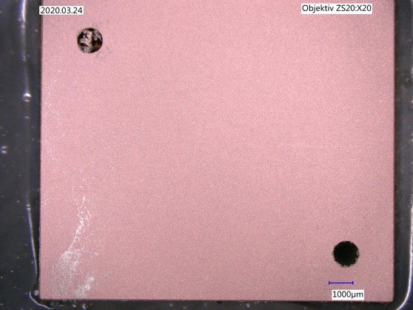
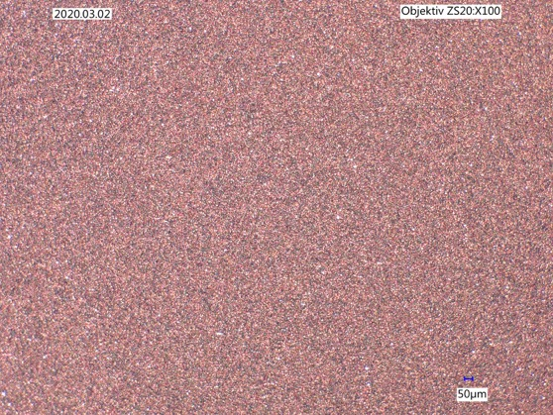
Surface optimization
- Not yet good enough…
Notes:
Different surface treatments methods were tested:
Lapping, Polishing,
dry etching
under the microscope you can see:
results are not yet good enough

Slide 17
Surface optimization – further ideas
Electropolishing:
  electrochemical process in acid (ph: 1) with some 100 mA / cm² at 40-65°C for some minutes
  „Real chemistry“
  Few 10 µm / min
Plasmapolishing:
  similar to dto, but ph: 3,5 … 7,5; 120 mA / cm² at > 85°C for few minutes
  Kinematic content due to high working potential > 200 V
  Few µm / min
  Dry etching (neutralized sputtering)/ sputtering
Laserpolishing:
  Laser ablation
    Short pulsed laser, removal of material, non-thermal process
  Laser polishing
    Pulses > ns, melting of material, thermal process
Notes:
Nicht die exakte Definition

Slide 18
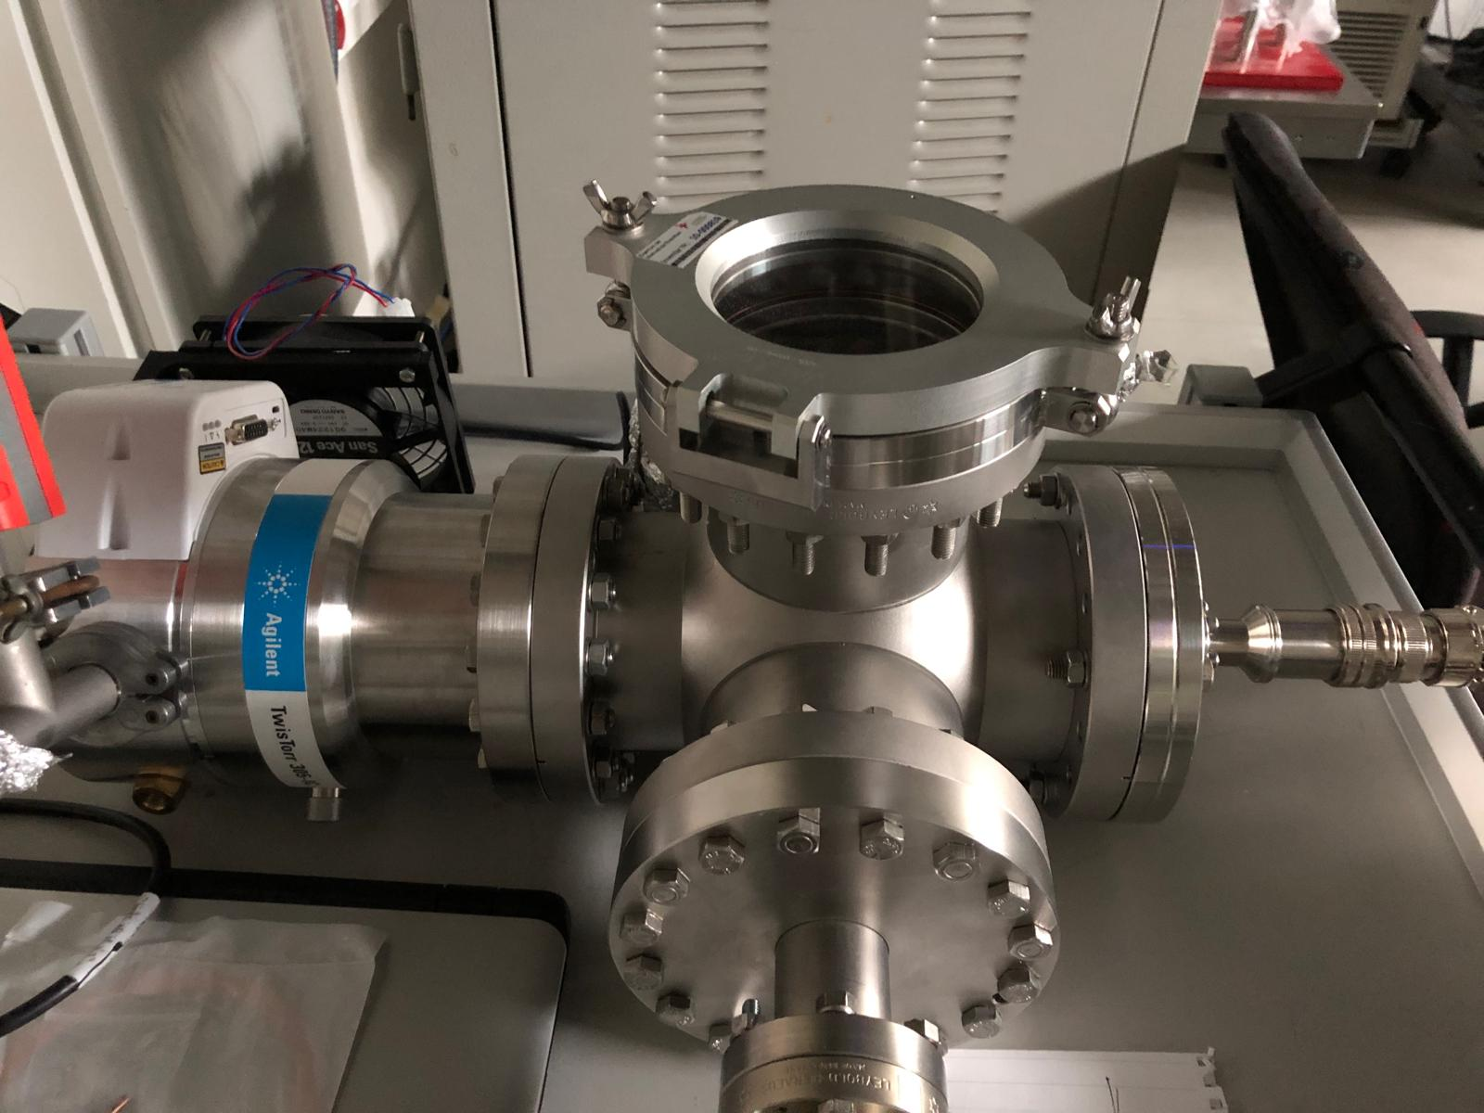

Laserpolishing - requirements
For ablation:
  Gaussian beam (linearly polarized)
  $λ$: wide range, e.g. 1030 nm
  Pulse lenght: 100 - 200 fs
  Repetition rate: > kHz
  Peak fluence: ~ 2 J / cm²
For polishing:
  Gaussian beam
  $λ$: wide range, e.g. 1030 nm
  High Duty Cycle
  Peak fluence: tbd
Infrastructure
  Vacuum chamber with sample exchange
  Sample heater
  Lateral scanning ~ 10 x 10 mm², either laser or sample
Laser
Entrance window
Focal plane
Vacuum generation
Vacuum measurement
Sampleholder with heater and lateral scanning
Notes:
Whats next?
New in situ treatment which combines:
Annealing,
Surface ablation (surface equalization, remove imperfections)
Laser polishing (surface melting)
same laser, different settings
High relevance for: semiconductor development and fusion

Slide 19
Working plan (ablation)
Setup vacuum chamber with pumping, analysis, heater and lateral scan (3 – 4 month → I / 2021)
First sample (OF Cu) with stripes of different integral fluence
Investigation by light microscope, SEM, profilometry, AFM (I – II / 2021)
Variation of parameters (depends what is possible)
Variation of sample temperature during ablation (II – III / 2021)
Choice of best parameters and preparation of full-size sample
Investigation of full-size sample by XRD (IV / 2021)
Investigation of full-size sample regarding diffusion
Investigation of full-size sample regarding ion-induced desorption (I / 2022)

Slide 20
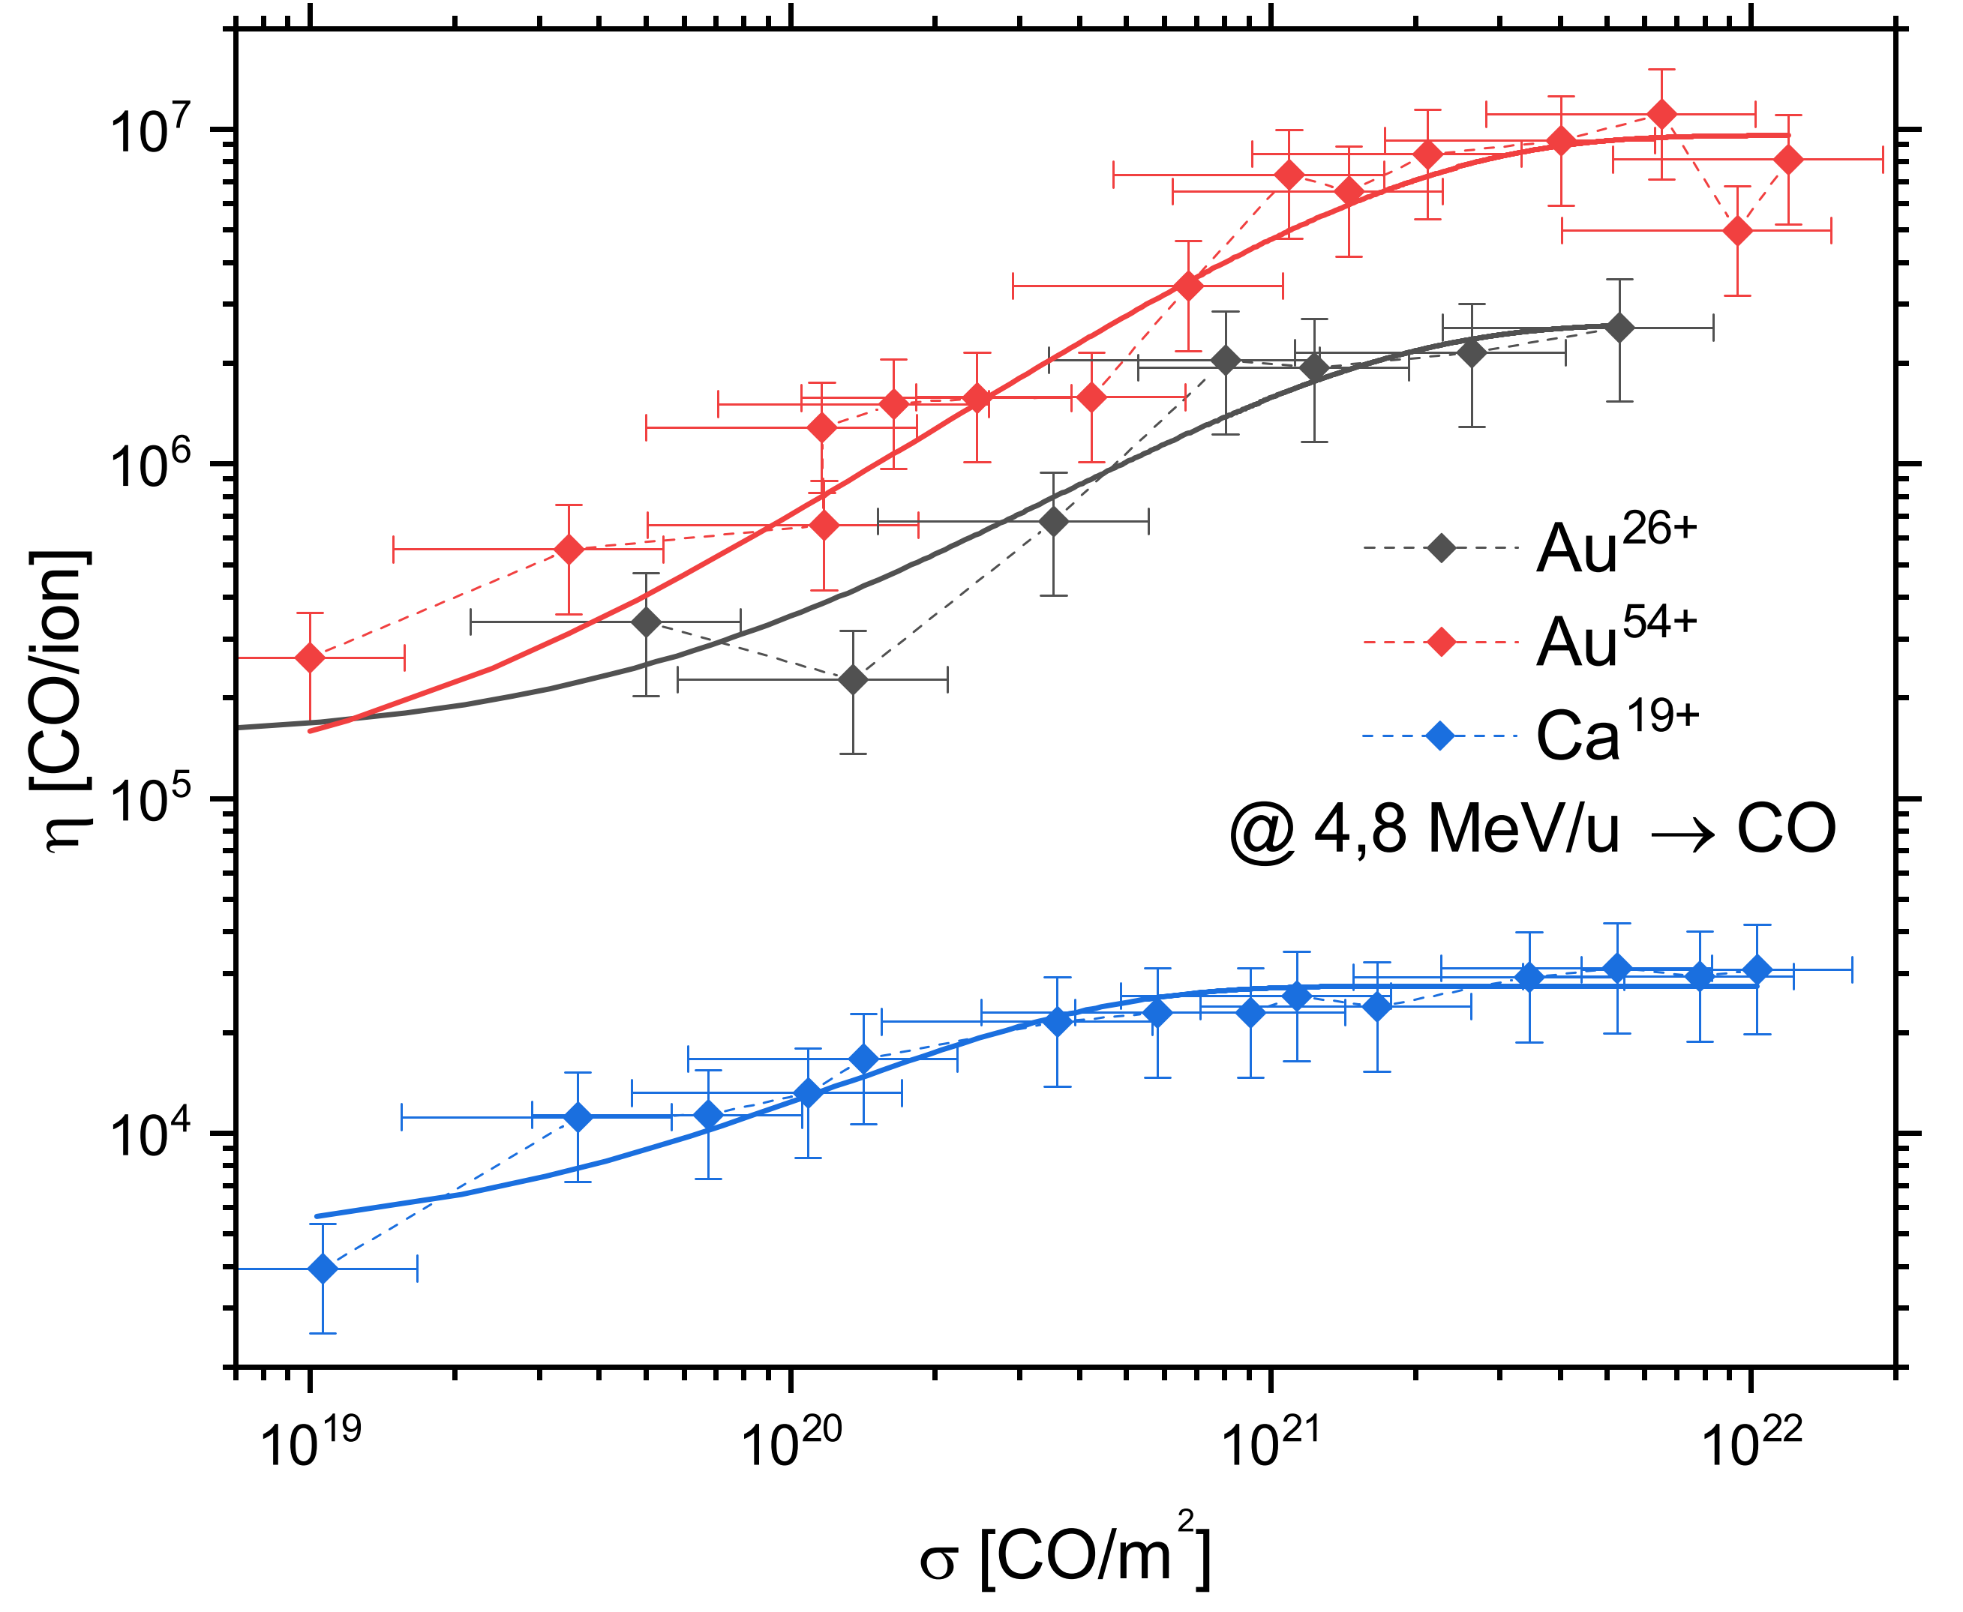
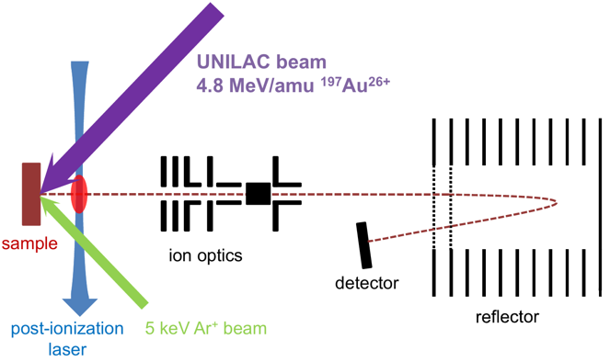
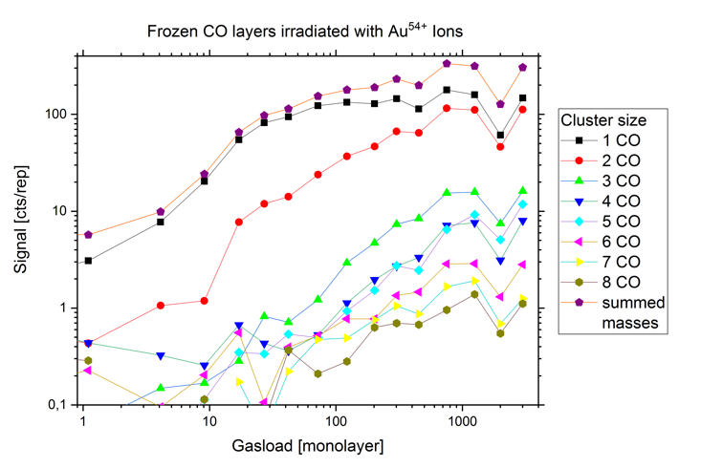
Cryogenic surfaces
L. Kirsch, to be published
Notes:
Besides ion stimulated desorption at room temperature we also prepared cryogenic surfaces
by depositingcarbon monoxide layers with increasing thickness up to 1000 monolayers.
Irradiated with different Ions at different charge states.
Steep increase up to about 300 monolayers you can see a saturation in desorption yield.
We also investigated cluster size distribution using a time of flight mass spectrometer.

Slide 21
Conclusion & Outlook
New setup for the investigation of gas desorption by different stimuli
  Next step: merge results together
Outgassing is interplay of diffusion, surface migration and desorption
  Driven by energy input (temperature)
Annealing at high temperatures to reduce desorption
  Empty gas reservoir
  Close desorption channels, improve surface quality
  Next step: quantify grain size and grain boundary size against desorption yields
Thank you for your attention!

Slide 22
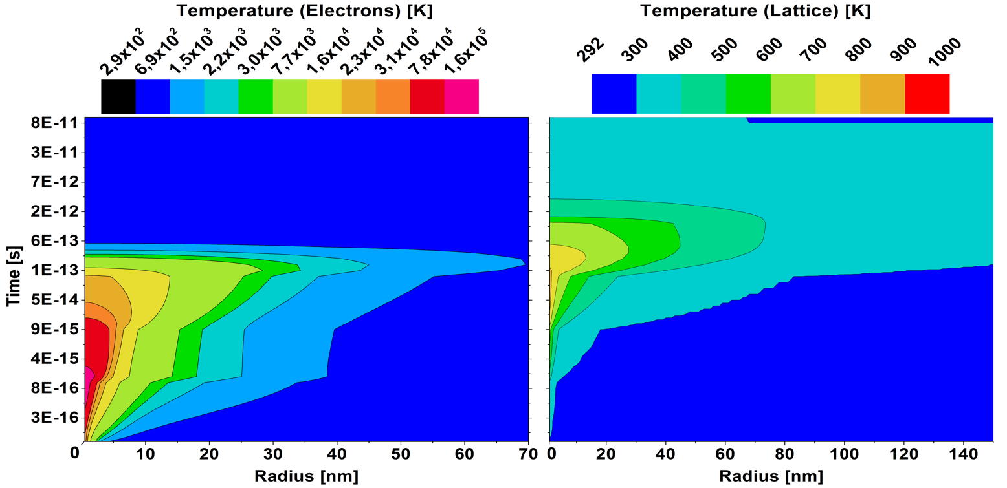
Inelastic Thermal Spike Model
1.4 MeV/u Xe → Cu
g(T_{e}-T_{a})
M. Bender et al., Nucl. Intr. Meth B 267 (2009)
Notes:
Classical heat flow equation with with source and sink terms
Temperature versus radius and time

Slide 23
Cryogenic surfaces
L. Kirsch, to be published

