Slide 1
KFSI: Komitee Forschung mit nuklearen Sonden und Ionenstrahlen
We are your elected representative body with the aim of promoting research with nuclear probes and ion beams
We are involved in interaction with the Projektträger and the ministry to develop research strategy and designing research calls to fit to your research interest
We are engaged in the user initiative DIGUM to promote digitization in the research of universe and matter
https://www.sni-portal.de/de

Slide 2
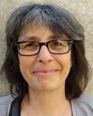

Who are we?
Our large scale facilities
GSI
HZDR
ISOLDE
Assoc. Prof. Dr. Judith Reindl (UniBw Munich and University of Oslo)
Dr. Daniel Severin (GSI)
Prof. Dr. Anton Wallner (TU Dresden and HZDR)
Dr. Lars Breuer (University Duisburg-Essen)
Prof. Dr. Doru Lupascu (University Duisburg-Essen and ISOLDE)
Dr. Silke Merchel (TU Wien)
Prof. Dr. Chrisoph Hugenschmidt (TU München and FRM II)
Head
Deputy Head
DIGUM Representative

Slide 3
Roof organization: KEKM (Kommission "Erforschung kondensierter Materie mit Großgeräten"
It is the commission of the committees involved in the matter research
KFSI, KFS (Synchrotron), KFN (Neutron), KFB (Accelerators)
Currently not much joint actions, KFS and KFN have initiative to do more together (more info next year)
Joint conference: SNI every 4 years. Next conference 8. – 10.9.2026 at DESY in Hamburg

Slide 4


DIGUM - Digital Transformation in the Research on Universe and Matter.
https://erumdatahub.de/dig-um/
Organization which represents all commitees from ErUM in the research framework ErUM-Data
Topic groups: Federated digital infrastructures, research data management, Big-Data-Analytics, user interface, and knowledge distribution
Workshops for students, PhDs and also train-the-trainer in the topics of big data and machine learning
Learning and teaching material and much more…

Slide 5
If you have any more questions please contact me:
Assoc. Prof. Dr. Judith Reindl
Judith.Reindl@unibw.de
Or any of the other members of the KFSI!

Slide 6


Shaping the Future of Radiobiology
Precision Ion Beams and the German Research Landscape
Assoc. Prof. Judith Reindl
University of Oslo
University of the Bundeswehr Munich
23.09.2025 Ionenstrahlworkshop

Slide 7

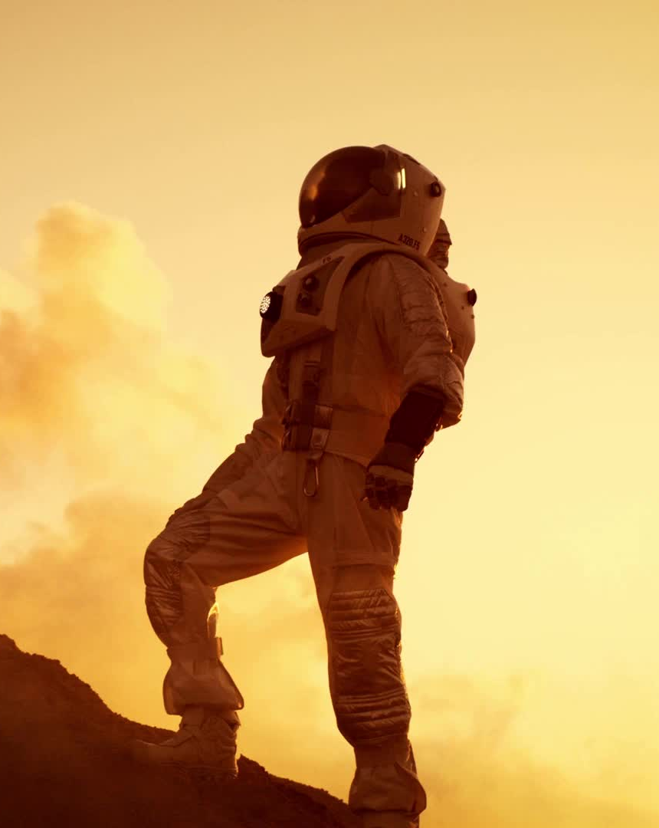
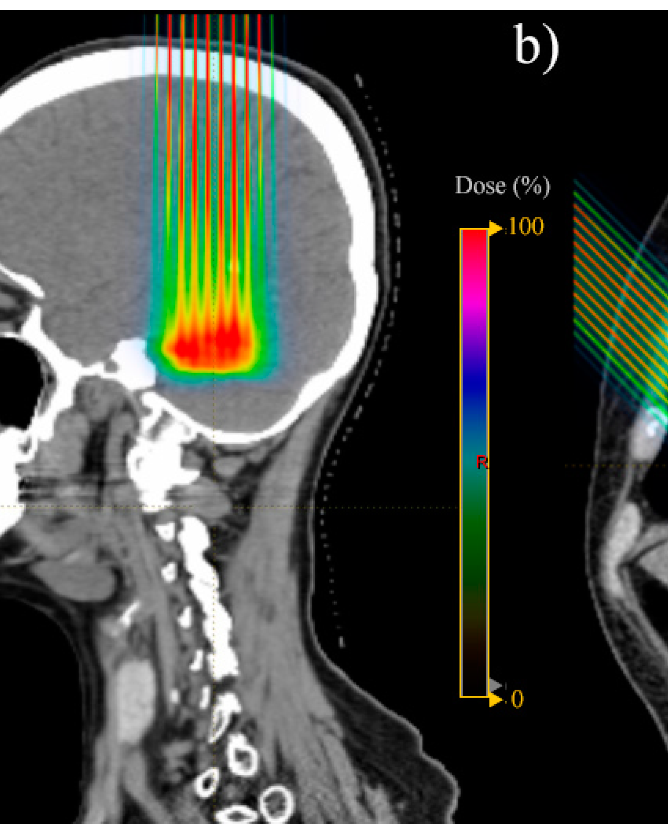
FamilyID=Office_ArchiveTorn
Where radiobiology matters:
Knowledge Base for Next-Generation Radiation Medicine, Radiation Protection, and Space Health.

Slide 8
The knowledge gap
Challenges
Particles show different damage distributions than x-rays
Particles can induce more damage than x-rays
X-ray data anyways used to predict outcome of particle radiation
Physics of Particle-Matter Interaction
Biological Radiation Response
Ionizations and excitations
Cross-sections
Electronic and nuclear interactions
Energy transfer
Etc.
Cell survival curves
Repair pathways
Immune effects
Side effects
Etc.
X-rays ✓
Particles and mixed fields
What is needed to understand particle effects?
Complex and diverse infrastructure
Proper biological models
Advanced computational systems
Experts in diverse fields:
Basic and applied physics, Engineering, Radiobiology, and Computation

Slide 9
The knowledge gap
Radiobiology is still rooted in X-ray / DNA-DSB paradigm
The paradigm is missing effects on or coming from
Low-dose/dose-rate
Spatiotemporal heterogeneity from heavy-ions or mixed fields
Those effects play a role in:
New therapies (ion-therapy, radionuclides, spatial-fractionation)
Environmental & occupational exposures (NORM, radon exposure, nuclear weapons and powerplants)
Space radiation (cosmic rays, mixed fields)
Immune system
Mitochondrial function

Slide 10
Which facilities are needed?
Micro- and nanobeams
Ultra-high dose rate facilities
Multimodal platforms
Pre-clinical and clinical research platforms

Slide 11
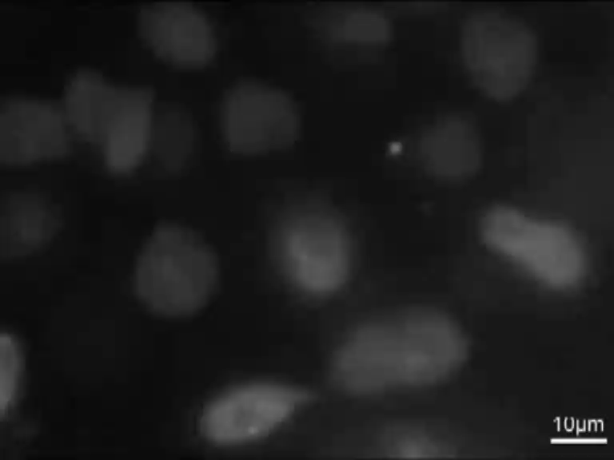
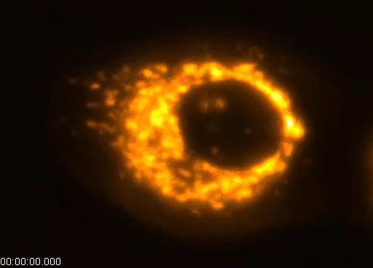
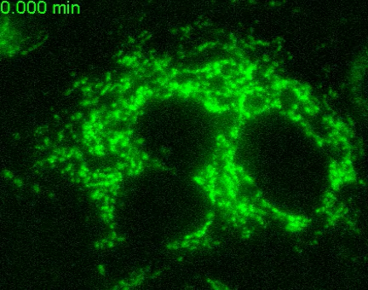
Micro- and nanobeams
DNA repair
Mitochdrial damage
Heavy ion microbeam at GSI
Heavy ions focused, coming from UNILAC
Sub-micrometer beam spot size
Single ion
BIOMICRO ion microbeam at HZDR (currently under construction)
Induction of H2O2
Upgrade of former SNAKE (Munich) microbeam
protons, helium, lithium, boron and carbon ions
500nm beam spot size
Single ion and ion pulses
Talk by: Nikolaos Mallousis
These two facilities bring Germany to the forefront of biological Mircobeam Research

Slide 12
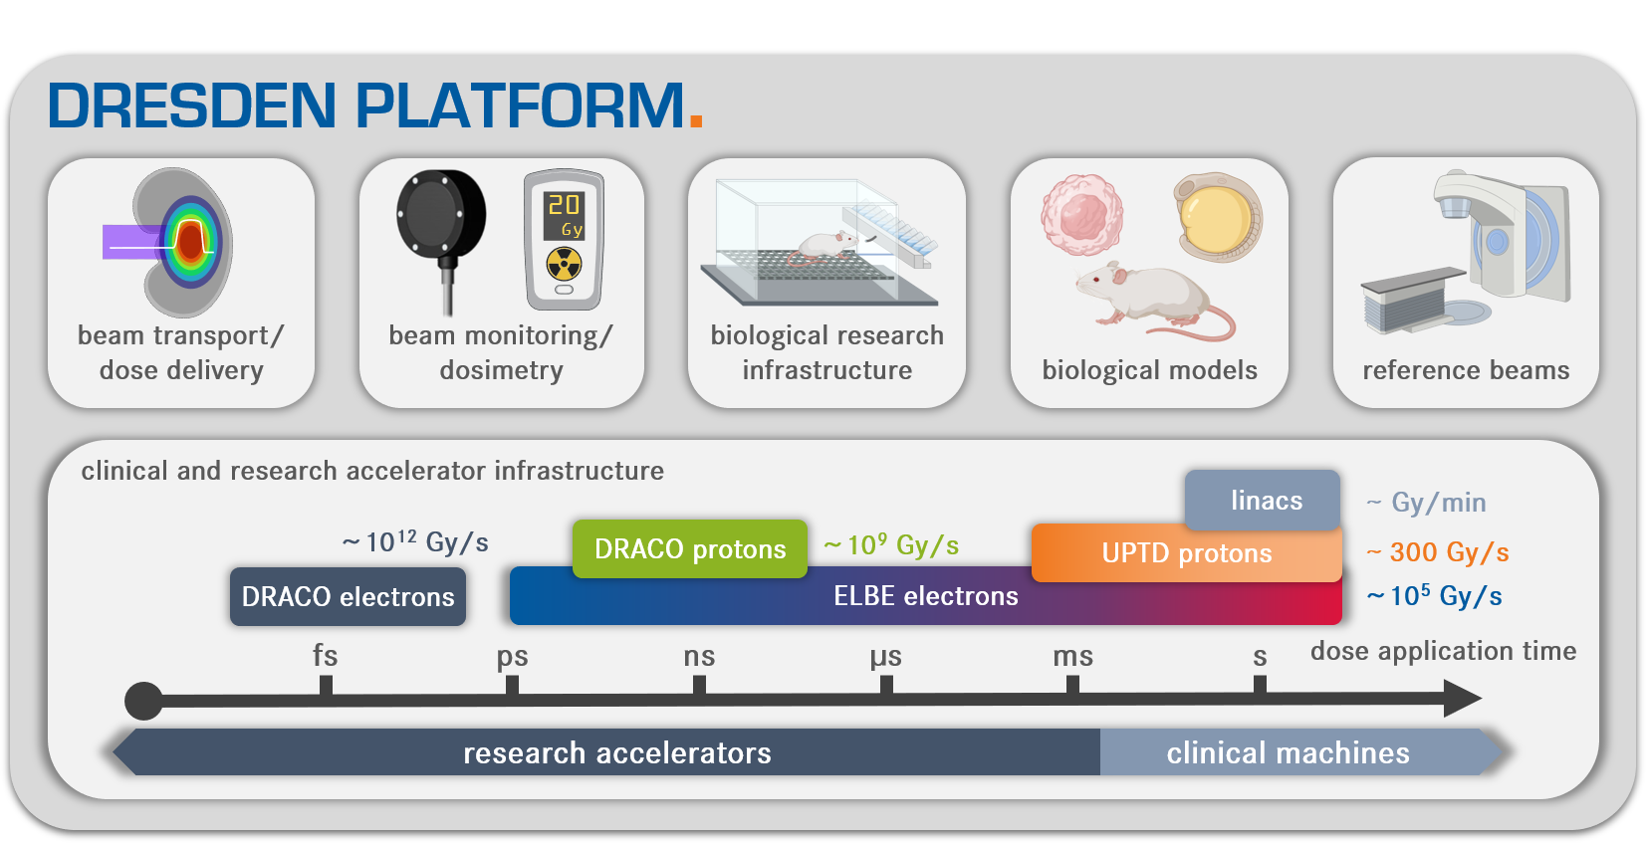
Ultra-high dose rate facilities for FLASH therapy research
Dresden Platform is a the forefront of UHDR technology development,
this could be used to do more efforts also for ions

Slide 13
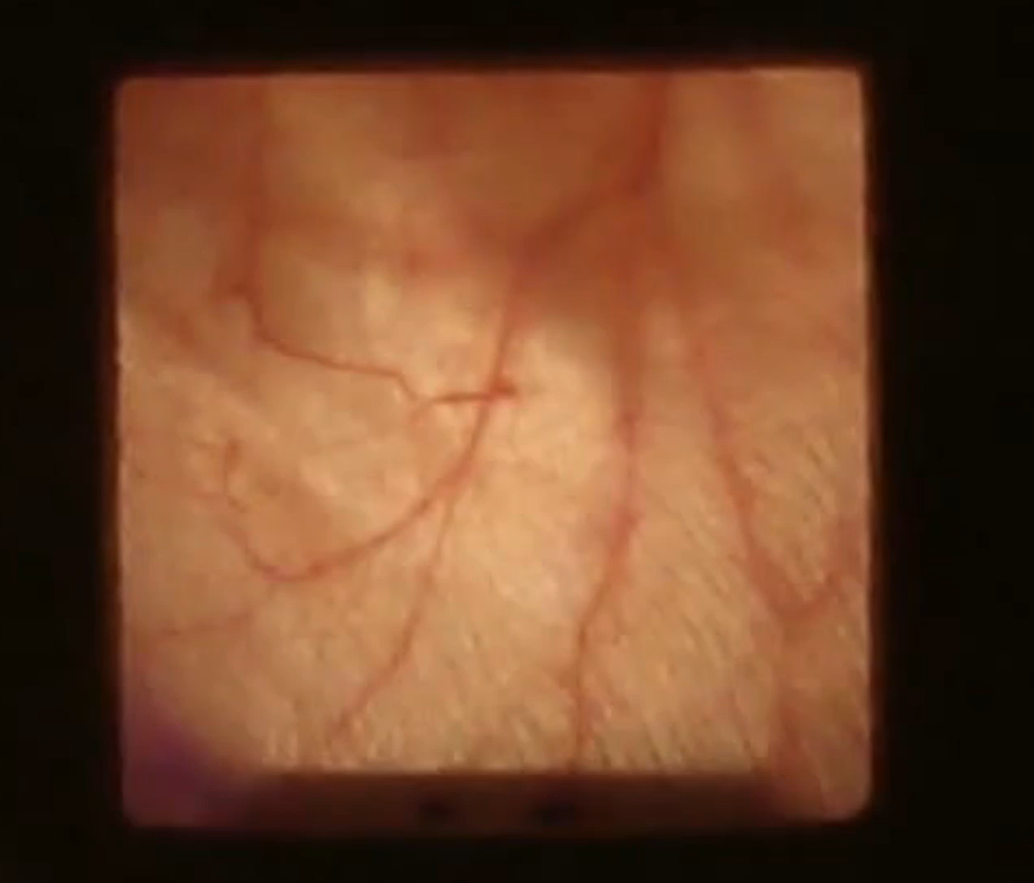
Pre-clinical and clinical research platforms
The leading institutes in Germany are DKFZ, HZDR, Oncoray, GSI and HZB are worldwide leading
Implementing of advanced technology for basic research and precision radiotherapy technologies
Talk by Aikaterini Rousseti
Sub-100µm positioning of a mouse by blood vessel matching

Slide 14
Multimodal radiobiology
Irradiation platforms
Omics
Imaging
Translation
Biological models (2D/3D in-vitro)
Immunology
Digital twins

Slide 15
Where to go next?
DNA & Molecular
Damage patterns (ion species & energy dependence)
Repair fidelity and misrepair
Chromatin structure effects
Cellular
Cell fate decisions (repair, apoptosis, senescence, transformation)
Stress and immune signaling interactions
Biomarkers of radiosensitivity
Tissue & Microenvironment
Tumor microenvironment effects (hypoxia, stroma, immune cells)
Immune modulation and combined therapies
Bystander and abscopal effects
Organism & Systems
Multi-scale predictive models (DNA → cells → tissues → organism)
Long-term health risks (second cancers, degenerative diseases)
Genetic and epigenetic variability
Translation & Clinical
Mechanistic RBE (Relative Biological Effectiveness) prediction
Standardized benchmarking platforms
Personalized therapy planning
Space & Protection
Mixed radiation fields (ions, photons, neutrons)
Chronic vs. acute exposures
Countermeasures and shielding strategies

Slide 16
Where to go next?
Research is currently moving away from descriptive to predictive radiobiology
More complex radiation exposures are investigated (heavy-ion, dose-rates, mixed fields, etc.)
Integrative models (immune response, adverse effects)
Multiomdal analysis becomes more and more important
With the facilities, technology and people in Germany we can shape the future of radiobiolgy, but only if we are joining forces now!
Thank you for your attention!

