Slide 1
SIS100 Magnet Measurement Tools
P. Spiller, C. Roux. A. Szwangruber,
S. Russenschuck

Slide 2
Outline
Motivation
Scope of work
Resources
Status of collaboration contract

Slide 3
Motivation
The new collaboration is a continuation of common developments in the area of
magnetic field measurements systems which were formalized in addendum #2 and #9.
Magnetic field measurement systems for the SIS100 superconducting dipoles | Annex to #2 #9, KR2984/TE | 2014 2016

Slide 4
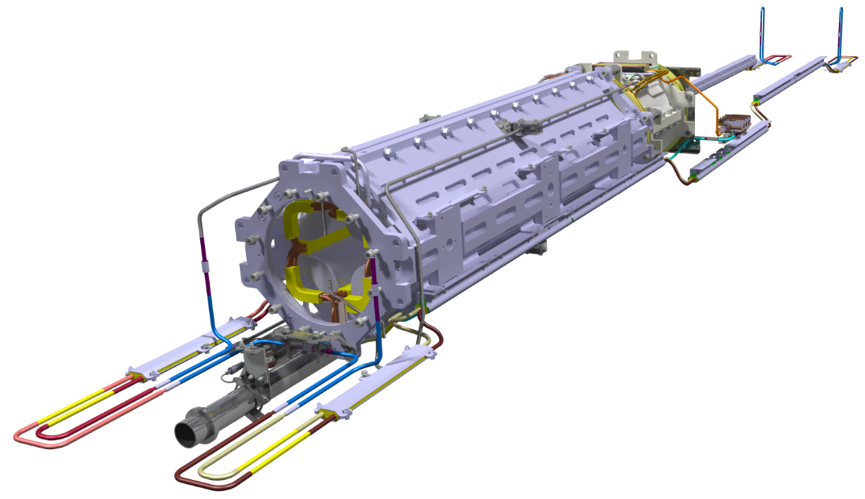
Motivation
Series production and cold testing of the superconducting quadrupole units (QU) for SIS100 is ongoing at JINR, Russia: 1. High risk, 2. Critical path for SIS100
Risk minimization by series production of QU in European industry.
Cold testing of industry units at GSI STF is required and to be enabled.
Cold testing contains qualification by magnetic field measurements on series QUs
A new GSI-CERN collaboration will focus on development and manufacturing of measurement systems for high precision magnetic field measurements on superconducting magnets
rotating coil probes
stretched wire system
control and data acquisition systems
QP unit for SIS100: main quadrupole and corrector magnet

Slide 5
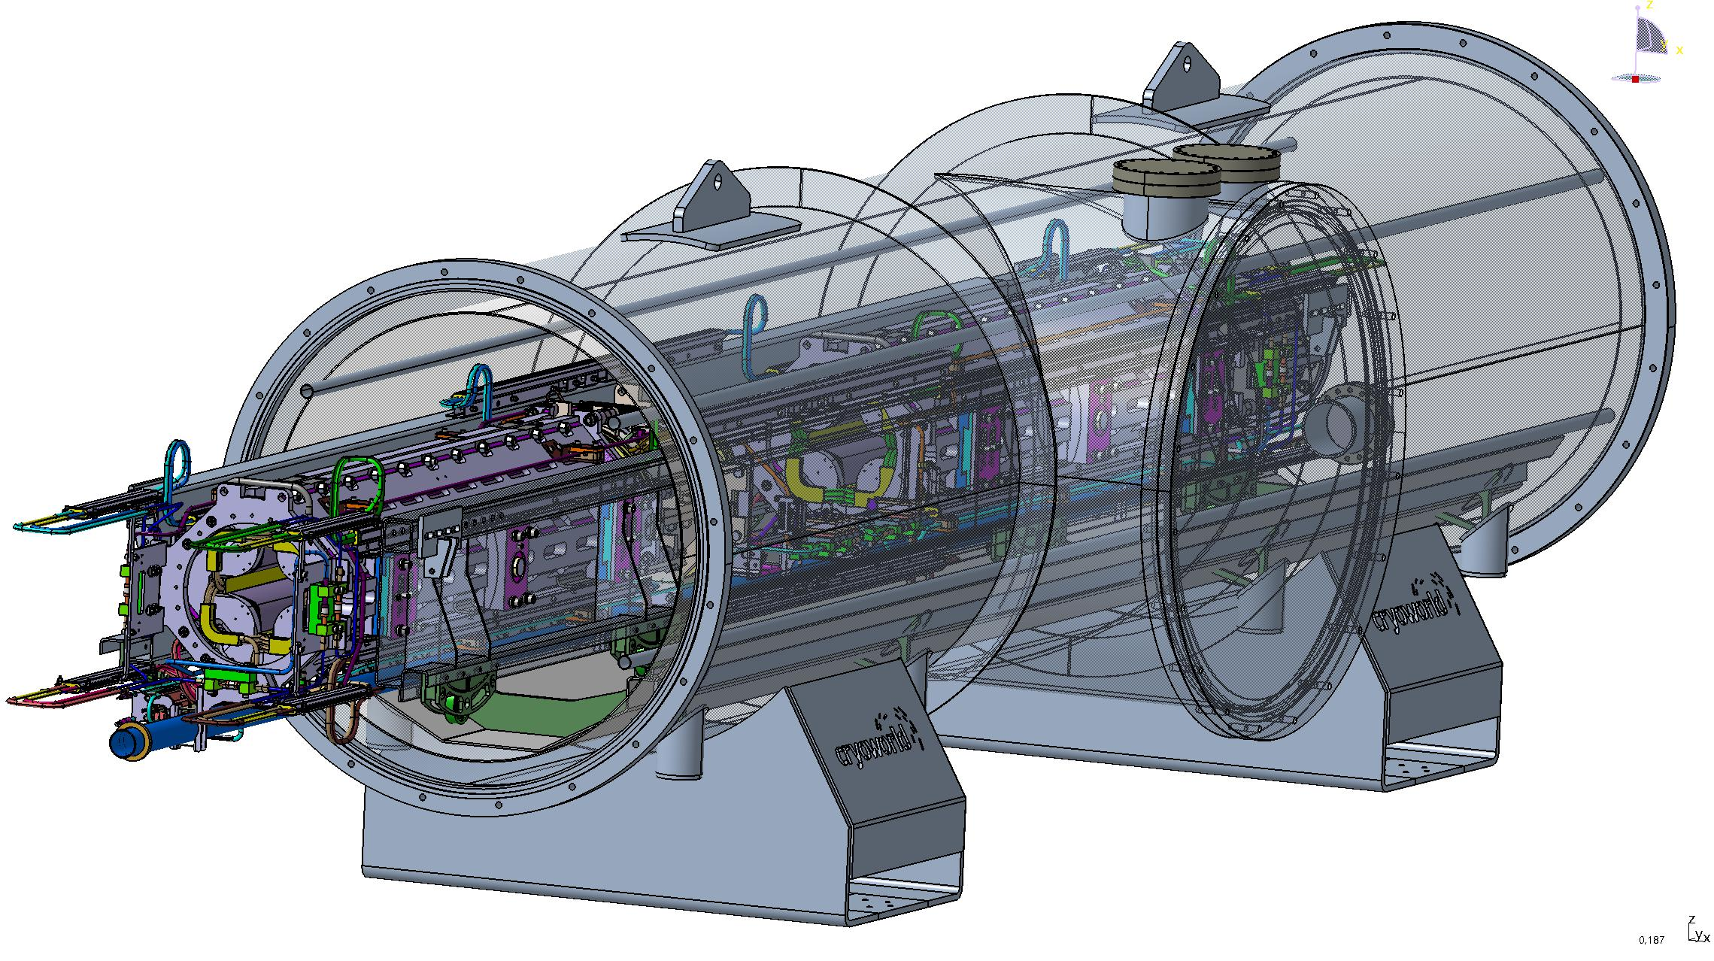
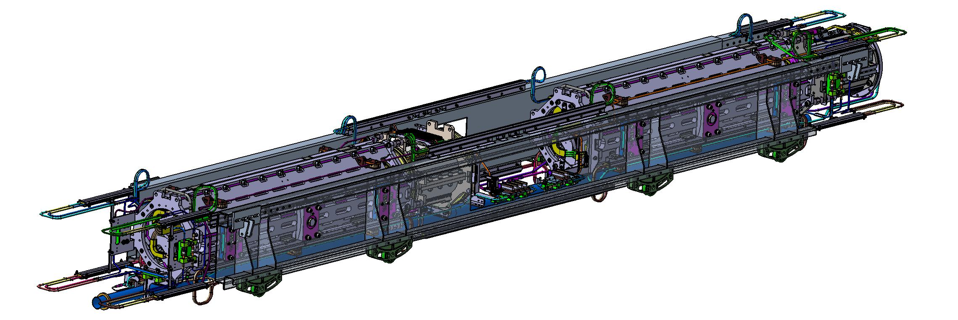
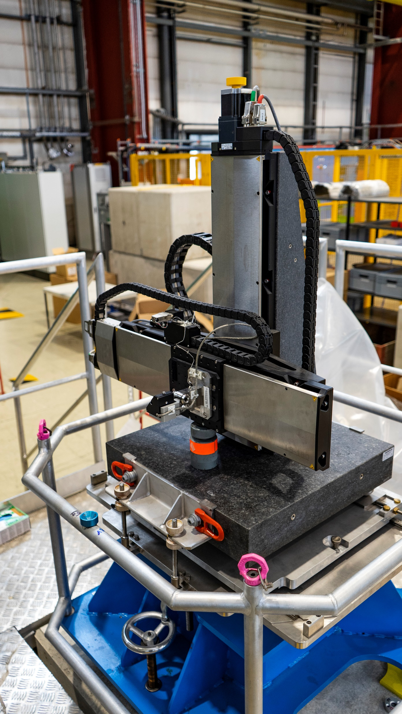
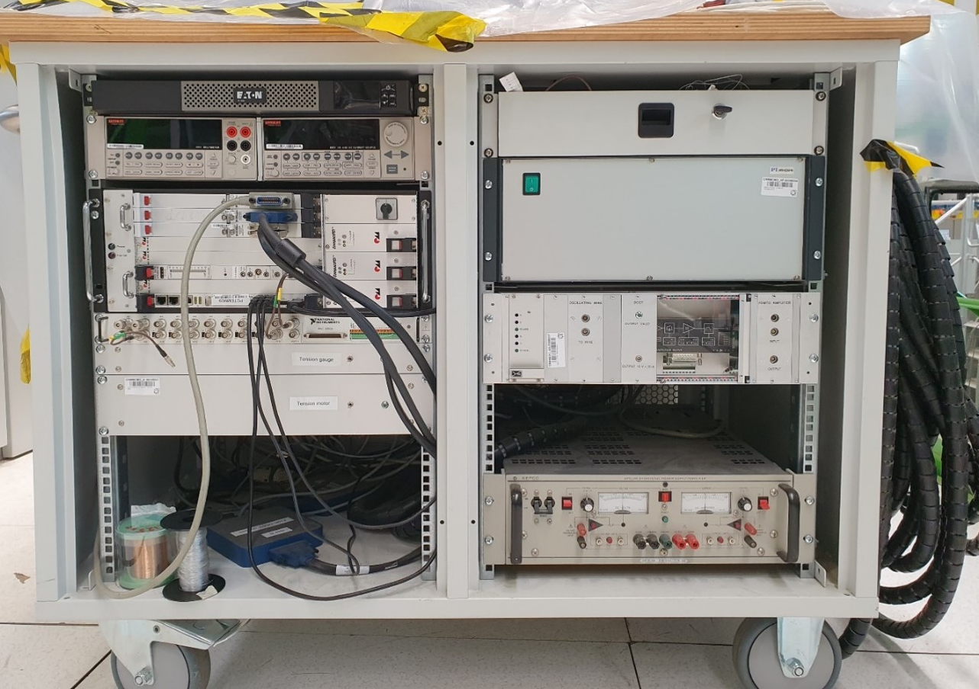
Motivation
Required infrastructure for cold testing of QU at STF:
Test cryostat with quadrupole units on a test girder. Design study at Cryoworld. Courtesy Cryoworld.
test cryostats for QD-units
bench and tooling for a fast mounting of the cold mass into the test cryostat (preparation towards series testing)
systems for magnetic field measurements
anticryostat for magnetic field measurements
optimisation of the existing infrastructure
Quadrupole units on a test girder. Courtesy Cryoworld.
Procurement strategy:
Test cryostats and installation benches - design and production by external company
Systems for magnetic field measurements - design and production within GSI-CERN collaboration
Components for the infrastructure upgrade – GSI (SCM, CRY)
Stretched wire system SSW6, magnetic axis measurements FAIR Super-FRS multiplets. Courtesy P.Kosek

Slide 6
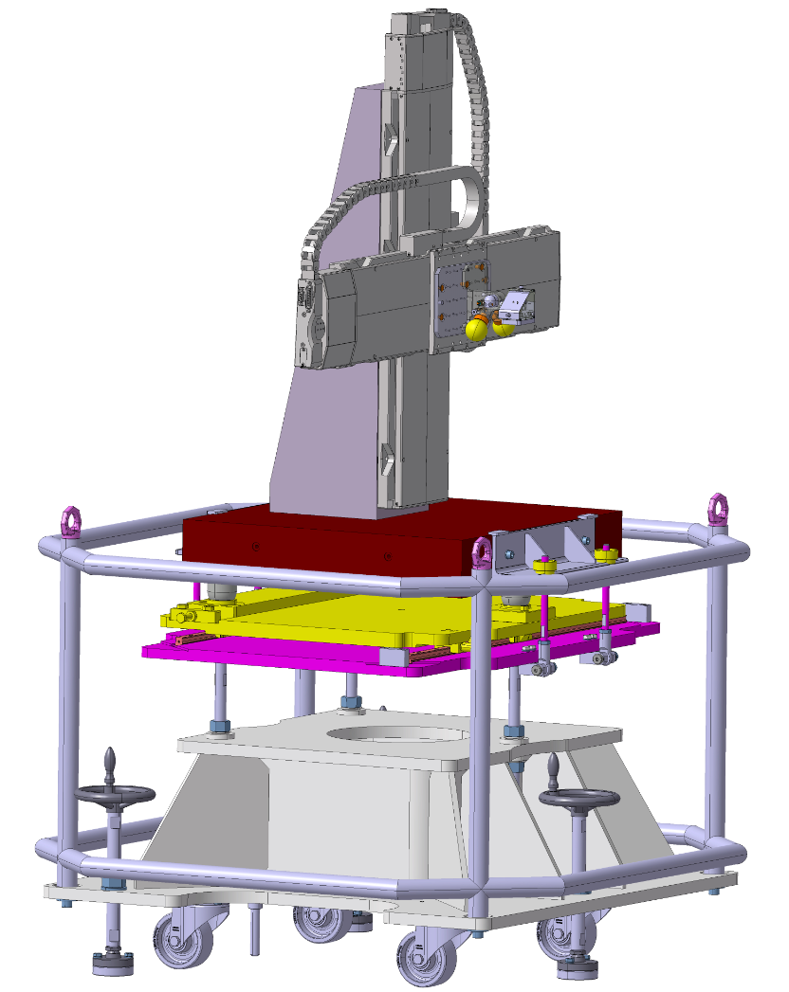
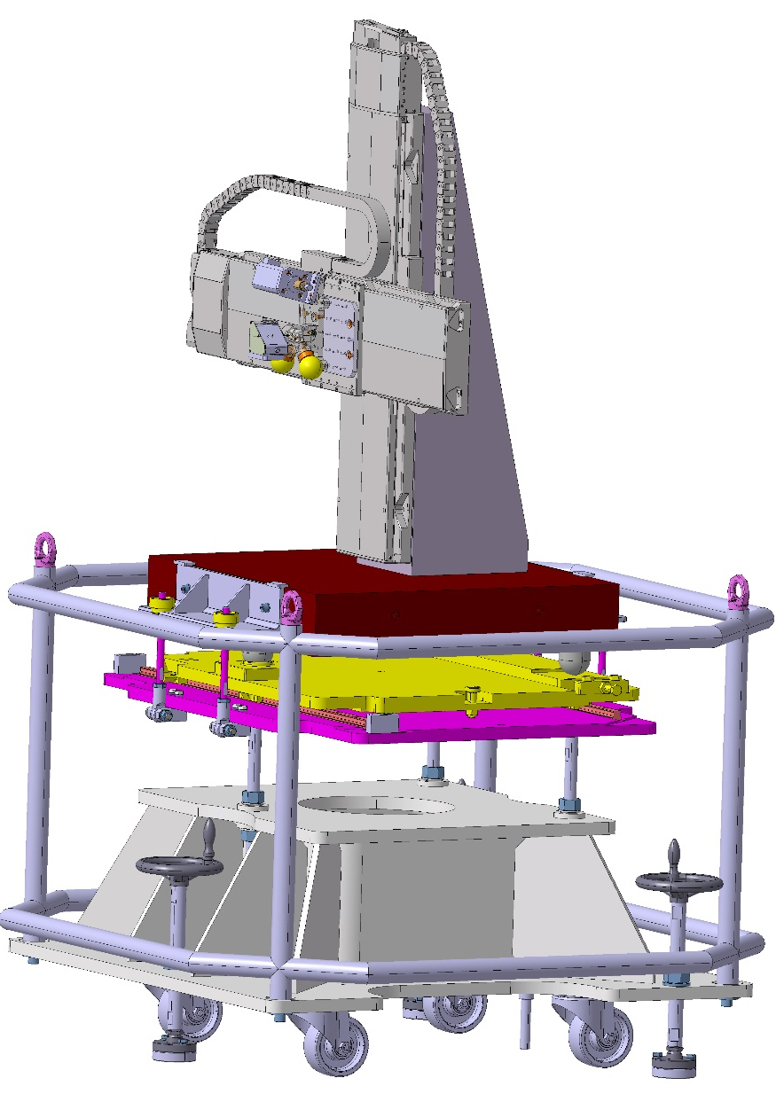
Development of new magnetic field measurement systems for GSI an CERN
Wire measurement system:
Position of the magnetic axis
Integral field gradient
Applicable for SIS100 units /doublets
Collaboration scope and contributions:
GSI | CERN
System development based on the CERN-SSW5 design
Hardware procurement | Training of GSI personnel
Final assembly and commissioning of the system
1.5 FTE | 0.8 FTE
~ 170.000 €
Model of a stretched wire system SSW6, magnetic axis measurements FAIR Super-FRS multiplets. Courtesy P.Kosek
Expected readiness for QU testing – Q4 2025

Slide 7
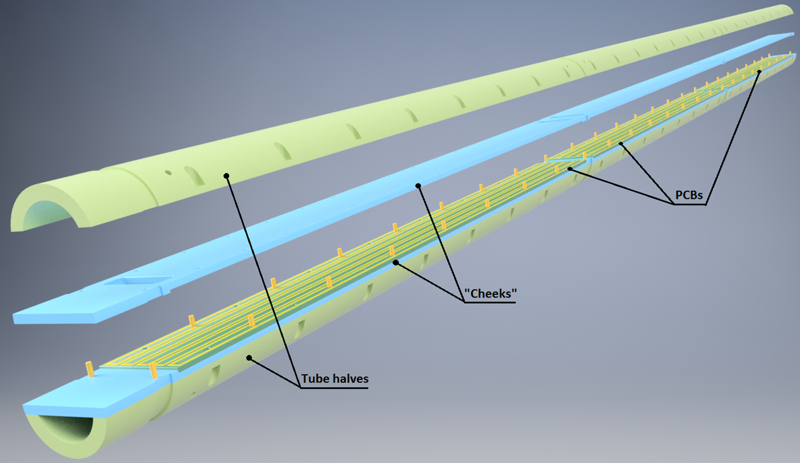
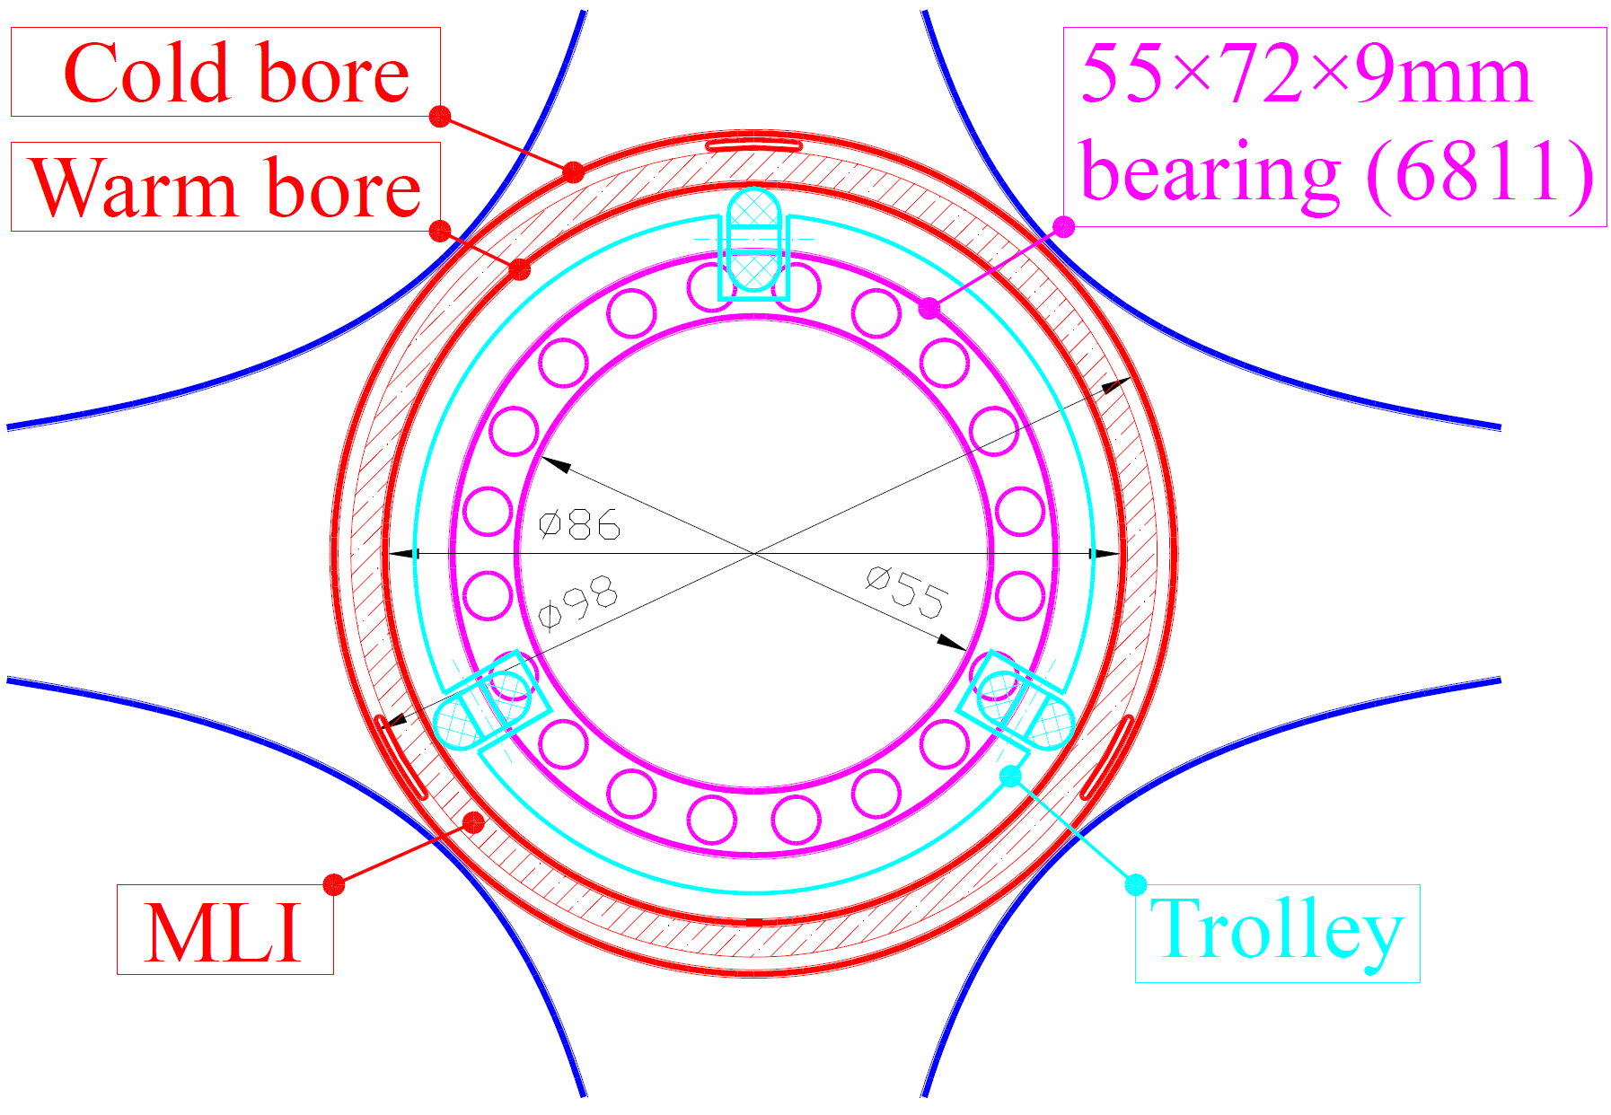
Development of new magnetic field measurement systems for GSI and CERN
Rotating coil system:
Field homogeneity
Integral field gradient for main quadrupole
Integral field strength for corrector magnets
Applicable for SIS100 quadrupole units
Only two rigid support points to avoid forced bending
Support points do not coincide with gaps between PCBs
Therefore, PCBs must fit inside the bearings
Collaboration scope and contributions:
GSI | CERN
Development of the measuring head based on PCB coils
Mechanical design and electrical layout for the PCB | PCB manufacturing and calibration
Procurement of components for measuring heads and motor units | Assembly and calibration of the measuring heads
Integration with motor units
Adjustment of the control and data acquisition software for operation at GSI
2.5 FTE | 0.2 0.8 FTE
~ 150.000 €
Tentative magnetometer design. Courtesy V. Marusov
Expected readiness for QU testing – Q4 2025 / Q1 2026

Slide 8
Benefit for CERN
Qualification of new suppliers for precision stages.
Development of new controller software for the new precision stages.
Training of (new) personnel.
Development of a new data acquisition systems for more commercially available components by GSI.
Replacement of the CERN FDI (Digital integrators) for which electronic components are no longer available.
Qualification of new suppliers for measurement shafts (G11 composite) and PCB plates
CERN will benefit from technological advancements, new suppliers and software updates

Slide 9
Description of work
GSI’s contribution:
Rotating coil system:
Mechanical design for a new coil shaft based on the CERN design.
Layout of the PCB (printed circuit boards) for single measuring segments.
Mechanical assembly and wiring of the segments for two rotating-coil shafts.
2. Single stretched wire (SSW) system (DC and AC mode):
Modification of the mechanical design of the support platforms.
Provision of one qualified expert (1 FE) for two 2 years for work within CERN’s Technology Department to enable the realization of the collaboration within the timeline defined.
> Position is announced by GSI

Slide 10
Description of work
CERN’s contribution:
Provision of the 3D models and drawings for the existing SSW.
Provision of access to the mechanical model and drawings of CERN's rotating coil shaft including anti-cryostat for adaptation by GSI.
Provision of access to the layout of the PCB Gerber files for the rotating coil shaft.
Provide the GSI expert access to the laboratories where mechanical assembly and intersegment wiring of the coil shaft is executed. Collaboration with GSI expert's in the development and improvement the software and hardware.
Testing and calibrating of the two new SSW systems at CERN (one for CERN and one for GSI).
Calibration of the rotating coil shafts.

Slide 11
Description of work
Joint contributions:
Procurement of mechanical parts and assembly of coil heads and single stretched wire system.
Update of the control and acquisition cards for the stretched wire system.
Adaptation of control and data acquisition (DAQ) software for communication with the new hardware.
Software adaptation based on the flexible framework for magnetic measurements FFMM for the specific common CERN and GSI applications.
Definition of acceptance criteria for the deliverables to fulfil the quality and safety aspects of both laboratories.
GSI and CERN will each procure their respective hardware independently and separately, with no shared responsibility or obligation.

Slide 12
Resources
Resources | Provided by CERN | Provides by GSI
Senior Scientist | 0.5 FTE (110 kEUR) | 1.5 FTE
Technician | 0.3 FTE (42 kEUR) | 1 FTE
GRAD |  | 1 FTE
Material | 250 kEUR | 340 kEUR
Infrastructure | 20 kEUR
Travel and accommodation | 10 kEUR | 50 kEUR

Slide 13
Status of New Addendum
New addendum is signed by GSI and CERN (beside KGF ?).

