Slide 1

Schedule Testing Super-FRS sc magnets
Hugo Bajas, M. Valentina Ricciardi
CERN-GSI Collaboration Steering Board Meeting
GSI, 07/05/2025

Slide 2
Super-FRS magnet testing - GOALS
Testing goals:
achieve early science objective
complete testing of magnets beyond early science

Slide 3
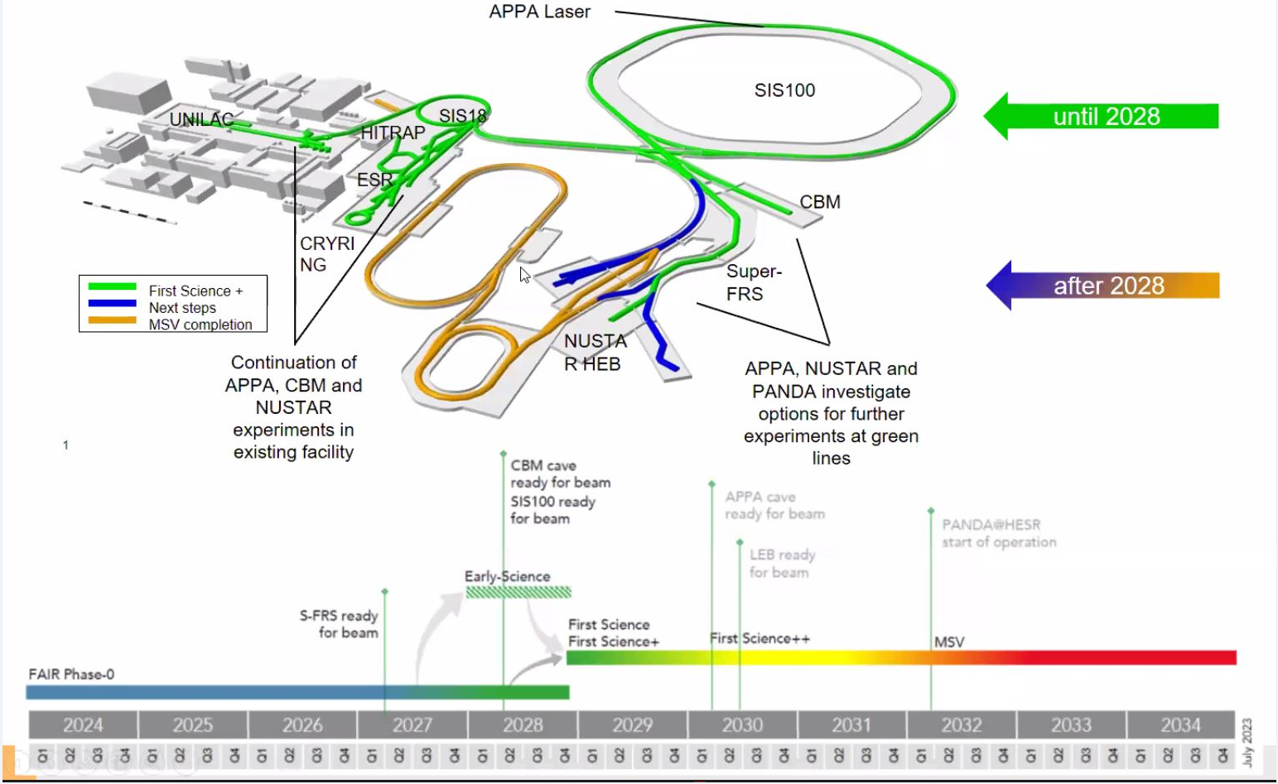
Early science objectives
Early science objectives start on Dec-2027
latest mechanical completion: Mar-2027
latest end of magnet installation in tunnel: Dec-2026
latest end of magnet testing at CERN: Oct-2026

Slide 4
CERN testing schedules
1. detailed test plan for CERN/GSI work coordination (Riddone, Bajas)
2. quarterly plan for coordination with manufacturers (Sugita)
3. long-run plan for project management (Ricciardi)
Scope of long-run testing schedule
have a nominal (“baseline”) schedule for ES
tool for project steering:
analyse consequences of input data and constrains
identify conflicts and risks
envisage possible solutions
extend the plan until end of project

Slide 5
Input and output data
internal
input data
(GSI, CERN)
FAIR installation schedule
(building, cryogenics,
other components)
OUTPUT:
testing schedule
external
input data
(ASG, Elytt)
Input (colour code):
should not be changed
can be changed with much effort
changes are assumed to be more feasible
→ multi-dimensional iterative calculation

Slide 6

Internal technical constrains
3 test benches (TB1, TB2, TB3)
activities on the bench grouped according to technical constrain:
Constrains on the bench | Assumptions for actual scheduling
Grey activities | max 2 grey activities simultaneously
require external support and crane
Brown activities | max 2 brown activities simultaneously
require a pre-cooler (only 2 pre-coolers)
Blue activities | max 1 blue activity simultaneously
require the main cryogenic plant (only 1)
Green activity | max 1 green activity simultaneously
require powering (only 1)
Constrains out of the bench | Assumptions for actual scheduling
Preparation Areas (PA) always available | only delivery of magnets as limiting factor

Slide 7
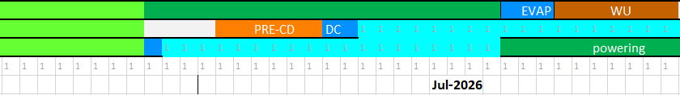
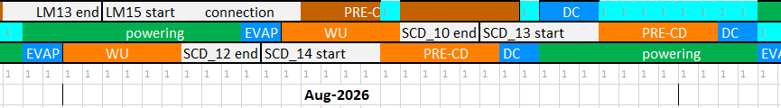
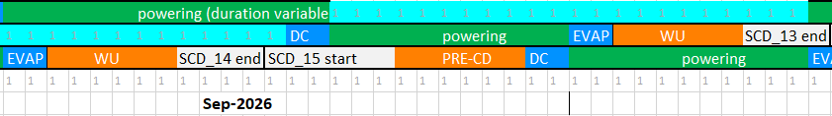
Consequence of technical constrains: Standby time
shutdown
standby time due to powering system
standby time due to powering system
standby time due to powering system

Slide 8
Other internal constrains
Periods of inactivity:
about 2-months/year for shutdown (June and December) and maintenance
7 working-days/year national holidays in addition to Christmas break (shutdown) (2 days in Easter, 1st of May, 1 day Ascension, 1 day Pentecost, 1 day Geneva’s days, 1 variable day)
Results from actual schedule, from now till end of ES objectives:
≈ 68% of the time, test is running (active testing time)
≈ 15% of the time, test is stopped due to shutdown
≈ 15% of the time, test is stopped due to standby
≈ 2% of the time, test is stopped due to public holidays

Slide 9
Result: Early-science testing schedule

Slide 10
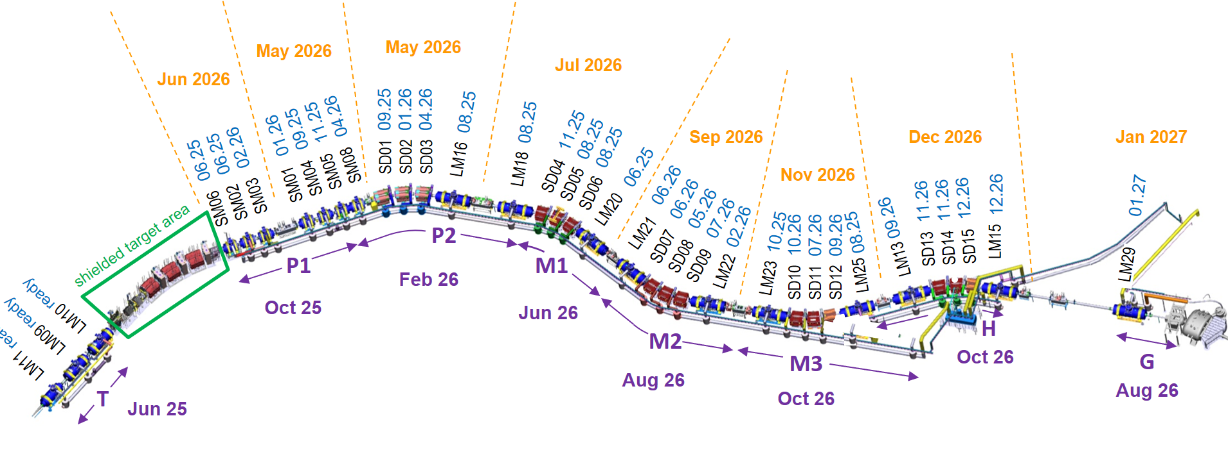
Results for Early Science
end of testing ES-magnets in October 2026 is achievable
sc-magnets installation completed:
in tunnel: Dec 2026
in HEC: Jan 2027
Local cryogenics sectors: installation completed (tendering results, Dec-24, Apr-25)
Magnets after pre-assembly, ready for installation (D.D.: 05.05.2025)
Magnets installation sections: installation completed (D.D.: 05.05.2025)

Slide 11
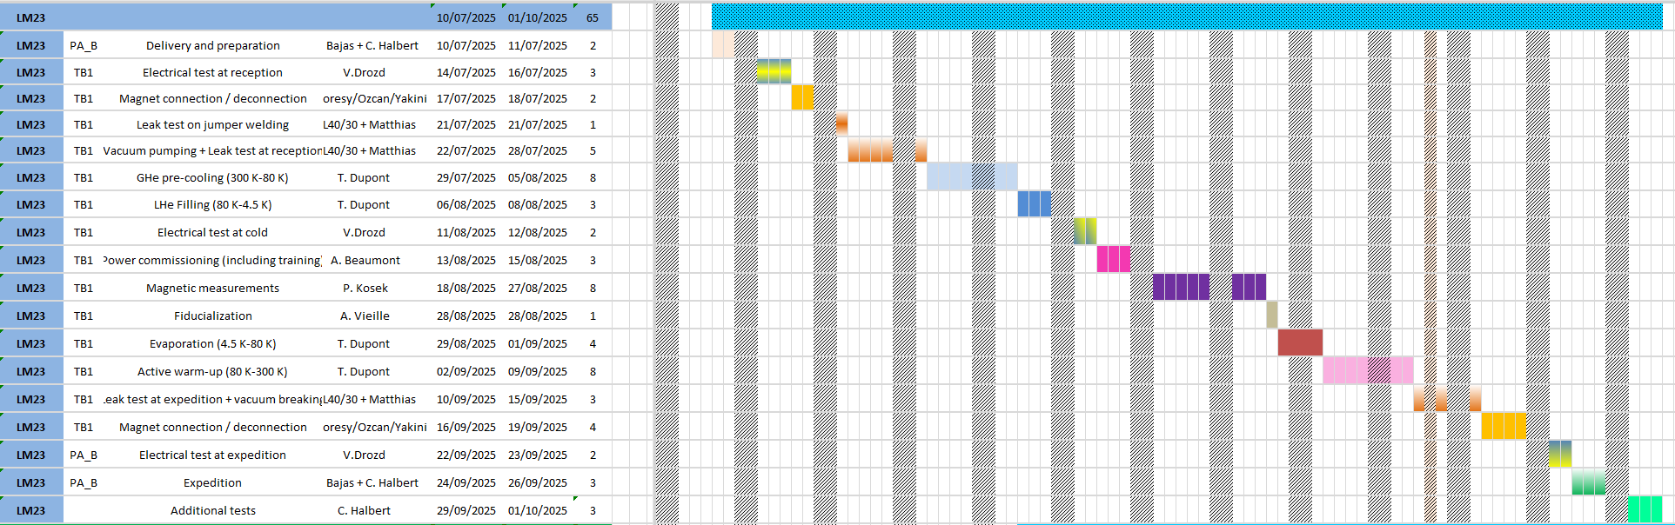
Detailed schedule by Bajas, Riddone
CERN detailed working schedule for daily tasks planning
Example LM23

Slide 12
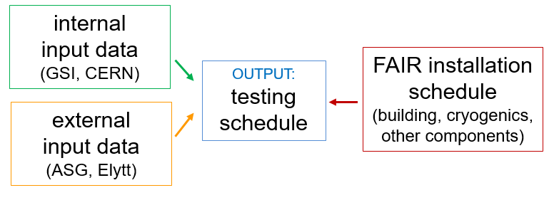
Actual schedule: used input data and constrains
Early-science constrain: latest magnet test in Oct-26 (consistent with actual building infrastructure and local cryogenics dates)
External constrains (magnet deliveries):
ASG dates as from Amendment June-24
(no deviations till now)
Elytt: deliveries in 2025 as agreed (Apr-25)
deliveries in 2026 according to bench availability
→ production rate in 2026: 1 dipole / 4 weeks
Internal constrains:
technical constrains as shown
nominal workload of activities on the bench
no buffer: no non-conformities, no late delivery, no show-stoppers, …

Slide 13
Comments on results for ES
GOAL: end of testing of ES-magnets in October 2026 is achievable with current input data and constrains but:
dipole production/rate to be followed up closely
still uncertainty on nominal workload of testing activities, in particular power commissioning/training, leak-test duration
no buffer included (no non-conformities, no late delivery, no contingencies, …)
What could be done for a resilient schedule
optimise technical constrains for activities on benches (→ reduce standby time): power-converter control and related systems for parallel powering, cryogenics stability for quenching sustainability, connection-disconnection optimisation, cold-test durations
envisage administrative and organisational solutions: availability of storage space and preparation area, rump-up personnel for parallel activities on more benches, mitigate impact of workload on duration by increasing FTE, flexible working-hours or shifts
analyse which risks may be accepted or postponed

Slide 14
Results: beyond Early schedule

Slide 15
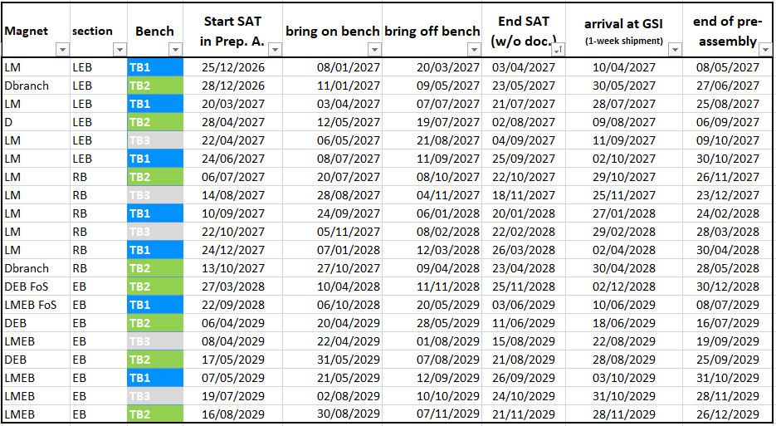
Next testing phase (till end 2029)
Next stage: mapping D3, branch dipoles, Low-Energy Branch magnets, Ring Branch long multiplets (due SAT to ASG), Energy Buncher spectrometer magnets (in Low-Energy Cave)

Slide 16
Conclusions
ES goal can be achieved
in order to match the deadline, buffer implementation is essential to face contingencies
further testing for next FAIR staging steps must be secured
last but not least: the established harmonic cooperation GSI-CERN allows easily solutions and mitigations of routinely problems

