Slide 1

Status Magnet Production and Further Collaboration Steps
Haik Simon
GSI, May 7th, 2025

Slide 2
Collaboration Topics
Task Force activities ➔ prepare series production
ASG Quality, Brazing
Elytt Quality, Brazing & Chamfer Fixation
Feed-Through Issue
Amendment #3 to Addendum #12 KR3912 to Agreement K1727/DG

Slide 3
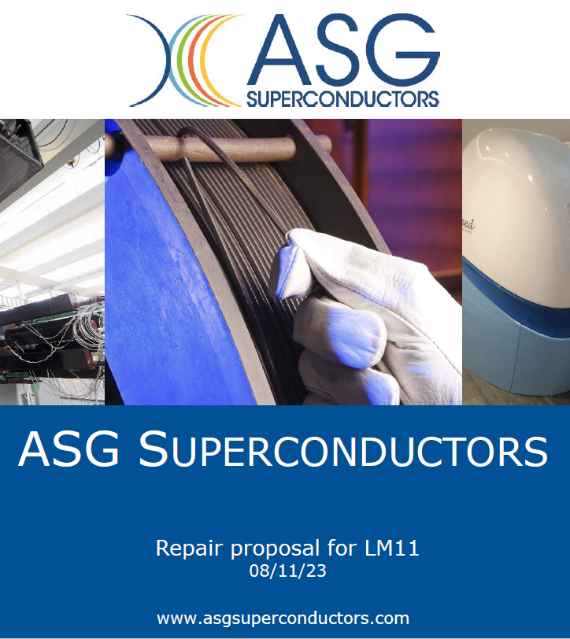
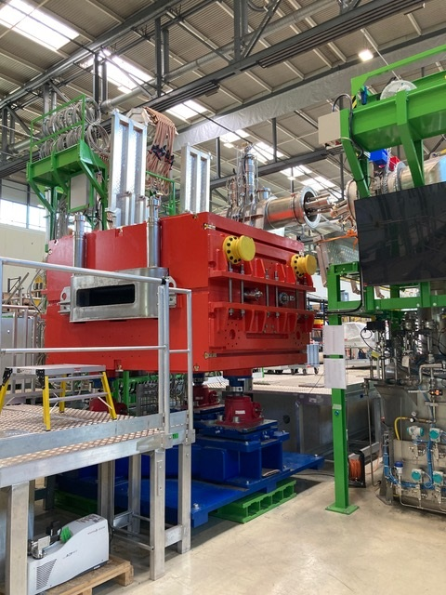
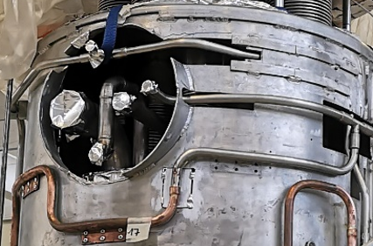
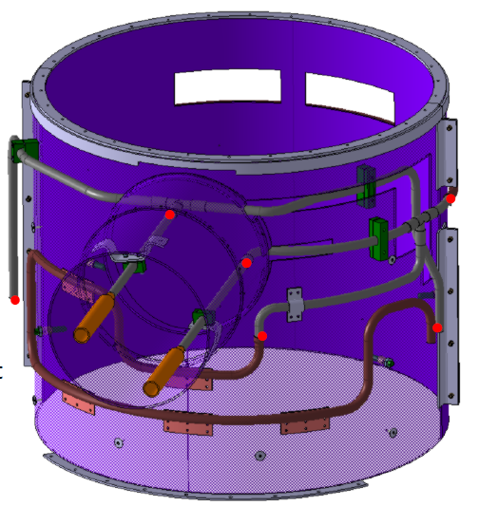
Superconducting multiplets
Mitigation and repair schedule in continuous work with ASG (since 20231120)
Decision points Feb 2024, May 2024 following revised magnet SAT testing
revision strategy for
5 pcs Early Science magnet incl. spare requested
finished magnets 5 pcs Early Science
assembled magnets
7 pcs Early Science, 1 pcs not Early Science
un-assembled
5 pcs Early Science: 9 pcs not Early Science
Finally, all magnets are being built with new design.

Slide 4
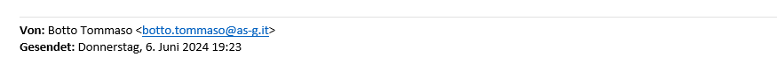
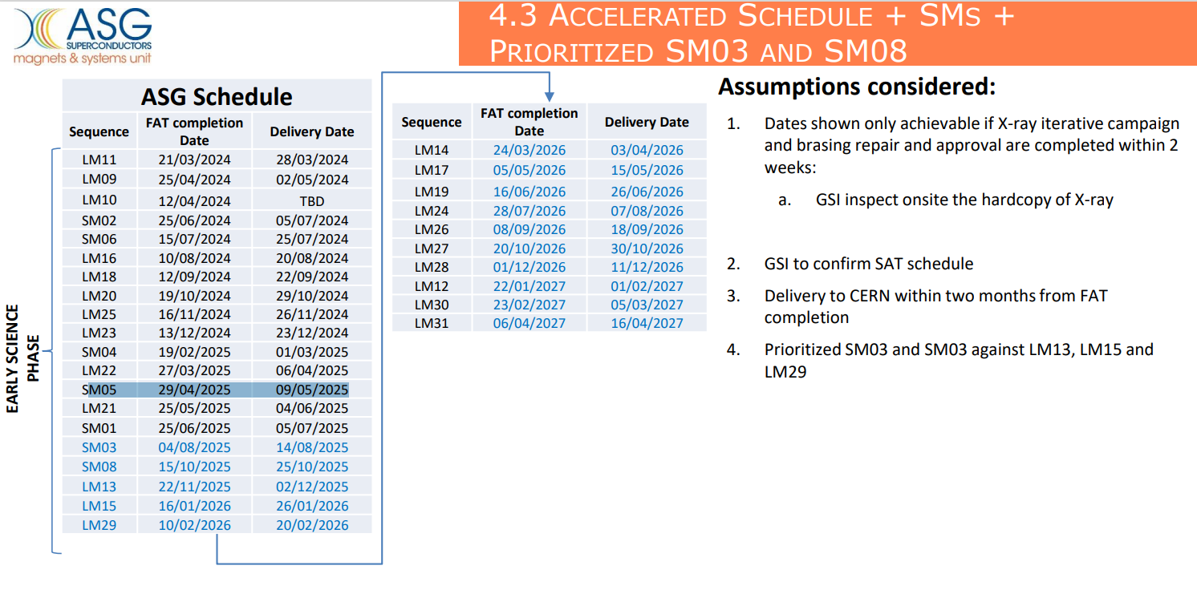
Delivery schedule agreed with ASG 06/2024
Stabilized schedule (see talk V. Ricciardi, H. Bajas)

Slide 5
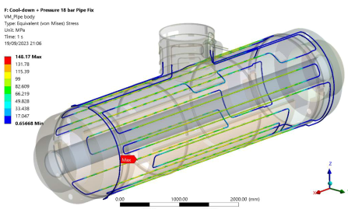
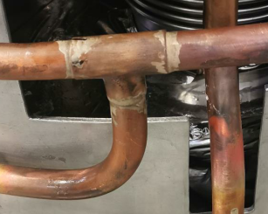
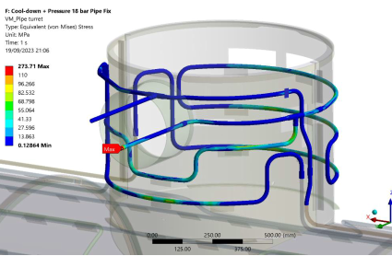
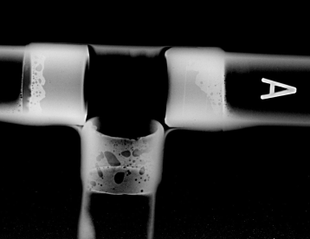
Activities
Joint task force (26.09.2023 – half year review, 19. June. 2024 )
Root cause analysis, verification of design, material, repair solution
June. 2024 -
Brazing
Brazing process review on/off-site
FEM
Verification of thermal shield design and repair solutions
Tests
Tomography, Metallographic inspection,
Leak test after thermal schock, Cold leak test,
Tensile test
Ni coating on stainless steel pipes
Evaluation of brazing quality of Cu-Cu joints and bi-metallic joints with X-ray
Improvement
Enhance brazing quality
Ni coating on
strainless pipes
for series multiplets
implemented
Partial replacement of
Cu-Cu socket
brazing with TIG
welding
Leaky joint
of LM11
ongoing
Expand testing activities to the joints of dipole magnets
done

Slide 6
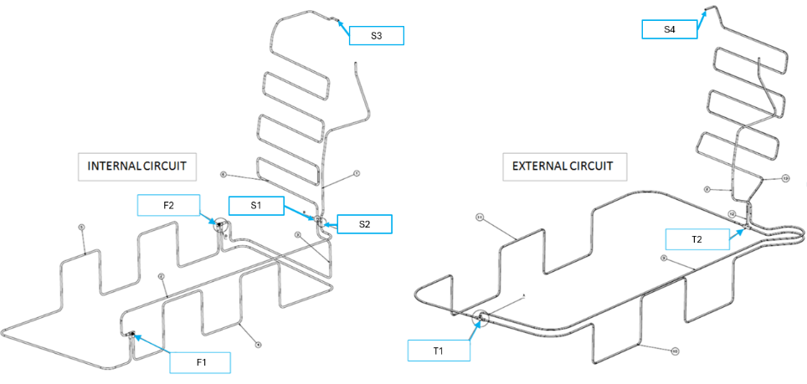
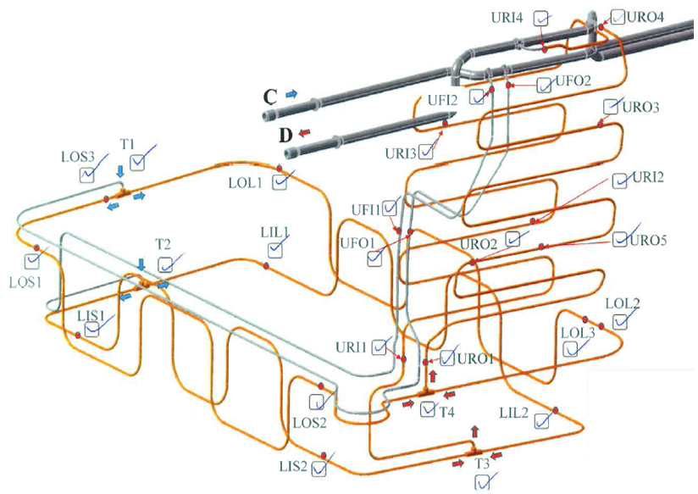
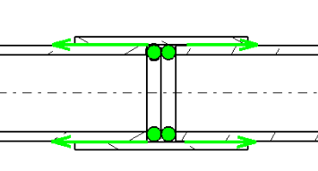
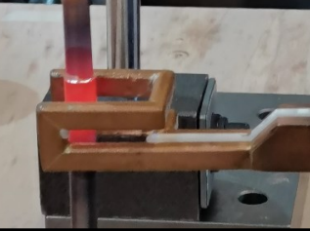
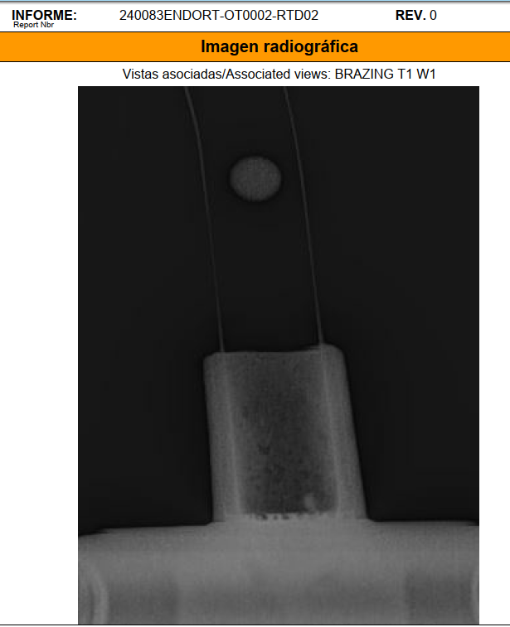
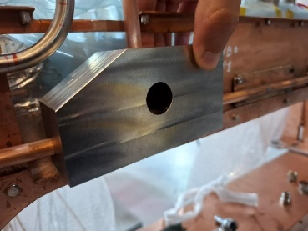
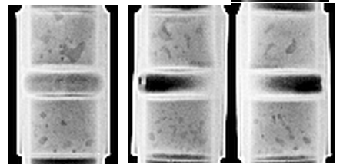
Sc dipoles technical aspects
Thermal shield brazing joints
Old Design:
6 m Cu pipes → about 20 brazing joints
New Design:
7 m Cu pipes → only 8 joints
2 F- and 2 T-joints in coil casing area
4 straight joints in chimney area
OLD
NEW
Status X-ray (31.10.24):
Full campaign done on 2D2 T- and F-joints
Evaluation meeting with CERN on 4.11.2024
New brazing method:
Using filler material rings
Inductive brazing
Additional intermediate test:
Local leak test of pressurized pipe with chamber on each brazing
X-ray inspection of each joint
Chamber for T-joint testing
CERN-X-ray on Elytt sample

Slide 7
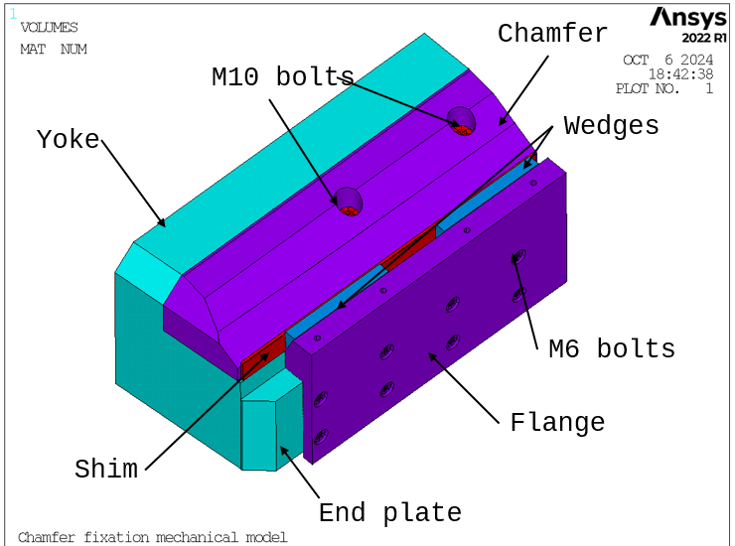
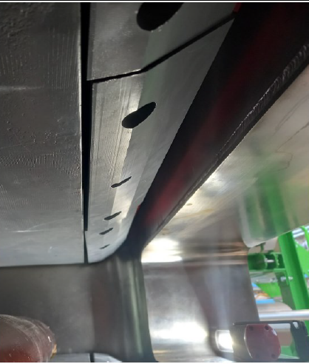
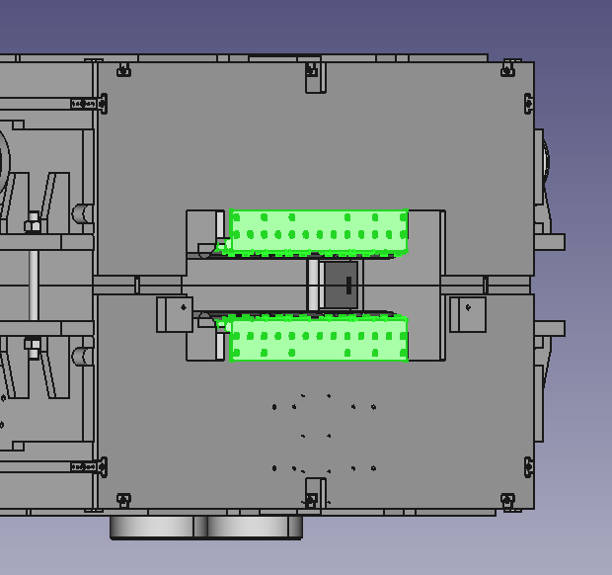
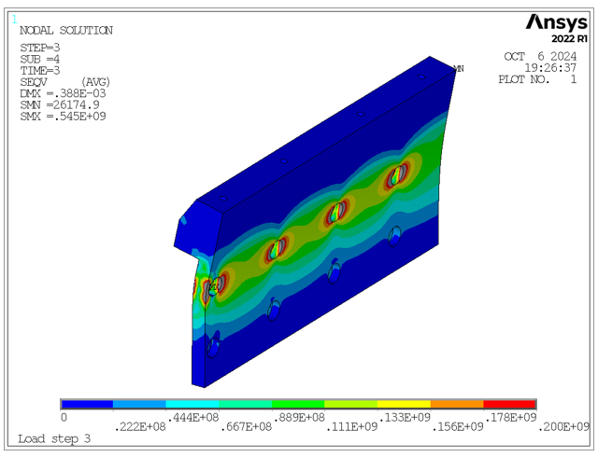
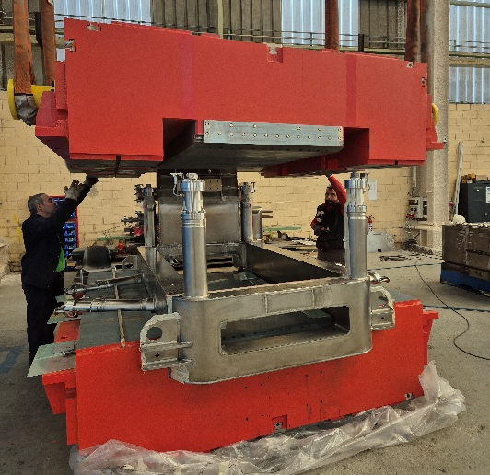
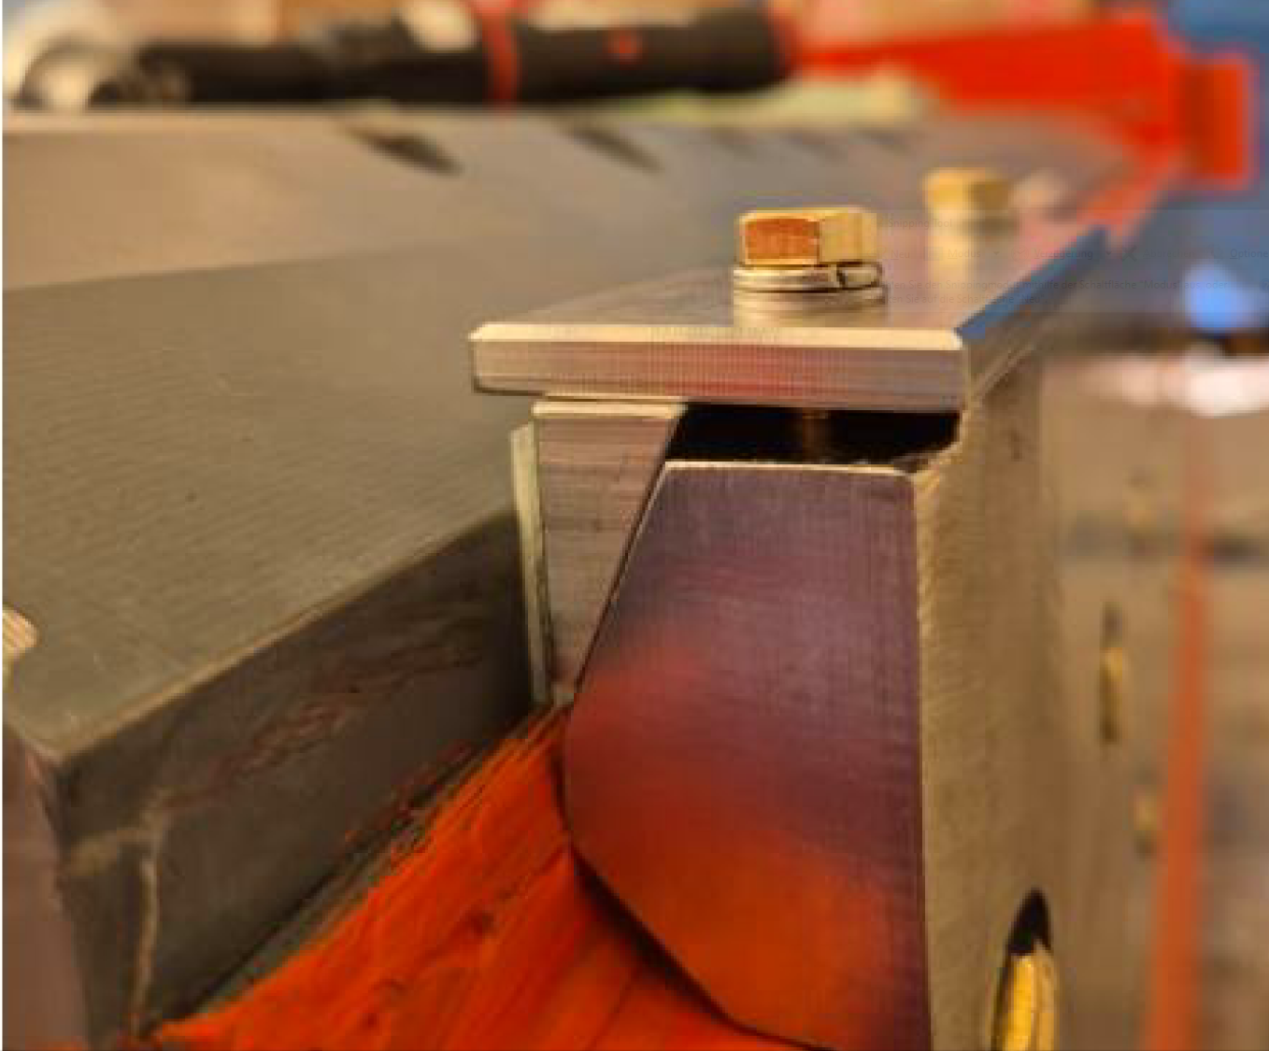
Sc dipoles technical aspects
Chamfer movements
caused by bending of screws and delamination in yoke due to high magnetic forces (40 kN) acting on chamfers
Solution:
External fixation with retainer screwed on end plate
Status (31.10.24):
Retainers for 2 magnets ready
Status (07.11.24)
Integration at Elytt
SAT tests ok Q1/2025

Slide 8
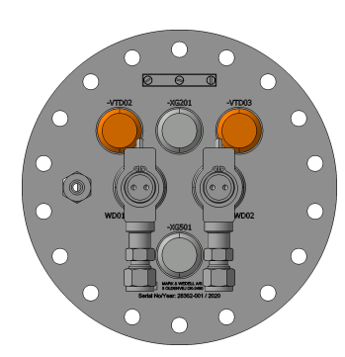
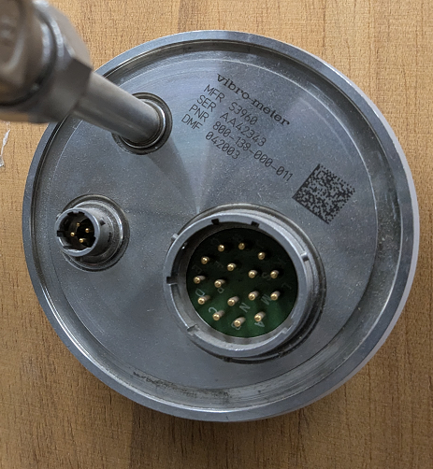
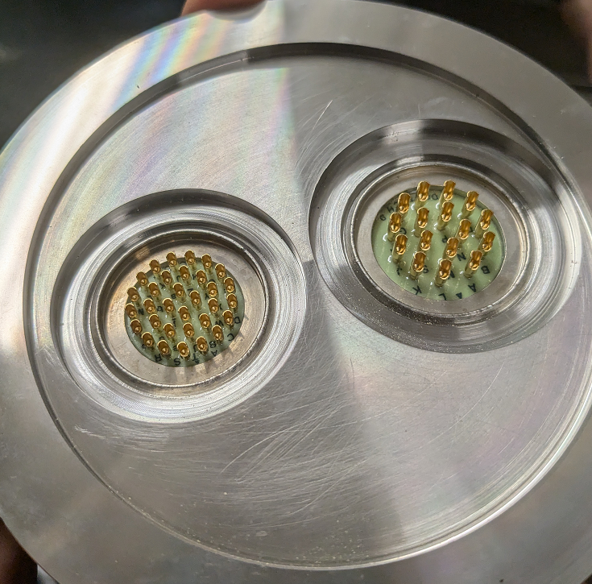
Sc dipole (multiplet) issues with
Lemo Feed-Throughs
Lemo Feed-throughs under pressure:
All mounted on current lead flange already by Marc & Wedell
Repair:
Would require removal of current leads
→ open up part of vacuum vessel
→ open up part of themal shield
→ open up part of He-vessel
to access joints at cold terminals
T90 temperature sensors
Voltage Taps
He-Level sensors
Leak test on magnets at CERN
D01 (FoS D2): Leaks detected (1e-4 mbarl/s) at 12 bar on three connectors D06 (3rd D3): no leaks detected at 1.3 bar
➔ Analysis in GSI-CERN task force started
Status:
Long term behaviour not clear
Values measured so far ok
Leak rates for safety valves 1e-3 mbarl/s
Irradiation Test with new potting material (Duromer) running at CERN (Results expected 06/2025)

Slide 9
Current collaboration contracts
On 14/04/2010, GSI and CERN signed the Agreement K1727/DG establishing an operational framework for collaboration in accelerator sciences and technologies, and other scientific domains of mutual interest:
collaborative effort
free information exchange except sensitive contract relevant issues
e.g. NC negotiations with suppliers
Following Addendums to Agreement K1727/DG
TITLE/SCOPE | Machine | Status | Addendum | Date
Cryogenic testing of the superconducting magnets for the Super-FRS | Super-FRS | active | #2 #4 #5 #12, KR3912 Amendment to #12 | 2012 2014 2016 2018 2023
31/10/2023
31/12/2026

Slide 10
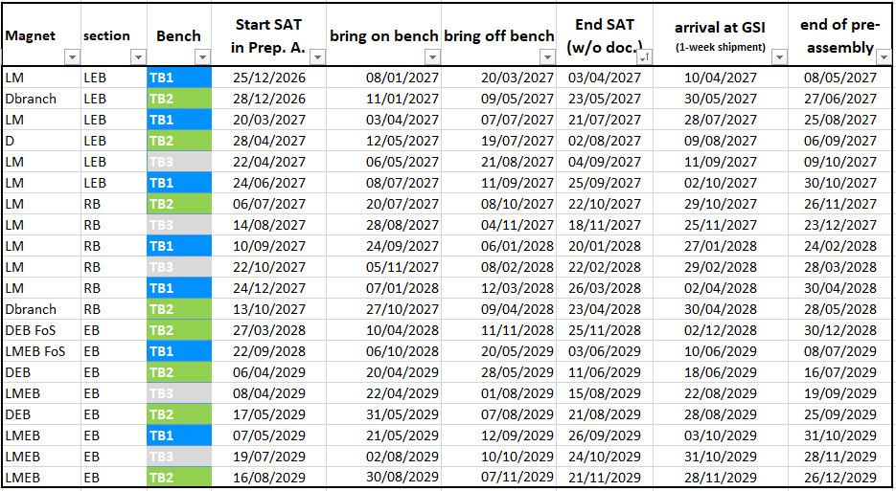
ES and beyond: testing phase (till end 2029)
Next stage: mapping D3, branched dipoles, Low-Energy Branch magnets, Ring Branch long multiplets (ASG scope), Energy Buncher spectrometer magnets (Low-Energy Cave)

Slide 11
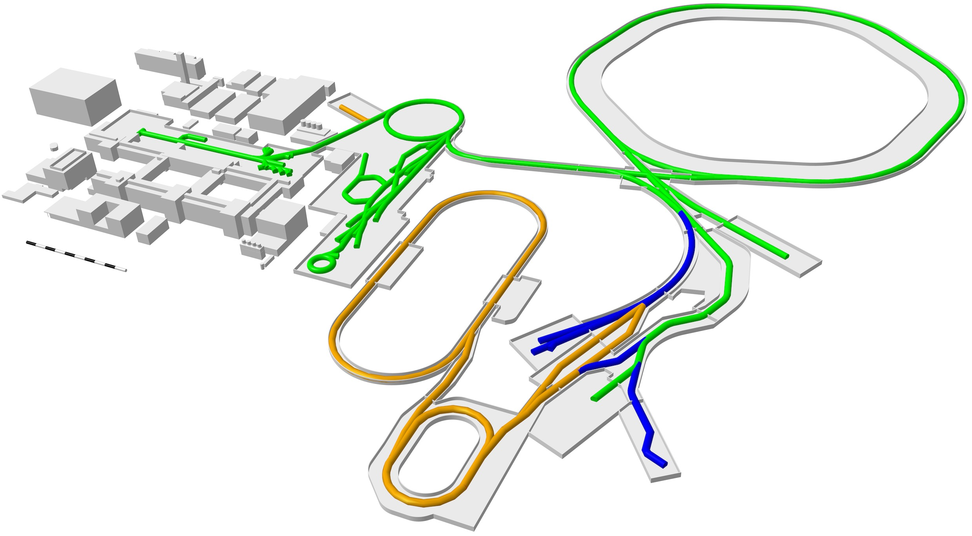
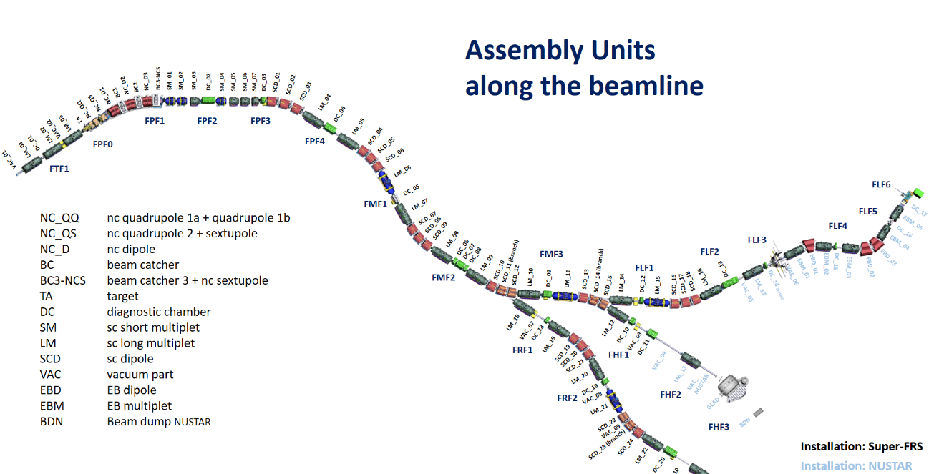
FAIR 2028 and beyond
Low energy
Branch with
Energy buncher
High energy Branch
Target
Ring Branch
According to current planning the
Low Energy Branch is the next NUSTAR facility to come (FS++)
Technical Design Report:
H. Geissel, et al. (2009)

Slide 12
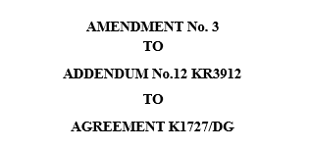
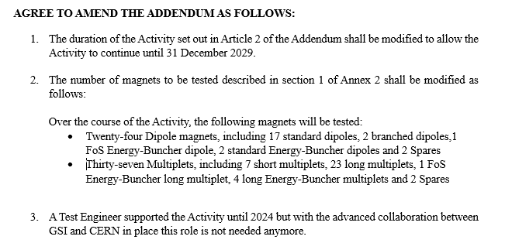
[…]

Slide 13
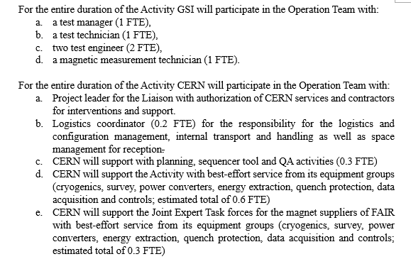
Amendment #3

Slide 14
Summary
Very successful collaboration !
Task Force activities enabled major improvements mitigating quality problems and FoS child deseases in both magnet supplier chains!
Expediting and technical advisors in place, especially to stabilize Elytt delivery schedule
No apparent issues for current Early Science scope
Potential ramp-up of GSI testing team if required
Facility related improvements (see following talk by Germana Riddone)
Next steps:
Early Science Shifted Scope / First Science++ scenario: Branched Dipoles / Low Energy Branch (2027 … 2028)
First Science++ scenario / MSVc : Energy buncher & spectrometer, Ring-Branch Multiplets (2028 … 2029)

Slide 15
Backup transparencies

