Slide 1
FAIR operation concept from the new Control Center
CERN-GSI Collaboration Steering Board Meeting, May 2025
Stephan Reimann
subproject leader FAIR commissioning,
head of GSI operations department

Slide 2
Outline
FAIR Commissioning
FAIR Operation Concept (FCC 2028)

Slide 3
GSI & FAIR – Integrated Campus Schedule
2024 2025 2026 2027 2028
First beam in T1S1
Beam Time
Beam Time
Beam Time
Beam Time
FCC Construction & Procurement of Interior equipment
Equipment
Installation
Commissioning
ACC operation
from new FCC
Injector Controls Upgrade: 1st version of new production system
Injector Controls Upgrade: finalization
Controls & BI Digitization UNILAC, SIS18, ESR, Cryring, HEBT
Civil Construction
FAIR Tech. Buildings Infrastructure
FAIR Buildings Testing & Commissioning
HBO
Regular Operation of Tech. Buildings Infrastructure
FAIR Accelerator / Experiments Procurement & Manufacturing
SFRS-ES
SIS100-FS
FAIR Accelerator / Experiments Installation
HEBT/SFRS-ES
SIS100-FS
Cryo 2
Commissioning
HEBT-ES Hardware-Commissioning
Dry-Runs
Start of ES
science program
SFRS Hardware-Commissioning
ES Beam Commissioning
start of first
science program
& first science+ program
Dry-Runs
SFRS Cooldown
HEBT & SIS100 -FS Hardware-Commissioning
FS Beam Commissioning
Dry-Runs
today
SIS100 Cooldown

Slide 4
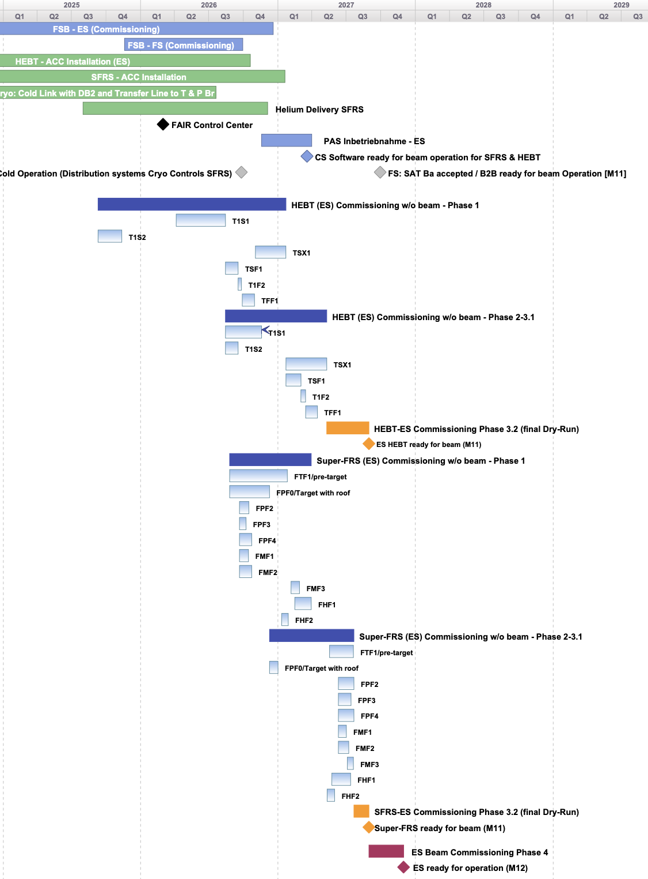
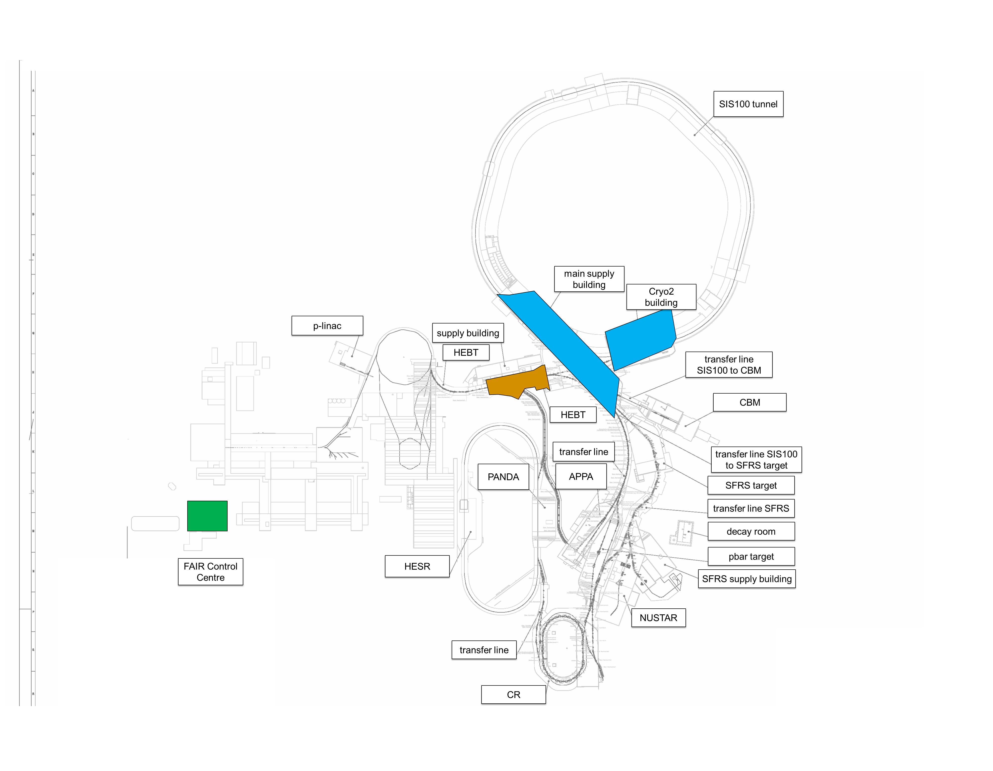
First 3 major Commissioning Milestones
FSB – ES Commissioning
← Early Science commissioning schedule on section level
Cryo2 Commissioning
Q2/2025 → Q4/2025: cryogenic plant “Cryo2” (building K0720A & parts of main supply building H0719A) (see coloured area right)
Q4/2025: start of first commissioning activities in Transfer Lines T1S2 and subsequently T1S1
(both ready for beam in Q4/2026)
Q1/2026 commissioning of FAIR Control Centre and new Main Control Room

Slide 5
Organisation of Commissioning
Commissioning is organized as a subproject within FAIR project
fully integrated in FAIR management lead team with other sub project leaders and in GSI accelerator organisation (ACC)
fully integrated into FAIR reporting structures (planning, risk management, controlling) and committees
Subproject Commissioning is divided in 12 work packages with dedicated work package leaders (commissioning responsible)
Full integration of experiment groups and facility management (technical building infrastructure) in the commissioning process
line management
project organisation (matrix)
Technical Director
J. Blaurock
Note: handover to operation organisation after delivering beam with project completion parameters (PCP) on target:
Early Science: 238U73+, 1 GeV/u, 2E9 ions/second
First Science: 238U28+, 1.4 GeV/u (60Tm), 2.5E10 ions/cycle
First Science+: 197Au79+, 11 GeV/u, 1E7 ions/second
Head Accelerator Operation & Development
R. Assmann
FAIR Project Lead
J. Blaurock
FAIR Commissioning Subproject Leader
& GSI Operation Manager
S. Reimann
HEBT
commissioning responsible
Cryogenic
commissioning responsible
FAIR Control Center
commissioning
responsible
Safety
commissioning responsible
technical building infrastructure
responsible
NUSTAR
commissioning responsible
Radiation Safety
commissioning responsible
SFRS
commissioning responsible
Controls
commissioning
responsible
associated GSI-group
(FAIR Commissioning and Operation) in ACC-OPE
Line management
S. Reimann to operations department OPE
first science
and beyond

Slide 6
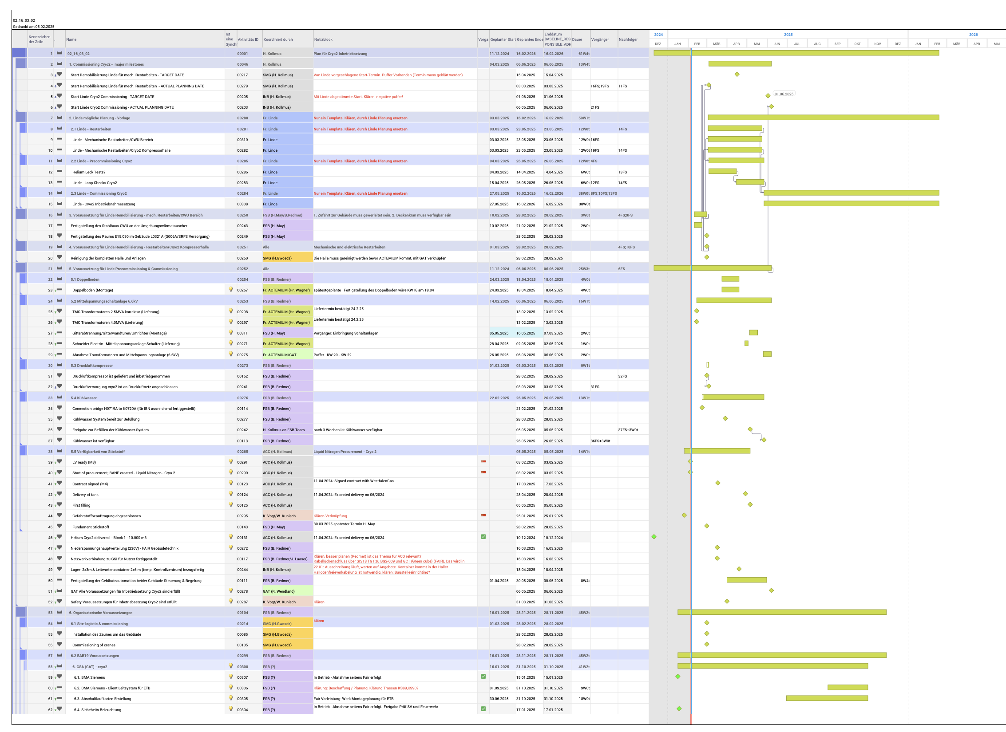
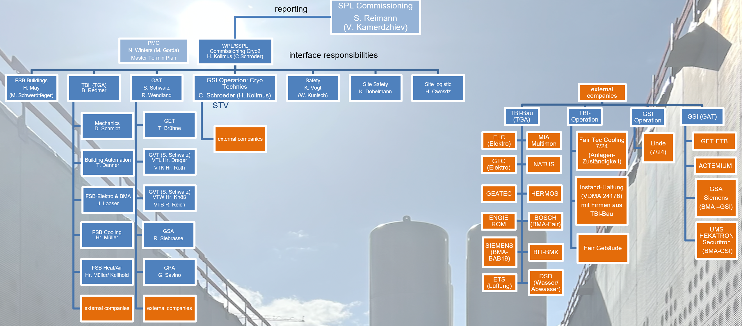
1st Major Milestone: Commissioning of cryogenic plant
Cryo2 Commissioning - work package organization with external companies
Cryo2 work package organization has been developed (as pilot for all further commissioning activities e.g. HEBT commissioning)
Organisation, processes and responsibilities including safety are clarified and documented
Lessons Learned from Cryo2 Commissioning are important for the next commissioning phases
Detailed commissioning schedule of cryo system

Slide 7
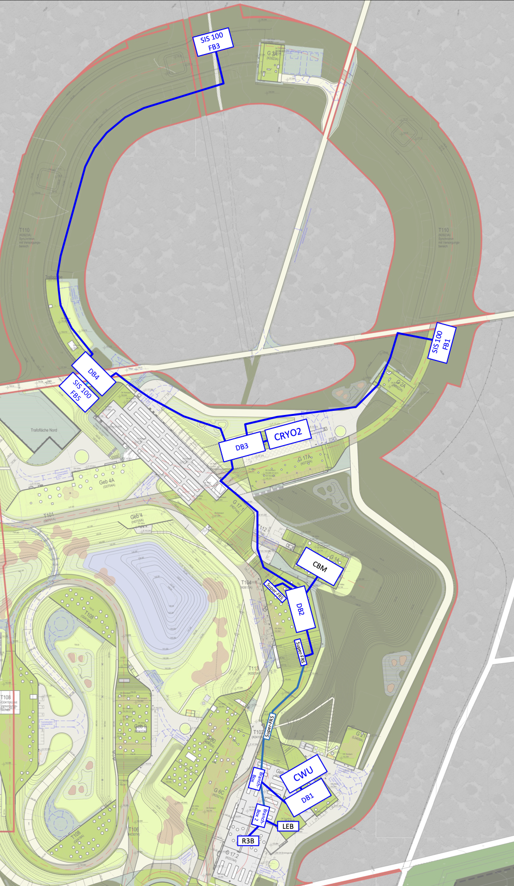
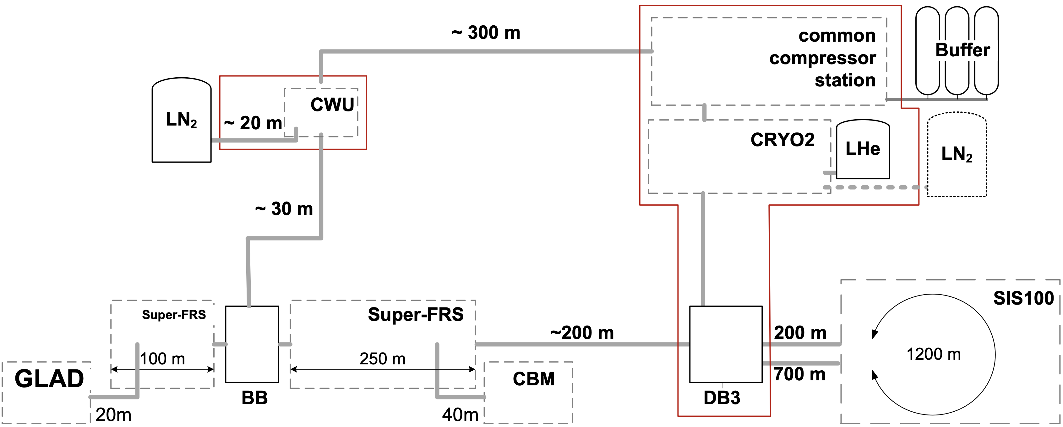
Commissioning of cryogenic system
Cryo2 commissioning starts June 2025 with distribution box DB3
involves cryoplant, compressor station, and the helium storage
an media from construction site
requires special safety measures due to surrounding construction site
following steps: Super-FRS and SIS100 cryo distribution systems

Slide 8
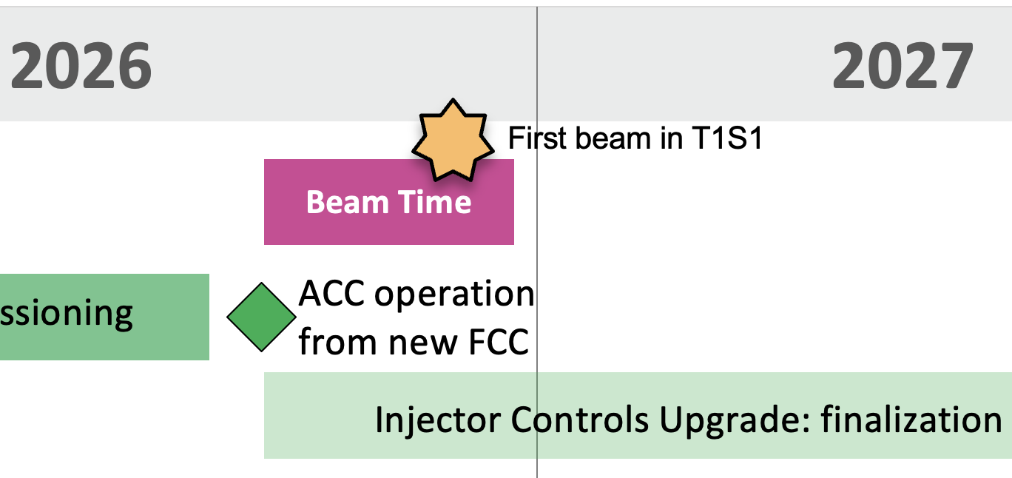
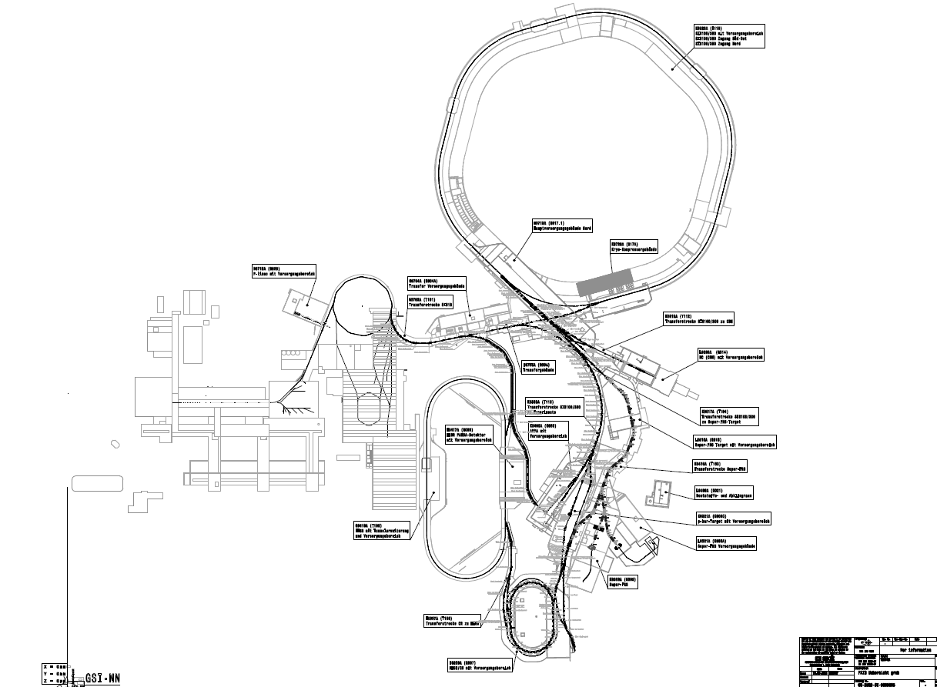
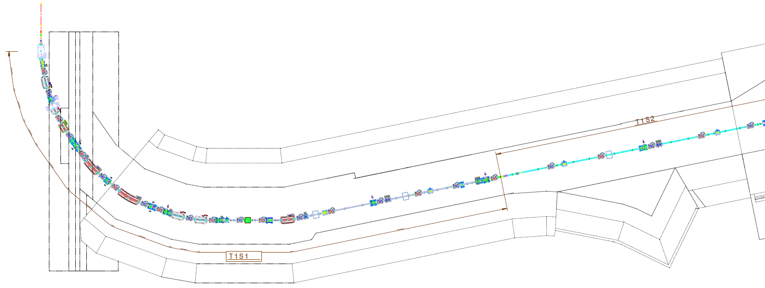
HEBT-Commissioning & First Beam Event in Q4 2026
GSI/FAIR
border
beam from
SIS18
Target: T1S1DF6 (Scintillator screen)
Wall
Boundary of the safety
zones NE1 and NE22
NE1 NE22

Slide 9
Preparation of Gate Reviews for phase transitions
Mechanical Completion
gate review concept under development
different readiness needs, depending on commissioning phase / concept
includes acceptance checklists and inspection walk-through
FSB: TBI & Media Ready
Safety / radiation safety
Commissioning: previous phase are completed
Readiness Review (Gate): release for the next phase
1. Pre-comm. & Local HW
3. Integration
M103-s
M103
M104-s
2. remote & single system
M104
3.1 Integration (multi system)
M11
M12
M12-s
3.2 Integration (Dry Runs)
M105
4. Pilot beam comm.
M12-A

Slide 10
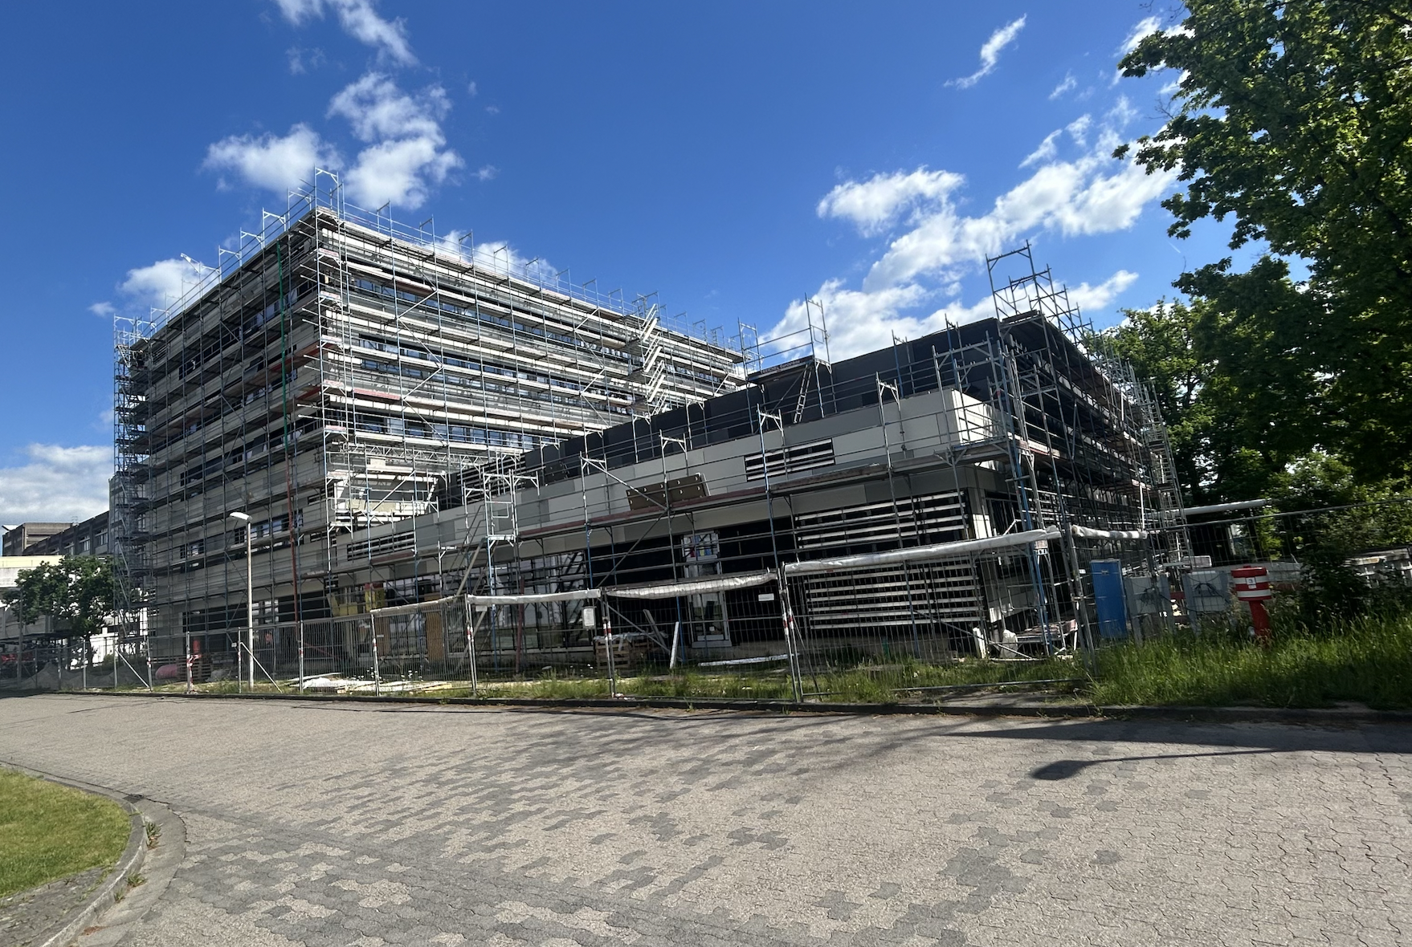
II. FAIR Control Center

Slide 11
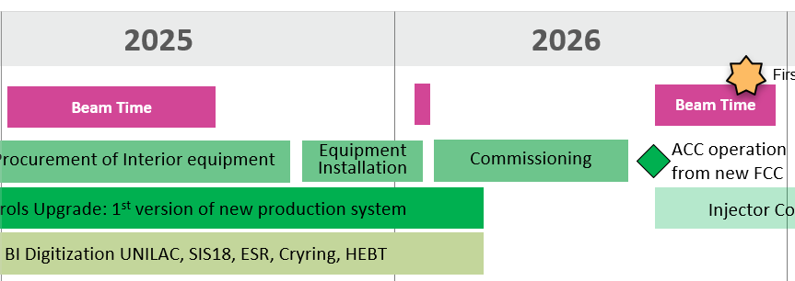
FAIR Control Center – Move and Commissioning
Bi-weekly FCC commissioning meeting with all stakeholders established
planning & steering of construction, procurement, installation and commissioning
final acceptance of injector controls upgrade with beam
10.11.2025 : new main control room will be ready for interieur installation
consoles: the call for tenders is closed, the order will be placed next week
procurement process for other equipment (displays etc.) hast also started
Extended dry test phase for data supply, control and readout

Slide 12
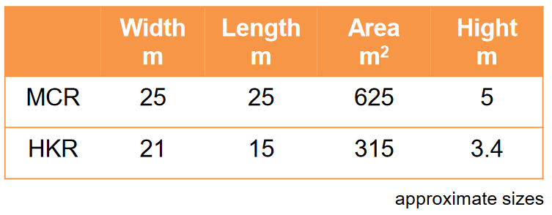
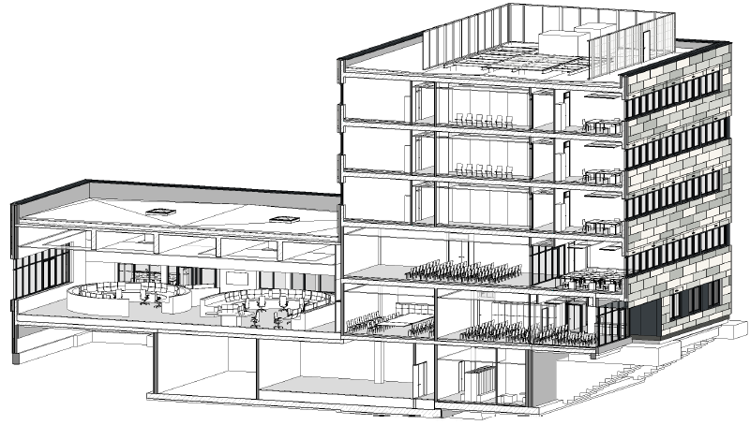
FAIR Control Center – basic facts
25 workstations
fully digital
access control
water-cooled consoles
height-adjustable tables
open space, no columns/pillars
holistic floor design with meeting rooms, visitor's gallery, showers, changing rooms, kitchen

Slide 13
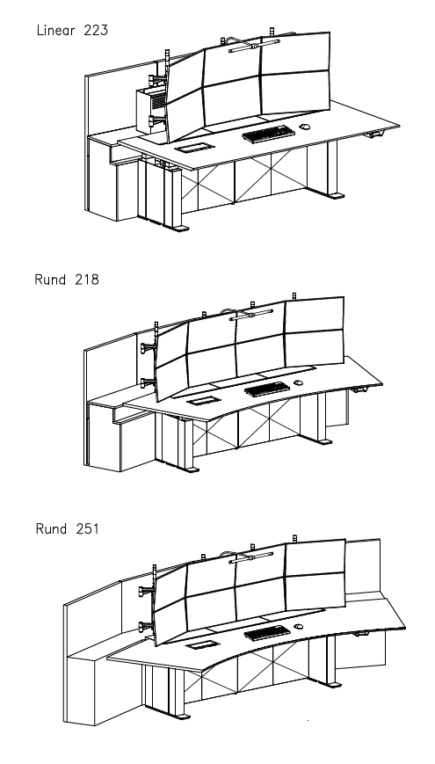
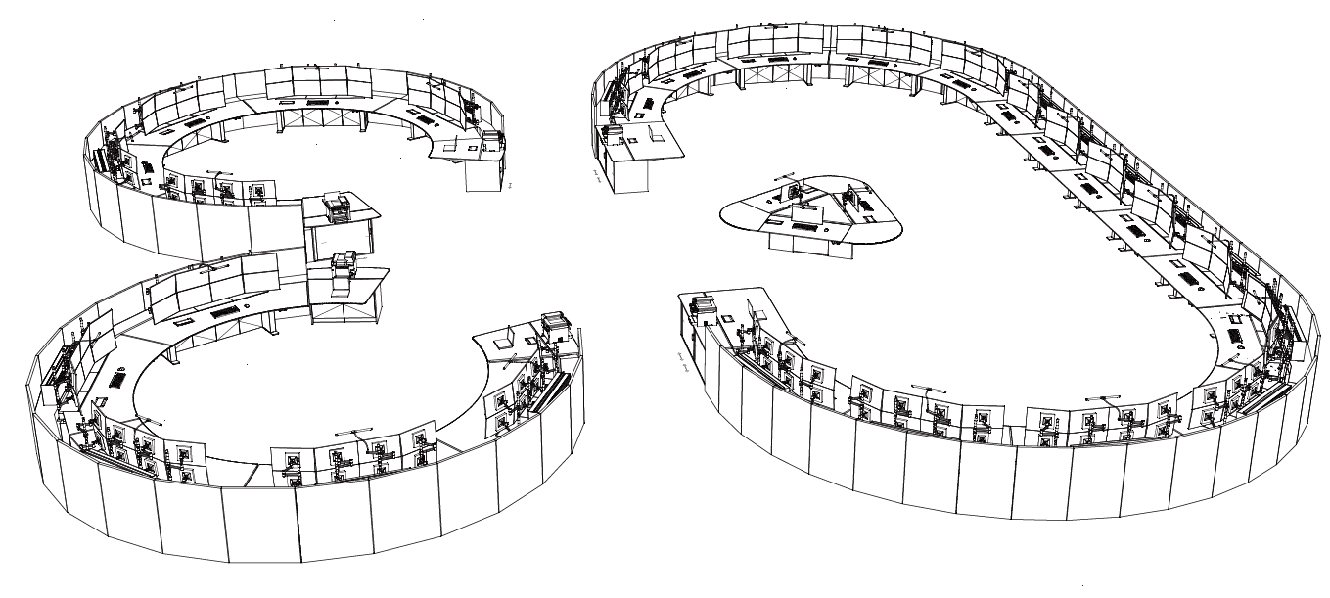
Interieur
Console specification has benefited from CERN experience
(screen size, accessibility, cryo and TI area)

Slide 14
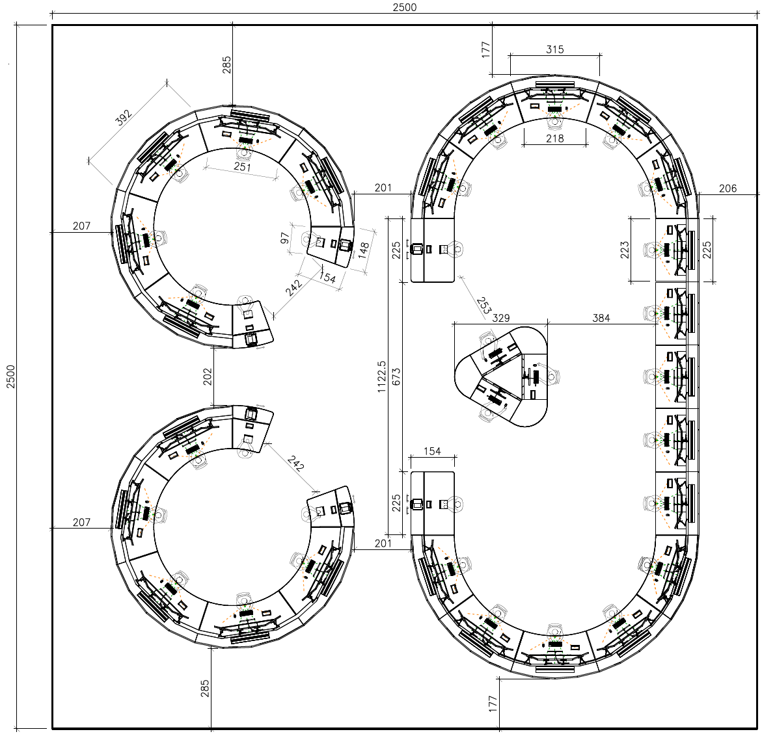
Main Control Room – start configuration
25 workstations a 6 monitors
Ion Sources & UNILAC: 5
SIS18: 2
HEBT: 1
SIS100: 3
Technical Infrastructure: 2
Access Systems (TVS, ZKS, PAS): 1
Cryogenic-system: 2
FRS & SFRS: 3
ESR: 2
HITRAP: 1
Cryring: 2
Testing: 1
1 wall with overview displays (LED-matrix)
UNI
UNI
Cryo
Src
TI
Cryo
UNI
PAS
TI
UNI
TEST
S18
S18
display wall
CRY
HEBT
CRY
S100
ESR
SFRS
S100
HITRAP
S100
ESR
SFRS
FRS

Slide 15
FCC: Staff deployment during commissioning phase
Assumptions
  Beam commissioning always runs parallel to GSI beam time
  Hardware commissioning mainly (but not always) takes place during GSI shutdown
Staff on site
  2-3 or 4 operators permanently present in 16/7 or 24/7 shift work
  Commissioning team (composition, depending on commissioning phase)
  1 cryo operator permanently (new)
  1 TI operator permanently (new)
  Machine experts on demand (UNILAC, SIS18, ESR, Cryring, FRS, HEBT, SFRS, SIS100)
staff on call
  Technical on-call services (accelerator, TI, IT)
  On-call services for safety and radiation protection
  On-call services for coordination

Slide 16
II FAIR Operation Concept (FCC 2028)

Slide 17
FCC 2028 - FAIR operation concept
Goal:
consistent operating concept for an effective and efficient GSI/FAIR operation from FCC for optimal science output
Scenario:
9 months full operation and 3 months shutdown
Deliverables:
highest availability for experimental operation and high beam quality to achieve optimal physics outcome
processes, roles & responsibilities
staff deployment (number, qualification)
Minimization of downtimes
automated fault tracking, fast fault analysis (archiving system, post-mortem system), preventive or even predictive maintenance
Minimization of setup time
optimized user interfaces for operation, fast trim times, automation of repetitive tasks, automatic tuning & beam-based feedback (e. g. spill optimization), maximized reproducibility
Optimization of parallel operation capabilities reduction of unwanted interaction between patterns running in parallel, flexible scheduling, backup user
Optimization of beam scheduling
to reduce setup periods (strategic long-term beam scheduling, e. g. long blocks with the same element)

Slide 18
Optimal staff deployment
Example: Operations Department OPE
the demands on operation have increased over the recent years
  increased parallel operation, new operation modes, a new storage ring and the new control system, new UI to the accelerators – and now FAIR
not all old operators could keep up with the increased demand
  experiences with engineers (and physicists) are increasingly better
  operators should also be able to develop tools (software, instrumentation)
this is reflected in the most recent hirings
  balance is important
  presently: 1/3 physicist, 1/3 engineers, 1/3 technicians, (Status 2015 ca.: 20%, 20%, 60%)
to be considered:
  impact of automatization, improving user interfaces and maturing control system are likely to shift the balance and personnel demand
  the domain knowledge of the machine departments must be preserved

Slide 19
Conclusion
With the start of commissioning, we are now entering a very intensive phase for FAIR
We have already been working together very well for years.
consulting on various commissioning topics (cryo-system, control room, cryo-magnet commissioning, general commissioning strategies and concepts, ...)
FAIR Commissioning Workshop, Safety Advisory Committee, ...
the GSI/FAIR control system landscape was partly taken over from CERN (e.g. LSA) and is now further developed in collaboration with CERN
  basic controls concepts are the same (patterns, chains, model-driven data supply, accelerator- and beam modes, RBAC, etc.)
  higher-level concepts can be developed jointly since we work on the same base
  commissioning tools and automation will benefit both operation teams
  a joint further development of the software creates synergies, as experts for these systems work at both institutes
The collaboration on FAIR Commissioning topics is to be intensified

Slide 20
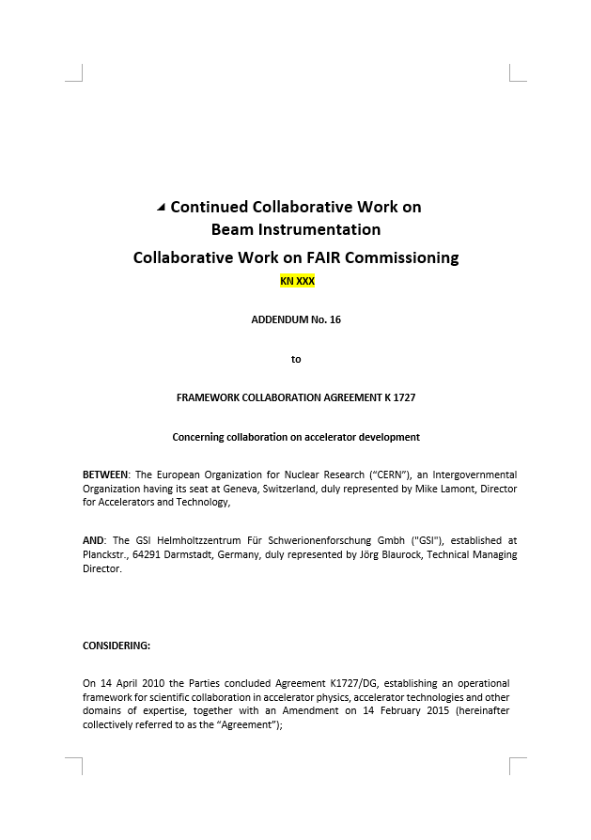
2 Work Packages defined in ADDENDUM No. 16
Collaboration on Beam instrumentation &
FAIR accelerator commissioning
WP 1.1: Cryogenic Current Comparators (CCC)
WP 1.2: Luminescence Monitor for LHC e-lens
WP 1.3: Ionisation profile collaboration
WP 1.4: FESA integration of beam diagnostics: Present focus on BSM and CCC
WP 1.5: SEM-Grid Monitor for high-intensity beams
WP 1.6: BPM Hardware development, analysis methods and signal simulation
WP 1.7: Beam Instrumentation design and usage for slowly extracted beam
WP 2.1: Support for hardware and beam commissioning of FAIR accelerators and systems
WP 2.2: Support for software tools for commissioning and early beam operation

Slide 21
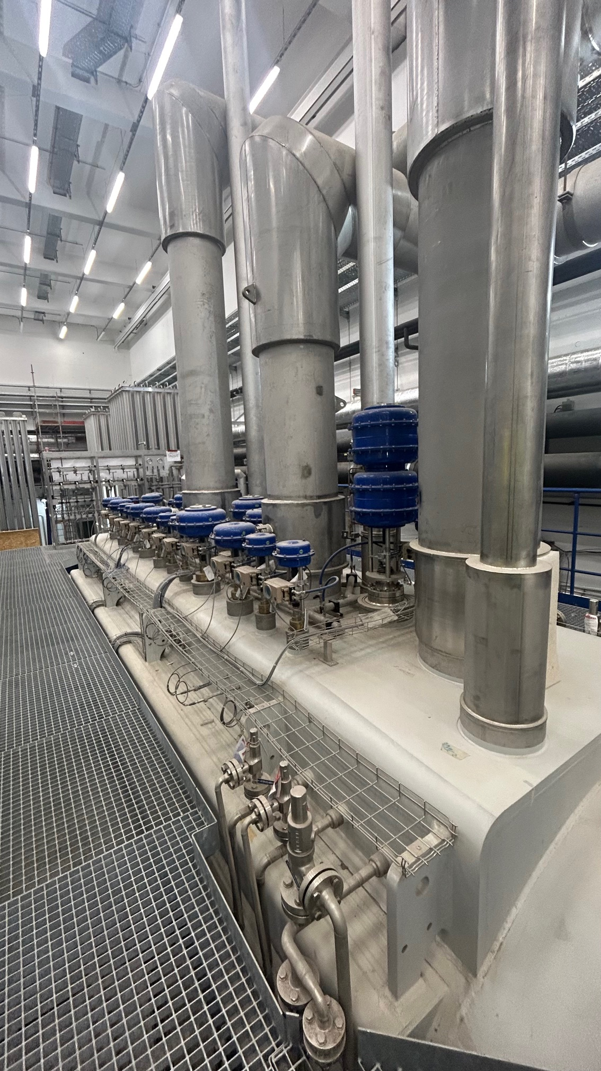
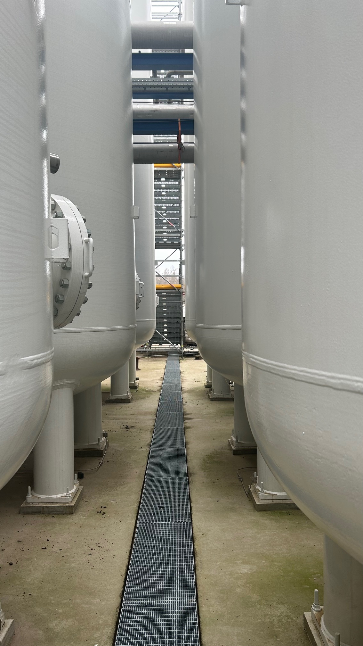


Thank You

Slide 22
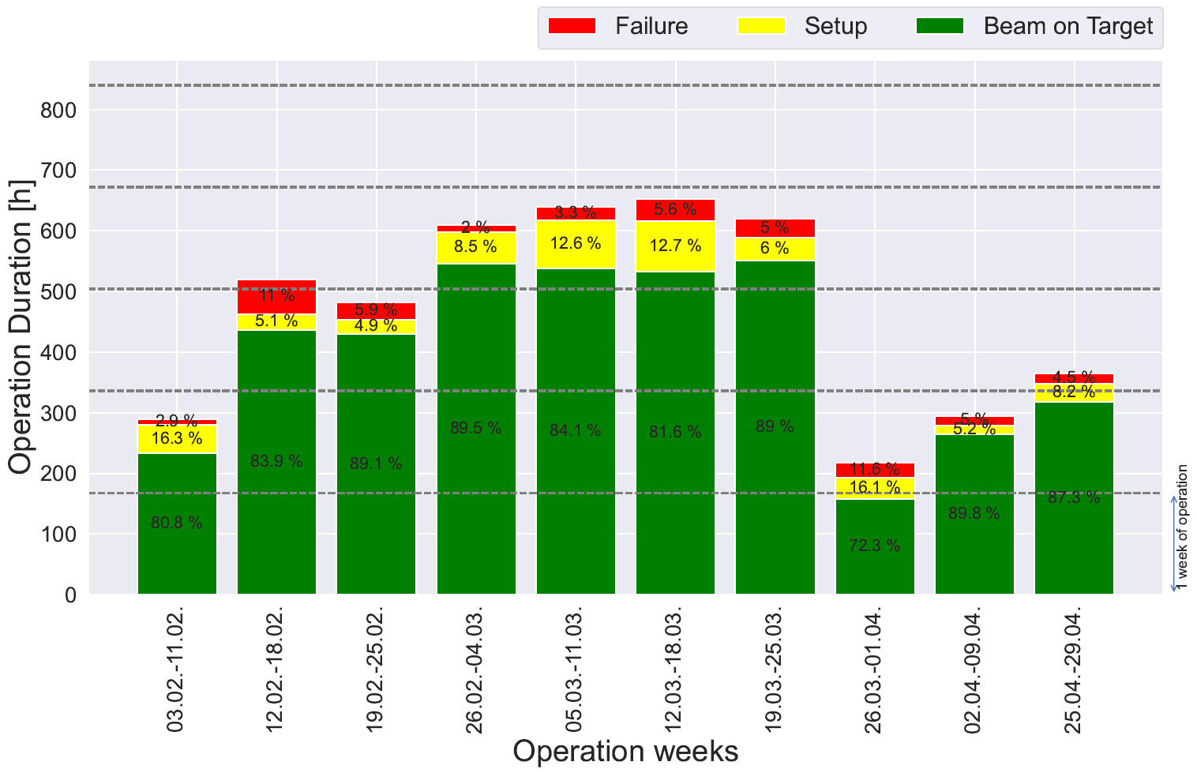
Recent Beamtime Statistics

Slide 23
GSI & FAIR parallel operation modes
Unilac-Chain
UNILAC
X, Y, Z, M
→ (2-3) of 4 parallel
HHT, HAD
SIS18 Chain
UNILAC
SIS18
→ (1-2) of 5 parallel
FRS
A, C, D, M
A
Storage Rings
& HITRAP
Cryring
local
→ 2 of 3 parallel
UNILAC
SIS18
ESR
FRS
HITRAP
CBM
→ 1-2 of 2 parallel
FAIR FS+
UNILAC
SIS18
SIS100
NUSTAR
SRFS
p_{f} = 6 - 9

