Slide 1

Neutron-induced reactions
and (some) open questions in the s-process
DPG Spring meeting workshop
11 March 2025, Köln, Germany
alberto.mengoni@cern.ch

Slide 2
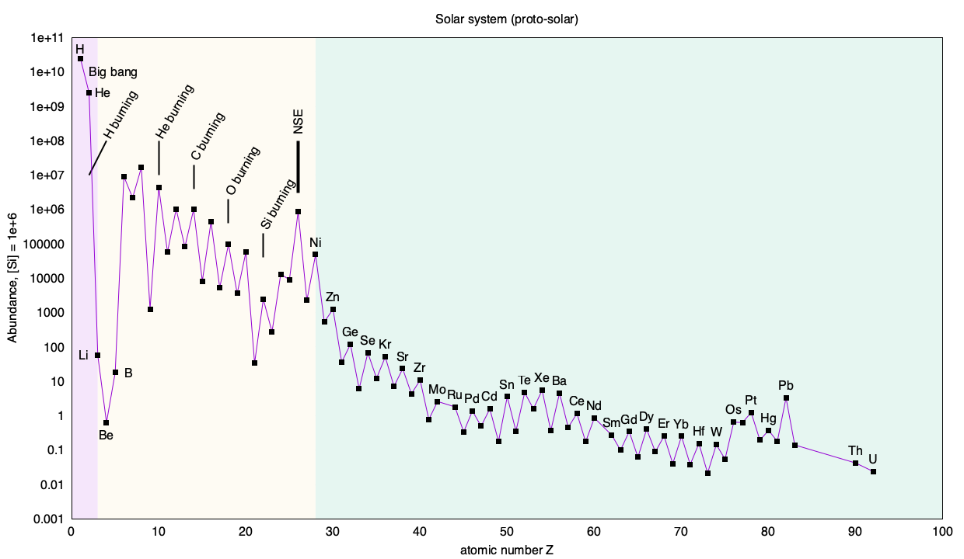
“Cosmic” abundance of
the chemical elements
neutrons & β-decay
N=50
N=82
N=126
Lodders, K. Relative Atomic Solar System Abundances, Mass Fractions, and Atomic Masses of the Elements and Their Isotopes, Composition of the Solar Photosphere, and Compositions of the Major Chondritic Meteorite Groups. Space Sci Rev 217, 44 (2021).
https://doi.org/10.1007/s11214-021-00825-8

Slide 3
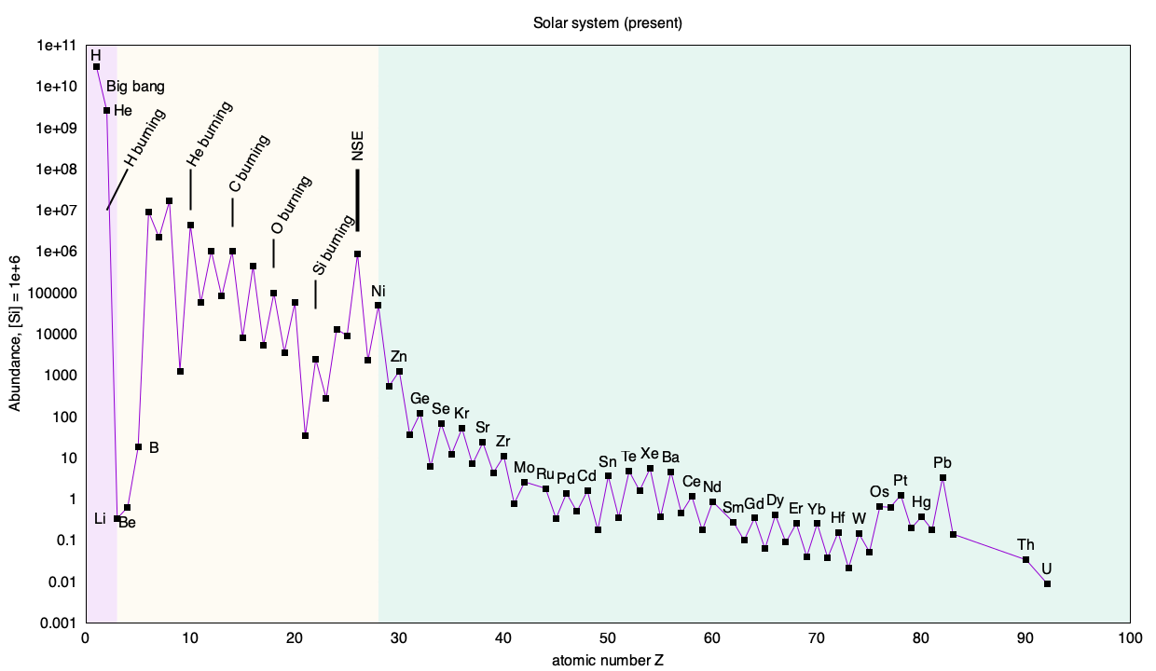
“Cosmic” abundance of
the chemical elements
neutrons & β-decay
N=50
N=82
N=126
Lodders, K. Relative Atomic Solar System Abundances, Mass Fractions, and Atomic Masses of the Elements and Their Isotopes, Composition of the Solar Photosphere, and Compositions of the Major Chondritic Meteorite Groups. Space Sci Rev 217, 44 (2021).
https://doi.org/10.1007/s11214-021-00825-8

Slide 4
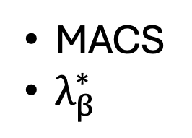
“Cosmic” abundance of
the chemical elements
MACS
$λ_{β}^{∗}$
neutrons & β-decay
N=50
N=82
N=126
Lodders, K. Relative Atomic Solar System Abundances, Mass Fractions, and Atomic Masses of the Elements and Their Isotopes, Composition of the Solar Photosphere, and Compositions of the Major Chondritic Meteorite Groups. Space Sci Rev 217, 44 (2021).
https://doi.org/10.1007/s11214-021-00825-8

Slide 5

Lead

Slide 6
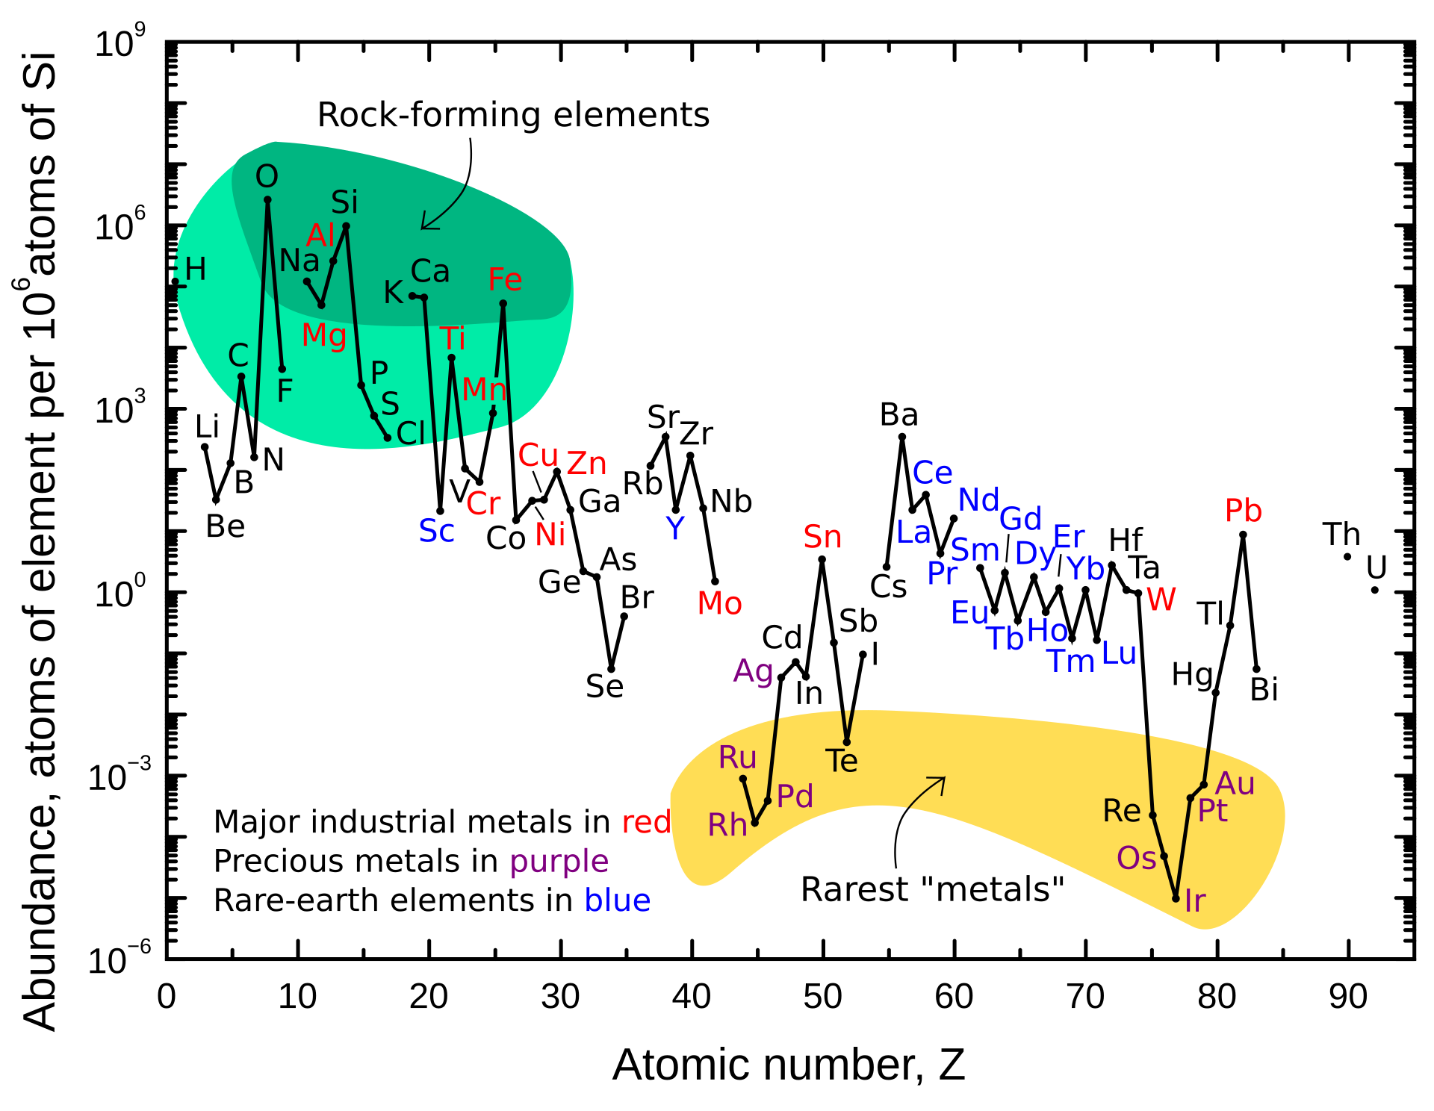
Lead
Earth crust abundance of the elements
source: Wikipedia
alberto.mengoni@cern.ch

Slide 7
Lead
Q: What is the origin of Lead?

Slide 8
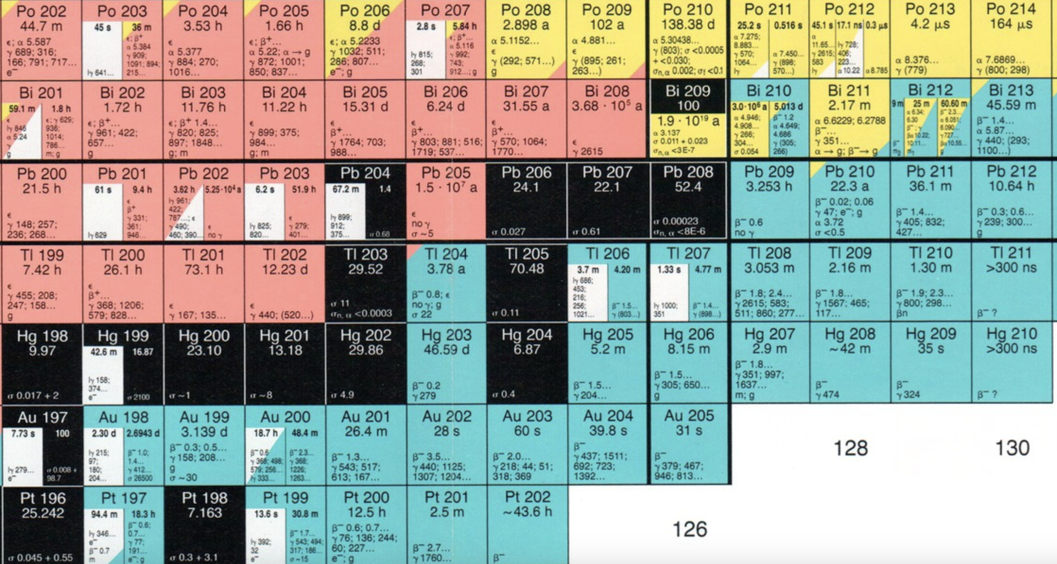
Radiogenic Lead

Slide 9
Uranium series (²³⁸U → ²⁰⁶Pb)
²³⁸U
(T_{1/2}: 4.5 Gyr)

Slide 10
Actinium series (²³⁵U → ²⁰⁷Pb)
²³⁵U
(T_{1/2}: 0.72 Gyr)

Slide 11
Thorium series (²³²Th → ²⁰⁸Pb)
²³²Th
(T_{1/2}: 14.1 Gyr)

Slide 12
Radiogenic Lead

Slide 13
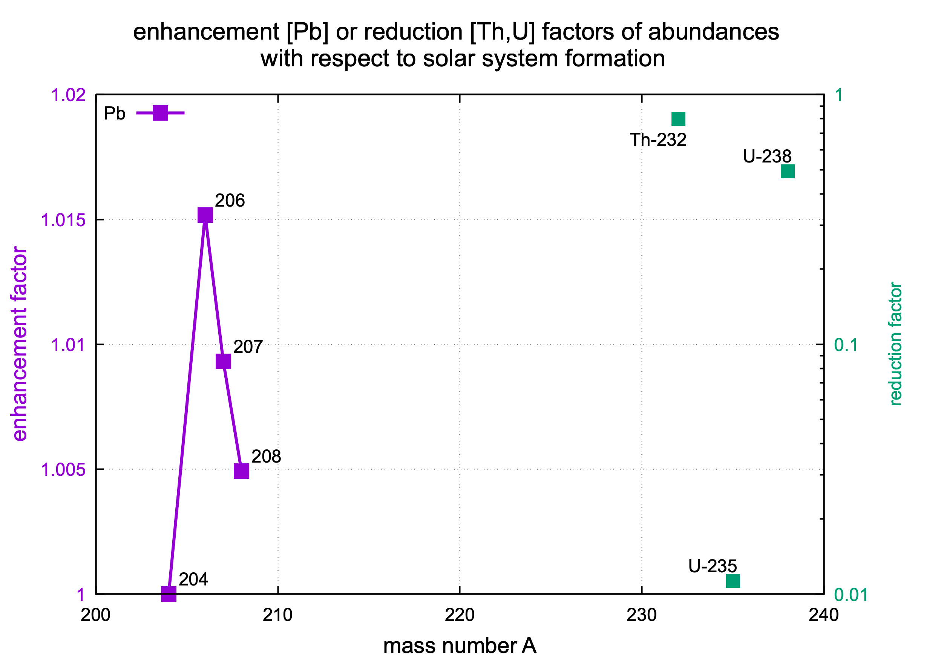
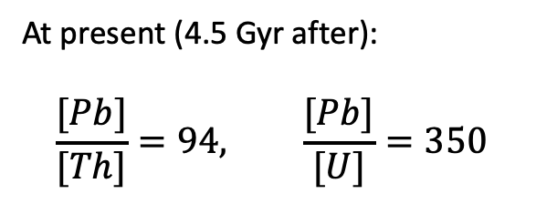
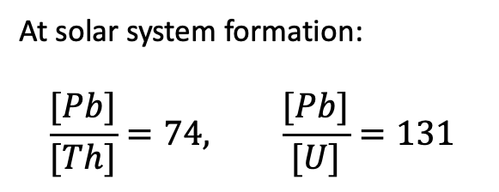
Radiogenic Lead
data from: E Anders & N Grevesse (1989)
At solar system formation:
$$\frac{[Pb]}{[Th]}=74, \frac{[Pb]}{[U]}=131$$
At present (4.5 Gyr after):
$$\frac{[Pb]}{[Th]}=94, \frac{[Pb]}{[U]}=350$$
Only a small amount of Pb (< 1%) is radiogenic

Slide 14
Radiogenic Lead (< 1%)

Slide 15
What about ²⁰⁴Pb?

Slide 16
What about ²⁰⁴Pb?
s-process
r-process

Slide 17
s-process branching at ²⁰⁴Tl
β⁻
(n,𝛾)
EC

Slide 18
s-process branching at ²⁰⁴Tl
β⁻
(n,𝛾)
EC

Slide 19
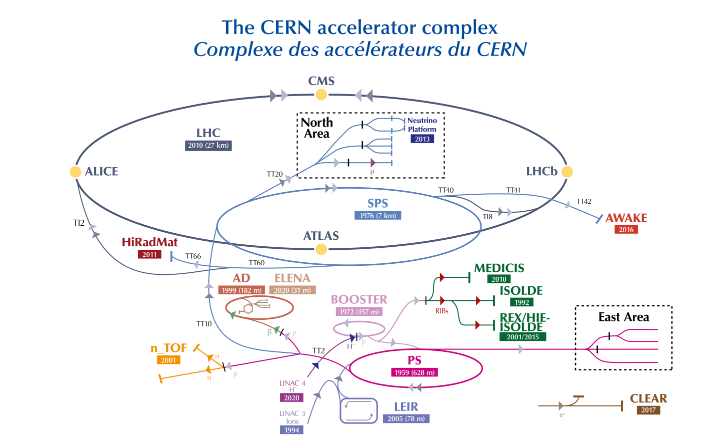

C. Rubbia et al., A high resolution spallation driven facility at the CERN-PS
to measure neutron cross sections in the interval from 1 eV to 250 MeV CERN/LHC/98-02(EET) 1998.
n_TOF @ CERN

Slide 20
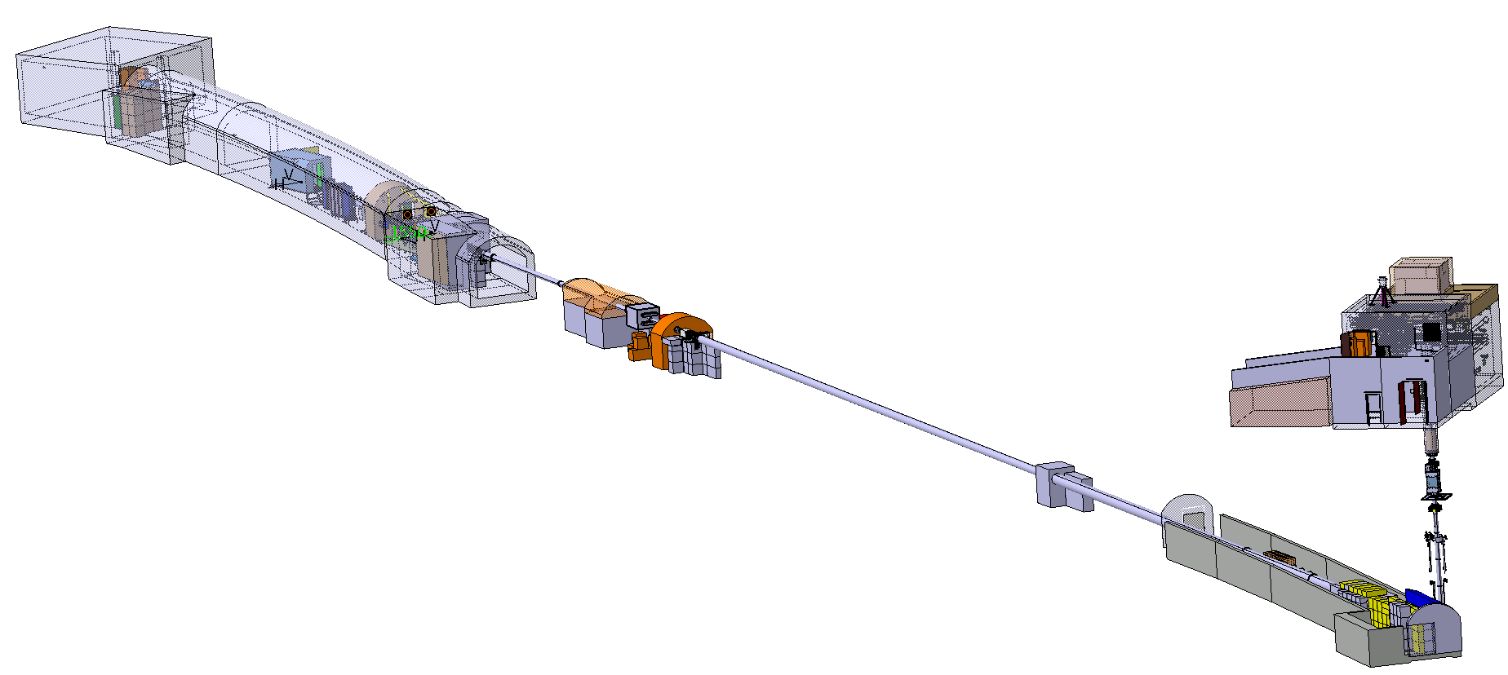
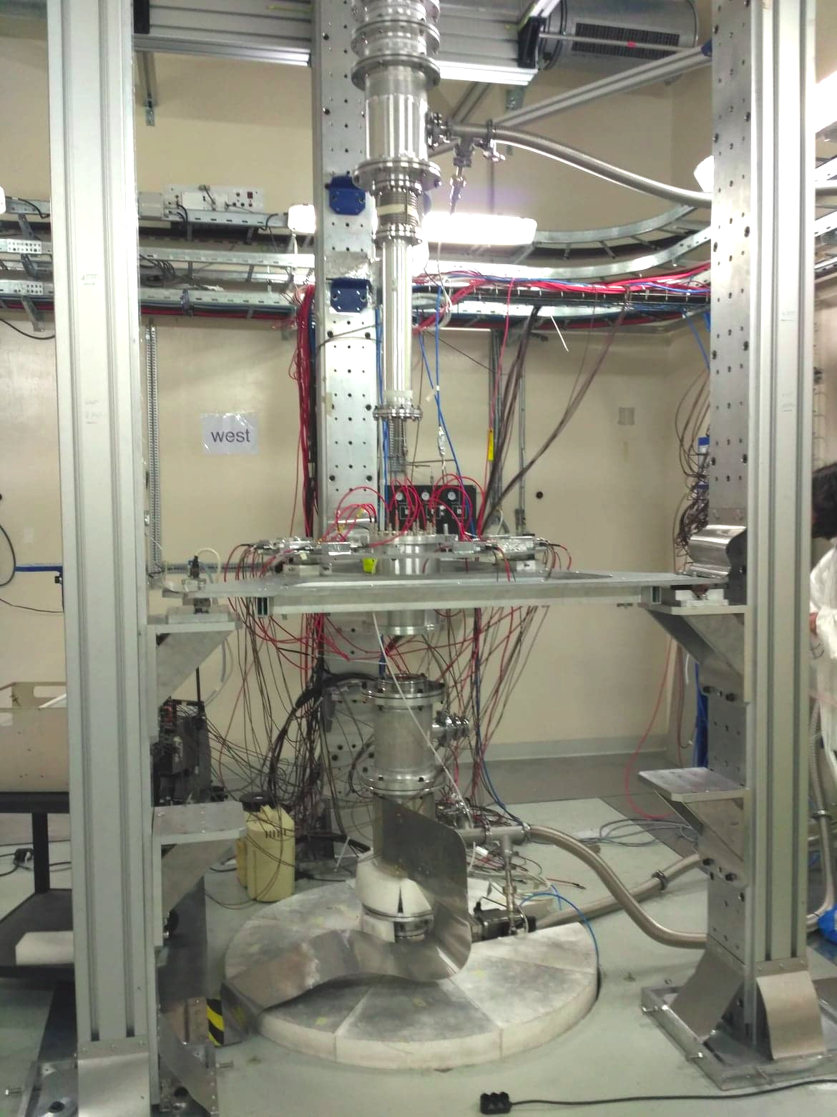
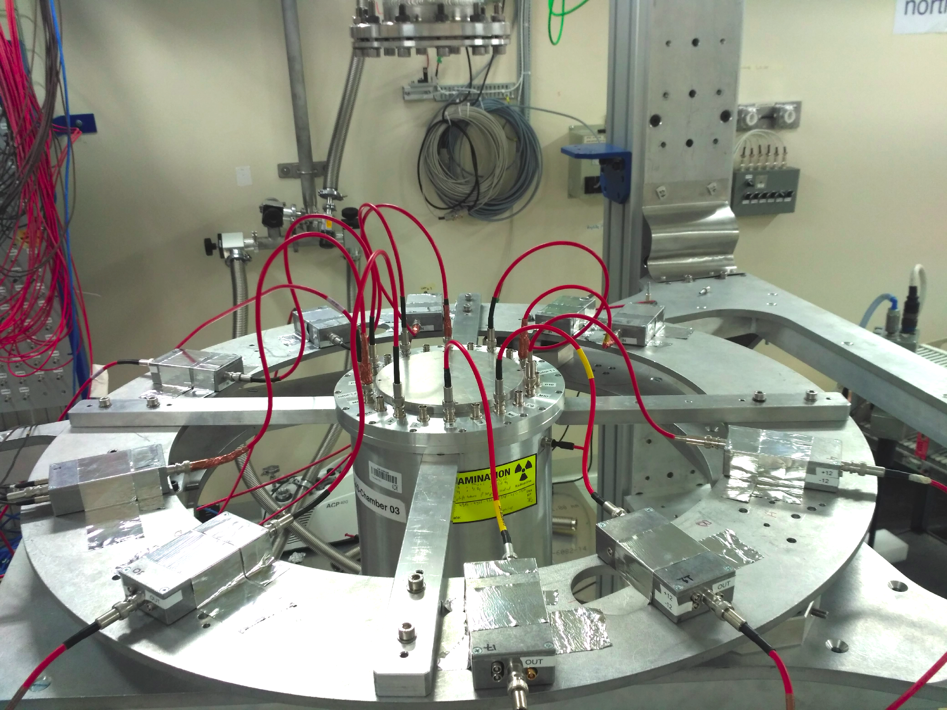
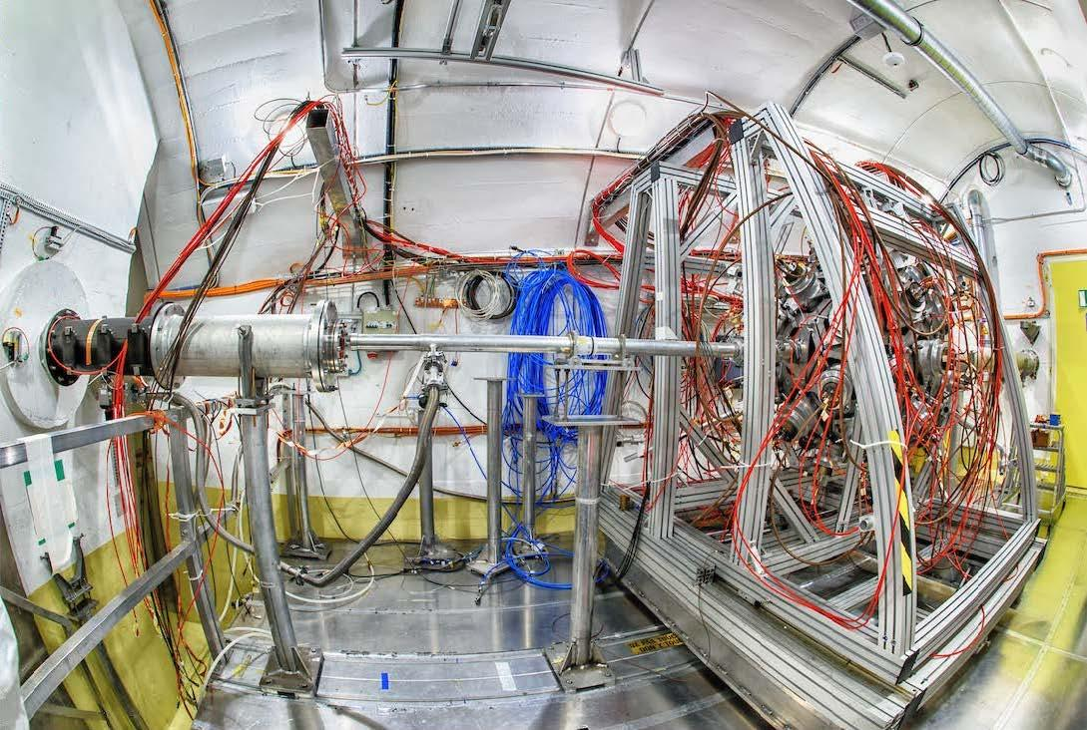
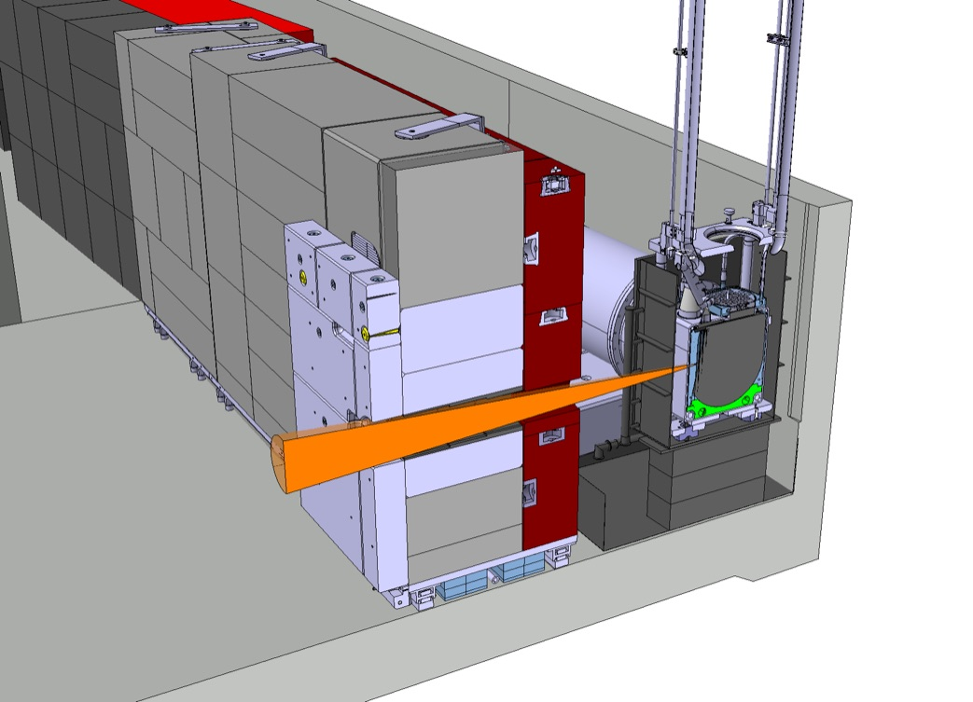
The n_TOF facility
@186 m
EAR2
@20 m
EAR1
NEAR
20 GeV/c proton beam from the PS

Slide 21
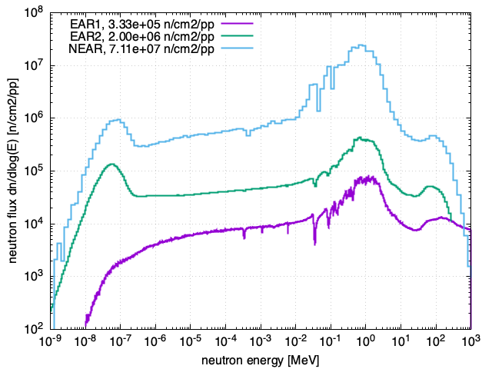
The n_TOF beams
proton beam momentum | 20 GeV/c
intensity (dedicated mode) | up to 9 x 10¹² protons/pulse
repetition frequency | 1 pulse/1.2s
pulse width | 6 ns (rms)
n/p | ~300
lead target dimensions | 70x76x63 cm³
cooling & moderation material | N₂ & H₂O (borated)
moderator thickness in the exit face | 5 cm
neutron beam dimension in EAR-1 (capture mode) | 2 cm (FWHM)
@20 m

Slide 22
Done at n_TOF
Radiative capture reactions (n,γ) (103)
Fission reactions (n,f) (37)
EAR2
Light particle emission reactions (n,lcp) (11)
EAR2
²³⁹Pu
Detector developments (7)
EAR2
Imaging
STEFF
EAR1
²³⁵U
EAR2
²⁴¹Am
²⁴⁶Cm
²⁴⁴Cm
STEFF
²³⁵U
C6D6
²³⁰Th
²⁴¹Am
DDX
Hpge
Trans
²³⁴U
²³⁶U
²³²Th
²³⁷Np
STEFF
MGAS
Varii
FIC0
³³S
²³⁷Np
³⁵Cl
¹⁴N
²⁴³Am
EAR2
MGAS
MGAS
Si + MGAS
EAR1
MGAS
DFGC
TARAT
X17
²³⁶U
¹⁶O
Varii
²⁴⁵Cm
²³³U
²⁴¹Am
²⁴³Am
FIC0
Si
⁷Be
²⁶Al
⁷Be
DFGIC
⁷⁹Se
FIC1
³³S
Si
EAR1
iTED
²⁴³Am
²³⁵U
²³⁸U
MGAS
¹⁴⁷Pm
¹⁷¹Tm
²³⁵U
¹²C
MGAS
²³⁴U
FIC2
²⁴⁰Pu
²⁴²Pu
C6D6
EAR1
RPT
Si
²³⁹Pu
FIC0
¹⁸⁶Os
¹⁸⁷Os
¹⁸⁸Os
⁹⁰Zr
⁹¹Zr
⁹²Zr
⁹⁴Zr
⁹⁶Zr
²⁴Mg
²⁶Mg
²⁰⁸Pb
¹³⁹La
MGAS
²³⁵U
²³⁵U
TAC
³⁰Si
⁴⁰Ar
⁸⁸Zr
²⁰⁹Bi
¹⁴⁶Nd
⁷⁹Se
⁹⁴Nb
²³⁷Np
²³³U
²³⁴U
²⁰⁹Bi
^{nat}Pb
²³²Th
CVD
⁵⁹Ni
Si
²⁴⁴Cm
RPT
²³²Th
²³⁴U
²³⁸U
EAR1
TAC
⁹⁴Nb
⁷⁹Se
^{63,65}Cu
^{92.94,95,96,97,98}Mo
^{166,167}Er
^{28,29,30}Si
¹⁶⁰Gd
^{50,53}Cr
²³⁸U
PPAC
PPAC
TAC
EAR2
²³⁷Np
²³⁷Np
²³⁰Th
⁸⁷Sr
²³²Th
PPAC
PPAC
¹⁵⁴Gd
⁷⁷Se
⁷⁸Se
⁶⁹Ga
⁷¹Ga
⁸⁹Yr
⁸⁸Sr
MGAS
sTED
¹⁵¹Sm
²⁰⁴Pb
²⁰⁶Pb
²⁰⁷Pb
²⁰⁹Bi
²³²Th
TAC
¹²C
MGAS
NEAR
C6D6
²³⁵U
¹⁴⁷Pm
²⁴²Pu
²⁰⁴Tl
⁷⁶Ge
⁷⁴Ge
⁷⁰Ge
TAC
²³³U
²⁰⁵Tl
³⁵Cl
¹⁴⁰Ce
⁸⁰Se
⁶⁸Zn
⁷⁶Ge
⁹⁴Zr
¹⁴⁰Ce
¹⁹⁷Au
⁸⁹Y
²⁴⁰Pu
²³⁷Np
²⁴³Am
²³³U
TAC
²³⁶U
⁶³Ni
⁶²Ni
⁵⁸Ni
⁵⁷Fe
²³⁸U
²⁵Mg
⁹²Zr
⁹³Zr
C6D6
C6D6
C6D6
EAR1
C6D6
C6D6
C6D6
¹⁵⁷Gd
¹⁵⁵Gd
⁷²Ge
C6D6
⁷⁹Se
⁹⁴Nb
¹⁶⁰Gd
TAC
⁶²Ni
⁵⁶Fe
⁵⁶Fe
²⁴¹Am
¹⁷¹Tm
⁷³Ge
C6D6
C6D6
C6D6
C6D6
C6D6
2001 - 2004
2009 - 2012
2014
2015
2016
2017
2018
2021-2024
Phase 1
Phase 2
Phase 3
Phase 4

Slide 23
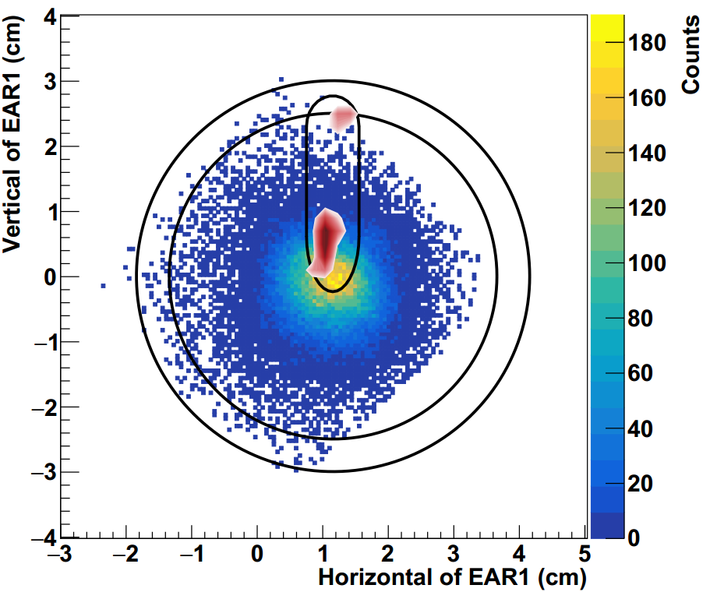
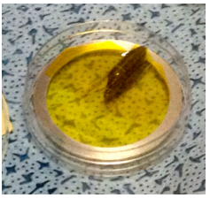
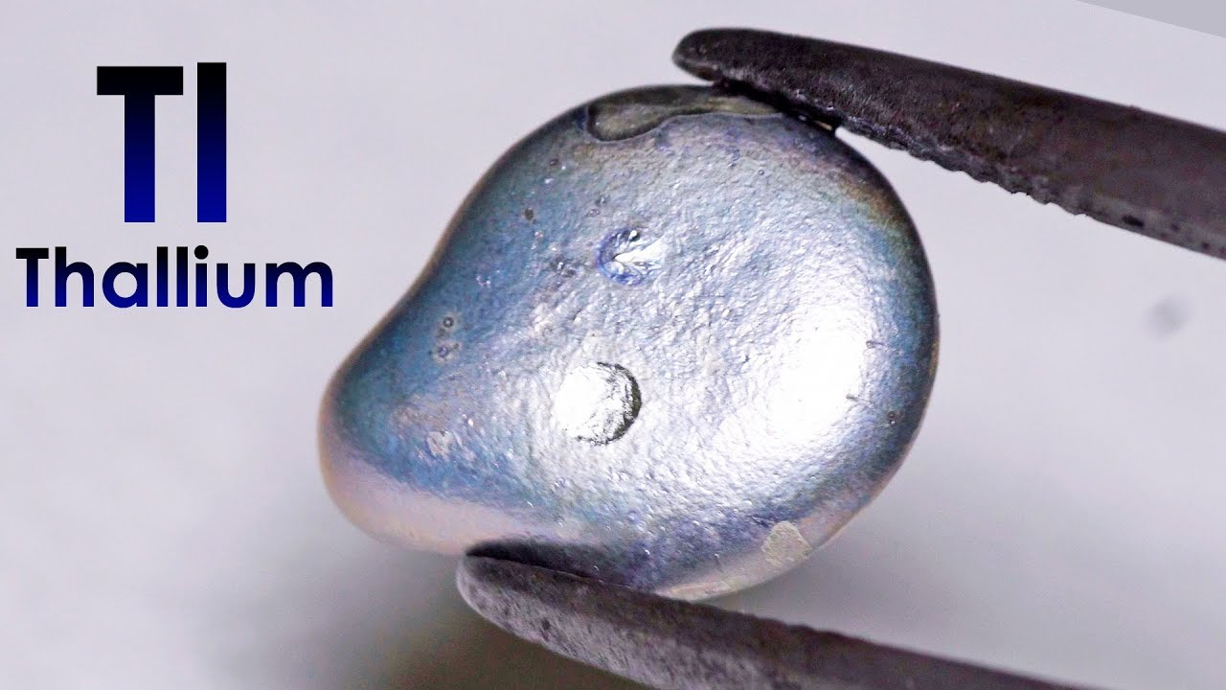
Scanner results
²⁰⁴Tl(n,𝛾) experiment
Quartz capsule
irradiated material
Pellet containing 225 mg of ²⁰³Tl, 99.5% isotopic purity, produced at PSI by machine pressing and inserted into quartz container
Irradiated at ILL reactor with thermal neutrons for 56 days: 9 mg of ²⁰⁴Tl produced
180 GBq of β activity plus radioactive impurities and bremsstrahlung
620 mSv/h contact, 18 mSv/h a 10 cm
n_TOF beam profile
Sample holder ring
A Casanovas-Hoste et al. (The n_TOF Collaboration)
Physical Review Letters 133, 052702 (2024)
DOI: 10.1103/PhysRevLett.133.052702

Slide 24
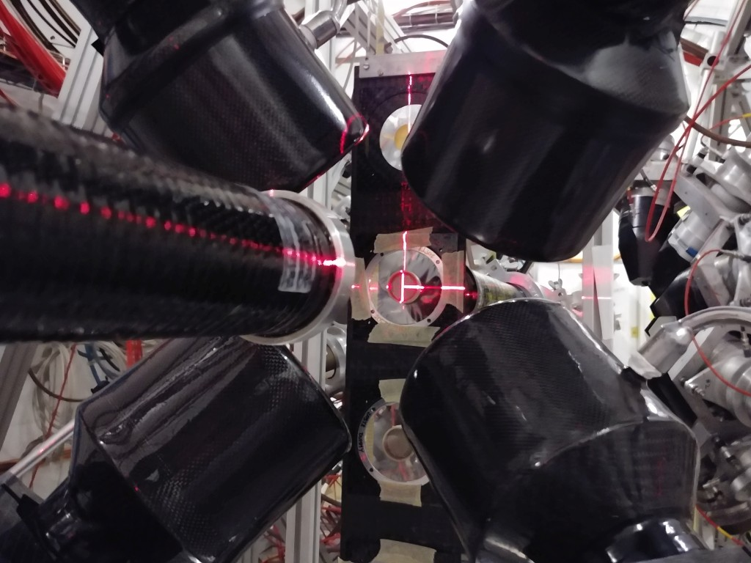
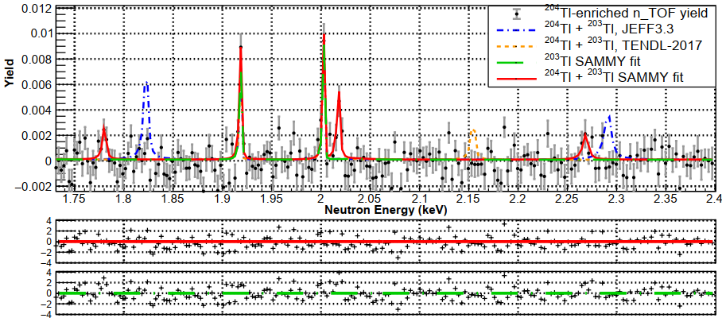
²⁰⁴Tl(n,𝛾) experiment
Pellet containing 225 mg of ²⁰³Tl, 99.5% isotopic purity, produced at PSI by machine pressing and inserted into quartz container
Irradiated at ILL reactor with thermal neutrons for 56 days: 9 mg of ²⁰⁴Tl produced
180 GBq of β activity plus radioactive impurities and bremsstrahlung
620 mSv/h contact, 18 mSv/h a 10 cm
A Casanovas-Hoste et al. (The n_TOF Collaboration)
Physical Review Letters 133, 052702 (2024)
DOI: 10.1103/PhysRevLett.133.052702

Slide 25
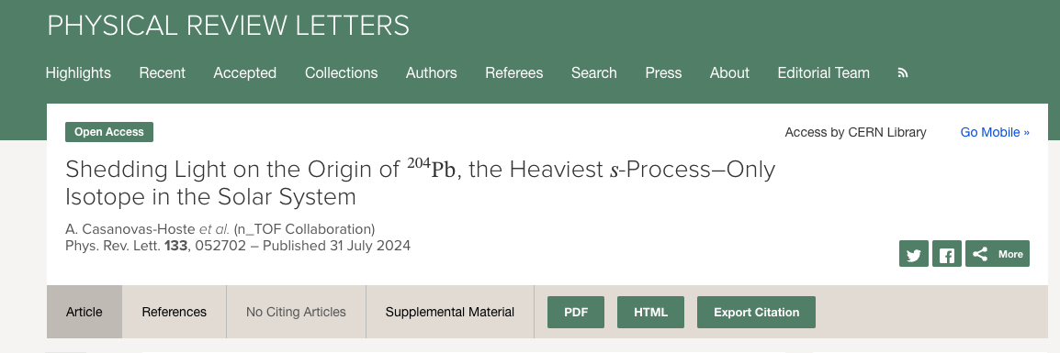
²⁰⁴Tl(n,𝛾) experiment
Maxwellian-averaged cross sections (MACS) of 580(168) mb and 260(90) mb, respectively at kT=8 keV and kT=30 keV. These are about 3% lower and 20% higher than the corresponding values widely used in astrophysical calculations, which were based only on theoretical calculations.
By using the new ²⁰⁴Tl MACS, the uncertainty arising from the ²⁰⁴Tl(n,𝛾) cross section on the 𝑠-process abundance of ²⁰⁴Pb has been reduced from ∼30% down to +8%/−6%, and the 𝑠-process calculations are in agreement with the latest solar system abundance of ²⁰⁴Pb reported by K. Lodders in 2021.
DOI: 10.1103/PhysRevLett.133.052702

Slide 26
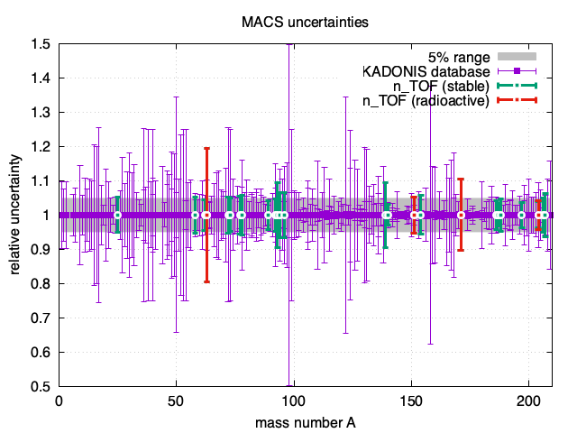

https://exp-astro.de/kadonis1.0/
MACS-30
276 nuclides
154 nuclides
with Δ𝜎 > 5%
69 nuclides
with Δ𝜎 > 10%
16 nuclides
with Δ𝜎 > 20%
30 nuclides measured @n_TOF
(several under analysis)
(*) exceptions with uncertainties > 5%:
⁶³Ni, t_{1/2} = 100 yr first measurement at n_TOF C Lederer-Woods et al., PRC 89 (2014)
¹⁷¹Tm via TOF and Activation
C. Guerrero, et al. PRL 125, 142701 (2020)
¹³⁹La, one of the first measurements at n_TOF R. Terlizzi et al., PRC 75, 035807 (2007)
The n_TOF Collaboration, Full list of publications (2025)
Notes:
Exceptions are Ni-63 (first measurement, radioactive sample) and to a less extent some Zr isotopes

Slide 27
MACS means more
Reducing the uncertainty in the MACS is not only a question of better nuclear data: higher accuracy in the reaction rates opens the possibility to investigate new astrophysical scenarios
[nuclear clocks, constrains on the BBN, AGB modeling, nucleosynthesis conditions in explosive scenarios, others]
The n_TOF Collaboration, Full list of publications (2025)
Notes:
Exceptions are Ni-63 (first measurement, radioactive sample) and to a less extent some Zr isotopes

Slide 28
s-process branching at ²⁰⁴Tl: β-decay
β⁻
(n,𝛾)
EC

Slide 29
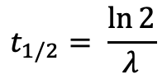
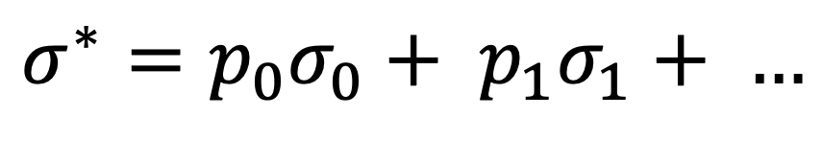
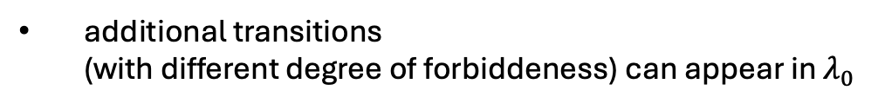

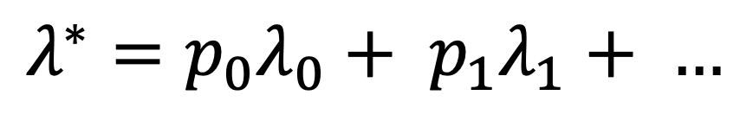
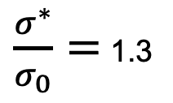
s-process branching at ²⁰⁴Tl: β-decay
$$σ^{∗}=p_{0}σ_{0}+ p_{1}σ_{1}+ …$$
Example:
¹⁸⁷Os at kT = 30 keV:
$\frac{σ^{∗}}{σ_{0}}=$ 1.3
$$λ^{∗}=p_{0}λ_{0}+ p_{1}λ_{1}+ …$$
$$t_{1/2}= \frac{\ln{2}}{λ}$$
$λ_{i}$ can differ by orders of magnitude
additional transitions (with different degree of forbiddeness) can appear in $λ_{0}$

Slide 30

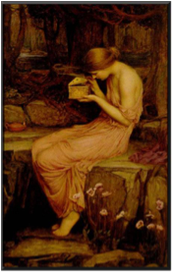
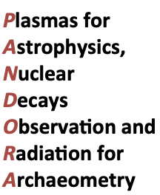

An experimental setup for measuring in-plasma β-decays of astrophysical interest
INFN-Bo
INFN-Pg
Laboratori Nazionali del Sud, Catania
courtesy of David Mascali (LNS, Catania)

Slide 31
PANDORA: measurement of β decay
in a plasma trap
A “buffer plasma” is created by He, O or Ar up to densities of 10¹³ cm⁻³
The isotope to be measured is then directly fluxed (if gaseous) or vaporized by appropriate ovens and then fluxed inside the chamber to be turned into plasma-state
Relative abundances of buffer vs. isotope densities range from 100:1 (if the isotope is in metal state) to 3:1 (in case of gaseous elements)
courtesy of David Mascali (LNS, Catania)

Slide 32
PANDORA: measurement of β decay
in a plasma trap
3 SC coils and a Cu monocoil hexapole are used as magnetic trap
14 HpGe detectors are used for tagging β-decays by the 𝛾-rays emitted from the decay-products in their excited states
The plasma is maintained in dynamical equilibrium by equalizing input fluxes of particles to losses from the magnetic confinement
courtesy of David Mascali (LNS, Catania)

Slide 33
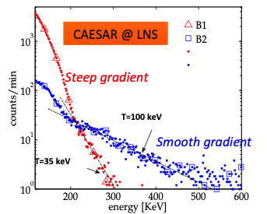
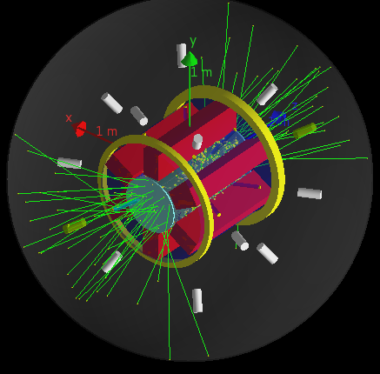
PANDORA: measurement of β decay
in a plasma trap
Plasma self-emission must be taken into account expected up to 1 MeV : < 1 count/sec
The plasma is maintained in dynamical equilibrium by equalizing input fluxes of particles to losses from the magnetic confinement

Slide 34
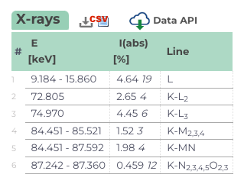
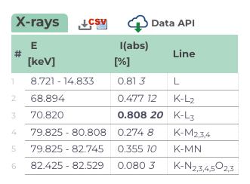


²⁰⁴Tl beta-decay
²⁰⁴Pb
3.78 yr
2⁻
²⁰⁴Tl
2.92% EC
Q_{EC} = 344.3 keV
0⁺
²⁰⁴Hg
²⁰⁴Hg
97.08% $β^{−}$
0⁺
Q$β^{−}$ = 763.76 keV
²⁰⁴Pb
no 𝛾’s !
However…
alberto.mengoni@cern.ch

Slide 35
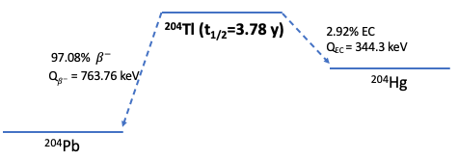
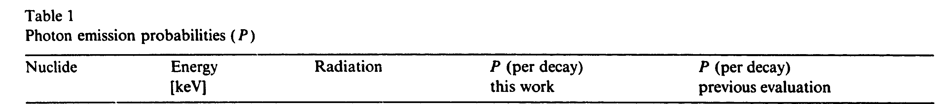
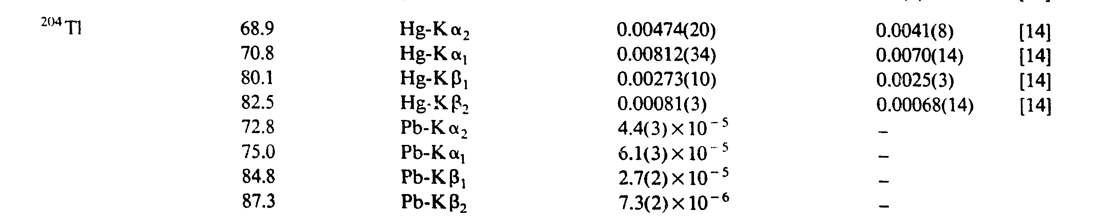
²⁰⁴Tl beta-decay
U Schötzig, NIMA 286, 523 (1980)
Starting with a source/sample (50 μg) of ²⁰⁴Tl (activity: 1 Gq):
~ 20-80 kBq of Hg and/or Pb X-ray lines
alberto.mengoni@cern.ch

Slide 36
²⁰⁴Tl beta-decay in stars
alberto.mengoni@cern.ch

Slide 37
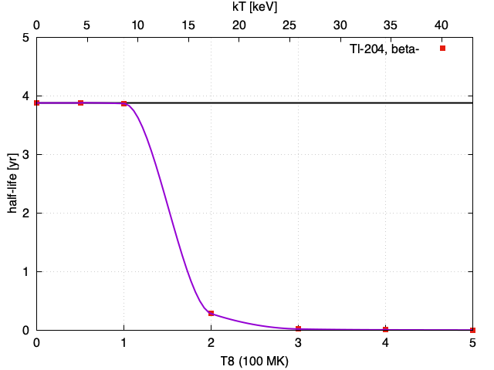
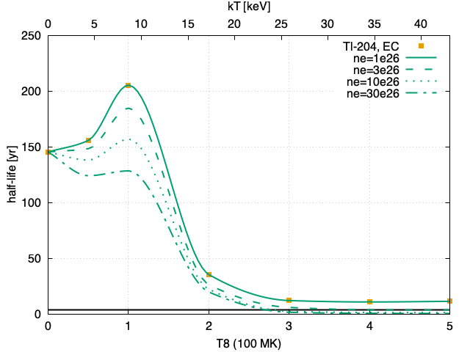
²⁰⁴Tl beta-decay in stars
145.9 keV
0⁻
140.0 keV
1⁻
2⁺
899 keV
2⁻
437 keV
2⁺
3.78 yr
²⁰⁴Tl
2.92% EC
Q_{EC} = 344.3 keV
0⁺
²⁰⁴Hg
97.08% $β^{−}$
0⁺
Q$β^{−}$ = 763.76 keV
²⁰⁴Pb
1st forbidden, unique (|ΔJ|=2, ∆π=yes)
1st forbidden (|ΔJ|=0,1, ∆π=yes)
Takahashi & Yokoi, ADNDT 36, 375 (1987)

Slide 38

²⁰⁴Tl beta-decay in stars
145.9 keV
0⁻
140.0 keV
1⁻
2⁺
899 keV
2⁻
437 keV
2⁺
3.78 yr
²⁰⁴Tl
2.92% EC
Q_{EC} = 344.3 keV
0⁺
²⁰⁴Hg
97.08% $β^{−}$
0⁺
Q$β^{−}$ = 763.76 keV
²⁰⁴Pb
𝛾-ray emission possible

Slide 39
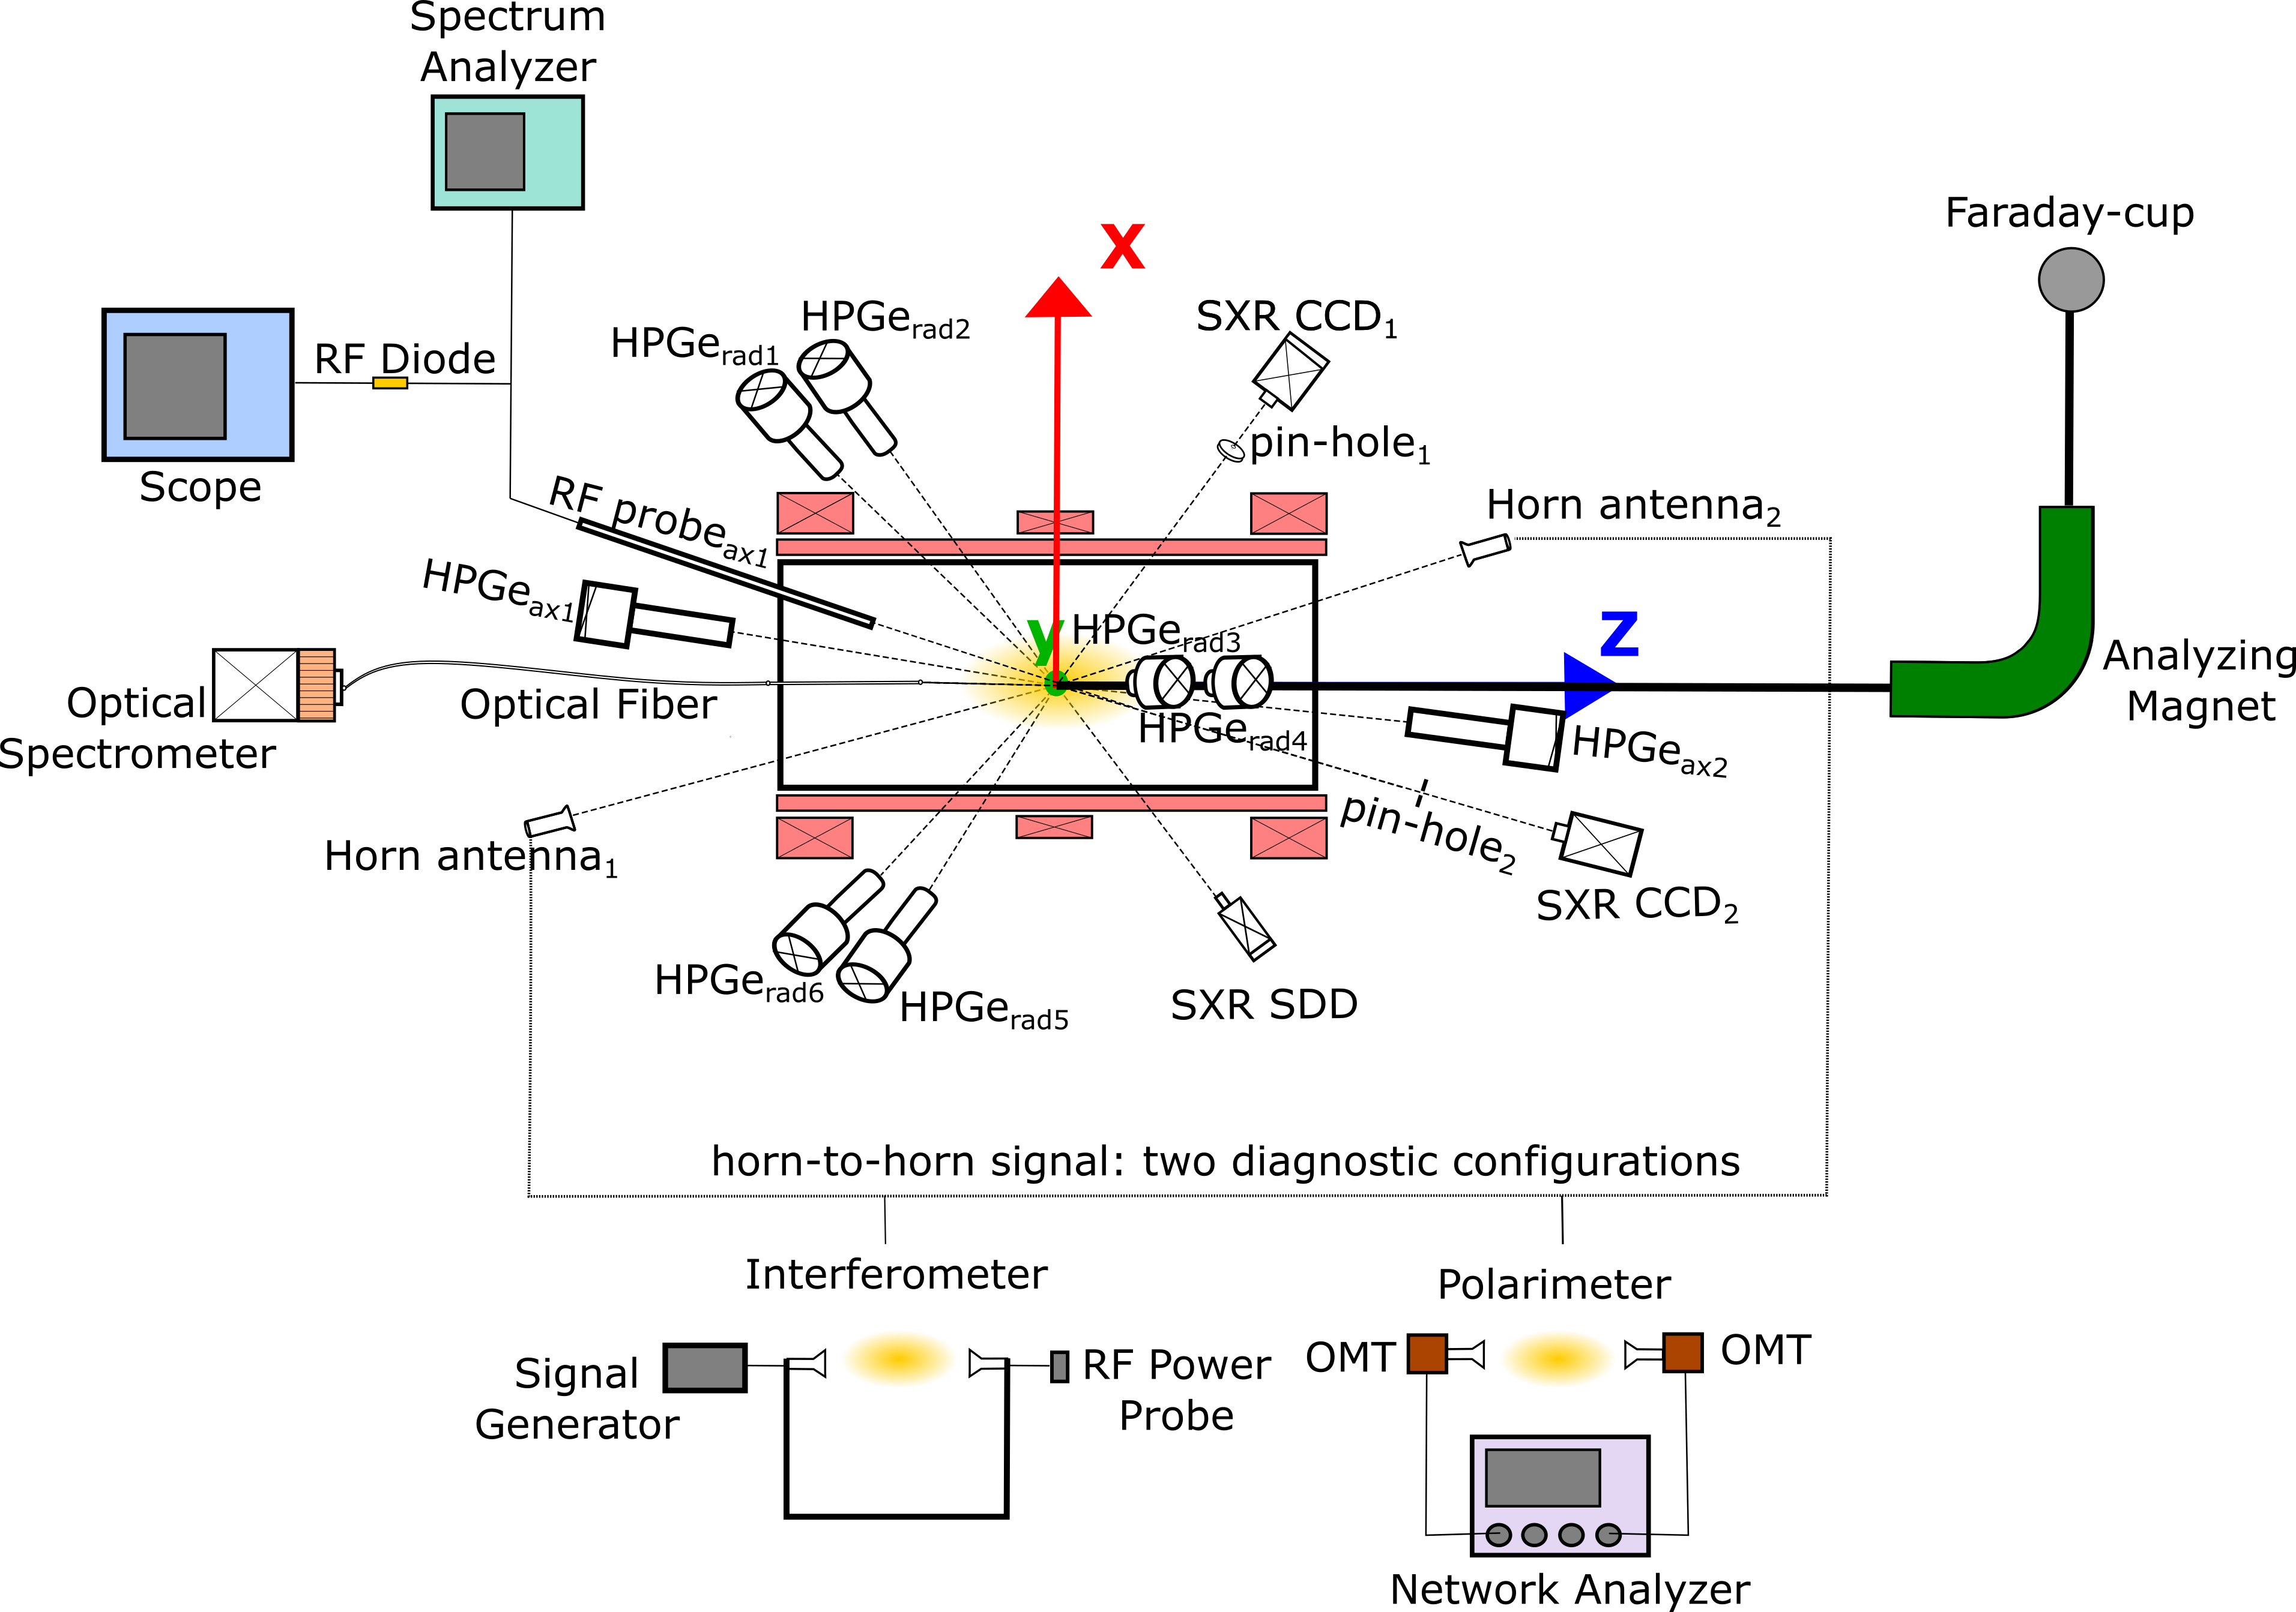
²⁰⁴Tl beta-decay in stars
Can we do it?
If we start with a source which is 1/180 the n_TOF sample (50 μg) of ²⁰⁴Tl (activity: 1 Gq):
~ 20-80 kBq of Hg and/or Pb X-ray lines
alberto.mengoni@cern.ch

Slide 40
n_TOF present & future

Slide 41
C. Rubbia et al., A high resolution spallation driven facility at the CERN-PS
to measure neutron cross sections in the interval from 1 eV to 250 MeV CERN/LHC/98-02(EET) 1998.
n_TOF @ CERN

Slide 42

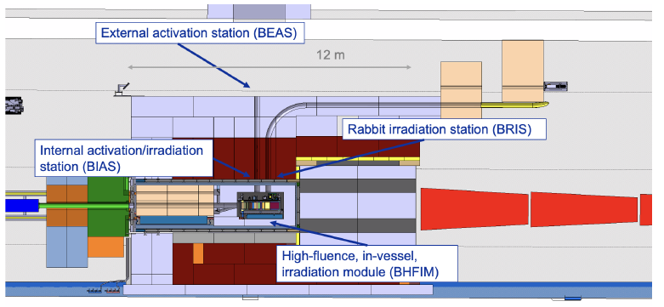
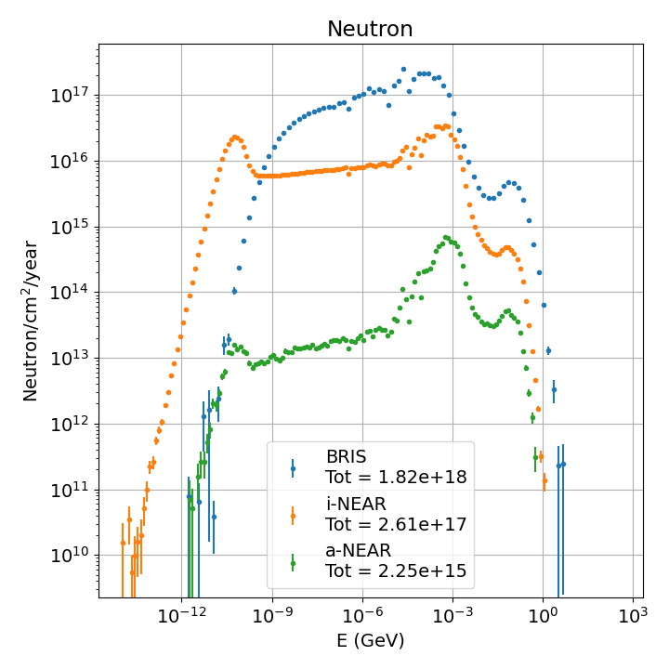
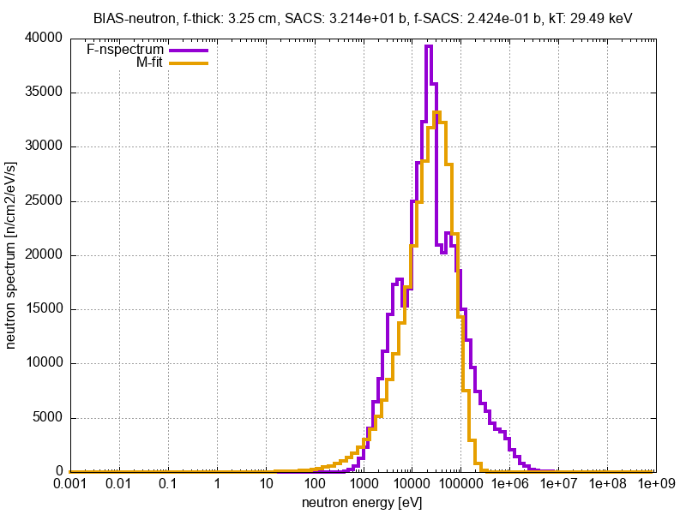
n_ACT@BDF
Parasitic use for neutron cross section measurements
Unique installation providing ultra high neutron fluxes over a wide energy range for activation measurements – complementary to n_TOF capabilities
Proximity to ISOLDE – measurements on radioactive nuclei
World-first measurements of key reactions for nuclear astrophysics and nuclear applications
Possible Activation Station
Flux 3-4 orders of magnitudes higher than at present n_TOF NEAR
C Lederer-Woods et al.(n_TOF Collaboration)
CERN-SPSC-2024-027 / SPSC-EOI-023
Filters create quasi- stellar neutron spectra

Slide 43
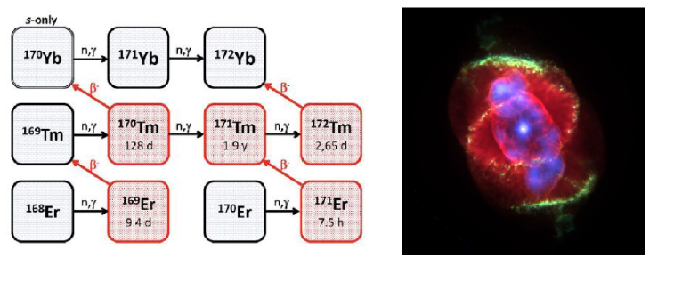
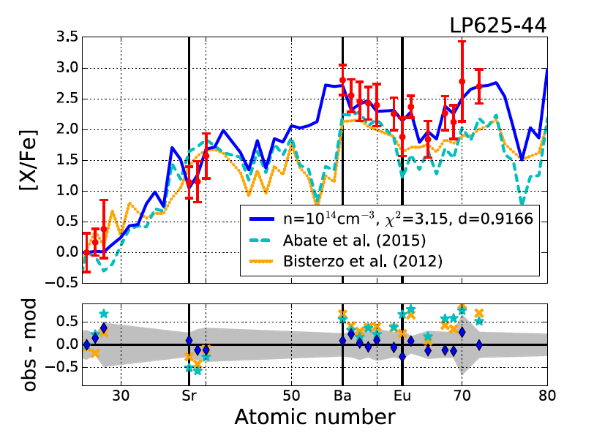

n_ACT@BDF: Science examples
Measurements to determine neutron densities and temperature in stellar interiors e.g. (n,γ) on ⁹⁴Nb, ¹⁴⁷Pm, ¹⁶³Ho and ¹⁷¹Tm
Measurements to explain peculiar abundances in old stars e.g. (n,γ) on ¹²⁵Sb, ¹³⁷Cs, ¹⁴⁴Ce
C Lederer-Woods et al.(n_TOF Collaboration)
CERN-SPSC-2024-027 / SPSC-EOI-023
Measurements for next generation fission and fusion reactors e.g. (n,2n) on ¹⁰⁹Ag, ^{151,153}Eu

Slide 44
²⁰⁴Tl(n,𝛾) experiment
Maxwellian-averaged cross sections (MACS) of 580(168) mb and 260(90) mb, respectively at kT=8 keV and kT=30 keV. These are about 3% lower and 20% higher than the corresponding values widely used in astrophysical calculations, which were based only on theoretical calculations.
By using the new ²⁰⁴Tl MACS, the uncertainty arising from the ²⁰⁴Tl(n,𝛾) cross section on the 𝑠-process abundance of ²⁰⁴Pb has been reduced from ∼30% down to +8%/−6%, and the 𝑠-process calculations are in agreement with the latest solar system abundance of ²⁰⁴Pb reported by K. Lodders in 2021.
DOI: 10.1103/PhysRevLett.133.052702

Slide 45
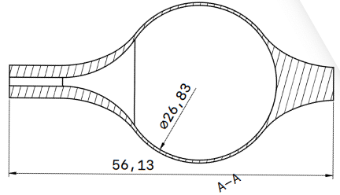
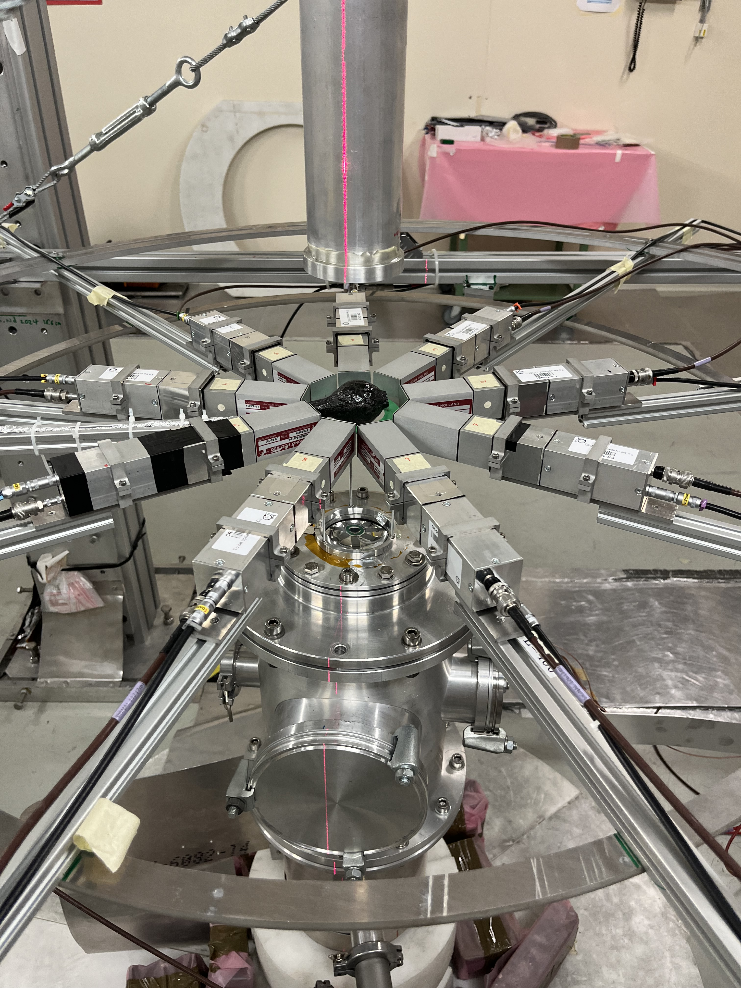
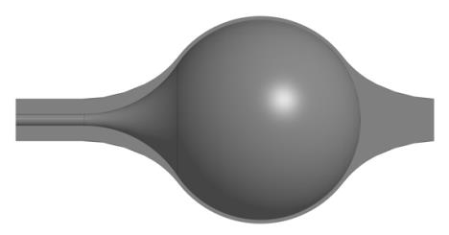
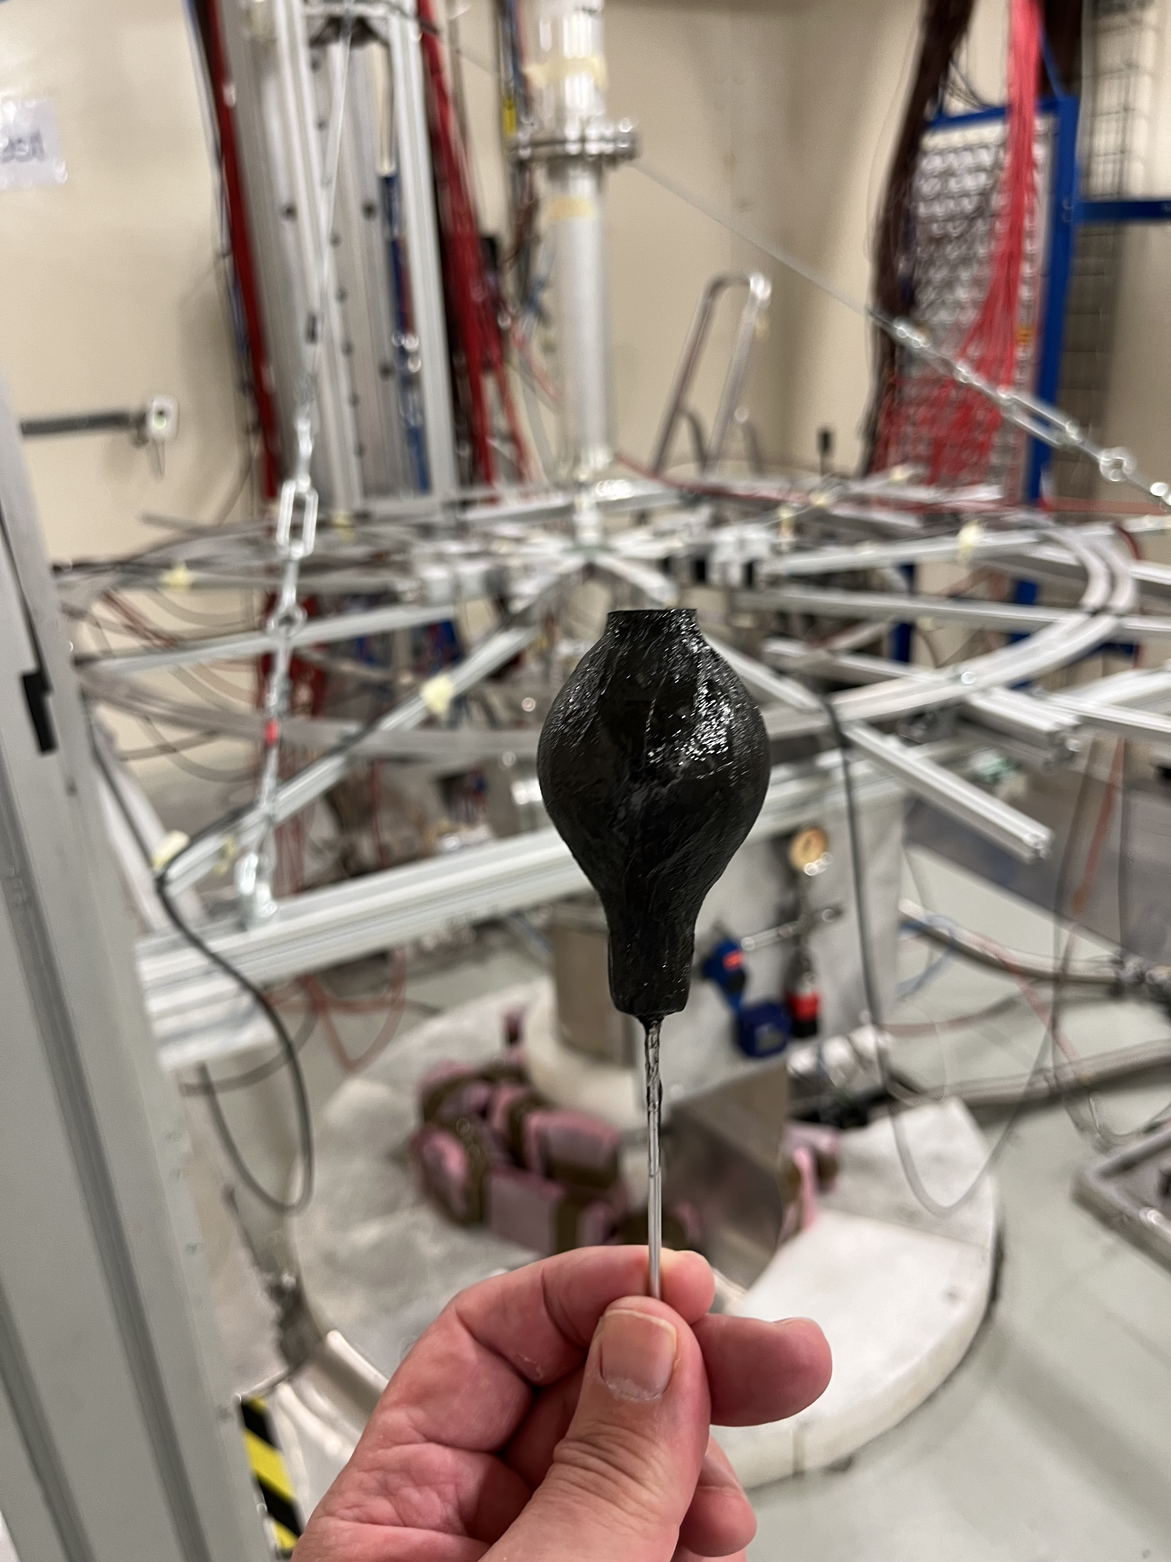
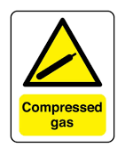
The MArEX* initiative at n_TOF
⁴⁰Ar(n,γ) | understanding neutron propagation in argon first capture measurement on a gas sample at n_TOF | INTC-I-256 | EAR2
First neutron capture measurement on a gas target performed at n_TOF
200 bar Argon gas-cell developed by the n_TOF Collaboration
full operation watched over by CERN safety authorities (including RP)
* Multiple Argon Experiments

Slide 46
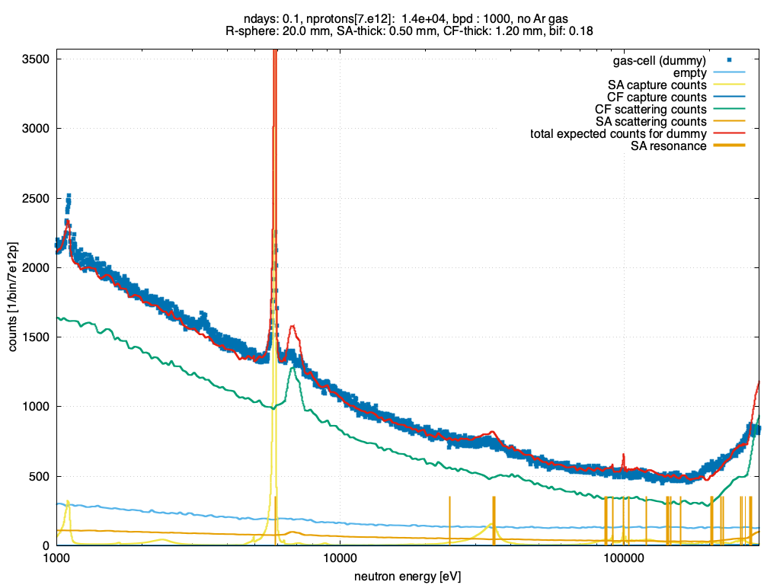

The MArEX* initiative at n_TOF
⁴⁰Ar(n,γ) | understanding neutron propagation in argon first capture measurement on a gas sample at n_TOF | INTC-I-256 | EAR2
⁴⁰Ar resonances
⁴⁰Ar neutron resonances clearly visible
* Multiple Argon Experiments

Slide 47
⁸⁸Zr(n,𝛾)
⁸⁸Zr(n,γ) ☢️ | extremely large neutron absorption cross section radioactive sample with t_{1/2}= 83.4 d | INTC-P-693 | EAR2

Slide 48

INTC-P-693
⁸⁸Zr(n,𝛾)
(n,𝛾)
⁸⁸Zr sample
material prepared at Los Alamos
separated at PSI
delivered to CERN on 15 August
# of atoms : 1.15e16
mass : 1.68 μg
activity : 1.1 GBq
: ~ 30 mCi

Slide 49
The End

