Slide 1
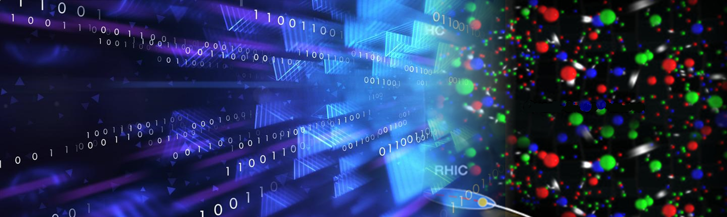







Towards Solving Computational Challenges in Lattice Field Theory
From Deep Learning to Quantum Computing
Lena Funcke
DPG Spring Meeting, 13 March 2025
dd

Slide 2
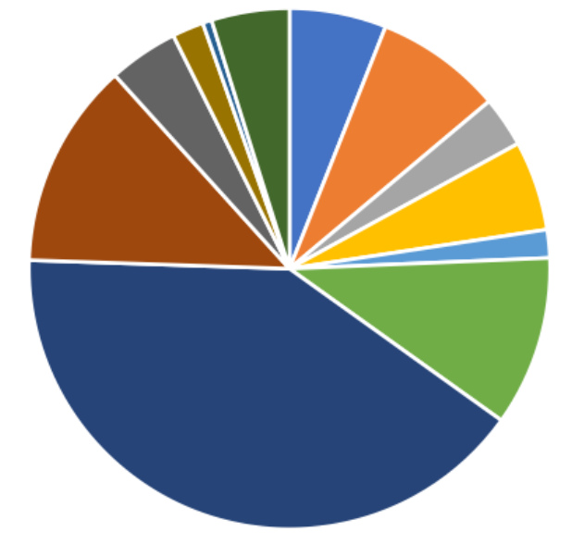
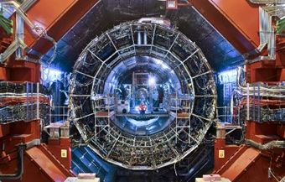
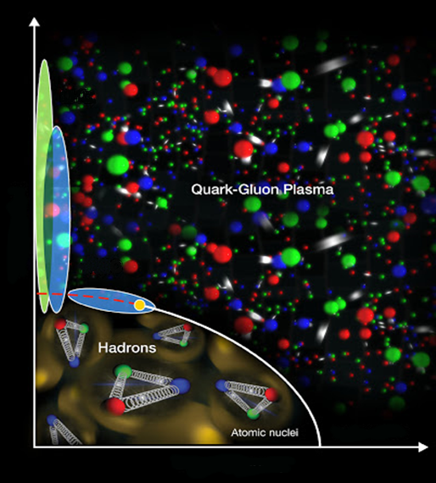

What are the computational challenges of lattice theory?
Computational costs
Computational limitations
Lattice QCD: dominant supercomputer usage (INCITE 2019) | → | deep learning
Cannot directly compute free energy, entropy, … | → | deep learning
Materials /
chemistry
LHC
Plasma
physics
Quark-Gluon Plasma
Lattice QCD:
$∼40$%
Temperature
Hadrons
Neutron
stars
Atomic nuclei
Baryon Density

Slide 3
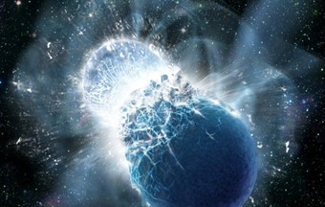
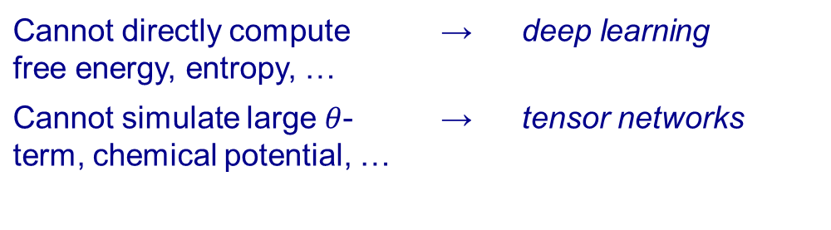
What are the computational challenges of lattice theory?
Computational costs
Computational limitations
Lattice QCD: dominant supercomputer usage (INCITE 2019) | → | deep learning
Cannot directly compute free energy, entropy, … | → | deep learning
Cannot simulate large $θ$-term, chemical potential, … | → | tensor networks
Materials /
chemistry
LHC
Plasma
physics
Quark-Gluon Plasma
Lattice QCD:
$∼40$%
Temperature
Hadrons
Neutron
stars
Atomic nuclei
Baryon Density

Slide 4
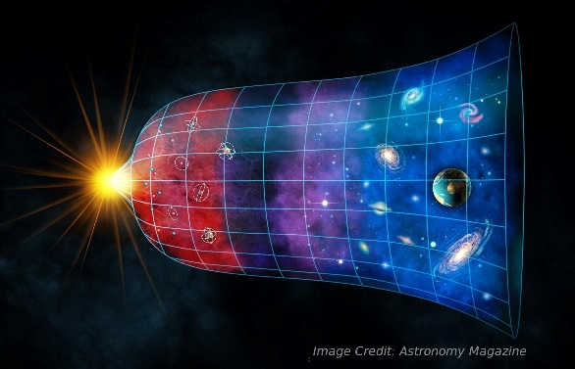
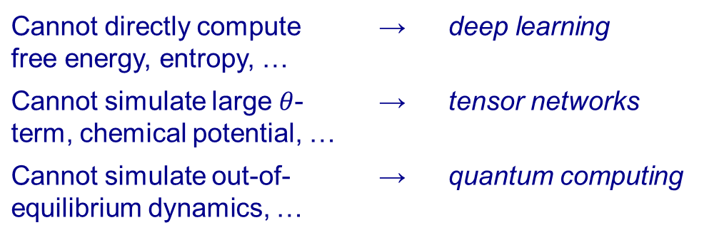
What are the computational challenges of lattice theory?
Computational costs
Computational limitations
Lattice QCD: dominant supercomputer usage (INCITE 2019) | → | deep learning
Cannot directly compute free energy, entropy, … | → | deep learning
Cannot simulate large $θ$-term, chemical potential, … | → | tensor networks
Cannot simulate out-of-equilibrium dynamics, … | → | quantum computing
Materials /
chemistry
LHC
Plasma
physics
Quark-Gluon Plasma
Lattice QCD:
$∼40$%
Temperature
Hadrons
Neutron
stars
Atomic nuclei
Baryon Density

Slide 5
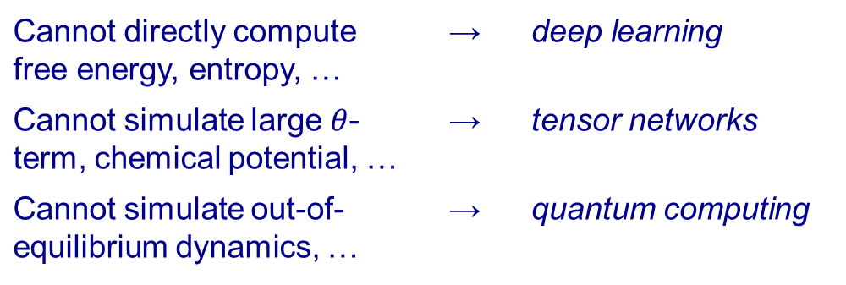
What are the computational challenges of lattice theory?
Computational costs
Computational limitations
Lattice QCD: dominant supercomputer usage (INCITE 2019) | → | deep learning
Cannot directly compute free energy, entropy, … | → | deep learning
Cannot simulate large $θ$-term, chemical potential, … | → | tensor networks
Cannot simulate out-of-equilibrium dynamics, … | → | quantum computing
Materials /
chemistry
LHC
sign problem
Plasma
physics
Quark-Gluon Plasma
Lattice QCD:
$∼40$%
Temperature
Hadrons
Neutron
stars
Atomic nuclei
Baryon Density

Slide 6
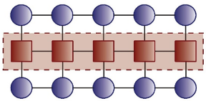
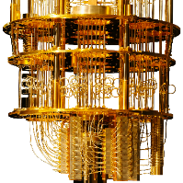

Overview: towards overcoming these challenges…
Standard method for Lattice QCD
New methods on the horizon
Deep
Learning
Markov Chain
Monte Carlo
$→$ powerful but limited
Tensor Networks
Quantum Computing

Slide 7
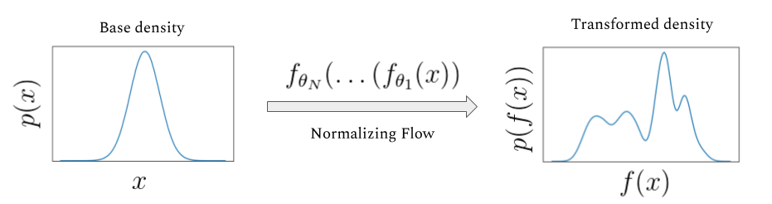
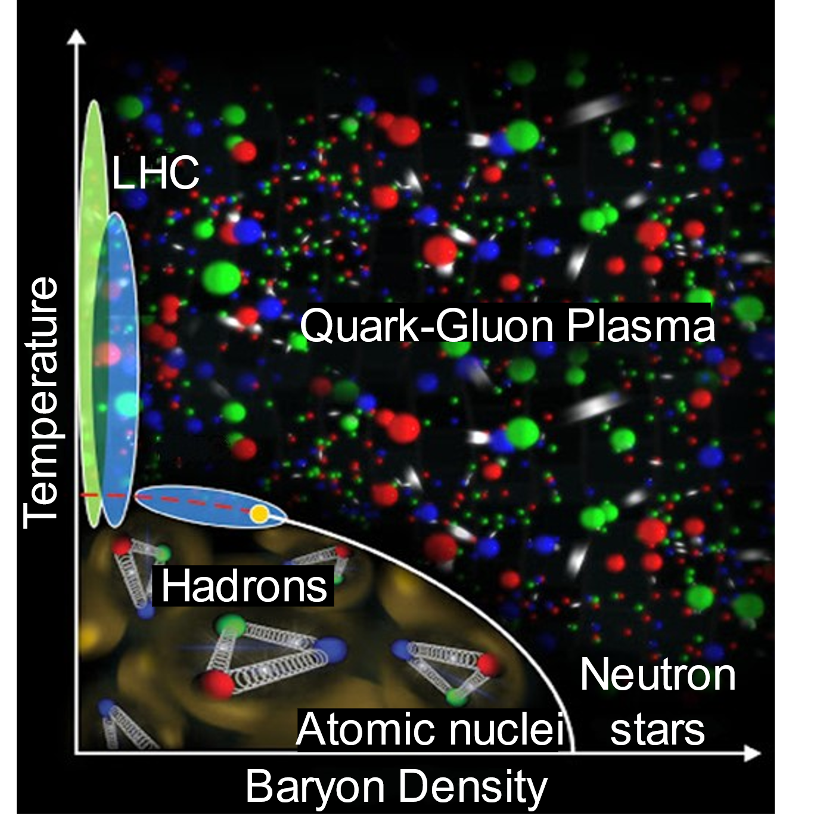
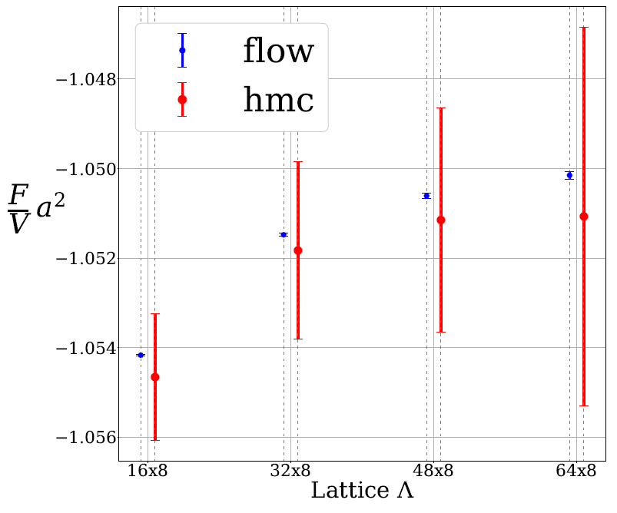






How to tackle MCMC challenges with new methods?
Standard method: MCMC for Lattice QCD
New method: deep learning
Concept
Compute observables: $\left\langle O\right\rangle =\frac{1}{Z}$ $∫Dφe^{−S\left(φ\right)}O\left(φ\right)$
Sample: $\left\langle O\right\rangle ≈\frac{1}{N}\sum{O(φ_{i})}$, where $φ_{i}∼p\left(φ\right)=\frac{1}{Z}e^{−S\left(φ\right)}$
Problem
Sequential, correlated sampling of $φ_{i}→$ slow and costly
No direct computation of free energy $→$ large errors
Concept
Train deep neural network:
bb
Results
Parallel, uncorrelated sampling of $x_{i}→$ get $φ_{i}=g_{θ}\left(x_{i}\right)$ ¹
Direct computation of free energy in 1+1D Higgs model ²
Future
Observables in
2+1D ³ & 3+1D ⁴
$$g_{θ}\left(x_{i}\right)$$
$$x_{i}∼q(x)$$
$$q_{θ}\left(φ\right)≈p(φ)$$
neural network
MCMC
free energy
¹ Albergo, Kanwar, Shanahan (2019); …
² Nicoli, Anders, LF, et al., (2021); …
³ Schuh, Kreit, Berkowitz, LF, Luu, Nicoli, Rodekamp (2025); …
⁴ Abbott et al. (2022); …; White Paper: Boyda, Cali, Foreman, LF, et al. (2022)
space-time lattice volume
7

Slide 8
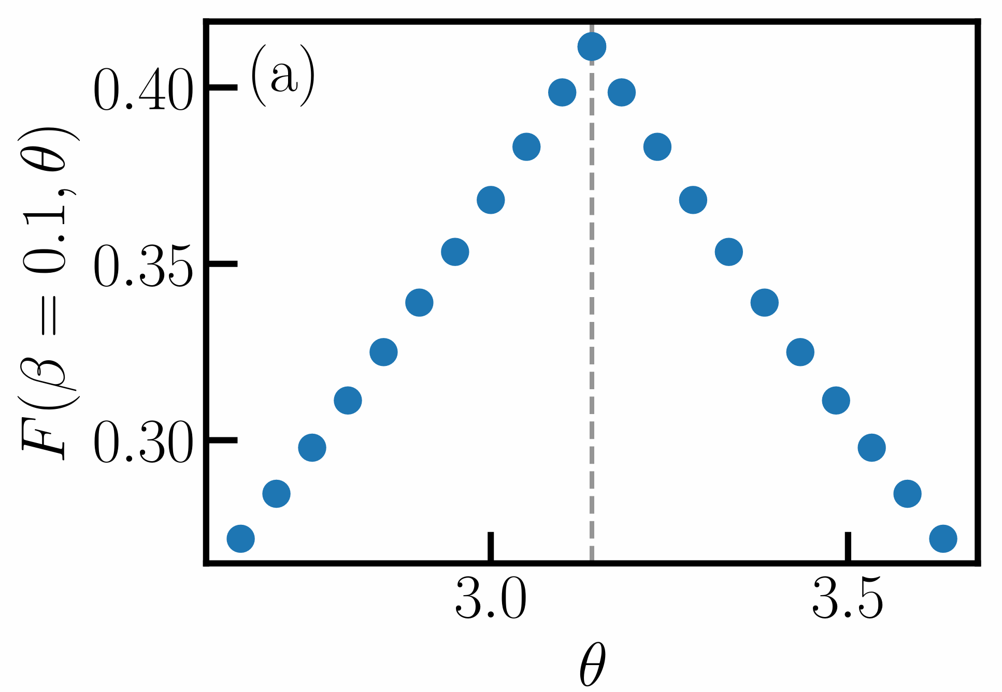
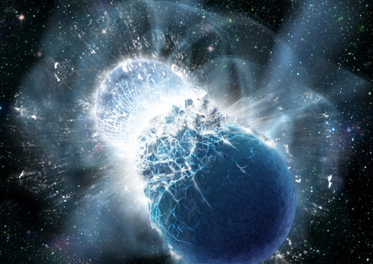
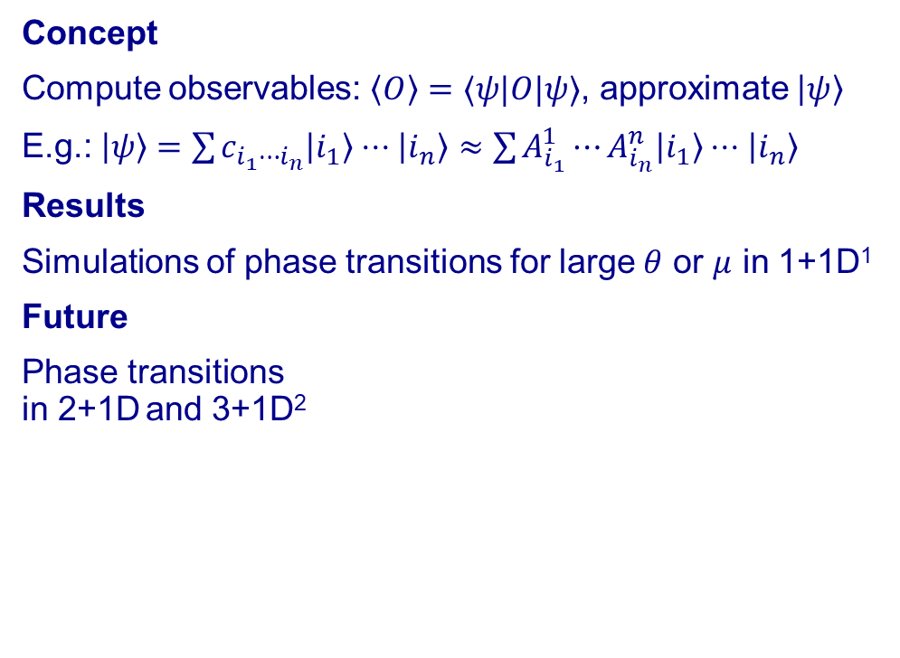

How to tackle MCMC challenges with new methods?
Standard method: MCMC for Lattice QCD
New method: tensor networks
Concept
Compute observables: $\left\langle O\right\rangle =\frac{1}{Z}$ $∫Dφe^{−S\left(φ\right)}O\left(φ\right)$
Sample: $\left\langle O\right\rangle ≈\frac{1}{N}\sum{O(φ_{i})}$, where $φ_{i}∼p\left(φ\right)=\frac{1}{Z}e^{−S\left(φ\right)}$
Problem
Complex action for $θ\text{−}\text{term}$and chemical potential $μ$
$→$“sign problem” $→$no simulations for large $θ$ or $μ$
Concept
Compute observables: $\left\langle O\right\rangle =⟨ψ|O|ψ⟩$, approximate $\left|ψ\right\rangle$
E.g.: $\left|ψ\right\rangle =\sum{c_{i_{1}⋯i_{n}}\left|i_{1}\right\rangle ⋅⋅⋅\left|i_{n}\right\rangle }≈\sum{A_{i_{1}}^{1}⋯A_{i_{n}}^{n}\left|i_{1}\right\rangle ⋅⋅⋅\left|i_{n}\right\rangle }$
Results
Simulations of phase transitions for large $θ$ or $μ$ in 1+1D¹
Future
Phase transitions
in 2+1D and 3+1D²
free energy
Nakayama,
LF, et al. (2022)
¹ Byrnes et al. (2002); Pichler et al. (2016); Banuls et al. (2017); Schneider et al. (2021); LF, Kühn, Jansen (2020); LF, et al. (2023); Avkhadiev, LF, et al. (2024); …
² Kuramashi et al. (2018); Felser et al. (2020); Magnifico et al. (2021);
Crane, et int., LF, et al. (2024); …

Slide 9
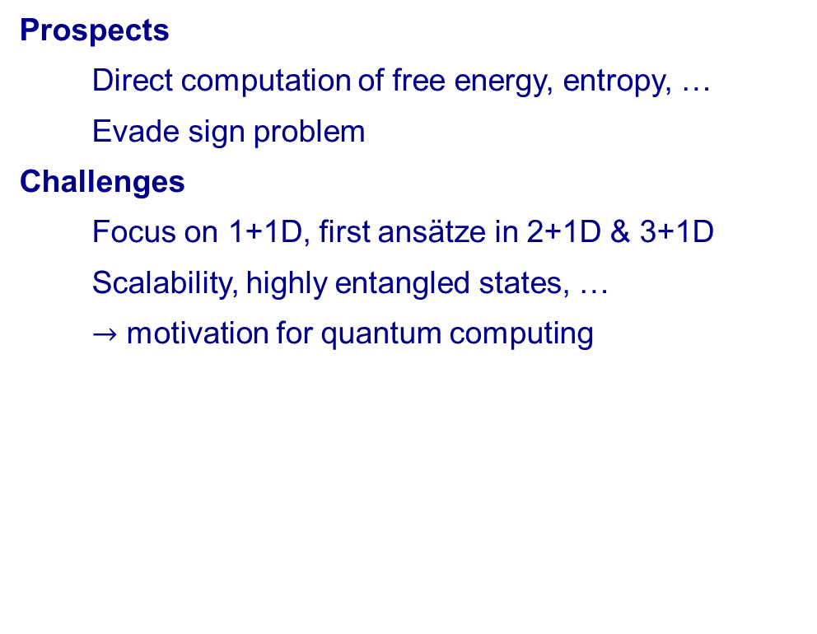
What are the prospects and limitations of these methods?
New method: deep learning
New method: tensor networks
Prospects
Direct computation of free energy, entropy, …
Mitigate sign problem
Challenges
Focus on 1+1D, first ansätze in 2+1D & 3+1D
Mode collapse, training costs, scalability, …
Prospects
Direct computation of free energy, entropy, …
Evade sign problem
Challenges
Focus on 1+1D, first ansätze in 2+1D & 3+1D
Scalability, highly entangled states, …
$→$ motivation for quantum computing
✓
✓
✗
✓
✓
✗
✗
✓
✓
✗
✗
neural network
MCMC
free energy
free energy
space-time lattice volume

Slide 10
Overview: towards overcoming these challenges…
Standard method for Lattice QCD
New methods on the horizon
Deep
Learning
Markov Chain
Monte Carlo
$→$ powerful but limited
Tensor Networks
Quantum Computing

Slide 11
Overview: towards overcoming these challenges…
Standard method for Lattice QCD
New methods on the horizon
Deep
Learning
Markov Chain
Monte Carlo
$→$ powerful but limited
Tensor Networks
Quantum Computing

Slide 12
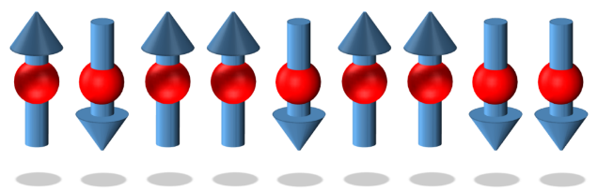
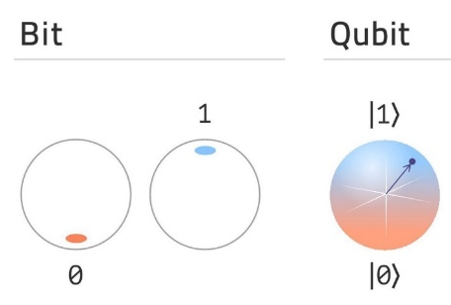
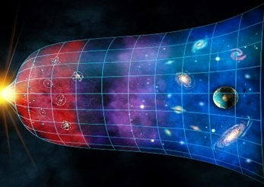


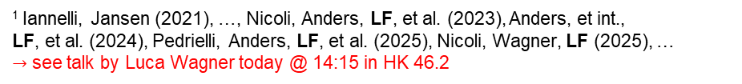

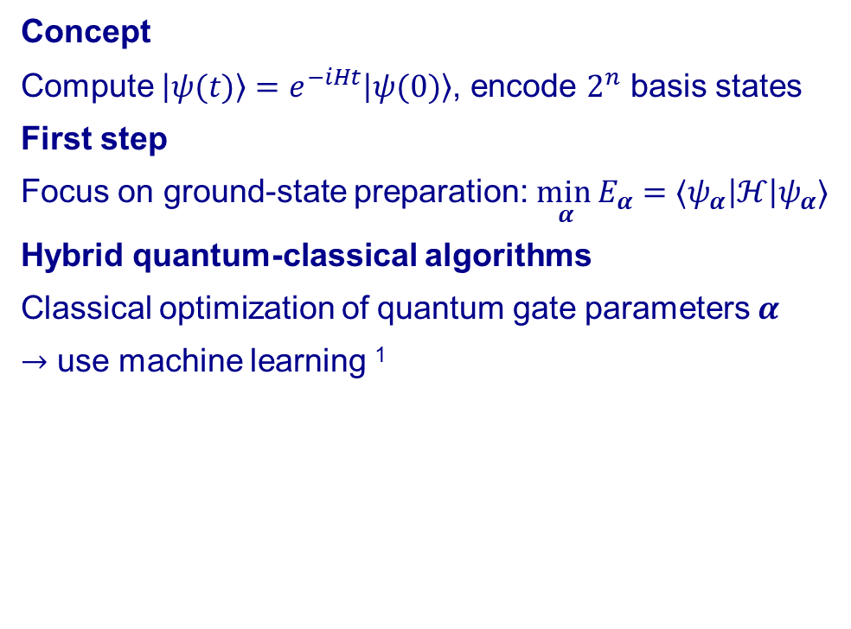

How to tackle MCMC challenges with new methods?
Standard method: MCMC for Lattice QCD
New method: quantum computing
Concept
Compute observables: $\left\langle O\right\rangle =\frac{1}{Z}$ $∫Dφe^{−S\left(φ\right)}O\left(φ\right)$
Sample: $\left\langle O\right\rangle ≈\frac{1}{N}\sum{O(φ_{i})}$, where $φ_{i}∼p\left(φ\right)=\frac{1}{Z}e^{−S\left(φ\right)}$
Problem
Euclidean action $S\left(τ=it\right)→$ no real-time evolution
$→$can be exponentially hard for tensor networks
Concept
Compute $\left|ψ(t)\right\rangle =e^{−iHt}\left|ψ(0)\right\rangle$, encode $2^{n}$ basis states
First step
Focus on ground-state preparation: $\min_{ α} E_{α}=⟨ψ_{α}\left|ℋ\right|ψ_{α}⟩$
Hybrid quantum-classical algorithms
Classical optimization of quantum gate parameters $α$
$→$ use machine learning ¹
$$\left|1\right\rangle =$$
$$\left|ψ\right\rangle =$$
$$\left|0\right\rangle =$$
Superposition
+ entanglement
¹ Iannelli, Jansen (2021), …, Nicoli, Anders, LF, et al. (2023), Anders, et int.,
LF, et al. (2024), Pedrielli, Anders, LF, et al. (2025), Nicoli, Wagner, LF (2025), …
$→$ see talk by Luca Wagner today @ 14:15 in HK 46.2

Slide 13
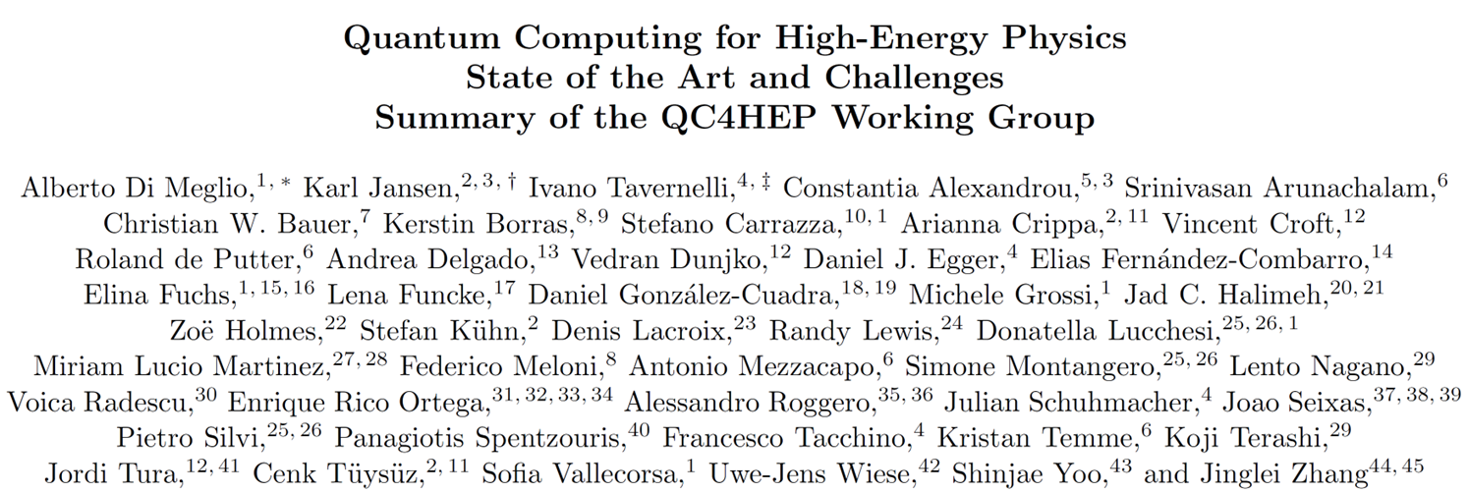
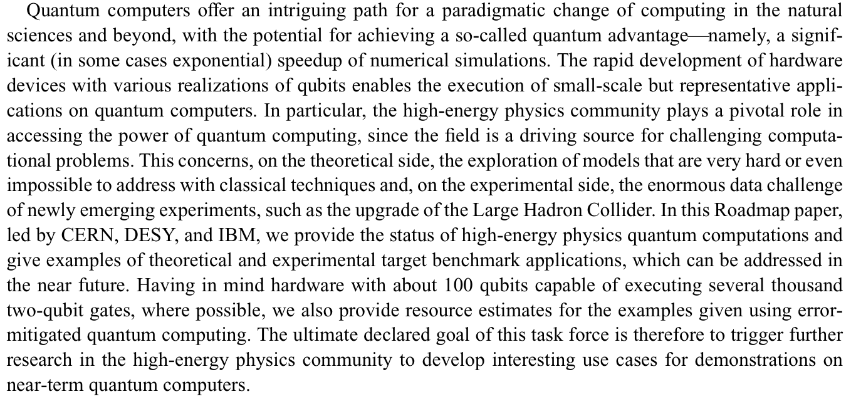

Slide 15
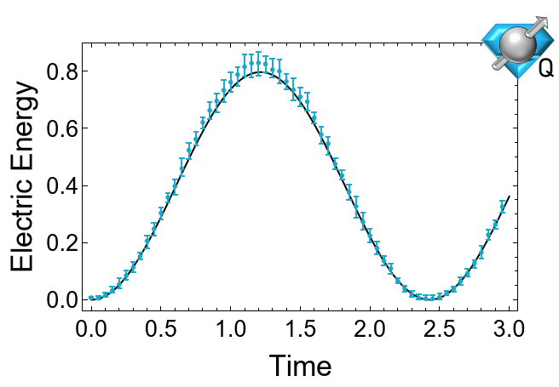

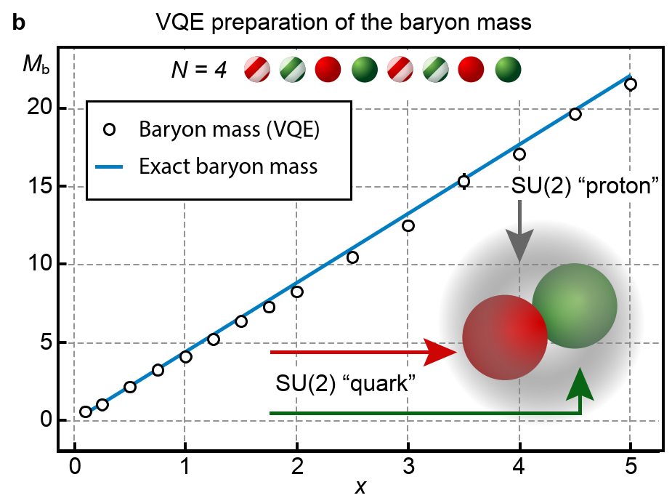
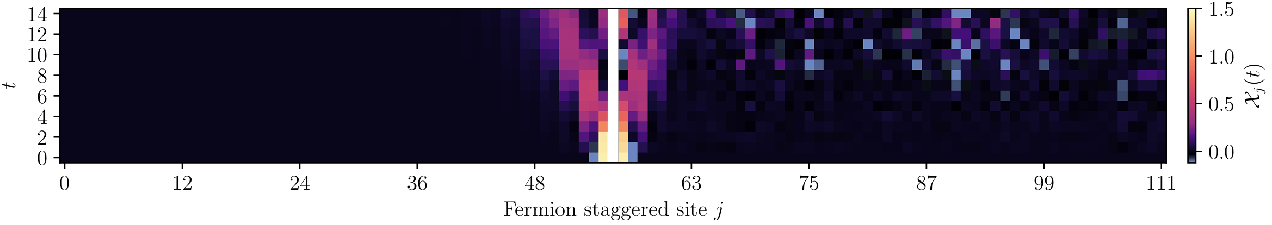

Which field theories have already been simulated?
Simulations on “public” quantum devices
Simulations on “private” quantum devices
Superconducting qubits
Real-time evolution: Schwinger model,¹ SU(2),² SU(3),³ ...
Variational computation:
SU(2) “hadron” masses ⁴
Trapped ions
Variational computation: 2+1D QED confinement string,⁵ …
Cold atoms
Real-time evolution: Schwinger model,⁶ Bose-Hubbard,⁷ ...
Superconducting qubits
Hadron dynamics: Schwinger model with $>100$qubits,⁸ …
Phase transitions: Schwinger model at finite density,⁹ …
¹ Klco et al. (2018), de Jong et al. (2021), …, ² Klco et al. (2019), …, ³ Ciavarella et al. (2019), Ciavarella, Bauer (2024), …, ⁴ Atas et al. (2021), …,
⁵ Crippa et al. (2024), …,⁶ Yang et al. (2020), ..., ⁷ Bloch et al. (2012), …, ⁸ Farrell et al. (2024), …, ⁹ LF et al. (2022), Schuster, Kühn, LF, et al. (2023), …
$→$ ongoing work on 2+1D QED at finite density: see talk by Emil Rosanowski today @ 14:00 in HK 46.1

Slide 16
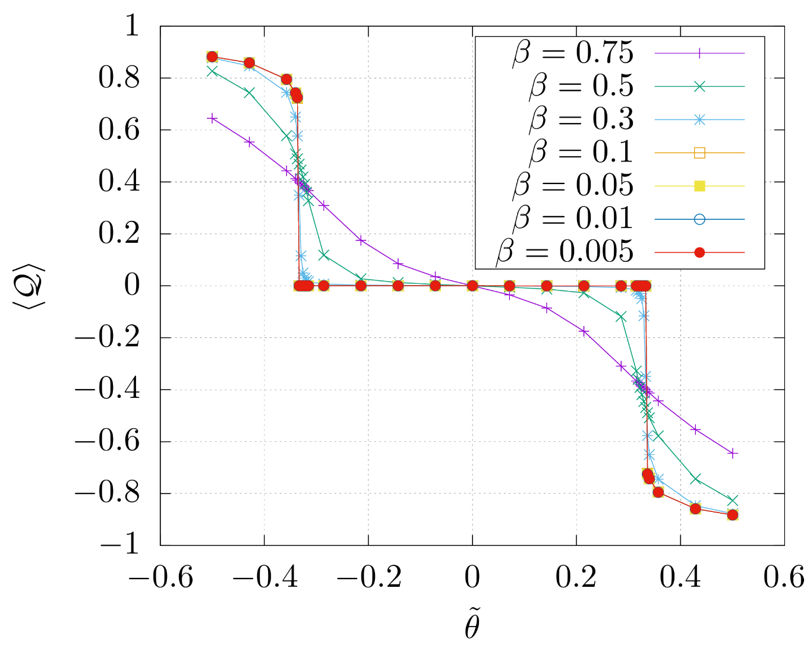
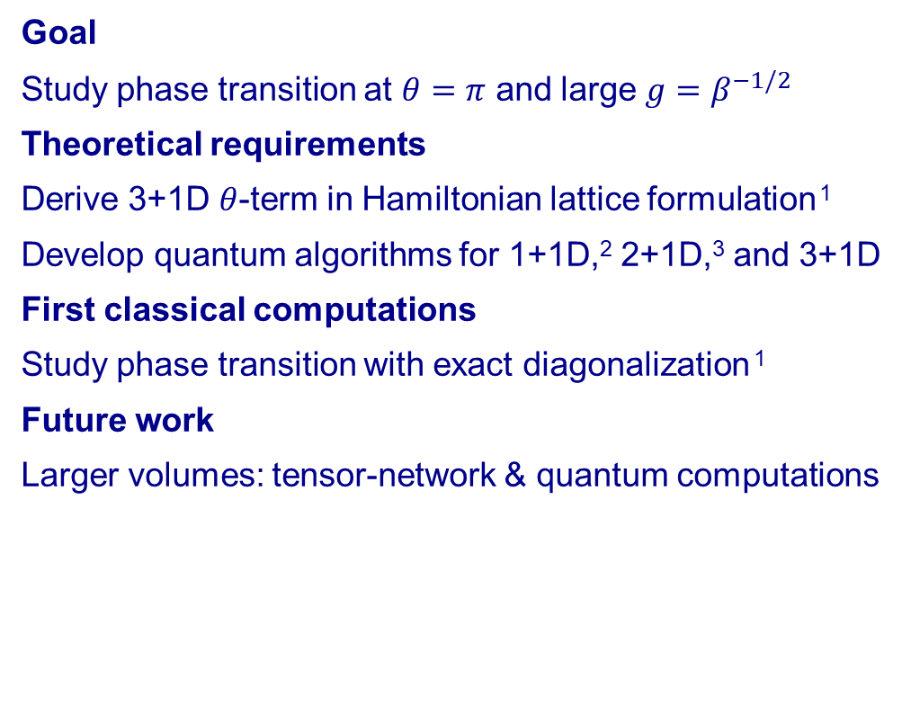


Outlook: how can we address the sign problem in 3+1D?
Example: U(1) lattice gauge theory with $θ$-term
First classical results for a single cube
Goal
Study phase transition at $θ=π$ and large $g=β^{−1/2}$
Theoretical requirements
Derive 3+1D $θ$-term in Hamiltonian lattice formulation ¹
Develop quantum algorithms for 1+1D,² 2+1D,³ and 3+1D
First classical computations
Study phase transition with exact diagonalization ¹
Future work
Larger volumes: tensor-network & quantum computations
Problem
Topological charge $⟨ℋ_{θ}⟩(−8π^{2}β/θV)$
Solutions
¹ Kan, LF, et al., (2021);
² Many papers by various groups…; Schuster, Kühn, LF, et al., (2023); …
³ Crippa, Romiti, LF, et al. (2024); Crane, et int., LF, et al. (2024); …
Reviews: LF, et al., (2023); …
$$θ/8π^{2}$$

Slide 17
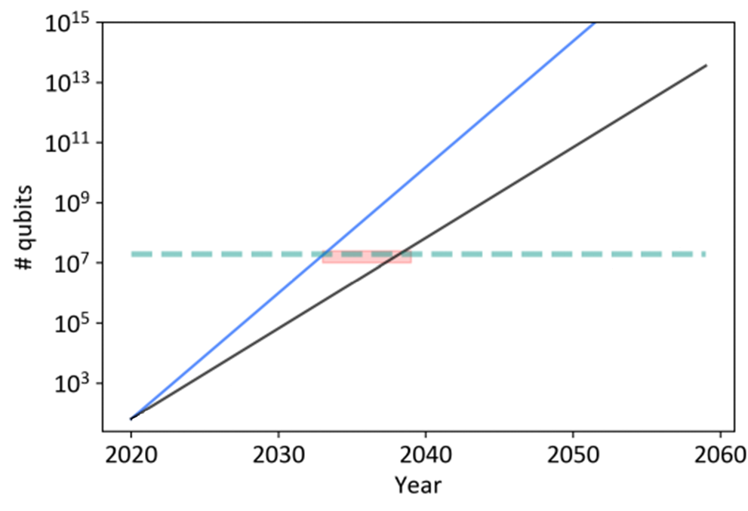
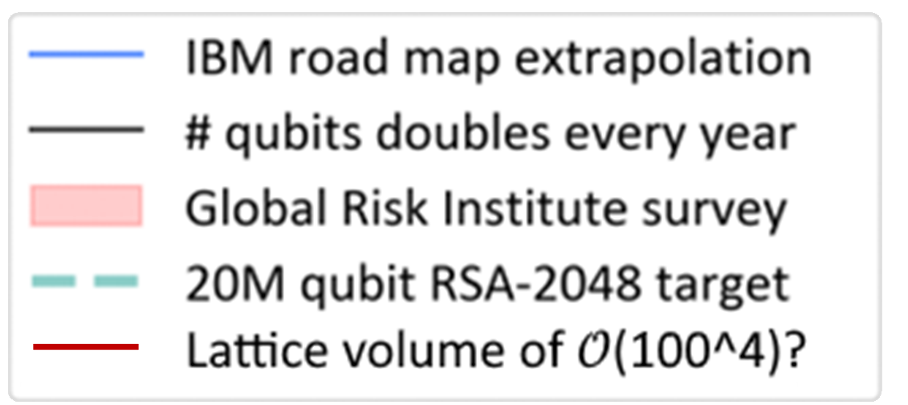

Summary: where do we stand, where will we go?
The path to go…
A rough sketch…
State of the art
First quantum simulations of 1+1D & 2+1D theories *
Error mitigation, circuit optimization, new algorithms
Future goals
Error correction, quantum simulations of 3+1D theories
… for real-time evolution, to evade sign problem, …
* Remember: for deep learning & tensor networks, first simulations in 3+1D
Present
Near future
Analogous to
Lattice QCD from 1980s to 2020s?
Adapted from
Groenland (2024)

Slide 18
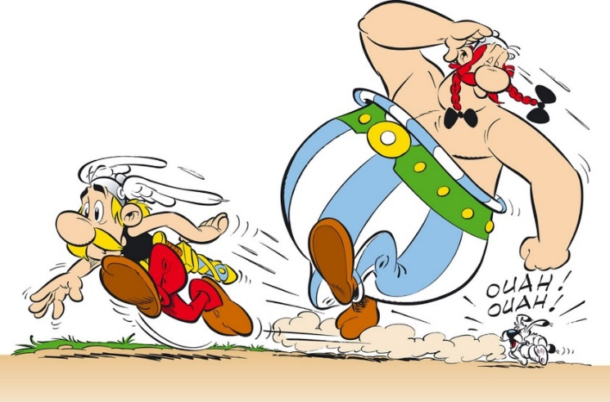


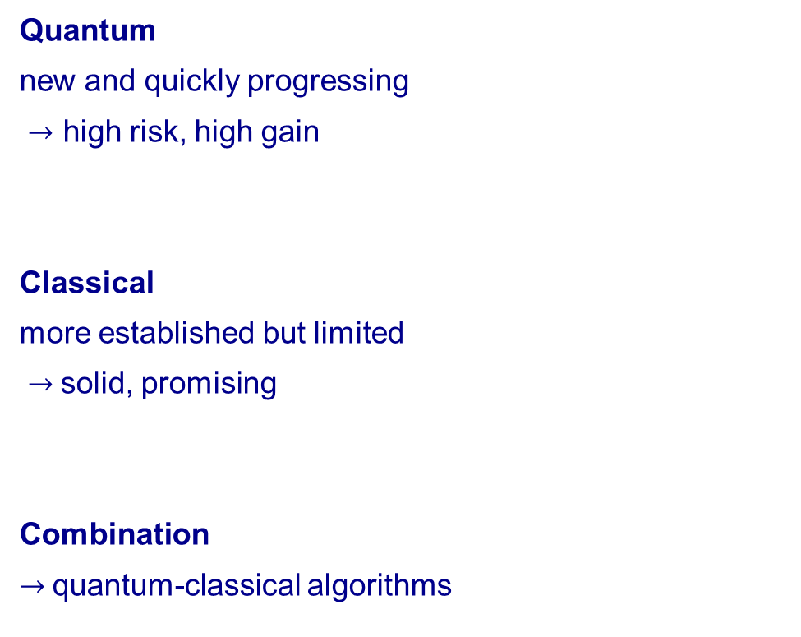
Summary: where do we stand, where will we go?
The path to go…
A rough sketch…
Quantum
new and quickly progressing
$→$ high risk, high gain
Classical
more established but limited
$→$solid, promising
Combination
$→$quantum-classical algorithms
Adapted from
Groenland (2024)

Slide 19
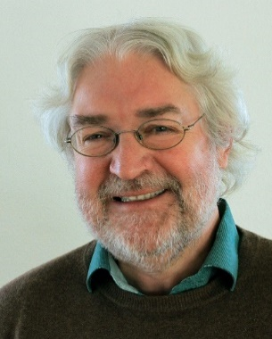
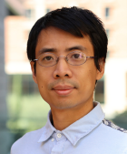
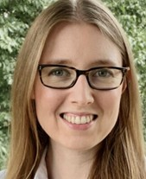
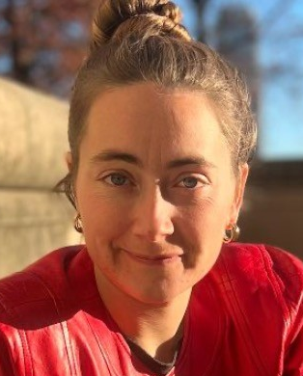
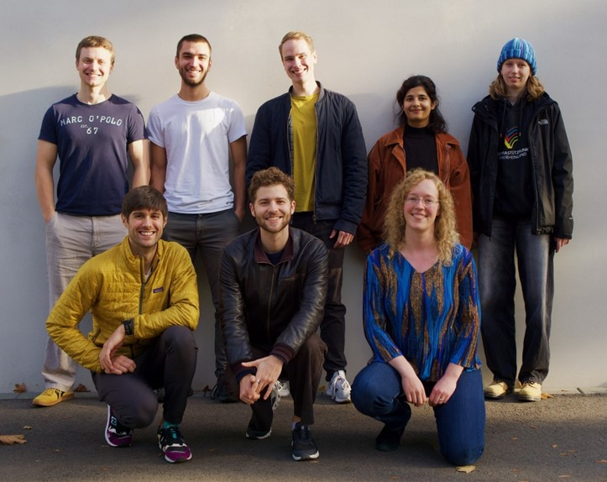
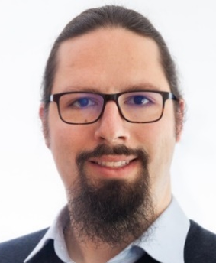
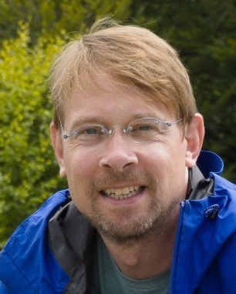
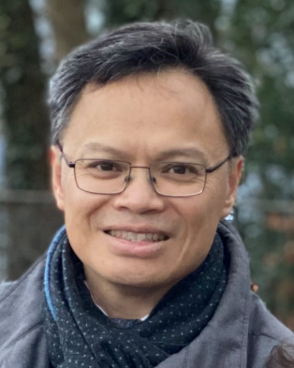
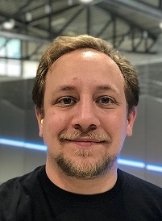
Thanks to my collaborators and my group!
Karl Jansen Di Luo Phiala Shanahan Eleanor Crane
(DESY) (UCLA) (MIT) (MIT)
Stefan Kühn Carsten Urbach Thomas Luu Evan Berkowitz
(DESY) (Bonn U.) (FZJ, Bonn U.) (Virgin Islands U.)
Thanks to you for listening! Questions?
and more…

Slide 20
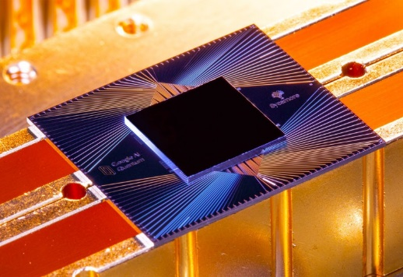
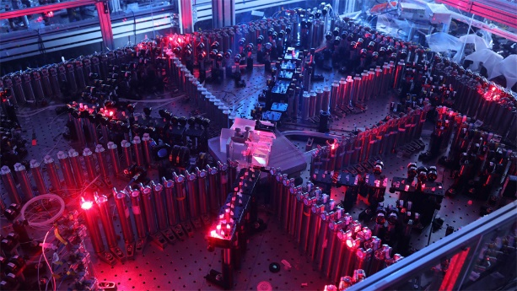





Backup: Quantum computing, where do we stand?
Quantum hardware
Quantum algorithms
Achievements
Quantum advantage: outperformed classical computers ¹
Exponential speedup of specific classical computations
Challenges
$𝒪(10−1000)$ qubits with $V_{Q}≤2^{21}$ $→$ increase size
Noise $→$ need quantum error mitigation / correction
Future applications
Cryptography, quantum chemistry, …
Particle / nuclear / condensed matter physics, …
Challenges
New technology $→$ need fundamentally new algorithms
Competition $→$classical algorithms quickly advance
Applications
$$\left|1\right\rangle =$$
$$\left|ψ\right\rangle =$$
Challenges
Arute et al. (2019)
Zhong et al. (2020)
Superposition
+ entanglement
$$\left|0\right\rangle =$$
¹ Morvan et al. (2024), earlier claims by e.g. Arute et al. (2019), Zhong et al.
(2020), Madsen et al. (2022) refuted by e.g. Liu et al. (2021), Oh et al. (2024)
Astibuag (2022)

Slide 21


Backup: How can we reduce the noise?
Error mitigation versus error correction
Progress in quantum error correction
Problem
Error rates $𝒪\left(0.1\%−1\%\right)$ for gates and measurement
Near-term solution
Error mitigation: reduce errors, e.g., by post-processing
Long-term solution
Quantum error correction (QEC): fault-tolerant devices
Bit-flip code,¹ Shor code,² surface code,³ GKP code,⁴ …
Quantum threshold theorem
For QEC, need extra qubits and errors below threshold ⁵
E.g. surface code needs $>1000$ extra qubits for $p<0.1\%$
Many recent advances, including:
…
Analogy: Curing (correcting) sickness (errors)
Current: less sick (less errors) after medication (“QEC”)
Future: cured (fault-tolerant) after medication (QEC)
¹ Peres (1985), ² Shor (1995), ³ Kitaev (1997), ⁴ Gottesmann et al. (2001), ...
⁵ Shor (1996), Knill et al. (1998), Kitaev (2003), Aharonov et al. (2008)

Slide 22




Backup: How can we reduce the noise?
Example: measurement error mitigation
Example: gate error mitigation
Operator rescaling method¹
Benchmark: $Z$ and $Z_{1}Z_{2}$ operators on IBM-Q hardware
Result: measurement error reduced by factor 10
Other mitigation techniques
Zero-noise extrapolation,² randomized compiling,³
quasi-probability decomposition,⁴ …
Lattice field theory applications
E.g. zero-noise extrapolation for lattice Schwinger model:
IBM-Q quantum hardware data
unmitigated mean error
standard deviation
Figure credit:
Graham Carlow
Klco et al. (2018)
power-law decline of
- mitigated mean error
- standard deviation
¹ Kandala et al. (2017), Yeter-Aydeniz et al. (2019), LF et al. (2020), ...,
² Temme et al. (2017), Li et al. (2017), ..., ⁴ Temme et al. (2017), ...
number of measurements
LF et al. (2020)

Slide 23












Backup: Which quantum-classical algorithms?
Example: variational algorithms
Variational Quantum Eigensolver (VQE) ¹
Key concept
Classical computer: main computation
Quantum computer: classically hard/intractable part
Goal
Find ground state of problem Hamiltonian $ℋ$
Variational approach
Minimize $E(\vec{α})=⟨ψ(\vec{α})\left|ℋ\right|ψ(\vec{α})⟩$ w.r.t. parameters $\vec{α}$
Quantum computer
Given ${\vec{α}}_{i}$, prepare $|ψ(\vec{α})⟩$ and measure $E\left({\vec{α}}_{i}\right)$
Classical computer
Given $E({\vec{α}}_{i})$, find optimized parameters ${\vec{α}}_{i+1}$
$→$ optimization using machine learning ²
$${\vec{α}}_{i}$$
$$E({\vec{α}}_{i})$$
$$|0⟩$$
$$U(α_{1})$$
$$U(α_{3})$$
Compare to tensor network states:
state: quantum circuit $↔$ tensor network
parameters: gate $↔$ tensor parameters
$$\left|ψ\left(\vec{α}\right)\right\rangle =$$
Sim et al. (2018)
$$|0⟩$$
$$U(α_{2})$$
$$U(α_{4})$$
¹ Peruzzo et al. (2014);
² Nicoli, Anders, LF, et al. (2023), Anders, et int., LF, et al. (2024)

Slide 24


Backup: dealing with gauge fields
Infinite Hilbert space
Gauge invariance
Problem
Continuous gauge theory requires $∞$-dim. Hilbert space
First approach
Integrate out gauge field: only possible in 1+1D
Second approach
Approximate gauge group:¹ e.g. $U\left(1\right)→\text{ℤ}\text{n}$
Third approach
Truncate irreps:² e.g. for $F_{j}\left|l\right\rangle =|l⟩$, use finite $\left|l\right|<L$
Many more approaches…
Problem
Gauge invariance requires imposing local constraints
First approach
Penalize unphysical states,³ e.g. $ℋ_{penalty}=λ{\left(\sum_{j=1}^{N}{Q_{j}}\right)}^{2}$
Second approach
Analytically solve Gauß law at every site ⁴
Third approach
Gauge-invariant formulation, e.g. loop-string-hadron ⁵
Many more approaches…
¹ Zohar et al. (2013), ..., ² Horn (1981), ..., ³ Banerjee et al. (2012), ..., ⁴ Klco et al. (2018), ..., ⁵ Raychowdhury, Stryker (2020)

