Slide 1
7. Treffen HKR-Modernisierung ICU project planning until beamtime 2026 and goals for the wet run July 2025

Slide 2
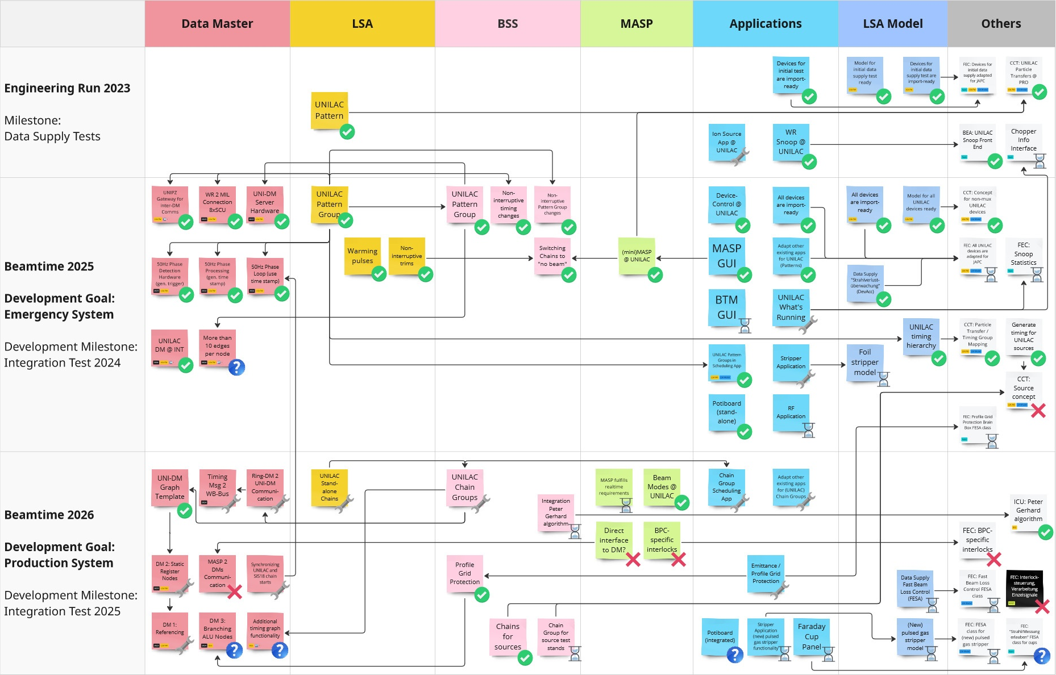
Achieved milestones and activities in progress
Final status after
Wet Run November 2024
achieved
in progress
pending
cancelled
to be clarified

Slide 3
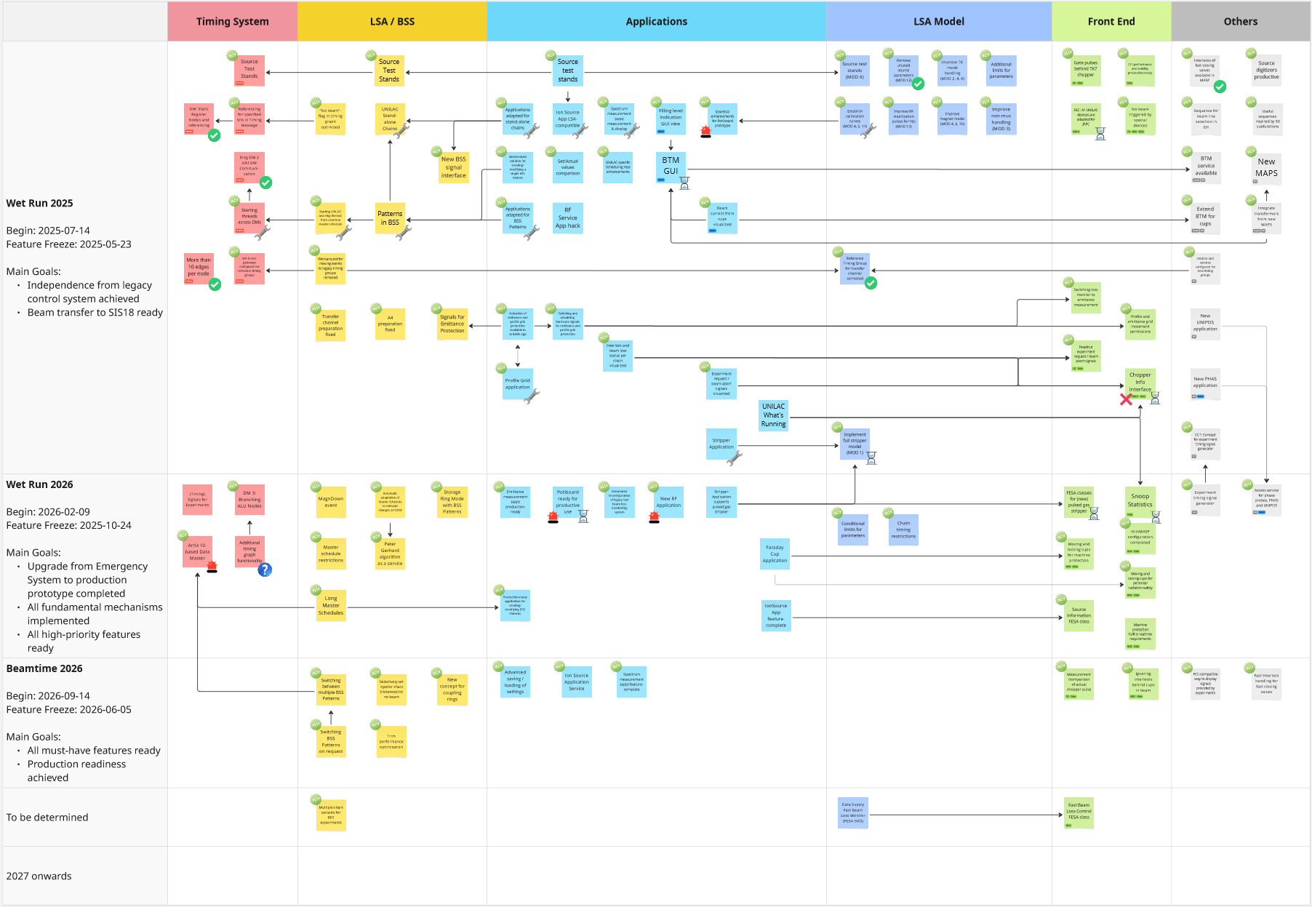
Achieved milestones and activities in progress
Updated
... work in progress
new activity
achieved
in progress
pending
cancelled
to be clarified
critical

Slide 4
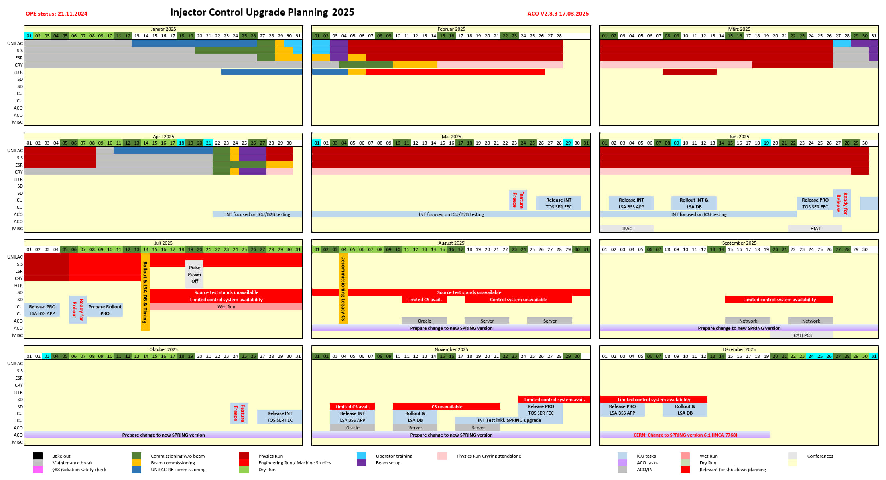
Project planning 2025

Slide 5
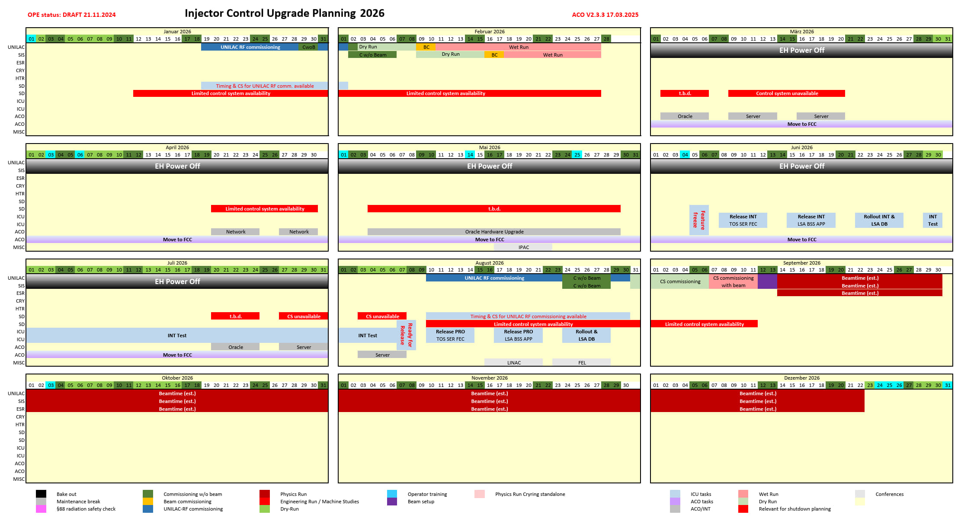
Project planning 2026

Slide 6
Major Milestones
Wet Run 2025
Independence from legacy control system achieved
Beam transfer to SIS18 ready
Wet Run 2026
Upgrade from Emergency System to production prototype completed
All fundamental mechanisms implemented
All high-priority features ready
Beamtime 2026
All must-have features ready
Production readiness achieved

Slide 7
Wet Run July 2025
Immediately after beamtime, only 1 day for conversion to new control system planned
Primary goal: beam injection into SIS18 (first and possibly only test run together with SIS18)
Secondary goal: verification of independence from old control system and HKR UNILAC equipment – to be sure we did not completely miss something

Slide 8
Next steps
Coordination of wet run preparation
follow-up of results from wet run
changes within LSA framework
adaptation of applications
development of model
HKR Modernisierung
Detailed planning of wet run
special attention to the conversion

