Slide 1
Possible ring layouts
March 6, 2025
O.Dolinskyy

Slide 2
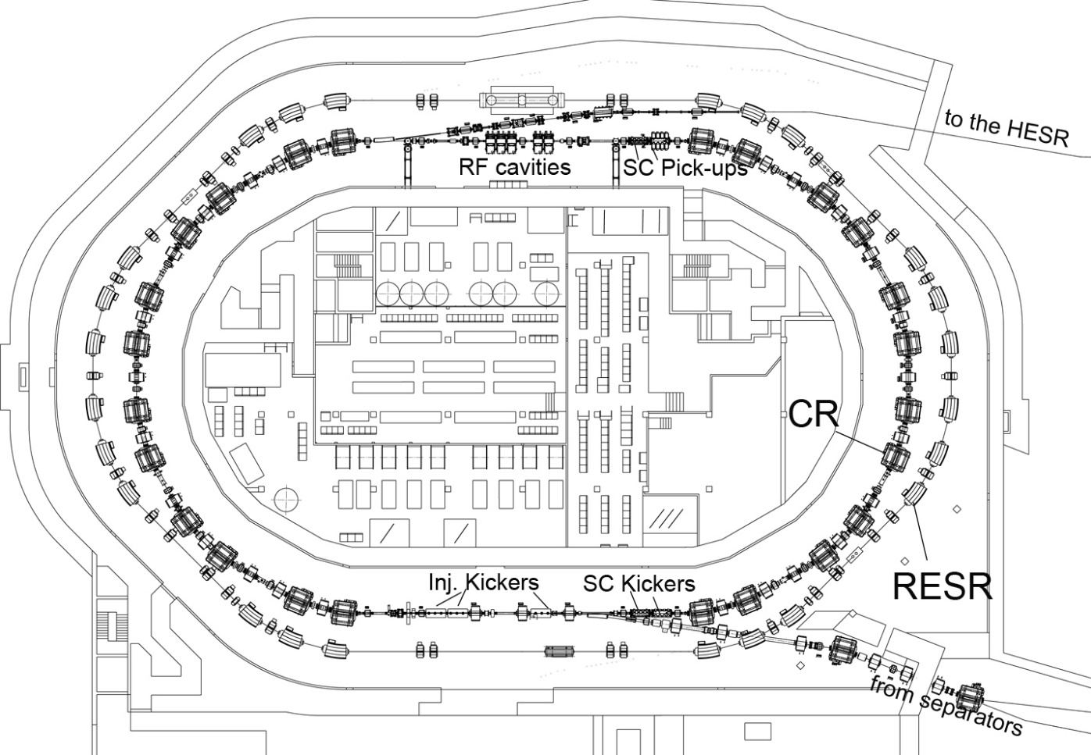
CR / RESR complex – main tasks
1.Antiproton accumulation up to 10¹¹ particles
at E_{kin} =3 GeV
(Momentum stacking by Stochastic cooling system)
2. RIBs deceleration within 1 s from 740 MeV up to
100 MeV.
3. Antiproton deceleration is an option

Slide 3
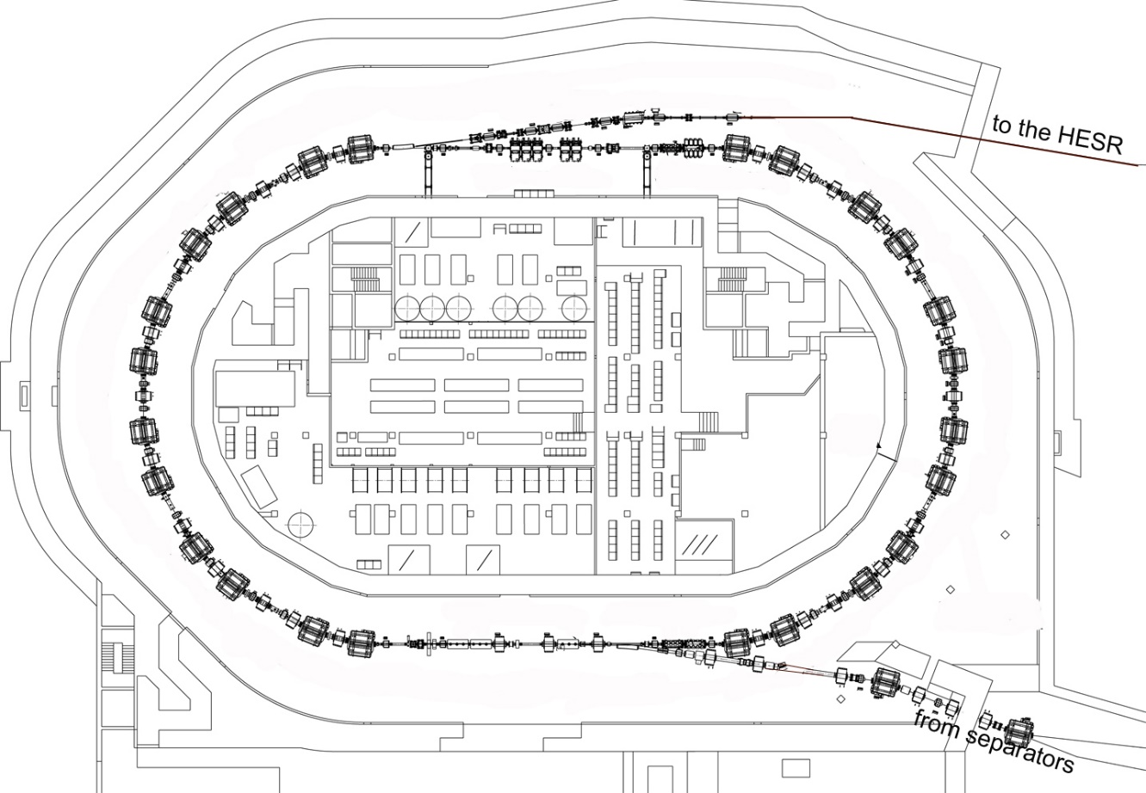
CR – Collector Ring
CR (MSV0-3):
-Delivery N=10⁸ antiprotons
every 10 s to HESR with a
very low momentum spread
and low beam emittances for
high precision experiments
at PANDA.
-in ring NUSTAR experiments
with RIBs intensity
up to 10⁸ particles
(Schottky resonators,TOF –detectors,
pocket-detectors)

Slide 4
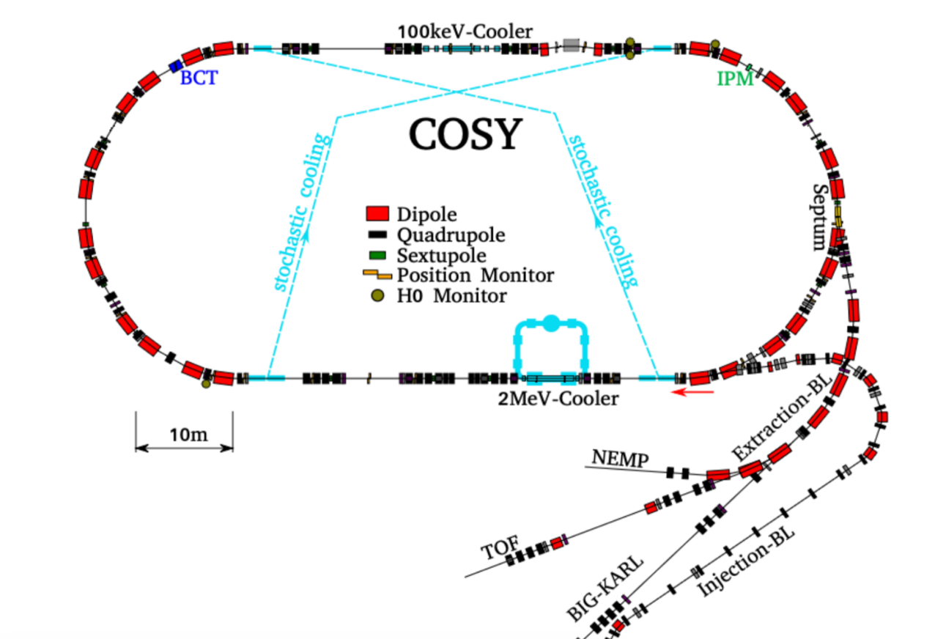
COSY
Circumference 184 m
Max Rigidity 12 Tm
Momentum acceptance 1%
H/V Transverse acceptance 150/35 mm*mrad

Slide 5
Option: COSY could be installed taking over RESR functions

Slide 6
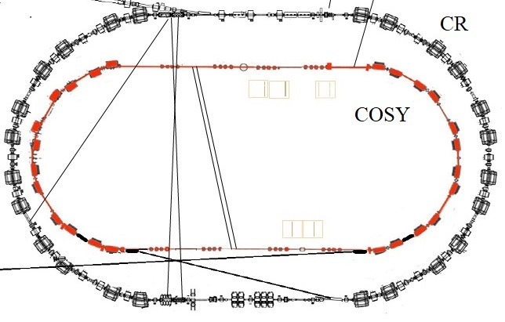
Option: COSY inside CR

Slide 7
Antiproton accumulation in COSY ??
The ring circumference is 184.094 m
The revolution period of 2.8 GeV antiproton is 634 ns
The allocation of barrier voltages and injection kicker
magnetic field and injection/accumulation area is quite tight
Small transition energy 2.26 (the slipping factor is 0.1332)
The cooling acceptance of stochastic cooling system is small
Almost half of the injected beam from the CR can not be accumulated.
The accumulation efficiency is low

Slide 8
Antiproton accumulation in COSY ??
The accumulation efficiency can be improved if :
Stochastic cooling system similar to CR could be used
The transition energy could be increased to 4.1
(quadrupole strength of 10 T/m is needed)
Problems:
Additional CR stochastic cooling system must be developed.
The COSY quadrupole strength of 7 T/m
Special barrier bucket RF cavity must be developed

Slide 9
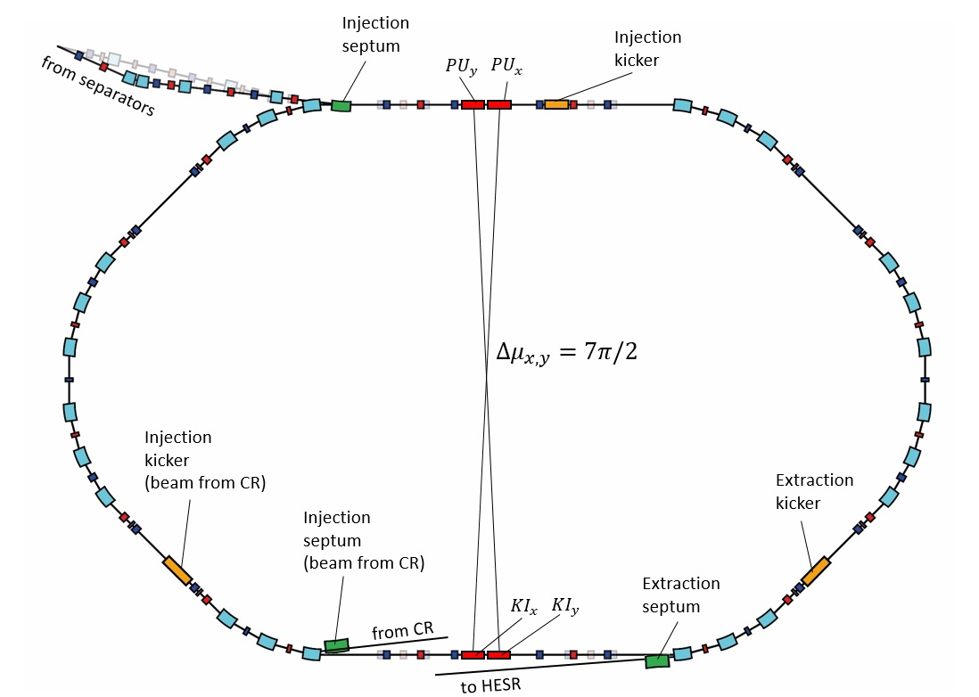
Option 2: The new ring reusing COSY components
Preliminary calculated layout of the ring with COSY magnets

Slide 10
Option 2: New ring reusing COSY components
Parameters
 | RESR (original) | New ring (option 1)
Ring circumference (m) | 240 | 240
Hor. Acceptance (mm.mrad) | 25 | 40
Ver. Acceptance (mm.mrad) | 25 | 35
Momentum acceptance (%) | ± 1 | ± 0.5
Injected emittance hor/ver (mm*mrad) | 5 | 5
Magnet rigidity (Tm) | 13 | 12
Injection/extraction energy of antiprotons (GeV) | 3.0 | 2.8
Maximum Inj/extr. energy of RIBs (MeV/u, A/Z=2.8) | 740 | 655
Accumulation 10¹¹ antiprotons | 3 hours | 3 hours ?

Slide 11
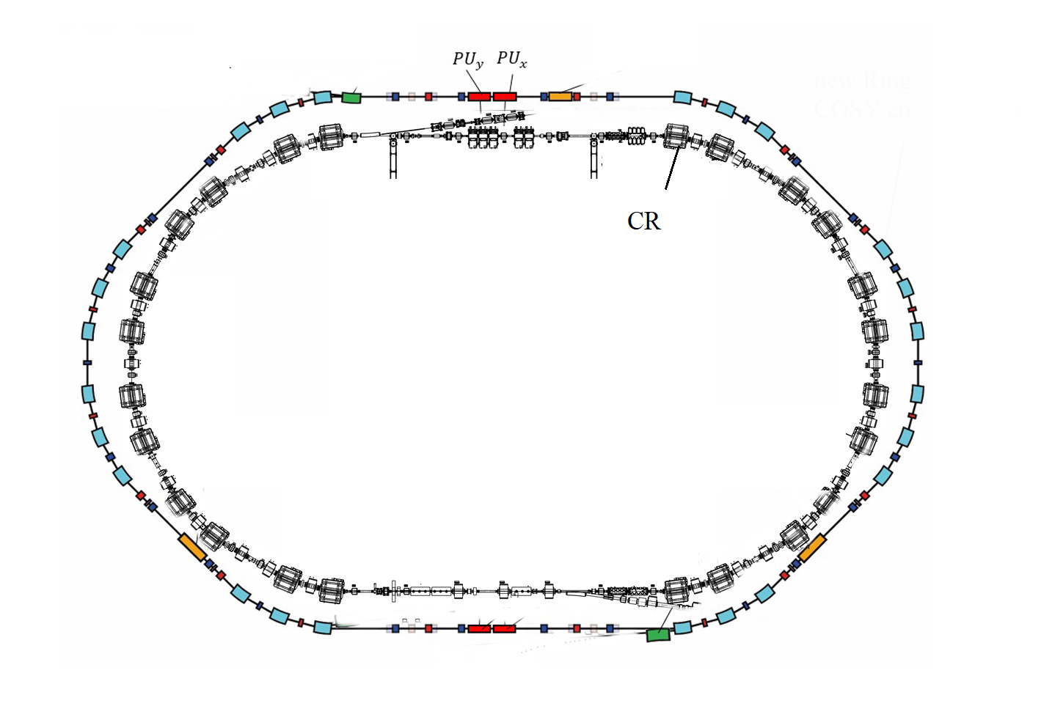
Option: New ring outside CR reusing COSY components
Preliminary layout of the new ring reusing COSY components has been calculated.

Slide 12
Antiproton accumulation in new ring reusing COSY components
The ring circumference is 240 m
The revolution period of 2.8 GeV antiproton is 826 ns
The allocation of barrier voltages and injection kicker magnetic field and injection/accumulation area are well reserved
High transition energy 4.58 (the slipping factor is 0.016)
The cooling acceptance of stochastic cooling system is acceptable
High accumulation efficiency up to 5 x 10¹⁰ antiprotons
The accumulation is possible up to 10¹¹ antiprotons
Deceleration high flux antiproton beam from 2.8 GeV to around 100 MeV or less, (no cross the transition energy).

Slide 13
Option 2: New ring reusing COSY components
Geometry of the new ring is similar to the RESR.

Slide 14
COSY components for a new ring
The parameters of the COSY ring and beams are very close to the characteristics of the RESR
The COSY components with available equipment can be used to build a new ring with functions of the RESR
Simultaneous installation of both CR and new ring can provide a fast accumulation of antiprotons to the intensities up to 10¹¹ particles
A new injection/extraction system must be designed
Due to the aperture of COSY magnets the max beam emittance of 5 mm*mrad can be injected into a new ring
The accumulation of antiprotons can be provided by a barrier bucked cavity in combination with stochastic cooling

Slide 15
COSY at FAIR
- The COSY components can be reused for construction of a new storage ring, which is similar to RESR
- The new ring with CR can serve accumulation of antiprotons up to 10¹¹ particles
- A new ring takes over functions of the RESR
-The layout of the new ring based on COSY can be the same as originally planned for the RESR
-The new storage ring based on COSY has no impact on layout, position and installation of the CR
-For a new storage ring the injection/extraction and vacuum systems must be designed
- The antiproton accumulation is proposed to be done by barrier bucket RF cavities in combination with stochastic cooling

Slide 16
Thank you

