Slide 1


NUSTAR and COSY Ring
Helmut Weick, GSI Helmholtzzentrum
Darmstadt 06.03.2025
Perfect Ring Scheme, Existing ESR
Reaction Experiments
Masses and Lifetimes, Decays
Requirements for COSY at FAIR

Slide 2
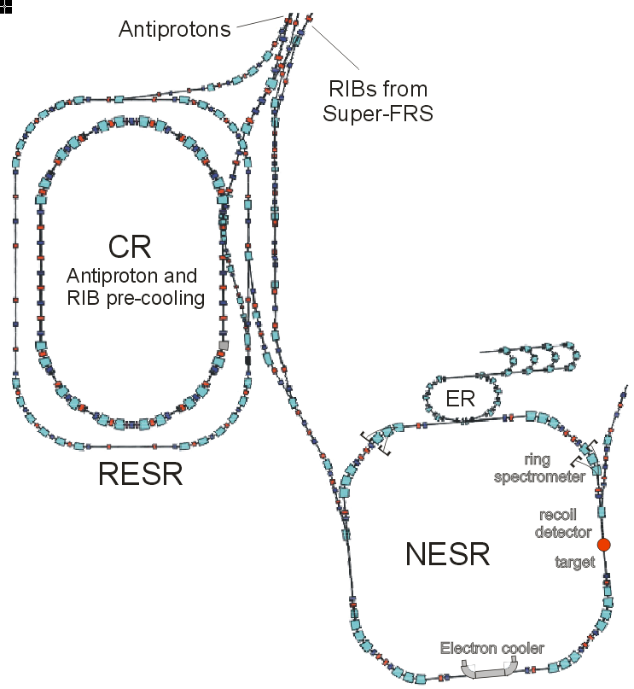
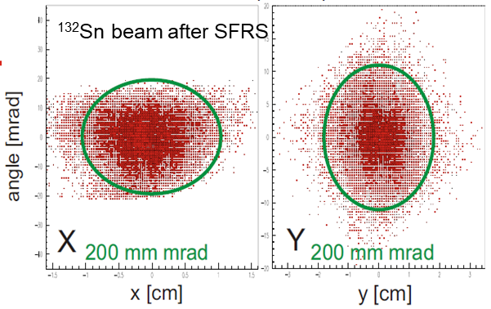
Perfect Ring Setup for Reaction Experiments
SIS-100 pulsed beams up to 1500 MeV/u
Super-FRS with high power target + separation ending at 740 MeV/u
Large acceptance CR, pre-cooling, separation,
RESR as buffer, maybe deceleration
NESR for accumulation, beam cooling, experiment.
Some functions of NESR also possible in HESR.
Super-FRS:
Production,
Separation
CR:
Bunch rotation
Stochastic cooling
at 740 MeV/u
also for separation
FAIR plan
before 2008
RESR:
Deceleration
down to
100 MeV/u
NESR:
Cooling,
accumulation,
measuring

Slide 3
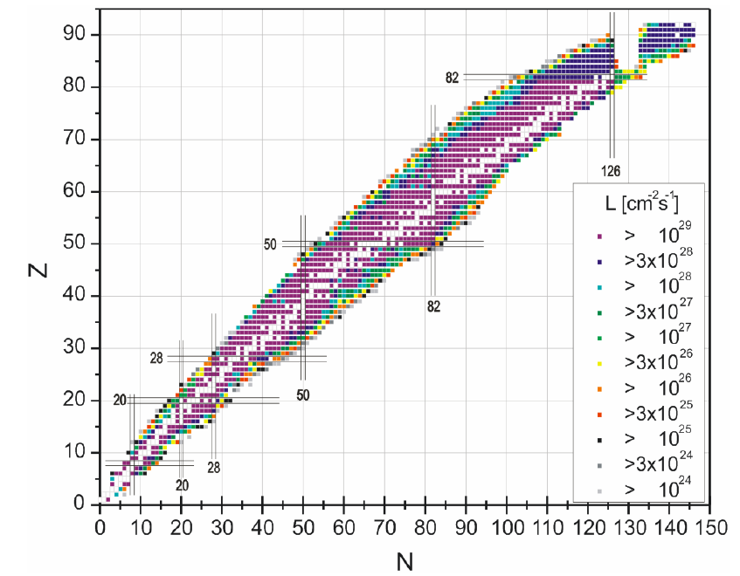
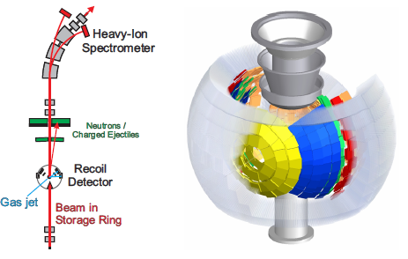
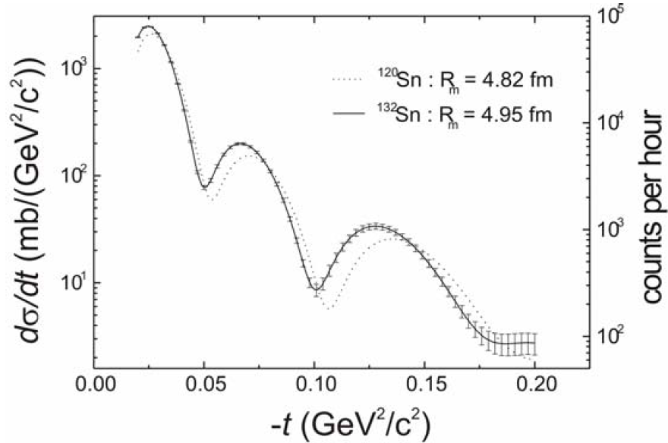
EXL in NESR
EXotic nuclei, Light hadronic probes
from EXL TP (2006)
High luminosity for many RIBs,
including accumulation in rings
Fast cooling with stochastic pre-cooling,
separate in ring what Super-FRS cannot.
Brilliant beams after electron cooling
small spot for target detector resolution.
Non disturbing thin gas jet target (H, He).

Slide 4
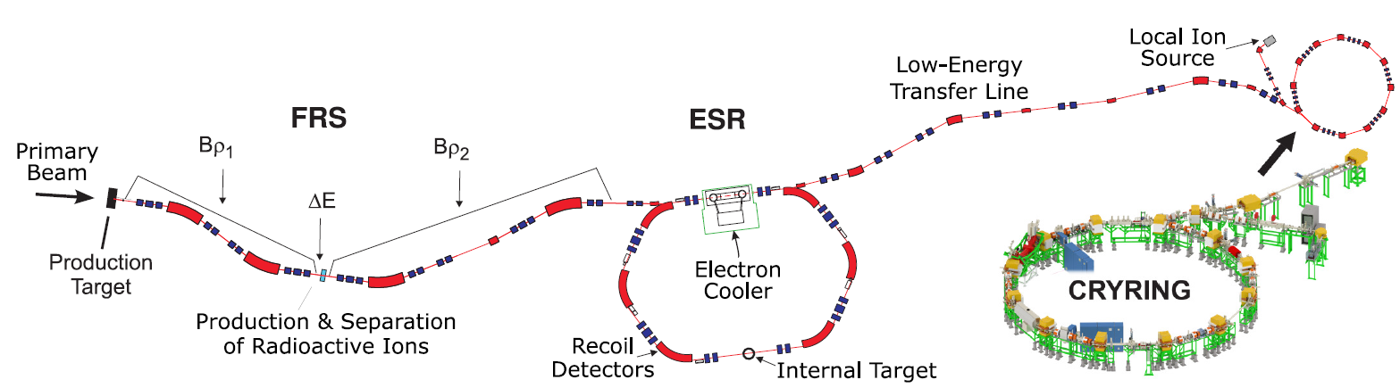
Existing Setup with ESR
SIS18
CRYRING
FRS for separation of wanted nuclides,
difficult injection (matching problem),
monitoring and tuning of separation difficult.
Low acceptance for secondary beams, ESR at Bρ ~ 8 Tm.
Measured acceptance 7 mm mrad * 8 Tm / 11.1 Tm = 5 mm mrad.

Slide 5
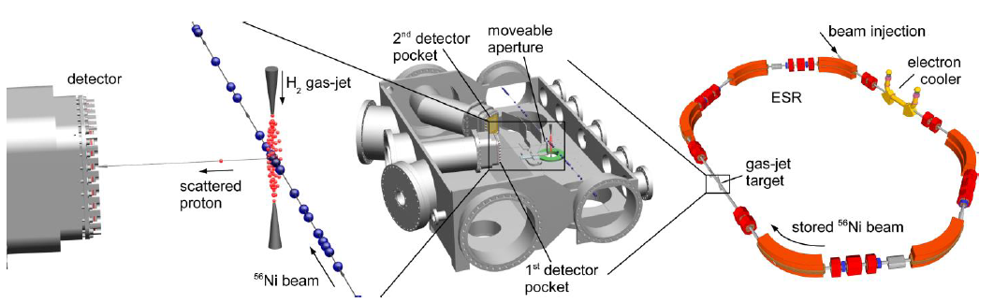
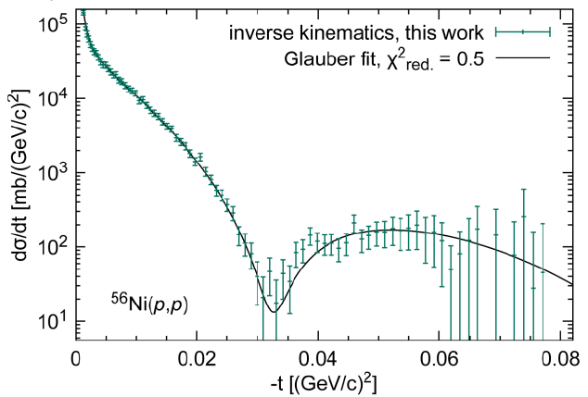
EXL
Exotic nuclei studied with light hadronic probes
Experiment E105, ^{56,58} Ni beams and gas jet target (H and He)
^{56,58}Ni(p,p) and ⁵⁸Ni(α,α‘)
LoI 2022 (J. Zamora, O. Kiselev)
next step ⁵⁶Ni(α,α‘) for ISGMR
--> compression of nuclear matter

Slide 6
Limits of ESR, Gain with CR
⁵⁶Ni is the easiest RIB of all for:
production, separation, efficient injection, accumulation.
Most other nuclides are not feasible in ESR ☹.
ESR injection is bottle neck,
in theory it should be a bit better, but is reproducible.
⁵⁶Ni transmission ~ 10%, others -> 1% -> 0.1% -> 0.01%.
Intense FAIR beams, better selection by Super-FRS
Much enlarged acceptance from ESR -> CR:
transverse: ε_{x,y} = 7-8 mm rad --> 200 mm mrad
longitudinal: Δp/p = 0.2% --> 1.0 (1.5) %
faster cooling, more accumulation 4s --> 1s
at higher energy 400 MeV/u --> 740 MeV/u
Parallel operation with two rings.
^{gain ~ 20 000}
SIS100 vs. SIS18 intensity gain varies,
for ²³⁸U f = 4 x 7 / pulse, for ⁵⁸Ni x 5 / pulse

Slide 7
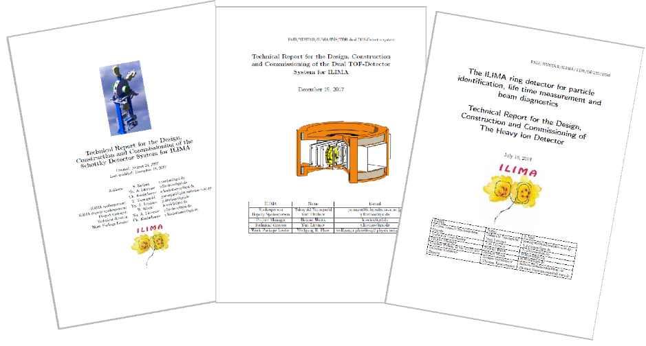
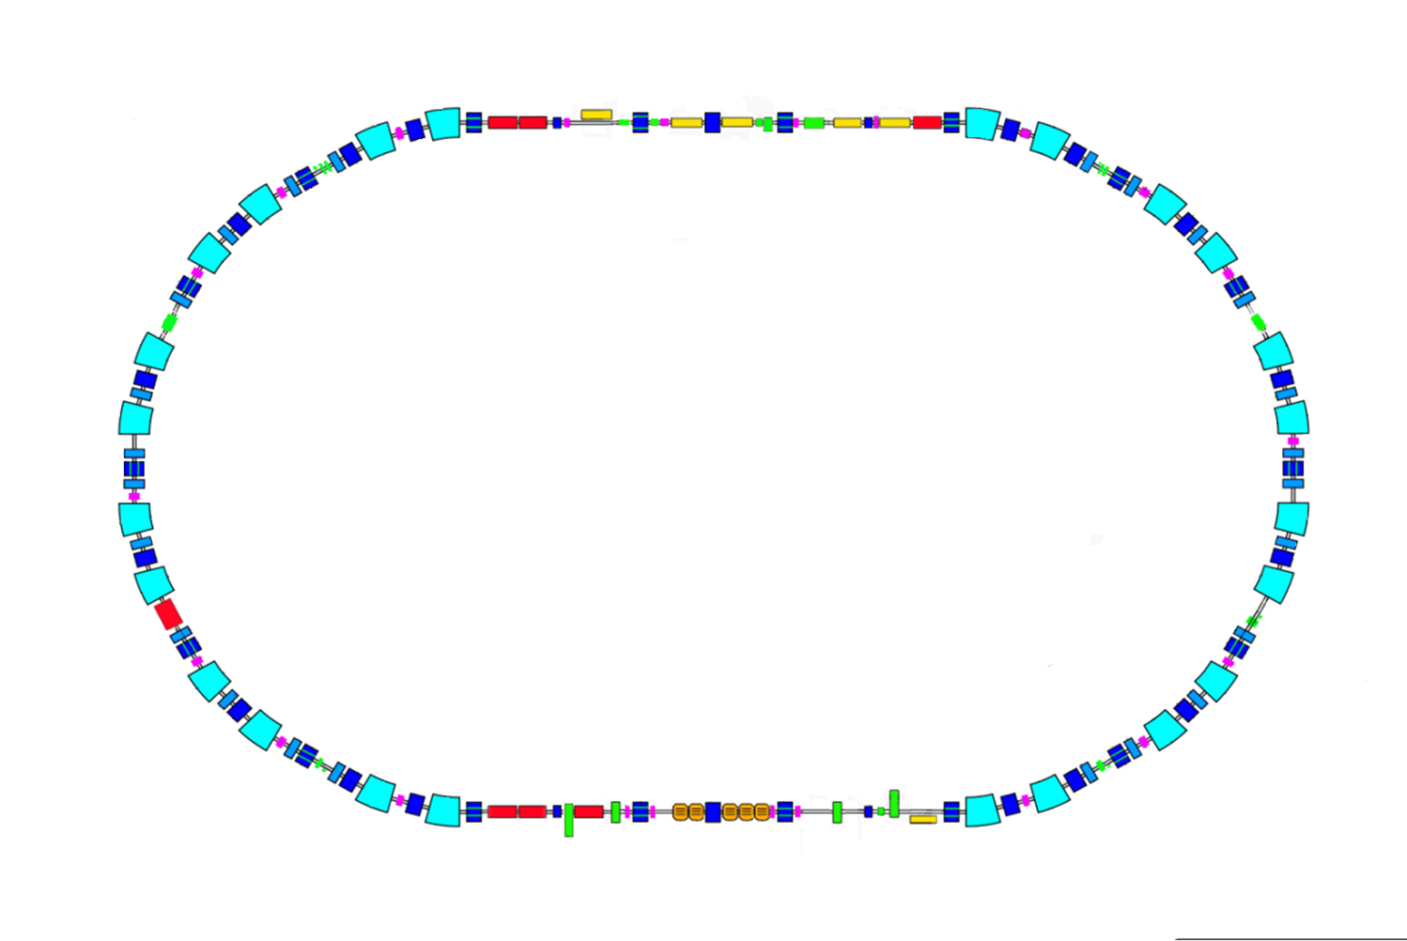
ILIMA in CR
Detector
PU
TOF + v
Isomers, LIfetimes, MAsses,
prepare special ion states
e.g. with attached electrons,
monitor decays in ring
mostly few ions, but can also be
many (²⁰⁵Tl decay, 10^8 in ring)
Three detector systems for
different types of experiments:
ToF detectors (T_{1/2} < 1 ms)
Schottky pickups
Particle detectors in pockets

Slide 8
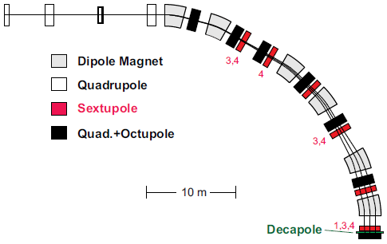
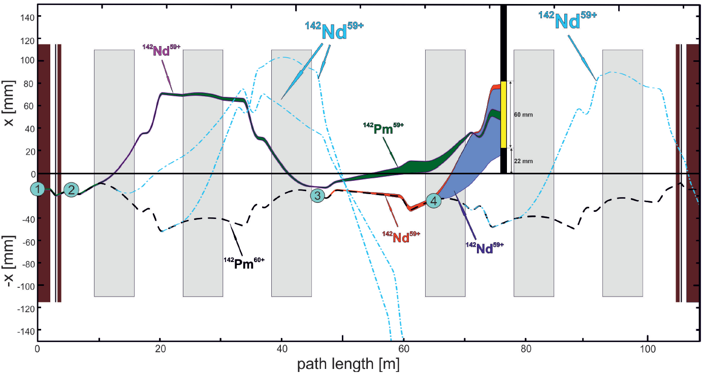
Large Acceptance Required by Experiment
Work with uncooled beam
Detour of faster ions in isochronous mode
-> large dispersion function in arc
Wide acceptance in ring to reach detector
after decay or reaction in target ions
of different mass, charge
^{one quarter of CR}
¹⁴²Pm beta decay detected in ESR

Slide 9
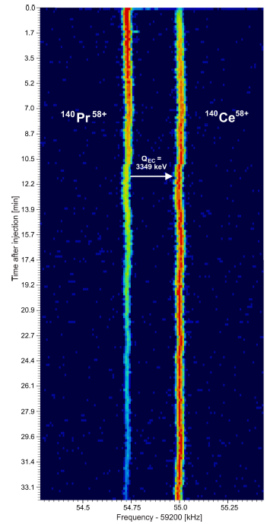
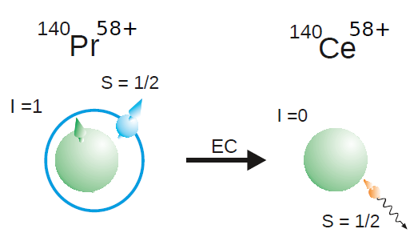


Hyperfine Interaction, Influence on Decay
Orbital electron capture (EC),
Consider spin coupling of nucleus and electrons.
Ragandeep Singh Sidhu has just submitted similar proposal on ¹¹¹Sn decay
with up to 3 electrons.
Z. Patyk et al., Phys. Rev. C 77, 014306 (2008).

Slide 10
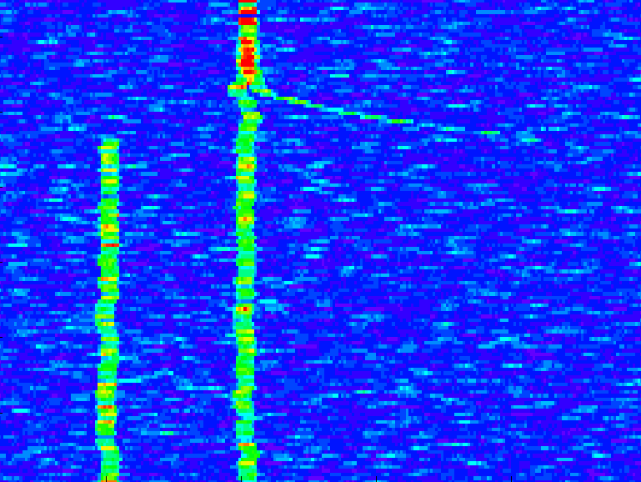
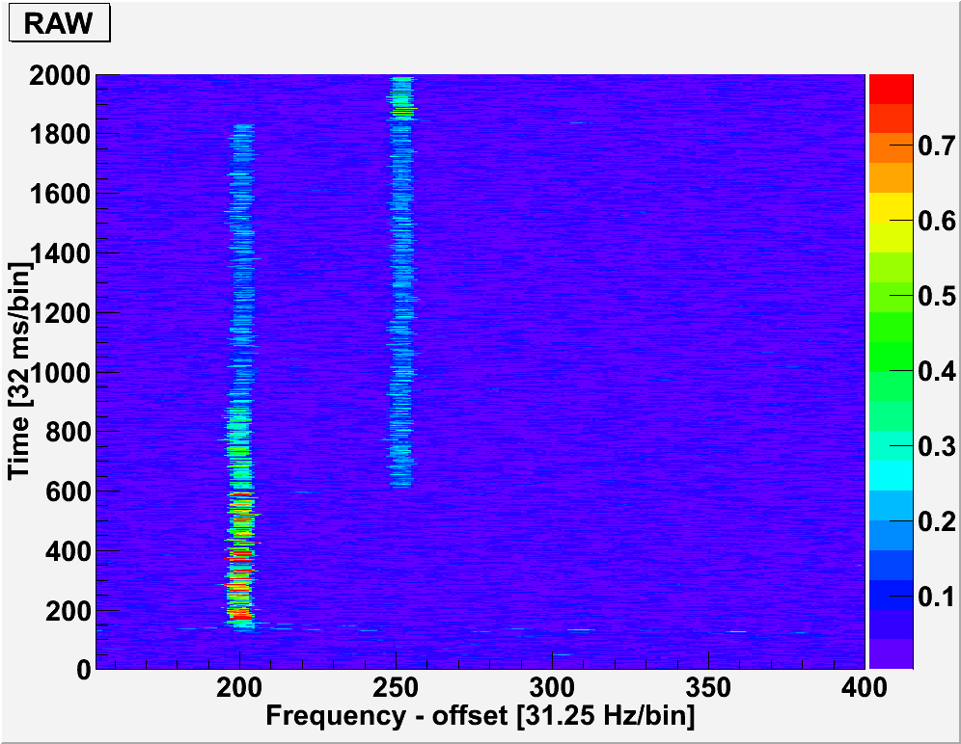
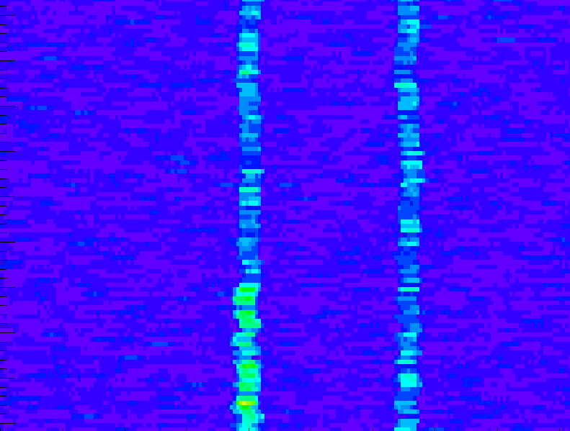
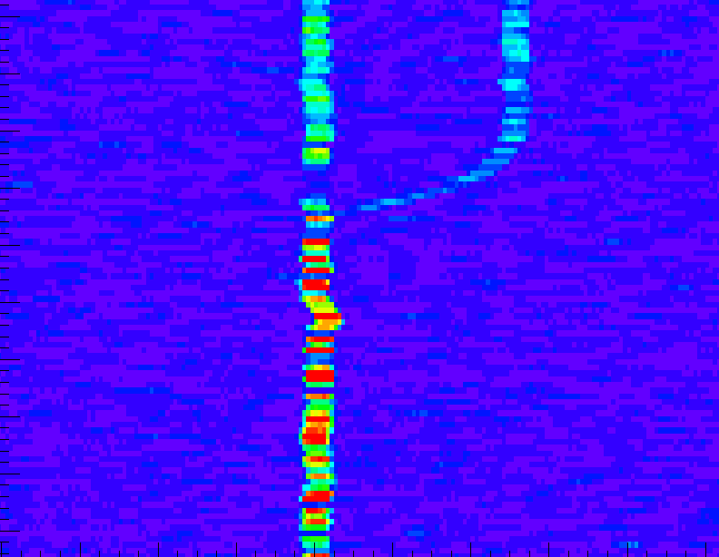
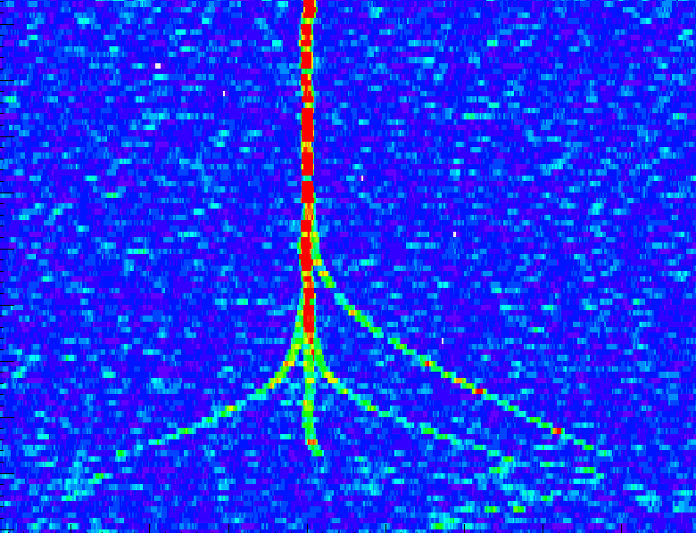
EC decay in ESR cooling, 2 EC and 2 β⁺ -decays
EC
142 59+
142 59+
Pm
Nd
β⁺
EC + β⁺
cooling

Slide 11
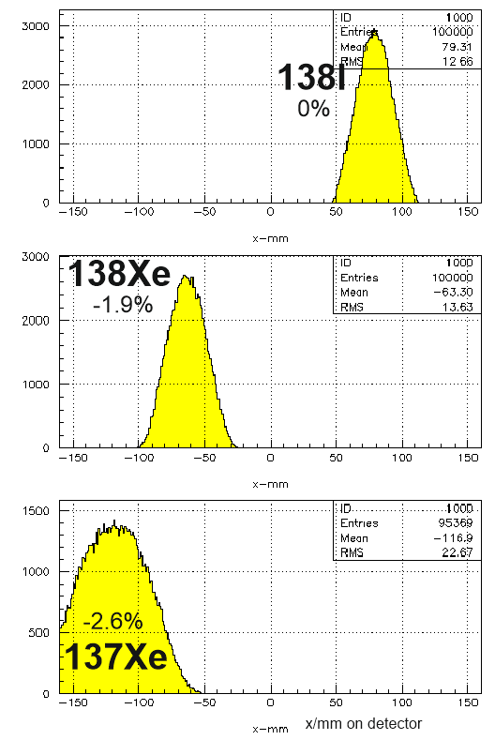
Detection after Decay
simulation
for ESR
Beta-delayed neutrons in ring,
often the case for fission fragments.
Neutrons are difficult to detect directly,
in ring by change of mass and charge.
Obtain branching ratio directly when
both can be observed,
relative Bρ difference -> x-pos in arc.
Requires pre-cooling in ring for
sharper peaks, Si detector for ΔE
and improved identification.
β
βn

Slide 12
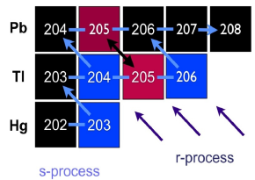
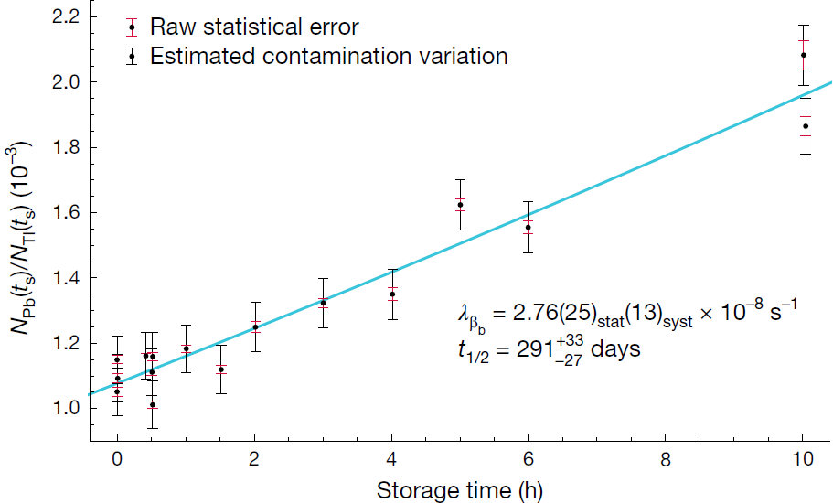
Bound-State Beta Decay of bare ²⁰⁵Tl
Lifetime of Highly Charged Ion
²⁰⁵Pb⁸¹⁺
Key technical points:
Accumulation of sec. beam from FRS
Long storage of cooled ions
Gas jet stripper
In-ring particle detector
Resonant Schottky detector
N_{Pb}/ N_{Tl} x 1e-3
LOREX project: solar neutrino detector with Tl crystals
Cosmo chronometer of the s-process
Guy Leckenby et al., Nature 2024.

Slide 13
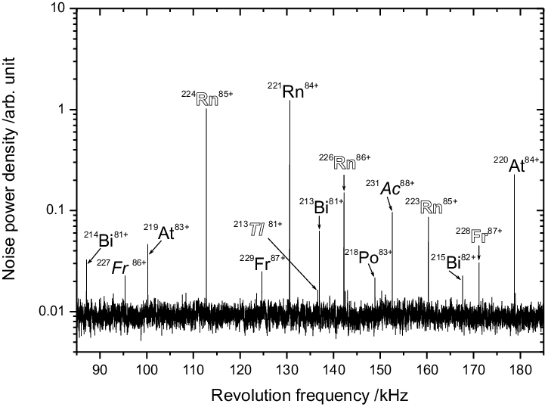

Schottky Frequency Spectrum of
²³⁸U Fragments for Mass Measurements
known / unknown masses:
Nice large overview, but
needs long cooling time,
most long T_{1/2} cases done.

Slide 14


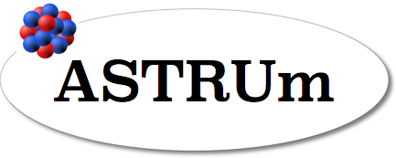
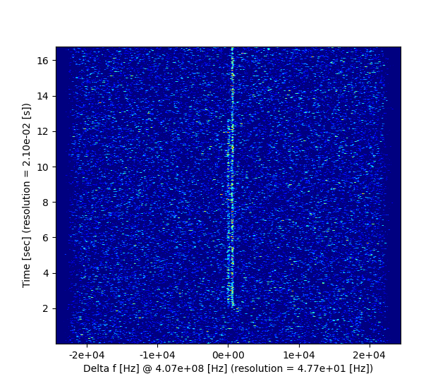
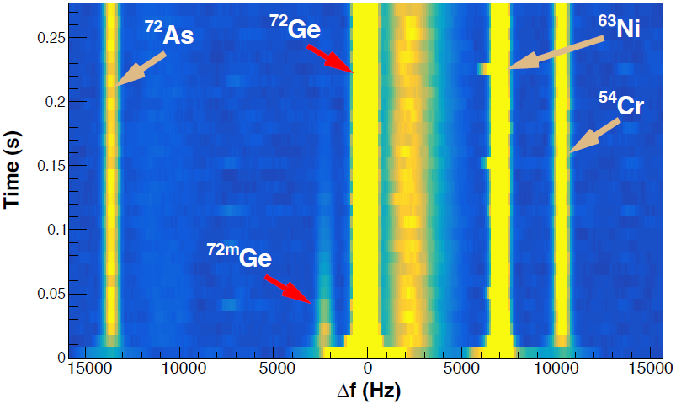
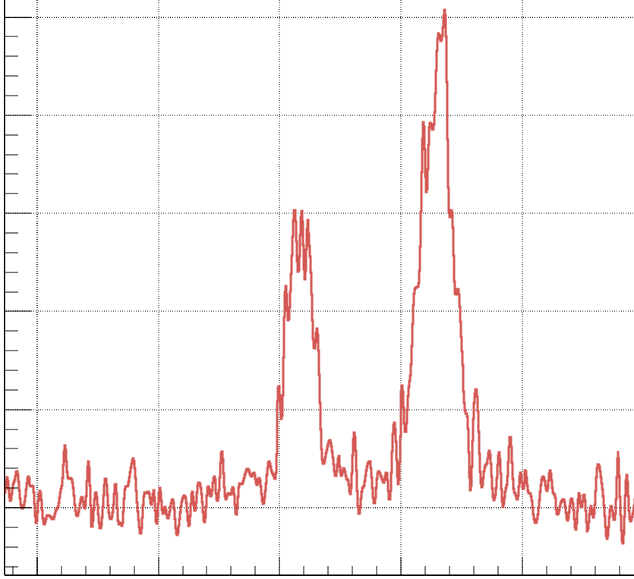
E143 Results in ESR
No cooling, isochronous mode,
working at transition point (γ = γ_{t}) requires large dispersion in arcs.
Very good resolution (with scrapers a bit closed)
Detection by Schottky pickups
for future position sensitive
planned for active correction.
2 photon decay of ^{72m}Ge
Δm = 695 keV, τ ~ 0.02 s
~101 keV (Δm/m = 1x10⁻⁶)
⁷²Br
^{72m}Ge
^{72m}Br
Decay
Injection
Injection
resonant Schottky at high harmonic h = 212

Slide 15
NUSTAR Requirements
Injection acceptance as good as possible.
Variable operation at different Bρ (11 Tm is good)
Heavy ion cooling (β = 0.8 - 0.95), stochastic and electron-cooling.
Accumulation of beams (barrier bucket), m/q = 2.2 - 2.65.
Transfer to detector in arc after Bρ change (Δm or Δq).
Dense gas jet target (H, He)
Isochronous mode of COSY ? (low acceptance)
Long term strategy:
→ more rings in combination, a real collector ring.
Ring branch of Super-FRS also is on hold, simplified beamline ?
Isochronous mode would make CR/COSY a wide range
mass measurement device (now only ESR, SRING / HIAF).
COSY alone without CR is no gain vs. ESR (for NUSTAR).
But higher pulse intensity with SIS-100 beam.
Gain in flexibility with Super-FRS in front:
Better separation, independent matching.

Slide 16
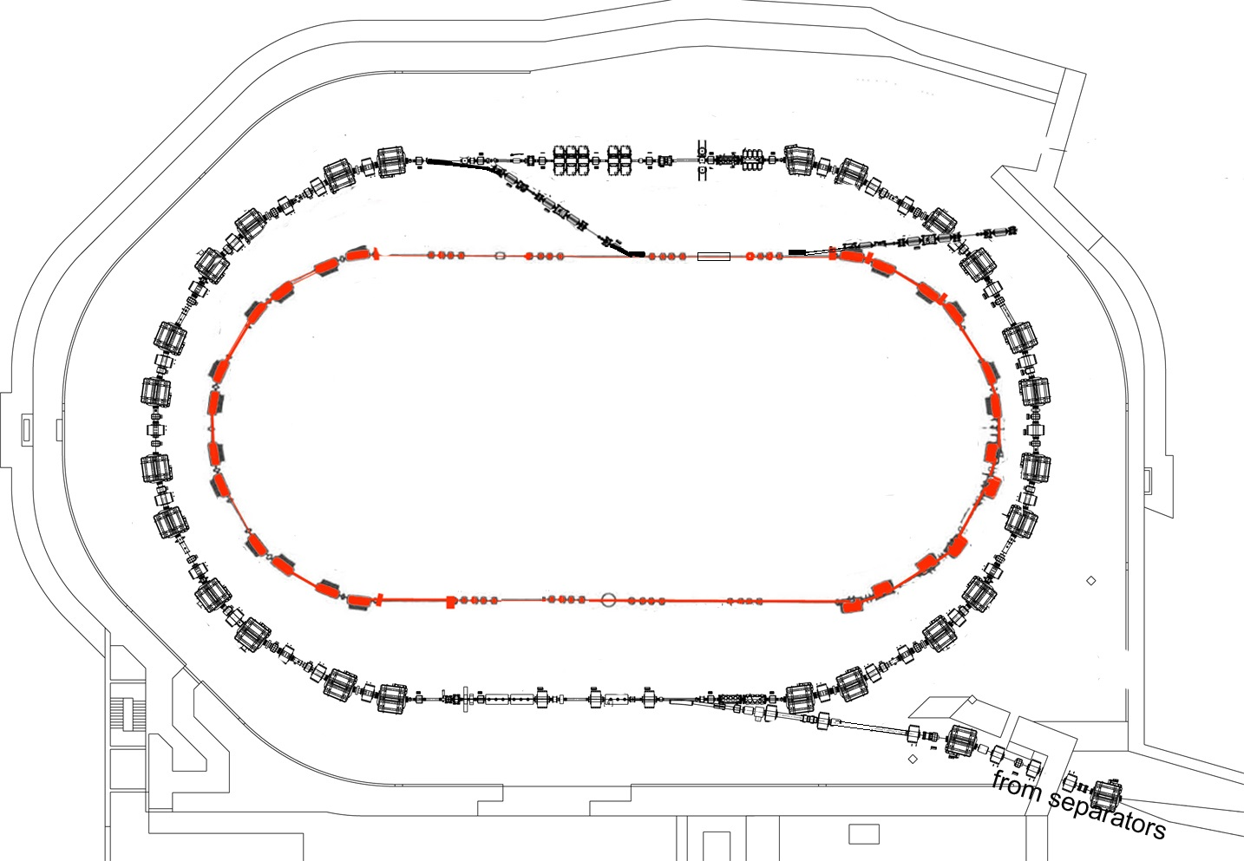
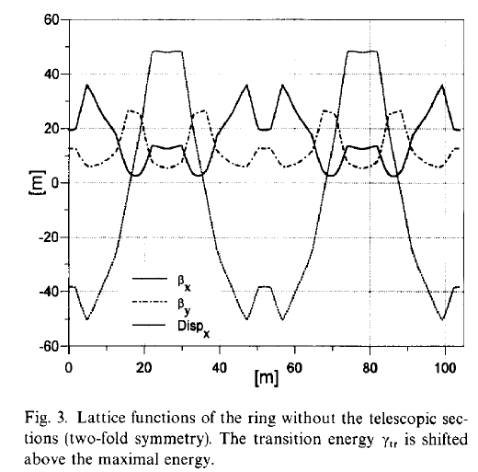
ESR:
7 mm mrad
~ 9 Tm
but inside
much larger
CR
detector
5 mm mrad
Bρ = 11 Tm
COSY
R. Maier, NIM A 390 (1997) 1

Slide 18
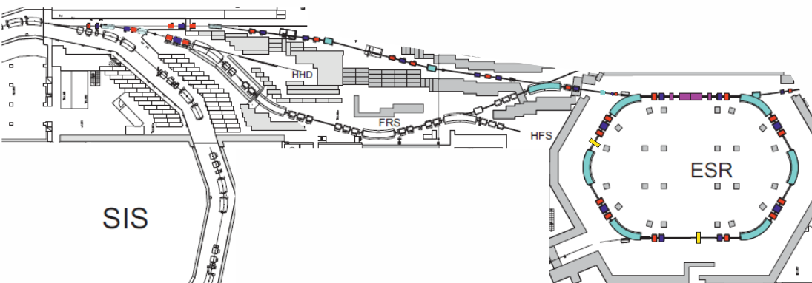
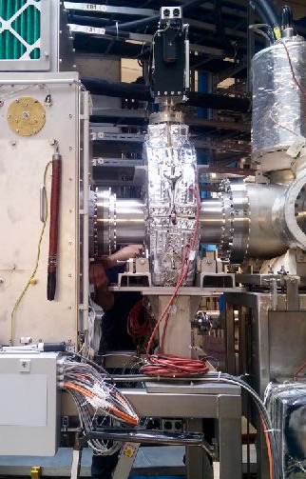
E143: Nuclear two-photon decay
440 MeV/u ⁷⁸Kr
target Be 1cm
slits
⁷²Ge (⁵²Mn, ⁷⁰Se)
Bare ^{72m}Ge can only decay by simultaneous
emission of two gammas.
ESR in isochronous mode (γ_{t} = 1.3956),
used Schottky for detection
high production cross section,
could use collimators in ESR.
  245 MHz Schottky and
  new 410 MHz resonator
S.Sanjari et al.,
Rev. Sci. Instr. 91, 083303 (2020)

Slide 19
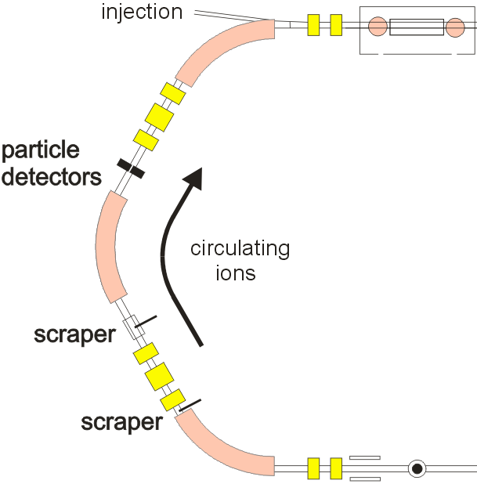
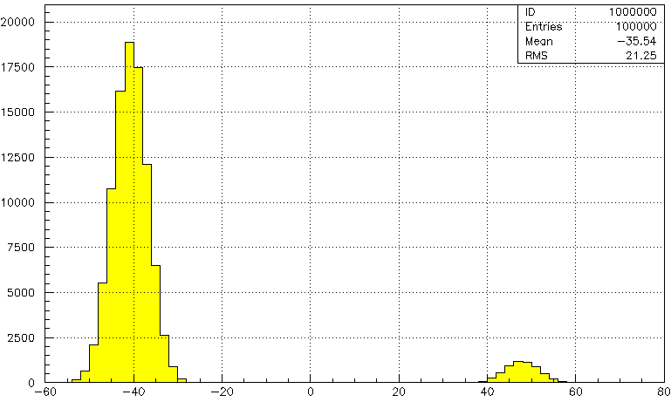
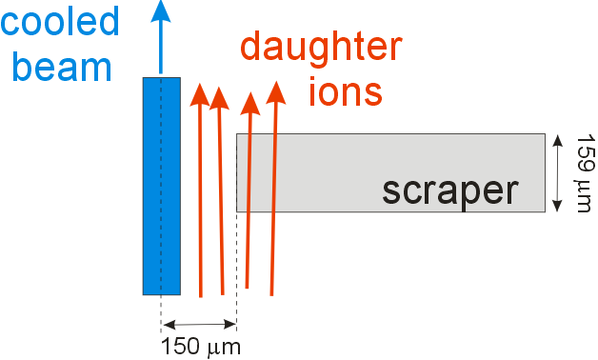
Prepare Isomeric beams
Magnify tiny separation by a degrader as scraper. Thin steel sheet changes Bρ by 1%.
Nice separation on detector after next dipole.
ΔE counter to identify Ce and Pr.
daughter
mother
-40
-20
0
20
40
60
x [mm]

Slide 20
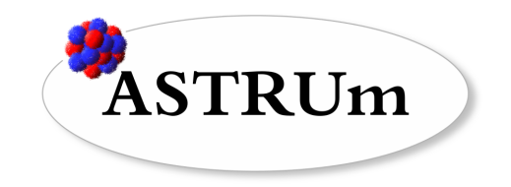
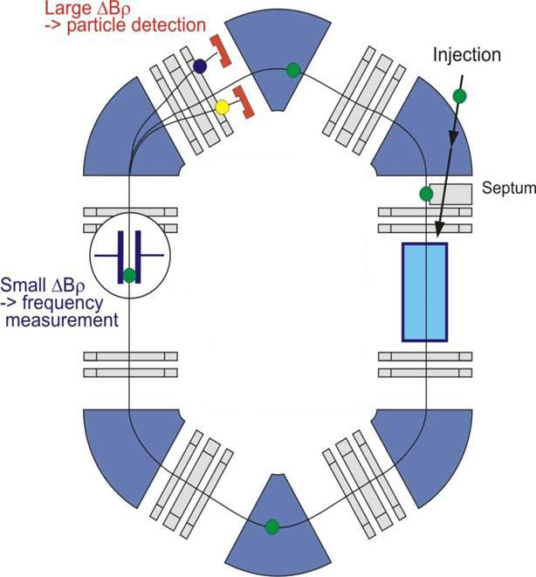
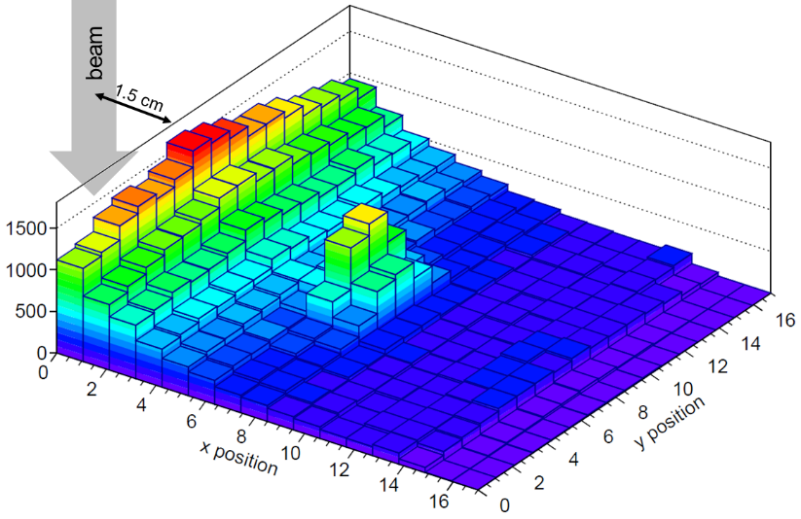
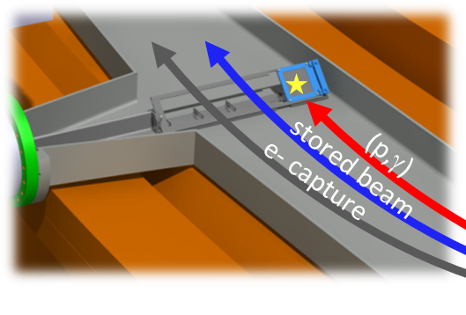
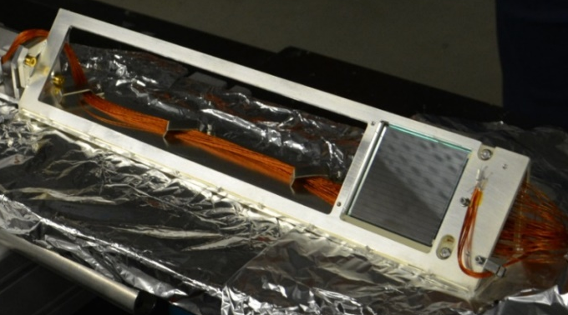
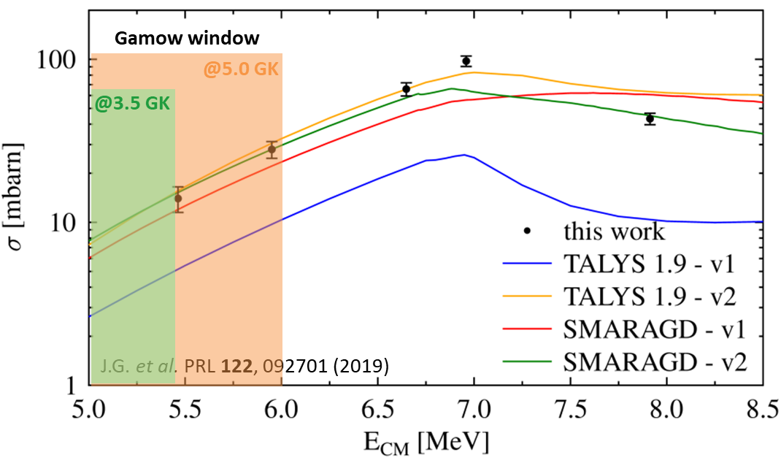
Campaign on Proton-Capture Reactions
(p,γ), (p,n)
Nuclear recoil separation & detection
proton-capture
efficiency = 100%
UHV compatible
detector setup
gas jet
3rd generation DSSSD
Slowed down rare ions
in/close to Gamow window
recent ¹¹⁸Te(p,γ)
¹²⁴Xe(p,γ)¹²⁵Cs
thesis Sophia Dellmann

Slide 21
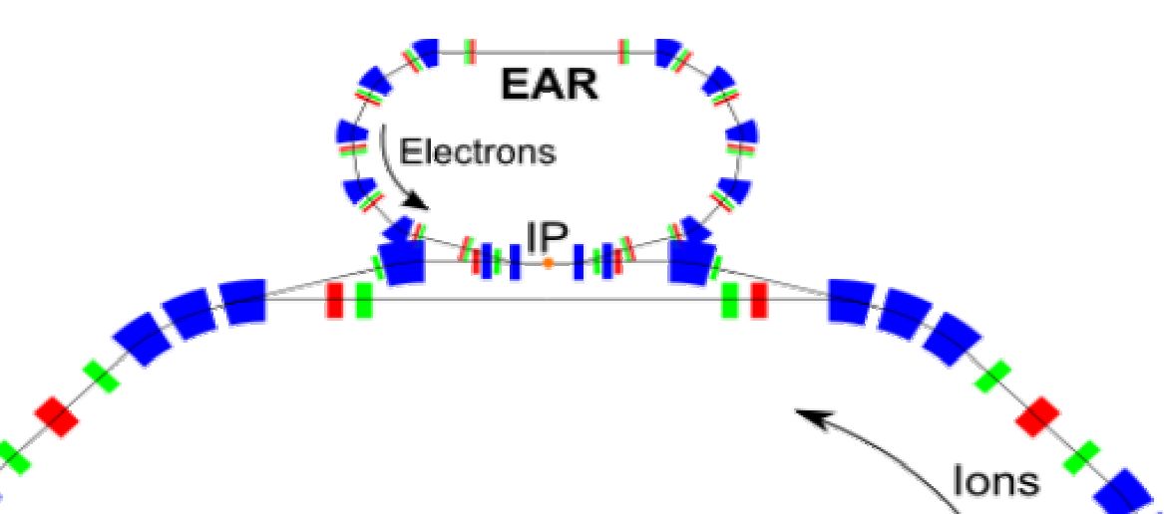
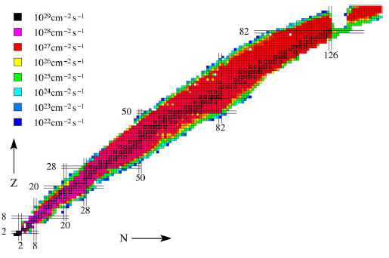
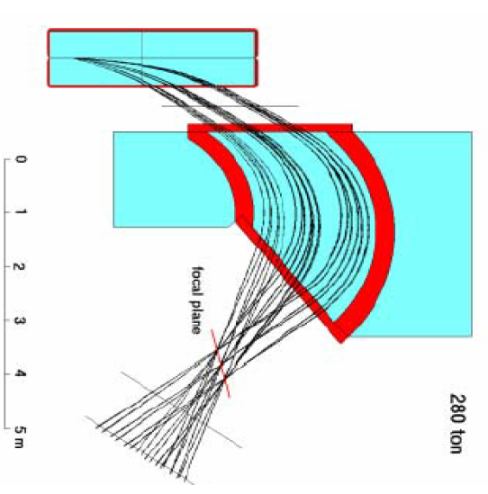
ELISE in NESR
from ELISe TP (2005)
Electron Scattering:
Electrons in separate ring fed by e-LINAC (~ 500 MeV)
Use large magnetic electron spectrometer.
Only place where such experiments could be done on rare isotopes
Requires well cooled beam for best overlap of beams.

