Slide 1
Introduction COSY at FAIR

Slide 2
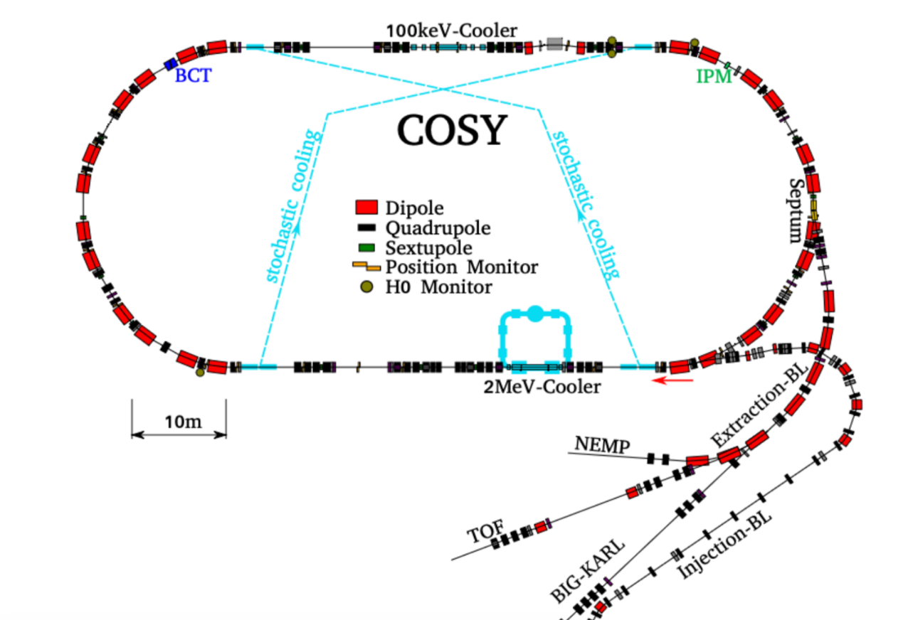
COSY
Circumference 184 m
Max Rigidity 12 Tm
Momentum acceptance 1%
H/V Transverse acceptance 150/35 mm*mrad

Slide 3
How can COSY be reused at FAIR ?
Can a new ring be build using COSY components?
Can the antiproton accumulation be achieved within COSY or in a new ring reusing COSY components ?
What are accumulation performance characteristics?
What about beam deceleration ?

Slide 4
COSY, CR and RESR

Slide 5
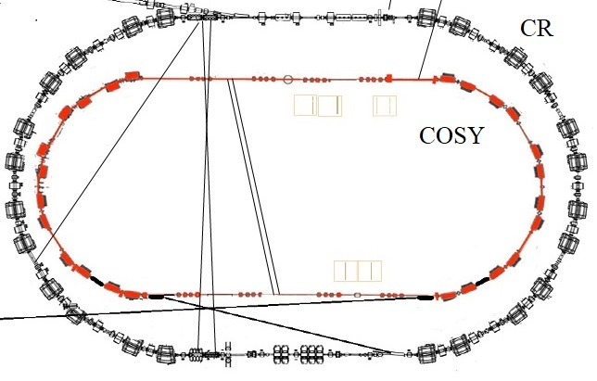
Option: COSY inside CR

Slide 6
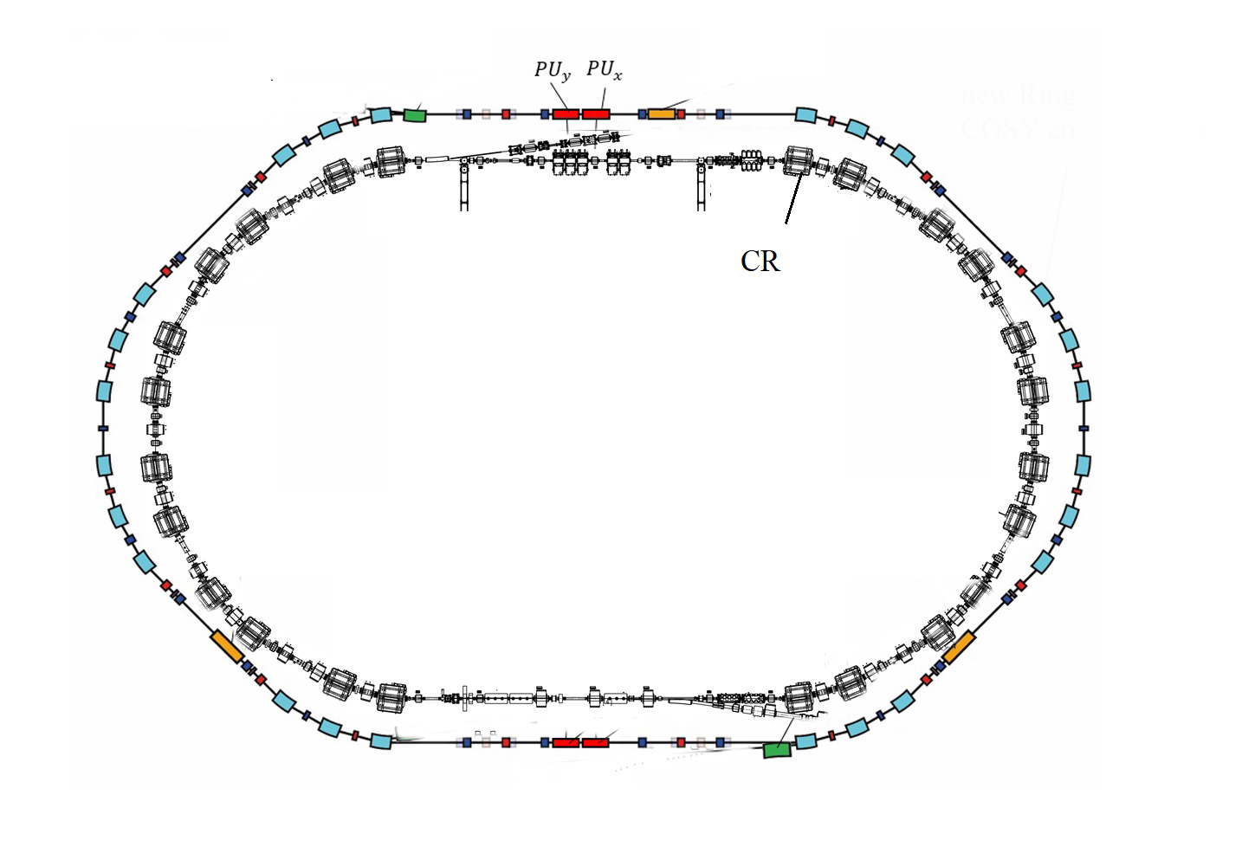
Option: New ring outside CR reusing COSY components
Preliminary layout of the new ring reusing COSY components has been calculated.

