Slide 1
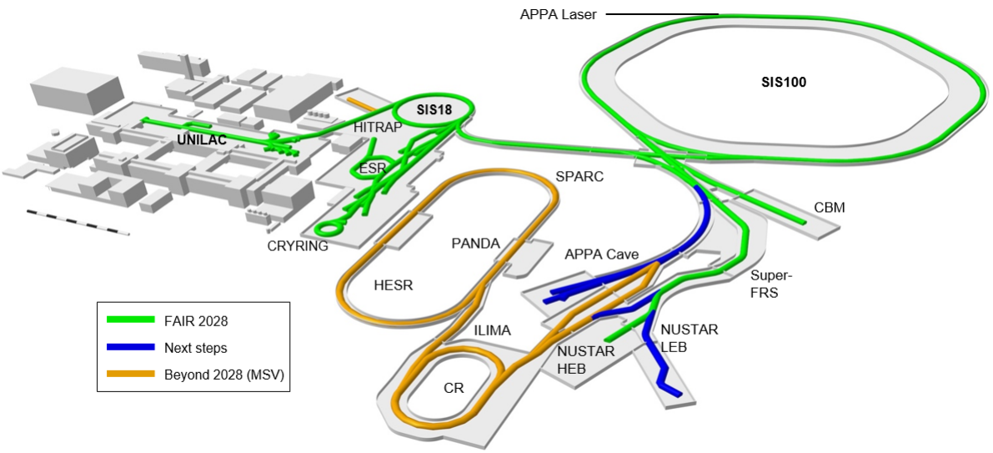
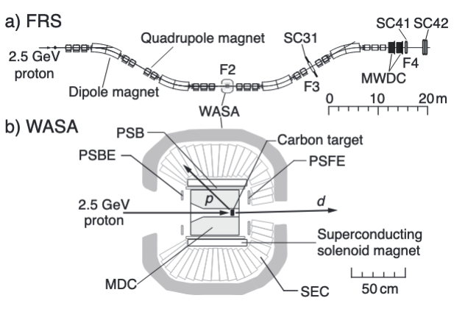
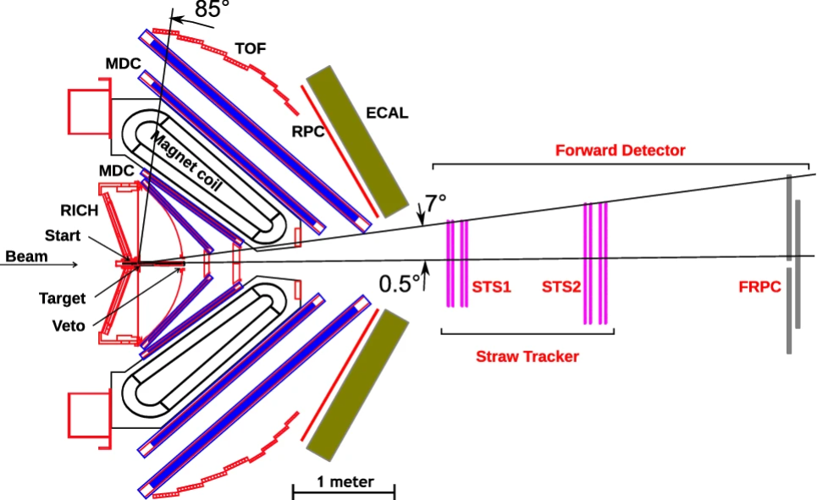
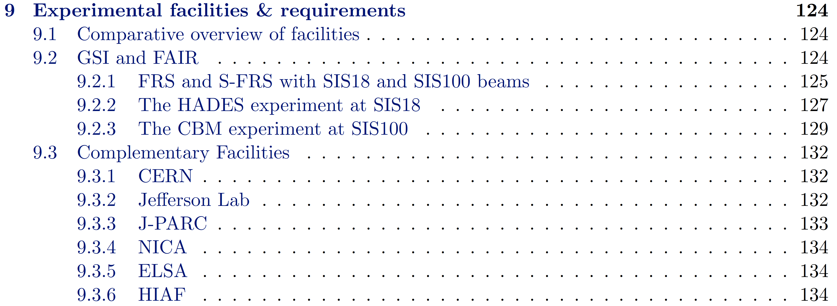
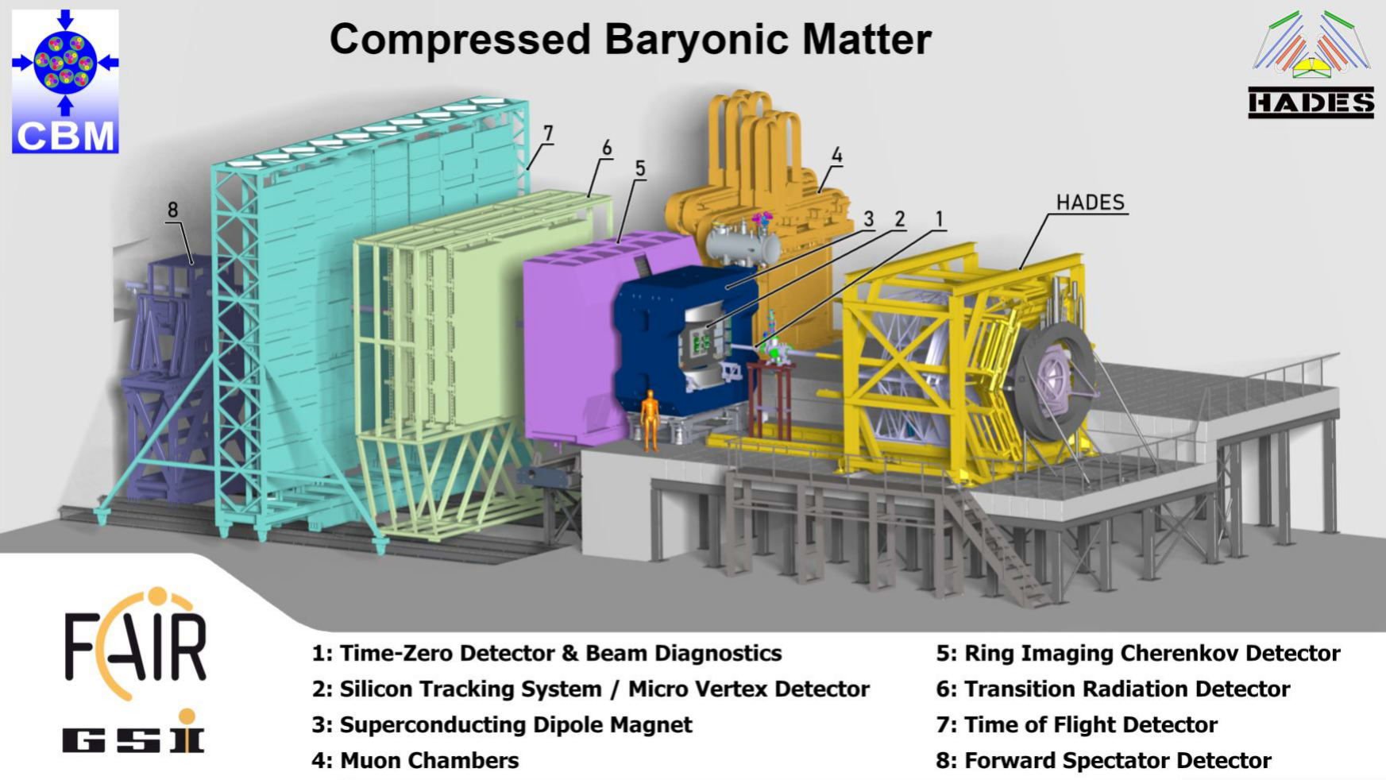
Chapter 9 - Experimental facilities & requirements
Contributors (to be adapted):
P. Achenbach, M. Bashkanov, A. Belias, J. Bernhard, P.P. Bhaduri, R. Das, M. Deveaux, A. Foda, P. Gasik, A. Guskov, K. Itahashi, R. Kliemt, E. Nandy, B. Ramstein, C. Rappold, J. Ritman, S. Roy, F. Sakuma, C. Scheidenberger, L. Schmitt, C. Sturm, H. Takahashi, J. Taylor, R. Tyson, G. Wolf .

Slide 2
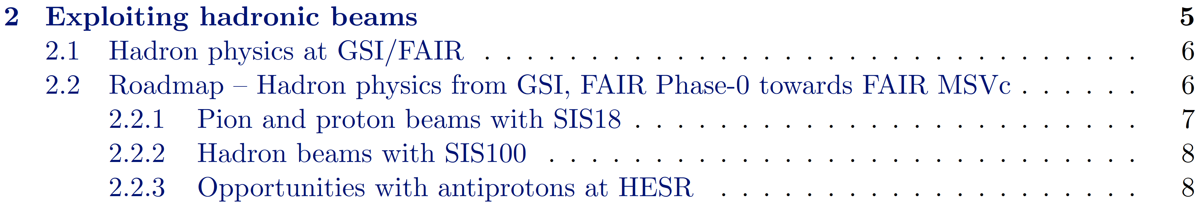
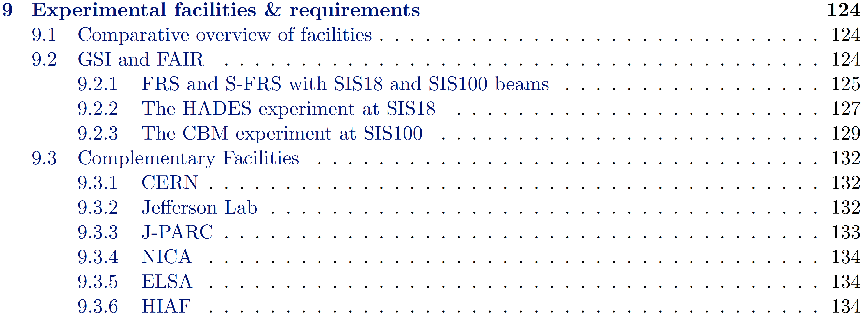
Chapter 9 - ToDos
Adjusting chapters 2 & 9: 2 - introduction & 9.2 - purely technical ?
Title Ch2 "Exploiting hadron beams at GSI/FAIR" ?
Merge 2 & 9.2 ?
Restrict to hadron physics ?
Technical details into appendix ?
Or just referring to experiment publications keeping it short and readable ?
9.3 Sequence of complementary facilities ? Grouping ?
Input to CERN & ELSA (accelerators and experiments).
Brief overviews machines & experiments. Restrict to hadron physics ?
9.1 Overview with summarizing tables & plots (last step).

