Slide 1
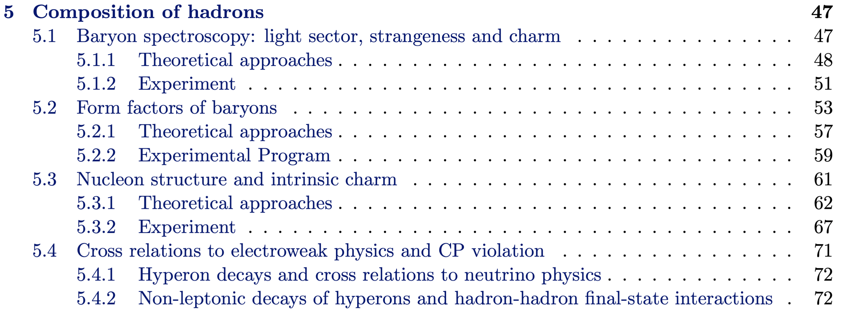
Chapter 5- Composition of hadrons
Conveniors : C. Fischer P. Salabura
All there,
Only editorial issues left
Contributions :
M. Bashkanov, S. Collins, S. Dobbs, S. Diehl, G. Eichmann C. Fischer, H.W. Hammer,
P. Hurck, M. Mai , R. Maciula, S. Leupold, D. Mohler, Y. Morino, H. Nuomi, T. Pena,
B. Ramstein, C. Roberts, P. Salabura, A.Szczurek, R. Tyson,

Slide 2
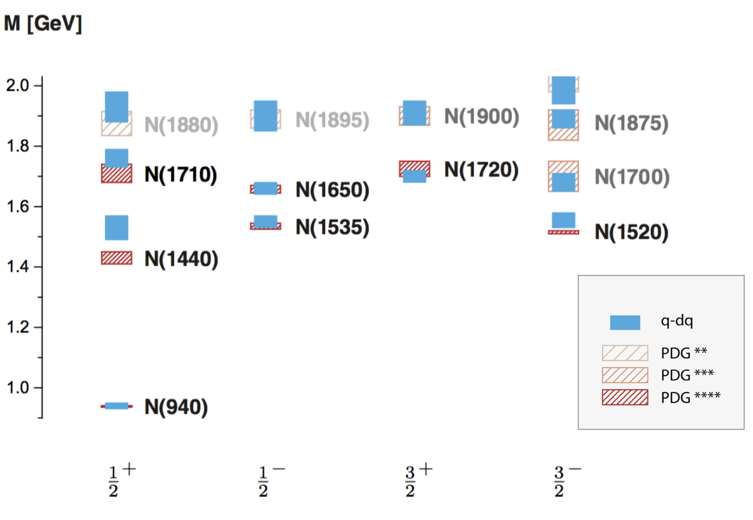
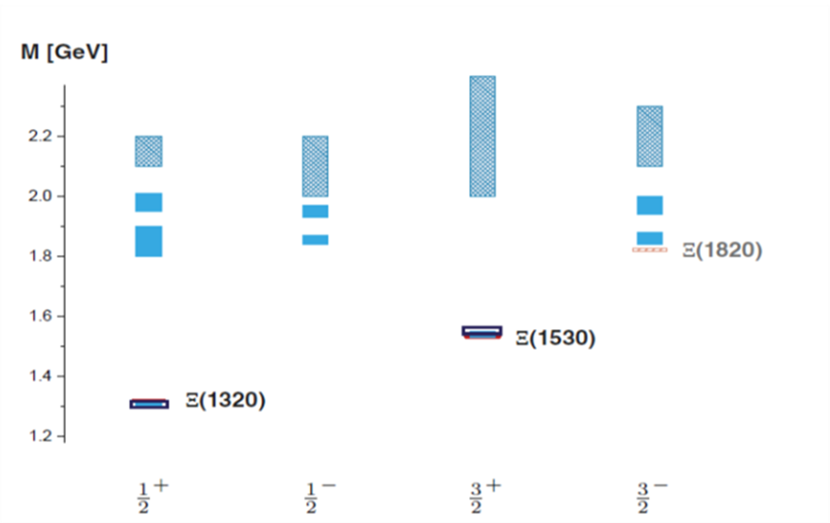
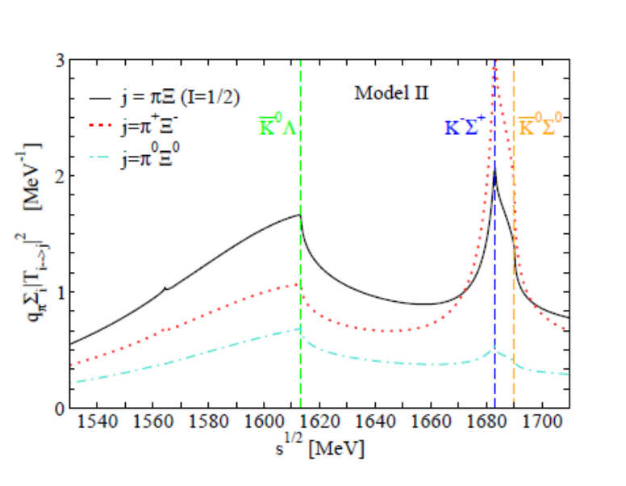

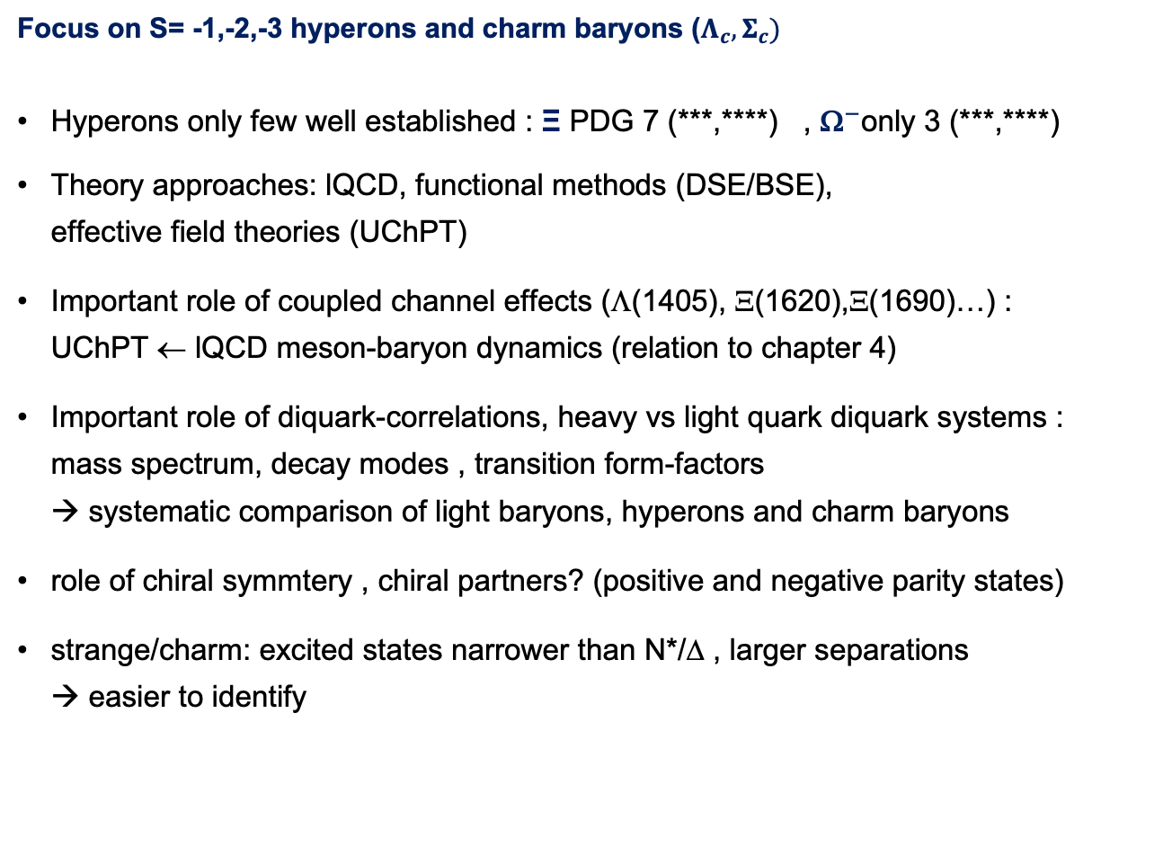
5.1.1 Baryon spectroscopy - Theory
Focus on S= -1,-2,-3 hyperons and charm baryons ($Λ_{c}, Σ_{c})$
Hyperons only few well established : Ξ PDG 7 (***,****) ,${ \text{}}^{−}$only 3 (***,****)
Theory approaches: lQCD, functional methods (DSE/BSE),
effective field theories (UChPT)
Important role of coupled channel effects (Λ(1405), Ξ(1620),Ξ(1690)…) : UChPT ← lQCD meson-baryon dynamics (relation to chapter 4)
Important role of diquark-correlations, heavy vs light quark diquark systems : mass spectrum, decay modes , transition form-factors
→ systematic comparison of light baryons, hyperons and charm baryons
role of chiral symmtery , chiral partners? (positive and negative parity states)
strange/charm: excited states narrower than N*/Δ , larger separations
→ easier to identify
G. Eichmann Few-Body Syst(2019) 60.
A. Feijooa

Slide 3
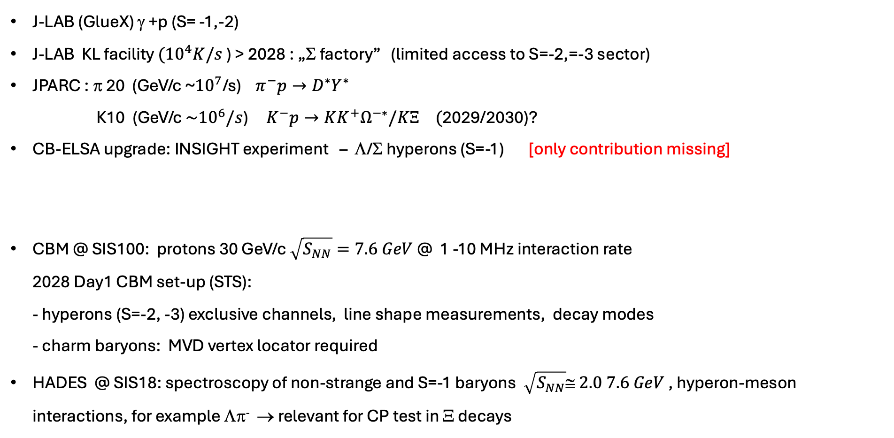
5.1.2 Baryon Spectroscopy - Experiments
Focus: discuss complementarity with HADES/CBM
J-LAB (GlueX) γ +p (S= -1,-2)
J-LAB KL facility $({10}^{4}K/s$ ) > 2028 : „Σ factory” (limited access to S=-2,=-3 sector)
JPARC : π 20 (GeV/c ~${10}^{7}$/s) $π^{−}p→D^{∗}Y^{∗}$
K10 (GeV/c ${\sim 10}^{6}/s$) $K^{−}p→KK^{+}Ω^{−∗}/KΞ ($2029/2030)?
CB-ELSA upgrade: INSIGHT experiment – Λ/Σ hyperons (S=-1) [only contribution missing]
CBM @ SIS100: protons 30 GeV/c $\sqrt{S_{NN}}=7.6 GeV$ @ 1 -10 MHz interaction rate
2028 Day1 CBM set-up (STS):
- hyperons (S=-2, -3) exclusive channels, line shape measurements, decay modes
- charm baryons: MVD vertex locator required
HADES @ SIS18: spectroscopy of non-strange and S=-1 baryons $\sqrt{S_{NN}}≅ 2.0 7.6 GeV$ , hyperon-meson interactions, for example Λπ⁻ → relevant for CP test in Ξ decays

Slide 4
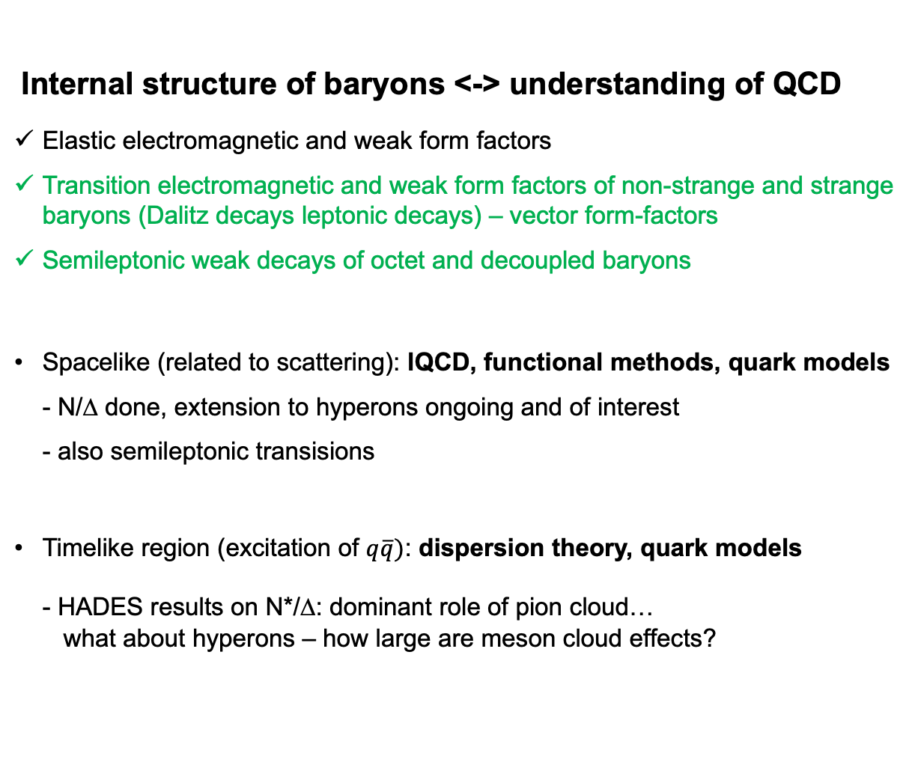

5.2.1 Form – Factors - Theory
Internal structure of baryons <-> understanding of QCD
Elastic electromagnetic and weak form factors
Transition electromagnetic and weak form factors of non-strange and strange baryons (Dalitz decays leptonic decays) – vector form-factors
Semileptonic weak decays of octet and decoupled baryons
Spacelike (related to scattering): lQCD, functional methods, quark models - N/Δ done, extension to hyperons ongoing and of interest
- also semileptonic transisions
Timelike region (excitation of $q\overline{q})$: dispersion theory, quark models
- HADES results on N*/Δ: dominant role of pion cloud…
what about hyperons – how large are meson cloud effects?
B* →B$l^{+}l^{−}$
N* (1520/1535)
eTFF
HADES

Slide 5

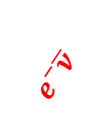
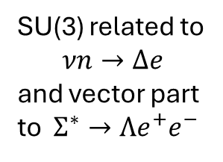
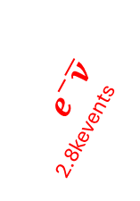
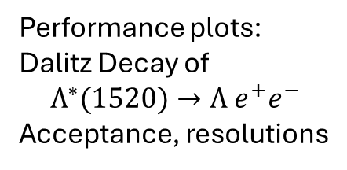

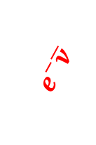



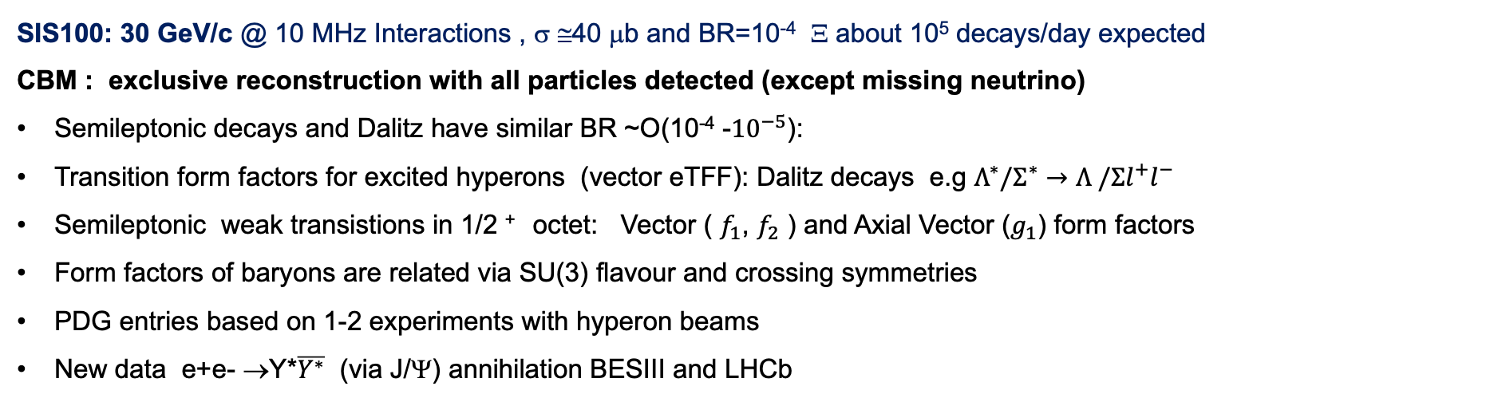
5.2.2. Form Factors Experiment : EM and Weak transistions
SIS100: 30 GeV/c @ 10 MHz Interactions , σ ≅40 μb and BR=10⁻⁴ Ξ about 10⁵ decays/day expected
CBM : exclusive reconstruction with all particles detected (except missing neutrino)
Semileptonic decays and Dalitz have similar BR ~O(10⁻⁴ -${10}^{−5}$):
Transition form factors for excited hyperons (vector eTFF): Dalitz decays e.g $Λ^{∗}/Σ^{∗}→Λ /Σl^{+}l^{−}$
Semileptonic weak transistions in 1/2 ⁺ octet: Vector ( $f_{1}$, $f_{2}$ ) and Axial Vector ($g_{1}$) form factors
Form factors of baryons are related via SU(3) flavour and crossing symmetries
PDG entries based on 1-2 experiments with hyperon beams
New data e+e- →Y*$\overline{Y^{∗}}$ (via J/Ψ) annihilation BESIII and LHCb
$$γ^{∗}$$
J^{P} =3/2⁺
Feasibility studies for CBM beyond scope of White paper (Horizon2025?)
150events
J^{P} =1/2⁺
37 kEvents
${ e}^{−}\overline{ν}$
$$γ^{∗}$$
$$e^{−}\overline{ν}$$
Performance plots:
Dalitz Decay of
$$Λ^{∗}(1520)→Λ e^{+}e^{−}$$
Acceptance, resolutions
$e^{+}ν$
16 events
${ e}^{−}\overline{ν}$ 2.8kevents
$$γ^{∗}$$
$$e^{−}\overline{ν}$$
not measured
SU(3) related to
$$νn→Δe$$
and vector part to $Σ^{∗}→Λe^{+}e^{−}$
Hyperon beam at SPS
Z.Phys.C 21 (1983) 1
Fermilab hyperon beam
Phys.Rev.D 41 (1990)780

Slide 6
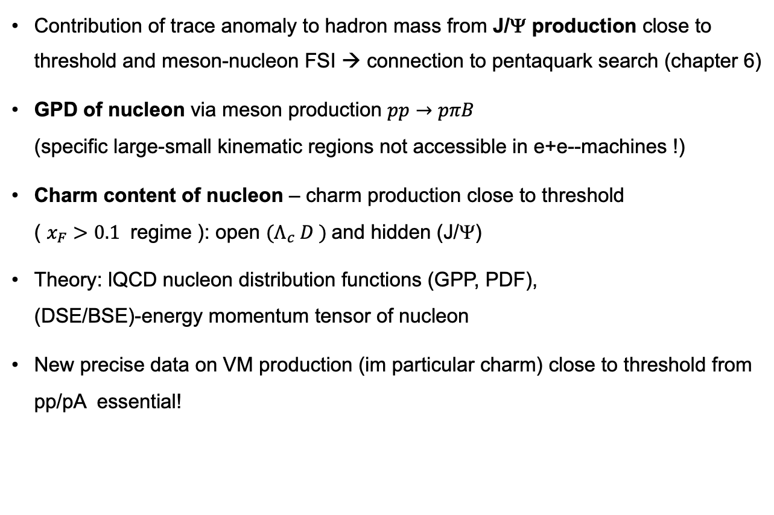

5.3.1 Theory: Nucleon structure and intrinsic charm
DSE/BSE: pressure distribution in nucleon
Contribution of trace anomaly to hadron mass from J/Ψ production close to threshold and meson-nucleon FSI → connection to pentaquark search (chapter 6)
GPD of nucleon via meson production $pp→pπB$
(specific large-small kinematic regions not accessible in e+e--machines !)
Charm content of nucleon – charm production close to threshold
( $x_{F}>0.1$ regime ): open $(Λ_{c} D )$and hidden (J/Ψ)
Theory: lQCD nucleon distribution functions (GPP, PDF), (DSE/BSE)-energy momentum tensor of nucleon
New precise data on VM production (im particular charm) close to threshold from pp/pA essential!
arXiv:2409.15547
$k_{T}$factoriation

Slide 7

5.3.2: Nucleon structure and intrinsic charm: experiments
$$Λ_{c} D$$
JLAB@12 GeV : Gluex : J/Ψ excitation function of photoproduction and t distributions . Factor x 2 stat. Expected in 2024. Gluex II proposed in 2024 with aim to increase x8 stat. (not yet scheduled). No evidence of P_{cc} CLAS12 quasi real photoproduction on proton and neutron up to 10.6 GeV: consistent with Gluex but no structure’s in excitation function, presumable smaller t coverage and J/Ψ -OO7 experiment . New Solid – x10 stat than CLAS12 (2029)
Model (VMD) dependent extraction of gluon grav. form factor and proton mass radius consistent with lQCD
J-PARC E16 experiment will focus on J/Ψ production in pp and pA (30 GeV) (mid- and backward rapidity)
FAIR CBM similarly as J-PARC will use proton beams:
- in pp: focus on exclusive reconstruction (Dalitz plot) of open and hidden charm
- in pA: CBM covers forward rapidities (complementary to E16).

Slide 8
5.4: Hyperon decays and cross-relations to EW
Weak hyperon decays
- Decays of Omega related to weak transitions of nucleons to Delta via interplay of vector and axial FF
Non-leptonic decays and hadron-hadron final state interaction
- SIS100 can act as Omega-factory → only decays weakly:
every decay of Omega is interesting, e.g. already the main branch
displays interesting interplay of p- and d-wave contributions

