Slide 1
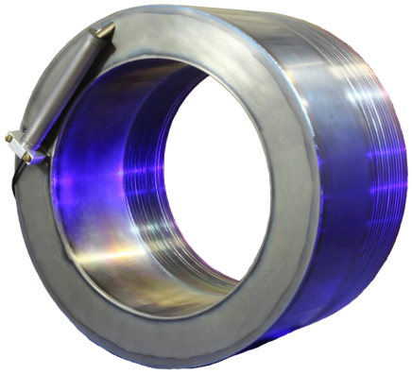
Cryogenic Current Comparators:
Status and challenges
Volker Tympel, HI-Jena
Sept. 17th, 2025
SPARC 2025
Topical Workshop

Slide 2
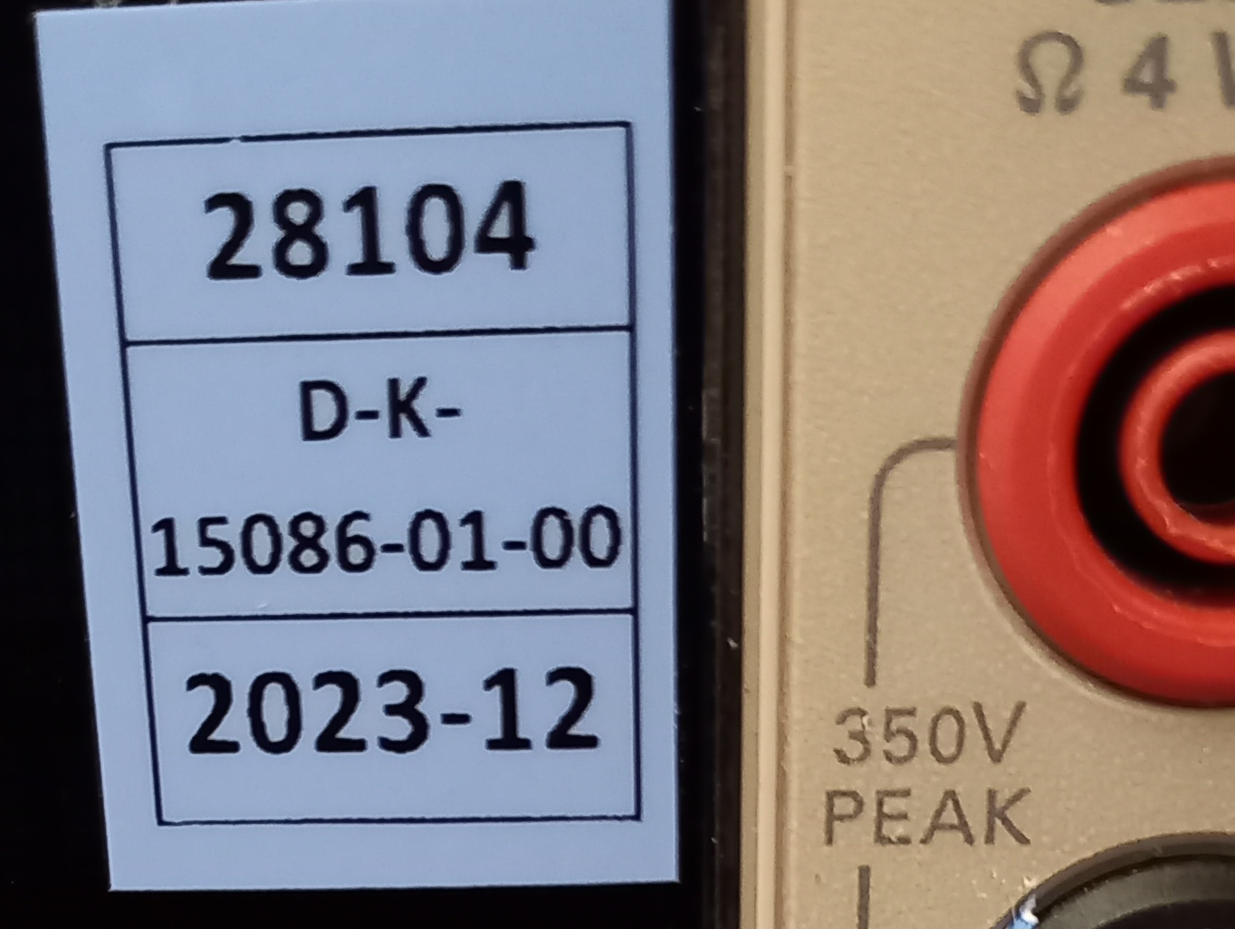
CCC?
Low intensity beam
i
B=0
-i
Principle of the
Cryogenic
Current
Comparator
B
charged
particle
beam
=> non-destructive
Thermal noise reduction
Superconductivity
DC transformer (=> un-bunched beam)
Magnetic shielding
Superconducting Quantum Interference Device (SQUID)
Calibration certificate
current source
=> absolute values

Slide 3
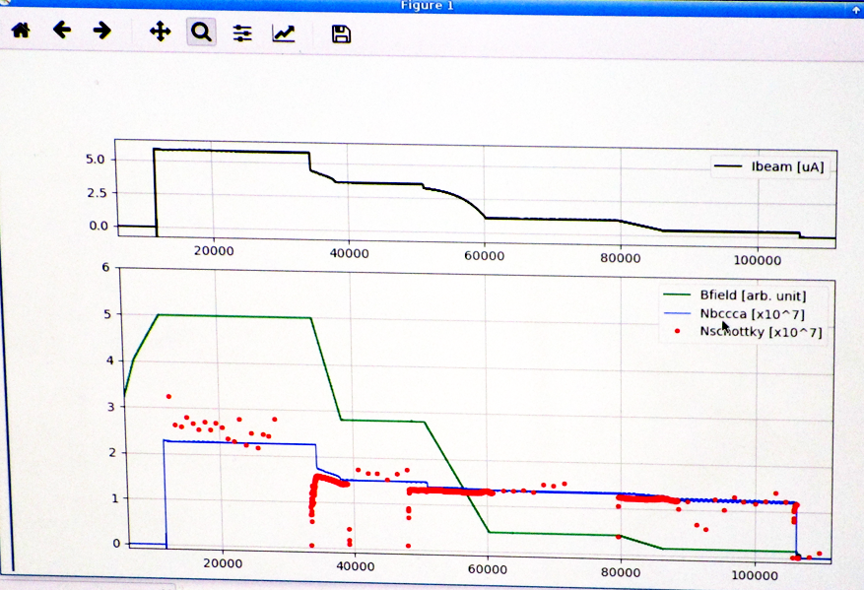
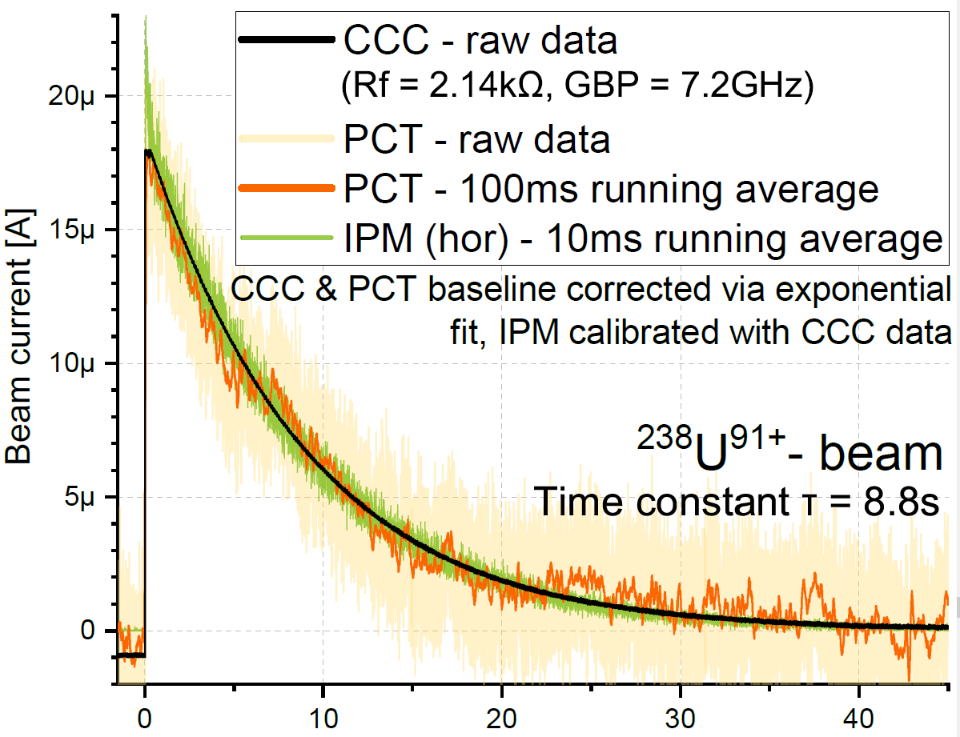

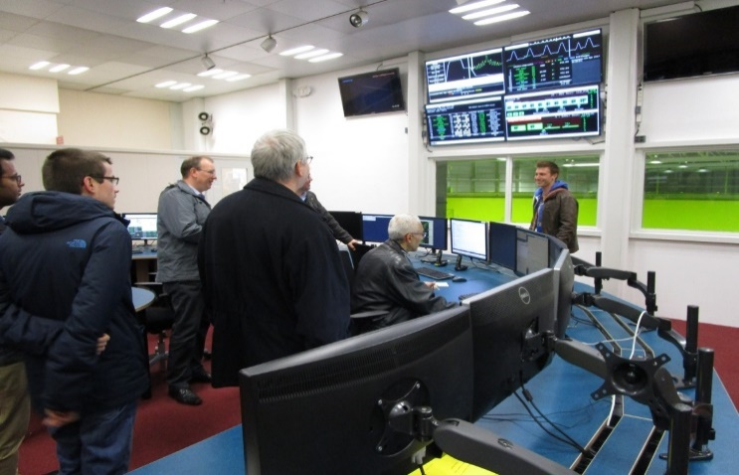
CCC?
Low intensity beam
Screen shot
CCC running @
CERN-AD.
Comparison test CCC against
Parametric Current Transformer and
Ionization Profile Monitor @
CRYRING@ESR in 2021
CCC is activated in the control room.
2017

Slide 4
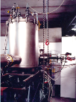

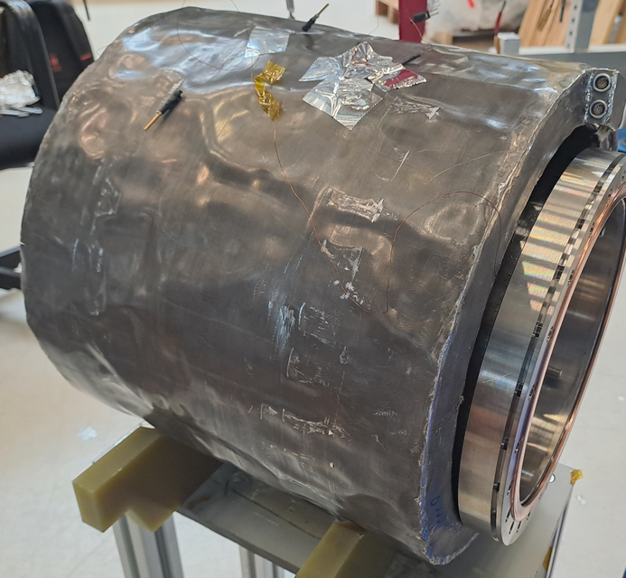

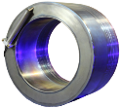
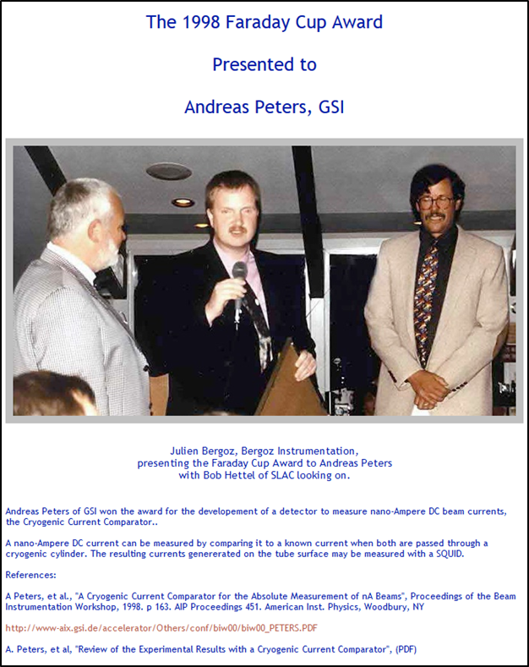
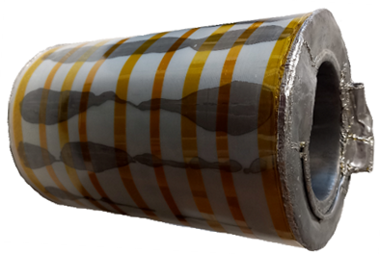
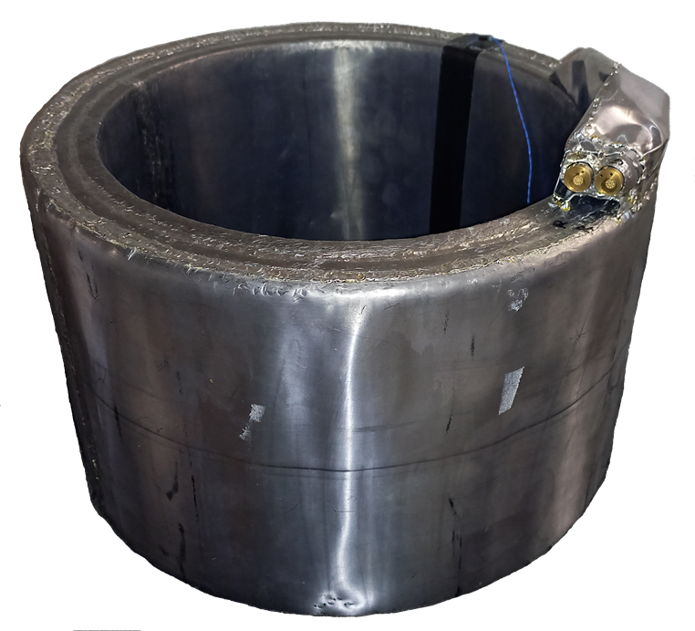
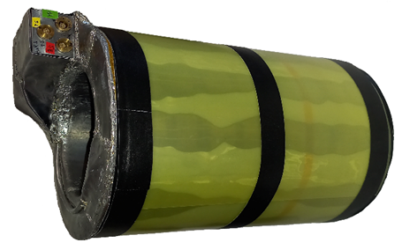
CCCs
Evolution until 2024
Pb-Coreless CCCs V1…V8, EMI-problems
unstable in the field of application
BMBF project:
05P18SJRB1
Pb-CCC-xD-V8-2
2024
Tested @ GSI
BESSY
2009
PhD theses
L. Crescimbeni
in progress
CERN-
Nb-CCC
2015
PhD theses
D. Haider
2022
GSI
1996
Pb-DualCoreCCC
PhD theses
R. Geithner
2013
PhD theses
F. Kurian
2016
PhD theses
M. Stapelfeld
2022
BLD 100 mm
FAIR-
Nb-CCC-xD
2017
PhD theses
M. Fernandes
2017
BLD 40 mm
BMBF project:
05P21SJRB1
BMBF project:
05P15SJRBA
Pb-DCCC-Sm-200
2022
BLD 150 mm
IBIC‘98
Farady Cup Award
to A. Peters (GSI)
Noise: 250 pA /√Hz
Finally
Pb-DCCC-Sm-300
2023
Pb-DCCC-xD
2024

Slide 5
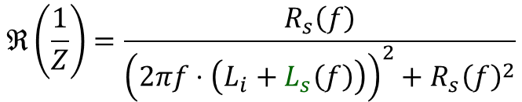
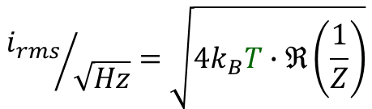
Status: Lab Limits
Sm version
Current resolution
White noise
Real part of the
inverse impedance
fixed by
SQUID
fixed for a
core material
Fluctuation–dissipation theorem*
$${i_{rms}}/{\sqrt{Hz}}=\sqrt{4k_{B}T∙ℜ\left(\frac{1}{Z}\right)}$$
$$ℜ\left(\frac{1}{Z}\right)=\frac{R_{s}\left(f\right)}{{\left(2πf⋅\left(L_{i}+L_{s}\left(f\right)\right)\right)}^{2}+{R_{s}\left(f\right)}^{2}}$$
Spectral
current noise
density
pA_{rms}/√Hz
Temperature
4.2 K → 1.9 K
Noise reduction:
0.67
Inductance
100 µH → 200 µH
Noise reduction:
≈0.7
* R. Geithner, PhD theses, Jena 2013
Confirmed Tympel, et al., High Inductance Cryogenic Current Comparators for Beamlines
IEEE Trans. Appl. Supercon. Vol. 34, Is.: 3, May 2024

Slide 6
Status: Lab limits
Sm version
Current resolution
White noise: 1 pA_{rms}/√Hz @ 300 µH, 2.1 K
Pulse / ramp
Pulse: 200 µs (Sm-200 un-damped)
Ramp: 10 ms (Sm-300 un-damped)
0.5 nA_{pp}

Slide 7
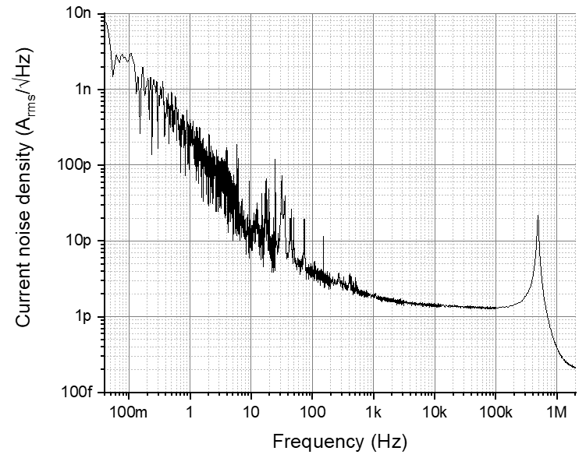
Status: Lab limits
Sm version
Current resolution
White noise: 1 pA_{rms}/√Hz
Pulse / ramp: 500 pA_{pp}
20 dB per decade
=> like Brownian noise
1/f²
Frequency bandwidth
from DC (to be defined!)
LC meander resonance
Low Frequency Noise
White noise
Current or voltage in dB
=> 20 ·lg₁₀(x_{out} / x_{in})
Measured @ 4.2 K

Slide 8
Status: Lab limits
Sm version
Current resolution
Calibration U=>I
via factor
White noise: 1 pA_{rms}/√Hz
Pulse / ramp: 500 pA_{pp}
via deconvolution
Frequency bandwidth
from DC
to 1.5 MHz
Deconvolution:
Digital data processing necessary !
Pb-DCCC-xD
FAIR-Nb-CCC-xD
CERN-Nb-CCC
Low sensitive SQUID
Pb-DCCC-Sm-300
final damped version

Slide 9
Status: Lab limits
Sm version
Current resolution
White noise: 1 pA_{rms}/√Hz
Pulse / ramp: 500 pA_{pp}
Frequency bandwidth
from DC
to 1.5 MHz
Low sensitive SQUID
Dynamics
7x slew rate extension
3 SQUIDs => 3 zero lines:
Digital data processing necessary !
Pb-DCCC-Sm-300
final damped version

Slide 10
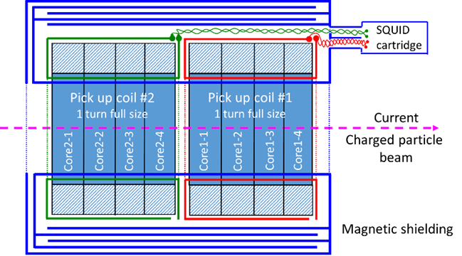
Status: Lab limits
Sm version
Current resolution
White noise: 1 pA_{rms}/√Hz
Pulse / ramp: 500 pA_{pp}
Nb-CCCs
10⁻⁵
Frequency bandwidth
from DC
to 1.5 MHz
Pb-foil CCCs
10⁻⁸
Dynamics
7x slew rate extension
Magnetic shielding
1000x

Slide 11
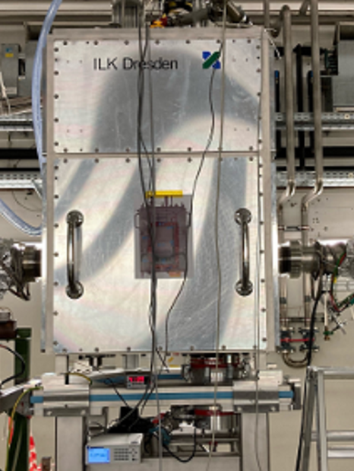
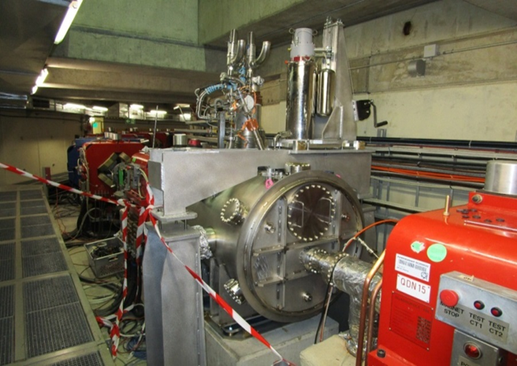
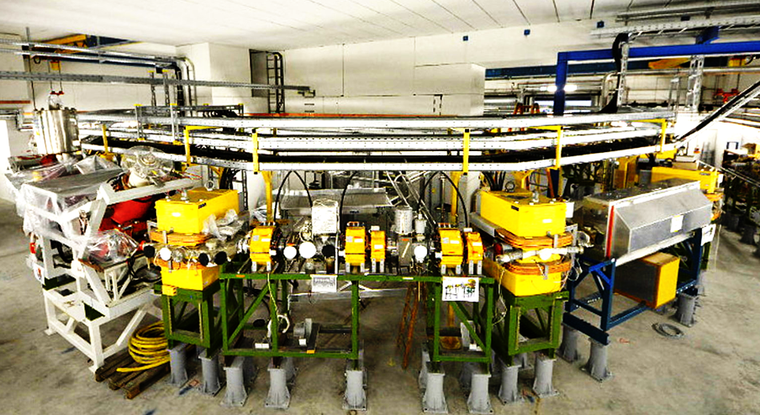
Status: Systems
Cryostats
Beamline Ø: 150 mm
100 mm
40 mm
FAIR #1
since 2021,
now alteration:
125 => 150 mm
CERN-AD
since 2017
Jena-GFK
since 2024
without He Reliquefier
FAIR #2
order placed
CRYRING@ESR
ongoing tender
CCC sensor versions:
-xD
-mD
-Sm

Slide 12

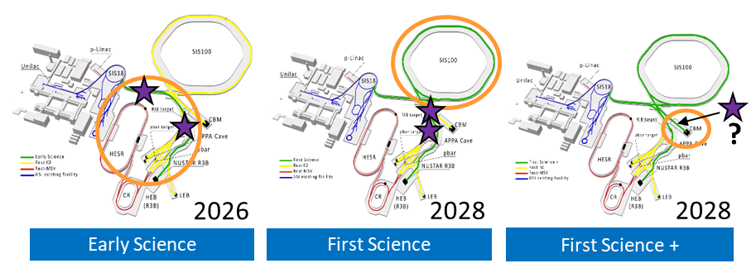
Challenge: FAIR
xD version
Planning for FAIR
FAIR #1 / #2

Slide 13
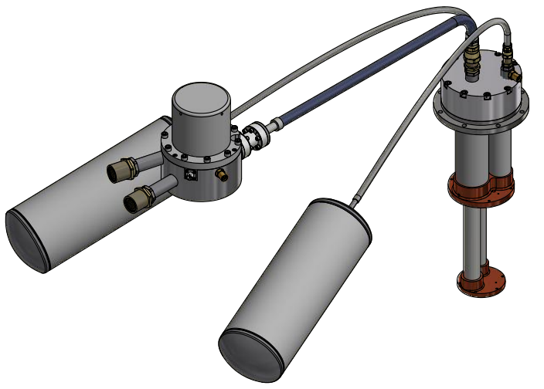
Challenge: Microphonics
He Reliquefier
PT425-RM cold head
150 mV
Rotary valve
He 7⬄25 bar
@ 1.4 Hz
He 7 bar
40 mV
He 25 bar
10 mV

Slide 14
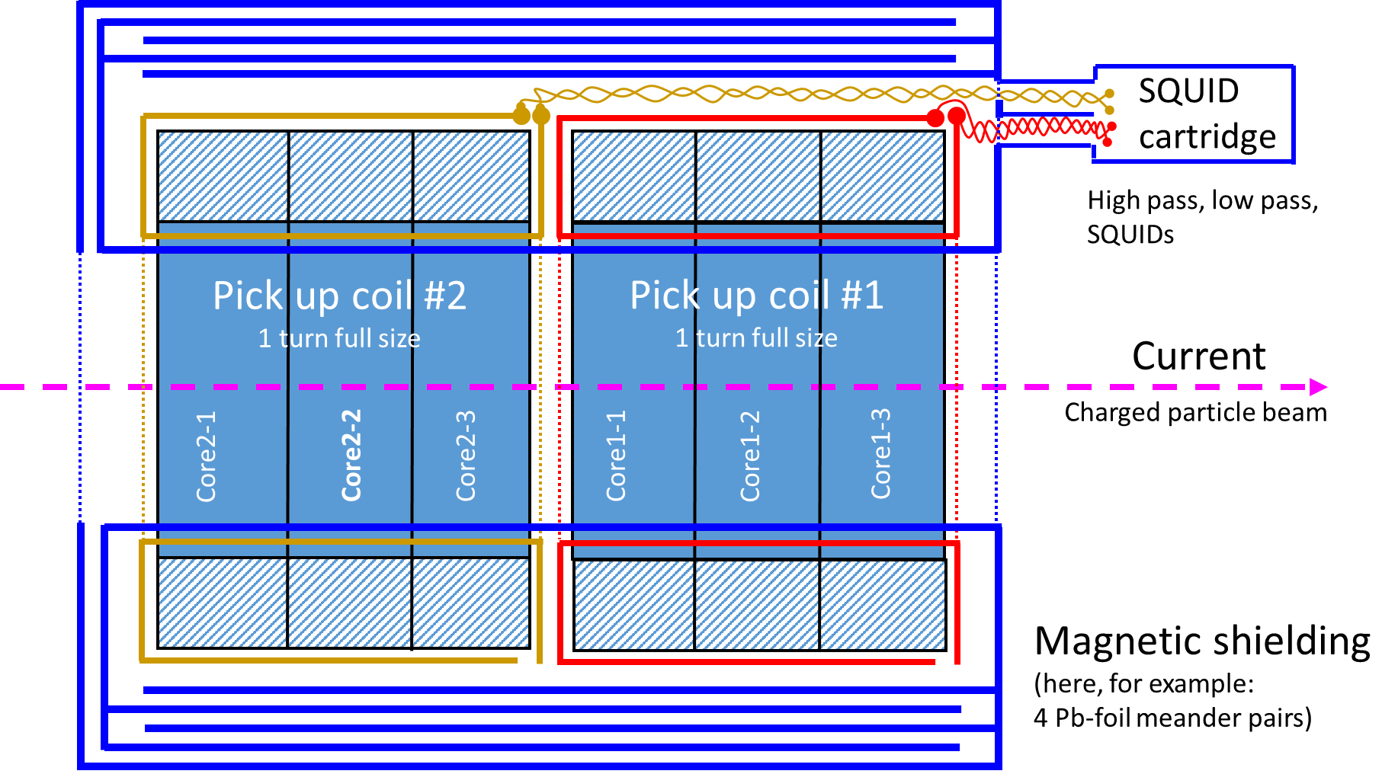
Challenge: Microphonics
He Reliquefier
?

Slide 15
Challenge: Microphonics
Digital data processing
Channel Red SQUID (LP-filtered)
Raw data
24 bit delta-sigma ADC
10 kSample/s
Calibration: 0.24 nA/mV
85 nA

Slide 16
Challenge: Microphonics
Digital data processing
5 min
Data sample
+
6.7 mHz

Slide 17
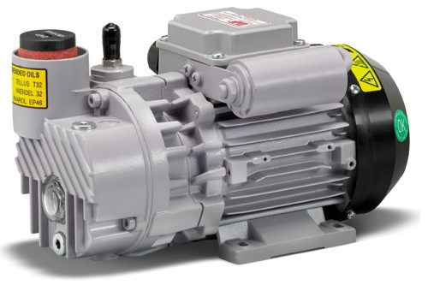
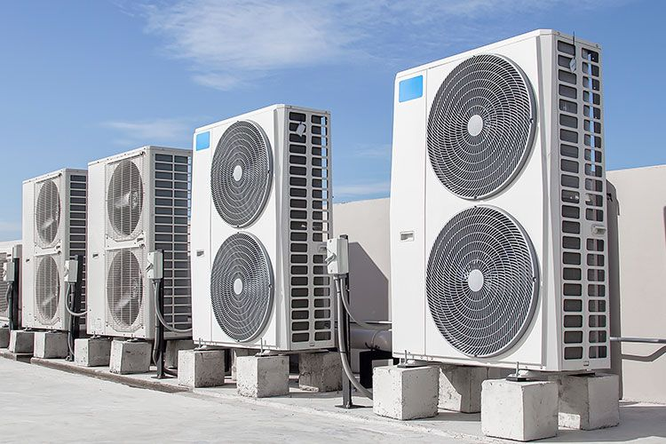
Challenge: Microphonics
Digital data processing
PT425-RM cold head
40 mV
?
?
Vacuum pumps ?
PT425-RM cold head
?
PT425-RM cold head
PT425-RM cold head
?
?
PT425-RM cold head
?
10 mV
Air conditioner ?

Slide 18
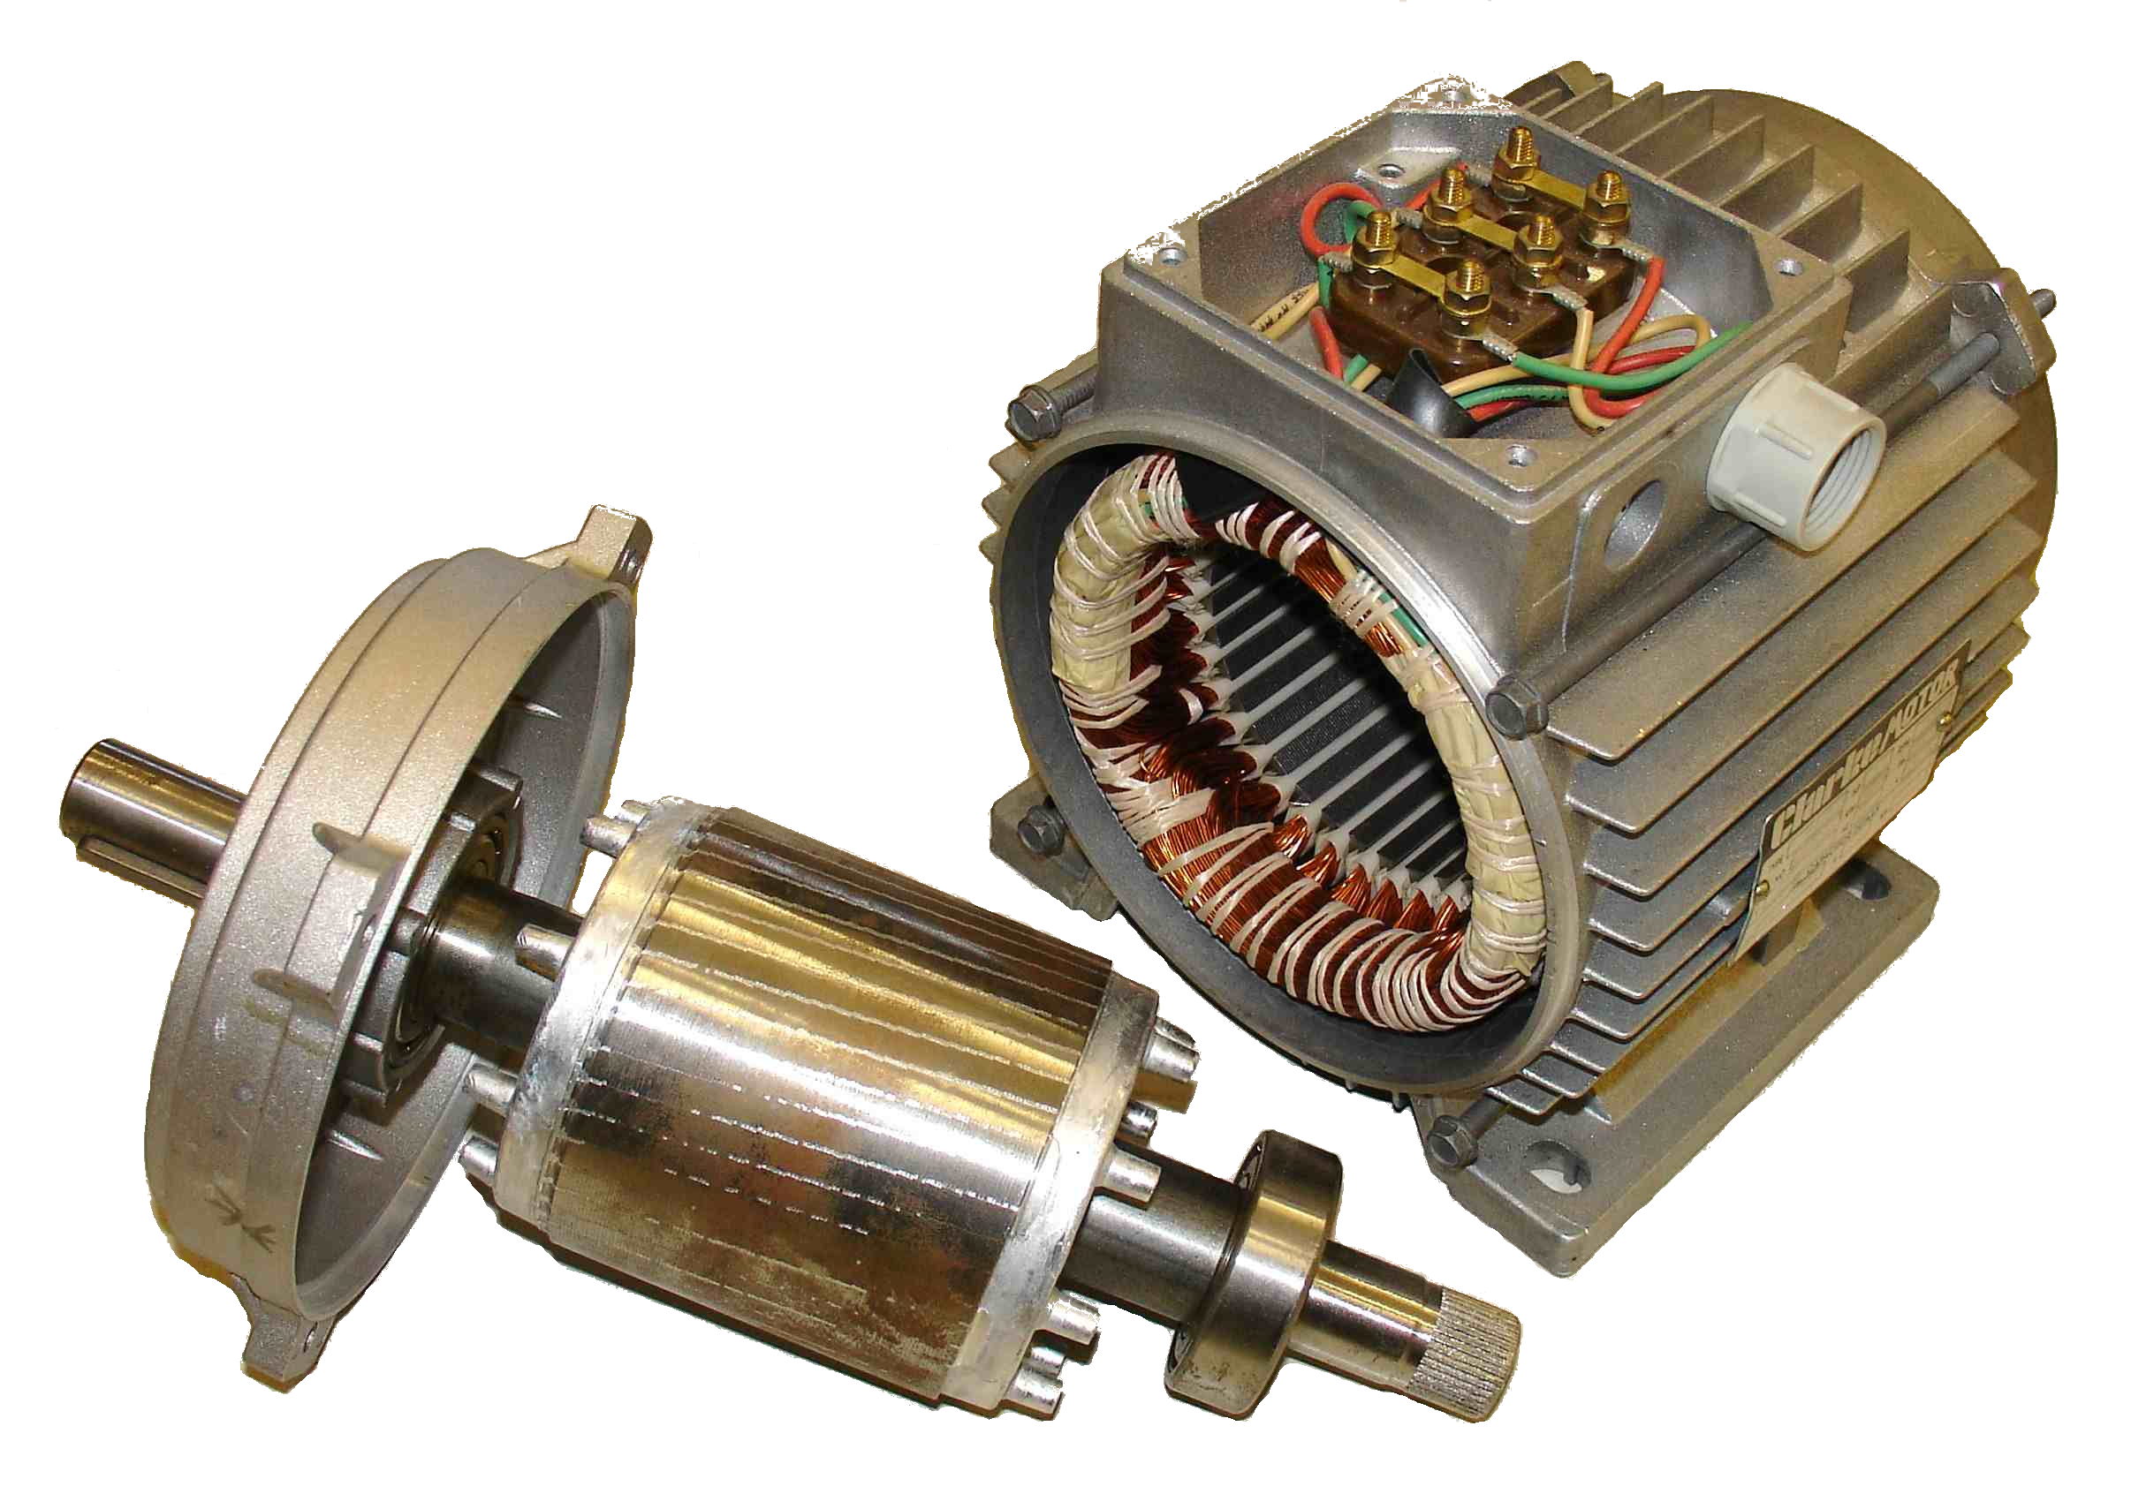
Challenge: Microphonics
Digital data processing
0.6 % slip
Asynchronous motors
(Induction motor)
1 % slip
10 mV
Mechanical coupling
Electrical coupling
Stator
50 Hz
Rotor
=> Slip frequency

Slide 19
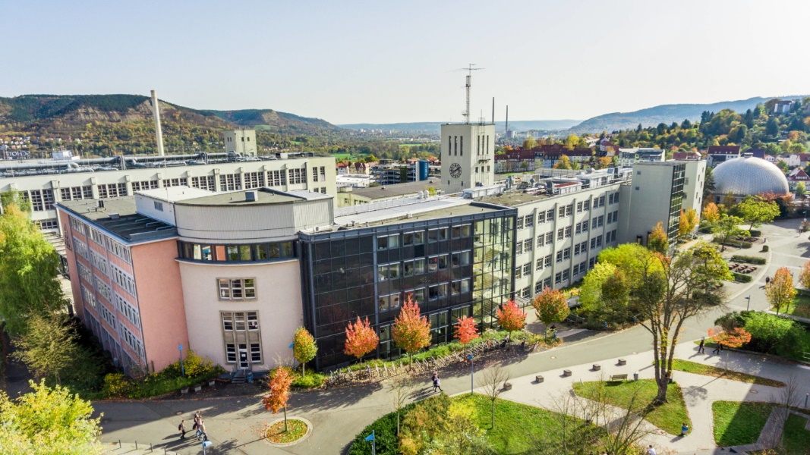
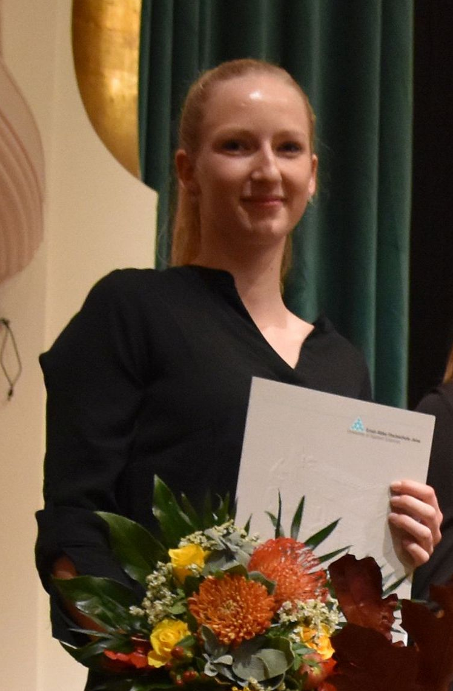
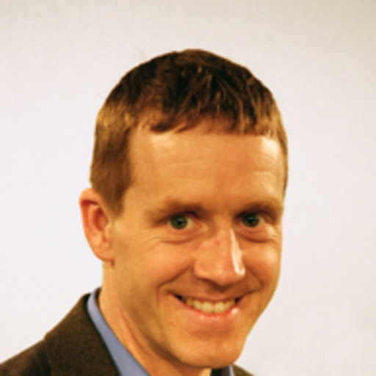

Challenge: Microphonics
Digital data processing
EAH-Jena University of Applied Sciences
Prof. Dr.-Ing.
Burkart Voss
Department of Electrical Engineering and Information Technology
BMFTR-Project:
05P24SHA 2024-27
M. Eng.
Svenja Kolbe

Slide 20
Challenge: ½ meter
CRYRING@ESR
ErUM Matter call in 2024
special ½ meter Compact CCC system
BMFTR-Project: C4CRY
05K25SJA 2025-28
Open PhD position!
Contract partner: University of Jena
Place of work: GSI Darmstadt

Slide 21
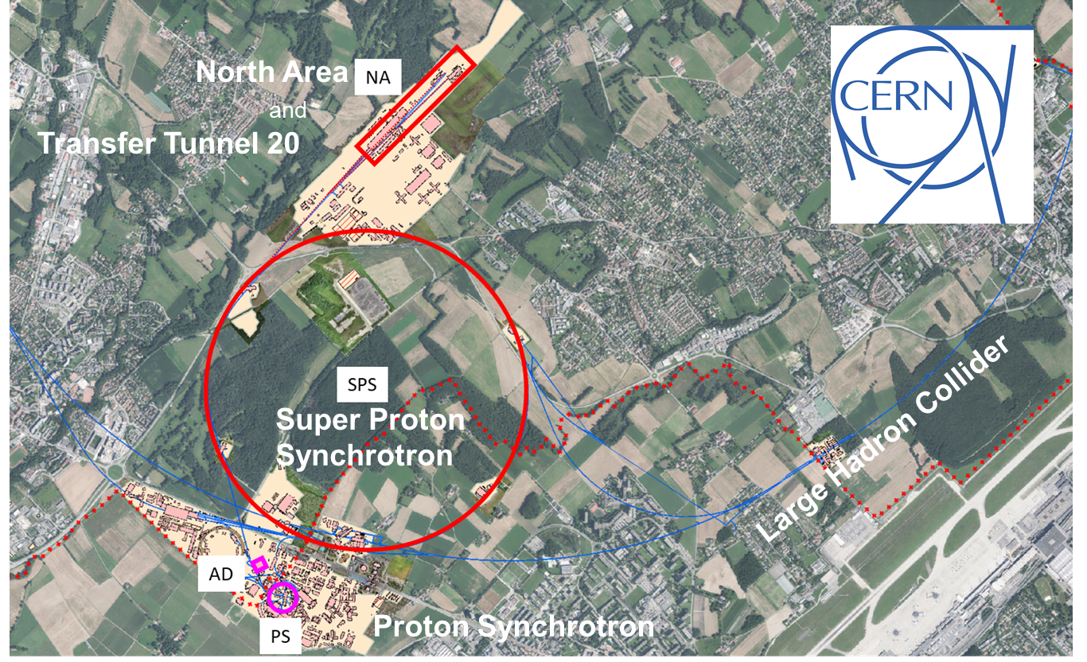
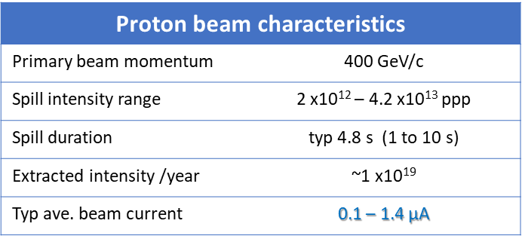
Challenge: CERN
2nd CERN system
Present situation with
DC beams:
Diagnostics relies only
on beam intercepting devices.
New Pb-DCCC for slow extraction from SPS to
North Area (TT-20). (J. Tan @ IBIC 2024)
2nd
1st
Why a CCC?
DC & AC,
<10 µA,
abs. current,
non-destructive
Sensor delivery: 2026 ?

Slide 22
Summary
Status: Clear Design & Lab Limits
Challenge: Data Processing (Microphonics, 3 SQUIDs)
Complete Systems
Growing: Cooling Costs (Beamline Cryostat, He Reliquefier)
Thank you for your attention!

