Slide 1
MAPS activities within DRD3
M. Deveaux

Slide 2

What is DRD3?
ECFA Detector R&D Roadmap (2021)
Drive detector technology forward in common effort of different collaborations / communities.
Build specific detector R&D collaborations (DRD).
Our community of interest: DRD3 – Silicon detectors.
Plan: Propose projects still in 2024.
1st DRD3 week on Solid State Detectors R&D, CERN, 17–21 Jun 2024
Projects of interest for future MAPS:
S. Spannagel (DESY), A. Besson (IPHC) et al. – OCTOPUS
J. Baudot (IPHC) et al. - A versatile pixel matrix in TPSCo 65 nm for future trackers
H. Pernegger (CERN) et al. - CASSIA
Might merge

Slide 3
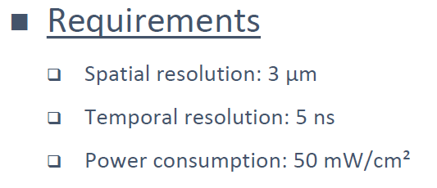
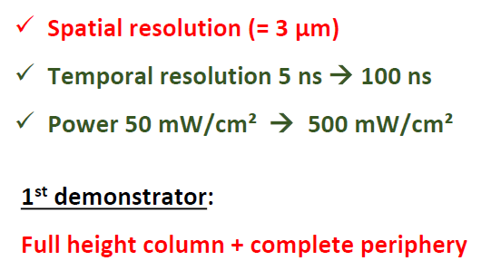
OCTOPUS
Idea:
Build fine pitch sensor optimized for Higgs factors vertex detector.
Use TPSCo 65nm.
Target for a beam telescope sensor in first step.
Participants: IPHC (A.Besson), DESY (S. Spannagel), many others.
Status:
Collaboration formed and structured.
Work starting.
Project proposal being prepared for submission.
Next steps:
Define detailed R&D goals.
Setup Simulation workgroup.
Task of GSI:
Presumably sensor test and simulation.
Participation to design if design group can be formed.
Targeted for OCTOPUS 1:

Slide 4
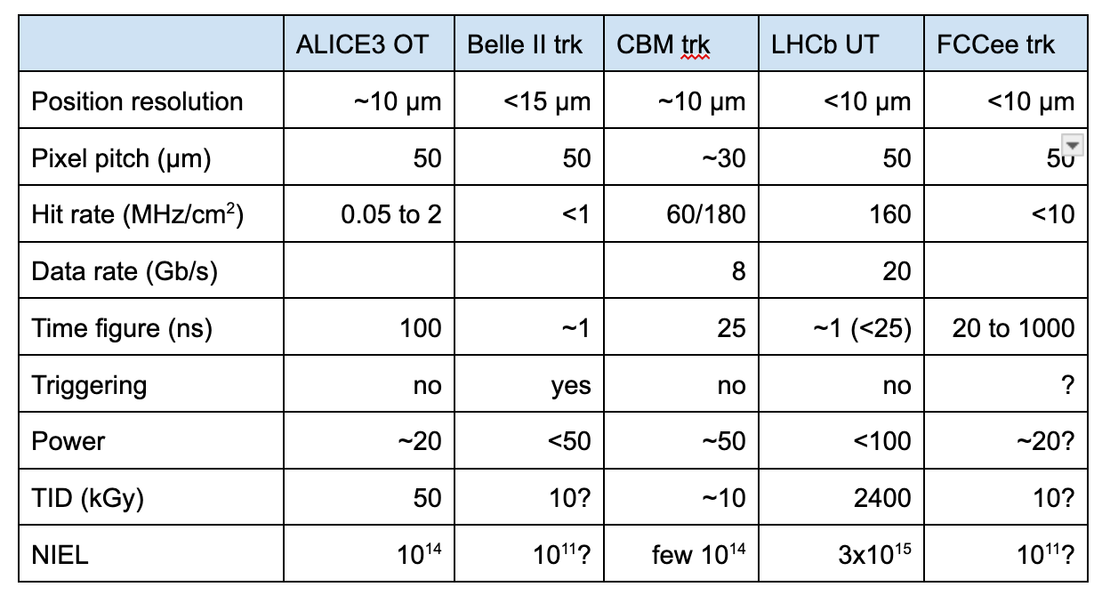
Versatile detector project
Idea:
Build sensor for tracking purposes (higher pitch, lower power).
Created general structure allowing to tune parameters
=> Several applications, one technology.
Participants: IPHC (J. Baudot)…
Overlap/synergies with OCTOPUS.
Status:
Project proposed, some project partners identified.
Kick-off pending.
Next steps:
Organize kick-off meeting.
Write proposal
Task of GSI:
Yet to be defined.
J. Baudot, 1st DRD3 week,
CERN, 17 June 2024
Many experiments, about similar requirements
B. Arnoldie-Meadows

Slide 5
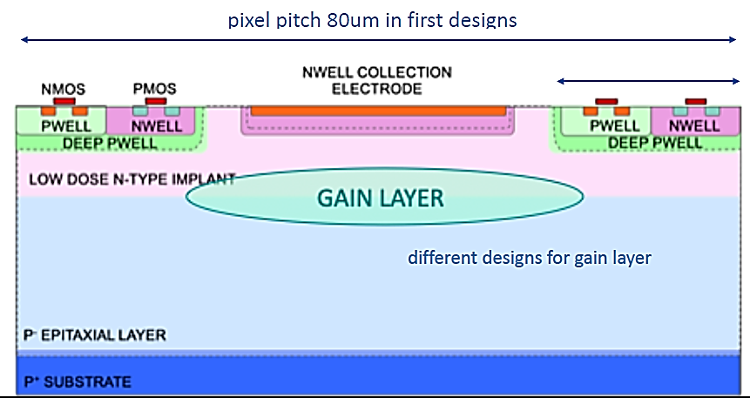
CASSIA
Idea:
Integrate a gain layer into pixels made with TJ180nm
(same production process as MIMOSIS).
Optimize and migrate to TPSCo 65nm
Improve S/N, reduce power, improve time precision.
Status:
First prototype made and tested by CERN + FER University Zagreb.
Test demonstrates feasibility for 180 nm
Next steps:
Optimize structures, integrate pixel FEE.
Test radiation tolerance.
Start related activity at IPHC Strasbourg.
Task of GSI:
Perform beam tests at UNILAC beam.
Study Single Event Effects (Single Event Burn out).
=> Beam time request filed (supported by CBM).
H. Pernegger, T. Suligoj, personal communication

Slide 6
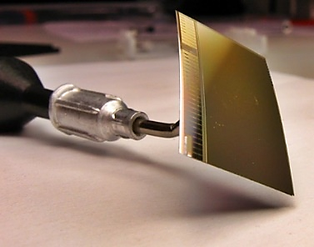
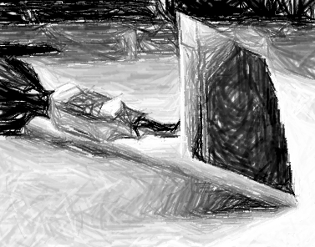

Toward the future: Think MAPS new
New high speed fine
pitch readout architecture.
Tunable device properties.
CMOS Monolithic Active Pixel Sensor
CMOS Monolithic Active Pixel Sensor
New frontiers for the
HI community.
CASSIA
Apologies to J.Pietraszko and co workers for not covering their great work on LGADs…

