Slide 1

Silicon@GSI Get together
31.01.2025 GSI
O. Vasylyev
1

Slide 2
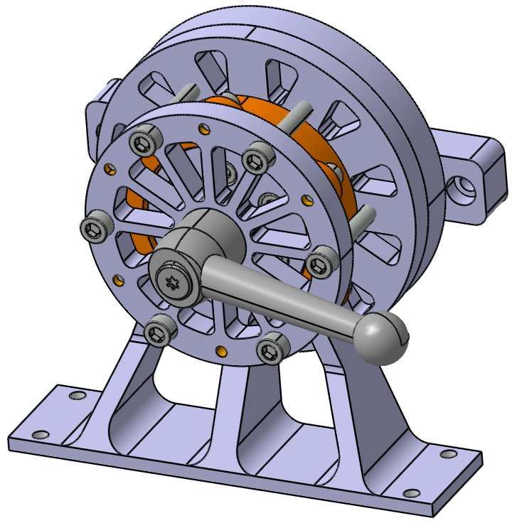
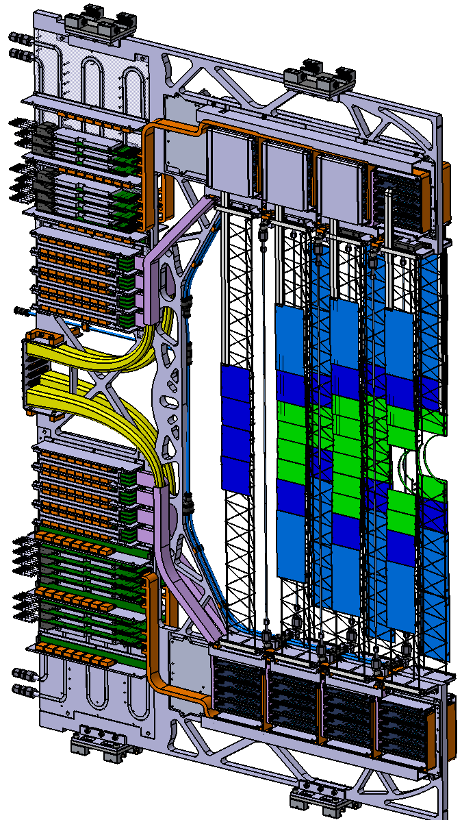
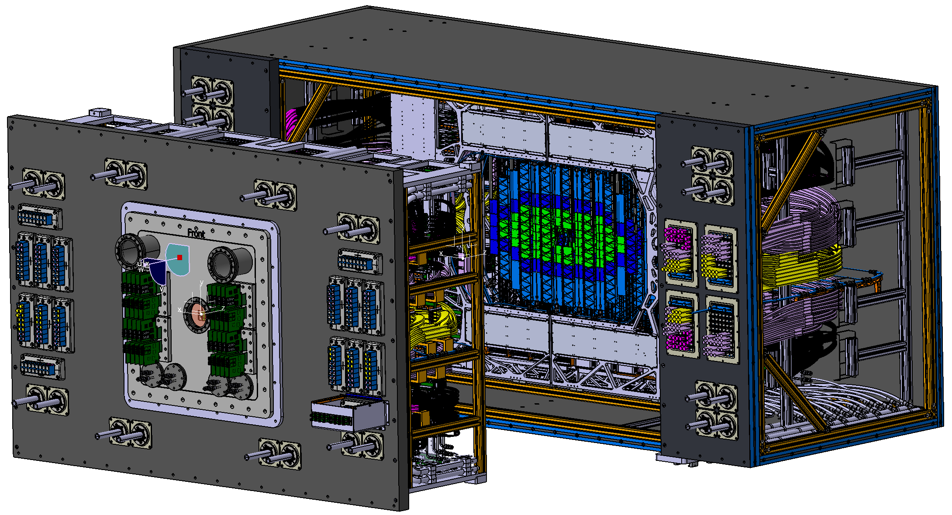
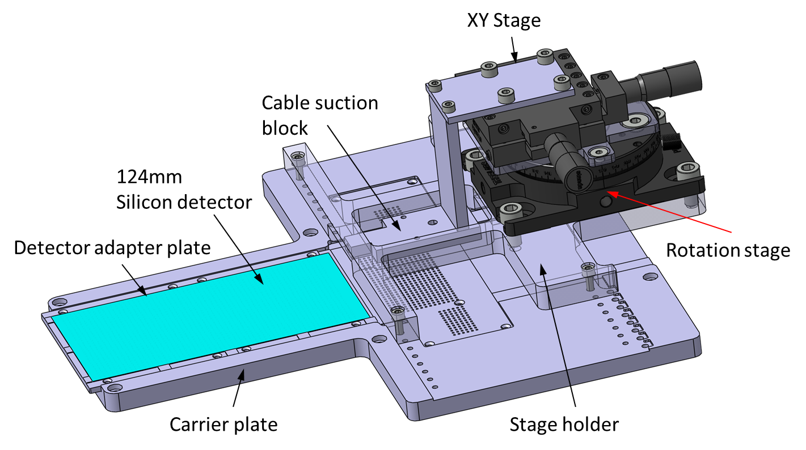
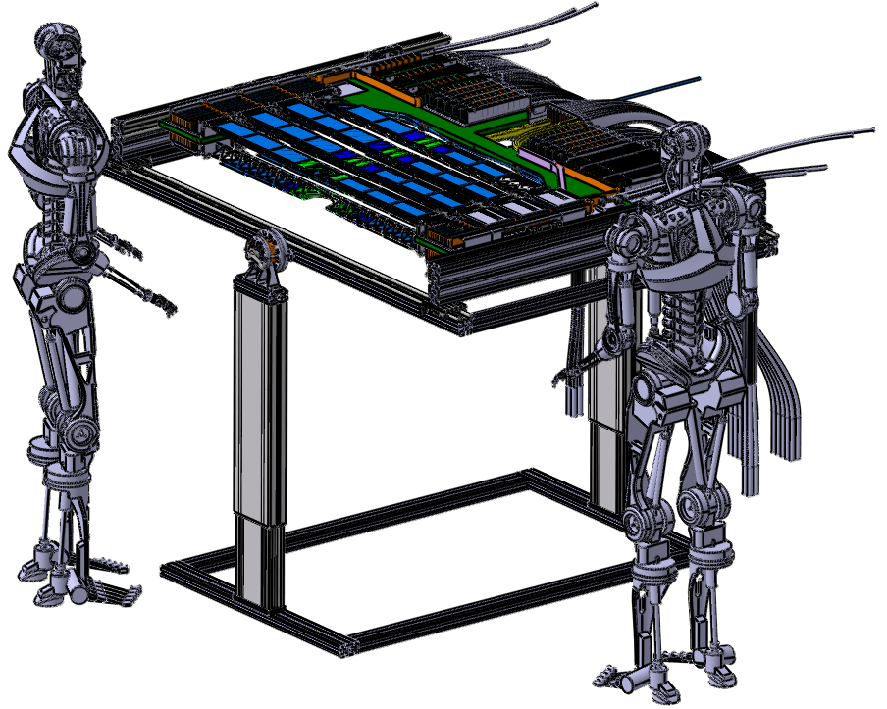
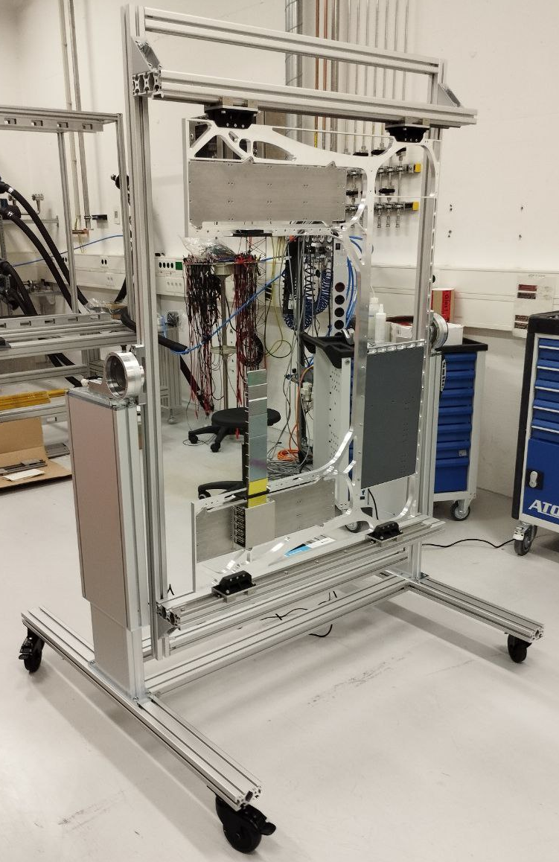
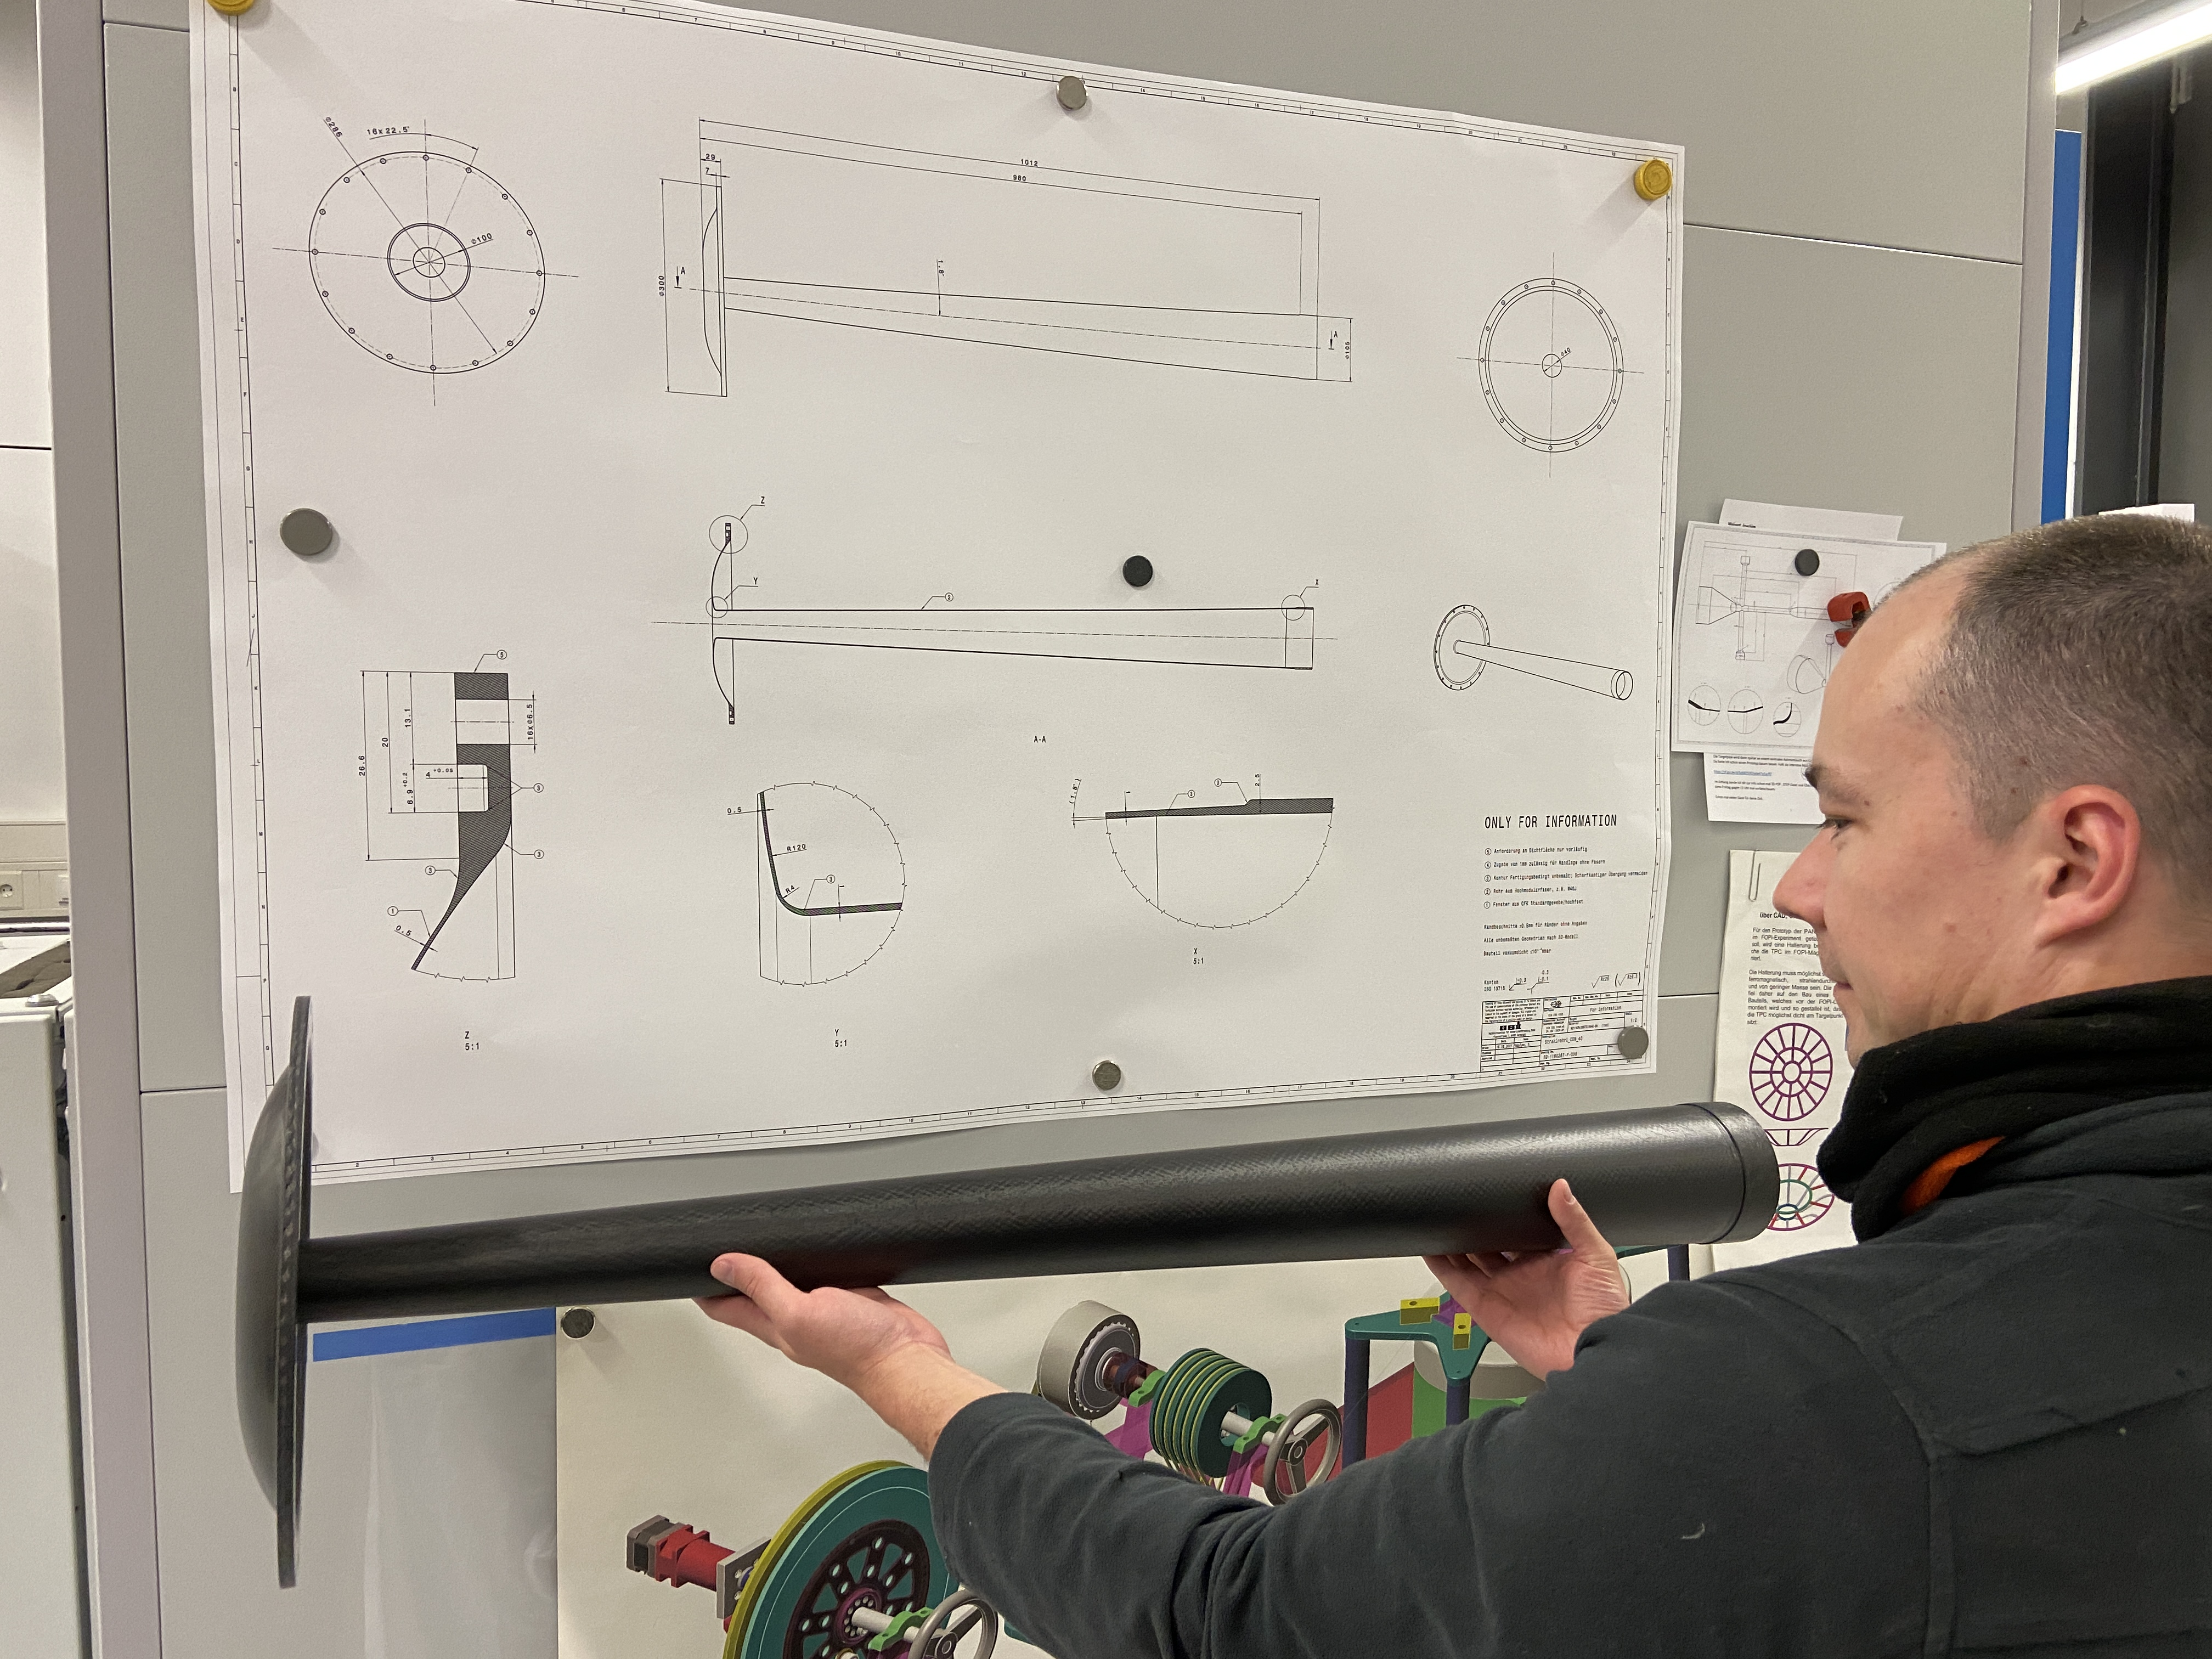
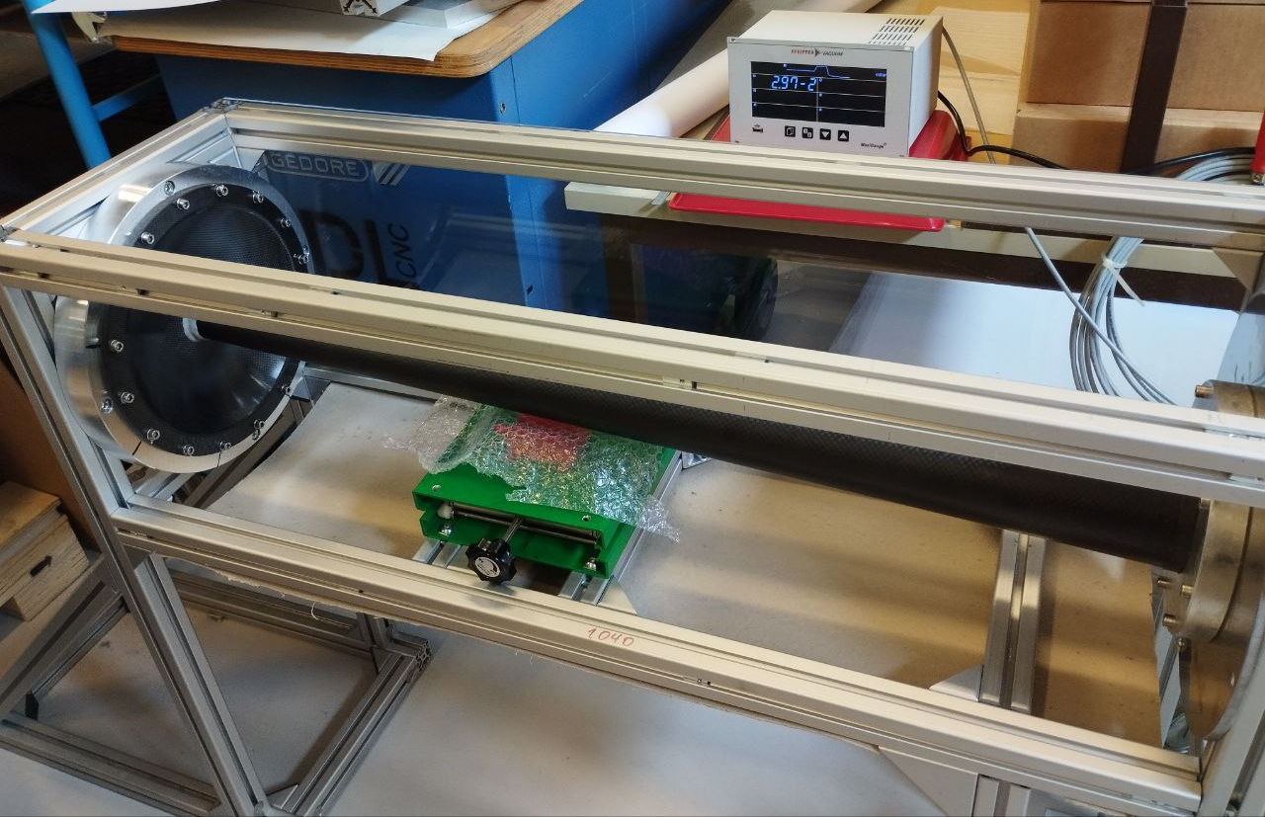
DETEKTORLABOR @
Mechanical engineering and integration
Development of components & assemblies
Integration into the full CAD model
Production preparation and coordination
Tech. drawings + specifications
Manufacturing process definition
Component validation
Prototyping and testing
Custom mechanism
STS Unit design
STS Detektor @ CBM
Sensor bonding jig
[Unit assembly jig CAD model]
[Unit assembly jig]
[STS Beam pipe first look]
[STS Beam pipe vacuum testing]

