Slide 1

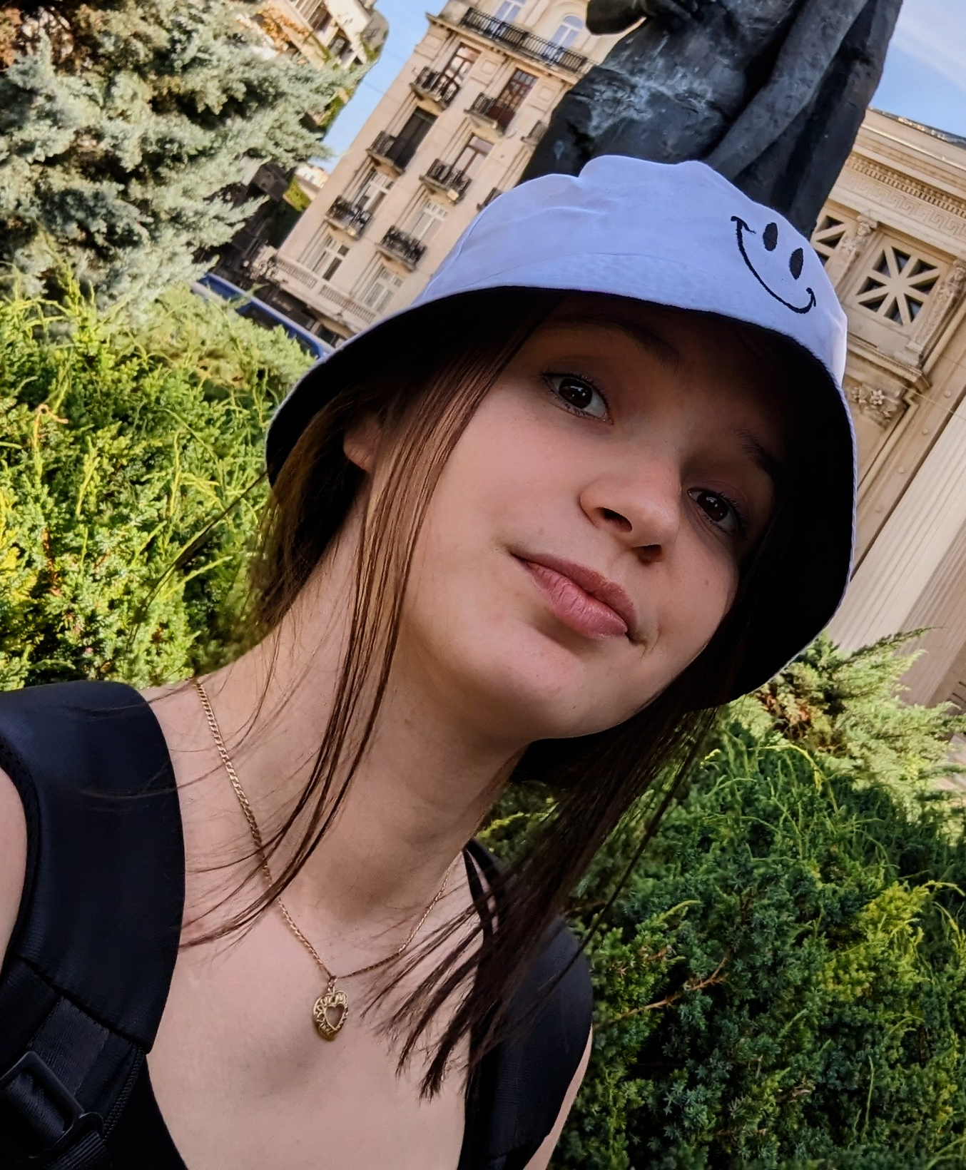
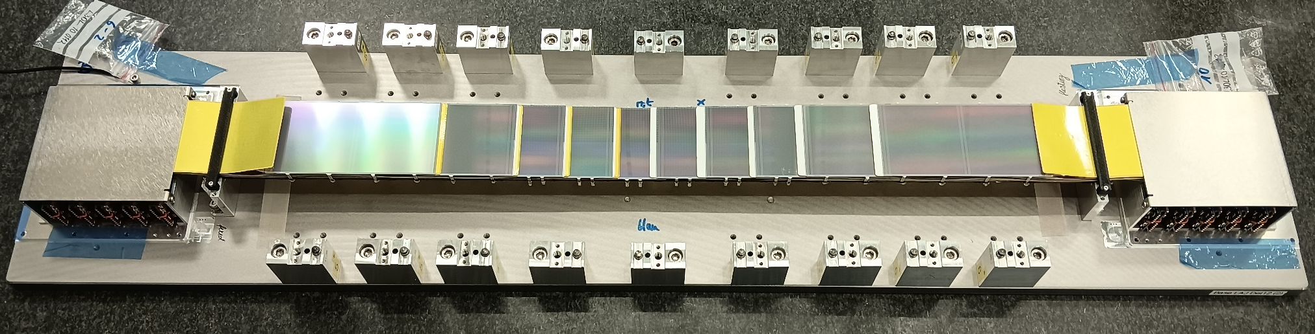
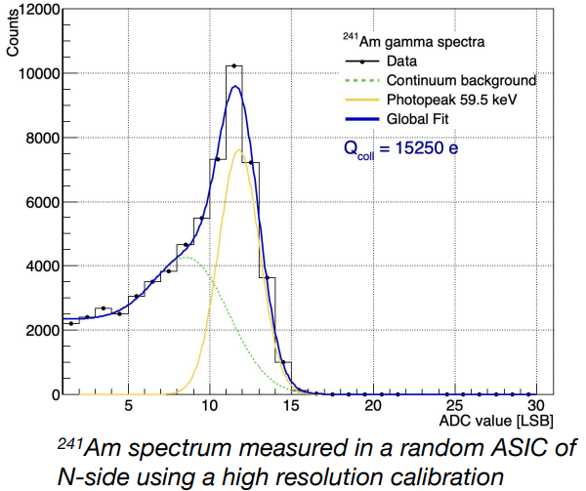
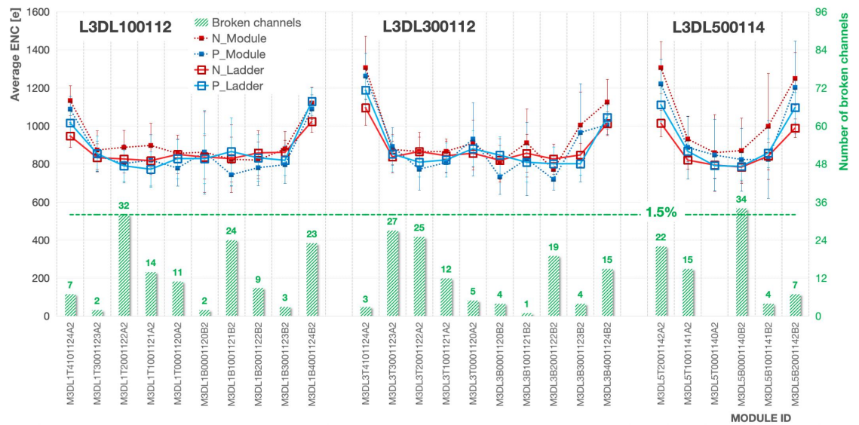
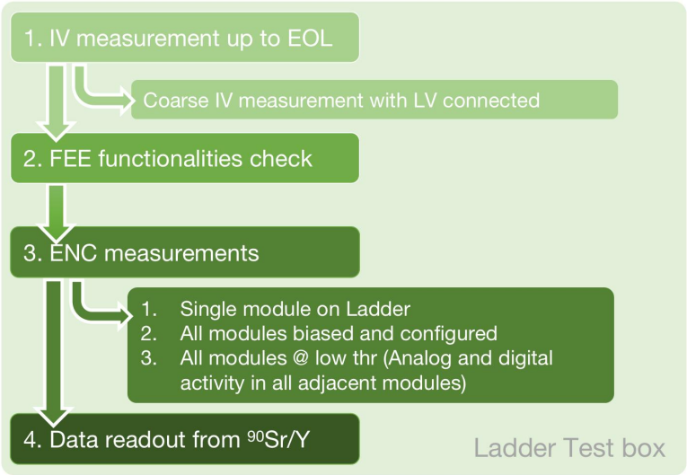
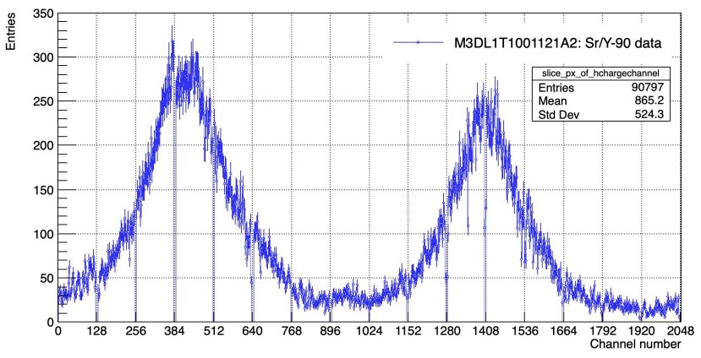



Performance assessment and operation aspects in the assembly process of the Silicon Tracking System of the CBM experiment at FAIR
STS Ladder performance and characterization
Lady Maryann Collazo Sánchez
PhD student
⁹⁰Sr/Y source measurement

