Slide 1
Flexible data transport for online reconstruction
M. Al-Turany
Dennis Klein
A. Rybalchenko

Slide 2
This talk:
Introduction
Design requirement
Zero MQ
Socket Pattern
Current Status
Results

Slide 3
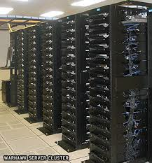
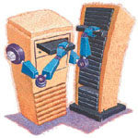
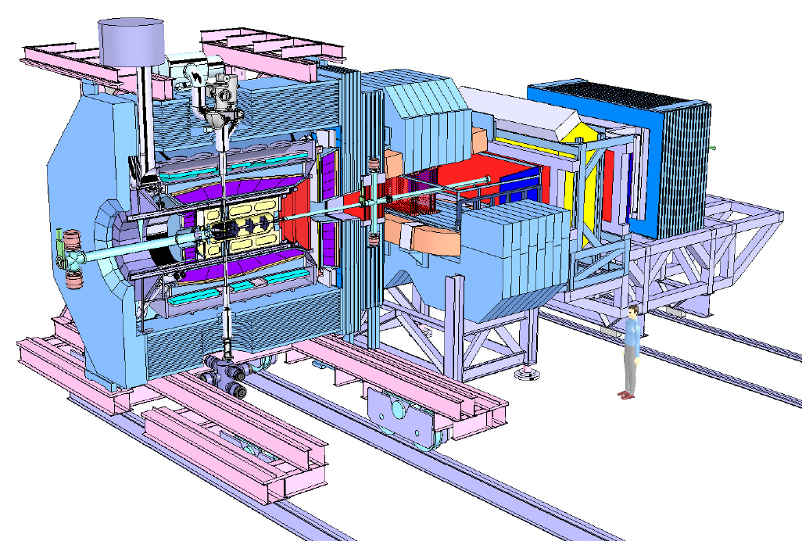
The Online Reconstruction and analysis
300 GB/s
20M Evt/s
< 1 GB/s
25K Evt/s
> 60 000
CPU-core
or Equivalent
GPU, FPGA, …
How to manage the data flow on such a huge cluster?
How to recover single/multiple processes?
How to monitor it?
……

Slide 4
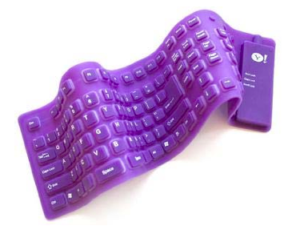
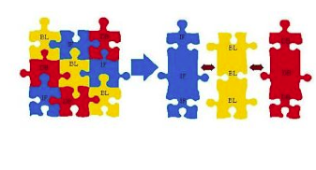
Design constrains
Highly flexible: different data paths should be modeled.
Adaptive: Sub-system are continuously under development and improvement
Should work for simulated and real data: developing and debugging the algorithms
It should support all possible hardware where the algorithms could run (CPU, GPU, FPGA)
It has to scale to any size! With minimum or ideally no effort.

Slide 5
Before Re-inventing the Wheel
What is available on the market and in the community?
ALICE, ATLAS, CMS, LHCb, …
Financial and weather application have also huge data to deal with
Do we intend to separate online and offline?
Multithreaded concept or a message queue based one?
Message based systems allow us to decouple producers from consumers.
We can spread the work to be done over several processes and machines.
We can manage/upgrade/move around programs (processes) independently of each other.

Slide 6
ØMQ (ZeroMQ) Available since 2011
A socket library that acts as a concurrency framework.
Faster than TCP, for clustered products and supercomputing.
Carries messages across inproc, IPC, TCP, and multicast.
Connect N-to-N via fanout, pubsub, pipeline, request-reply.
A synch I/O for scalable multicore message-passing apps.
30+ languages including C, C++, Java, .NET, Python.
Most OSes including Linux, Windows, OS X, PPC405/PPC440.
Large and active open source community.
LGPL free software with full commercial support from iMatix.

Slide 7
Zero in ØMQ
Originally the zero in ØMQ was meant as "zero broker" and (as close to) "zero latency" (as possible). In the meantime it has come to cover different goals:
zero administration,
zero cost,
zero waste.
More generally, "zero” refers to the culture of minimalism that permeates the project.
Adding power by removing complexity rather than exposing new functionality.

Slide 8
ZeroMQ sockets provide efficient transport options
Inter-thread
Inter-process
Inter-node
which is really just inter-process across nodes communication
PMG : Pragmatic General Multicast (a reliable multicast protocol)
Named Pipe: Piece of random access memory (RAM) managed by
the operating system and exposed to programs through a file descriptor and
a named mount point in the file system. It behaves as a first in first out
(FIFO) buffer

Slide 9
The built-in core ØMQ patterns are:
Request-reply, which connects a set of clients to a set of services. This is a remote procedure call and task distribution pattern.
Publish-subscribe, which connects a set of publishers to a set of subscribers. This is a data distribution pattern.
Pipeline, which connects nodes in a fan-out / fan-in pattern that can have multiple steps, and loops. This is a parallel task distribution and collection pattern.
Exclusive pair, which connect two sockets exclusively

Slide 10
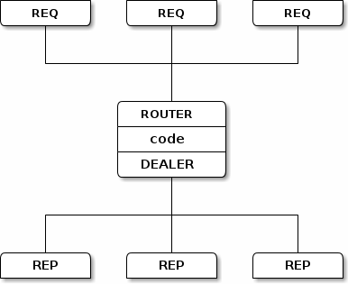
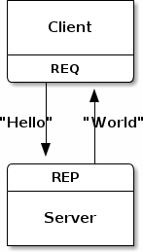
Request-Reply Pattern
Socket type | REQ | REP
Compatible peer sockets | REP, ROUTER | REQ, DEALER
Direction | Bidirectional | Bidirectional
Send/receive pattern | Send, Receive | Send, Receive
Outgoing routing strategy | Round-robin | Last peer
Incoming routing strategy | Last peer | Fair-queued
Action in mute state | Block | Drop

Slide 11
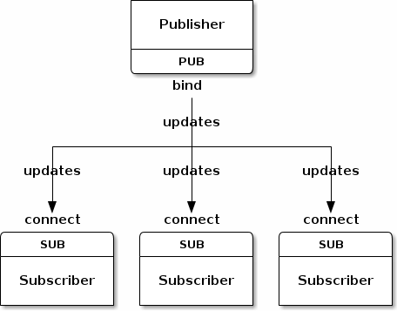
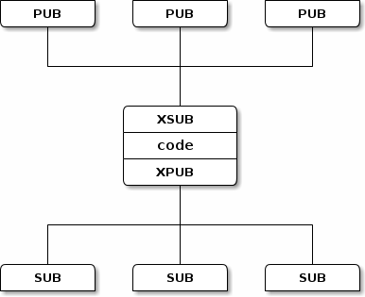
Publish-Subscribe Pattern
Socket type | PUB | SUB
Compatible peer sockets | SUB, XSUB | PUB, XPUB
Direction | Unidirectional | Unidirectional
Send/receive pattern | Send Only | Receive only
Outgoing routing strategy | Fan-out | N/A
Incoming routing strategy | N/A | Fair-queued
Action in mute state | Drop | Drop

Slide 12
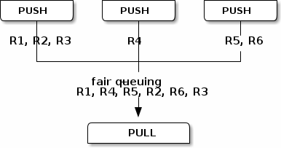
Pipeline Pattern
Socket type | PUSH | PULL
Compatible peer sockets | PULL | PUSH
Direction | Unidirectional | Unidirectional
Send/receive pattern | Send Only | Receive only
Outgoing routing strategy | Round-Robin | N/A
Incoming routing strategy | N/A | Fair-queued
Action in mute state | Block | Block

Slide 13
Example of sending control commands
A worker process can manages two sockets (a PULL socket getting tasks, and a SUB socket getting control commands)
Could be very useful for calibration and alignment parameter

Slide 14
Data Transfer Framework as Extension to FairRoot! Why?
Modeling the pipeline processing within the online analysis
Enable concurrency in FairRoot for offline analysis
Reliable and efficient data transport through message queuing technology
The long term plan is to have the same framework for online and offline

Slide 15
Data flow example
Simulation
Experiment
Online Reconstruction and Analysis
Sampler 1
Merger 1
Sub-detector 1
Processor 1
Sampler 2
Merger 2
Merger
Sub-detector 2
Processor 2
Sampler 3
Merger 3
Sub-detector 3
Processor 3

Slide 16
Current Status
The Framework deliver some components which can be connected to each other in order to construct a processing pipeline.
All component share a common base called Device (ZeroMQ Class).
All devices are grouped by three categories:
Source: Sampler
Message-based Processor:
Sink, BalancedStandaloneSplitter, StandaloneMerger, Buffer
Content-based Processor: Processor

Slide 17
Sampler
Devices with no inputs are categorized as sources
During RUN state the sampler loops infinitely over the loaded events and send them through the output socket.
A variable event rate limiter has been implemented to control the sending speed

Slide 18
Message-based Processor
All message-based processors inherit from Device and operate on messages without interpreting their content.
Four message-based processors have been implemented so far

Slide 19
Content-based Processor
The Processor device has one input and one output socket.
A task is meant for accessing and potentially changing the message content.

Slide 20
Design
Detector specific code

Slide 21
New simple classes without ROOT are used in the Sampler (This enable us to use non-ROOT clients) and reduce the messages size.

Slide 22
Device
Each processing stage of a pipeline is occupied by a process which executes an instance of the Device class

Slide 23
Message format (Protocol)
Potentially any content-based processor or any source can change the application protocol.
The framework provides a generic Message class that works with any arbitrary and continuous junk of memory.
One has to pass a pointer to the memory buffer and the size in bytes, and can optionally pass a function pointer to a destructor, which will be called once the message object is discarded.

Slide 24
Test setup and results

Slide 25
Four identical nodes were connected to a GigabitEthernet switch for testing
CPU: Intel Xeon L5506 @ 2.13 GHz
Memory: 24 GiB, 6 4 GiB
Network: Intel 82574L Gigabit Network Connection, speed=1Gbit/s
Operating system GNU/Linux 3.2.32-1 x86_64, Debian 7.0
ZeroMQ 3.2.0
FairRoot PandaRoot oct12 release,
Fairsoft development version from 18.12.2012

Slide 26
ZeroMQ reaches the upper TCP throughput for message sizes larger than a hundred bytes.
The last two measured values at 10 MB and 100 MB message size appear to be less efficient due to non-fractional output of the benchmark program. The near to maximum throughput for these last two values has been confirmed by monitoring the throughput with the linux tool iftop

Slide 27
Results
TCP throughput of 117.6MB/s was measured which is very close to the theoretical limit of 117.7 MB/s for the TCP/IPv4/GigabitEthernet stack.
This was achieved using the Linux default values for the Ethernet MTU (1500 B) and TCP buffer size (85.3 KB).
The throughput for the named pipe transport between two devices on one node has been measured around 1.7 GB/s

Slide 28
Thanks!

Slide 29
Backup slides

Slide 30
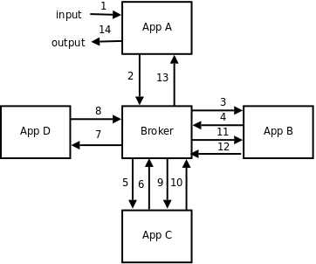
Broker
Architecture of most messaging systems is distinctive by the messaging server ("broker") in the middle.
Every application is connected to the central broker.
No application is speaking directly to the other application. All the communication is passed through the broker.

Slide 31
Advantages
Applications don't have to have any idea about location of other applications. The only address they need is the network address of the broker.
Message sender and message receiver lifetimes don't have to overlap. Sender application can push messages to the broker and terminate. The messages will be available for the receiver application any time later.
Broker model is to some extent resistant to the application failure. So, if the application is buggy and prone to failure, the messages that are already in the broker will be retained even if the application fails.

Slide 32
Drawbacks
It requires excessive amount of network communication.
The fact that all the messages have to be passed through the broker can result in broker turning out to be the bottleneck of the whole system.

Slide 33
Broker pattern
pipelined fashion
service-oriented architectures (SOA)

Slide 34
Examples of No Broker model in ZeroMQ
No Broker
Broker as a Directory Service

Slide 35
More Models
Distributed directory service
Distributed broker

Slide 36
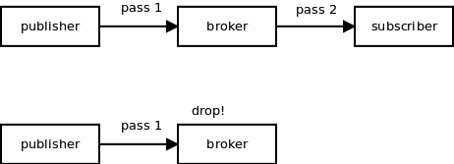
PUB/SUB (publish/subscribe)
In most broker-based systems consumers subscribe for messages with the broker, however, there's no way for broker to subscribe for messages with the publisher. So, even if there is no consumer interested in the message it is still passed from the publisher to the broker, just to be dropped there

Slide 37
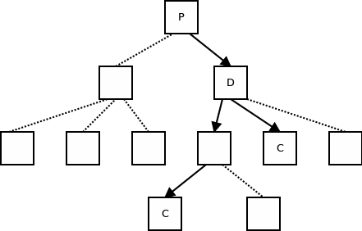
Messages should travel only through those lattices in the message distribution tree that lead to consumers interested in the message

Slide 38
Subscription Forwarding
XPUB is similar to a PUB socket, except that you can receive messages from it. The messages you receive are the subscriptions traveling upstream.
XSUB is similar to SUB except that you subscribe by sending a subscription message to it.
Subscription messages are composed of a single byte, 0 for un-subscription and 1 for subscription

