Slide 1
Online Tracking Overview & Triplet Finder Status
Marius C. Mertens^{1,2}
Sean Dobbs³, Jim Ritman¹, Peter Wintz¹
¹ Forschungszentrum Jülich
² Justus-Liebig-Universität Gießen
³ Northwestern University, Evanston

Slide 2
Outline
Continuous Online Tracking Overview
Online Manager Status (Sean Dobbs)
Triplet Finder Status
Key Topics for Future Investigations

Slide 3
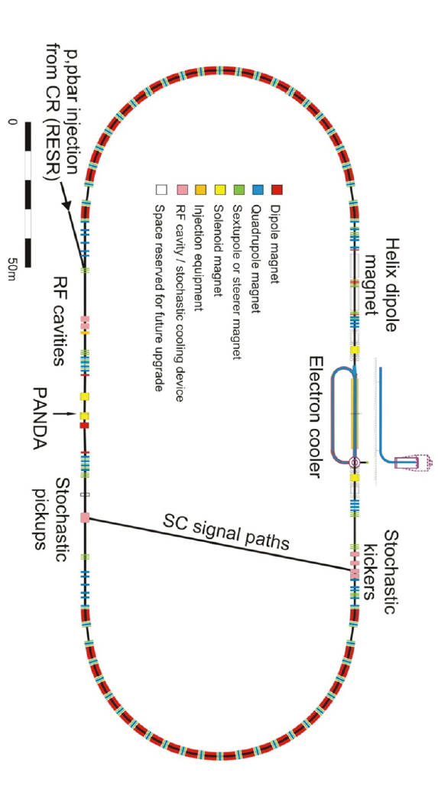
PANDA Operating Conditions
Gap estimate:
Barrier Bucket: 80% Filling
HESR length: 575 m
Antiproton velocity: c
Revolution time: 2000 ns
Gap: 400 ns
Fill/Gap ratio may vary
Events per revolution → Burst:
2·10⁷/s·2 µs = 40

Slide 4
Continuous Online Tracking: Motivation/Concept
Similar topology of signal and background → No simple criteria with high suppression potential
Quasi-continuous high-rate operation of PANDA → Overlapping events, stateless pattern recognition started upon simple criteria may process redundant time windows
Most channel selections require tracking information

Slide 5
Continuous Online Tracking
Detector Hits/Digis
Triplet Finder
Hough Transform
…
Local Clustering
Calibration
Alignment
…
STT Tracking
Global Tracking
Online Tracking
Information Merging:
PID, etc
Tracks
Software Trigger

Slide 6
Online Manager Status
New/faster interface to simulation data implemented
Fully operational for algorithm testing → Triplet Finder benchmarks
Under construction:
Output to ROOT tree
Event reconstruction
Release to public as soon as ROOT file output is implemented
Big thanks to Sean for his developments!

Slide 7
Triplet Finding in Axial Straws
Find Triplets within pivot straws → Calculate center of mass around pivot straw and adjacent straws with hits
Once two Triplets are found, calculate circle through origin
Associate nearby hits with track candidate
Pivot straws
Pivot straws
Interaction Point

Slide 8
Triplet Finder Status
First quantitative test with 15 GeV/c DPM
Full burst processing: 2000 ns
Animated display in finer granularity: 5 ns
Raw data results:
Total reconstructed track count: 100179
Reached MC ID: 5130
Reconstructable MC track count: 10679
MC Tracks reconstructed: 5993
Reco Status Good: 13790
Reco Status Bad: 86389
Secondary Tracks: 475
Results:
> 50% reconstruction efficiency
Δφ: < 100 mrad
Δp_{t}: < 10% (below 450 MeV/c)

Slide 9
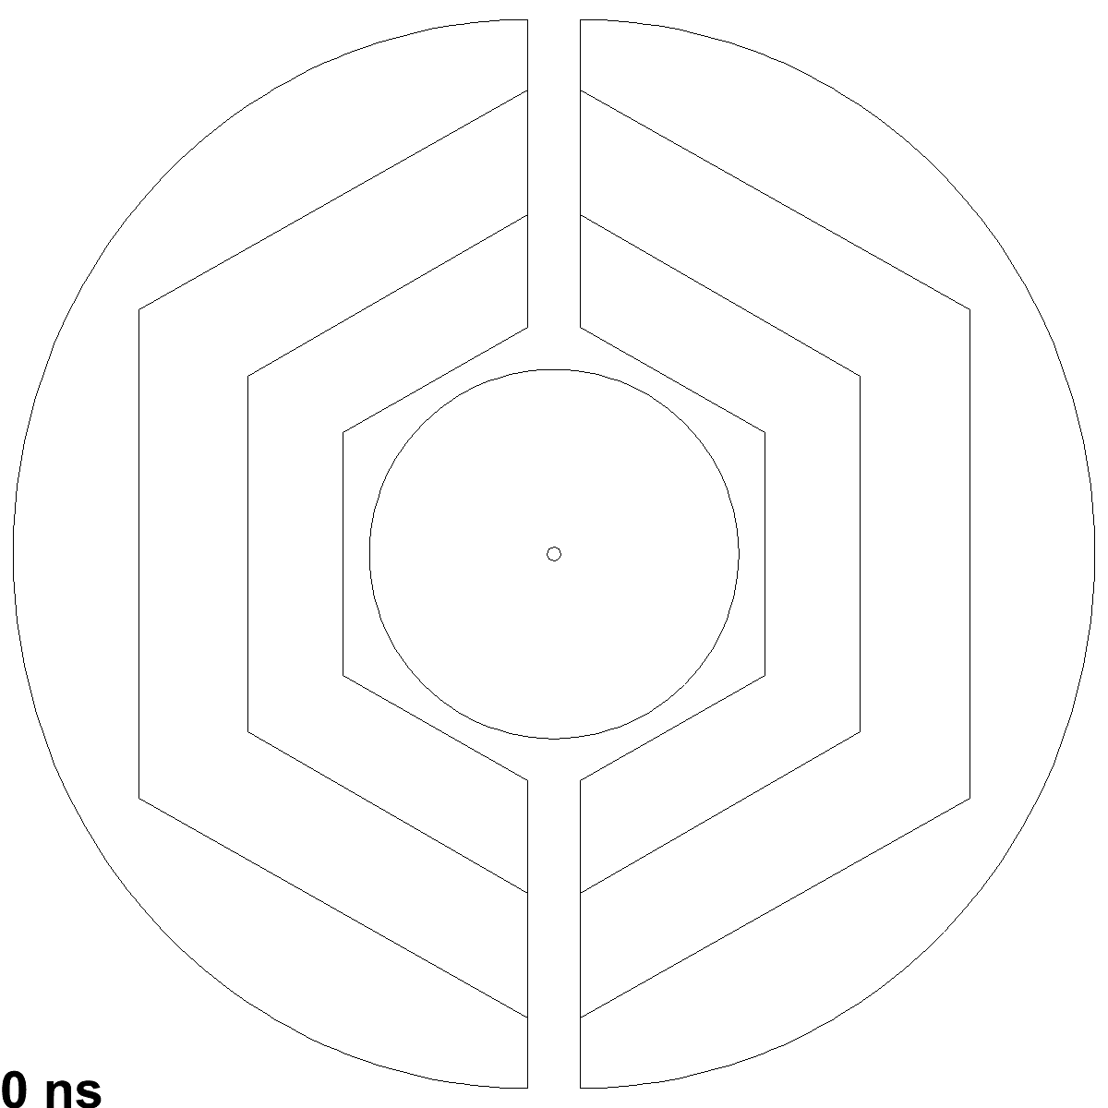
Hitstream Display: 15 GeV/c DPM, 50 ns Mean Time
XY-View
Dual Parton Model (DPM): Standard pp background generator
Black circles: Early isochrone
Blue circles: Early skewed isochrone
Green circles: Close isochrone
Red circles: Late isochrone
Black dots: MVD hits
Green dots: MVD hits r/z > 0.3
Black+Red dots: Triplets/Skewlets
Yellow tracks: Vetoed
Blue tracks: Accepted
DPM Benchmark: > 50% of primary tracks in the STT reconstructed by basic triplet finder

Slide 10
Triplet Finder Status
t₀ constraining concept for Triplets and tracks:
Pivot straws
t₁
t₃
t₂
220 ns

Slide 11
Future Investigations: Fit/Finder Quality
Association of hits to tracks → Design questions
Ideal storage for these associations?
Desired parameters to store?
Override old values? Store list?
Parameters for assigned hits/tracks:
Unassigned
Bad Hit – Clutter, Noise, etc.
Low Quality – veto value close to threshold
Mid Quality
High Quality – additional quality criterion passed
Multi Algorithm Confirmed Quality

Slide 12
More (Online) Tracking Algorithms
Algorithm | Comments
Hough Transform, Yutie Liang | FPGA implementation
Hough Transform, Mohammad Al-Turany/Andreas Herten | GPU implementation
Non-Origin Trackfinder, Lia Lavezzi | Focused on offline, online application(?)
Triplet Finder, MCM | No isochrone info required
Track Segment Finder + Linker, Sean Dobbs | Template based
Fast Combinatorial Finder / Fitter, Sean Dobbs | Based on CLEO‘s SOLO
Forward Hough, Martin Galuska | Focused on offline, applicable for online
Riemann Tracker, Tobias Stockmanns | Focused on offline, online application(?)
Global Tracking in PandaRoot, Gianluigi Boca | Focused on offline
Neural networks pattern reco, Pablo Genova | Focused on offline, applicable for online
Rieman Tracker, Andreas Herten | GPU implementation
Other developments?

Slide 13
Summary/Outlook
Online Manager: Implementation of canonical ROOT interface
Quantitative Triplet Finder benchmark (DPM): > 50% reconstructed tracks
Outlook
Development of track finder quality bookkeeping
Currently missed tracks:
Characteristics need to be investigated
Triplet Finder adaptions
Additional algorithms for reconstruction
Triplet finder resolution:
Enough for certain selections?
Other algorithms with higher resolution at momenta > 450 Mev/c?
Thank you for your attention

