Slide 1
Status of the Yoke Interfaces
Presented by Evgeny Koshurnikov
February 2013

Slide 2
List of interface problems to be finalized for the technical specifications
Solenoid coil tolerances v.r.t. the yoke
Attachment of the cryostat to the yoke:
positions (coordinates) of the support points
engineering design of the attachment units (part of the unit connected to the yoke)
estimates of maximal loads (components of force and momentum) acting on the attachment units
Engineering design of the attachment units, loads on them (components of force and momentum) and their geometrical characteristics for fixation to the yoke:
target production system
target dump (also shape and dimensions of the recess for it in the lower barrel beam)
forward EMC and disc DIRC (information taken from presentation by H.Löhner, 2009)
backward EMC (possible interference with the door and its rails)
cryogenic system on top of the magnet (chimney, bucket)
Additional equipment attached to the magnet from outside (fixation points, masses, possible loads and acceptable deformations):
on the upper barrel beam (pumps, …?)
on the lower barrel beam (optical system for the target dump control, …?)
at the magnet side, on the platform (boxes with electronics, …?) – possible interference with the support frame that includes outer inclined beams
muon filter – distance to the upstream magnet end cap, possibility of door opening: access to the units of the door halves fixation to each other is necessary
Final positions, shape and dimensions of recesses in the yoke for the cable passages
Limitations for the yoke parts displacements???

Slide 3
Interface with disc EMC
requested mounting plates in solenoid
ca. 250x200x25 mm

Slide 4
Position of EMC for mechanical computations

Slide 5
Vertical deflection of the W1L1 plate under weight of the calorimeter

Slide 6
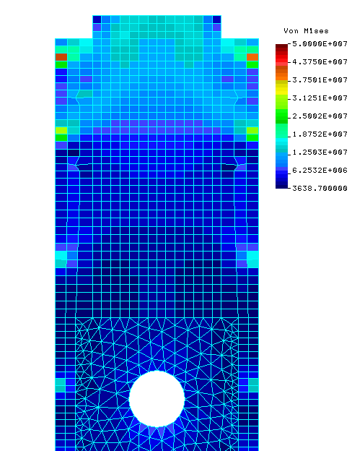
Equivalent stress for the barrel beam plate W1 L1

Slide 7
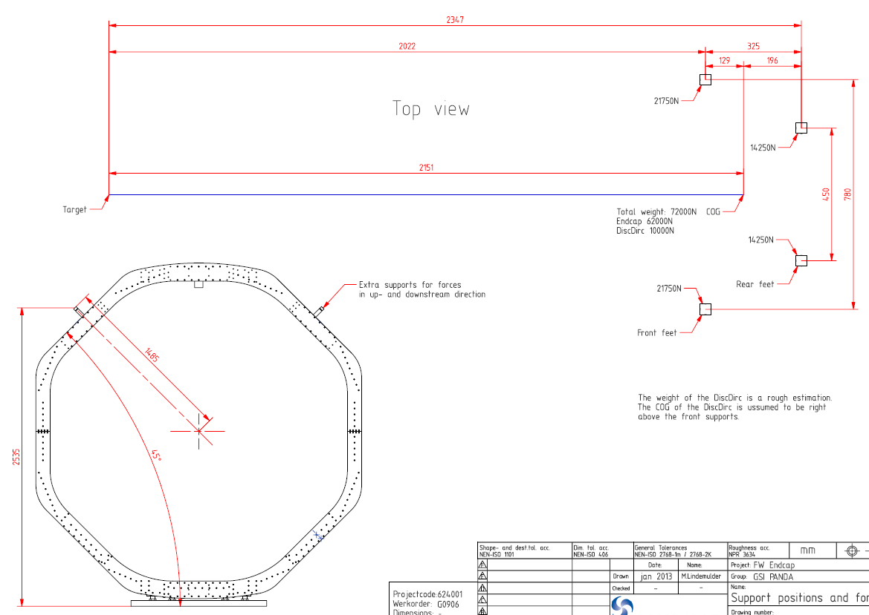
Interface with disc EMC

Slide 8
Interfaces with target

Slide 9
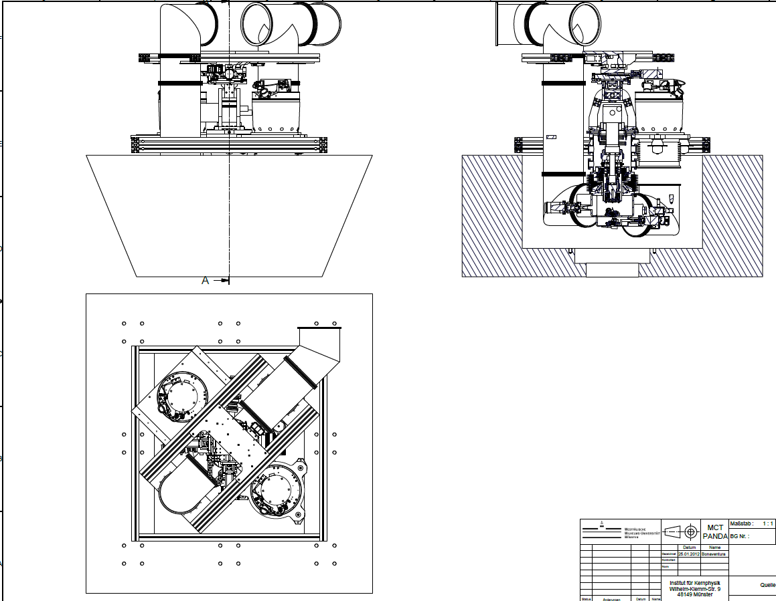
Drawing for the attachment of the Cluster-jet target source of 26.01.12

Slide 10
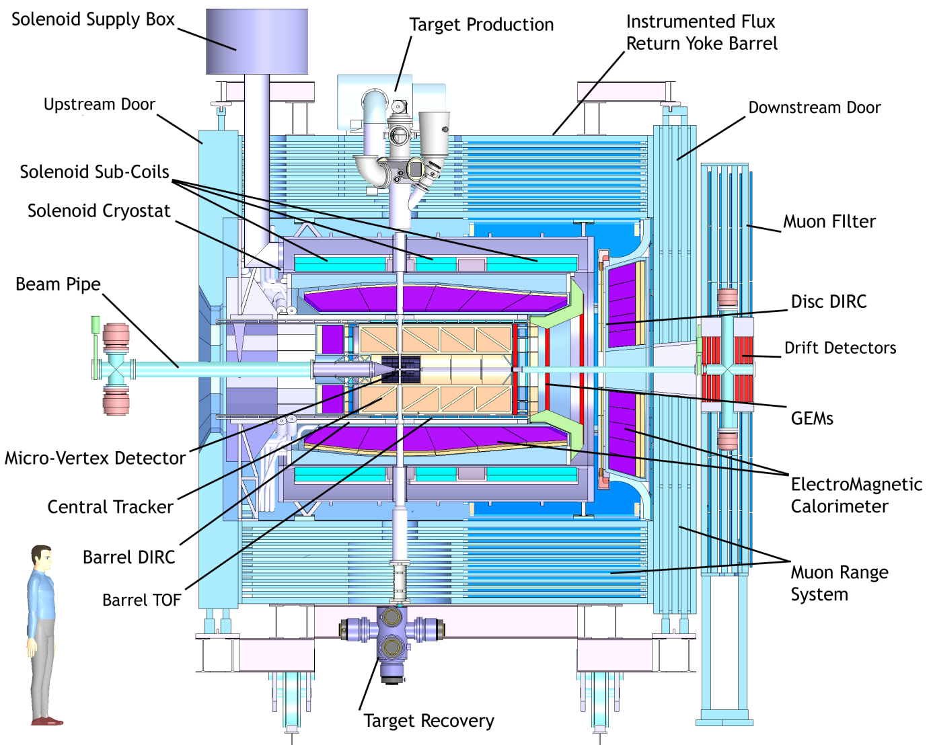
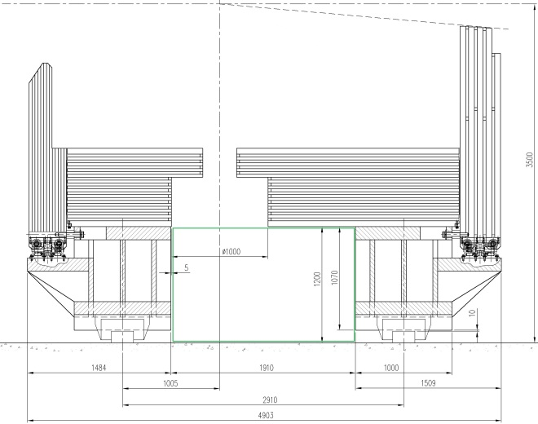
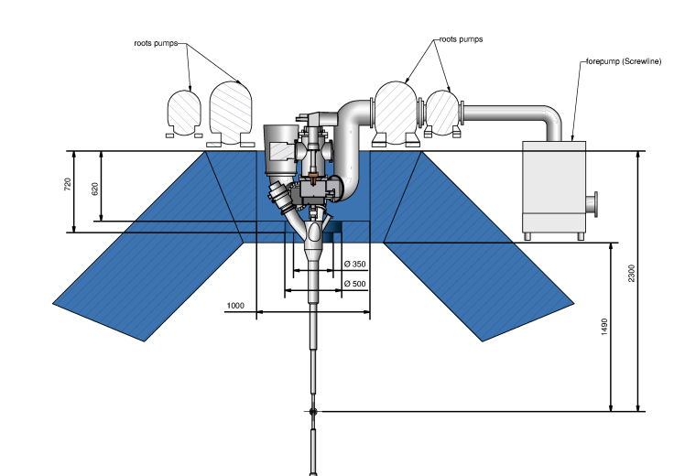
Target/Magnet Interface

Slide 11
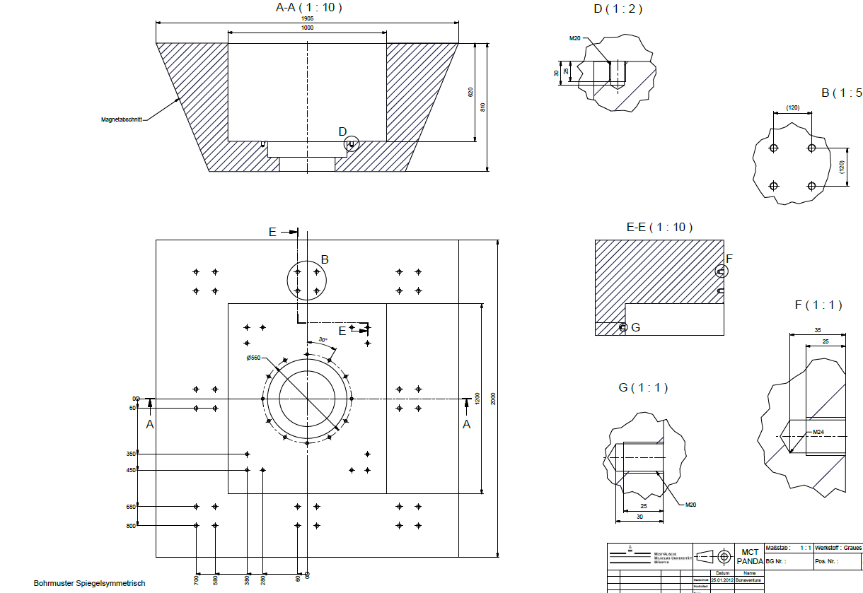
Drawing for the attachment of the Cluster-jet target source of 26.01.12

Slide 12
H.Orth questions about the target
Dear Andrea,
last week I discussed the mounting of target equipment with the magnet group in Dubna while I was there. This belongs to the many interfaces with the magnet.
From Alfons I received some drawings how to mount the cluster-jet source on the top of the yoke. The equivalent problem arises for the target dump. The urgent question there is the size of the recess in the yoke, since A. Makarov from Dubna is redoing all the stress calculation for the yoke again and wants to have the important structural details for his model. I made this recess now quadratic 1m^2 and the same depth like for the source.
Could you look into the details if this is sufficient for the pellet tracking and the aditional pumps which Hans Calen was asking for?

Slide 13
H.Orth questions about the target
Dear Alex,
ad 1). The distance between the support beam and the bottom recess is serious since i do not see the possibility of a cut-out in the beam. On the other hand I would propose to make the bottom hole also square (1x1 m) and not circular. In his way the 25 mm distance are only in a small angular range of say about 1 radian. The length of the bottom hole with diam. 350 can be changed to 190 mm if this is really necessary .
ad 2) The change of the hights of the holes comes due to the 'digitization' of the yoke thickness in laminating the iron. I assume these differences won't matter. The overall length of the target pipes can be adapted. I do not see a change in positioning the target source. The exact length of the target pipe cannot be fixed now anyway.
Please clearify the things with respect to the pellet requirements.
I will look at the Genova dump for making sure that the cluster requirements can be met.

Slide 15
Interface with muon panels
Clearance allowance for the yoke beams slots
Because of magnet deformity under action of loads +/-1 mm
Because of steel plates processing and beam welding +/-2 mm
All slots have to be controlled by go and no-go gages

Slide 16
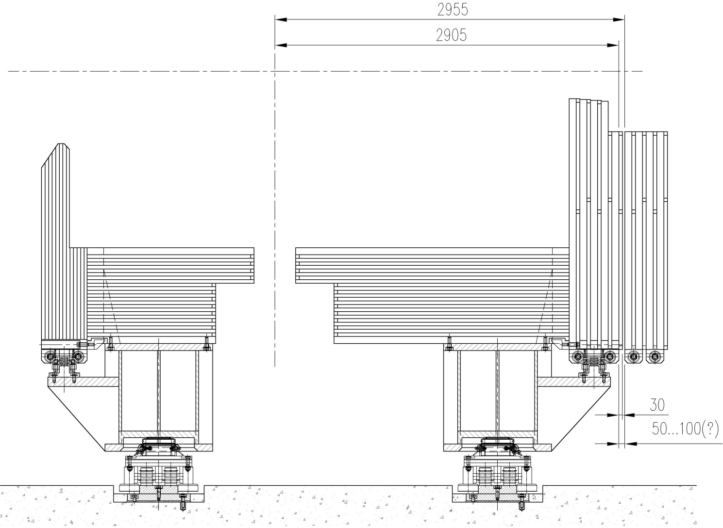
Interface with muon filter
It takes to extract the muon filter to open the door
The filter supports are not connected with the magnet
Muon filter

Slide 17
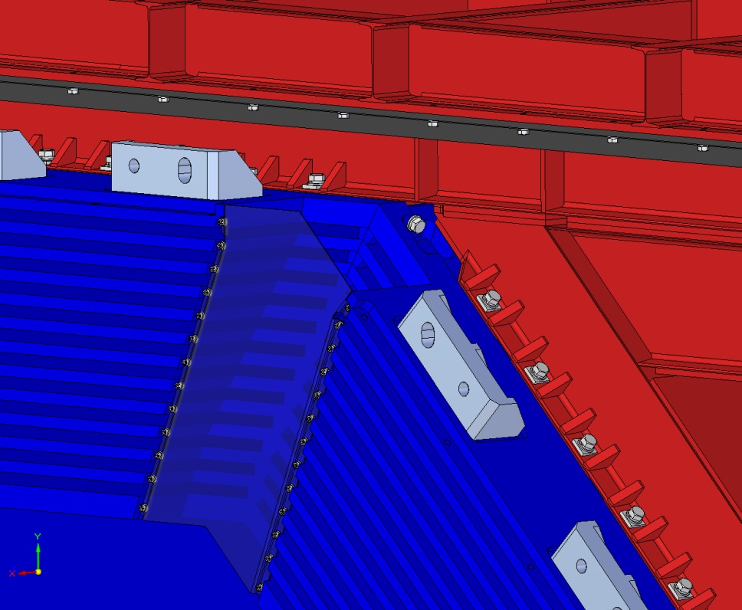
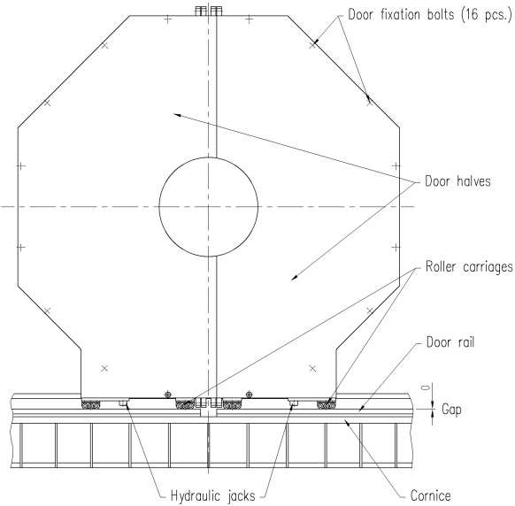

Slide 18
Yoke/Cryostat Interface

Slide 19
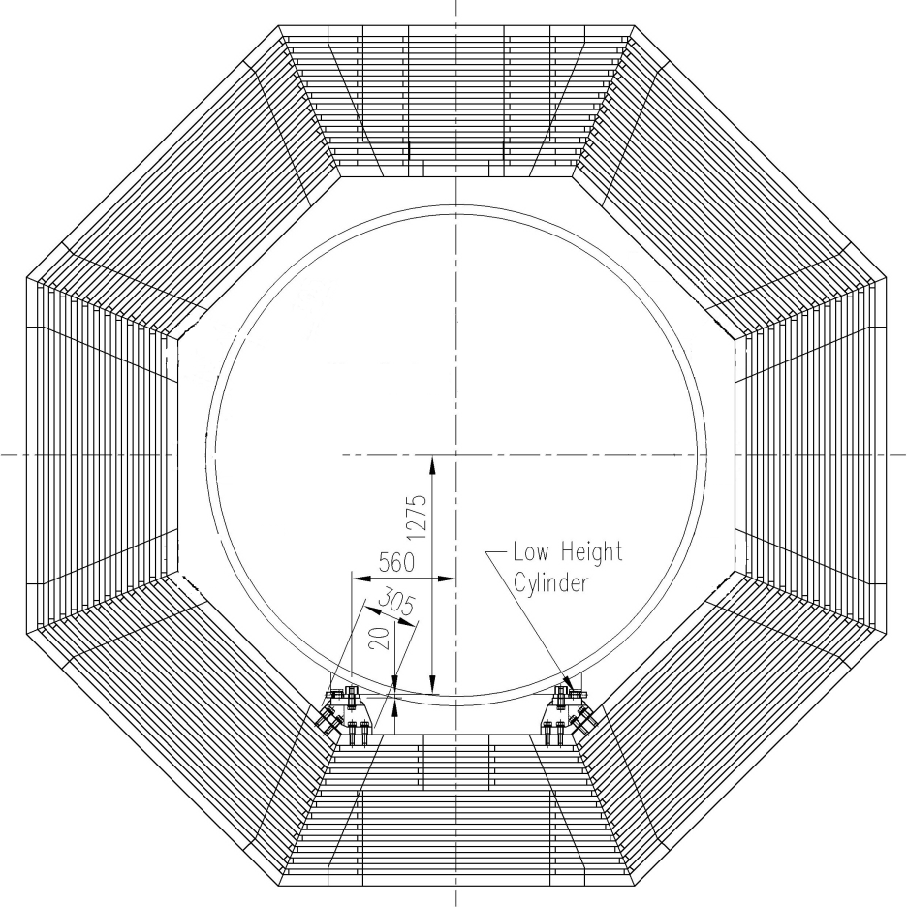
Cryostat fixation options
Option 1.
Option 2.

Slide 20
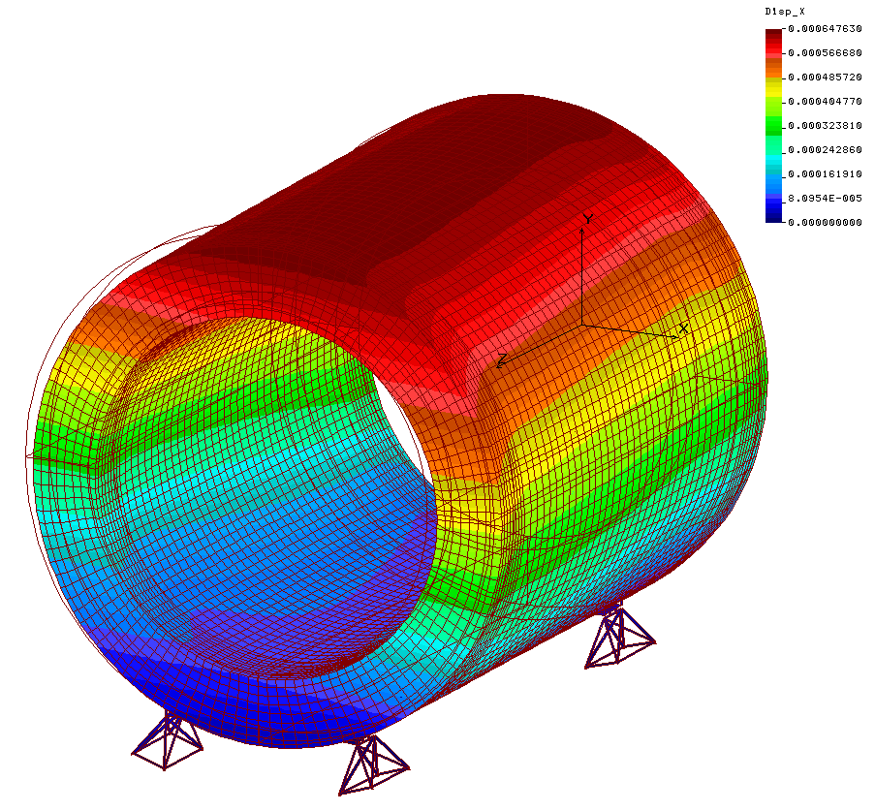
Cryostat deformity under action of magnetic forces Fx=45kN + Fz=140kN
Cryostat Support Option 1
Deformity in X direction
Deformity in Y direction
0.64
0.22
0.65
-0.18
0.23
-0.07
0.41
0.44
0.3
0.41
0.12
-0.41
0.03
0.13
0.04
-0.09
Δαmax = 0.137 mrad < [0.3 ] mrad

Slide 21
Cryostat deformity under action of magnetic forces Fx=45kN + Fz=140kN
Deformity in Y direction
Cryostat Support Option 2
0.18
-0.02
0.11
0.02
0.14
-0.01
Δαmax = 0.07 mrad
0.05
0.03

Slide 22
Cryostat adjustment in the yoke aperture
To choose a method of cryostat adjustment in yoke aperture in the process of magnet commissioning it takes a description of this procedure.
The means for adjustment occupies the space and weakens the fixation units.

Slide 23
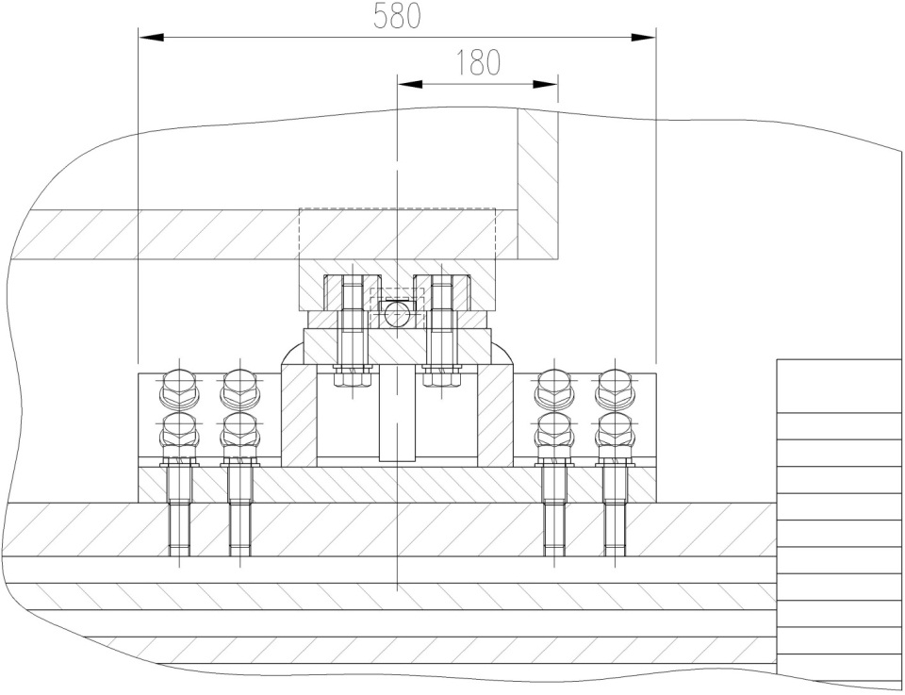
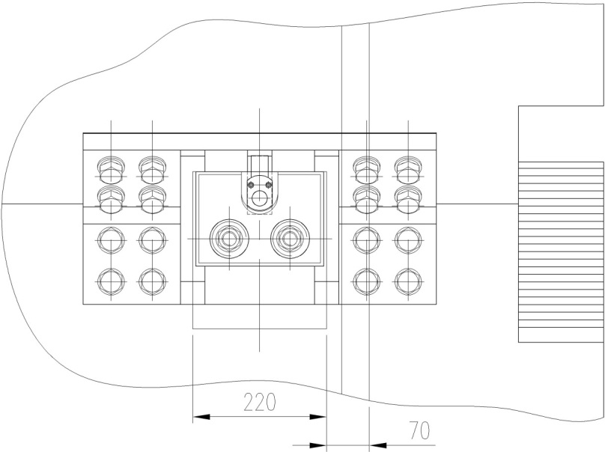
Vertical adjustment of the cryostat
Hydraulic jack
Shim
The slot for the hydraulic jack

Slide 24
Equivalent stresses in the upper plate of the support unit
σ=134 MPa<[σ]=212 MPa

Slide 25
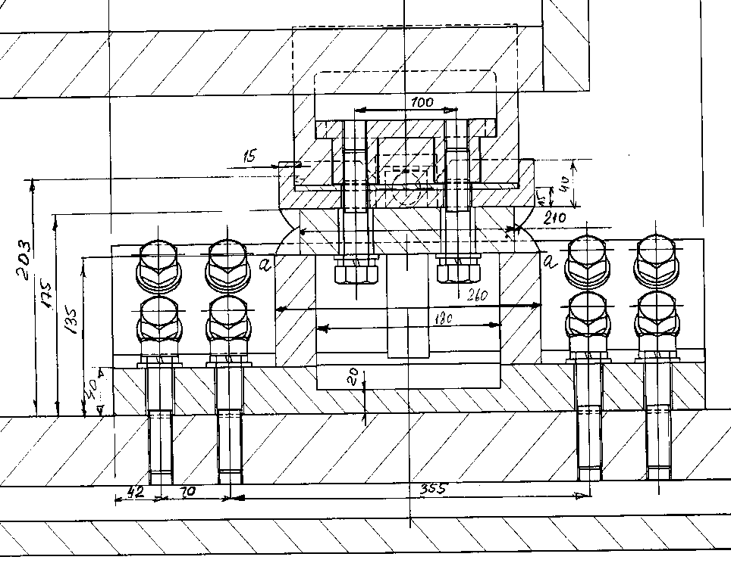
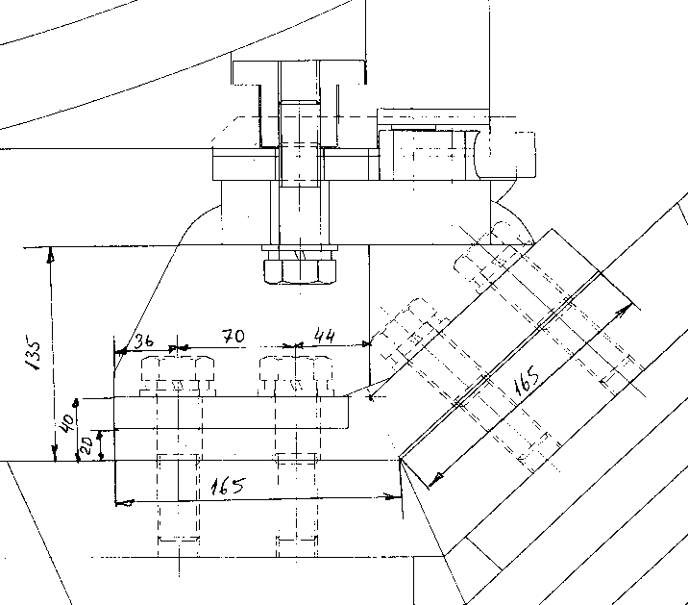
Welded Caps for Adjustment of the Cryostat in the Horizontal Plane
Adjusting cap
Welding seams

Slide 26
Reactions in Cryostat supports
Maximal reactions in cryostat supports (option 1)
Vertical Ry=-151kN/+47kN
Axial Rz=70kN
Lateral Rx=27kN
Maximal reactions in cryostat supports (option 2)
Vertical Ry=-105kN
Axial Rz=74kN
Lateral Rx=46kN
For option 1 as design load combination agreed following one:
F_{y}= 47.7 kN, F_{z}=±70 kN, F_{x}=±26.5 kN

Slide 27
Required structural improvements
The following design improvements have to be performed to ensure the strength of the cryostat supports:
Addition of weld seams between the top plate and the vertical walls (or set the braces to the vertical walls).
Ensuring weld penetration in the seams between the vertical walls and base plates.
Increase the thickness of the “cup” edge up to 20 mm

Slide 28
Octagon Shape Hole in the Downstream Door - Influence on the Force Balance
 | Axial force (kN)
 | Current option of the door shape | Octagon hole shape
Upstream door | 870 | 868
Downstream door | -772 | -745
Coil | -42 | -73
Initial hole dimensions 920x920 mm² (equivalent radius = 367 mm)
Octagon shape a=480mm (equivalent radius = 472 mm)

Slide 29
THANK YOU FOR YOUR ATTENTION!

