Slide 1
Proposal on the production of superconducting cable in Europe
A.Vodopyanov
JINR, Dubna
PANDA Magnet Coordination Meeting
GSI, Darmstadt, 7-8.02.2013

Slide 2
Selected SP cable producers
CELLO SACLEY
BESIII FURUKAWA Ltd.
CDF HITACHI Ltd.
DELPHI RAL
ALEPH SACLEY
CLEO II OXFORD INSTRUMENTS
ATLAS SOLENOID HITACHI Ltd.
ATLAS TOROIDS CERN+NEXAN (SWISS)

Slide 3
CERN participation in SP cable procurement
CERN teams took part in the procurement of the superconducting cables for ATLAS toroid magnets (Herman Ten Kate) and CMS (Benoit Cure);
Two my colleagues from JINR have now contracts at CERN:
Nikolay Zimin (ATLAS Magnet Group)
Vladimir Datskov (MSC – Magnets, Superconductors and Cryostats Group);
Herman Ten Kate is the Head of ATLAS Magnet Group and he is willing to help with SP cable for PANDA;
Alexey Dudarev from CERN PH might take part in this effort as well;

Slide 4
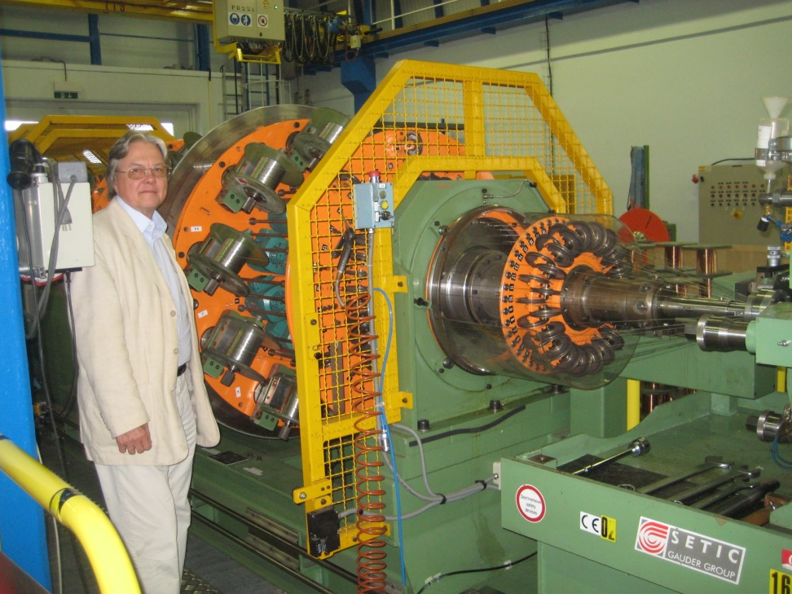
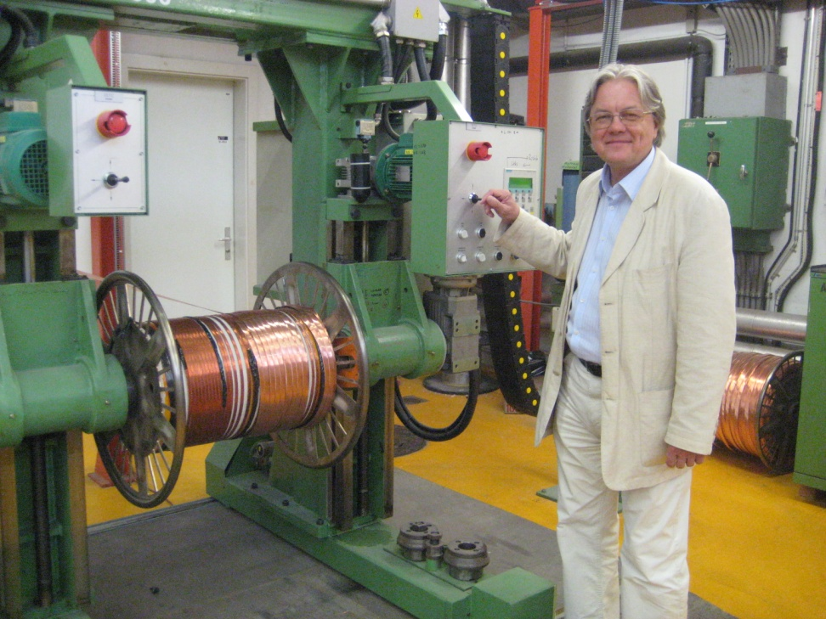
CERN Facility to twist superconducting cables

Slide 5
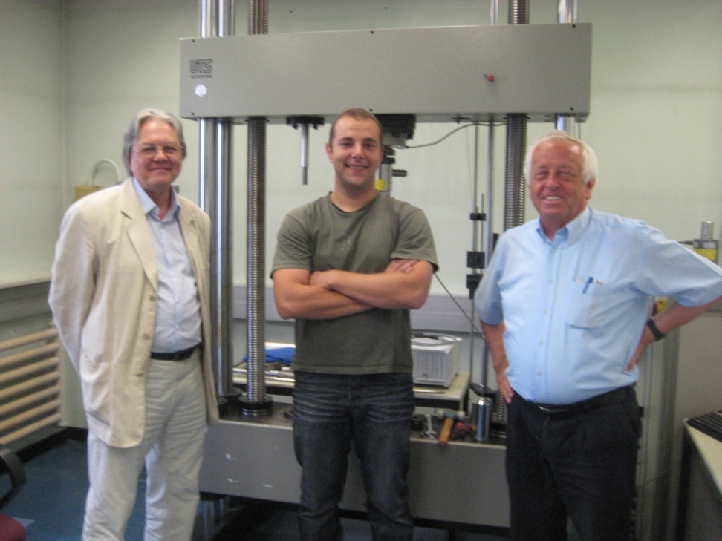
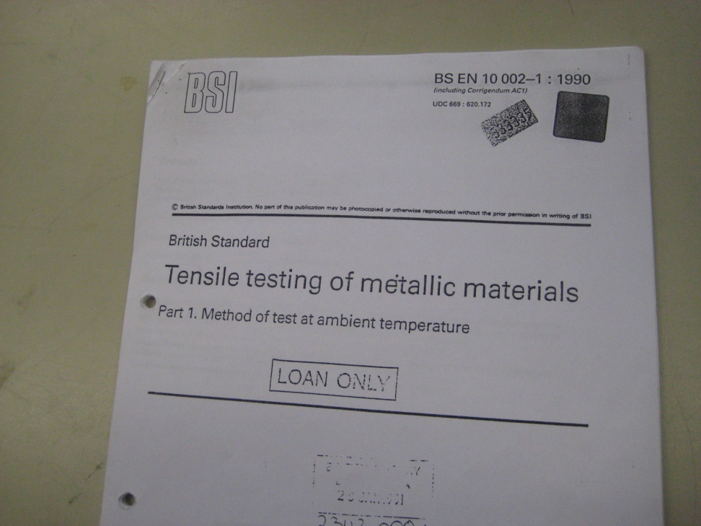
CERN Tensile test machine

