Slide 1
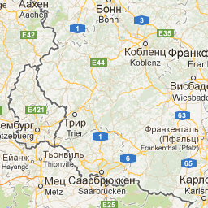
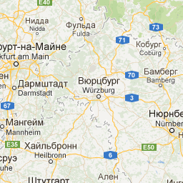
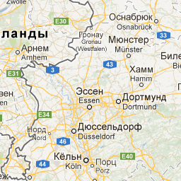
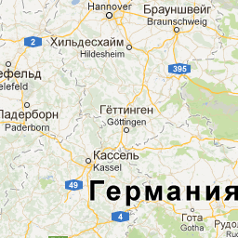
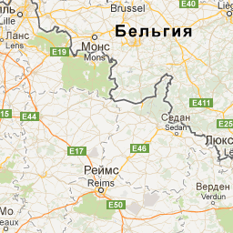
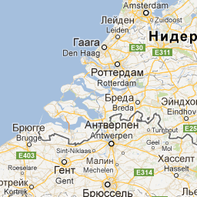
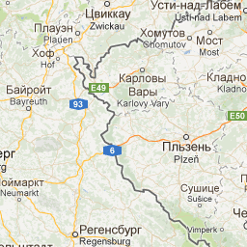
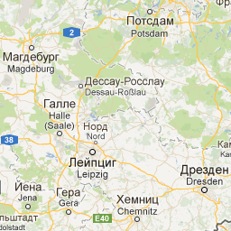
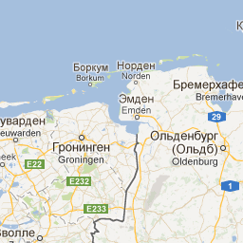
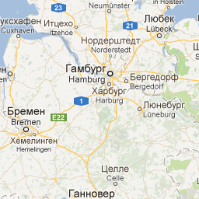
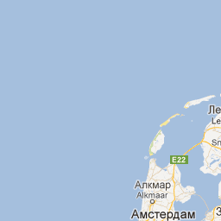
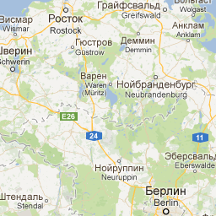
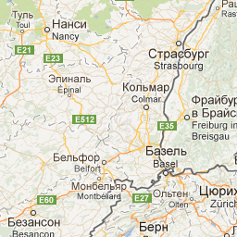
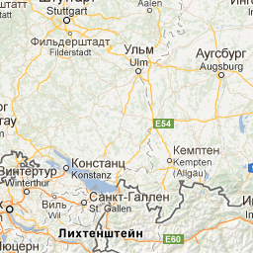
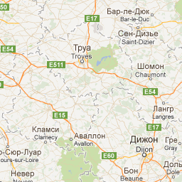
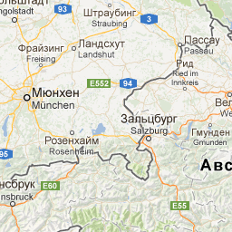
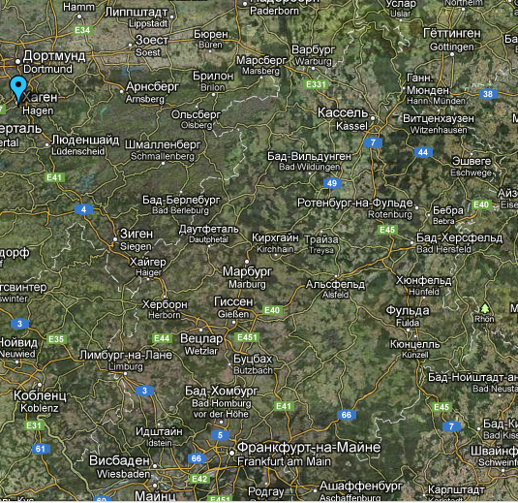
Visit to Börkey GmbH February 05, 2013 (Resume of discussions)
Presented by Evgeny Koshurnikov
Hagen-Vorhalle
(250 km Nord-West from Darmstadt)

Slide 2
Participations of the meeting at the Borkey place
GSI & JINR
H.Orth, J Luehning, C.Kindziore & A.Vodopianov,
E.Koshurnikov
Boerkey GmbH
Christian, Jeanne, Thomas and Walter Boerkey and J. Augustin

Slide 3
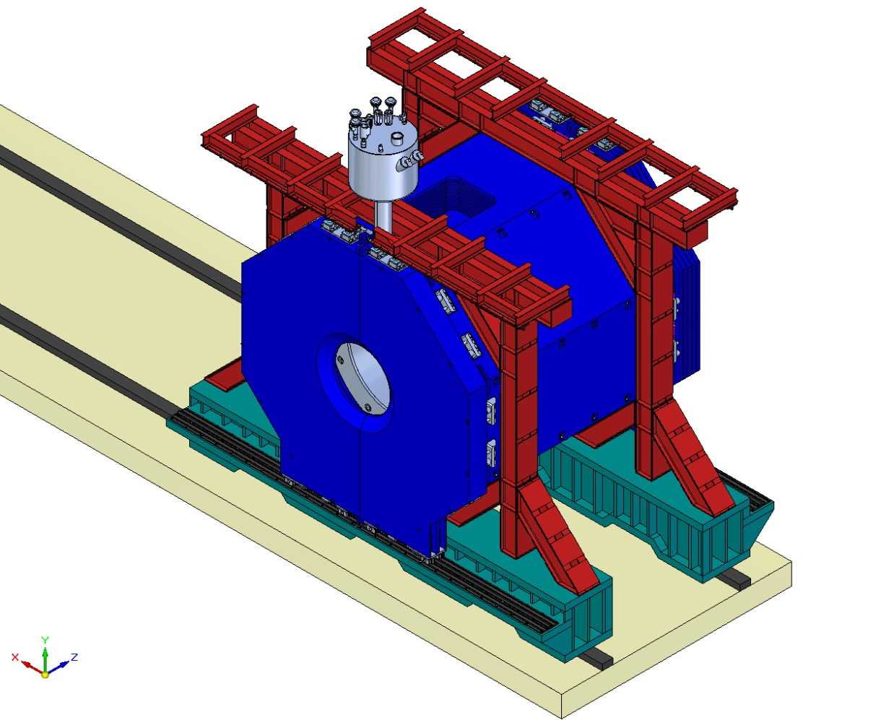
PANDA Magnet - the Object to be moved on Roller Skates
The magnet will be moved forth and back to ~15 meter about 2 times per year within 15 years (in all about 30 runs)
Width 4903 mm
Length 7930 mm
Height 6330 mm
Weight 3300 kN

Slide 4
Question to be answered
Footprints of the platform beams are tilted relative the horizontal plane under action of weight loads in the area of contacts with roller skates. It takes to understand weather we need special means to mate platform footprint and roller skate (elastic pads for example)
Some of four magnet roller skates have to be supplied with cam followers. It takes to specify their optimal number and positions

Slide 5
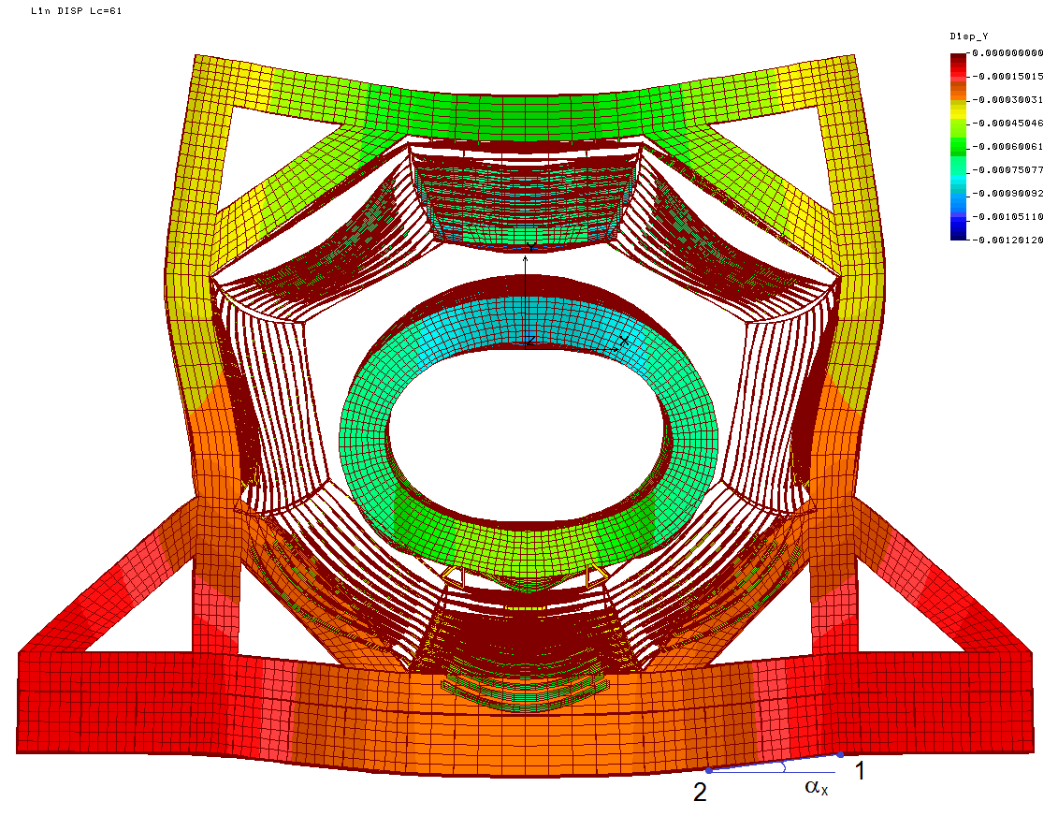
Footprint inclination in plane XY
Δy₁ = -1.147 ∙ 10⁻⁴ m
Δy₂ = -2.224 ∙ 10⁻⁴ m
x₁ – x₂ = 1.0499 m
tg α_{x} = (Δ y₁ - Δ y₂) / (x₁ – x₂)
α_{x} = 0.103 mrad

Slide 6
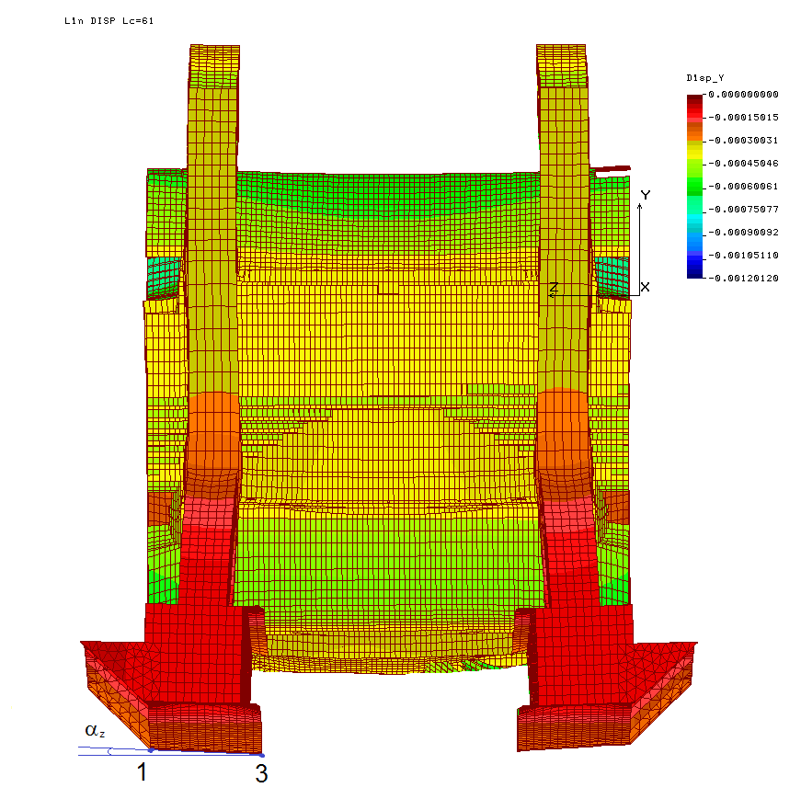
Footprint inclination in plane YZ
Δy₁ = -1.147 ∙ 10⁻⁴ m
Δ y₃ = -1.342 ∙ 10⁻⁴ m
z₃ – z₁ = 0.910 m
tg α_{z} = (Δ y₁ - Δ y₃) / (z₃ – z₁)
α_{z} = 0.0214 mrad

Slide 7
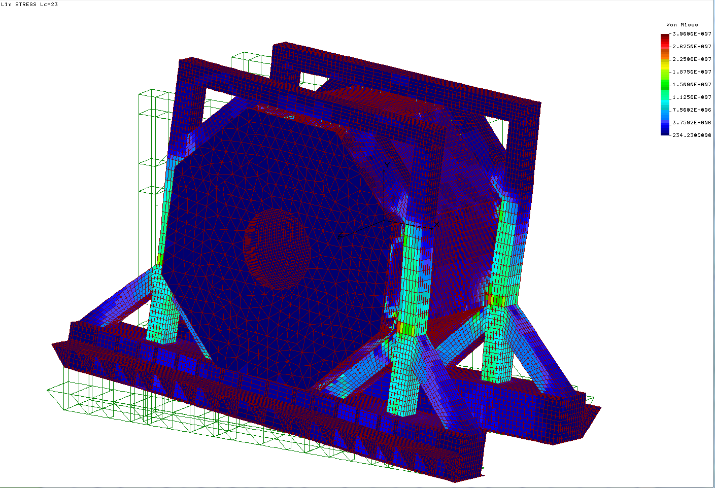
Deviations of Vertical Reactions in the Magnet Supports
Smooth way | Run into an elevation +1mm by a support S11
R_{s11}=834 kN; R_{s12}=834 kN; R_{s21}=822 kN R_{s22}=822 kN | R_{s11}=1221 kN; R_{s12}=447 kN; R_{s21}=435 kN R_{s22}=1209 kN
Roller skate S11 runs onto an unevenness +1 mm on the track
Vertical stiffness of the support
C=225÷387 kN/mm
(depend on the rigidity of the door
fixation to the barrel)

Slide 8
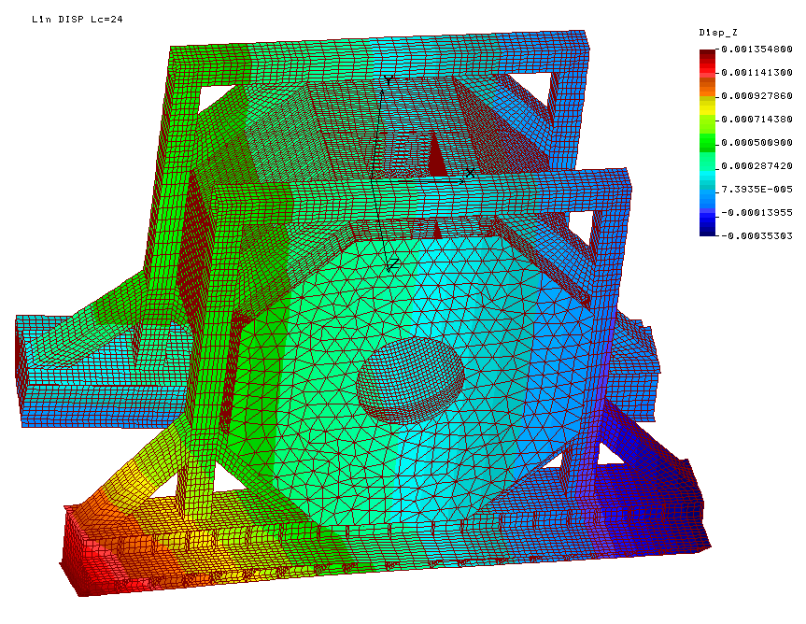
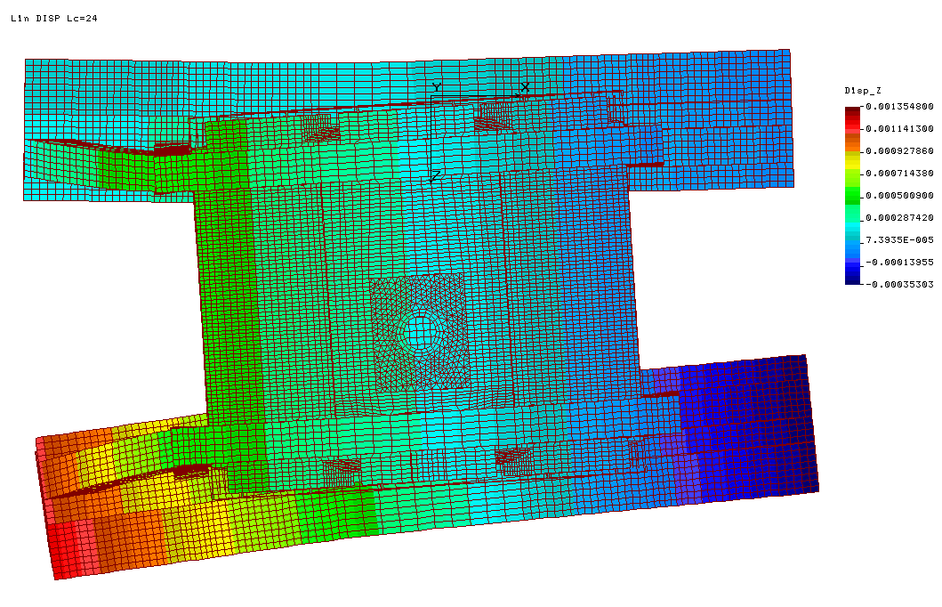
Divergence of moving directions of skates as an origin of lateral load application to the platform beams
Top view
Fz
According to the design constraints the platform beam ends can’t be tightly linked
Lateral force applied to the platform beams

Slide 9
Lateral stiffness of the platform
Option 1:
ΔZ₁₁= ΔZ₁₂ = 1 mm
C = c₁₁ = c₁₂= 152 kN/mm
Option 2:
ΔZ₁₁= 1 mm
c₁₁ = 143 kN/mm;
c₁₂ =-2860 kN/mm.
C – lateral stiffness

Slide 10
Lateral Separation of the Platform Beams
Allowable separation of the platform beams is ±1mm. It corresponds to the safety margin of the yoke units η=1.2
X
F_{friction}
F_{x}
Rail
α
Roller skate
F_{z}
F
R – reaction in the support
C – lateral stiffness of the platform
Maximal vertical support load 1220 kN
C = 143 kN/mm
Maximal separation of the platform beams before rollers starts slipping:
Z_{max}= k_{friction} R/C = 0.1 ∙ 1220 /143 = 0.85 mm
F_{z} = ΔX∙C ∙ tang(α)
F_{z} = F_{friction} = k_{friction} ∙ R
X

Slide 11
Can we avoid excessive separation of the platform beams?
What is the friction factor for the Boerkey roller/rail pairs in lateral direction?
Can be ensured its value for the entire period of magnet operation?
What should be provided for this purpose?

Slide 12
Roller Skates for the Magnet Doors
The magnet doors slide apart on roller skates (two rollers per a door wing, total number of the door roller skates for magnet 8 pcs).
Platform cornices are supplied by rails for roller skates
Weight of a door wing - 25 ton.
It takes to choose a roller skates type and rail dimension

Slide 13
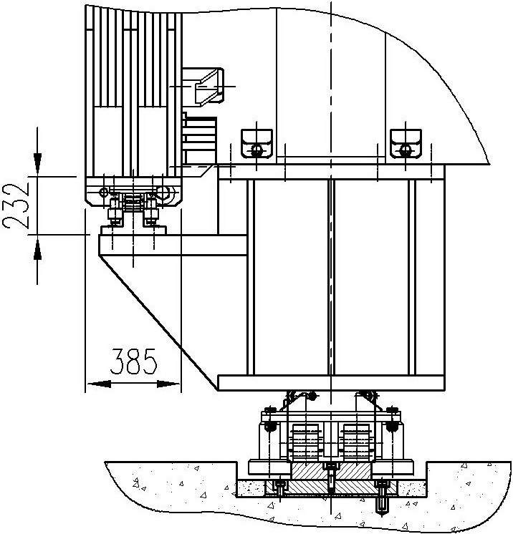
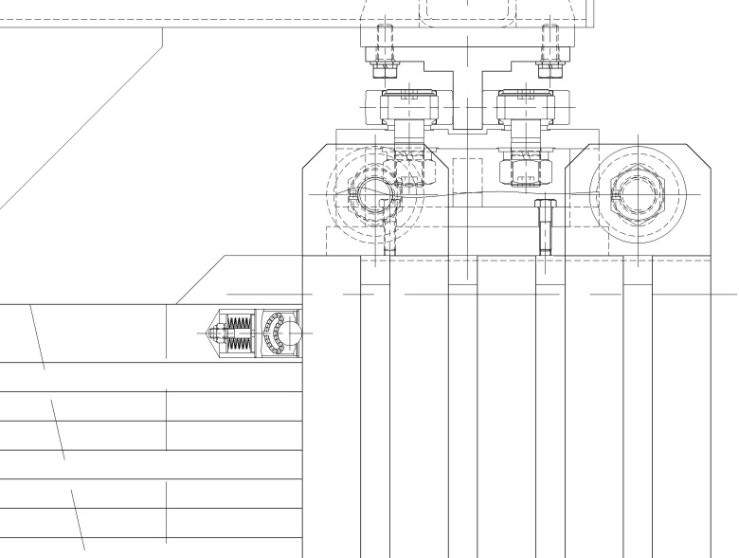
Rollers for the Magnet Doors
Ball bearing guiding of the door

Slide 14
The transport position of the doors
Is contact loss of the roller chains and rail surface permissible?

Slide 15
Initial suggestion of Boerkey
Two rollers AS-H-FR-E Mod. VI (200 tons, 4 guide wheels on one rail)
Two AS-H Mod VI (200 tons , no guide weels on the other rail)
Roller rail: height 60 mm x width 180 mm, surface hardened steel (same yield strength as roller weels) Rail protection in a groove below surface is needed

Slide 17
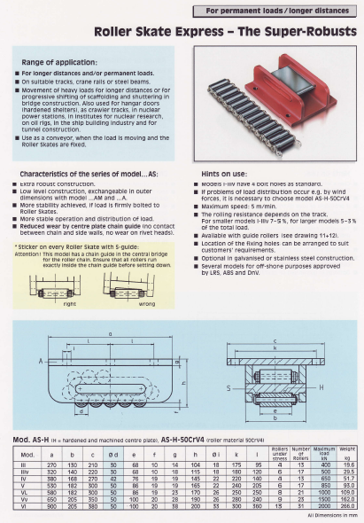

Slide 19
Resume of discussion
We need guidance rollers on one rail only
The elastic pads can be used to compensate the rail track unevenness and tilting of the yoke platform beam footprint
The Boerkey roller skates of AS-H type possess self-regulated characteristics – the straight-line motion of a skate will be kept in spite of a lateral load. Platform beam separation will never been come up 1 mm
Friction factor 0.05 and safety margin 2 has to be applied for hydraulic cylinder of the magnet moving system choice
Guidance rollers play +/- 0.5 mm is enough to provide straight motion of the magnet (this tolerance is required for the magnet adjustment at the beam position as well)

Slide 20
Quality assurance at the factory (first sight)
Management (there are responsible persons for designing, production , procurement)
Personal qualification (welding engineer, engineers, managers, welders, programmers, machine operators, etc)
Previous expertise (ZEUS magnet in DESY, Heavy equipment movement in CERN)
Working place is separated on the zones (material storage, rough cutting, welding, machining, assembly, control operations)
Production partnership - heat treatment (certificated producer)
Input material is stored separately (clearly marked). There is documentation (certificates) for all input materials, including welding wire. Material input control is organized.
Welder has the German certificate . He is able to be certificated in accordance with any requirements.
Machine tools are quite modern ones. (robotized welding machine, multifunction digital processing centers and plasma cutting machine etc)
Output control (control of geometry, magnetic control of weld seams). Control of friction force at customer's request

Slide 21
THANK YOU FOR YOUR ATTENTION! СПАСИБО ЗА ВНИМАНИЕ!

Slide 22
Problems in the Process of the STAR Detector Movement
There were some problems of movement on large capacity Roller truck assemblies of a 1200-ton STAR Detector at Brookhaven Nation Laboratory (USA)

Slide 23
Main Support System
The STAR Detector is a 1200-ton device located at the 6 o’clock intersection region of the RHIC at BNL. This massive nuclear physics detector is cylindrical in shape approx. 26-ft in diameter by 26-ft long. It is moved north and south between assembly building and interaction region in 5-ft. increments using a closed loop servo-hydraulics system and a series of large capacity Hilman Roller truck assemblies.
The STAR Detector shown in the assembly building for maintenance. The detector can be rolled on steel rails imbedded in the concrete floor using two horizontal hydraulic cylinders. Also shown attached to the main detector to the left (south) and right (north) are the 3-story utility platforms also on roller assemblies.

Slide 24
Main Support System
The left photo shows the detector being rolled south from the assembly building into the IR. The hydraulic pump/control unit is the blue unit on the floor between east/west rails.
Hydraulic control unit
The right photo shows a closer view of the north/east area of the main support and horizontal cylinder.
Hilman roller truck assembly with cam follower guides
East horizontal hydraulic piston
East guided rail

Slide 25
Main Support System
This shows a cross section drawing of the east edge of the east guided floor rail plate that has on the east and west edge a pocket in the concrete for cam follower guides mounted to the detector Hilman roller assemblies.

Slide 26
Main Support System
This shows a cross section detail of the west un-guided floor rail plate that runs north and south from assembly building to interaction region.

Slide 27
Main Support System
The details of the main support east cradle is shown below as a side view (left) and end view (right). Hilman roller truck assembly with cam followers is shown bolted and pinned to the main support cradle.

Slide 28
Main Support System
Supplied by Hilman Rollers for mounting to the support cradle, this drawing shows the NE truck assembly with single fixed cam followers on east edge and dual eccentric cam followers on west edge of floor rail.

Slide 29
Main Support System
Since 1999 we have rolled the STAR Detector from the Assembly Building (AB) to the Interaction Region (IR) , 88-ft. (in 5-ft. hydraulic stroke increments), and back out to the AB each year; having rolled twice this year for a total of 16 translations. This year after rolling out into the AB we noticed deformation of the east edge of the east guided rail.
This photo shows the raised east edge of the east rail that measured 0.175-in.
This photo shows the swaging of the east edge of the east rail from vertical.

Slide 30
Main Support System
Over time and translations the detector has shifted to the west approximately 0.5-in, orthogonally to the guided roller north-south direction.
Original east edge of roller imprint on rail.
New east edge of roller imprint on rail.
Start of affect raised rail surface.

Slide 31
Main Support System
The four fixed cam followers on the east edge and their mounting brackets have been deformed and bent away from the rail edge.
Photo shows deformation of cam follower and support bracket that is bolted and pinned to the Hilman truck assembly.

