Slide 1
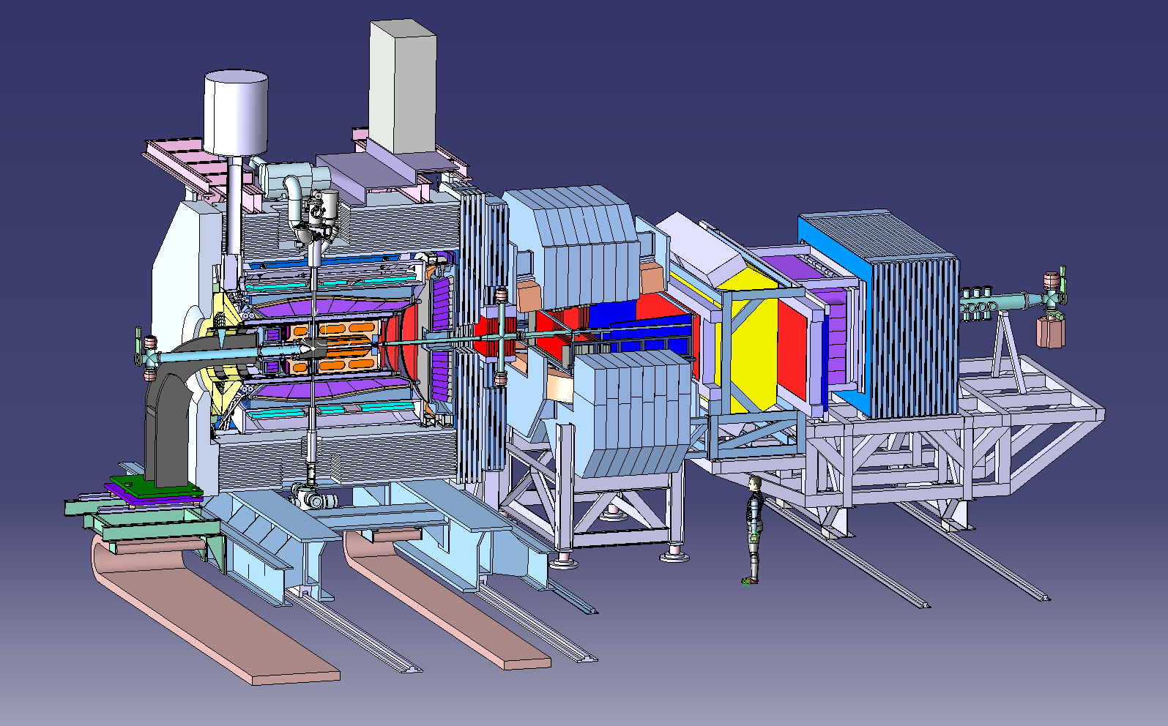
Magnet Coordination Meeting for PANDA Location: GSI, Theory Seminar Romm Date: 7 Feb. 2013 Time: 11.00 - 18:00 h
Darmstadt, 7 February 2013, Herbert Orth

Slide 2
AGENDA
Thursday 7 Feb.:
10:30 coffee
11:00 Status of the Yoke and report on the Strength Analysis, Evgeny Koshurnikov ( 45' )
12:00 Rails of the Panda Target spectrometer, Herbert Orth (10')
12:15 Report from the Visit to Börkey, Evegeny Koshurnikov (20')
13:00 Lunch 60’
14:00 Status of the PANDA Soleniod, Renzo Parodi (15')
14:20 Superconducting cable from Japan, Renzo Parodi, Lars Schmitt (15’
14:40 Proposal for production of superconducting cable in Europe, Alexander Vodopyanov (15')
15:00 Interfaces to the magnet, Herbert Orth (10')
15:15 Yoke-Target Interface, Alexander Täschner, Daniel Bonaventura (20')
15:40 Yoke-Forward EMC interface, Herbert Löhner, Michel Lindemulder (15')
16:00 Coffee break 60' location: cafeteria
17:00 small group meetings
19:00 Workshop dinner at Weisser Schwan, Arheilgen
Friday 8. Feb.:
11:00 Summary talk and next steps.
14:00 Techncal Board Meeting

Slide 3
The PANDA Detector at FAIR
This solenoid needs to be moved
‘Target Spectrometer’

Slide 4
PANDA

Slide 5
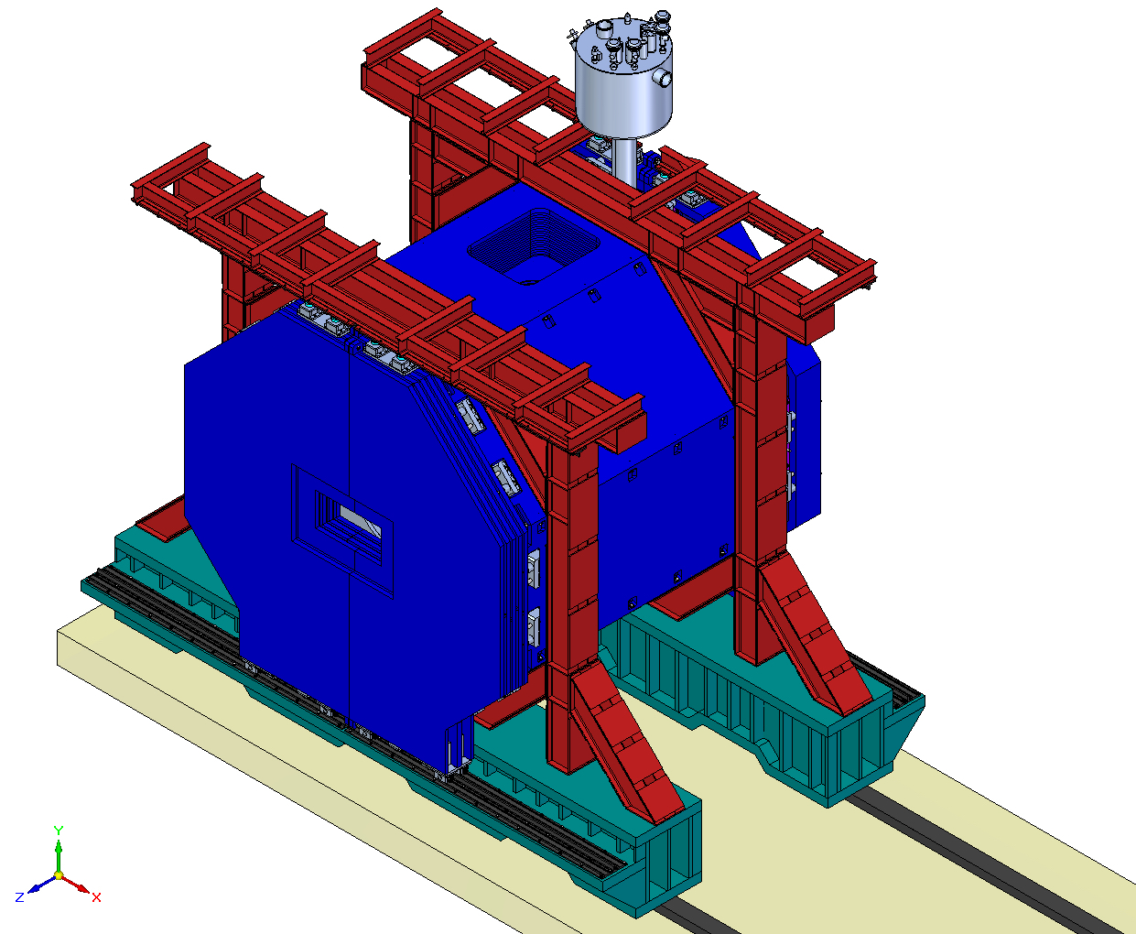
Design of the iron yoke for the Target Spectrometer (appr. 400 tons)
2 rigid beams as structural component of the yoke
Rail system based on Börkey rollers

