Slide 1
Status of the PANDA Magnet Yoke
Presented by E. Koshurnikov
GSI , February 7, 2013

Slide 2
Status of the Magnet Yoke
Yoke strength analysis is completed
Coordination of the main magnet interfaces is at the stage of finalization
We are faced with final corrections of the yoke drawings on the base of computations and interface coordination
Yoke technical specification and test manual are to be prepared
Preliminary discussions with the supposed yoke producers can be started

Slide 3
Yoke Strength Analysis
Initial data preparation
Design model and choice of the load cases
Analysis of the results
Design modifications on the base of analysis

Slide 4
Initial Data
All main dimensions of the yoke FE model are in accordance with CAD model https://edms.cern.ch FAIR Project, PANDA, Magnets, Solenoid yoke ID = 1064509
Cryostat FE model (dimensions, loads and points of their application) is in accordance :
  http://panda-wiki.gsi.de/pub/Magnet/Internal/keep_away_25_02_2011.zip
  http://panda-wiki.gsi.de/pub/Magnet/Internal/pandaTS_spectrometer_25_02_2011.zip
  http://panda-wiki.gsi.de/pub/Magnet/Internal/panda_coil_25_02_2011.zip,
  (Letter from R.Parodi of 30.11.11)
Material properties of the cryostat shells are from presentation «Panda TS Aluminium Cryostat» (letter from R.Parodi of 12.05.12).

Slide 5
Magnetic and seismic forces
New load table of R. Parodi and H. Orth, May 8, 2012,
 | F_{x} (kN) | F_{y} (kN) | F_{z} (kN) | Z_{g} (mm)
Magnetic forces in nominal position | - | - | -40
Magnetic decentering forces | ±45 | ±45 | ±100 | 355
 | F_{x} (kN) | F_{y} (kN) | F_{z} (kN) | Z_{g} (mm)
Horizontal seismic forces | ±24 |  | ±24 | 264

Slide 6
Weight loads
Yoke Barrel mass ≈ 173 ton
Mass of the doors ≈ 2x100 ton
Total magnet mass ≈ 338 ton
 | m∙10³ (kg) | Z_{g} (mm)
SC coil and cryostat | ≈10 | 355
Inner detectors | 22 | 220

Slide 7
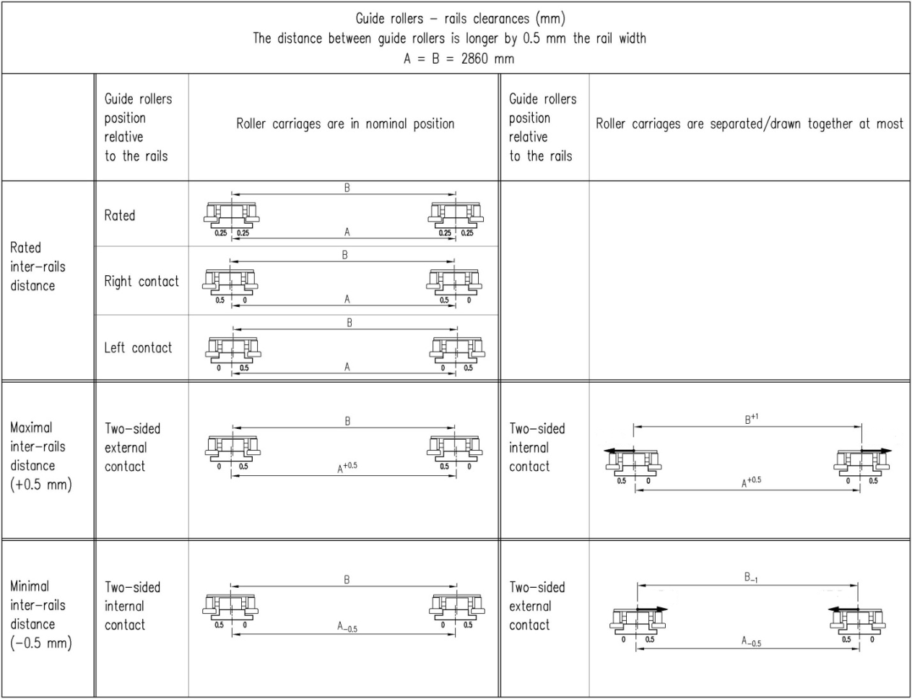
Rail track parameters
Distance between the rails: 2860 ±0.5 mm
Rail nonparallelism <0.2 mrad (1 mm/5 m)
Rail dimensions 325_{-0.14} x 70 mm
Gap between cam followers and rail +0.5 mm.

Slide 8
Requirement to the cryostat axe inclination
Cryostat axe inclination under action of axial force has to be limited Δα ≤ 0.3 mrad
Herbert Orth letter of 31.10.12.

Slide 9
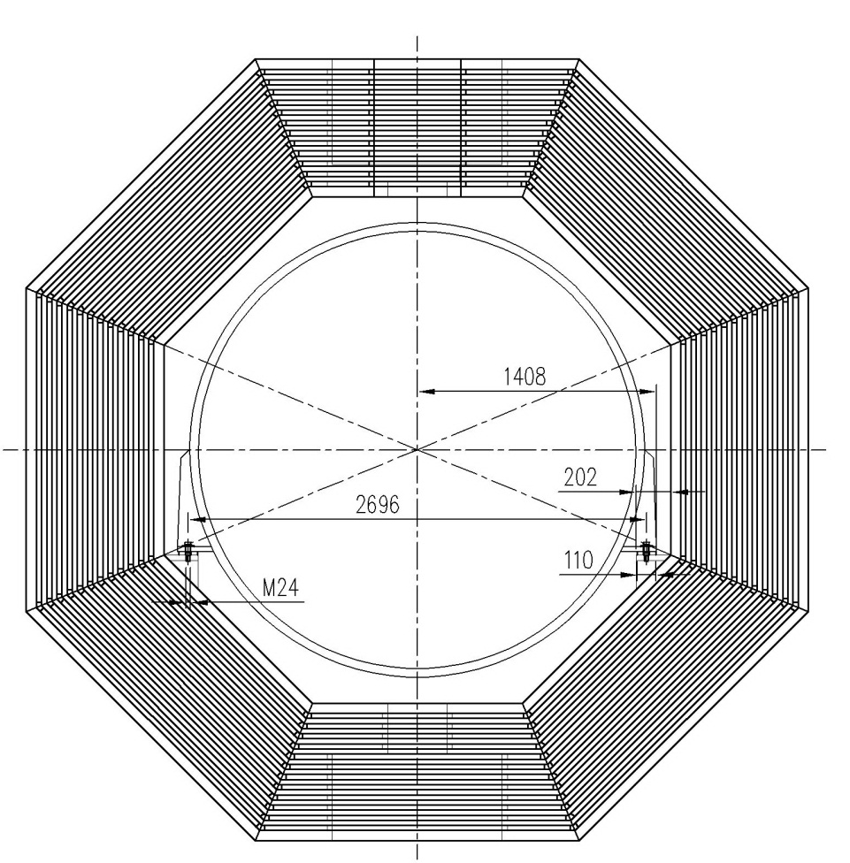
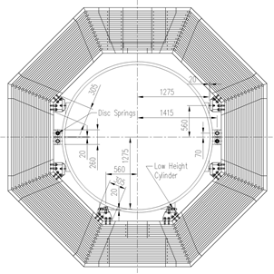
Cryostat fixation units
Option 1. Bottom beam fixation
Option 2. Tilted beam fixation

Slide 10
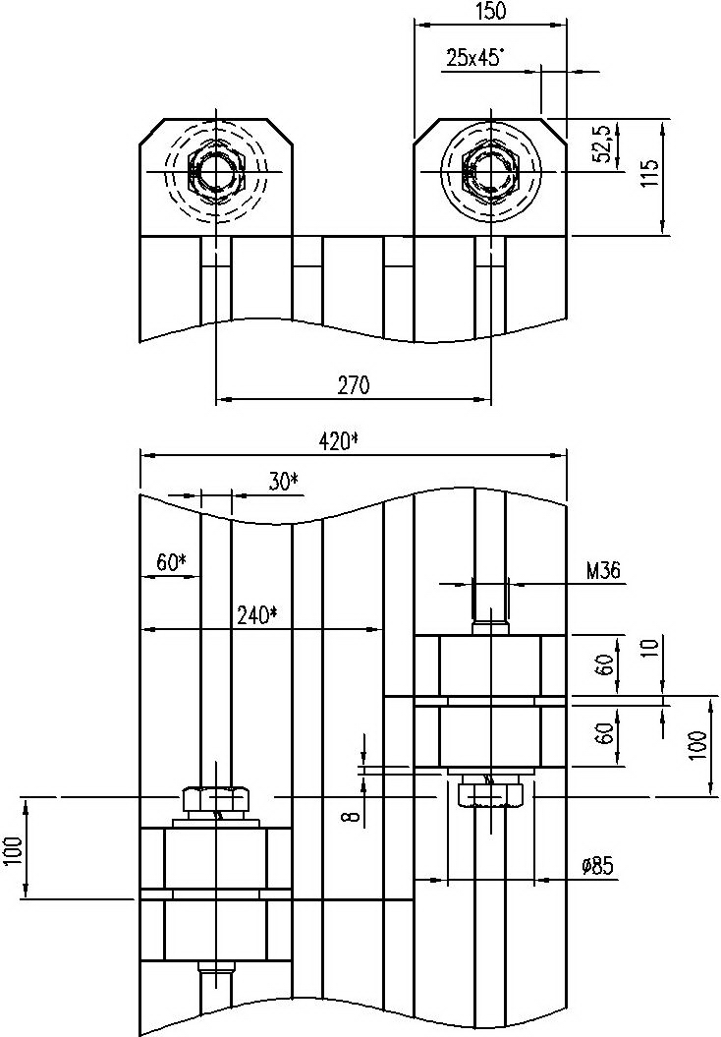
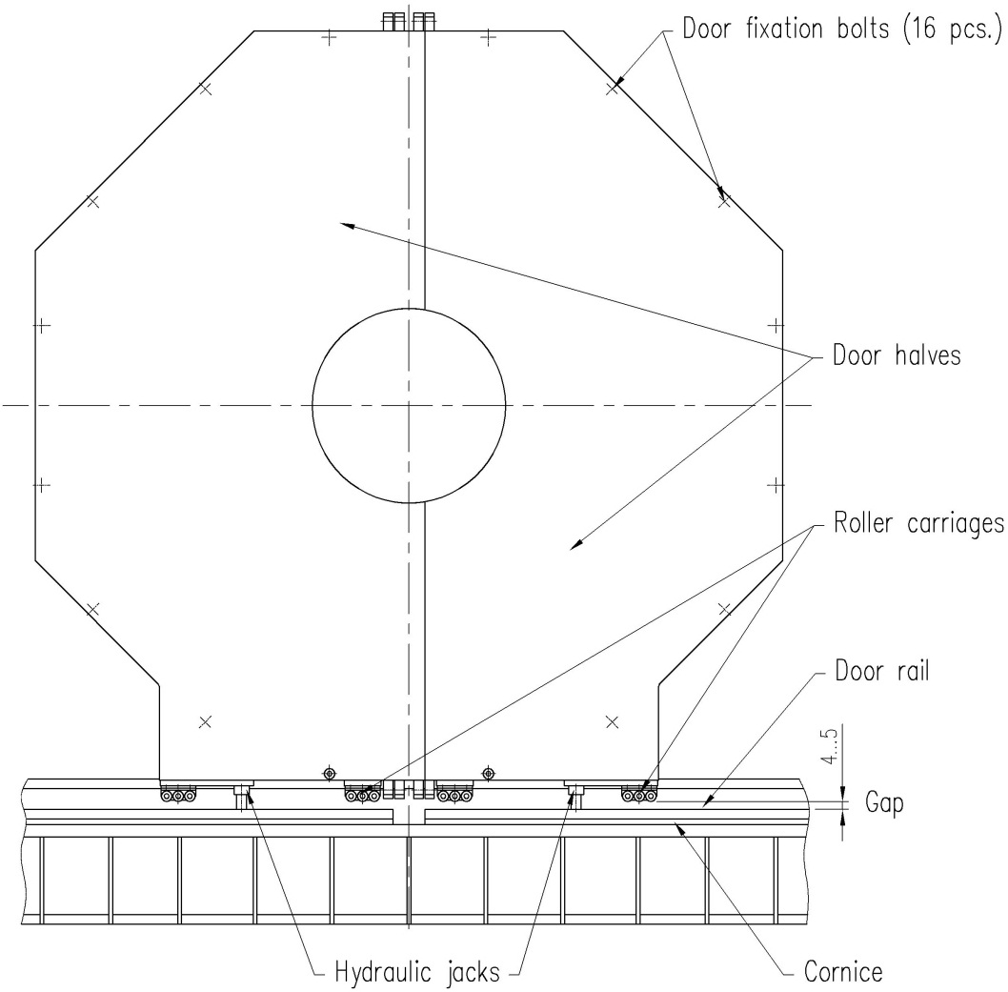
Magnet door component arrangement

Slide 11
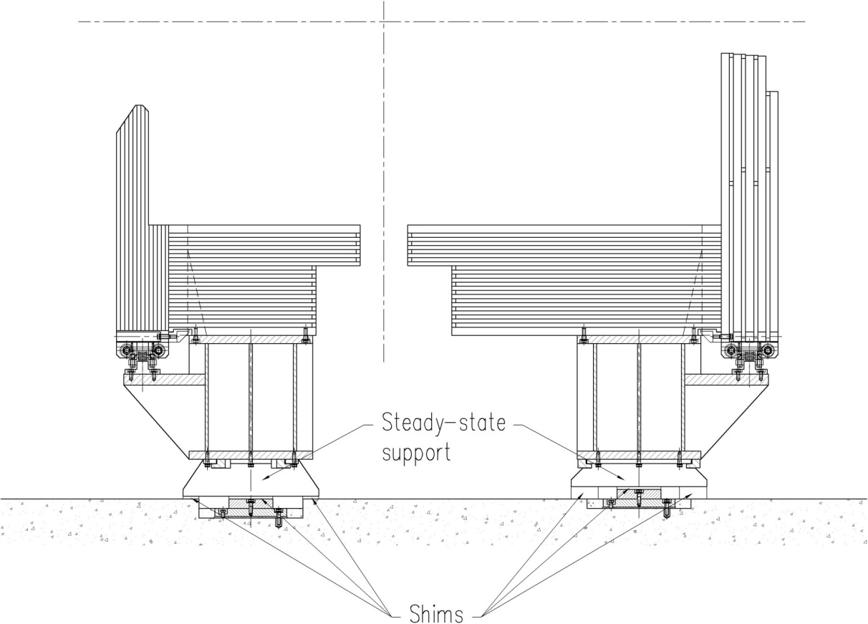
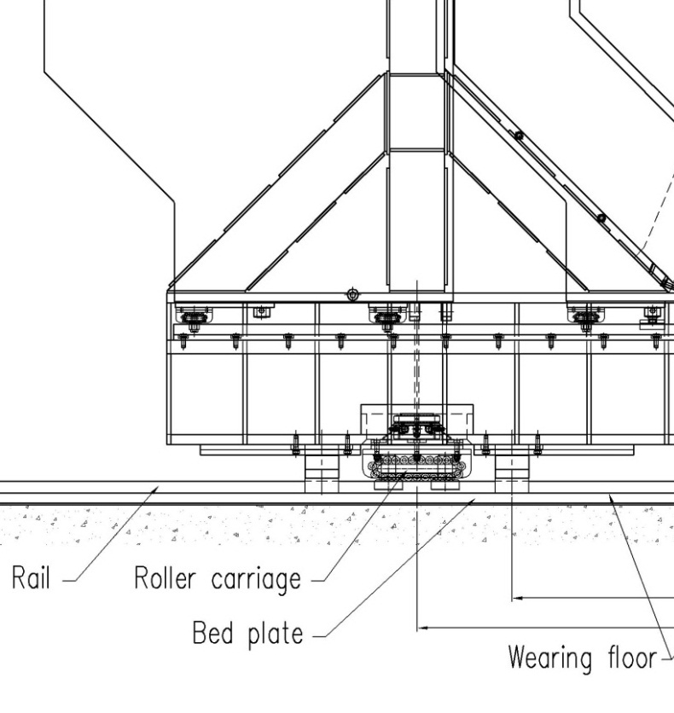
Magnet supports

Slide 12
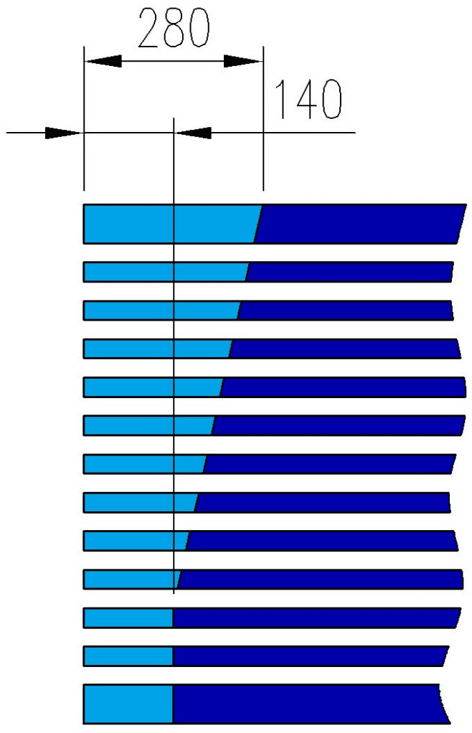
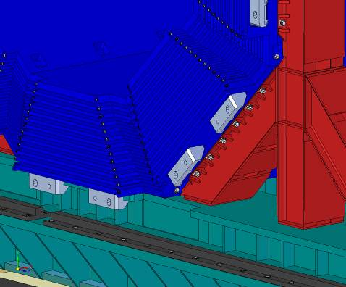
Passages for tubing and cabling
Additional space requested for muon cabling

Slide 13
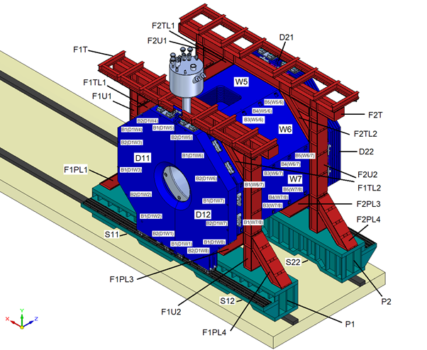
Nomination of the magnet parts

Slide 14
Design criteria
Steel 10/Steel 3: σ_{0.2}=210 MPa, σ_{u}=340 Mpa
Allowable stress for steel construction [σ]= σ_{0.2}/1.5,
[σ]=140 MPa, [τ]=70 MPa
Criteria for steel plates σ_{m}≤[σ], σ_{m}+σ_{b} ≤1.3[σ],
Criteria along the plate thickness [τ]=0.5[σ]
Allowable stress for weld seems [τ] = 63 Mpa
Bolts M24×2: [P]=99.8 kN; [τ]=117 kN; P_{tighten}=100 kN
Bolts M36×3: [P]=225 kN; [Q]=265 kN; P_{tighten}=225 kN

Slide 15
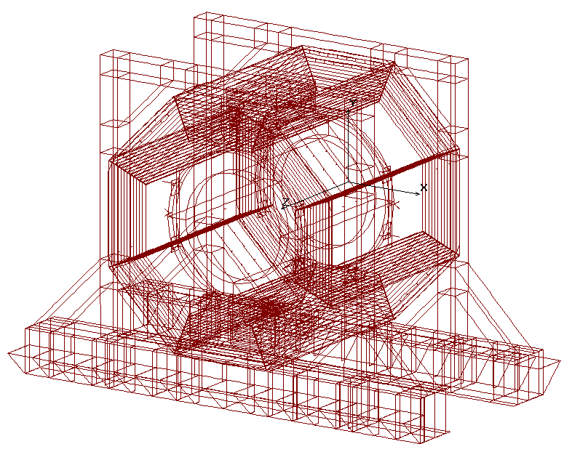
Magnet FE model
Model - Shell and beam finite elements
Number of elements ~260 000
Computation time of a basic load case ~30 minutes
Data base volume for one computation case -1.5Gb

Slide 16
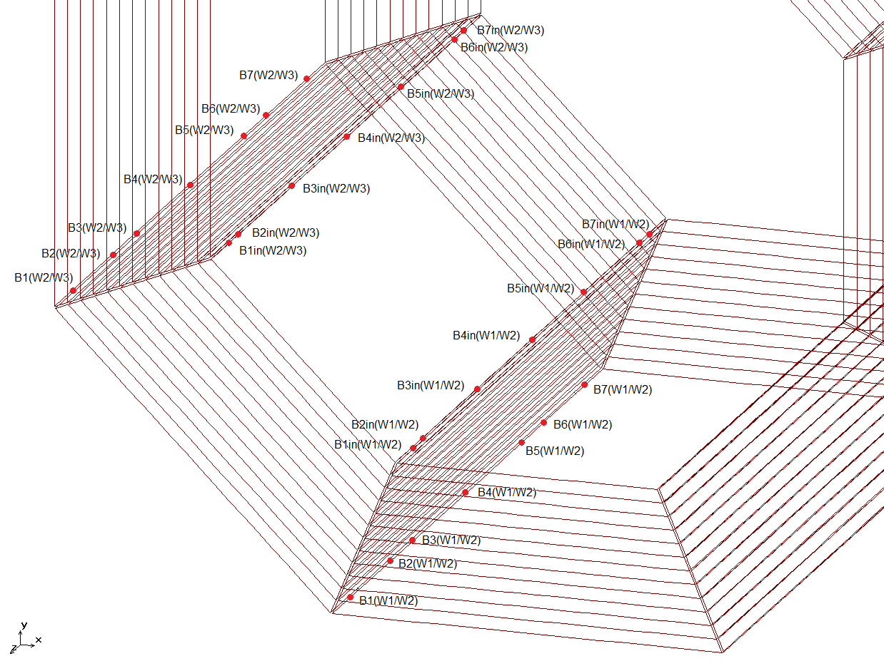
Yoke beam modeling

Slide 17
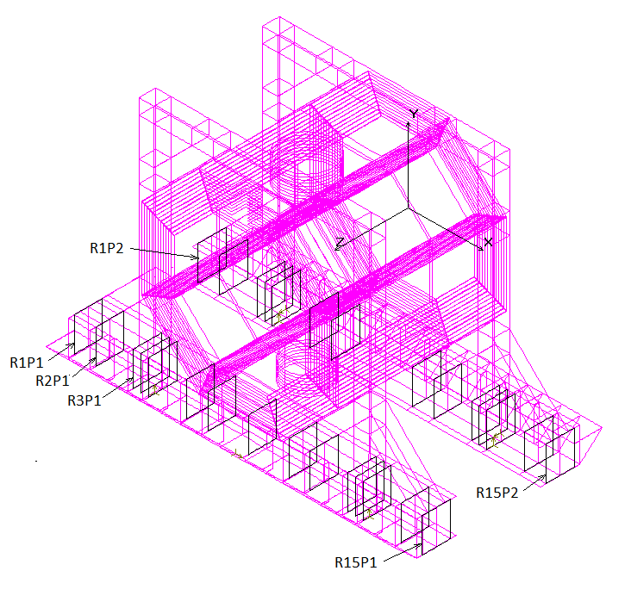
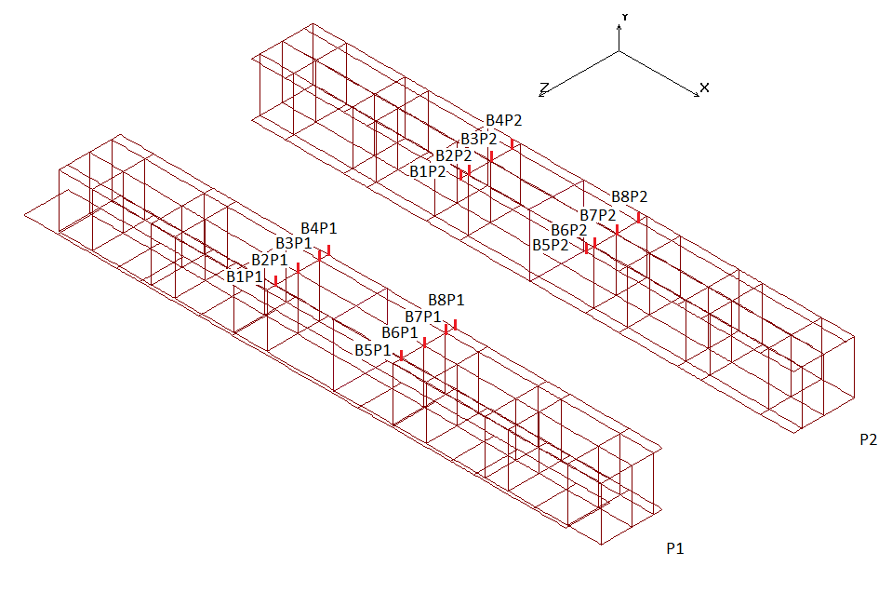
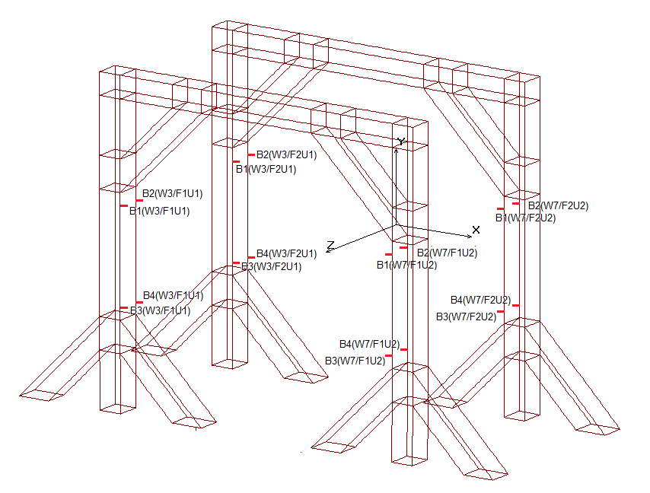
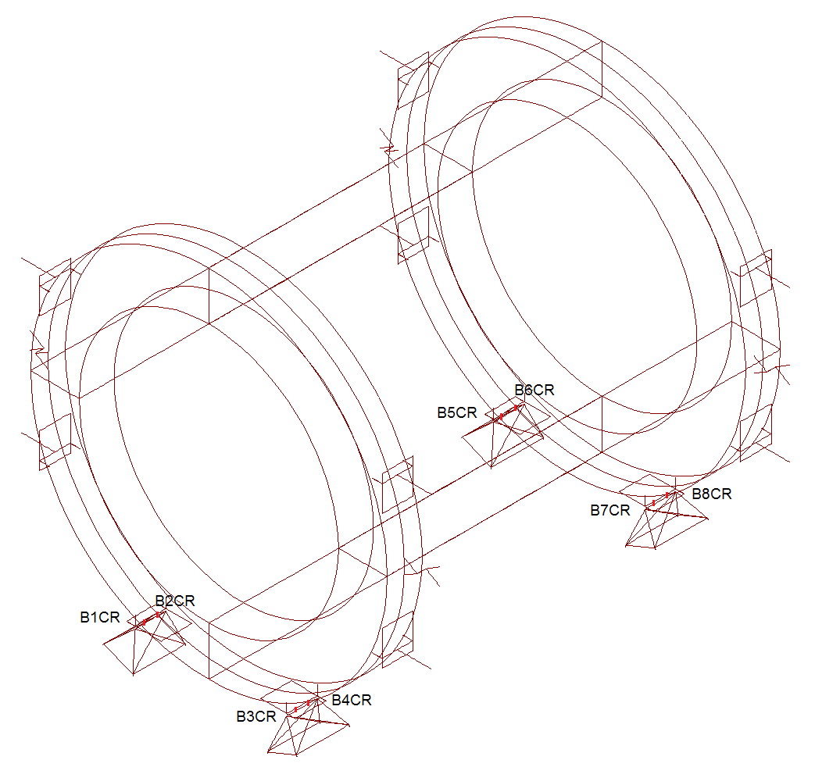
Details of the FE design model

Slide 18
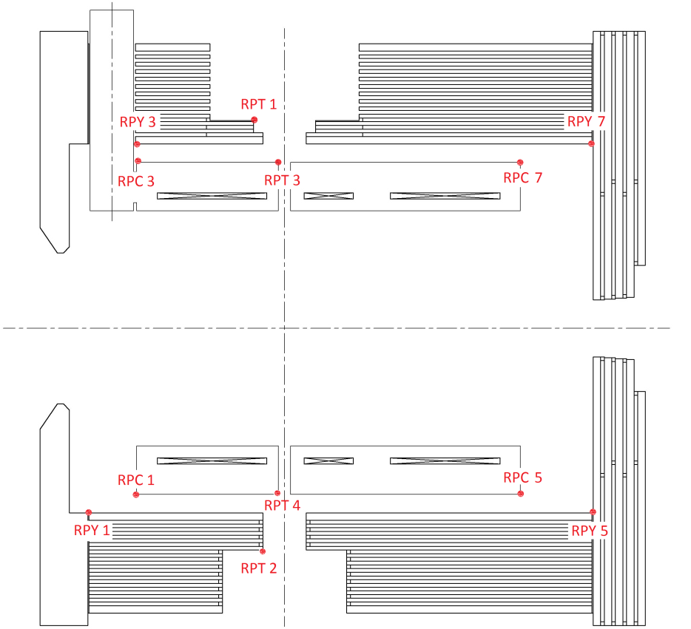
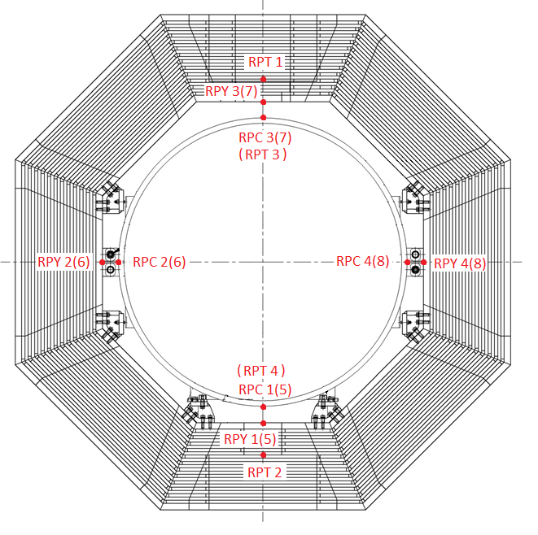
Reference points of the yoke and cryostat

Slide 19
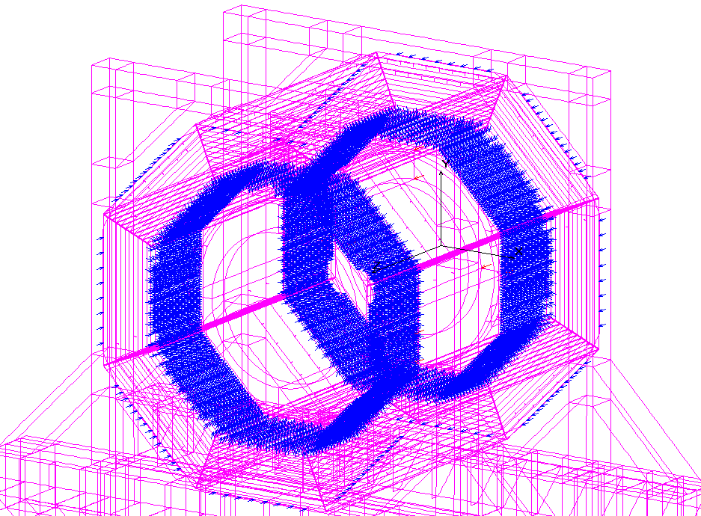
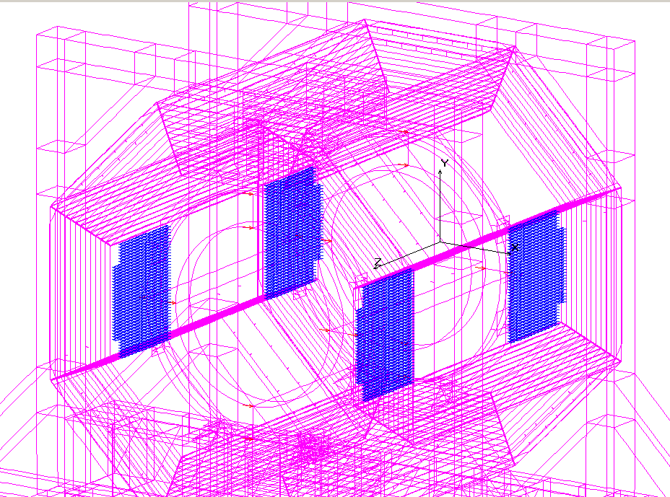
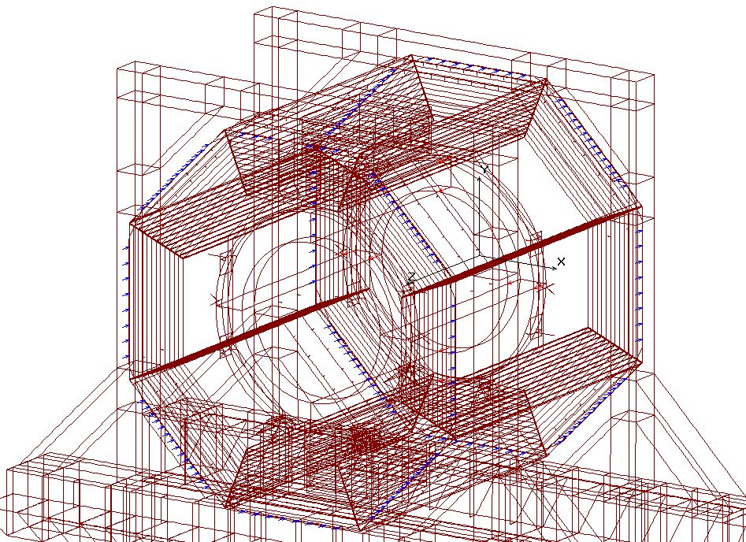
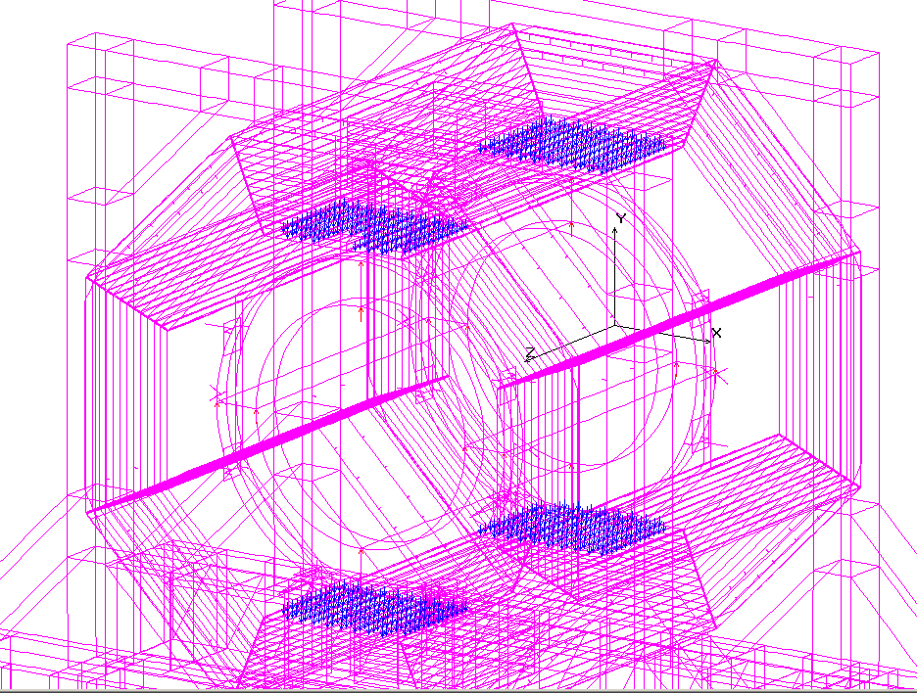
Magnetic pressure and forces applied to the yoke barrel

Slide 20
Load cases
Difference in magnet structure properties has bean treated in different FE models
  Rigid/non-rigid fixation of the door to the yoke
  Two/five support point for a platform beam
  Bottom/tilted beam fixation of the cryostat supports
Different kind of loads were applied within one FE model type
  Gravity
  Seismic loads
  Magnetic forces
Load case –
some stages of magnet assembly , transportation and operation were considered as combinations of results for different FE models with different sets of loads
  LC1-LC49 basic load cases
  LC51-LC55 magnet assemble regimes
  LC61-LC69 magnet transportation regimes
  LC71-LC78 magnet operation regimes
  LC81-LC87 magnet regimes with the cryostat fixation to the tilted beams

Slide 21
List of Load Cases
LC# | Support scheme |  | Door position and fixation type* |  |  | Gravity load |  |  | Magnetic forces are applied to the yoke and to the coil at maximal current and for nominal position of the cryostat | Magnetic forces applied to the cryostat and to the yoke at maximal current due to tolerable misalignments of the cryostat |  |  | Horizontal seismic forces (acceleration) applied to the yoke parts and to the cryostat |  | Run over an on-path irregularity of 1 mm in height | Separation of platform beams due to misalignment of the rails
 |  |  | Doors at the cornices | Doors weight is applied to the barrel (without stiffness) | Doors stiffness is applied (without weight) |  |  |  |  | F_{X} = -45 kN | F_{Y} = +45 kN | F_{Z} = -100 kN | a_{X} = -0.75 m\s² | a_{Z} = -0.75 m\s²
 | Two supports for every platform beam (magnet transportation) | Fifteen steady-state supports for every platform beam (magnet assembly and magnet operation) |  |  |  | Gravity of the yoke | Gravity of cryostat | Gravity of the inner detectors |  |  |  |  |  |  |  | Δ₁₁ = +1mm | Δ₁₁= -1mm | Δ₁₂ = +1mm | Δ₁₂ = -1mm
51 |  | x |  |  |  | x
52** |  | x | x |  |  | x | x | x
53** |  | x | x |  |  | x | x | x
54 |  | x |  | x |  | x | x | x
55** |  | x | x |  |  | x | x | x
61 | x |  |  | x |  | x | x | x
63 | x |  | x |  |  | x | x | x
64 | x |  |  | x | x | x | x | x |  |  |  |  |  |  | x
65 | x |  |  | x | x | x | x | x |  |  |  |  |  |  |  | x
66 | x |  |  | x | x | x | x | x |  |  |  |  |  |  |  |  | x
67 | x |  |  | x | x | x | x | x |  |  |  |  |  |  |  | x |  | x
68 | x |  |  | x | x | x | x | x |  |  |  |  |  |  |  |  | x |  | x
69 | x |  |  | x | x | x | x | x |  |  |  |  |  |  |  | x |  |  | x
71 |  | x |  | x |  | x | x | x | x
72 |  | x |  | x | x | x | x | x |  |  |  |  |  | x
73 |  | x |  | x | x | x | x | x | x | x |  | x |  | x
74 |  | x | x |  |  | x | x
75 |  | x |  | x | x | x | x |  | x | x | x | x
76 |  | x |  | x | x | x | x | x |  |  |  |  | x
77 |  | x |  | x | x | x | x | x | x | x |  | x | x
78 |  | x |  | x | x | x | x | x | x | x |  | x
81*** |  | x |  | x |  | x | x | x
82**** |  | x |  | x |  | x | x | x
83 | x |  |  | x |  | x | x | x
84 | x |  |  | x | x | x | x | x |  |  |  |  |  |  | x
85 |  | x |  |  | x | x | x | x | x | x |  | x
86 |  | x |  |  | x | x | x | x | x | x |  | x | x
87 |  | x |  | x |  | x | x | x | x | x |  | x

Slide 22
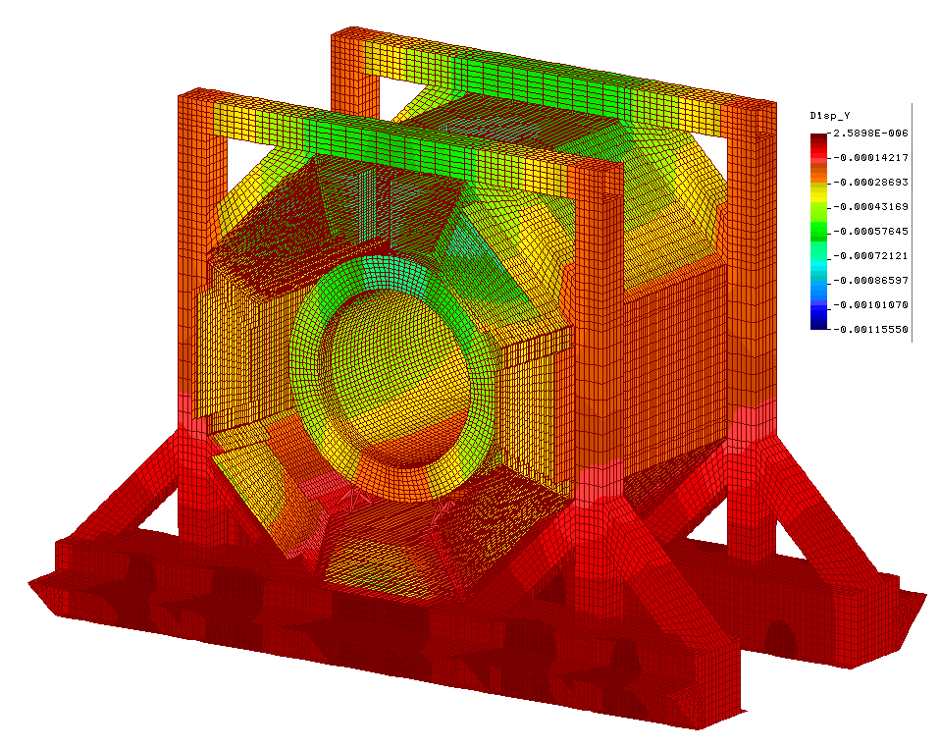
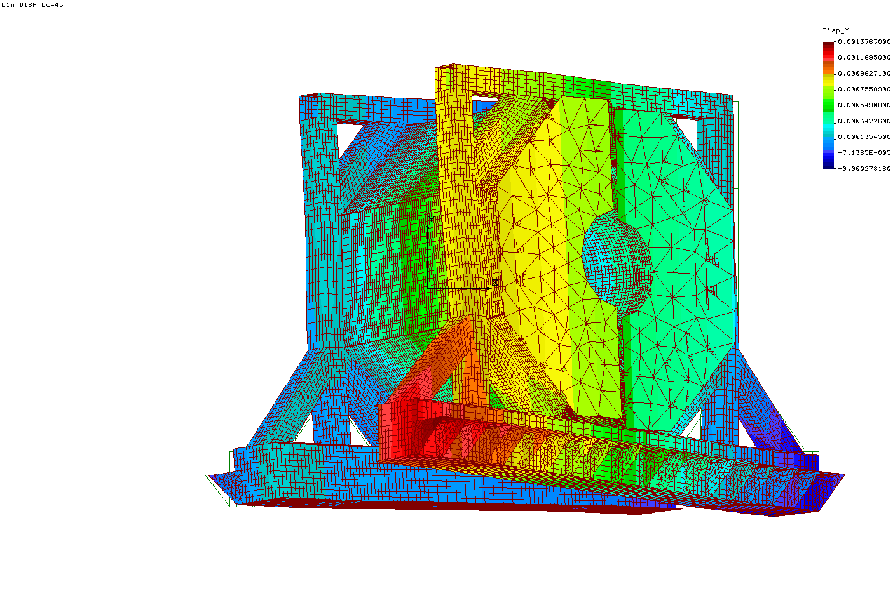
Vertical deformity of the magnet
Weight load (LC54)
Run into on-path unevenness of 1 mm in high

Slide 23
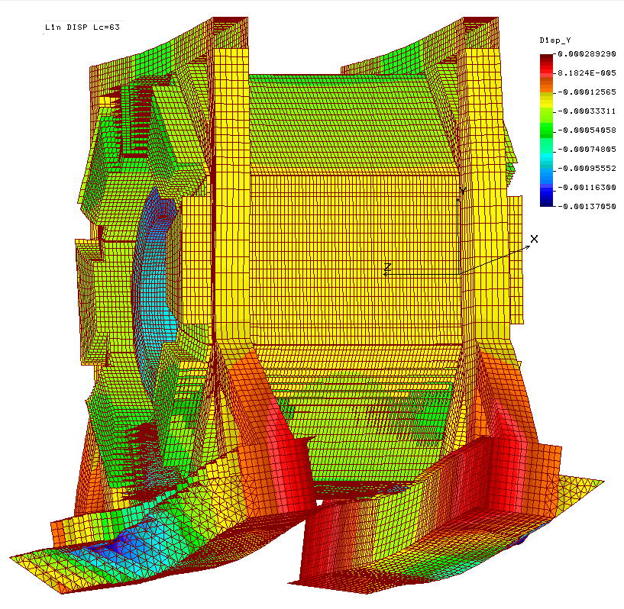
Emergency in the process of magnet transportation
LC63
Door opened

Slide 24
Vertical characteristics of the magnet supports
Maximal vertical load on a support (roller carriage) in the process of movement up to 1221 kN
Torsion stiffness of the yoke
rigid fixation of the door 387 kN/mm
nonrigid fixation of the door 240 kN/mm
Separation on rail/roller interface
rigid fixation of the door 2.1 mm
nonrigid fixation of the door 3.4 mm

Slide 25
Axal characteristics of the magnet supports
Axial stiffness of the platform arrangement
152 kN/mm
The friction force between the roller carriage and the rails in lateral direction (friction factor is 0.1)
1221 kN x 0.1 = 122 kN
Maximal possible separation of the platform beams before roller carriage starts slipping
122/152=0.8 mm
The roller carriages will start slipping before cam followers at the roller carriages interact with the rails because of platform beam separation in the process of movement
0.8<1 mm

Slide 26
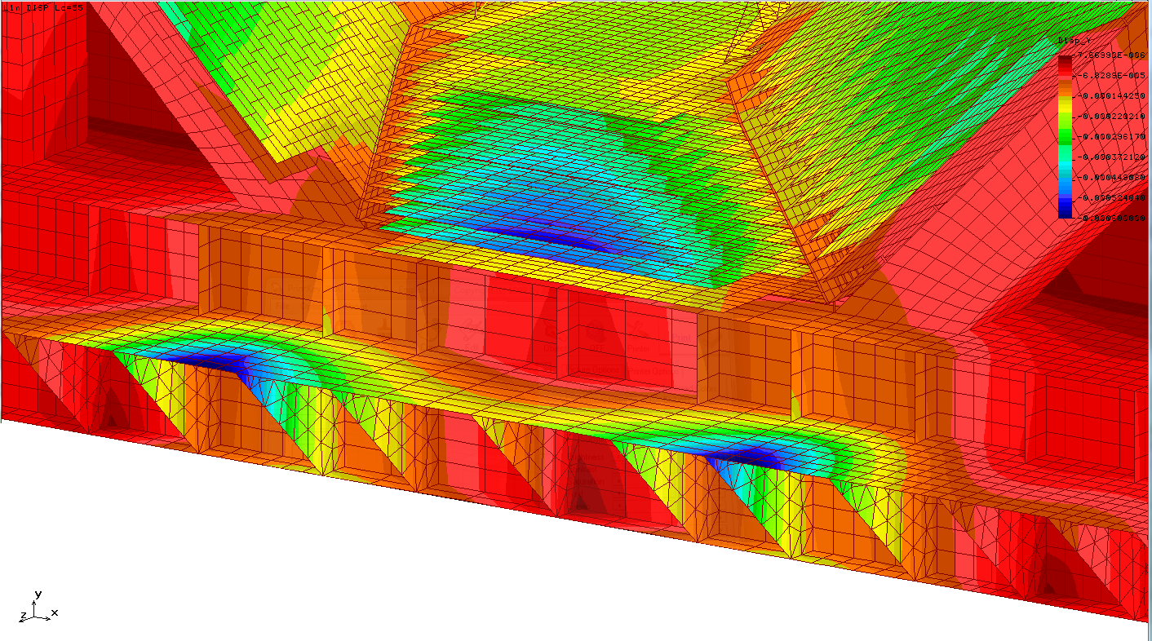
Vertical deformation of the cornices under action of the door jacks
LC 55
Vertical sag up to 0.6mm

Slide 27
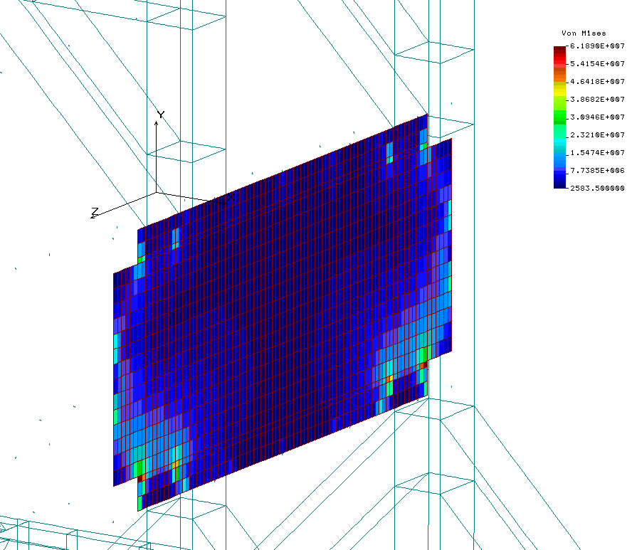
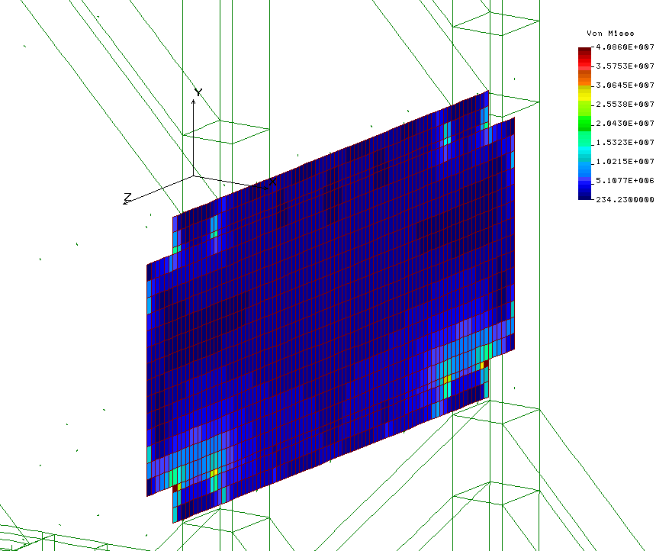
Equivalent stress (Von Mises) in the plate L13 of the beam W7 (LC64)
62+40=102MPa
η = 140/102 ≈1.4
LC61 (transportation position on four rollers)
Run into on-path irregularity 1 mm in hight

Slide 28
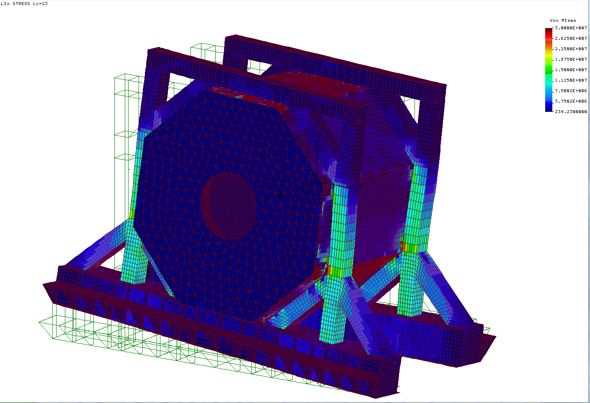
Deformity and Equivalent stress (Von Mises) for a run into on-path irregularity 1 mm in hight (without gravity load)

Slide 29
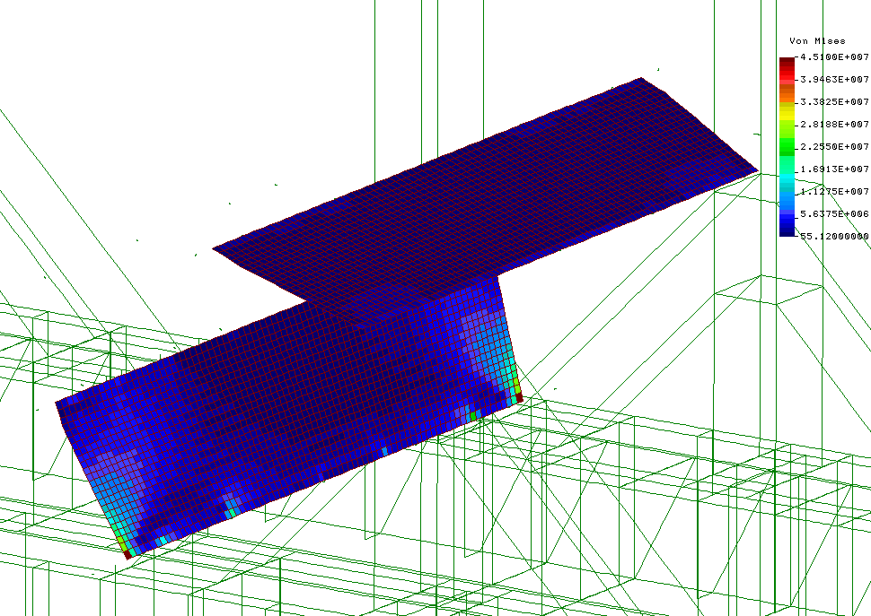
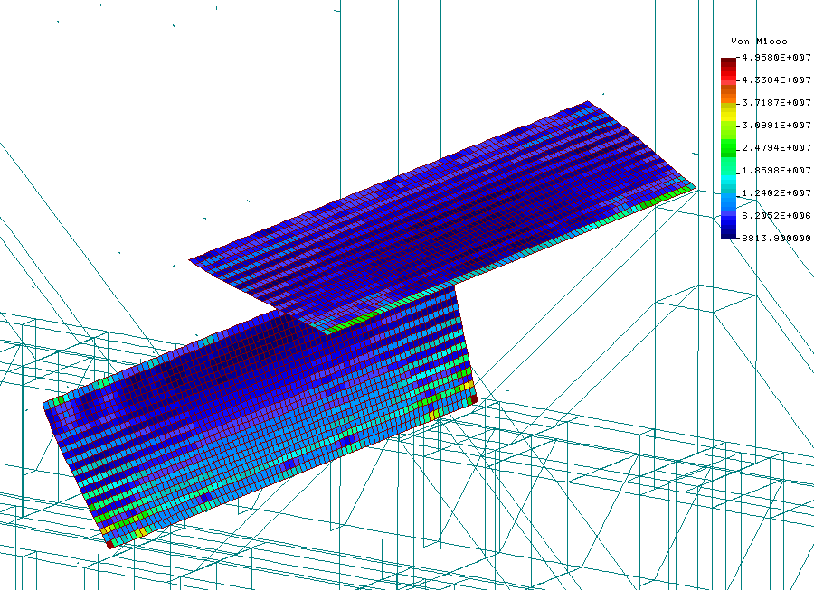
Equivalent stress (Von Mises) in the side plate of the beam W8 (junction W8/W1)
LC61 (transportation position on four rollers)
Widening of the roller track up to +1mm
50+45 = 94 Mpa
η = 140/94 ≈1.5 LC67

Slide 30
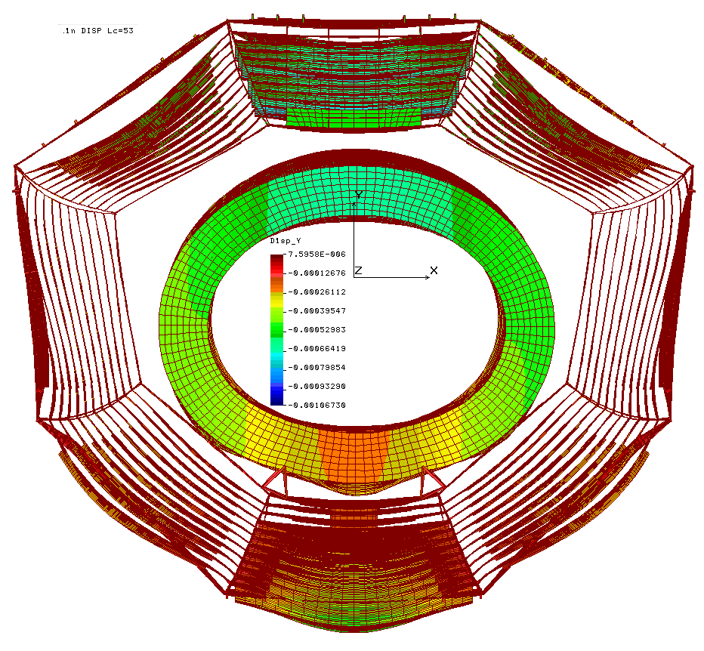
Vertical deformity of the yoke barrel beams
LC53
Maximal decreasing of gaps ~-0.7mm (Δ12W8)

Slide 31
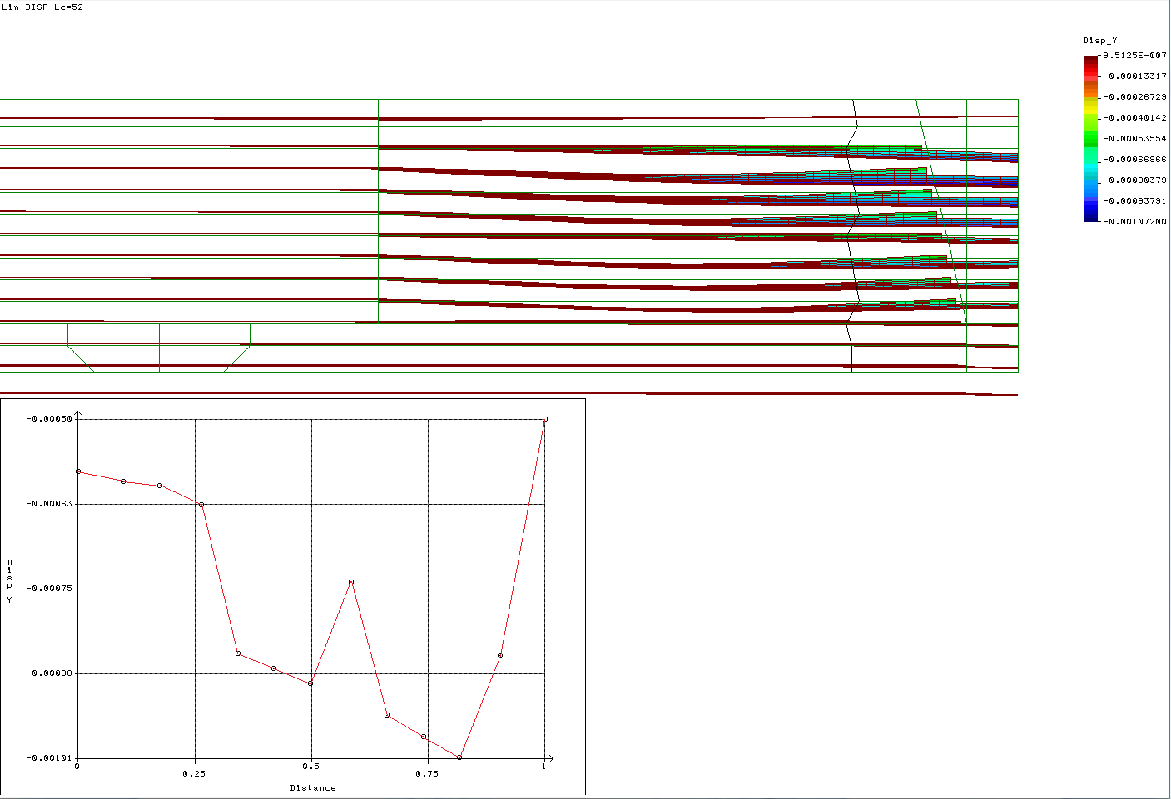
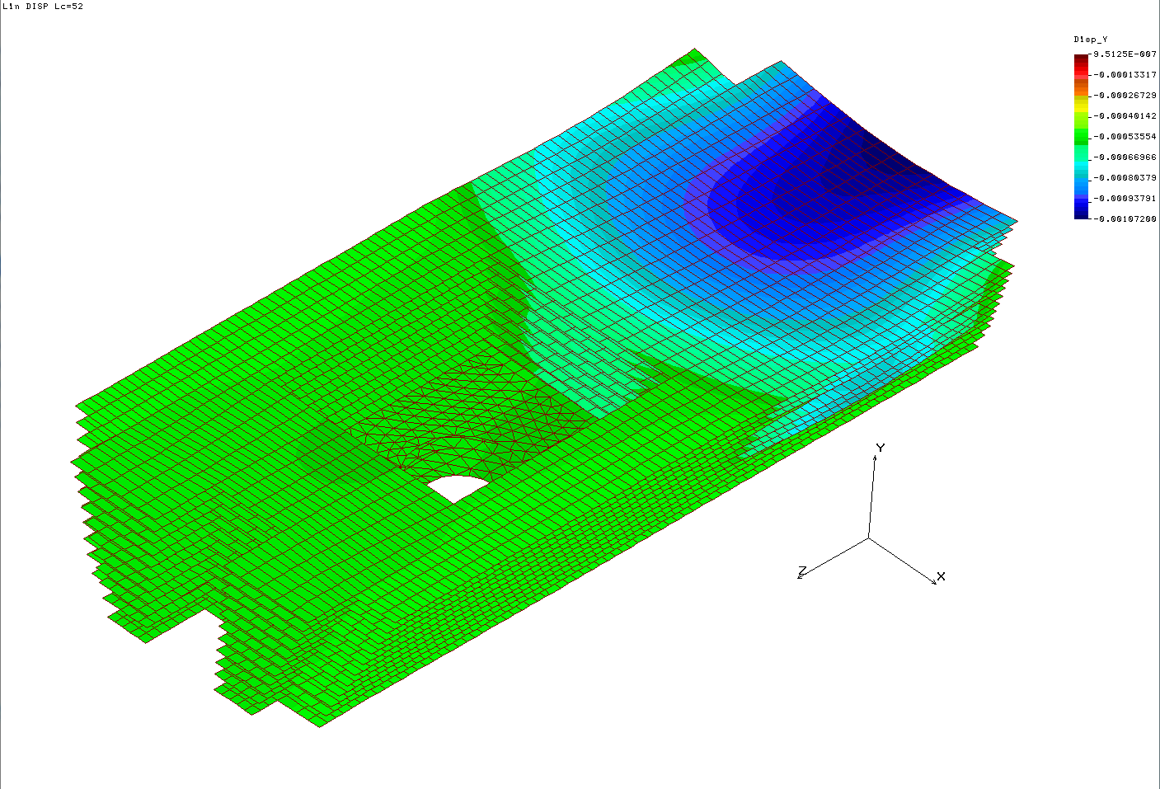
Vertical deformity of the top barrel beam plates (W5)
Maximal sag is 1.1 mm (L12W5)
Maximal decreasing of gaps -0.2mm (Δ4W5)
Beam W5
(w/o plate L13)

Slide 32
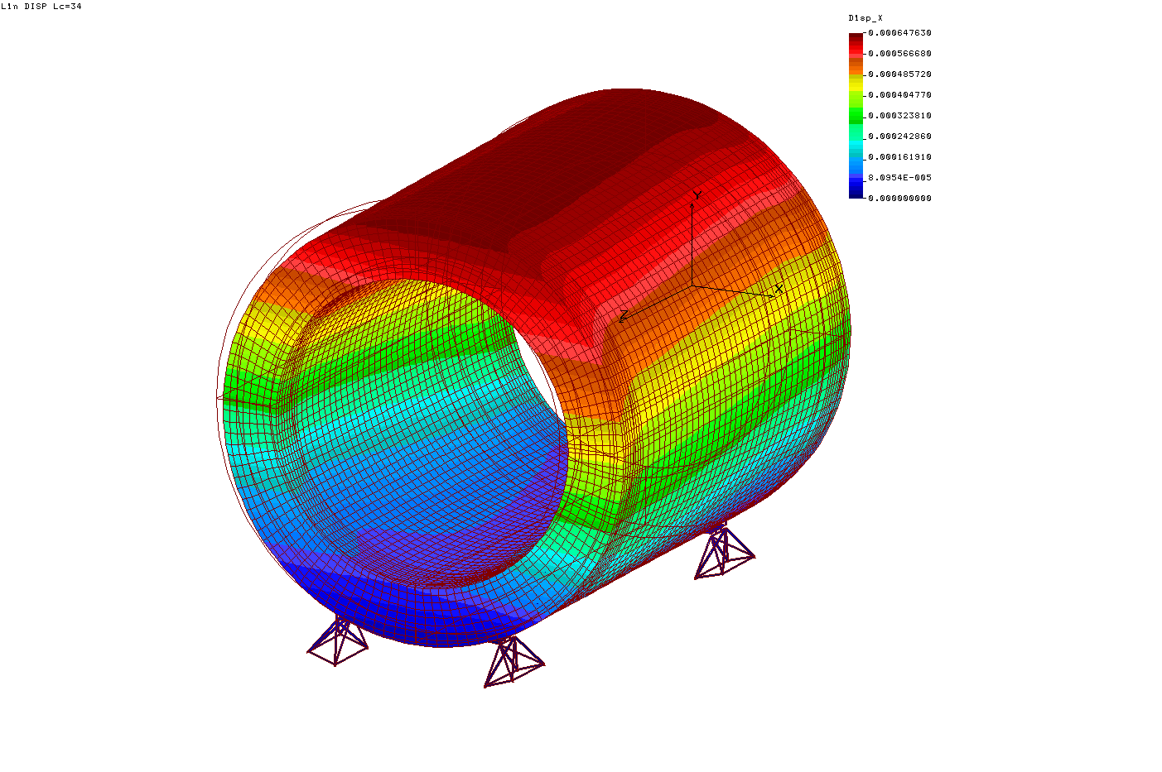
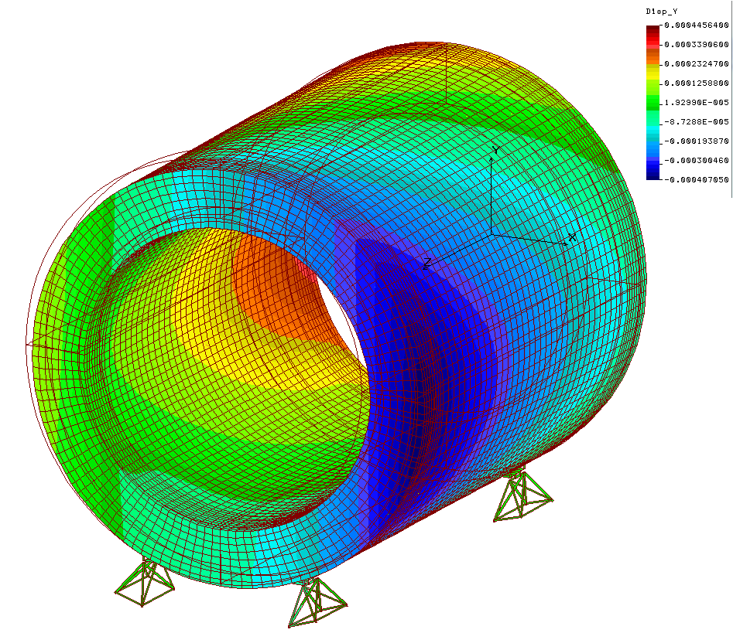
Cryostat deformity under action of magnetic forces Fx=45kN + Fz=140kN
Deformity in X direction
Deformity in Y direction
ΔXmax≈0.65mm
ΔYmax≈0.45mm

Slide 33
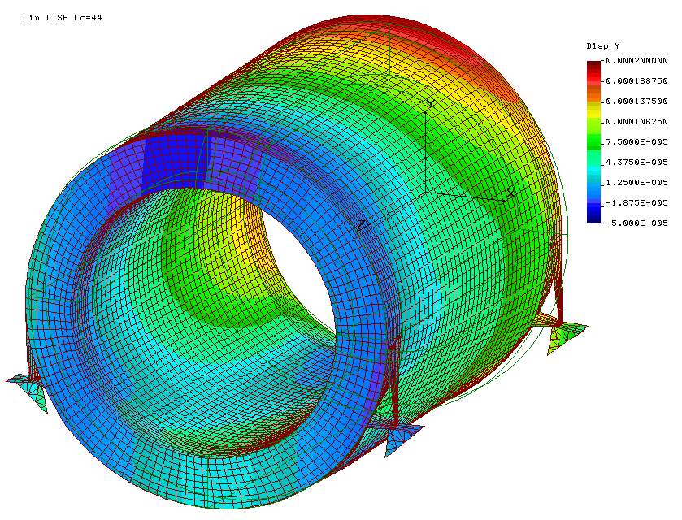
Cryostat deformity under action of magnetic forces Fx=45kN + Fz=140kN
Deformity in Y direction
Cryostat Support Option 2
ΔYmax≈0.2mm

Slide 34
Cryostat inclination under action of the axial magnetic force 140kN
Load case LC78 (support option 1)
αmax = 0.137 mrad < [0.3 ] mrad
Load case LC84 (support option 2)
αmax = 0.07 mrad

Slide 35
Cryostat support characteristics
(support option 1)
Maximal reactions in a cryostat support
Vertical Ry=151kN
Axial Rz=70kN
Lateral Rx=27kN
Maximal vertical rigidity of the cryostat supports 2.6 MN/mm

Slide 36
Deformity and Equivalent stress (Von Mises) for barrel beam plate L1W1 with “b” and without “a” gravity of the disc calorimeter
Maximal sag ≈0.7mm

Slide 37
Margin of safety for fixation units
 |  | η_{tension} | η_{shear} | Position | Load case
1. | Barrel bolts M24x2 | 1.7 |  | B5(W8/W1) | LC67
2. | Platform bolts M24x2 | 1.4 |  | B8P2 | LC63
3. | Cryostat support boltsM24x2 | 2.1 |  | B6CR | LC75
4. | Space frame bolts M24x2 |  | 1.9 | B7(W2/F2PL2) | LC85
5. | Door/barrel bolts M36x3 |  | 4 | B1(D1/W3) | LC64
6. | Door wings bolts M36x3 |  | 9 | B1(D11/D12) | LC83
 | η_{min=} | 1.4 |  | B8P2 | LC63

Slide 38
Summary – main results
The strength of the main components and fixation units of the iron yoke is on a sufficient level. The yoke is able to bear loads in all assembly, transportation and operative regimes with minimal safety margin 1.4.
The request of muon group for increased passages for cabling has been met.
It takes some minor design modifications before preparation of the Technical Specification of the yoke (see next page).
The both cryostat support design options meet the demand of the GSI/INFN colleagues. From yoke strength point of view they are virtually identical.
Rigidity characteristics of the cryostat supports are obtained. They can be implemented for strength analysis of the cryostat with sc winding without yoke modeling.
Main characteristics of the yoke supports are prepared for Technical Specification of the rail track in GSI.

Slide 39
Recommendations made as a result of computations and analysis
Barrel connection bolts are loaded by essential shear forces. Since it is difficult to provide their gapless mounting it takes the addition dowel pins to bear the shear forces in radial and axial directions.
The bolts B8P2, B4P2, B1P1 и B5P1 in barrel/platform interface bear tension/compression loads, other 12 bolts are always compressed. All bolts accept large shear forces. It takes to remove bolts which doesn’t bear tension loads and to use addition rests for shear.
The bolts on the cryostat supports B2CR, B4CR, B5CR, B7CR (first option of the cryostat fixation) are loaded by a small part of the vertical tension load. So it takes to leave bolts B1CR, B3CR, B6CR, B8CR only and to have special measures to exclude shear load on these bolts.
Vertical sag of the beam plate under action of the disc calorimeter gravity is 0.7 mm. To constrain deflection of the plate it takes a steel pad rigidly fixated to the beam plate.

Slide 40
THANK YOU
FOR YOUR ATTENTION!

