Slide 1
Central Trackers assembly sequence
and Interface with cross-pipe - draft proposal -
G. GIRAUDO - D. ORECCHINI
Beam-Target line for PANDA – GSI – 4 February 2013

Slide 2
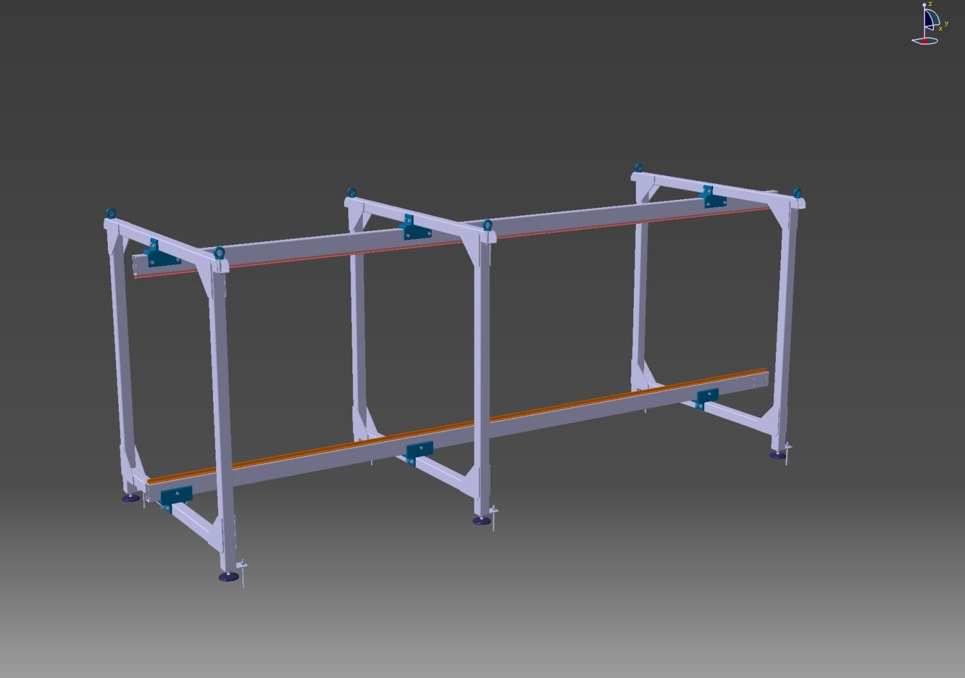
ASSEMBLY SEQUENCE
Preliminary work in a Clean Dedicated Area
Auxiliary Support Structure + Dummy Rails Aligned
(Survey Service Assistance)
G. GIRAUDO - D. ORECCHINI
Beam-Target line for PANDA – GSI – 4 February 2013

Slide 3
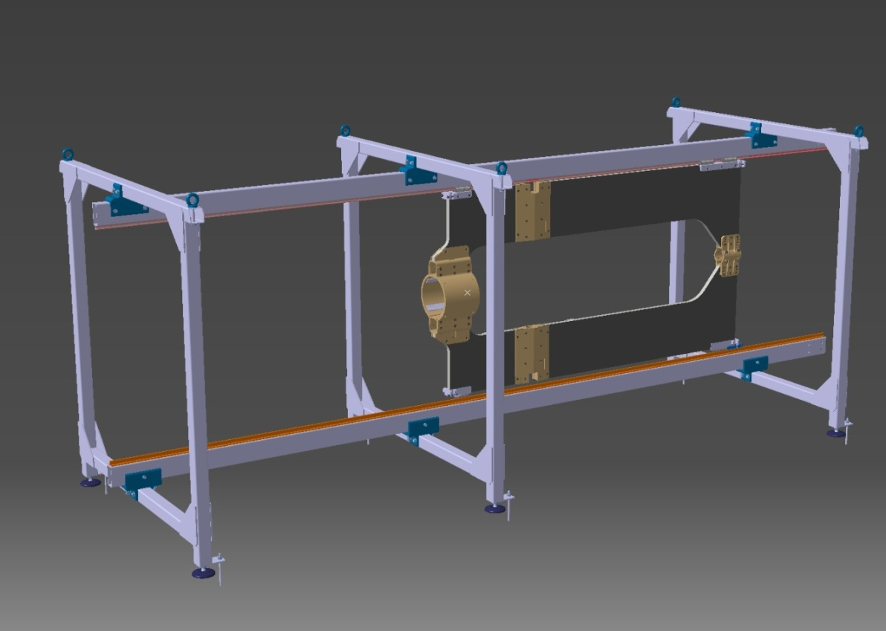
ASSEMBLY SEQUENCE
Preliminary work in a clean Dedicated area
Auxiliary Support Structure + Dummy Rails Aligned
(Survey Service Assistance)
Central Frame on Rails
G. GIRAUDO - D. ORECCHINI
Beam-Target line for PANDA – GSI – 4 February 2013

Slide 4
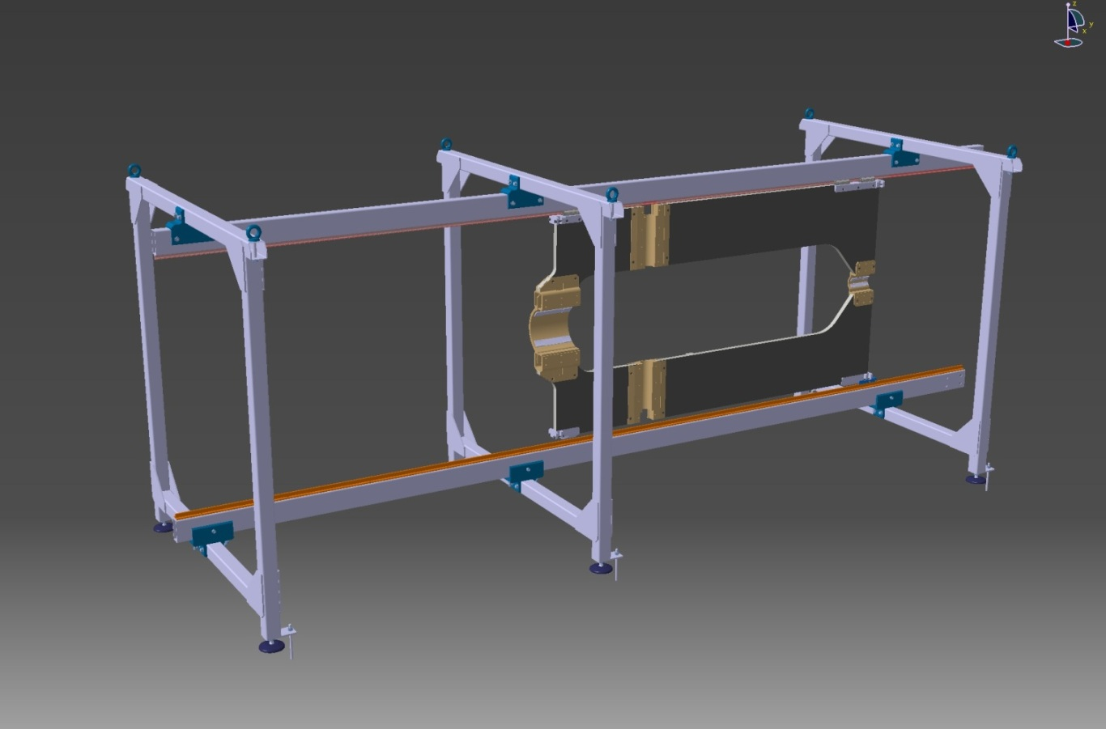
ASSEMBLY SEQUENCE
Preliminary work in a clean Dedicated area
Auxiliary Support Structure + Dummy Rails Aligned
(Survey Service Assistance)
Central Frame on Rails
Clamps Open
G. GIRAUDO - D. ORECCHINI
Beam-Target line for PANDA – GSI – 4 February 2013

Slide 5
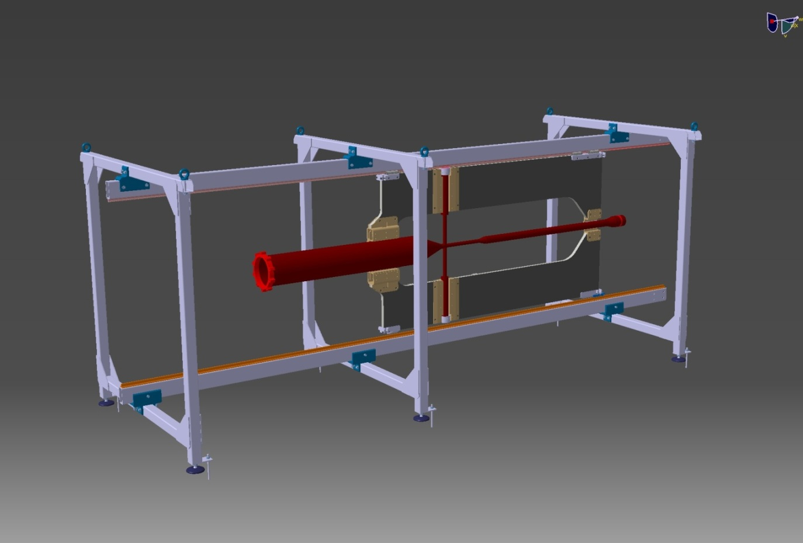
ASSEMBLY SEQUENCE
Preliminary work in a clean Dedicated area
Auxiliary Support Structure + Dummy Rails Aligned
(Survey Service Assistance)
Central Frame on Rails
Clamps Open
Cross Pipe Mounting and Alignments
G. GIRAUDO - D. ORECCHINI
Beam-Target line for PANDA – GSI – 4 February 2013

Slide 6
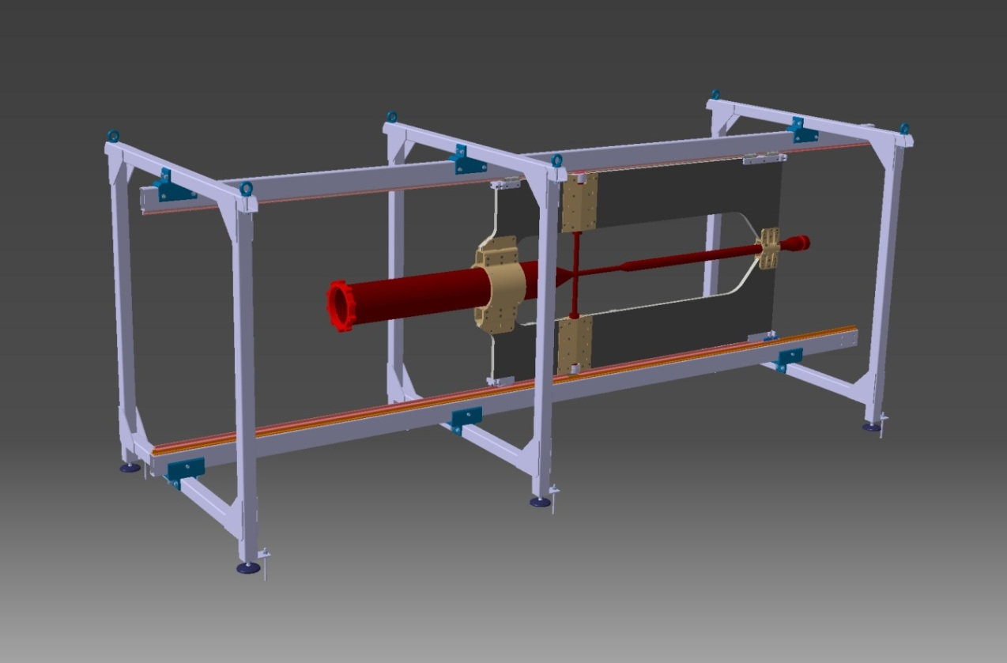
ASSEMBLY SEQUENCE
Preliminary work in a clean Dedicated area
Auxiliary Support Structure + Dummy Rails Aligned
(Survey Service Assistance)
Central Frame on Rails
Clamps Open
Cross Pipe Mounting and Alignments
Clamps Close
G. GIRAUDO - D. ORECCHINI
Beam-Target line for PANDA – GSI – 4 February 2013

Slide 7
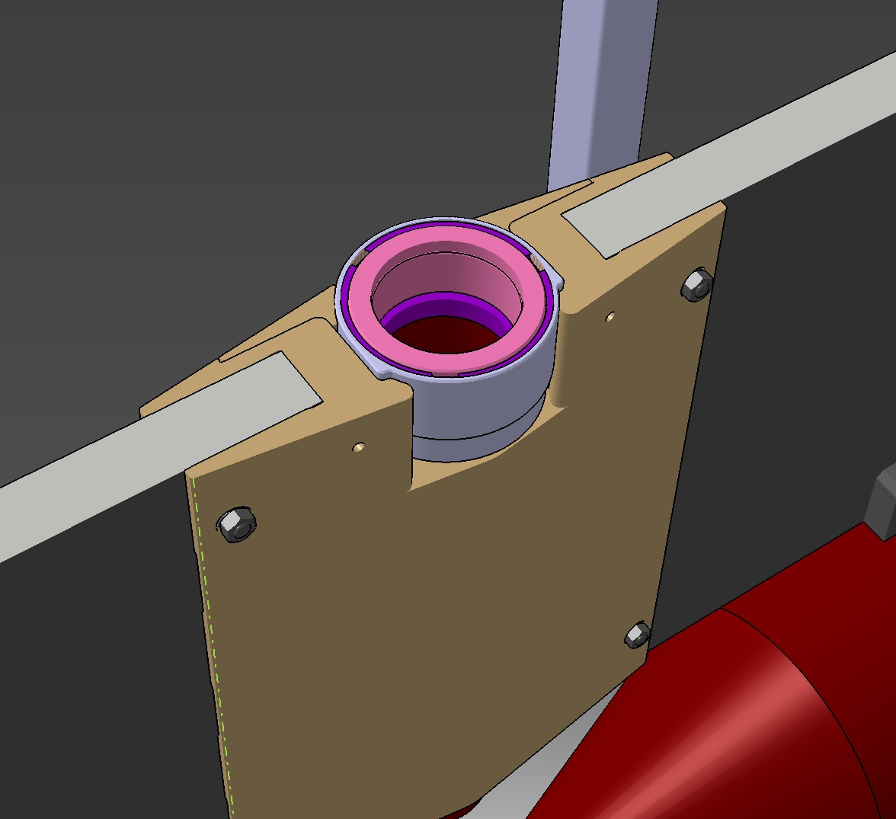
ASSEMBLY SEQUENCE
Cross Pipe – CF Interfaces (existing design)
Clamping Sleeve must be integrated with the Target Arm
Clearance Sleeve/CF → CRITICAL
Relative Orientation, Coaxiality → CRITICAL
Position of the horizontal pipe → CRITICAL
New Solution must be evaluated
G. GIRAUDO - D. ORECCHINI
Beam-Target line for PANDA – GSI – 4 February 2013

Slide 8
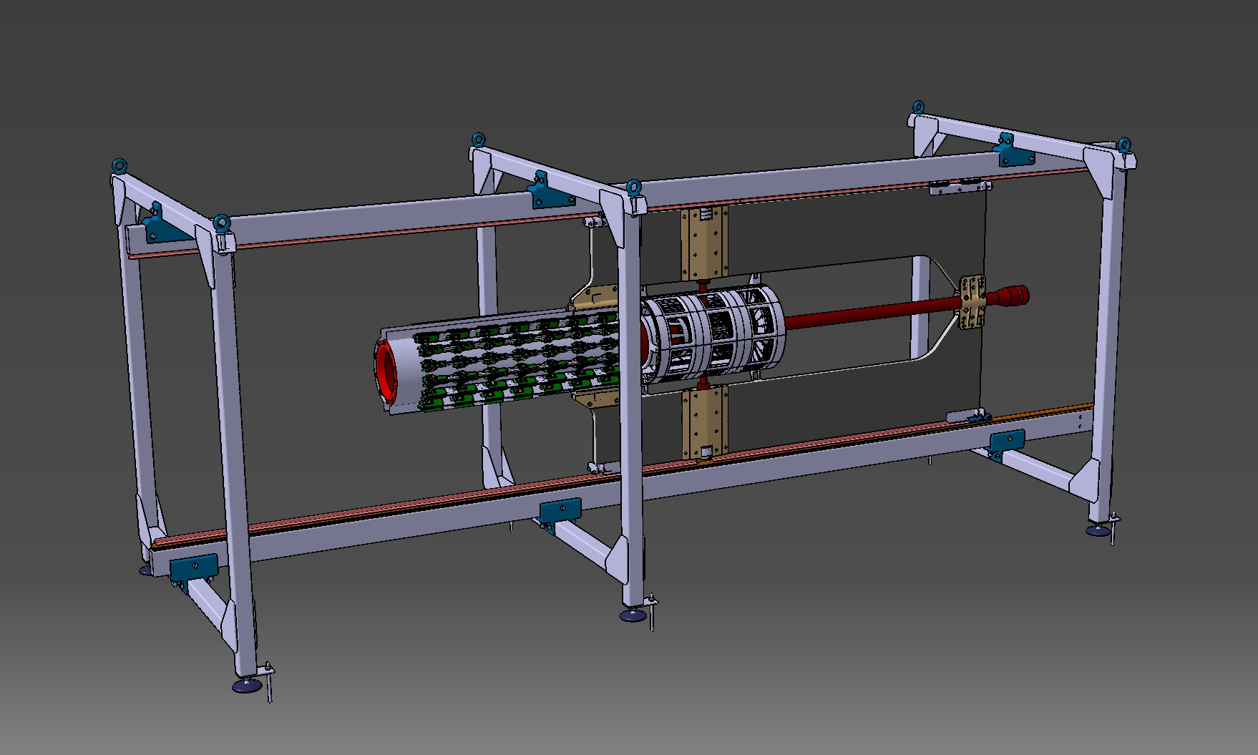
ASSEMBLY SEQUENCE
Preliminary work in a clean Dedicated area
Auxiliary Support Structure + Dummy Rails Aligned
(Survey Service Assistance)
Central Frame on Rails
Clamps Open
Cross Pipe Mounting and Alignments
Clamps Close
MVD & MVD’s cooling + electronics assembly
GBT set Fixed on Flange & CF
G. GIRAUDO - D. ORECCHINI
Beam-Target line for PANDA – GSI – 4 February 2013

Slide 9
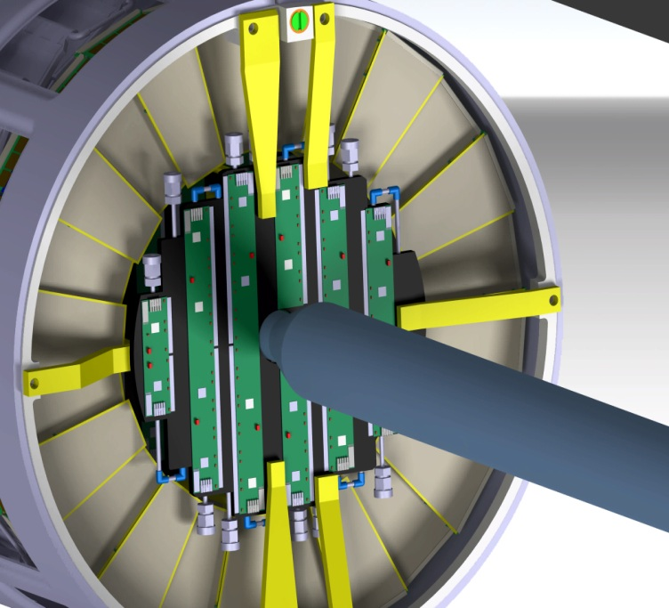
ASSEMBLY SEQUENCE
Manufacturing tolerances
Assembly tolerances
0.8 mm clearance between beam pipe and disks
G. GIRAUDO - D. ORECCHINI
Beam-Target line for PANDA – GSI – 4 February 2013

Slide 10
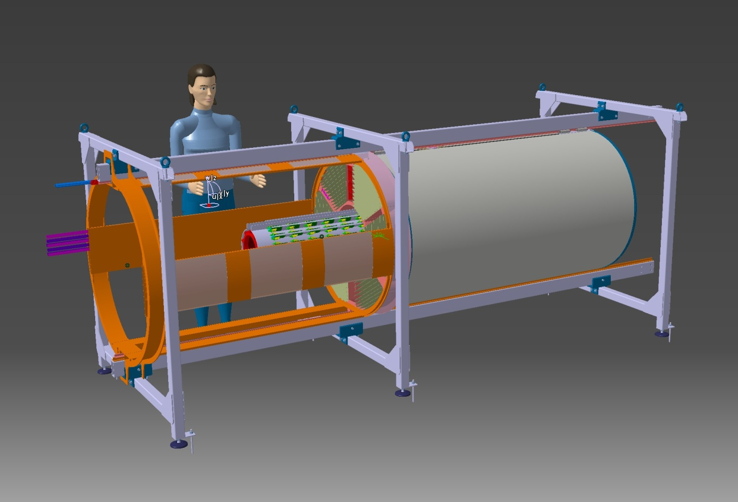
ASSEMBLY SEQUENCE
Preliminary work in a clean Dedicated area
Auxiliary Support Structure + Dummy Rails Aligned
(Survey Service Assistance)
Central Frame on Rails
Clamps Open
Cross Pipe Mounting and Alignments
Clamps Close
MVD & MVD’s cooling + electronics assembly
STT & STT’s electronics assembly
G. GIRAUDO - D. ORECCHINI
Beam-Target line for PANDA – GSI – 4 February 2013

Slide 11
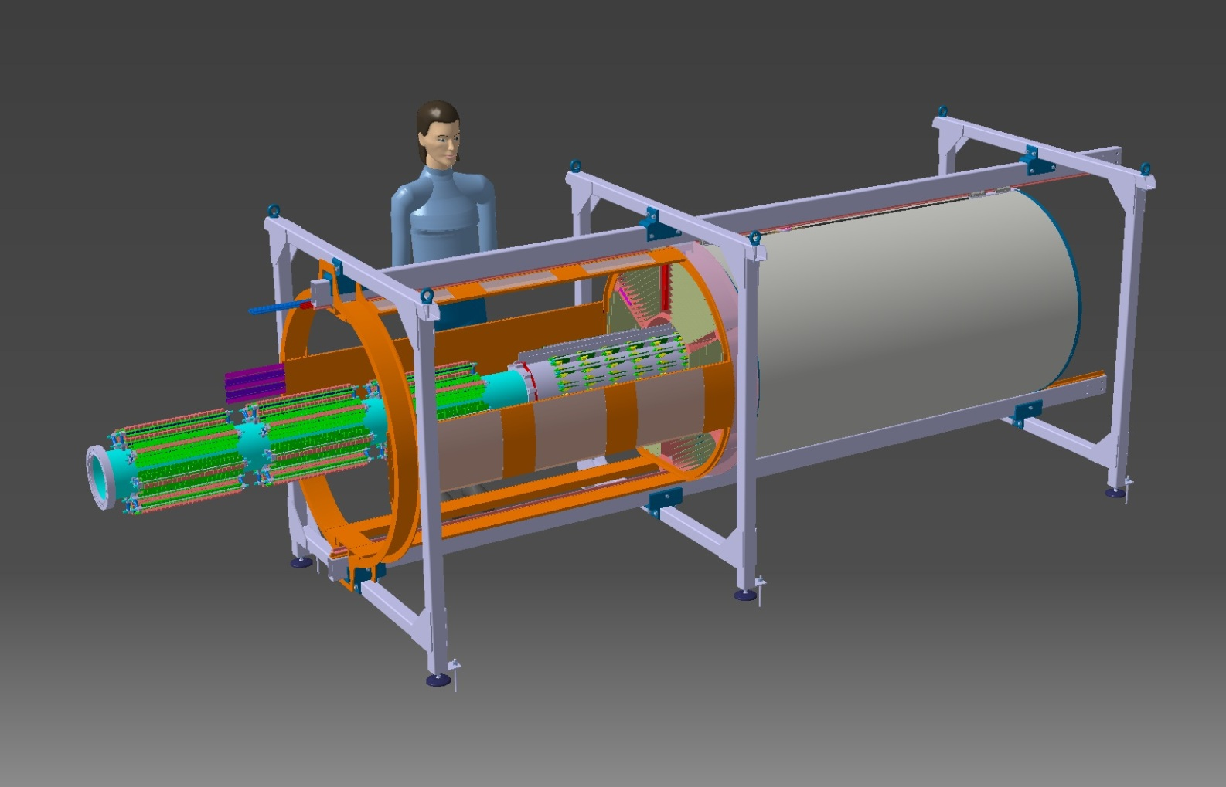
ASSEMBLY SEQUENCE
Preliminary work in a clean Dedicated area
Auxiliary Support Structure + Dummy Rails Aligned
(Survey Service Assistance)
Central Frame on Rails
Clamps Open
Cross Pipe Mounting and Alignments
Clamps Close
MVD & MVD’s cooling + electronics assembly
STT & STT’s electronics assembly
Beam Pipe Upstream Sector (DC-DC Converters)
ADDITIONAL SUSPENSION MUST BE ADDED Auxiliary support structure must be extended
G. GIRAUDO - D. ORECCHINI
Beam-Target line for PANDA – GSI – 4 February 2013

Slide 12
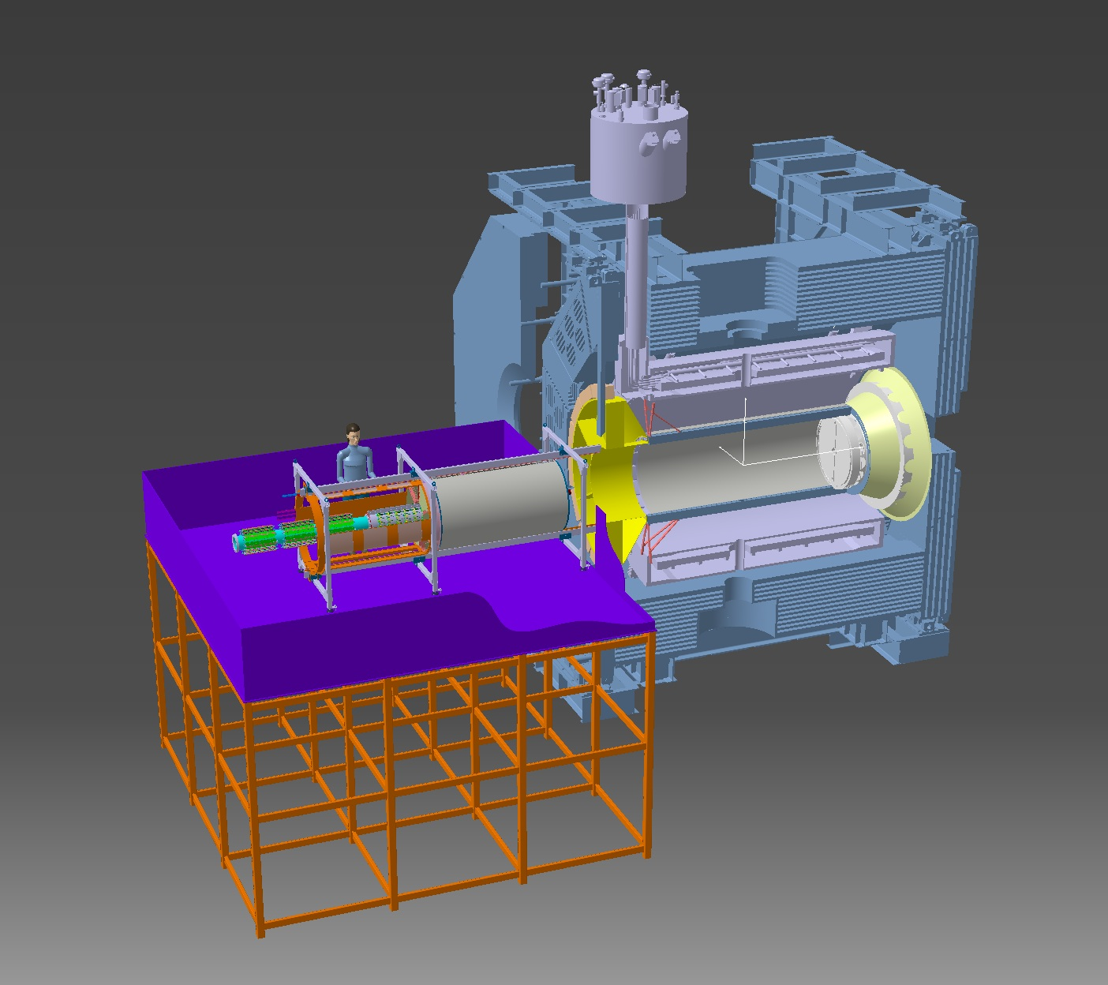
ASSEMBLY SEQUENCE
READY TO MOVE TO THE SERVICE PLATFORM
G. GIRAUDO - D. ORECCHINI
Beam-Target line for PANDA – GSI – 4 February 2013

Slide 13
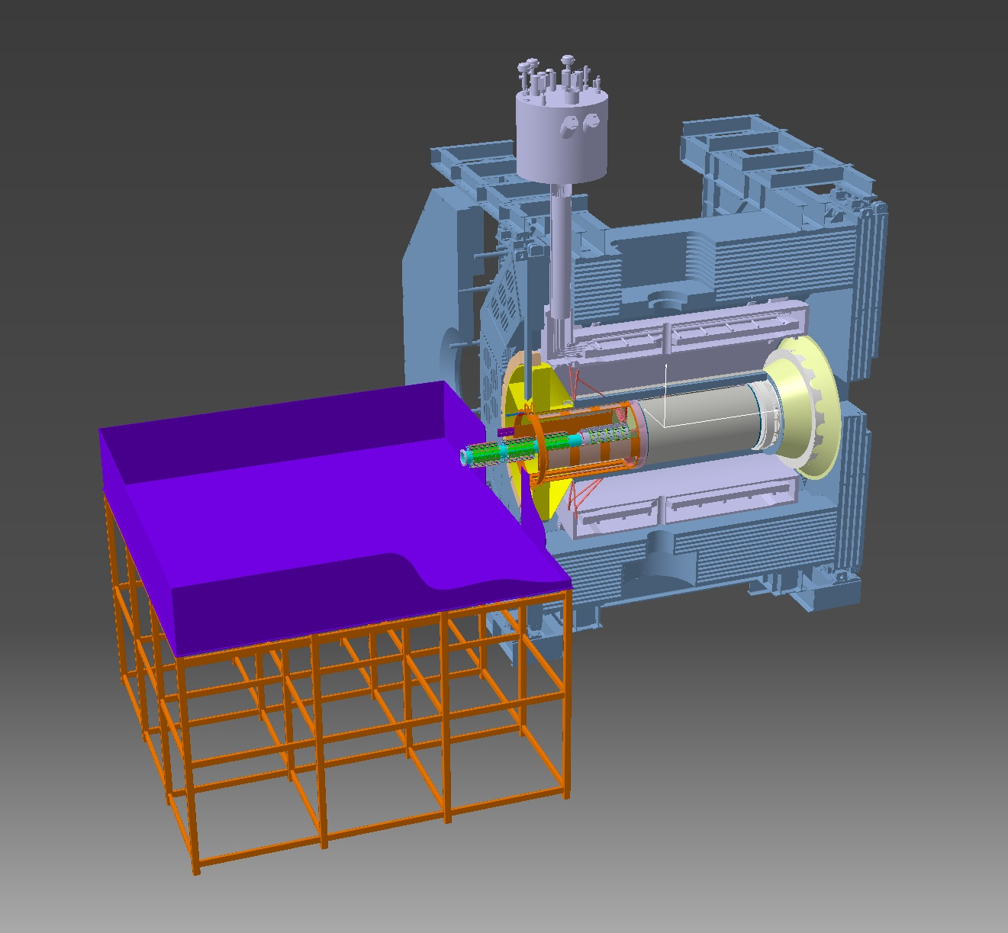
ASSEMBLY SEQUENCE
CENTRAL TRACKING SYSTEM SLIDES IN
G. GIRAUDO - D. ORECCHINI
Beam-Target line for PANDA – GSI – 4 February 2013

Slide 14
SUMMARY
The clamping sleeves must be integrated with the Target Arms
Tolerances (geometry, manufacturing & assembly)
MVD assembly – Possible problem with Beam Arm
Tolerances (geometry, manufacturing & assembly)
Beam Pipe Upstream Sector act as DC-DC Converters holder
Beam Pipe Upstream Sector (DC-DC Converters) must be suspended during assembly and handling
Interaction with End-Cap EMC during assembly
G. GIRAUDO - D. ORECCHINI
Beam-Target line for PANDA – GSI – 4 February 2013

Slide 15
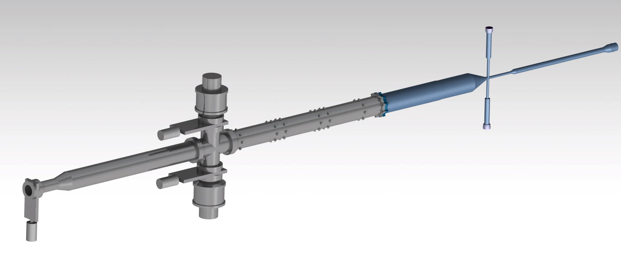
ASSEMBLY SEQUENCE
Beam Pipe sector as a whole
G. GIRAUDO - D. ORECCHINI
Beam-Target line for PANDA – GSI – 4 February 2013

Slide 16
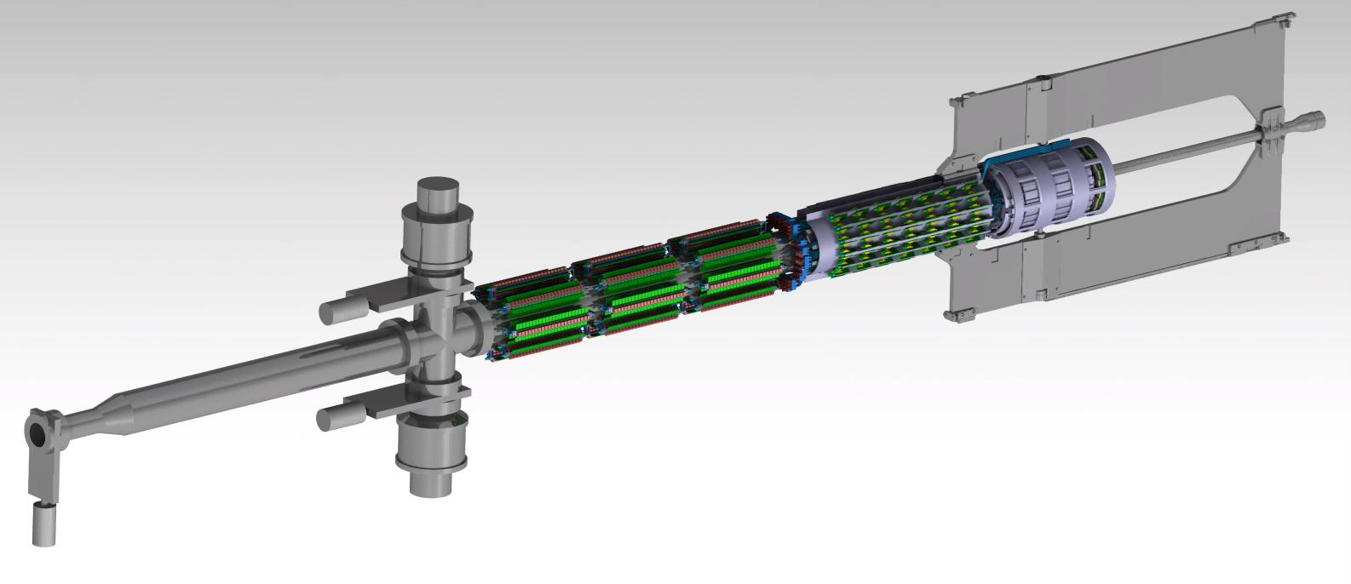
ASSEMBLY SEQUENCE
Whole MVD assembled
2840
G. GIRAUDO - D. ORECCHINI
Beam-Target line for PANDA – GSI – 4 February 2013

Slide 17
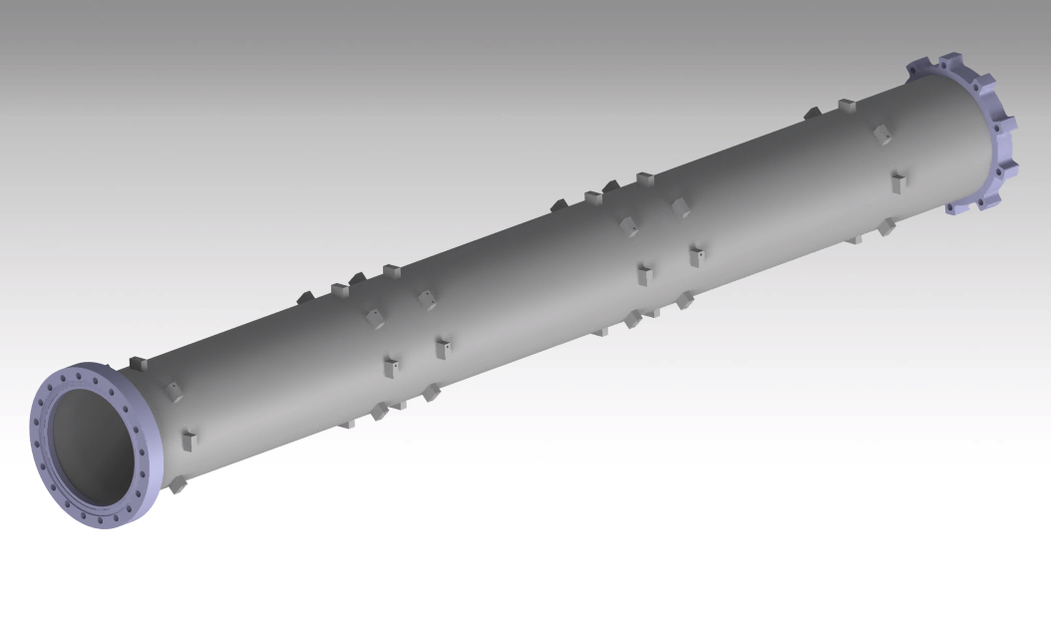
ASSEMBLY SEQUENCE
Upstream pipe sector: (Preliminary) welded support for electronics
Support for cooling pipe still missing
G. GIRAUDO - D. ORECCHINI
Beam-Target line for PANDA – GSI – 4 February 2013

Slide 18
G. GIRAUDO - D. ORECCHINI
Beam-Target line for PANDA – GSI – 4 February 2013

