Slide 1
STT Detector risk’s assessment

Slide 2
STT detector work packages
ST construction and modules assembly
Detector/General mechanics
Gas system
Front end & Read out electronics
Slow Controls
DAQ
Online software
Offline software

Slide 3
Preamble
Except FZJ and IFIN-HH, all the other involved institutions have not yet got funding for the STT construction.
This imply that there is a general risk that in case the needed funding will not be available, the STT construction will be delayed.

Slide 4
ST construction and modules assembly
Both the Forschungszentrum Julich and the LNF laboratories are equipped with the necessary tools to start the production.
The ST components have been chosen.
Some materials have been ordered.
Single straw construction procedure and quality check are under definition.
No Risks

Slide 5
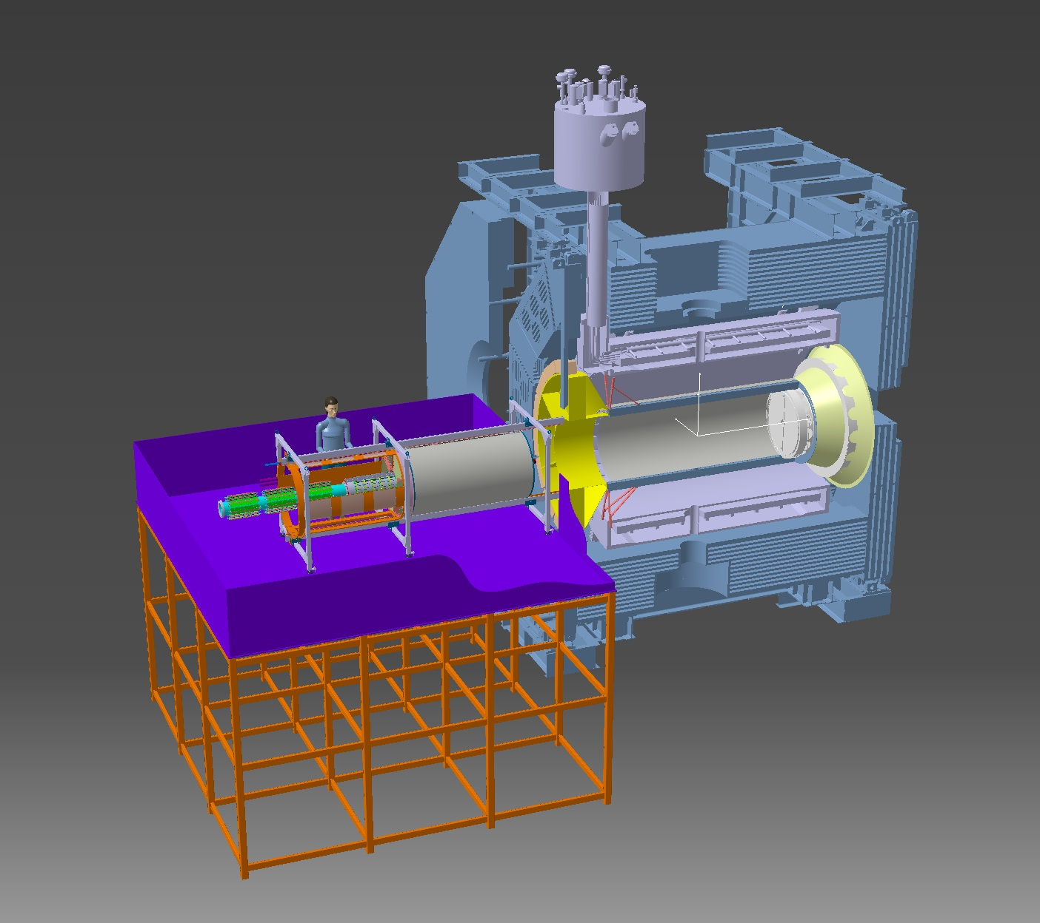
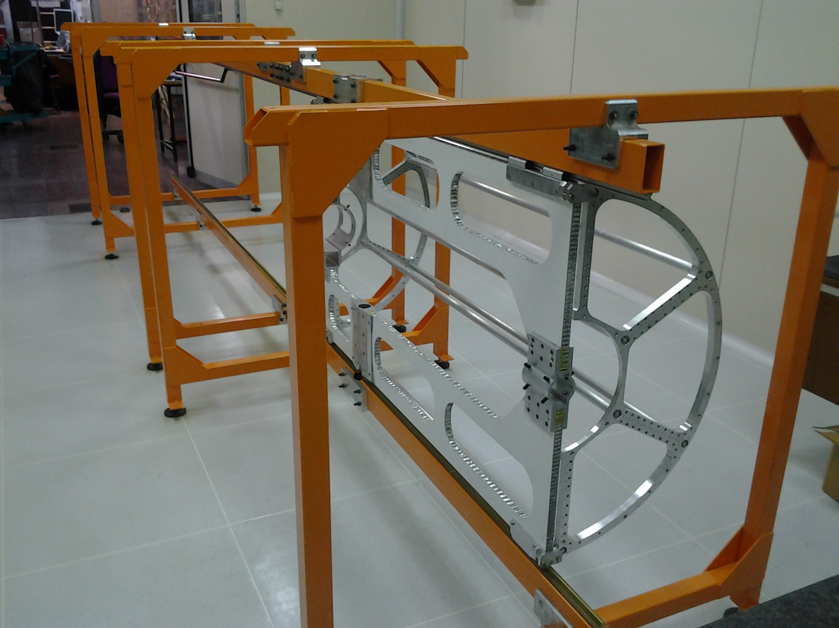
Detector Mechanics
The mechanical structure of the STT has been designed. A prototype has been realized. Optimization of the mounting scheme is ongoing.
The general mechanics for integrating STT with neighboring detectors is ongoing. Interferences with Bw-EMC and DIRC have been solved.
A second prototype will be realized this year.
No Risks

Slide 6
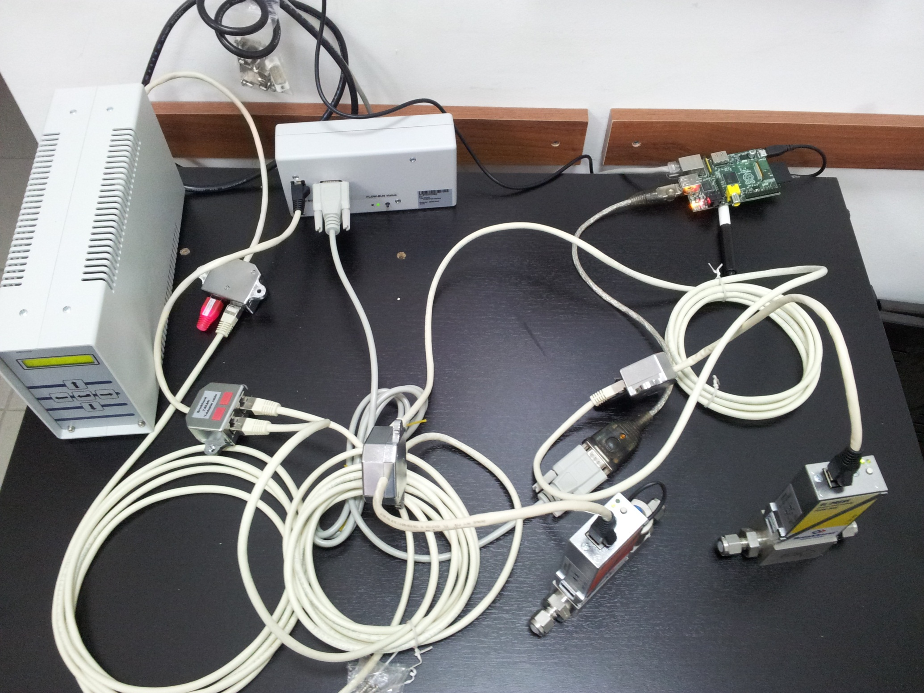
Gas system
The scheme of the STT gas system is ready. Some elements are already available.
RS232/FLOW-BUS interface
Raspberry PI board
Gas pipes routing, gas distribution and slow control are under development
FLOW-BUS E7500
Power Supply/ Readout System
No Risks
USB to RS232 converter

Slide 7
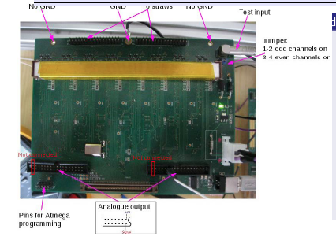
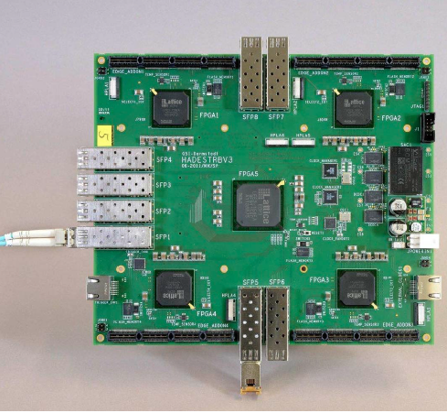
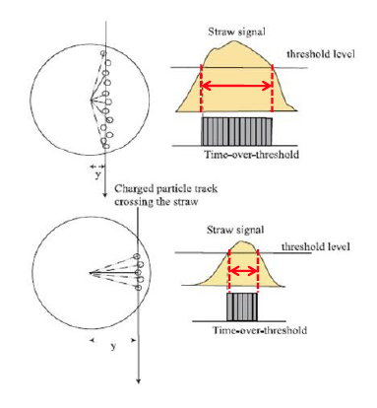
Front end & Read out electronics
Basic elements have been identified:
New ASICS for analog readout
New version of TRB (v3) for the Digital part
Two risks have been identified:
TOT will not provide enough resolution;
New ASICS development will take more time.
dE/dx using FADC
Delay in STT commissioning

Slide 8
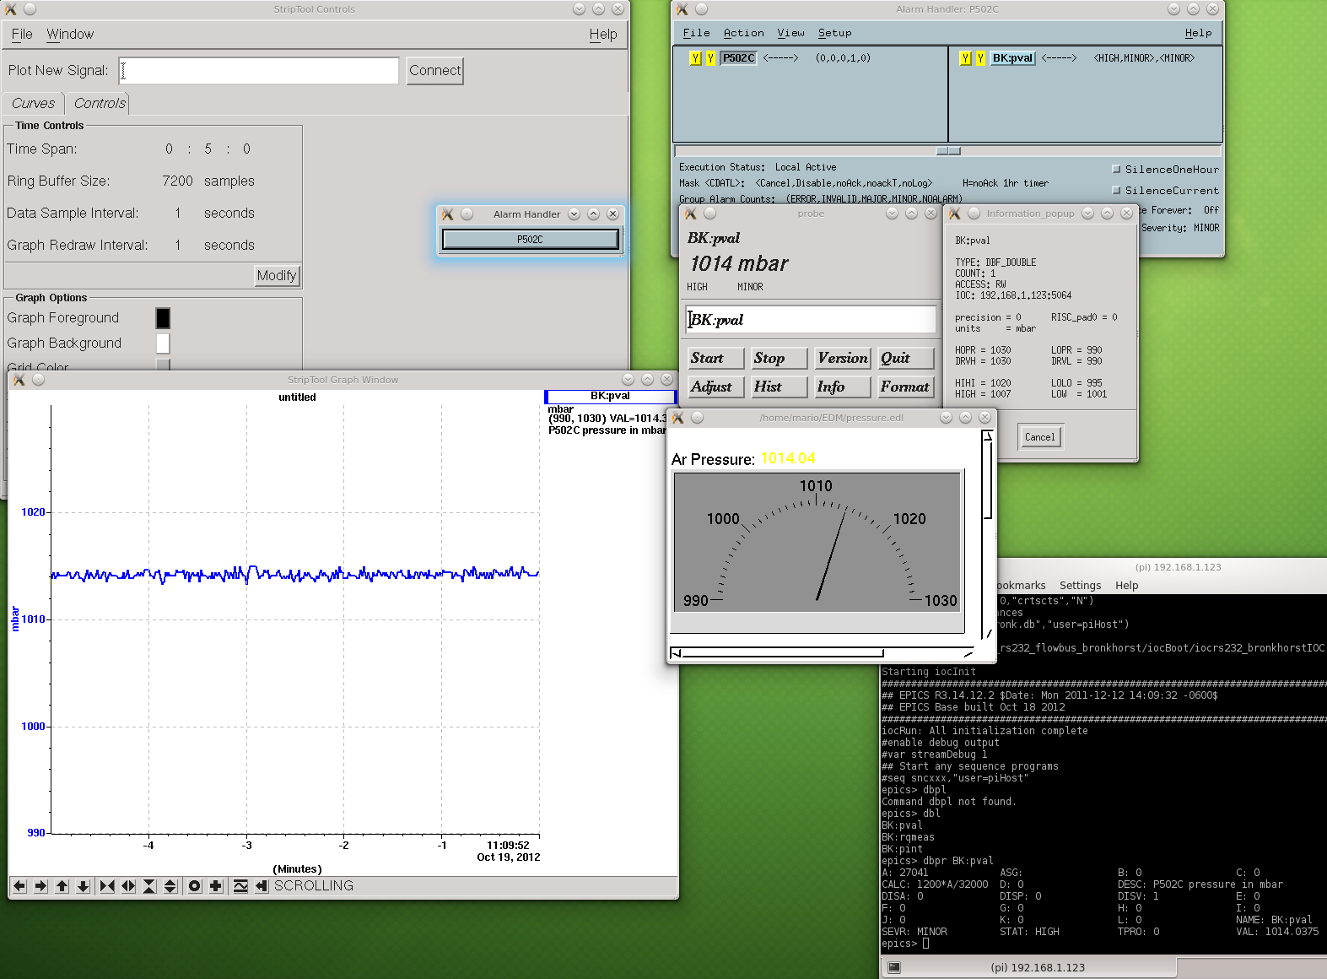
Slow Controls
Development of the first prototype of STT Slow Control System based on EPICS has been done.
Raspberry Pi terminal
StripTool, Alarm Handler, EDM and PROBE running on a Linux PC located in the same LAN with Raspberry PI
No Risks

Slide 9
DAQ
Central tracker : 4636 straws
Drift time ~ 200 ns
Time measurement: req. electronics resolution ~ 1 ns
sensitivity (threshold) ~ 2 fC
dE/dx for PID: MIP: signal charge 10⁶⁻10⁸ e⁻
10% resolution in 24 layers
detector capacitance: ~ 10-15 pF (9 pF/m)
Hit rates up to 800 kHz/channel
FE
DB
Common Clock Distribution
(i.e SODA)
Panda DAQ - network
Developments in agreement with the general requirements of the whole PANDA DAQ.
No Risks

Slide 10
Online software
Algorithm | Comments
Hough Transform, Yutie Liang | FPGA implementation
Hough Transform, Mohammad Al-Turany/Andreas Herten | GPU implementation
Non-Origin Trackfinder, Lia Lavezzi | Focused on offline, online application(?)
Triplet Finder, MCM | No isochrone info required
Track Segment Finder + Linker, Sean Dobbs | Template based
Fast Combinatorial Finder / Fitter, Sean Dobbs | Based on CLEO‘s SOLO
Forward Hough, Martin Galuska | Focused on offline, applicable for online
Detector Hits/Digis
Local Clustering
Calibration
Alignment
…
  PANDA‘s Online Tracking requires interplay of different tracking algorithms for optimum results. Work is ongoing.
STT Tracking
Global Tracking
Online Tracking
Information Merging:
PID, etc
Tracks
No Risks
Software Trigger

Slide 11
Offline software
New faster fitting methods, non-recursive has been implemented;
2) Progress has been made in the cpu time consumption;
3) Further speed can be gained by changing the search of clusters belonging to tracklets;
4) This should also clear the path to the parallelization of the code.
No Risks

