Slide 1
Target induced gas flow and vacuum calculations Johann Zmeskal SMI, Vienna
at
Calculations: A. Gruber; SMI
Measurements: H. Orth, A. Gerhardt,
J. Lühning, W. Quick; GSI
F. Ravera; Torino

Slide 2
PANDA interaction region
H₂
p^{bar}

Slide 3
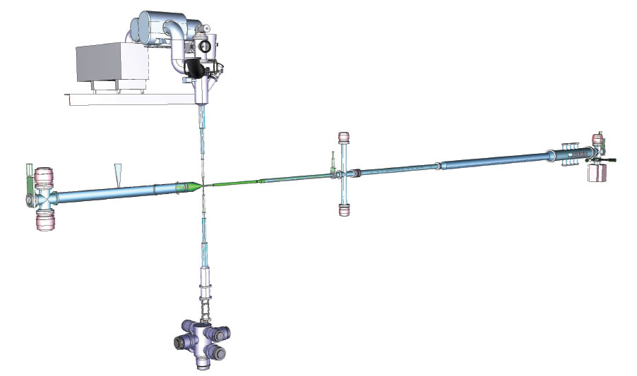
PANDA antiproton beam line
9500 mm
3000 mm
3000 mm

Slide 4
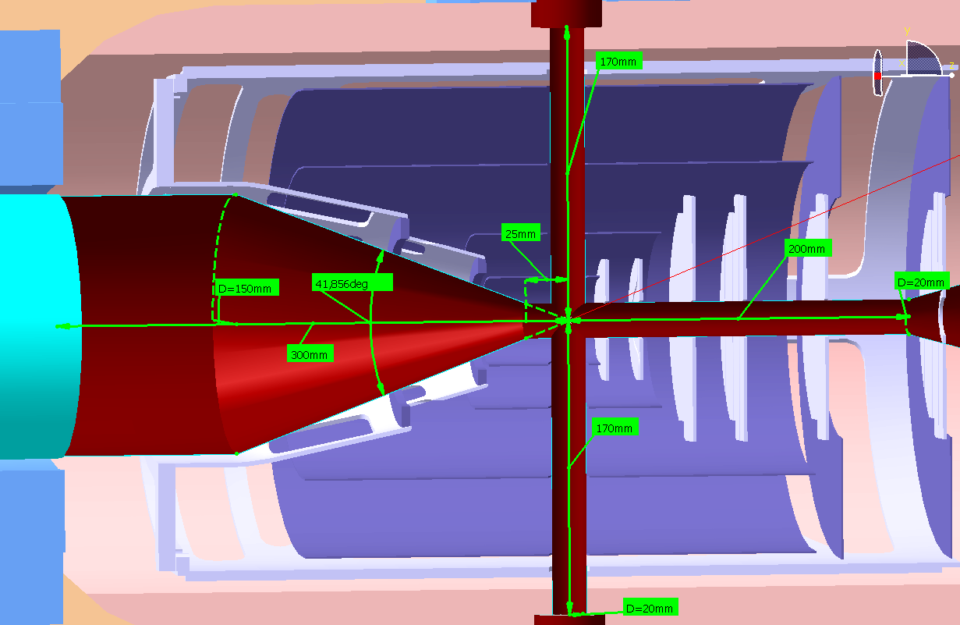
PANDA IP-cross
Current dimensions of beam-target cross:

Slide 5
PANDA antiproton beam line
pumping ports
TMP
S_{H2} =970 l/s
S_{H2} =580 l/s
S_{H2} =970 l/s
IGP
S_{H2} ~ 800 l/s
3000
3000
9500
Vacuum calculations: VAKTRAK and VAKLOOP,
written by V. Ziemann of Uppsala University

Slide 6
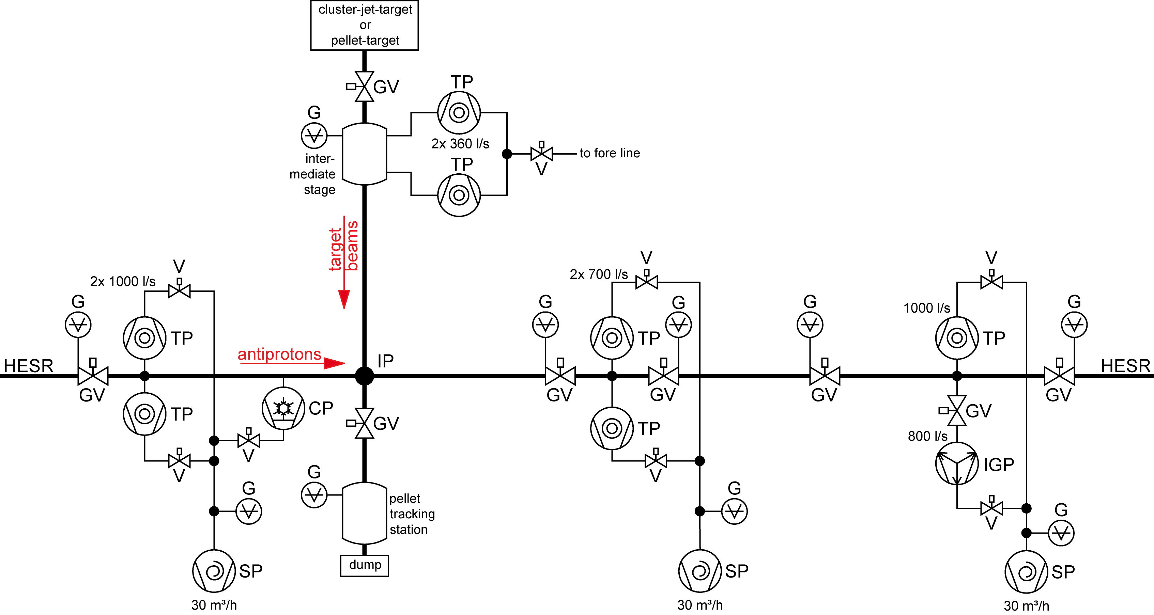
Pumping system
Details of beam line pumping system:
3 x TMP with S_{H2}=1000 l/s
2 x TMP with S_{H2}=600 l/s
1 x Ion-Getter-Pump (IGP) with S_{H2} as high as possible
1 x baffle type cryo pump upstream (under discussion)
3 x oil-free fore pumps (scroll pumps)
Cooling water required (3 x chiller)

Slide 7
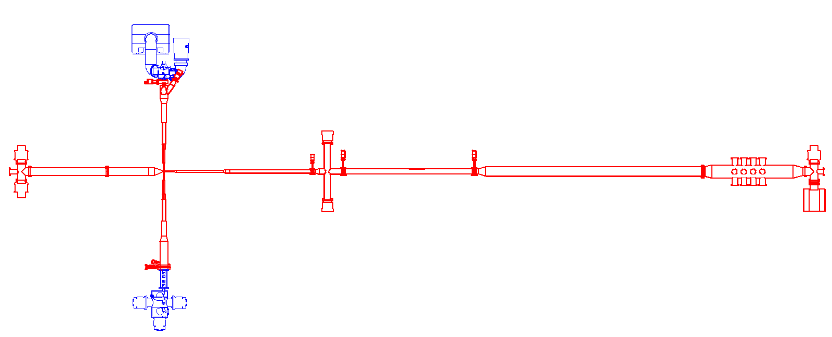
Assumptions for vacuum calculations
q_{nozzle}=67.6 mbar*l/s
S_{H2}=340 l/s
q_{jet}=0.1 mbar*l/s
S_{H2}=970 l/s
S_{H2}=970 l/s
S_{H2}=580 l/s
IGP
S_{H2}=800 l/s
q_{dest}=1.37 mbar*l/s
(4.93 [mbar*l/s]/3.6)

Slide 8
H₂ pressure profile – target line
q _{dump→IP} =3*10⁻⁵ mbar*l/s

Slide 9
H₂ pressure profile – p^{bar} line

Slide 10
Laboratory set-up
D
p^{bar}
C
B
A
cluster
p^{bar}
F

Slide 11
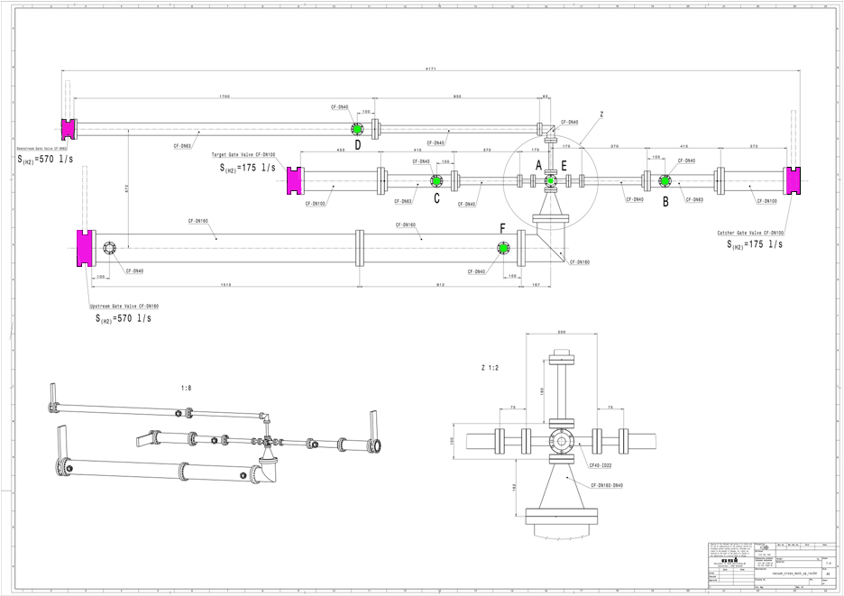
Laboratory set-up
Antiprotons Beam
Cluster jet
Antiprotons Beam
Legend:
Turbopumps
Pressure gauges

Slide 12
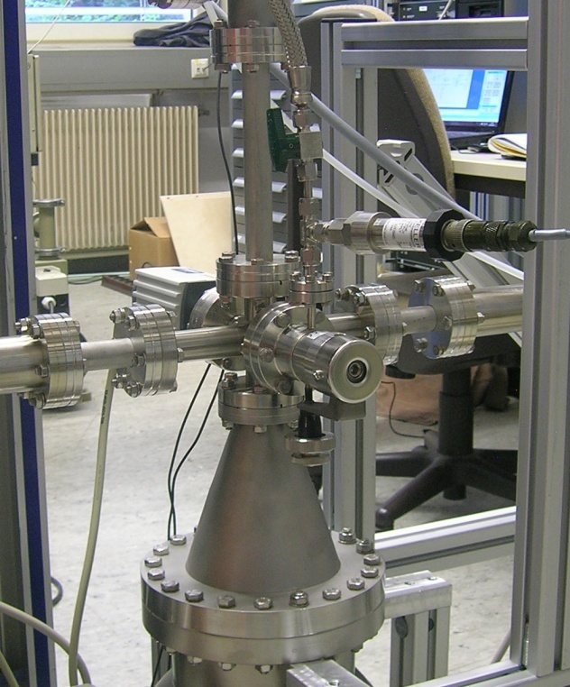
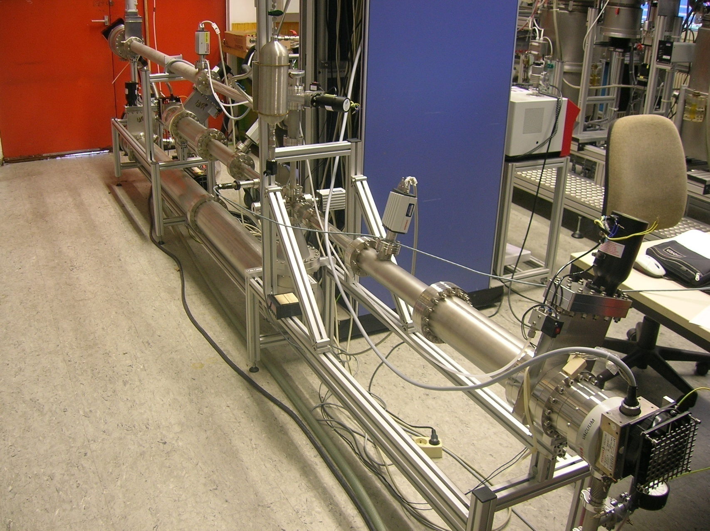
Laboratory set-up
D
C
A
B
F

Slide 13
H₂ leak measurements – inlet at “E”
 |  |  |  |  | Pressure gauge (nitrogen mode)
Fluid | Volume | t | Δp | leak rate | A | B | C | D | F
 | l | min | mbar | mbar*l/s | mbar | mbar | mbar | mbar | mbar
 | 0 |  |  | 0 | 1,5E-08 | 2,1E-08 | 8,5E-09 | 4,8E-09 | 2,7E-09
H₂ | 0,16 | 5 | 87 | 4,6E-02 | 1,8E-04 | 2,0E-05 | 2,0E-05 | 5,2E-06 | 8,6E-06
H₂ | 0,16 | 10 | 13 | 3,5E-03 | 8,3E-07 | 1,4E-07 | 1,1E-07 | 4,9E-08 | 7,1E-08
H₂ | 0,16 | 10 | 26 | 6,9E-03 | 1,3E-05 | 1,4E-06 | 1,4E-06 | 4,0E-07 | 7,0E-07
H₂ | 0,056 | 10 | 60 | 5,6E-03 | 2,4E-05 | 2,5E-06 | 2,5E-06 | 7,1E-07 | 1,2E-06
H₂ | 0,056 | 5 | 235 | 4,4E-02 | 2,0E-04 | 2,1E-05 | 2,1E-05 | 5,9E-06 | 1,3E-05
H₂ | 7,7E-03 | 10 | 20 | 2,6E-04 | 1,0E-06 | 1,3E-07 | 1,2E-07 | 4,7E-08 | 6,1E-08
H₂ | 7,7E-03 | 10 | 67 | 8,6E-04 | 5,0E-06 | 5,4E-07 | 5,6E-07 | 1,7E-07 | 2,7E-07
H₂ | 7,7E-03 | 5 | 81 | 2,1E-03 | 1,1E-05 | 1,1E-06 | 1,2E-06 | 3,5E-07 | 5,5E-07
H₂ | 7,7E-03 | 5 | 296 | 7,6E-03 | 3,7E-05 | 4,1E-06 | 4,3E-06 | 1,3E-06 | 2,0E-06
H₂ | 0,053 | 10 | 119 | 1,1E-02 | 4,9E-05 | 5,2E-06 | 5,3E-06 | 1,5E-06 | 2,4E-06
H₂ | 8,1E-03 | 270 | 128 | 6,4E-05 | 5,5E-07 | 7,4E-08 | 6,5E-08 | 2,5E-08 | 3,5E-08
H₂ | 8,1E-03 | 1185 | 433 | 4,9E-05 | 1,8E-07 | 1,8E-07 | 2,4E-08 | 1,0E-08 | 1,3E-08
H₂ | 8,1E-03 | 54 | 29 | 7,3E-05 | 1,2E-06 | 1,3E-07 | 1,3E-07 | 4,2E-08 | 7,0E-08
H₂ | 8,1E-03 | 10 | 81 | 1,1E-03 | 5,1E-06 | 5,3E-07 | 5,4E-07 | 1,7E-07 | 2,9E-07
H₂ | 8,1E-03 | 5 | 66 | 1,8E-03 | 9,9E-06 | 1,0E-06 | 1,1E-06 | 3,2E-07 | 5,5E-07
H₂ | 8,1E-03 | 5 | 326 | 8,8E-03 | 4,3E-05 | 4,5E-06 | 4,6E-06 | 1,3E-06 | 2,2E-06

Slide 14
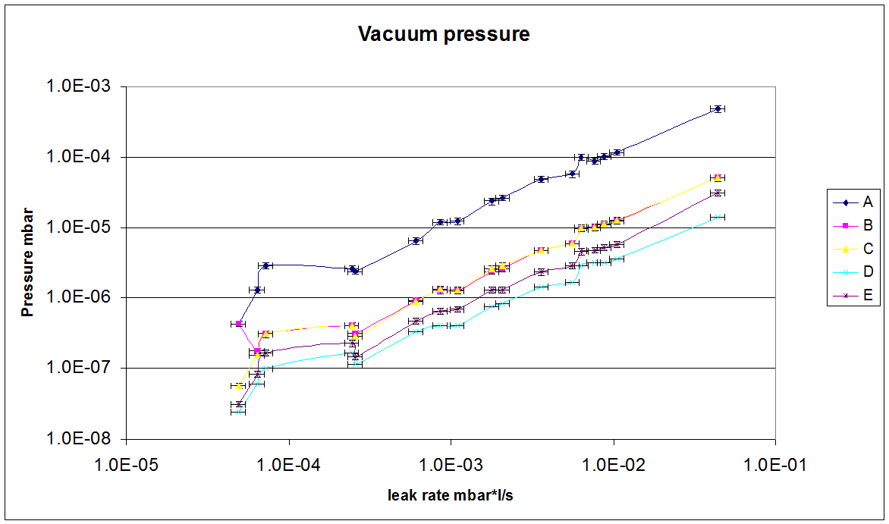
H₂ leak measurements – inlet at “E”

Slide 15
H₂ leak measurements with calibrated leak – inlet at “E”
 |  |  |  |  |  | Pressure gauge N₂ mode
Date | Fluid | Volume [l] | t [min] | Δp [mbar] | q_{pV} [mbar*l/s] | A [mbar] | B [mbar] | C [mbar] | D [mbar] | F [mbar]
06.09.2011 | H₂ | 8,3E-03 | 60 | 106 | 2,4E-04 | 1,1E-06 | 1,7E-07 | 1,7E-07 | 6,9E-08 | 9,4E-08
06.09.2011 | H₂ | 8,3E-03 | 20 | 88 | 6,1E-04 | 2,7E-06 | 3,8E-07 | 3,7E-07 | 1,4E-07 | 2,0E-07
07.09.2011 | H₂ | 5,4E-02 | 30 | 211 | 6,3E-03 | 4,2E-05 | 4,0E-06 | 4,1E-06 | 1,2E-06 | 1,9E-06
07.09.2011 | H₂ | 5,4E-02 | 20 | 80 | 3,6E-03 | 2,0E-05 | 2,0E-06 | 2,0E-06 | 6,0E-07 | 9,8E-07
08.09.2011 | H₂ | 5,4E-02 | 1317 | 139 | 9,5E-05 | 1,5E-07 | 2,4E-08 | 1,5E-08 | 9,5E-09 | 1,1E-08
15.09.2011 | H₂ | 5,4E-02 | 5 | 150 | 2,7E-02 | 1,4E-04 | 1,3E-05 | 1,1E-05 | 3,5E-06 | 5,5E-06
29.11.2011 | He | - | - | - | 0,0 | 2,4E-08 | 1,3E-08 | 1,3E-08 | 1,8E-08 | 7,4E-09
 |  | - | - | - | 4,4E-06 | 9,9E-08 | 2,1E-08 | 2,1E-08 | 1,0E-07 | 1,3E-08
30.11.2011 | He | - | - | - | 0,0 | 2,0E-08 | 9,2E-09 | 9,3E-09 | 1,7E-08 | 4,9E-09
 |  | - | - | - | 4,4E-06 | 7,7E-08 | 1,6E-08 | 1,6E-08 | 8,0E-08 | 9,9E-08
02.12.2011 | H₂ | - | - | - | 0,0 | 1,50E-08 | 5,60E-09 | 6,80E-09 | 1,00E-08 | 3,20E-09
 |  | - | - | - | 6,20E-06 | 7,60E-08 | 1,30E-08 | 1,40E-08 | 7,40E-08 | 8,80E-09
04.05.2012 | N₂ | - | - | - | 0,0 | 2,30E-09 | 1,10E-09 | 1,30E-09 | 5,00E-10 | 5,40E-10
 |  | - | - | - | 1,66E-06 | 8,80E-08 | 9,60E-09 | 1,10E-08 | 8,30E-08 | 1,20E-08
11.05.2012 | H₂ | - | - | - | 0,0 | 6,20E-09 | 3,10E-09 | 1,60E-09 | 2,70E-09 | 9,10E-10
 |  | - | - | - | 6,20E-06 | 7,10E-08 | 9,90E-09 | 9,30E-09 | 6,00E-08 | 9,30E-09

Slide 16
H₂ pressure profile – p^{bar} line

Slide 17
Conclusions
Vacuum calculations under control
for more refined calculations:
input from beam dump measurements;
gas losses of the cluster jet (pellet) beam;
leak measurements of the junctions:
cluster head, beam dump, p^{bar} line, .....

