Slide 1
Development of
hydrogen purifier
Johann Zmeskal
Stefan-Meyer-Institut für subatomare Physik
FP7-HP3: FutureJet Workshop
Vienna, April 18-19, 2013

Slide 2
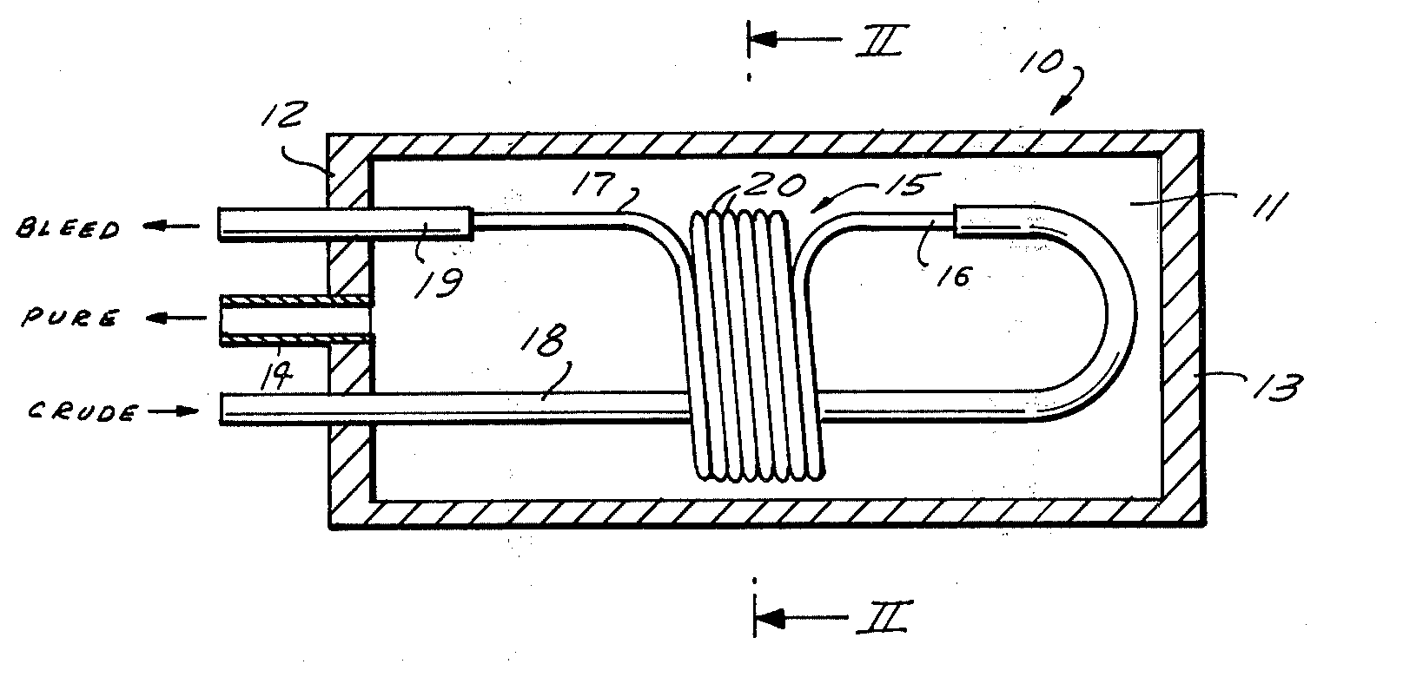

Slide 3
Theory of Operation
Palladium (Pd) membrane purifiers operate on the principle of diffusion.
The Pd membrane absorbs hydrogen molecules onto its surface, where each hydrogen molecule dissociates into two hydrogen atoms.
Each hydrogen atom loses its electron to the Pd alloy and diffuses through the Pd metal lattice as a proton.
The protons recombine with two electrons on the far side of the lattice to form a hydrogen molecule that is desorbed from the Pd alloy membrane.
The partial pressure of hydrogen on each side of the palladium membrane determines the direction and flow rate of hydrogen across the membrane.
Typical temperatures for the diffusion process are about 300° - 350°C, with a pressure of 1.0 to 1.5 MPa.
For leak-free purifier membrane, the total concentration of impurities has been shown to be less than 1 ppb.

Slide 4
Advantage of Palladium Membrane Technology
Solid barrier with no breakthrough
Catalytic purifiers will allow hydrogen and impurities to flow through the purifier, while the palladium alloy is a solid barrier to all contaminants.
Catalytic purifiers may under some conditions (flow rate, temperature, vessel orientation) desorb impurities, resulting in breakthrough.

Slide 5
Disadvantages of Palladium Membrane Technology
Membranes can crack
Pd membrane purifiers can crack when the cell is repeatedly allowed to cool (i.e., from power failure) in presence of hydrogen.
Therefore, a control system has to protect the membrane by removing all H2 automatically (within minutes) while replacing the hydrogen, e.g. with non-reactive nitrogen.

Slide 6
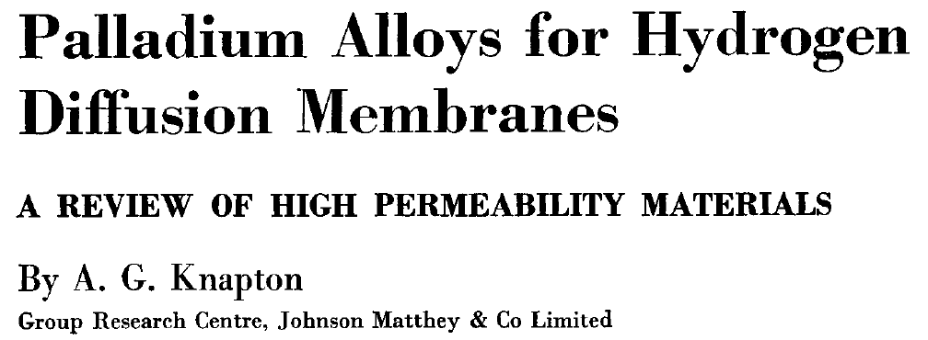
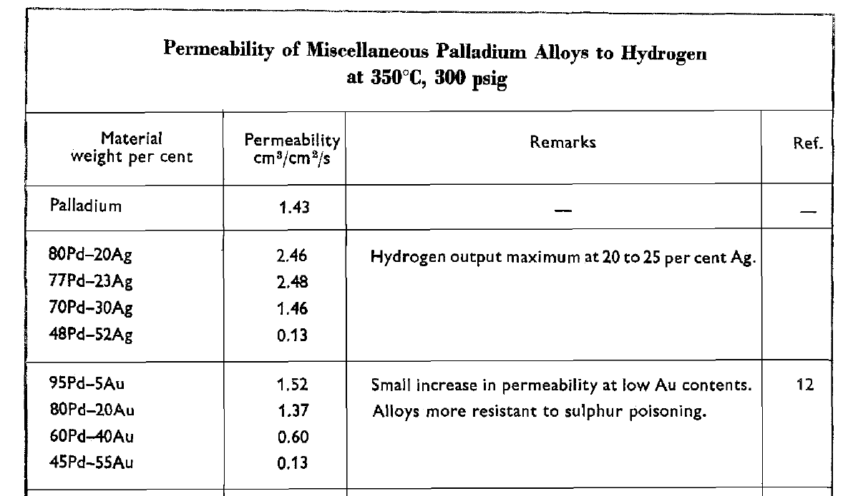
for a given membrane thickness of 25 µm

Slide 7
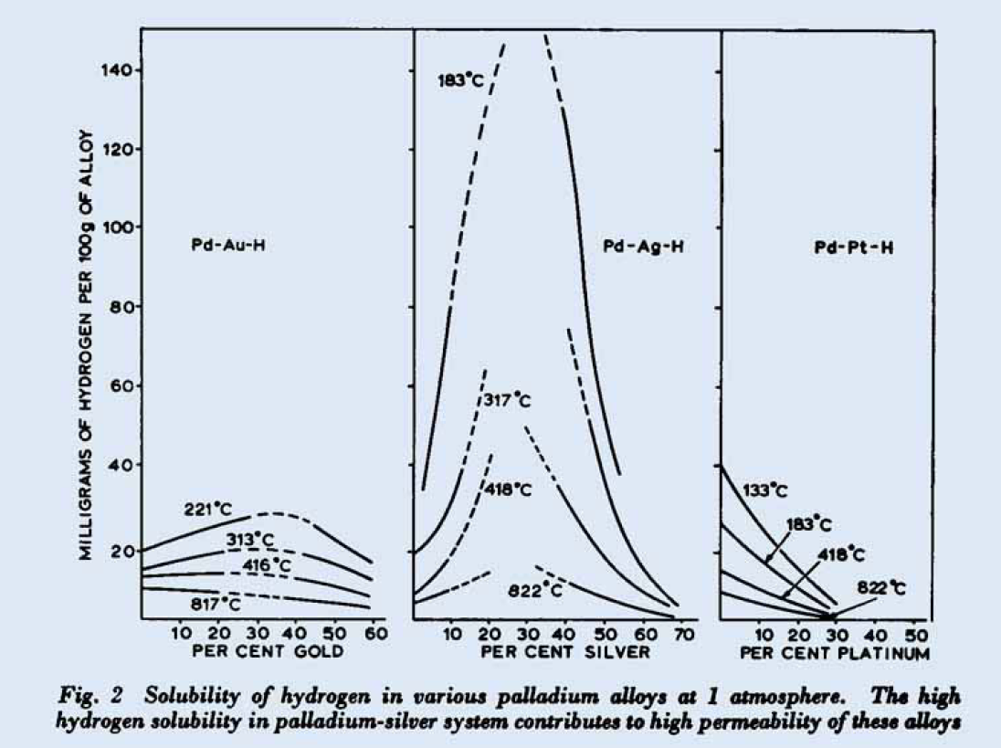

Slide 8
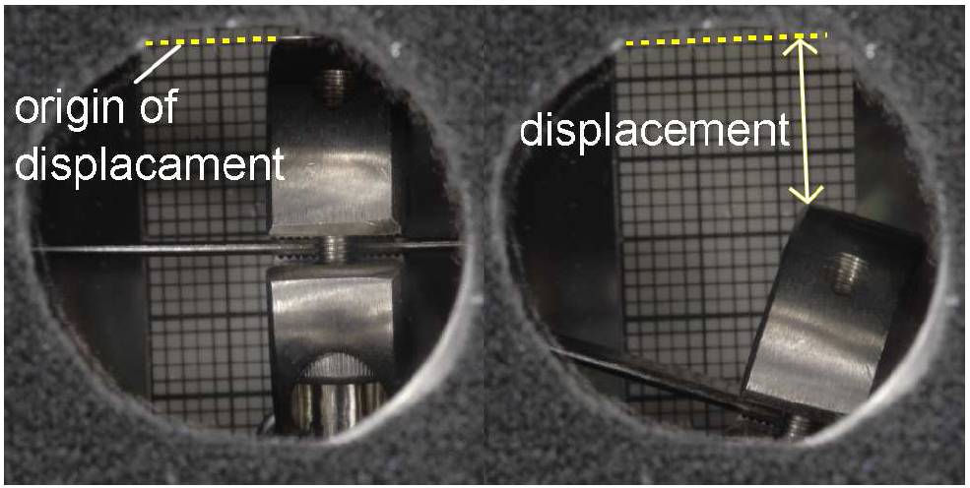
Deformation of Palladium Plates by a Small External Stress during Hydrogen Absorption and Desorption
Akio Kawasakiª, Satoshi Itoh^{a,b}, Kunihiro Shima^{c}, Toshimitsu Yamazaki^{a,b}
a) Department of Physics, University of Tokyo, Bunkyo, Tokyo 113-0033, Japan
b) RIKEN, Nishina Center, Wako, Saitama-ken 351-0198, Japan
c) Tanaka Kikinzoku Kogyo K.K., Tomioka, Gunma-ken 370-2452, Japan
The displacement by a cycle of absorption and desorption of hydrogen was from 9.4 mm to 17.1 mm.

Slide 9
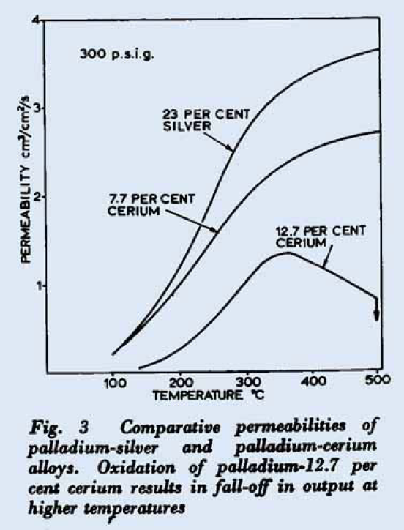
for a given membrane thickness of 25 µm

Slide 10
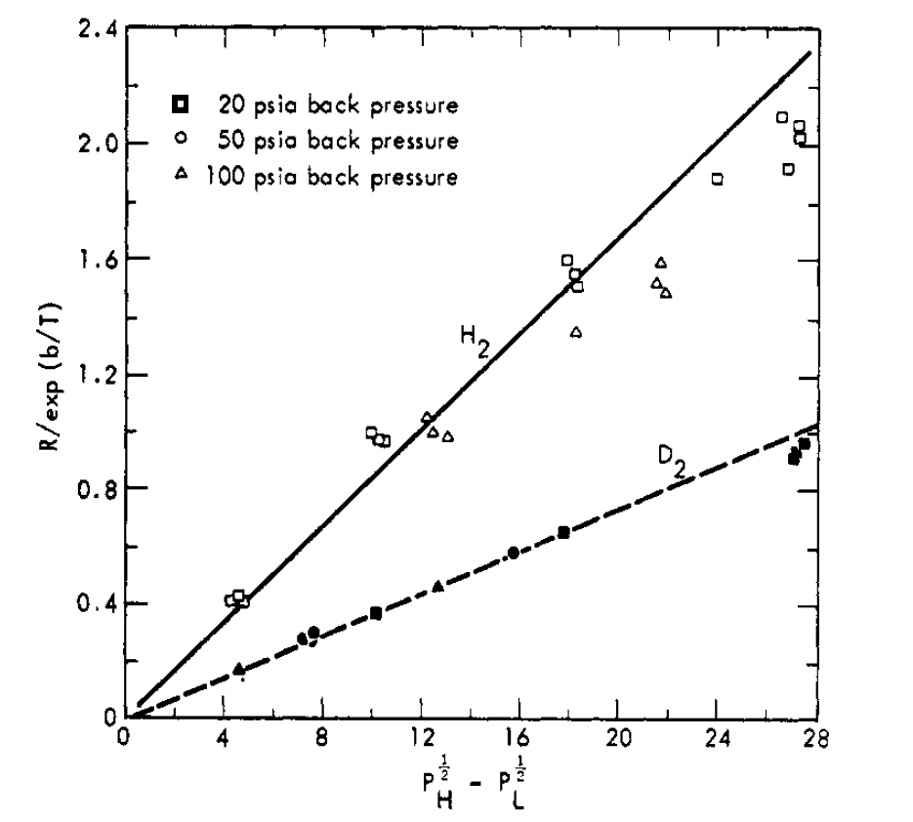
Hydrogen and deuterium permeation
300°C
[mol/min]
A..area [cm2], T...temperature [K], P...pressure [pisa]

Slide 11
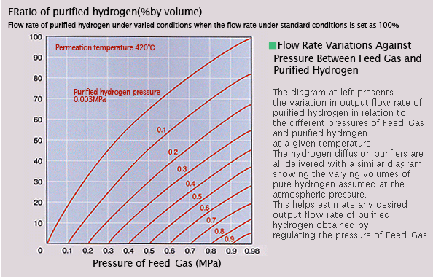

Slide 12
It is imperative that the palladium membrane never cool down in the presence of hydrogen to insure long life of the hydrogen purifier. When the palladium (Pd) membrane cools in the presence of hydrogen, the Pd alloy may absorb hydrogen, increase in volume, and become distorted. The physical expansion of the palladium alloy causes stress on the membrane and the joints where the membrane is attached to the manifold. The result is reduced life of the membrane and possible leakage at the joints.

Slide 13
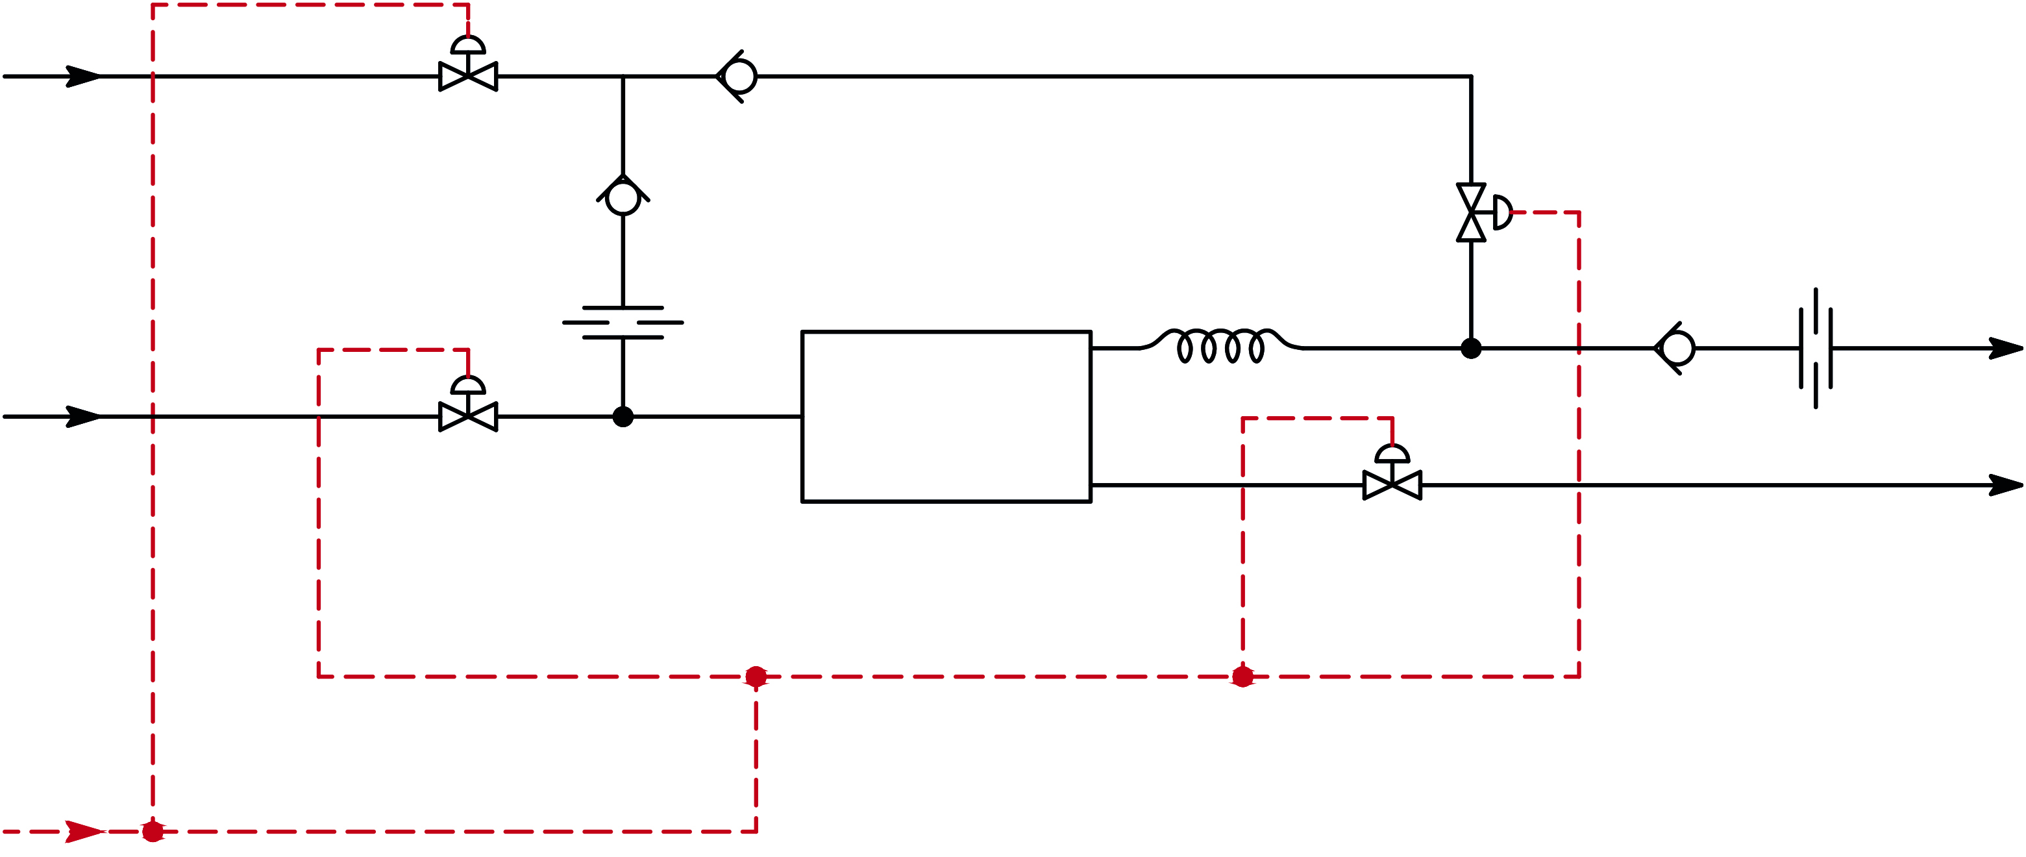
Hydrogen purifier control circuit
N2 feed
N.O.
N.O.
Pd-filter
bleed
H2 feed
bleed
feed
N.C.
pure
N.C.
UPH
pressurized
air

Slide 14
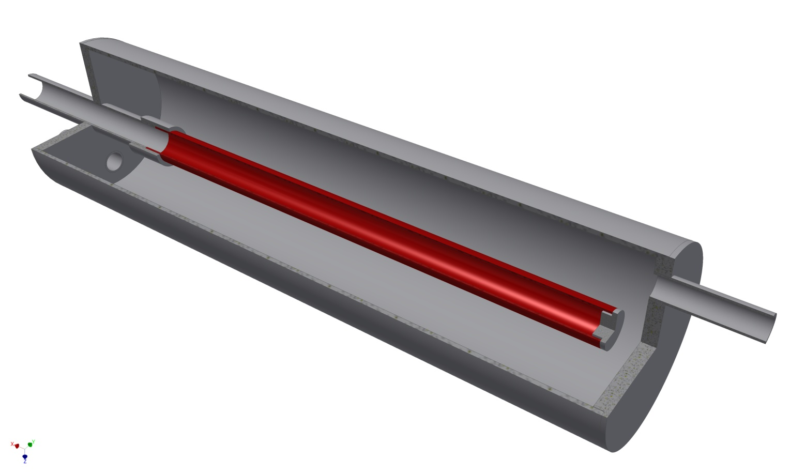
Palladium-tube test cell
Pd-silver alloy tube:
Ag 25%
length 300 mm
diam. 6,35 mm
wall 0,5 mm
pure
crude
400 mm
bleed
Planned to be used for SIDDHARTA at LNF:
Designed for medium pressure (< 10 bar) and a large Δp (> 5 bar).

Slide 15
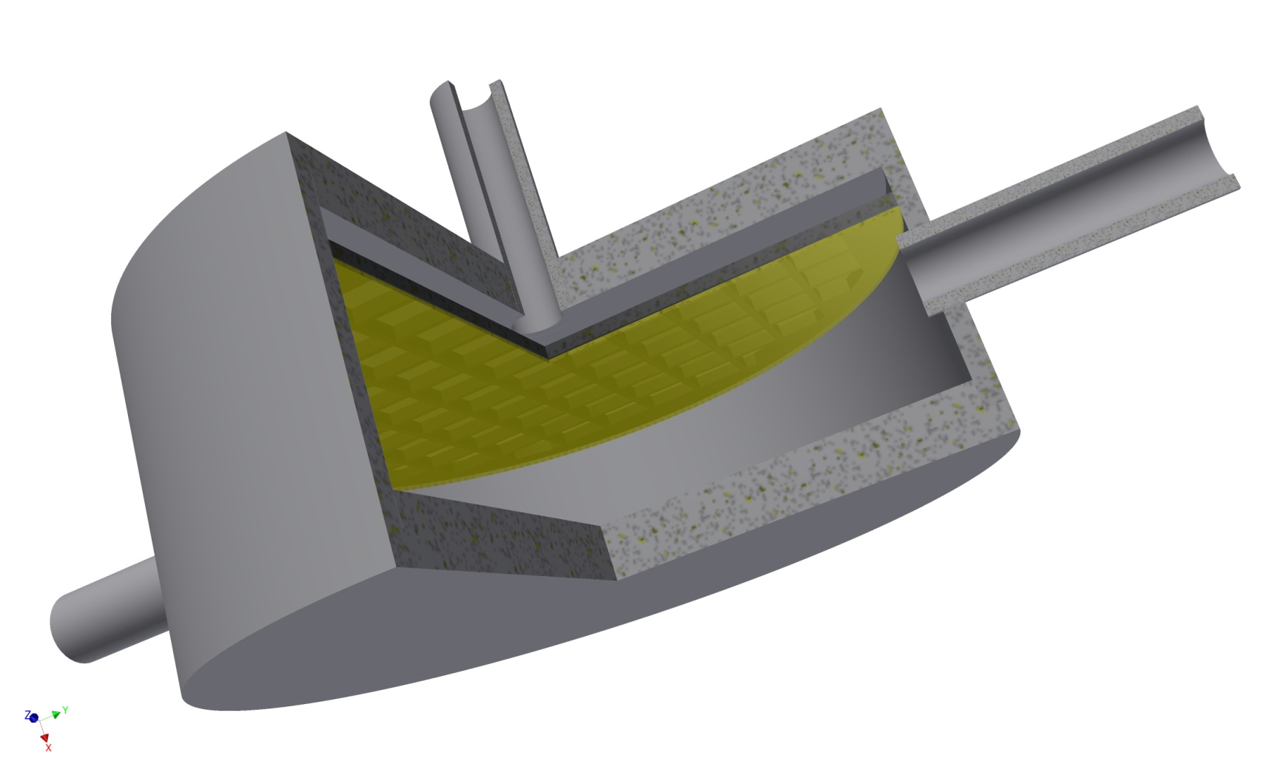
Palladium-foil cell
Pd-silver foil:
Ag 25%
diam. 30,0 mm
wall 0,25 mm
pure
bleed
crude
Used for purification of tritium
at TRIUMF:
Designed for low pressure (< 1 bar) and small Δp (~0,2 bar).

