Slide 1


Slide 2
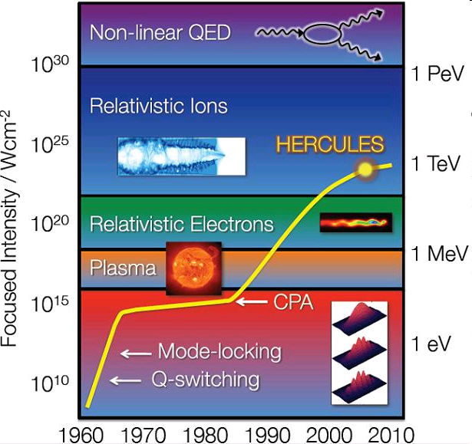
Development of laser intensities
Focussed
intensity
(W/cm²)
Characteristic
electron energy

Slide 3
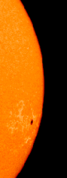


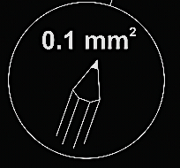
High intensities …
1367 W/m²
10²⁰ W/cm²
Notes:
Solarkonstante: 1367 W/m²; Fläche der Erdscheibe: 1.29 x 10^8 km² = 1.29 x 10^8 km²
Ges. Strahlungsfluss auf die Erde: 1,76 x 10^17 W
dto. bezogen auf 0.1 mm²: 1,76 x 10^20 W/cm²

Slide 4
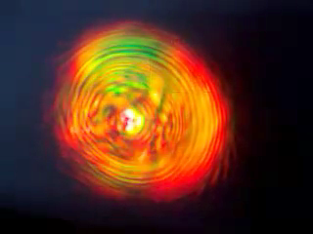

Particle acceleration: typical setup
ultra-short
high-intense
laser pulse
target
gas jets
underdense plasma
solid targets
overdense plasma
particles
electrons
up to ~100 MeV*
*
protons / ions
up to ~10 MeV*
Video from: http://www.youtube.com/watch?v=jBjqT3AQkH0&feature=related
* typical values at HHUD
Notes:
Laser: 100GW, 35fs, 1kHz, beam waist ~5mm FWHM, lens f=40mm singlet, \lambda = ~800nm

Slide 5

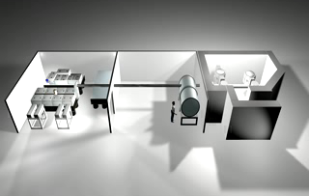
DARCTURUS
Institute für Laser- und Plasmaphysik, Univ. Düsseldorf (Prof. O.Willi)
PULSAR Ti:Sapphire Laser: 100 + 200 TW, 800 nm
~ 2,5 Joule, less than 25 femtoseconds
focused on 10 microns

Slide 6
Acceleration mechanisms
Radiation pressure („direct“, thin foil targets)
Wake fields / bubbles (gas targets)
Target Normal Sheath Acceleration (foil targets)
Break-Out Afterburner (thin foil targets)
…

Slide 7
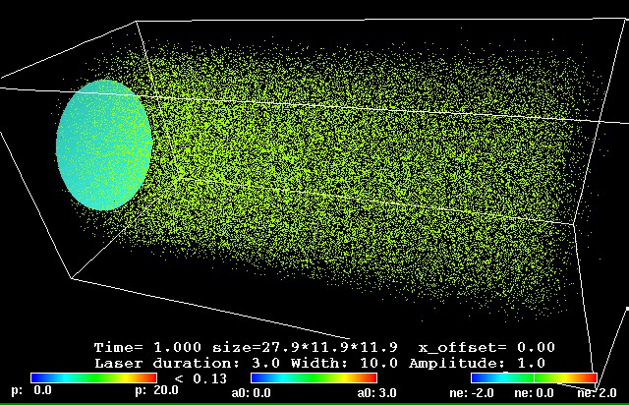
“Bubble“ acceleration (gas targets)
simulation: P.Gibbon, FZ Jülich
accelerates
electrons

Slide 8
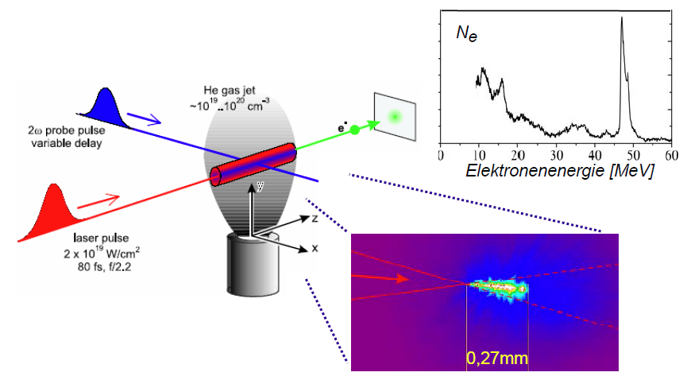
Formation of plasma channel
J.Hein, R.Sauerbrey, Generation of ultrahigh light intensities and relativistic laser-matter interaction,
in Springer Handbook of Lasers and Optics (2007), ISBN 978-0-387-95579-7

Slide 9

Target Normal Sheath Acceleration (TNSA)
Target foil
~ 100 GV/m
Notes:
Carbon hydrites

Slide 10
Target Normal Sheath Acceleration (TNSA)
H. Schwörer et al., Nature 439, 445 (2006)

Slide 11
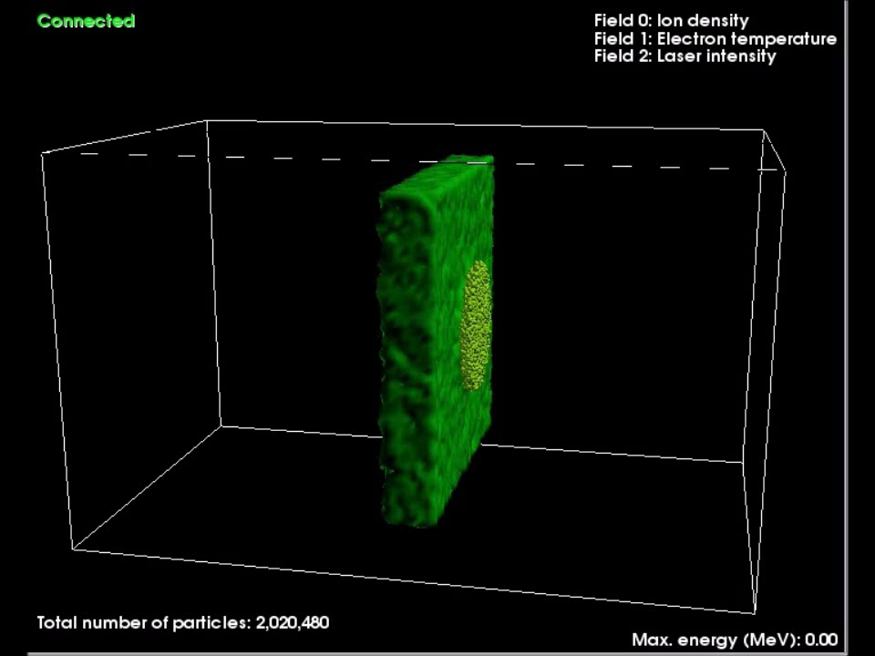
TNSA (foil targets)
simulation: P.Gibbon, JSC, FZ Jülich
accelerates
protons/ions

Slide 12
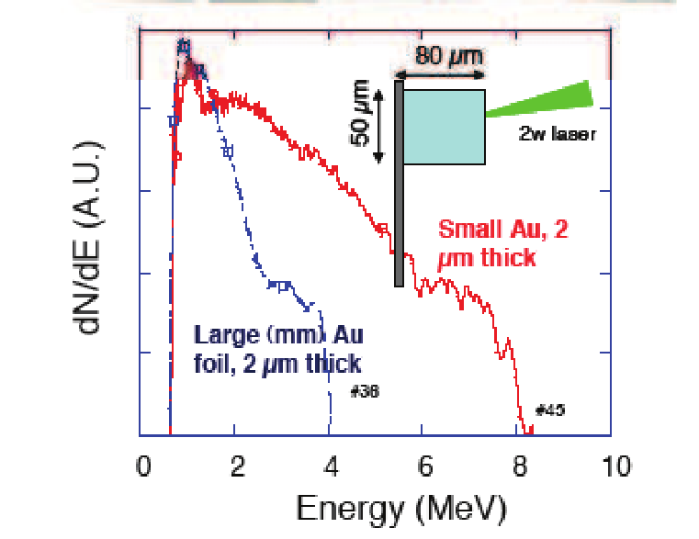
Limited-mass targets
Accumulation of protons in regions with high field strength
Reduced reflux of electrons from the target
J.Fuchs, M. Borghesi,
T. Cowan, O. Willi et. al.

Slide 13
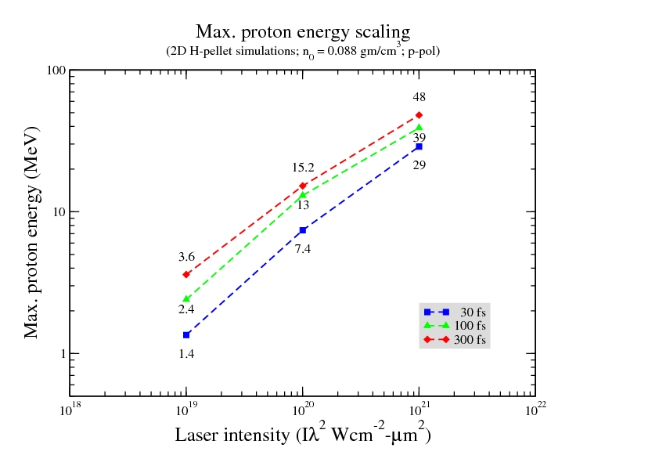
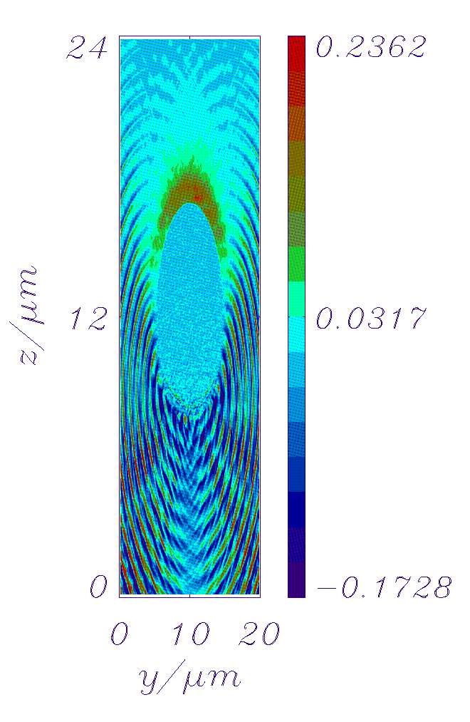
Hydrogen pellets as target
2-D Simulations from the JSC Jülich
Laser pulse (λ=1 µm, focus Ø =10 µm) hits a 10 µm frozen H₂ pellet
COSY injection energy

Slide 14
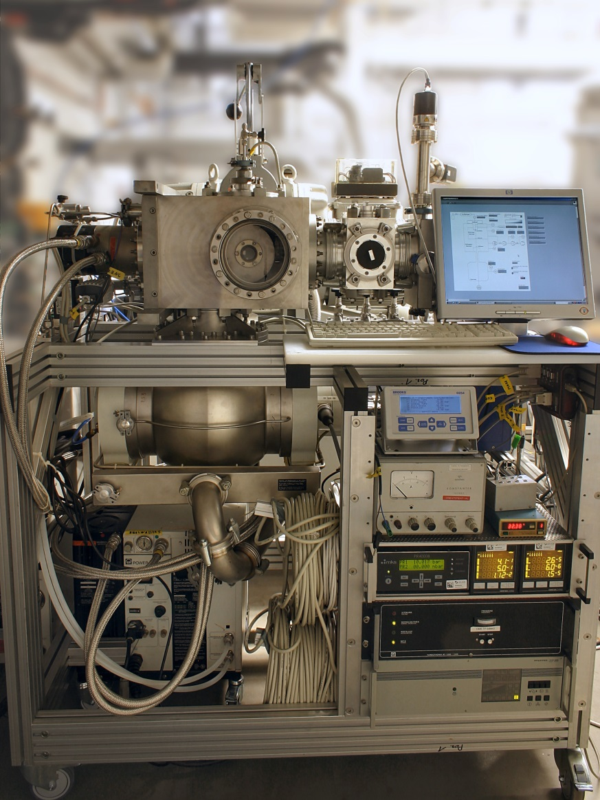
A cluster-jet target for laser applications
Photo:
Target in test stand / Univ. Münster
April 2013
Transfer to HHUD
Summer 2013
First measurements with „small“ laser
Fall 2013

Slide 15
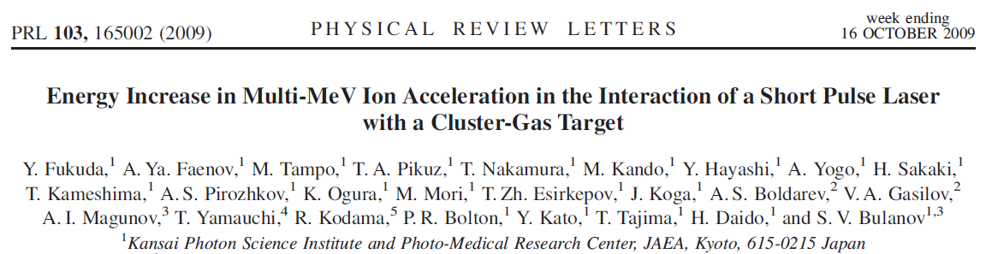
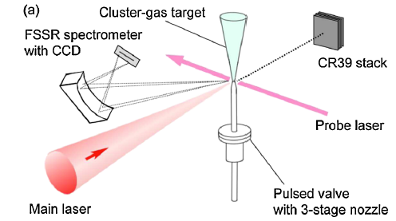
Laser-cluster interaction
A first experiment
Target:
CO₂ clusters in He gas (60 bar)
Cluster Ø ~ 400 nm
3·10⁹ cluster/cm³

Slide 16
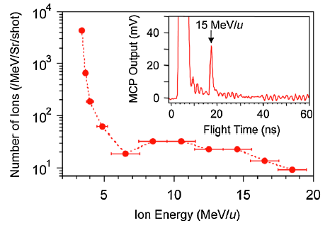
Laser-cluster interaction
Much higher energies as from pure gas or foil targets!
Laser:
4(!) TW Ti:Sa
40 fs / 150 mJ / 1 Hz

Slide 17
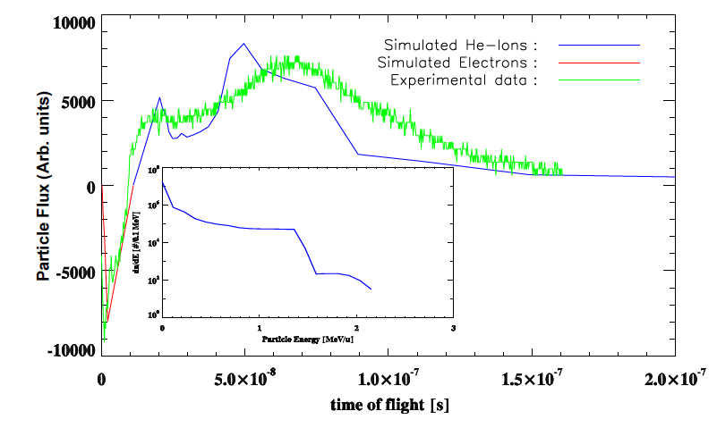
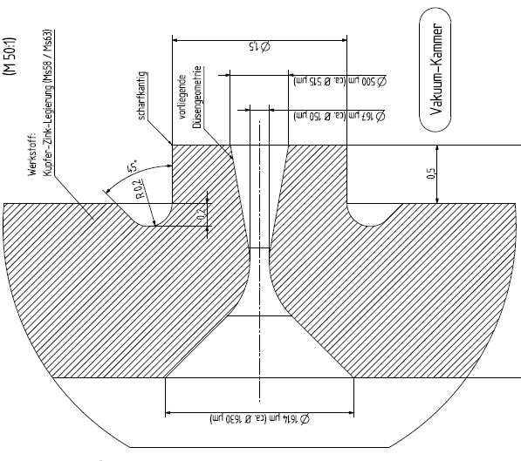
Ions from gas target
Data: Arcturus / HHUD (~100 TW)
Thin (~500 µm) ⁴He gas jet → TNSA-like acceleration
Simulations: EPOCH on JUROPA supercomputer (JSC/FZJ)
See P.Greven, Diploma Thesis, RWTH Aachen (April 2013)

Slide 18
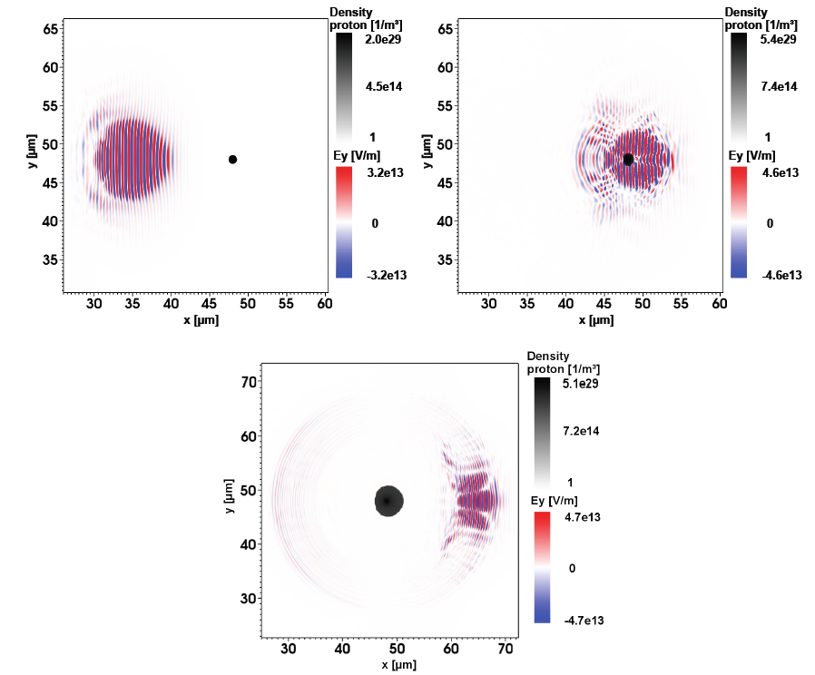
Laser-cluster interaction
Simulation for Arcturus / HHUD (100 TW, 1.3 · 10²⁰ W/cm²)
H₂ cluster (Ø =1 µm) in a H₂ gas
Laser pulse
Expanding cluster
Simulations: EPOCH on JUROPA supercomputer (JSC/FZJ)
See P.Greven, Diploma Thesis, RWTH Aachen (April 2013)

Slide 19
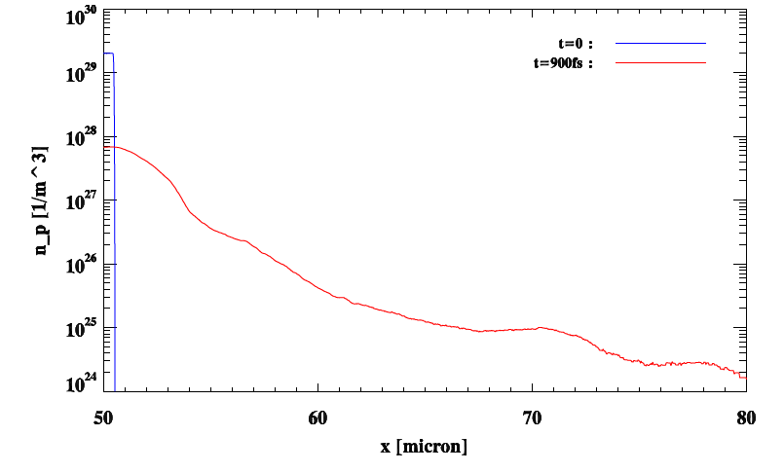
Cluster expansion
Pressure of hot electrons & Coulomb explosion

Slide 20
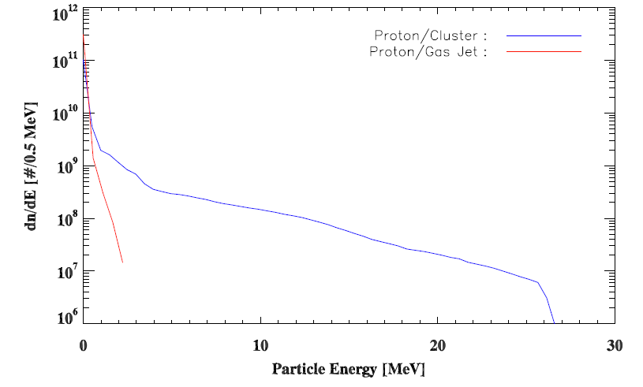
Protons from cluster/gas target
Simulation for pure H₂ clusters / gas

Slide 21
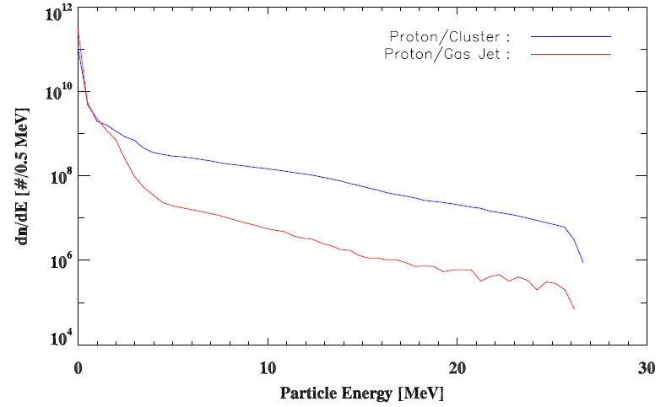
Protons from cluster/gas target
Simulation for H₂ cluster in H₂ gas
Clusters enhance acceleration from surrounding gas!

Slide 22
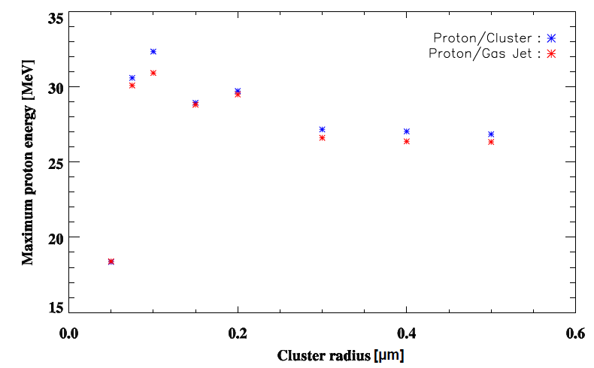
Protons from cluster/gas target
Optimization of cluster radius

Slide 23
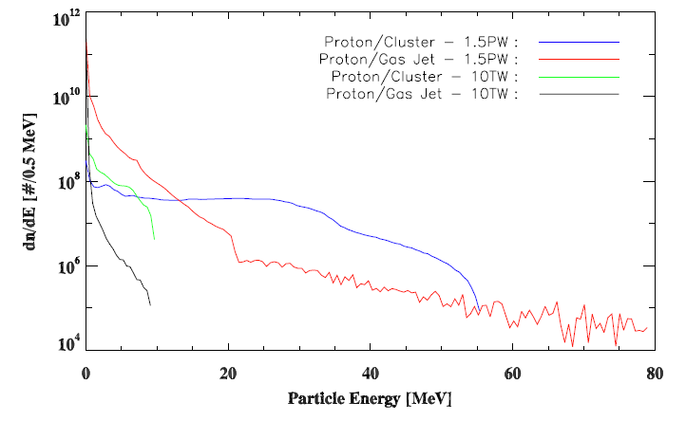
Possible applications (1):
Proton acceleration at JuSPARC

Slide 24
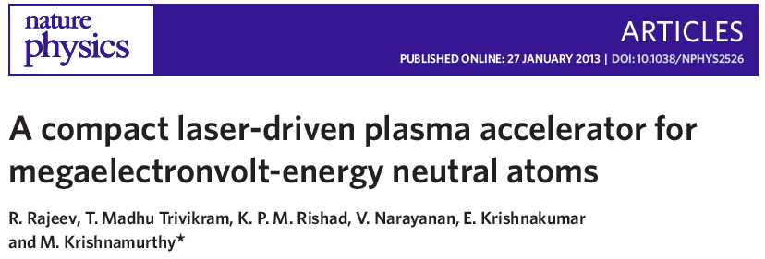
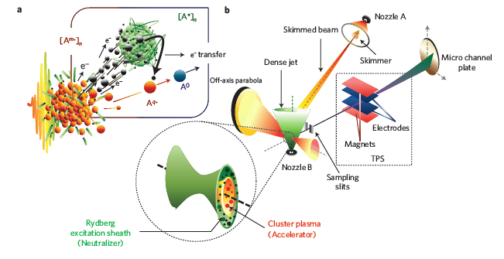
Possible applications (2):

Slide 25
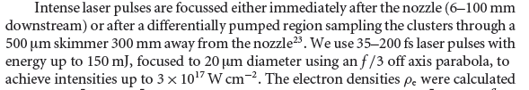
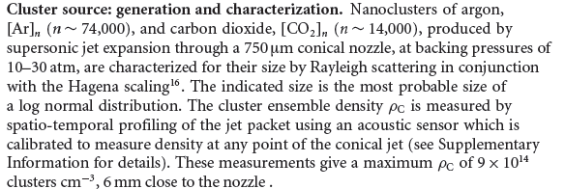
Possible applications (2):

Slide 26
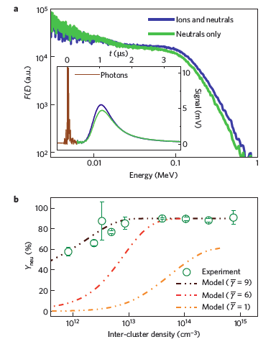
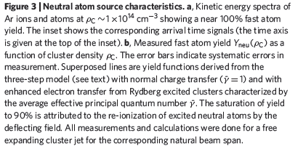
Possible applications (2):
MeV neutral atoms

Slide 27
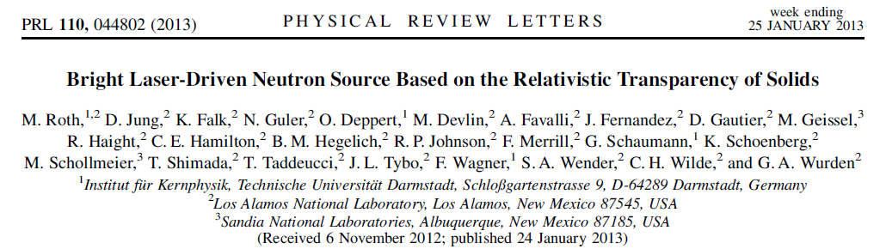
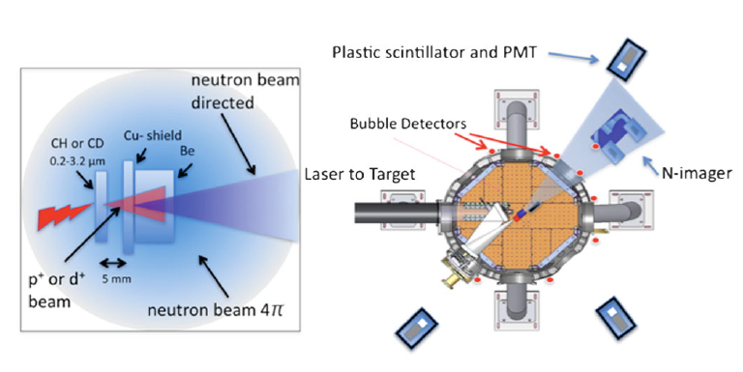
Possible applications (3):
TRIDENT Laser, Los Alamos
200 TW / 80 J / 600 fs

Slide 28
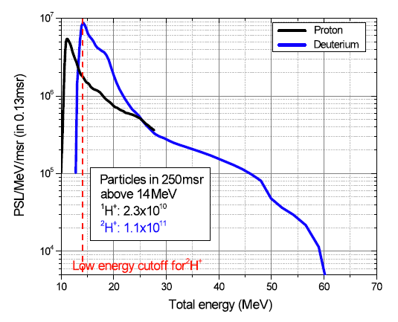
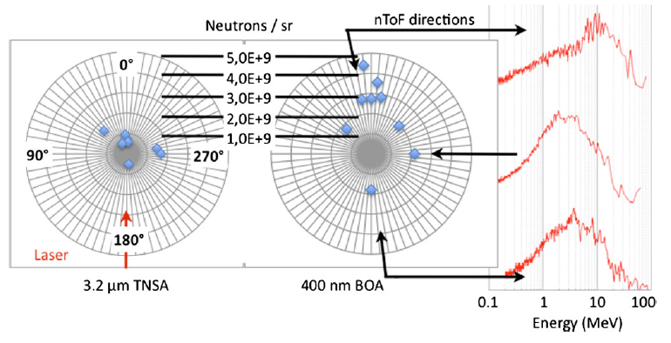
Possible applications (3):
Pulsed MeV neutron source
Up to 10¹⁰ n/sr

Slide 29
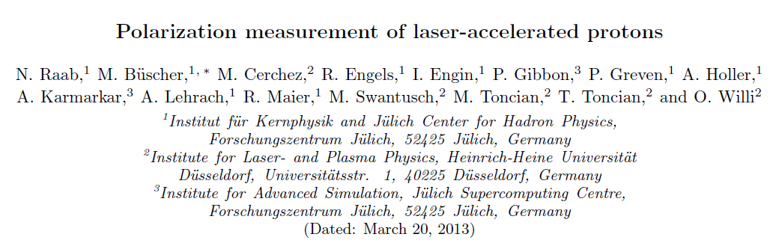
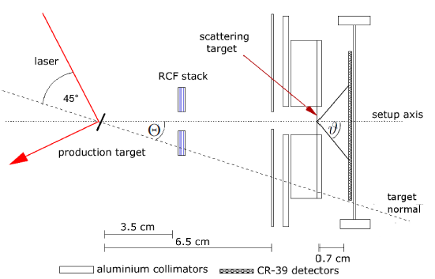
Possible applications (4):
Polarized ion sources
Submitted to PRL

Slide 30
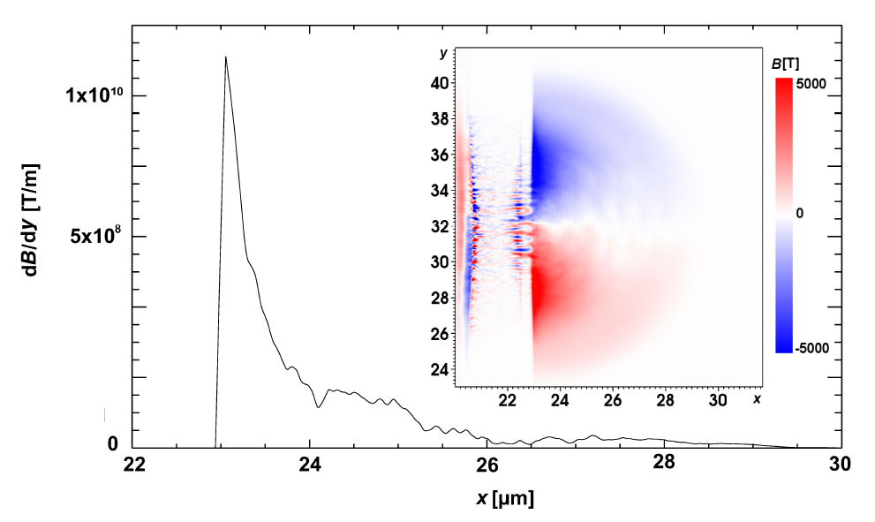
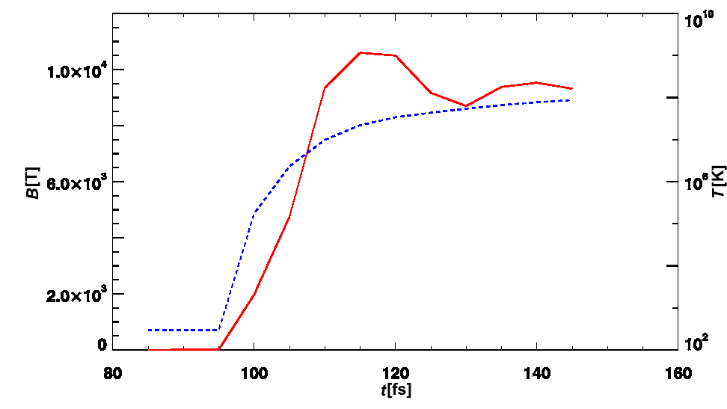
Possible applications (4):
Polarized ion sources
Unpolarized foil target:
No polarization build-up through
magnetic field (gradient)

Slide 31
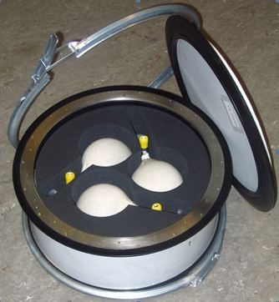
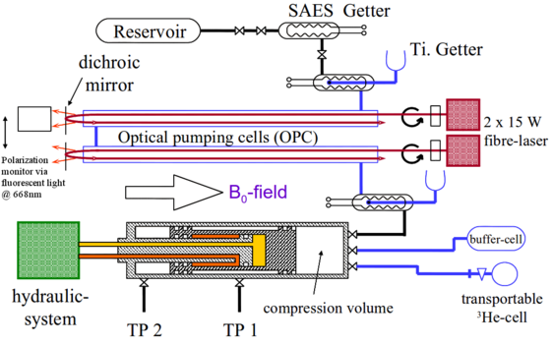
Possible applications (4):
Polarized ion sources using polarized ³He gas
Stable (days) nuclear polarization @ room temperature
Available from Univ. Mainz
Production
Transport

Slide 32
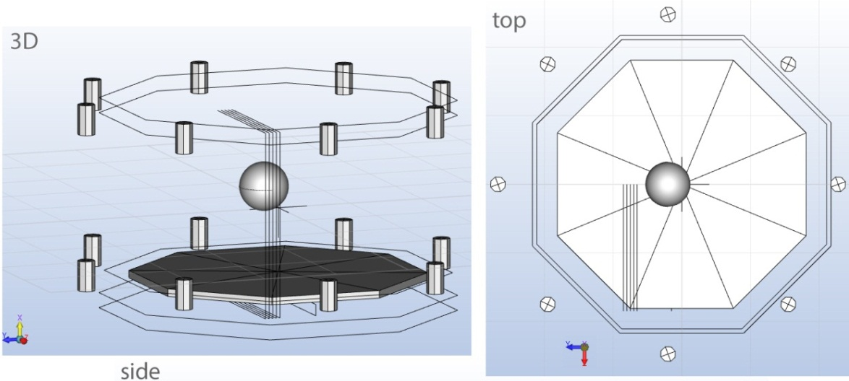
Possible applications (4):
Polarized ion sources using polarized ³He gas
Holding field: Halbach array of permanent magnets
Enhanced ³He²⁺ yield by adding clusters?

Slide 34
Polarized beams from laser plasmas: possible scenarios
1) Polarization is generated
Laser-acceleration process polarizes particles from unpolarized targets (plasmas) due to large magnetic fields and/or gradients
→ foil targets
2) Polarization is preserved
Spin direction is invariant in strong laser & plasma fields
→ polarized ³He gas
P = 0

Slide 36
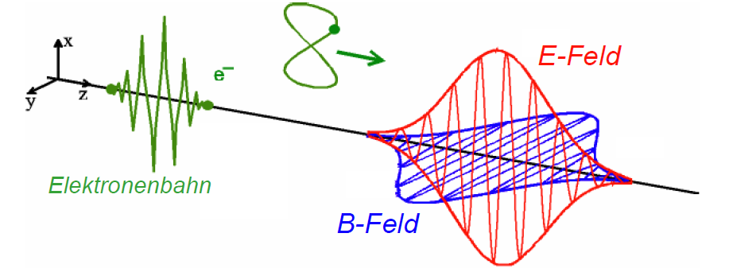
Response of electrons to plane waves
Electron is at rest again when laser pulse is gone!
mooving system
Lab system
E field
electron trajectory
B field

Slide 37
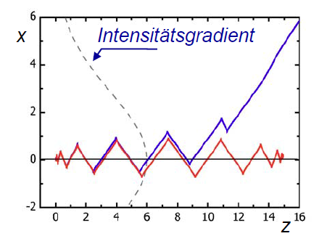
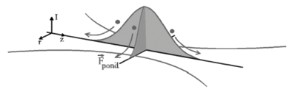
Response to finite wave packet
Intensity gradient
Response to
focused light pulse
plane wave
Ponderomotive force

Slide 38
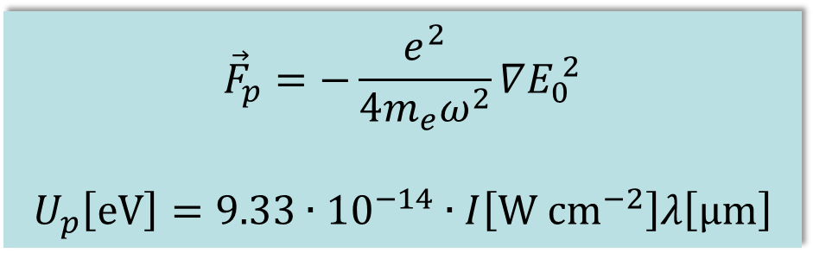
Ponderomotive force
Force that a charged particle experiences in an inhomogeneous oscillating electromagnetic field
$${\vec{F}}_{p}=−\frac{e^{2}}{4m_{e}ω^{2}}∇E_{0}^{ 2}$$
$$U_{p}\left[eV\right]=9.33∙{10}^{−14}∙I\left[\text{W} {\text{cm}}^{−2}\right]λ\left[µ\text{m}\right]$$

Slide 39

Plasma oscillation
Rapid oscillations of the electron density in conducting media such as plasmas or metals
Frequency only depends weakly on the wavelength
$$ω_{p}=\sqrt{\frac{{n_{e}e}^{2}}{ε_{0}m_{e}}}$$
$$f_{p}\left[Hz\right]≈8980\sqrt{n_{e}\left[cm^{−3}\right]}$$
n_{e} = electron density
e = electron charge
m_{e} = electron mass
ε₀ = permittivity of vacuum
Notes:
Bsp.: Gastarget mit n_e ~ 10^24 -> f ~ 10^16 Hz (Licht 5 * 10^14)

Slide 40
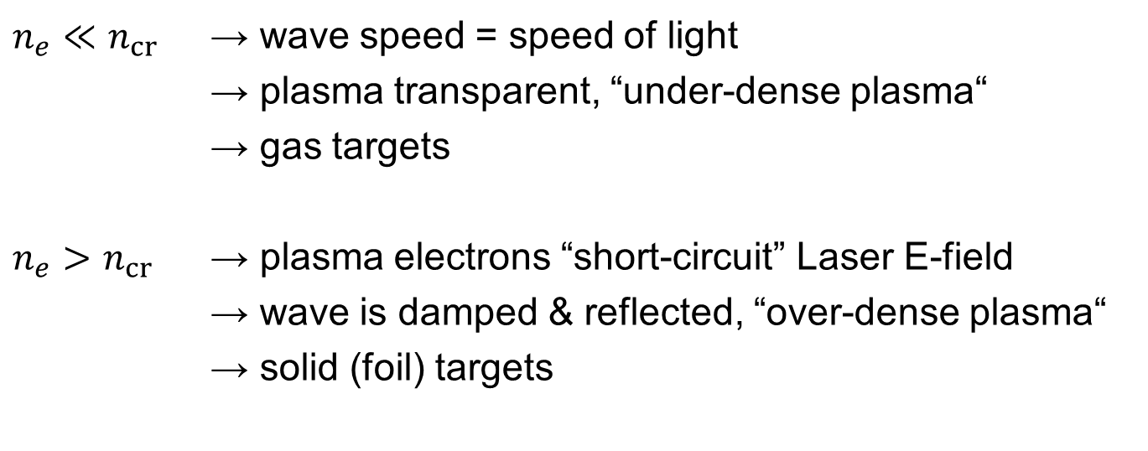
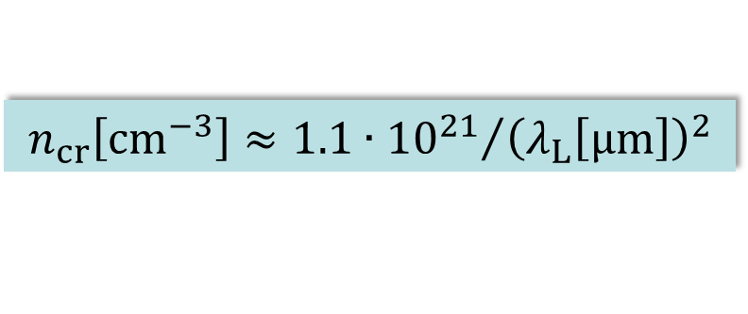
Critical plasma density
$$n_{cr}\left[{cm}^{−3}\right]≈{1.1∙{10}^{21}}/{{\left(λ_{L}\left[µm\right]\right)}^{2}}$$
$n_{e}≪$ $n_{cr}$ → wave speed = speed of light
→ plasma transparent, “under-dense plasma“
→ gas targets
$n_{e}>$ $n_{cr}$ → plasma electrons “short-circuit” Laser E-field
→ wave is damped & reflected, “over-dense plasma“
→ solid (foil) targets

Slide 41
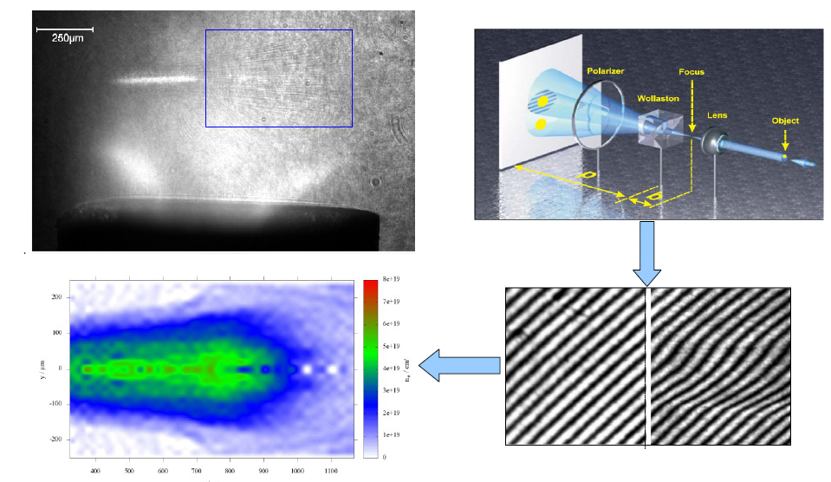
Plasma observation: interferometry
Electron density

Slide 42
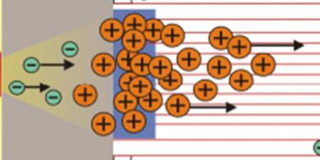
Target Normal Sheath Acceleration (TNSA)
Proton rich dot
20x20x0.5 μm
~ 100 GV/m
H. Schwörer et al., Nature 439, 445 (2006)

Slide 43
Polarization of a particle beam
1 particle  1 spin direction
Ensemble of particles
disordered spins
no polarization
P = 0
Polarization P
all spins show into same direction
fully polarized beam
P = 1 = 100%
N = occupation number
of up/down state

Slide 44
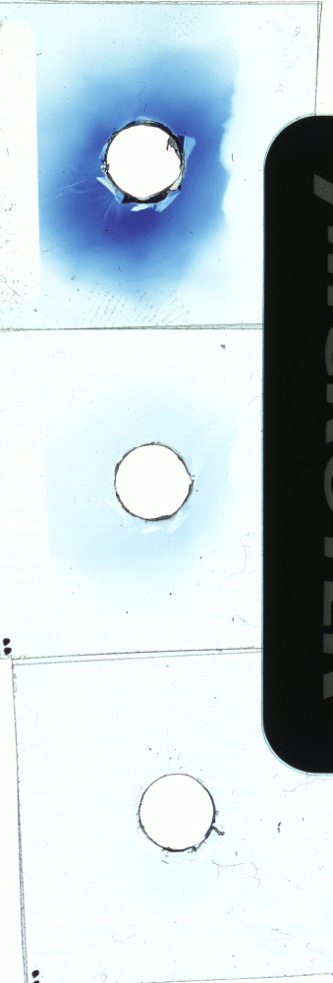

Proton acceleration  foil targets
Laser pulse
Proton „beam“
Aluminium foil
3-4 MeV
Conversion efficiency ~ 5%
Point-like source (< 10 μm)
Emission angle ~ 30° (15 MeV)
Broad, exponential energy spectra
Short duration (sub-ps pulses)
} small vertical emittance
} small longitudinal emittance

Slide 45
Particle detection

Slide 46

Time stability of electron beams
2°
40 fs
23 bar He

Slide 47

Frozen Pellet Target (FZJ, ITEP, MPEI)
Target prototype, COSY hall
Frozen pellets ∅ ~ 20 µm
H₂, N₂, Ar (D₂, Kr, Xe)
Pellet rate ~10 kHz
Pellet velocity ~80 m/s
Pellet beam Ø < 1 mm

Slide 48


Cluster-Jet Target (Univ. Münster)

Slide 49


Proton energy and intensity
Maximum proton energy (MeV)
Number of protons
in a 1 MeV bin around 10 MeV
COSY injection energy: 40 MeV
Notes:
Figure 4 Comparison between ﬂuid-model predictions and previously
published data. a, Maximum proton energy as a function of laser pulse duration.
Circles and squares are experimental data for the two intensity ranges; the
intensities are in units of W cm−2 . Lines represent calculations for various laser
intensities, as indicated in units of W cm−2 , using the ﬂuid model assuming
20-μm-thick targets and a 10 μm FWHM laser spot size. b, . Circles and squares are experimental data for the two
laser-pulse-duration ranges shown. The line is given by the ﬂuid model assuming
20-μm-thick targets, a 10 μm FWHM laser spot size and a 0.5 ps laser pulse
duration. References are as follows: LOA12 , JanUSP20 , RAL PW46 , Nova PW2 ,
RAL VULCAN16,17 , Osaka47 , CUOS48 , MPQ21 , Tokyo49 , ASTRA18 . LULI represents the
data presented in this article (see Fig. 2).

Slide 50
Helmholtz Association HGF
Research Centers: 18
Total staff: ~ 33 000
Total budget ~ 3.4 billion €
Research Fields:
  Energy
  Earth and Environment
  Health
  Key Technologies
  Structure of Matter
  Aeronautics, Space and Transport

Slide 51
“Big” lasers in the HGF: e.g. DESY Hamburg
Sept. 2010:
Laser/plasma group established
J. Osterhoff, Talk at 470 W.-E. Heraeus-Seminar, 12/2010
 Plasma-based particle accelerators

Slide 52

“Big” lasers in the HGF: e.g. GSI Darmstadt
2008:
PHELIX (Petawatt Hoch- Energie Laser für SchwerIoneneXperimente)
500 TW
 Ion-laser interactions
 X-ray laser

Slide 53

“Big” lasers in the HGF: e.g. Dresden-Rossendorf
2008: High-Power Laser Laboratory
150 TW laser DRACO (Dresden laser acceleration source)
2012:
PW Laser
 Laser particle acceleration
 Cancer research

