Slide 1

A slow control system for a
GEM-TPC prototype
Johann Zmeskal
Stefan-Meyer-Institut für subatomare Physik
Stefan Meyer Institute
FP7-HP3: FutureJet Workshop
Vienna, April 18-19, 2013

Slide 2
GEM based Time Projection Chamber
Time Projection Chamber
Gas Electron Multiplier
Design of GEM-TPC prototype
GEM-TPC gas system
cRIO based slow control system
Stefan Meyer Institute

Slide 3
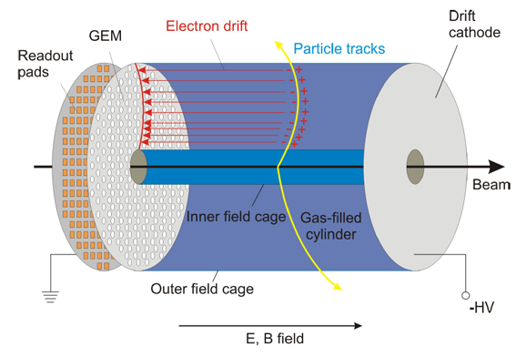
Time Projection Chamber
Stefan Meyer Institute
J. Zmeskal

Slide 4
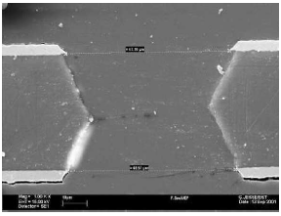
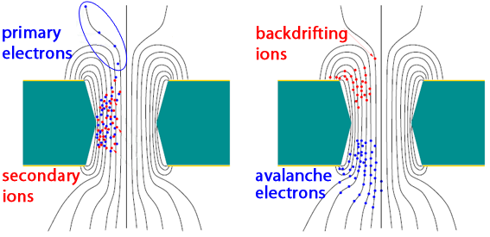
GEM – Gas Electron Multiplier
50 μm Kapton foil
2-5 μm copper cladding
Conical shaped micro-holes,
Ø ~70 μm
Hole distance 140 μm
Stefan Meyer Institute
A potential difference of
300-400 V between the copper sides leads to a high electric fields inside the hole of several
10 kV/cm.
J. Zmeskal

Slide 5
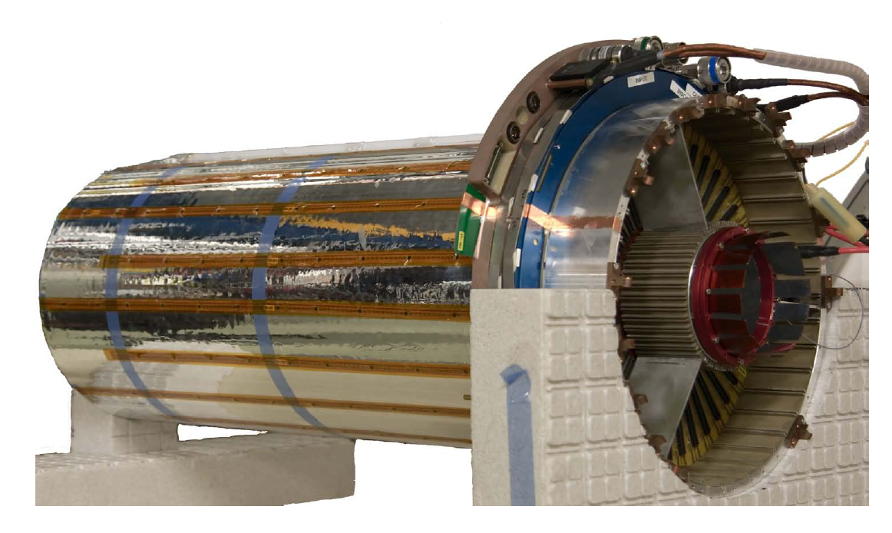
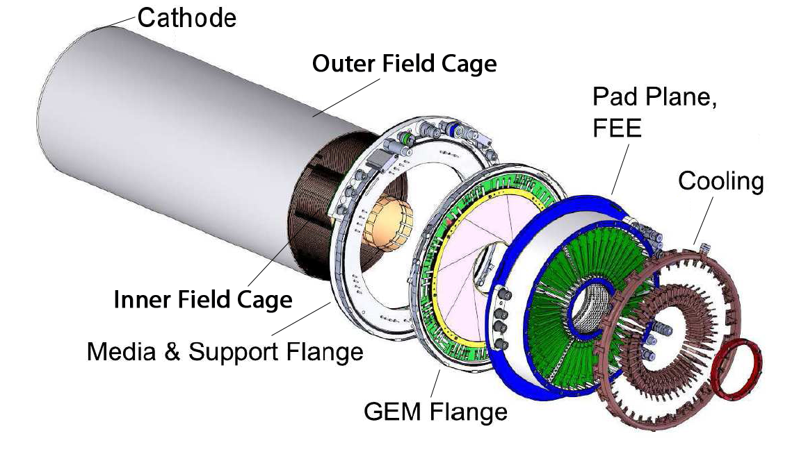
GEM-TPC prototype
Field cage:
Self-supporting
light weight structure,
drift length = 73 cm
inner Ø = 10 cm
outer Ø = 30 cm
→ 45l drift volume
Stefan Meyer Institute
Pad plane:
~10 000 readout pads
Spatial resolution:
σ_{xy} ≈ 150 μm
σ_{z} ≈ 1 mm
J. Zmeskal

Slide 6
Gas system requirements
Gas mixture of counting and quenching gases:
  Counting gas: Noble gases, e.g. He, Ar, Ne, Kr, Xe
  Quenching gas: Organic gases (e.g. CH₄), Nitrogen, Freons, CO₂
  Ar/CO₂ or Ne/CO₂ (90/10) Closed cycle gas system
Stable CO₂ fraction: 10.0 ± 0.1%
→ CO₂ fraction influences drift velocity and electron diffusion
Pressure Stability: 5.0 ± 1.0 mbar (overpressure)
→ safety issues
Low O₂ content: ≤ 10 ppm
→ high electron attachment, loss of primary e⁻
Stefan Meyer Institute
J. Zmeskal

Slide 7
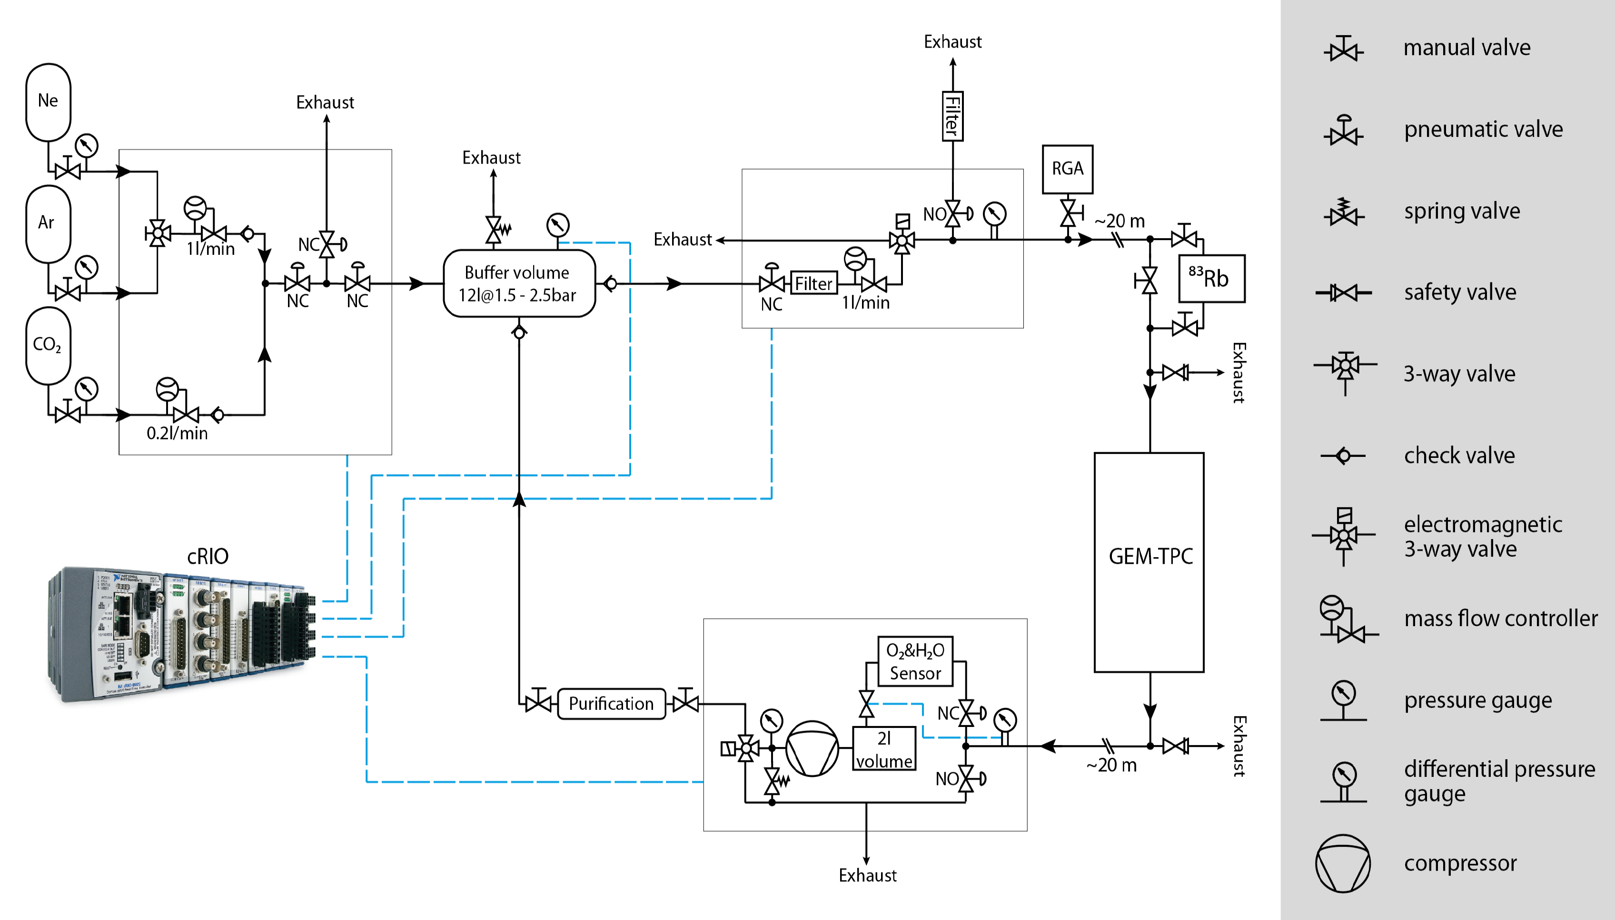
Sketch of the GEM-TPC gas system

Slide 8
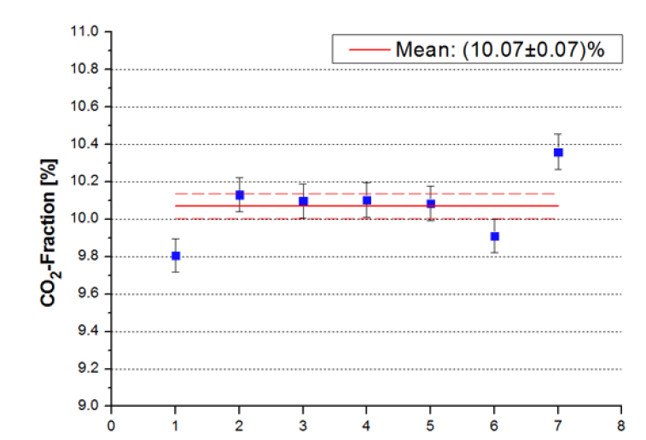
Ar-CO₂ mixture
t [days]

Slide 9
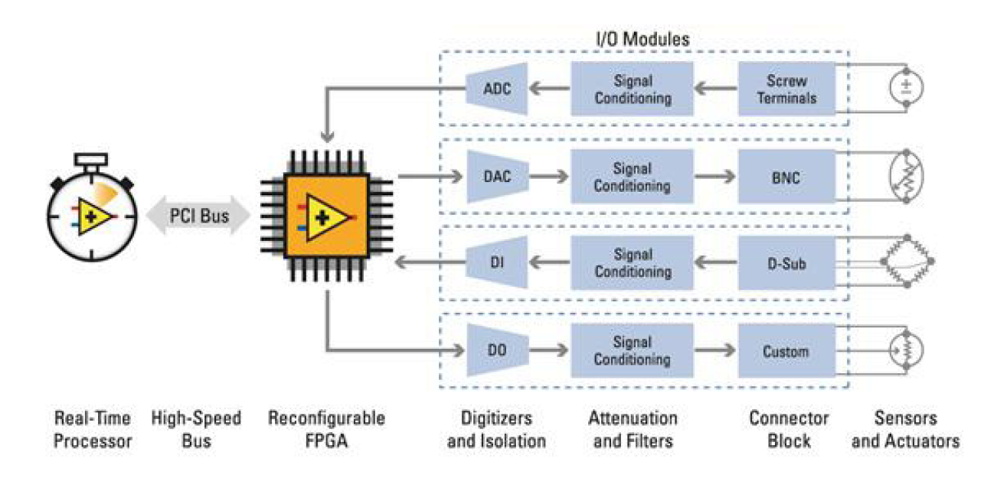
National Instrument reconfigurable I/O (RIO)
Introduction:
NI reconfigurable I/O (RIO) is an integral part of the NI graphical system design platform for designing, prototyping, and deploying embedded systems.
The graphical system design combines the open NI LabVIEW graphical programming environment with commercial off-the-shelf hardware.
RIO system architecture:
Stefan Meyer Institute
Notes:
NI reconfigurable I/O (RIO) technology is based on four components:
a processor, a reconfigurable field-programmable gate array (FPGA), modular I/O hardware, and graphical design software.
Combined, these components give you the ability to rapidly create custom hardware circuitry with high-performance I/O and unprecedented flexibility in system timing control.

Slide 10
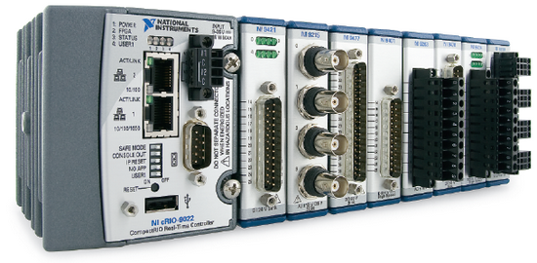
National Instruments CompactRIO
Reconfigurable embedded control, monitoring
and data acquisition system
Stand-alone device
Programmable with LabVIEW
Hardware:
  Reconfigurable FPGA Chassis
  Embedded Real-Time Controller
  50 different I/O Modules
Stefan Meyer Institute
J. Zmeskal

Slide 11
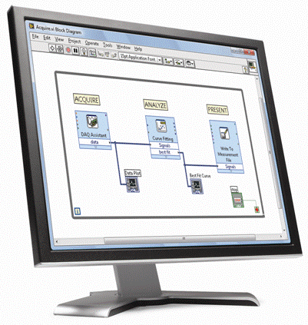
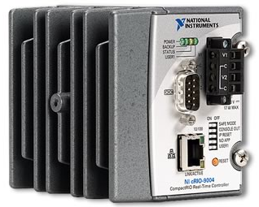
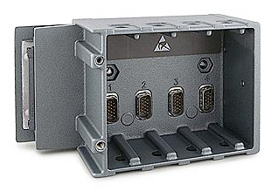
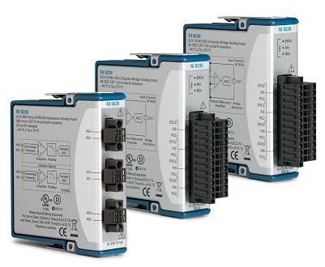
CompactRIO Architecture
HOST PC:
  Graphical User Interface
  for online monitoring
Real-Time Controller:
  stand-alone controlling
  data storage
Reconfigurable Chassis
& I/O Modules:
  data acquisition
  time-critical controlling
Host PC
Network
Stefan Meyer Institute
Real-Time
Controller
Internal
PCI Bus
Output
Input
FPGA Chassis
I/O Modules
J. Zmeskal
Notes:
In computing graphical user interface (GUI, sometimes pronounced 'gooey‘) is a type of user interface that allows users to interact with electronic devices using images rather than text commands.

Slide 12
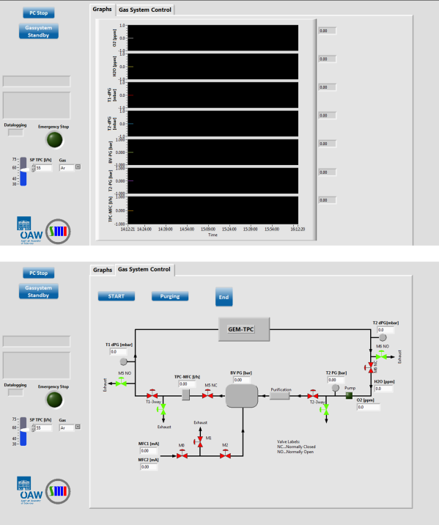
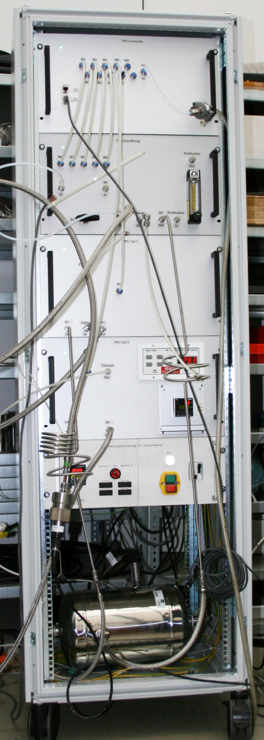
Slow control of GEM-TPC gas system
GEM-TPC
gas system
PC
Controlling
MFC, Pump, Valves
Stefan Meyer Institute
NI-cRIO
Stand alone device
Network communication
Online observation
General settings
Data logging
Gas flow, Pressure, O₂, H₂O
J. Zmeskal

Slide 13
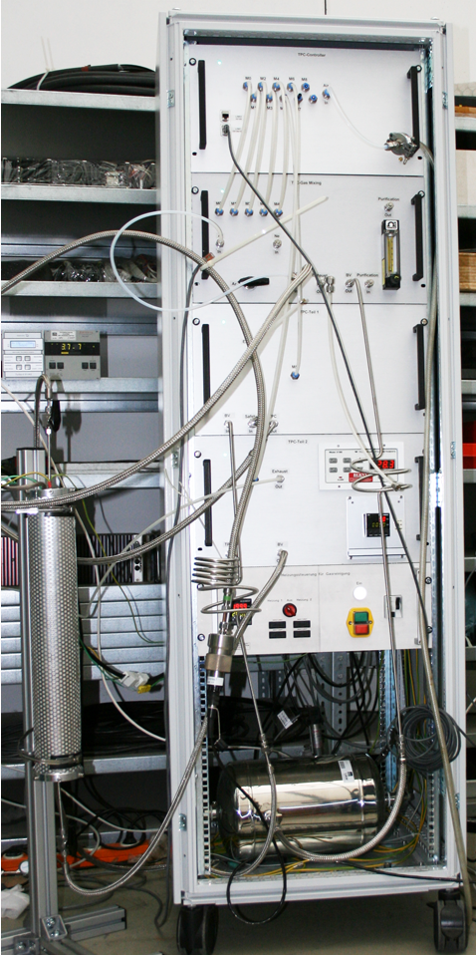
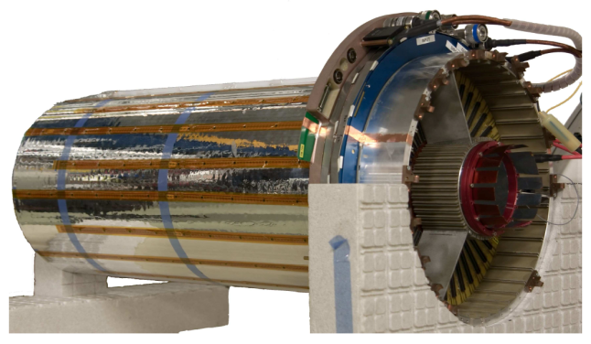

Gas System Design
Gas analyser
Gas mixture measurement
Mixing module
Mixing of gas mixtures
Ar/CO₂ or Ne/CO₂
(90/10)
Buffer volume
Gas reservoir
within gas system
Flow control
Regulation of gas flow
through GEM-TPC
(30-75 l/h)
Stefan Meyer Institute
cRIO module
Stand alone device
Pressure control
Regulation of pressure
inside the GEM-TPC.
O₂ and H₂O sensor, pump
Purification
Activated Copper for
O₂ adsorption.
J. Zmeskal

Slide 14
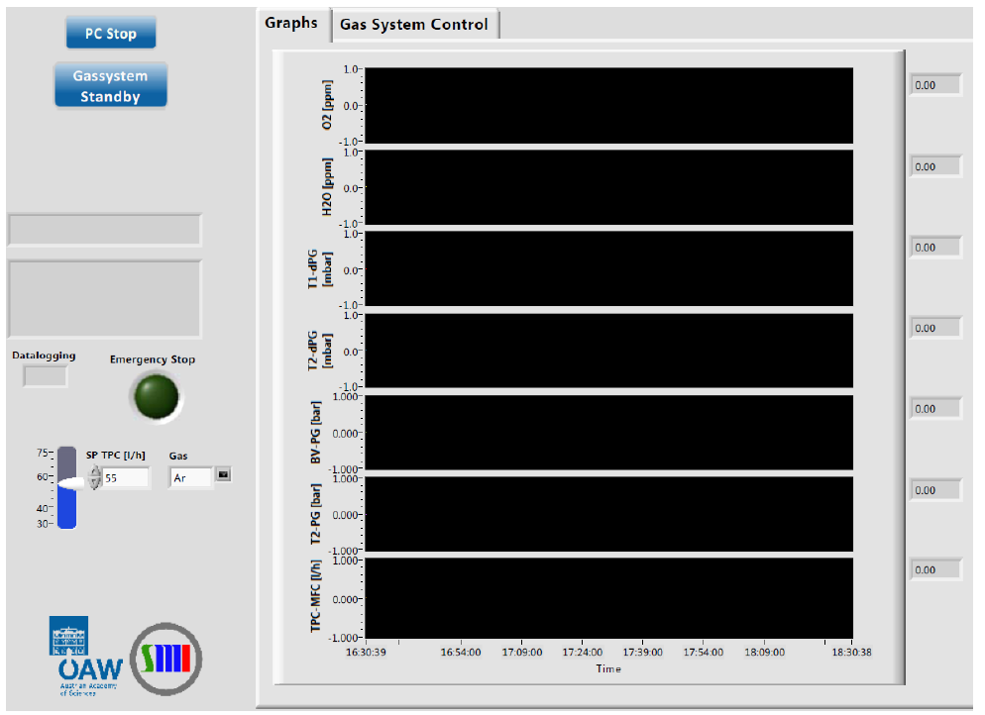
Screenshot of the "Graph" display

Slide 15
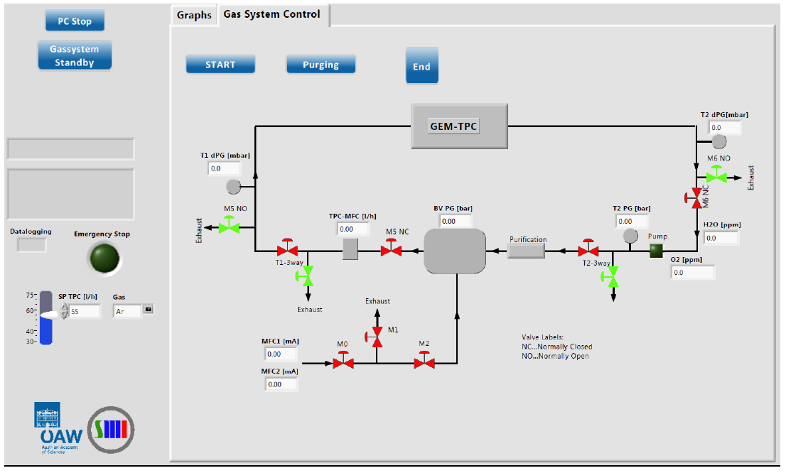
Screenshot of the "Gas System Control" display

