Slide 1





HEavy-Flavor TheorY for QCD Matter: HEFTY
Ralf Rapp
Cyclotron Institute +
Dept of Phys & Astro
Texas A&M University
College Station, TX, USA
International School of Nuclear Physics (46th Course)
Erice (Sicily, Italy), Sept. 17-21, 2025

Slide 2
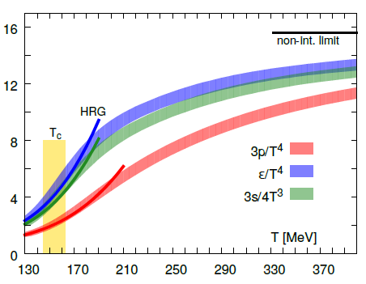
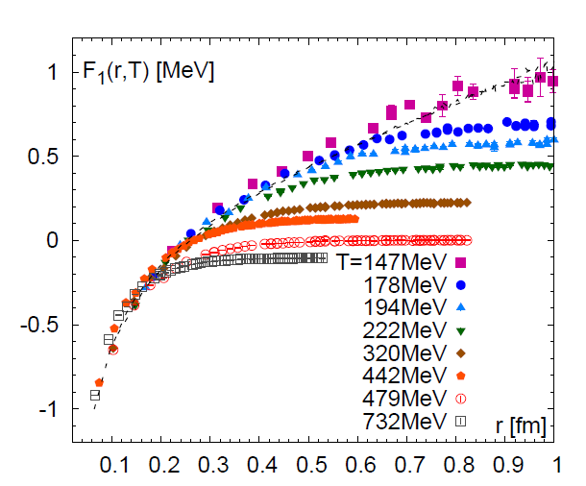
Intro-1: QCD Matter and In-Medium Force
Equation of State Heavy-Quark Free Energy
μ_{Β} = 0
[GeV]
[Bazavov
et al ’13,’14]
- - -
“Change” in dofs above T~160 MeV
F_{QQ} = U_{QQ} – T S_{QQ}
Non-perturbative above T_{c}
How to probe the QCD force in medium?
Consequences for heavy-quark transport + spectral functions?
Structure of the strongly coupled QGP?

Slide 3

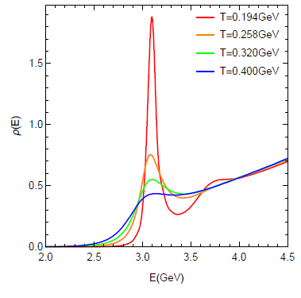
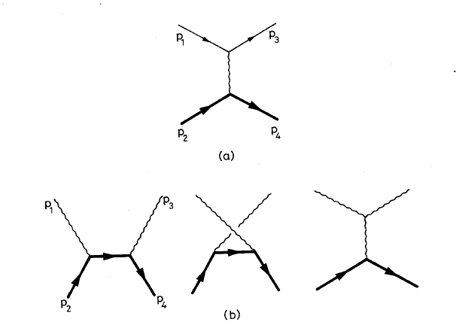
Intro-2: Quarkonia in Medium: A Force Gauge
potential V(r,T) → binding energy E_{B}(p,T)
Dissociation rate → width G(p,T,E_{B})
ϒ(1S): color-Coulomb force
J/y, ϒ(2S), …: confining force
Quarkonium spectral functions
Melting (criterion)?
How do heavy quarks
within quarkonia interact
with the medium?
[Matsui
+Satz ‘86]
Charmonium Spec. Fct.
1⁻
vacuum
QGP
Q
−
Q
Simpler problem: one heavy quark!
(m_{c} ~ 1.5 GeV, m_{b} ~ 4.5 GeV)

Slide 4
Intro-3: Heavy Quarks in QGP
Q
Brownian motion via elastic interactions
(radiation suppressed q₀ ~ q²/2m_{Q} << q ~ T << m_{Q})
Thermalization delayed by m_{Q}/T → memory in heavy-ion collisions
Direct access to transport coefficient: <x²> − <x>² = 6 D_{s} t
Scattering rates
→ widths (quantum effects), quasiparticles?
→ estimate: D_{s}(2πT) = 3 ⇒ Γ_{Q} ~ 1 GeV > T
⇒ Implications for QGP structure
Non-perturbative interactions (potential)
Probe of hadronization: c → D, D_{s}, Λ_{c}, … (m_{Q} >> T_{c})
QGP
Q

Slide 5
1.4 Topical Collaboration in Nuclear Theory:
HEavy Flavor TheorY (HEFTY) for QCD Matter
Mukherjee
Qiu
Frawley
Vogt
Petreczky
Dong
[Rapp (PI), Petreczky + Vogt (co-spokespersons), + 9 co-PIs]
Vitev
Rapp
Hanlon
Lee
Bass

Slide 6
Outline
1.) Introduction
● Nonperturbative QCD Matter, Heavy Quarks + HEFTY
2.) Open Heavy Flavor in QGP + HICs
● Brownian Motion + Transport Parameters
● T-Matrix + Hadronization
● Charm Observables
3.) Quarkonia in QGP
● Lattice-QCD Constraints + Quarkonium T-Matrix
● Reaction Rates + Transport Approach
● Bottomonia in Hydrodynamics
4.) Conclusions

Slide 7
2.1 Heavy-Flavor Transport in URHICs
0 0.5 5 10
| | | |
τ [fm/c]
D
c
initial cond.
(nPDFs, …),
pre-equil. fields
c-quark diffusion
in QGP liquid
c-quark
hadronization
D-meson
diffusion in
hadron liquid
no “discontinuities” in interaction
⇒ diffusion toward T_{pc} and hadronization same interaction (confining!)
[Svetitsky ’87, Mustafa et al ‘04, Moore+Teaney ‘05, van Hees et al ‘05, Gossiaux et al ‘08, Vitev et al ‘08, Das et al ‘09,
Uphoff et al ’10, M.He et al ‘11, Beraudo et al ‘11, Cao et al ’13, Greco et al ‘14, Bratkovskaya et al ‘14, …]

Slide 8

2.2 Heavy-Flavor Transport Equation
p² ~ m_{Q} T >> q² ~ T² ⇒ Brownian Motion:
Fokker-
Planck
Q
thermalization rate diffusion coefficient
g p = ∫ d³q w_{Q}(q,p) q
~ ∫ |T_{Qj}|² (1-cosq) f ^{j}
D_{p} = ∫ d³q w_{Q}(q,p) q²
thermal relaxation time τ_{Q} = 1/γ
Einstein relation: T = D_{p} / γ m_{Q}
Spatial diffusion constant: D_{s} = T / γ (0) m_{Q} , <x²> - <x>² = 6 D_{s} t
Quantum effects encoded in γ, D_{p} via folding over spectral functions
⇒ Brownian particle in a liquid!

Slide 9
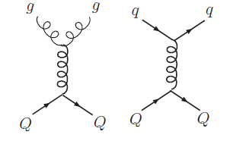
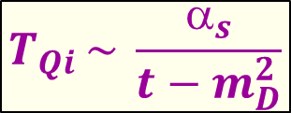
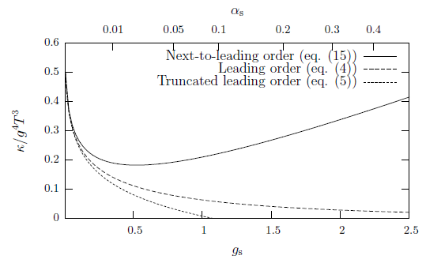
2.3.1 Heavy-Light Interactions: Perturbative QCD
Leading Order
screened 1-gluon exchange
long thermalization: τ_{c} ≥ 20 fm/c
large diffusion coeff.: D_{s} (2πT) ≥ 30
[Svetitsky ’88, Mustafa et al ’98, Molnar et al ’04, AMPT,
Teaney+Moore’04, Nantes, Torino, Catania, PHSD,
BAMPS, LBT,…]
Next-to-Leading Order
uncontrolled convergence
(even for α_{s} ~ 0.1)
γ m_{Q} / T²
[Caron-Huot+Moore ‘08]

Slide 10
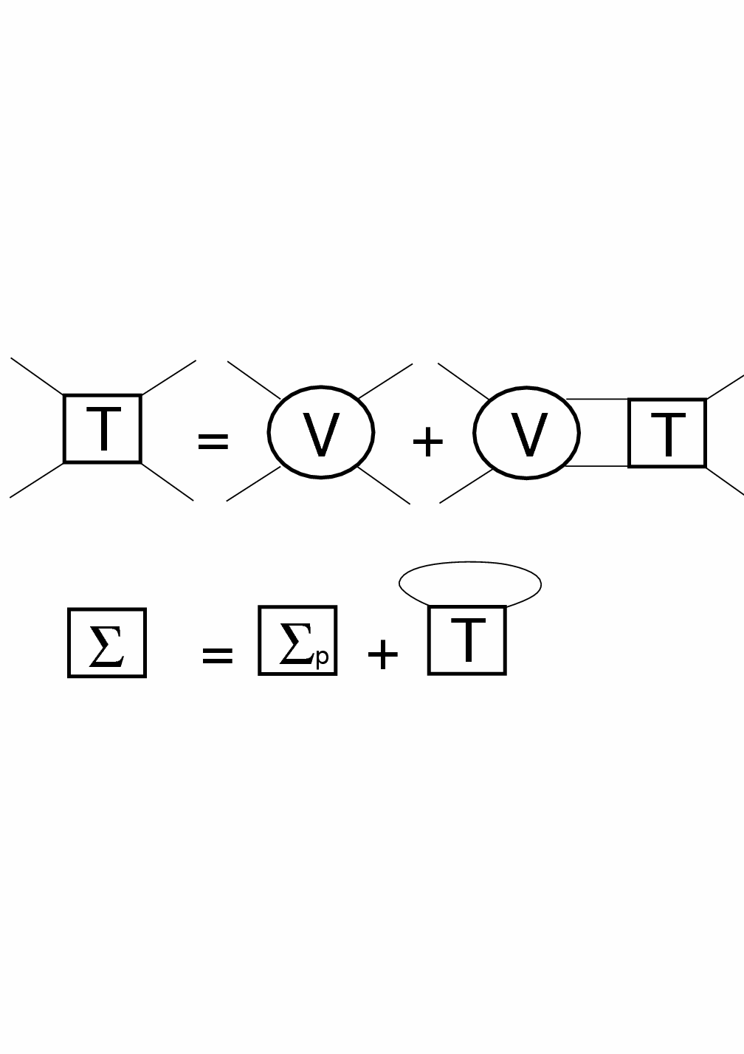
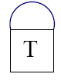
2.3.2 Thermodynamic T-Matrix in QGP
Scattering
equation
i=Q
j=Q,q,g
Born approximation (weak coupling): T_{ij} ≈ V_{ij}
Strong coupling → resummation: T_{ij} = V_{ij} + ∫ V_{ij} G_{i} G_{j} T_{ij}
Thermal parton propagators: G_{i} = 1 / [ω – ω_{k} –Σ_{i}(ω,k)]
Parton self-energies → self-consistency:
q ~ T << m_{Q} ⇒ q₍₄₎² = q₀² - q² ≈ -q²
⇒ 3D reduction of Bethe-Salpeter equation
In-medium potential V constrained by lattice QCD
j=q,g
Σ_{i}
=
ij
[Riek+RR’10 Liu+RR ‘18,
Tang et al.’24 ]

Slide 11
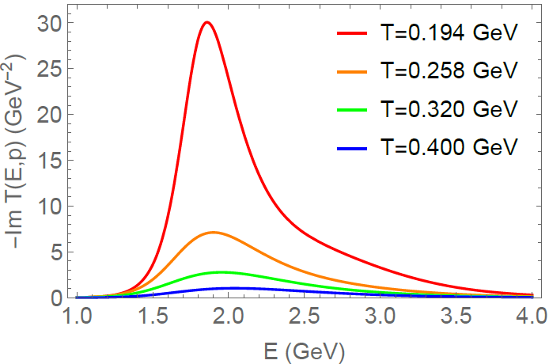
2.3.3 Charm-Quark Transport Coefficient
Charm-Light Quark T-Matrix
k
QGP
k'
γ_{c}(p)
- Im T_{cq} [GeV⁻²]
-
T_{cq}
cq threshold
p
p'
Broad D-mesons near T_{c}
- non-pert. interaction strength (~10x pQCD)
- broad SFs to evaluate γ: quantum effects critical!
- τ_{c} = 1/γ_{c} ≈ 3 fm/c , D_{s} (2πT) ≈ 2
- connects diffusion + hadronization
[Liu,He+RR ‘19]

Slide 12


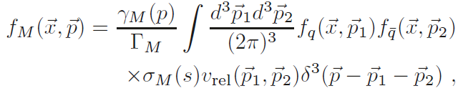
2.4 Hadronization of Heavy Quarks
Fragmentation
c → D, D*, D_{s}, Λ_{c}, …
- empirical fragmentation functions D_{c→Hc}(z)
- universal in “vacuum”: e⁺e⁻, pp collisions (large p_{T})
Coalescence/Recombination
c + q (s) → D (D_{s}), D*,… ; c + q + q (s) → Λ_{c} (Ξ_{c}), …
- depends on environment (surrounding anti-/quarks)
- test hadronization through “charm hadro-chemistry”
- Resonance Recombination Model
σ_{Μ} (s) v_{rel} ~ |T_{Qi} |² : resonant heavy-light amplitude
[Hwa et al ‘03,
Fries et al ‘03,
Greco et al ’03]
[Ravagli+RR ’07]

Slide 13
2.5 D-Meson Data at the LHC
Semicentral Central Pb-Pb
Previously
[ALICE ‘21]
near T_{c}: 1.5 ≤ D_{s}(2πT) ≤ 4.5
[Krishna et al ’25]
“Flow bump” in R_{AA} + large v₂
⇒ strong coupling near T_{c}
Scattering rate ~ 1 GeV ⇒ liquid!
Remnants of confining force!
Now: D_{s} (2πT) ≤ 2

Slide 14
Outline
1.) Introduction
● Nonperturbative QCD Matter, Heavy Quarks + HEFTY
2.) Open Heavy Flavor in QGP + HICs
● Brownian Motion + Transport Parameters
● T-Matrix + Hadronization
● Charm Observables
3.) Quarkonia in QGP
● Lattice-QCD Constraints + Quarkonium T-Matrix
● Reaction Rates + Transport Approach
● Bottomonia in Hydrodynamics
4.) Conclusions

Slide 15
3.1 Quarkonium Transport in URHICs
0 0.5 5 10
| | | |
fireball time
τ [fm/c]
c
-
c
production +
evolution of
cc wave pack.
c-quark
diffusion
in QGP
~ T_{melt}:
ψ can
form
QGP
kinetics
c+c ↔ ψ
~ T_{pc}:
c and c
hadronize
-
-
hadronic
kinetics
-
t_{form}~1fm/c t_{c}^{eq} ~3fm/c t_{y}^{eq} ~ 1/ G_{y}
[Satz et al, Capella et al, Spieles et al, PBM et al, Thews et al, Grandchamp et al, Ko et al, Zhuang et al, Zhao et al,
Chaudhuri, Gossiaux et al, Young et al, Ferreiro et al, Strickland et al, Brambilla et al, …]

Slide 16
3.2 Wilson Line Correlators vs. T-Matrix
[Tang,Mukherjee,Petreczky+RR, EPJA60]
Static quarkonium
spectral fct:
LQCD: first cumulant:
[Bala et al ‘22]
First microscopic description
Need smaller screening masses,
even less potential screening

Slide 17
3.3 Complex-Pole Analysis of in-Medium T-Matrix
2S
3S
1S
4S
Binding vs. Width
1S
2S
[GeV]
E_{B} = G_{Y}
E_{B}
G_{Y}
[Tang et al ’25]
Bottomonium states survive deep into sQGP,
even into the continuum (after vanishing of E_{B}!)

Slide 18
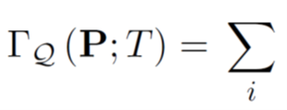
3.4 Quarkonium Reaction Rates in sQGP
Σ_{Q}
Im T_{QQ} ⇔ Im S_{Q}
Σ_{Q}
d⁴p'r_{Q}' d⁴q r_{i} f_{i} d⁴q' r_{i}'(1-f_{i}')
Integrations over (broad) in-medium spectral functions r_{Q,i}
Structure effects: interference factor 1-exp(ik⋅r) ensures G_{Q} (r→0) → 0’
[Wu et al ’25]

Slide 19
3.5 Bottomonium Reaction Rates in sQGP
Importance of binding energy + structure effects for break up
Numerically large (up to GeV for excited states)
[Wu et al ’25]

Slide 20
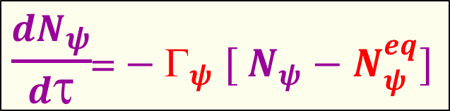
3.6 Kinetic Rate Equation Approach
-
Β
→
←
Inelastic reactions:
Y + p b + b + p
-
ϒ
Β
[Grandchamp+RR ’01-’04, Wu+RR, ’24…]
Detailed
balance:
b
-
b
ϒ
Transport coefficients:
- Equilibrium limit N_{Y}^{eq}(m_{Y} ,T, N_{cc}) + reaction rate G_{y}(p, T, E_{B}, r)
Implementation into viscous hydro [KSU]
- Trajectories for primordial suppression
Extension of regeneration to
non-uniform medium

Slide 21
3.7 Bottomonium Transport at the LHC
[Wu et al ’25]
Fair predictions (no tuning), problems at higher p_{T}?

Slide 22
4.) Summary
Comprehensive collaborative approach to heavy flavor in medium:
- Lattice-informed quantum-many body theory
- Reliable calculations of nonperturbative transport coefficients
- Transport in AA implemented into state-of-the-art hydrodynamics
- Open HF hadronization with modern recombination model
- Quantum transport for quarkonia to be elaborated
- Small systems: initial conditions for AA + applications to EIC
Highlights thus far:
- New lattice results on quarkonia and HQ diffusion
- Quarkonia survive deep into the QGP (complex-pole analysis)
- Remnants of confining force provide strong coupling in QGP, large widths
+ pave way for hadronization toward T_{pc}
- HQ diffusion coefficient from phenomenology: D_{s} (2πT) ≤ 2

Slide 23
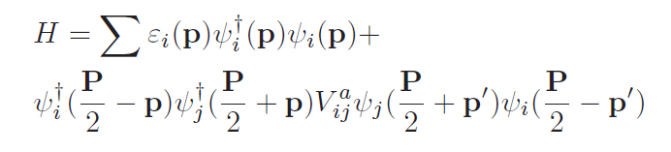
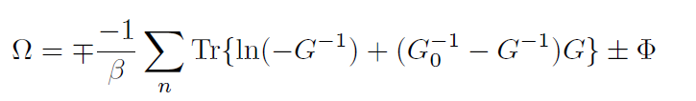



4.2 QGP Equation of State + Spectral Functions
In-Medium
Hamiltonian
Thermodynamic
Potential (pressure)
Selfconsistent SFs
Lutttinger-Ward
Functional
G = G₀ + G₀S G
S = GT
T = V + VGGT
n,n
Full off-shell resummed Luttinger-Ward functional (!)
→ accounts for dynamically emerging hadronic resonances
Fit “bare” quark + gluon masses

Slide 24
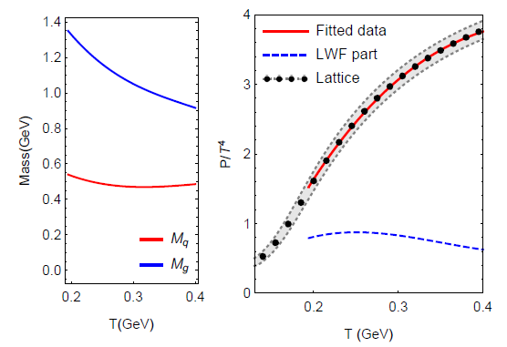
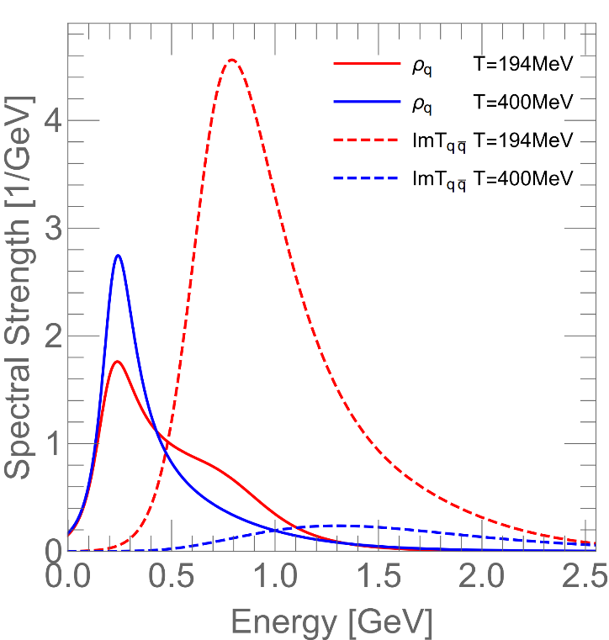
4.3 QGP Equation of State + Degrees of Freedom
Input Masses Pressure Quark + “Meson” Spectral Fcts
Confining force near T_{pc} : - soft partons melt
- broad hadronic resonances emerge

Slide 25
5.3 LQCD Constraint II: Extended Operators
[Tang,Mukherjee,Petreczky+RR, in prep]
[Larsen et al ‘20]
Quarkonium spectral fct:
Effective mass
Slightly less potential screening

Slide 26
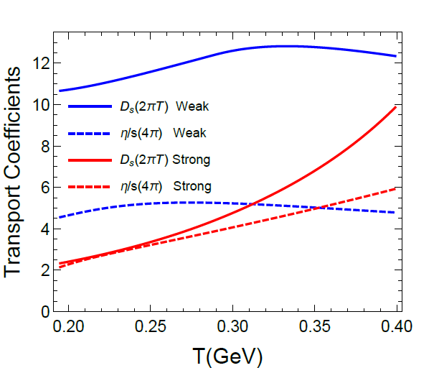
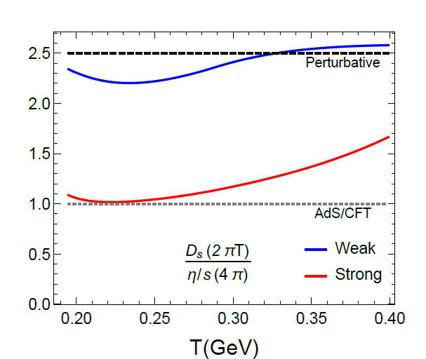
4.4 Transport Coefficients + Strong-Coupling Limit
Shear Viscosity and Heavy-Quark Diffusion
Strongly coupled: (2πT) D_{s} ~ (4π) η/s
Perturbative: (2πT) D_{s} ~ 5/2 (4π) η/s
Transition as T increases

Slide 27
3.4 Charmonia - Open-HF Coupling II: Elliptic Flow
QGP charm-quark diffusion + RRM
Recombination reaches out to p_{T} ~ 8 GeV [He,Wu+RR ’22]

Slide 28
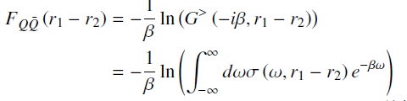


2.2 Potential Extraction from Lattice Data
Free energy ≠ potential: F_{QQ} = U_{QQ} – T S_{QQ}
Microscopic many-body approach:
−
QQ spectral function
Use trial potential
Self-consistently calculate self-energies to fit lattice-QCD data for F_{QQ}
Weak coupling (small Σ_{I}): F → V

Slide 29
2.3.2 Heavy-Light Interactions: T-Matrix
Q
i=q,g
Σ
=
Strong coupling → resummation: T_{Qi} = V_{Qi} + ∫ V_{Qi} D_{Q} D_{i} T_{Qi}
Key input: in-med potential V_{Qi} ,
constrained by lattice QCD
→ “confining” force above T_{c}
Non-perturbative effects:
- thermalization time τ_{c} ≈ 3-4 fm/c
- hadronization
[TAMU ’05-’18]

Slide 30
3.7 Recent Progress I: Spin-Induced Interactions
Higher order in
1/m_{Q} expansion:
Vector component in confining potential
Much improved hyper/fine splittings!
Significant impact on transport
coefficient (harder 3-mom dependence)
[Tang+RR ‘23]

Slide 31
3.4 Susceptibilities
μ_{B} dependence of bare masses + potential
fit b_{m}=0.1, b_{s}(T) to
predict charm susceptibilities
Susceptibilities compatible with heavy-light resonances above T_{pc}
Genuine prediction of negative χ^{uc}
[Liu+RR ‘22]

Slide 32


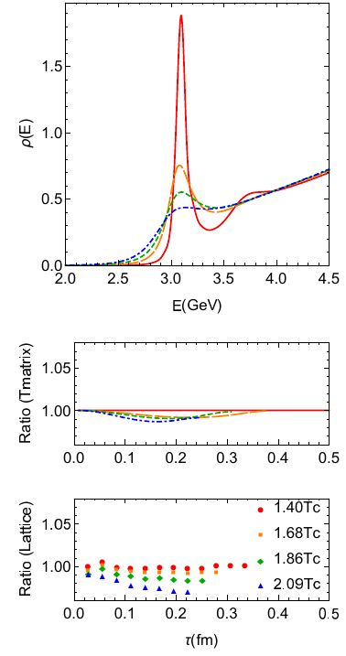
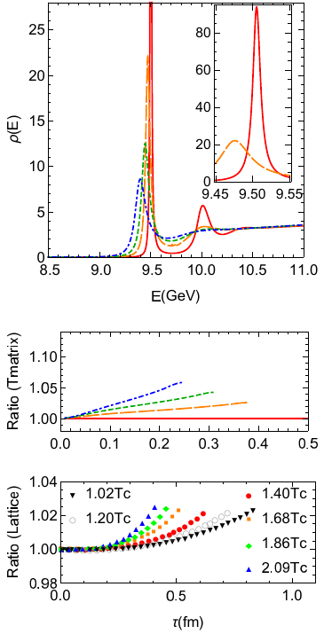
2.3 Lattice Constraints II: Euclidean Correlators
Charmonium Bottomonium
[Liu et al ’18]
[Aarts et al ’18]
J/y melts near T~ 320 MeV
ϒ(1S) survives until T > 500 MeV

Slide 33

3.) Hamiltonian Approach to QGP
In-Medium Hamiltonian with ``bare” 2-body interactions
- effective light-parton masses
Interaction: Cornell potential with relativistic corrections
- as used in heavy-quark sector
Implement into Brueckner / Luttinger-Ward-Baym approach

Slide 34
3.3.3 Heavy-Flavor Spectral Functions
Charm-Light Quark T-Matrix Charm + Bottom Quark SFs
Broad D-meson resonances emerge near T_{pc}
Despite large widths, G_{Q} ~ 0.6GeV << w_{Q}
⇒ c + b quarks remain reasonable quasiparticles!

Slide 35
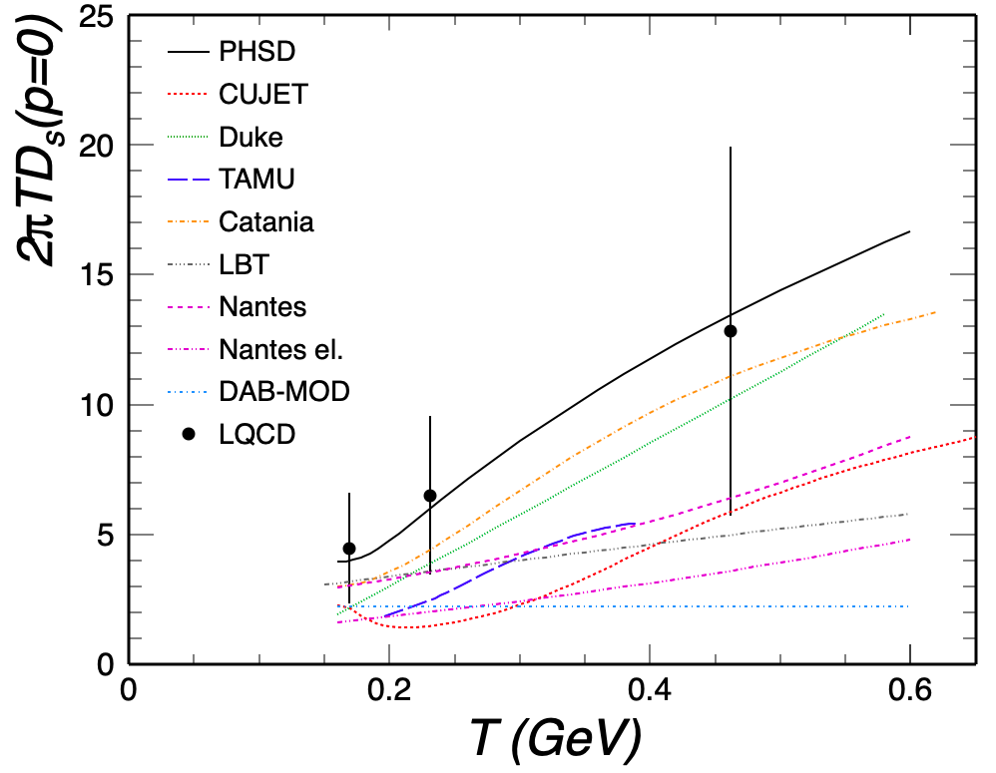
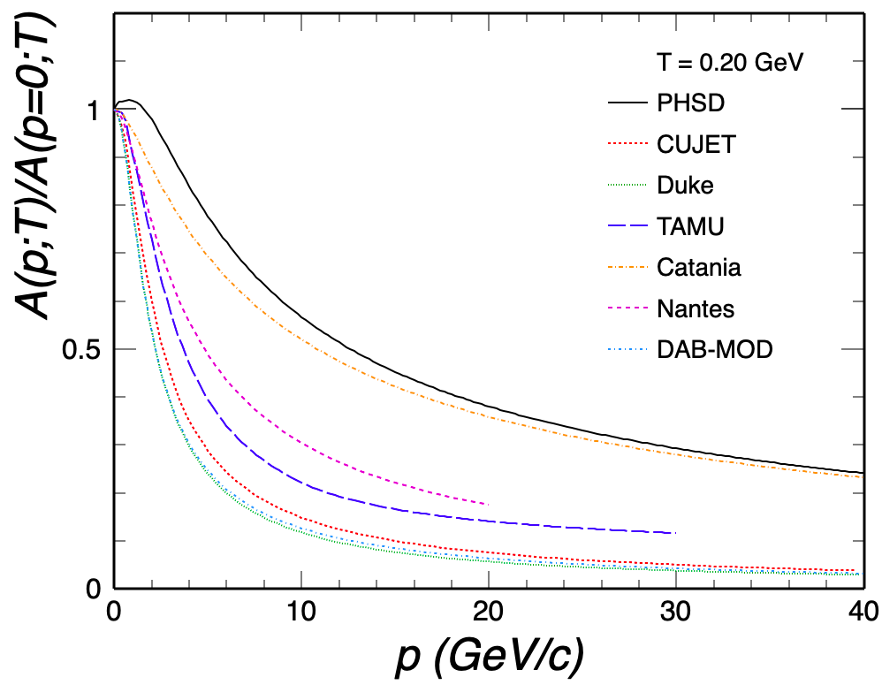
2.6 Temperature vs Momentum Dependence
[ECT* HF workshop ’21, RR et al]
correlation: large D_{s} ↔ weak p-dependence
need control over momentum dependence

Slide 36
4.5 In-Medium Quarkonium Binding Energies

Slide 37
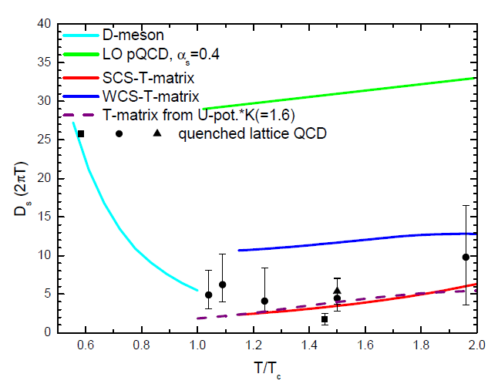
4.2 Spatial Charm-Quark Diffusion Coefficient
D_{s} =T / [m_{Q} γ(p=0)]
Τ/Τ_{c}
suggests minimum of D_{s}(2πT) ~ 2 near T_{pc}
width: Γ_{coll} ~ 3 / D_{s} ~ 1 GeV − no light quasi-particles!

Slide 38
4.4 Two Main Observables in Heavy-Ion Collisions
Modification of transverse-momentum (p_{T}) spectra in AA collisions
relative to pp collisions:
R_{AA} (p_{T}) ≡ (dN/dp_{T} )_{AA} / ( N_{coll} dN/dp_{T} )_{pp}
Angular distribution of the particle spectra
v₂: “elliptic flow” coefficient
→ reflects coupling strength of
heavy quark to medium expansion
Q

Slide 39
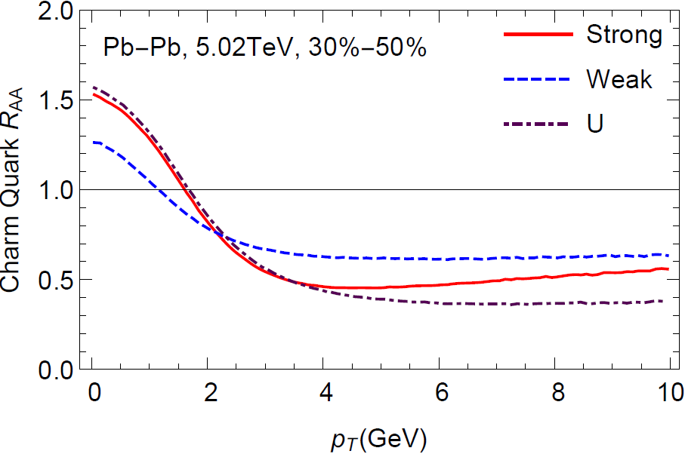
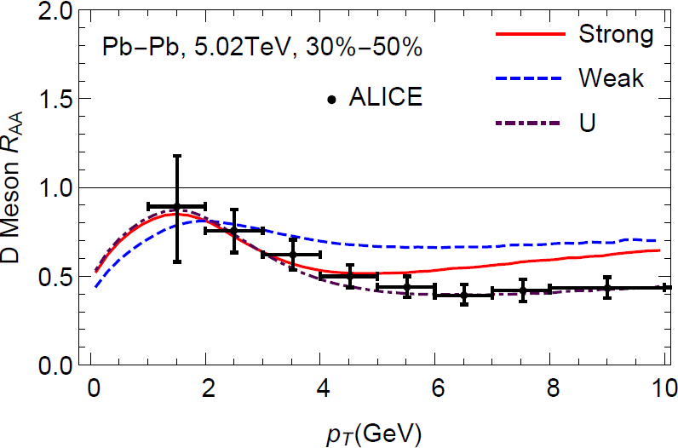
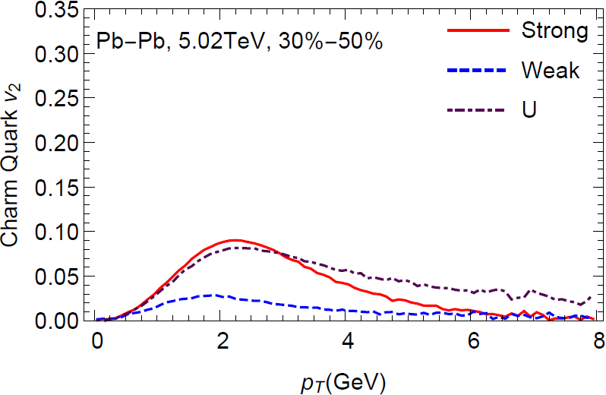
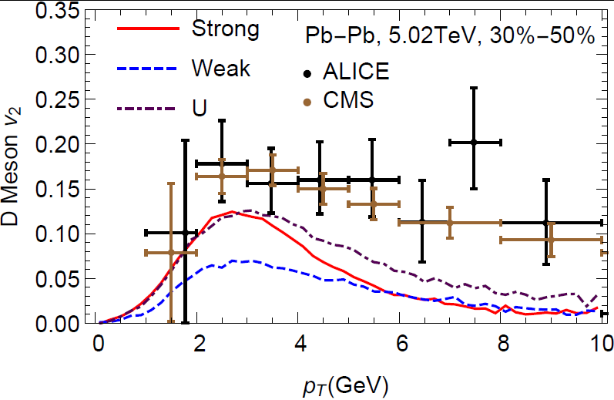
4.5 Sensitivity to Heavy-Quark Potential
Charm Quark D Meson
Strongly-coupled potential gives max. low-p_{T} c-quark v₂
Weakly-coupled potential (~ free energy) insufficient
[Liu,He+RR ‘19]

Slide 40
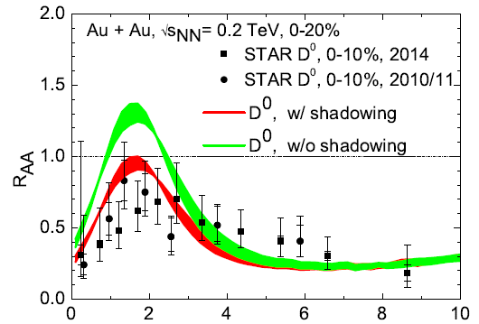
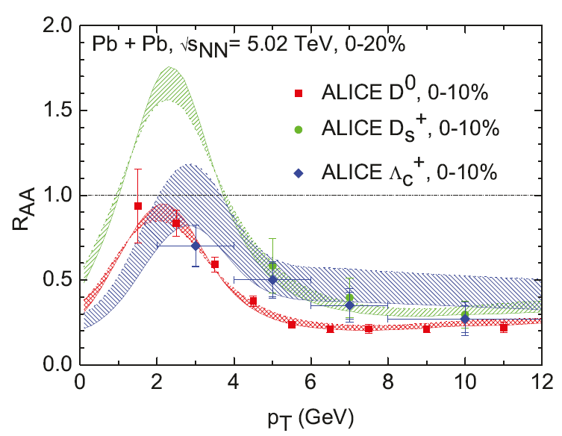
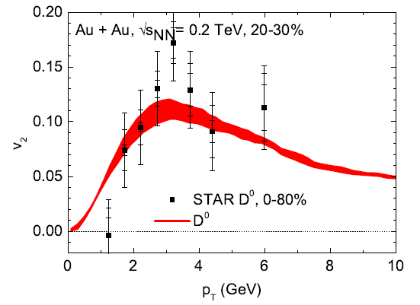
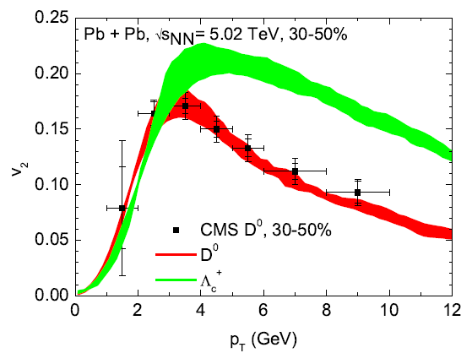
4.6 Charm-Hadron Spectra at RHIC + LHC
Flow bump in R_{AA} + large v₂ ↔ strong coupling near T_{pc}
Diffusion coefficient D_{s}(2πT) ~ 2 near T_{pc}
Distinct hadronization patterns for D vs. D_{s} vs. Λ_{c}
[M.He+RR ‘19]

Slide 41

2.6 Charm Hadro-Chemistry
-
D meson with strange quark: D_{s}= (cs)
[ALICE ‘21]
Strange quarks in
QGP enhance D_{s}
via recombination
[He,Fries+RR ‘13]
Charm Baryon-to-Meson Ratio: Λ_{c} / D⁰
Recombination + flow
effect on Λ_{c}

Slide 42
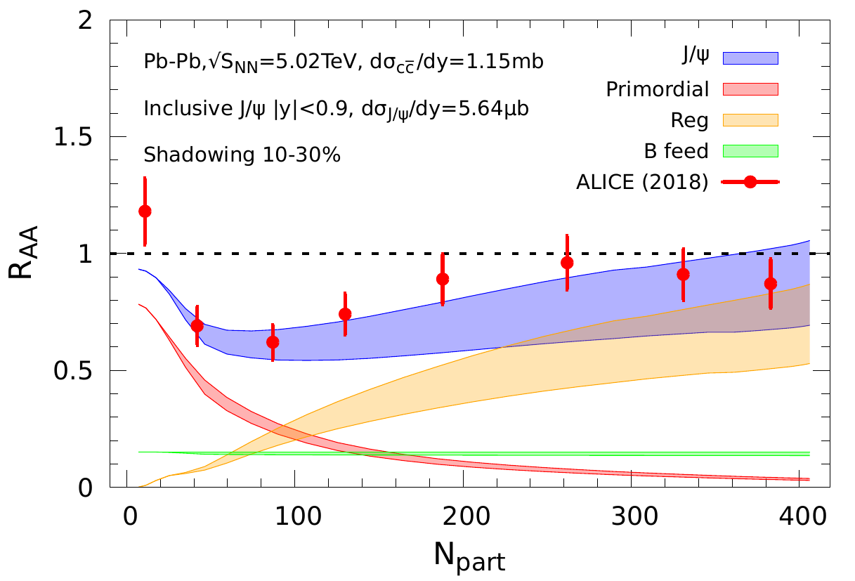
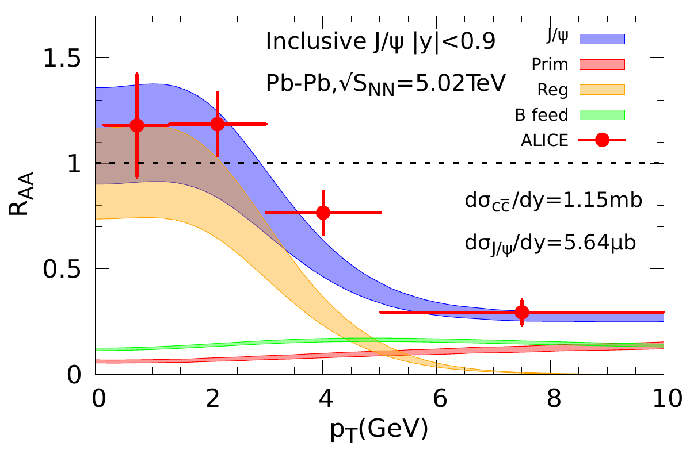
3.4 Charmonium Transport: LHC
Centrality p_{T} Dependence
Mid-
Rapidity
Forward
Rapidity
substantial regeneration, concentrated at low p_{T}

Slide 43
3.5 Interplay of Transport Coefficients: Charmonia
Phenomenological constraints on Γ_{ψ} from d/p-A:
J/ψ suppressed in QGP, ψ(2S) in hadronic matter
Transport in AA:
J/ψ / ψ(2S) near equilibrium in QGP / hadronic phase
→ “Sequential Regeneration” [Du+RR ’15]
[Wu+RR ‘24]

Slide 44
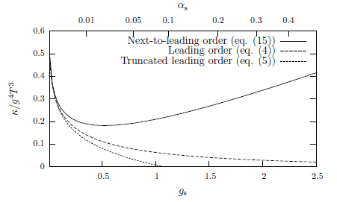
3.3 Heavy-Quark Interactions in QGP
Minimal / Desirable Ingredients and Features
Microscopic description of scattering amplitude
Realistic in-medium interaction kernel (screening)
Nonperturbative interactions
(color-Coulomb / pQCD not enough)
Resummation (strong coupling)
Hadronization approaching T_{c} from above
(bound states)
Elastic + radiative processes (low / high p_{T})
Realistic medium partons:
quasiparticles, widths, parton spectral functions, …? Equation of state?
Quantitatively rooted in constraints from lattice QCD
QGP
Q
[Caron-Huot+Moore ’08]

Slide 45
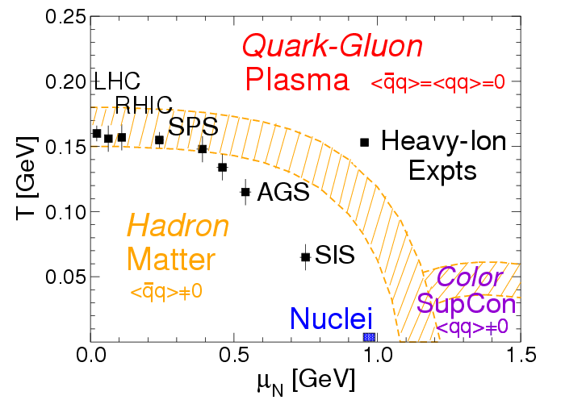
1.2 QCD Matter
De-/confinement and mass de-/generation
From heavy-ion collision phenomenology:
strongly coupled medium; η/s, (D_{s}2πT),… near lower quantum bound
Microscopic structure and interactions at strong coupling?

Slide 46
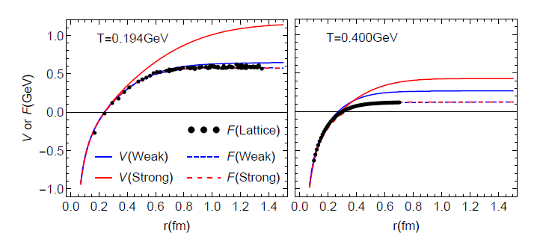
2.2.2 In-Medium Potential from Lattice Data
Two types of solutions:
weakly coupled scenario (WCS) vs. strongly coupled scenario (SCS)
WCS: potential close to free energy F, Γ_{Q} = 2Σ_{I} ~ 0.1 GeV
SCS: remnants of confining force well above T_{c}, Γ_{Q} ~ 0.6 GeV

Slide 47
1.5 Strongly Coupled QGP
⇔ Quantum liquid with transport coefficients
near conjectured lower bounds
Microscopic calculation of transport coefficients should
obey quantum-lower bounds
Description of bulk medium through which heavy quarks
propagate should encode strong-coupling properties
→ transport coefficients: (4π)η/s, D_{s}(2πT), σ_{el}/T
Large scattering rates → large collisional widths
→ broad spectral functions → off-shell (quantum) effects
Q
QGP
Q

