Slide 1

Overview on Hypernuclei (present and future)
Koji Miwa (Tohoku Univ.)
Introduction of hypernuclei
Λ hypernuclei
Double hypernuclei
Hyperon-proton scattering experiments
Erice : INTERNATIONAL SCHOOL OF NUCLEAR PHYSICS, 46th COURSE
Sep. 17th – 21st, 2025

Slide 2
Hypernuclei
Nuclei containing hyperons
Better (generalized) understanding of strong interaction
Change of nuclear cluster (wavefunction)
Investigation of new matter in the extreme condition
neutron
proton
Λ
Σ
Ξ
d
u
u
u
s
d
d
s
d
s
d
s
u
d
u
Decay with weak interaction
(same as neutron/proton rich unstable nuclei)
Decay with strong interaction
(ΣN→ΛN, ΞN→ΛΛ)

Slide 3
Hypernucler Physics
Scattering between hyperon and nucleon
Study of hypernuclei
Nuclei including hyperon
Hyperon
Nuclear structure reflects the interaction between hyperon and nucleon
proton
scattered by interactions between hyperon and proton
Λ particle
Ξ particle
Nuclear potential for hyperons can be evaluated from the hyperon’s binding energy
Essential to elucidate the nature of the extended nuclear force (Baryon-Baryon interaction)
Various phenomena in multi-particle system
Linking these two studies is important for understanding hyperon-containing matter
Notes:
このハイペロンと核子にはたらく力の解明に向けた2つの柱が、ハイペロンと陽子の散乱の研究と、ハイペロンを含んだ原子核であるハイパー核の研究です。ハイペロンと陽子の散乱の測定では、２粒子間にはたらく力で散乱されますので、どの角度にどれだけ散乱されるかを調べることで２粒子間にはたらく力を調べることができます。またビームのエネルギーを変えることで、粒子間の距離の依存性などの詳細も調べることができます。まさに核力の研究の時に陽子と陽子の散乱実験で力の詳細が分かったのと同じ流れです。そしてハイパー核の研究では、原子核を構成する粒子間にはたらく力の重ね合わさることで、全体として感じる引力の強さがわかります。この研究では、ハイペロンと核子にはたらく力を平均化したときにどれくらい引力を感じるかということが分かります。
（例えば、Ξが原子核の中に束縛されていることが、J-PARCの研究で発見されましたが、それだけで、Ξと核子の間には平均すると引力がはたらいていることが分かり、それだけで大きな情報になります。散乱の場合は、引力がはたらいて散乱するのか、反発力がはたらいて散乱するのかは、逆に慎重に解析する必要があります。）
原子核の研究では、多粒子系の多様な現象が現れます。我々は、相互作用を理解した上で、これらの多様な現象を理解し、最終的には、中性子星まで拡張したいというのが大きな目標です。ですので、この2つの研究を有機的に連携して、研究をすることがハイペロンを含んだ物質を理解する上で重要になります。

Slide 4
Hypernucler Physics
Scattering between hyperon and nucleon
Study of hypernuclei
Nuclei including hyperon
Hyperon
Nuclear structure reflects the interaction between hyperon and nucleon
proton
scattered by interactions between hyperon and proton
Λ particle
Ξ particle
Nuclear potential for hyperons can be evaluated from the hyperon’s binding energy
Essential to elucidate the nature of the extended nuclear force (Baryon-Baryon interaction)
Various phenomena in multi-particle system
Linking these two studies is important for understanding hyperon-containing matter
Notes:
このハイペロンと核子にはたらく力の解明に向けた2つの柱が、ハイペロンと陽子の散乱の研究と、ハイペロンを含んだ原子核であるハイパー核の研究です。ハイペロンと陽子の散乱の測定では、２粒子間にはたらく力で散乱されますので、どの角度にどれだけ散乱されるかを調べることで２粒子間にはたらく力を調べることができます。またビームのエネルギーを変えることで、粒子間の距離の依存性などの詳細も調べることができます。まさに核力の研究の時に陽子と陽子の散乱実験で力の詳細が分かったのと同じ流れです。そしてハイパー核の研究では、原子核を構成する粒子間にはたらく力の重ね合わさることで、全体として感じる引力の強さがわかります。この研究では、ハイペロンと核子にはたらく力を平均化したときにどれくらい引力を感じるかということが分かります。
（例えば、Ξが原子核の中に束縛されていることが、J-PARCの研究で発見されましたが、それだけで、Ξと核子の間には平均すると引力がはたらいていることが分かり、それだけで大きな情報になります。散乱の場合は、引力がはたらいて散乱するのか、反発力がはたらいて散乱するのかは、逆に慎重に解析する必要があります。）
原子核の研究では、多粒子系の多様な現象が現れます。我々は、相互作用を理解した上で、これらの多様な現象を理解し、最終的には、中性子星まで拡張したいというのが大きな目標です。ですので、この2つの研究を有機的に連携して、研究をすることがハイペロンを含んだ物質を理解する上で重要になります。

Slide 5
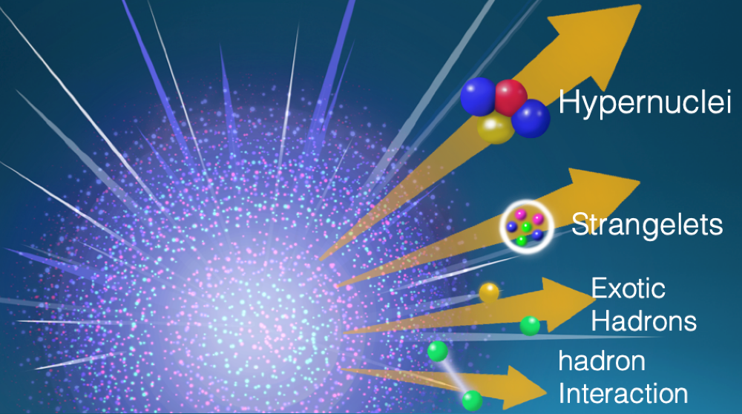
Production of hypernuclei
K⁺
π⁺
n
Λ
Meson induced reaction
Κ⁻
u
s
u
d
π⁻
π⁻
~mb
d
d
u
s
d
u
n
Λ
n
Λ
K⁻
u
d
u
s
π⁺
Κ⁺
Heavy ion collision
d
d
u
s
d
u
~100μb
n
Λ
Electromagnetic reaction
e
e’
u
u
s
Κ⁺
p
d
u
s
d
u
~μb
Λ
^{A}Z + ^{A’}Z’ → ^{A’’}_{Λ}Z’’ + X
via N + N → N + Λ + K⁺/K⁰

Slide 6
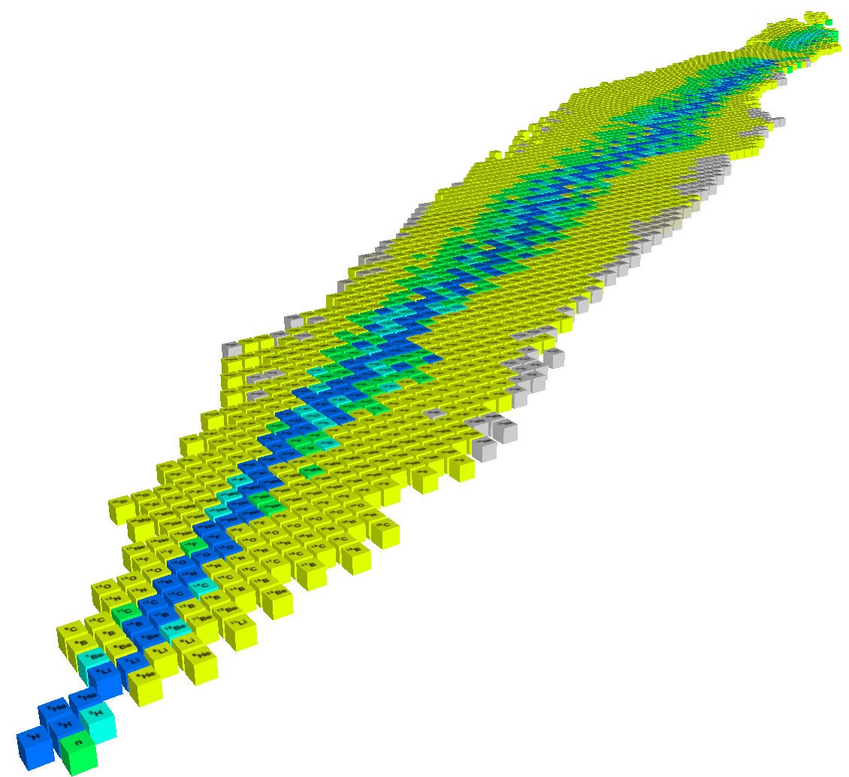
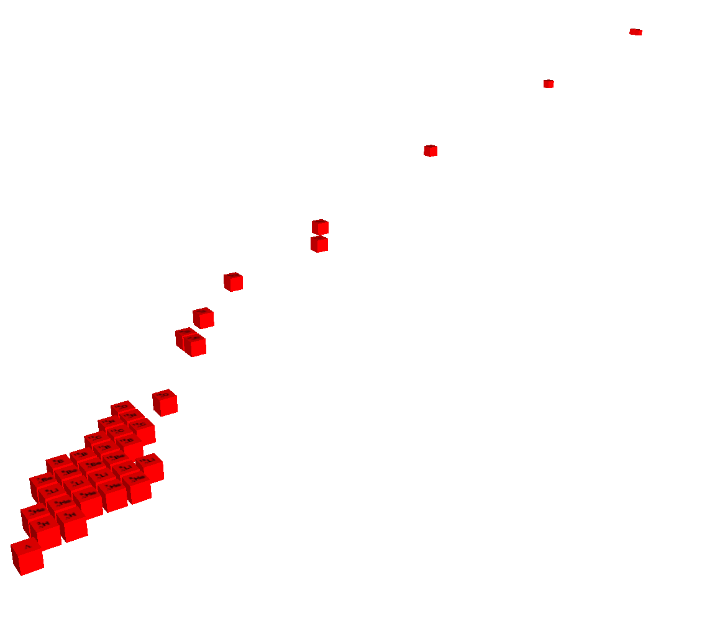


Matter of universe extended by strange quark
Nu ~ Nd ~ Ns
Existing at the center of a neutron star?
Strange matter(Electrically neutral, Mass number→∞ bound by gravity)
Nuclei and matter consisting of u, d, and s quarks
p, n, Λ, Ξ⁰, Ξ⁻
High density
strangeness
ΛΛ, Ξ nuclei
proton number
Λ, Σ hypernuclei
− 2
Ξ−
Λ
neutron number
−1
p
n
0
Notes:
We want to explain about Strangeness nuclear physics and its physics motivation.
This is a nuclear chart for normal nuclei as represented by neutron number and proton number.
In the strangeness physics, we add new axis of Strangeness and we investigate the nature of hypernuclei
including hyperons in the nuclei.
This is the S=-1 sector mainly come from L hyper nuclei.
This is the S=-2 sector such as LL hypernuclei and Xi hypernuclei.
S=-2 system is the door way to the multi-strangeness system and this is one of the main topics at J-PARC.

Slide 7
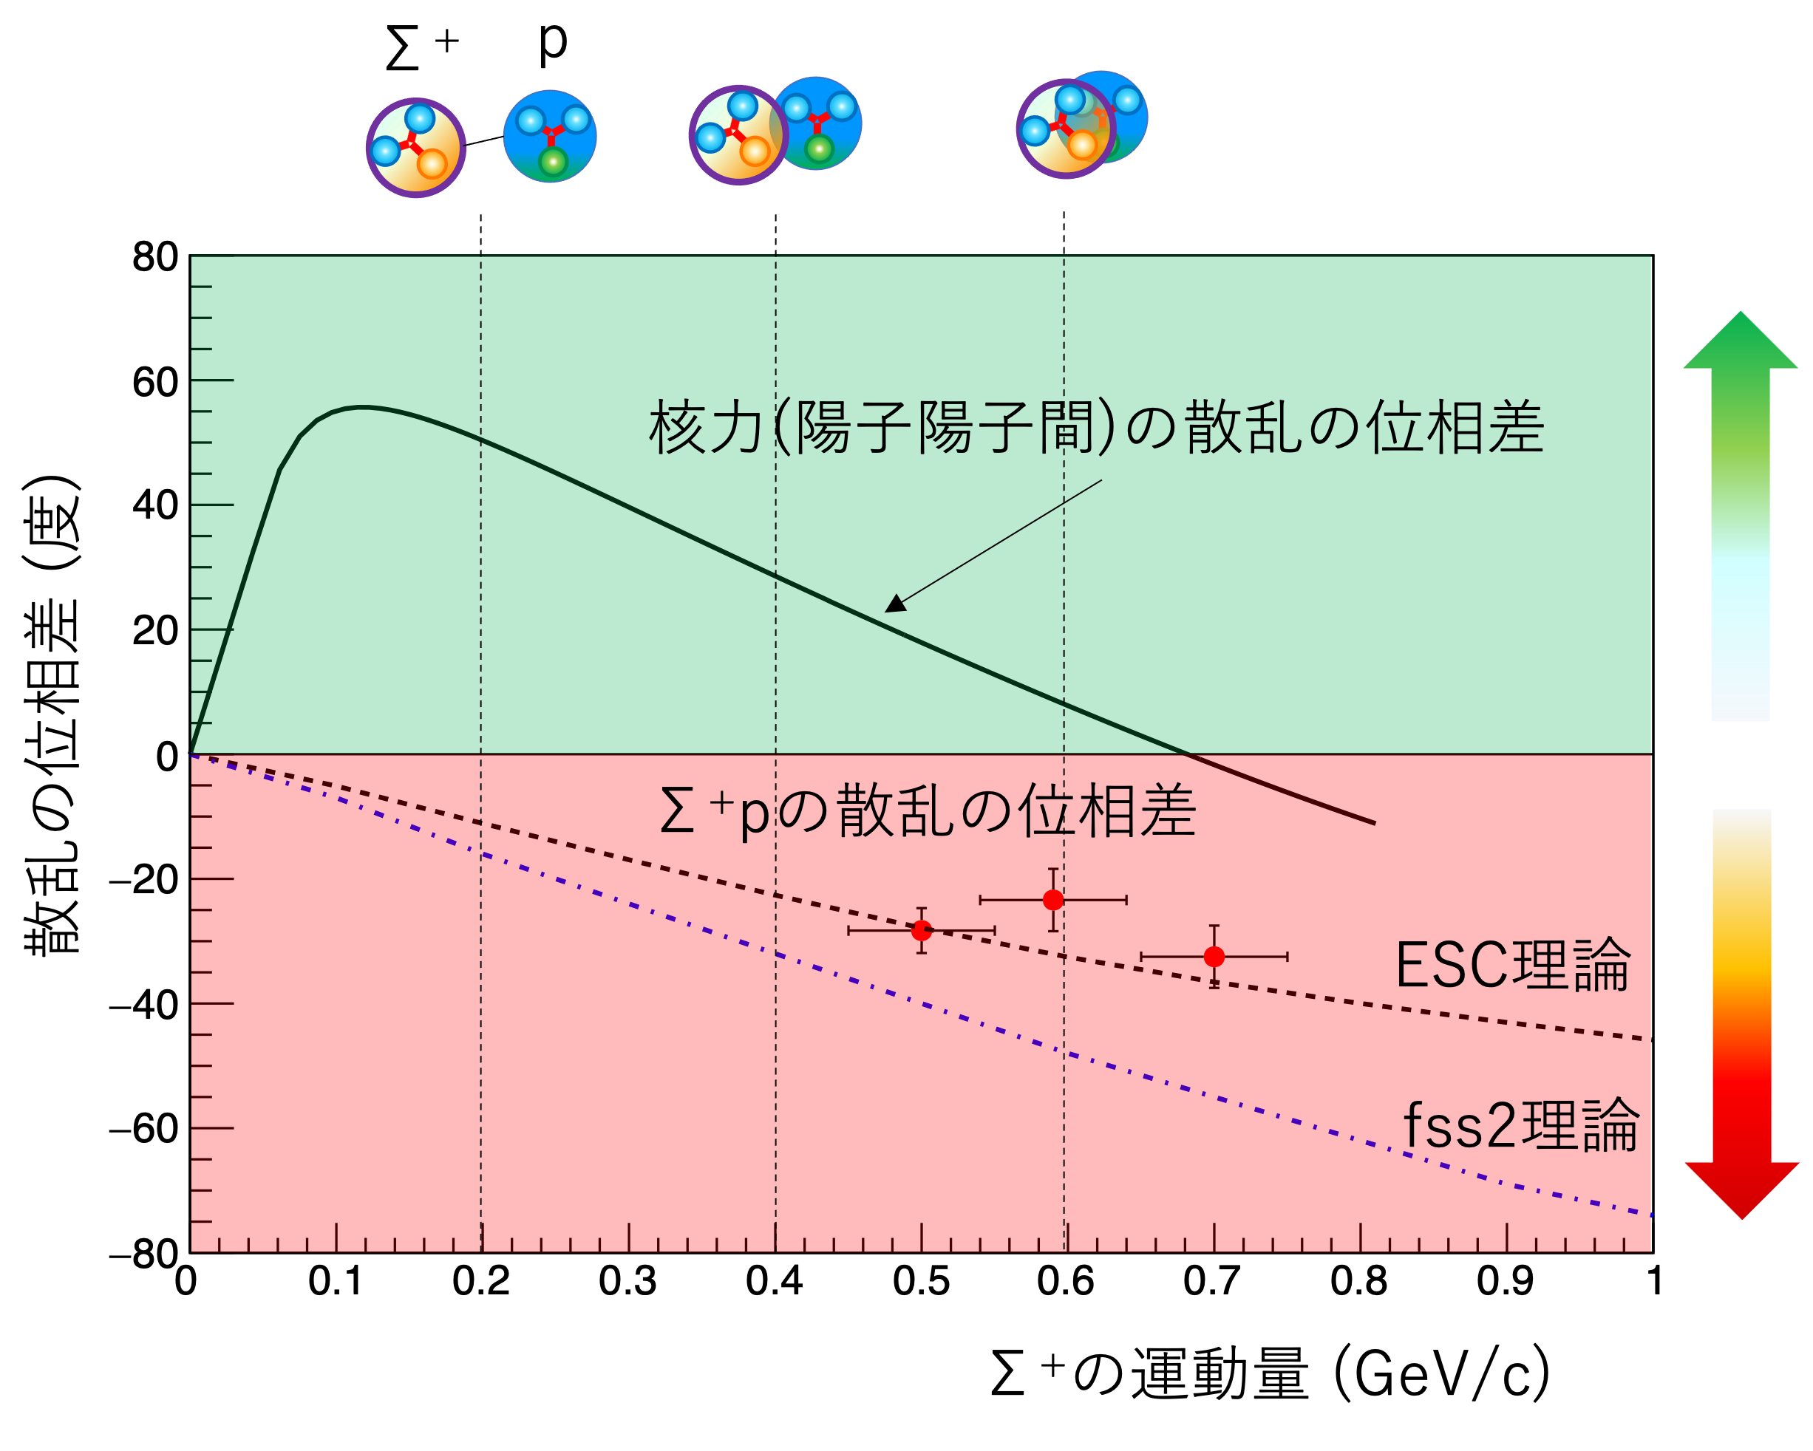
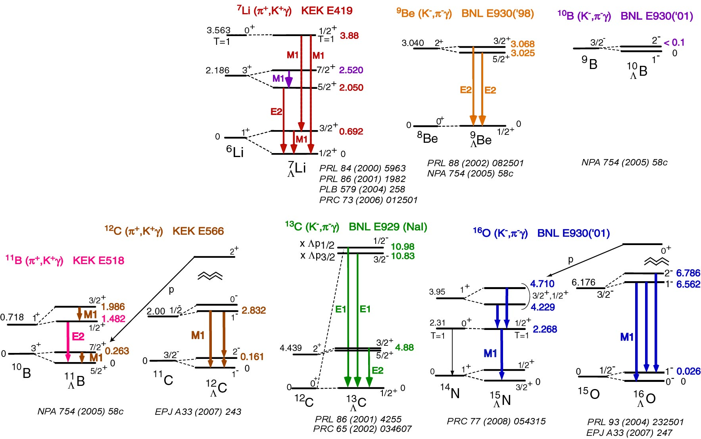










Hypernuclear Physics
Better (generalized) understanding of strong interaction
Why is spin-orbit force of ΛN interaction so small?
Why is the ΣN interaction quite repulsive?
H-dibaryon resonance ?
$$L$$
$$s_{Λ}$$
H-dibaryon
¹²C
$$L$$
α
$$s_{Λ}$$
$$s$$
$$u$$
α
Phase shift for pp scattering
$$u$$
$$s$$
$$d$$
$$d$$
Phase shift (degree)
Phase shift for Σ⁺p scattering
Attractive color-magnetic interaction
Σ⁺ momentum (GeV/c)
These new natures could be related to the role of quarks
in the interactions.

Slide 8
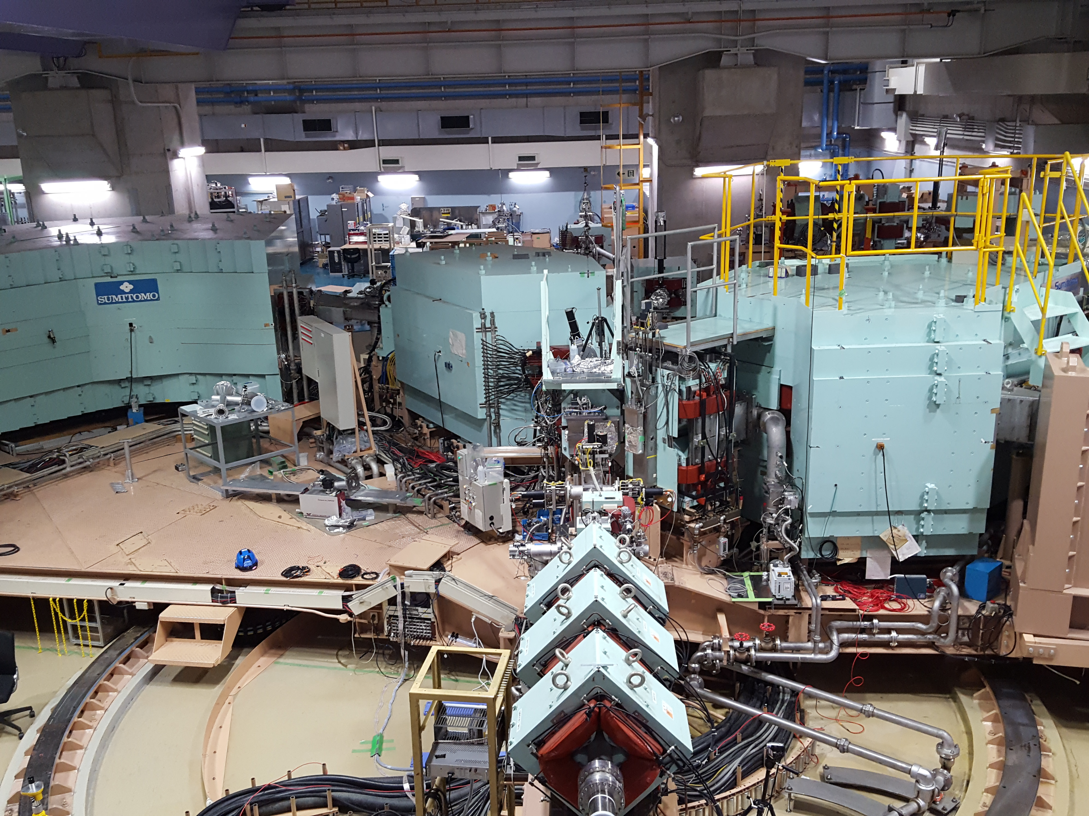

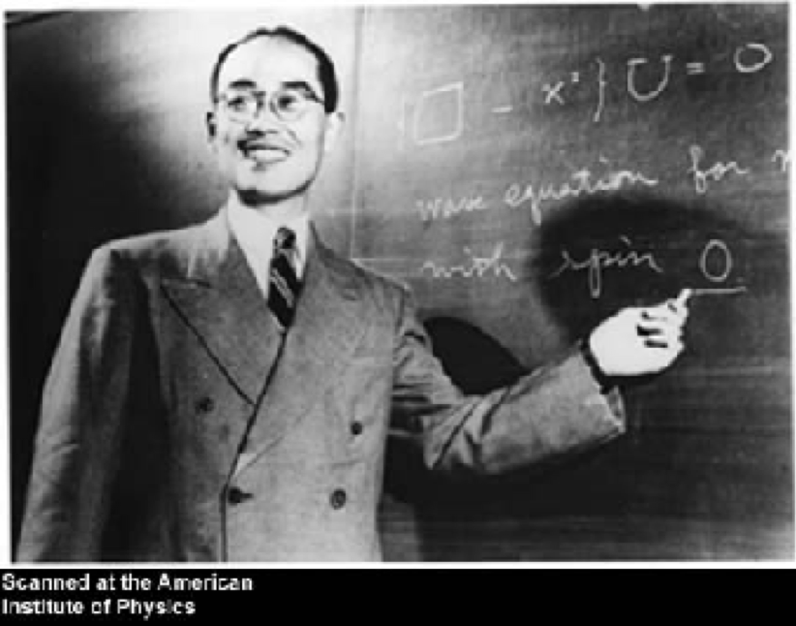
History of research on nuclear force
Yukawa’s meson exchange theory (1935)
NN scattering experiment at cyclotron accelerator
The nuclear force works by exchanging mesons (pions) between nucleons.
Established through nuclear force theory and scattering experiments
RCNP,
University of Osaka
Short range
(repulsive core)
Intermediate range
(strong attraction)
Long range
(weak attraction)
Short range where nucleons overlap each other
→Quark must play important role
ω, ρ
2π, σ
π
quark？
Nuclear force research including new type of quark
What is the origin of repulsive core？
NN Distance
1 fm
2 fm
Notes:
この核力の研究の歴史を振り返ると、1935年に湯川博士が核力は、陽子と中性子の間に中間子を交換することで、引力がはたらくという中間子交換理論から始まります。実際に核力がどのような引力や斥力の振る舞いを示すかという実験的な検証は、加速器を用いた陽子陽子散乱実験の測定を通して、ここに示すような遠距離では引力で、それが斥力になっていくということが分かってきました。この核力理論と散乱実験で、現在の核力の描像は確立してきて、遠距離ではパイ中間子を交換することによる弱い引力、中間領域では複数のパイ中間子やもう少し重たい中間子を交換することによる強い引力、そして近距離では急激に斥力へと移り変わっていく。この短距離での斥力がはたらくことは、現象としてそうなることは分かっていますが、どんな理由で斥力となっているのかは分かっていません。このような領域では核子どうしが重なり合うような近距離になっていますので、内部に含まれるクォークが重要な役割をはたすはずです。これを調べるには、陽子・中性子間の核力を調べるだけでは不十分です。新しいクォークを含んだ核力がどうなるか？これを調べる必要があります。

Slide 9
Extended nuclear force (Baryon-Baryon interaction)
Short range
(repulsive core)
Intermediate range
(strong attraction)
Long range
(weak attraction)
Nuclear force
(NN int.)
ω, ρ
2π, σ
π
quark？
1 fm
NN distance
2 fm
Hyperon-Nucleon interaction
ω, ρ
Κ∗
Intermediate range
Long range
Short range
2π, σ,
π exchange could be forbidden in some cases
Κ, η
π
quark？
No attractive force but strong repulsive force
1 fm
Distance between particles
2 fm
No repulsive core
Notes:
ここでは、核力と、ハイペロンと核子の間にはたらく力を比較しています。まず、ストレンジクォークを入れることで、新しい中間子の交換をすることが出来るようになりますし、逆に、今まで交換できていたパイ中間子の交換が禁止されるような場合も出てきます。また最も重要なのは、短距離での力がどう変わるか？新しいクォークを入れることによってどう変わるか？です。
そこでは、このようにほとんど引力がなくなって、斥力が非常に強い力や、今までとは全く逆で、短距離では引力芯になるような力、と新しいクォークが作る相互作用は、短距離部分で非常に多様な力を示すことが予想されています。

Slide 10















Baryon-Baryon interaction (8 x 8)
$B_{8}B_{8}$ case
p
n
p
n
Σ⁺
Σ⁰
Λ
Σ⁻
Σ⁺
Σ⁰
Λ
Σ⁻
= ?
Ξ⁰
Ξ⁻
Ξ⁰
Ξ⁻
$$a$$
$$a$$
$$⊗$$
=
$$b$$
$$⊕$$
$$⊕$$
$$⊕$$
$$a$$
$$⊕$$
$$a$$
$$⊕$$
$$a$$
$$b$$
$27$-plet
$10$-plet
$\overline{10}$-plet
$8_{S}$-plet
$8_{A}$-plet
$1$-plet

Slide 11
Baryon-Baryon interaction in SU_{F}(3) symmetry
Same multiplet with NN interaction
Newly appeared interaction in BB(YN, YY) interaction
27
8s
symmetric for particle exchange
1
nn
pn+np
pp
0
-1
ΣN(T=3/2)
ΣN-ΛN(T=1/2)
ΣN-ΛN(T=1/2)
-2
Strangeness
-3
-4
10*
pn-np
10
8a
0
anti-symmetric for particle exchange
-1
ΣN(T=3/2)
-2
Strangeness
-3
-4
Ξ⁰Ξ⁻-Ξ⁻Ξ⁰
aa

Slide 12
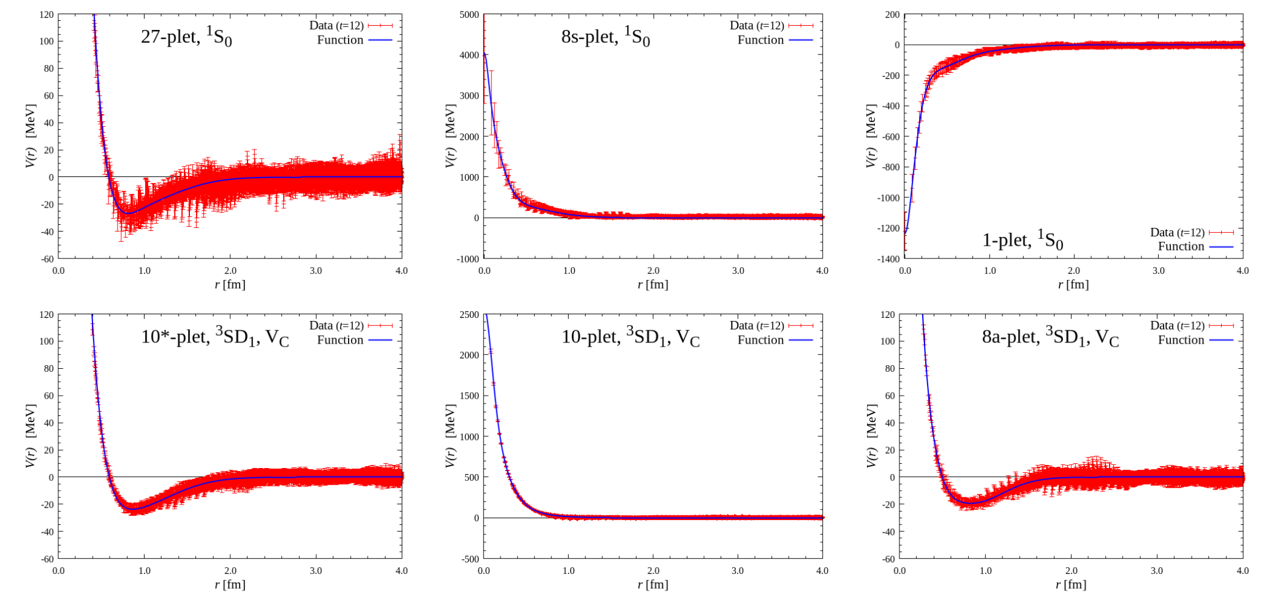
Baryon-Baryon interaction (Lattice QCD calculation)
NN int. (¹S₀)
Strong repulsive force
due to quark Pauli effect
Attractive pocket
at short range
T. Inoue, AIP Conf. Proc. 2130,
020002 (2019)
NN int. (³S₁)
Strong repulsive force
due to quark Pauli effect
Relatively weak repulsive core
The interactions created by strange quarks are expected to
exhibit diverse forces in the short-range domain.
Notes:
ここではLattice QCDによるバリオン間力の6つの相互作用の多重項のポテンシャルの計算結果を示しています。左にあるのが、核力に現れる力で、先程のような引力のポケットと斥力芯がある形です。ストレンジクォークを入れた拡張された力では、右に示すような新しい力が出てきます。そこでは、このようにほとんど引力がなくなって、斥力が非常に強い力や、核力に似ているけれども、斥力芯が弱くなっている力、そして、今までとは全く逆で、短距離では引力芯になるような力、とクォークの種類を増やすことで生じる新しい相互作用は、短距離部分で非常に多様な力を示すことが予想されています。

Slide 13
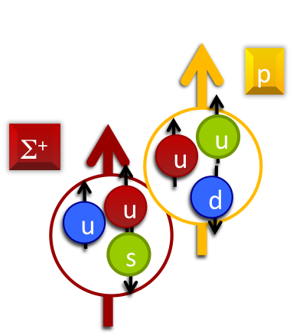
Baryon-Baryon interaction (Lattice QCD calculation)
Hypernuclei
H-dibaryon
NN int. (¹S₀)
Strong repulsive force
due to quark Pauli effect
Attractive pocket
at short range
Σ⁺p scatterng
$$s$$
$$u$$
$$u$$
$$s$$
T. Inoue, AIP Conf. Proc. 2130,
020002 (2019)
$$d$$
$$d$$
Λ
Ξ
¹E or ³O ³E or ¹O
6 quarks can stay in s state in normal case
NN (I=0) ------ (10*)
NN (I=1) (27) -----
ΛN (I=1/2) 1/√10[(8_{s}) + 3(27)] 1/√2[-(8_{a}) + (10*)]
ΣN(I=1/2) 1/√10[3(8_{s}) - (27)] 1/√2[(8_{a}) + (10*)]
ΣN(I=3/2) (27) (10)
Pauli Forbidden !
Relatively weak repulsive core
NN int. (³S₁)
Strong repulsive force
due to quark Pauli effect
l=0
s
u
u
u
u
d
Σ⁺
p
YN channels ware represented as the superposition of these flavor multiplets.
The interactions created by strange quarks are expected to
exhibit diverse forces in the short-range domain.
Notes:
ここではLattice QCDによるバリオン間力の6つの相互作用の多重項のポテンシャルの計算結果を示しています。左にあるのが、核力に現れる力で、先程のような引力のポケットと斥力芯がある形です。ストレンジクォークを入れた拡張された力では、右に示すような新しい力が出てきます。そこでは、このようにほとんど引力がなくなって、斥力が非常に強い力や、核力に似ているけれども、斥力芯が弱くなっている力、そして、今までとは全く逆で、短距離では引力芯になるような力、とクォークの種類を増やすことで生じる新しい相互作用は、短距離部分で非常に多様な力を示すことが予想されています。

Slide 14
Λ hypernuclear structure
spin dependent ΛN interaction
•
•
•
× Λ d_{3/2}
central force
V_{ΛN}(r) = V₀(r)
+ V_{σ}s_{N}s_{Λ}
+ V_{Λ}l_{NΛ}s_{Λ}
+ V_{N}l_{NΛ}s_{N}
+ V_{T}[3(s_{N}r)(s_{Λ}r)/r²-s_{N}s_{Λ}]
spin-spin interaction
3−,2−, 1−, 0−
spin-orbital force between Λ’s spin and
relative orbital momentum
4−, 3−,2−, 1−
spin-orbital force between Nucleon’s spin and
relative orbital momentum
× Λ d_{5/2}
tensor force
•
•
•
Level splitting due to LS force
× Λ p_{1/2}
Λ’s major shell
structure
2+,1+
3+,2+,1+,0+
どちらに入るか？
1/2−
1/2−
•
•
•
•
•
•
3/2−
3/2−
× Λ p_{3/2}
1/2−
1/2−
1/2+
1/2+
2−
3/2−
3/2−
n
Λ
3/2−
1−
1/2+
1/2+
0−
n
Λ
1/2−
1−
1/2−
1/2−
2−
spin doublet
3/2−
3/2−
3/2−
s_{N}s_{L}, LS_{Λ}, T
¹¹C
× Λ s_{1/2}
1−
1/2+
1/2+
¹²_{Λ}C
n
Λ

Slide 15
Λ hypernuclear structure
•
•
•
× Λ d_{3/2}
3−,2−, 1−, 0−
major shell
structure
→ V₀
4−, 3−,2−, 1−
× Λ d_{5/2}
•
•
•
Level splitting due to LS force
× Λ p_{1/2}
LS splitting
→ V_{Λ}
Λ’s major shell
structure
2+,1+
3+,2+,1+,0+
•
•
•
•
•
•
× Λ p_{3/2}
Core excited
state
→ V_{N}
2−
3/2−
1−
0−
1/2−
1−
spin doublet
Spin doublet
→ V_{σ,}, V_{Λ}, V_{T}
3/2−
2−
1−
s_{N}s_{L}, LS_{Λ}, T
¹¹C
× Λ s_{1/2}
¹²_{Λ}C
4 MeV FWHM
(π+, Κ+)
1.5 MeV FWHM
(π+, Κ+)
0.2 MeV FWHM
(e, e’Κ+)

Slide 16
Λ hypernuclear structure
•
•
•
× Λ d_{3/2}
3−,2−, 1−, 0−
major shell
structure
→ V₀
4−, 3−,2−, 1−
× Λ d_{5/2}
•
•
•
Level splitting due to LS force
Resonance state
× Λ p_{1/2}
LS splitting
→ V_{Λ}
Λ’s major shell
structure
2+,1+
3+,2+,1+,0+
•
•
•
p+¹¹_{Λ}B
particle emission threshold
•
•
•
× Λ p_{3/2}
Core excited
state
→ V_{N}
2−
3/2−
1−
0−
Bound state
1/2−
1−
spin doublet
Spin doublet
→ V_{σ,}, V_{Λ}, V_{T}
3/2−
2−
1−
s_{N}s_{L}, LS_{Λ}, T
¹¹C
× Λ s_{1/2}
¹²_{Λ}C
4 MeV FWHM
(π+, Κ+)
1.5 MeV FWHM
(π+, Κ+)
0.2 MeV FWHM
(e, e’Κ+)

Slide 17
Λ hypernuclear structure
•
•
•
× Λ d_{3/2}
3−,2−, 1−, 0−
major shell
structure
→ V₀
4−, 3−,2−, 1−
× Λ d_{5/2}
•
•
•
Level splitting due to LS force
Resonance state
× Λ p_{1/2}
LS splitting
→ V_{Λ}
Λ’s major shell
structure
2+,1+
3+,2+,1+,0+
•
•
•
p+¹¹_{Λ}B
particle emission threshold
•
•
•
× Λ p_{3/2}
Core excited
state
→ V_{N}
2−
3/2−
1−
γ rays can be measured
for bound states
0−
Bound state
1/2−
1−
spin doublet
Spin doublet
→ V_{σ,}, V_{Λ}, V_{T}
3/2−
2−
1−
s_{N}s_{L}, LS_{Λ}, T
¹¹C
× Λ s_{1/2}
¹²_{Λ}C
4 MeV FWHM
(π+, Κ+)
1.5 MeV FWHM
(π+, Κ+)
0.2 MeV FWHM
(e, e’Κ+)

Slide 18
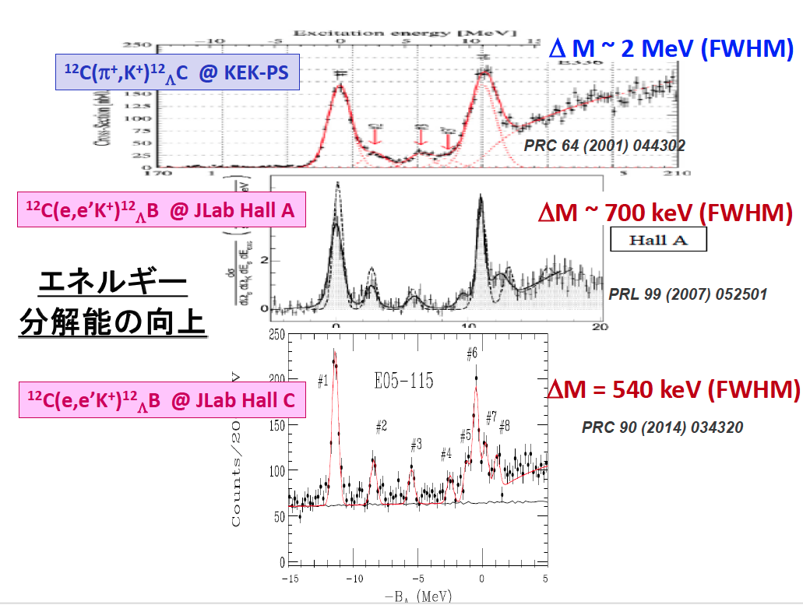
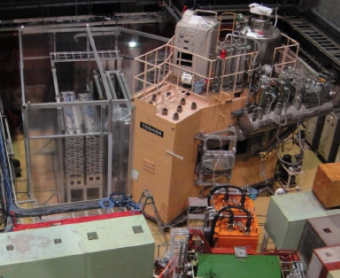
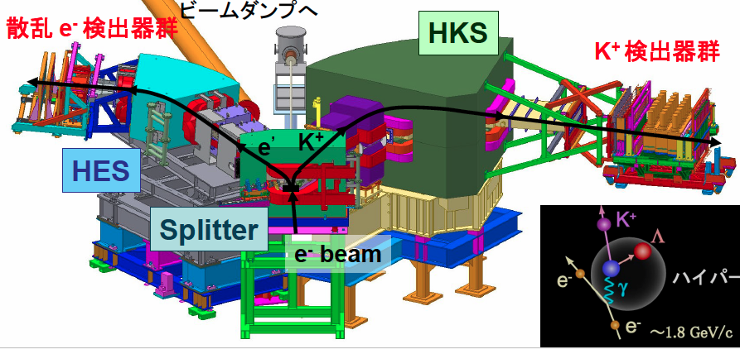
Improvement of
energy resolution

Slide 19
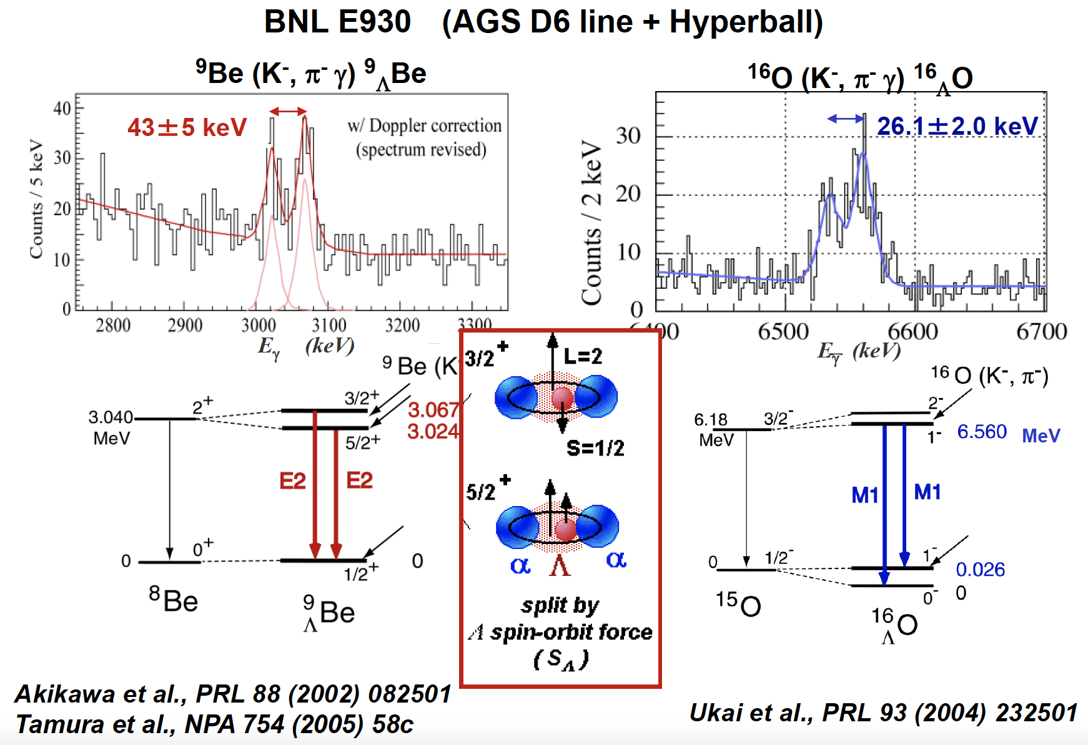
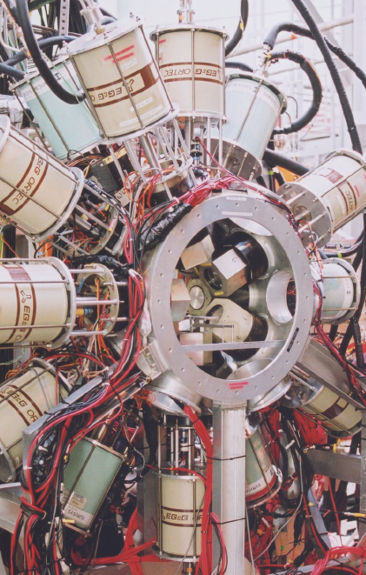
Gamma-ray spectroscopy

Slide 20
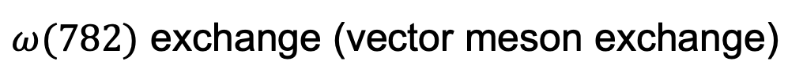
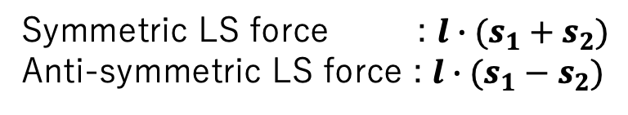
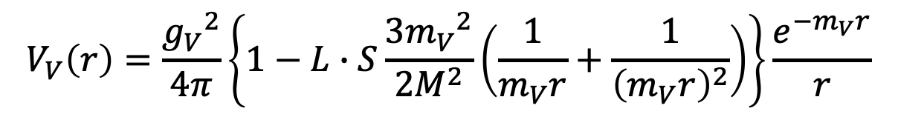
What is the source of LS force?
Boson exchange potential
Intermediate
Short
Long
$ω(782)$ exchange (vector meson exchange)
[MeV]
$$V_{V}\left(r\right)=\frac{{g_{V}}^{2}}{4π}\left\{1−L∙S\frac{3{m_{V}}^{2}}{2M^{2}}\left(\frac{1}{m_{V}r}+\frac{1}{{\left(m_{V}r\right)}^{2}}\right)\right\}\frac{e^{−m_{V}r}}{r}$$
Repulsive core
150
Case of ΛN interaction : Both SLS and ALS can contribute
100
LS force
L
s₁
V(³P₁)
Symmetric LS force : $l∙(s_{1}+s_{2})$
Anti-symmetric LS force : $l∙(s_{1}−s_{2})$
s₂
50
¹E or ³O ³E or ¹O
0
0.5
1.0
1.5
2.0
2.5
NN (I=0) ------ (10*)
NN (I=1) (27) -----
ΛN (I=1/2) 1/√10[(8_{s}) + 3(27)] 1/√2[-(8_{a}) + (10*)]
ΣN(I=1/2) 1/√10[3(8_{s}) - (27)] 1/√2[(8_{a}) + (10*)]
ΣN(I=3/2) (27) (10)
V(¹S₀)
r [fm]
ALS
SLS
−50
V(³P₀)
SLS
V(³P₂)
π
−100
π
π
ALS OK
ω, ρ
σ,

Slide 21
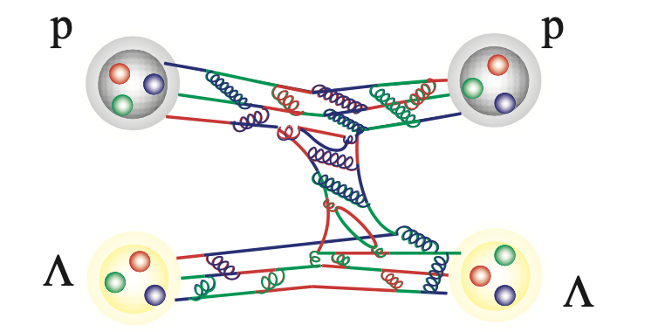








What is the source of LS force?
Boson Exchange Model (Nijmegen)
Quark based model
$$p$$
$$g_{ΛNK}$$
$$Λ$$
$$K∗$$
quark & gluon
$$Λ$$
$$g_{ΛNK}$$
$$p$$
Time
時間
Vector meson exchange
One gluon exchange between quarks
SLS : Large as NN force
SLS : Large as NN force
ALS : Small contribution is predicted
ALS : Large as NN force
$$∝M_{N}^{2}−M_{Y}^{2}$$
Naturally explain small LN LS force
by the cancellation of SLS and ALS
Predict sizable ΛN LS force
LS(ΛN) = SLS - ALS
The small LS force in the ΛN interaction is evidence for the quark contribution in the BB interaction.

Slide 22
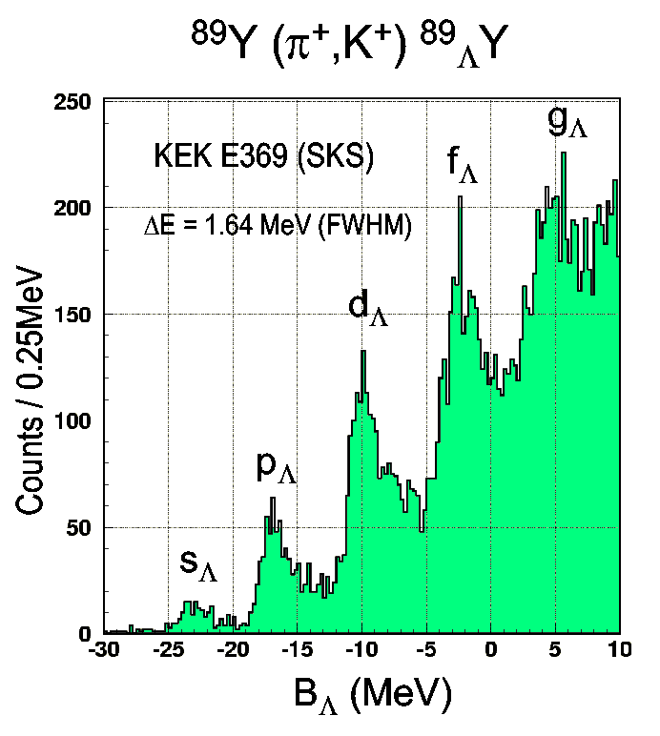

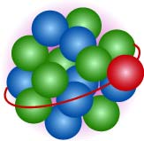
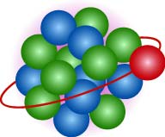
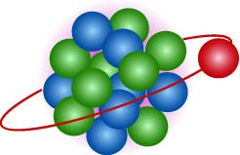
Investigate deep inside of nuclei
Energy
r
Λ can be identified even in the deep inside
Nuclear s-hole state
by knocking out s-state nucleon
89
_{Λ}Y
Width of s-state is quite large
impossible to get information nuclear interior
39
49
Hypernuclear mass (Λ binding energy)(MeV)
M. Yosoi et al. Phys. Lett. B 551 (2003) 255

Slide 23
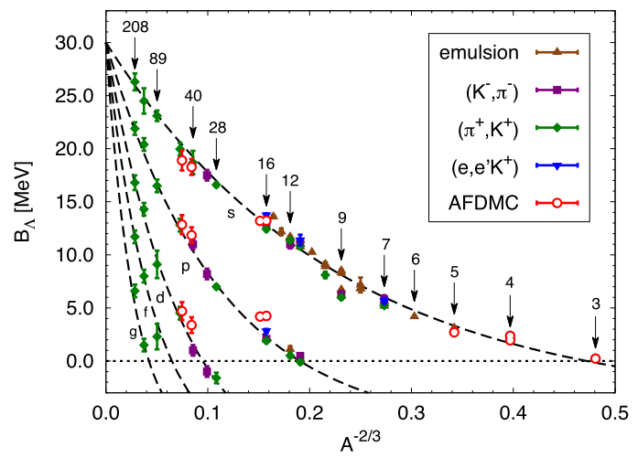
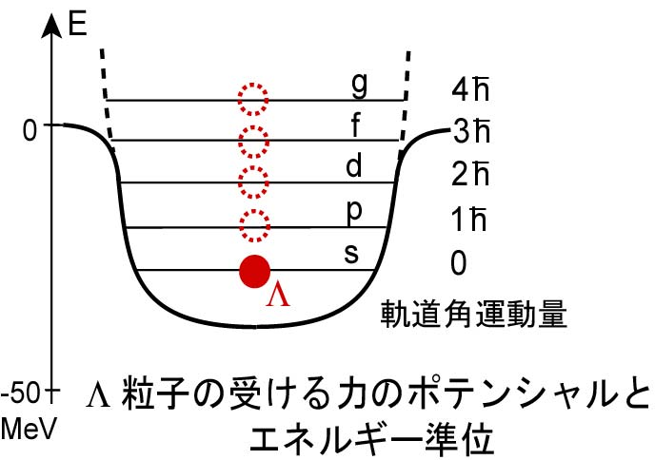

Λ potential in nuclear matter
Potential of Λ particle in nuclei :
Well type potential with depth of V₀ (Assumption)
$$R∝A^{1/3}$$
-30 MeV
F.Pedriva et al. arXiv:1506.04042

Slide 24
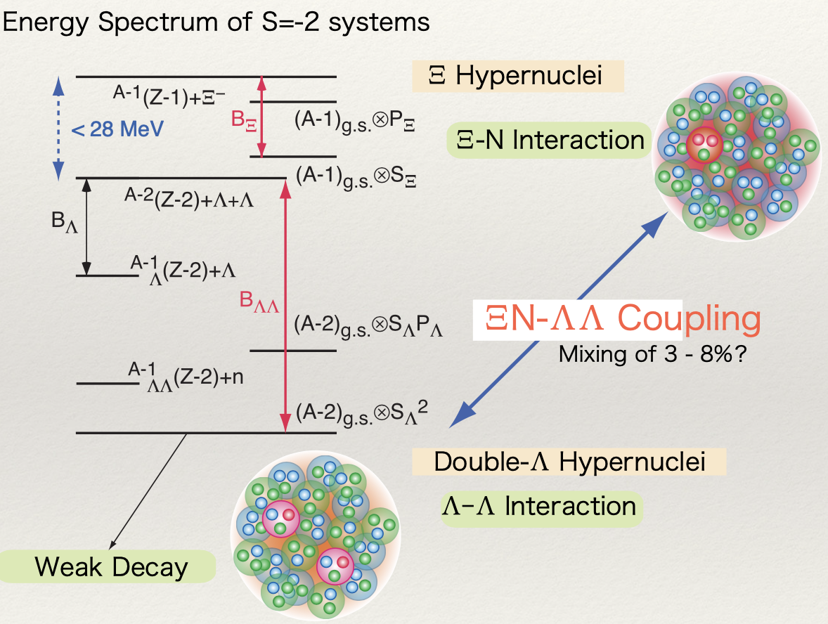
Topics with S=−2 hypernuclei
Performed experiment
Future experiment
s-shell ΛΛ hypernuclei
⁵_{ΛΛ}H : Possible lightest ΛΛ hypernucleus (E75)
A=6~17 ΛΛ hypernuclei
Confirmation of ΛΛ interaction and nuclear structure effect such as shrinkage due to Λ (E07)
Ξ hypernuclei
Emulsion (E07) & spectroscopy (E70)
ΞN interaction with X-ray from Ξ-atoms (E03, E07)
ΞN interaction at nuclear surface
ΛΛ p-wave interaction
excited ΛΛ hypernuclear state with one Λ hyperon in p-orbit
Direct production of ΛΛ hypernuclei via (K⁻, K⁺) reaction (E70 ?)
Search for H-dibaryon state (E42)
Sharp resonance just below ΞN threshold is predicted by LQCD
Notes:
In S=-2 system, mass difference between LL and NX is small (about 28 MeV), this double L hypernuclei and X hypernuclei can be mixed with XN-LL coupling.
These are topics of S=-2 hypernuclei.
S-shell LL hypernuclei, 5LLH is expected to be lightest LL hypernucleus and will be measured in E75 experiment.
A=6~17 LL hypernuclei, the confirmation of LL interaction and nuclear structure effect such as shrinkage due to L is important topics and E07 emulsion experiment are covering this topics.
Xi hypernuclei are very hot topic today and emulsion group reported the first evidence of the bound X hypernuclei and Xi hypernuclear spectroscopy will be performed soon at J-PARC.
X-ray measurement from X-atom is important constraint to determine the XN interaction at nuclear surface, it is covered by E03 and E07 experiments.
LL p-wave interaction, that is excited LL hypernuclear state with one L hyperon in p-orbit.
To investigate this p-orbit state, direct production of LL hypernuclei via (K-, K+) reaction might be possible experimental method.
H-dibaryon is also closely related to the S=-2 system and sharp resonance just below XN threshold is predicted by lattice QCD.
E42 took data of double lambda events and analysis is ongoing.

Slide 25
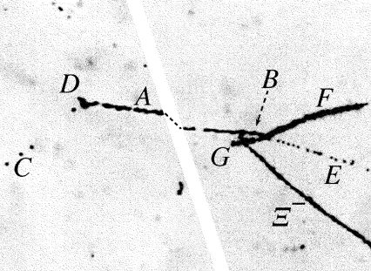
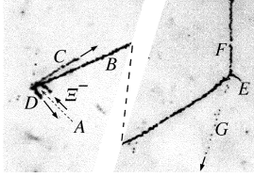
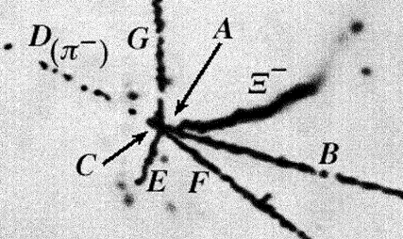
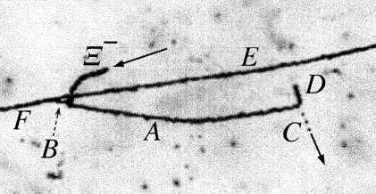
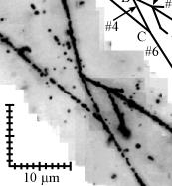
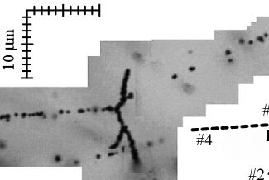
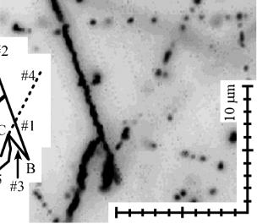
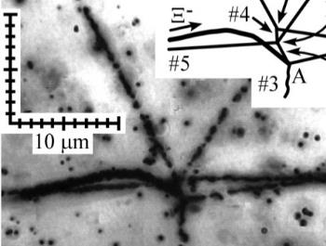
Evolution of experiments with hybrid emulsion method for S=-2
KEK-PS E176 (1988-89)
Nuclear Physics A 828 (2009) 191–232
Slide from J. Yoshida
#10-09-06
#14-03-35
#13-11-14
#15-03-37
* ~80 Ξ⁻ stop events
* Existence of double Lambda hypernucleus
X10 statistics
KEK-PS E373 (1998-2000)
PHYSICAL REVIEW C 88, 014003 (2013)
Nagara
Mikage
Demachiyanagi
Hida
Ξ ⁻
Ξ ⁻
Ξ ⁻
Ξ ⁻
* At least ~650 Ξ⁻ stop events; Prog. Theor. Exp. Phys. 2019, 021D01
* NAGARA, KISO
Emulsion gel
0.8 tons
2.1 tons
K⁻ purity
25%
~82%
Beam intensity
1*10⁴/spill
3*10⁵/spill
X10 statistics
KEK-PS E373
J-PARC E07
J-PARC E07 (2016-17)
* ~10k Ξ⁻ stop events
Notes:
Let me start from hybrid emulsion experiment.
This slide shows the evolution of hybrid emulsion experiment for S=-2 system.
KEK-PS E176 is the first emulsion experiment and about 80 X- stopped events are collected and confirmed the existence of double L hypernucleus.
In KEK-PS E373, about 10 times larger X- stop event was accumulated and the epoch making “Nagara” and “Kiso” were observed.
In J-PARC E07 experiment, again 10 times larger statistics is obtained by increasing emulsion amount and by using much pure K- beam.

Slide 26
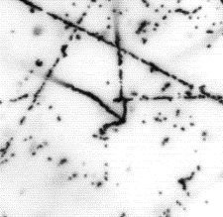
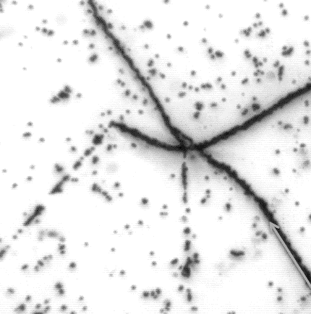
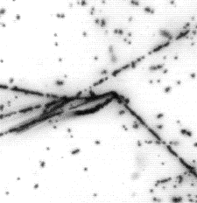
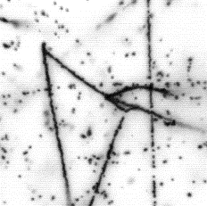
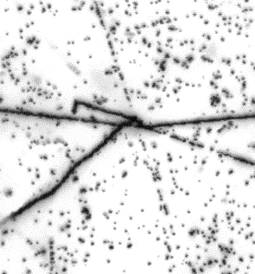
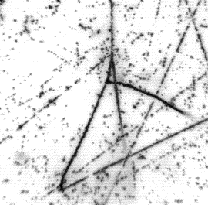
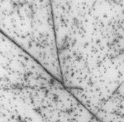
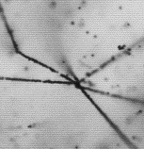
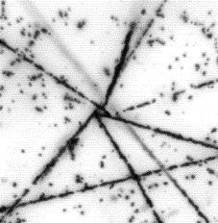
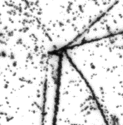
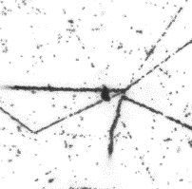
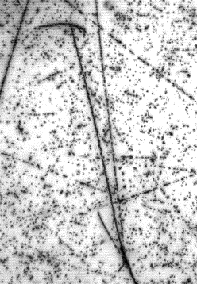
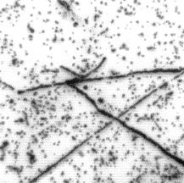

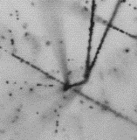
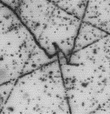
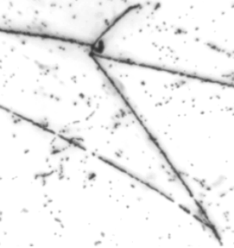
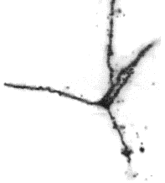
















List of detected DBL HY in E07 (Apr., 2020)
KEK-PS E373 J-PARC E07
Searching period ~7 years 2 years (Apr., 2018 ~ )
S=-2 system 9 33
14 double-Λ events
13 twin-hyper events
7 confused
_{ΛΛ}⁸Li
or _{ΛΛ}¹⁰Be
_{ΛΛ}C
Many
candidates
Many
candidates
¹⁴N + Ξ⁻
¹⁴N + Ξ⁻
_{Ξ}¹⁵C
_{ΛΛ}B or _{ΛΛ}C
_{ΛΛ}C
Many
candidates
¹⁶O + Ξ⁻
atomic
¹⁴N + Ξ⁻
Many
candidates
IBUKI
_{ΛΛ}Be
_{ΛΛ}⁸Li, _{ΛΛ}⁹Li or
_{ΛΛ}¹⁰Be
MINO
Under Analysis
¹⁴N + Ξ⁻
¹²C + Ξ⁻
¹²C + Ξ⁻
Developing
X-ray microscope
7 ➔ 6
_{Ξ}¹⁵C
Under Analysis
Under Analysis
Many
candidates
¹⁴N + Ξ⁻
¹⁴N + Ξ⁻
Many
candidates
_{ΛΛ}⁶He?
Many
candidates
¹²C + Ξ⁻
or ¹⁴N + Ξ⁻
New events are being accumulated successfully and rapidly.
Slide from K. Nakazawa
Notes:
This is a list of detected S=-2 hypernuclei in E07 experiment.
In J-PARC E07, during the 2 year’s searching period, they already find 33 S=-2 hypernuclei.
These are 14 double L events and these are 13 twin-hyper events.

Slide 27








Double Λ hypernuclei at J-PARC and KEK
H. Ekawa et al.,
Prog. Theor. Exp. Phys. 2019, 021D02 (2019)
Mass number dependence for B_{ΛΛ}
$${}_{ΛΛ}^{13}B$$
E176
Nuclide B_{ΛΛ} [MeV]
$${}_{ΛΛ}^{11}{Be}$$
_{ΛΛ}¹⁰Be 15.05 +- 0.11
_{ΛΛ}¹¹Be 19.07 +- 0.11
_{ΛΛ}¹²Be 13.68 +- 0.11
double Λ hypernuclei
Mino
$${}_{ΛΛ}^{10}{Be}$$
Demachi-Yanagi
Danysz et al,
$${}_{ΛΛ}^{10}{{Be}^{∗}}$$
10 μm
Where, B_{Ξ−} = 0.23 MeV
$${}_{ΛΛ}^{6}H$$
Nagara
Single Λ hypernuclei
¹¹_{ΛΛ}Be is the most kinematically plausible
(in the assumption of capture on atomic 3D state)
→ B_{ΛΛ} (ΔB_{ΛΛ}) = 19.07 $±$ 0.11 (1.87 $±$ 0.37) MeV
The value of ΔB_{ΛΛ} seems to be inconsistent with that of the NAGARA event
Notes:
This is the recently identified Be double L hypernucleus, called MINO event.
There are three possibilities from 10LLBe to 12 LL Be, but 11LLBe is the most kinematically plausible.
Based on te assumption of capture on atomic 3D state, BLL was obtained to be 19 MeV and bond energy (DB LL) was obtained to be 1.87+-0.37 MeV.
The value of DBLL seems to be inconsistent with that of the Nagara event and E07 group are considering the medium effect can be observed.
Here we compared BL for single L hypernuclei and BLL for double L hypernuclei.
In the single L hypernuclei, the emulsion experiment played essential role to determine the binding energy.
Now, as for the double L hypernucleus, such systematic information are being obtained like this.
We believe more events will be identified from E07 experiment.

Slide 28




Ξ hypernuclei
Confirm the attractive Ξ-nuclear potential from observation of Ξ hypernuclei in emulsion
Measure the mass of Ξ nuclei produced by absorption of Ξ⁻ into ¹⁴N nucleus in emulsion.
Ξ atom
Energy
distance
Two different energy levels
BE ~1 MeV (p state)
BE ~6 MeV (s state)
Ξ nucleus
p state
~1 MeV
Coulomb potential
s state
Nuclear p state
~6 MeV
Kiso event
Ibuki event
Nuclear s state
X nuclear potential
¹⁰_{Λ}Be
⁵_{Λ}He
Irrawadi event
⁵_{Λ}He
Ξ⁻
⁴He
Ξ⁻
¹⁰_{Λ}Be
⁵_{Λ}He
Ξ⁻
⁵_{Λ}He
K. Nakazawa et al.,
PTEP. 2015, 033D02
S. H. Hayakawa et al.,
PRL, 126, 062501 (2021)
M. Yoshimoto et al.,
PTEP. 2021, 073D02
Notes:
Let me move to the Xi hypernuclei.
As we already presented before, X hypernuclear formations were confirmed not only in the p state but also in deeply bound s state.

Slide 29


Spectroscopic study of ¹²_{Ξ}Be hypernucleus
J-PARC E05 experiment
Y. Ichikawa et al., PTEP 2024 (2024) 9, 091D01
→ To be updated in E70 with S-2S
¹²C (K-, K+) reaction
w/ 1.8 GeV/c K- beam
Events below the threshold
Bound state ?
Continuous state ?
Moderate Mass resolution
of 8.2 MeV (FWHM)
Still not decisive, but some hint of bound state
This should be confirmed or denied by updated experiment
using new high-resolution S-2S spectrometer
Notes:
This is the summary of X- + 14N system with other identified events.
The group around -1 MeV is p state and the group around -6 MeV might be s state.
Roughly speaking, theoretical calculation with different interaction models are supporting this interpretation.
In E07 experiment, number of X- captured by 14N is estimated to be about 300.
If the IRRAWADDY event is assumed to be s state, the X- capture probability in s orbit is about 0.33%.
This value is much larger than theoretical calculations by Koike and Zhu with this size of imaginary potential.
This fact supports the weak XN-LL coupling predicted by HAL QCD.
For more details, the X hypernuclear spectroscopic studies are highly important to investigate spin-dependent XN interaction.
This is the preliminary 12C(K-, K+) spectra taken in E05 experiment.
This measurement will be updated using much high-resolution spectrometer, S-2S.
The weak XN-LL coupling is very advantageous for the spectroscopic studies.

Slide 30




¹²_{Ξ}Be spectroscopy with S-2S spectrometer
Data taking has been completed!
Aerogel Cherenkov
K⁺
Water
Cherenkov
TOF
Active Fiber Target
for energy loss correction
Drift Chambers
1.8 m
$\frac{Δp}{p}=5.5×{10}^{−4}$ (FWHM)
K⁻
Now analysis is ongoing.
1.8 GeV/c
Notes:
Now the S-2S spectrometer has been installed at the K1.8 beam line and the active fiber target has already been fabricated.
We will start a commissioning run in the coming spring and start a physics run in Autumn.

Slide 31


High density matter w/ hyperon ?
Particle composition deep inside neutron stars
Is it a system consisting of neutrons and Λ?
More symmetric matter consisting various hyperons
p
n
Λ
Ξ⁰
Ξ⁻
n
Λ
Appearance of Ξ⁻
allow appearance
of proton
Nu ~ Nd ~ Ns
Λ hypernuclei
Ξ hypernuclei
エネルギー
グザイ原子核距離
89
p状態
~1 MeV
クーロンポテンシャル
_{Λ}Y
39
49
伊吹イベント
s状態
~6 MeV
⁵_{Λ}He
-30 MeV
??
グザイ核子力ポテンシャル
Mass (Λ Binding energy) (MeV)
¹⁰_{Λ}Be
Ξ⁻
Λ feels ~30 MeV attractive potential
inside nuclei
Ξ also feels attractive potential inside nuclei
Notes:
Σとは逆に、Λは原子核の中で引力を感じ、Λが束縛されたハイパー核が形成されます。ここにΛが原子核の深部にいる状態から、高い軌道状態を持った状態が作られていることがハイパー核の質量を測定することで確認することができます。30MeVの深さの引力ポテンシャルを感じて、その中でここに示された状態が作られているのがわかります。
一方で、Ξが原子核の中で、引力を感じるかどうかは全く分かっていませんでした。最近、J-PARCの実験で、Ξ粒子が原子核で束縛された状態が発見され、原子核の中でグザイは引力を感じることが確定しました。
これら引力を感じるハイペロンは、中性子星の深部では出現しやすくなるので、Λの出現に続いて、Ξも出現して、非常に多彩な核物質が中性子星深部で作られうると分かってきました。

Slide 32



High density matter w/ hyperon ?
Particle composition deep inside neutron stars
Is it a system consisting of neutrons and Λ?
More symmetric matter consisting various hyperons
p
n
Λ
Ξ⁰
Ξ⁻
n
Λ
Appearance of Ξ⁻
allow appearance
of proton
Nu ~ Nd ~ Ns
Λ hypernuclei
Ξ hypernuclei
エネルギー
neutron matter
Theoretical calculation of internal structure
グザイ原子核距離
n
Ishizuka, Ohnish et al.
Strange matter
Λ emerges
クーロンポテンシャル
Λ
89
p状態
~1 MeV
_{Λ}Y
Ξ⁻ emerges
n
39
49
伊吹イベント
p
s状態
Ξ
~6 MeV
Particle fraction
⁵_{Λ}He
-30 MeV
??
グザイ核子力ポテンシャル
Mass (Λ Binding energy) (MeV)
¹⁰_{Λ}Be
Ξ⁻
density
Surface
Inside of
neutron star
Λ feels ~30 MeV attractive potential
inside nuclei
Ξ also feels attractive potential inside nuclei
Notes:
Σとは逆に、Λは原子核の中で引力を感じ、Λが束縛されたハイパー核が形成されます。ここにΛが原子核の深部にいる状態から、高い軌道状態を持った状態が作られていることがハイパー核の質量を測定することで確認することができます。30MeVの深さの引力ポテンシャルを感じて、その中でここに示された状態が作られているのがわかります。
一方で、Ξが原子核の中で、引力を感じるかどうかは全く分かっていませんでした。最近、J-PARCの実験で、Ξ粒子が原子核で束縛された状態が発見され、原子核の中でグザイは引力を感じることが確定しました。
これら引力を感じるハイペロンは、中性子星の深部では出現しやすくなるので、Λの出現に続いて、Ξも出現して、非常に多彩な核物質が中性子星深部で作られうると分かってきました。

Slide 33





Hyperon puzzle in neutron stars
Observation of
2 M◉ neutron stars
Current two-body ΛN interaction alone cannot support massive neutron stars
Neutron stars
Λ hypernuclei
Onset of Λ
Λ
Reduce Fermi energy
by changing to hyperons
From slide of W. Weise
Λ single particle energy
It must change significantly to a repulsive force as the density increases.
We need two-body interaction-based approach
Λp scattering
Lattice QCD calc.
p
0
Λ
density ρ
-30 MeV
5ρ₀
ρ₀ (Normal nulcear density)
Establish ΛN interaction including ΛN-ΣN coupling
Notes:
_{s}

Slide 34
Hypernucler Physics
Scattering between hyperon and nucleon
Study of hypernuclei
Nuclei including hyperon
Hyperon
Nuclear structure reflects the interaction between hyperon and nucleon
proton
scattered by interactions between hyperon and proton
Λ particle
Ξ particle
Nuclear potential for hyperons can be evaluated from the hyperon’s binding energy
Essential to elucidate the nature of the extended nuclear force (Baryon-Baryon interaction)
Various phenomena in multi-particle system
Linking these two studies is important for understanding hyperon-containing matter
Notes:
このハイペロンと核子にはたらく力の解明に向けた2つの柱が、ハイペロンと陽子の散乱の研究と、ハイペロンを含んだ原子核であるハイパー核の研究です。ハイペロンと陽子の散乱の測定では、２粒子間にはたらく力で散乱されますので、どの角度にどれだけ散乱されるかを調べることで２粒子間にはたらく力を調べることができます。またビームのエネルギーを変えることで、粒子間の距離の依存性などの詳細も調べることができます。まさに核力の研究の時に陽子と陽子の散乱実験で力の詳細が分かったのと同じ流れです。そしてハイパー核の研究では、原子核を構成する粒子間にはたらく力の重ね合わさることで、全体として感じる引力の強さがわかります。この研究では、ハイペロンと核子にはたらく力を平均化したときにどれくらい引力を感じるかということが分かります。
（例えば、Ξが原子核の中に束縛されていることが、J-PARCの研究で発見されましたが、それだけで、Ξと核子の間には平均すると引力がはたらいていることが分かり、それだけで大きな情報になります。散乱の場合は、引力がはたらいて散乱するのか、反発力がはたらいて散乱するのかは、逆に慎重に解析する必要があります。）
原子核の研究では、多粒子系の多様な現象が現れます。我々は、相互作用を理解した上で、これらの多様な現象を理解し、最終的には、中性子星まで拡張したいというのが大きな目標です。ですので、この2つの研究を有機的に連携して、研究をすることがハイペロンを含んだ物質を理解する上で重要になります。

Slide 35
Hypernucler Physics
Scattering between hyperon and nucleon
Study of hypernuclei
Nuclei including hyperon
Hyperon
Nuclear structure reflects the interaction between hyperon and nucleon
proton
scattered by interactions between hyperon and proton
Λ particle
Ξ particle
Nuclear potential for hyperons can be evaluated from the hyperon’s binding energy
Essential to elucidate the nature of the extended nuclear force (Baryon-Baryon interaction)
Various phenomena in multi-particle system
Linking these two studies is important for understanding hyperon-containing matter
Notes:
このハイペロンと核子にはたらく力の解明に向けた2つの柱が、ハイペロンと陽子の散乱の研究と、ハイペロンを含んだ原子核であるハイパー核の研究です。ハイペロンと陽子の散乱の測定では、２粒子間にはたらく力で散乱されますので、どの角度にどれだけ散乱されるかを調べることで２粒子間にはたらく力を調べることができます。またビームのエネルギーを変えることで、粒子間の距離の依存性などの詳細も調べることができます。まさに核力の研究の時に陽子と陽子の散乱実験で力の詳細が分かったのと同じ流れです。そしてハイパー核の研究では、原子核を構成する粒子間にはたらく力の重ね合わさることで、全体として感じる引力の強さがわかります。この研究では、ハイペロンと核子にはたらく力を平均化したときにどれくらい引力を感じるかということが分かります。
（例えば、Ξが原子核の中に束縛されていることが、J-PARCの研究で発見されましたが、それだけで、Ξと核子の間には平均すると引力がはたらいていることが分かり、それだけで大きな情報になります。散乱の場合は、引力がはたらいて散乱するのか、反発力がはたらいて散乱するのかは、逆に慎重に解析する必要があります。）
原子核の研究では、多粒子系の多様な現象が現れます。我々は、相互作用を理解した上で、これらの多様な現象を理解し、最終的には、中性子星まで拡張したいというのが大きな目標です。ですので、この2つの研究を有機的に連携して、研究をすることがハイペロンを含んだ物質を理解する上で重要になります。

Slide 36



Progress of theory & experiment of BB int. study
Theoretical progress
Hyperon-Nucleon int. w/ chiral effective field theory
(J. Haidenbauer et al.)
Hyperon potential by Lattice QCD
BB interaction at almost physical point for multi-strangeness sector
reaction
2body int.
3body int.
data
K. Sasaki et al., Nucl. Phys. A 998 (2020) 121737
LO
chiral EFT calc.
NLO
Particle correlation
between Λ and p
NNLO
p_{Σ} = 500 MeV/c
+ …
Improving accuracy w/ our new data
Experimental progress
ALICE Collaboration,
Phys. Lett. B 833
(2022) 137272
BB interaction from femtoscopy
$$c\left(k^{∗}\right)=\int{S(r^{∗}) {\left|Ψ(\vec{k^{∗} },\vec{r^{∗}} )\right|}^{2}}d^{3}r^{∗}$$
Fix source size(S(r*)) →
Study interaction from wave function ($Ψ(\vec{k^{∗} },\vec{r^{∗}} )$)
Λ
proton

Slide 37



NN scattering and hyperon-nucleon (YN) scattering
Clearly there is a big difference in data quality between NN and YN scatterings
Λp scattering
Σ⁺p scattering
np scattering
YN scattering experiment was regarded as impossible experiment
Notes:
これが核子散乱(ここでは中性子と陽子の散乱)とハイペロンと陽子の散乱の微分断面積(どの角度に散乱されやすいか)の比較です。データの質の違いは明らかで、核子散乱は非常に精度良く測定されていますが、ハイペロンと陽子の散乱では、非常に精度の悪い測定しか出来ませんでした。そのため、ハイペロンと陽子の散乱実験は出来ない実験としてレッテルが貼られます。様々なハイパー核の研究の論文の出だしには、枕詞のように、ハイペロンと核子の散乱は難しくて出来ないので、ハイパー核で相互作用を測るのであるという一文が数多く見られます。

Slide 38






NN scattering and hyperon-nucleon (YN) scattering
Clearly there is a big difference in data quality between NN and YN scatterings
Λp scattering
Σ⁺p scattering
np scattering
YN scattering experiment was regarded as impossible experiment
Notes:
これが核子散乱(ここでは中性子と陽子の散乱)とハイペロンと陽子の散乱の微分断面積(どの角度に散乱されやすいか)の比較です。データの質の違いは明らかで、核子散乱は非常に精度良く測定されていますが、ハイペロンと陽子の散乱では、非常に精度の悪い測定しか出来ませんでした。そのため、ハイペロンと陽子の散乱実験は出来ない実験としてレッテルが貼られます。様々なハイパー核の研究の論文の出だしには、枕詞のように、ハイペロンと核子の散乱は難しくて出来ないので、ハイパー核で相互作用を測るのであるという一文が数多く見られます。

Slide 39



Produce a lot of hyperons at J-PARC
We recently realized hyperon proton scattering experiment by producing 100 times more hyperons than that in previous experiment.
π meson beam
Proton beam
K meson
Au target
Proton beam
π meson
Proton target
Σ⁺ beam
10¹²-10¹³ / spill
10⁷-10⁸ / spill
100 / spill
Notes:
また、Σ粒子は、多段階の過程を経て生成させるのですが、J-PARCは大強度の陽子ビームを用いることができるため、最終的に過去の実験の100倍のΣ粒子を作り出すことで、精度の高い測定を可能にしました。

Slide 40

J-PARC E40 :
Measurement of dσ/dΩ of Σp scatterings
Verification of quark Pauli repulsion
Σ⁺p scatterng
6 quarks can stay in s state in normal case
Pauli Forbidden !
$l$=0
s
u
u
u
u
d
Σ⁺
p
Notes:
Our first step toward precise hyperon-nucleon scattering experiments is the differential cross section measurements of Sp scatterings.
One biggest motivation of this experiment is to verify the quark Pauli repulsion.
In the quark picture, the S+p (S=1) system contains an up-quark pair having the same spin and color.
The Pauli effect in the quark level makes the S+p potential quite repulsive like the Lattice QCD potential.
Another important motivation is to put constraints on BB interaction theories from the accurate cross section measurement.
Like these theoretical calculations, the predictions are different depending on theories.
We will provide systematic measurement of differential cross sections of these three channels.
Especially, we are going to derive the phase-shift value from the S+p differential cross sections to compare with theories.

Slide 41

J-PARC E40 :
Measurement of dσ/dΩ of Σp scatterings
Verification of quark Pauli repulsion
Σ⁺p scatterng
Lattice QCD calculation
T. Inoue, AIP Conf. Proc. 2130, 020002 (2019)
Very repulsive interaction
6 quarks can stay in s state in normal case
Pauli Forbidden !
$l$=0
s
u
u
u
u
d
Σ⁺
p
Notes:
Our first step toward precise hyperon-nucleon scattering experiments is the differential cross section measurements of Sp scatterings.
One biggest motivation of this experiment is to verify the quark Pauli repulsion.
In the quark picture, the S+p (S=1) system contains an up-quark pair having the same spin and color.
The Pauli effect in the quark level makes the S+p potential quite repulsive like the Lattice QCD potential.
Another important motivation is to put constraints on BB interaction theories from the accurate cross section measurement.
Like these theoretical calculations, the predictions are different depending on theories.
We will provide systematic measurement of differential cross sections of these three channels.
Especially, we are going to derive the phase-shift value from the S+p differential cross sections to compare with theories.

Slide 42



J-PARC E40 :
Measurement of dσ/dΩ of Σp scatterings
Verification of quark Pauli repulsion
Constraint for BB int. theories
Lattice QCD calculation
T. Inoue, AIP Conf. Proc. 2130, 020002 (2019)
Quark Cluster model (FSS, fss2)
Σ⁺p scatterng
Nijmegen model
Chiral EFT (NLO)
Σ⁺p (0.5 < p (GeV/c) < 0.6)
Very repulsive interaction
$${dσ}/{dΩ} ({mb}/{sr})$$
6 quarks can stay in s state in normal case
Pauli Forbidden !
$l$=0
s
u
u
u
u
d
$$\cos{θ}$$
Σ⁺
p
Notes:
Our first step toward precise hyperon-nucleon scattering experiments is the differential cross section measurements of Sp scatterings.
One biggest motivation of this experiment is to verify the quark Pauli repulsion.
In the quark picture, the S+p (S=1) system contains an up-quark pair having the same spin and color.
The Pauli effect in the quark level makes the S+p potential quite repulsive like the Lattice QCD potential.
Another important motivation is to put constraints on BB interaction theories from the accurate cross section measurement.
Like these theoretical calculations, the predictions are different depending on theories.
We will provide systematic measurement of differential cross sections of these three channels.
Especially, we are going to derive the phase-shift value from the S+p differential cross sections to compare with theories.

Slide 43
J-PARC E40 :
Measurement of dσ/dΩ of Σp scatterings
Verification of quark Pauli repulsion
Constraint for BB int. theories
Lattice QCD calculation
T. Inoue, AIP Conf. Proc. 2130, 020002 (2019)
Quark Cluster model (FSS, fss2)
Σ⁺p scatterng
Nijmegen model
Chiral EFT (NLO)
Σ⁺p (0.5 < p (GeV/c) < 0.6)
Very repulsive interaction
$${dσ}/{dΩ} ({mb}/{sr})$$
6 quarks can stay in s state in normal case
Pauli Forbidden !
$l$=0
Systematic measurements of dσ/dΩ
Σ⁺p elastic scattering
Σ⁻p elastic scattering
Σ⁻p → Λn inelastic scattering
s
u
u
u
u
d
$$\cos{θ}$$
Σ⁺
p
Notes:
Our first step toward precise hyperon-nucleon scattering experiments is the differential cross section measurements of Sp scatterings.
One biggest motivation of this experiment is to verify the quark Pauli repulsion.
In the quark picture, the S+p (S=1) system contains an up-quark pair having the same spin and color.
The Pauli effect in the quark level makes the S+p potential quite repulsive like the Lattice QCD potential.
Another important motivation is to put constraints on BB interaction theories from the accurate cross section measurement.
Like these theoretical calculations, the predictions are different depending on theories.
We will provide systematic measurement of differential cross sections of these three channels.
Especially, we are going to derive the phase-shift value from the S+p differential cross sections to compare with theories.

Slide 44
J-PARC E40 :
Measurement of dσ/dΩ of Σp scatterings
Verification of quark Pauli repulsion
Constraint for BB int. theories
Lattice QCD calculation
T. Inoue, AIP Conf. Proc. 2130, 020002 (2019)
Quark Cluster model (FSS, fss2)
Σ⁺p scatterng
Nijmegen model
Chiral EFT (NLO)
Σ⁺p (0.5 < p (GeV/c) < 0.6)
Very repulsive interaction
$${dσ}/{dΩ} ({mb}/{sr})$$
6 quarks can stay in s state in normal case
Pauli Forbidden !
Phase-shift measurement
$l$=0
Systematic measurements of dσ/dΩ
Σ⁺p elastic scattering
Σ⁻p elastic scattering
Σ⁻p → Λn inelastic scattering
s
u
u
u
u
d
$$\cos{θ}$$
Σ⁺
p
Notes:
Our first step toward precise hyperon-nucleon scattering experiments is the differential cross section measurements of Sp scatterings.
One biggest motivation of this experiment is to verify the quark Pauli repulsion.
In the quark picture, the S+p (S=1) system contains an up-quark pair having the same spin and color.
The Pauli effect in the quark level makes the S+p potential quite repulsive like the Lattice QCD potential.
Another important motivation is to put constraints on BB interaction theories from the accurate cross section measurement.
Like these theoretical calculations, the predictions are different depending on theories.
We will provide systematic measurement of differential cross sections of these three channels.
Especially, we are going to derive the phase-shift value from the S+p differential cross sections to compare with theories.

Slide 45
J-PARC E40 experimental setup
Two successive two-body reactions
Σ production by πp→K⁺Σ reaction
Σp scattering reaction
@ J-PARC K1.8 beam line
CATCH
KURAMA spectrometer
Identification of K⁺
Momentum analysis
π⁻
LH₂ target
Σ⁻
p
Κ⁺
Momentum tagging of Σ beam
Beam-line spectrometer
Momentum analysis of π beam
π⁺
Notes:
This is the total detector setup including the beamline spectrometer.
For the high rate beam handling at beamline spectrometer, we already developed and installed
two beamline fiber detectors.
These fiber tracker has high efficiency for intense beam and good timing resolution and
we already achieved 12 M/spill p beam at E10 experiment using these detectors.
In this presentation, we focus on the optimization of KURAMA setup and CATCH development status.

Slide 46
J-PARC E40 experimental setup
Two successive two-body reactions
Σ production by πp→K⁺Σ reaction
Σp scattering reaction
@ J-PARC K1.8 beam line
CATCH
KURAMA spectrometer
Identification of K⁺
Momentum analysis
p
π⁻
LH₂ target
Σ⁻
p
n
Κ⁺
π⁻
Momentum tagging of Σ beam
Beam-line spectrometer
Momentum analysis of π beam
π⁺
Notes:
This is the total detector setup including the beamline spectrometer.
For the high rate beam handling at beamline spectrometer, we already developed and installed
two beamline fiber detectors.
These fiber tracker has high efficiency for intense beam and good timing resolution and
we already achieved 12 M/spill p beam at E10 experiment using these detectors.
In this presentation, we focus on the optimization of KURAMA setup and CATCH development status.

Slide 47


dσ/dΩ of the Σ⁻p channels
Σ⁻p elastic scattering
K. Miwa et al., PRC 104, 045204 (2021)
K. Miwa et al., PRL 128, 072501 (2022)
Σ⁻p→Λn inelastic scattering
Moderate forward peaking dependence
Clear forward peaking angular dependence
Comparison with theories
fss2, Chiral EFT show a reasonable angular dependence.
Nijmegen ESC models clearly underestimate the forward angle.
Notes:
Finally, we have obtained these differential cross sections for S-p elastic scattering and S--p→Ln inelastic scattering.
These blackpoints are our experimental data and the accuracy has been improved to 10% level for narrow angular step of dcos(theta)=0.1.
Now, we can identify the clear forward peaking angular dependence in S-p elastic scattering and moderate forward peaking dependence in the S-p →Ln scattering.
The fss2(blue line) and chiral EFT(yellow, and red lines) show a reasonable angular dependence for both channels.
On the other hand, Nijmegen ESC models clearly underestimate the forward angle.

Slide 48


dσ/dΩ of Σ⁺p elastic scattering
Pauli Forbidden !
L=0
T. Nanamura et al., Prog. Theor. Exp. Phys. 2022 093D01
s
u
u
u
u
d
Σ⁺
p
First experimental derivation of phase shift of ³S₁
NSC97f
ESC16
δ(³S₁)
fss2
E40 data : much smaller than fss2 prediction and E289 results
Derived phase shift suggests that the ³S₁ interaction is moderately repulsive.
Notes:
In particular, we published this differential cross section data of S+p elastic scattering in this fiscal year. This channel is very important to understand the repulsive force due to the quark Pauli effect.
Our data was much smaller than previous experimental results and many theories predicting large quark Pauli effect.
To discuss qualitatively, we derived the phase shift value of 3S1 quark Pauli blocking channel for the first time.
The derived phase shift suggests that the 3S1 interaction is moderately repulsive.

Slide 49

dσ/dΩ of Σ⁺p elastic scattering
T. Nanamura et al., Prog. Theor. Exp. Phys. 2022 093D01
Comparison with HAL QCD ΣN potential
E40 data
E40 data : much smaller than fss2 prediction and E289 results
H. Nemura et al., EPJ Web of Conf., 175, 05030 (2018)
Derived phase shift suggest that the ³S₁ interaction is moderately repulsive.
Notes:
This obtained phase shift was compared with lattice QCD prediction.
At the reasonable time slice, they are consistent with each other.

Slide 50

New Σp scattering data and progress of Chiral EFT
Difficulty at higher momentum
Development of Chiral EFT at NNLO have got started with E40 data
reaction
elastic scattering
elastic scattering
data
chiral EFT calc.
Σ⁺p
K. Miwa et al.,
PRL 128, 072501 (2022)
K. Miwa et al.,
PRC 104, 045204 (2021)
T. Nanamura et al., PTEP 2022 093D01
J. Haidenbauer et al.,
arXiv:2301.00722
But, the interactions are not uniquely determined yet.
We need more data from additional channels (Λp, …) and additional differential observables (polarizations, …)
Future Λp scattering experiment w/ polarized Λ in the extension project.
Notes:
We also have realized an accurate Sp scattering experiment at J-PARC.
We derived these differential cross sections of Sp channels systematically.
By using these new data, chiral EFT are updated to next-next leading order.
These red lines are calculations at NNLO.
But, they still have difficulties reproducing the S+p channel at the higher momentum region.
No unique determination of all P-wave LECs is possible.
We need more data from additional channels and additional observables.
We are planning Lp scattering experiment with a polarized L beam in the extension project.

Slide 51



Updated ΛN, ΣN chiral interaction
J. Haidenbauer et al., Eur. Phys. J. A 59 (2023) 63
Based on the E40 Σp scattering data,
U_{Σ} becomes less repulsive and
U_{Λ} becomes more attractive.
Calculation by J. Haidenbauer
Λp cross section
Λp differential cross section
NNLO predicts larger cross section

Slide 52


Building ΛN interaction from ΛN scattering experiment using photo-produced Λ
Activity at
SPring-8
Building the realistic ΛN interaction by providing ΛN scattering data to chiral EFT theory
We plan to perform Λp scattering experiment at BL33LEP
Momentum tagged Λ particle produced γp→K⁺Λ reaction
Existing YN scattering detector system (CATCH)
Advantage at BL33LEP
Λp total cross section
Λp differential cross section
Clear Λ identification widen Λp scattering angular acceptance
Tagging low-middle energy Λ beam for nuclear study
p_{F} in nucleus
p_{F} in
neutron stars
Λ can be tagged cleanly by detecting only forward K+
measurement
range
Λp scattering
dσ/dΩ (mb/sr)
Simulation
Liquid H₂
Cross section (mb)
Data taking can start by reconstructing the existing systems.
(Spectrometer, CATCH)
Simulation
Λ beam momentum (MeV/c)
Scattering angle (cosθ)
Density (radial) dependence of ΛN interaction
Essential input for constructing realistic ΛN interaction

Slide 53


Integrated Λ beam
Missing mass spectrum of γp→K⁺X reaction
Λ
Σ⁰
Very preliminary
10⁶
Σ(1385)/
Λ(1405)
Λ(1520)
Data taking stop
due to laser trouble
(~1 Month)
mis-ID of π+
Accelerator shutdown period
Operation w/
8 W laser
Missing mass [GeV/c²]
Operation w/
24 W laser
Λ yield with 24 W laser was as expected (or larger than expectation).
Once data taking was suspended due to laser trouble.
Anyway, we have accumulated ~10⁶ Λ
We will continue data taking until 2027 July to accumulate 10⁷ Λ
date
New Λp scattering data will be provided within a few years !

Slide 54



Summary : Hypernuclear physics
Baryon-Baryon interaction
Study of light Λ, Ξ hypernuclei
Spectroscopy of heavy hypernuclei
Density at Λ orbit
p
³_{Λ}H
Λ
Λ
Λ
Λ
Λ
deuteron
s_{Λ}
p_{Λ}
d_{Λ}
f_{Λ}
Energy
Λ
h_{Λ}
g_{Λ}
f_{Λ}
Ξ hypernuclei
d_{Λ}
Two-body YN int.
Neutron star
p_{Λ}
p
Ξ
s_{Λ}
?
n
Λ
ΛN-ΣN coupling, ΛNN int., ΛΛ, ΞN int.
Density dependent ΛN int., ΛNN int.
Notes:
Hypernuclear physics covers many phenomena regarding hyperons.
Basic and important topic is the understanding of the baryon-baryon interaction.
Now, we have new two-body baryon-baryon data such as scattering and femtoscopy.
The light hypernuclei are best objects to check the validity of the YN interaction and deduce the LN-SN coupling and LNN three-body interaction.
Precise L binding energy measurement up to heavy hypernuclei is indispensable to obtain the density dependent LN interaction based on LNN interaction.
These studies are essential to investigate the deep inside of the neutron star, where appearance of hyperon is expected.
Today, I want to cover these topics.

Slide 55


Hadron Experimental Facility extension (HEF-ex) Project
expand research programs
at the Hadron Experimental Facility
to further explore
Origin & Evolution of Matter
Present HEF
(2009～)
Extended HEF
K10
HIHR
K1.8
K1.8BR
K1.8
KL2
KL
T2
K1.8BR
T1
High-p
K1.1/K1.1BR
Test-BL
30 GeV
primary
proton beam
T1
High-p (π20)
COMET
Extended hall
1 production target (T1)
1 secondary-charged beamline (K1.8/K1.8BR)
1 neutral beamline (KL)
1 primary beamline (High-p)
1 muon beamline (COMET)
COMET
＋
1 new production target (T2)
4 new beamlines (HIHR, K1.1/K1.1BR, KL2, K10)
2 updated beamlines (High-p (π20), Test-BL)
＋
＋
Notes:
We are promoting the activities to realize the hadron experimental facility extension project.
We are going to double the experimental hall and put additional production target and construct new unique beam lines.

Slide 56





Hyperon puzzle in neutron star
Strange Hadronic Matter in neutron star ?
Hyperon’s appearance is reasonable scenario because of the huge Fermi energy of neutrons in the inner core.
3 Baryon Force (3BF):
Significant repulsive contribution at high density
Low
High density
s
Hyperons
Λ
d
u
D. Gerstung et al., Eur. Phys. J. A(2020) 56:175
Ξ
s
s
n
p
How can we reconcile ?
Hyperon appearance → soften EOS
Repulsive
Two-solar-mass NS → require stiff EOS
YN(ESC)+3BF(MPa)
Y. Yamamoto et al. PRC90, 045805 (2014)
YN (ESC) only
We have to understand the density dependence of ΛN interaction from Λ binding energy data in hypernuclei.
→ determine the strength of the ΛNN force
Notes:
Today, the hyperon puzzle in neutron stars is big issue.
The hyperon’s appearance is a reasonable scenario because of the huge Fermi energy of neutrons in the inner core of neutron stars.
However, how can we reconcile these two points?
One is that hyperons are expected to appear and soften the EOS
The other is that the observed two-solar-mass neutron stars require a stiff EOS.
As you know, the inclusion of only two-body YN interaction makes EOS quite soft.
Many theorists claim the importance of three baryon forces including hyperons.
The existence of the repulsive nucleon-three-body force
is well established from binding energy data of (non-strange) nuclei.
If there is a similar repulsive three-baryon forces between
baryons including hyperons, it makes the EOS stiff.
Therefore, the 3 baryon force is key to solve the hyperon puzzle.
This is an example of the calculated the density dependence of L single particle potential.
At the higher density region, the three-body force is predicted to make a significant repulsive contribution.
We have to understand this density dependence of LN interaction from L binding energy data in hypernuclei.
Then this enables us to derive the strength of the LNN force.

Slide 57

Λ binding energy measurement deep inside of nucleus : Unique for Λ hypernuclei
Energy spectra of ¹³_{Λ}C, ¹⁶_{Λ}O, ²⁸_{Λ}Si, ⁵¹_{Λ}V, ⁸⁹_{Λ}Y, ¹³⁹_{Λ}La, ²⁰⁸_{Λ}Pb with Nijmegen ESC16 model
Nuclear density is different for each Λ orbital state
Density at Λ orbit
M.M. Nagels et al. Phys. Rev. C99, 044003 (2019)
g_{Λ}
f_{Λ}
d_{Λ}
Λ
Λ
Λ
Λ
p_{Λ}
s_{Λ}
p_{Λ}
d_{Λ}
f_{Λ}
s_{Λ}
Energy
Two directions for study of the density dependence of ΛN interaction
Mass number dependence of B_{Λ}
Λ orbital dependence of B_{Λ}
w/ ΛN int. w/o ΛNN int.
w/ ΛN int. w/ ΛNN int.
Difference
Accurate B_{Λ} measurement
Calculation w/ only ΛN int : Over bound
Effect of density dependence of ΛN interaction
ΛNN repulsive interaction is introduced to explain Λ hypernuclear binding energy
This density dependence should be explained from ΛNN force.
→ Predict ΛN int. in higher density nuclear matter.
Notes:
For this purpose, we will measure the binding energies of L deep inside of nucleus.
Such measurement is only possible for hyperons.
In L hypernuleus, we can access directly to sL state.
In addition, the nuclear density for a L in each orbital state is different,
as shown here by Isaka’s AMD calculation for example.
Therefore, we have two directions to study the density dependent LN interaction.
Fist one is mass dependence of L binding energy and second one is L orbital dependence of L binding energy.
This is the comparison of the measured BL value and theoretical calculation for wide-mass region.
This is the calculation with the LN interaction from the Nijmegen ESC16 model.
The blue line shows the calculation with only two-body LN interaction and this results in over bound.
The difference between accurate BL measurements and calculation with reliable two-body LN interaction includes the effect of density dependence of the LN interaction.
This difference should be explained from LNN force consistently for wide mass range and all L orbits.
Then we can predict LN interaction in higher density nuclear matter.
In this calculation, the LNN repulsive interaction is introduced to explain L hypernulear binding energy.

Slide 58



High-resolution Λ hypernuclear spectroscopy at HIHR
HIHR : Dispersion-matching beam line
→ Realize high-resolution spectroscopy without beam intensity limit
High intensity π beam of > 10⁸ /pulse
(~100 times stronger than KEK-PS)
Thin target can be used
→ High resolution and various target options
Focal plane
B_{Λ}=0 MeV
Impossible to separate peaks
with a few MeV resolution
0.4 MeV (FWHM) resolution
B_{Λ}=−5 MeV
B_{Λ}=−10 MeV
²⁰⁸_{Λ}Pb (KEK-PS)
Clear separation of sub-major as well as major peaks
B_{Λ}=−15 MeV
ΔE=2.3 MeV (FWHM)
h_{Λ}
Each peak cannot be separated
HIHR
g_{Λ}
Precise Λ binding energies
for wide-mass range
Density dependence of ΛN interaction (ΛNN interaction)
f_{Λ}
d_{Λ}
T.Hasegawa et al., Phys. Rev. C 53 (1996) 1210.
p_{Λ}
Calculate U_{Λ} at high density region
Untangle hyperon puzzle in neutron star
s_{Λ}
Notes:
HIHR beamline is a centerpiece beamline in this project.
HIHR is a dispersion-matching beam line for the 2ndary beam line.
The dispersion-matching technique is a well established method at RCNP and RIKEN, but this is the first challenge for the GeV 2nddary beam.
This beam line realizes the high-resolution spectroscopy without beam intensity limit by removing the beamline detectors.
We can use high intensity pi beam of more than 10^8 / pulse.
Thin targets can be used.
We can have a high resolution and various target options.
In the KEK experiment, it was impossible to separate peaks for heavy hypernuclei like Pb 208 Lambda due to limited resolution.
In HIHR, Clear separation of major peaks as well as sub-major peaks can be realized.
Precise L binding energies for wide-mass range including heavy hypernculei become possible.
This enables us to study the density dependence of LN interaction which is hopefully explained from the LNN three-body interaction.
Then, by extrapolating the Lambda single particle potential to the higher density region, we want to untangle the hyperon puzzle in neutron stars.

Slide 60








Relatives of protons and neutrons containing strange quarks
Quarks
up ($u$)
charm ($c$)
top ($t$)
charge $+2/3e$
~2 MeV/c²
(300 MeV/c²)
1.15~1.35 GeV/c²
170~180 GeV/c²
charge $−1/3e$
down ($d$)
strange ($s$)
bottom ($b$)
Baryon octet : lowest mass particles containing 3 quarks
~8 MeV/c²
(300 MeV/c²)
~100 MeV/c²
(450 MeV/c²)
4~5 GeV/c²
n
p
Tz
proton・neutron (nucleon)
These consist of up and down quarks
difference of up and down quarks
Σ⁻
Σ⁰
Λ
Σ⁺
hyperons
particles (baryons) containing strange quarks
Ξ⁻
Ξ⁰
Nuclear system with hyperons
Interactions between baryon octet ?
Nature of nuclei with hyperons ?
Number of strange quarks
Notes:
陽子、中性子の仲間は、実は数多く存在します。陽子と中性子は、内部に3つのクォークをコアとして含んでいますが、それはクォークの中で最も軽い世代のアップクォークとダウンクォークで、陽子はアップクォークが2つとダウンクォークが1つ、中性子はアップクォークが1つでダウンクォークが2つで出来ています。この3つのクォークの中に、三番目に軽いストレンジクォークを含んだ粒子がハイペロンです。この絵で、横の軸にアップクォークとダウンクォークの数の差、下向きの軸にストレンジクォークの数で表すと、このような対称的な粒子達がグループをなします。ストレンジクォークを1つ含む粒子として、Λ粒子や、3つの電荷の異なる状態を持つΣ粒子、さらに2つのストレンジクォークを含むΞ粒子です。こらが、陽子・中性子の兄弟の粒子になります。あんまり一般的には知られていないので、隠し子的な粒子になります。これらの粒子の間にも核力に似た力がはたらくはずです。これらを調べることで、クォークのどのような役割が分かるでしょうか？

Slide 61
Basic nature of hyperons
 | Mass [MeV/c²] | Lifetime τ [s] | cτ [cm] | Decay mode | Interaction that cause decay
Λ | 1116 | 2.6 x 10⁻¹⁰ | 7.87 | Λ → π⁻p/π⁰n | Weak int.
Σ⁻ | 1197 | 1.47x 10⁻¹⁰ | 4.43 | Σ⁻ → π⁻n | Weak int.
Σ⁰ | 1193 | 7.4 x 10⁻²⁰ | 2.22 x 10⁻¹¹ | Σ⁰ → Λγ | Electromagnetic int.
Σ⁺ | 1189 | 0.80 x 10⁻¹⁰ | 2.40 | Σ⁺ → π⁺n/π⁰p | Weak int.
Ξ⁻ | 1321 | 1.63 x 10⁻¹⁰ | 4.91 | Ξ⁻ → π⁻Λ | Weak int.
Ξ⁰ | 1315 | 2.90 x 10⁻¹⁰ | 8.71 | Ξ⁰ → π⁰Λ | Weak int.
Many of hyperon decays with weak interaction.
The lifetime is short (10⁻¹⁰ sec),
but it is much longer than the time scale of strong interaction (10⁻²³ s)
Scattering experiment is technically difficult.
But, nuclei with hyperon (especially Λ particle) really form new type of nuclei.

Slide 62







Λ particle in nuclei
Let‘s estimate how many times Λ particle circulates in nucleus during Λ’s lifetime
Non-relativistic approximation
$$\frac{p^{2}}{2M}=20 MeV$$
$$Λ$$
$$M :Λ^{′}s mass (1116 MeV)$$
Kinetic energy ~ 20 MeV
U₀ ~ 30 MeV
$$p=211 MeV/c$$
→ Λ’s velocity $v\sim 0.19 c$
Nuclear radius $R\sim 1.2 A^{1/3} fm$
Let’s take nuclear radius R = 3 fm
Period T for Λ’s circular motion in nucleus
$$T=\frac{2πR}{v}=\frac{2π×3×{10}^{−15} [m]}{0.19×3×{10}^{8} [m/s]}=33×{10}^{−23} [s]$$
Therefore, during Λ’s lifetime of 10⁻¹⁰ [s], Λ can rotate ~3x10¹¹ times.
Λ hypernuclei can be regarded as quasi stable nuclei

Slide 63


First discovery of hypernuclei
Λ hypernucleus was discovered by Polish physicists Marion Danysz and Jerzy Pniewski.(1952)
Nuclear emulsion plate irradiated to
cosmic rays on a balloon
p
Hypernuclei
decay
Notes:
First

Slide 64

Origin of the density dependence of ΛN interaction
Λ is the only isospin 0 baryon that makes up matter
→ One-pion exchange is forbidden
Interaction in free space
NN interaction
ΛN interaction
wo/ ΛN-ΣN coupling
N
N
Λ
N
Λ
N
π
Forbidden
Σ
π
π
π
ΛN interaction becomes less attractive (repulsive) w/o ΛN-ΣN coupling
Λ
N
w/ ΛN-ΣN coupling
N
N
Λ
N
Source of ΛN int.
Interaction in nuclear medium
N
N
N
Suppression of two-body ΛN int.
3 body int. mediated with Σ
Λ
N
N
N
Λ
N
π
π
π
Σ
N
→ Less attractive
Σ
N
N
N
π
π
Λ
N
N
N
Λ
N
Two-body NN int. might not be affected very much by other nucleons
Due to the Pauli blocking for the intermediate nucleon, ΛN-ΣN coupling can be very suppressed
Additional three-body interaction, which does not appear in NN interaction.
What is the density dependence of this 3-body int. ?

Slide 65







Spin-orbit force in NN and YN channels
L
s₁
In general, the spin-orbit interaction is classified to these two types.
Symmetric LS force : $l∙(s_{1}+s_{2})$
Anti-symmetric LS force : $l∙(s_{1}−s_{2})$
s₂
Let’s see how these LS forces operate on the $pp$ channel.
$$pp for l=1 \left(asymmetric\right)and S=1(symmetric)$$
L
s₁
$$\left.|L, L_{z}, s_{1z}, s_{2z}\right\rangle =\left.|1, −1, +, +\right\rangle$$
(L and spin are anti-parallel)
The let’s operate the symmetric LS force first.
s₂
$$l∙\left(s_{1}+s_{2}\right)\left.|1, −1, +, +\right\rangle =$$
$$\left\{\frac{1}{2}\left(l_{+}s_{1−}+l_{−}s_{1+}\right)+l_{z}s_{1z}\right\}\left.|1, −1, +, +\right\rangle +\left\{\frac{1}{2}\left(l_{+}s_{2−}+l_{−}s_{2+}\right)+l_{z}s_{2z}\right\}\left.|1, −1, +, +\right\rangle$$
$$=\frac{1}{\sqrt{2}}\left(\left.|1, 0, −, +\right\rangle +\left.|1, 0, +, −\right\rangle \right)−\left.|1, −1, +, +\right\rangle$$
This is symmetric for the spin exchange between two protons
Then let’s operate the anti-symmetric LS force
$$\frac{1}{\sqrt{2}}\left(\left.|1, 0, −, +\right\rangle −\left.|1, 0, +, −\right\rangle \right)$$
$$l∙\left(s_{1}−s_{2}\right)\left.|1, −1, +, +\right\rangle =$$
This is anti-symmetric for the spin exchange between two protons

Slide 66
Spin-orbit force in NN and YN channels
¹E or ³O ³E or ¹O
NN (I=0) ------ (10*)
NN (I=1) (27) -----
ΛN (I=1/2) 1/√10[(8_{s}) + 3(27)] 1/√2[-(8_{a}) + (10*)]
ΣN(I=1/2) 1/√10[3(8_{s}) - (27)] 1/√2[(8_{a}) + (10*)]
ΣN(I=3/2) (27) (10)
ALS
SLS
SLS
ALS OK
SLS : Flip spin and orbital angular momentum without changing the total spin state
ALS : Flip spin and orbital angular momentum with changing the total spin state
NN interaction： Due to isospin symmetry, changing the spin state (from spin triplet to spin singlet) is prohibited.
YN、YY interactions： ALS transitions are possible between two multiplets with different spin states, 8s and 8a.
In the YN interaction, both ALS and SLS contribute to the LS force, which may be significantly different from the LS force in the NN interaction.

Slide 67










Charge Symmetry Breaking in A=4 system
³H + Λ
³He + Λ
M. Bedjidian et al., Phys. Lett. B 83, 252 (1979)
J-PARC E13 (K1.8)
T.O. Yamamoto et al., Phys. Rev. Lett. 115 (2015) 222501
1.07$±$0.02
1⁺
1⁺
0.98$±$0.03
1.09$±$0.02
0⁺
1.406$±$0.002$±$0.002
2.157$±$0.005$±$0.077
0⁺
A. Esser et al., Phys. Rev. Lett. 114 (2015) 232501
F. Schulz et al., Nucl. Phys. A 954 (2016) 149
2.39$±$0.03
What is origin of CSB ?
effective V_{ΛΣ} : spin-dependent central interaction
⁴_{Λ}He
A. Gal, Phys. Lett. B 744 (2015) 352
⁴_{Λ}H
B_{Λ} (MeV)
Tensor is small ?
Solid determination of s-shell hypernuclei
How about CSB in p-shell hypernuclei ?
Notes:
Hydrogen 4 Lambda and Helium 4 Lambda are mirror hypernuclei.
Because Lambda’s isospin is 0, large charge sysmmetry breaking in LN interaction is naively small.
But, recent accurate measurements for 4LH and 4LHe confirmed the large CSB.
Decay pion spectroscopy at MAMI determined the binding energy of 4LH.
Hyperball experiment at J–PARC measured level spacing very precisely from gamma-ray transition.
What is the origin of CSB?
Avraham Gal used spin-dependent central interaction for CSB to explain CSB in A=4 system.
We have to understand the nature of interaction more.
Solid determination of s-shell hypernuclei is necessary and we want to know how about CSB in p-shell hypernuclei.
As for the level spacing of 4LH, there are three gamma-ray measurement with NaI detector.

Slide 68
Charge Symmetry Breaking in A=4 system
³H + Λ
³He + Λ
M. Bedjidian et al., Phys. Lett. B 83, 252 (1979)
J-PARC E13 (K1.8)
T.O. Yamamoto et al., Phys. Rev. Lett. 115 (2015) 222501
Updated with Ge detector measurement in J-PARC E63
1.07$±$0.02
1⁺
1⁺
0.98$±$0.03
1.09$±$0.02
0⁺
1.406$±$0.002$±$0.002
2.157$±$0.005$±$0.077
0⁺
A. Esser et al., Phys. Rev. Lett. 114 (2015) 232501
F. Schulz et al., Nucl. Phys. A 954 (2016) 149
2.39$±$0.03
What is origin of CSB ?
effective V_{ΛΣ} : spin-dependent central interaction
⁴_{Λ}He
A. Gal, Phys. Lett. B 744 (2015) 352
⁴_{Λ}H
B_{Λ} (MeV)
Tensor is small ?
How about CSB in p-shell hypernuclei ?
Notes:
This level spacing should be measured by Ge-detector and we should determine the level spacing with a few keV resolution.

Slide 69



Ξ⁻+¹⁴N hypernucleus
Ξ⁻ + ¹⁴N → ⁵_{Λ}He + ⁵_{Λ}He + ⁴He + n
IBUKI event
IRRAWADDY event
KISO event
¹⁰_{Λ}Be
⁵_{Λ}He
Ξ⁻
⁵_{Λ}He
⁵_{Λ}He
⁴He
Ξ⁻
⁵_{Λ}He
¹⁰_{Λ}Be
K. Nakazawa et al., PTEP. 2015, 033D02
S. H. Hayakawa et al.,
Physical Review Letters, 126, 062501 (2021)
M. Yoshimoto et al., PTEP. 2021, 073D02
1st discovery of clear Ξ nuclear state
1st uniquely identified Ξ nuclear state
1st observation of nuclear s-sate of Ξ hypernucleus
Two possibilities of B_{Ξ−} depending on ¹⁰_{Λ}Be state
B_{Ξ−} (¹⁰_{Λ}Be_{g.s.}) = 3.87 $±$ 0.21 MeV
B_{Ξ−} (¹⁰_{Λ}Be_{1st. Ex.}) = 1.03 $±$ 0.18 MeV
One reaction process satisfied kinematical consistency.
B_{Ξ−} = 1.27 $±$ 0.21 MeV
B_{Ξ−} = 6.27 $±$ 0.27 MeV
Notes:
Next is the Xi hypernucleus.
Recently, the group reported series of X- + 14N hypernucleus.
1st discovery of clear X nuclear state is found in E373 emulsion sheet with a general scan method.
In this case, two possibilities of BX- remained depending on the daughter 10LBe state.
One is the 3.8 MeV and the other is 1.03 MeV.
But this is much deeper than the X- 3D atomic state and this is regarded as X nuclear state.
Then, soon, IBUKI event was observed and the X binding energy is uniquely identified to be 1.27 MeV.
This is considered as pX- state.
Recently, Irrawaddy event was found and the much deeper binding energy of 6.27 MeV was obtained.
This is the 1st observation of nuclear s-state of X hypernucleus.

Slide 70


Particle and Nuclear Physics at HEF
Comprehensive research on the origin and evolution of matter and the universe
the mystery of the matter-dominated universe,
the evolution from quarks to hadrons (the smallest composite particles)
neutron star as a giant atomic nucleus.
Intensity frontier accelerator
providing intense and variety of secondary beams
K1.8BR
K1.8
< 2.0 GeV/c
~10⁶ K-/spill
< 1.1 GeV/c
~5x10⁵ K-/spill
~ 2.1 GeV/c (16 deg extraction)
~ 10⁷ K⁰_{L}/spill
KL
30 GeV proton
~10¹⁰ /spill
Primary proton
30 GeV, 82 kW
(Goal 100 kW)
High-p line
COMET
μ⁻ beam
Notes:
In the hadron hall, we are performing comprehensive research on the origin and evolution of matter and the universe for understanding the mystery of the matter-dominated universe, the evolution from quarks to hadrons and neutron stars as a giant atomic nucleus.
J-PARC is an intensity frontier accelerator providing an intense and variety of secondary beams for each beam line, low momentum charged kaon and pions and neutral kaon and high-momentum primary proton and muon.

Slide 71




Particle and Nuclear Physics at HEF
Comprehensive research on the origin and evolution of matter and the universe
the mystery of the matter-dominated universe,
the evolution from quarks to hadrons (the smallest composite particles)
the neutron star as a giant atomic nucleus.
μ→e conversion measurement
Search for charged lepton flavor violation
COMET
100 times improvement over present upper limits
Rare decay of neutral kaon
Search for CP violation beyond the standard model
KOTO
The world's highest sensitivity exceeding the standard model
Mass modification of vector mesons in nuclei
High-p
Elucidation of the mass acquisition mechanism of hadrons
Vector meson in nuclei : 10 times more precision
Systematic study of Kaonic nuclei
K1.8BR
Study of exotic hadron bound system including K⁻
Mass number dependence of kaonic nuclei
Spectroscopy of S=-1, -2 hypernuclei
K1.8
Elucidation of the appearance mechanism of Ξ, Λ hyperons in dense matter
Excellent mass resolution of 2 MeV for Ξ hypernuclei
Notes:
At each beam line, these experiments are being performed.
u -> e conversion measurement and rare decay search of neutral kaon for beyond standard model.
Confirming the mass modification of vector mesons in nuclei
This is for the elucidation of the mass acquisition mechanism.
Systematic study of kaonic nuclei and spectroscopy of S=-1 and -2 hypernuclei.
This is for elucidating the appearance mechanism of hyperons or kaons in dense matter.

Slide 72



Realistic nuclear force : base for nuclear physics
Realistic Nucleon-Nucleon Potential
(CD Bonn, AV18, Nijmegen I, II)
Updated based on a lot of scattering observables of NN scattering
Solid base for nuclear studies
Nucleon-Deuteron scattering
Nuclear binding energy
3 Nucleon Force
K. Sekiguchi et al.
Phys. Rev. C 65, 034003 (2002)
Equation of State of Nuclear Matter
Notes:
As you know, the realistic nucleon-nucleon potentials such as CD Bonn, AV18 and Nijmegen NN potential have been already established.
At the stages of updating these theories, a lot of scattering observables of NN scattering are essential input.
Nowadays, the realistic NN interactions have been making a solid base for nuclear studies.
Three-nucleon force was confirmed from nucleon-deuteron scatterings and this three-nucleon force is known as necessary interaction to reproduce the nuclear binding energy and equation of state of neutron stars.

Slide 73
Origin of the density dependence of ΛN interaction
Λ is the only isospin 0 baryon that makes up matter
→ One-pion exchange is forbidden
Interaction in free space
NN interaction
ΛN interaction
wo/ ΛN-ΣN coupling
N
N
Λ
N
Λ
N
π
Forbidden
Σ
π
π
π
ΛN interaction becomes less attractive (repulsive) w/o ΛN-ΣN coupling
Λ
N
w/ ΛN-ΣN coupling
N
N
Λ
N
Source of ΛN int.
Interaction in nuclear medium
N
N
N
Suppression of two-body ΛN int.
3 body int. mediated with Σ
Λ
N
N
N
Λ
N
π
π
π
Σ
N
→ Less attractive
Σ
N
N
N
π
π
Λ
N
N
N
Λ
N
Two-body NN int. might not be affected very much by other nucleons
Due to the Pauli blocking for the intermediate nucleon, ΛN-ΣN coupling can be very suppressed
Additional three-body interaction, which does not appear in NN interaction.
What is the density dependence of this 3-body int. ?

Slide 74

Toward the elucidation of the density dependence of the ΛN interaction
Ingredients of ΛN interaction
in nuclear medium
ΛN int. in nuclear medium
Neutron star
Λ single particle energy
Λ hypernuclei
ρ₀
0
ρ
Two-body ΛN force
5ρ₀
ΛN int. in free space
(1) ΛN int. in free space
repulsive
p
N
Forbidden
270 MeV/c
Momentum
attractive
Λ
570 MeV/c
Source of ΛN attraction

Slide 75




Toward the elucidation of the density dependence of the ΛN interaction
Ingredients of ΛN interaction
in nuclear medium
ΛN int. in nuclear medium
Neutron star
Λ single particle energy
Λ hypernuclei
(2) ΣN coupling suppression
Suppression of
two-body ΛN int.
Σ mediated ΛNN int.
Suppression due to Pauli blocking at intermediate state
ρ₀
0
ρ
$$Σ$$
$$Λ$$
エネルギー
上がる
Two-body ΛN force
5ρ₀
(1) ΛN int. in free space
相互作用
repulsive
ΛN int. in free space
エネルギー
下がる
パウリブロッキング
p
N
Forbidden
270 MeV/c
Momentum
attractive
Λ
570 MeV/c
Source of ΛN attraction
neutron
939 MeV

Slide 76
Toward the elucidation of the density dependence of the ΛN interaction
Ingredients of ΛN interaction
in nuclear medium
ΛN int. in nuclear medium
Repulsive force by ΛΝΝ force
ΛNN int. mediated with Σ*
N
Λ
π
N
Σ∗
Neutron star
π
N
Λ
N
Λ single particle energy
Λ hypernuclei
(2) ΣN coupling suppression
Suppression of
two-body ΛN int.
Σ mediated ΛNN int.
Suppression due to Pauli blocking at intermediate state
ρ₀
0
ρ
$$Σ$$
$$Λ$$
エネルギー
上がる
Two-body ΛN force
5ρ₀
(1) ΛN int. in free space
相互作用
repulsive
ΛN int. in free space
エネルギー
下がる
パウリブロッキング
p
N
Forbidden
270 MeV/c
Momentum
attractive
Λ
570 MeV/c
Source of ΛN attraction
neutron
939 MeV

Slide 77
Toward the elucidation of the density dependence of the ΛN interaction
Ingredients of ΛN interaction
in nuclear medium
ΛN int. in nuclear medium
Determination of Σ* mediated
ΛNN force
ΛNN int. mediated with Σ*
N
Λ
π
N
Σ∗
Precise Λ hypernuclear spectroscopy
Neutron star
π
N
Λ
N
Λ single particle energy
Λ hypernuclei
(2) ΣN coupling suppression
Determination of
ΛN-ΣN coupling
Suppression of
two-body ΛN int.
Σ mediated ΛNN int.
ρ₀
ΣN cusp measurement
Lattice QCD
0
ρ
Two-body ΛN force
5ρ₀
ΛN int. in free space
(1) ΛN int. in free space
repulsive
Realistic ΛN interaction
p
N
Forbidden
ΛN scattering data
Lattice QCD
270 MeV/c
Momentum
attractive
Λ
570 MeV/c
Source of ΛN attraction

Slide 78

Collaborative research regarding the two-body ΛN, ΣN int.
(1) Λp scattering experiment
(Koji Miwa)
(2) ΣN cusp measurement
(Yudai Ichikawa)
The differential cross section and cusp structure must be represented with the same ΛN-ΣN coupling
ΛN differential cross section
ΣN thr.
Chiral EFT NLO13
Simulation
Chiral EFT NLO19
Simulation
E90 simulation
dσ/dΩ (mb/sr)
Determination of the ΣN (I=1/2, S=1) scattering length from the cusp shape
Momentum dependence of
dσ/dΩ
ΛN-ΣN coupling
Scattering angle (cosθ)
Independent determinations of ΛN-ΣN coupling through the scattering length measurement
Universal understanding of ΛN interaction from scattering and Lattice QCD
ΣN-ΛN potential
central
(3) ΛN, ΣN Lattice QCD potential
(Takahiro Doi)
ΛN, ΣN and ΛN-ΣN coupling potentials by HAL QCD
T. Doi, presentation
at 3rd J-PARC HEF-ex WS
ΛN-ΣN coupling

Slide 79



Λp scattering experiment with polarized Λ beam (J-PARC E86)
Advantage of scattering experiment: Spin observables can be measured thanks to self polarimeter of hyperon
Polarization can be measured from angular distribution of p
Left-Right asymmetry of Λp scattering
(Analyzing power)
→ spin-orbit interaction
Polarization change before and after the scattering
(Depolarization)
→ spin-spin interaction, tensor interaction
p
Λ spin can be automatically polarized
Λ
Decay
Production
Scattering
π⁻
Analyzing power
Depolarization
Λ
p
Analysis by T. Sakao
Λ polarization
Simulation
Simulation
Essential constraint to determine spin-dependent ΛN interaction
cosθ_{K0,CM}
Notes:
Λp散乱実験に関しての研究の特徴、独創的な点です。
それはハイペロンのスピンを制御して、散乱のスピン観測量の測定が可能であることです。
すなわち、Λの生成時にそのスピンが自動的に偏極します。そして散乱後のΛの崩壊の角度分布の非対称度からΛの偏極度を測定できます。
この特徴を生かして、これらのスピンに関する測定から、例えばスピン軌道力、スピン-スピン力やテンソル力の情報を得ることができます。
このΛN相互作用のスピン依存力も含めた検証は本研究のみで可能な大きな特徴で、他の研究では行うことができません。
核力研究でも同様の測定が行われ、現実的な核力模型が確立したという歴史があります。
ここに測定量の1例として偏極分解能の理論予想と我々の実験精度を示します。
このように非常に大きな理論模型依存性があり、高精度のデータが強く望まれています。
我々は実験のフィージビリティも確認しており、世界初のスピン依存の散乱データを系統的に提供することで、現実的なLN相互作用を理論と協力して構築します。

Slide 80
Λp scattering experiment with polarized Λ beam (J-PARC E86)
Advantage of scattering experiment: Spin observables can be measured thanks to self polarimeter of hyperon
Polarization can be measured from angular distribution of p
Left-Right asymmetry of Λp scattering
(Analyzing power)
→ spin-orbit interaction
Polarization change before and after the scattering
(Depolarization)
→ spin-spin interaction, tensor interaction
p
Λ spin can be automatically polarized
Λ
Decay
Production
Scattering
π⁻
Analyzing power
Depolarization
Λ
p
Analysis by T. Sakao
Λ polarization
Simulation
Simulation
But, it takes long time to perform this experiment,
because this experiment needs a construction of new K1.1 beam line.
We have taken action to take data using photon beam at SPring-8 to measure dσ/dΩ.
Essential constraint to determine spin-dependent ΛN interaction
cosθ_{K0,CM}
Notes:
Λp散乱実験に関しての研究の特徴、独創的な点です。
それはハイペロンのスピンを制御して、散乱のスピン観測量の測定が可能であることです。
すなわち、Λの生成時にそのスピンが自動的に偏極します。そして散乱後のΛの崩壊の角度分布の非対称度からΛの偏極度を測定できます。
この特徴を生かして、これらのスピンに関する測定から、例えばスピン軌道力、スピン-スピン力やテンソル力の情報を得ることができます。
このΛN相互作用のスピン依存力も含めた検証は本研究のみで可能な大きな特徴で、他の研究では行うことができません。
核力研究でも同様の測定が行われ、現実的な核力模型が確立したという歴史があります。
ここに測定量の1例として偏極分解能の理論予想と我々の実験精度を示します。
このように非常に大きな理論模型依存性があり、高精度のデータが強く望まれています。
我々は実験のフィージビリティも確認しており、世界初のスピン依存の散乱データを系統的に提供することで、現実的なLN相互作用を理論と協力して構築します。

Slide 81
Hadron Experimental Facility extension (HEF-ex) Project
expand research programs
at the Hadron Experimental Facility
to further explore
Origin & Evolution of Matter
Present HEF
(2009～)
Extended HEF
K10
HIHR
K1.8
K1.8BR
K1.8
KL2
KL
T2
K1.8BR
T1
High-p
K1.1/K1.1BR
Test-BL
30 GeV
primary
proton beam
T1
High-p (π20)
COMET
Extended hall
1 production target (T1)
1 secondary-charged beamline (K1.8/K1.8BR)
1 neutral beamline (KL)
1 primary beamline (High-p)
1 muon beamline (COMET)
COMET
＋
1 new production target (T2)
4 new beamlines (HIHR, K1.1/K1.1BR, KL2, K10)
2 updated beamlines (High-p (π20), Test-BL)
＋
＋
Notes:
We are promoting the activities to realize the hadron experimental facility extension project.
We are going to double the experimental hall and put additional production target and construct new unique beam lines.

Slide 82


Expanded Research Programs at the Extended Facility
Extract density dependent ΛN interaction
HIHR
Ultra-high-resolution Λ hypernuclear spectroscopy
intense dispersion matched π beam
Systematic ΛN scattering measurement
intense polarized Λ beam
K10
K1.1
HIHR
Investigate diquarks in baryons
high-p
(π20)
High-resolution charm baryon spectroscopy
intense high-momentum π beam
High-resolution multi-strange baryon spectroscopy
intense high-momentum separated K beam
KL2
K10
Search for new physics beyond the SM
K1.1
KL2
Most sensitive ${K_{L}^{0}→π}^{0}ν\overline{ν}$ measurement
intense neutral K beam
high-p (π20)
Notes:
Here are the research programs at the extended hall.
At HIHR and K1.1 beam lines, we aim at extracting density dependent LN interaction to solve the hyperon puzzle in neutron stars.
We’ll combine the Ultra-high-resolution L hypernucler spectroscopy and systematic LN scattering measurement.
At high-p and K10 beam lines, we aim at investigating diquarks in baryons through the high-resolution charm baryon and multi-strange baryon spectroscopy.

Slide 83


ΣN (I=3/2) phase shift in chiral EFT
NN (I=1)
NLO19

