Slide 1
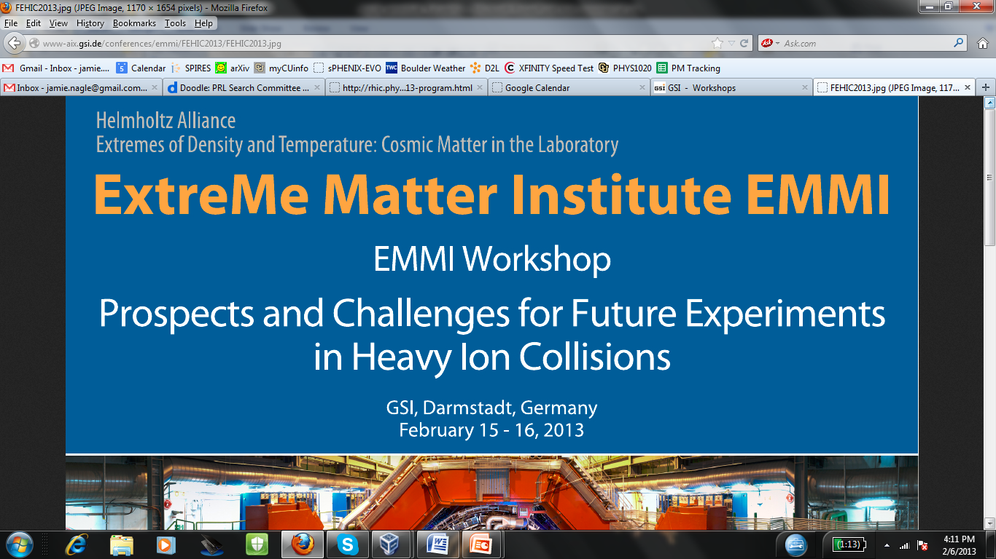
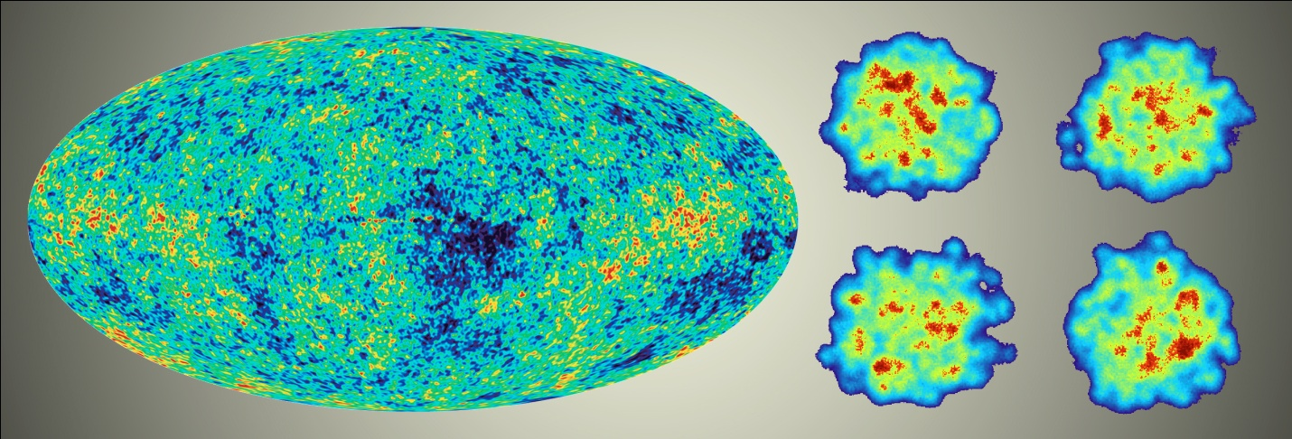
Prospects and Challenges for Future Experiments
at RHIC with Hard Probes
Jamie Nagle
University of Colorado

Slide 2
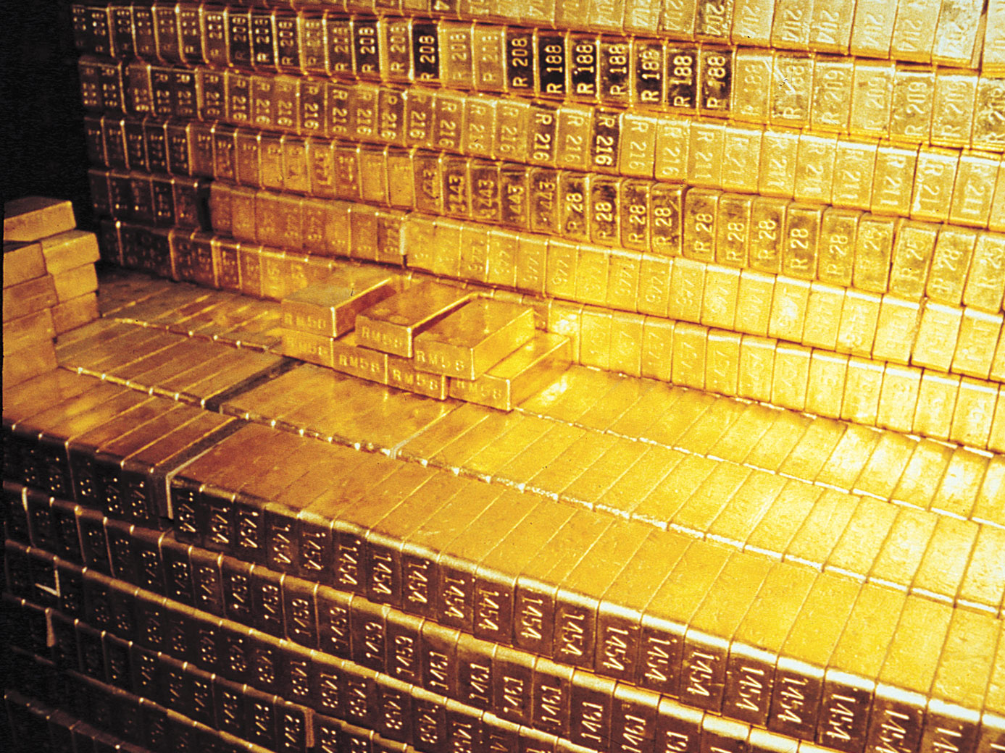

Current budgetary issues represent an existential crisis for the world wide field of
quark-gluon plasma physics
U.S. Nuclear Science Advisory Committee Report:
science.energy.gov/~/media/np/nsac/pdf/20130201/
2013_NSAC_Implementing_the_2007_Long_Range_Plan.pdf
“The subcommittee was unanimous in endorsing the
modest growth budget scenario … that is needed to maintain
a viable long-term U.S. nuclear science program”
“Closing RHIC at this time would leave unexploited a major fraction of the investments, both intellectual and financial, made by the United States in the science of quark-gluon plasma over the past decade.”
Department of Energy has no plans for closing RHIC, and there are positive budget indications for the modest growth scenario.
http://www.golem.de/news/rhic-kein-geld-keine-kollisionen-1301-97275.htm

Slide 3
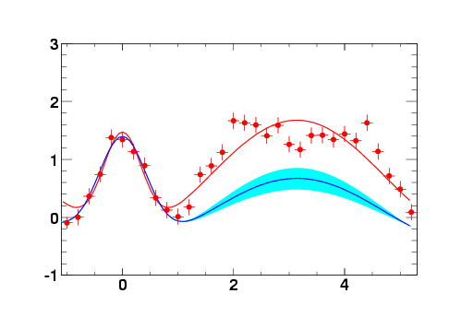
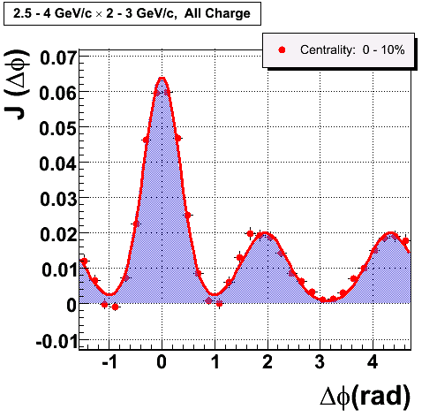
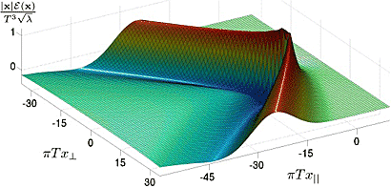
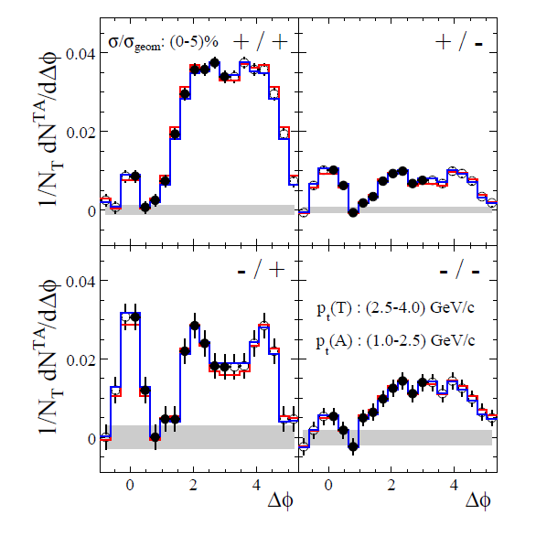
World Wide Progress (Example #1)
STAR Preliminary (2004)
Au+Au 0-5%
PHENIX
Background subtracted
Δφ
Mach cone
CERES [CERN-SPS] @ 17 GeV

Slide 4
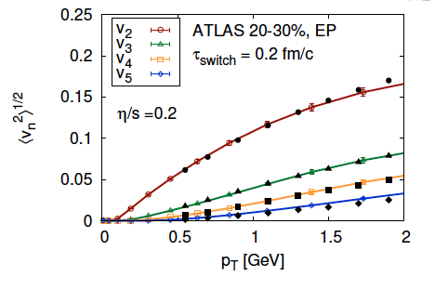
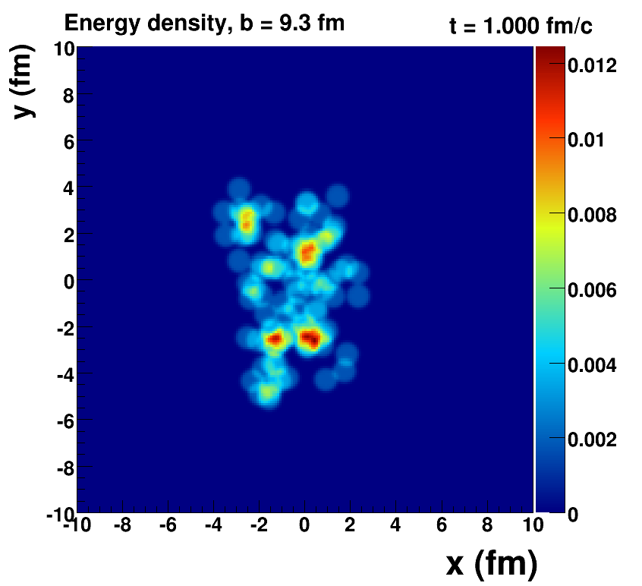
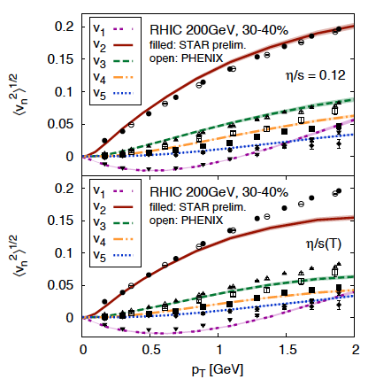
World Wide Progress (Example #1)
Initial State Fluctuations play a very important role….
Romatschke Viscous Hydro
Quantum Fluctuations
Survive Evolution!
Calculation from Bjoern Schenke

Slide 5
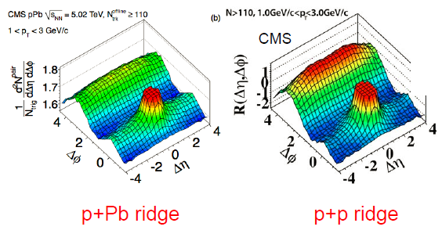

World Wide Progress (Example #2)
“Quark-gluon plasma isn't possible with p+Pb collisions”,
and thus signature of “New State of Matter CGC”
ALICE & ATLAS follow with nearly equal away-side correlation

Slide 6
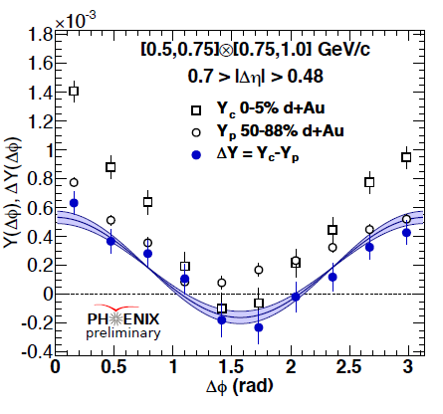
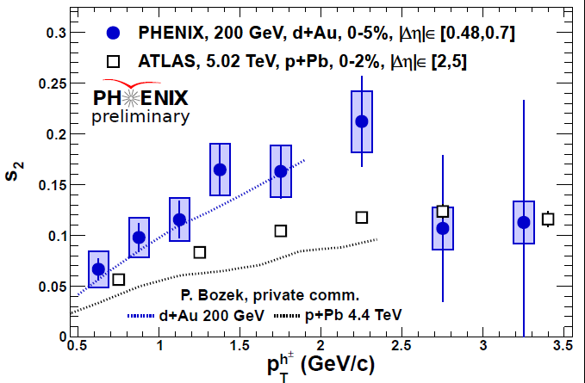
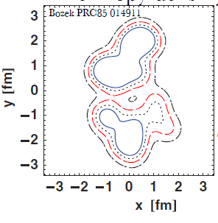
World Wide Progress→ Advantage of Deuterons
PHENIX observes similar signal, though significantly larger
As predicted by Bozek:
larger initial eccentricity & viscous hydrodynamics
See talk of Anne Sickles: rhic.physics.wayne.edu/~bellwied/wwnd2013/wwnd2013-sickles.pdf

Slide 7

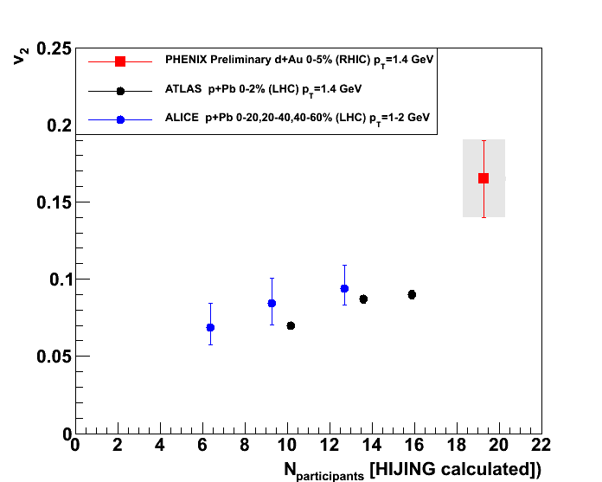
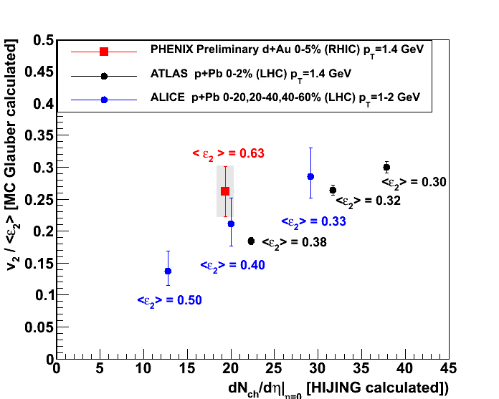
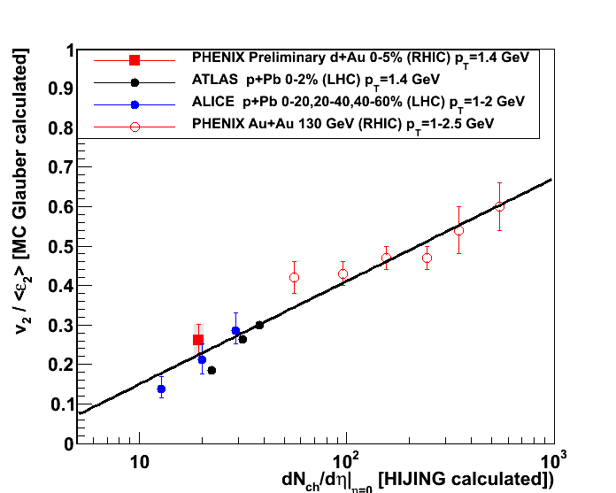

Slide 8
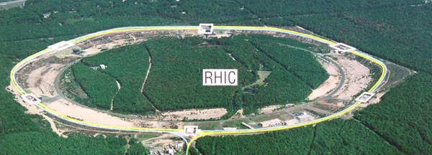
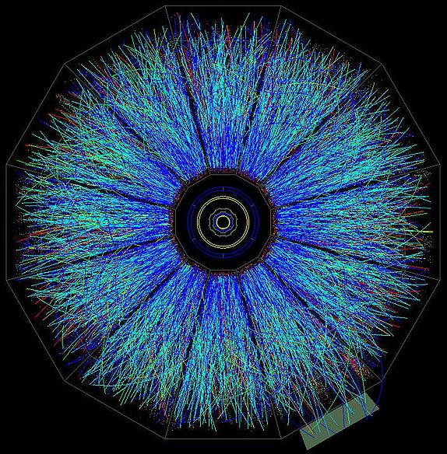
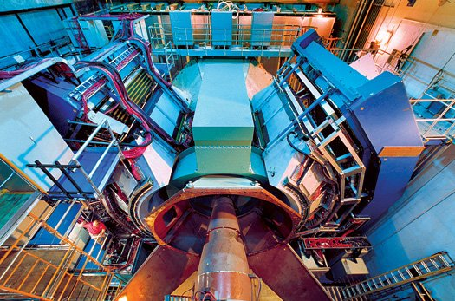
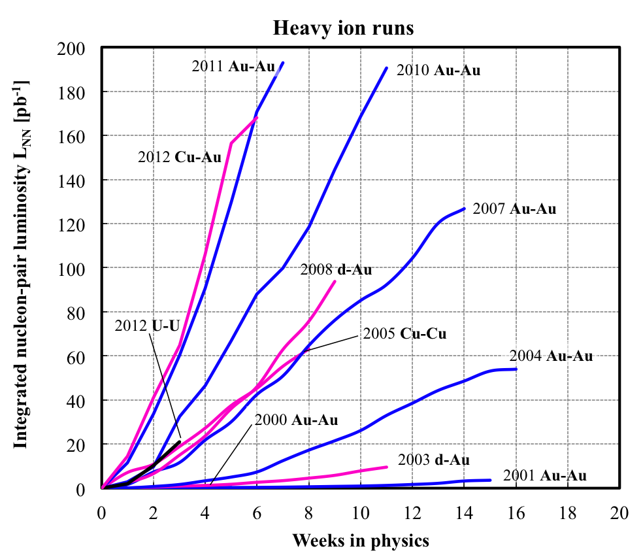
Laboratory Tool (RHIC)
RHIC – 7-200 GeV/nn
PHENIX
STAR
RHIC Machine Performance
3D stochastic cooling
L > 15 x RHIC design Au+Au
New EBIS Source provides
new geometries (U+U)
Great energy flexibility
Polarized p+p / p+A Program
Integrated Luminosity
Weeks in Physics

Slide 9

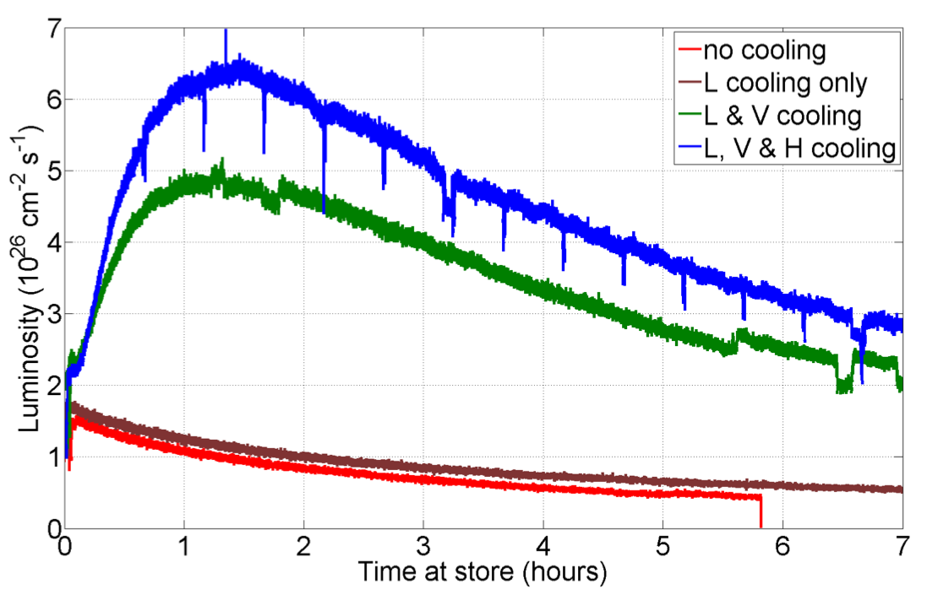
Stochastic Cooling Success
2012 RHIC U-U run
RHIC like a shiny new Gold Coin

Slide 10
Study of QGP is about the temperature dependence
What does this have to do with hard probes?

Slide 11
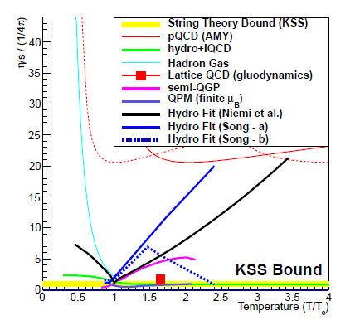
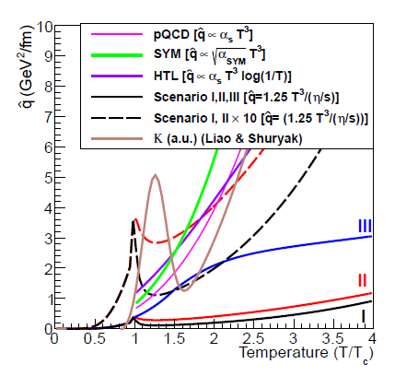
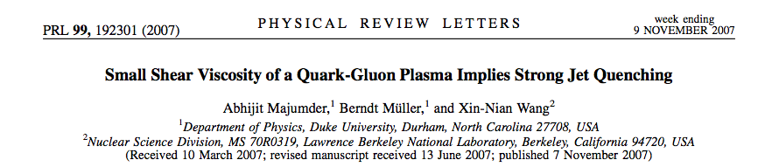
At what scale does bulk coupling relate to probe coupling?

Slide 12
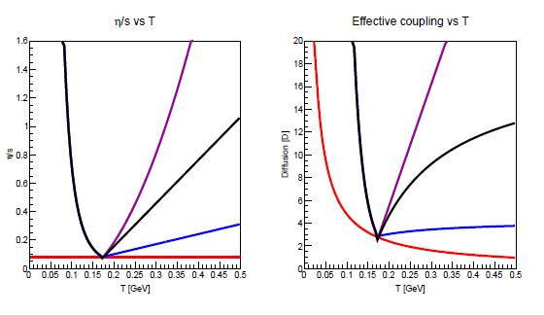
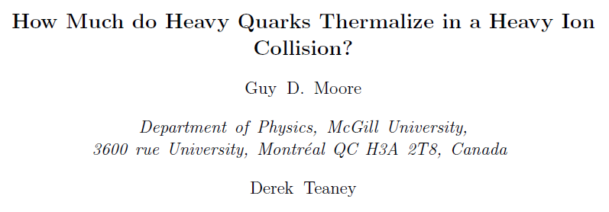
At what scale does bulk coupling relate to probe coupling?
η/s
Charm Diffusion (D)
Temperature [GeV]
Temperature [GeV]

Slide 13
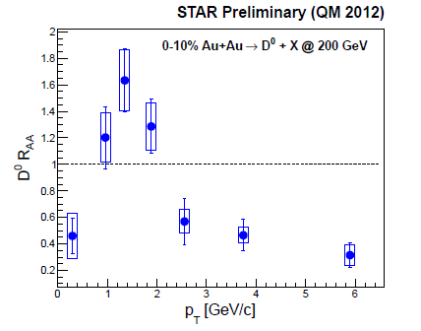
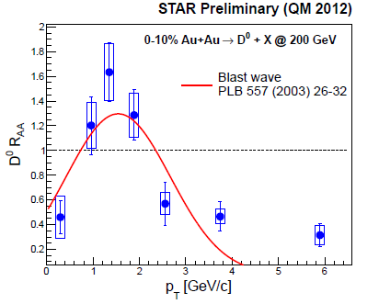
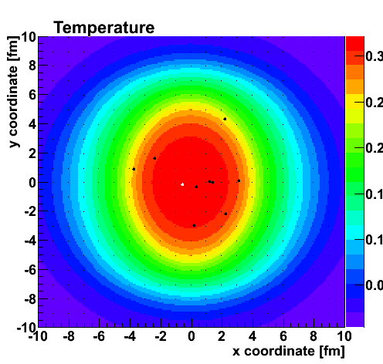
Golden Charm Results
“Does the charm flow
at RHIC?”
JN, Miklos Gyulassy (2003)
Answer = YES
Langevin + Viscous Hydrodynamics
Adare, McCumber, JN
Testing various scenarios of coupling versus Temperature

Slide 14
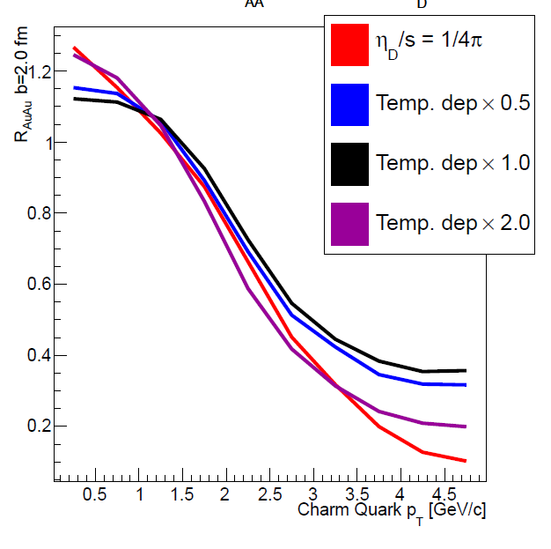
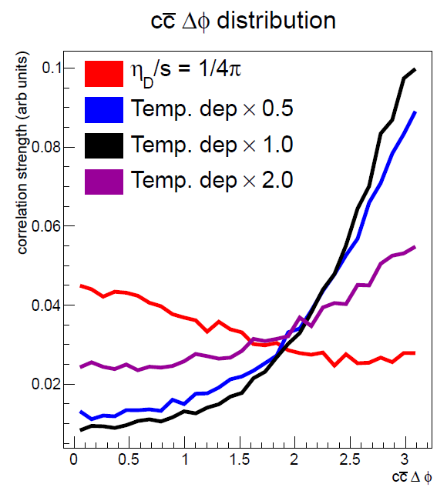
Sensitivity to Earlier Times
Adare, McCumber, JN
Charm quark R_{AA} at low p_{T} a balance of early time slow down and late time boost
Charm / Anti-Charm azimuthal correlation very sensitive to early time coupling!
Does the Beauty Flow at RHIC (at the LHC)?

Slide 15
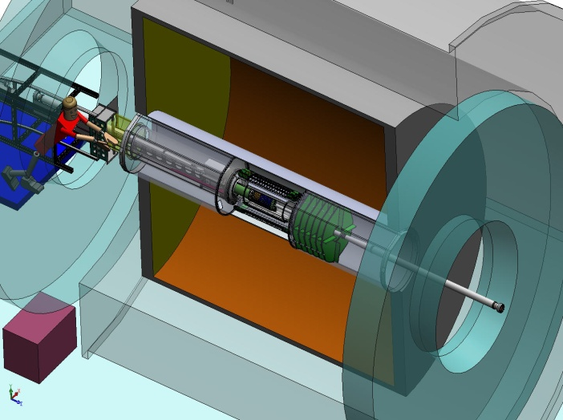
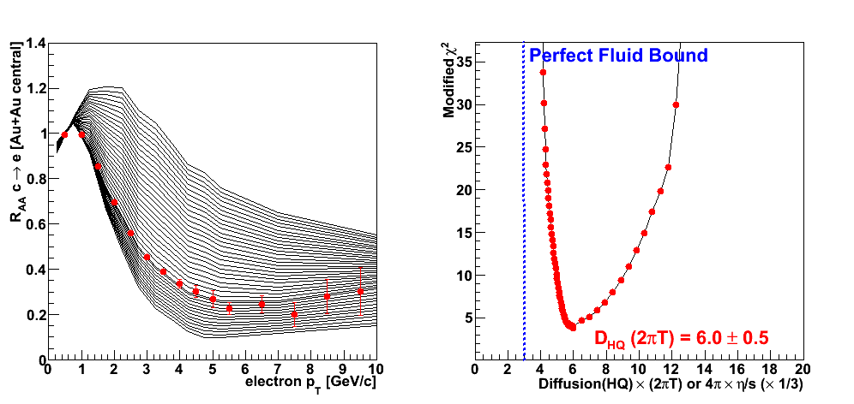
Silicon Upgrades and Investments
PHENIX
VTX (2011)
FVTX (2012)
STAR
HFT (2014)
Example RHIC precision measurement by 2016
Charm Suppression (van Hees et al.)

Slide 16
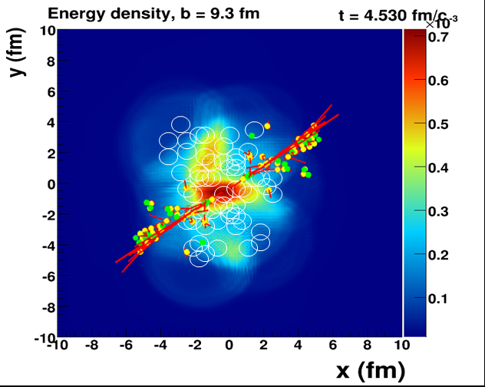

When does the strongly coupled bulk (lower momentum IR)
transition to a weakly coupled probe (higher momentum UV)?

Slide 17
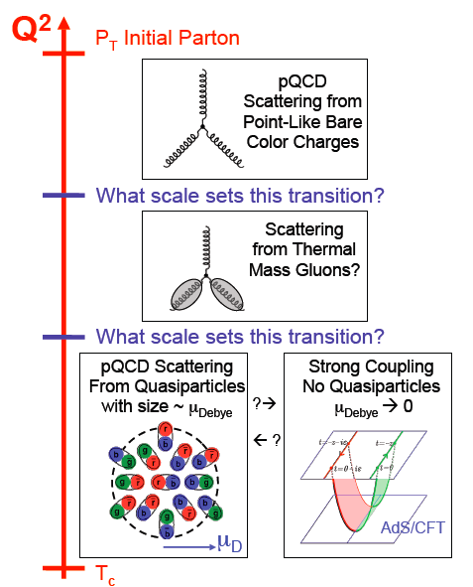
As high energy quarks or quark-antiquark pairs traverse the QGP, what do they see?
Do the highest energy
jets at LHC see
point-like color charges?
1/λ
Do the lowest energy jets at RHIC scatter from coherent fields or only excite sound waves?

Slide 18

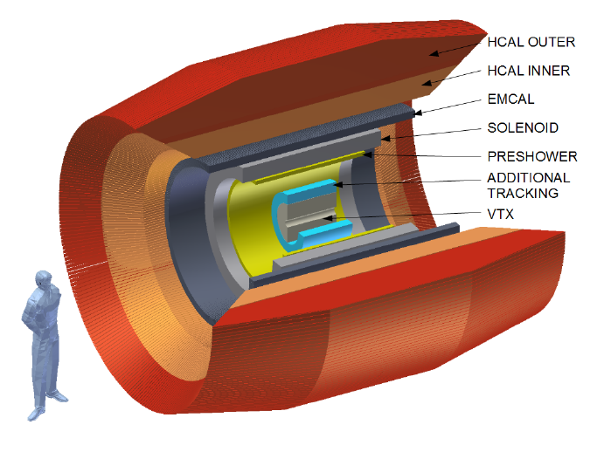
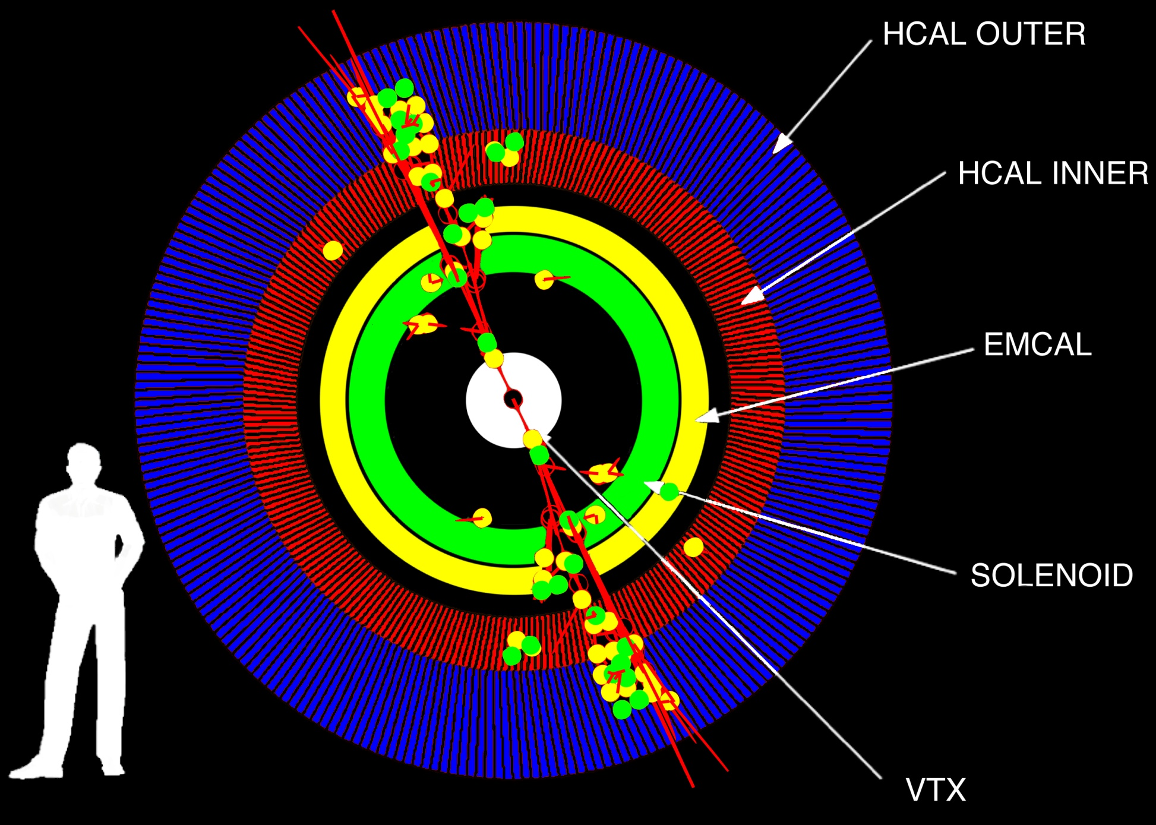
Major Upgrade to PHENIX Proposed
Taking advantage of significant technology advances (exciting synergies with LHC upgrades)
http://arxiv.org/abs/arXiv:1207.6378

Slide 19

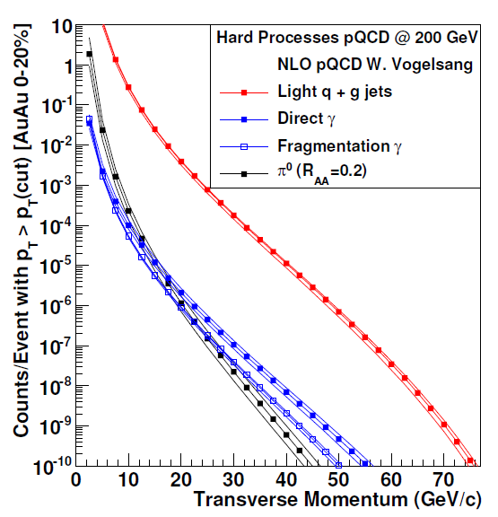
sPHENIX Rates: Jets, Dijets, γ-Jet
Sampling 50 billion Au+Au
events in one year
(can record 20 billion without selective triggers)
10⁷ jets > 20 GeV
10⁶ jets > 30 GeV
80% are dijet events
10⁴ direct γ > 20 GeV
A+B
p+A (different nuclei)
U+U
Differential measures
Jets Rates for Au+Au @ 100 GeV and Unique Flexibility of RHIC Enable Additional Lever Arm

Slide 20
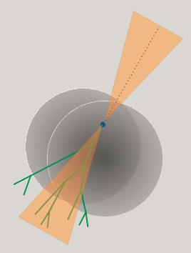
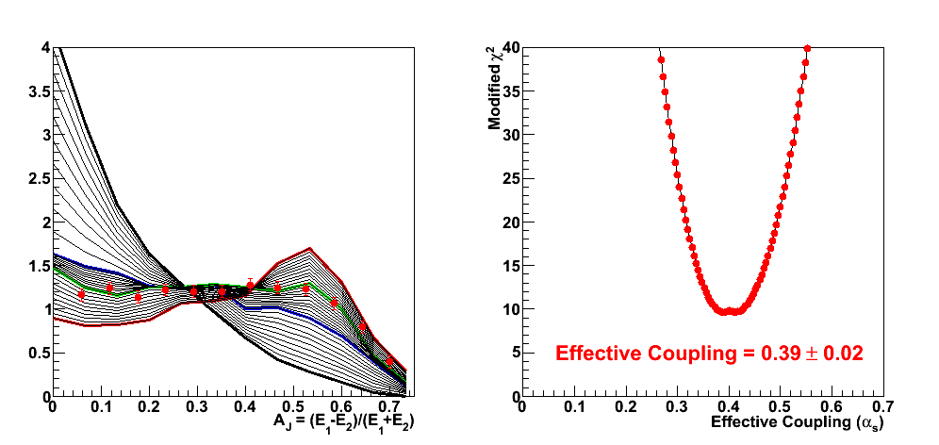

Comprehensive picture across scales and QGP temperatures spanned by RHIC and LHC needed
Lever Arm, Strongest Coupling Near T_{c}?
What is the Underlying Physics (not just η/s value)?
Example RHIC precision measurement by 2019

Slide 21
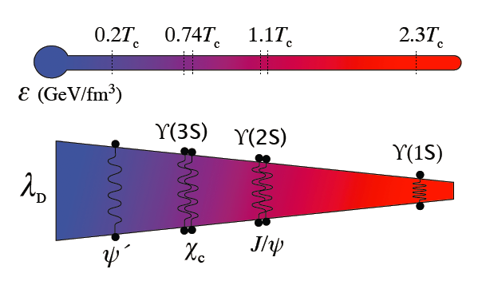
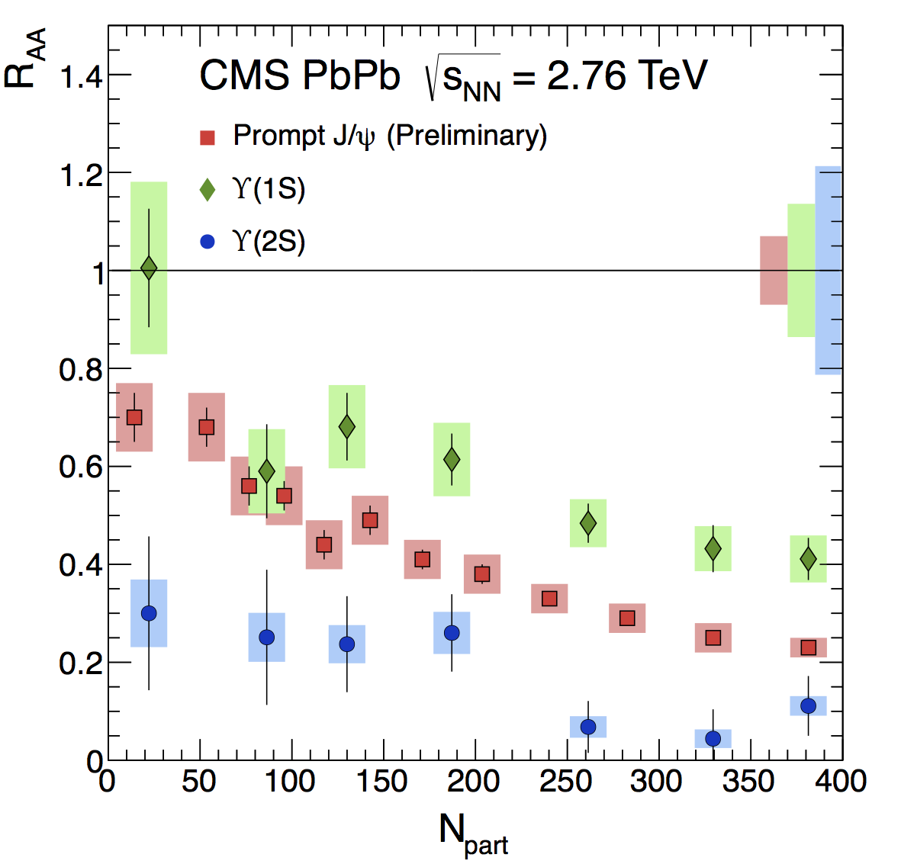
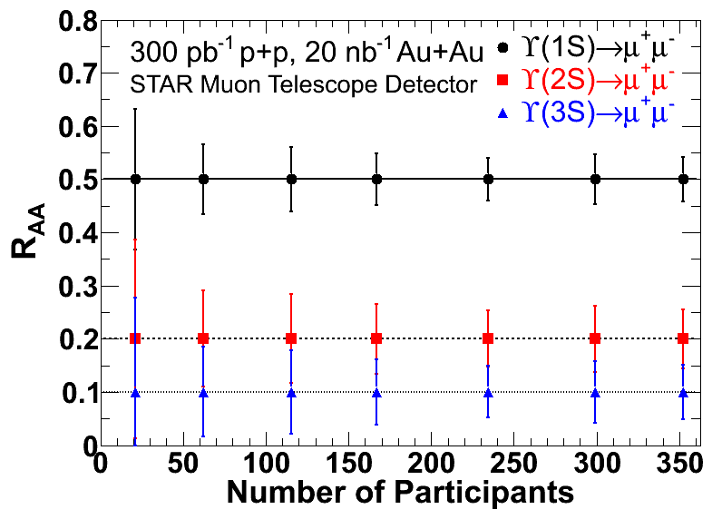
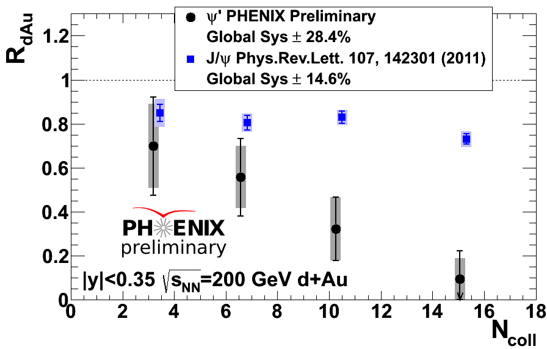



Quarkonia Thermometer
STAR and CMS data consistent with melting of Υ(2s,3s)
PHENIX d+Au
Requires RHIC p+A and A+A
for a complete picture and
to bracket the screening lengths
STAR MTD 2014 install
sPHENIX 2018 install (7x stats)
J/ψ
ψ’
N_{part}

Slide 22

Golden Summary
Exciting path to knowledge with RHIC and LHC working
together (as well as theory and experiment)
Exciting heavy flavor program and new observables
sPHENIX proposal for full jet, dijet, γ-jet program at RHIC
Full quarkonia comparison between RHIC and LHC
Future forward spin and polarized p+A low-x program,
with detectors designed as first stage Electron-Ion
Collider experiments

Slide 24
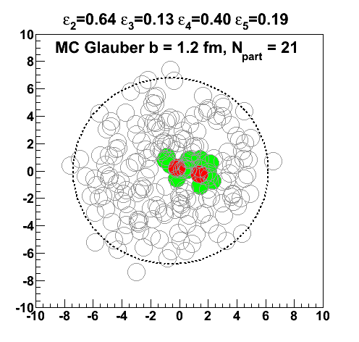
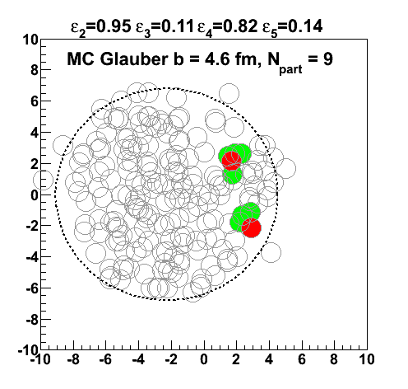
MC Glauber Event Display (JN)
Is the eccentricity value meaningful?
How far apart can the “hot spots” be and still be connected?

Slide 25
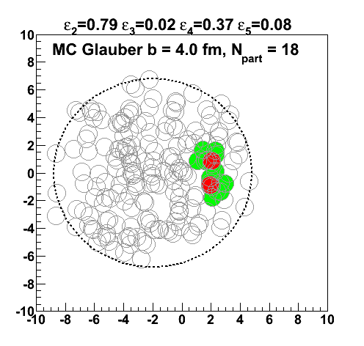
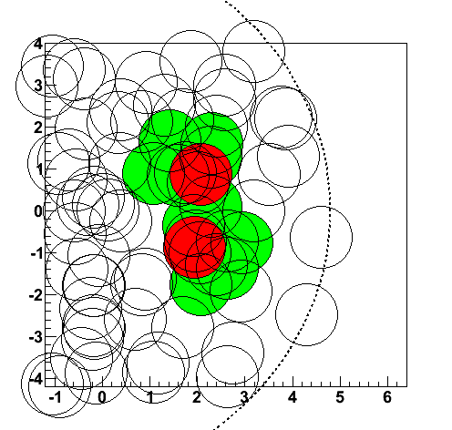

Slide 26
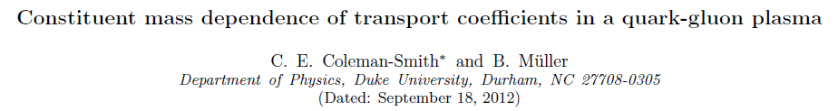



Sensitivity to Medium Composition (at a given Scale)
http://arxiv.org/abs/arXiv:1209.3328
qhat → scattering of lead parton → radiation e-loss
ehat → energy transferred to the QGP medium
Jet E_{T} = 30 GeV
T = 350 MeV
α_{s} = 0.3
Limit of infinitely massive scattering centers yields all radiative e-loss.
Medium parton

Slide 27

p + A and Gluon Saturation
Geometric
Dependence is Key
Test picture of factorization of nPDFs,
multi-parton interaction (MPI) contributions,
and high-x anti-shadowing / EMC effects at backward rapidity.
Stochastic Cooling at RHIC enables switch to p+A quickly.
Very exciting option for p+C, p+Si, p+Cu, p+Au all in one run!

Slide 28



Cold Nuclear Matter and Gluon Saturation
Does gluon density saturate?
Precision via direct γ in 2016
MPC-EX
700nb⁻¹ p+Au
50pb⁻¹ p+p
Measured by 2016
90% C.L.
The nucleus is an amplifier of high gluon densities
Direct photon channel.
Key is connecting RHIC forward-y to LHC mid-y

Slide 29

Polarized p-A Insights
RHIC is a unique collider with spin polarized protons
Large transverse spin effects observed at forward rapidity (x_{F})
p+p A_{N}(π) @ 62 GeV
Exploiting the link between the TMD and Gluon Saturation frameworks, one can learn about the saturation scale via transverse spin asymmetries!
http://arxiv.org/abs/arXiv:1106.1375

Slide 30


STAR/PHENIX Forward Upgrades
STAR Staged Approach:
Calorimeters: 2015-2017
GEM Trackers: ~2017
Cerenkov: 2018-2019
Extension of sPHENIX at forward angles
GEM based tracking
Diamond pixel for heavy flavor tagging
RICH based PID (π/K/p)
EM and hadronic calorimetry
Muon identification
Excellent transverse spin capabilities, and first stage EIC option

Slide 31






