Slide 1
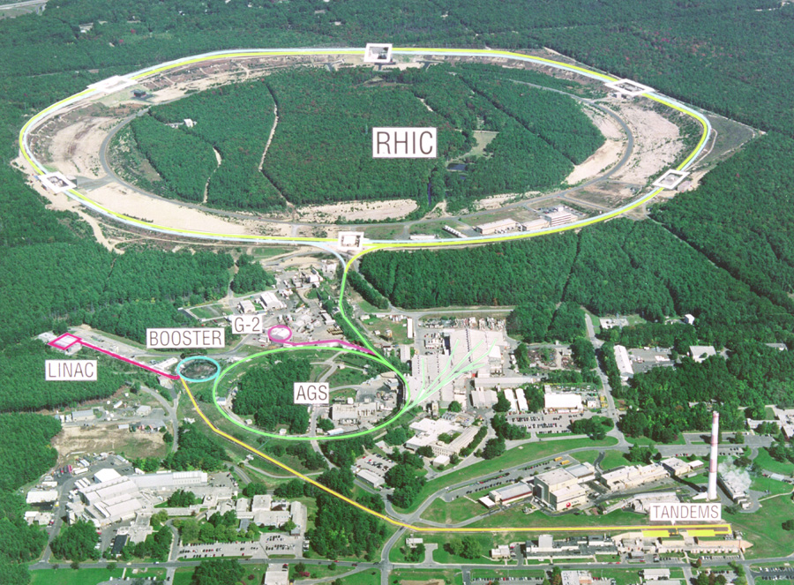
Future of Heavy Ion Collisions @ RHIC
Barbara Jacak
February 16, 2013
Prospects & Challenges for Future Experiments In Heavy Ion Collisions

Slide 2
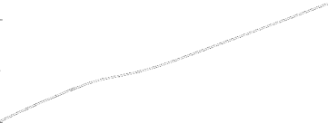

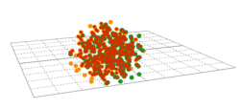

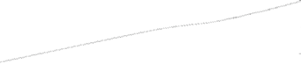


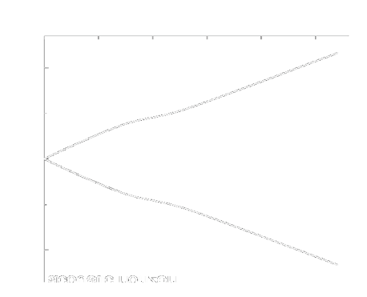
From HIC to plasma to detected particles
distributions and correlations of produced particles
kinetic
freeze-out
QGP Phase Boundary
lumpy initial energy density
QGP phase
quark and gluon degrees of freedom

Slide 3
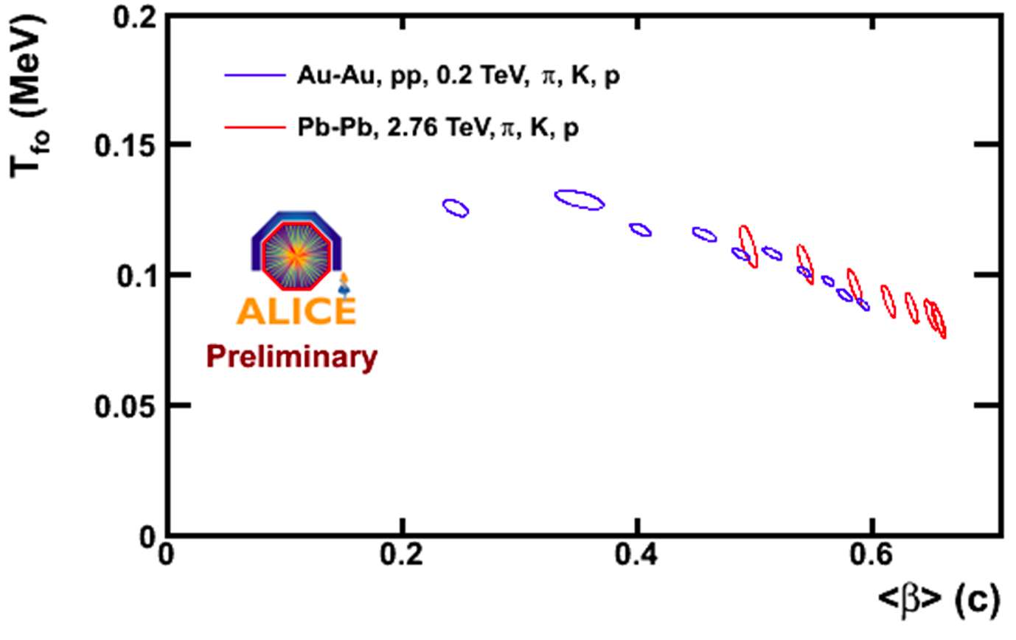
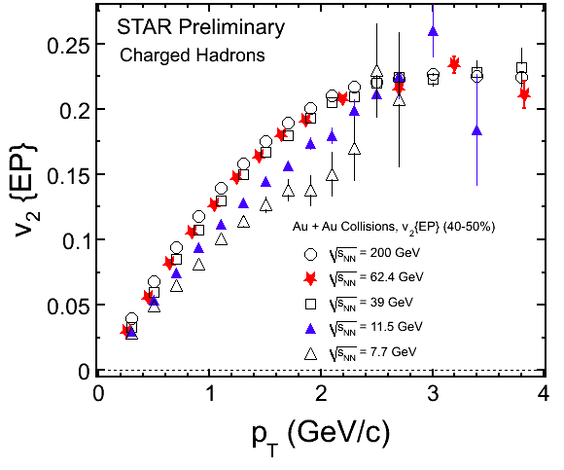
We need to understand*
Dynamical Evolution
  RHIC & LHC together: a consistent picture
  multiplicities, system size & lifetimes
  as a function of √s
QGP properties
Thermalization mechanism
Initial conditions
* Working backwards
Blast Wave
v₂ changes
@ 11.5 GeV

Slide 4
Open questions driving our field
What are the properties of the QGP?
  How perfect is the near-perfect liquid?
  Are there novel symmetry properties?
  Is there a characteristic color screening length? What is it?
  At what scales is the coupling strong?
  Are there quasiparticles in the medium? What are they?
How does the strongly coupled plasma emerge?
  What is the mechanism for parton-plasma interactions?
  Is there evidence for the onset of deconfinement and/or
  the QCD critical point?
How does cold nuclear matter behave?
  Is there evidence for saturation of the gluon density?
  How do initial state fluctuations affect observables?

Slide 5
QGP properties

Slide 6
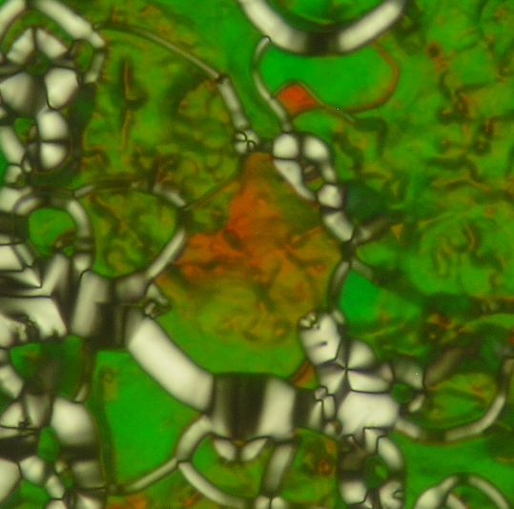

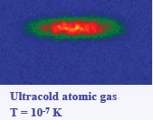
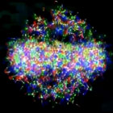
In context of other strongly coupled matter
Quark gluon plasma is like other systems with strong coupling - all flow and exhibit phase transitions
Cold atoms: coldest & hottest matter on earth are alike!
Dusty plasmas & warm, dense plasmas
have liquid and even crystalline phases
Strongly correlated condensed matter:
liquid crystal phases and superconductors
In all these cases have a competition:
Attractive forces ⇔ repulsive force or kinetic energy
High T_{c} superconductors: magnetic vs. potential energy
Result: many-body interactions, not pairwise!

Slide 7
Where is QGP on the viscosity map? Why?
  How perfect is the near-perfect liquid?
  At what scales is the coupling strong?
  Are there quasiparticles in the medium? What are they?

Slide 8
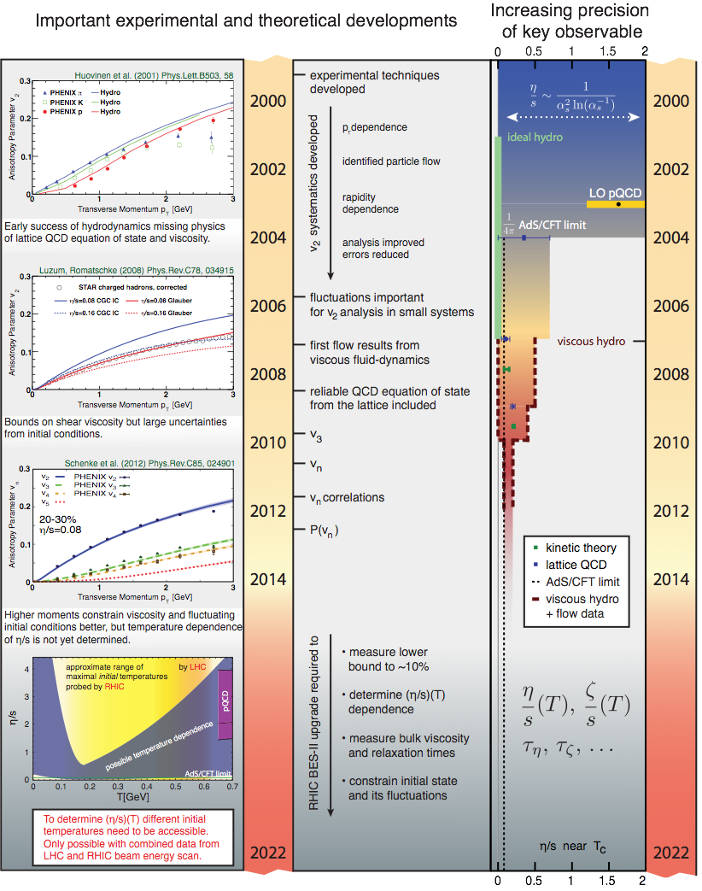
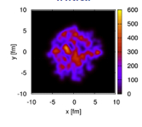
Quantify η/s precisely
At RHIC:
Tailor initial shapes using U+U and asymmetric systems like Cu+Au
  Pick apart fluctuations from geometry
Vary beam energy: minimum η/s @ T_{c}?

Slide 9
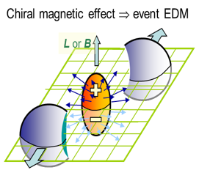
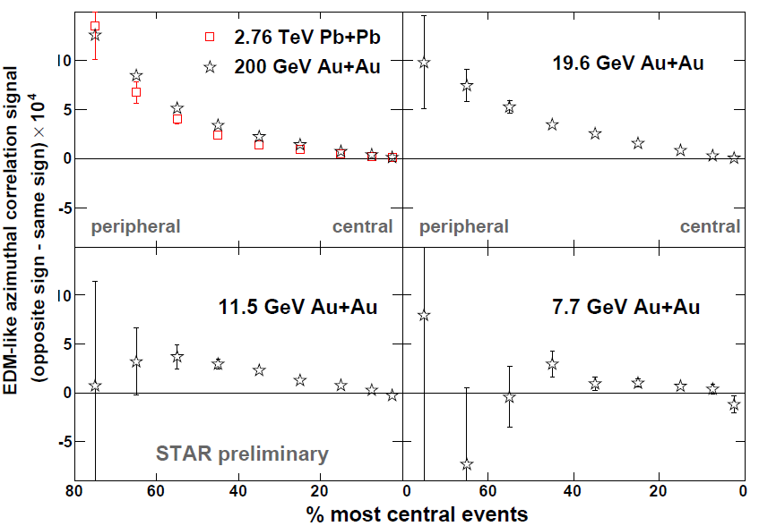
Novel symmetry properties?
Improve statistics with U+U & very central collisions
Turn down √s to see how effects turn off

Slide 10
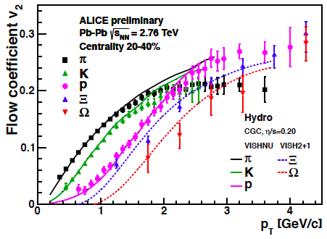
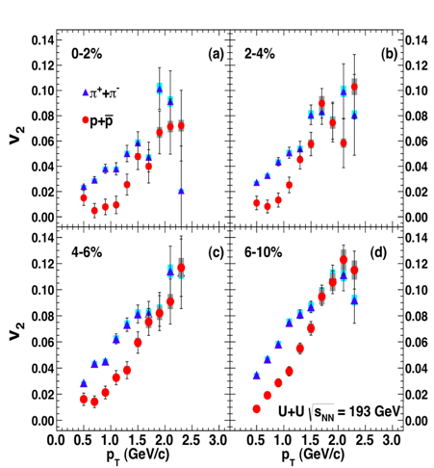


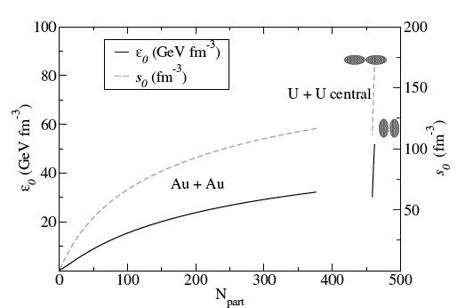
Varying beams a key feature of RHIC
?

Slide 11
Scales where coupling is strong?
Investigate by changing energy & mass of the probe
Study as a function of plasma temperature
  Scan RHIC beam energy in the higher E (QGP) side
  Combine RHIC and LHC data for maximum lever arm
Separate plasma effects from initial geometry effects with different beam combinations & centrality selection
Hmm, this sounds like condensed matter physics
  Learn the properties by “pumping and probing” QGP

Slide 12
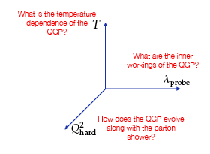
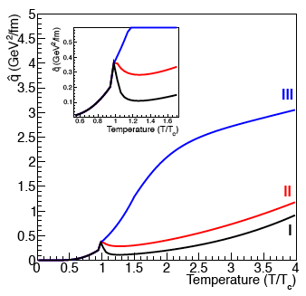
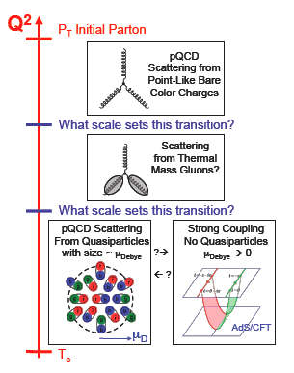
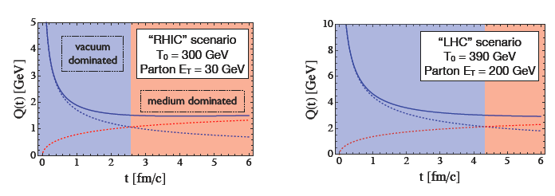
RHIC + LHC together provide the knobs
T ⬅➔coupling
Probe λ ⬅➔ length scale
1/λ
probe
virtuality

Slide 13
What’s inside the QGP?*
Do quasiparticles exist? At what scale?
Probe using parton-medium interactions
  Also shed light on thermalization mechanisms
* One of the hot topics at this workshop!

Slide 14
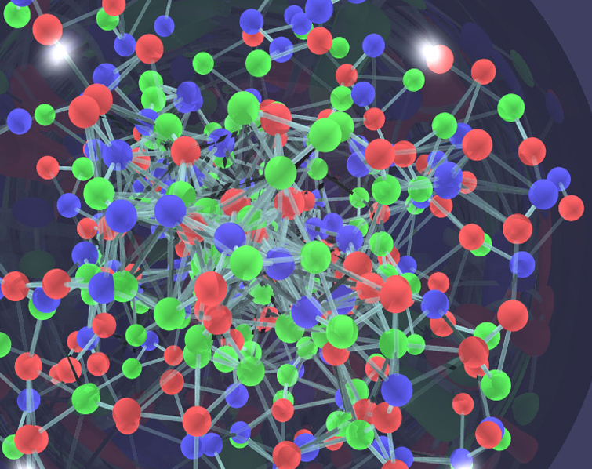
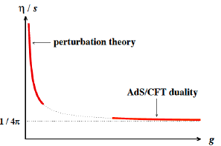
Currently a raging debate
Just WHAT is interacting in the hot dense plasma?
  Individual gluons?
  Pure fields?
  Multi-gluons continuously
  splitting & re-forming?
  i.e. composite quasiparticles
  (in classical liquids voids fill this role)
Kovtun, Son, Starinets 2004
Answer must be scale dependent!
  Tools: Energy loss vs. M and E of probe parton
Affects transport of momentum, energy & particles
  i.e. Viscosity, speed of sound, diffusion
Has particles!
Excitations??

Slide 15

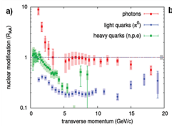
What’s inside? “throw rocks at it”
heavy
quarks
Diffusion, collisional energy loss…
Collisions with what?
c vs. b to help resolve

Slide 16
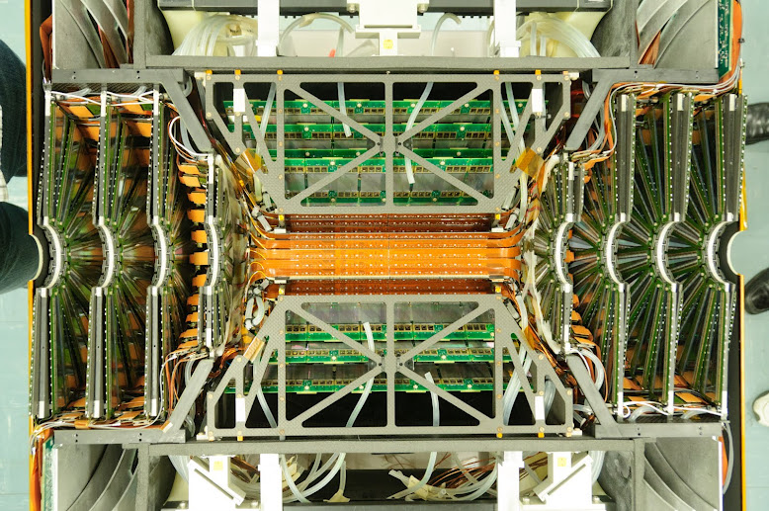
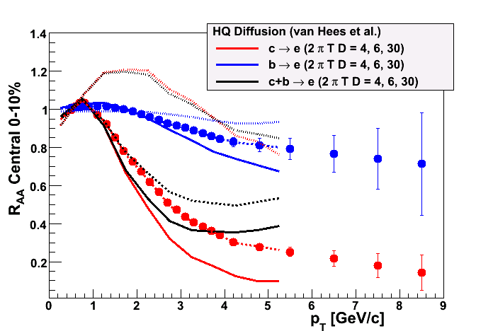

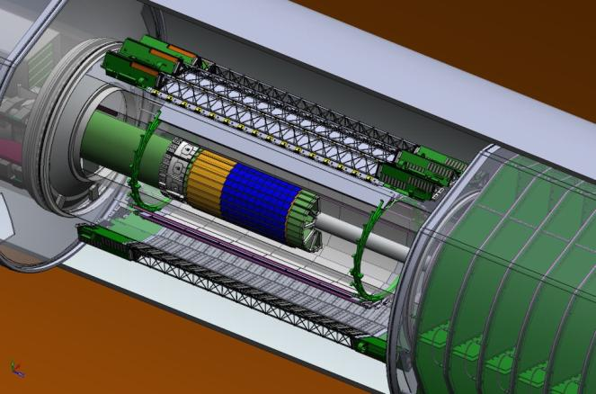
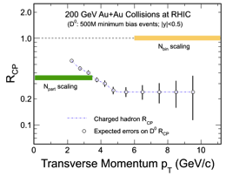
Heavy probes: in the next few years!
STAR

Slide 17
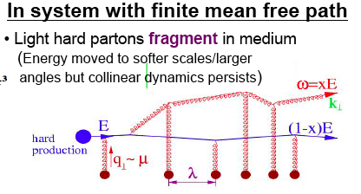
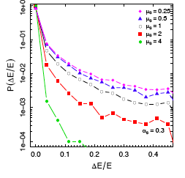
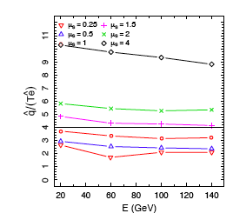
“throw rocks at it”
jets
Scale: E
heavy quarks
scale:M
arXiv:1209.3328
100 GeV parton
Study medium by using it as a “filter” for
gluon splitting
color effects
(Urs Wiedemann)
Parton energy loss, transport sensitive to mass of medium constituents. Dijets probe α_{s}

Slide 18
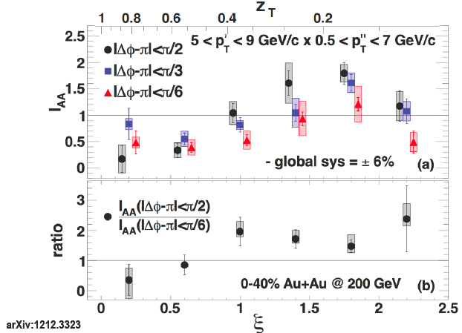
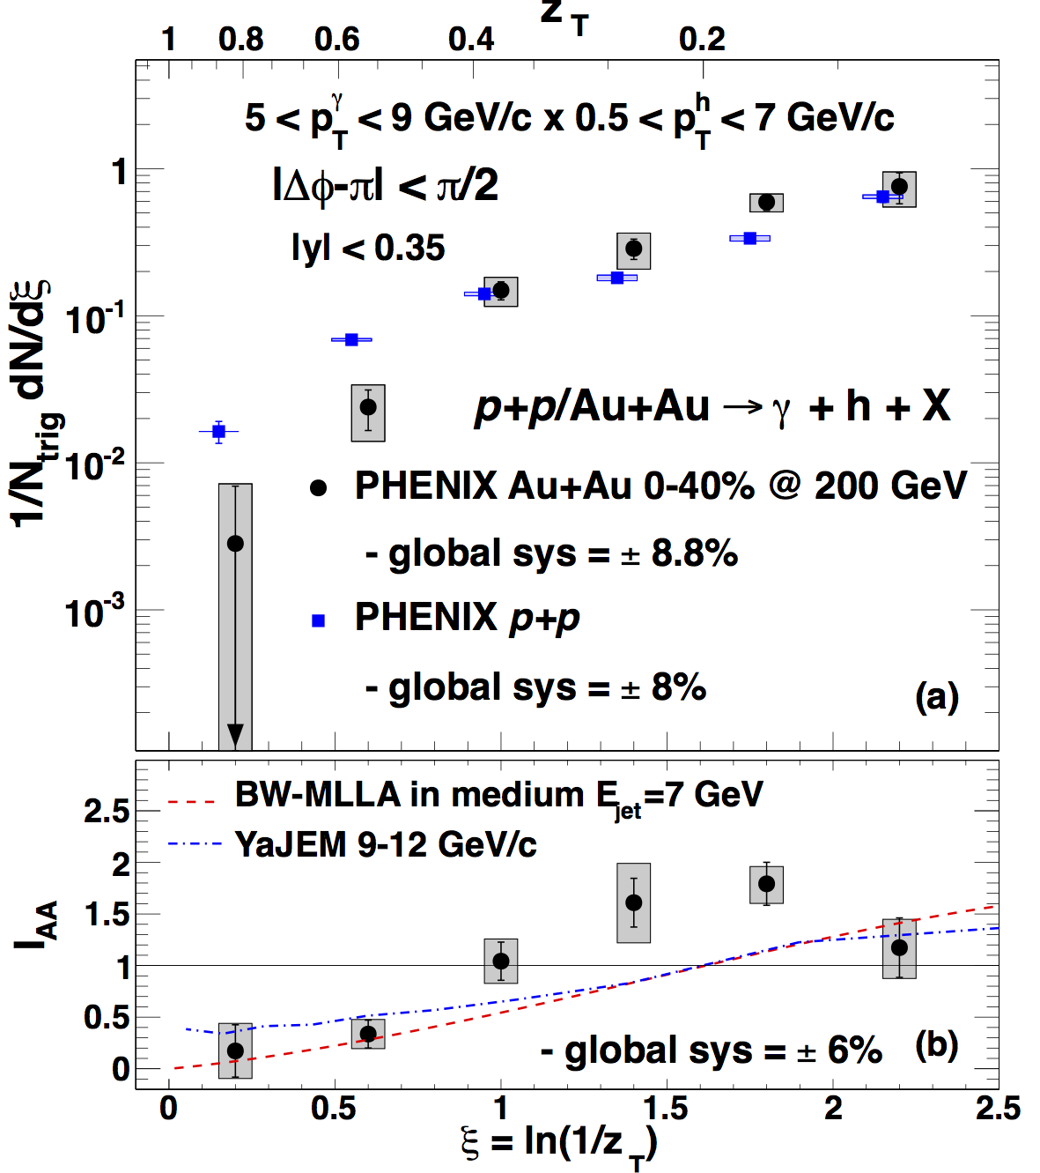

Parton-medium interaction: γ-h correlations
γ: parton energy, h: fragmentation fn.
“Extra” soft particles at larger angles near the away side jet
Au+Au/
p+p
Provide constraints on gluon splitting
Perturbative?

Slide 19
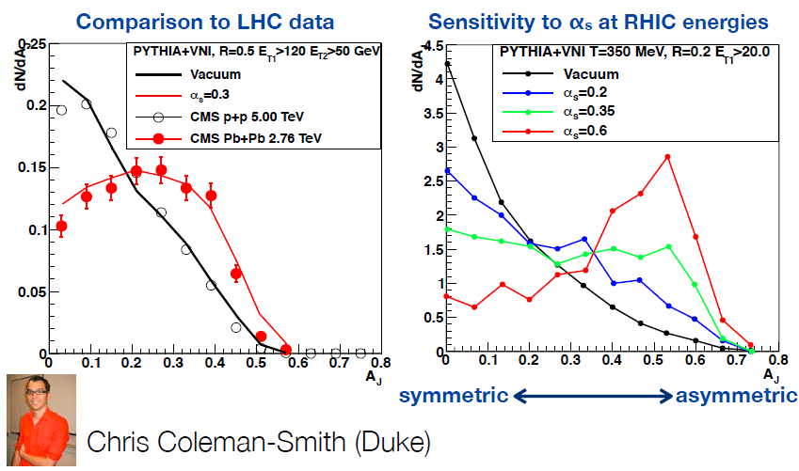
RHIC+LHC to tease out T dependence
B. Mueller,
Nuc.Phys.A855, 74 (2011)
Can separately control T_{medium} and parton virtuality
Reconstruct jets:
extend p_{T} range
Di-jets, γ-jet:
Sensitivity to q, e, α_{s}
∧
∧

Slide 20
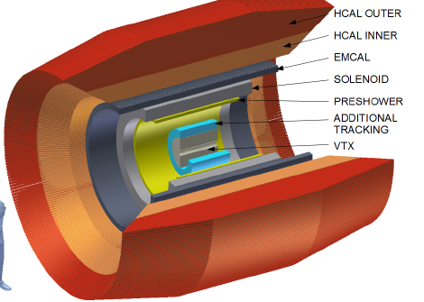
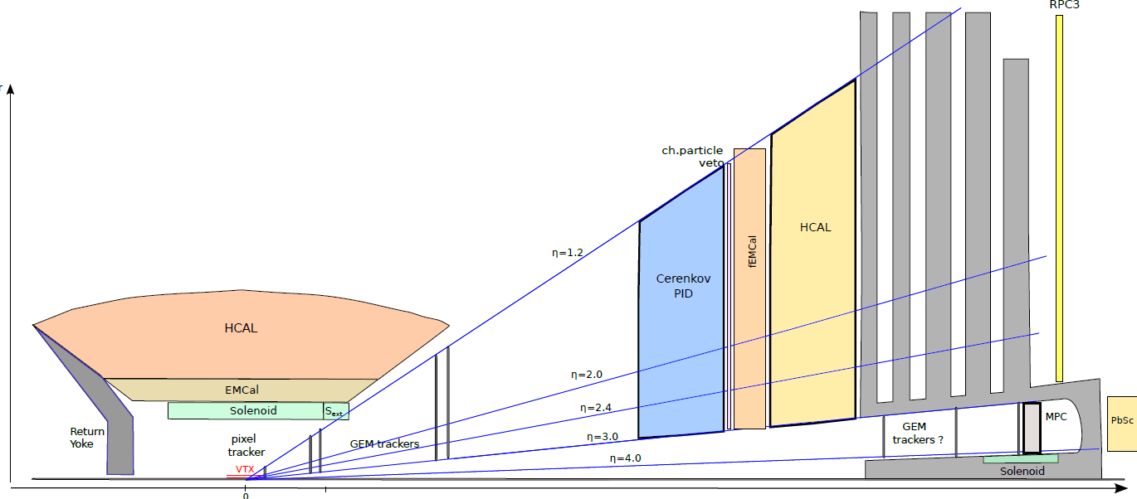
sPHENIX upgrade
Jet, di-jet and γ-jet physics
Additional tracking layers (RIKEN)
  ➔high-z fragmentation fn.
Add pre-shower to EMCAL
  ➔π⁰ R_{AA} to 40 GeV/c
  ➔eID for ϒ states; tag c,b jets
Forward upgrade for spin &
cold nuclear matter
(NSF, RIKEN)

Slide 21
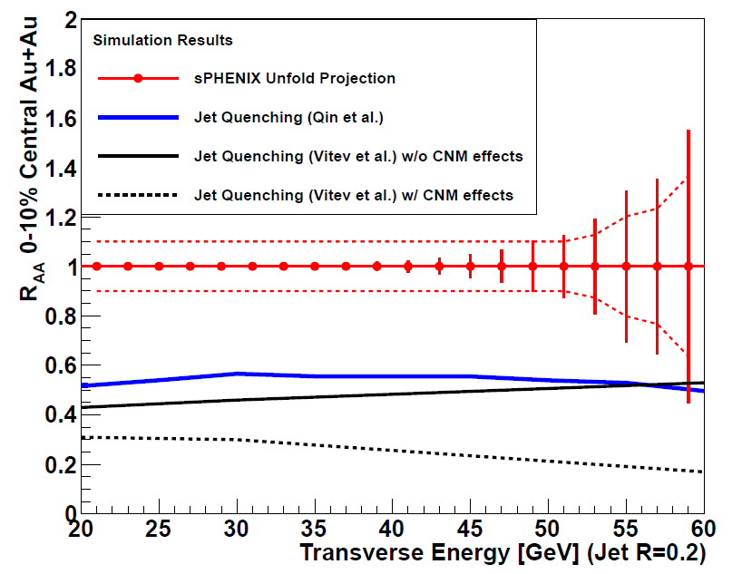
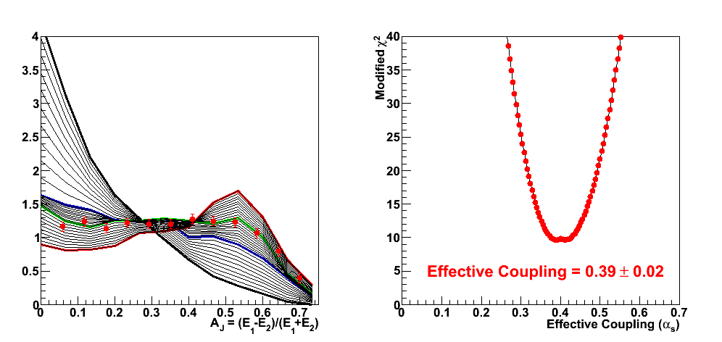
Jet and Di-jet performance
Dijet Asymmetry
E_{T1} > 35 GeV
Varying medium coupling
Theory (Coleman-Smith)
50B events sampled
200 GeV Au+Au
Add also heavy quark jets

Slide 22
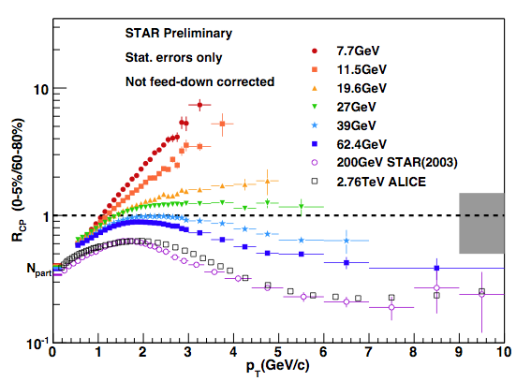
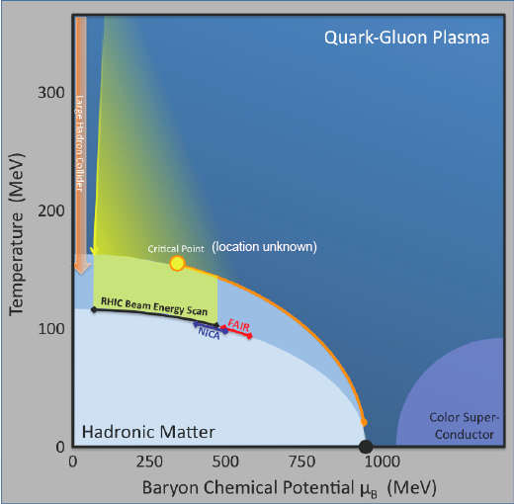
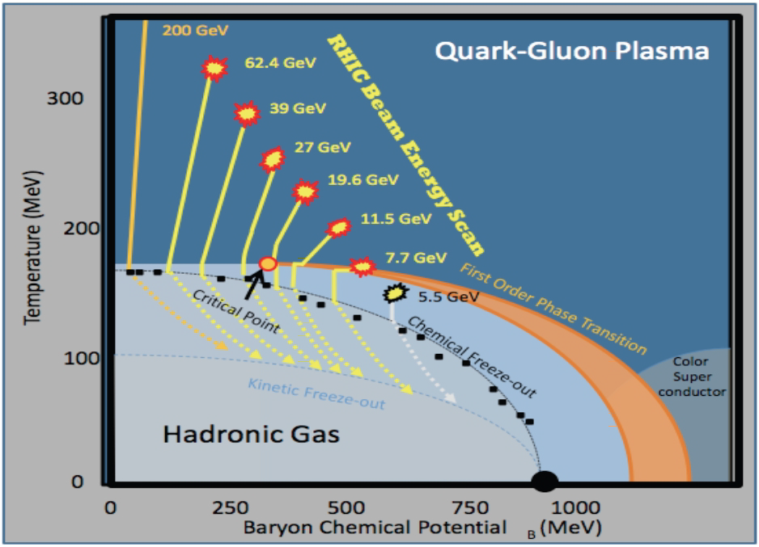
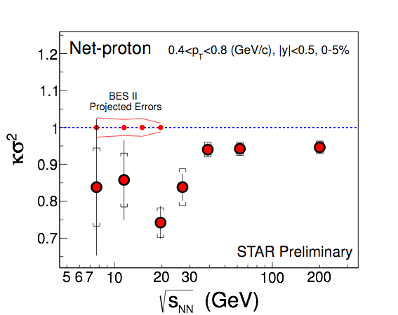
RHIC question: Emergence of QGP?
Probing the QCD Phase-Diagram
RHIC Beam-Energy-Scan: vary T_{init} and μ_{B}
beam energy range in area of relevance is unique to RHIC!
BES-II will deliver precision required to search for signatures of the CEP

Slide 23
Need high statistics at ~10-30 GeV
Also see non-statistical fluctuations @ ~20 GeV
  ⇒ approaching critical point?
Need low-energy e-cooling of AGS beam
  improve luminosity @ √s < 20 GeV to study:
  fluctuations in conserved quantities
  particle ID flow
  symmetry-breaking sensitive correlations
-> Beam Energy Scan 2 (BES2)
    Ready in 2018
    Technically driven schedule

Slide 24
Initial State

Slide 25
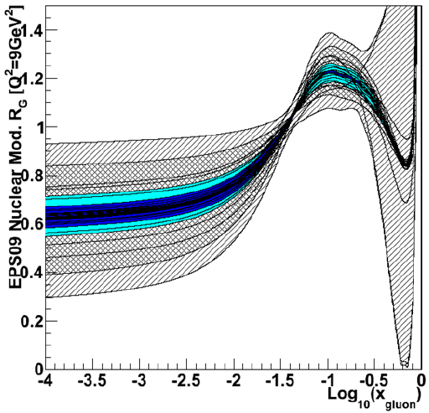
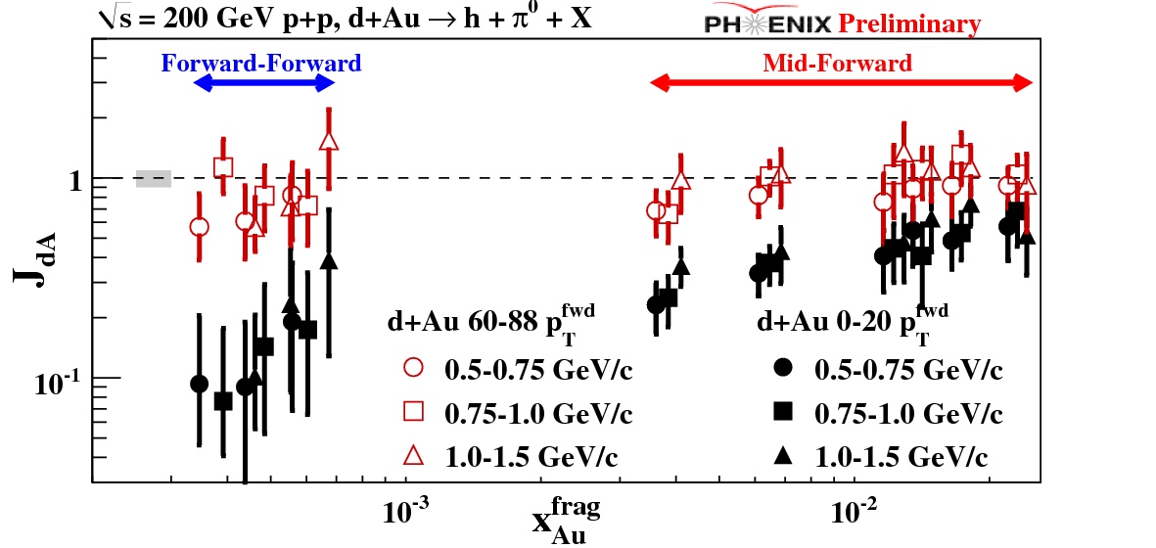
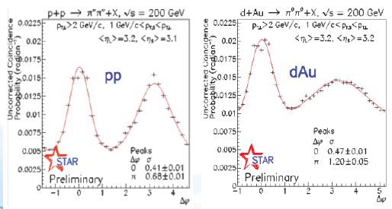
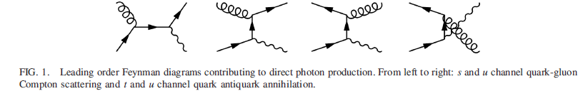
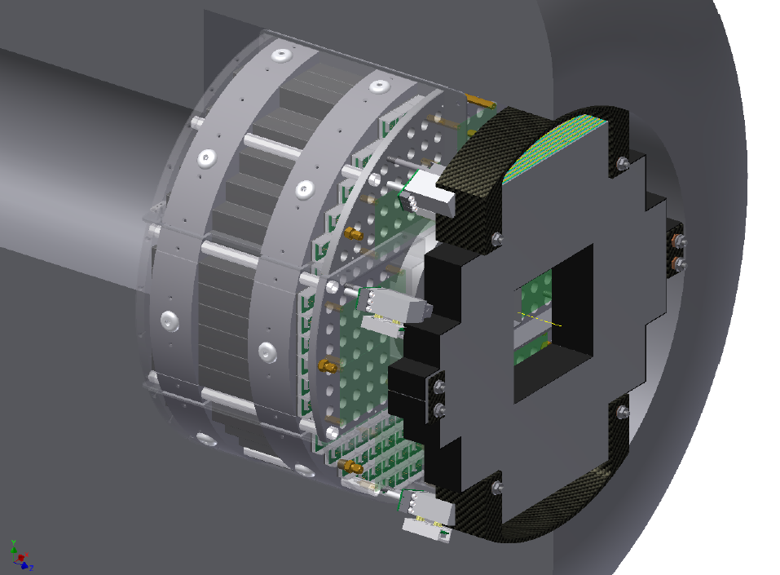
Initial State: just dense or CGC?
Direct γ in MPC-EX
700nb⁻¹ p+Au
50pb⁻¹ p+p
Measured by 2016
Dilute parton system (deuteron)
P_{T} is balanced by many gluons
Dense gluon
field (Au)
MPC-EX: 2014
Si/W preshower/
tracker before MPC
90% C.L.

Slide 26
Future HIC at both RHIC + LHC essential!
Question | Facilities | Comments
How perfect is “near-perfect” liquid? | RHIC & LHC | Next 5 years. T dependence is key
How does strong coupling emerge and over what scales? Parton-plasma interaction? | RHIC & LHC | > 5 years @ RHIC; needs sPHENIX upgrade
Evidence of novel symmetries? | Mostly RHIC | Exploits U+U and μ_{B} ≠ 0 reach
Are there quasiparticles in the plasma? | RHIC & LHC | Next 5 years. Heavy quarks are key probes
Evidence for onset of deconfinement and/or critical point? | RHIC alone | > 5 years, needs low-E cooling
Color screening length? | RHIC & LHC | LHC mass resolution a plus; √s-dependence important
Saturated gluon densities in nuclei at small x? | RHIC, LHC & EIC | Want to see onset at RHIC& LHC; need EIC to quantify
Control T, Q², λ: RHIC + LHC together ➔ vary knobs selectively
Control geometry & pinpoint phase transition: needs RHIC!

Slide 27

Schedule for RHIC
Years | Beam Species and Energies | Science Goals | New Systems Commissioned
2013 | 500 GeV pol p+p 15 GeV Au+Au | Sea antiquark and gluon polarization QCD critical point search | Electron lenses upgraded pol’d source STAR HFT
2014 | 200 GeV Au+Au and baseline data via 200 GeV p+p (needed for new det. subsystems) | Heavy flavor flow, energy loss, thermalization, etc. quarkonium studies | 56 MHz SRF full HFT STAR Muon Telescope Detector PHENIX Muon Piston Calorimeter Extension (MPC-EX)
2015-2017 | High stat. Au+Au at 200 GeV and ~40 GeV U+U / Cu+Au at 1-2 energies 200 GeV p+A 500 GeV pol p+p | Extract η/s(T_{min}) + constrain initial quantum fluctuations further heavy flavor studies sphaleron tests @ μ_{B}≠0 gluon densities & saturation finish p+p W prod’n | Coherent Electron Cooling (CeC) test Low-energy electron cooling STAR inner TPC pad row upgrade
2018-2021 | 5-20 GeV Au+Au (BES phase 2) Long 200 GeV Au+Au w/ upgraded detectors baseline p+p/d+Au data at 200 GeV 500 GeV pol p+p 200 GeV pol p+A | x10 sens. increase to QCD critical point and deconfinement onset jet, di-jet, γ-jet quenching probes of E-loss mechanism color screening for different qq states transverse spin asyms. Drell-Yan & gluon saturation | sPHENIX forward physics upgrades
27

Slide 28
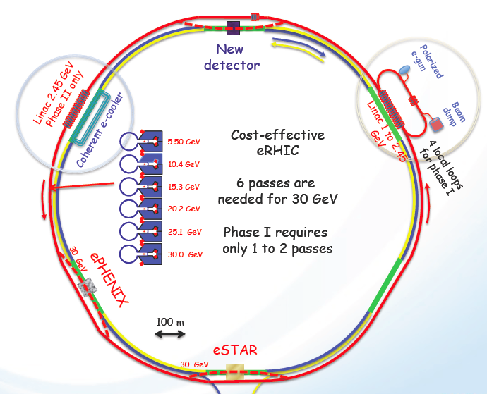
From RHIC to eRHIC

Slide 29
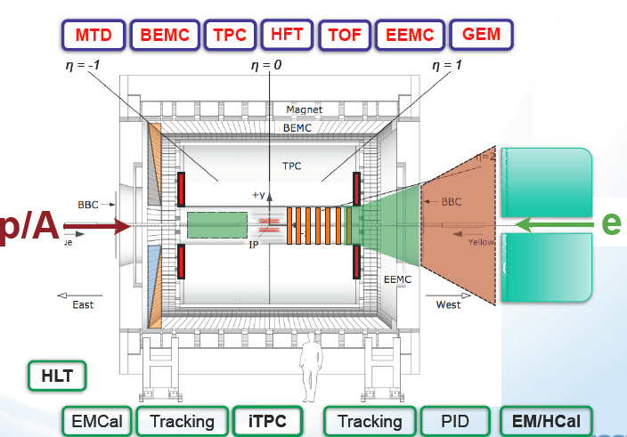

Detectors for first eRHIC measurements
eSTAR
ePHENIX

Slide 30
Summary
The physics questions are now even more interesting
Some will be answered by new data from RHIC, some by LHC, but most need RHIC and LHC together
U.S. budget problems certainly a cause for concern
  But I am (cautiously) optimistic
RHIC offers the most sensible path toward EIC
  Cost effective to add electrons rather than hadrons
  ePHENIX and eSTAR for first measurements

Slide 31
backup slides

Slide 32
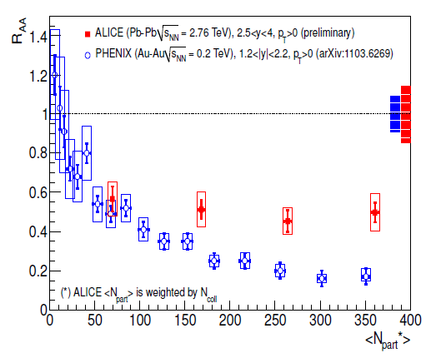





Is there a characteristic color screening length?
LHC
RHIC
sPHENIX projection
STAR projection with MTD

Slide 33

√s dependence is key to sorting it out!
RHIC + LHC both!
Shadowing in CNM
Measure along with other hard probes in d/p+A
J/ψ yield
Cold matter
effective absorption
√s
Final state recombination
Screening in QGP
LHC: important effect
the goal!
J/ψ yield
J/ψ yield
√s
√s

Slide 34



Magnet
Solenoid 2 Tesla, R_{inner} = 70 cm
VTX inner tracker
Accordion Tungsten-Fiber EMCal
SBIR with Tungsten Heavy Powder
Prototype being constructed; EIC R&D
10 cm thick; 14%/sqrt(E) resolution
Full GEANT-4 simulation results
Silicon Photomultiplier (SiPM) readout
Fe-Scintillator HCal
Acts as flux return for magnetic field
Prototype being constructed
1 meter total thickness
75%/sqrt(E) resolution
Full GEANT-4 simulation results
Common SiPM/electronics with EMCal

Slide 35


How well will we do?
γ-jet well reconstructed for 20<p_{T}<40 GeV/c γ
Good jet efficiency p_{T}>20 GeV/c
 | Au+Au (central 20%) | p+p | d+Au
>20GeV | 10⁷ jets 10⁴ photons | 10⁶ jets 10³ photons | 10⁷ jets 10⁴ photons
>30GeV | 10⁶ jets 10³ photons | 10⁵ jets 10² photons | 10⁶ jets 10³ photons
>40GeV | 10⁵ jets | 10⁴ jets | 10⁵ jets
>50GeV | 10⁴ jets | 10³ jets | 10⁴ jets

Slide 36


Jets at RHIC to date
Both STAR and PHENIX have preliminary results
Publications in preparation – these jets are tricky
Jet-h energy balance (vs. p+p)
Jet R_{cp} < 1 in d+Au

Slide 37

Jet probes of QGP quasiparticles
Radiative E-loss only
Radiative + Collisional E-loss
±10% changes in coupling strength
Heavy quarks in next few years!
then
Jets, di-jets, γ-jet to pin down the theorists

Slide 38


T dependence of both η/s and qhat
dial T and Q² knobs, check q near T_{c} & vs η/s
RHIC + LHC together ➔range in both T & Q²
Also need different T with same Q² probe

Slide 39



Heavy quark energy loss: a wakeup call
PRC 84, 044905 (2011)
Non photonic electrons
π⁰, η
► more energy loss than gluon radiation can explain!
► charm quarks flow along with the liquid
Mix of radiation + collisions (diffusion)
but collisions with what?
Drag force of strongly coupled plasma on moving quark?
Test with b quarks…

Slide 40

In 2015: Direct photons in MPC-EX in CNM
Anticipated performance with direct γ in MPC-EX
  49 pb⁻¹ of p+p and 0.35 pb⁻¹ of d+Au (full vertex)
  ~ 12 weeks of d+Au and p+p. Start in Run-14
May require p+Au instead, due to dilution from isospin effect on q+g -> q+γ. If so, will request dedicated p+Au run in 2015
      Issue is being investigated…

Slide 41
Evolve into ePHENIX for eIC physics
Goal: physics with initial electron beams from 5-10 GeV
Add to sPHENIX: hadron ID in barrel & forward
  backward EMCAL for scattered electron
  Measure: nuclear PDF’s, 3-d nucleon structure via g & q helicity & transverse distributions

