Slide 1
FAIR PLM Lifecycle Management for FAIR/GSI
Klaus Höhne
Operator School 2024

Slide 2
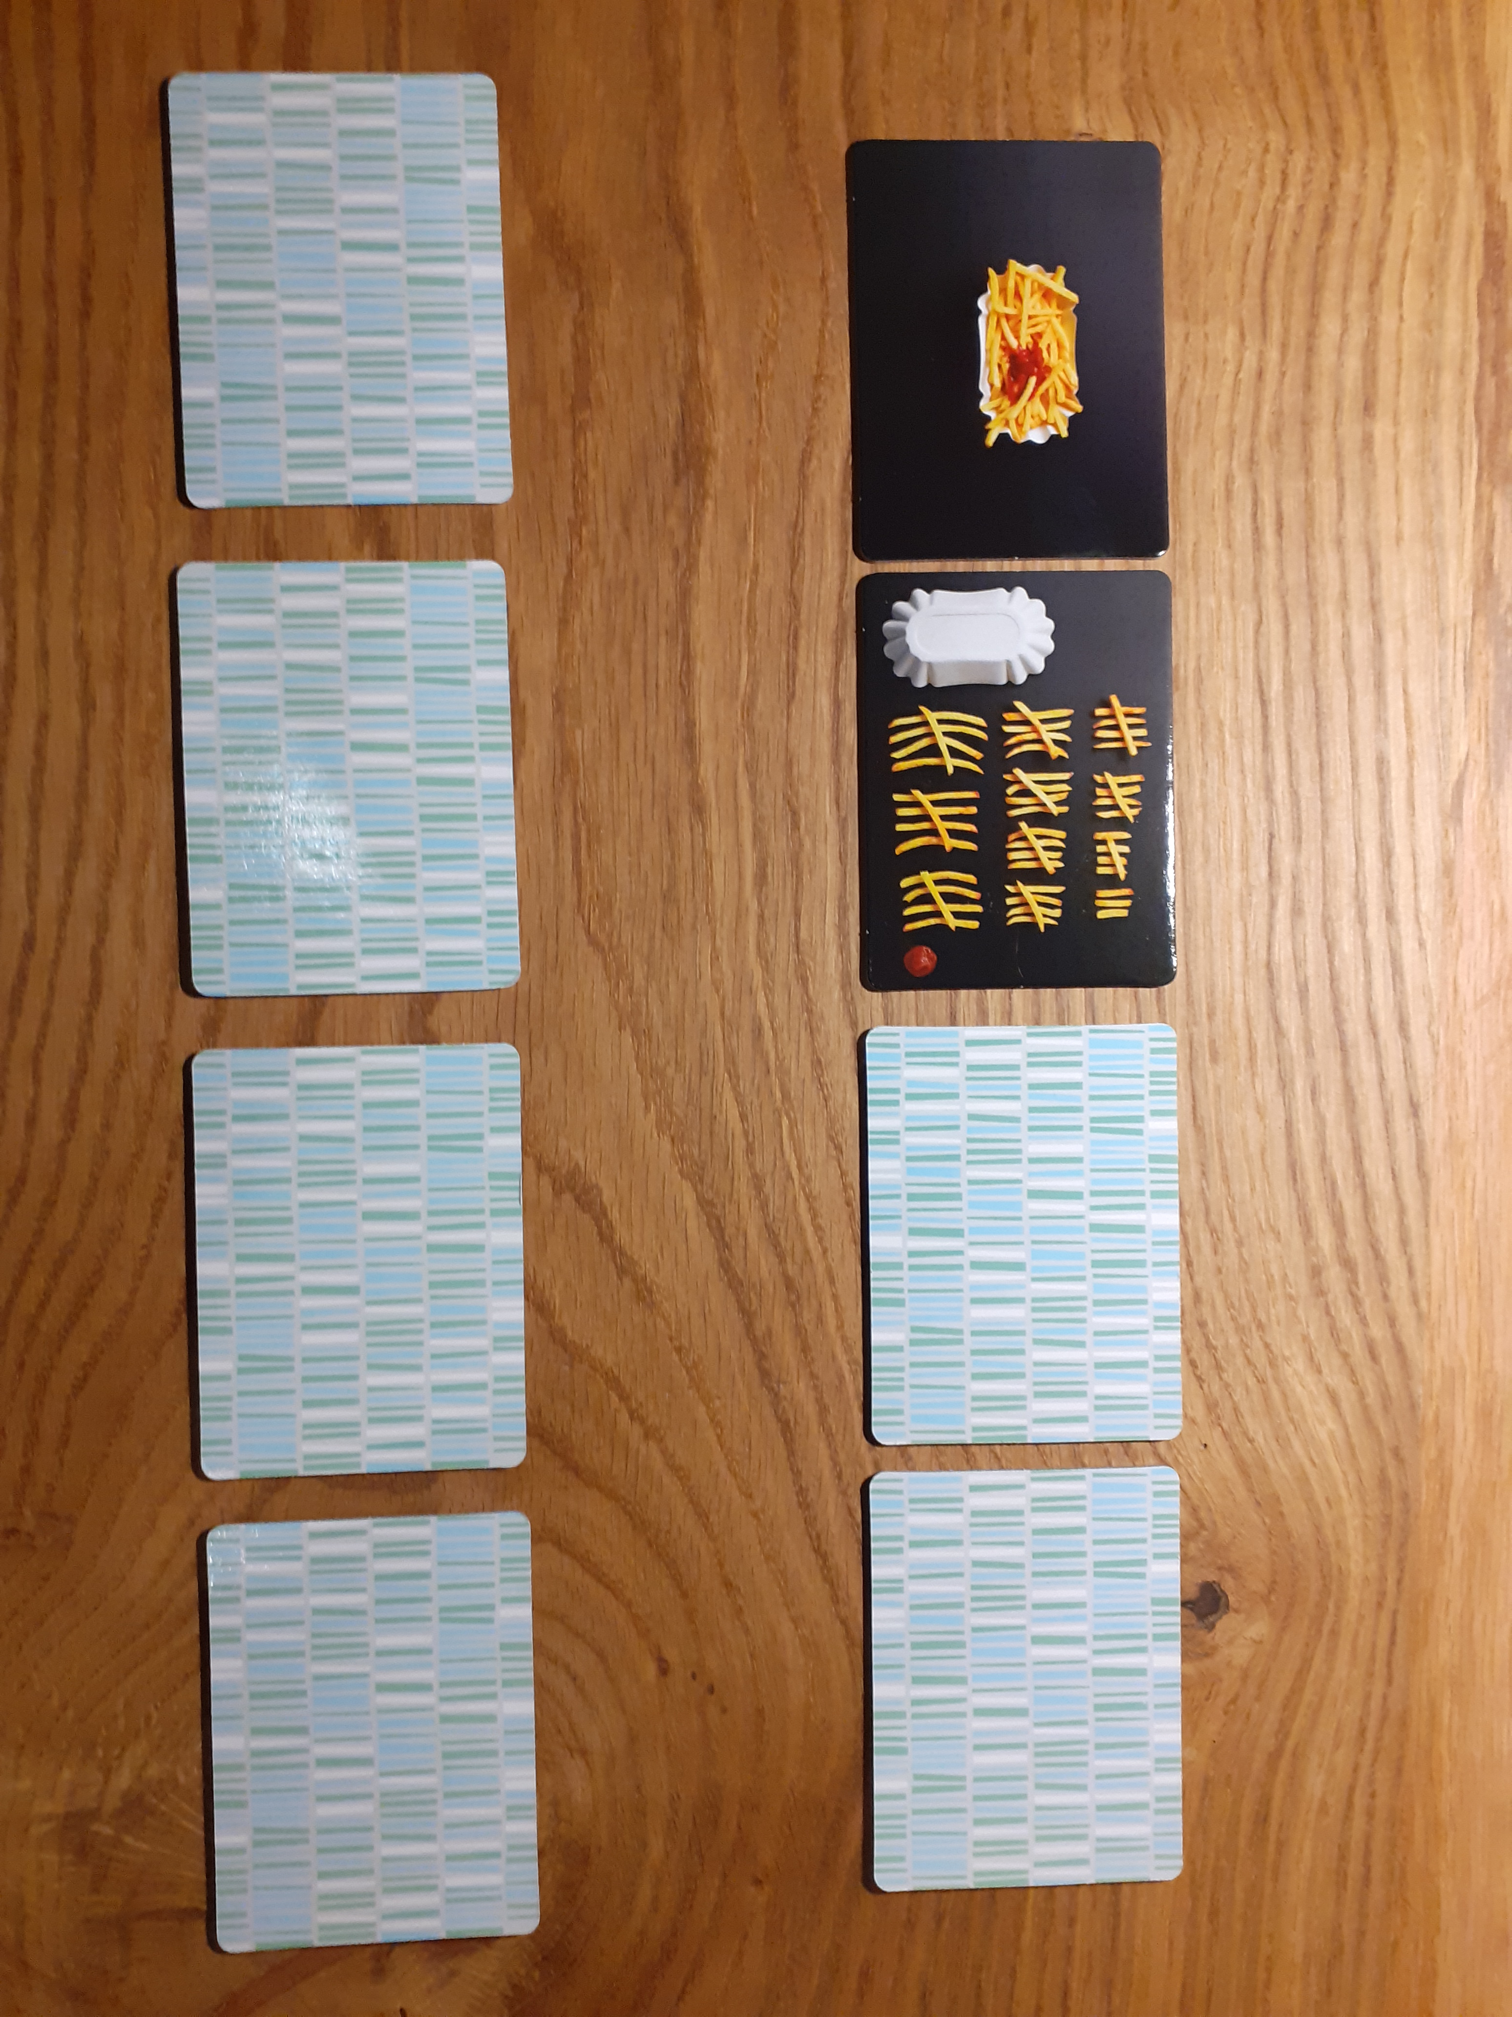
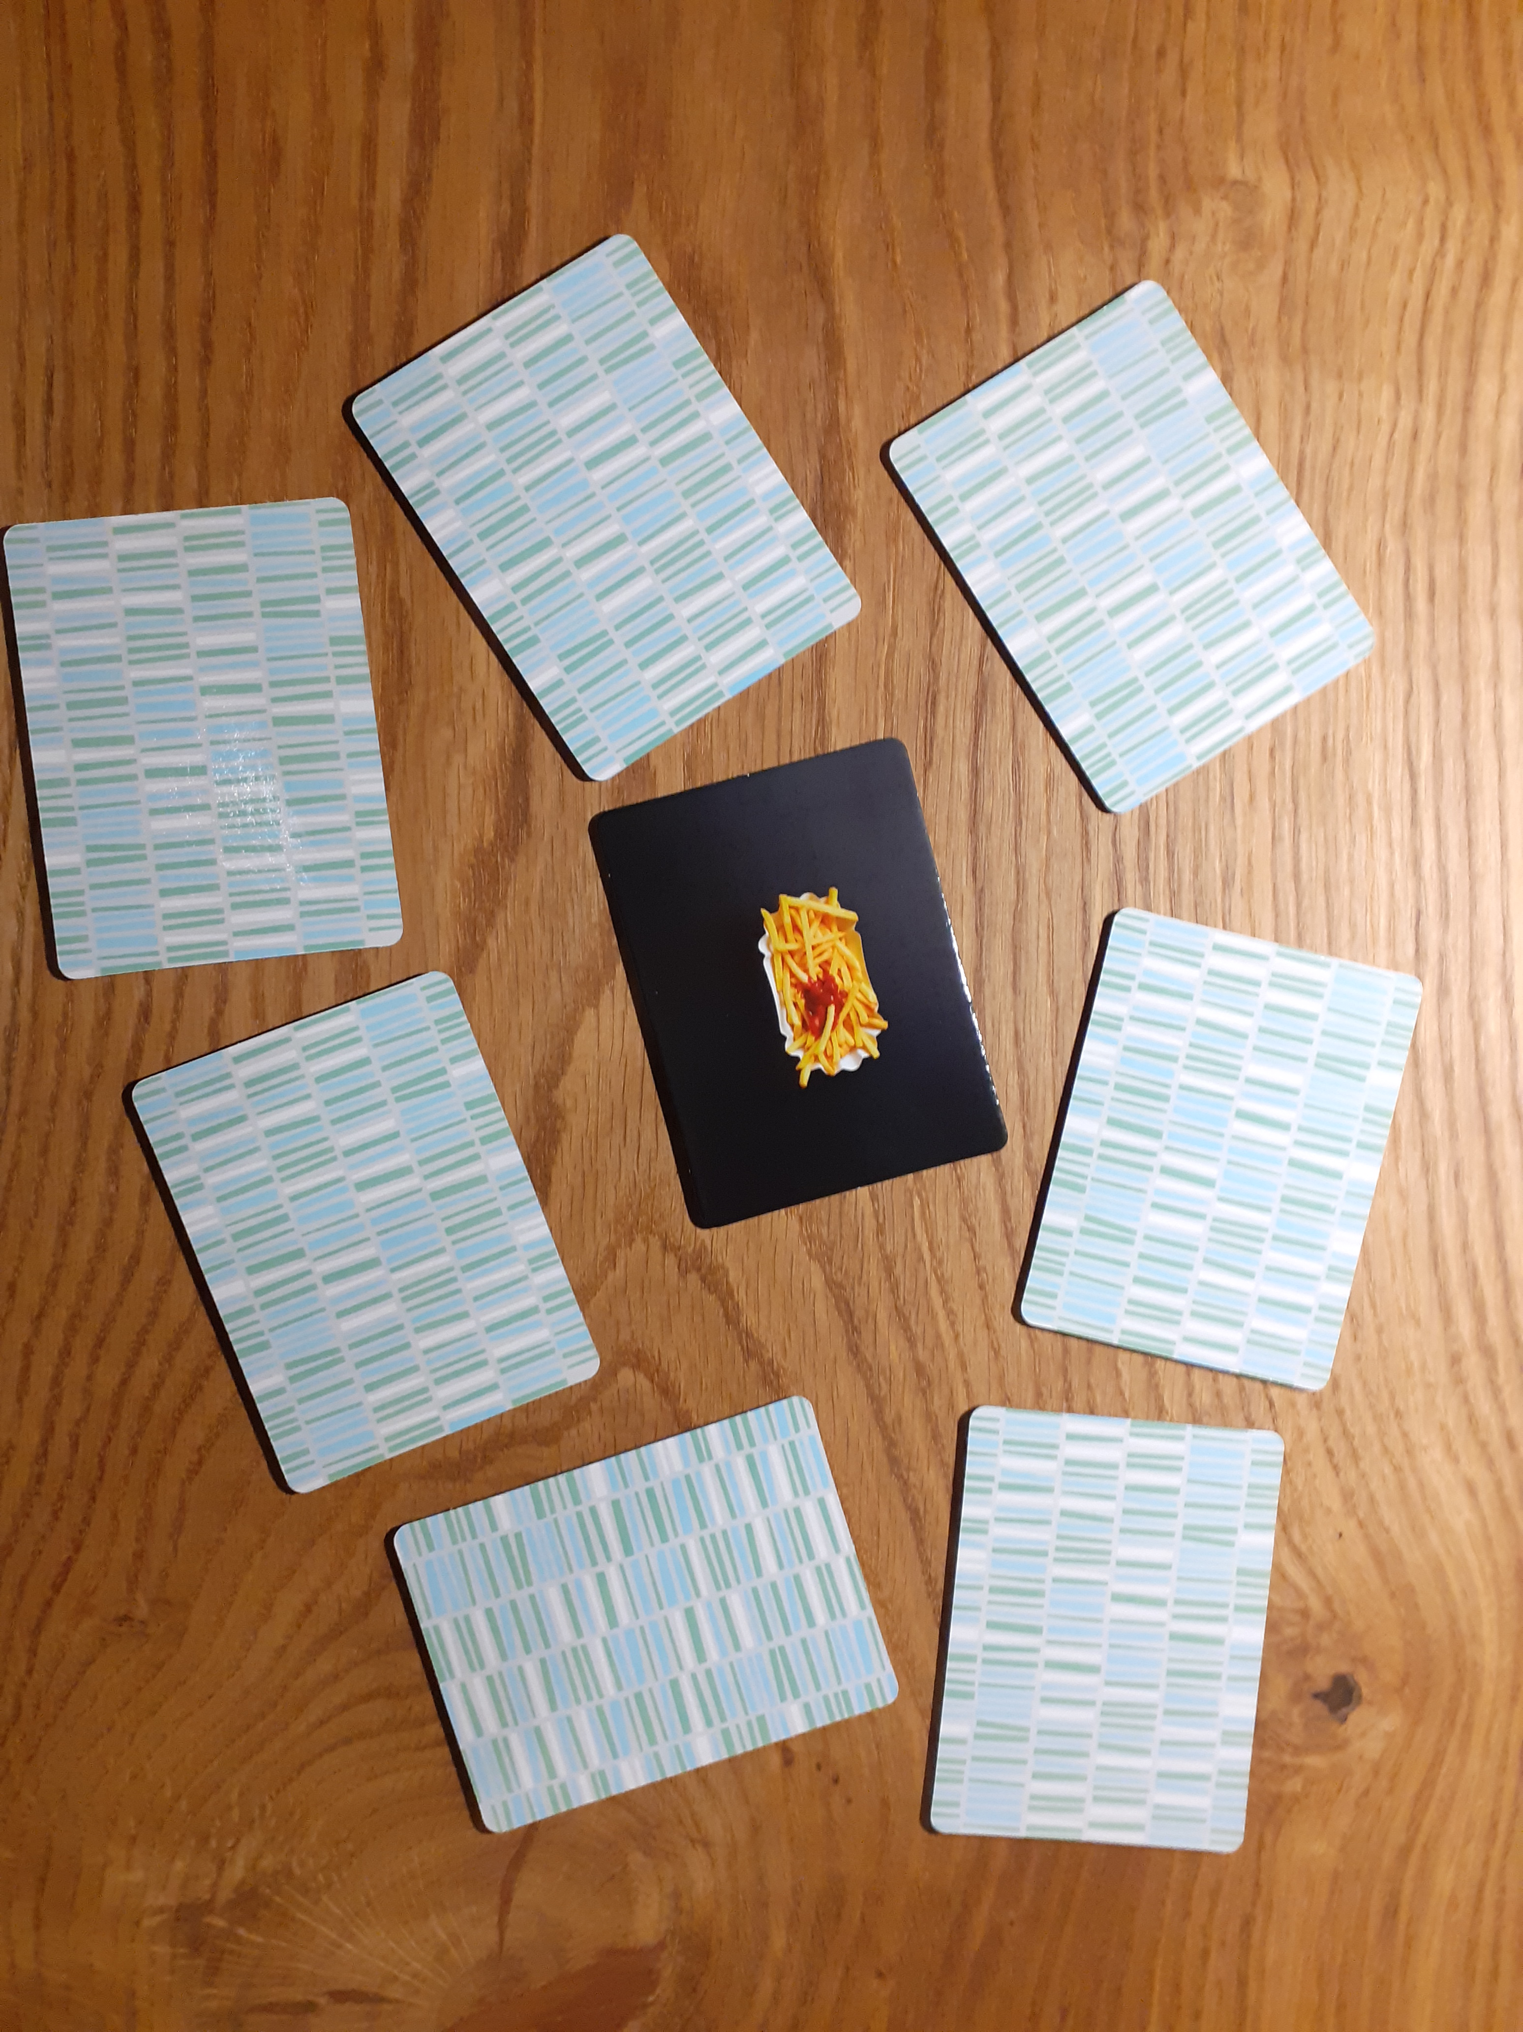

Slide 3
Why?
FAIR is a
Complex project.
Many people are involved in the project
Involved people are distributed over many countries
Very long lifetime of FAIR (> 30 years)
Significant fluctuations on involved people (getting retired, new job opportunities, changes due to private situations, ...)
Documentation is therefore essential
to know what is where
to have access to relevant data every time
to understand who made which decision
to keep know-how on site
to organize maintenance
* Source: CERN EDMS Team, adapted for FAIR

Slide 4
Identifier for technical Objects
Before the introduction of the PLM data model identifier made for a different purpose have been used to identify technical objects.
Those identifier are
good for their purpose
not good for lifecycle management
Requirements for PLM identifier
unique
1:1 mapping to technical objects
large enough number range (#)
constant over the life cycle (t)
global rules (§)
Identifier | Purpose | Mapping | # | t | §
PSP code | Shares/budget | m:n | ü | O | ü
Specification no. | Document (contract) | m:n | ü | ü | ü
Drawing no. | Drawing/model | 1:1 | ü | O | O
Device type | Multiple articles | 1:n | ü | ü | ü
Acc nomen | Controls address | 1:1 | O | O | ü
CDB Component* | = Device type + Acc nomen | 1:n | O | O | ü
Component (CID)* | Physical device | 1:1 | ü | ü | ü
Name | Org. unit internal solution | 1:1 | ü | O | O
* A component (CID) is called asset in the CDB

Slide 5
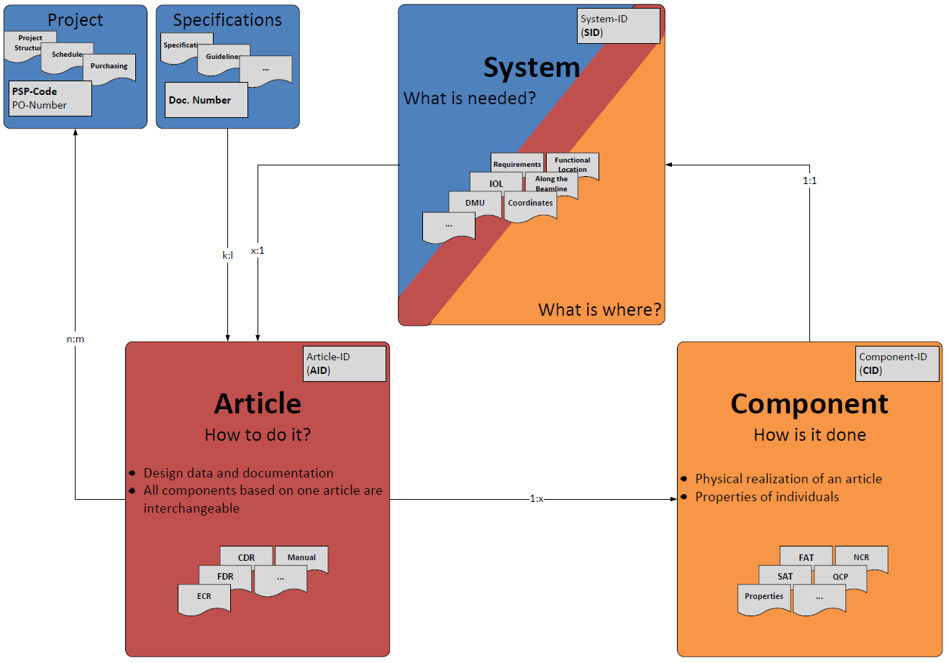
PLM Concept Data Model

Slide 6
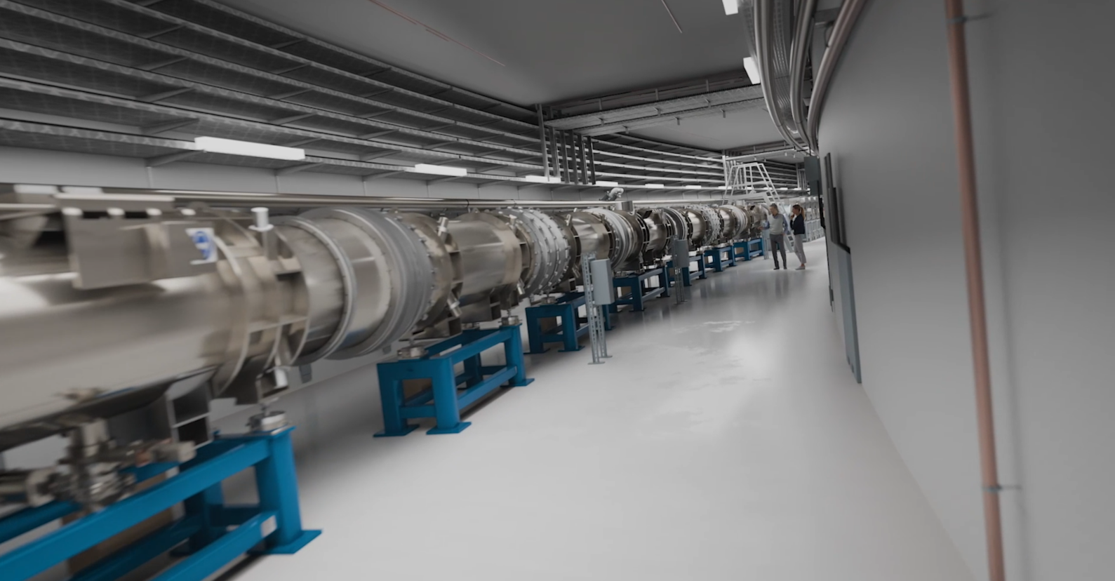
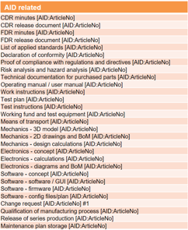
PLM Concept Planning, Design
AID:0002558 SIS100 Dipole Bellow E13.200
AID:0000029 SIS100 Dipole Assembly Dip
AID:0000325 SIS100 Dipole Di
AID:0000381 SIS100 Elliptic dipole chamber
AID:0000363 SIS100 DP-DP Interconnection Tee
AID:0000089 SIS100 Cryosorption Pump
AID:0002559 SIS100 Dipole Bellow E13.350
F.1S.1S36.0030
F.1S.1S37.0010
F.1S.1S37.0020

Slide 7
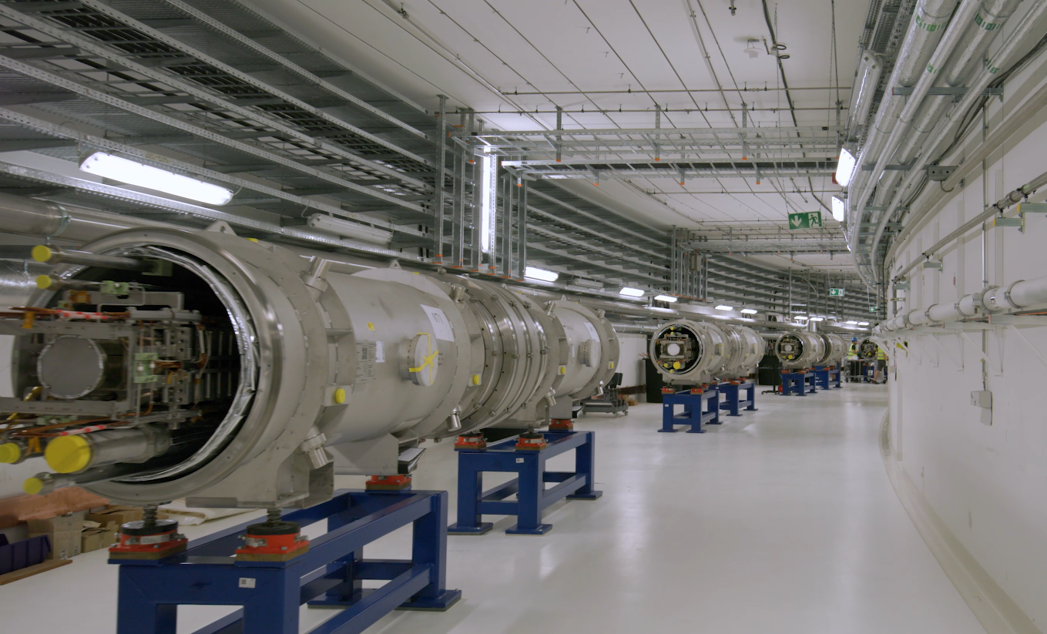
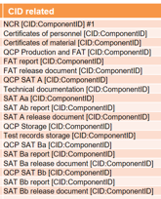
PLM Concept Production, Installation, …
CID:02000250188 AID:0002558 SIS100 Dipole Bellow E13.200
CID:02000260316 AID:0000029 SIS100 Dipole Assembly Dip
CID:02000010317 AID:0000325 SIS100 Dipole Di
CID:07000005103 AID:0000089 SIS100 Cryosorption Pump
CID:07000061093 AID:0000381 SIS100 Elliptic dipole chamber
CID:07000120479 AID:0000363 SIS100 DP-DP Interconnection Tee
CID:02000251048 AID:0002559 SIS100 Dipole Bellow E13.350
F.1S.1S36.0030
F.1S.1S37.0010
F.1S.1S37.0020

Slide 8
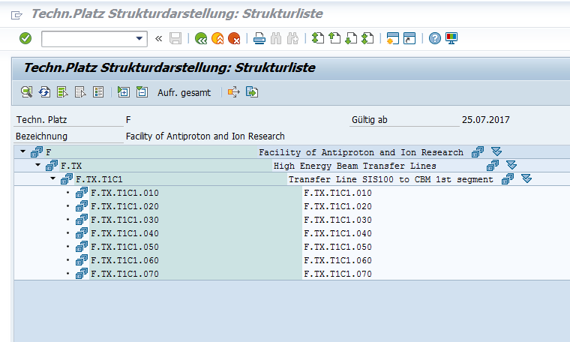
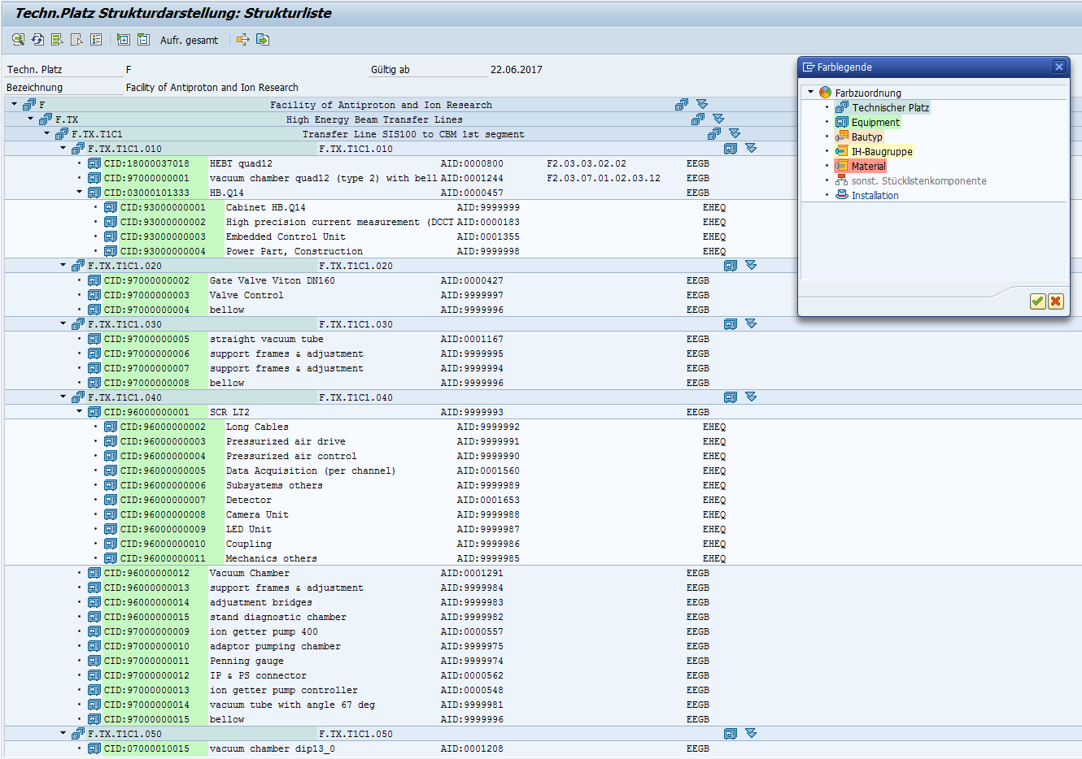
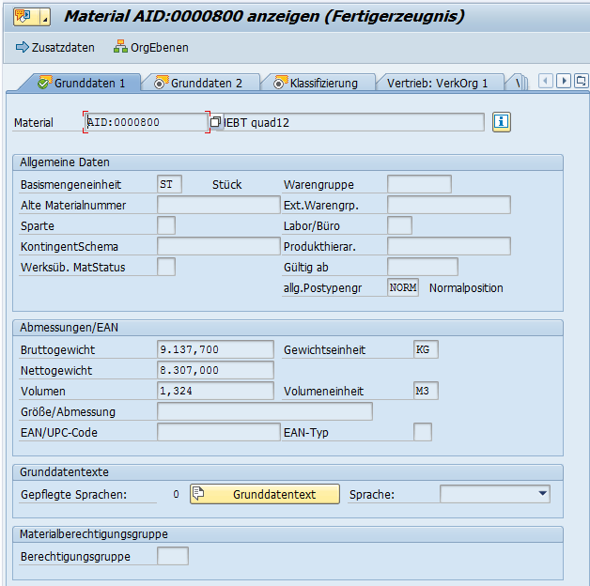
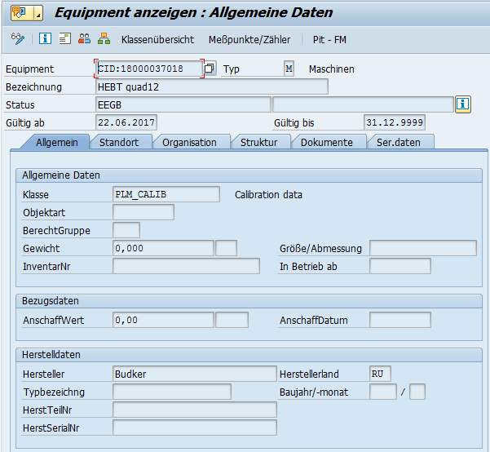
PLM Realization Translation to SAP
Planning:
Functional Location
BoM Functional Location
Installation, Operation, Maintenance
Functional Location
Equipment
Procurement, Design:
Material
Production, Shipment, Storage
Equipment

Slide 9
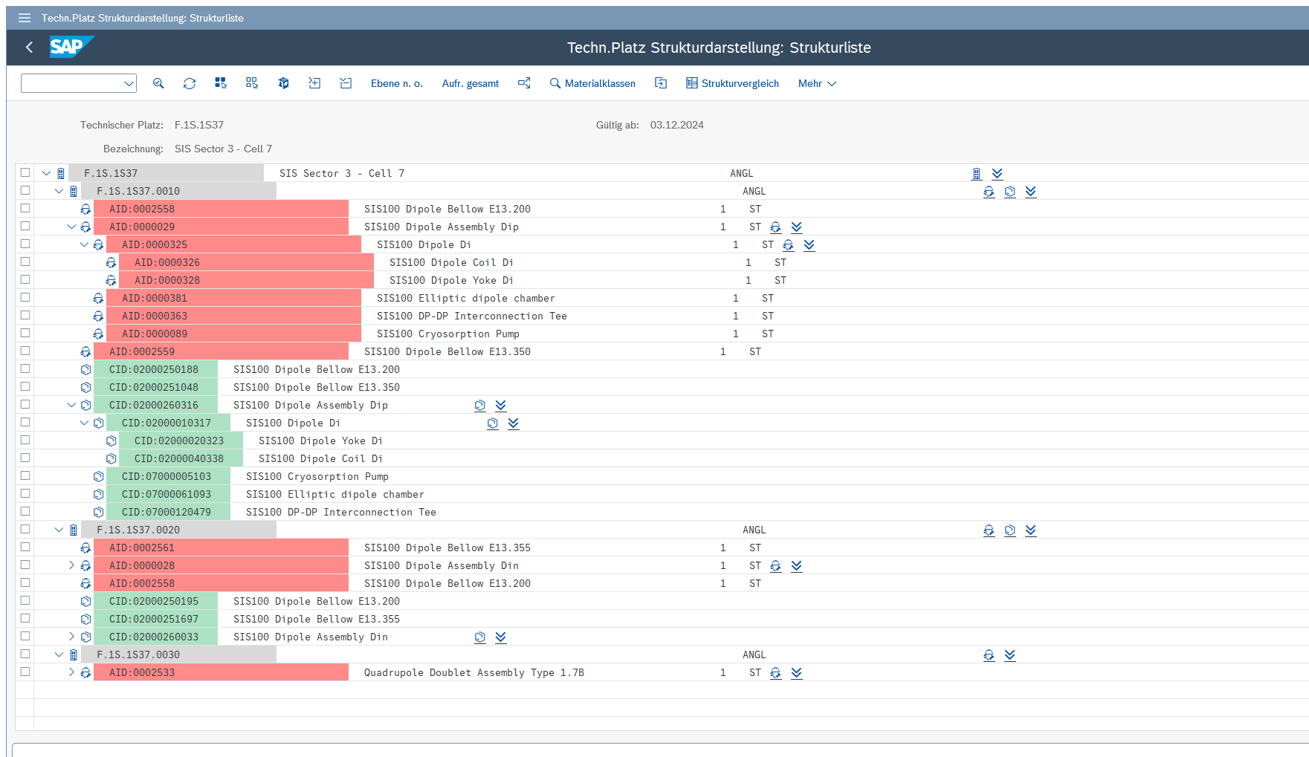
PLM Realization Fuctional Locations w/ AID & CID

Slide 10
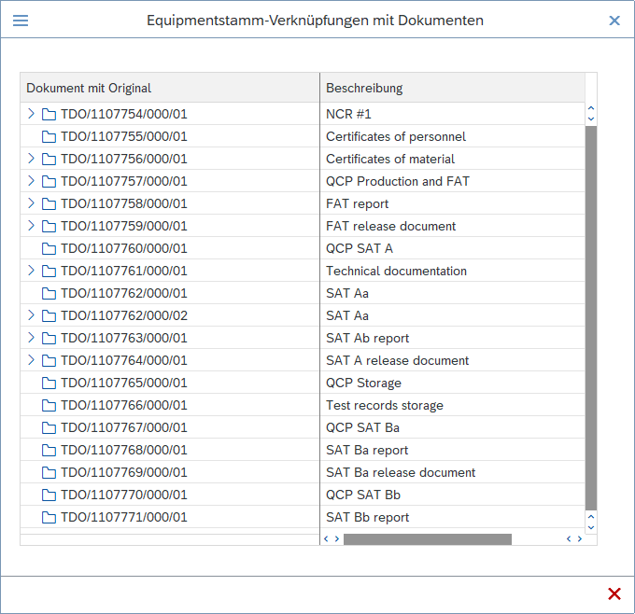
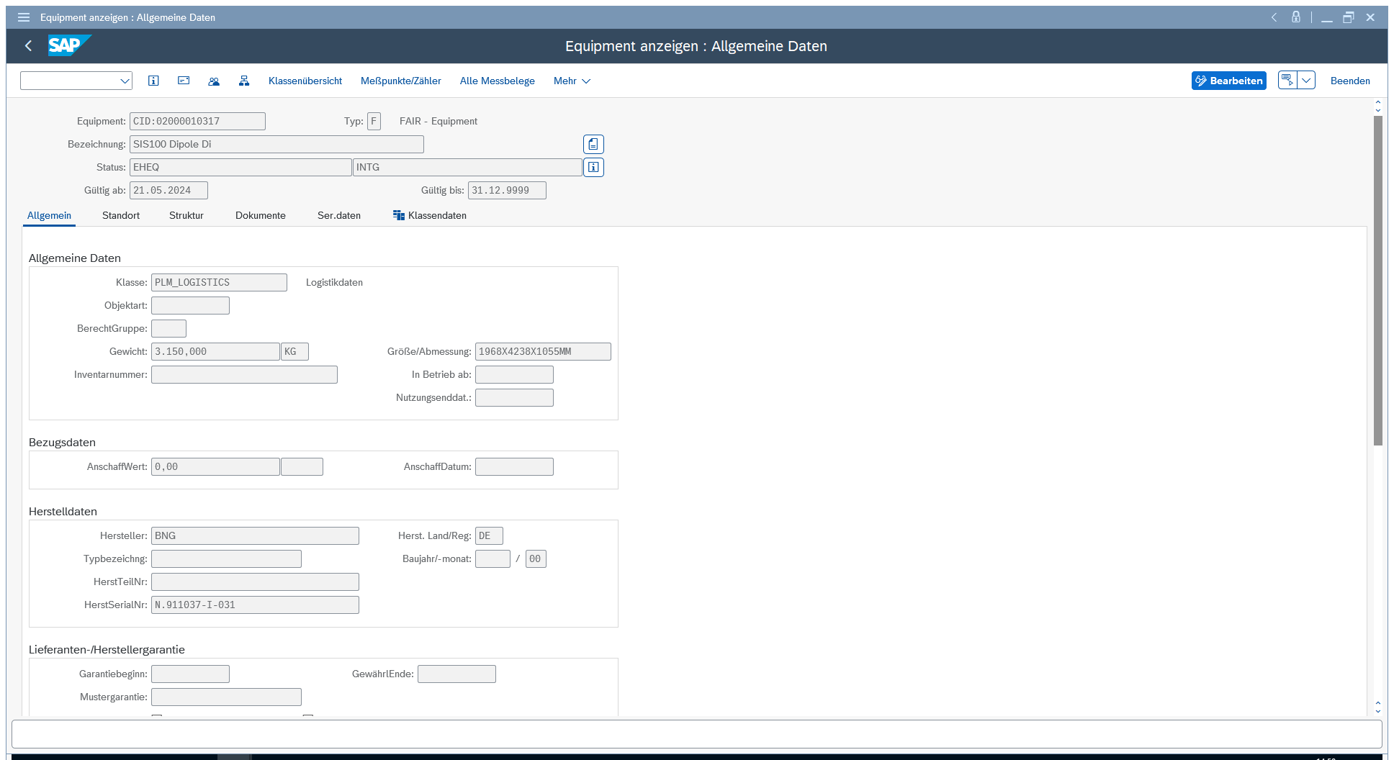
PLM Realization Components - Documents & History

Slide 11
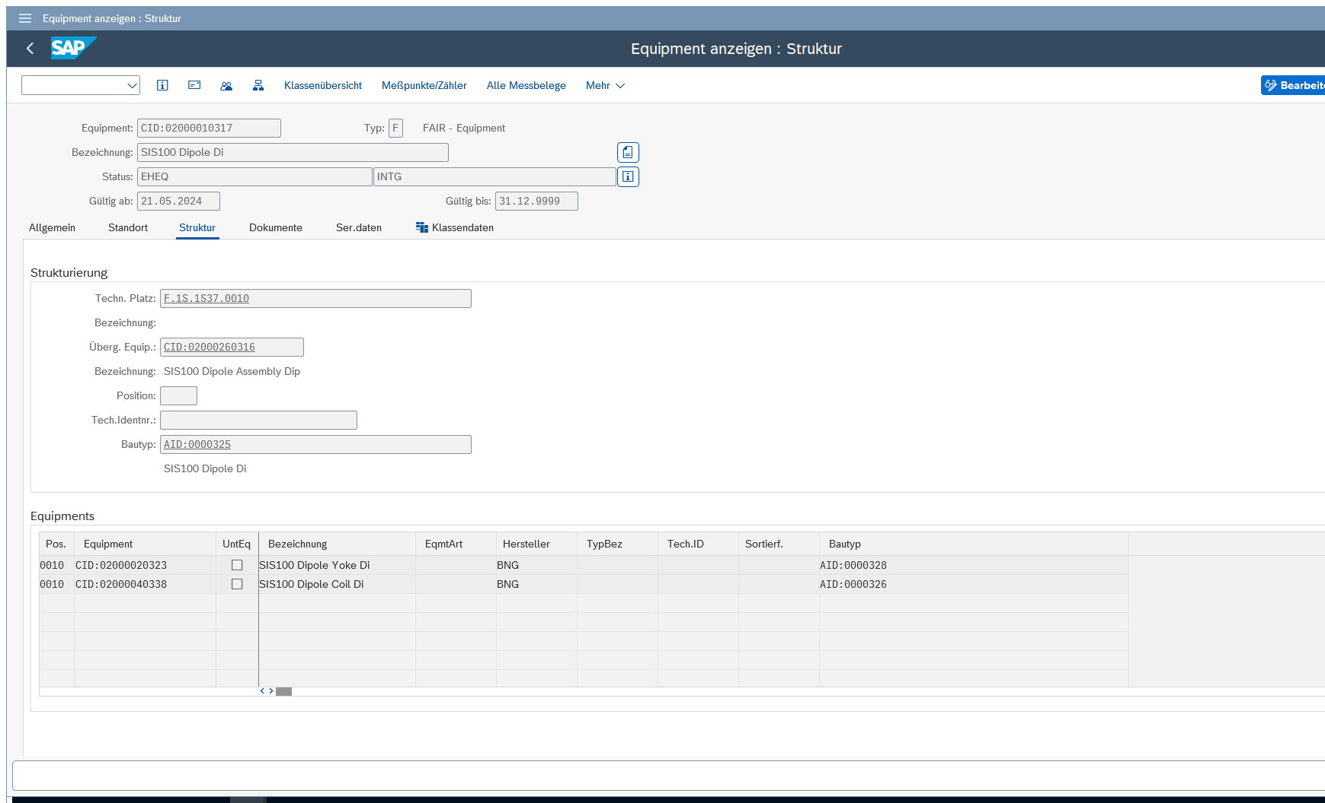
PLM Realization Components - Structure & Attributes

Slide 12
Summary
Documentation is essential for efficient and successful operation/maintenance of the facility. The long lifecycle time of > 30y amplifies this argument!
The PLM concept follows the approaches in other accelerator facilities, industries, and text books.
Main objects are System (Functional Location), Article (Material), Component (Equipment).
FAIR/GSI wide standards are set/used.
At FAIR/GSI SAP in standard configuration is used.
The PLM concept is successfully established for all phases up to installation. Roll-out for following phases in due time.

Slide 13
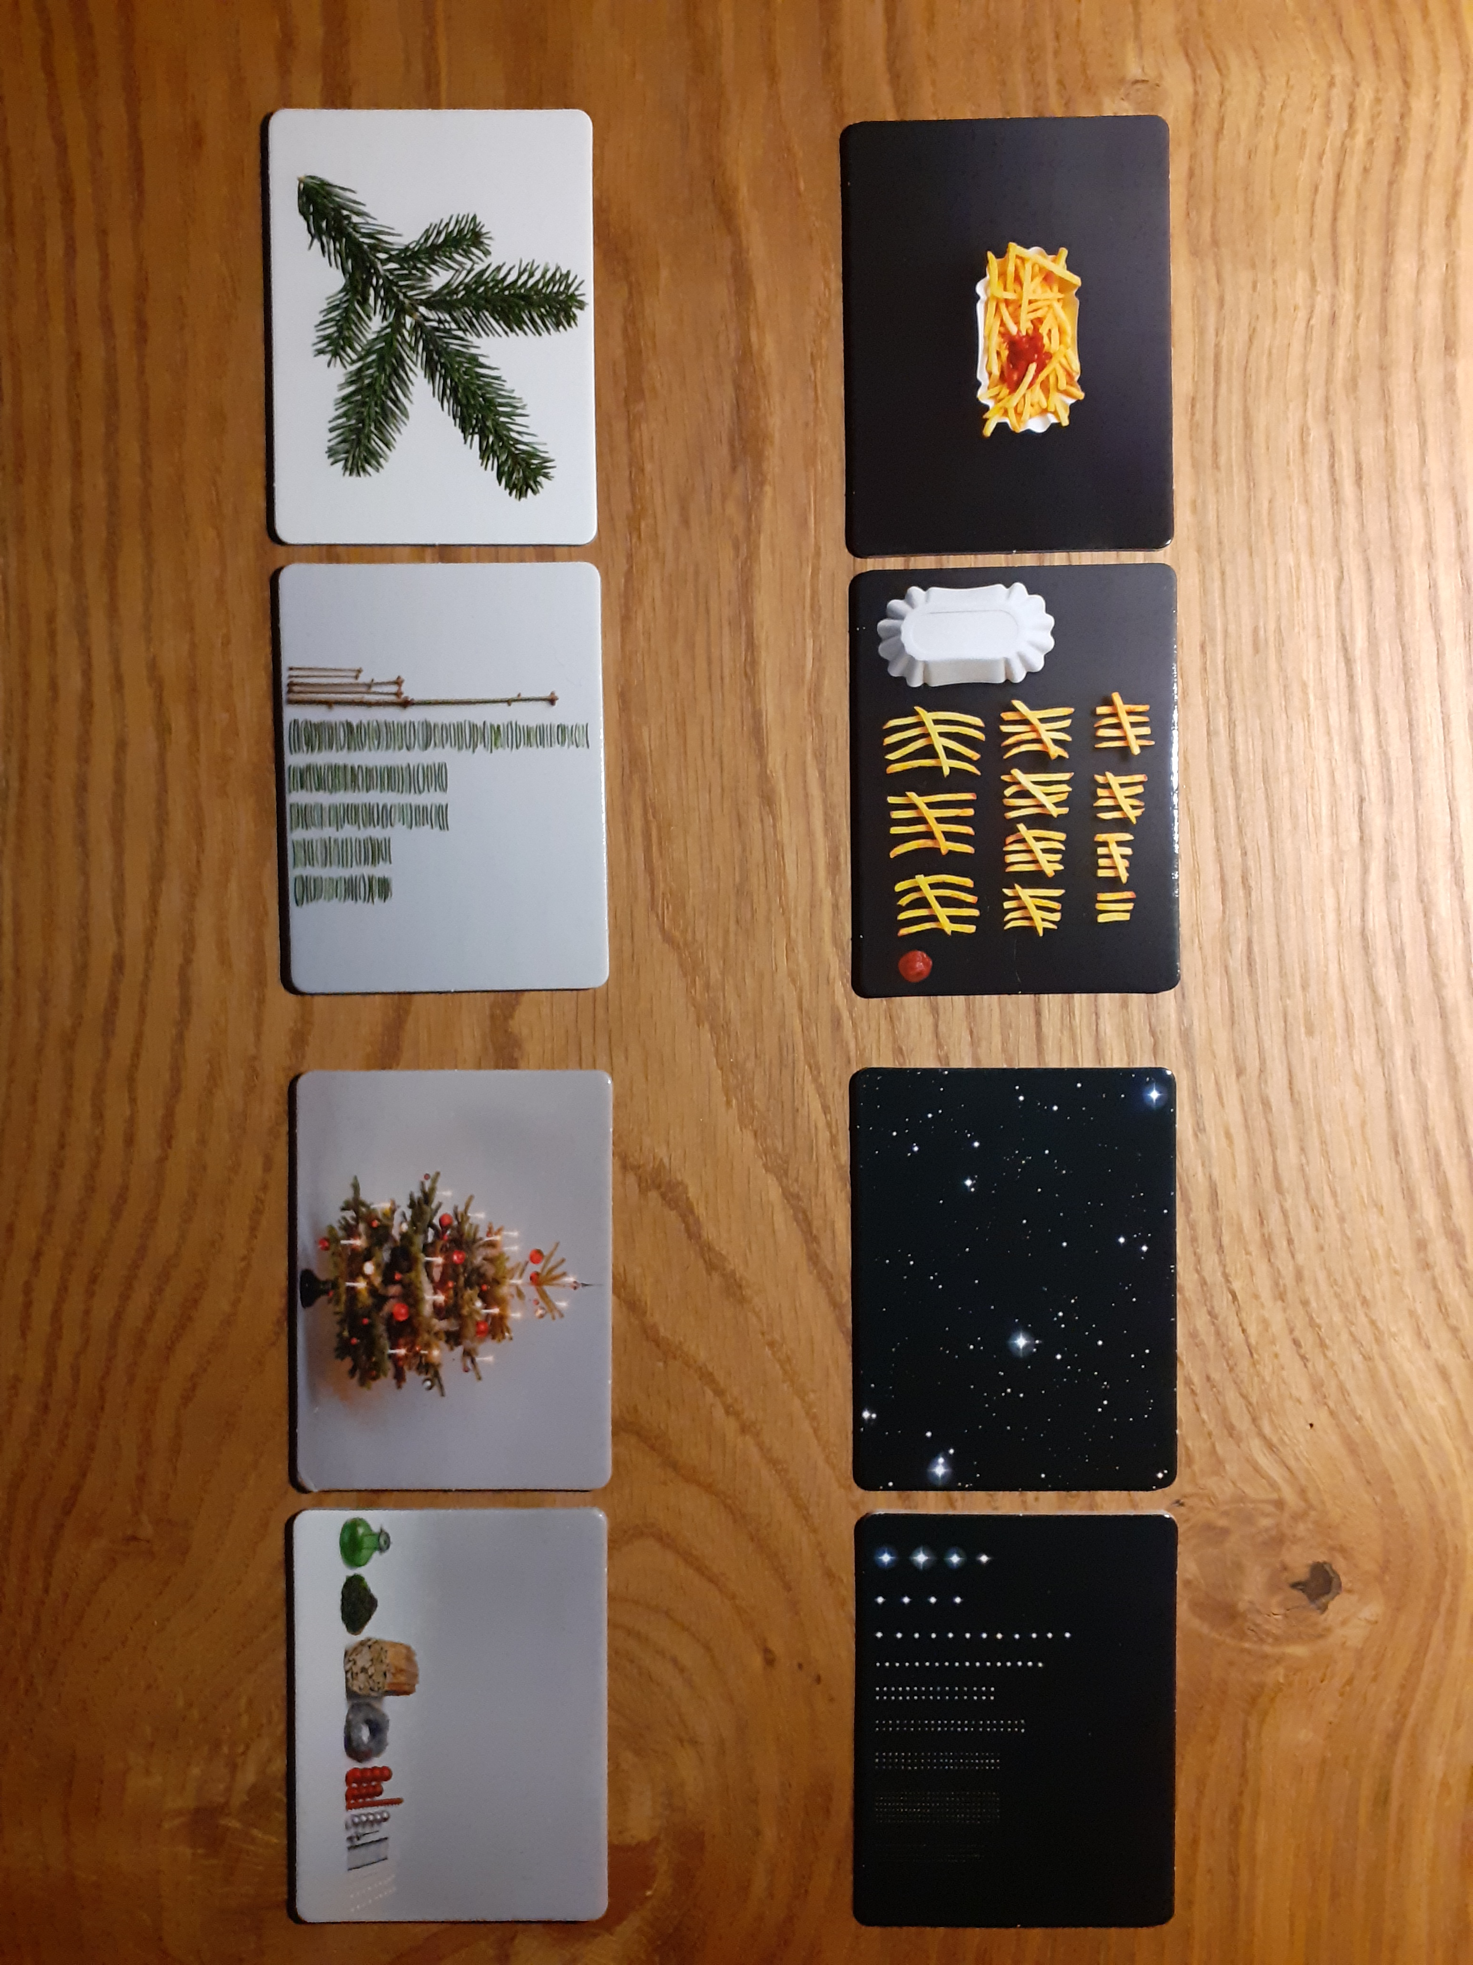
Thank you for your attention
and have a peaceful
Advent and Christmas season!

Slide 14
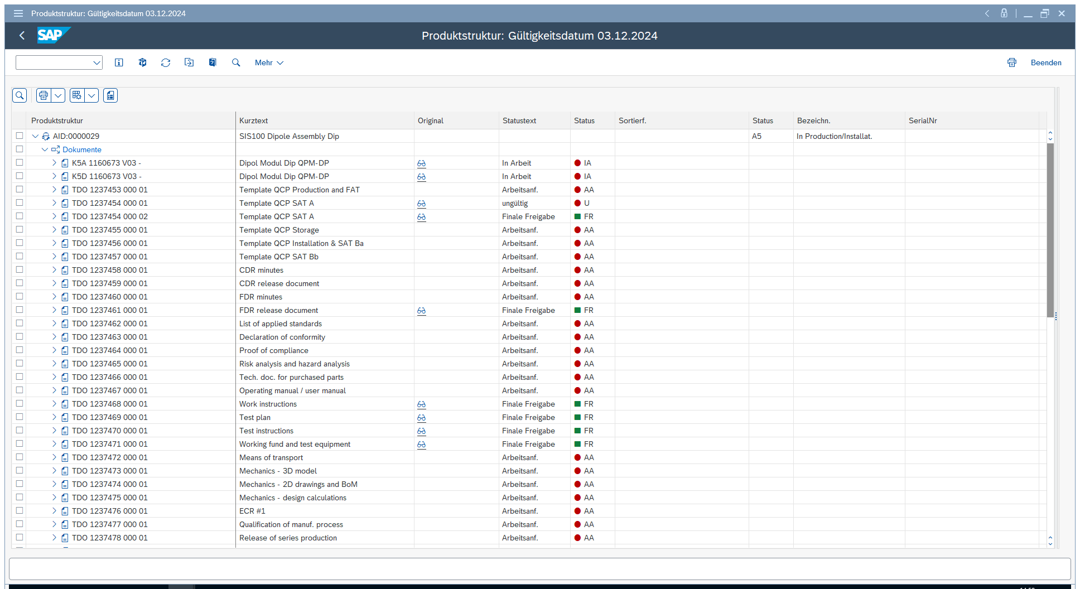
PLM Realization Product Structure Browser - AID & Docs

Slide 15
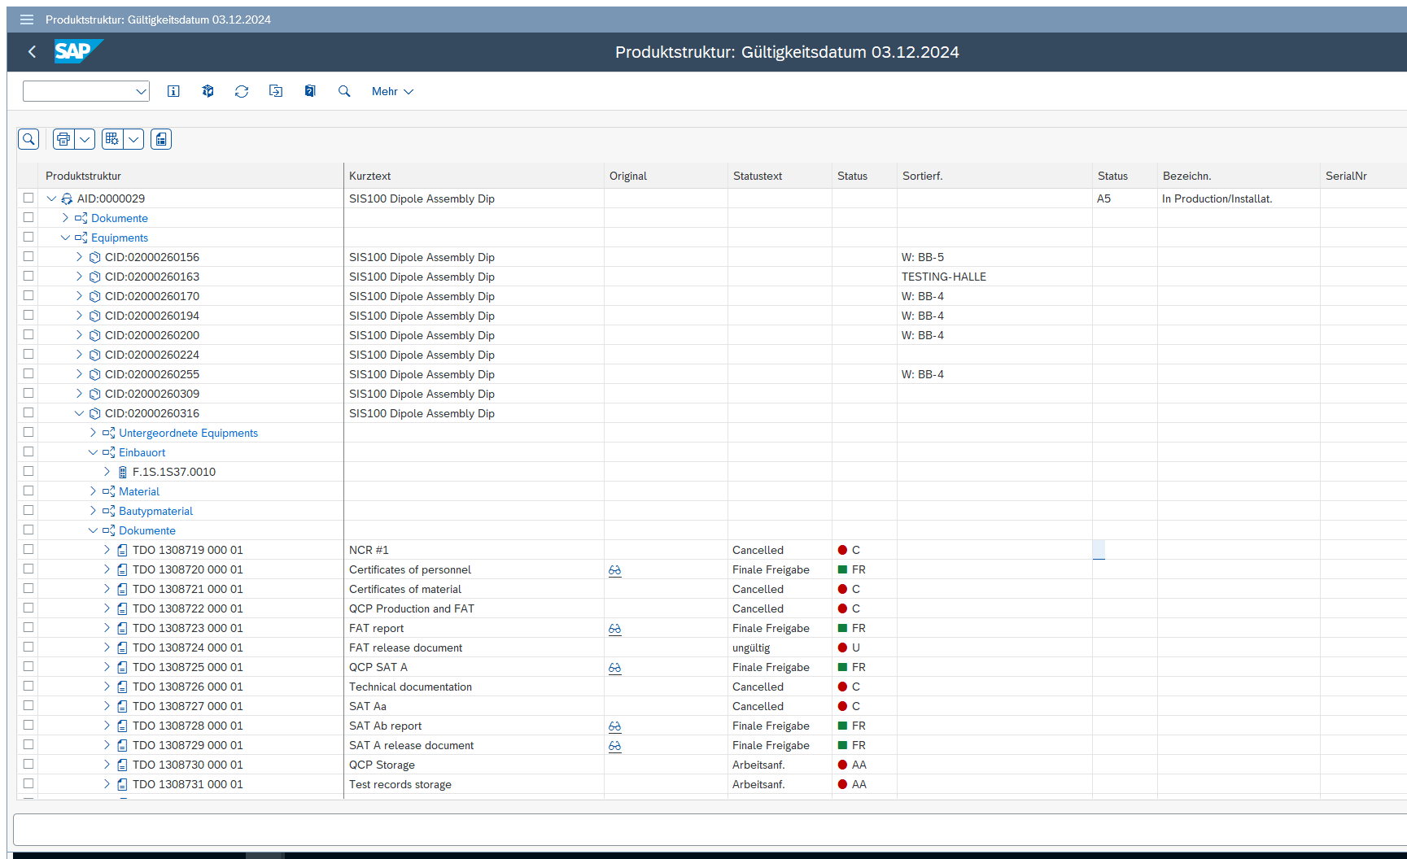
PLM Realization Product Structure Browser - AID, CID, Docs

Slide 16
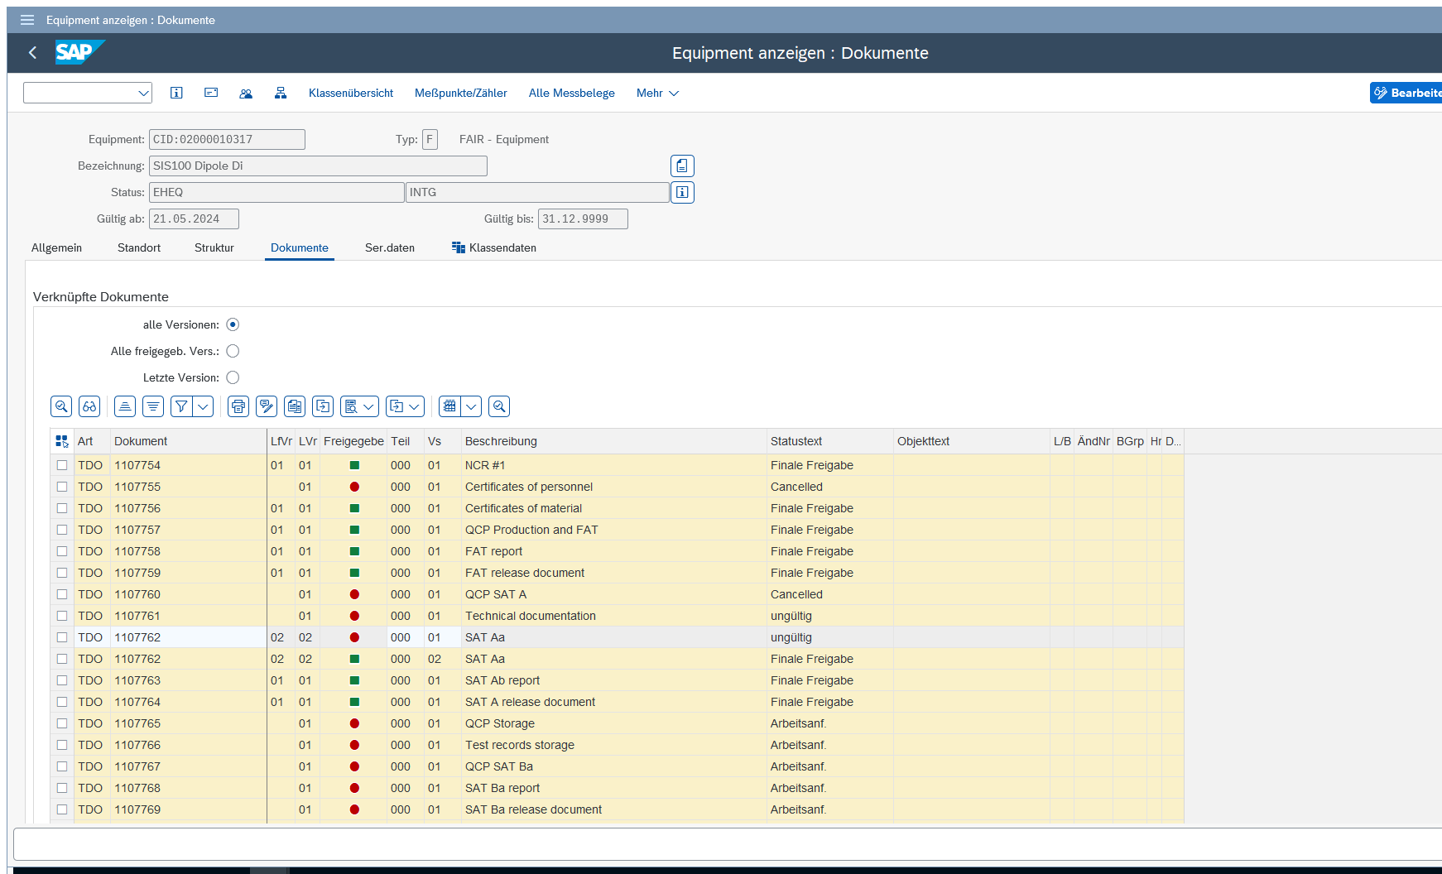
PLM Realization Components - Documentation

Slide 17
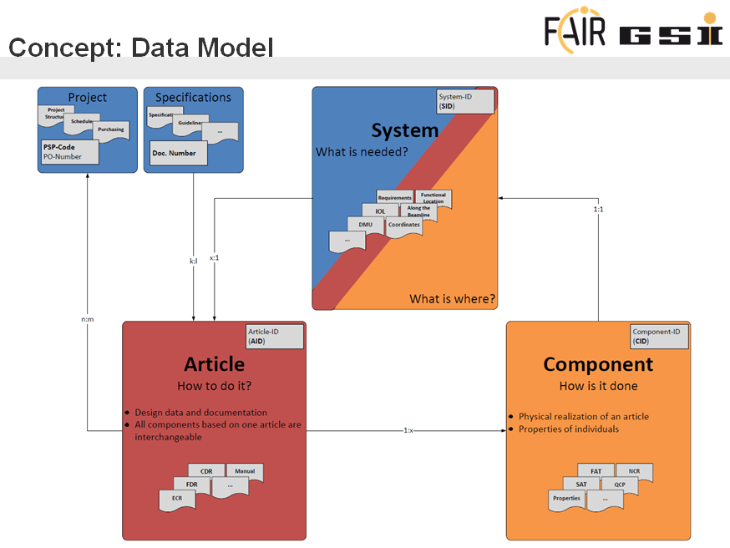
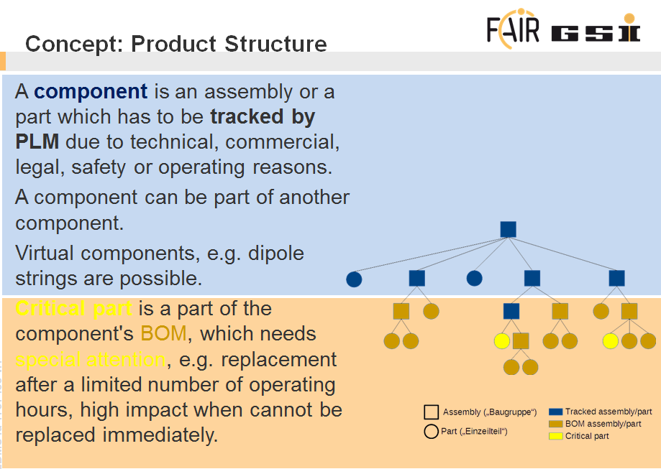
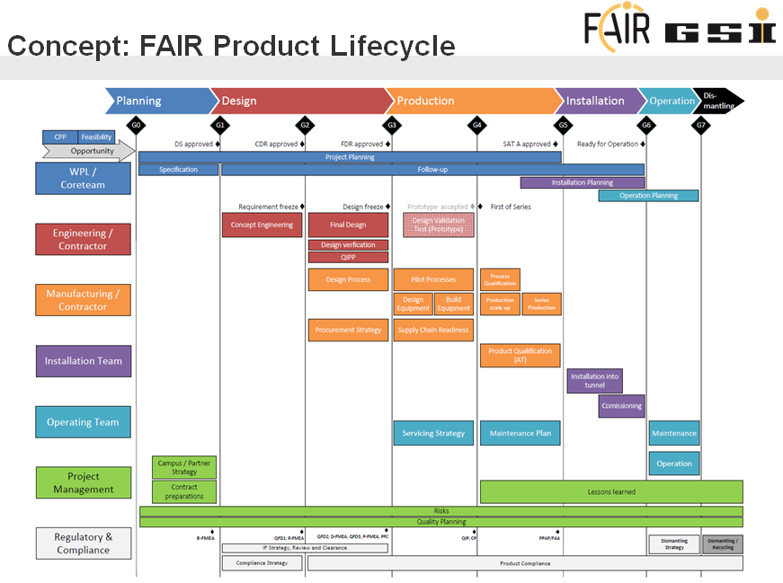
FAIR/GSI PLM Concept
Standard Data Model
The system describes the facility. It answers the questions
Where is what?
What is connected to what?
Article describes the design/common data of a set of identical components
A component is one (of multiple) physical realizations of an article.
Standard Product Structure
Consisting of assemblies, sub-assemblies and parts
Level can vary according to particular needs, with a reasonable, individual cut-off
All information below cut-off is part of component‘s documentation
Standard Product Lifecycle
Phases
Planning
Design
Production
Installation
Operation
Dismantling
Dedicated gates
Responsibilities can vary over the lifecycle
Lifecycle > 40y

Slide 18
FAIR/GSI PLM Concept
GF-Entscheidungen zu Product Lifecyclemanagement
Die GF stimmt der stufenweisen Einführung eines Product Lifecyclemanagements zu […] (GSI GF-Runde 14.10.2014)
Beauftragung des PLM-Teams Product Lifecyclemenatement für FAIR und GSI zu implementieren (FAIR/GSI GF Runde 24.06.2016)
Die GF bestätigt den vom PLM-Team gemachten Vorschlag für das PLM Konzept (Entscheidungsvorlage 16.12.2016)
The Management Board approves the choice of SAP for the PLM pilot (FAIR/GSI GF-Runde 16.03.2017)
The Management Board approves the implementation of the PLM system (FAIR/GSI GF-Runde 13.10.2017)
Standard Data Model
The system describes the facility. It answers the questions
Where is what?
What is connected to what?
Article describes the design/common data of a set of identical components
A component is one (of multiple) physical realizations of an article.
Standard Product Structure
Consisting of assemblies, sub-assemblies and parts
Level can vary according to particular needs, with a reasonable, individual cut-off
All information below cut-off is part of component‘s documentation
Standard Product Lifecycle
Phases
Planning
Design
Production
Installation
Operation
Dismantling
Dedicated gates
Responsibilities can vary over the lifecycle
Lifecycle > 40y

