Slide 1
RBAC @ GSI
Current State & Outlook

Slide 2
What is RBAC
RBAC : Role-Based Access Control
CERNs developed solution for providing a sufficient level of device access security
Fully integrated into the CMW RDA library
Originally deployed at LHC, but used widely nowadays
Motivation behind RBAC *:
Protects against human mistakes
A well meaning person from doing wrong thing at the wrong time
An ignorant person from doing anything at anytime
Can be deployed anywhere in the Controls Infrastructure
Aims to enhance the overall Machine Safety
Provides Authentication (A1) and Authorization (A2) services
Does not prevent hackers from doing damage
* taken from CERN Presentation slides

Slide 3
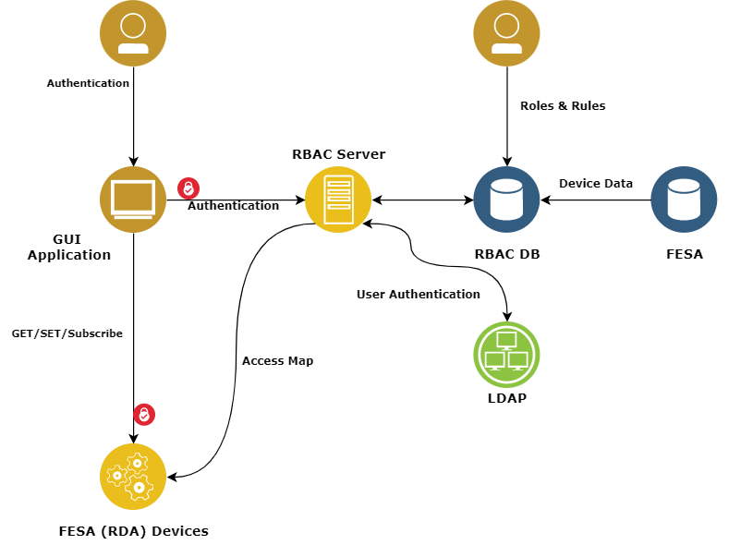
Architecture
Authentication
User can be authenticated with password or location
RBAC Server returns a token containing a list of associated roles
Authorization:
Application sends token to CMW (FESA) when connecting
FESA verifies token signature once and uses the credentials for every subsequent request
CMW checks access map to authorize a request

Slide 4
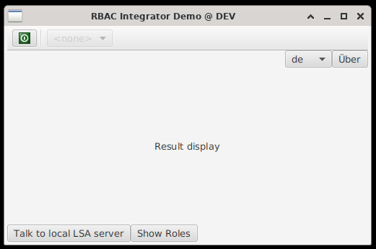
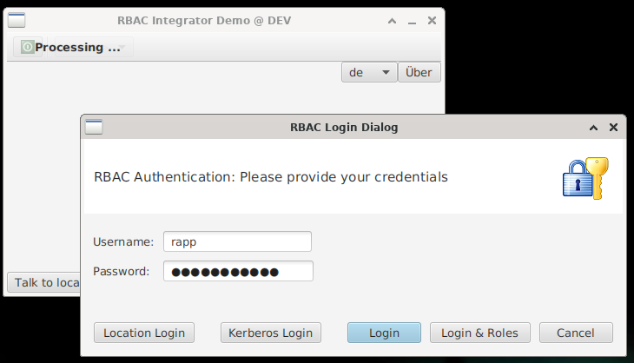
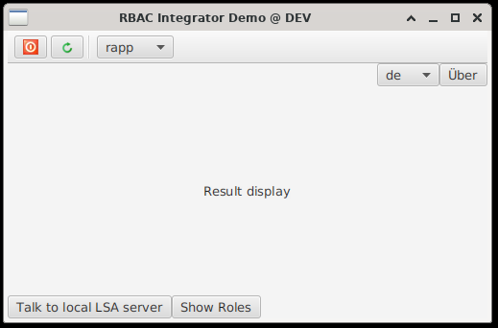
User Perspective

Slide 5
Components and state @ GSI
Database
Database is available but, mostly, empty
Will be filled gradually when use-cases are defined
Server
Source code adopted for GSI and is up and running
Connects to ACC LDAP
Controls Account required for personal authentication
Client
JAVA and C++ clients are available at GSI
Will be integrated into new FESA and YOCTO based devices
Summary
Technically RBAC components are available and can be used
First simple Use-Cases are in elaboration

Slide 6
Next Steps
Definition of a basic Roles and Rule Concept for the operation (ongoing)
Can and will be refined in the future
Input from Operations group is required
Step-by-Step integration into the operation
Understanding the actual GSI needs and use cases
Identify and address technical shortcomings
Refining of the Rule concept
Definition of responsibilities
etc.

Slide 7
Questions ?

