Slide 1
SIS18 - IPM
FESA - Software

Slide 2
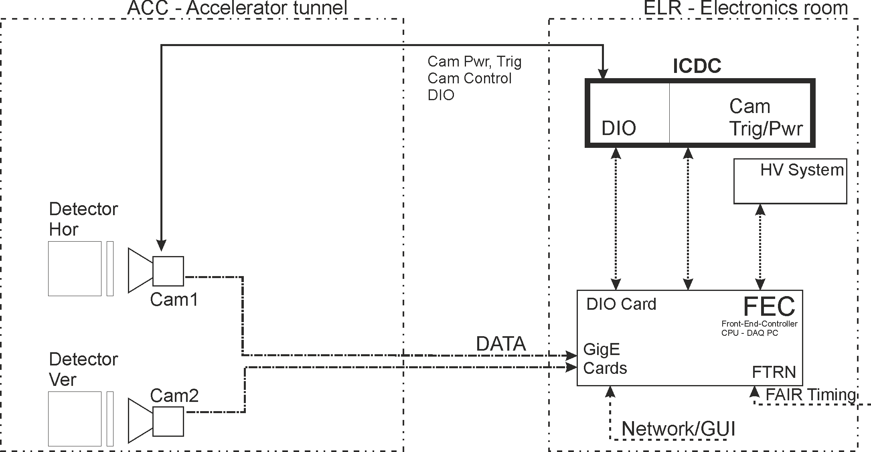
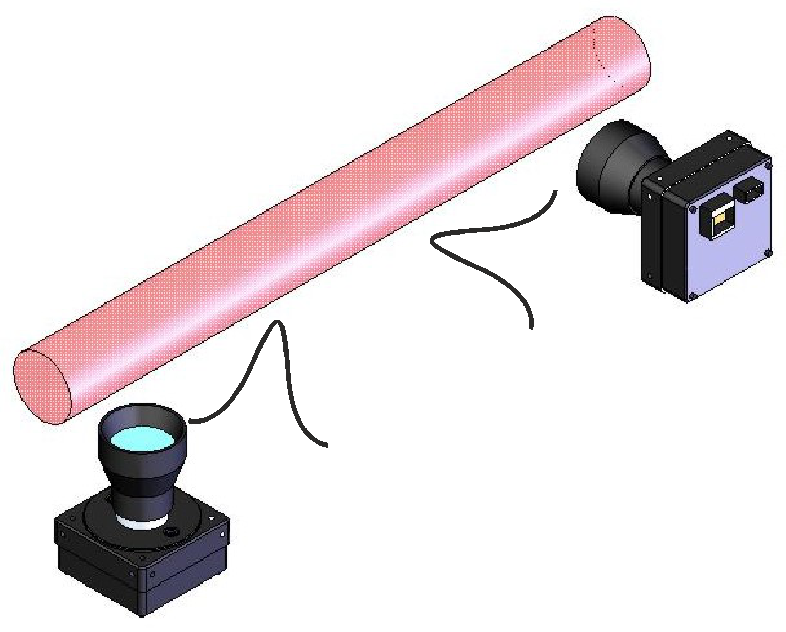
IPM - SIS18 - Control Overview
Ionization
IPM Detector
Camera
Start/Stop automated by
Ma #Ev - FAIR Timing
PC
Cam Control
FTRN
HV
Profiles
hor / ver

Slide 3
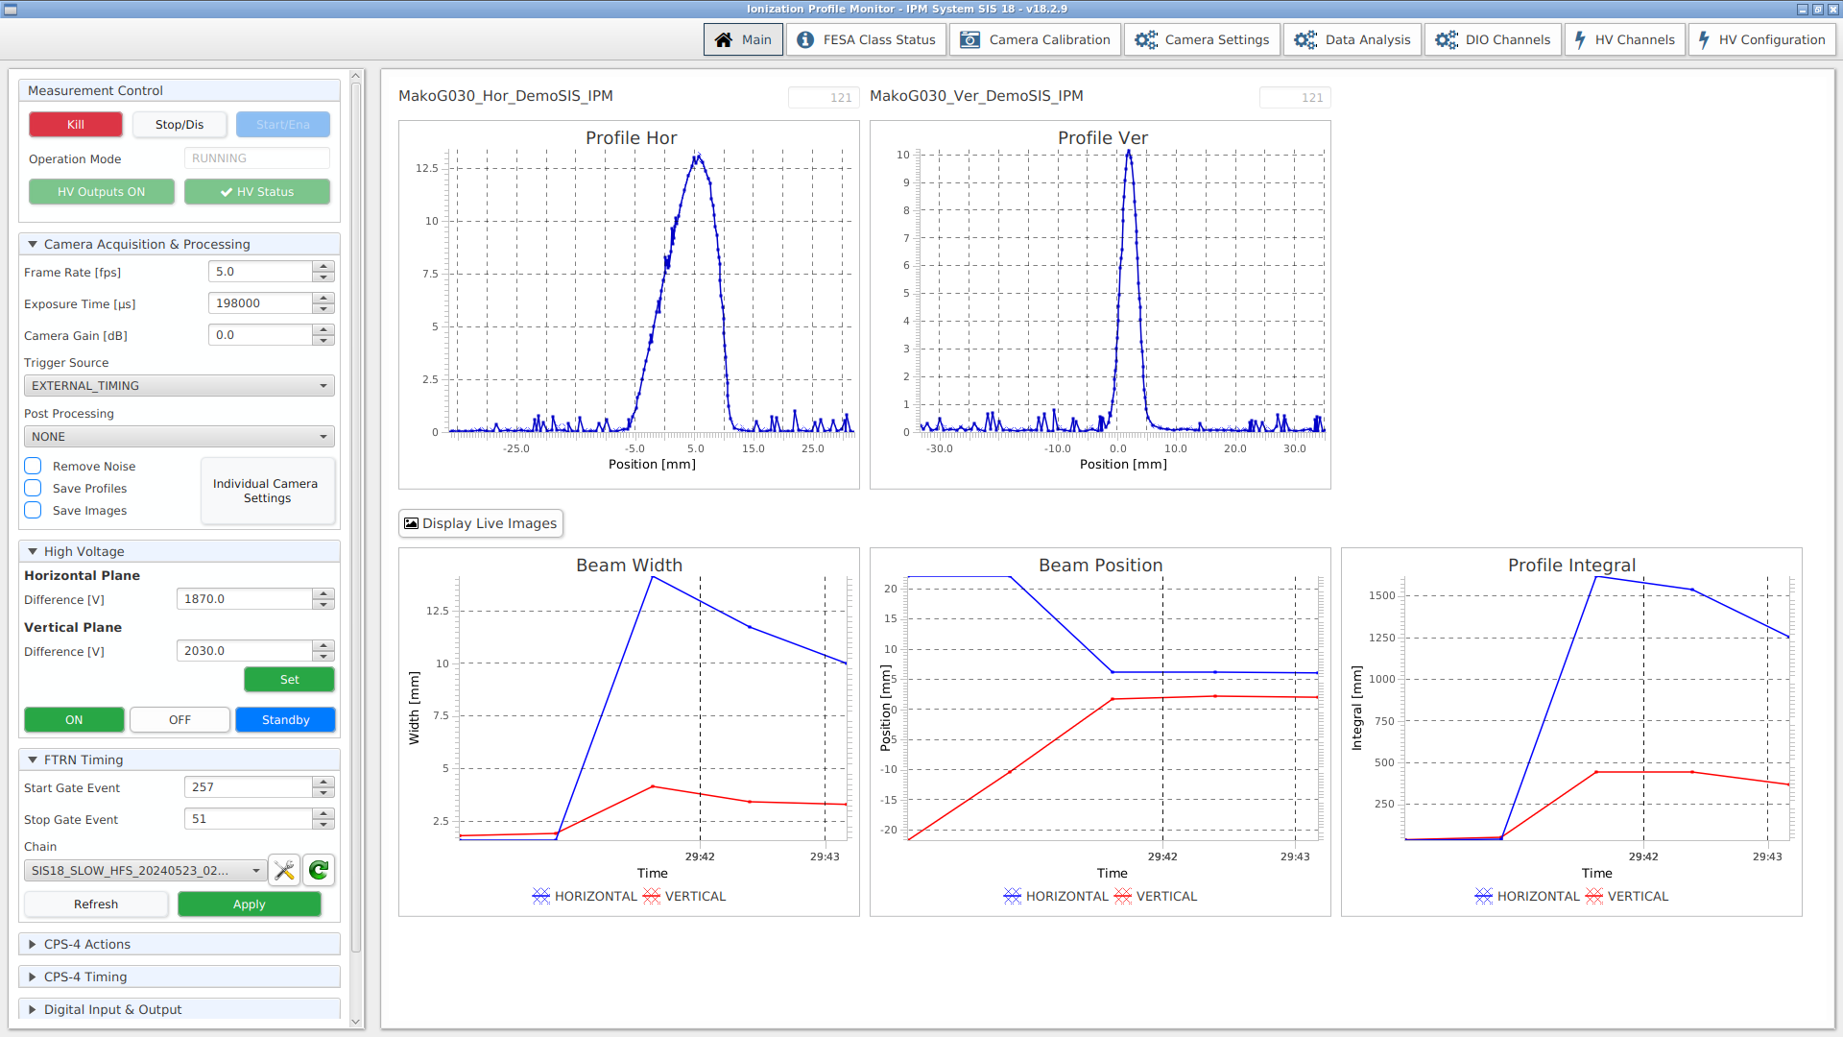
Main GUI
Typ. GUI
@ IPM meas.
running
Graphs BW, BP, PI
or
Cam Live Images

Slide 4
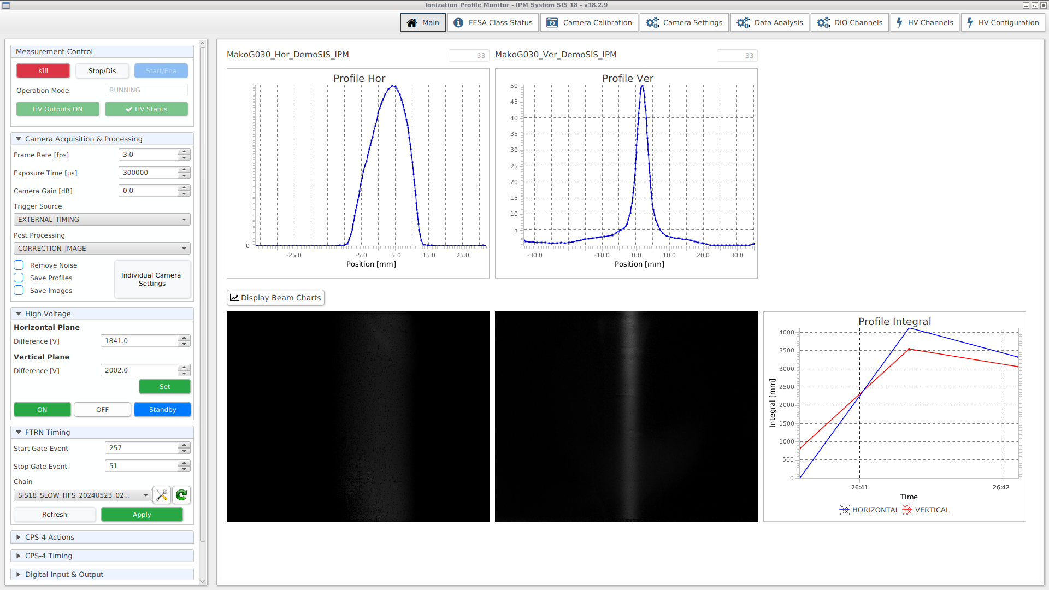
Main GUI
Typ. GUI
@ IPM meas.
running
Graphs BW, BP, PI
or
Cam Live Images
1 Profile

Slide 5
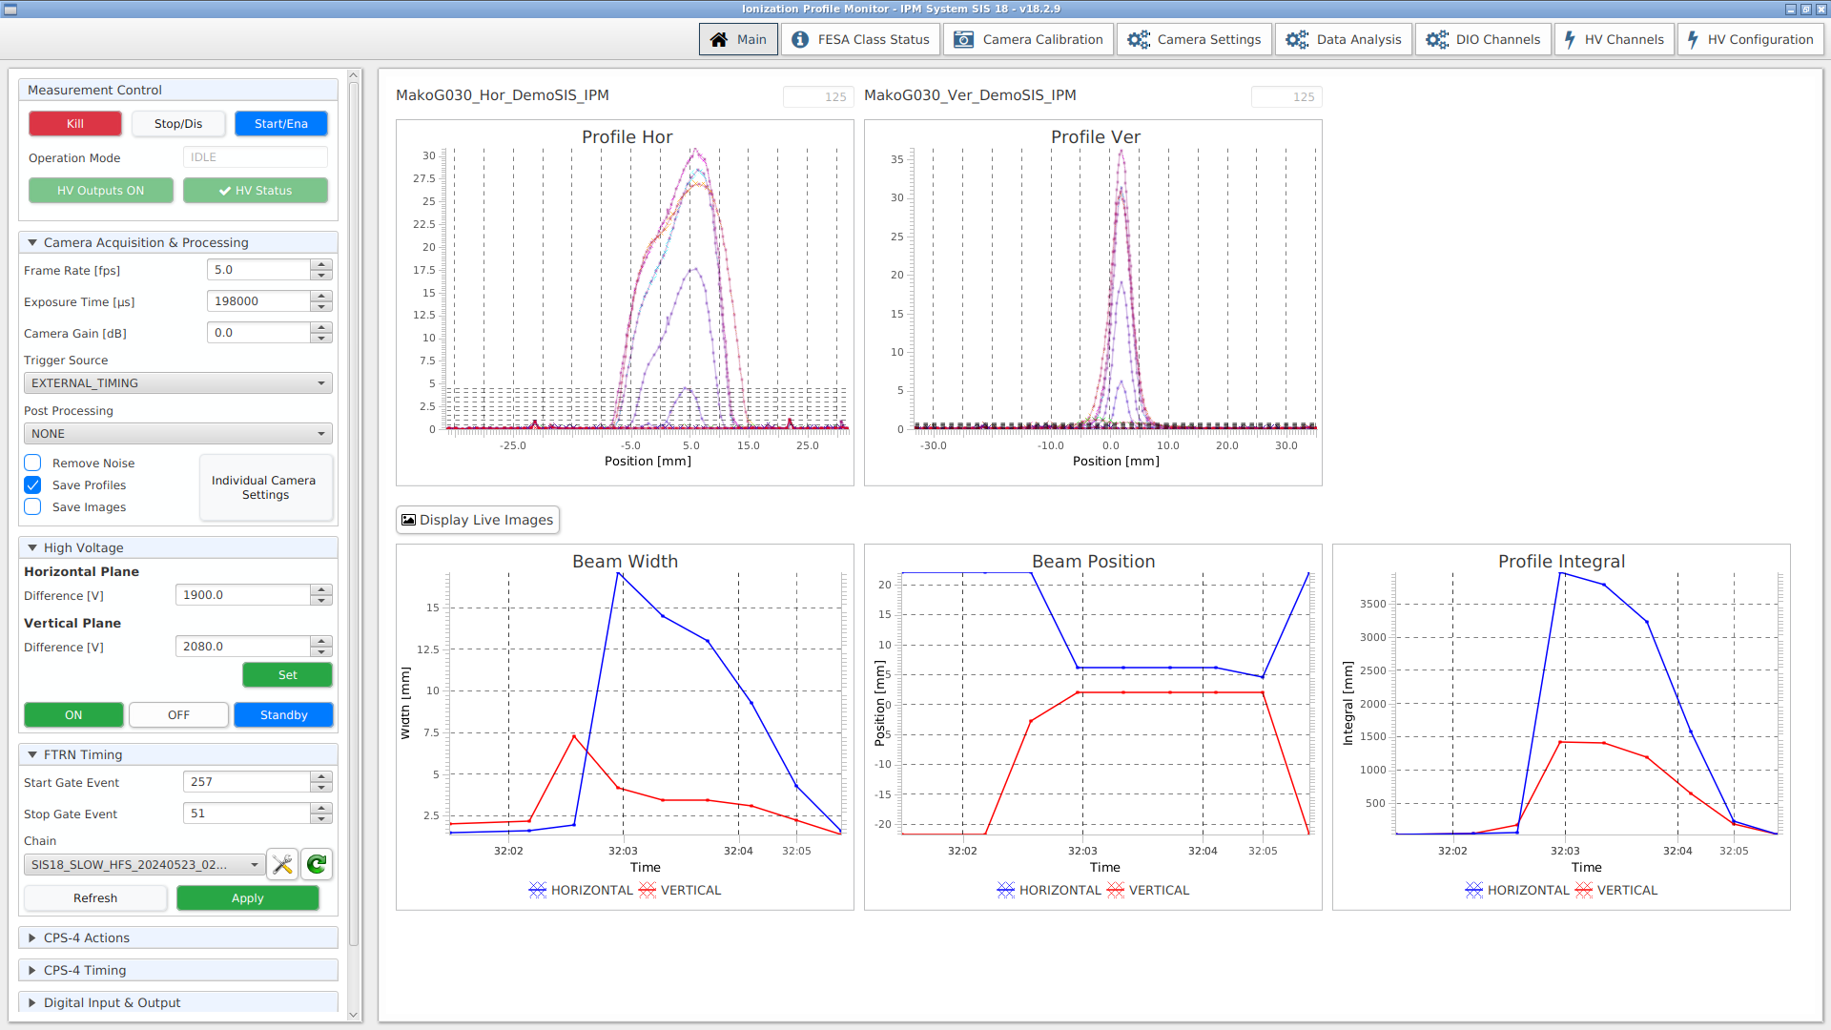
Main GUI
Typ. GUI after
IPM meas.
All profiles analysed
& displayed.

Slide 6
Main GUI
Main task : DAQ
measure & save the data.
Random profiles to GUI.
Meas runs endless -
started/stopped by
Ma #Ev.
Button function :
Start/Ena - Stop/Dis

Slide 7
Timing - FTRN - Cam Trigger
Start Event:
Sequence Start
Ev 257
FTRN -
FAIR Timing
Receiver Node
ICDC -
IPM Camera
Device Control
Stop Event:
Extraction End
Ev 51

Slide 8
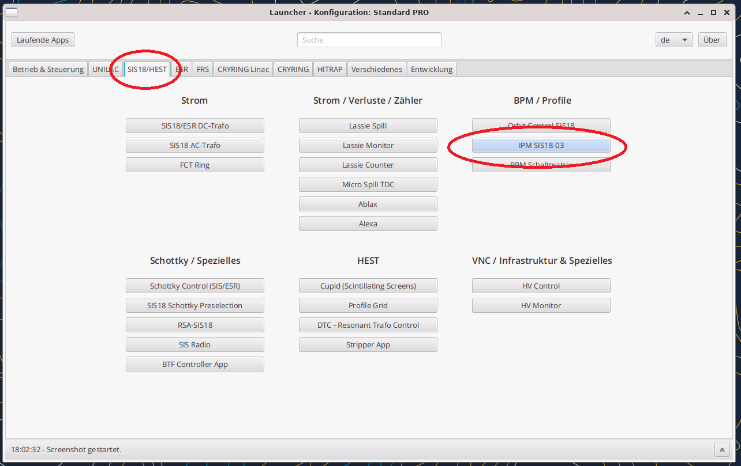
Start IPM GUI

Slide 9
IPM GUI - Main Tab
Startup

Slide 10
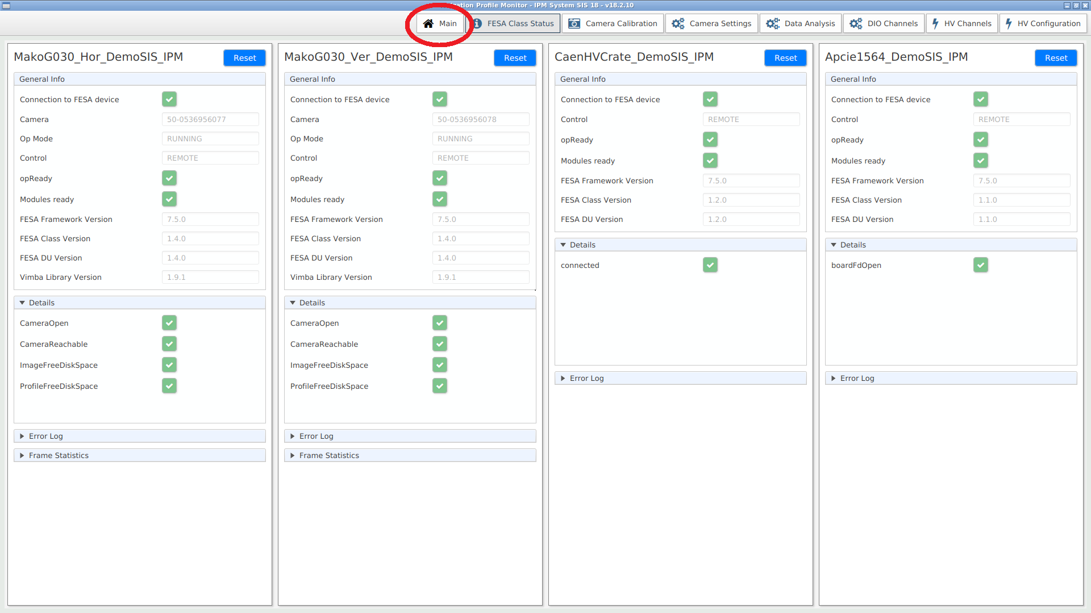
IPM GUI - Status Tab
Device Status
Check

Slide 11
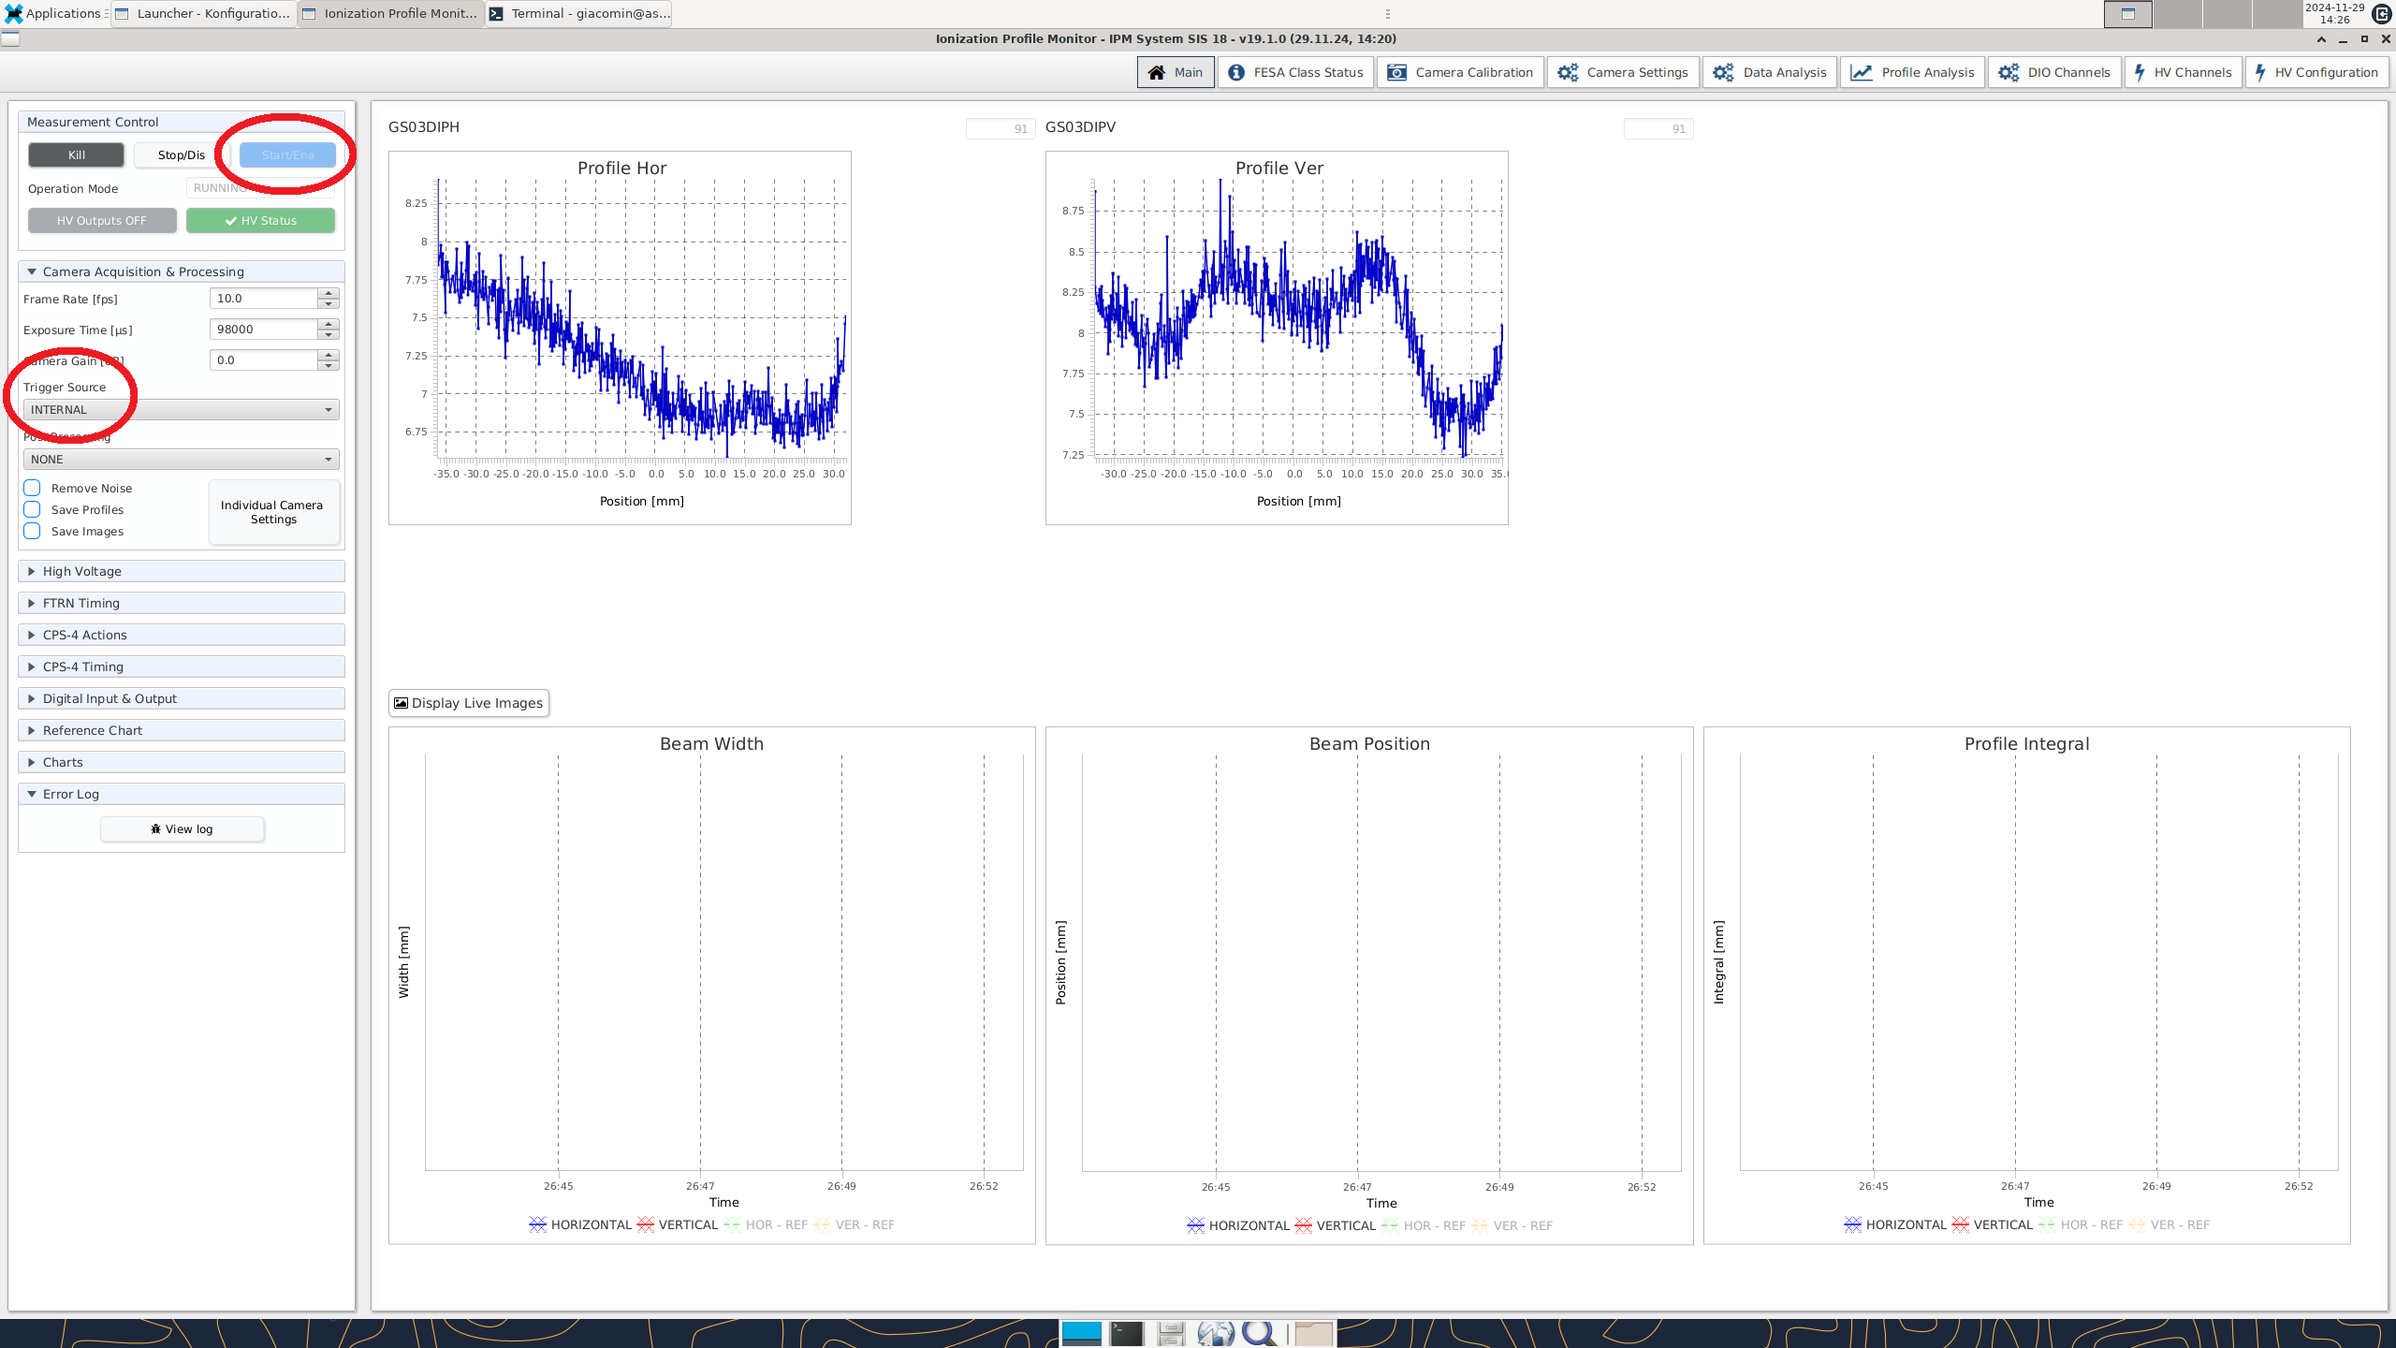
Start - Internal Timing
1st Start
Internal Trigger Src
Cam Data
No BW, BP, PI
Detector inactive.

Slide 12
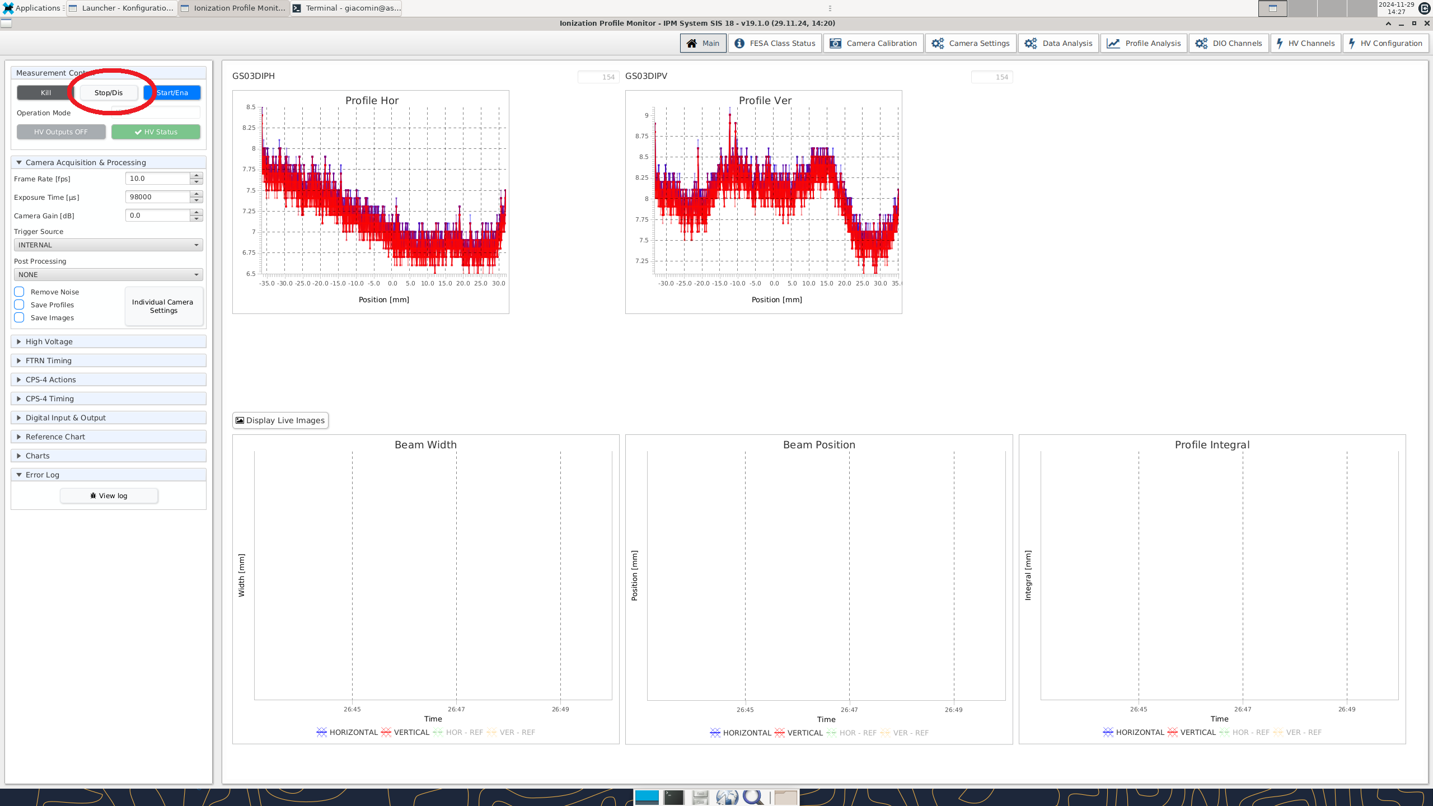
Internal Timing
Stop
Cam Data
of full measurement
No BW, BP, PI
Internal Timing:
Cams free running =
internal triggered.
No FTRN involved.
Cam noise

Slide 13
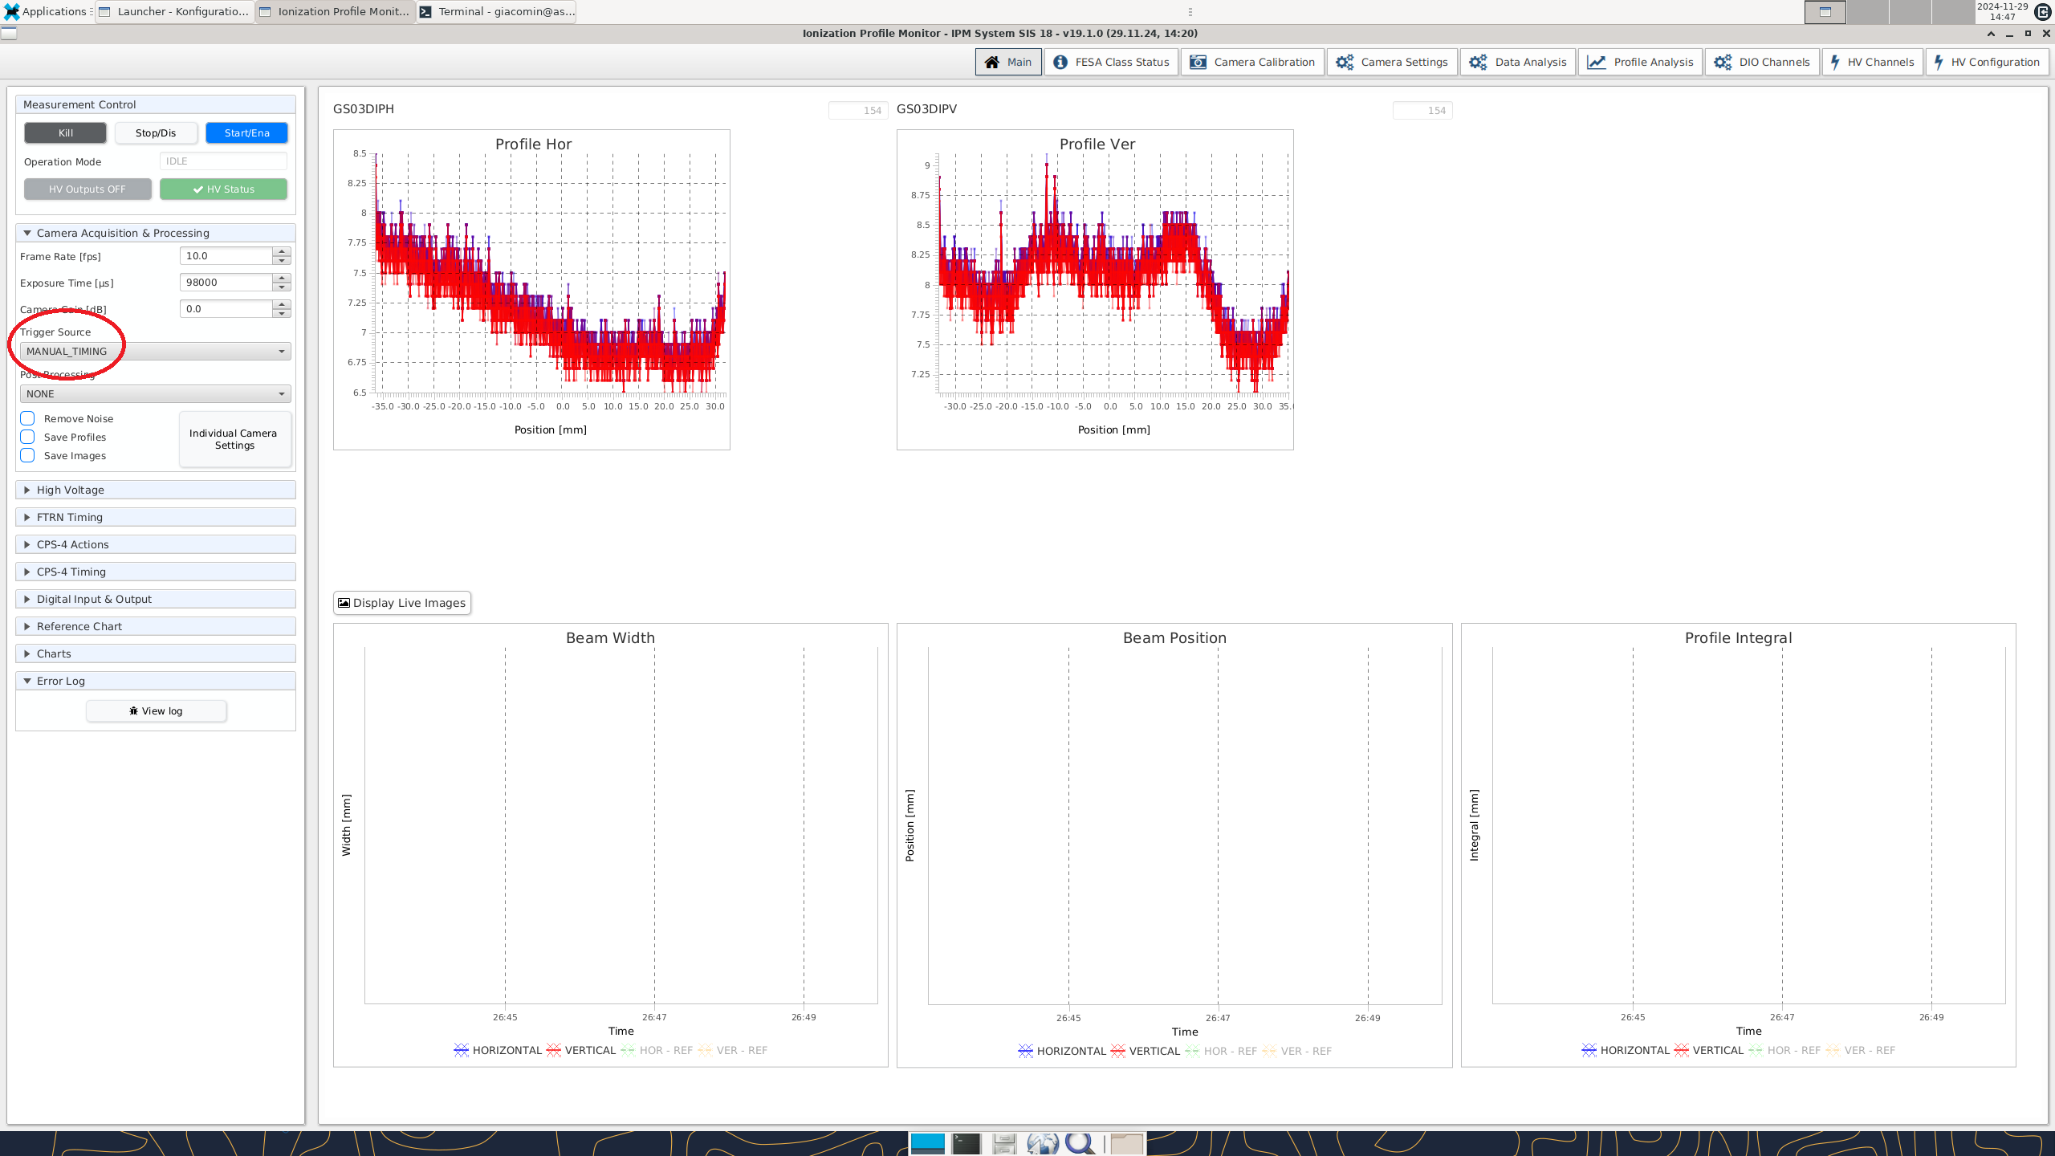
Manual Timing
Manual Timing:
FTRN generates
triggers after
Start/Stop.
Cams extern
triggered.
No Ma #Ev yet.
Determin. triggers

Slide 14
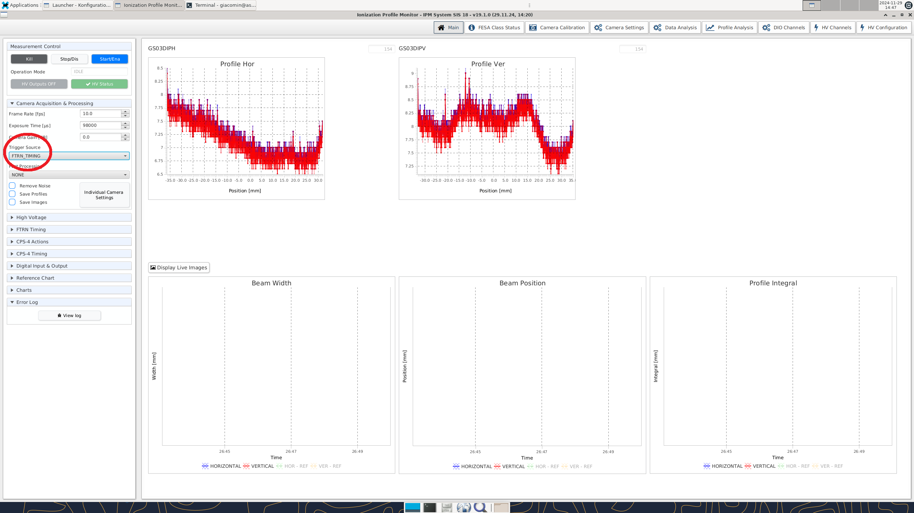
FTRN - Timing
FTRN Timing:
FTRN generates
triggers after
Ma #Ev
Enabled by
Start-Button.
Cams extern
triggered.

Slide 15
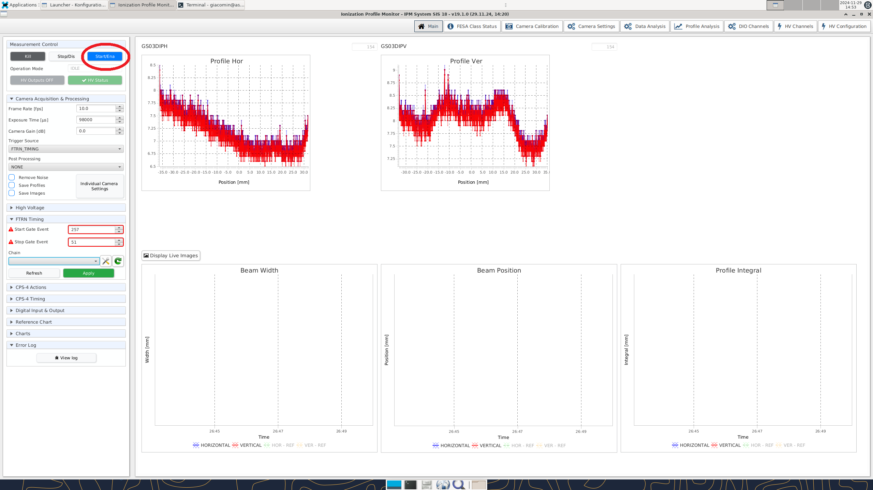
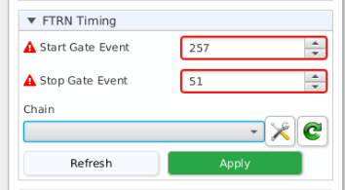
Machine Events
Start Event:
Sequ. Start
Ev 257
Stop Event:
Extraction End
Ev 51
Chain

Slide 16
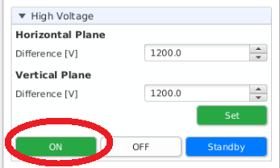
HV - Setup
Standby HV

Slide 17
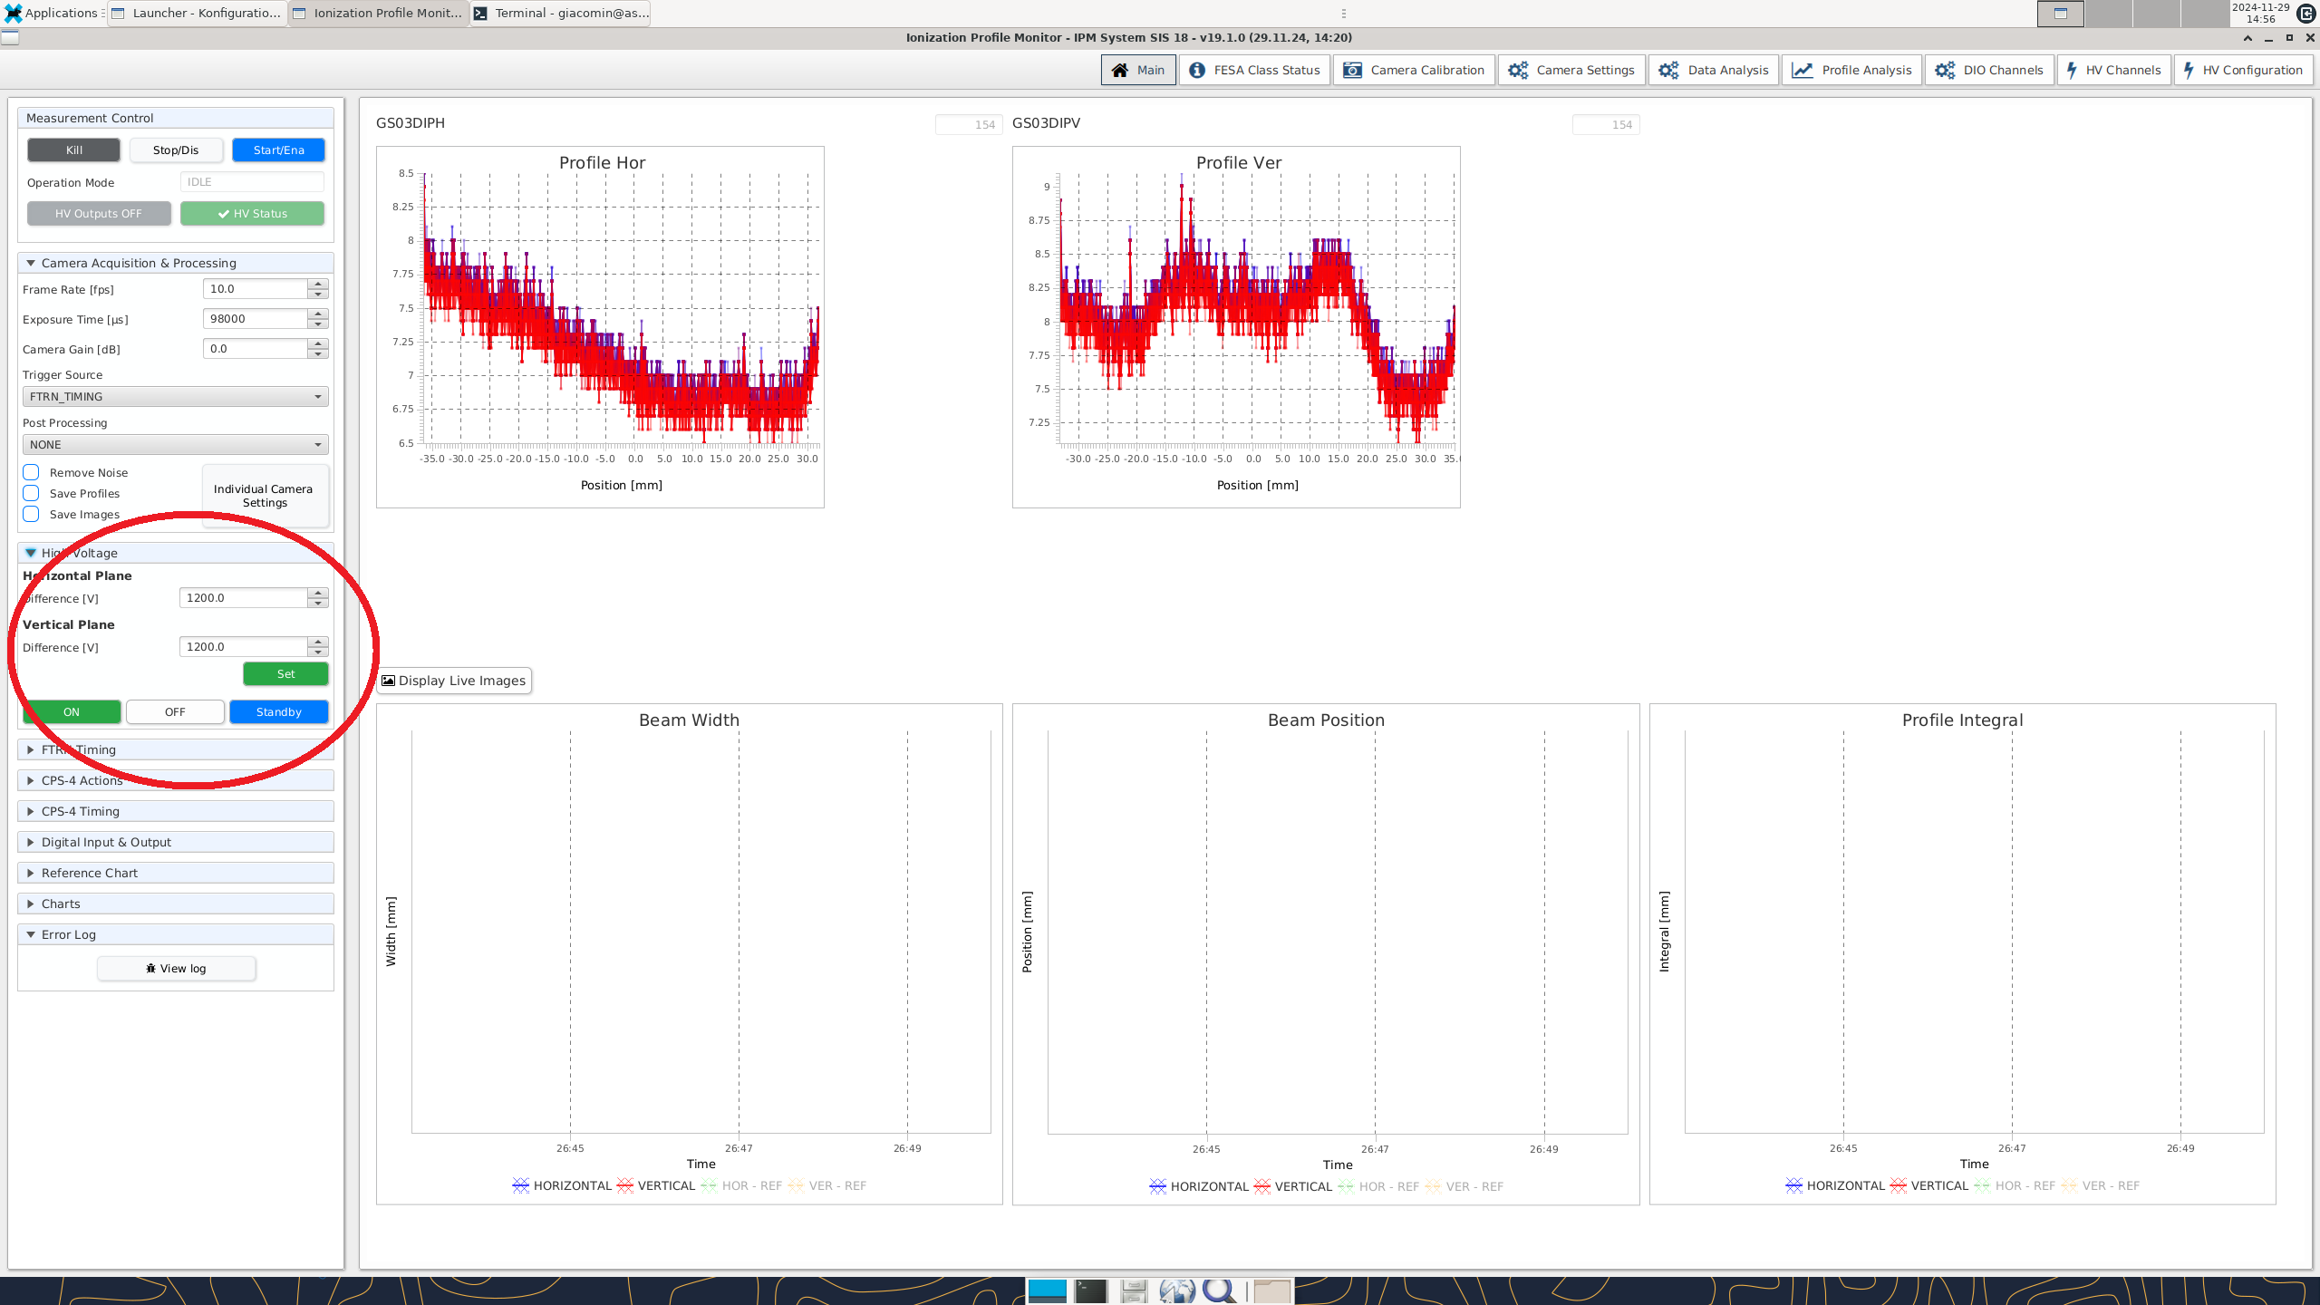
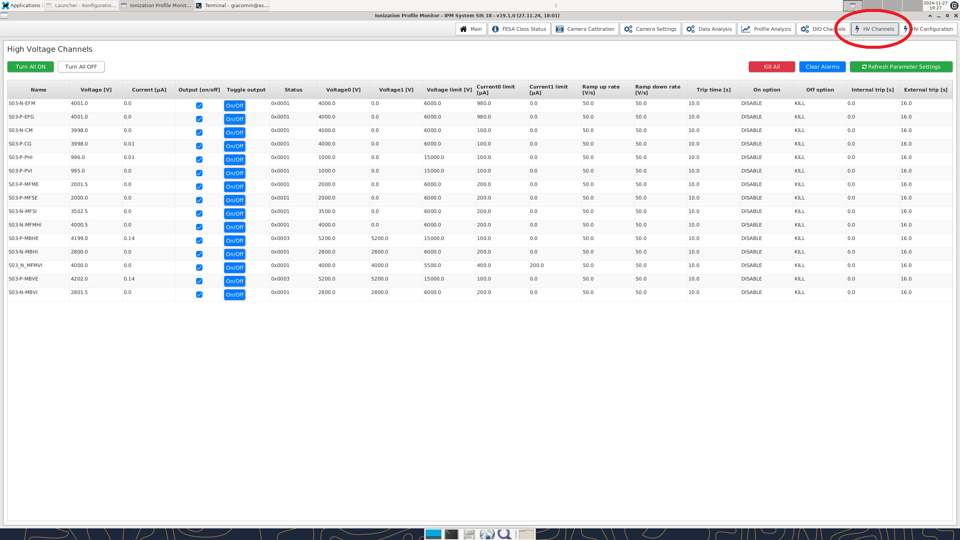
HV - Channels
HV Check

Slide 18
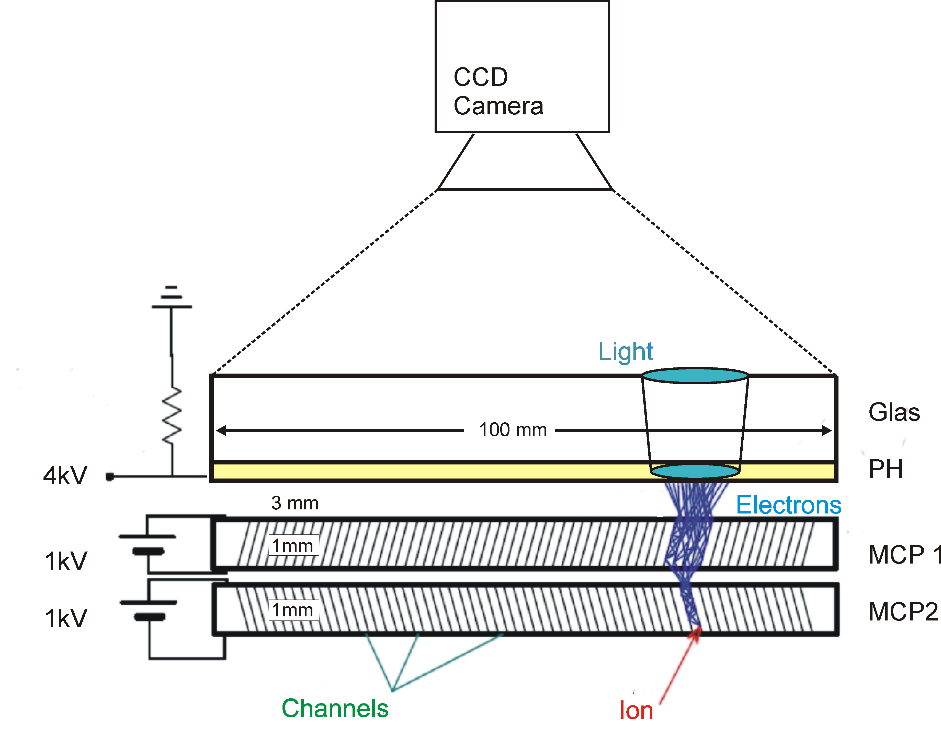
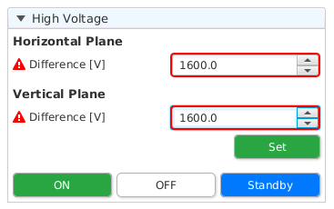
HV - Detector
1600 V

Slide 19
Measurement
Typ. GUI
@ IPM meas.
5 Hz
198 ms
#Ev 257 - 51
HV
1870 V
2030 V
Post process:
Def Pix
Correction

Slide 20
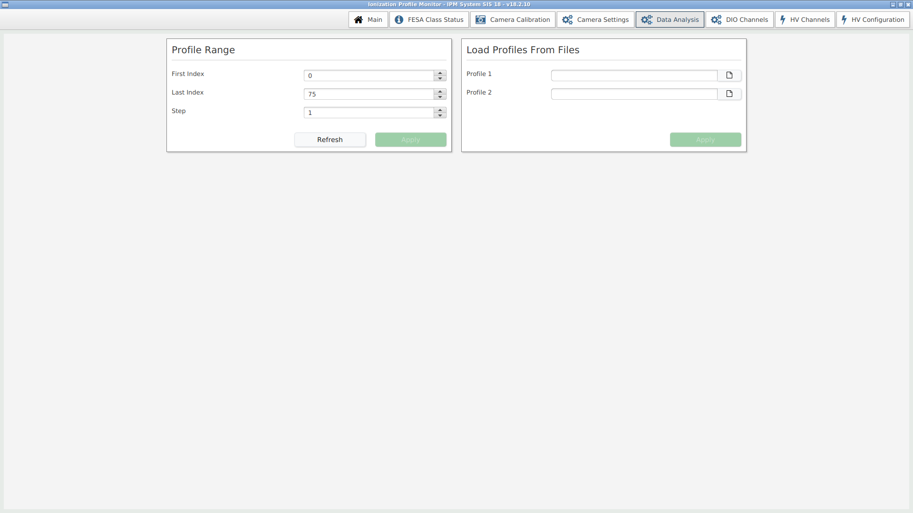
Data Selection GUI

Slide 21
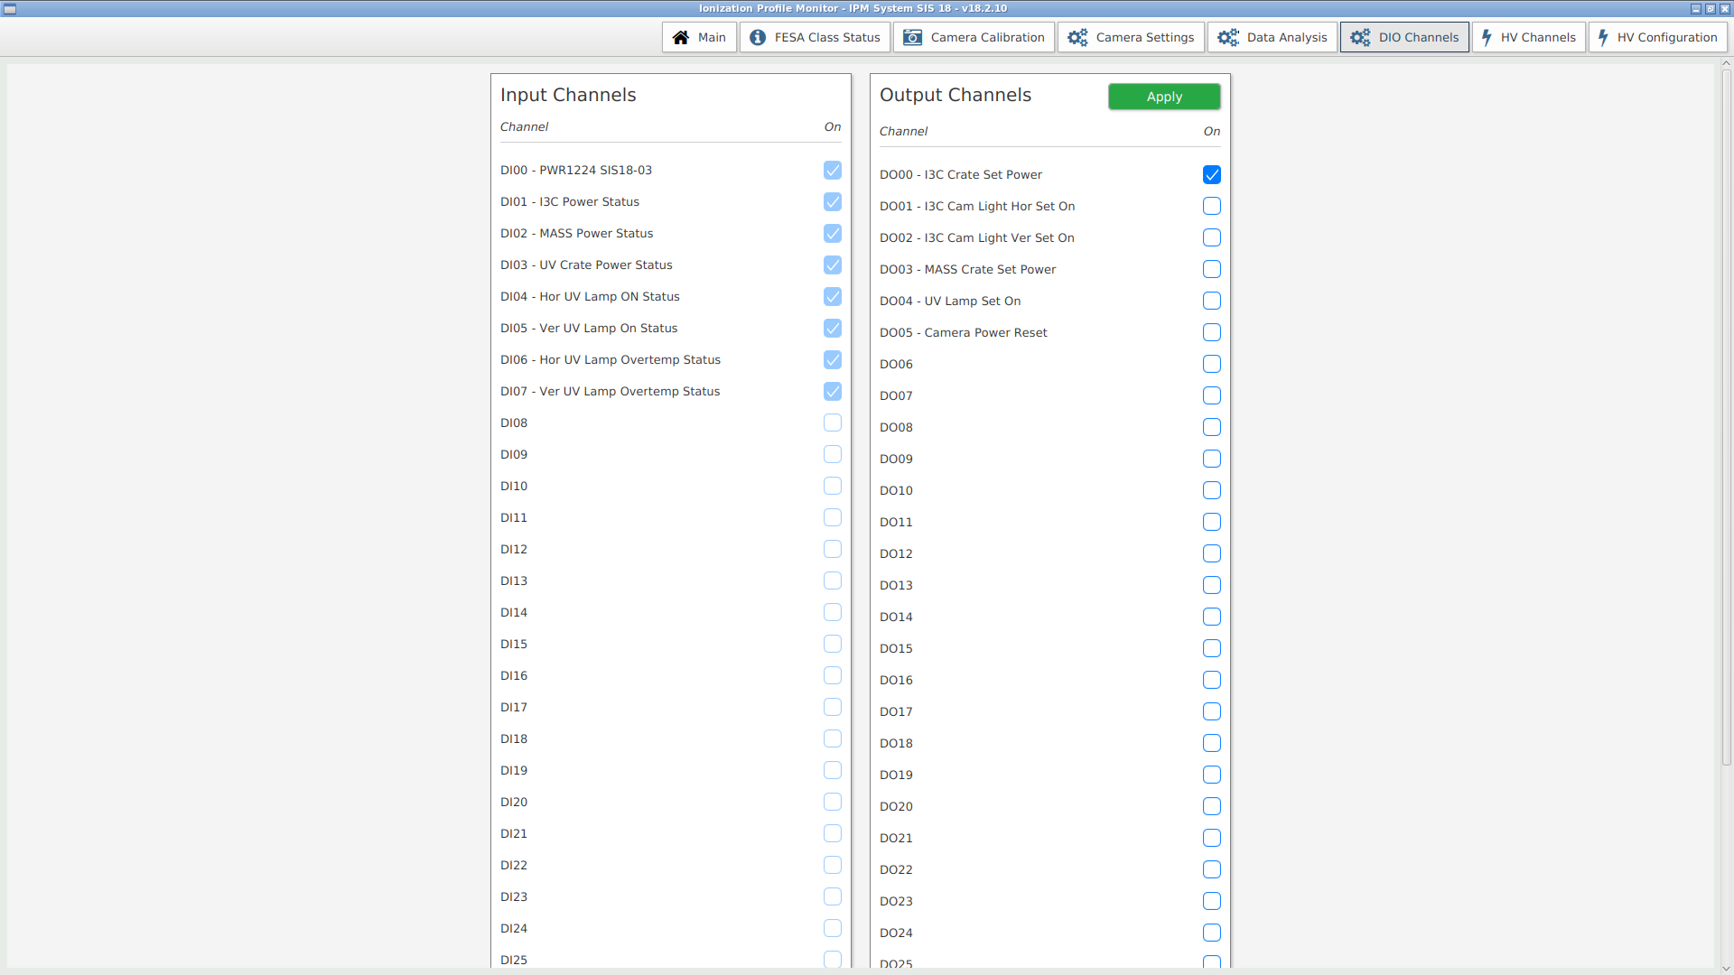
DIO GUI

Slide 22
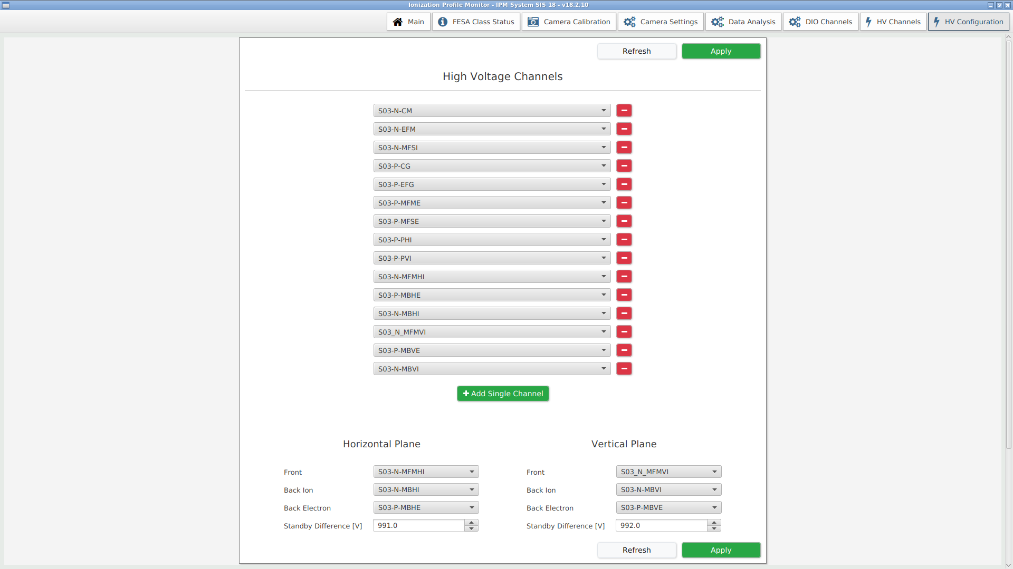
HV Configuration GUI

Slide 23
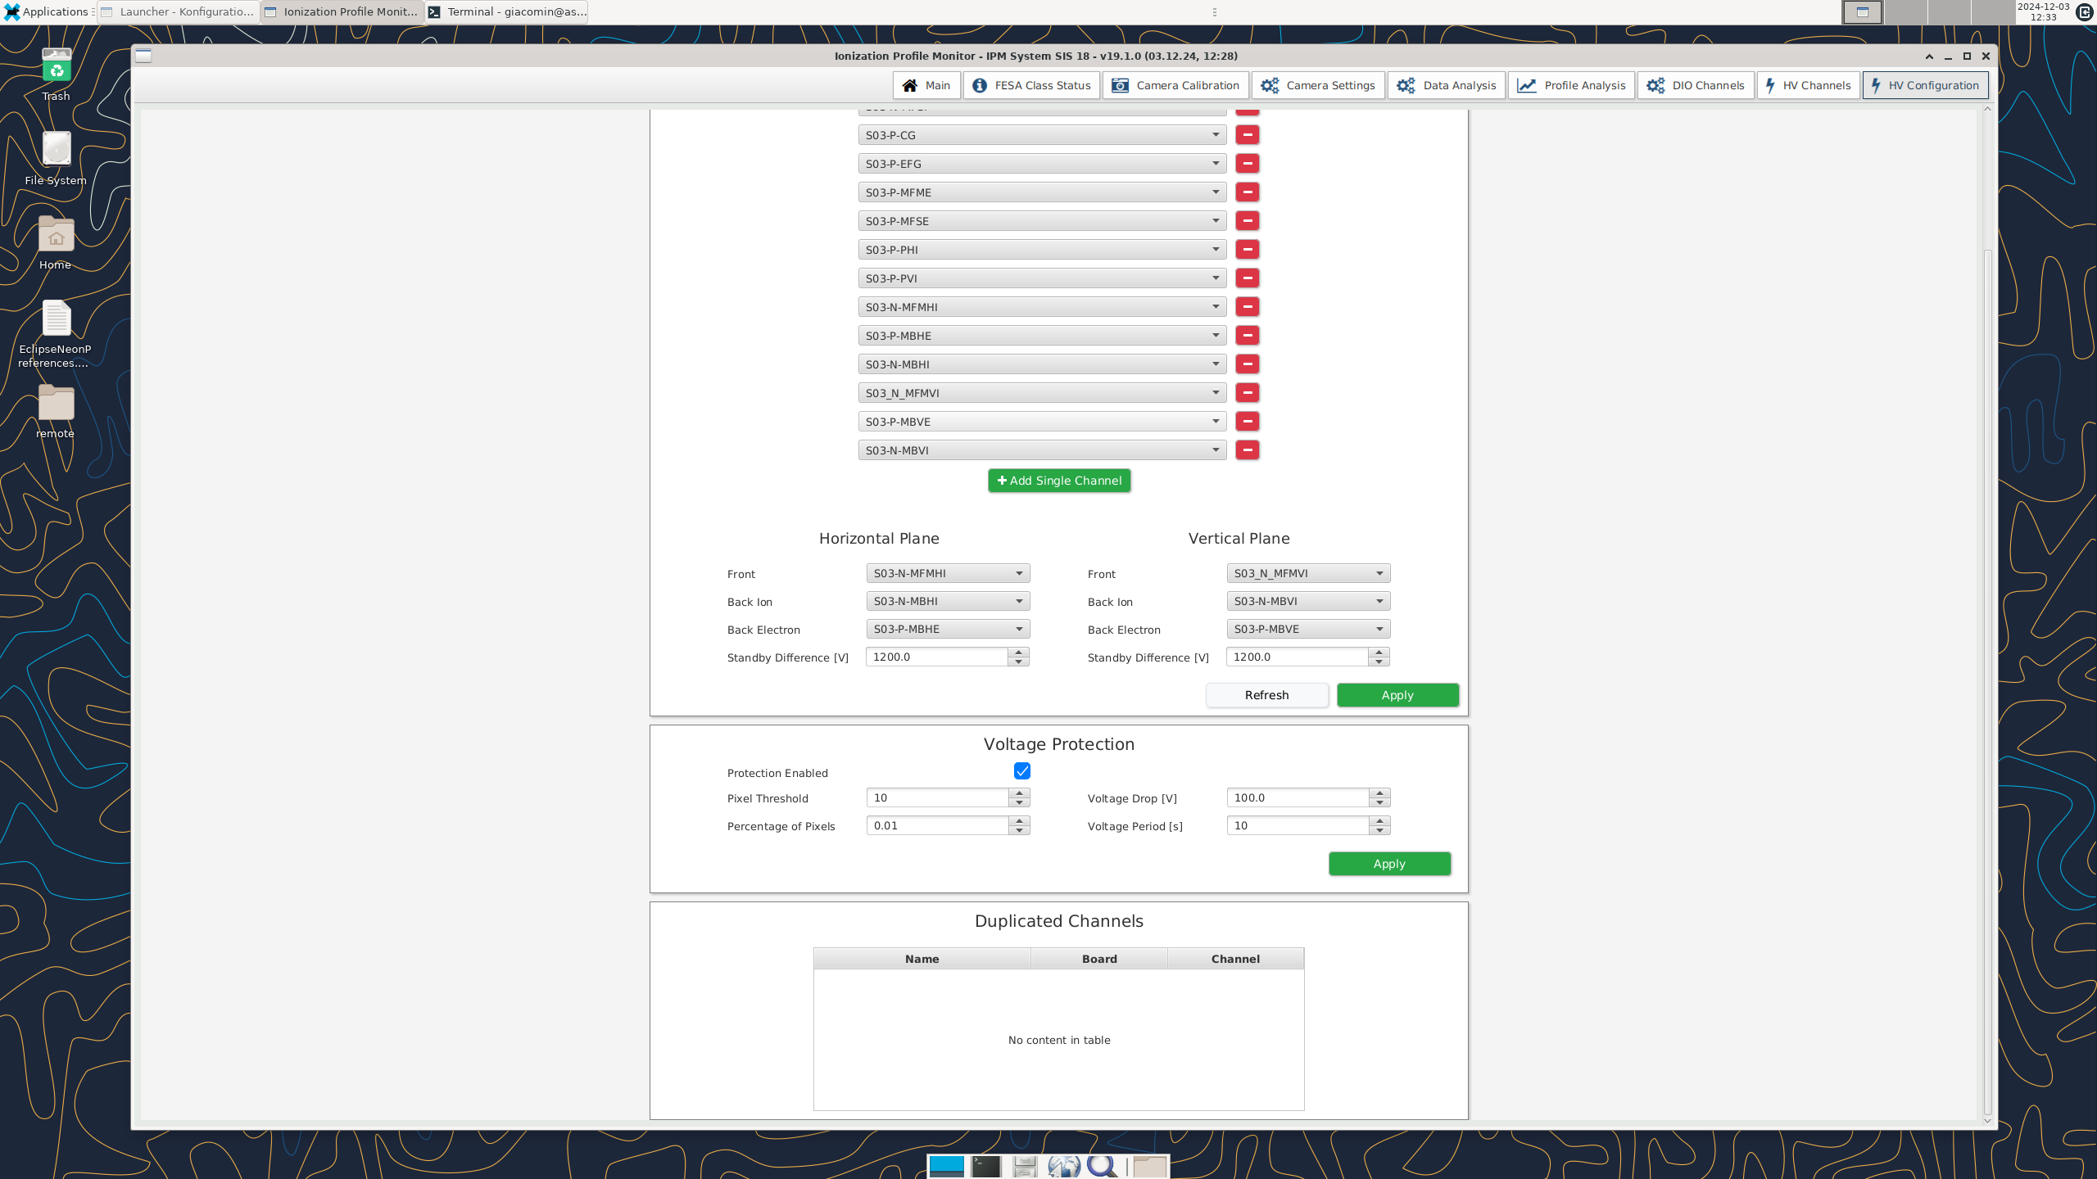
HV Configuration GUI

Slide 24
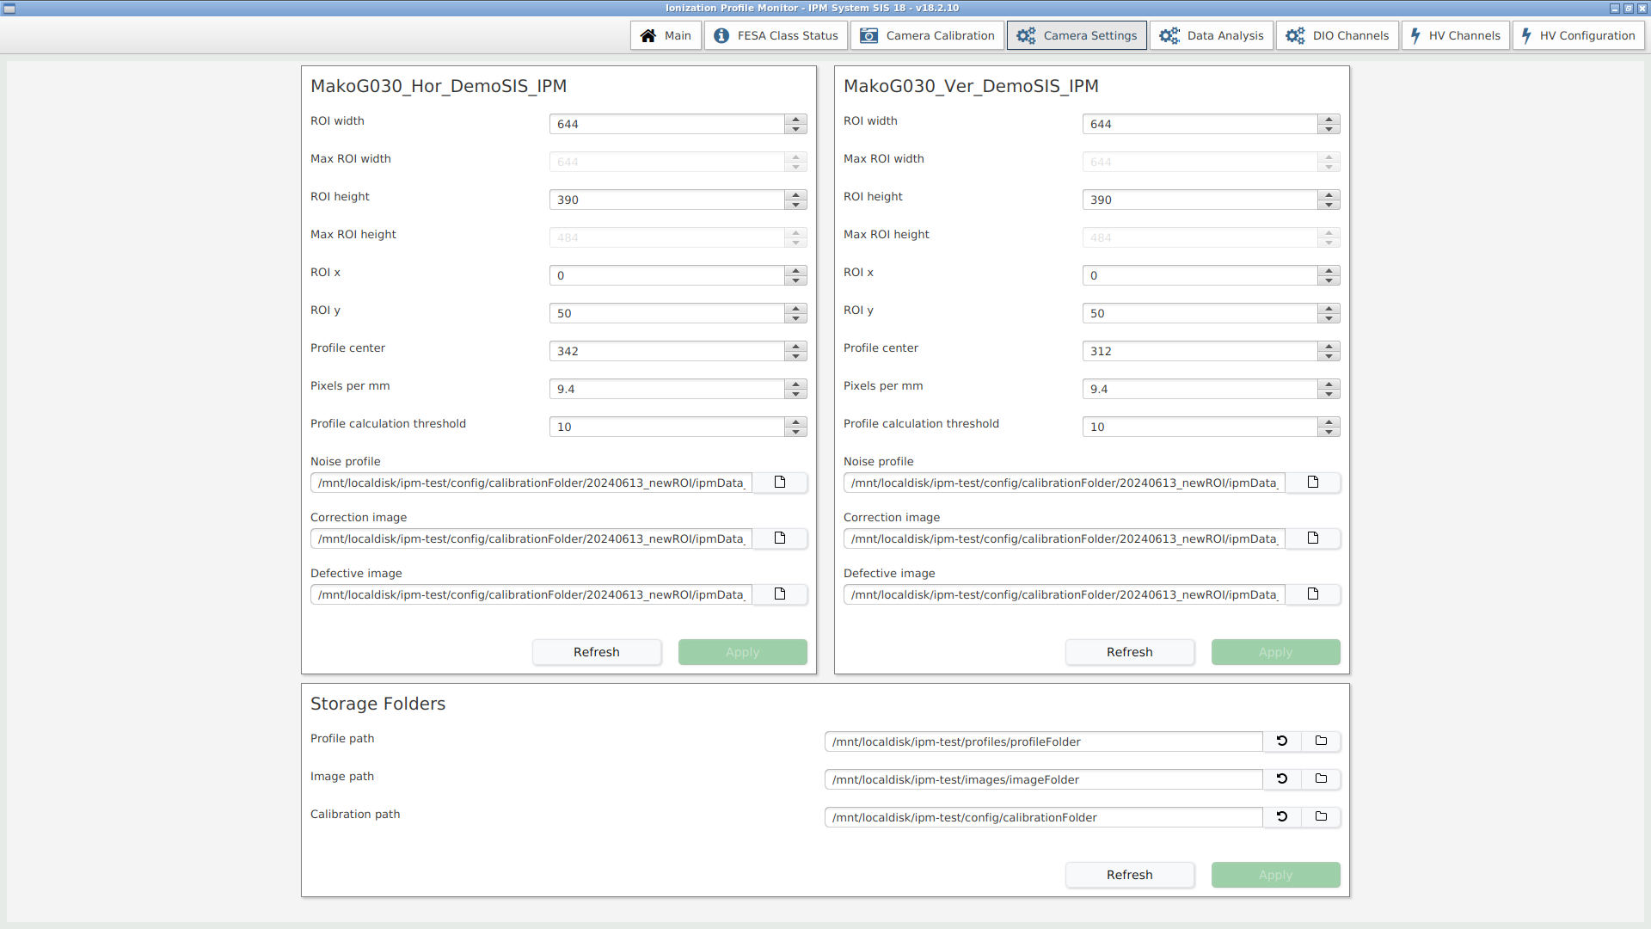
Camera Settings GUI

Slide 25
Camera Calibration

Slide 26
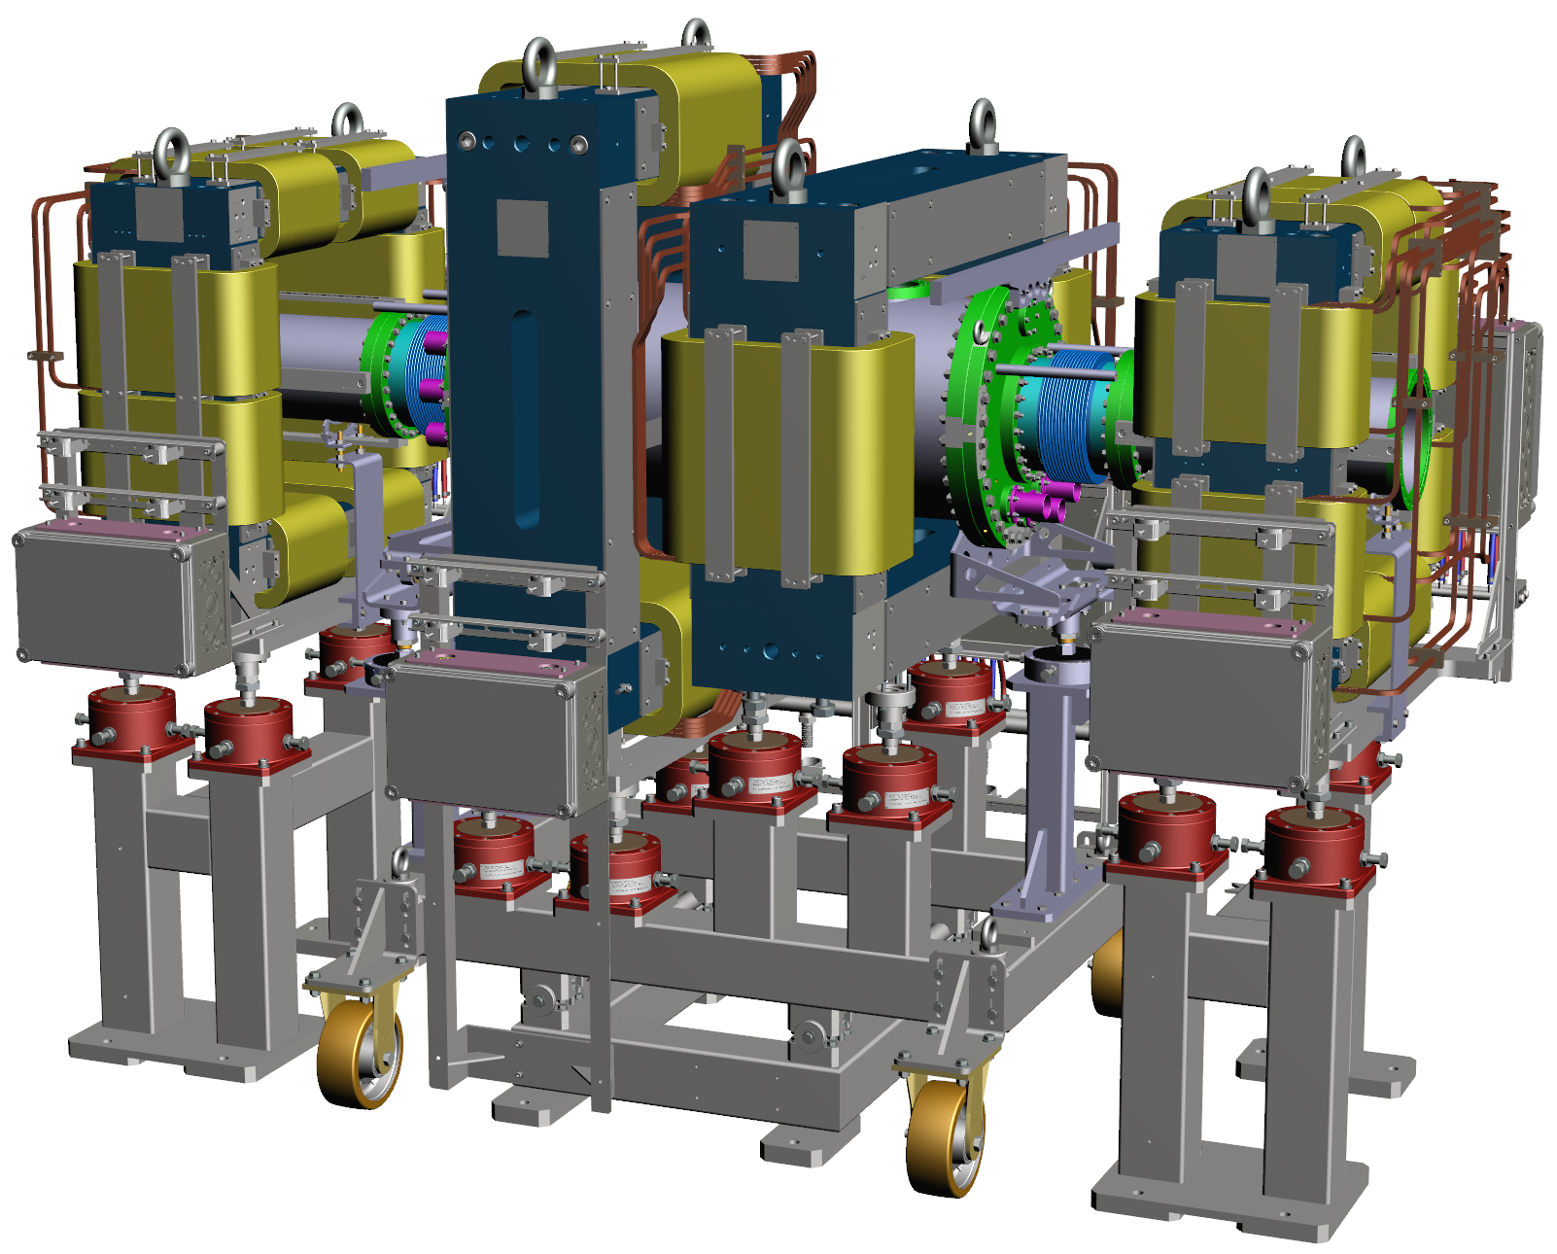
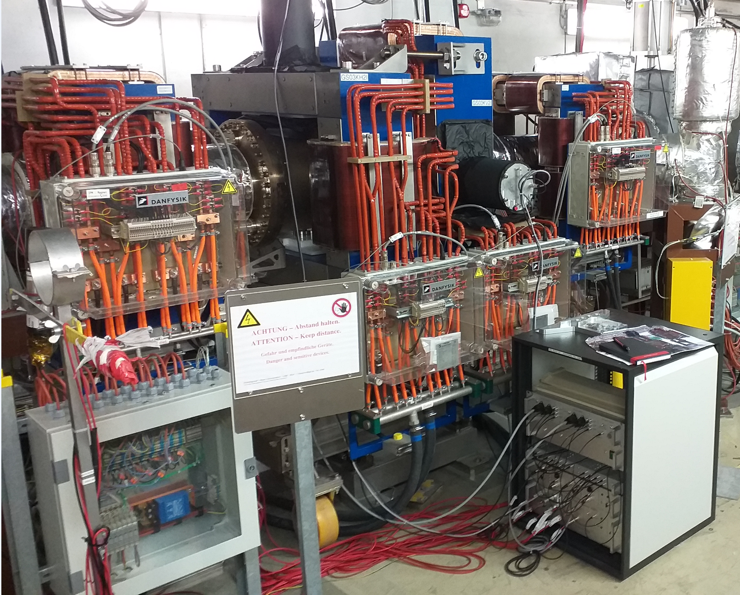
Danke

