Slide 1
MRPC Production and Development for CBM-TOF at Tsinghua University
- Kai Sun

Slide 2
Outline
MRPC Production and Testing Progress
Future Production Plans and Funding Requirements
Study on MRPC Detectors for CBM High-Rate Beam X-Ray Experiment Setup and Objectives Preliminary Results
Summary

Slide 3
Production and Testing Progress

Slide 4
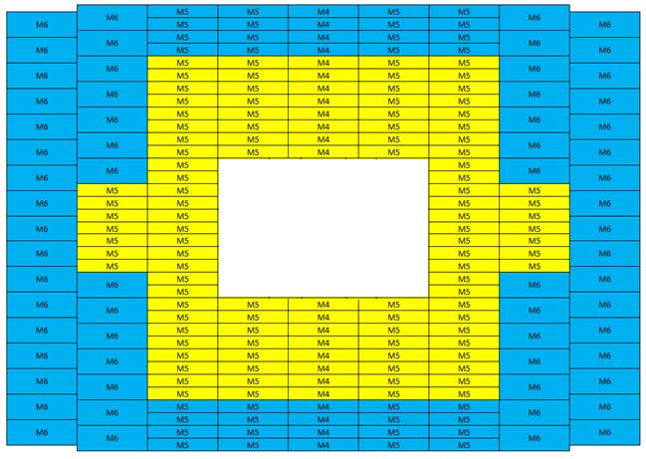
Structure of CBM-TOF Wall
MRPC2 forms modules M4 and M5 at yellow area.
580 MRPC2 will form 116 yellow modules, 5 MRPC2 in each module.
 | MRPC2 Detector
Active area per detector (cm) | 33 x 27.6
Efficiency | 97%
Time resolution(ps) | 60
Max rate (Hz/cm²) | 1k - 5k
Glass type | Low resistive glass
Fig: The conceptual design of CBM-TOF outer wall (from TOF PRR Document).
Tab: Parameter requirement of MRPC2 detector.

Slide 5
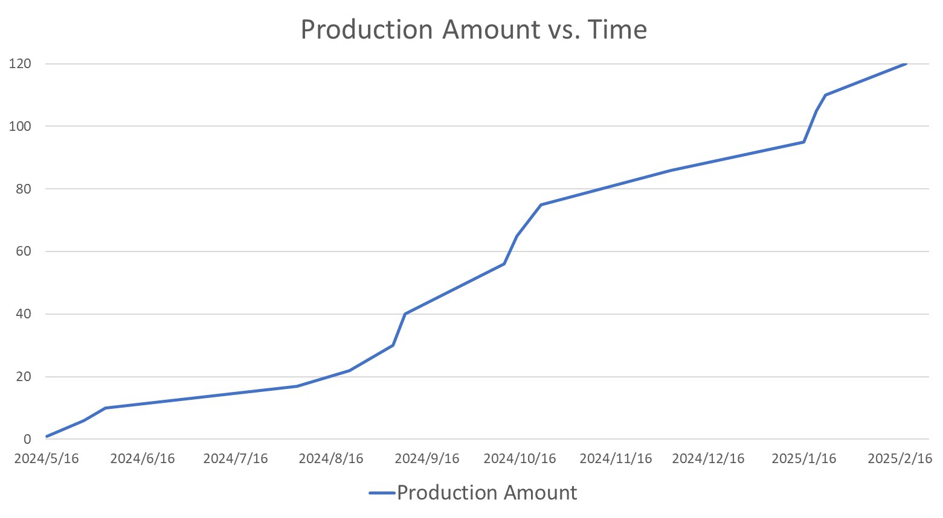
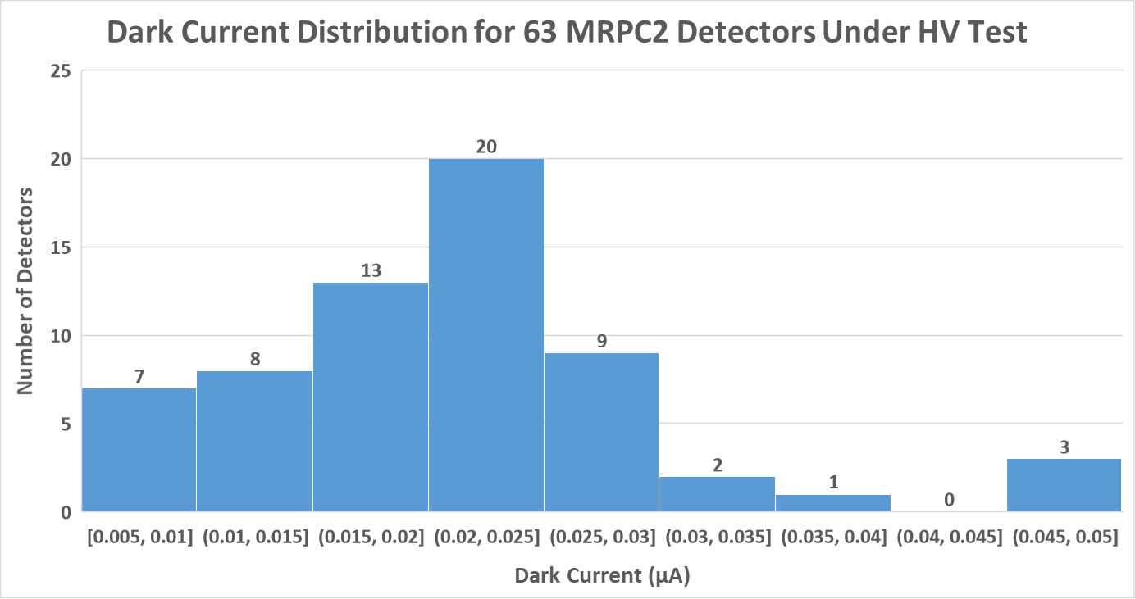
Current Production Status
Fig: The first batch production of 120 MRPC2 From May. 2024 To Feb. 2025
Fig: Dark current distribution of 63 MRPC2 that overcame high voltage test till Sep. 2025.

Slide 6
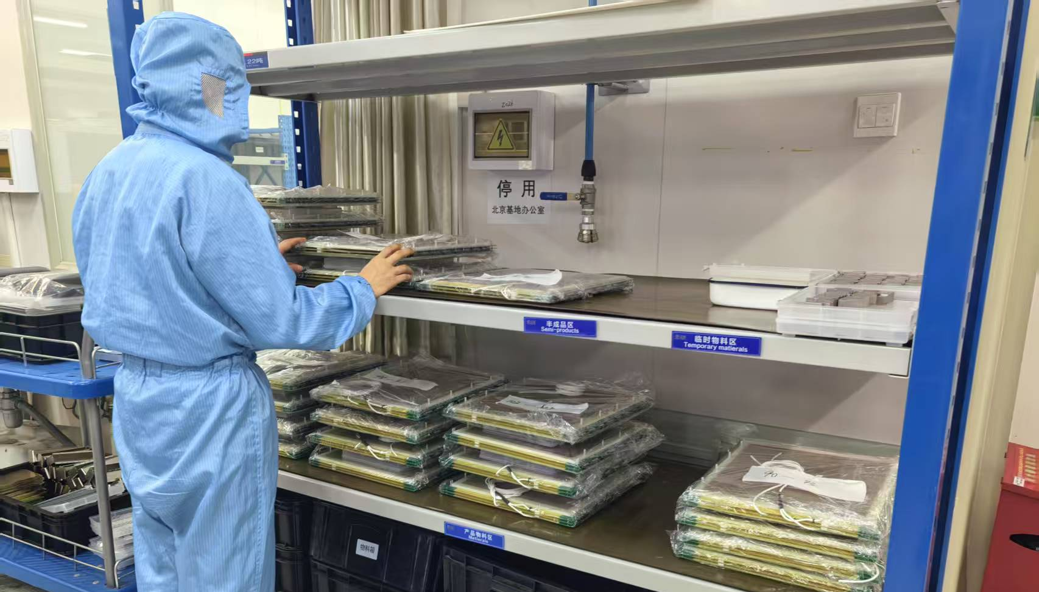
Current Production Status
Fig: The MRPCs tested are stored in the clean room.

Slide 7
Future Production Plans
and Funding Requirements

Slide 8
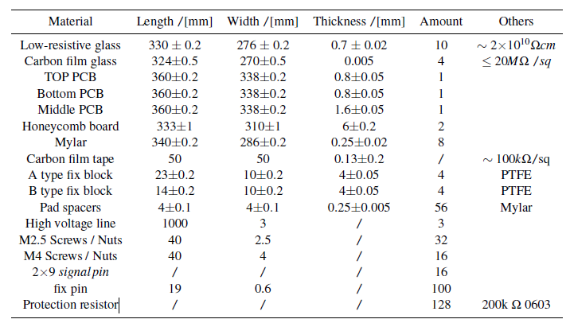
Future Production Plan and Funding Requirements
Production Plan for MRPC2:
Production Timeline: 10 months is required to produce 460 MRPC2 detectors with 10 full-time employees.
Performance Test: 100 MRPC2 will be tested for efficiency and time resolution.
HV Test: other 360 MRPC2 will be tested for high-voltage reliability.
Overall Process: Production and testing can run in parallel, with the entire timeline expected to take 12 months.
Funding Requirements for MRPC2:
2.5 million CNY / 0.3 million EUR required
At present 460/580 MRPC2 still needs to be finished.
Tab: MRPC2 detector components and their geometric parameters.

Slide 9
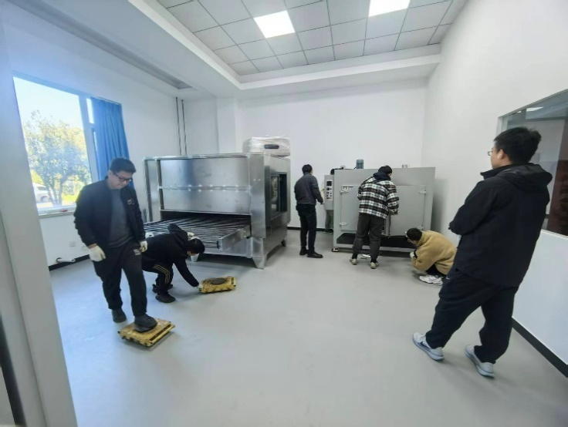
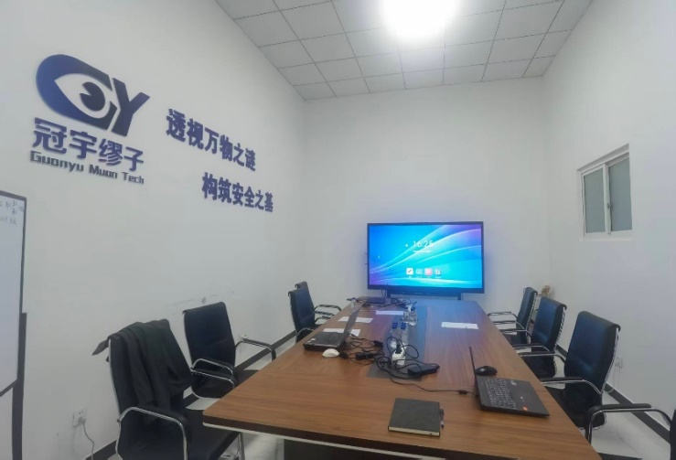
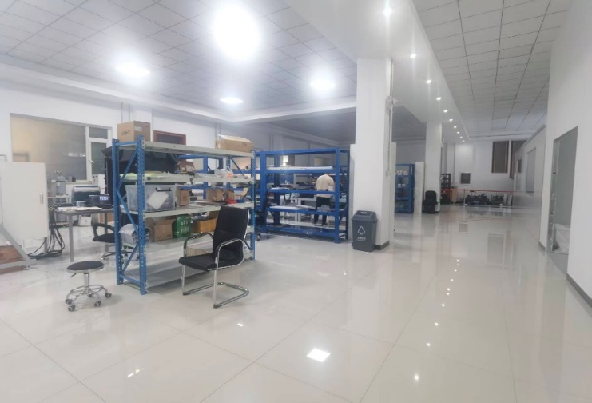
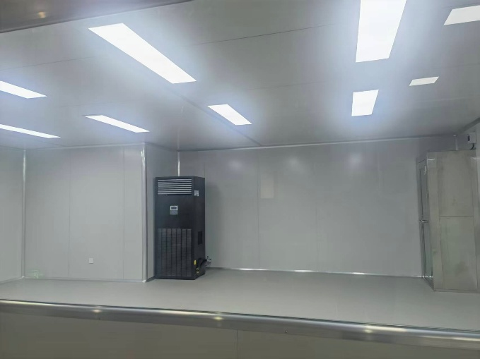
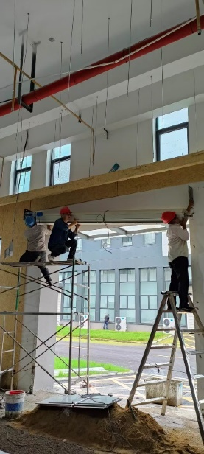
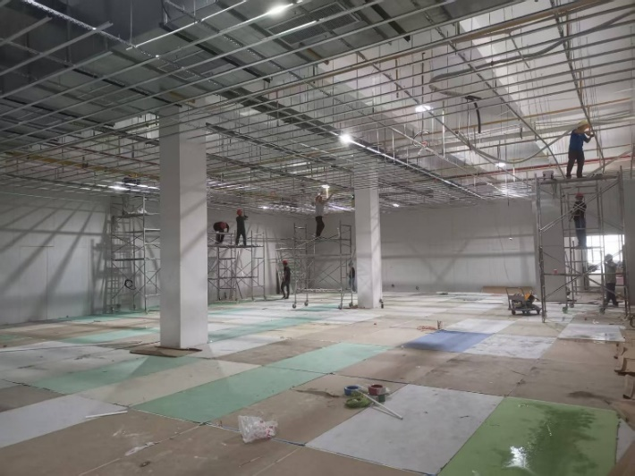
New Production Workshop at THU
Electrode production room
Office
Work Hall
Our New Workshop at Beijing, China is ready.
Our Factory at Yichang, China is under construction.
Clean Room

Slide 10
Study on MRPC Detectors
for CBM High-Rate Beam

Slide 11
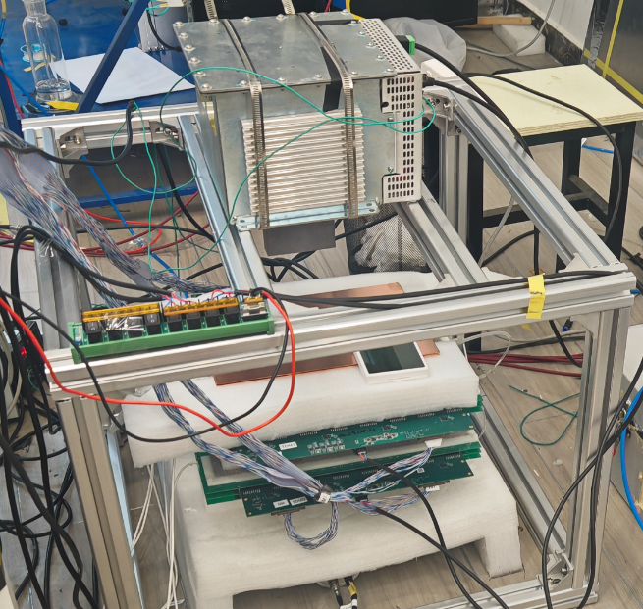
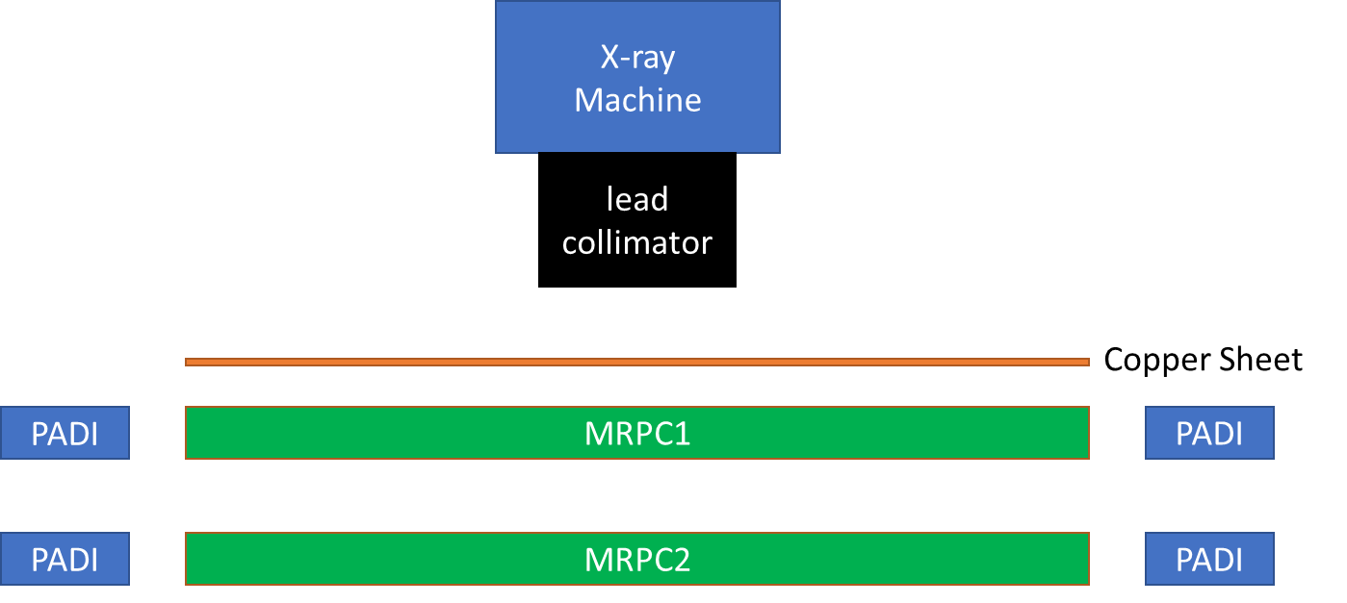
X - Ray Experiment ongoing
Research Goal:
Experimental method: Use an X-ray machine to simulate the high-rate beam in CBM, evaluating the performance and aging of fishing-line spacer MRPC and pad spacer MRPC under high flux conditions.
Key Focus: Examine the behavior of spacer regions in high beam flux environments.
Experiment Setup:
X-ray Machine
Copper Sheet (for hardening and reducing X-ray strength)
MRPCs & Electronic

Slide 12
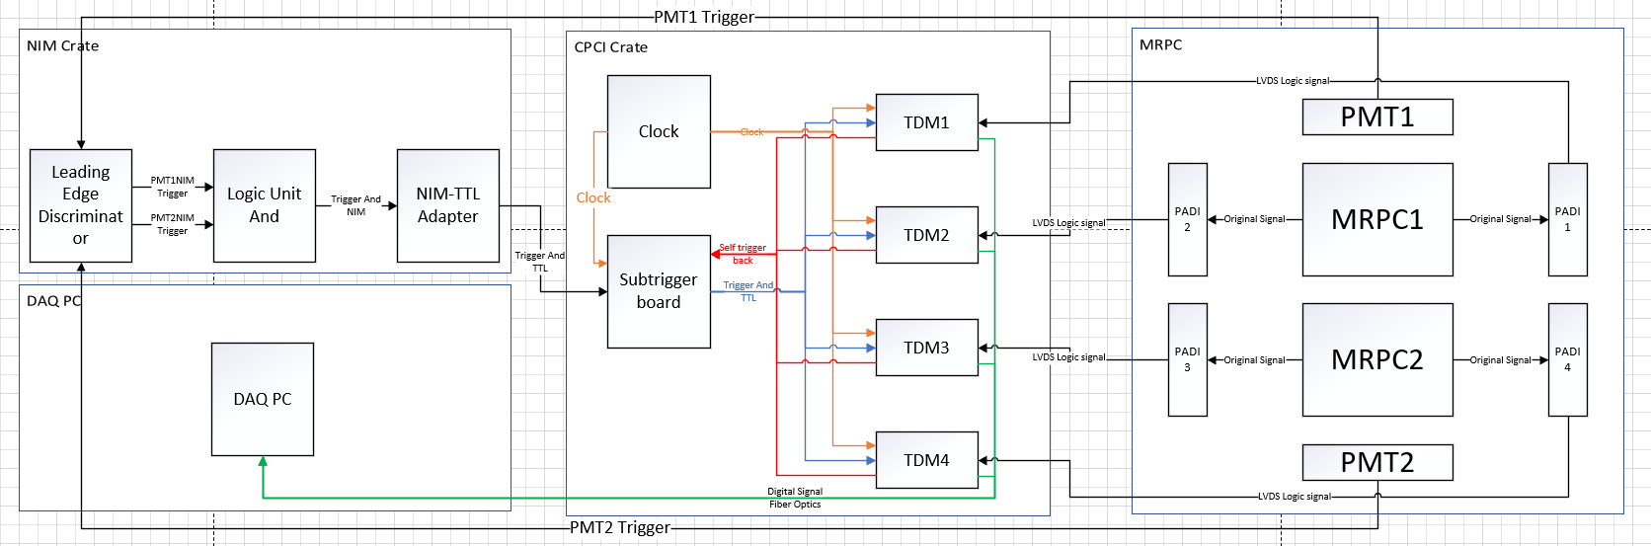
Experiment Setup: Electronic Readout System
PADI-X Preamplifier.
Time Digitization Module from Lei Zhao USTC.

Slide 13
Experiment Plan
Cosmic test without X-ray with different trigger method
PMT Trigger: efficiency, time resolution, cluster size .etc
2 MRPC Self Trigger: time resolution, cluster size
1 MRPC Self Trigger: cosmic rate map & noise rate map
X-ray test
1 MRPC Self Trigger: X – ray tube current scan
1 MRPC Self Trigger: X – ray position scan
1 MRPC Self Trigger: X – ray aging test

Slide 14
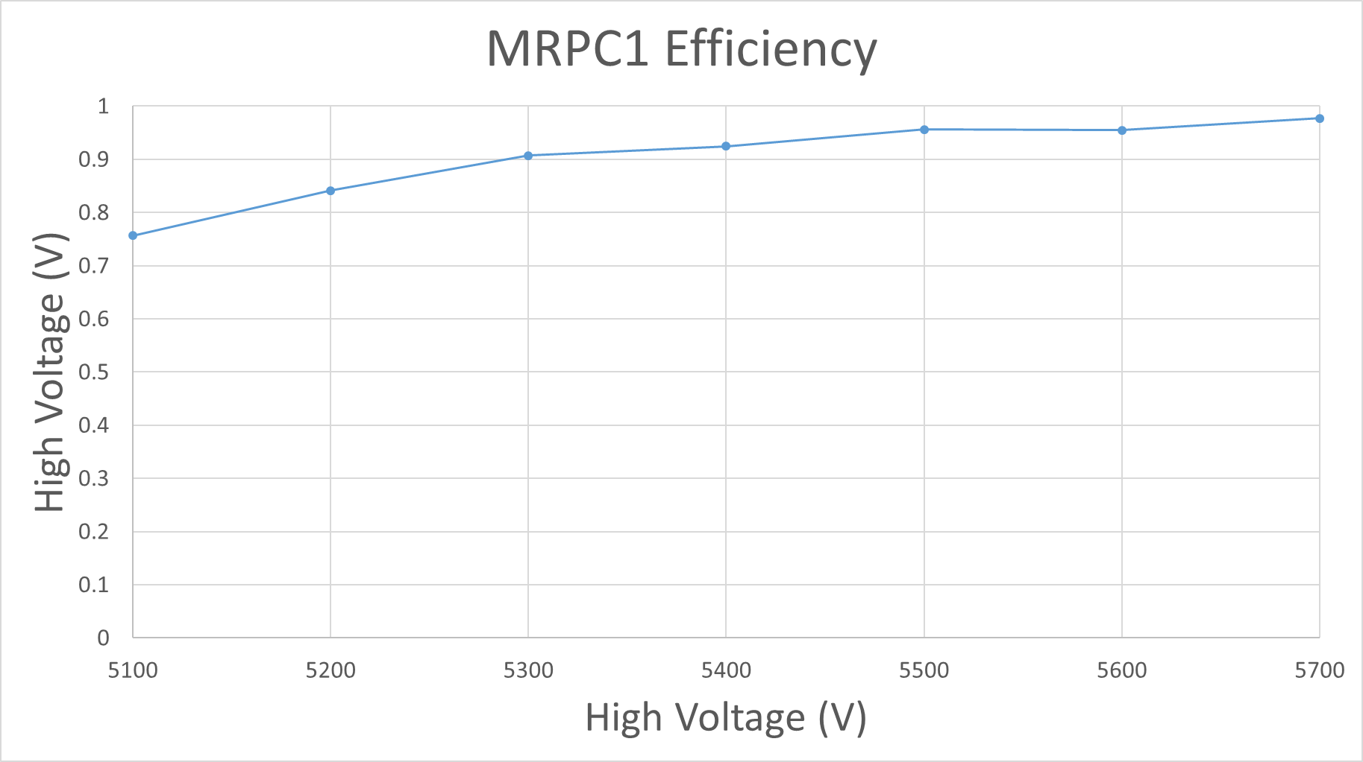
Cosmic test result – PMT Trigger
System verification
Efficiency ＞ 98 % under a HV = ±5700 V

Slide 15
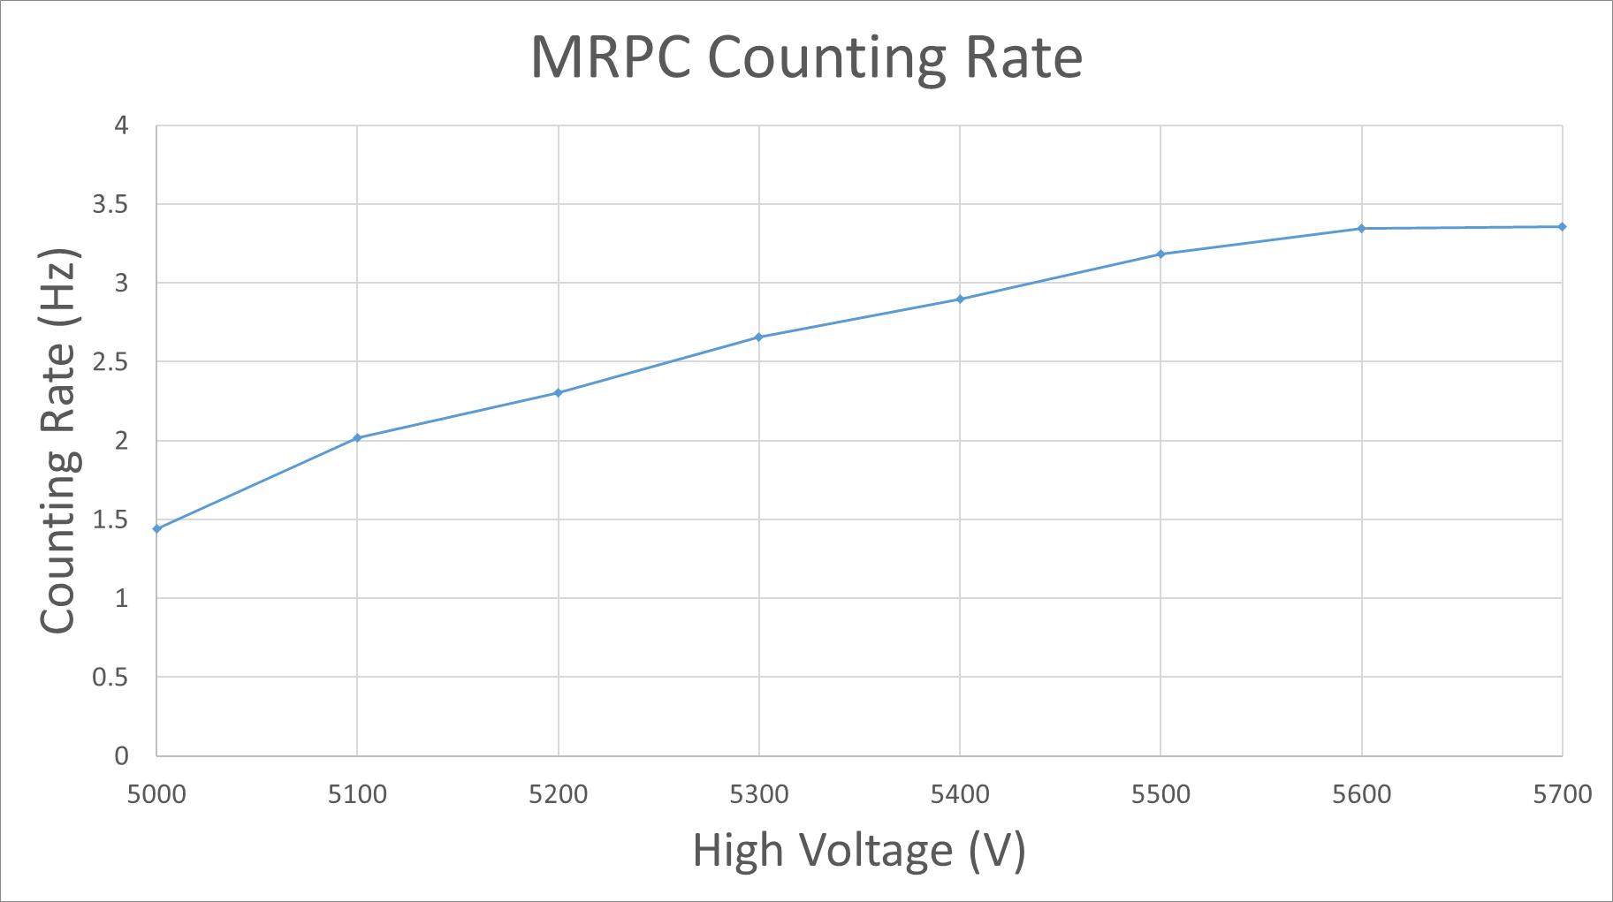
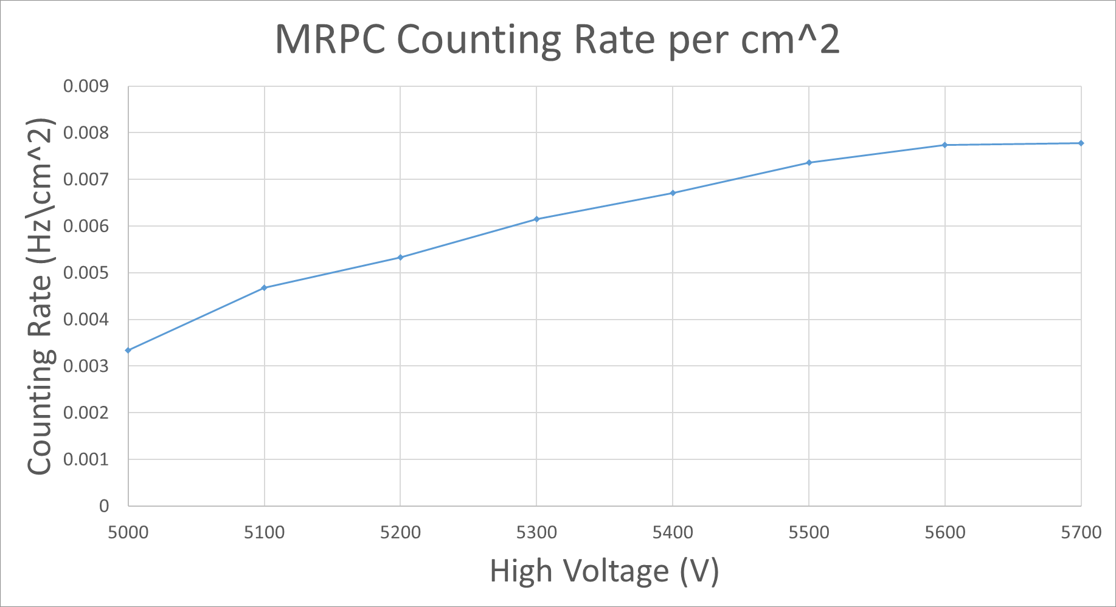
2 MRPC Self Trigger
Typically cosmic ray muon flux rate Rμ ≈ 1 min⁻¹cm⁻² ≈ 0.017 Hz/cm²
Given the angle distribution of cosmic ray muons and the geometry between the two detectors, about 60% of muons passing through one MRPC will also pass through the other
If geometric parameters G ≈ 0.6 is considered, R_{MRPC}/G = 0.013 ≈ Rμ
MRPC counting rate is similar to the cosmic muon rate.

Slide 16
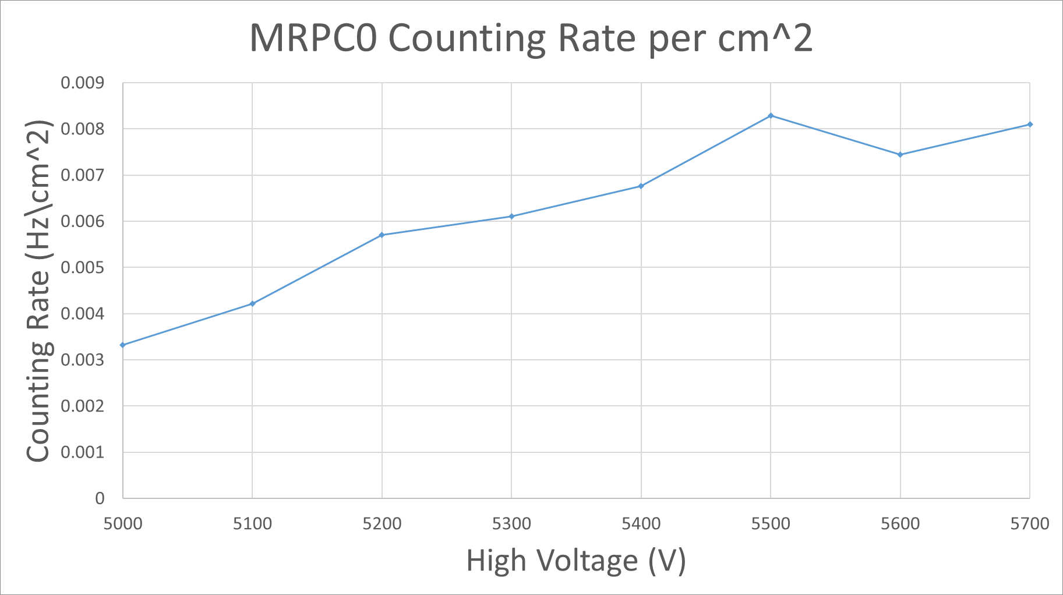
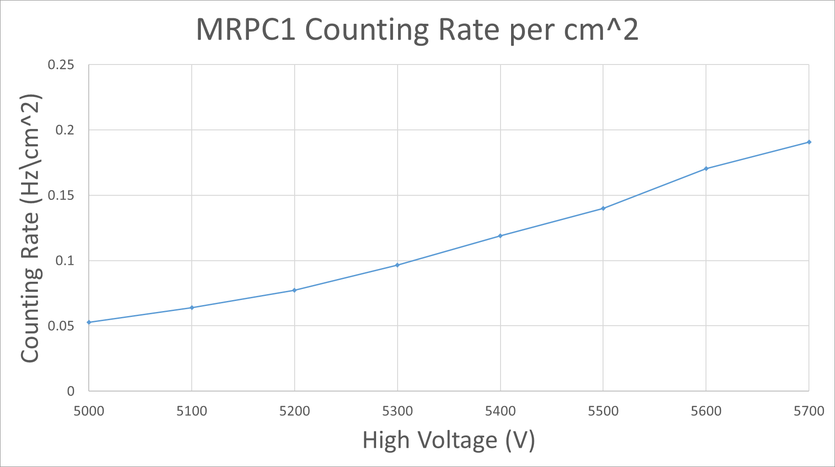
1 MRPC Self Trigger
Use MRPC1 as Trigger
Rate of MRPC0 is similar with rate at 2 MRPC Trigger– Proving That’s real cosmic signal rate
Rate of MRPC1 represents the entire signal rate including noise and real signal

Slide 17
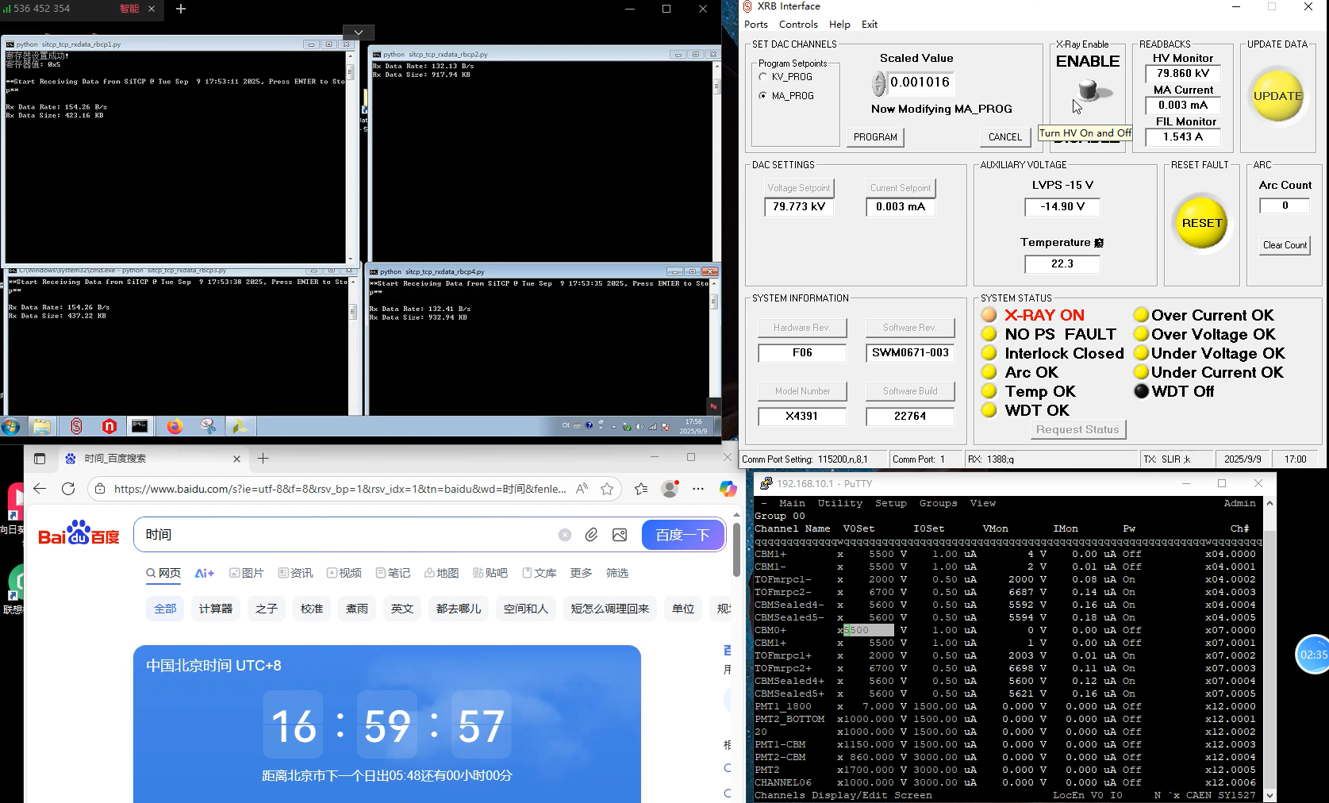
X - ray Experiment
Electronic readout System
X-ray
Control
Date & Time
Voltage & Current
Fig: The X-ray experiment is under commissioning and progressing smoothly.

Slide 18
Summary

Slide 19
Summary
MRPC Production Progress
120 MRPC2 detectors produced, 460 remaining to be produced.
Total timeline including test of 460 MRPC2: 12 months.
Funding requirement: 0.3 million EUR.
Research on High-Rate Beam MRPC
X-ray experiments are ongoing to simulate high beam flux.
Focus on spacer behavior under high flux conditions.
Future Production Plans
New workshops in Beijing and Yichang.
Increasing manufacturing capacity for upcoming production.

Slide 20
Thank You!

