Slide 1


46th CBM Collaboration Meeting
IMP-CAS
Lanzhou, China
High Voltage Power Supply System
Han Zhang，Juan Li
Institute of Modern Physics(IMP)
October 21，2025
Notes:
Good afternoon everyone。I‘m Han Zhang。from the Institute of Modern Physics。The topic of my report 。is the high-voltage power supply system。

Slide 2
Why should we develop our own high-voltage power supply system?
Supply Cycle
Maintenance Time
Domestic Technology
Notes:
Before I begin my presentation。There is a question。Why should we develop our own high-voltage power supply system? There are three main reasons。
First issue。Supply cycle。 Some of these power units。can take six months to a year just to arrive。
Then there is the maintenance issue。If something breaks。 waiting for their tech support。can take ages。
And thirdly。the technology here in China。is now fully mature。
These are the key reasons。we need to independently develop the high-voltage power supply system。

Slide 3
CONTENTS
Single-channel High-voltage Power Supply System
Four-channel High-voltage Power Supply System
Eight-channel High-voltage Power Supply System
Notes:
My presentation will focus on the following three points。the single-channel。the four-channel。and the eight-channel high-voltage power supply system。I will now introduce each of them one by one。

Slide 4
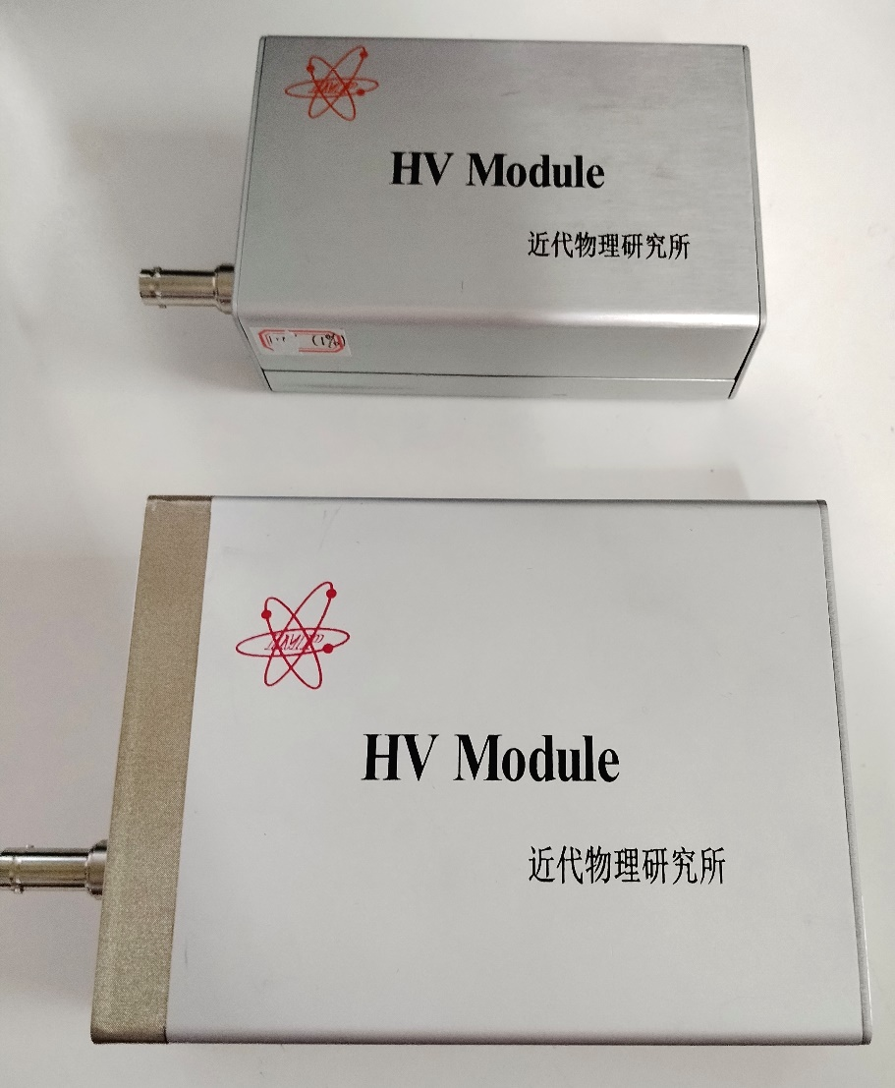
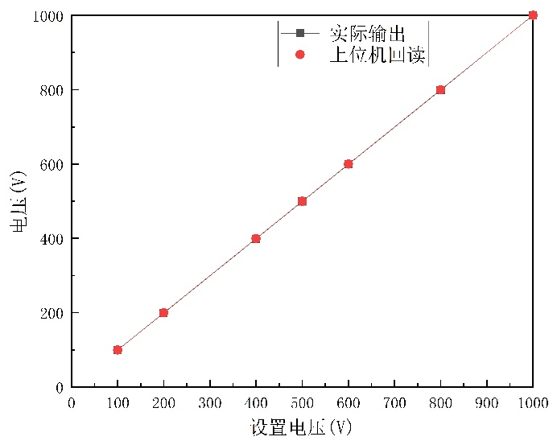
Single-channel High-voltage Power Supply System
Types of Power Supply | Voltage | Current
1 | 2kV | 1mA
2 | -2kV | 1mA
3 | 5kV | 1mA
4 | -5kV | 1mA
±2KV
Ripple test results ：13ppm@1800V
±5KV
2000V power supply linearity test
Single-channel power supply
Notes:
We have four types of single-channel power supplies。Positive and Negative two thousand volts。Positive and Negative five thousand volts。Their output current is one milliampere。And we did a linearity test on the two thousand volts power supply。The output and readback voltages are pretty much the same。When the output voltage is one thousand eight hundred volts。The ripple is thirteen ppm。

Slide 5
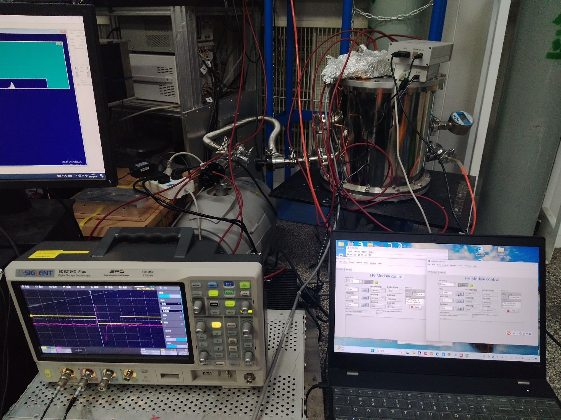
On-site Testing For TPC Application
High-voltage power supply
Host computer interface
Notes:
This is our in-house developed power supply in a practical experimental application。It powers the TPC。The power supply works normally。And we can monitor and control the power supply in real time from the computer。

Slide 6
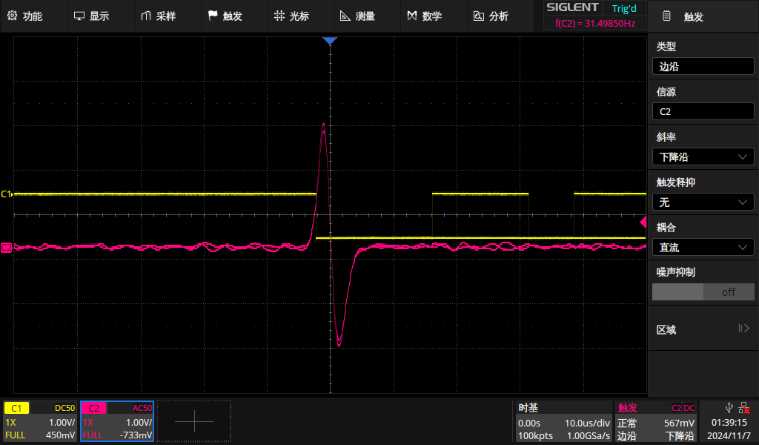
Test In The Ionization Chamber（Composed of a cathode, field cage, grid, and anode）
The comparative test between the self-developed power supply and the German ISEG power supply
(-2kV and -5kV power supplies).
Voltage | Self-developed resolution | ISEG SHR resolution
C-2100V G-300V | 4.573% | 4.801%
C-2600V G-600V | 4.365% | 5.665%
C-3000V G-900V | 5.761% | 7.231%
Oscilloscope signal acquisition diagram
Notes:
We tested different power supplies in the ionization chamber。This ionization chamber consists of a cathode, a field cage, a grid, and an anode。The test results indicate that。our self-developed power supplies perform similarly to the German ISEG SHR models。

Slide 7
CONTENTS
Single-channel High-Voltage Power Supply System
Four-channel High-Voltage Power Supply System
Eight-channel High-Voltage Power Supply System
Notes:
The use of single-channel power supplies has its limitations。So we built a 4-channel high-voltage power supply for more complex experiments。

Slide 8
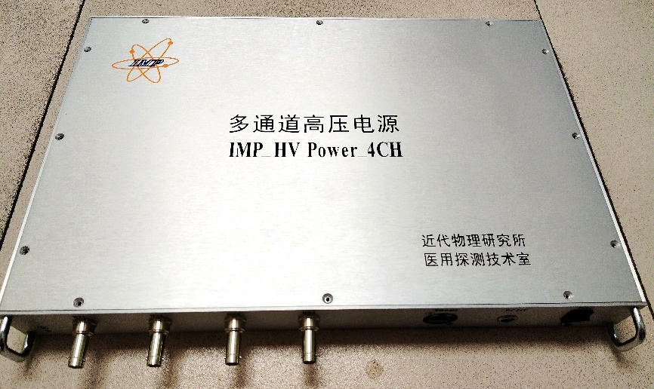
Four-channel High-voltage Power Supply System
Technical Specifications：
Four-channel independent output, control, and display；
Ripple ≤ 10ppm；
RJ45 gigabit ethernet port for remote control；
Powered by 24V, 3A；
19-inch 1U chassis 426mm×286mm × 44mm；
Four-channel high-voltage power supply system
Notes:
This is the self-developed four-channel high-voltage power supply system。All four channels。support independent output, independent control。and independent display。And the ripple of each channel is less than ten millivolts。It also has an RJ45 port。So we can control it remotely。

Slide 9
CONTENTS
Single-channel High-Voltage Power Supply System
Four-channel High-Voltage Power Supply System
Eight-channel High-Voltage Power Supply System
Notes:
To meet the needs of various scenarios。We have also developed the 8-channel high-voltage power supply system。

Slide 10
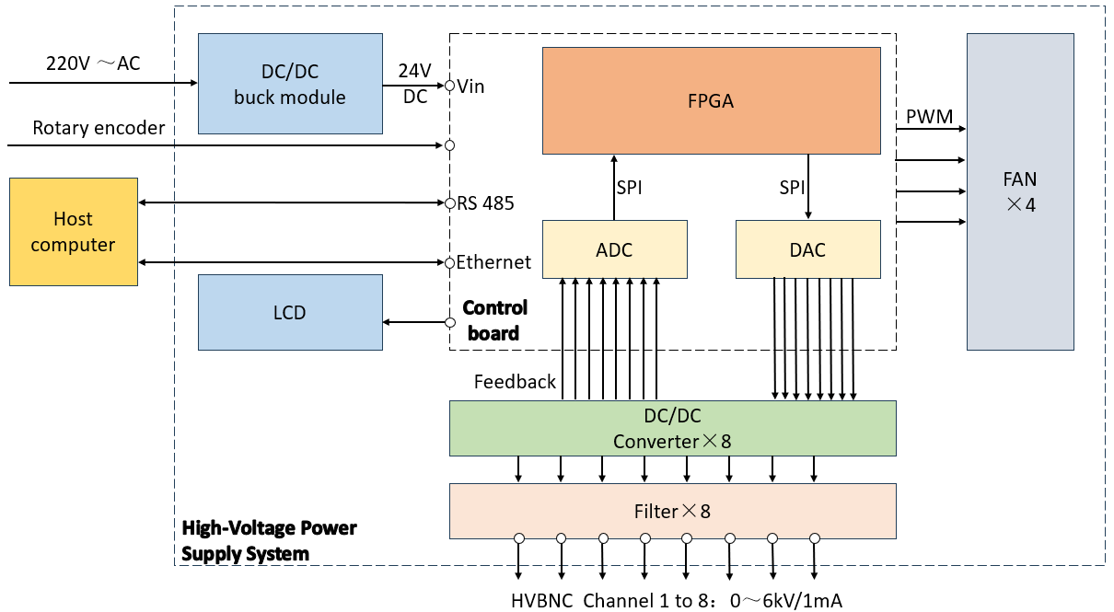
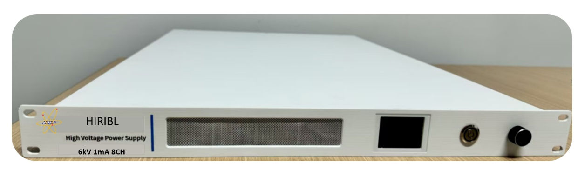
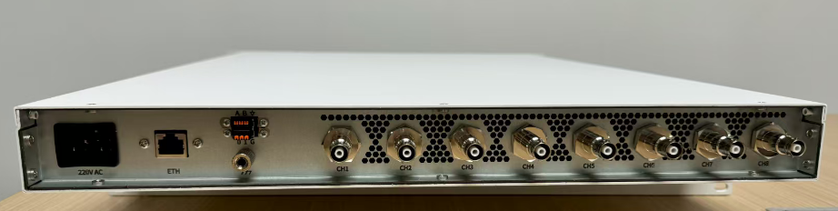
Eight-channel High-voltage Power Supply System
Technical specifications：
1U standard rack-mountable, 580mm depth；
8-channel, 6kV/1mA, with three control modes (RS485/Web/EPICS)；
Integrated with FPGA for easy functional expansion, such as triggering and safety interlock；
Notes:
This is the eight-channel high-voltage power supply system。This system also supports independent output, control, and display for all eight channels。It has an RJ45 port。and an RS485 port。So we can achieve remote control。There is an LCD screen on the front of the device。We can monitor the device‘s output voltage。and current in real time。And the black knob on the right。can adjust the output voltage of each channel。
Here is the logic diagram。To enhance system integration and improve reliability。We have replaced the MCU with an FPGA as the core control unit。Now。I will present some of the test results。

Slide 11
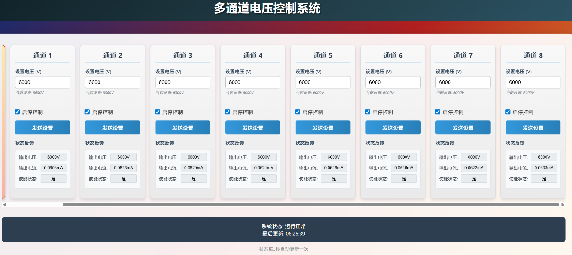
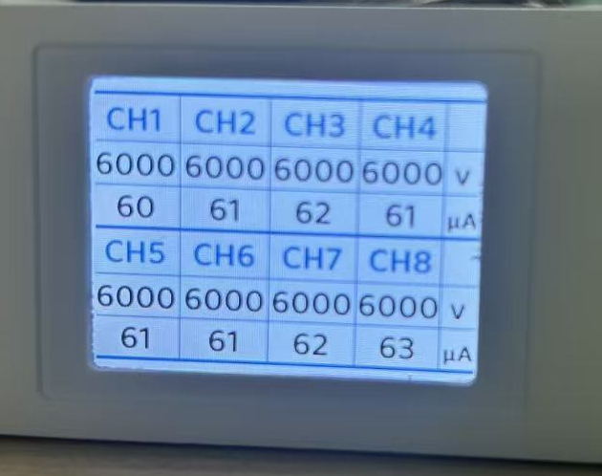
Web Interface And No-Load Test
The output voltage of all 8 channels is set to 6kV
No-load test
Web interface
LCD
Notes:
Look at the web page on the left。We can perform independent 8-channel control here。And each channel can be individually started and stopped。Meanwhile。we can observe the output voltage, output current, and enable status of each channel。
During no-load testing。We set the output to six kilovolts。The system works normally。Meanwhile, we can monitor the output voltage and current on the LCD screen。Based on multiple tests。the output voltage deviation is within two volts。

Slide 12
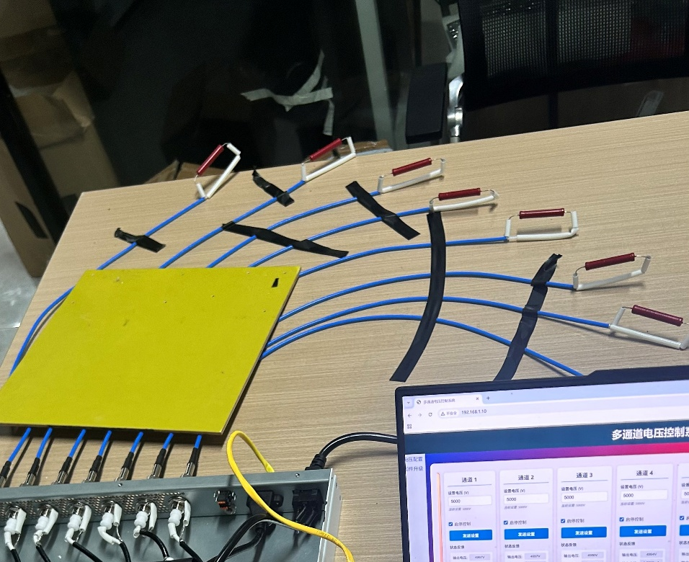
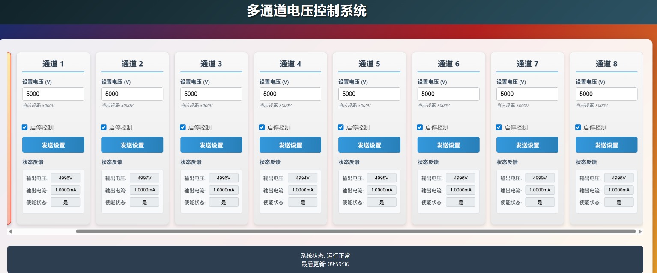
Load Test
All 8 channels loaded with 5MΩ
Experimental platform
Web interface
Notes:
During load testing。We connect all eight channels to five meg ohm loads。The system works normally。And the output current of all 8 channels is one milliampere。

Slide 13
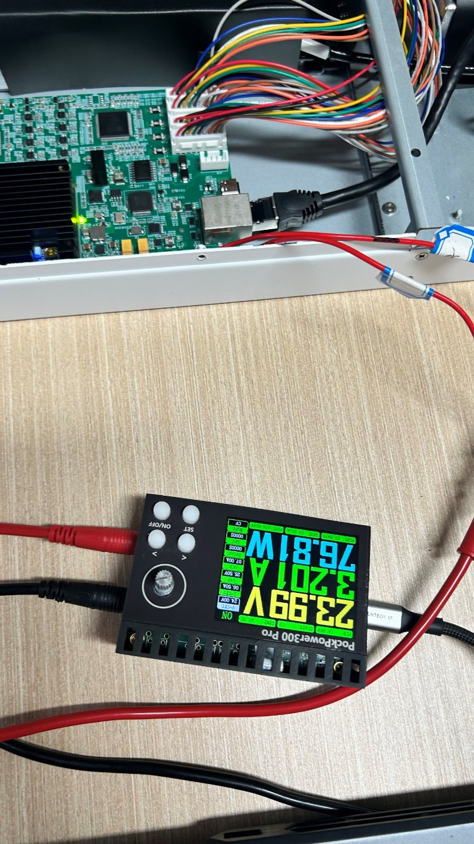
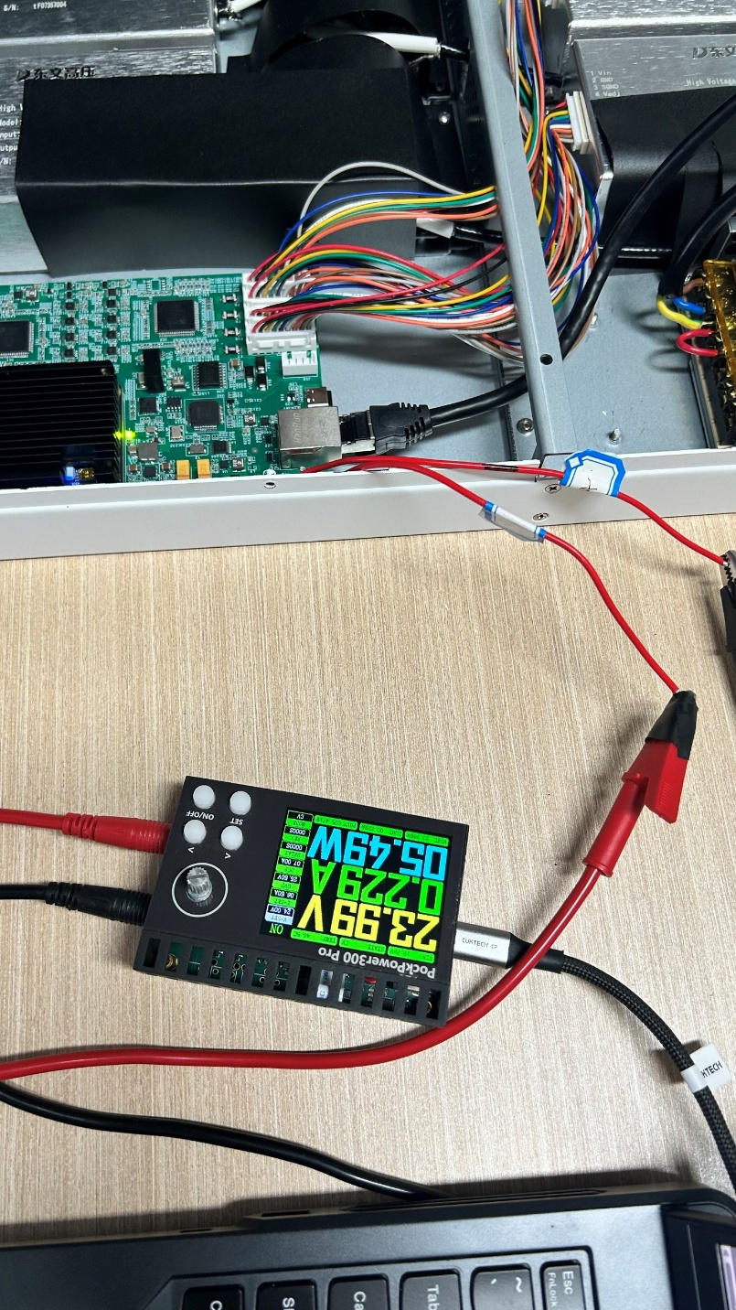
Power test
All 8 channels loaded at 5MΩ each；
The system power consumption is 76.81W
All 8 channels under no-load conditions；
The system power consumption is 5.49W
Notes:
Under the same conditions。We connect the programmable power supply to the control board。We can observe an input voltage of 24 volts, an input current of 3.2 amps, and a system power of 76.81 watts。When we disconnect all 8 output channels, the system power is about 5.5 watts。

Slide 14
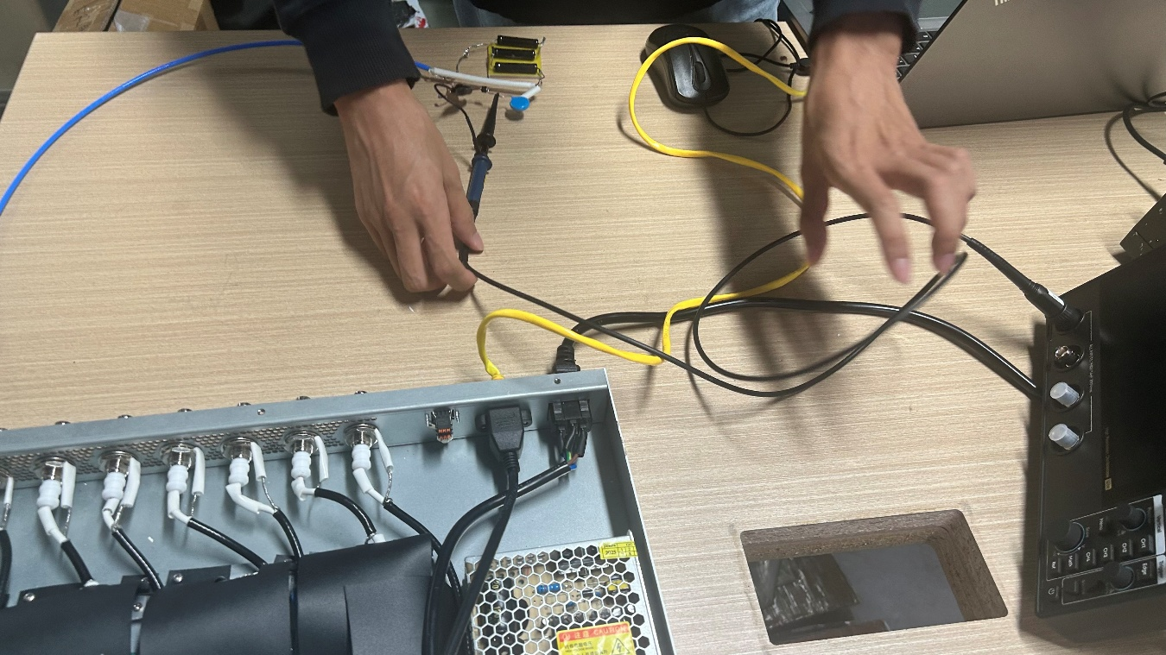
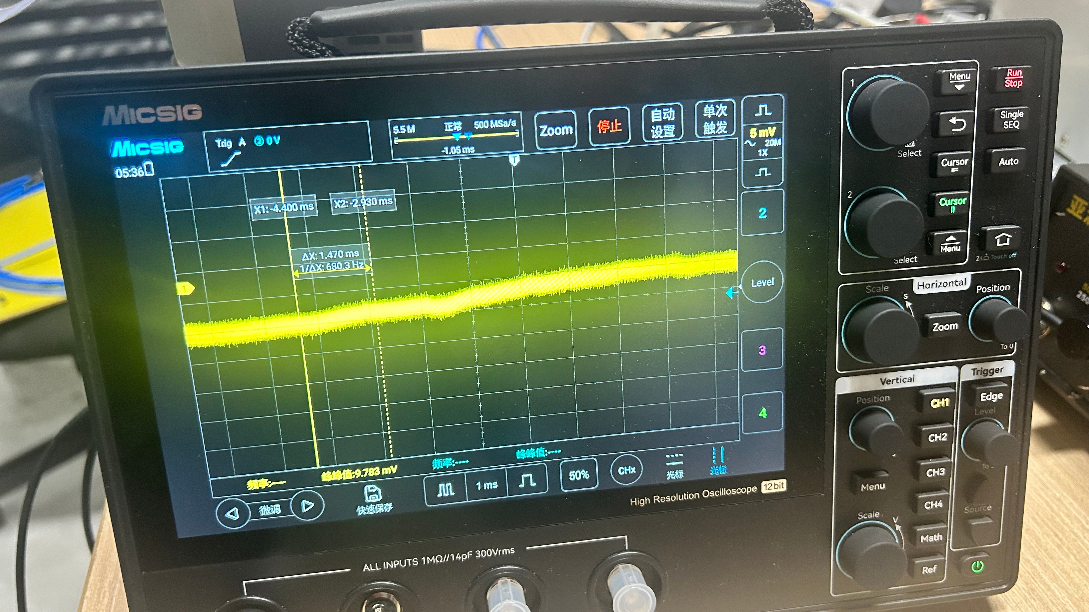
Single-channel Ripple Test
The output is 5kV
Loaded with 5MΩ
Experimental platform
Vp-p ≈ 5mV
Notes:
This is the ripple test on a single channel。The output is five kilovolts with a five megohm load。On the oscilloscope。 we can observe that the ripple is about five millivolts。

Slide 15
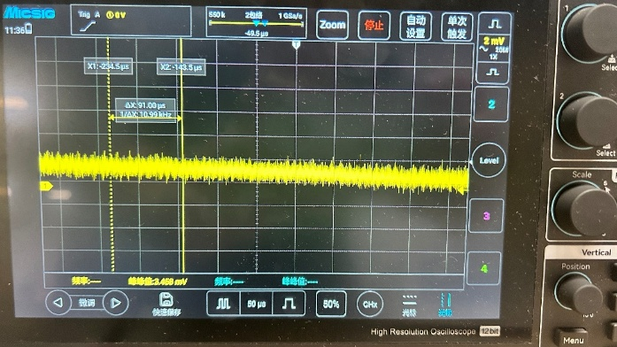
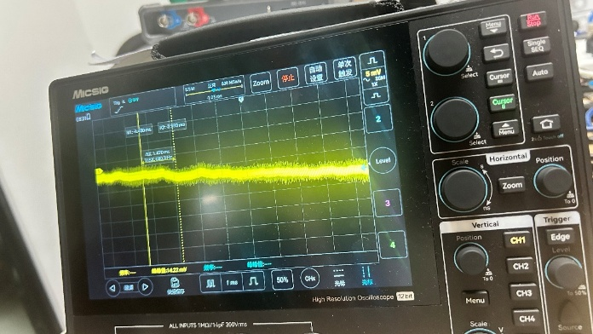
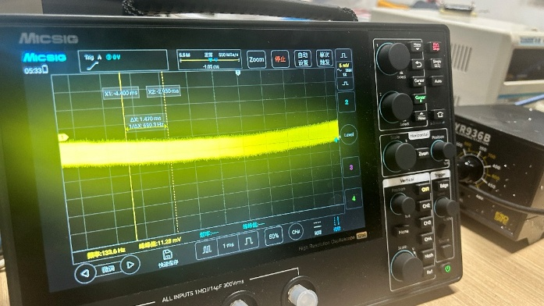
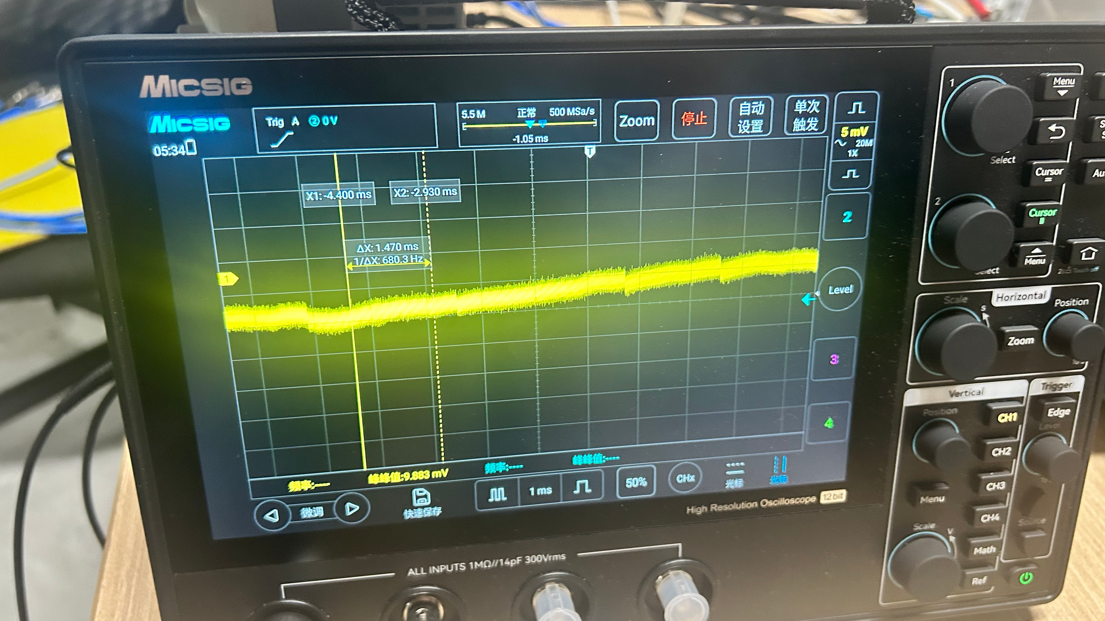
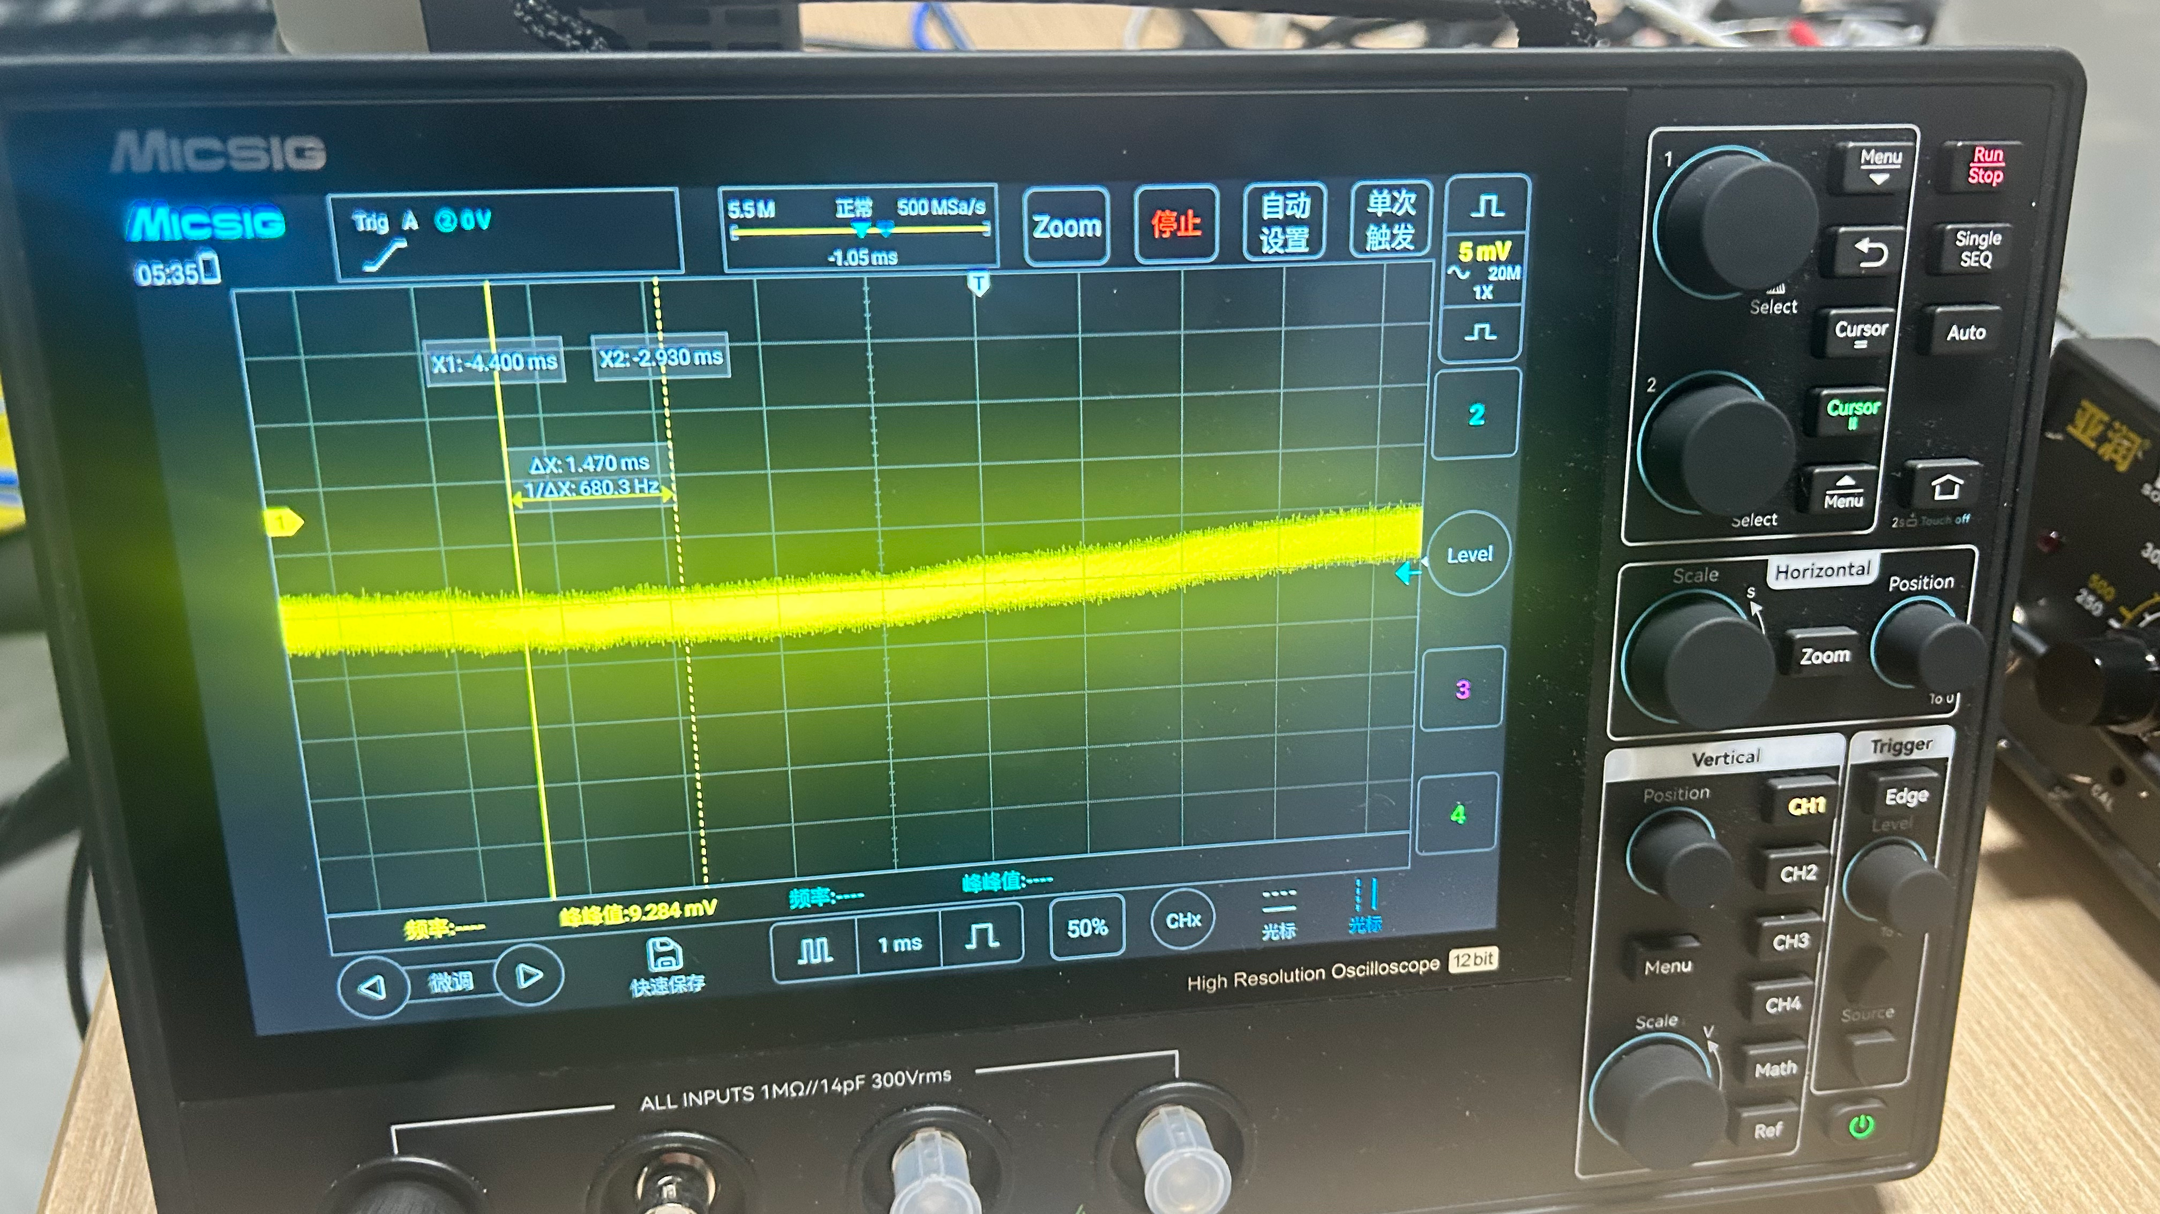
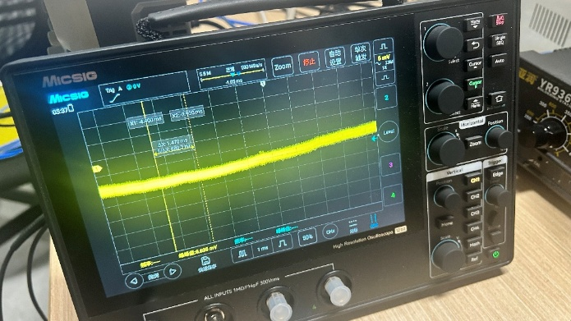
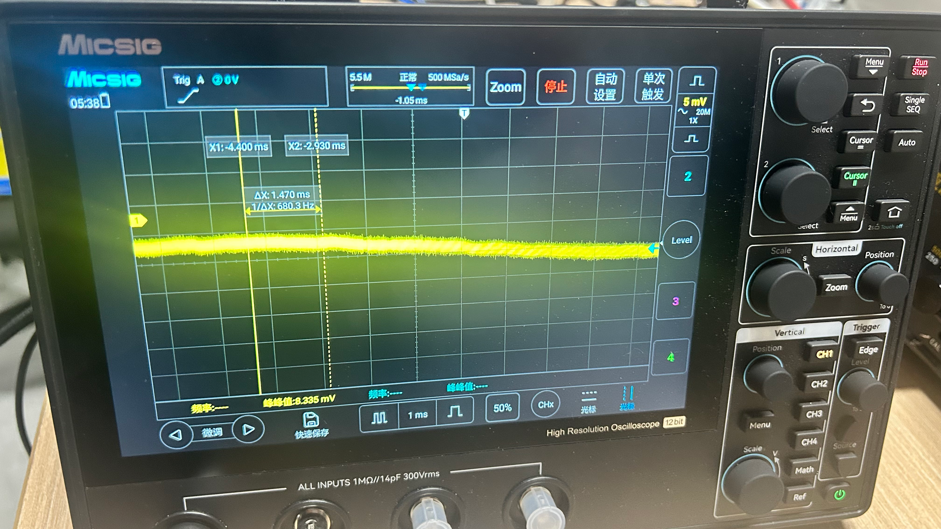
Eight-channel Ripple Test
The output of all 8 channels is 5kV
Loaded with 5MΩ
CH1 4mV
CH2 6mV
CH3 8mV
CH4 5mV
CH5 5mV
CH6 5mV
CH7 4mV
CH8 4mV
Notes:
We tested all 8 channels under the same conditions。Repeated experiments have shown that。the ripple of all 8 channels remains below ten millivolts。

Slide 16
Performance Comparison
Similar high-voltage power supply systems
The ripple of our in-house developed power supply system is comparable to that of the EHS F060p model from Germany's ISEG
Manufacturer | Equipment type | Ripple | Voltage accuracy | Voltage resolution
IMP-CAS | HIRIBL 8 Channels 6kV | 10mV P-P | ±2V | Web interface: 1V/Knob adjustment
ISEG | EHS F060p 16 Channels 6kV | 10mV P-P | / | /
CAEN | A7460 12 Channels 6kV | 5mV P-P | / | /
CAEN | A1632H 8 Channels 6kV | 3mV P-P | / | /
Notes:
After lots of tests, we see the ripple on our power supply staying under 10 millivolts。The voltage accuracy is about two volts。We can adjust the output voltage either through the web page or via the knob。Our power supply performance is close to the level achieved by international manufacturers

Slide 17
Thank you！
Notes:
OK。This is the end of my presentation。Thank you all for your attention。Now。I welcome questions and discussions from all the experts and professors!

