Slide 1
RDMA-based Data Transmission System Prototype
Yuqiao Zhang , Min Li, Kai Zhou, Kejie You, Han Zhang
Institute of Modern Physics（IMP）
October 21, 2025

Slide 2
CONTENTS
Introduction of RDMA Data Transmission System
Preliminary Application of the System
Software update & optimization
Conclusion

Slide 3
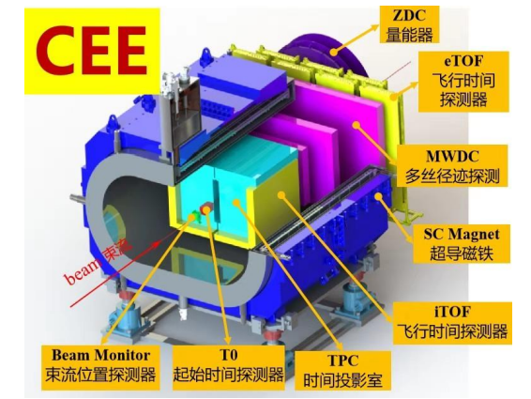
Why We Choose RDMA Technology
CEE: CSR External-Target Experiment, it will be the first-large nulclear physics experimental device at HIRFL-CSR, heavy-ion collisions
The experimental requirement for real-time data transmission throughput is > 5 GB/s.
The network communication is implemented using the TCP/IP infrastructure
Notes:
As you can see, the CEE network architecture adopts a three-layer structure. Some relevant communication protocols used, such as EPICS CA and ZeroMQ, are built on the TCP/IP nfrastructure, so the TCP is the cornerstone of CEE network communication.

Slide 4
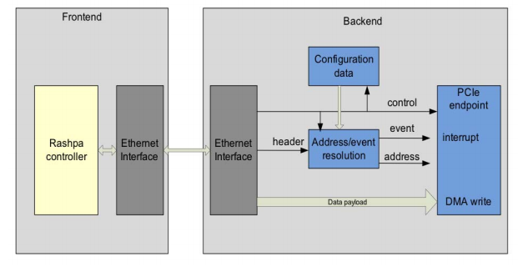
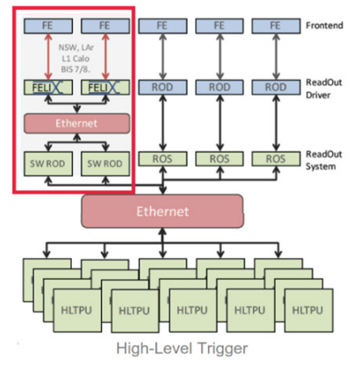
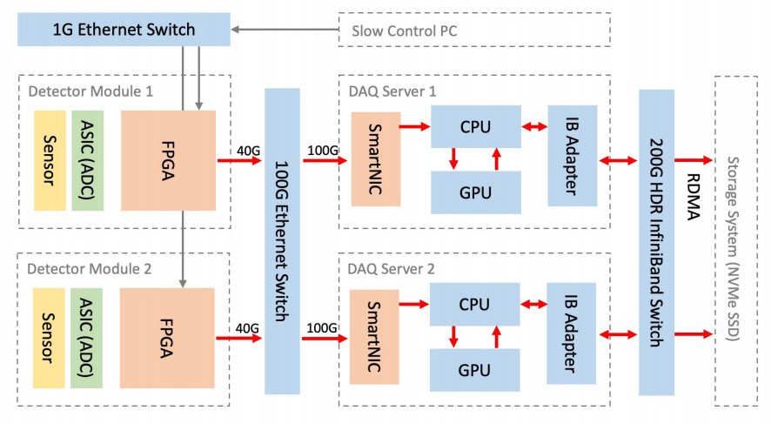
Why We Choose RDMA Technology
Many institutions choose RDMA as a performance boost solution for their next-gen data transmission systems.
ESRF’s RASHPA framework
FELIX-RDMA
STARLIGHT Transmission Architecture
Traditional TCP solutions : cross-machine data-copy, kernel scheduling jitter, and tail latency.
Infiniband/RDMA has become the "standard component" in HPC and large-scale science.
Notes:
Computer and electronic communication tech is getting better all the time, when we comes to high-throughput data transmission, the old TCP protocol starts having problems and bottlenecks.
For reference, a lot of major research institutions choose RDMA as a performance boost solution for their next-gen data transmission systems, And Infiniband/RDMA basically becomes a "standard part" now for HPC and large-scale science projects

Slide 5
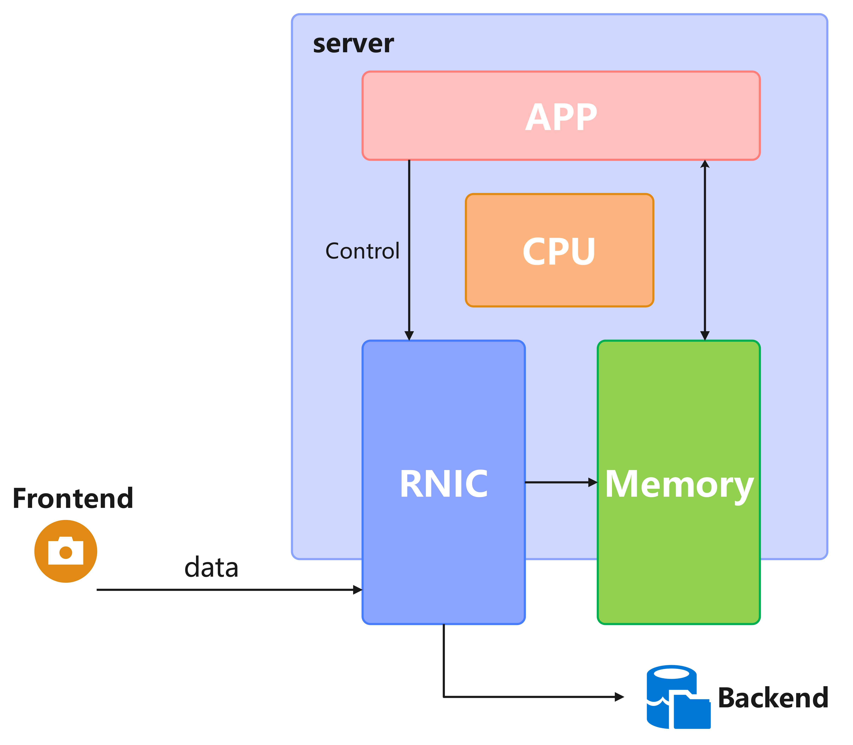
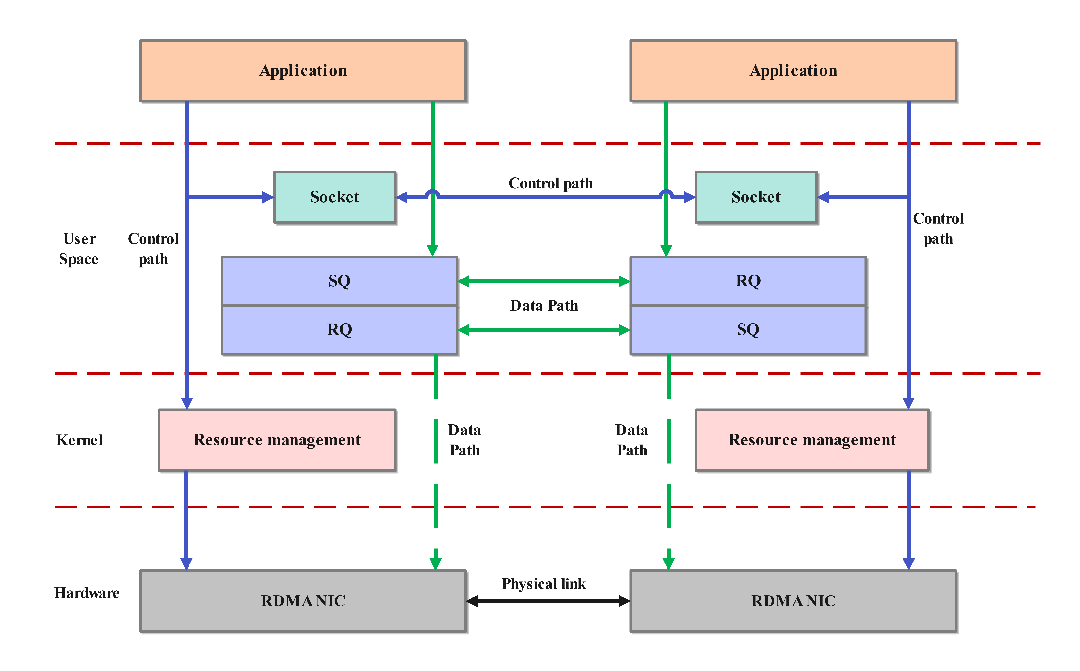
Design of RDMA Data Transmission System
Composed of control path and data path;
control path handles low-frequency kernel operations, data path managing high-frequency transmission
Basic data flow
Control path and Data path
Notes:
So because of this, we designed and built a prototype RDMA data transmission system for handling the growth of data transmission in the future.
The basic idea behind the design is this: the network card does direct DMA to the pre-registered memory of the process, and moves data directly.
The system uses a two-channel structure: RDMA for the data side and TCP/HTTP for the control side. The control side handles low-frequency operations, while the data side takes care of high-frequency ones.

Slide 6
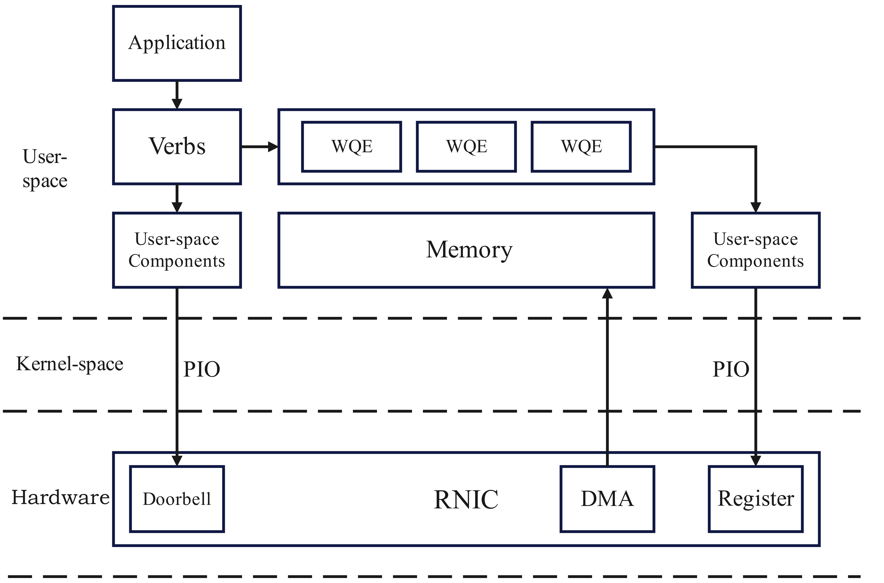
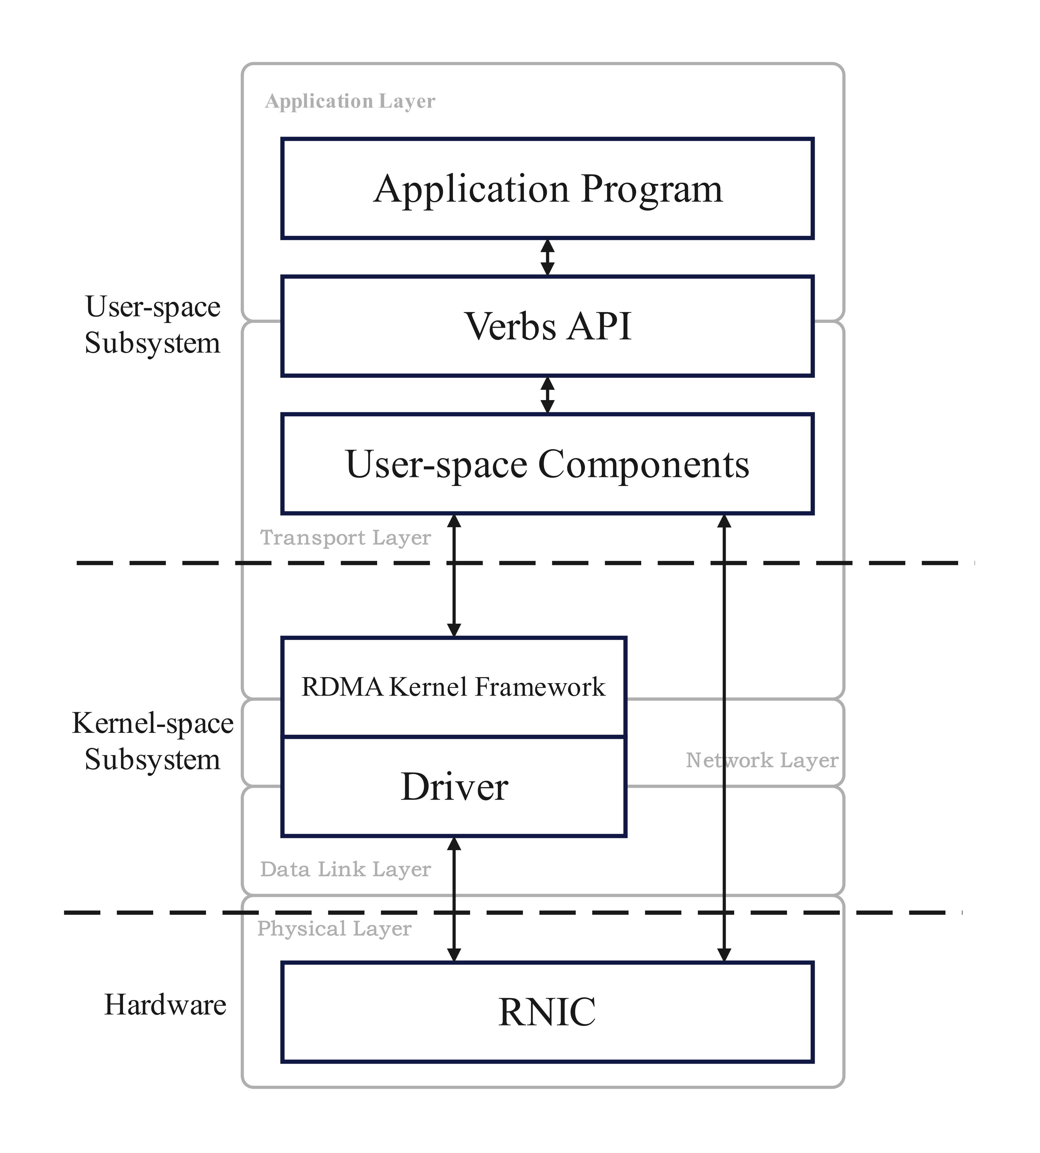
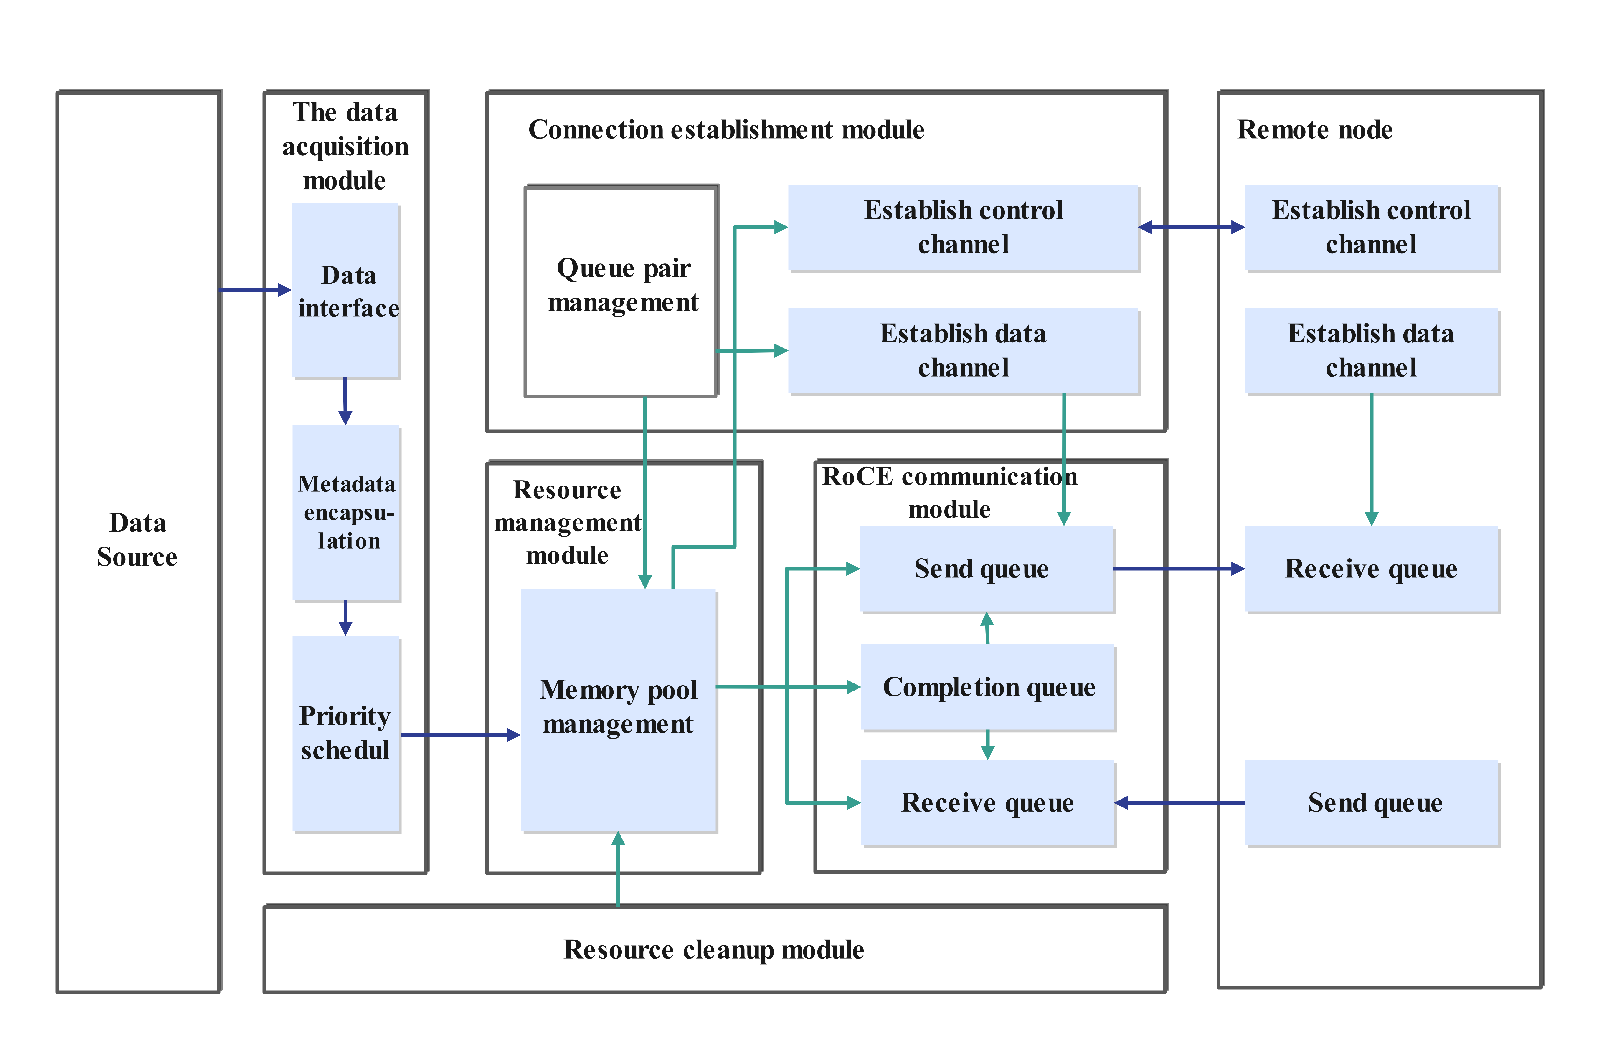
Design of RDMA Data Transmission System
Combined with network communication models, the system architecture is designed in layers
System Layering
Kernel Bypass
Programmed I/O, Doorbell, Memory Mapping, DMA
Basic System Structure
Notes:
Building on the classic network model, we designed the transport system's layered structure.The user-mode subsystem is on top. It handles interactions between upper apps and lower hardware.The kernel-mode subsystem is Linux's RDMA kernel framework and NIC drivers , let apps access devices via Verbs.
We also use Programmed I/O, Doorbell, Memory Mapping, DMA and other mechanisms to bypass the kernel for data movement.
As for Application basic sysytem structure, We split the user-mode app into six functional modules that work together. They cover the full process from data acquisition to high-speed transmission.

Slide 7
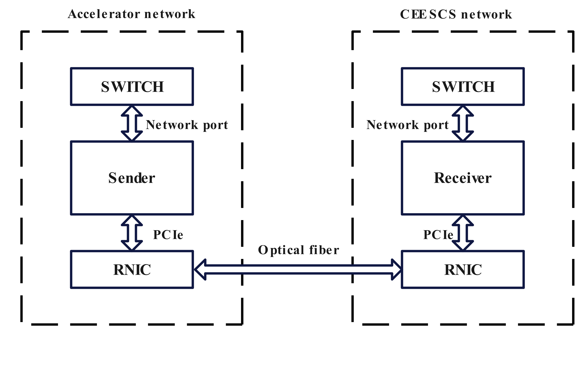
Data Transmission Test
The sender node connects to the accelerator network to acquire PVs and transmit it to the CEE DCS
Configuration | Sender/Receiver
CPU | Core i7-10700
Thread/Core | 8 cores / 16 threads
Memory | 16GB
Memory frequency | DDR4 2667MHz
Operating system | Ubuntu64 20.04
Network Card | M2890-2QSFP200G
Driver | MLNX_OFED_LINUX-5.8-3.0.7.0
Transmission medium | Optical fiber
EPICS base | 7.0.4.1
Pylon | 5.0.12
one sender and one receiver node with identical hardware and software conditions
Notes:
Once we designed and built the system, we ran initial tests to check the systems’ performance advantages.
2 servers were connected(one on as sender the accelerator network, the other as receiver on the CEE DCS network) via optical fibers , we conduct cross-network PV data transmission situiation.

Slide 8
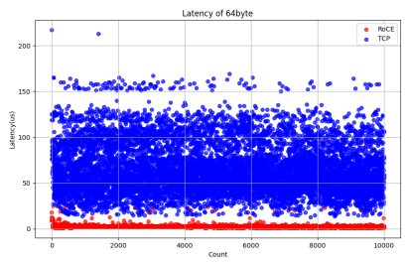
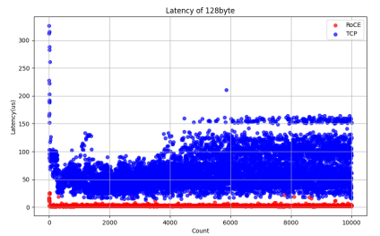
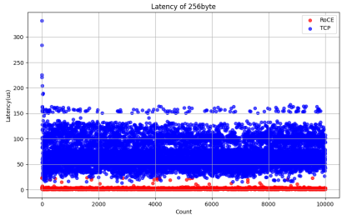
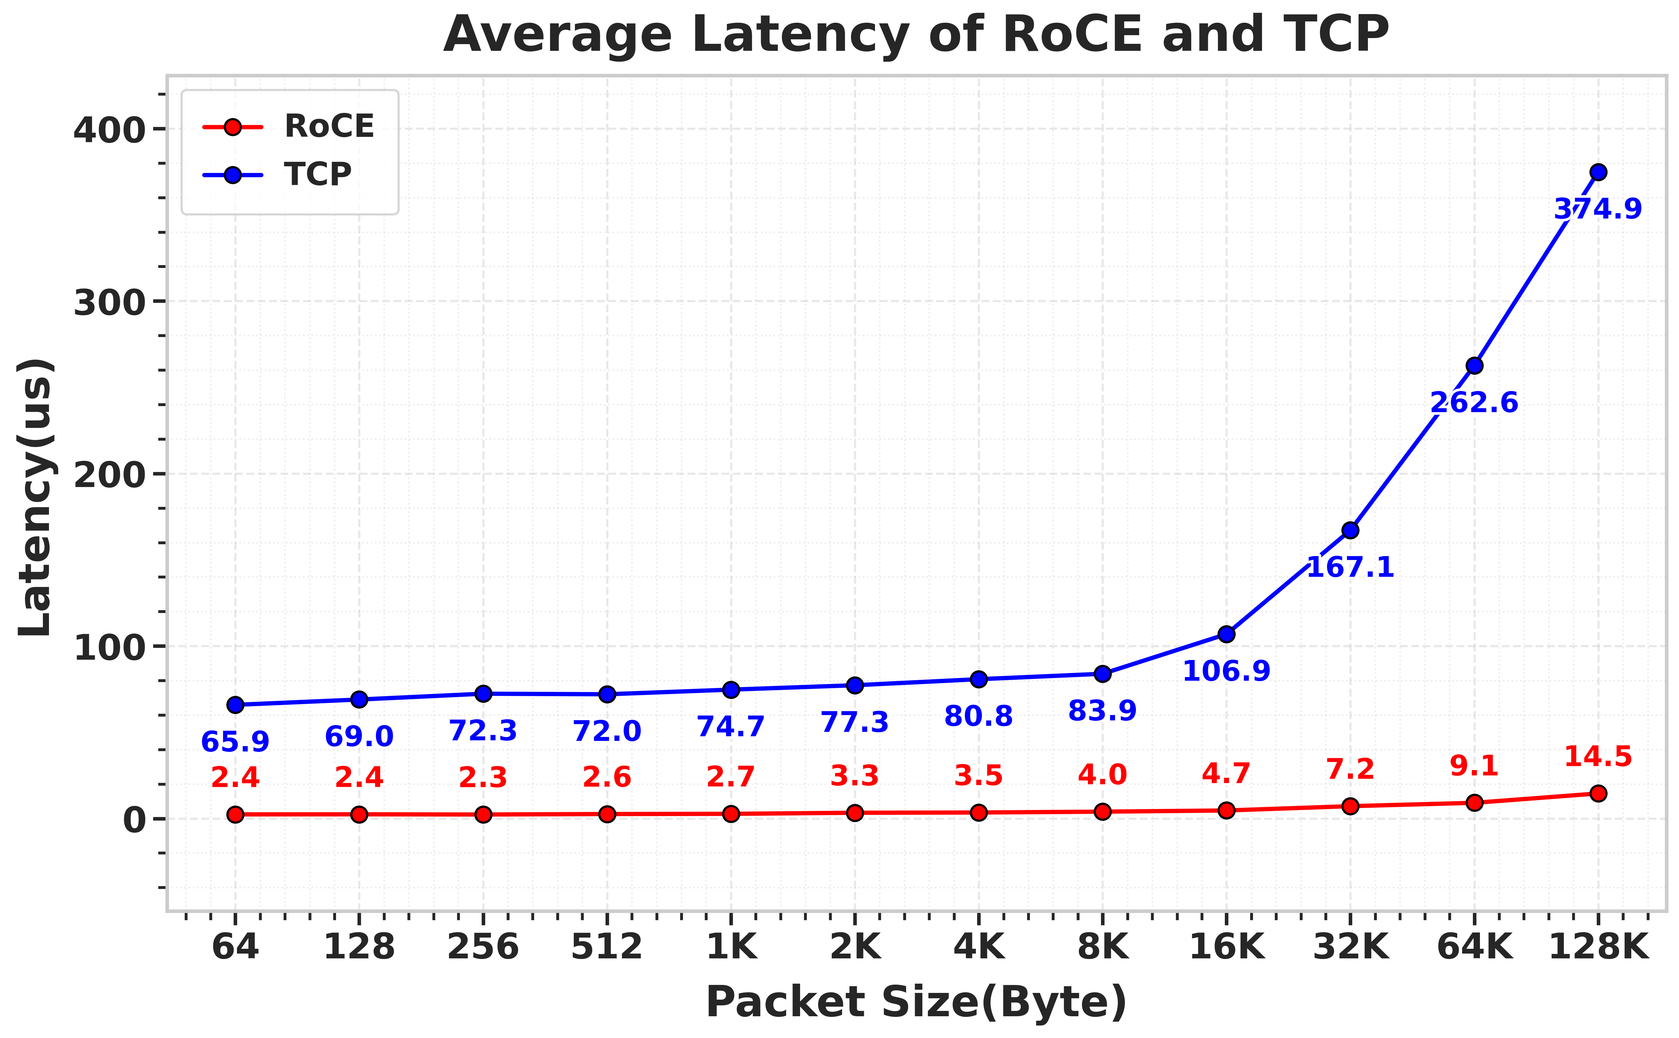
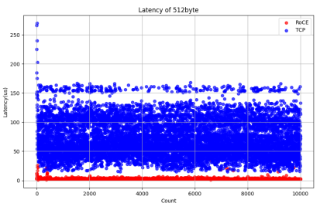
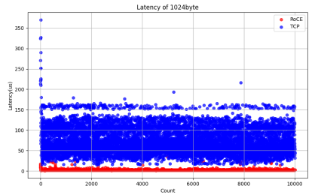
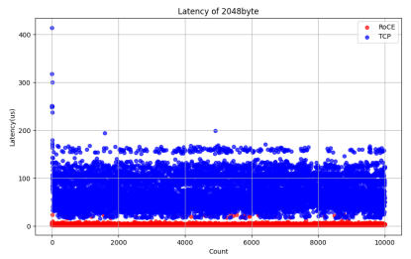
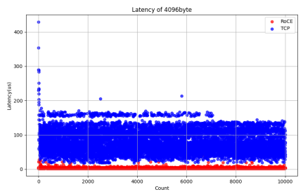
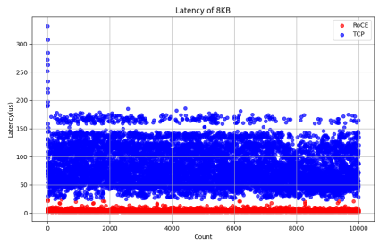
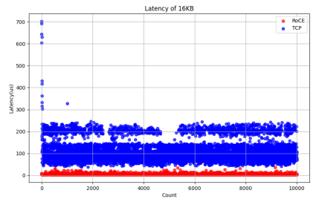
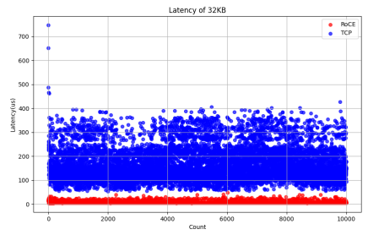
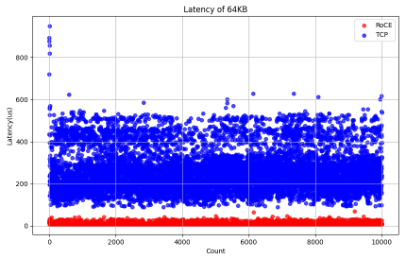
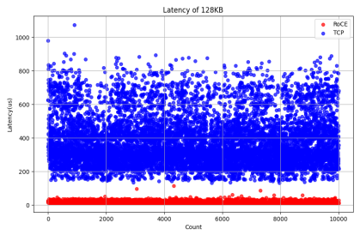
Data Transmission Test
Conduct preliminary tests to compare the data transmission performance of RDMA and traditional TCP transmission systems.
Three performance metrics: Latency, Throughput, and CPU Utilization.
64Byte
128Byte
256Byte
512Byte
1KB
2KB
4KB
8KB
16KB
Avergae Latency comparison
32KB
64KB
128KB
Notes:
Set the RDMA data transmission system as the experimental group and the TCP one as the control group. We compared them across three performance metrics: latency, throughput, and CPU utilization.

Slide 9
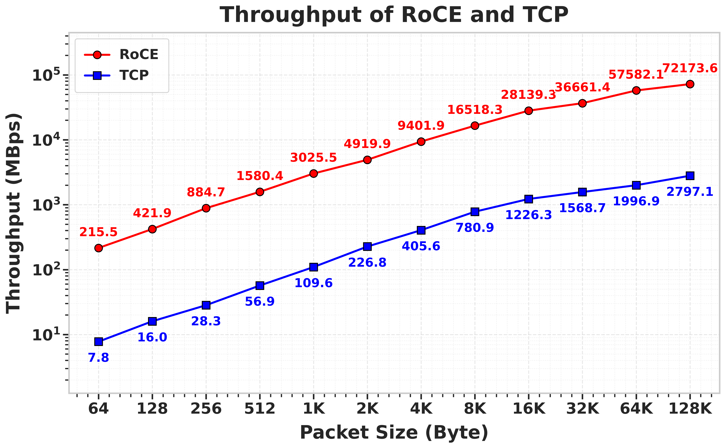
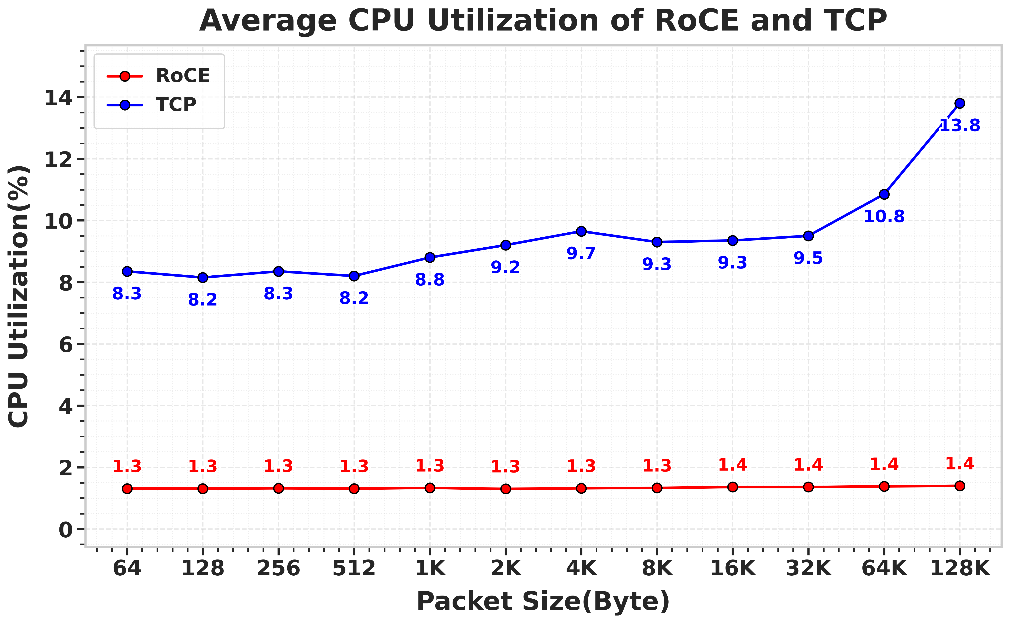
Data Transmission Test
Three performance metrics: Latency, Throughput, and CPU Utilization.
Throughput comparison
Average CPU utilization comparison
RDMA reduced latency by 96.3%, increased throughput by 95.1%, and lowered CPU utilization by 85.6% compared to TCP.
μ_{avg}: overall average improvement, the interval [i,j]: the range of lengths for the data packets,
Q: the test value of RoCE, P: the test value of TCP, N: the number of different packet lengths.
Notes:
We used an "average performance improvement rate" formula to calculate the overall average improvement for each performance metric. After transmitting over 100,000 data packets and analyzing the results, we found that:
RDMA reduced latency by 96.3%, increased throughput by 95.1%, and lowered CPU utilization by 85.6% compared to TCP.
This initially proves the system’s performance advantages over traditional network transmission protocols.

Slide 10
CONTENTS
Introduction of RDMA Data Transmission System
Preliminary Application of the System
Software update & optimization
Conclusion

Slide 11
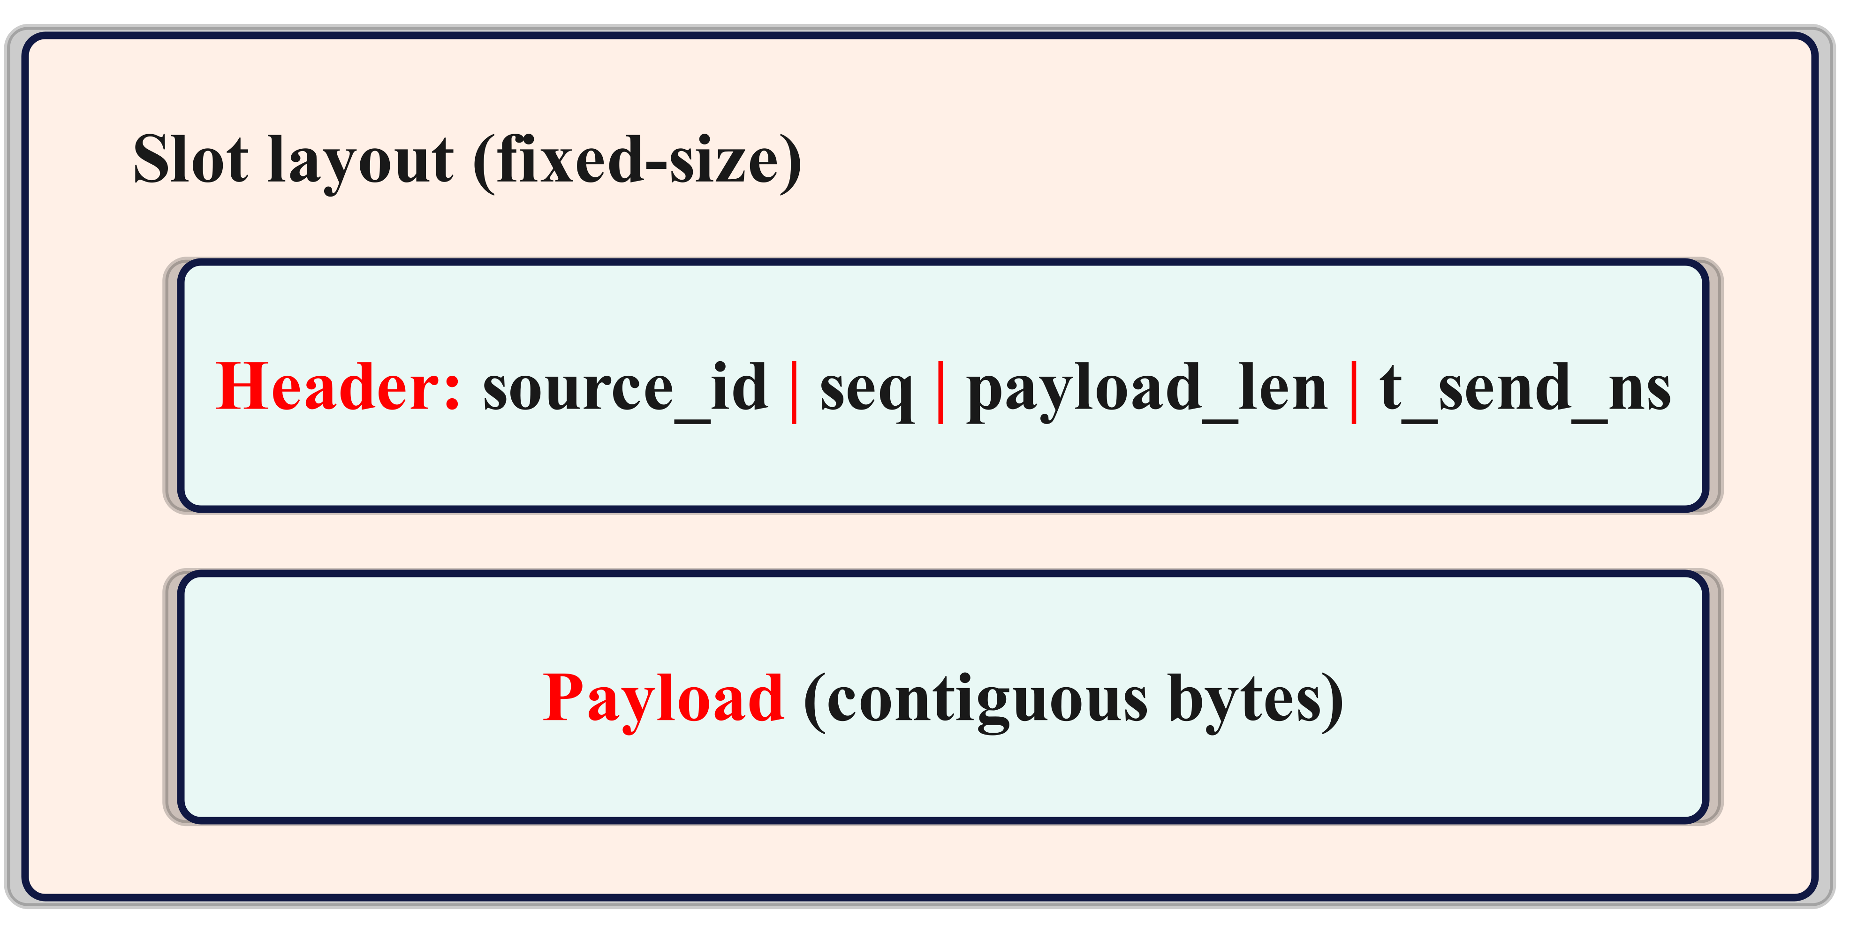
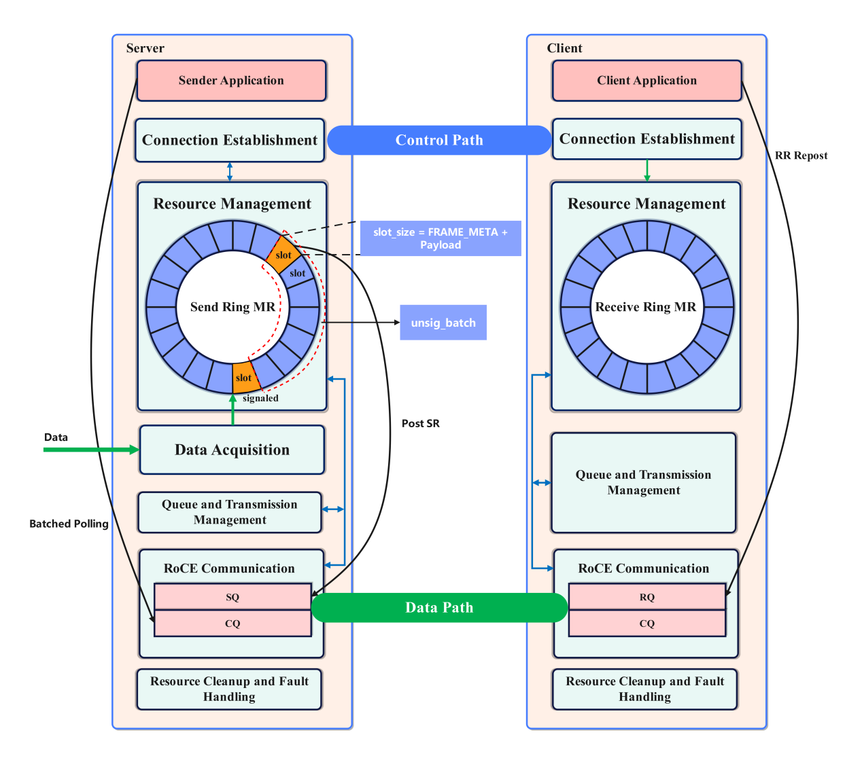
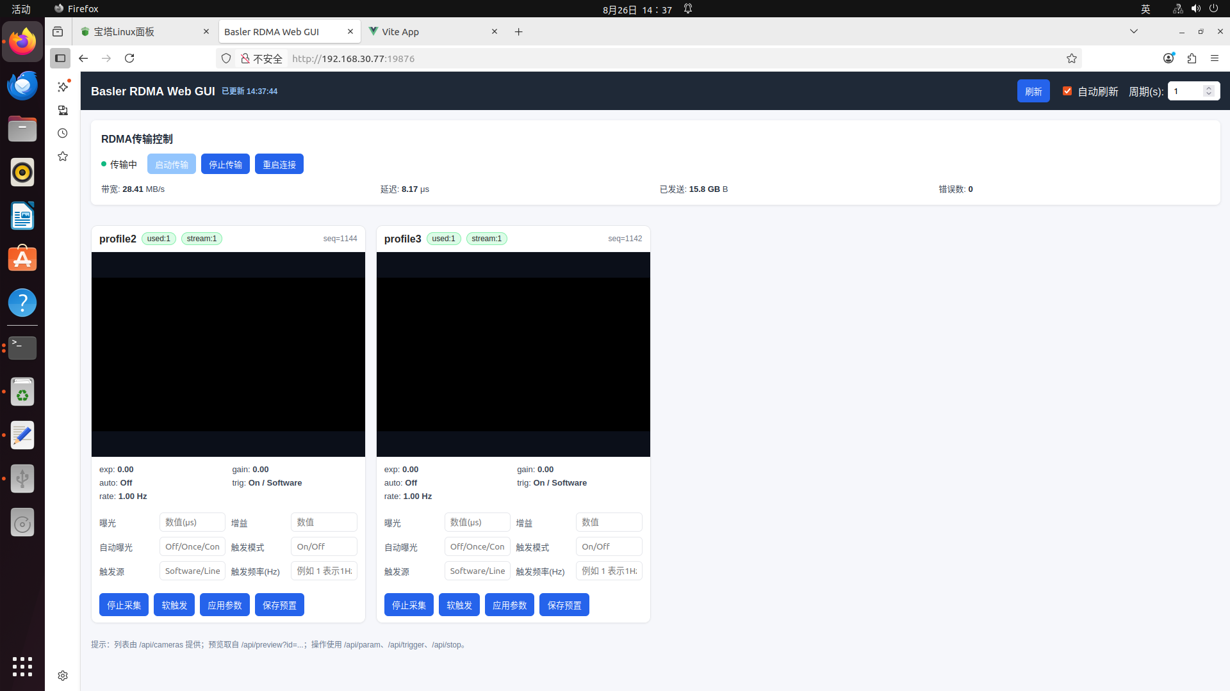
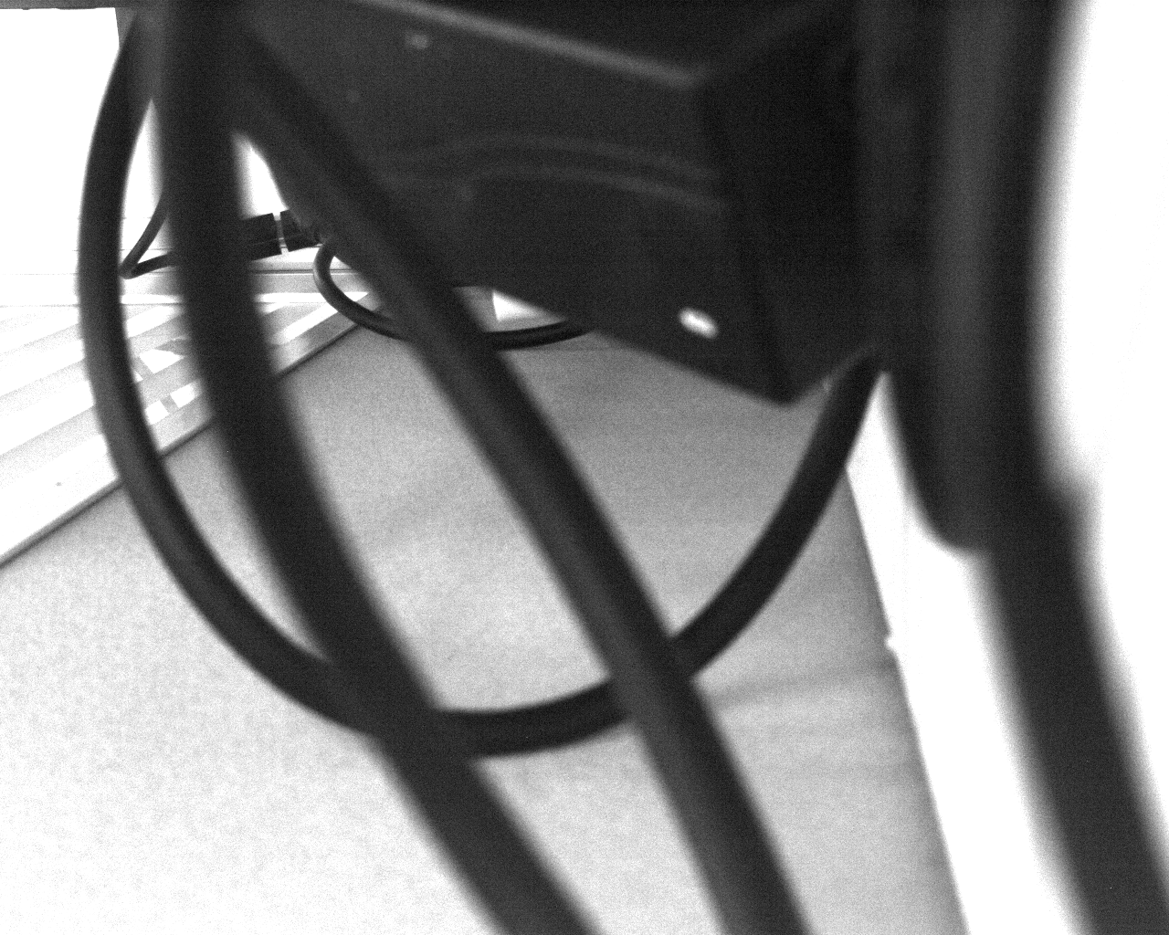
Imaging System for the Laser Wakefield Electron Accelerator at SIOM
Real-Time Image Acquisition & Transmission: Integrates camera control and real-time high-bandwidth acquisition for fast image transmission
FRAME_META
Trasnmission Pipeline
GUI of the Imaging System
Notes:
We’ve applied this system to the "X-ray Imaging System" project in collaboration with Shanghai Institute of Optics and Fine Mechanics. To achieve real-time camera control image acquisition and transmission.
Based on the control and data path design I’ve illustrated before, we built a transmission pipeline using a pair of lock-free ring buffers in the memory registration area.
And custom transport layer protocol header (FRAME_META) includes meta info like data source ID, sequence number, data index and timestamp. The client parses and converts data using the header to ensure accurate storage.

Slide 12
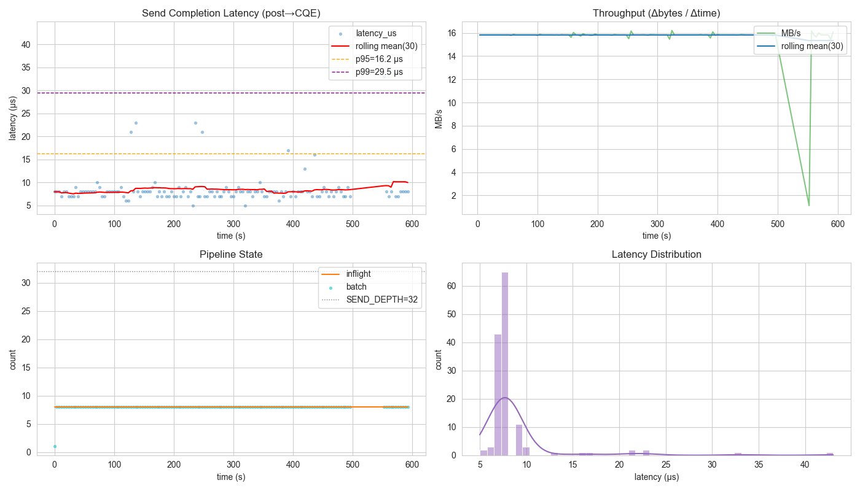
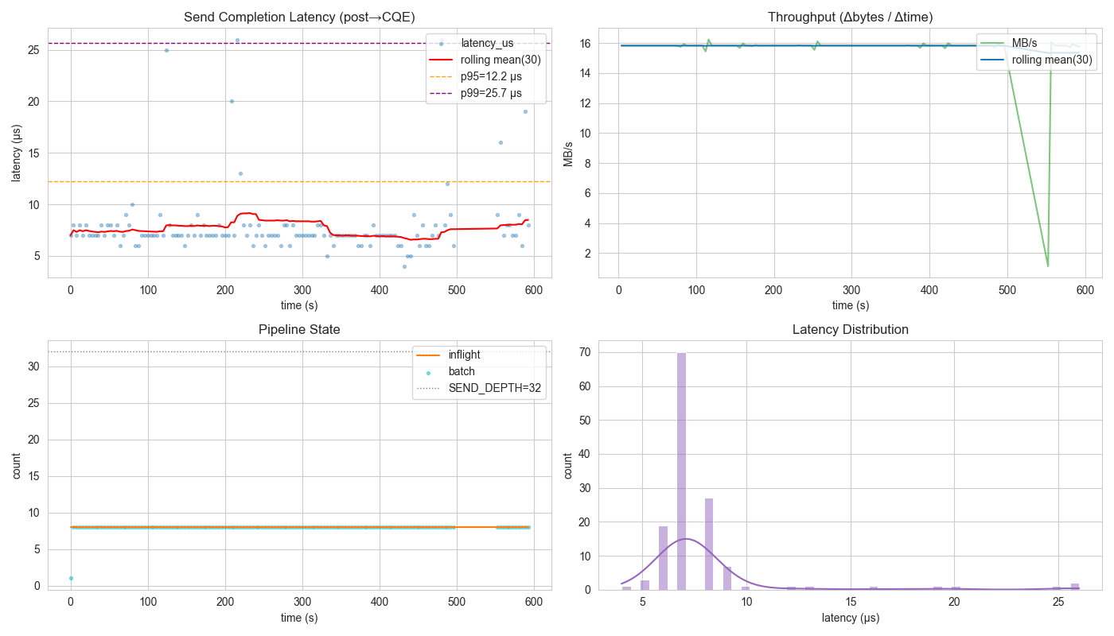
Imaging System for the Laser Wakefield Electron Accelerator at SIOM
microsecond-level latency dispersion
stable latency distribution
stable transmission pipeline
The results show this system has industrial stability and feasibility.
Notes:
We evaluated server-side RDMA send “post-to-completion” batch latency under a unified methodology.
Looking at each camera stream, we saw this: at the 2Hz trigger frequency, all data streams had a steady rhythm and microsecond-level dispersion. The transmission pipeline stayed stable too, this shows the RDMA stack is nowhere near its capacity limit under this configuration and load.

Slide 13
CONTENTS
Introduction of RDMA Data Transmission System
Preliminary Application of the System
Future Work
Conclusion

Slide 14
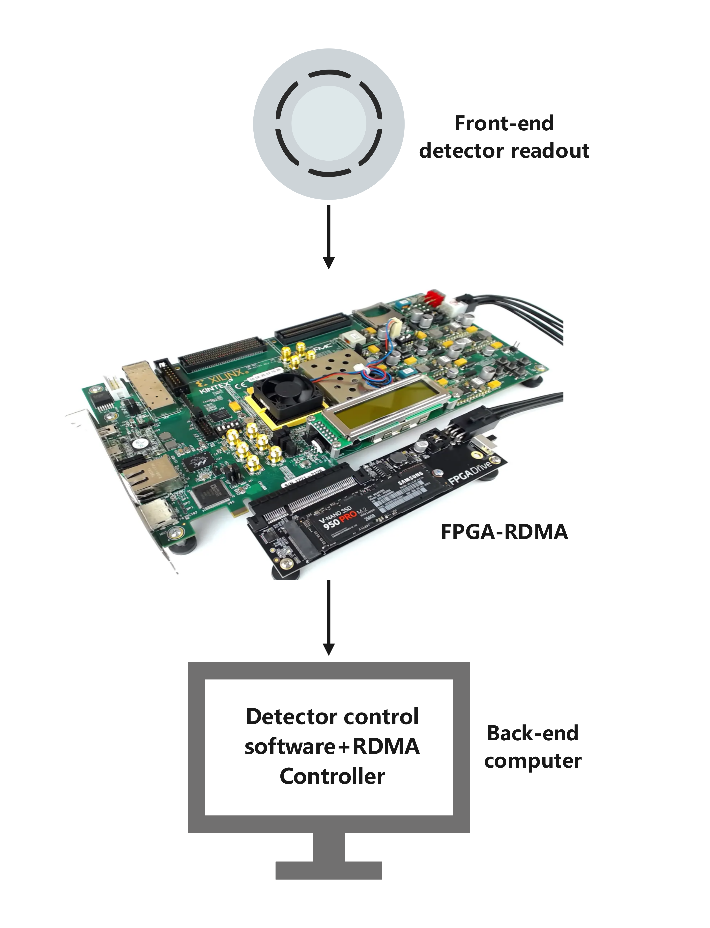
Future Work
Implementation of the FPGA-RDMA transmission model and apply it to the general data transmission
FPGA-RDMA data flow
FPGA-RDMA basic architecture
Notes:
The construction of a "hardware acceleration + protocol optimization" dual-driven technology system has been launched, to implement a universal FPGA-RDMA data acquisition and transmission framework for detectors, which is planned to be applied to the data acquisition system of the next-generation particle detector.

Slide 15
CONTENTS
Introduction of RDMA Data Transmission System
Preliminary Application of the System
Future Work
Conclusion

Slide 16
Conclusion
A RDMA-based Data Transmission System Prototype was designed and implemented. Compared with the traditional TCP transmission mode, its performance advantages were verified.
It was applied to the X-ray imaging system of the laser accelerator, realizing stable parallel processing of pipeline tasks and verifying its industrial reliability and applicability in large-scale physical experiments.
Implement a universal FPGA-RDMA data acquisition and transmission framework for detectors.

Slide 17
Thank You Very Much !

