Slide 1
DCS DevOps, CI/CD, Container
Kai Zhou Min Li
Institute of Modern Physics（IMP）
2025.10.21

Slide 2

01
CONTENTS
Introduction of DevOps, CI/CD
02
​How CI/CD Works and the Tools
03
​CI/CD Practices
04
Future Work

Slide 3
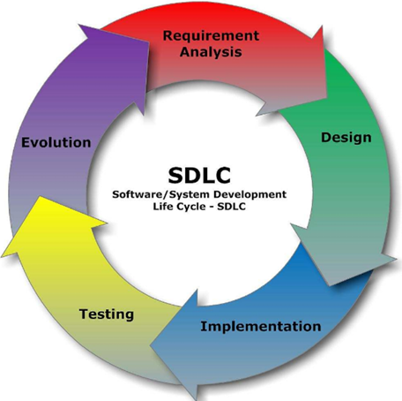
Software Development Life Cycle
Software Development Life Cycle （SDLC），It is a collection that integrates the processes of planning, development, testing, and deployment.
Requirement Analysis​: Analyzing project requirements and feasibility to define what the system must do
Design: system architecture and detailed specifications for how the system will be built
Implementation: Programing according to the design specifications to develop the software
Testing​: Conducting tests to identify defects and ensure the software meets requirements
Evolution: Continuously improve and maintain the product based on feedback

Slide 4
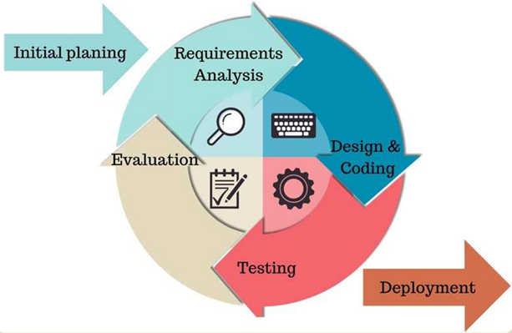
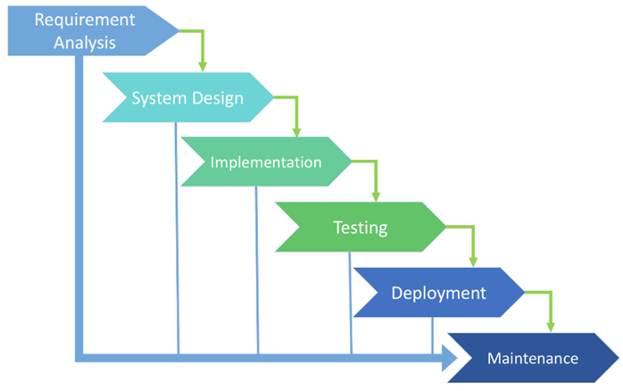
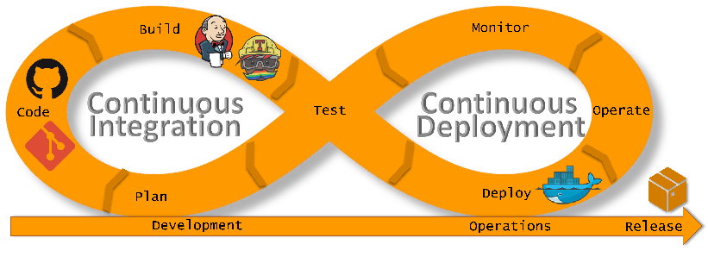
Software Development Models
Waterfall Model
Agile Development
DevOps
The Waterfall Model: A sequential, phase-by-phase development process, each stage must be fully completed before the next begins.
Agile Development: An iterative and incremental approach that emphasizes flexibility, customer collaboration, and rapid response to change.
DevOps: A culture and practice that bridges development and operations teams, aiming to accelerate delivery through automation (e.g., CI/CD).

Slide 5
Software Development Models
CI/CD: Continuous Integration & Continuous Delivery/Deployment
Continuous Integration (CI):​​ Frequently merging code changes into a main branch, followed by automated builds and tests to ensure quality.
​Continuous Delivery:​​ An extension of CI where code is automatically prepared and validated for a manual release to production.
​Continuous Deployment:​​ The final stage, where validated changes are automatically deployed to production, enabling rapid releases.
CI/CD is a development method that connects and automates all stages from code integration to deployment, emphasizing continuity and automation to reduce manual effort and improve efficiency.
DevOps is a software development method, and CI/CD is its implementation method

Slide 6
Software Development Models
Development Model | ​Usage Scope | ​Characteristics | ​Advantages | ​Disadvantages
​Waterfall Model | Large projects: - Clear user requirements - Stable environments | - Phased and sequential - Strict top-down stages - Deliverables required at each phase - Black-box model (role-specific tasks) | 1. Clear phase definitions 2. Strict timeline control 3. Progress tracked via ​deadlines | 1. Inflexible to changing requirements 2. Final results only at later stages 3. Minimal user involvement
​Agile Development | Small teams | - Collaborative iteration - Prioritizes customer collaboration over contracts | 1. Simple design (avoids over-engineering) 2. Adaptability to changes 3. Minimal documentation | 1. Requires strong team expertise 2. Unclear initial cost planning 3. Technical debt blocks iteration
​CI/CD | Universal | - Continuous automation | 1. Reduces time/cost 2. Improves code quality 3. Simplifies communication | 1.Complex ​pipeline setup 2. High maintenance effort 3. Frequent update pressure
6

Slide 7
01
CONTENTS
Introduction of DevOps, CI/CD
02
​How CI/CD Works and the Tools
03
​CI/CD Practices
04
Future Work

Slide 8

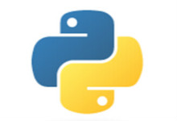
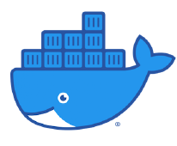




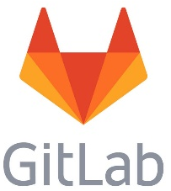

How CI/CD Works
Pipeline
Check out
Build
Test
Code Analysis
Build
Packages
Deploy
Test
Deploy
Unit test
Build Pipeline
Developers
Pipeline content can be defined in Jenkins projects or in the Jenkin`s file within the code repository.
Update build status
Submit code, Merge branches
Jenkins
View build status
Trigger build
Multiple trigger methods: Polling, Hook, Scheduled, Scheduled Polling, Manual trigger, etc.
Developers only need to submit code to GitLab, which will automatically trigger a build.
Code reviewers evaluate based on build results and test results, and merge branches if conditions are met.

Slide 9
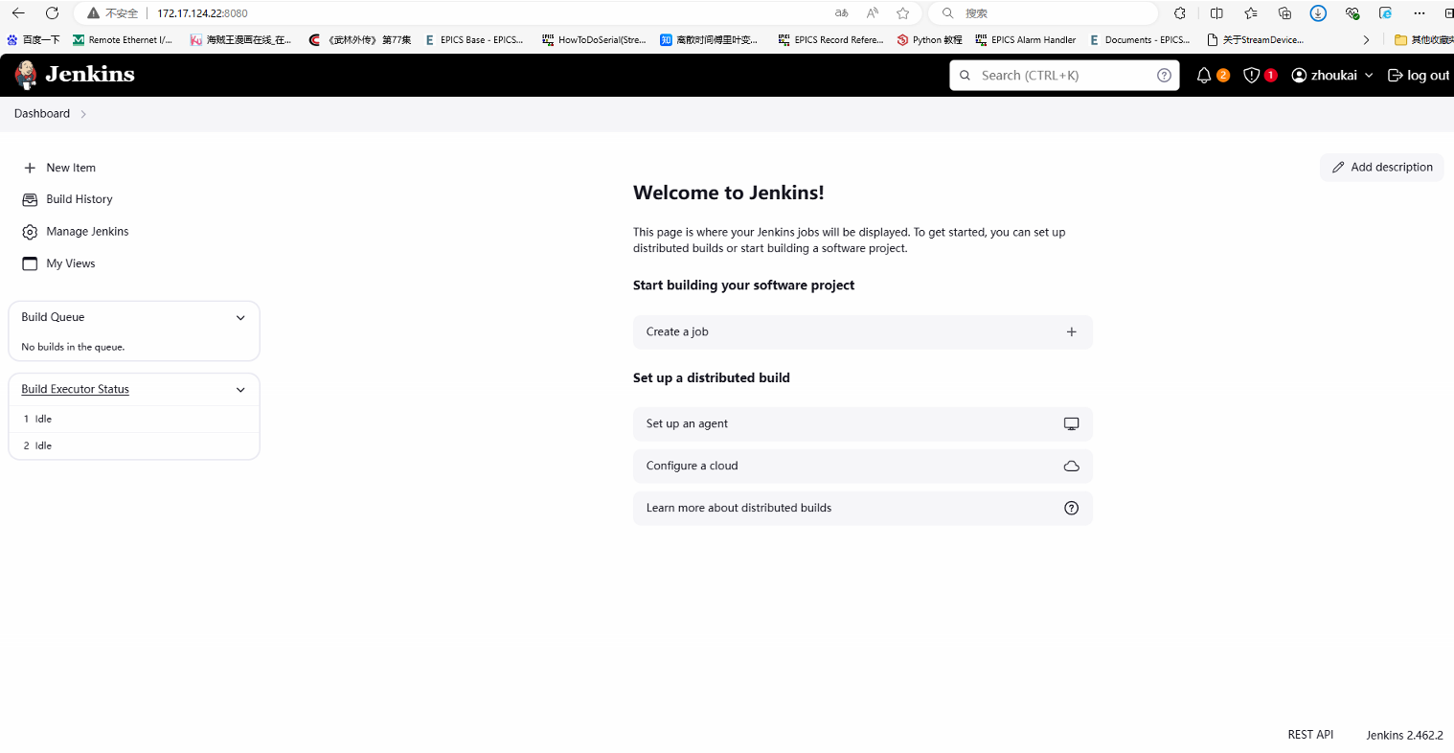
CI/CD Tools-Jenkins
Jenkins: an open-source automation server for building, testing, and deploying software via CI/CD pipelines.
Jenkins is widely used, with most internet companies adopting Jenkins in combination with GitLab, Docker, and K8s as the core tools for implementing DevOps.

Slide 10
CI/CD Tools-Container
Containers​ are a lightweight virtualization technology where all containers share the host OS kernel, but each has an isolated filesystem, libraries, and configurations.
Common Container Engines:​​Docker, Podman, containerd
Container Orchestration Platforms:​​Kubernetes (K8s), Portainer
Aspect | Virtual Machine | Container
Disk Usage | Large (GBs) | Small (MBs/KBs)
Startup Speed | Slow (minutes) | Fast (seconds)
Runtime | Runs on Hypervisor | Runs directly on host kernel
Concurrency | Dozens per host | Hundreds to thousands
Performance | Weaker than host | Near-native host performance
Resource Efficiency | Low | High
Container
Container
Container
IOC1
IOC2
MySQL
Container Engine
Host Operating System
Hardware

Slide 11
01
CONTENTS
Introduction of DevOps, CI/CD
02
​How CI/CD Works and the Tools
03
​CI/CD Practices
04
Future Work

Slide 12
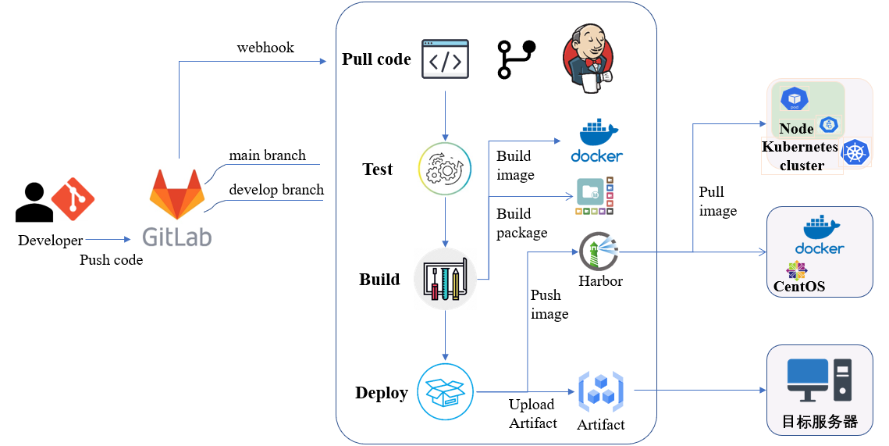
CI/CD Workflow

Slide 13
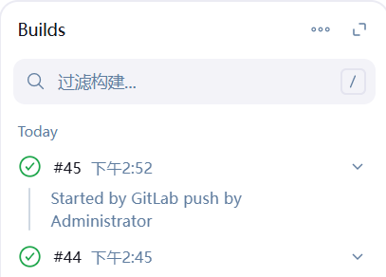
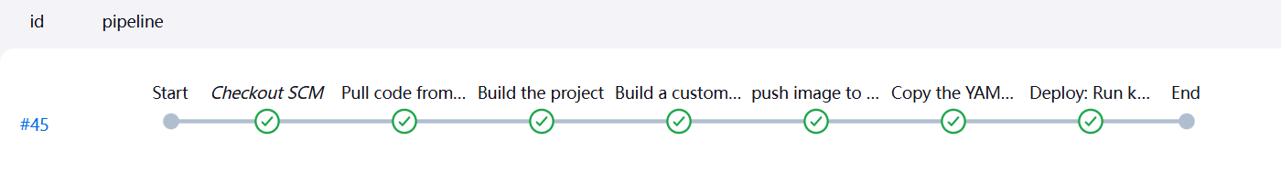
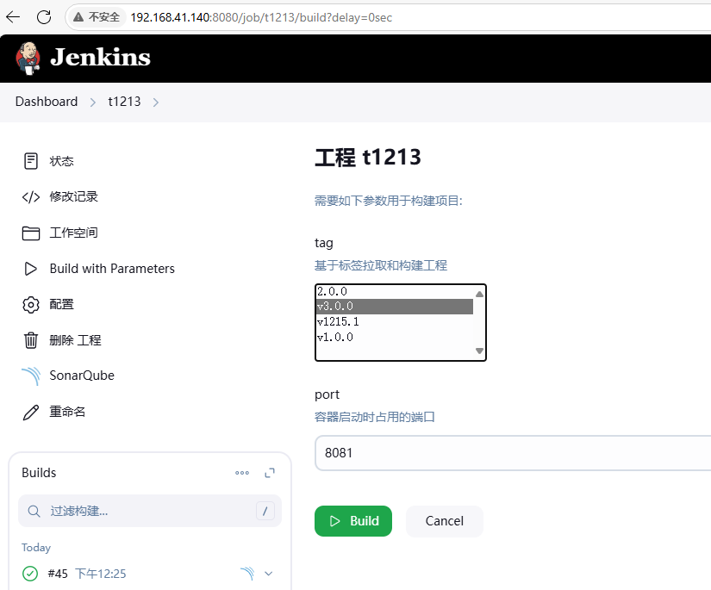
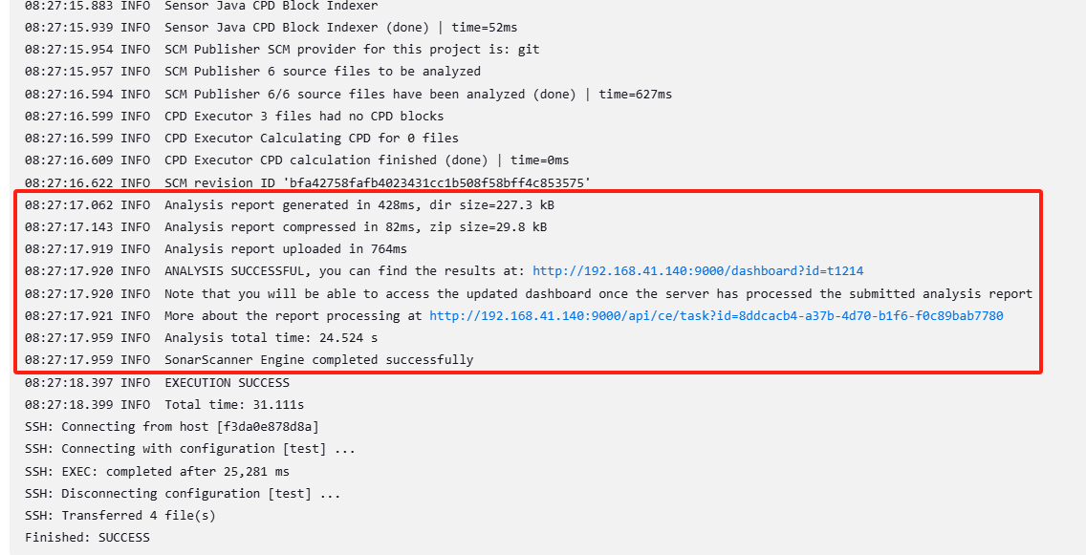
CI/CD Practices
Code submission triggers build
Automated CI/CD pipeline execution
Manual quick rollback to previous version (if current version fails)
Log output

Slide 14
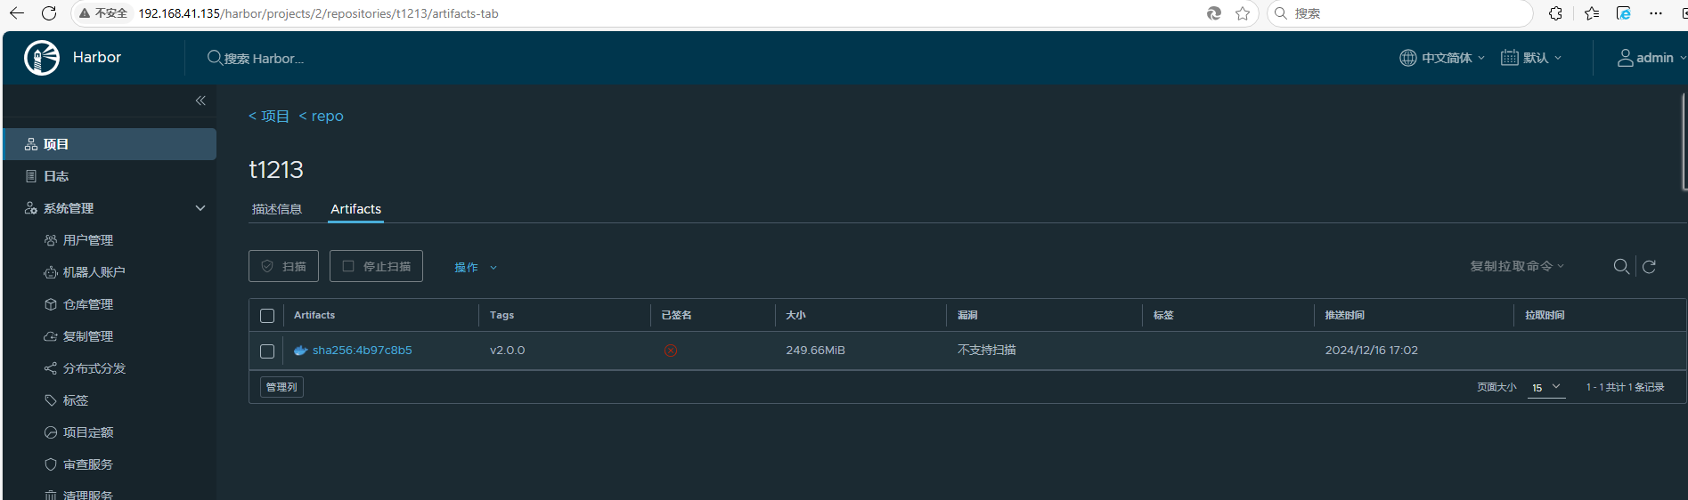
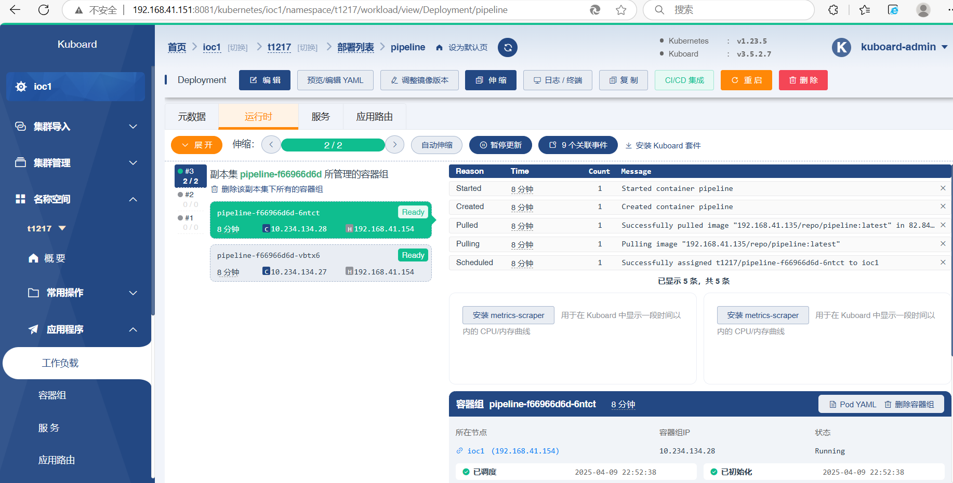
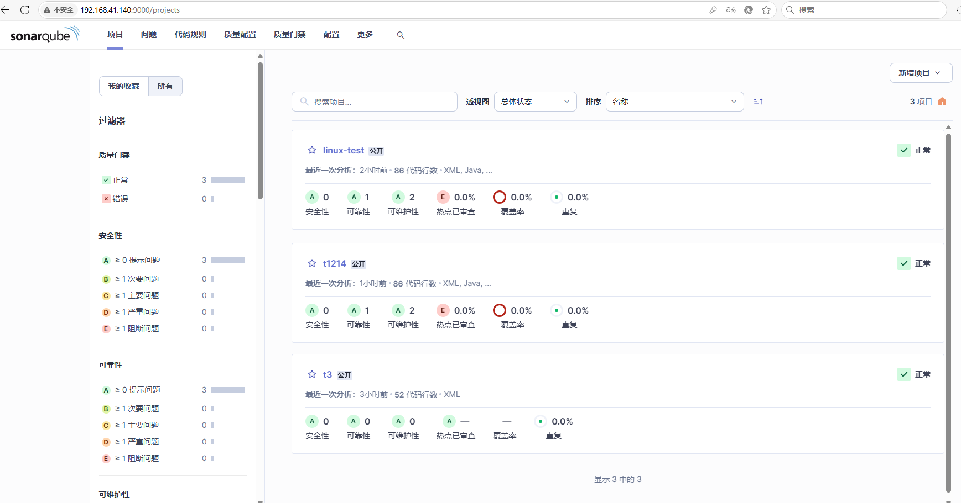
CI/CD Practices
Generate container image and auto-push to image repository
Automated deployment to production environment
Code inspection report generation

Slide 15
01
CONTENTS
Introduction of DevOps, CI/CD
02
​How CI/CD Works and the Tools
03
​CI/CD Practices
04
Future Work

Slide 16
Future work
GOAL: Develop a platform for automated integration, testing, deployment, and release
Implementation of visual and automated pipeline configuration: allowing users to achieve automated construction, configuration, and retrieval of container environments simply by configuring the desired environment parameters.
Integration of multiple CI/CD tools to better serve the needs of various projects.

Slide 17
Thanks & Questions

