Slide 1
DataBase Strategies
KeJie You
46th CBM Collaboration Meeting
IMP-CAS
Lanzhou, China
Notes:
Thank you all for attending the CBM Collaboration Meeting. It‘s a great honor（O） to share my work with you today. Here is what I'll be covering.

Slide 2
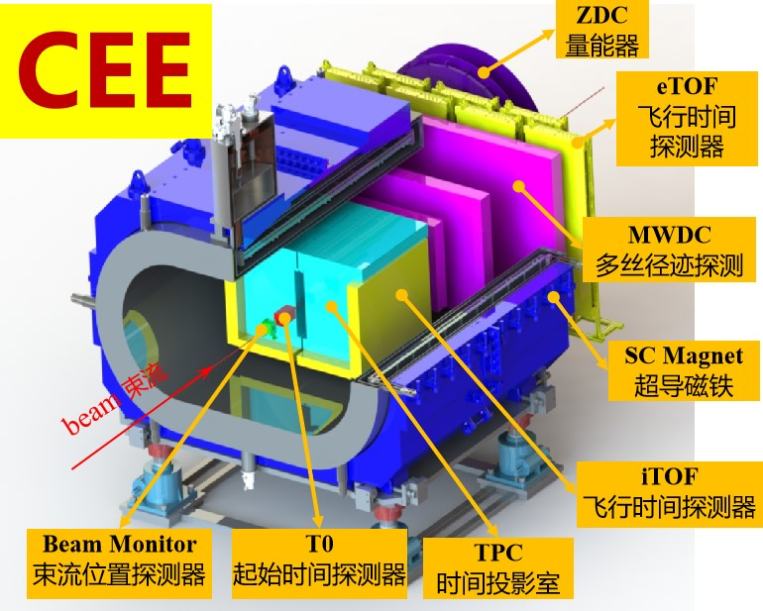
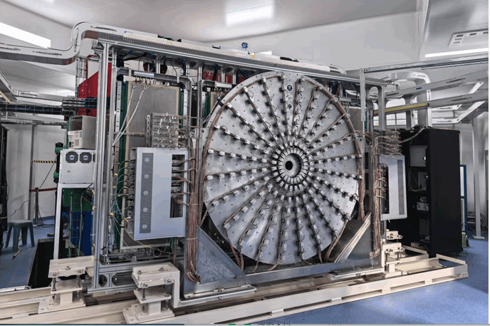
Database application
Project Overview
The Cryogenic extreme-high-density nuclear matter Spectrometer (CEE) is a Major Scientific Instrument Development Project funded by the National Natural Science Foundation of China (NSFC). It comprises 13 subsystems.
Notes:
CEE is comprises（kəmˈpraɪzɪz） thirteen subsystems. My primary role in the CEE project was to develop a system for real-time monitoring and data storage.

Slide 3
Database application
System Functions
1
storage of PV data
2
storage of image data
3
Log System
Notes:
The system's main functions include:
Real-time monitoring and storage of PV data.
storage of image data
And A log system.

Slide 4
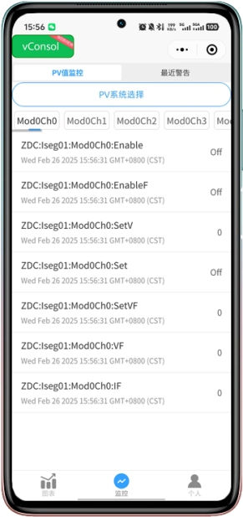
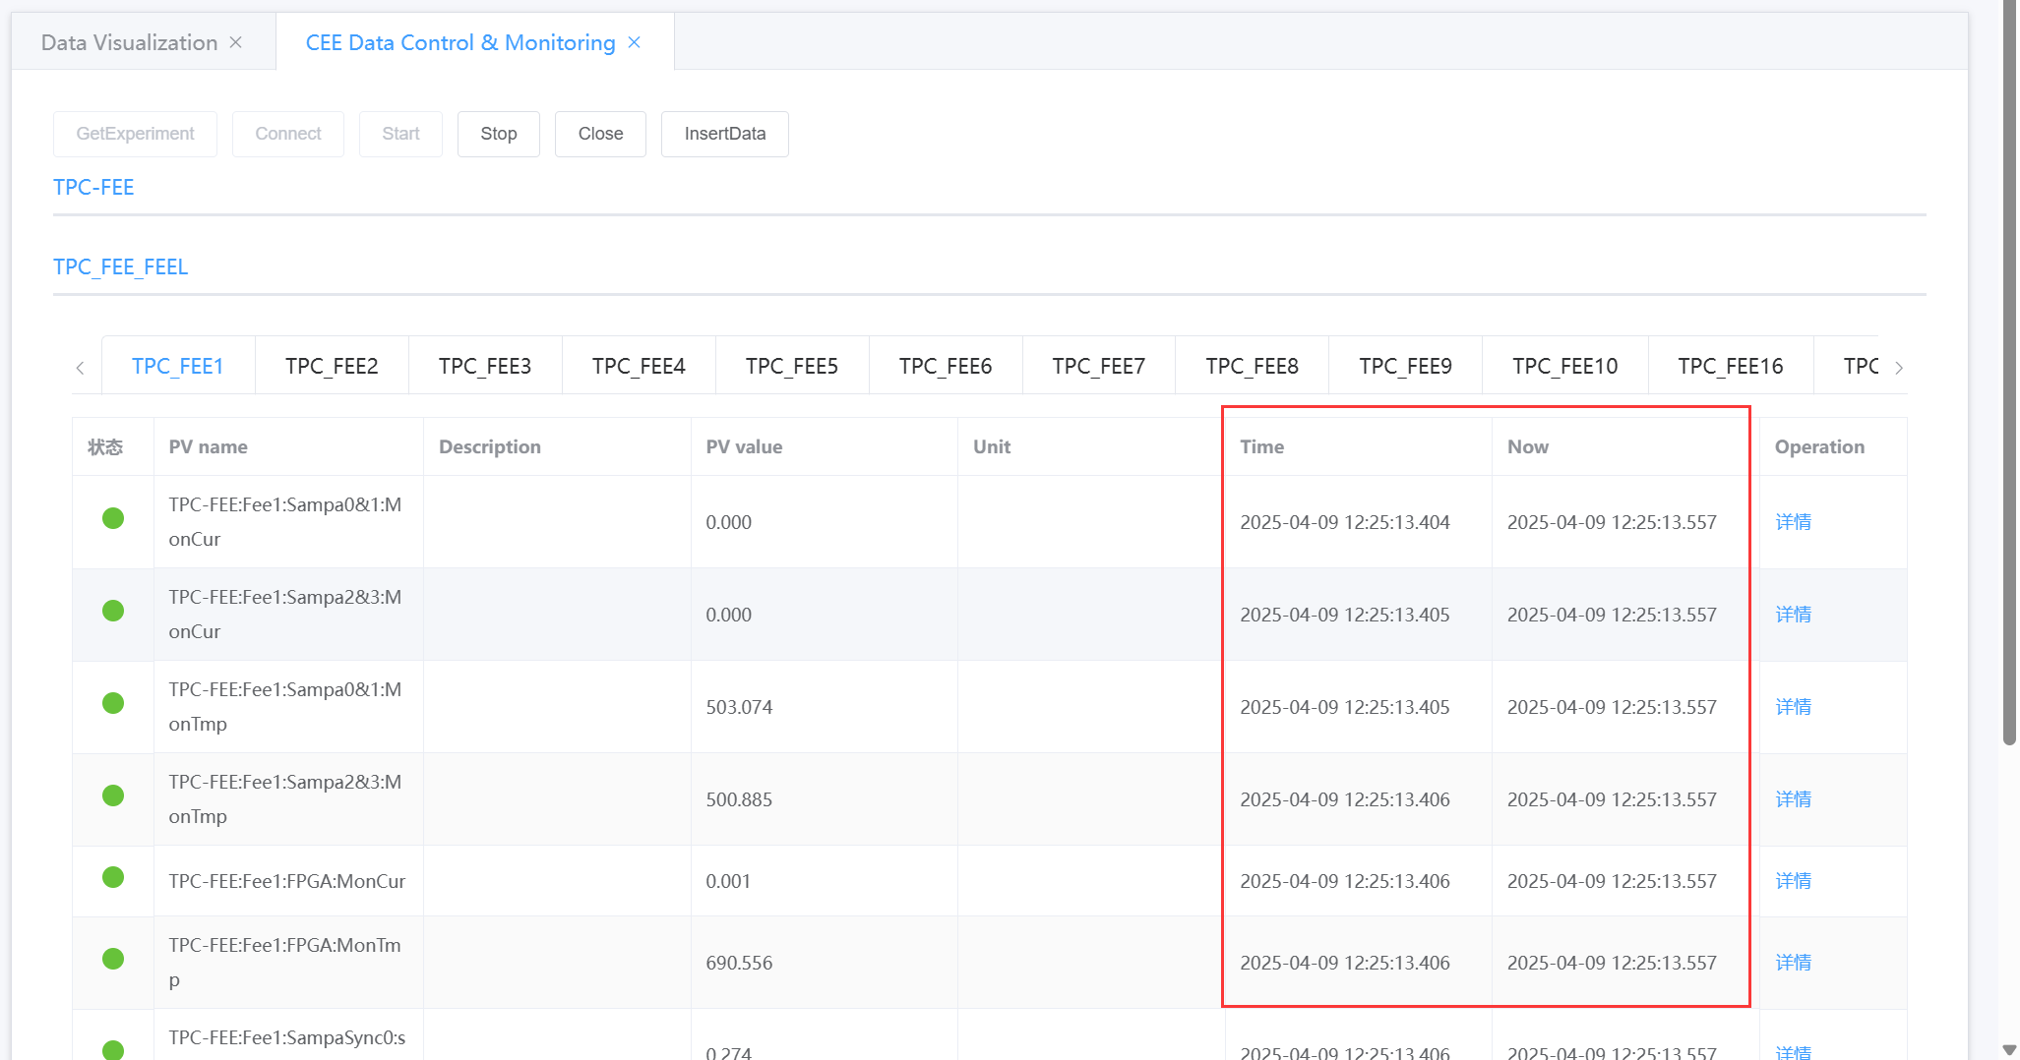
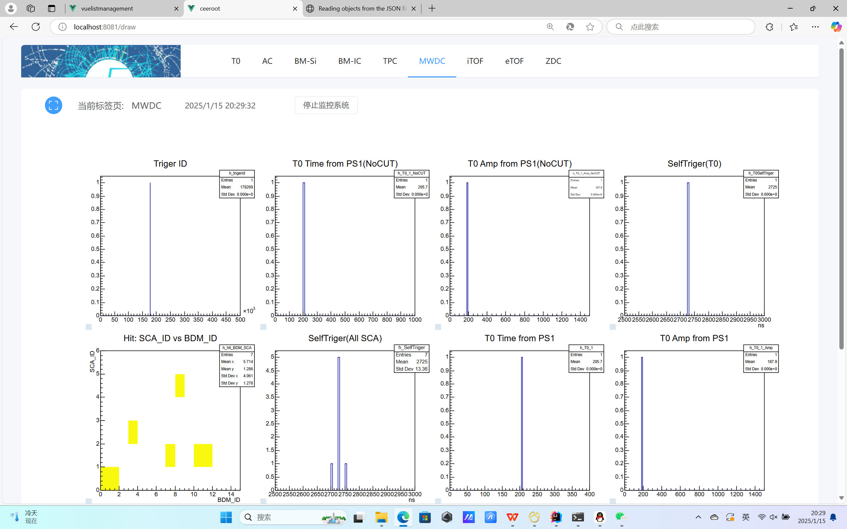
Database application
System Functions
1
Monitoring Requirements
1
EPICS Archiver Appliance vs
2
Each PV variable is collected at a frequency of 1 Hz.
3
The monitoring interface is available on both PC and mobile platforms, supporting data from CEE-ROOT for real-time monitoring.
CEE System Data Monitoring Interface - PC
CEE-ROOT Monitoring Interface - PC
CEE System Monitoring Interface - Mobile
Notes:
With over twenty thousand PV variables（veərɪəblz） across thirteen subsystems, the system must continuously transmit all data at 1 Hz（hertz）—including processes like data cleansing and alarm triggering—within a short time frame（freɪm）.
To optimize（ˈɒptɪmaɪz） server resource usage, the data transmission module adopts a publish-subscribe pattern and a one-to-many transmission approach.
By combining triggered transmission with the WebSocket protocol, the system achieves sub-100 milliseconds low latency while maintaining（meɪnˈteɪnɪŋ） reasonable resource consumption.
In addition to PV data monitoring, the system also supports real-time display of CEE-ROOT data on web pages. A mobile monitoring interface is provided for the convenience（kənˈviːniəns） of researchers during experiments.

Slide 5
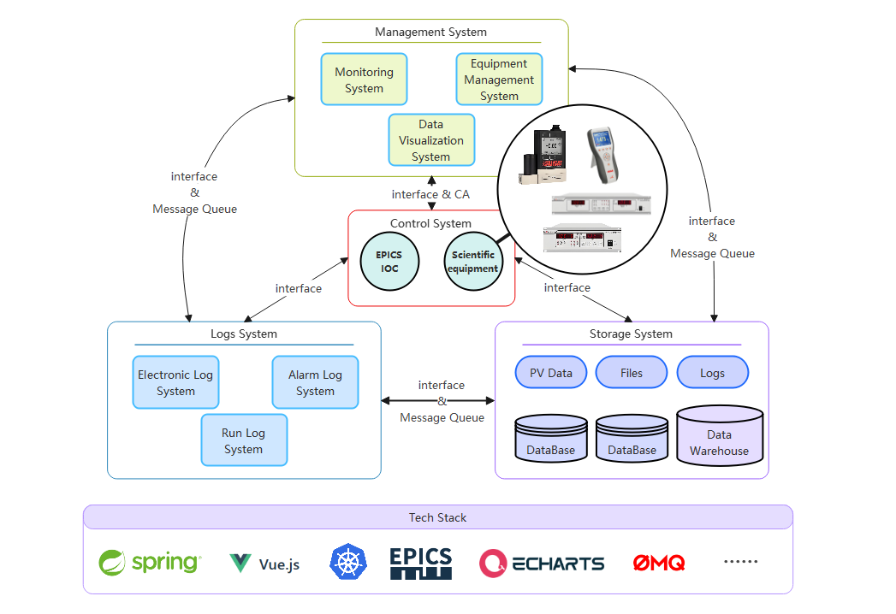
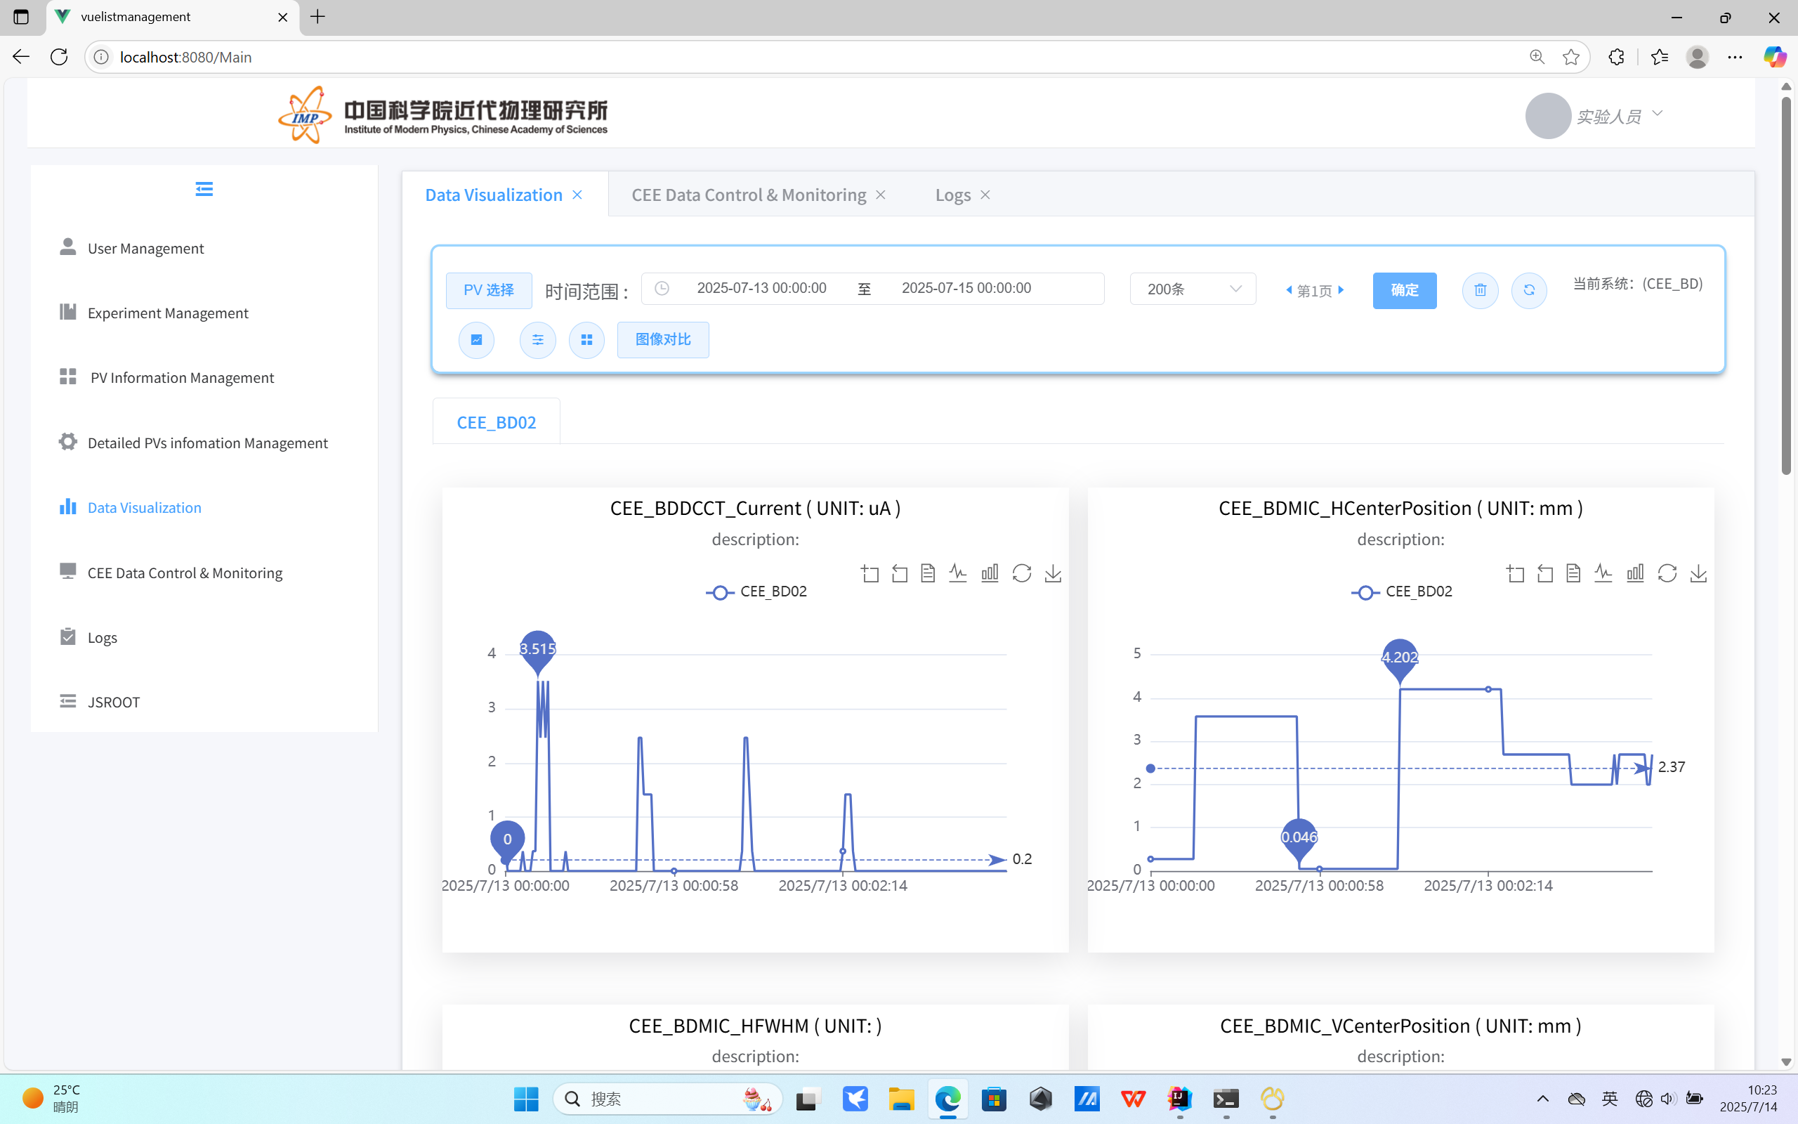
Database application
System Functions
1
storage of PV data
1
Distributed deployment, using Kubernetes for node management
2
A hybrid storage approach, using a relational database（MySql） combined with a time-series database （influxDB）, is employed to store data.
CEE Historical Experiment Data Analysis Interface.
System Architecture.
Notes:
our system uses a distributed deployment（dɪˈplɔɪmənt） managed by Kubernetes and a hybrid storage model. This model combines a time-series database, a relational database, and in-memory caching. Relational databases, with their atomicity（ˌætəˈmɪsəti）, are well-suited for storing modifiable（ˈmɒdɪfaɪəbl） data, such as key configuration messages for each device. || Time-series databases, excellent for handling massive data volumes, are used to store the experimental process variable（ˈveəriəbl） data in real-time.
Data cleansing algorithms(ˈælɡərɪðəmz) are also employed to ensure the system can store large amounts of experimental data accurately and rapidly

Slide 6
Database application
System Functions
1
Data Query​
1
Data Volume at the Tens of Millions Level​
incorporates reasonable indexing
employs a multi-thread segmented query approach.
Combined with optimizations from the time-series database's own query syntax and in-memory caching
Data Query Latency
Notes:
After several experiments , Most of subsystems will generate data volumes reaching the tens of millions level.
To enhance the system‘s data query efficiency, the database design incorporates reasonable indexing, utilizing（ˈjuːtəlaɪzɪŋ） time ranges for secondary index design.
It also employs a multi-thread（ˈmʌlti θred） segmented query approach. Combined with optimizations（ˌɒptɪmaɪˈzeɪʃənz） from the time-series database‘s own query syntax and in-memory caching, these measures reduce search latency(ˈleɪtənsi) to below 500 milliseconds.

Slide 7
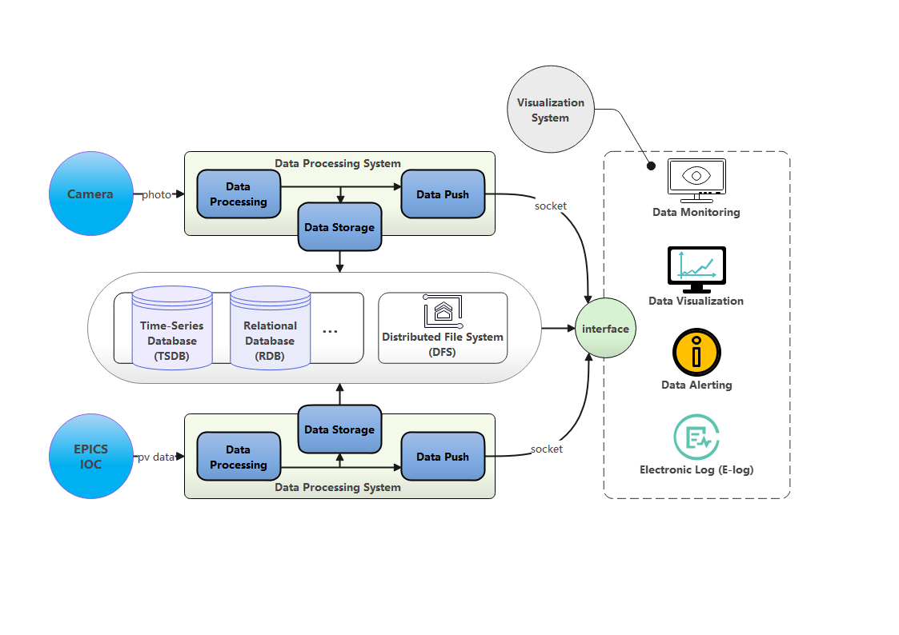
Database application
System Functions
2
Storage of image data
1
Get camera data using RDMA high-speed transfer.
2
Use a distributed deployment setup.
Store data with: time-series database + relational database + distributed file storage + HDF5.
3
4
Support image formats like TIFF, PGM, BMP.
Architecture expansion diagram.
Notes:
Our system can also monitor and store camera images. We pack multiple images into HDF5 files at set intervals. Then save these HDF5 files to the distributed storage. Meanwhile, use a time-series database to store image metadata for file tracking.

Slide 8
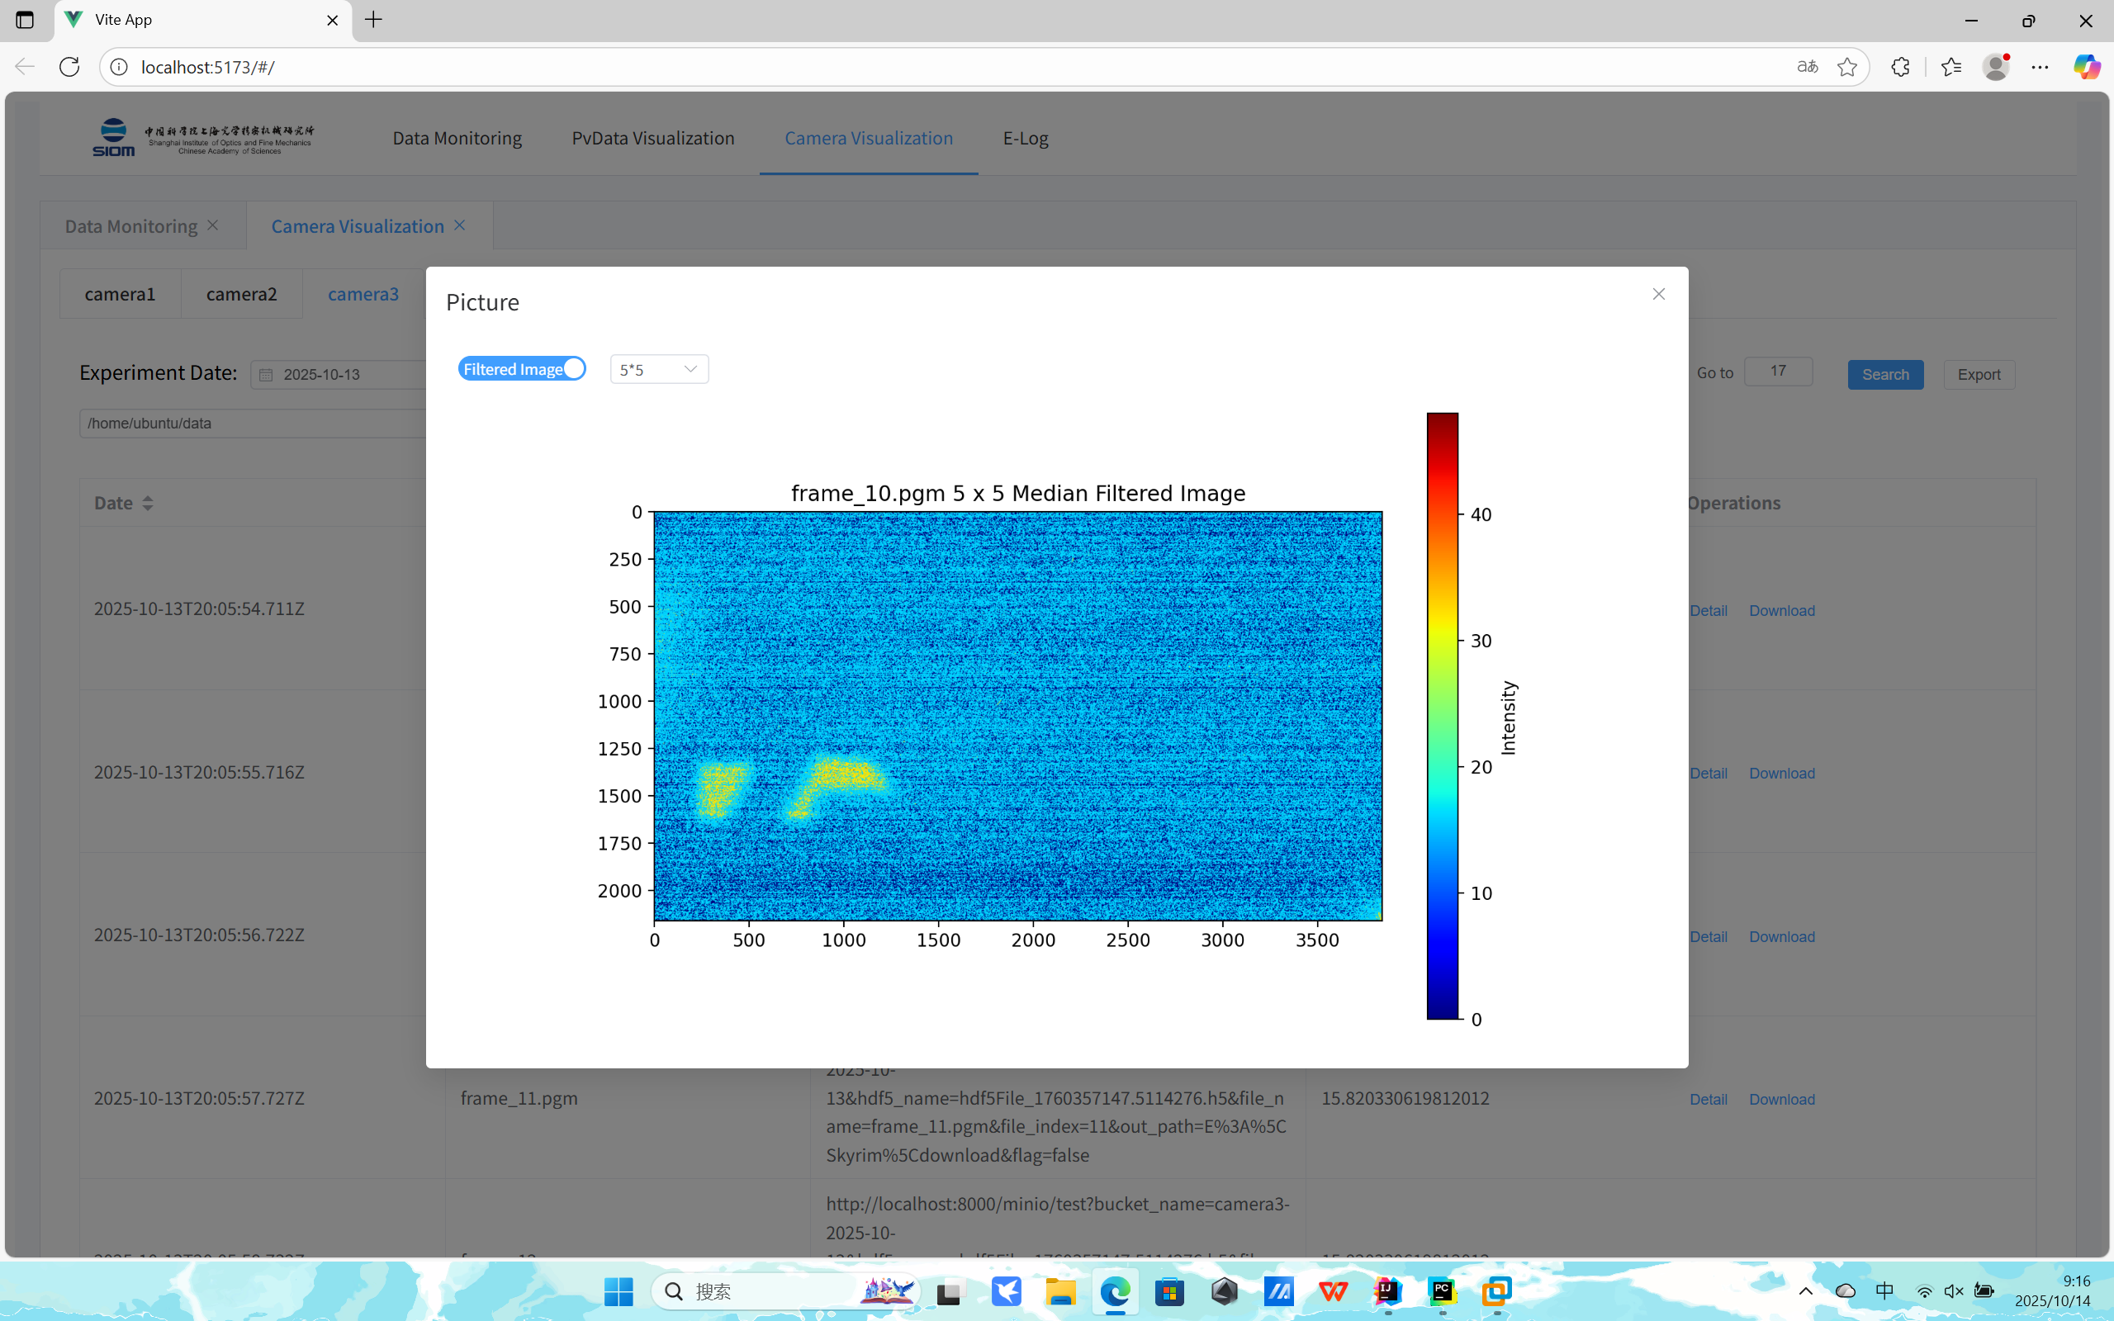
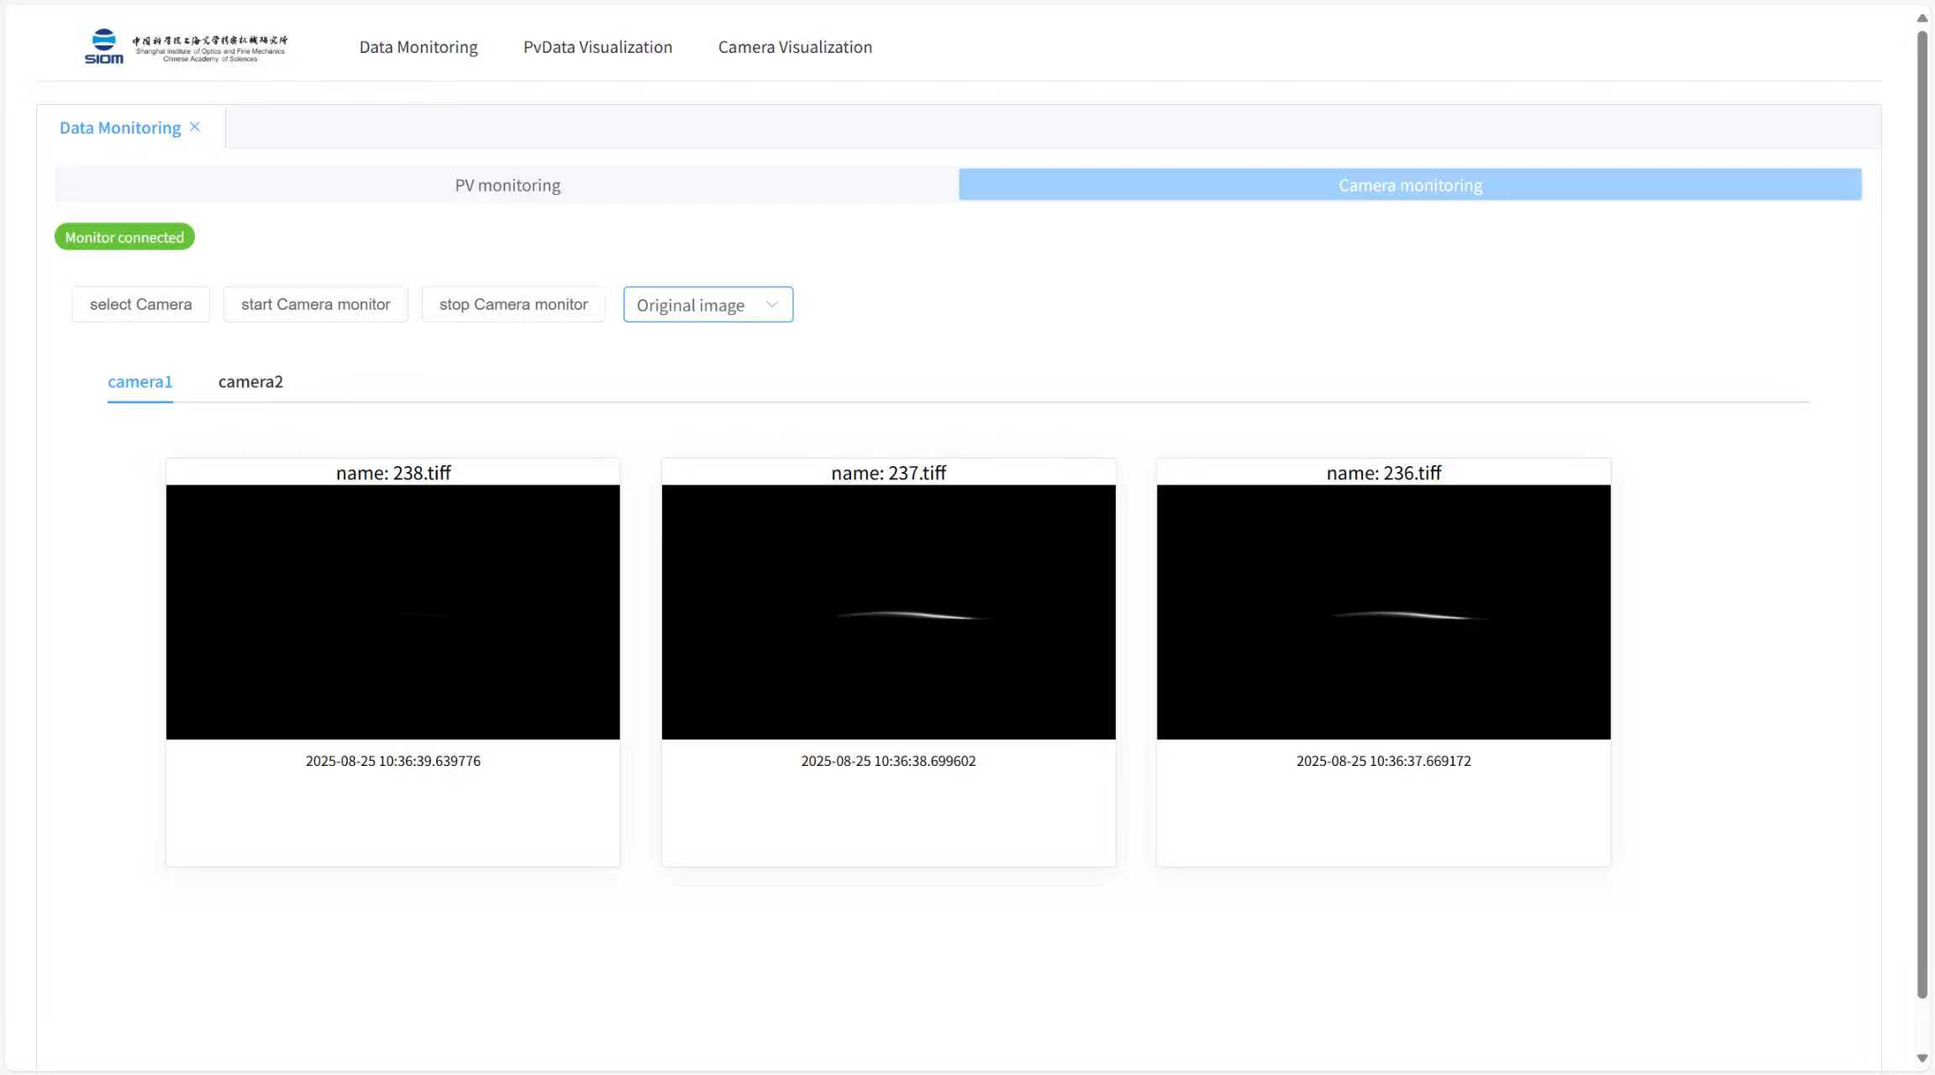
Database application
System Functions
2
Storage of image data
Online image filtering.
Image monitoring.
Notes:
These two images show online image filtering and image monitoring.

Slide 9
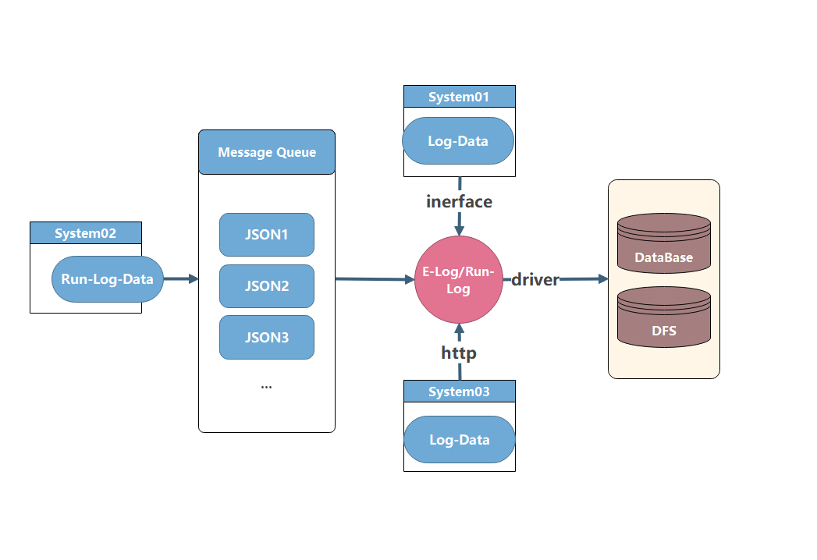
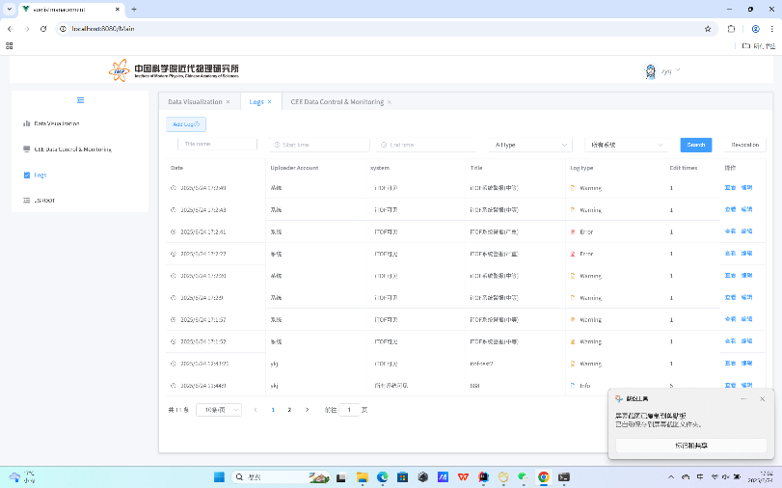
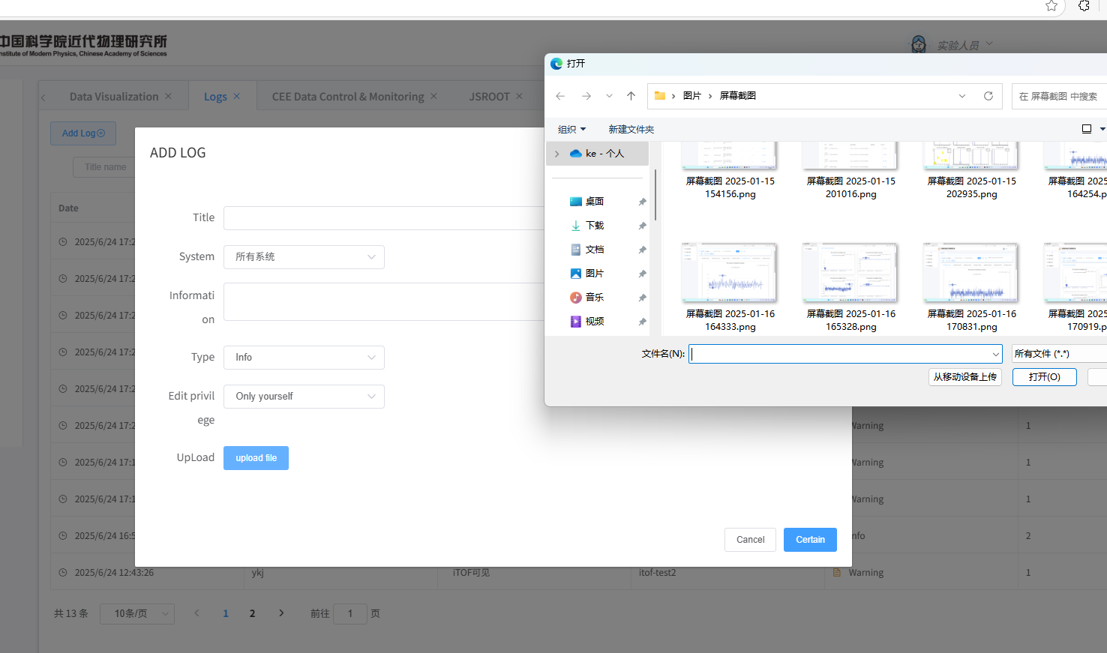
Database application
System Functions
3
Log System
Support for custom templates
Upload various types of data (information, images, videos, code, etc.)
Restore and track experimental data
Log System Architecture
Log List
Log Upload Interface
Notes:
To facilitate（fəˈsɪlɪteɪt） the recording of experimental processes, the system includes a log system. This system allows users to customize experiment log templates, supports the upload of information, images, videos, data files, code, and other data. It also enables users to locate and reference original data, helping to reconstruct the complete experimental process from the logs
To store the large volume of file data, the log system employs a hybrid storage approach, utilizing both a database and a distributed file storage system
The system also supports importing data from other systems via various methods, including APIs, HTTPS requests, and message queues

Slide 10
Thank you
Notes:
That's all for my report. Thank you

